Slide 1
4. Big Picture for 2030

Slide 2
IODE Challenges
Staffing – open positions
Reliance on VLIZ for staff, offfices, IT support (pluses and minuses) – need for relationship building and establishment of stable platform for collaboration
Lack of management and team coordination
Lack of focus across all components
Overly complex governance processes and paperwork
Unnecessary working groups being mandated
Lack of coordinated holistic approach with IOC and other UN partners
Reliance on specific individuals (with own (scientific) ideas, interests and agendas) inc at key meetings
Too many websites!
Lack of IOC identity on webpages / comms
IODE being treated and thought of as a separate entity to IOC
Mandates from IODE28/A33 - Priorities?
- the three ToRs for ODIS
IOC Data Architecture
Better defining the CD Strategy implementation plan to provide guidance to OTGA and OLOcean Best Practices System
Ocean Best Practices System

Slide 3
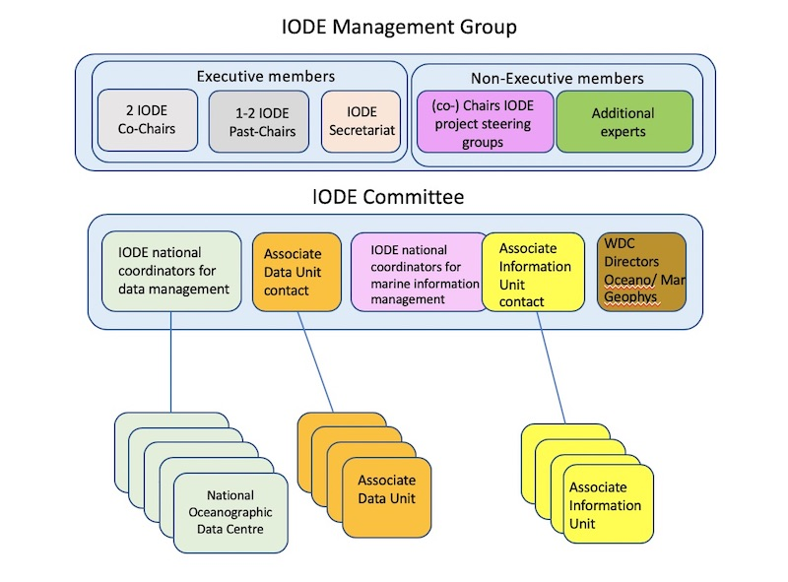
Challenges - Governance
Steering groups
IODE has 3 PC and 10 PA
This means there are 13 Steering Groups
3 Programme Components
OBIS: https://oceanexpert.org/group/230
OTGA: https://oceanexpert.org/group/68
ODIS: https://oceanexpert.org/group/472
10 Programme Activities (managed under ODIS)
Aquadocs: https://oceanexpert.org/group/475
OE: https://oceanexpert.org/group/473
OBPS*: https://oceanexpert.org/admin/group/448
GTSPP: https://oceanexpert.org/group/256
IQUOD: https://oceanexpert.org/group/323
GODAR: has no SG
GOSUD : https://oceanexpert.org/group/350
ICAN: https://oceanexpert.org/group/266
QMF: https://oceanexpert.org/admin/group/462
WOD: has no SG
*OBPS now IOC activity
World data system - ISC

Slide 4
ama.iode.vliz.be |  | wordpress.iode.vliz.be
 | africanmarineatlas.com |  | iode.org
 | africanmarineatlas.net |  | pacman.obis.org
bigbluebotton3.iode.vliz.be |  |  | book.oceaninfohub.org
 | bbb3.oceanteacher.org |  | genocean.org
bigbluebotton2.iode.vliz.be |  |  | hab.ioc-unesco.org
 | bbb.oceanteacher.org |  | oceandata2030.net
dspace-prod.iode.vliz.be |  |  | oceandata2030.org
 | repository.oceanbestpractices.org |  | oceandataconference.org
iocafrica.iode.vliz.be |  |  | oceaninfohub.net
 | oih.ioc-africa.org |  | oceaninfohub.org
iodeint.iode.vliz.be |  |  | odinblacksea.iode.org
 | wiki.iode.vliz.be |  | odincarsa.iode.org
 | http://iodeint.iode.vliz.be/zabbix |  | odinecet.iode.org
iodew1.iode.vliz.be |  |  | oih.aquadocs.org
 | ioc-cd.org |  | oih.oceanbestpractices.org
 | legacy.globalhab.info |  | survey.gosr.ioc-unesco.org
iodew4.iode.vliz.be |  |  | survey2.gosr.ioc-unesco.org
 | ctic.ioc-unesco.net |  | surveys.ioc-cd.org
 | ctic.ioc-unesco.org |  | surveys.iode.org
 | globalhab.info | dev.oih.iode.vliz.be
 | ican.iode.org |  | dev.oih.iode.vliz.be
 | ioc-tsunami.org | tsunamiready.iode.vliz.be
 | iotic.ioc-unesco.net |  | tsunamireadyviewer.ioc-tsunami.org
 | iotic.ioc-unesco.org | matomo.iode.vliz.be
 | itic.ioc-unesco.net |  | analytics.iode.org
 | itic.ioc-unesco.org | oceanteacher.iode.vliz.be
 | legacy.ctic.ioc-unesco.org |  | oceanteacher.org
 | legacy.icr.ioc-unesco.org | oceandecade.iode.vliz.be
 | legacy.ioc-cd.org |  | matchmaking.oceandecade.com
 | legacy.ioc-tsunami.org |  | matchmaking.oceandecade.net
 | legacy.iode.org |  | matchmaking.oceandecade.org
 | legacy.itic.ioc-unesco.org | AWS
 | legacy.neamtic.ioc-unesco.org |  | search.oceanbestpractices.org
 | legacy2.ctic.ioc-unesco.org | Digital Ocean
 | msp.ioc-unesco.net |  | obis.org
 | msp.ioc-unesco.org |  | iobis.org
 | mspes.ioc-unesco.net |  | dashboard.ednaexpeditions.org
 | mspes.ioc-unesco.org |  | resources.obis.org
 | mspfr.ioc-unesco.net | AquaDocs-D2T
 | mspfr.ioc-unesco.org |  | aquadocs.org
 | neamtic.ioc-unesco.net |  | oceandocs.org
 | neamtic.ioc-unesco.org | coml.org
 | sidsworkshop.iode.org |  | coml.org
 | tsunami.ioc-unesco.org
iodew5.iode.vliz.be
 | dashboard.oceanbestpractices.org
 | oceanbestpractices.net
 | oceanbestpractices.org
iodew6.iode.vliz.be
 | data.hais.ioc-unesco.org
 | gosr.ioc-unesco.org
 | haedat.iode.org
 | pacman.obis.org
iodew7.iode.vliz.be
 | goosocean.org
 | compendium.ioc-cd.org
 | dev.actions.oceandecadeforum.org
 | gallery.iode.org
 | goosocean.org
 | ioc-unesco.org
 | iocaribe.ioc-unesco.org
 | oceancd.org
 | piwigo.iode.org
mail.iode.vliz.be
 | mail.iode.org
 | rainloop.mail.iode.org
 | roundcube.mail.iode.org
oceanexpert.iode.vliz.be
 | 2.7.oceanexpert.org
 | dev.oceanexpert.net
 | dev.oceanexpert.org
 | oceanexpert.net
 | oceanexpert.org
 | stag.oceanexpert.org
odis.iode.vliz.be
 | catalogue.odis.org
 | odis.iode.org
 | odis.org
wod.iode.vliz.be

Slide 5
IODE next steps..
IMPORTANT to stop current trajectory
We need to REALIGN AND FOCUS
How do we best coordinate/ evolve governance
What are the primary/baseline functional needs, including staff?
What should the substantive focus be on (long term and short term)?
What are the interactions with Decade initiatives including DCO-data – and how do we create positive legacy?
How do we engage best with MS and IODE community to realign and refocus
How do we convert IODE28 / A33 mandates into a prioritized and focused budgeted plan for next 2 years? and socialize this approach
What are the appropriate staff reporting lines

Slide 6
Who are the critical clients?
Member States | Providers of data, information & knowledge | Users of data, information & knowledge
MOST IMPORTANT | NODC ADUs RTCs GOOS UN Ocean Decade Programmes/Projects Private Sector Philanthropy | NODCs (inc those not part of IODE) ADUs (inc those not part of IODE) RTCs & OTGA Learners, partners IOC Regional Subcommissions UN Ocean Decade UN conventions / frameworks Navy Funders Private sector Philanthropy / Foundations Ocean community/ practitioners/ researchers Technical partners / Institutions developing services on top of our data DTO Copernicus Marine/Mercator Media

Slide 7
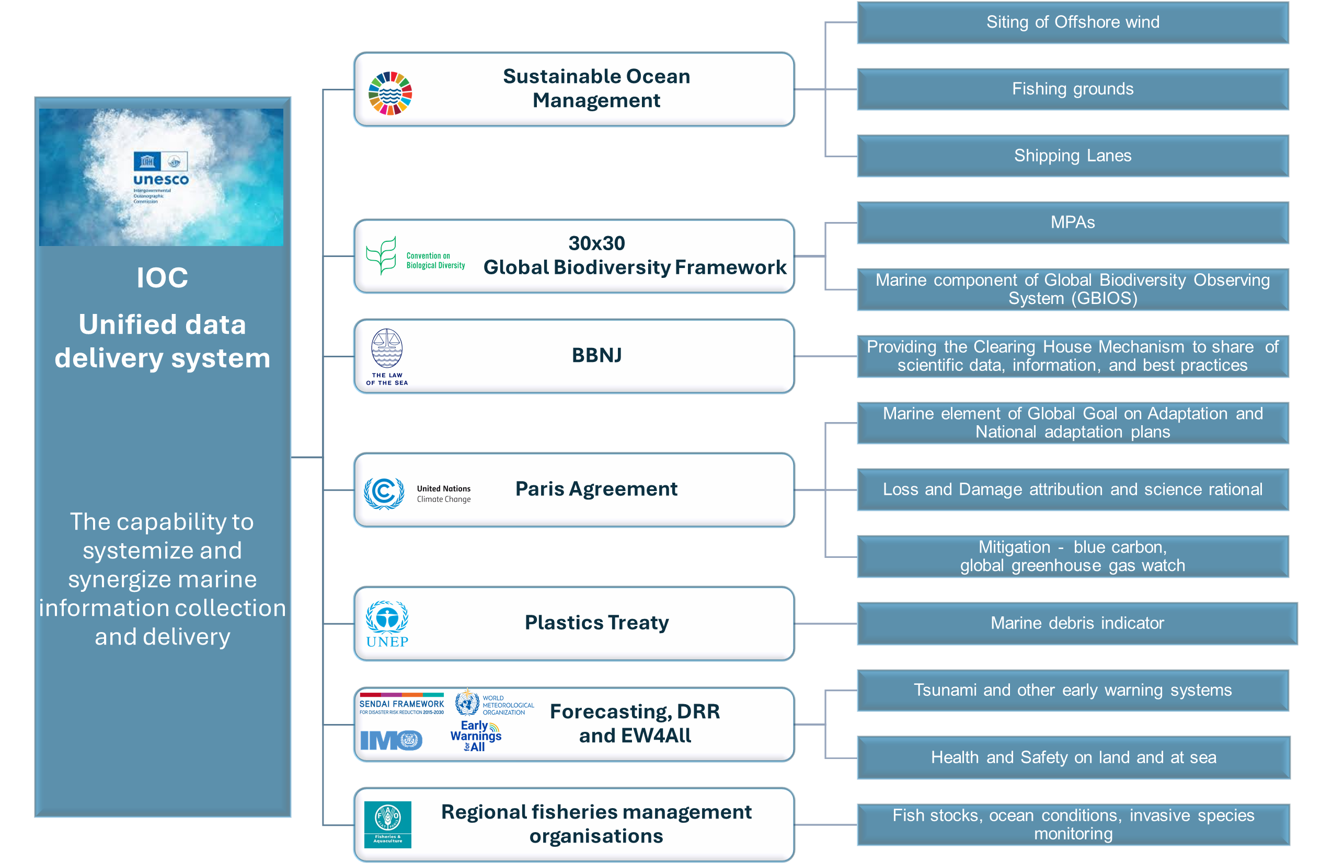

Slide 8
The IOC Value Cycles
Observations and Data
GOOS¹ and
IODE² (includes OBIS)
Services & Decision support tools
Early Warning Systems
Sustainable ocean management and planning support
Responding to multilateral agreements (BBNJ, UNFCCC, CBD, IMO, FAO, WMO etc)
Scientific Knowledge and Data Products
e.g. Indicators
Research, Modelling, Capacity development
Examples
- Ocean Data atlas
- Scientific foundation for BBNJ CHM (including batch identifiers)
- State of the Ocean report
- Early Warning Systems
- Tsunami
- Sea level rise
- Pest Species (e.g. HAB/Invasives)
SDG 14.3.1, 14.a
Oxygen
Carbon
Quality of food sources for fisheries (e.g. plankton) such as abundance, biomass, size fraction
IOC Data Architecture
Standards, QA & QC and Best Practices
Member States and other partners & stakeholders

Slide 9
THE IODE OBJECTIVES
Recalling the revision of the IODE objectives through Recommendation IODE-XVIII.1 and Recommendation IODE-XXI.4,
Noting the importance of including the ocean research and observation community as key stakeholders of the IODE,
Noting further the importance of providing societal benefits through appropriate data services and products,
Recommends that the Objectives of the IODE Programme be modified as follows:
(i) To facilitate and promote the discovery, exchange of, and access to, marine data and information including metadata, products and information in real-time, near real time and delayed mode, through the use of international standards, and in compliance with the IOC Oceanographic Data Exchange Policy for the ocean research and observation community and other stakeholders;
(ii) To encourage the long term archival, preservation, documentation, management and services of all marine data, data products, and information;
(iii) To develop or use existing best practices for the discovery, management, exchange of, and access to marine data and information, including international standards, quality control and appropriate information technology;
(iv) To assist Member States to acquire the necessary capacity to manage marine research and observation data and information and become partners in the IODE network;
(v) To support international scientific and operational marine programmes, including the Framework for Ocean Observing for the benefit of a wide range of users.

Slide 10
Data - 2030
STOP
IODE governance making independent decisions
Creating different identities for new things
Thinking in terms of projects
Stop IODE Programme Activities and/or their SG that are not relevant
Strengthen and grow NODCs and ADUs
GOOS/IODE standards and endorsed approach for MS
Coordinate EOV observation data exchange technology (frictionless / Machine–Machine)
Relevant knowledge products
Coordinated data exchange system
standards and best practices
shared, Useable, Useful Guidance (Clear process of how to be part of the global system) – What is FAIR data
Clear principles and procedures
Clear responsibilities by all contributors
3. Streamlined communication (Technical and user)
Advocacy and Communication – consistent messaging also by members of the community
Fix the brand
Appropriate governance processes
Prioritize Member State engagement/support
Notes:
IODE has been delivering support service to MS but mandates and budget dictate need to streamline governance processes and set workplan and priorities
We need to understand what IODE is and does – so we are clear what the priorities are…What is our unique selling point?
MTS provides framework
MS are our primary focus – IOC architecture must focus on EOV (and other) data for purpose and with needs of end user in mind
More discipline needed in IODE governance and structure and focus
OBIS as part of the IODE system
Reduce confusion including in branding/identity

Slide 11
Next steps
Building a sustained team
IODE and ODIS coordinator: regraded vacant P4 – to be advertised
OBIS technical coordinator: vacant P3 – to be advertised
OBIS Admin support: funded through the OBIS EXB
Building IOC data architecture
EXB
Executive secretary has requested suggestions for streamlining governance and processes
Progress will be delivered to:
IOC EC as update on E/S streamlining processes (as requested by 33rd Assembly)
34th IOC Assembly as part of E/S delivery on the request of the 33rd Assembly)
Future governance/ structure – how to? (session 6)
Currently everything except OBIS and OTGA sits under ODIS (guided by ODIS SG)
NODC /ADU engagement
IOC Data Architecture
Databases: GODAR, GOSUD, GSTT; WOD; IQuOD
Websites and infrastructure: OceanExpert and AquaDocs
Organisational systems and communities: QMF, ICAN

Slide 12
Capacity Development - 2030
STOP
Overpromising
Driving priorities from top down
Desigining in siloes
Regarding all training as equal
CD-hub
Ensure coordination across the whole of IOC
Ensure connectivity between activities
Create efficiencies and reduce duplication
Develop systems that allow for evaluation of progress against the strategy
Re-embed the priorities of the regional sub-commissions
Connect and support the Regional Sub-Commissions
Ensure priorities inform programmatic activities
3. Reframe the group of experts to address priorities of the CD strategy
One group of experts for CD and OL, recognising that OL is a core component of CD as set out in the IOC CD Strategy
Greater engagement with RSC task teams
4. Strengthen OTGA and IOC traineeships
Transition OTGA into CD programme for delivery across the whole of the IOC
Create systems and funding pipelines that support sustainability

Slide 13
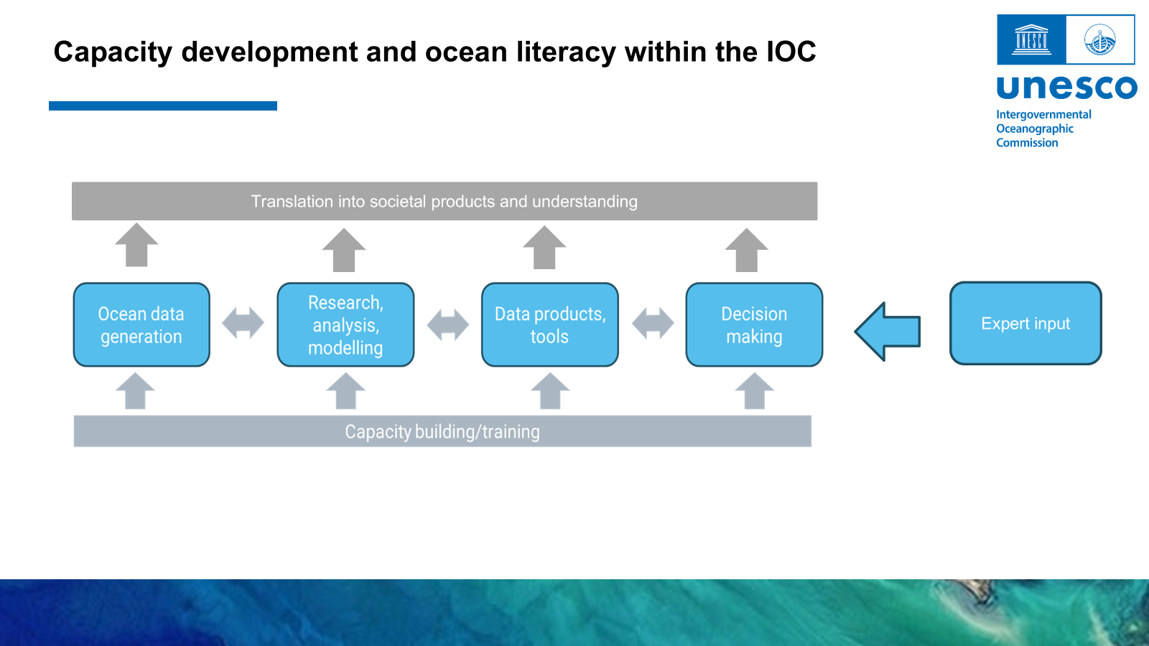
Capacity Development – Next steps
Building a sustained team
Capacity Development and Ocean Literacy coordinator: funded through the currently vacant core staff position – to be advertised
Admin officer: half funded through the ocean literacy DCO and half funded through capacity development/ocean literacy budgets
OTGA Manager: VLIZ secondment (in place)
IOC traineeship and Ocean Expert development officer (in place): NORAD funds (secured)
Realignment presented to the IOC Officers meeting (January 2026)
Progress will be delivered to:
IOC EC as update on E/S streamlining processes (as requested by 33rd Assembly)
34th IOC Assembly as part of E/S delivery on the request of the 33rd Assembly)
nitial

Slide 14
Capacity Development – Next steps
Building a sustained team
Capacity Development and Ocean Literacy coordinator: funded through the currently vacant core staff position – to be advertised
Admin officer: half funded through the ocean literacy DCO and half funded through capacity development/ocean literacy budgets
OTGA Manager: VLIZ secondment (in place)
IOC traineeship and Ocean Expert development officer (in place): NORAD funds (secured)
Realignment presented to the IOC Officers meeting (January 2026)
Progress will be delivered to:
IOC EC as update on E/S streamlining processes (as requested by 33rd Assembly)
34th IOC Assembly as part of E/S delivery on the request of the 33rd Assembly)

