Slide 1
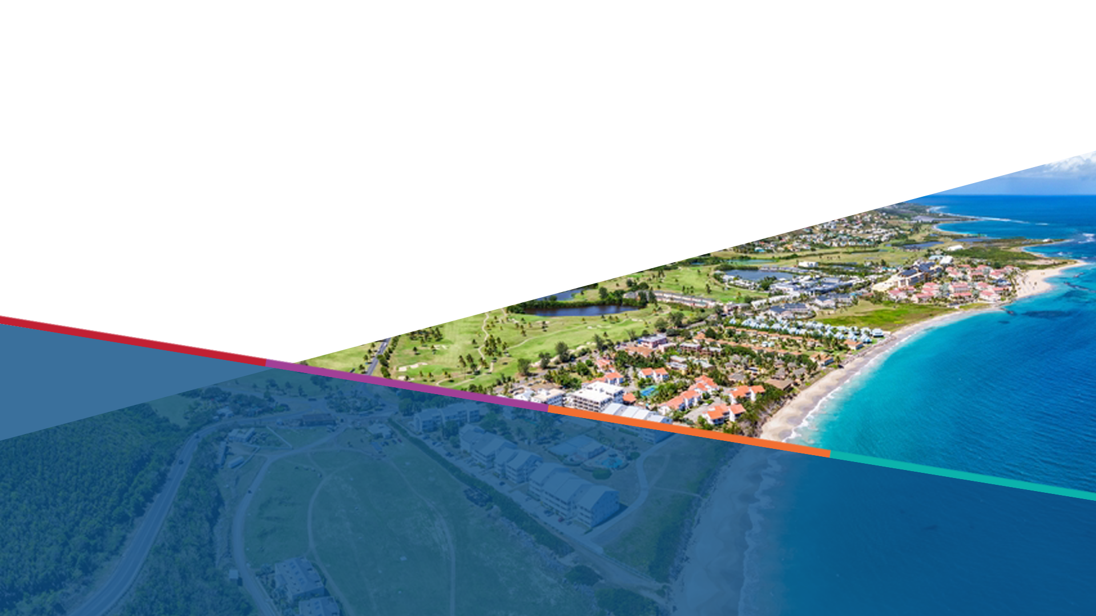


Progress report WTAD and EW4ALL
ICG-CARIBE-EWS
UNDRR Regional Office for the Americas and Caribbean

Slide 2

WTAD 2025 Theme and Objectives
To achieve the goal of the Sendai Framework of reducing disaster losses by promoting resilience
building measures that protect lives, livelihoods, and economies from the devastating impacts of
tsunamis from all sources, including volcanos, the theme of World Tsunami Awareness Day 2025,
on 5 November, will be “Be Tsunami Ready: Invest in Tsunami Preparedness”.
Mobilise increased funding commitments from governments and the private sector through highlighting the economic case for investing in tsunami preparedness and early warning systems.
Strengthen and encourage regional cooperation towards strengthened MHEWS and tsunami resilience.
Raise awareness of tsunami readiness and encourage more coastal communities and international partners to join by showcasing its benefits and sharing real-world success stories.
Contribute risk communication tools and outreach resources that support the implementation of Tsunami Ready preparedness indicators, with a focus on public education, regular drills, and community engagement.
Empower local leaders as champions for tsunami preparedness.
Promote peer-to-peer learning and knowledge-sharing of DRR technologies and solutions.

Slide 3
WTAD 2025 Key Messages
Tsunami preparedness is a public good and a sound economic strategy
Investments in tsunami early warning, evacuation mapping, risk education, and regular drills reduce mortality, limit disruption, and protect development gains along coasts.
Regional coherence is key for tsunami early warning
Interoperable, cross-border systems and shared protocols create timely, trusted tsunami alerts and a common operating picture across entire coastlines.
Financing and innovation for tsunami resilience is necessary
Financing aligned with coastal risk, together with proven and emerging tsunami technologies (e.g., detection networks, inundation modelling, resilient infrastructure), underpins durable coastal economies.
Tsunami risk communication should be continuous
Because tsunamis are low-frequency, high-impact hazards, sustained public awareness maintains tsunami risk memory, keeps evacuation routes and roles familiar, and supports whole-of-society resilience.
Tsunami readiness is measurable
A performance-based community framework using tsunami-specific indicators such as accessible public information, routine education activities, and community tsunami drills signals that essential safeguards are in place.

Slide 4


EW4ALL Progress in the Caribbean
7
National Roadmaps
Approved by 2025
KEY ACHIEVEMENTS
Validated Implementation Plans: Antigua & Barbuda, Barbados, Belize, Guyana, and Haiti.
NEXT STEPS
2026 Priorities: Targeted focus on sustainability and funding for implementation plans.
New Roll-outs: Expanding coverage to Grenada, Saint Kitts & Nevis, and Suriname.

Slide 5
Thank you very for your attention
For more information please contact:
Raphael Hamoir
Programme Management Officer for the Caribbean
raphael.hamoir@un.org

