Slide 1





SMART Cables
Infrastructure to observe the ocean and earth: Caribe
Observing the Ocean and Earth with
ICG/CARIBE-EWS XIX
Curaçao
22 April 2026
Ceci Rodríguez Cruz
JTF SMART Cables – SMART IPO
University of Hawaiʻi at Mānoa
Scientific Monitoring And Reliable Telecommunications

Slide 2
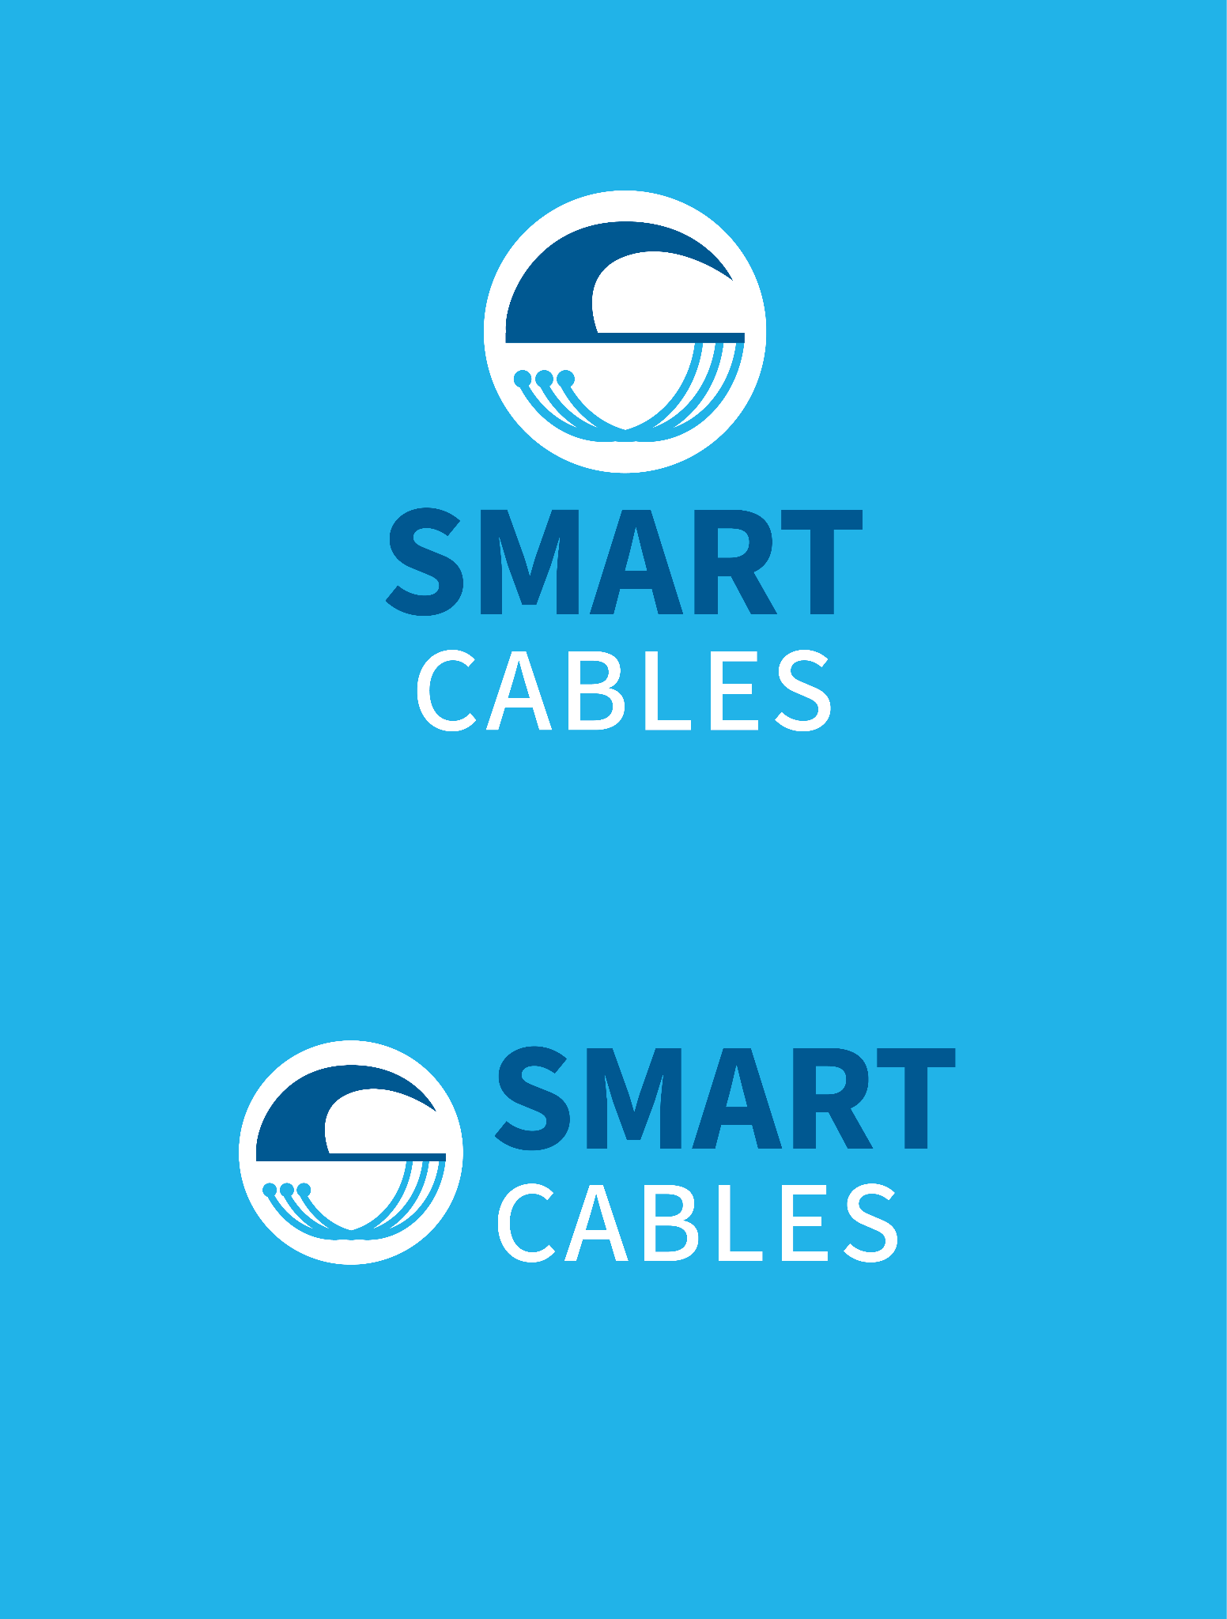


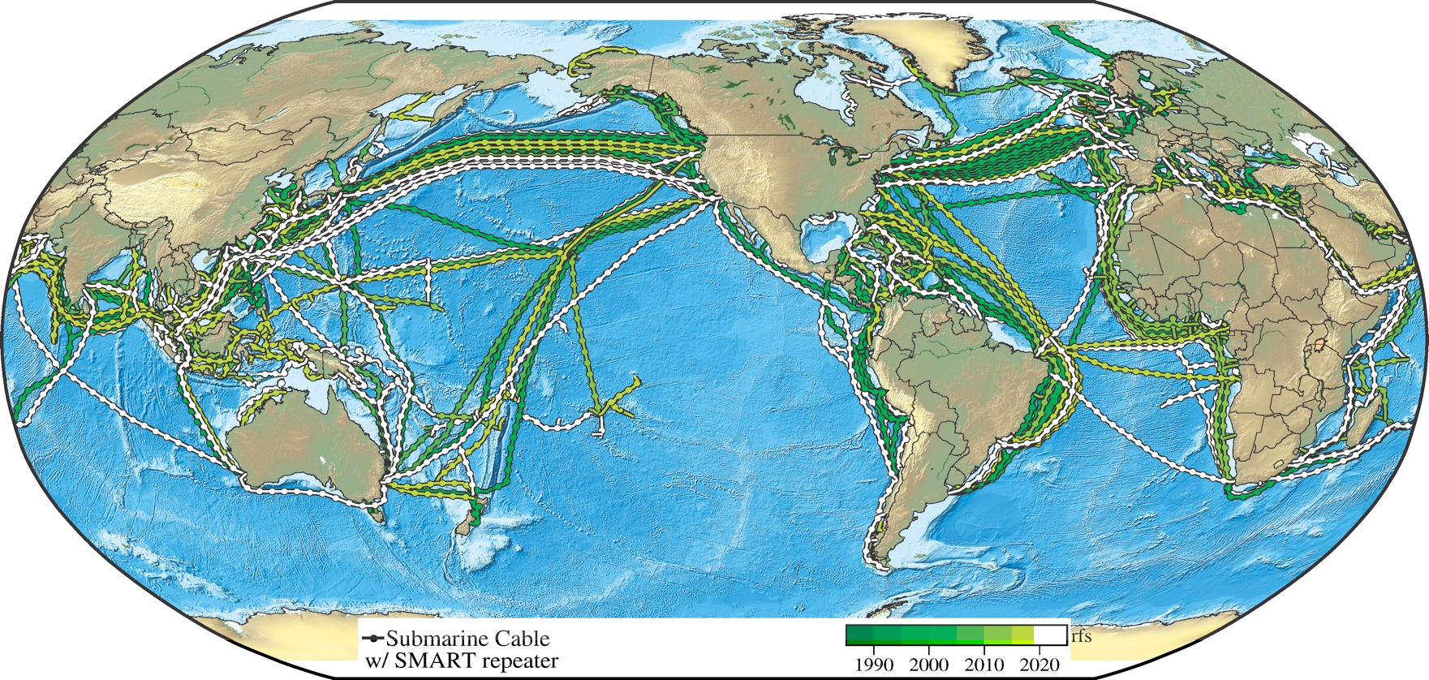

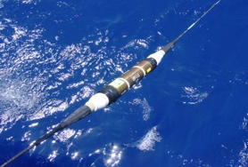


SMART Cables
Global Multi Purpose Infrastructure (connectivity + science)
for the benefit of Society
NO Interference
Global array
1st order addition to Ocean-Earth observing system
Societal Benefit:
Climate
Oceans
Earthquakes
Tsunamis
Emerging
Network
Financed Systems:
Atlantic CAM
Tamtam
Know the environment, protect the network
Notes:
Antarctic cables

Slide 3
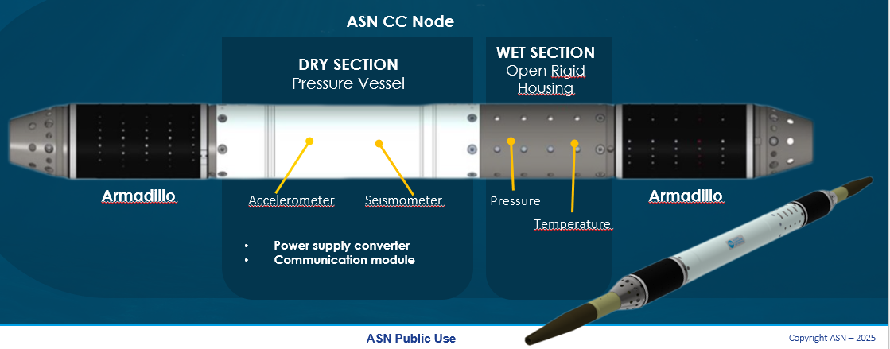

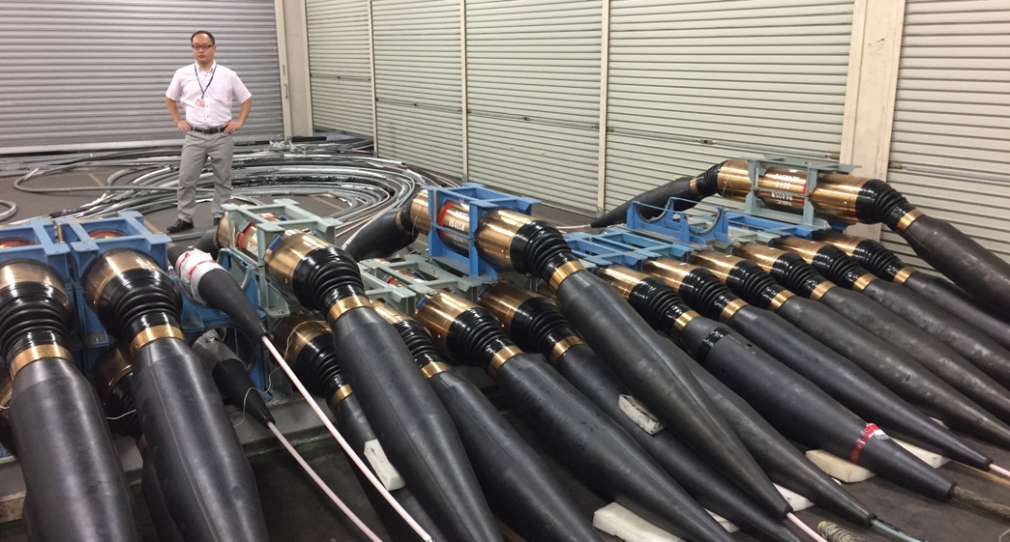





SMART Capability
Shared Cable Infrastructure: Telecom + Science
No Interference
Sensors:
Temperature
Pressure
Seismic
Key point:
Essential Ocean Variables, Global Ocean Observing System
Repeater
Existing Technology

Slide 4
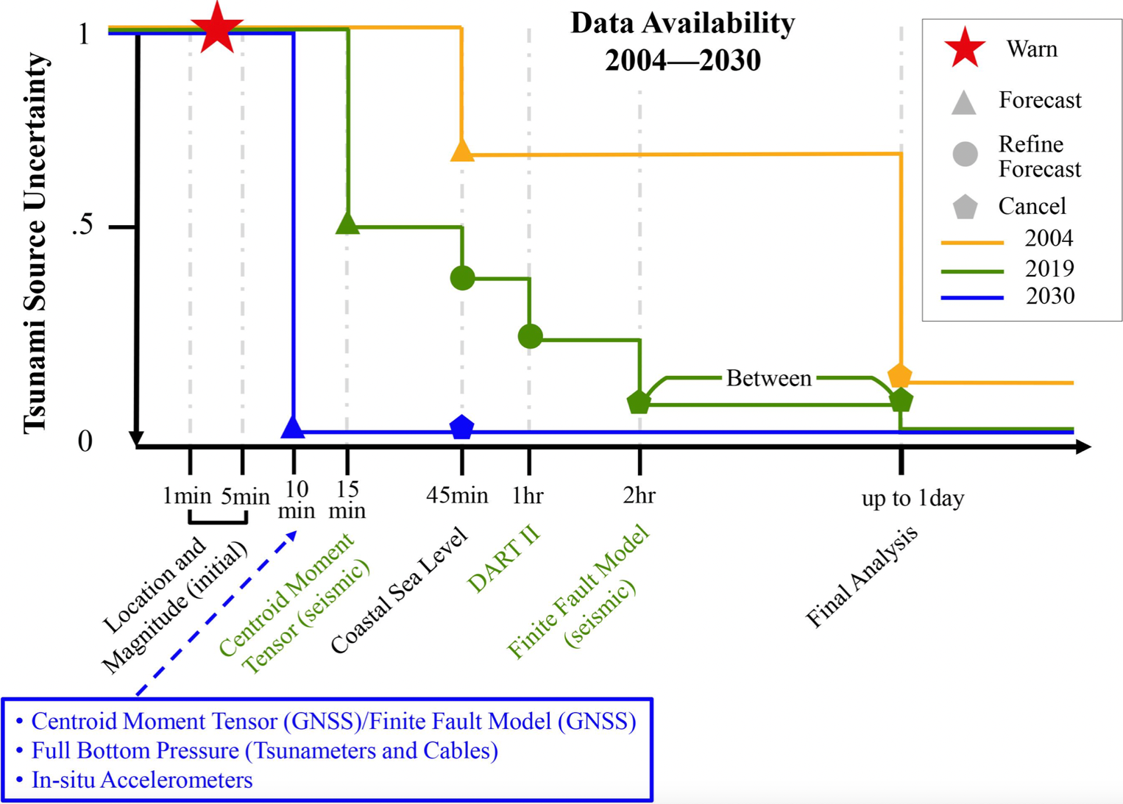
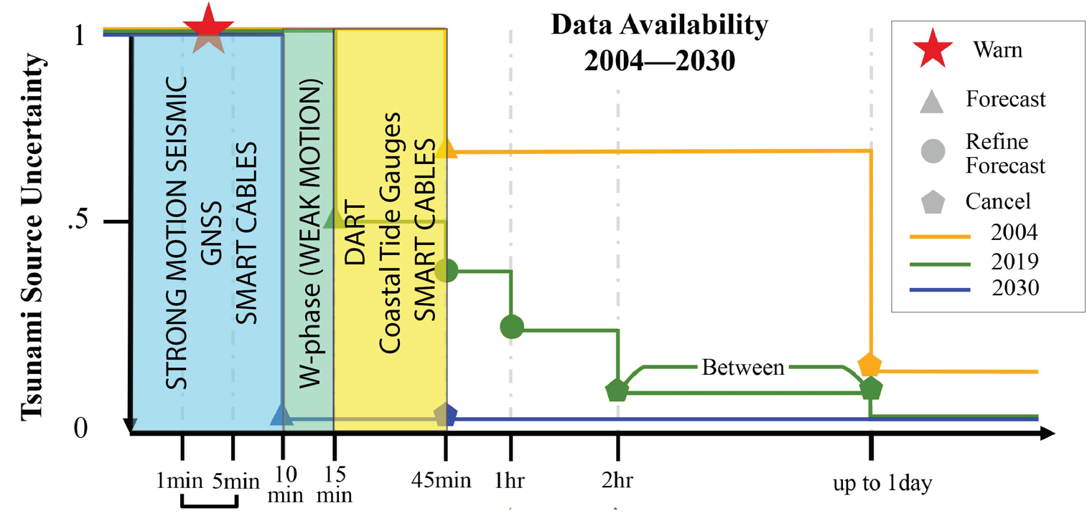

Ocean Decade Tsunami Programme
Improving
Early Warning
by integrating
SMART Capability into
early warning systems
2004
2019
2030

Slide 5
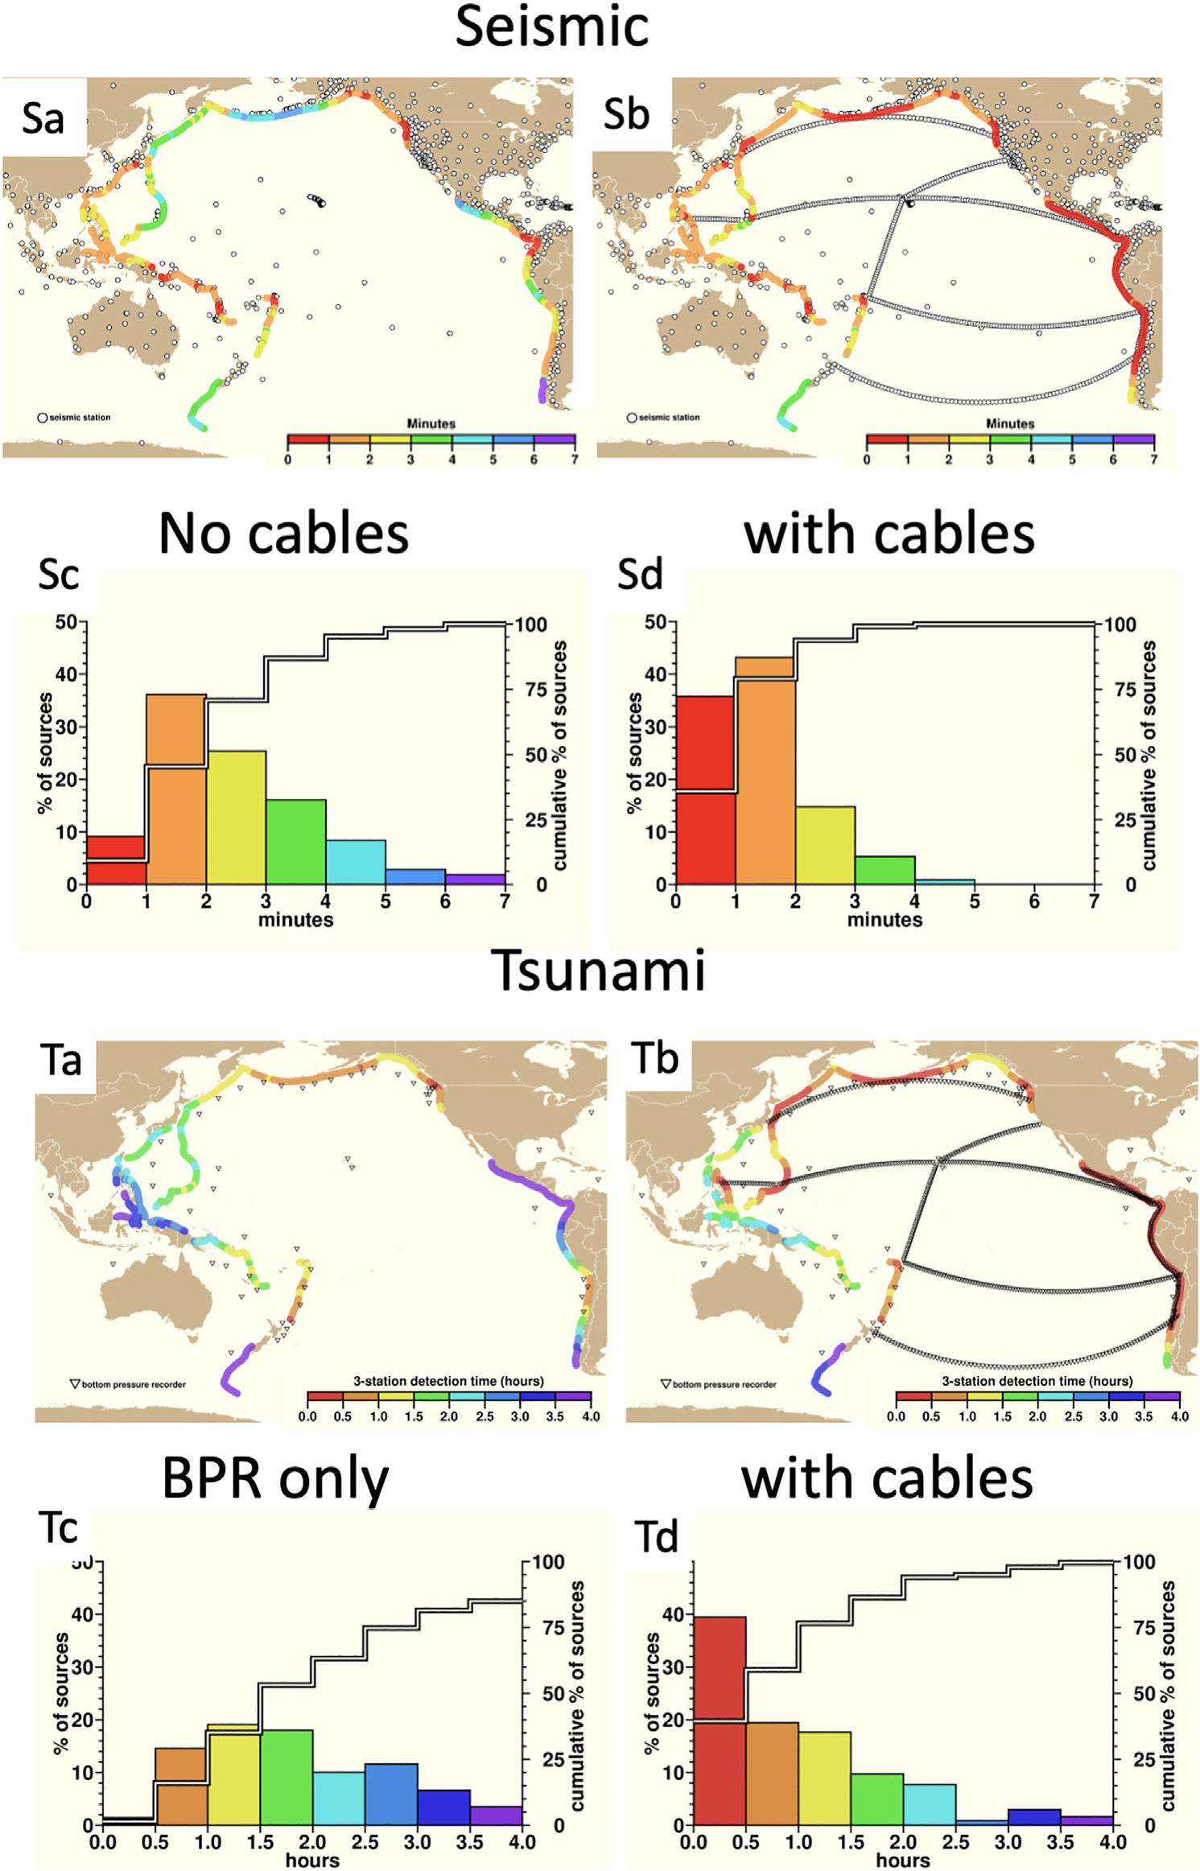



Earthquake and Tsunami Warning
0 - 4 hours
Time scales:
0 - 7 minutes
Deep-ocean propagation → minutes to hours SMART pressure sensors refine amplitude
Earthquake → 0–7 min SMART seismic + pressure supports confirmation

Slide 6


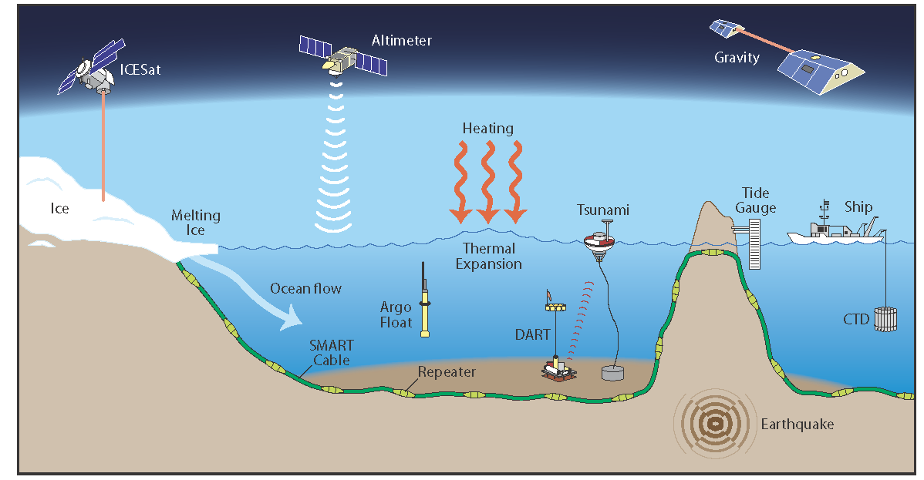
SMART contribution: Ocean + Climate change + DRR
Status Southern Ocean – SMART Can Help
SMART Data – International Frameworks
SMART (pressure)
Embedded
25-year life
No surface buoy
DART (pressure)
Dedicated system
Flexible deployment
Other Sensing Techniques
Monitor ocean circulation that drives weather and climate
SMART Cables measure Essential Ocean Variables:
Temperature, Pressure; Seismic motion/Ocean Sound + …

Slide 7
Contribution to Early Warning Community
Increasing deep-ocean pressure density
Improving detection confirmation and amplitude
Supporting resilient long-term infrastructure
Enabling multi-hazard integration
HOW to make it possible in a global scale?
SMART Cables – a new way to observe the ocean – real time, reliable, 25-year life, low lifetime cost.
Early systems underway setting valuable precedents, preparing for more
SMART will catalyze further tech development, research, and funding
Funding sources, coming from outside ocean/research – telecom related. (EU Digital Infrastructure)

Slide 8
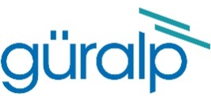
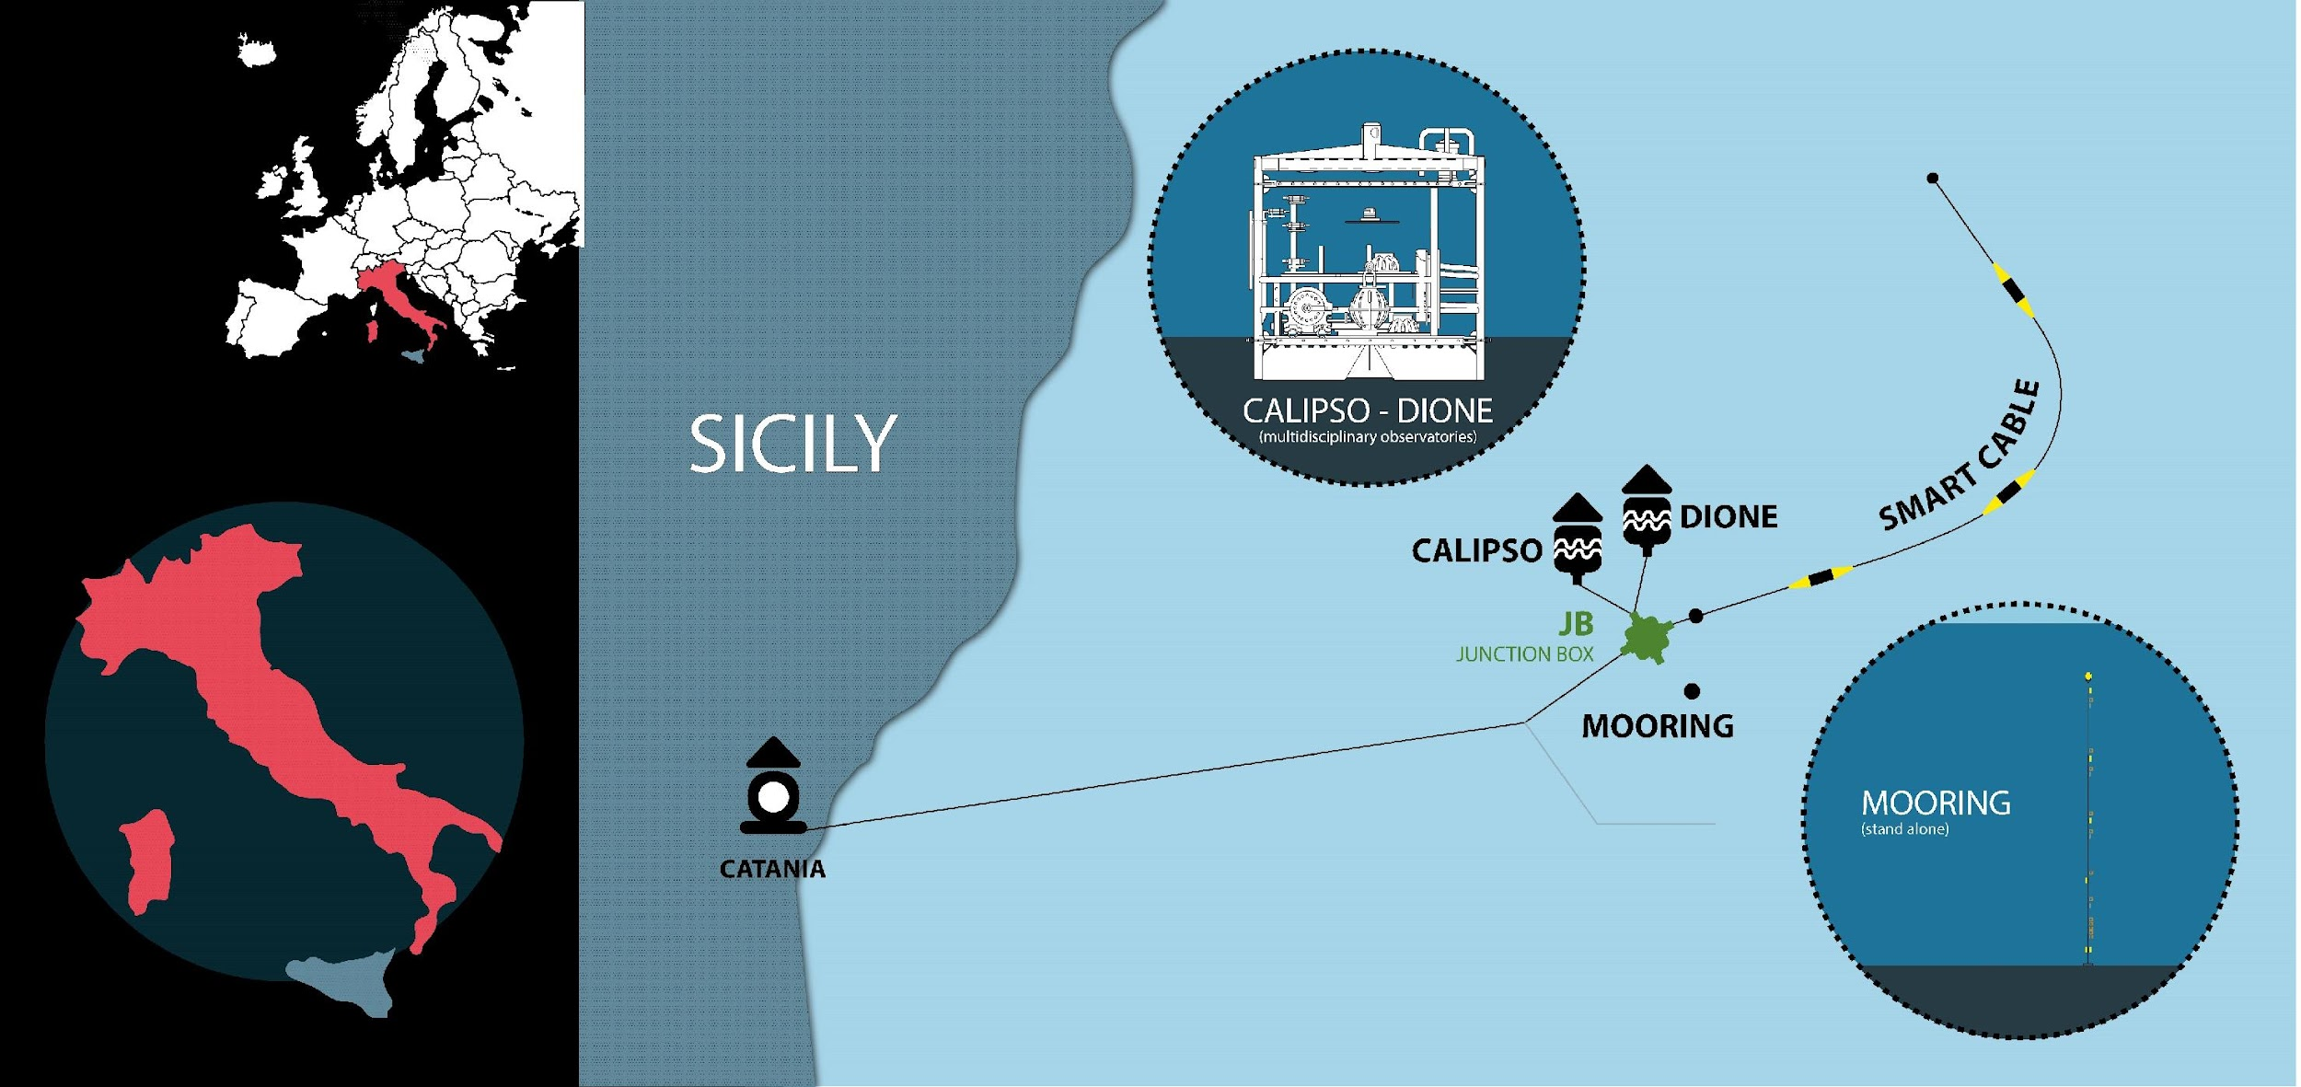
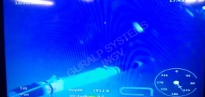







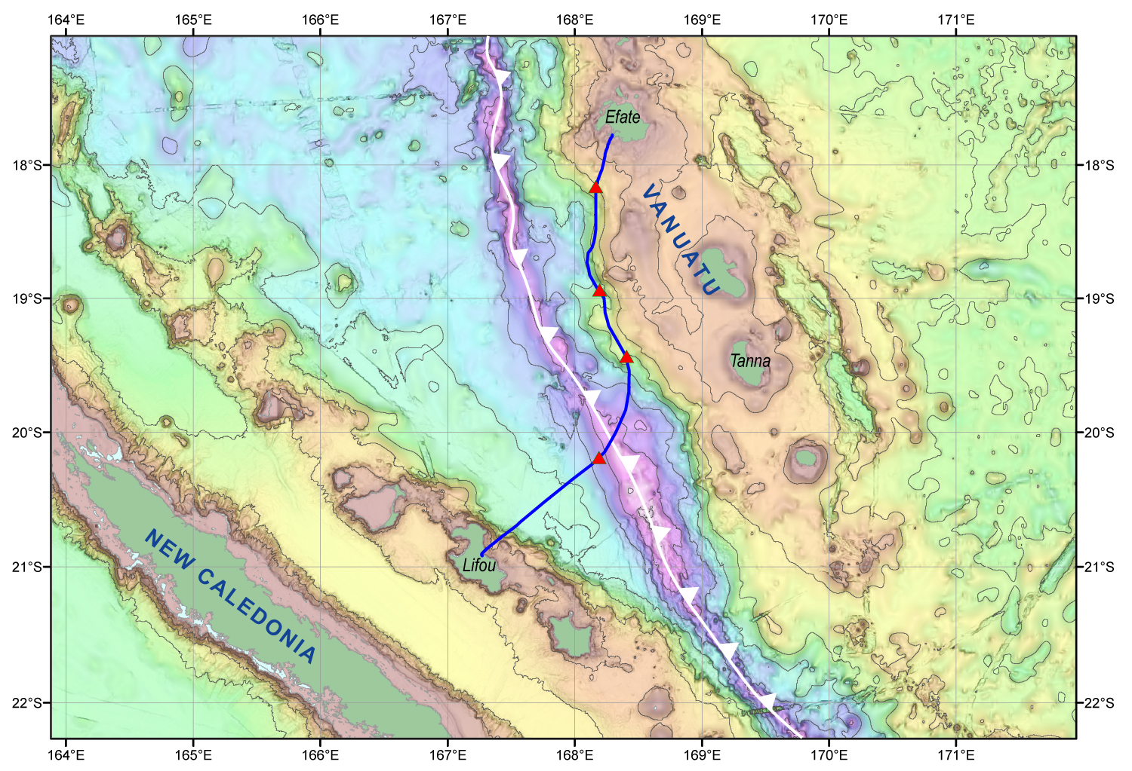
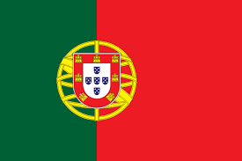
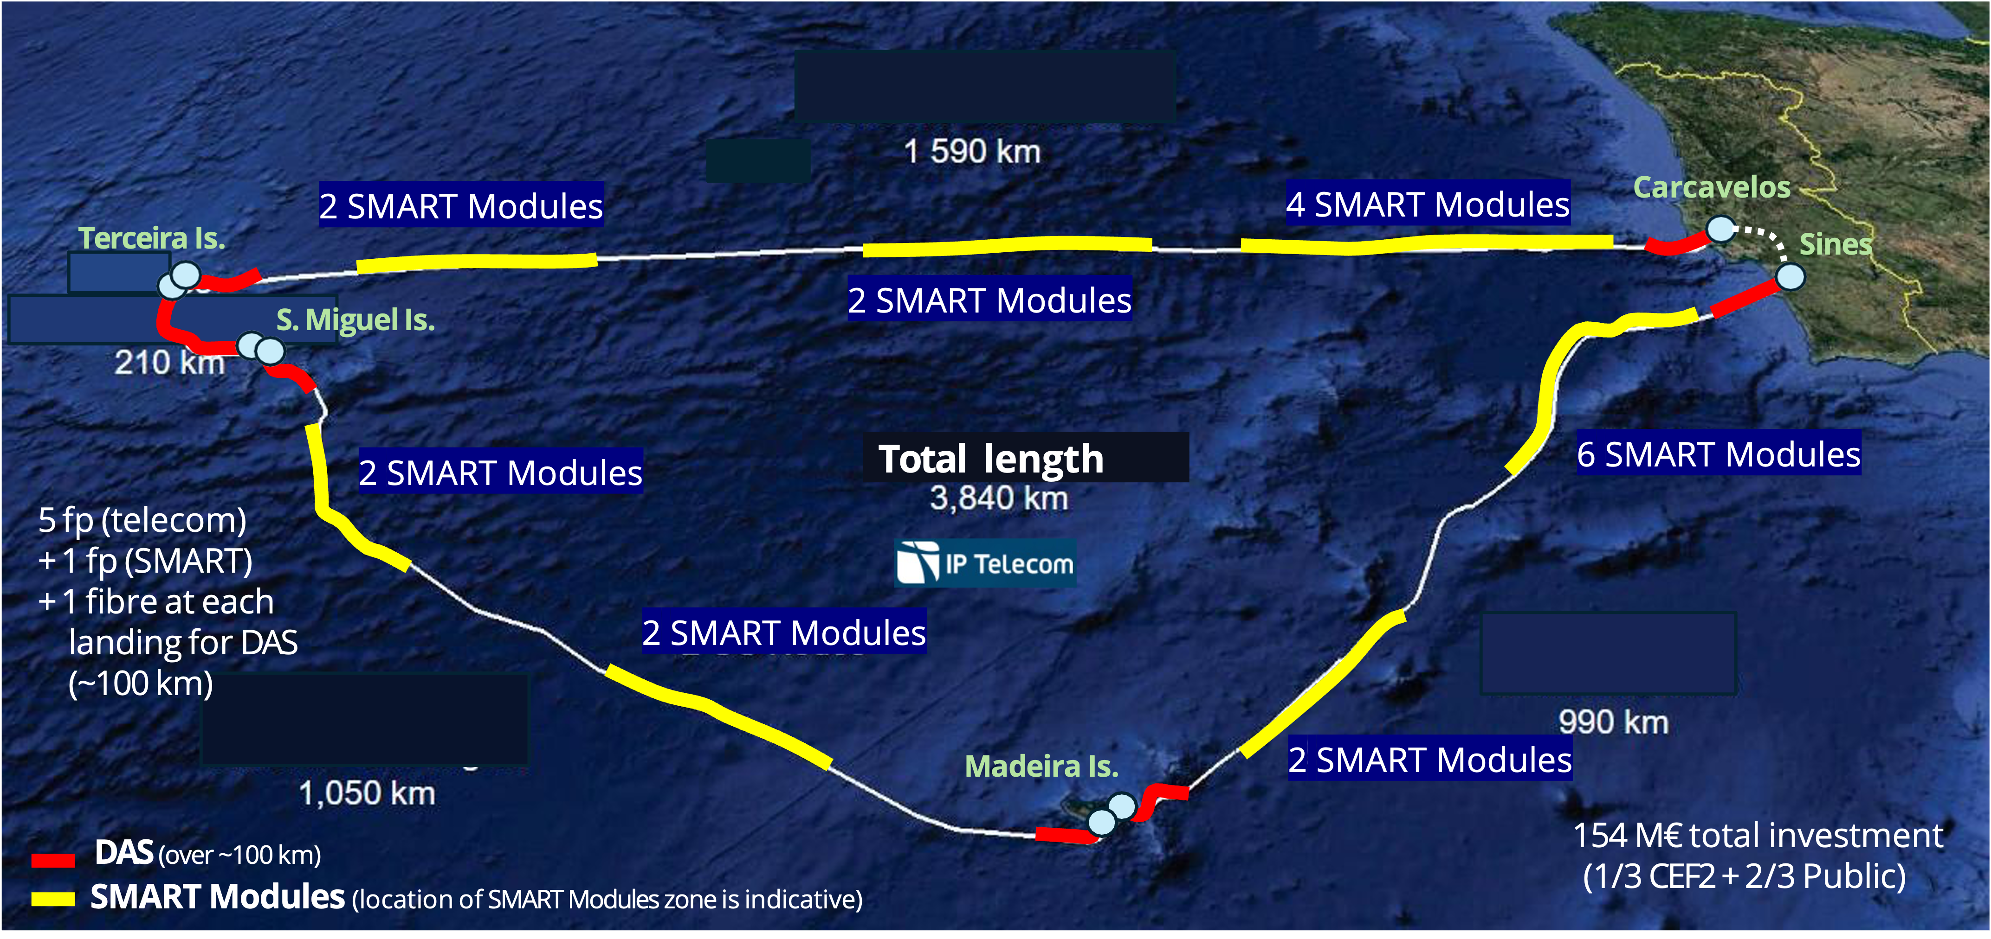



Current Deployments
InSEA Wet Demo
Tamtam
Atlantic CAM
Vanuatu
RFS 2027
New Caledonia

Slide 9

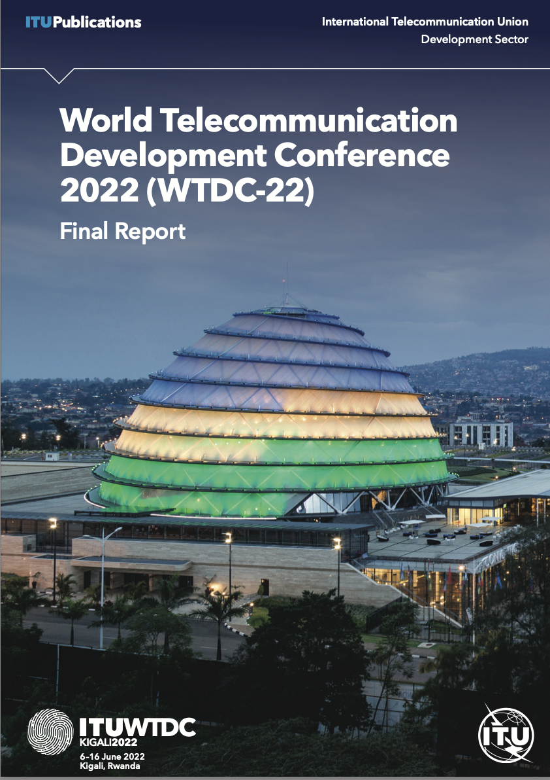
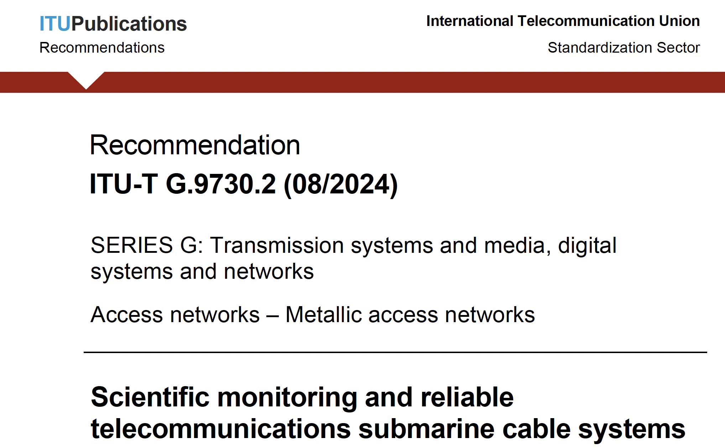

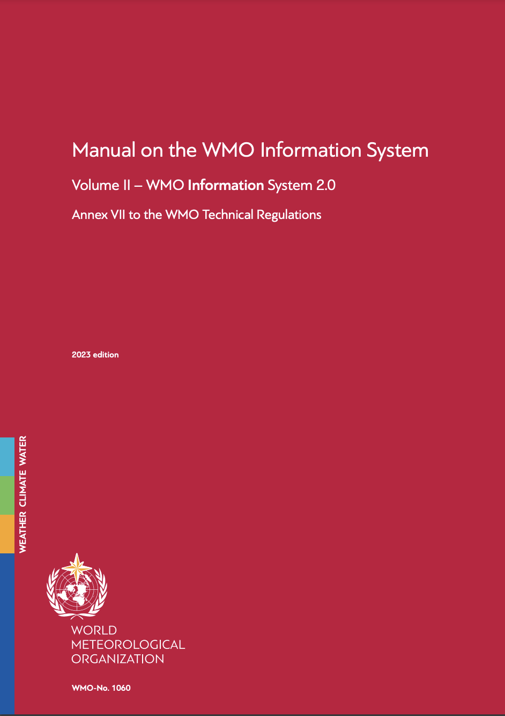







Governance and Alignment
Status Southern Ocean – SMART Can Help
JTF Secretariat
Resolutions on climate change Disaster Risk Reduction (DDR) includes SMART
Recommendations SG15/Q8 G.dsssc/9730.1 and G.SMART/9730.2
Integrates SMART into WMO Information platform
Global Ocean Observing System (GOOS)
Tsunami Programme
UN Ocean Decade: endorsed Project
Emerging Observing Network of GOOS

Slide 10
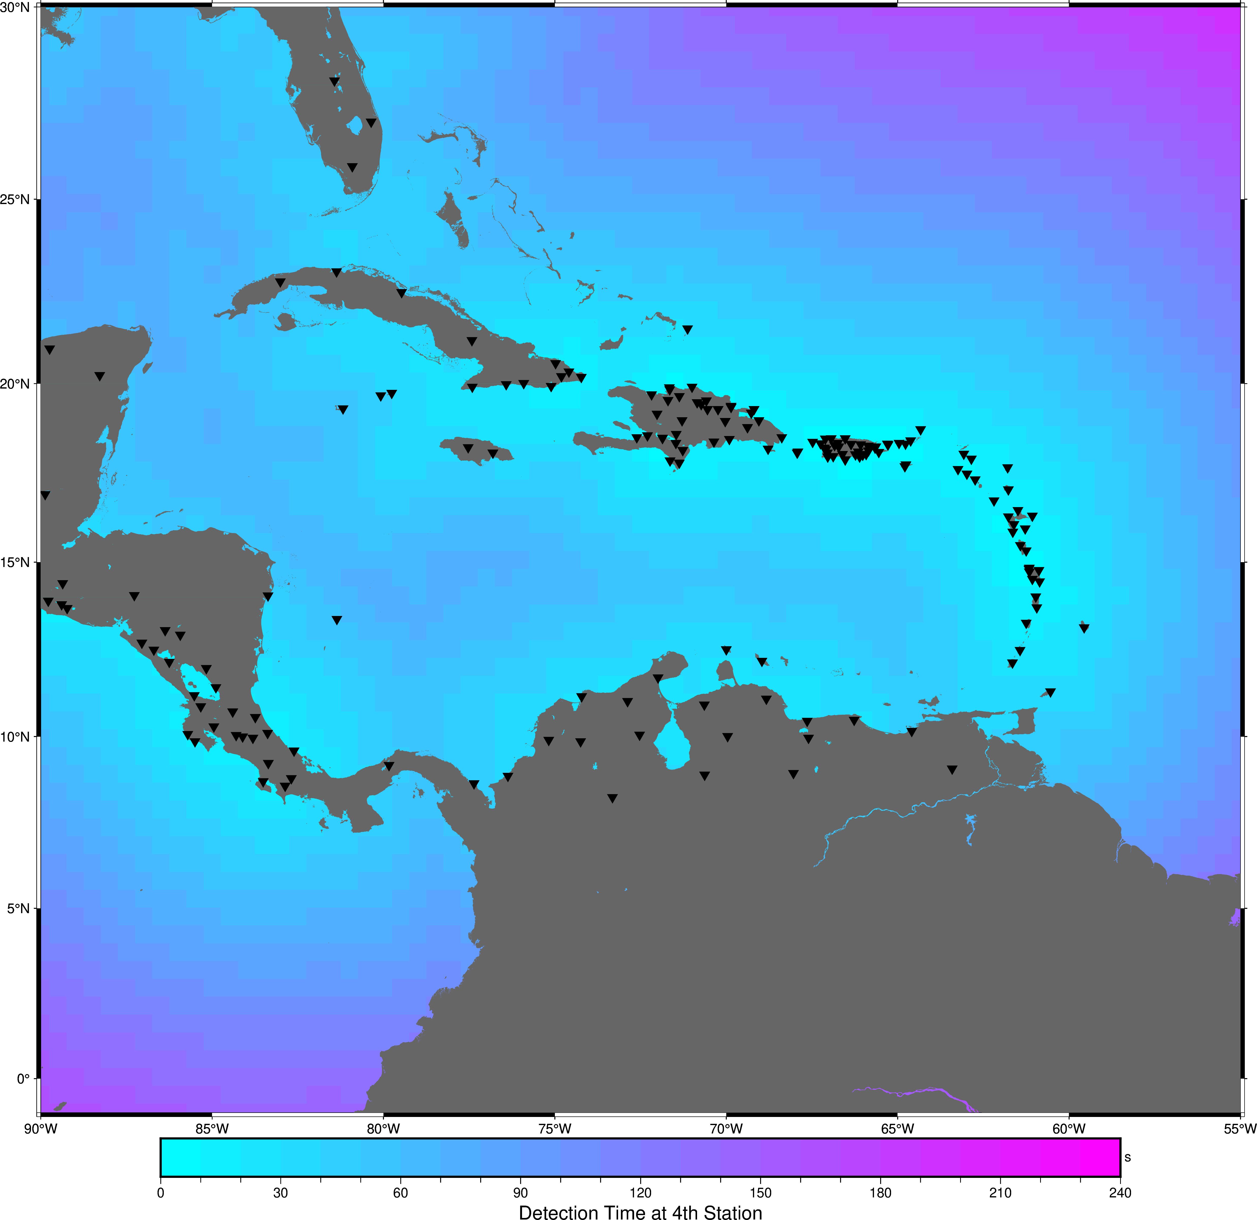
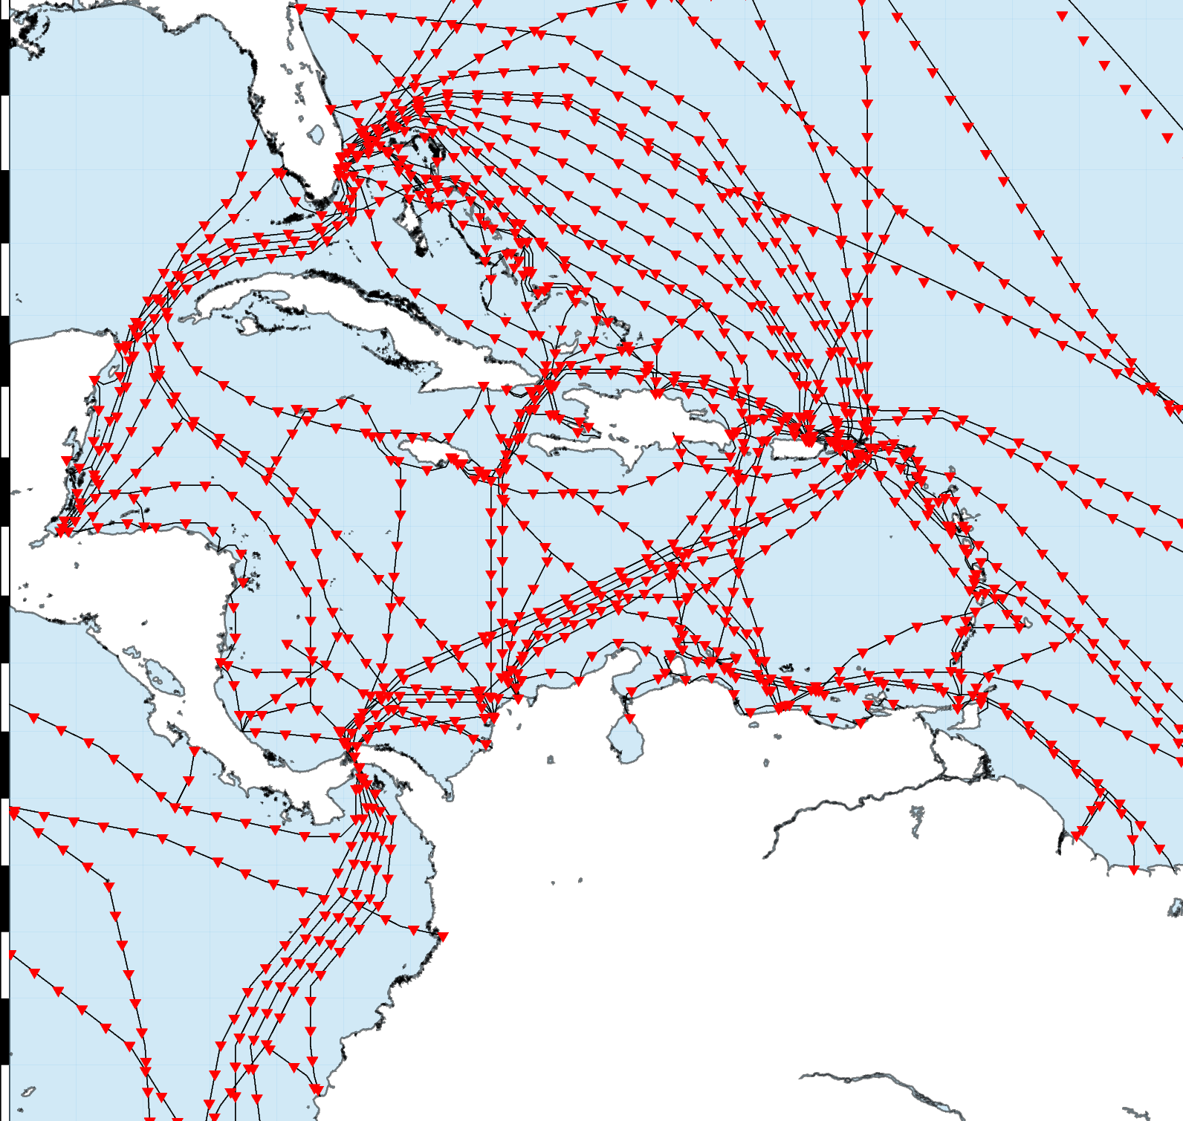
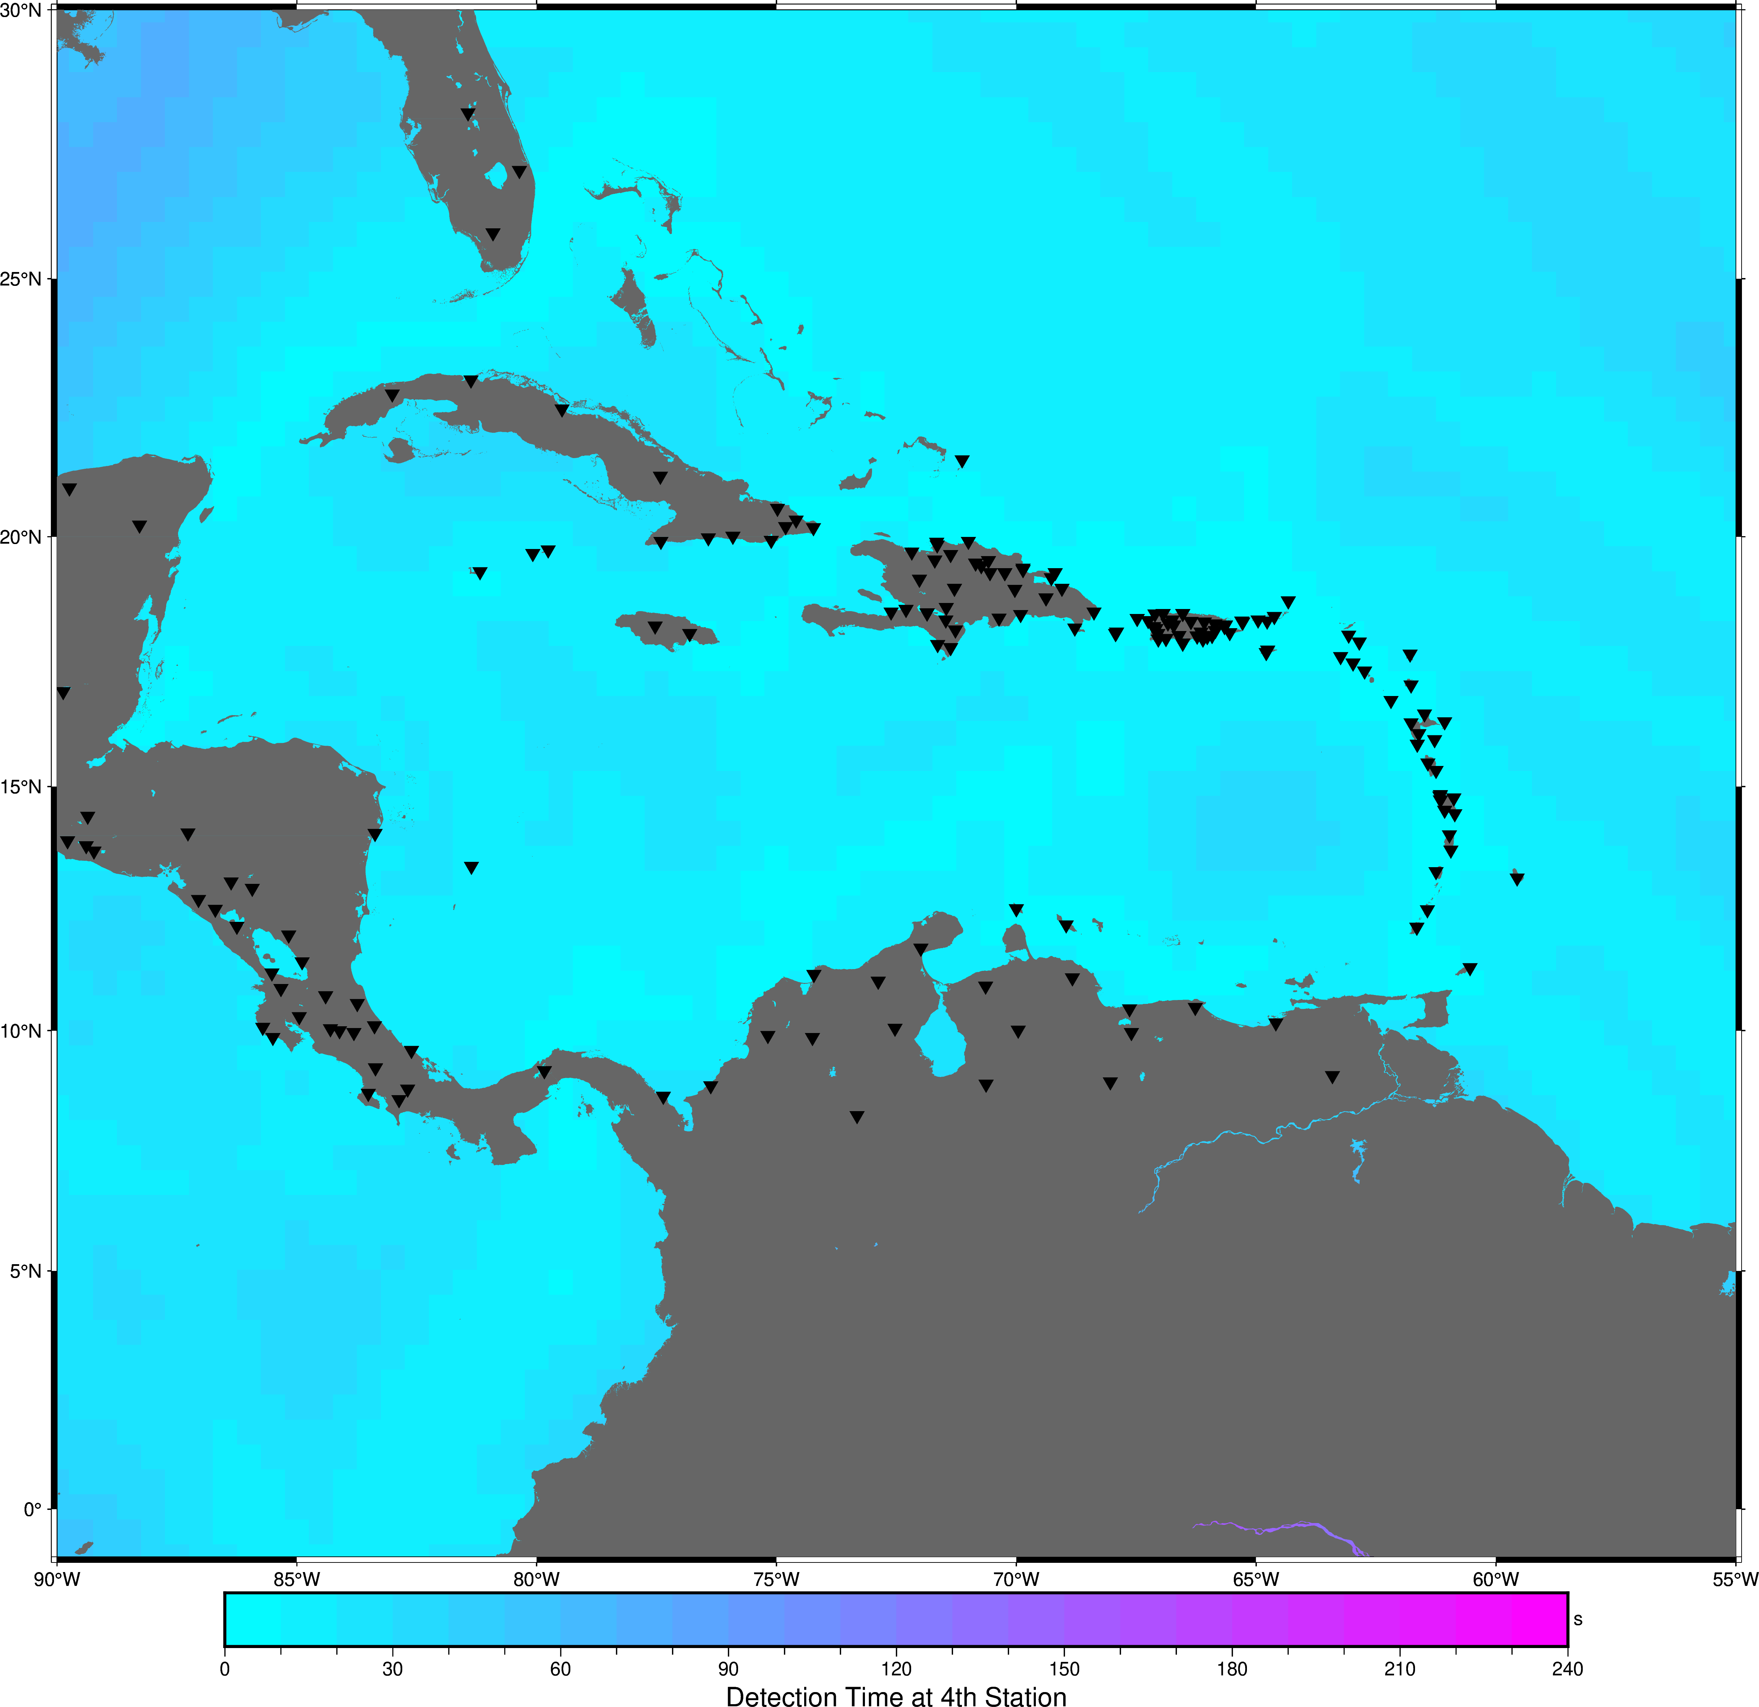
Caribbean: Eq + Ts
Detection times
Existing, NO SMART
Optimistic
all existing cables SMART
Detection times
EXISTING + SMART
100 s
30 s
Detection Times for Earthquakes (at 4th station)
elizabeth.vanacore@upr.edu
Dr Elizabeth A Vanacore,
Chair Task Team CARIBE WAVE 2

Slide 11
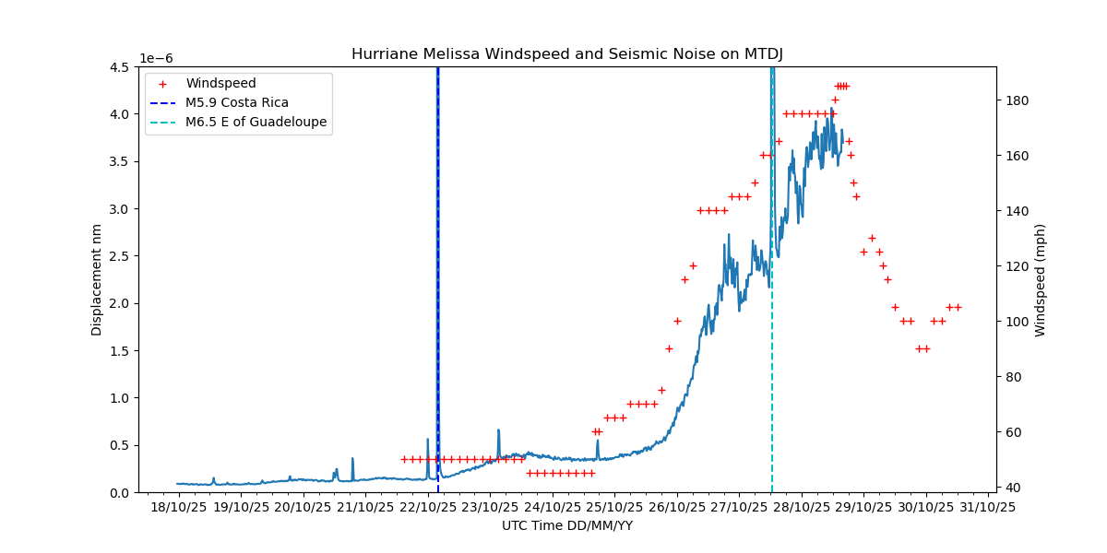
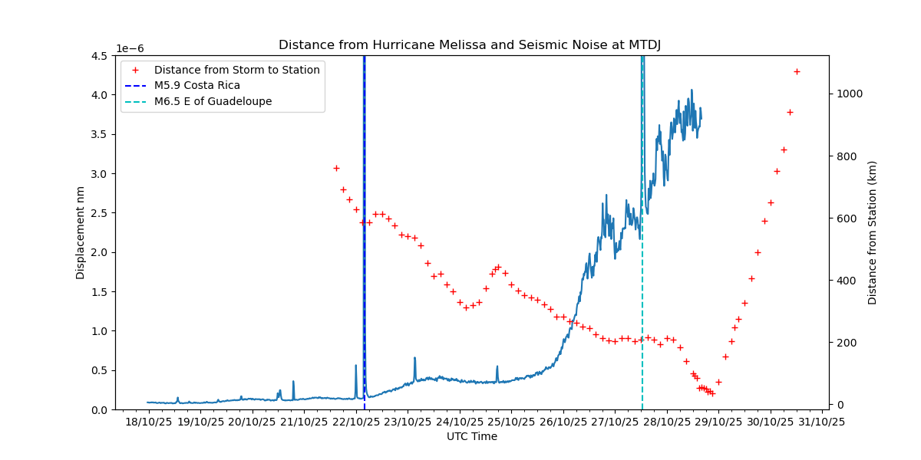
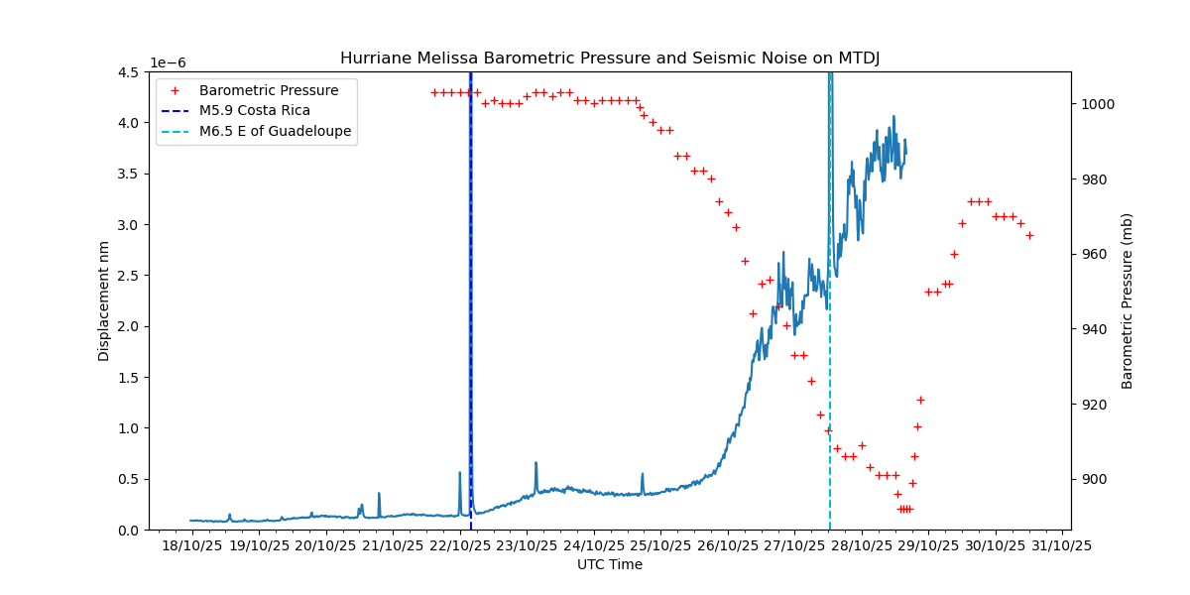
Caribbean: Hurricane Melissa
Dr Elizabeth A Vanacore,
Chair Task Team CARIBE WAVE 2

Slide 12

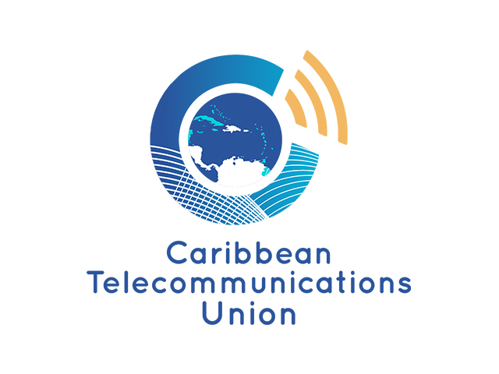
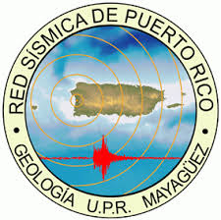


SMART Cables: Caribbean Regional Dialogue
Regional Leadership
IOCARIBE (UNESCO-IOC)
International Telecommunications Union (ITU)
WMO Regional Office
Caribbean Telecommunications Union (CTU)
Coordination
ITU/WMO/UNESCO-IOC JTF SMART Cables
Focus: Awareness and structured dialogue
Tailored Regional Webinars
Establish a core Regional Coordination Group
Assess relevance and readiness
Potential Contributions to the Caribbean
Offshore earthquake and tsunami detection
Ocean temperature and bottom pressure monitoring
Sea- level rise
Hurricane and storm surge
Cable resilience and environmental awareness
Complement to existing regional observing systems
Mid-Term Goal
Shared regional understanding
Coordinated pathway toward possible pilot
Potential regional visibility at COP32–33
1rst Webinar
May 21

Slide 13
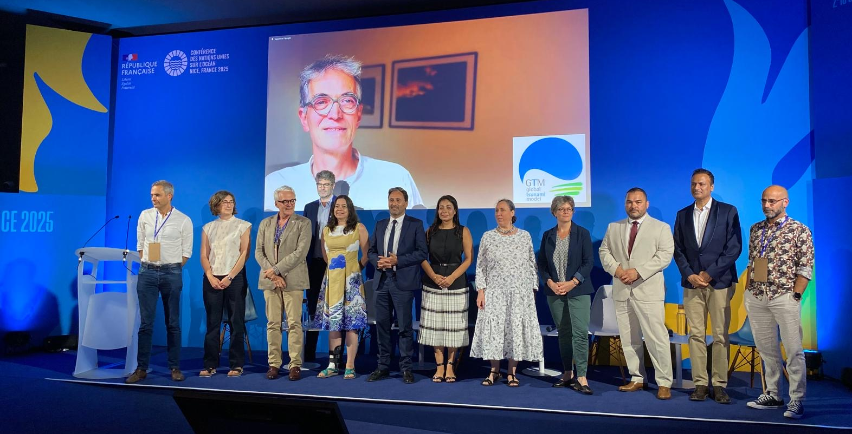
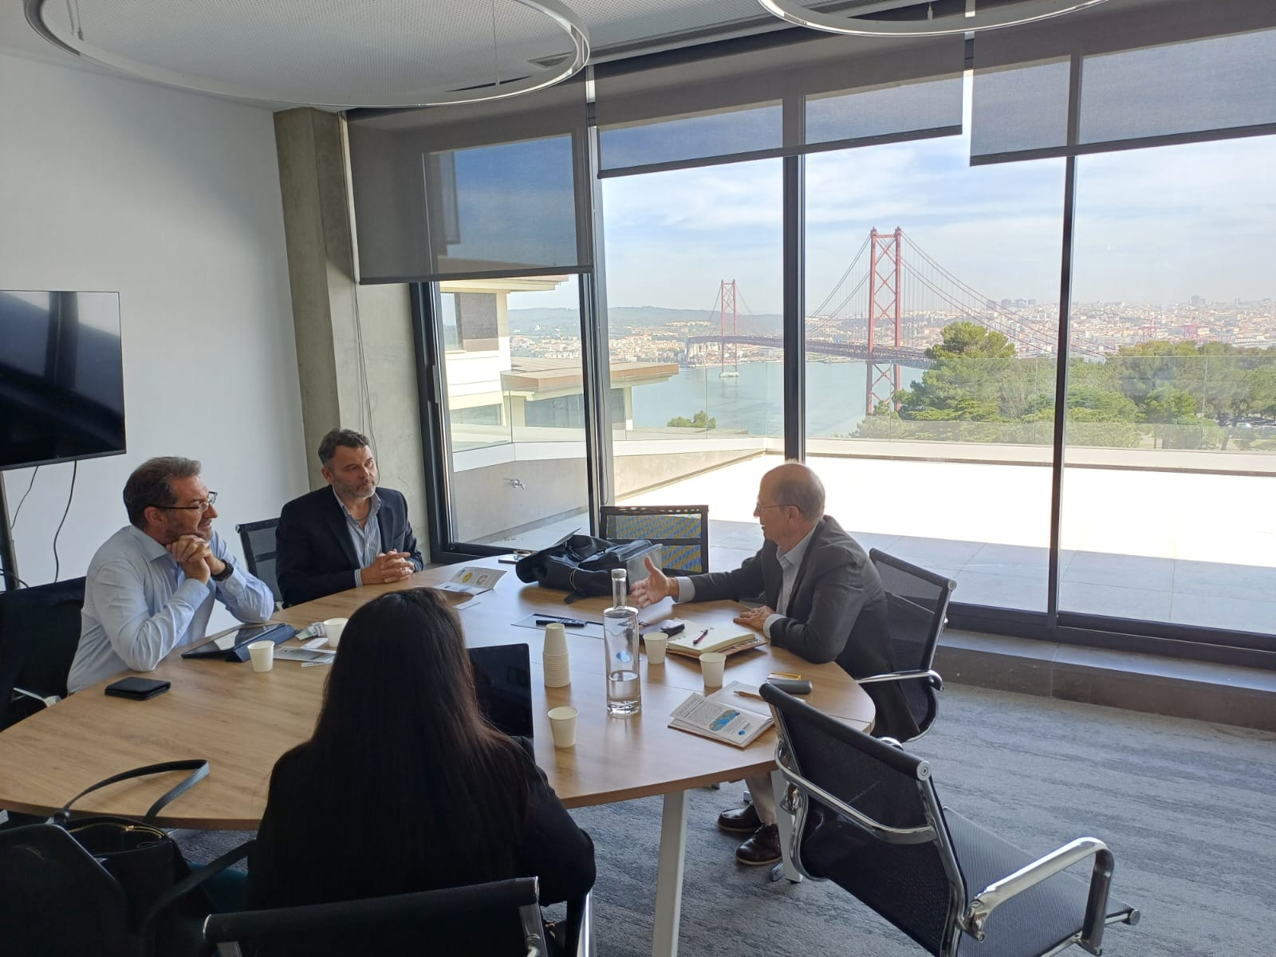


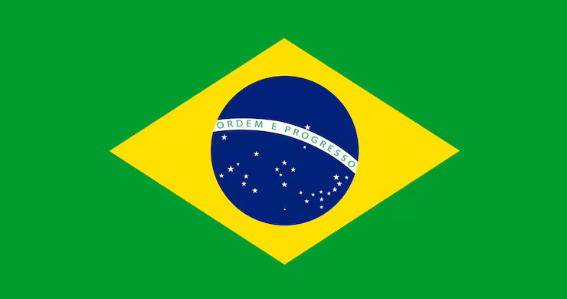
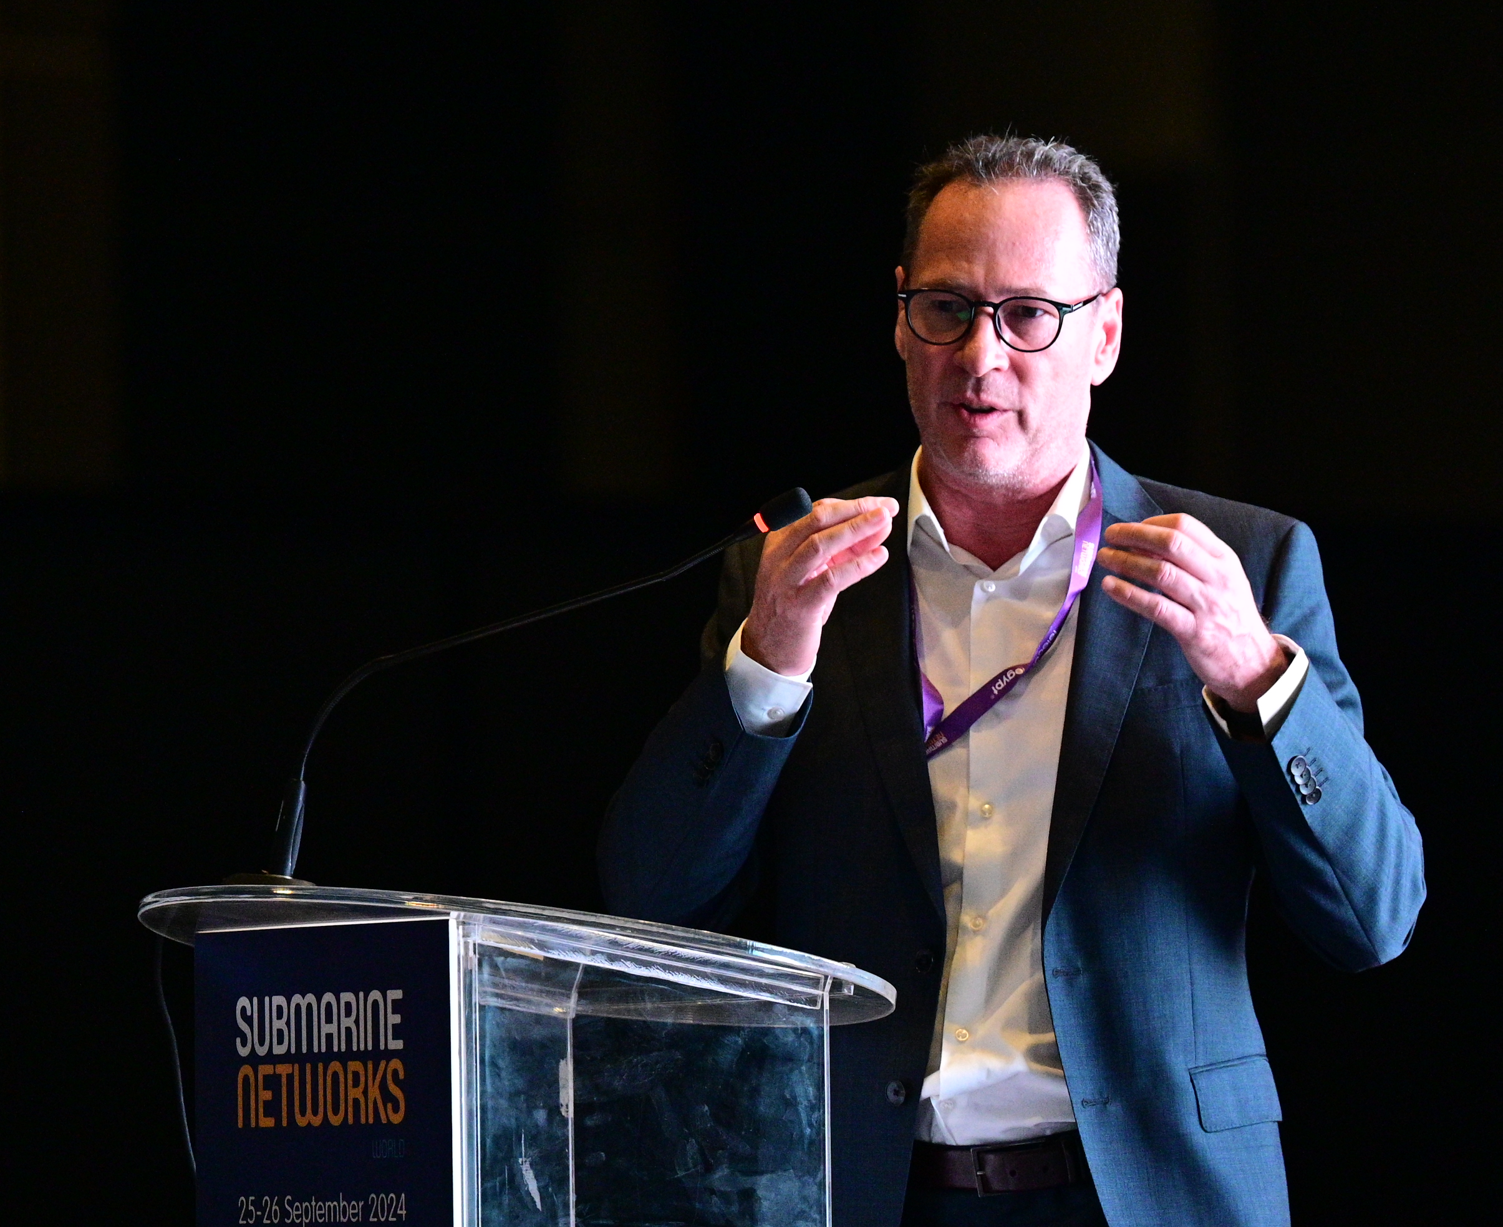

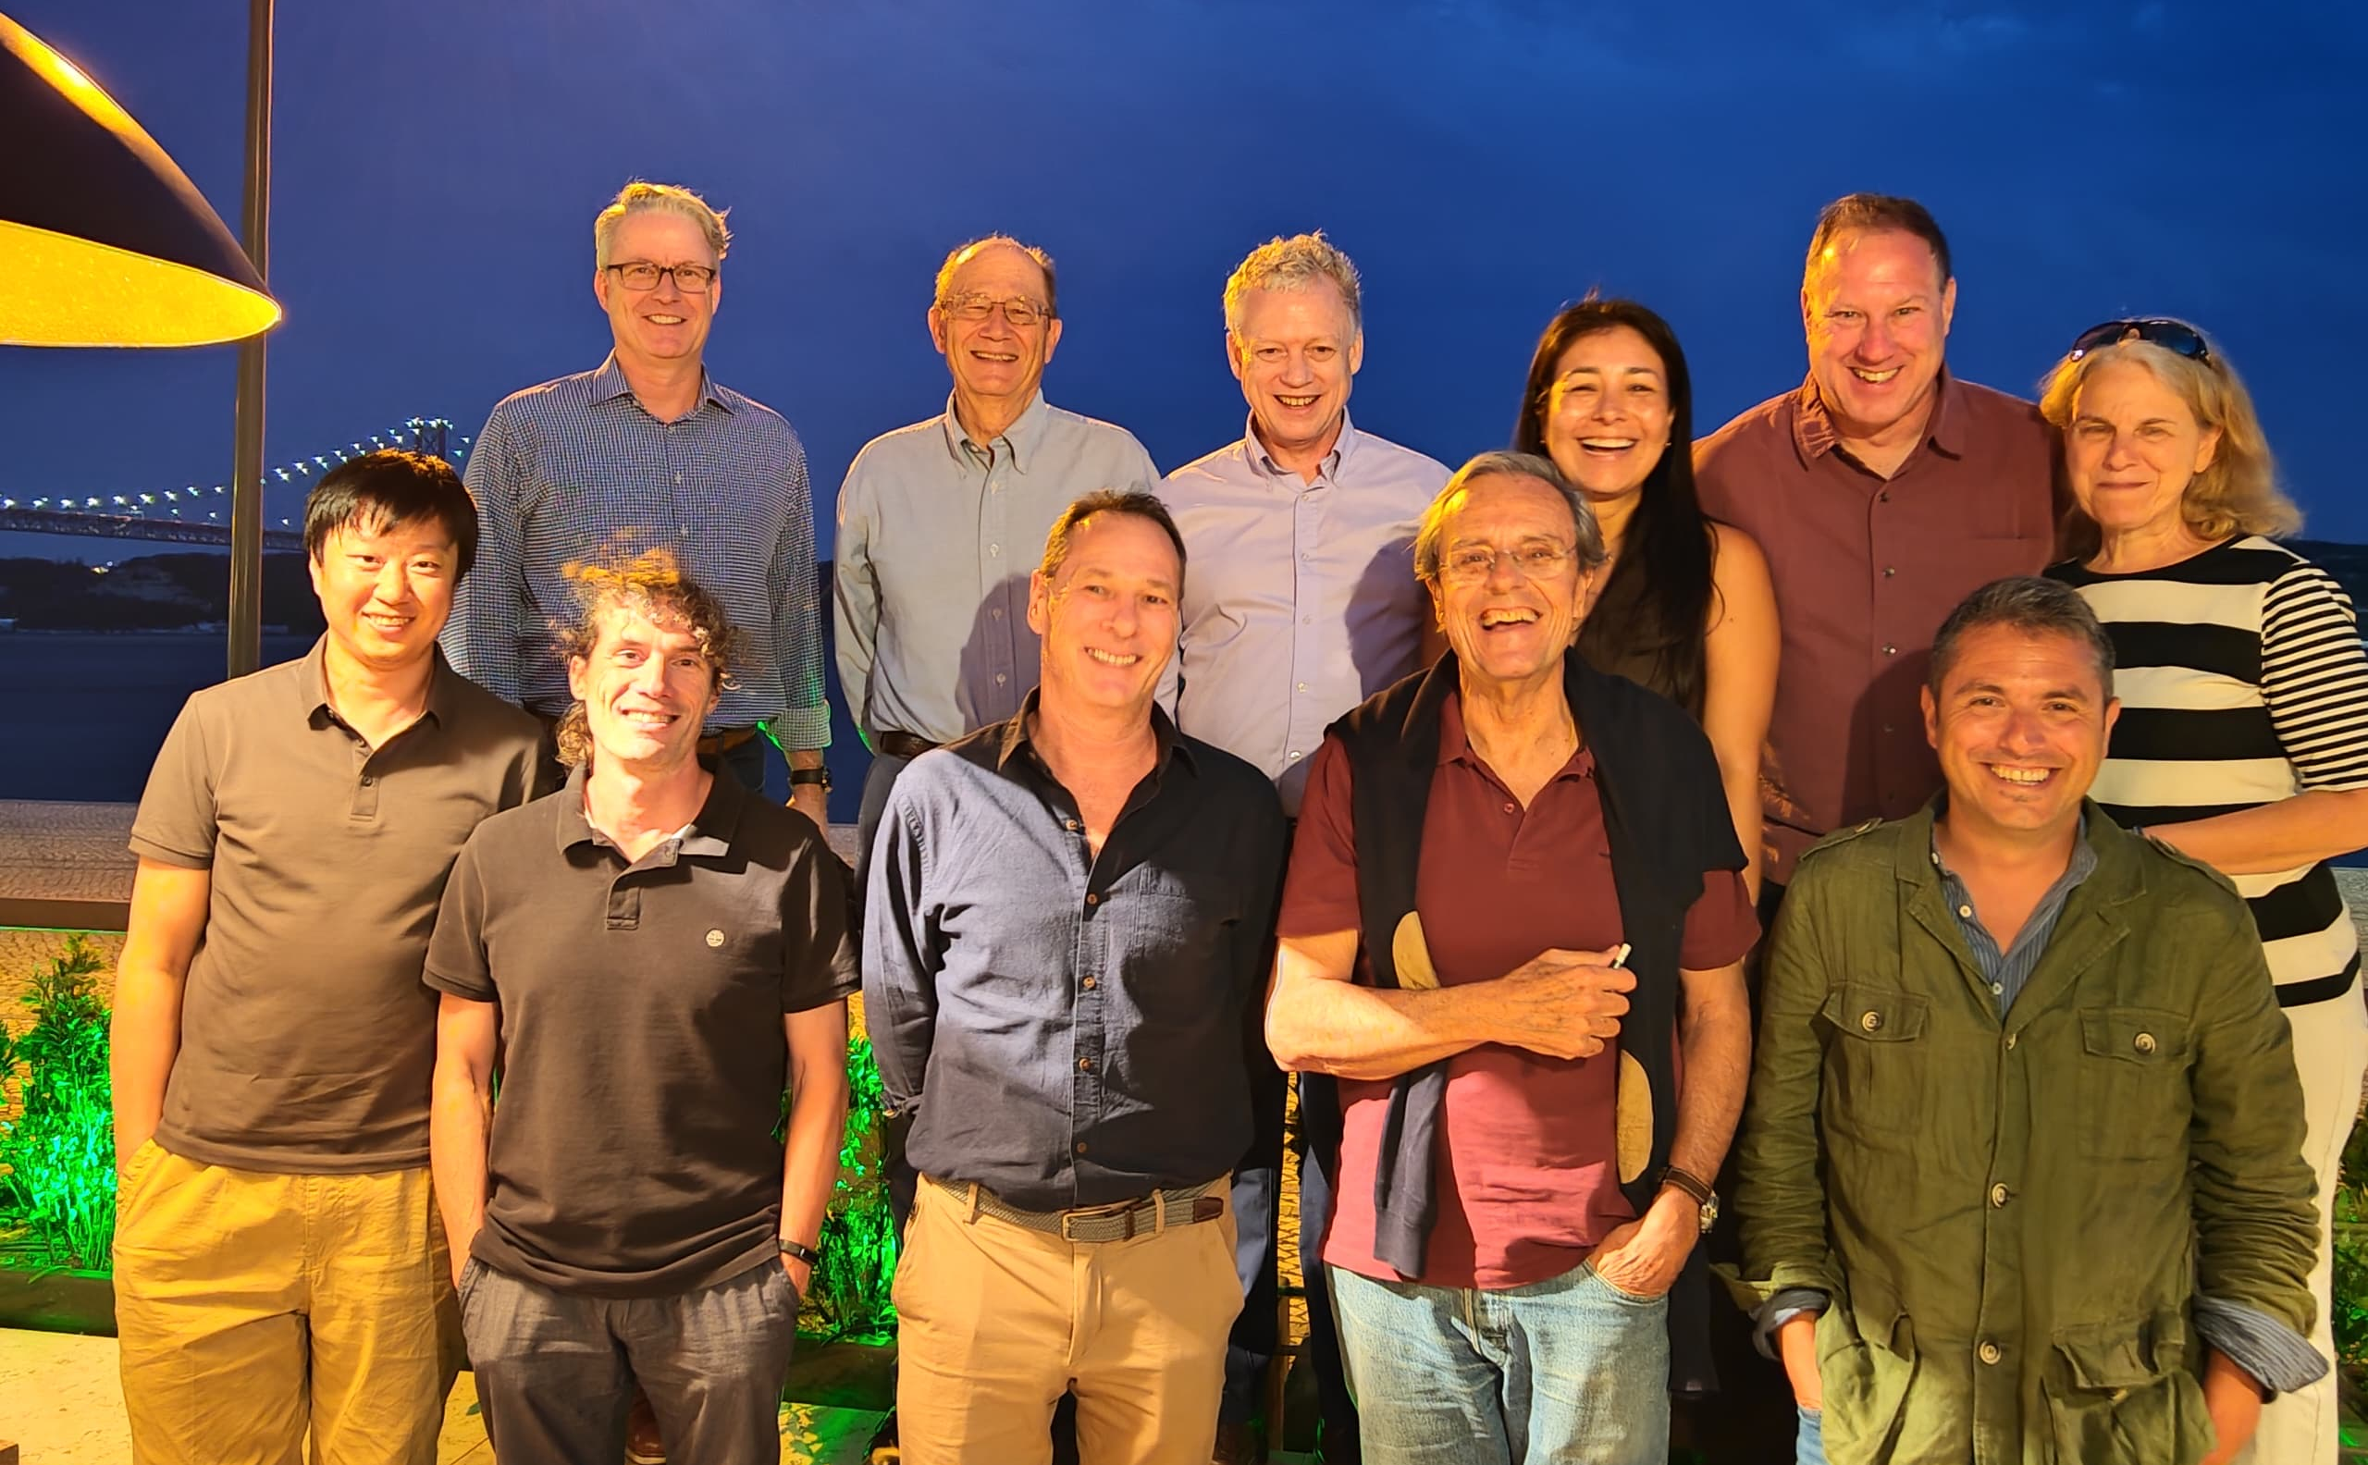
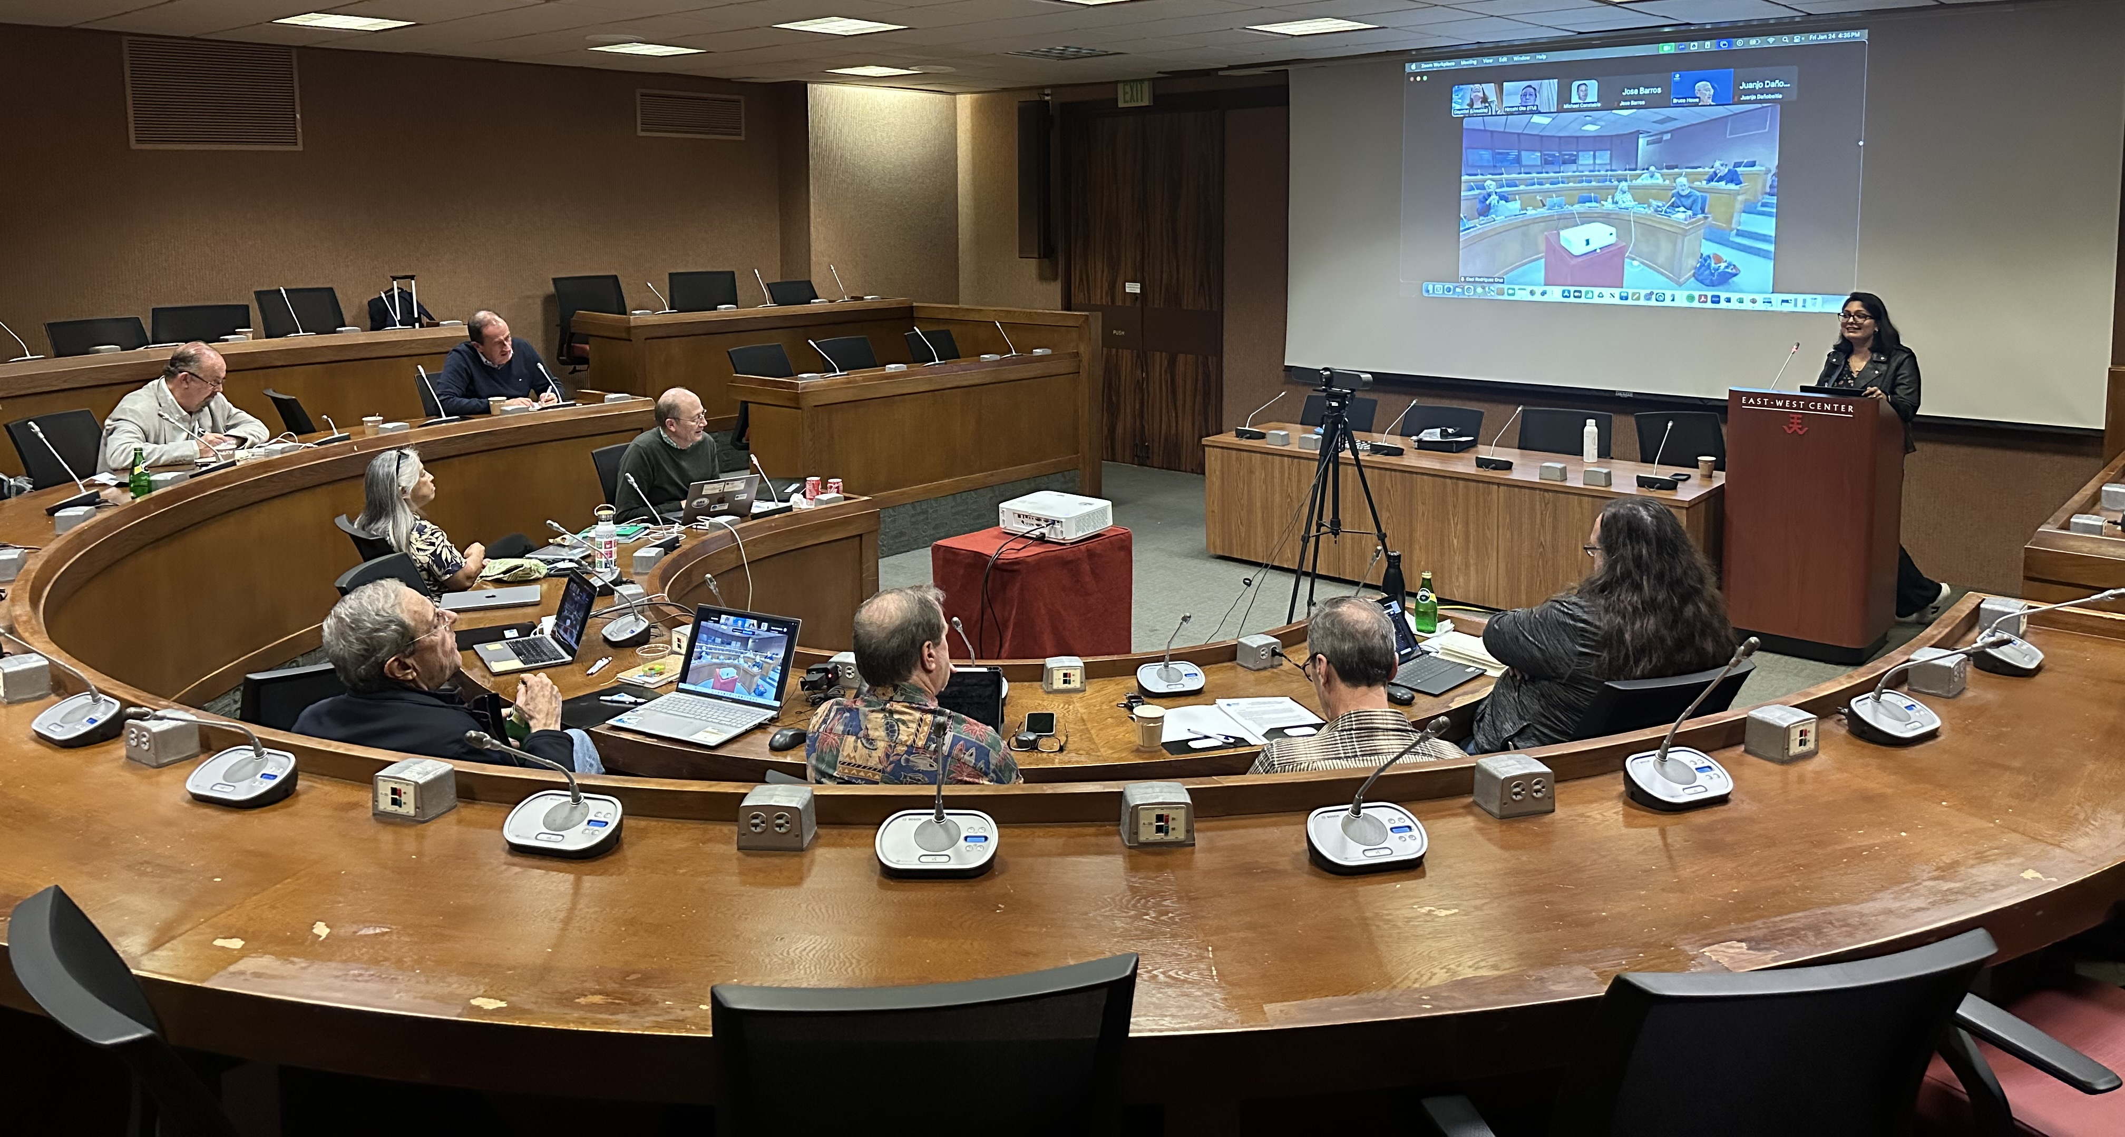
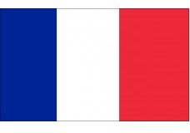
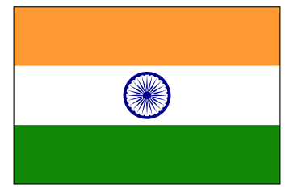


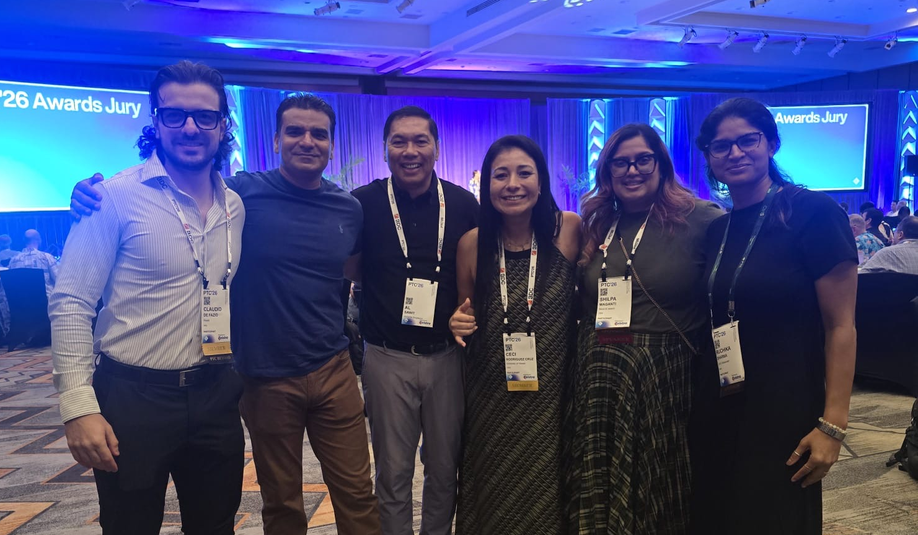
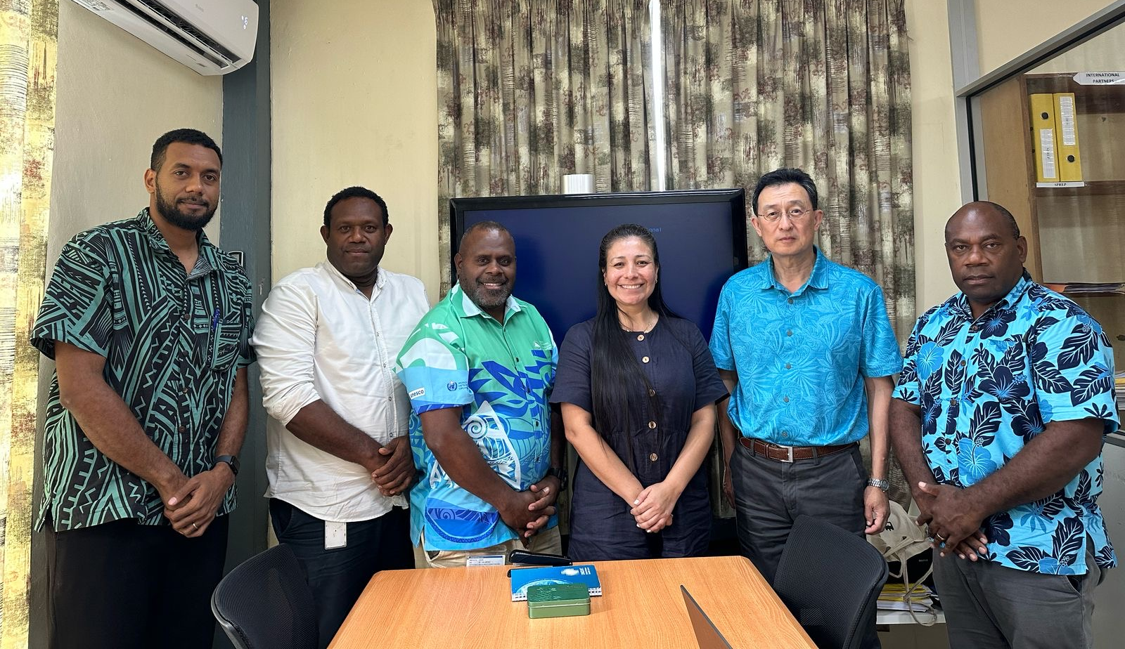




SMART Cables: Global Engagement, Multilateral contribution.
Emerging
Network
🔬 + 📡 + 🏛️

Slide 14
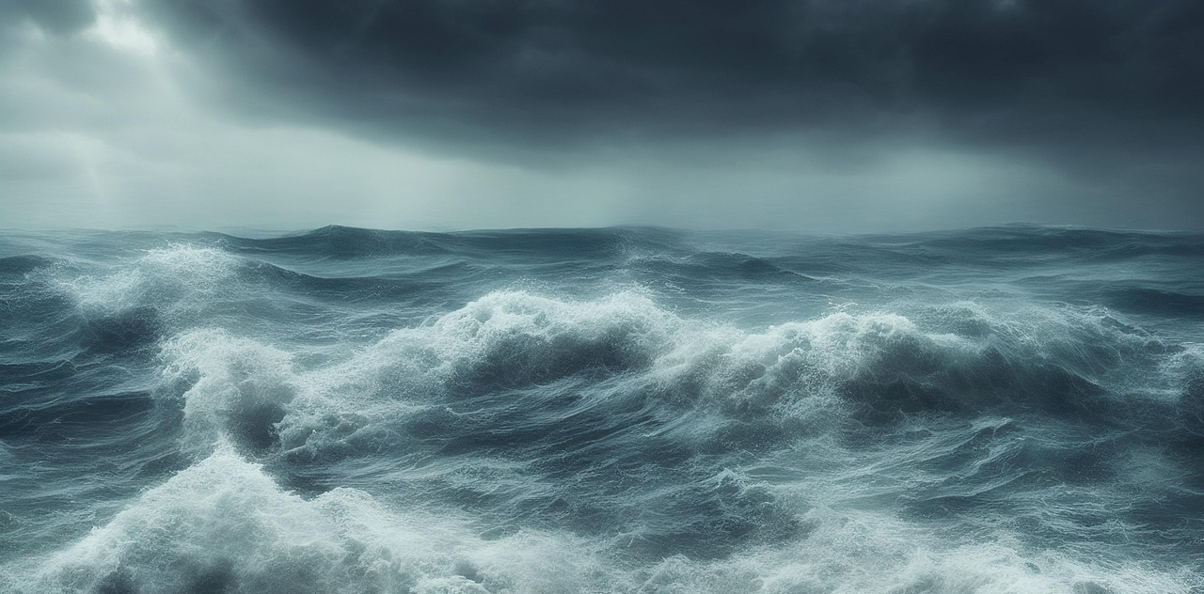
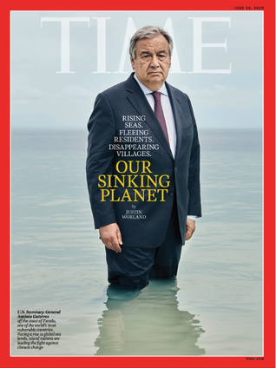
SMART Cables
SMART Cables enable ocean and Earth observing,
contributing to cable protection as well.
SMART Cables are a
good example of multipurpose critical infrastructure
providing
Connectivity and Science serving Society
José Barros
António Guterres
Courtesy J. Plenio

Slide 15



Mahalo!
SMARTCables.org
ITU/WMO/UNESCO-IOC Joint Task Force
Scan to Join!
Danke Gracias ありがとう Thank you Terima kasih Obrigado Arigatō Dhanyavaad Merci Tankyu tumas Takk Grazie Mālō 'aupito
Kop koon 谢谢 Xièxiè Salamat po S' efharistó

