Slide 1
ICG/CARIB-EWS-XIX
22 April 2026
Item: 3
Intergovernmental Coordination Group for the Indian Ocean Tsunami Warning and Mitigation System (ICG/IOTWMS)
Eluri Pattabhi Rama Rao
Chair, ICG/IOTWMS
Acknowledgements:
Yuelong Miao, Harkunti Rahayu
Srinivasa Kumar, Ardito Kodijat, Nora Gale
22 April 2026

Slide 2
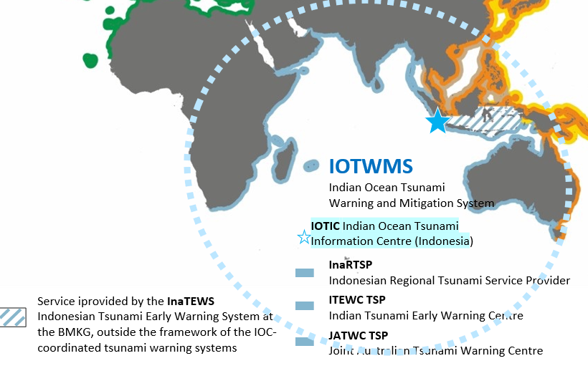
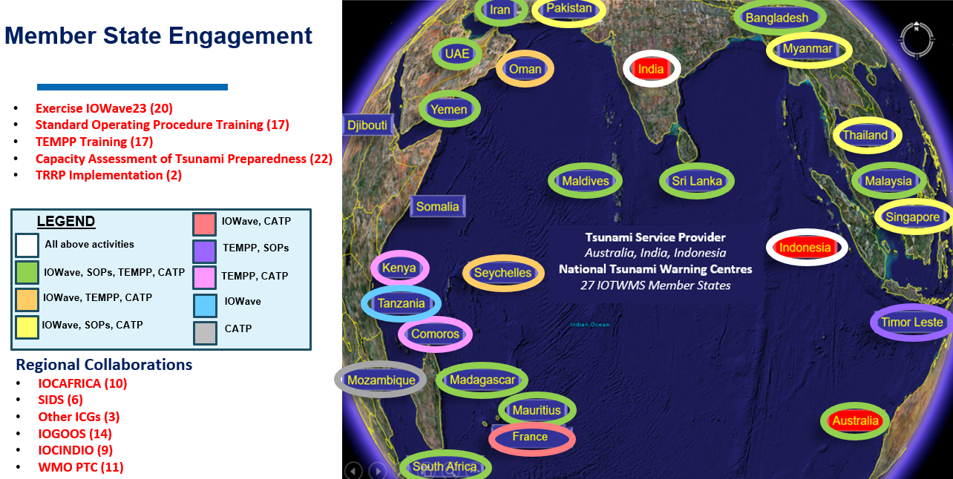
IOTWMS - Key Elements, AoS and Member States
Risk Assessment and Reduction
Systematically collect data and undertake risk assessments
Detection, Warning and
Dissemination
Develop hazard detection, monitoring and warning services Communicate threat information and early warnings
Awareness and Response
Build national and community response capabilities

Slide 3
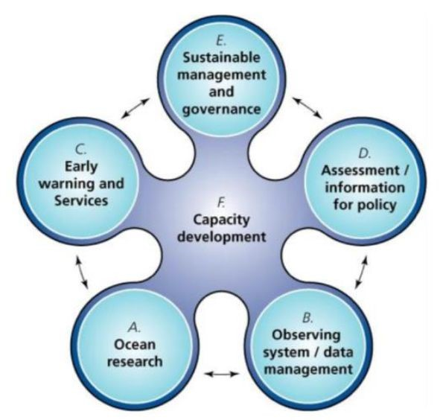
IOTWMS - Governance
UNESCO-IOC (1960)
Specialised UN Ocean Agency
Assembly/Executive Council
UN OCEAN DECADE
2021 - 2030
WMO, IHO, IMO, UNDRR, UNDP, UNESCAP…
UN Ocean Decade Tsunami Programme
Science Committee
Task Team Disaster Management & Preparedness
Global Coordination
Working Group for Tsunami & Other sea level related Warning & mitigation Systems (TOWS-WG) [4x ICG Chairs, WMO, UNISDR, UNDP, IMO, IHO]
Task Team Tsunami Watch Operations
ICG/IOTWMS Secretariat
Srinivasa Kumar Tummala
Nora Gale
Hosted by BOM, Australia
ICG
Caribbean & Adjacent Seas (CARIBE-EWS)
Intergovernmental Coordination Group (ICG)
Indian Ocean Tsunami Warning & Mitigation System (IOTWMS)
Chair: Mr. Pattabhi Rama Rao Eluri (India)
Vice Chair: Dr. Yuelong Miao (Australia)
Vice Chair: Dr. Harkunti Rahayu (Indonesia)
ICG
Pacific Tsunami Warning & Mitigation System (PTWS)
ICG
NE Atlantic & Mediterranean Seas (NEAMS-TWS
UNESCO-IOC Tsunami Resilient Section
152 UNESCO-IOC Member States
UNESCO Disaster Risk Reduction Section
Steering Group: Officers, WG Chairs/VCs, TT Chairs
WG1 Tsunami Risk, Community Awareness and Preparedness
Chair: Ms. Weniza (Indonesia)
WG2 Tsunami Detection, Warning & Dissemination
Mr Jijjavarapu Padmanabham (India)
Indian Ocean Tsunami Information Centre (IOTIC) Ardito Kodijat
Housed at UNESCO-JAK IOTIC-BMKG Programme office hosted by BMKG Indonesia
WG3 Tsunami Ready Implementation
Chair: Ms. Suci Anugrah (Indonesia)
Task Team –New Technologies Observations and Forecasting (under WG2)
Chair: Dr. Wahyu Pandoe (Indonesia)
Task Team – IOWAVE25
Chair: Dr. Ajay Kumar Bandela (India)
RWG North-West Indian Ocean
Chair: Ms. Sunanda Manneela (India)
Task Team –Mid-Term Strategy (MTS)
Chair: Dr. Yuelong Miao (Australia)
IOC Regional Programmes and Offices
Notes:
Highlight only the boxes with green background that are related to the ICG/IOTWMS
Mention the WGs / TTs / Secretariat / IOTIC and how they work on the 3 pillars of the IOTWMS
Highlight the contributions of Australia and Indonesia for the Secretariat and IOTIC – highlighted in red font

Slide 4
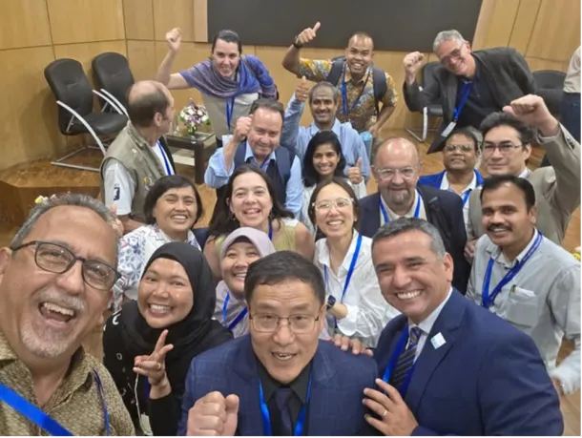
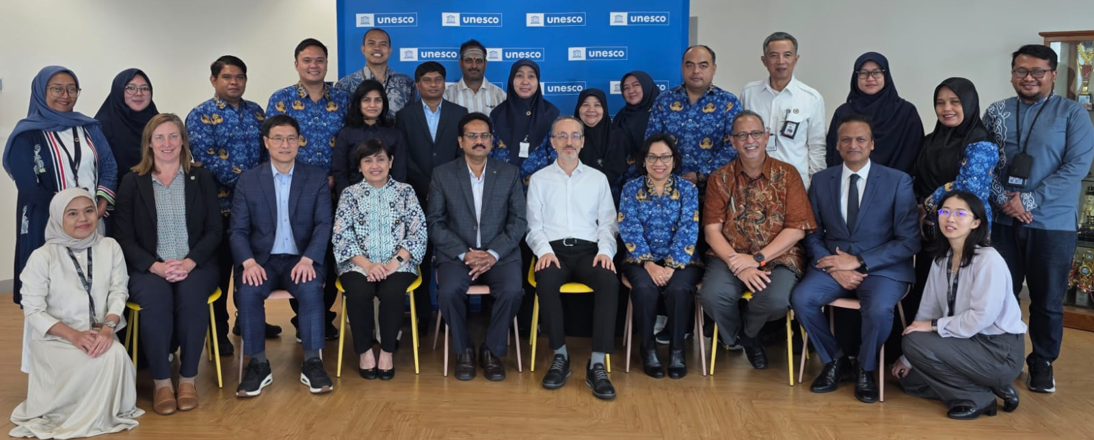
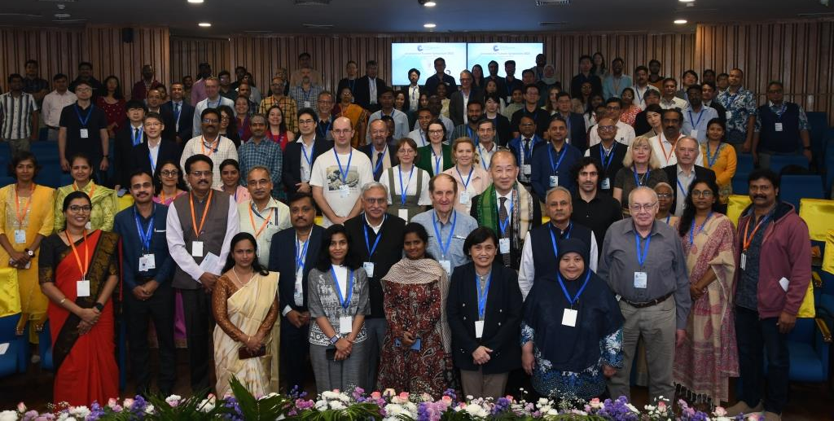
Intersessional Meetings 2025-2026
Conferences
ITS-2025, 12-14 Nov 2025, Hyderabad, India
ODTP Conference, 10-11 Nov 2025, Hyderabad, India
PCTWIN, 08-11 April 2025, Kochi, India
Intersessional Meetings
Working Group 1 on Tsunami Risk Community Awareness & Preparedness, 23 July 2025
19th Meeting of the Steering Group, Jakarta, Indonesia, 17-19 June 2025
Working Group 2 on Tsunami Detection, Warning and Dissemination, 25 Aug 2025
Working Group 3 on Tsunami Ready Implementation, 15 Oct 2025
Subregional Working Group for the North- West Indian Ocean, 8 Oct 2025
Task Team on Exercise IOWave25, 30 April 2025
Upcoming Meetings
Intersessional Meetings of the Working Groups & Task Teams (to be confirmed)
20th Meeting of the Steering Group, Perth, Australia, 9-11 June 2025
15th Session of the ICG/IOTWMS, Muscat, Oman, 15-19 Nov 2026

Slide 5
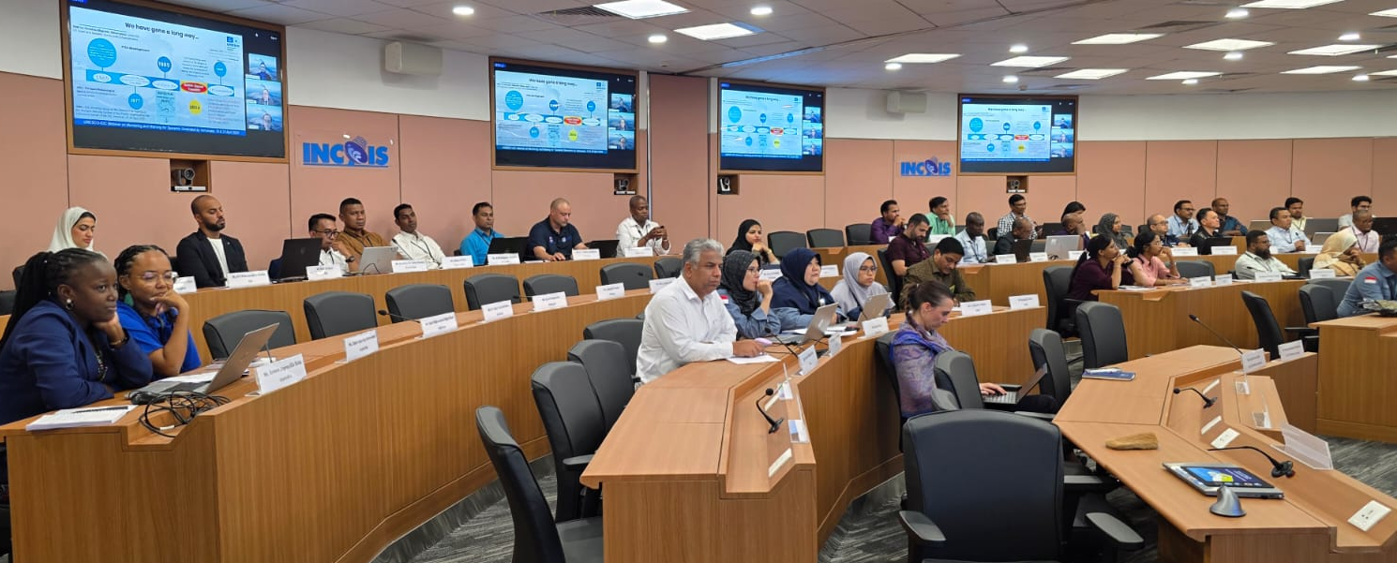
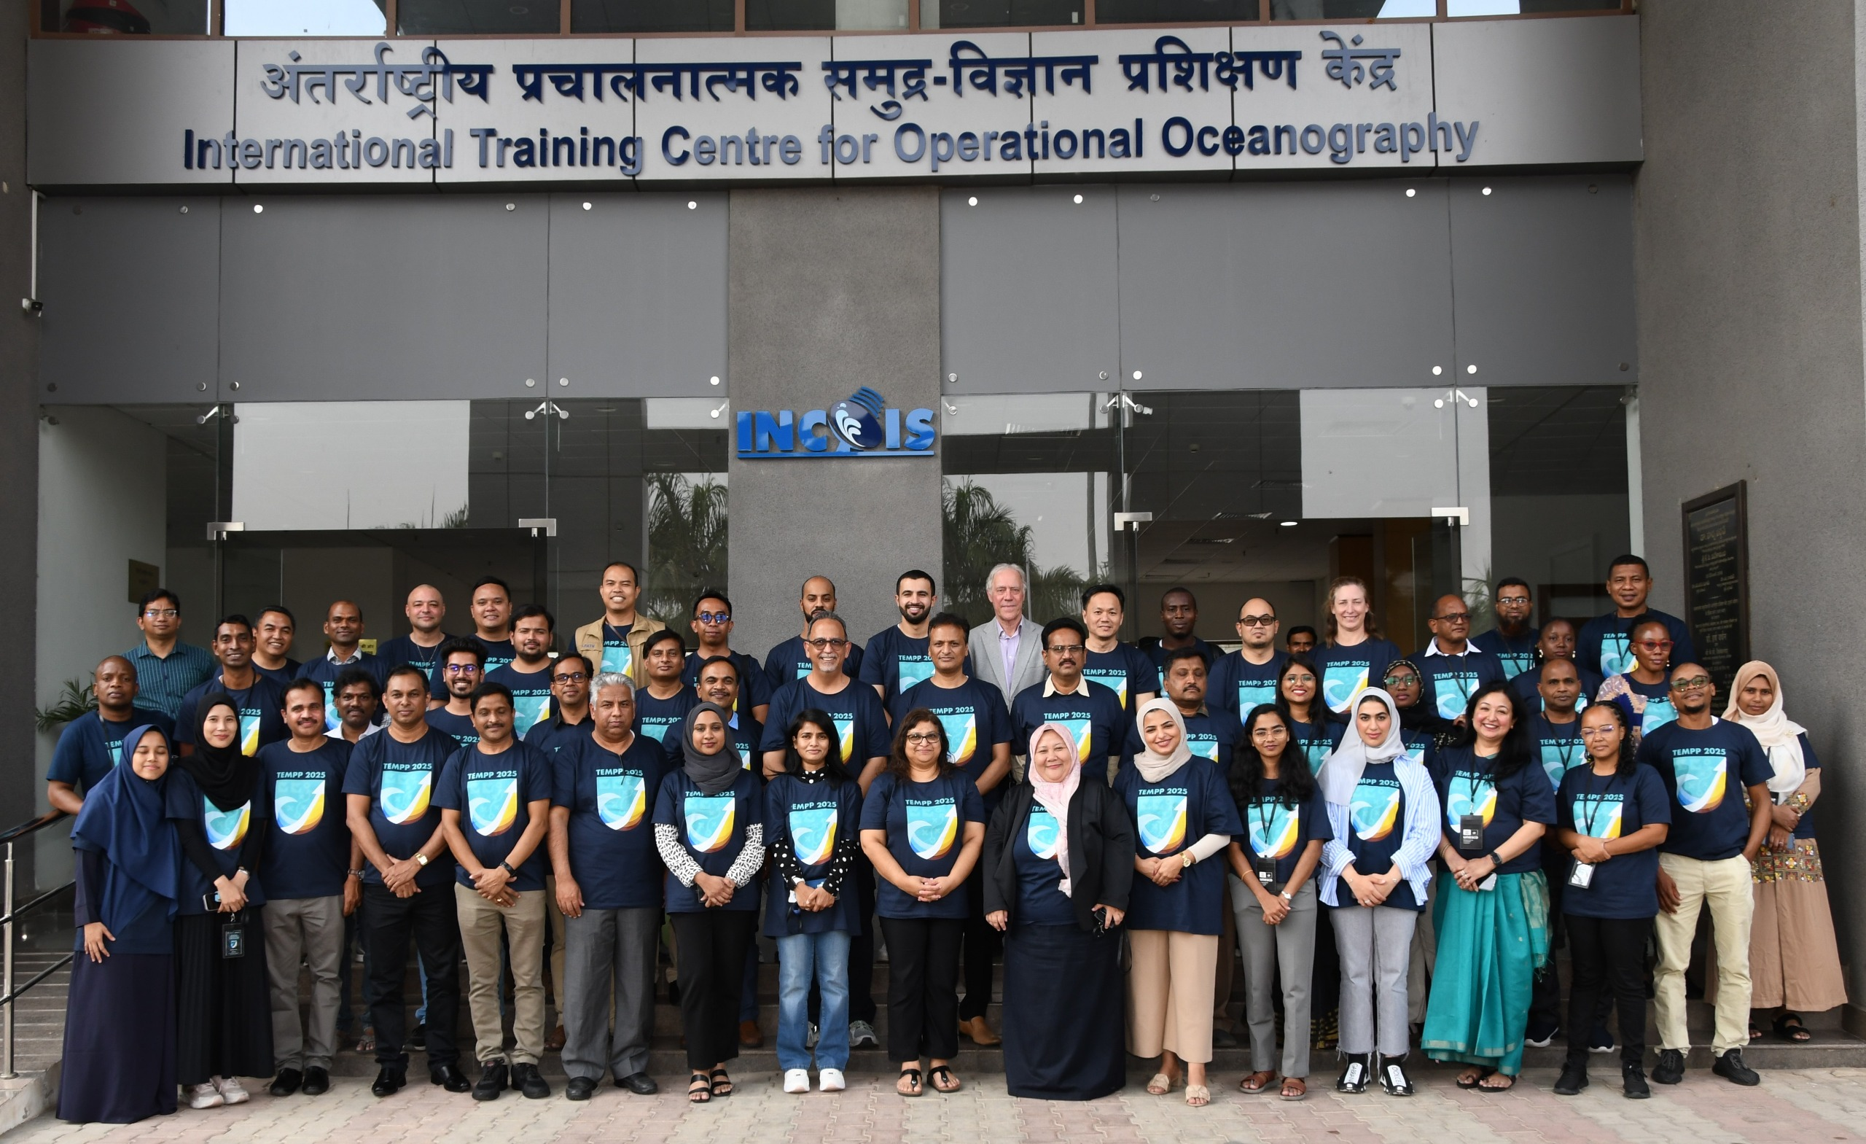
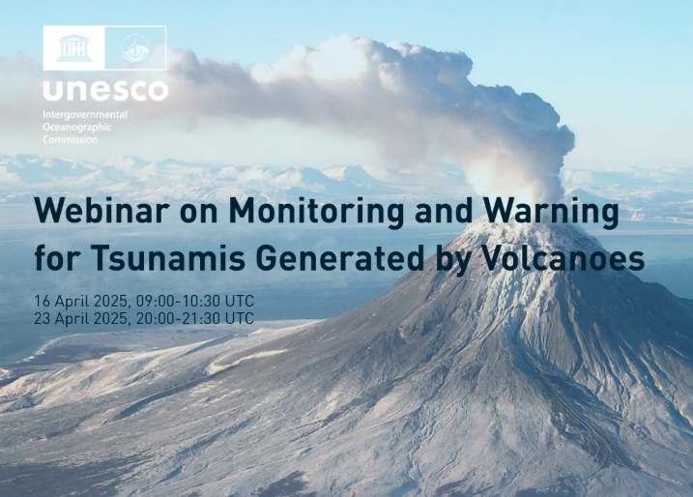
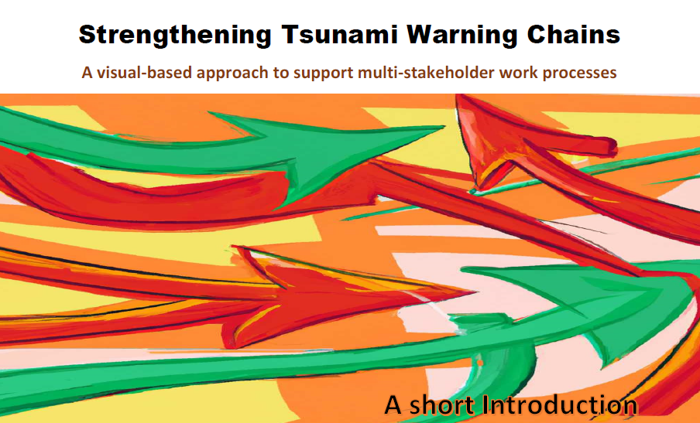
Capacity Development Activities 2025-2026
      Tsunami Generated by Volcanoes
      Webinar on Monitoring and Warning for Tsunamis Generated by Volcanos, 16 & 23 April 2025
      Tsunami United Sessions
      Tsunami United Sessions for high school students including interactive online session, coaching and campaigns to raise awareness and build resilience against tsunami threats, 14 Aug – 19 Sep 2025
      Tsunami Evacuation Maps, Plans and Procedures
TEMPP Training focused on a) Tsunami Inundation Modelling, b) Tsunami Evacuation Maps, Plans and Procedures & c) the UNESCO-IOC Tsunami Ready Recognition Programme ( 15-23 April 2025, Hyderabad, India)
TIMM Training focused on Tsunami Ready implementation in Madagascar, Seychelles and Sri Lanka (16-21 March 2026, Hyderabad, India)
      Early Warning Chains and SOPs
Pre-IOWave 2025 Workshops on Standard Operating Procedures for National Tsunami Warning Centres and Disaster Management Organisations
      Eastern Indian Ocean Member States, 04-06 Aug 2025
      Western Indian Ocean Member States, 11-13 Aug 2025
      Online regional workshops and in-person national workshops.
      Draft booklet on Strengthening Tsunami Warning Chains
      Tsunami Messages for NAVAREA Coordinators
      Pre-IOWave25 Webinar for NAVAREA Coordinators on Strengthening Maritime Tsunami Alerting Mechanism.
      Post-IOWave25 Webinar
      Webinar on Lessons Learnt during Exercise Indian Ocean Wave 2025, 16-17 Dec 2025

Slide 6
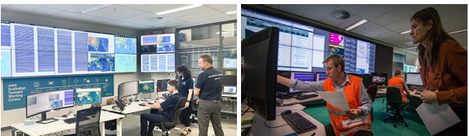
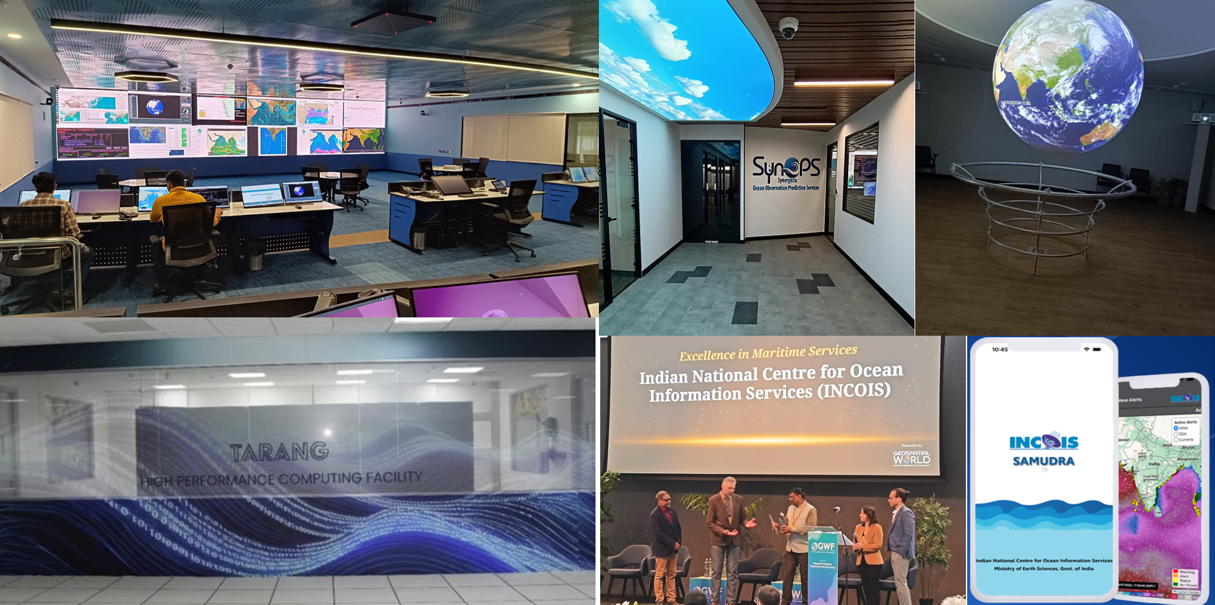
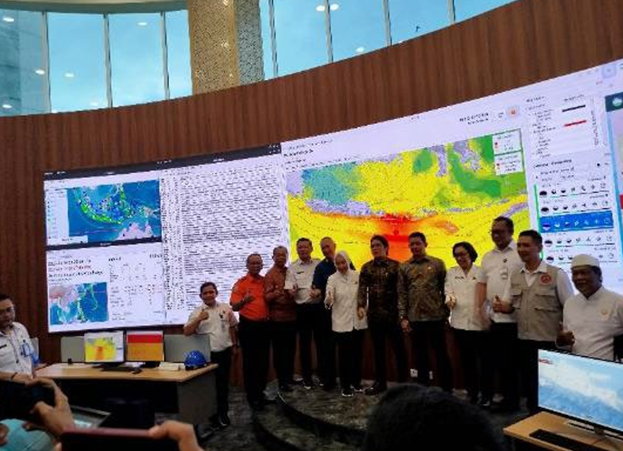
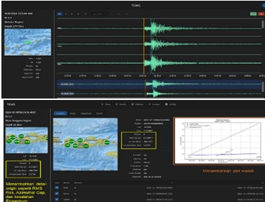
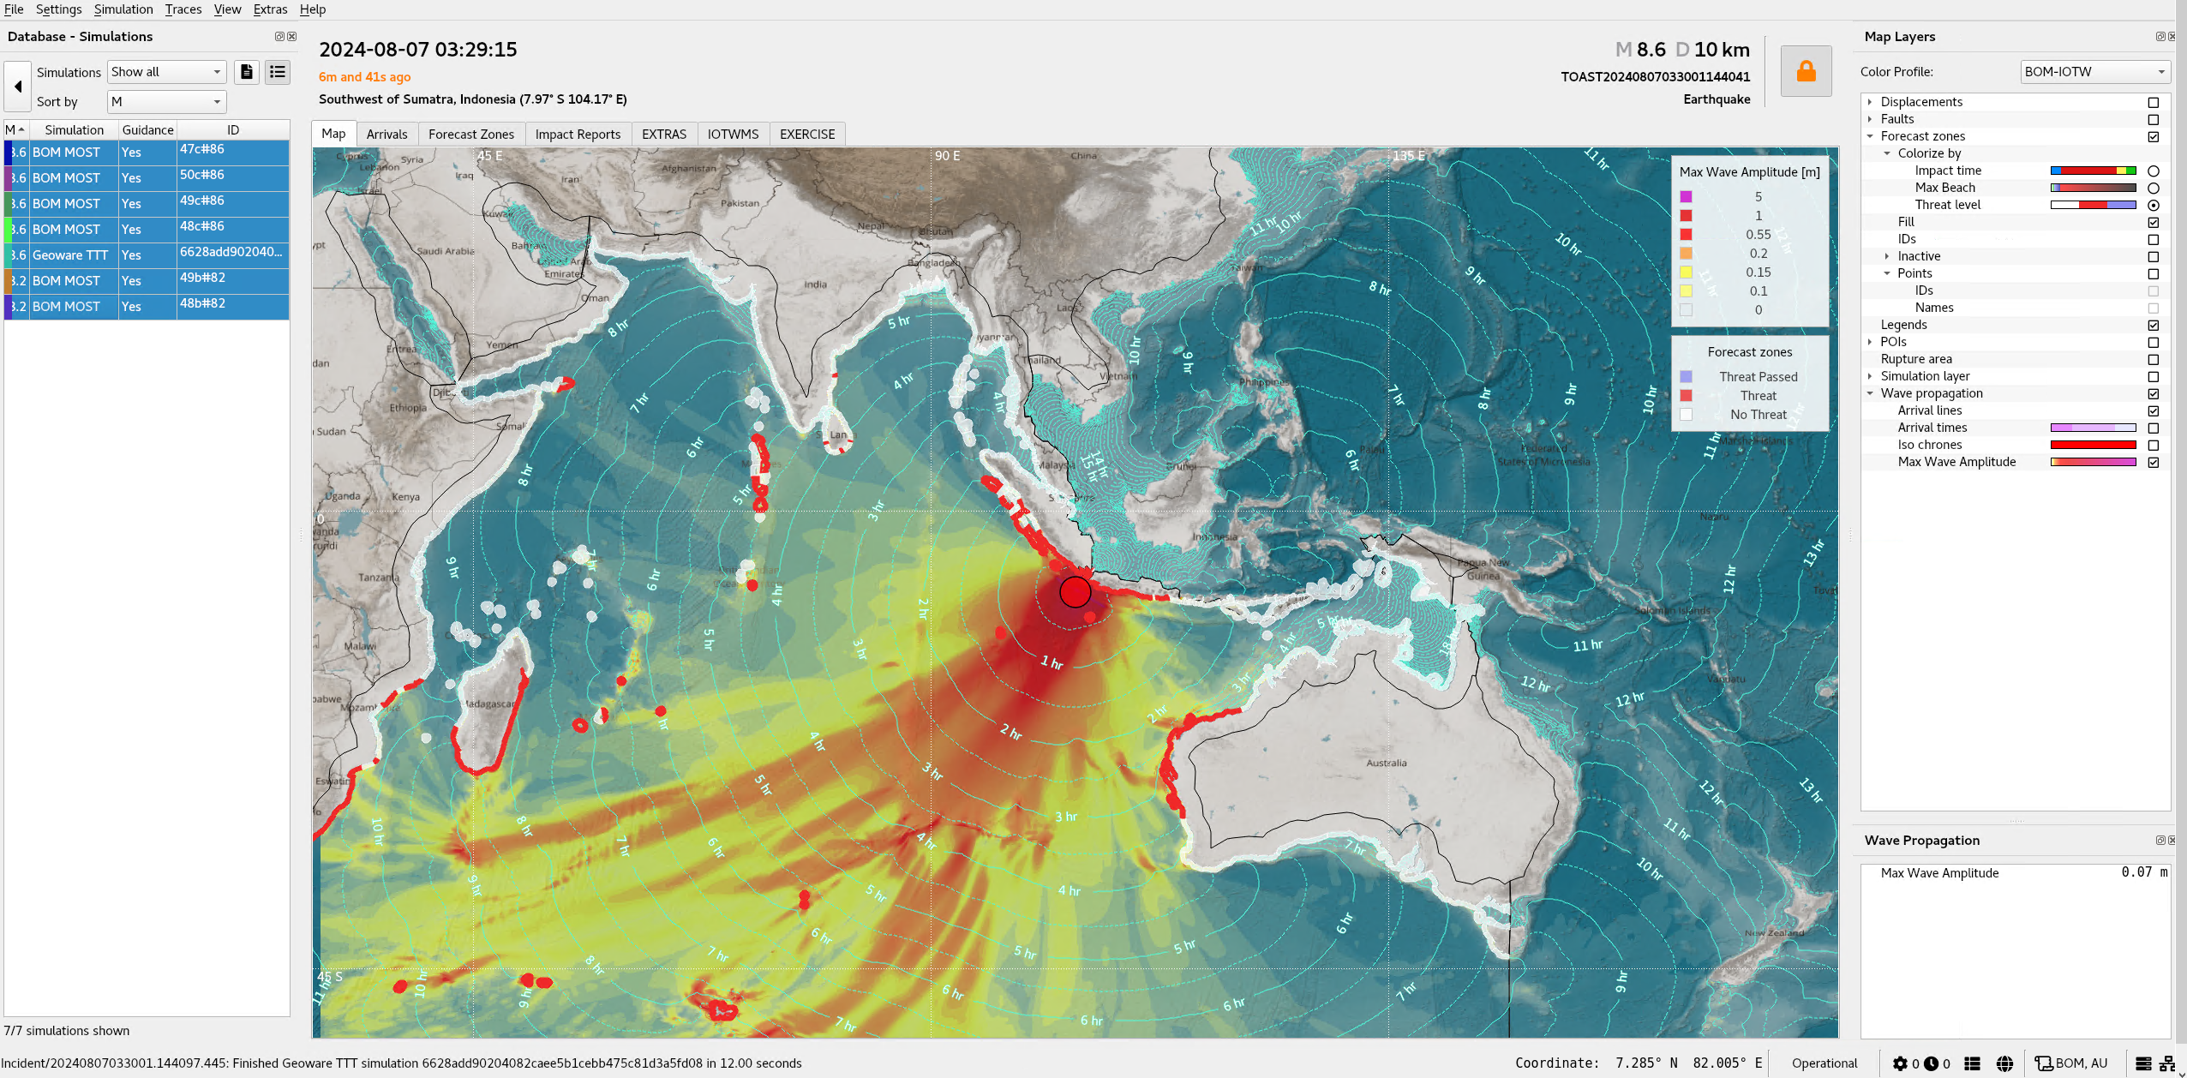

Progress of Tsunami Watch Operations 2025 - 2026
TSP Australia TSP India
TSP Indonesia
NAVAREA & TGV Products: Implemented
BOM‑JATWC ISO 9001: Accredited 2020; re-accredited 2023 → valid to 2026
Audits: Annual surveillance
Bureau-JATWC has implemented 2 minor updates to TOAST system. These updates contain bug fixes and ease of use features.
DART Stations: Two Tasman Sea DARTs restored; 5 of 6 are online.
GA‑JATWC ISO 9001: Work underway toward ISO 9001:2015
Upgraded to SeisComP6 & currently in testing
Seismic Array: Real-time processor tested in parallel; performance assessment ongoing
NAVAREA & TGV Products: Implemented
Maintaining CFZs Layers for IOTWMS
Established 15 new tide gauges with co-located GPS along Indian coast.
Upgraded SeisComP7 and operational.
HPC facility “TARANG” at INCOIS - Dedicated to real-time tsunami inundation modeling,
ODTP endorsed projects - PCTWIN, SMART Cables, Tsunami Ready at Odisha, etc.
Contributing to ESCAP Phase-3 project of NWIO region.
Hosted TEMPP-2025, TIMM-2026, ODTP Conference-2025, ITS-2025
Tested NAVAREA & TGV Products
Backup Operational Center of InaTEWS at Bali launched on 14 June 2025 by BMKG equipped with Base Isolator Technology to ensure earthquake resilience and operational continuity;
Experimenting AI-based earthquake processing and ~10,000 tsunami scenarios for faster, more comprehensive warnings.
Develop a New Magnitude Formula Mbmkg
Expanded Sunda Zone tsunami database with 1,800 new pre-calculated scenarios (Mw 7.1–7.3), including ‘odd’ magnitudes from West Sumatra to Sumbawa
During the reporting period, the Indian Ocean experienced three earthquake events of magnitude ≥ 6.5, all of which were assessed as posing no tsunami threat by TSPs.​
3

Slide 7

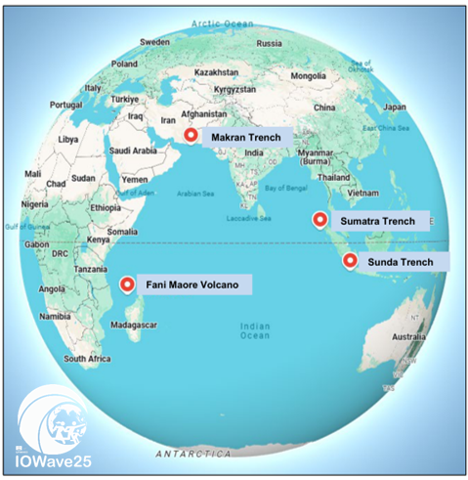
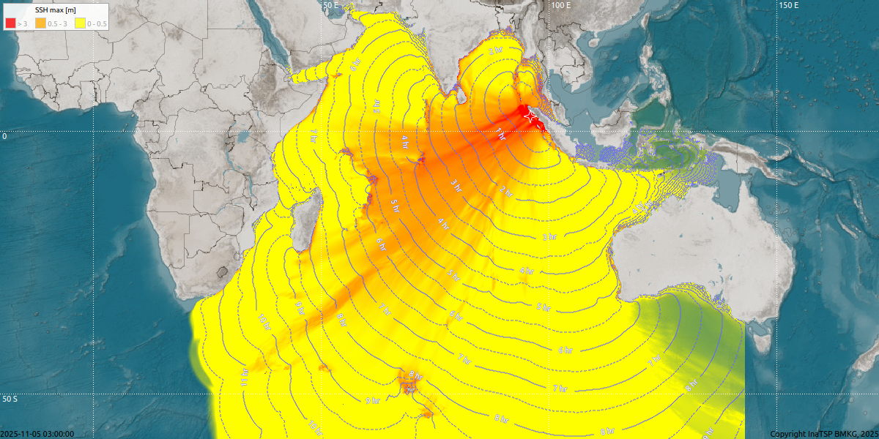

Indian Ocean Wave Exercise IOWave2025
Overview
25 September to 05 November 2025
4 Scenarios including1 Non-seismic event and outside of working hours
Included non-seismic and NAVAREA products
Encourage the Member States to ensure the participation of TR recognised communities
Pre-IOWave SOP & Post-IOWave25 Lessons Learnt Workshops
Participation
At least 20 countries participated in IOWave25 through simulations, drills, tests and evacuations.
Community evacuations involved ~330,000 people overall across the region
Seven countries carried out community-level evacuations: India (112,000), Indonesia (207,000), Sri Lanka (3,000) , Timor Leste (200), United Arab Emirates (108)
NAVAREA messages: Trial dissemination of was conducted during IOWave25 with all Indian Ocean NAVAREA coordinators (VII-XI) participating.

Slide 8

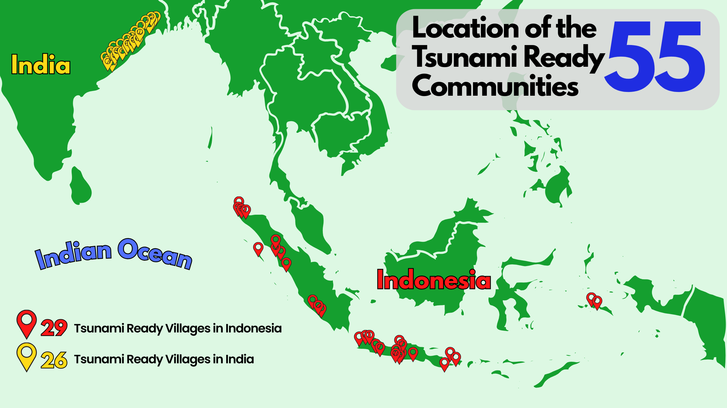
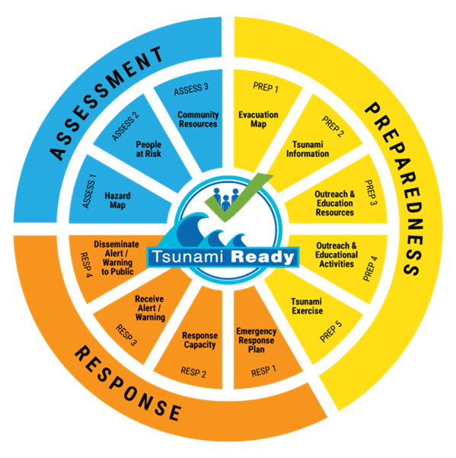
Tsunami Ready Recognition Programme
19 National Tsunami Ready Focal Points
3 National Tsunami Ready Boards - India, Indonesia and Seychelles
55 Communities - 26 in India and 29 in Indonesia

Slide 9


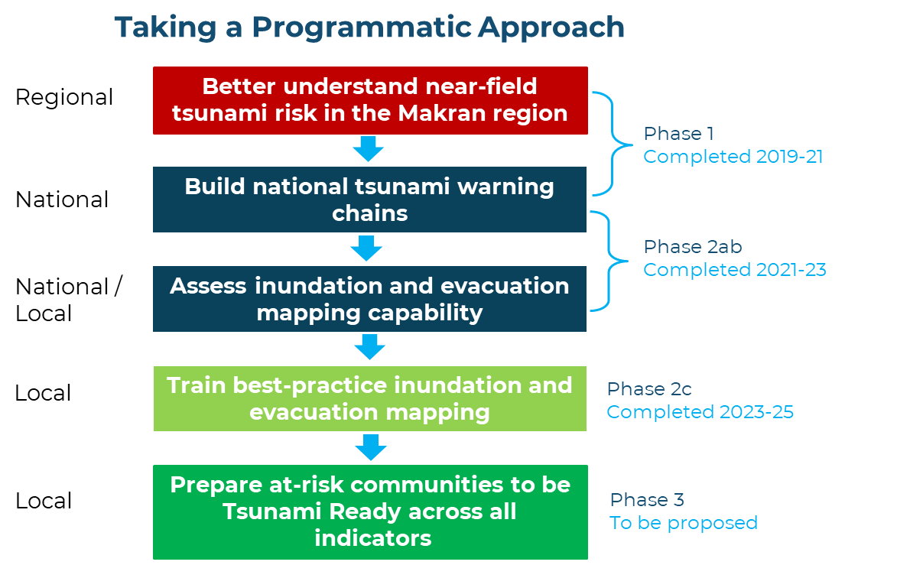
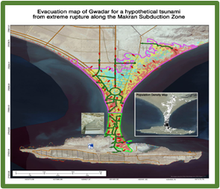
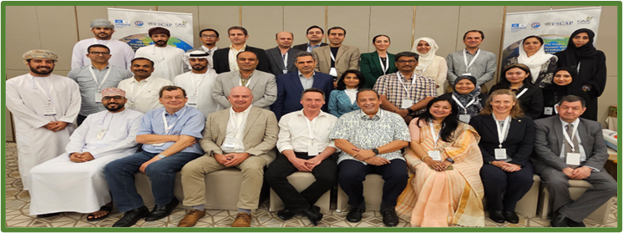
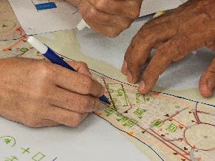
Strengthening tsunami warning in the North-West Indian Ocean through regional cooperation: Phase 3
Objective 6: Improved community capacities for tsunami preparedness and response that are in line with the set of indicators of the UNESCO Tsunami Ready Recognition Programme
Support the strengthening of Tsunami Ready Indicators
6.1
Build the capacity of Maldives and Sri Lanka on Tsunami Inundation Modelling and Mapping
6.4
Strengthening local DMO warning SOPs and coming up with recommendations for a multi-hazard framework
6.5
Further research on non-seismic and complex sources of tsunami generation in the Makran Subduction Zone
Pilot communities
India:
Purakkad; Alappad /
Okha; Pingleshwar
Iran:
Chabahar, Jask
Pakistan:
Gwadar, Karachi
Maldives:
Diffushi, Fuvahmulah
Sri Lanka: Ambalangoda
Oman:
Alhail North
UAE:
Fujairah
6.2
Support pilot communities to strengthen their capacity to meet the UNESCO-IOC TR Indicators and apply for the recognition process
6.3
Support the establishment of the National Tsunami Ready Board (NTRB) or identify a similar function in the country
6.2
Strengthening the capacities of the national, local, and community facilitators
Support for the planning and implementation of Tsunami Ready indicators in pilot communities

Slide 10
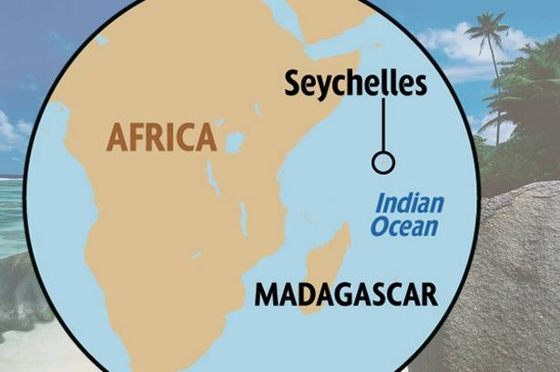


Strengthening Community Resilience to Ocean Hazards through implementation of Tsunami Ready in Indian Ocean SIDS and Africa
Project duration: 18 Months
Budget: ~ USD 50,000
Funding Agency: Flanders UNESCO Science Trust Fund (FUST)
Complements the Projects on Strengthening Sea Level Monitoring and Data Management in East Africa for Coastal Resilience and Community Safety (SEAMARCS) -
Kenya, Madagascar, Mozambique, Seychelles
IOTIC & IOTWMS Secretariat
IOTWMS Working Group – 3
TNCs / TRFPs / Stakeholders / Coastal Communities - Madagascar, Seychelles
IOCAFRICA / TRS / FUST
Objective 1
Capacity Building on TIMM for Madagascar & Seychelles
Objective 2
Capacity building for Tsunami Ready Communities in Madagascar & Seychelles
Objective 3
Tsunami Ready Communities are recognized by UNESCO-IOC
Support for the planning and implementation of Tsunami Ready indicators in pilot communities
Activity 1.1
On-the-job training at INCOIS on TIMM for two experts each from Madagascar and Seychelles
Activity 1.2
Identification of Pilot Sites (1 each in Madagascar & Seychelles) for Tsunami Ready Implementation
Activity 2.1
Support the National Stakeholders to coordinate and facilitate the establishment of the NTRB
Activity 2.2
National Tsunami Ready Training for stakeholders and facilitators in Madagascar
Activity 2.3
Support on Community Capacity Building on UNESCO-IOC 12 Tsunami Ready Indicators

Slide 11


Roadmap 2025-2026
SOP Workshop
Hazard Assessment Training
TRRP Facilitators & Community Training
2027 & beyond
Pre-IOWave25 Workshop
TGV + NAVAREA Webinar
Post-IOWave25 Webinar
2026
TEMPP Workshop, Hyderabad, India
Global TGV Webinars
    IOTWMS Intersessional Meetings
    ICG/IOTWMS-XV, Muscat, Oman
Launch of UNESCAP Phase 2c Makran Project (November 2023)
Post-IOWave23 Webinar (December 2023)
NWIO Workshops on inundation modelling & evacuation mapping
(April 2024)
2025
    ODTP Conference & ITS2025
    IIOSC Conference
Capacity Development
    Exercise IOWave 2025
SOP Training Workshops
(July-Aug 2023)
Warning System & Governance
2024
    IOTWMS Communications Test (June 2025)
    TSP testing of NAVAREA products
    Steering Group Meeting (June 2025)
    Intersessional Meetings
    IOR-DCC & Steering Group Meetings (February 2024)
    IOTWMS Communications Test (June 2024)
    Intersessional Working Group Meetings (July & August 2024)
2023
    Indian Ocean Capacity Assessment of Tsunami Preparedness
    Global Tsunami Symposium, Banda Aceh (November 2024)
    ICG/IOTWMS-XIV, Banten, Indonesia
    48 Tsunami Ready Communities: India (26) & Indonesia (22)
    Exercise IOWave 2023
    TSP Australia commenced issuing products for Tsunamis Generated by Volcanos (TVGs)
Notes:
Progress of activities during 2023-2024 are listed in blue boxes. These activites are already covered in the earlier slides.
So the focus of this slide is to highlight the IOTWMS Workplan for 2025-2026 in brown boxes;
Activities listed on the Top of the Road relate to CD and those listed in the Bottom related to Warning System & Governance
The box has acknowledgements of key contributions made by important partners to the IOTWMS

Slide 12
