Slide 1
Nineteenth Meeting of the Intergovernmental Coordination Group for the Tsunami and Other Coastal Hazards Warning System for the Caribbean and Adjacent Regions (ICG/CARIBE-EWS-XIX) - Curacao
22 – 24 April 2026
REPORT OF THE OCEAN DECADE TSUNAMI PROGRAMME SCIENTIFIC COMMITEE (ODTP-SC)
Dr.rer.nat. Silvia Chacón-Barrantes
Acting Chair
ODTP-SC

Slide 2
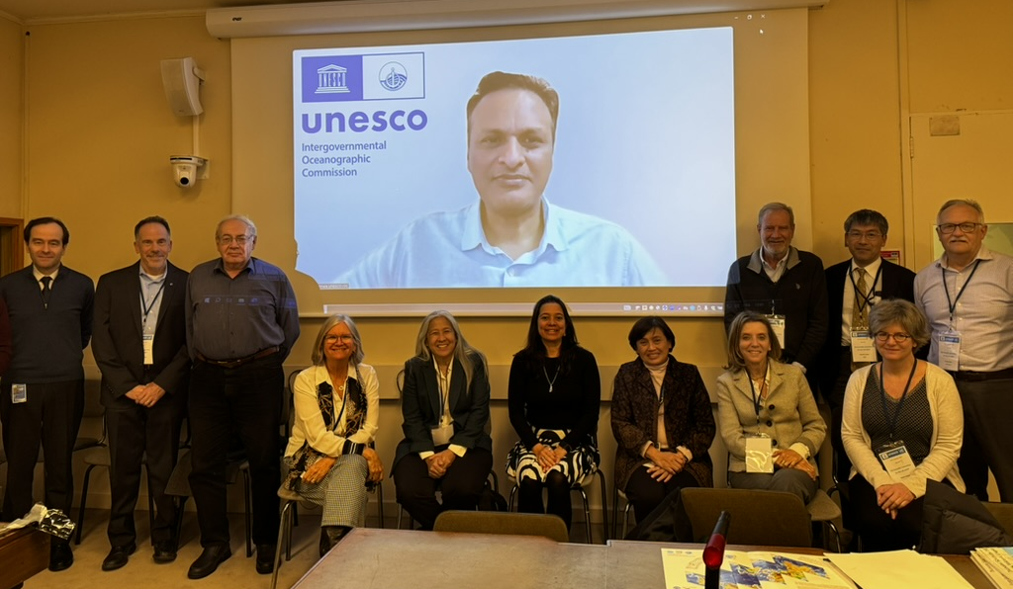
ODTP-SC Meetings
The last one was in January 2025
Reported at ICG-XVIII

Slide 3
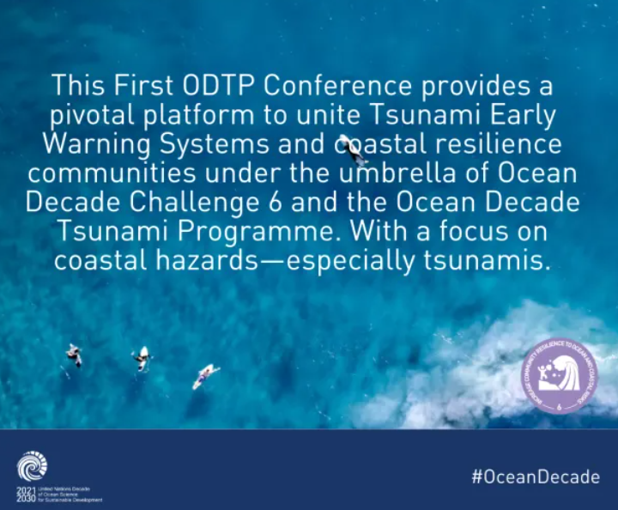
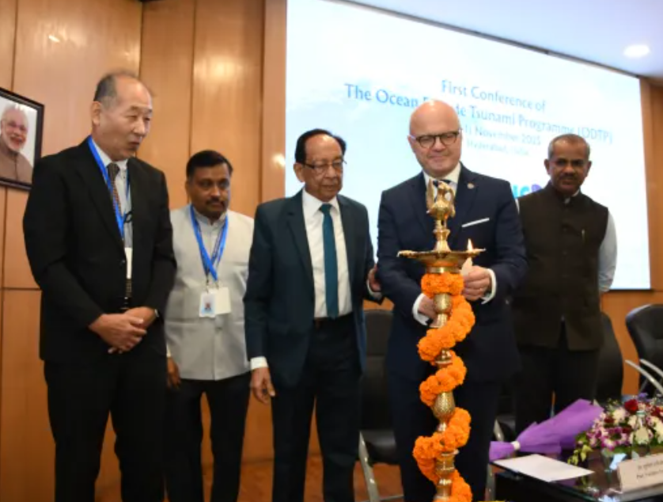
FIRST CONFERENCE OF THE OCEAN DECADE TSUNAMI PROGRAMME (ODTP) Building Resilient Coasts: Accelerating Actions to ODTP Challenge 6
OPENING CEREMONY
HIGH LEVEL TALKS ON ODTP HIGH LEVEL OBJECTIVES (ACTIONABLE AND TIMELY WARNINGS-PREPARED AND RESILIENT)
SESSION 1 (ACTIONABLE AND TIMELY WARNING)
SESSION 2 (PREPARED AND RESILIENT)
SESSION 3 (TOOLS & INSTRUMENTS)

Slide 4
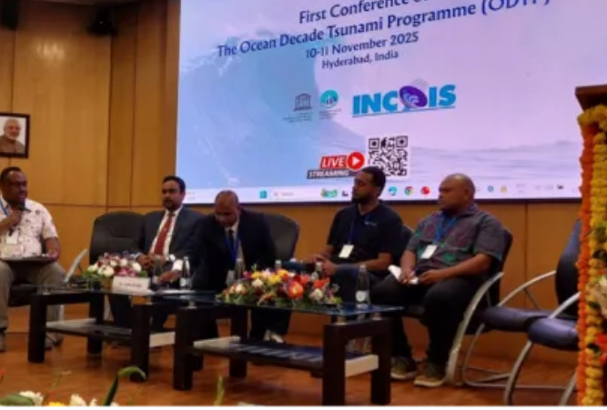
SESSION 4 (SIDS)Tsunami Resilience
Objective
Identify key gaps and priorities in:
Hazard/risk assessment
Observing systems
Preparedness & response (TRRP) Based on regional capacity assessments (IO & Pacific)
Moderators: Ardito Kodijat, Juita Koravulavula (supported by Srinivas Kummar and Denis Chang Seng)
SIDS reps: Maldives, Sri Lanka, Vanuatu, Solomon Islands
Partners: UNESCAP, UNDP, IORA
Country inputs on:
Risk assessments
Monitoring systems
Preparedness (TRRP)
Multi-hazard integration
One national priority
Partner responses:
Address gaps through projects, capacity support, and regional collaboration

Slide 5
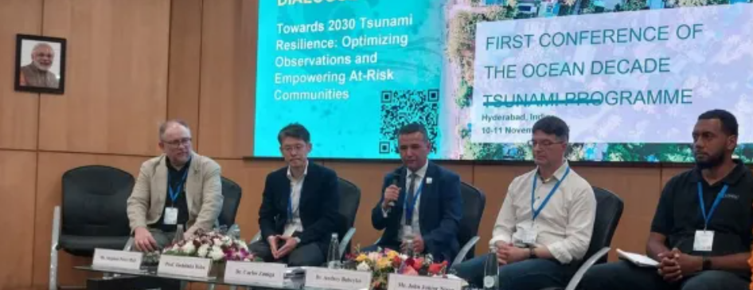
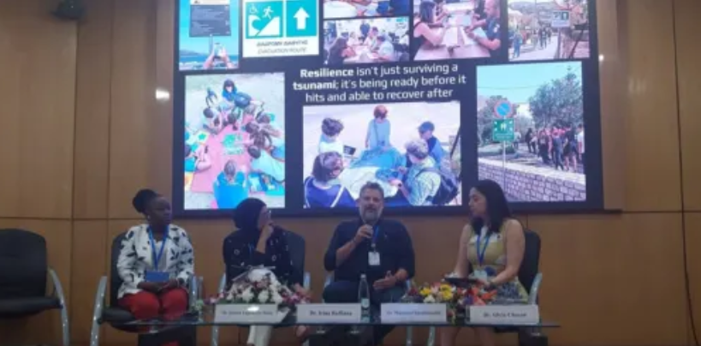
SESSION 5 (ROUNDTABLE DIALOGUE ON ODTP HLOs)
Objective
Define priorities and a shared roadmap to 2030 for tsunami resilience by:
Optimizing observation systems (HLO 1)
Empowering at-risk communities (HLO 2)
Leads: Dr Carlos Zúñiga, Dr Silvia Chacón
HLO 1 experts: Steve Hall, Toshitaka Baba, Andrey Babeyko, John Niroa (Vanuatu)
HLO 2 experts: Marinos Charalampakis, Irina Rafliana, Silvia Chacón-Barrantes, Doreen Lugemalila Ikula (Seychelles)
Thematic discussion:
Technical innovation & interoperability
Data-to-decision processes
Community preparedness & inclusion
Governance, policy & partnerships
Priority setting:
Faster warnings (≤10 minutes)
100% tsunami-ready communities by 2030
Collaboration focus:
Strengthen links between science, government, and communities
Promote partnerships and investment

Slide 6
SIDE EVENTS
Two side events were also organized at the First ODTP Conference.
- UNESCAP Side Event on 10 November
Co-hosted by Dr. Srinivas Kumar (UNESCO-IO) and UNESCAP, this session focused on strengthening regional cooperation on tsunami preparedness and resilience.
- SMART Cables Roundtable (10 November)
This roundtable explored opportunities to integrate environmental sensors into submarine telecommunications cables, enabling real-time ocean monitoring across the Indian Ocean

Slide 7
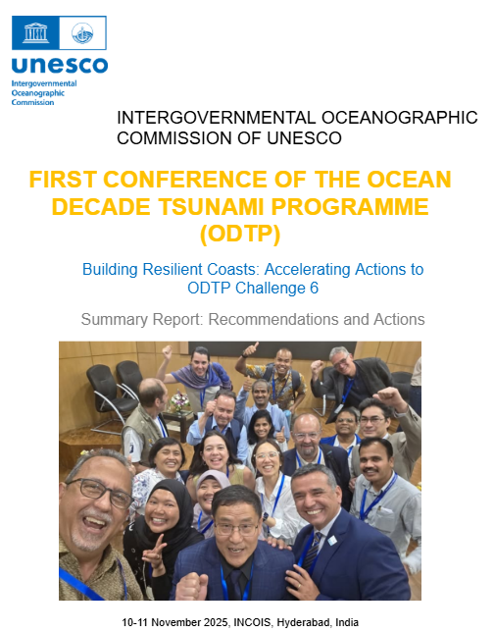
Key Priorities & Recommendations for the First Conference of the Ocean Decade Tsunami Programme
1. Actionable & Timely Warning Systems
Integrate all sensors into interoperable, real‑time data systems to enable actionable tsunami warnings within 10 minutes for all sources.
Advance open‑source tools and tsunami modelling and strengthen collaboration with regional and international scientific partners.
Accelerate global high‑resolution bathymetry mapping (e.g., GEBCO‑2030) to support impact‑based forecasting and risk assessment.

Slide 8
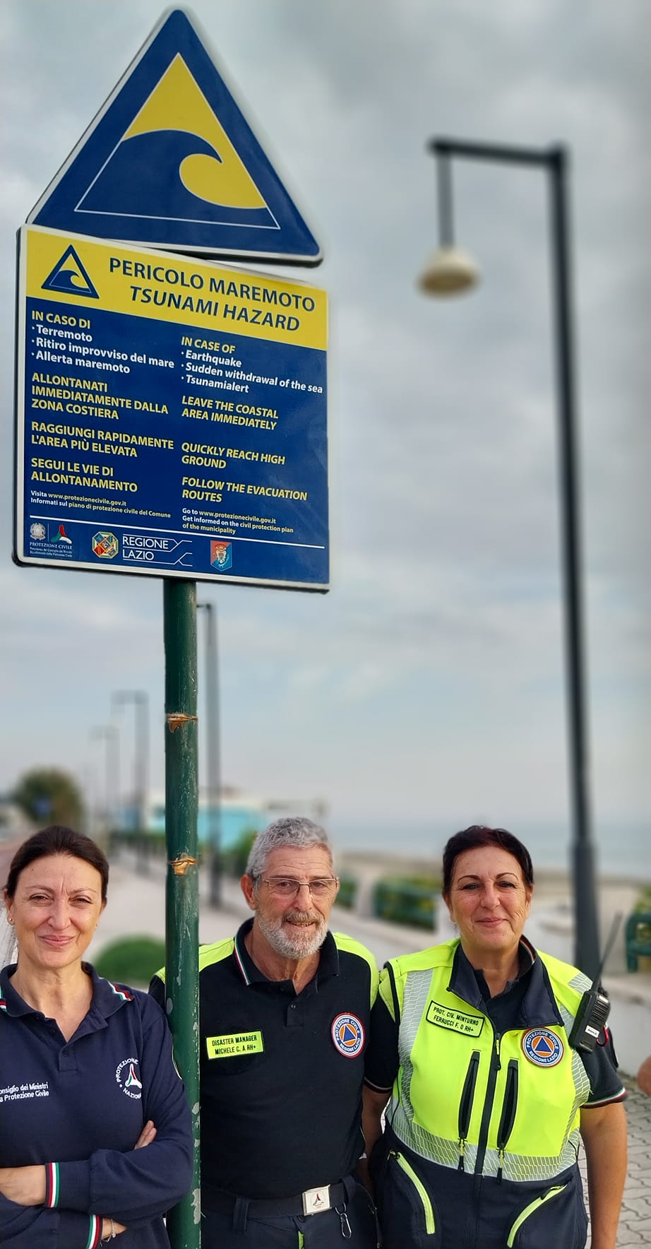
2. Prepared & Resilient Communities
Improve accessibility of inundation maps and hazard data for communities.
Strengthen governance, community engagement, and collaboration with Civil Protection Authorities, including promotion of local champions and vertical evacuation planning.
Enhance understanding of cascading risks and promote earthquake‑ and tsunami‑resistant design.

Slide 9
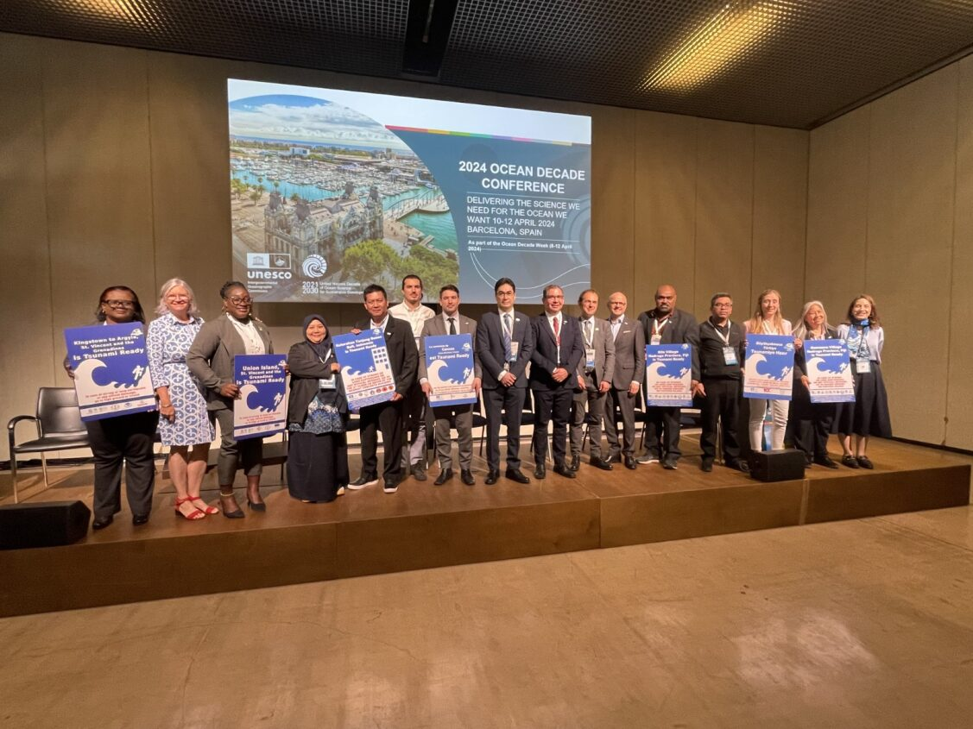
3. Tools & Instruments for Implementation
Strengthen regional knowledge‑sharing and last‑mile training, building networks of local champions.
Promote adoption of real‑time impact‑based forecasting tools such as TsunamiCast to support hazard assessments and emergency planning.

Slide 10
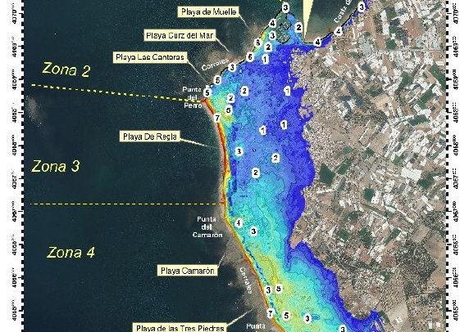
4. Priorities for Small Island Developing States (SIDS)
Provide high‑resolution inundation mapping and data for evidence‑based planning.
Support management of cascading risks across interconnected island systems and help identify critical infrastructure priorities.
Image source : IHCantabria

Slide 11
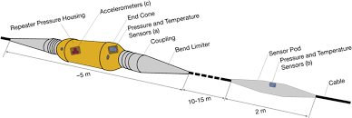
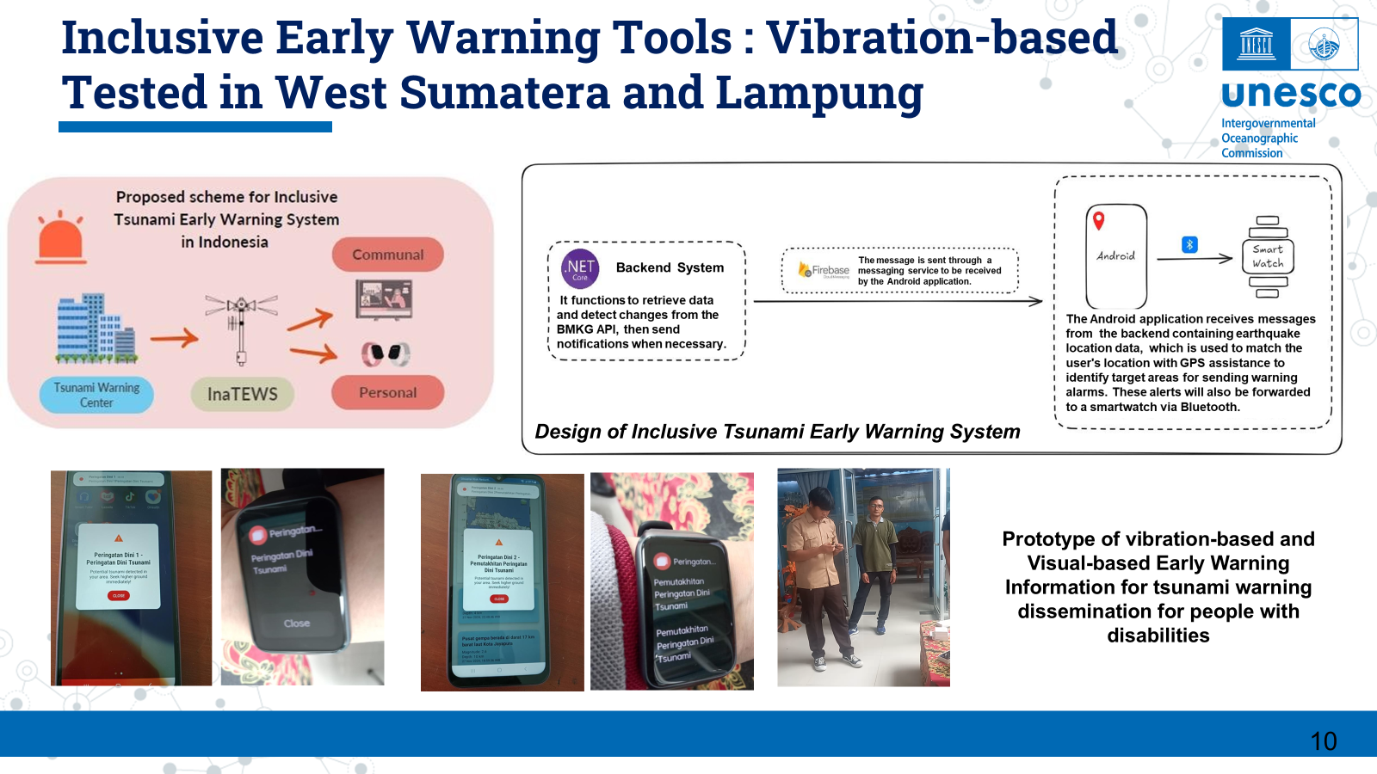
5. ODTP High‑Level Objectives (Roundtable)
Strengthen partnerships and leverage emerging technologies (AI, GNSS, SMART cables) to improve detection and reduce costs.
Promote inclusive, multi‑format communication tailored to vulnerable groups
Source : Prof. Harkunti Pertiwi Rahayu

Slide 12
More notes
Discussion on the 10 min warning threshold relative to impact versus generation
Showcase of advancements and gaps around the world
Last mile = weakest link everywhere: greatest challenge
Great opportunity to
groups from both HLOs to sit together so they could hear the other side (hard sciences & social sciences)
knowledge exchange between countries

Slide 13
Governance ODTP-SC Chair and Members (2024–2025)-Update
Acting Interim Chairperson
Ms Silvia Chacon Barrantes
Members
Mr Michael ANGOVE, National Tsunami Hazard and Mitigation Programme, NOAA, United States of America
Mr Sergio BARRIENTOS, National Seismic Centre, University of Chile
Ms Maria Ana BAPTISTA, Professor at the Instituto Superior de Engenharia de Lisboa and a researcher at Instituto Dom Luiz, University of Lisbon (Portugal)
Ms Silvia CHACON, Costa Rica National Tsunami Warning System, National University of Costa Rica
Mr David COETZEE, National Emergency Management Agency, New Zealand
Mr Yutaka HAYASHI, Meteorological Research Institute, Japan Meteorological Agency
Ms Hélène HEBERT, National Tsunami Warning Centre, Atomic Energy and Alternative Energies Commission, France
Ms Christa von HILLEBRANDT-ANDRADE, International Tsunami Information Center Caribbean Office, United States of America
Mr Alexander RABINOVICH, Tsunami Laboratory, P.P. Shirshov Institute of Oceanology, Russian Academy of Sciences, Russian Federation
Ms Harkunti Pertiwi RAHAYU, Research Center for Disaster Mitigation, Institute of Technology Bandung, Indonesia
Mr Yuelong MIAO, Bureau of Meteorology, Australia
Ad-Hoc Invited Expert
Ms Laura Kong, Chairperson for Tsunami Ready Coalition

Slide 14
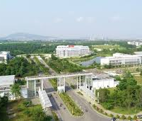
Renew/ Nomination of New ODTP-SC Chair and Membership 2026-2027 & Next ODTP-SC Meeting
Initiate procedures and communication to renew ODTP-SC Chair and membership (2026–2027) ahead of the 6th meeting
ODTP-SC 6th meeting tentatively rescheduled to June–September 2026.
Initially planned as an online meeting due to budget constraints.
Ongoing discussions with Prof Harkunti P. Rahayu, who has offered to host the session at Institut Teknologi Sumatera, Faculty of Infrastructure and Regional Technology, Lampung Selatan, Indonesia.
Hosting offer under review, subject to budget availability (2026–2027)

Slide 15
ODTP - SC 6th meeting
Key Proposed Agenda:
***
TSUNAMI READY COALITION (TRC) ODTP IMPLEMENTATION PLAN AND POTENTIAL NEW OD SUPPORT RESOURCES
UPDATES ON ODTP SUPPORT TOOLS
GROUP DISCUSSION: TRANSFORMING THE FIRST CONFERENCE OF THE ODTP RECOMMENDATIONS INTO ACTIONS
GLOBAL INITIATIVES
Planning for the 2027 Ocean Decade Conference, 7-9 April, Brazil, and the City of Rio de Janeiro.

