Slide 1
Summary of revised structure following Wednesday’s discussions
Session chairs: Matias Sifon and Suzan M. El-Gharabawy
15th GOOS Steering Committee meeting | 25-27 March 2026 | Hyderabad, India

Slide 2
Agreed Updates to Proposal
Mission
To lead and evolve a globally integrated, responsive, and resilient ocean observing system for thriving communities and a healthy ocean

Slide 3
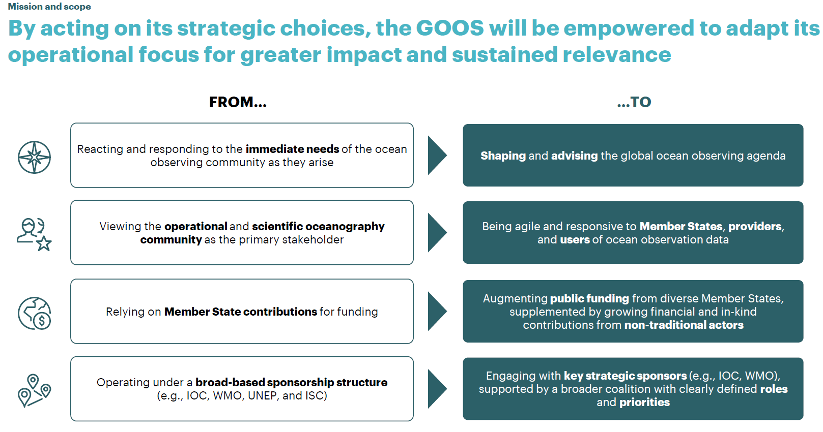
Recognising 3 key areas of impact: operational forecasting, climate and ocean health
Delivering for application areas in forecasting, climate and ocean health

Slide 4
1
2
3
4
5
6
7
Proposed structure – 1. Streamline GOOS reporting structure and refresh responsibilities
Streamlining reporting lines will promote greater integration and accountability across GOOS components (1/3)
Proposed GOOS reporting structure
IOC¹
WMO¹
GOOS Steering Committee
GOOS Secretariat
Donors¹
Partners
Endorsed Projects
Biology and Ecosystems (BioEco) Panel
Physics and Climate (OOPC)
Panel²
Biogeo-chemistry (BGC) Panel³
Infrastructure Coordination Group (ICG)
81
National Focal Points (NFPs)¹
GOOS Regional Alliances (GRAs)⁴
Expert Team on Operational Ocean Forecast Systems (ETOOFS)
OCG 2.0
NFP Advisory Group
GRA council
ETOOFS tbc
?
Ocean Observing Data Providers
GOOS Networks
Other communities and contributors (e.g., BioEco observing communities, DOOS, national observing networks, private sector)
1) Member States are represented in the GOOS structure via IOC and WMO Governing Bodies, NFPs, and Donors
2) Additionally reports to the GCOS Steering Committee 3) Additionally reports to the ISC SCOR
4) GRAs role and position is still under revision and therefore is not detailed out in this proposal, options are included in the appendix
Note: GOOS components are organized in the diagram by following the value chain view
#
Number of NFPs
GOOS component
External contributor
Oversight
Coordination

Slide 5
1
2
3
4
5
6
7
Proposed structure – 1. Streamline GOOS reporting structure and refresh responsibilities
Refreshing and strengthening responsibilities across GOOS components will enhance efficiency across the ocean observing community (2/3)
Responsibilities of GOOS components
GOOS Steering Committee
Develop and oversee GOOS strategy and biennial workplans for submission to IOC and WMO Governing Bodies and respond to governing body requests
Oversee, monitor, guide, and evaluate GOOS system performance to ensure alignment with strategic objectives and workplans
Advise Member States and other donors on the importance of and benefits from GOOS
Approve updates to component Terms of Reference (excluding the GOOS Steering Committee’s own TOR), Chair/Co-Chairs (per component TOR), workplan, and GOOS endorsed projects
Advocate for ocean observing and provide senior level representation of GOOS and ocean observing in appropriate fora
Support Secretariat with resource mobilization and donor engagement
Drive tactical/day-to-day interaction between GOOS components (e.g., ex officio removed from the SC)
GOOS Secretariat
Details on next slide
Ocean observing system coordinator
Strategic advisor and advocacy champion
Standards steward
Innovation catalyst
BGC Panel
OOPC Panel
BioEco Panel
Infrastructure Coordination Group (ICG)
NFPs
GRAs
ETOOFS
Identify, set specifications, evaluate, and evolve Essential Ocean Variables (EOVs)
Co-design and develop optimal system design requirements and implementation strategies for EOVs
Collaborate across disciplines and GOOS components, including with other GOOS Expert Panels
Support development of user-oriented data and information products
Monitor observing system design
Coordinate observing networks / communities, including management of the BioEco Portal (moved to ICG)
Develop data-flow standards and data quality control protocols (moved to ICG)
Coordinate, provide guidelines and specifications for ocean observing data providers
Grow the network of ocean observing data providers (GOOS networks and other observing communities including private sector)
Monitor performance and coordinate reporting of the operational system on behalf of ocean observing data providers
Promote innovation in observing technologies and methodologies
Set metadata standards for ocean data networks and communities and integrate with IOC and WMO systems
Monitor performance and assets distribution (e.g., ensure data flow, data services, and management)
Report directly to IOC and WMO (incl. communication, engagement, etc.)
Promote the importance of ocean observation through capacity building
Coordinate national ocean observing activities and engage key stakeholders (e.g., via National Coordination Committees)
Provide national inputs for GOOS reporting, EOV tracking, and system assessments
Support and strengthen national participation in global and regional GOOS initiatives
Promote adoption of GOOS best practices and open data-sharing standards at the national level
Identify national needs for ocean observation
Advocate for national investment in sustained ocean observing systems
To be confirmed – under revision
Set global standards and guidance to ensure continuous improvement of operational ocean forecasting systems
Improve integration of observations and models and coordinate forecasting efforts
Assess forecasting system performance and strengthen capacity across Member States
To be included and info added from outcomes from GRA council
ICG scope to be updated
In-scope activity
Out of scope activity
Notes:
Bioeco duplicate changed to BGC Panel

Slide 6
1
2
3
4
5
6
7
Proposed structure – 1. Streamline GOOS reporting structure and refresh responsibilities
Empowering and prioritizing GOOS Secretariat roles will help advance its mandate and better support the ocean observing community (3/3)
Responsibilities of GOOS Secretariat
Ocean observing system coordinator
Strategic advisor and
advocacy champion
Standards steward
Innovation catalyst
Current in-scope activities
Facilitate planning, coordination, and communication across GOOS components to ensure system-level integration and alignment with the 2030+ strategy
Support the development of standards that enable worldwide engagement and data sharing for a unified, comprehensive ocean monitoring value chain
Facilitate alignment with sponsors
Support and monitor GOOS components as defined by TOR
Develop, formalize, and maintain strategic partnerships with policy makers, scientific community, ocean observing data providers, implementors, funders, and other relevant users
Strengthen GOOS visibility through communication tools and guidance
Promote and maintain best practices and standards for ocean observing (setting EOVs, network, and metadata specifications)
Coordinate activities across GOOS components to leading to new and better standards
Promote emerging technologies in ocean observing
Would require additional skills/resources on top of those already needed
New activities
Advise on ocean observing strategies and solutions in response to policy-based queries and respond to Member States requests
Facilitate alignment with Member States and other donors
Lead engagement, provide insights and coordinate feedback mechanisms for donors and partners
Promote GOOS endorsement, such as through new projects, to facilitate evolvement of the system
Activate government and private sector engagement for project design based on current and new technologies
Catalyze pilots of technologies and tools
Promote the use of ocean observing data for products and services for the ocean economy and disaster risk reduction
Out of scope
activities
Matchmaking between different entities or stakeholders
Detailed project management activities for smaller research projects
Organize individual seminars or workshops
N/A
N/A
Maintain
Preserve and strengthen existing core functions and responsibilities
Broaden scope or scale to increase impact and reach
Innovate and test new approaches or partnerships for future opportunities
This view does not include internal facing activities like strategy design, progress tracking and monitoring
Expand
Explore

Slide 7

1
2
3
4
5
6
7
Proposed structure – 4. Elevate the GOOS Steering Committee
Elevating the GOOS SC by enhancing oversight, expert skills, and member terms will lead to better governance and more effective decision making
Proposed membership structure of the GOOS Steering Committee (SC)
Recommended changes
 | # | Role / representation | Rotation (illustrative) | Illustrative role description
Regional experts | 1 | Group I | Year 1 | Ensure regional priorities are reflected in GOOS decisions Provide input on capacity development needs and regional resource mobilization
 | 2 | Group II | Year 1
 | 3 | Group III | Year 1
 | 4 | Group IV | Year 3
 | 5 | Group V | Year 3
Scientific and technical experts | 6 | Private sector | Year 1 | Oversee operational coordination and system performance Drive adoption of emerging technologies and partnerships Strengthen private sector engagement and funding opportunities Align GOOS outputs with global policy frameworks Promote training and equitable participation globally
 | 7 | Data management | Year 1
 | 8 | OceanOPS liaison | Year 1
 | 9 | Innovation | Year 1
 | 10 | Science policy advisor | Year 1
 | 11 | ... | Year 3
 | 12 | ... | Year 3
 | 13 | ... | Year 3
 | 14 | ... | Year 3
 | 15 | ... | Year 3
Ex-officio | 16-25 | Components reps. | NA
Steering Committee (SC) will serve as a decision-making and governing body, overseeing GOOS components and responsible to IOC and WMO Governing Bodies
SC members will have ocean observation expertise, more targeted skillsets and corresponding roles aligned with 2030+ strategy
Ex-officio for GOOS components will no longer be considered as part of the SC, but will continue to collaborate via the GOOS Executive Committee and joint meetings
Two Co-Chairs – one from regional expert groups (suggested rotation by region) and one from scientific and technical experts – will be elected by the SC every 2 years with opportunity to renew for 2 more years
Term length for all SC members will be extended from 2 to 4 years including renewal opportunity to serve up to two consecutive terms (8 years total)
A phased (staggered) transition will be implemented with 7 to 8 members renewed every 2 years
Regional expert group members will be selected by IOC electoral groups and approved by the IOC Assembly
Scientific and technical experts will be nominated by an open call to IOC and WMO Member States, selected by the IOC Executive Secretary with WMO approval, while considering representation across both skillsets and ocean basins
Timebound SC task teams will address specific issues
Co-chair x1
Co-chair x1
Leadership of GOOS components will remain as Ex-officios in GOOS SC
Members of components cannot be SC members – conflict of interest
WMO repo: At least member INFCOM MG - will need to expose the proposal to WMO decision makers, and let MS decide.

Slide 8
1
2
3
4
5
6
7
Proposed structure – 5. Empower the GOOS Secretariat
Formalizing the identity of GOOS Secretariat with additional staff will boost coordination across GOOS and reinforce its operational capacity
Proposed organizational chart for the GOOS Secretariat
Recommended changes
IOC Executive Secretary ¹
The GOOS Secretariat, including existing IOC and WMO staff and additional proposed resources, will be formalized as an official component of GOOS and will take on an expanded scope with four prioritized roles supported by existing and new key activities to advance its mission
Updated team structure will align with the expanded responsibilities and improve operational efficiency
The OOPC Scientific Officer will continue to report to their respective WMO department
Staffing resources for Panel Scientific Officers, ICG Officers, and other technical roles can be adopted by other organizations (ex: National observing networks, etc.)
Clear accountabilities will be established across GOOS Secretariat team members to ensure role clarity and balanced workload distribution (see slide #58)
Contributions from other GOOS components will be formalized to provide complementary capabilities e.g., resource mobilization, strategic planning (see slide #59)
GOOS Secretariat will create an onboarding document outlining its responsibilities, expectations, etc.
GOOS Secretariat
GOOS Director (P5) ¹
Head of Section, Ocean Observations, Data and Services Section (OODS)
IODE
Programme Specialist 1 (P4) ¹
Programme Specialist 2 (P3) ¹
Programme Specialist Standards, Outreach and Innovation (P4)
Admin Assistant (G4/5) ¹
Additional Consultants³
Programme Specialist 3 (P2)
Programme Specialist 4 (P3)
Communication Officer (P2/3) ^{2, 7}
Admin Assistant (G3) ⁷
Potentially outsourced roles
BioEco Panel Scientific
Officer (P3) ^{2, 7}
OOPC Panel Scientific
Officer ⁴
BGC Panel Scientific
Officer (P3) ⁵
ICG Officer (P2/3) ^{6, 7}
Needs further discussion
1) Currently an established post
2) Currently an affiliate consultant post, proposed to be formalized as an established post
3) Currently an affiliate post determinated by the budget, not needs
4) Continue to be funded and staffed under WMO
5) Continue to be served by the IOCCP Director and Officer
6) Previously filled through secondments until 2024
7) New position identified as part of the GOOS SC Workplan (A-33/4.5.2.)
IOC Professional
IOC General Service
IOC Consultant
Other Professional
Oversight
Coordination
New position
External

Slide 9
1
2
3
4
5
6
7
Proposed structure – 6. Introduce the Infrastructure Coordination Group (ICG)
Introducing the Infrastructure Coordination Group will centralize ocean data provider coordination, data management, and strengthen integration
Proposal for Infrastructure Coordination Group (ICG)
Recommended changes
Infrastructure Coordination Group (ICG)
Network and data coordination provided currently by OCG, OceanOPS, BioEco Panel and IODE will be merged into a single component – Infrastructure Coordination Group (ICG)
ICG will have an expanded mandate to coordinate all ocean observing data providers (e.g., GOOS Networks, biology community, regional and coastal observations)
OceanOPS will facilitate implementation of ICG workplan
A Co-Chair system will be established with one focused on network and one on data, while also introducing Vice Chairs to represent external contributors, ensure biological expertise, and the user community
ICG will report to GOOS Steering Committee on behalf of all ocean observing data providers contributing to ocean observation and system wide data coordination efforts
NFPs will continue to communicate and collaborate with their respective national observing networks and communities to develop and sustain its national ocean observing coordination
Ocean observing data providers will follow data management standards and protocols set forth by IOC and WMO
Ocean observing data providers will be encouraged to integrate their own data platforms (e.g., BioEco Portal) with the OceanOPS product
Evolve from
Observations Coordination Group (OCG)
OceanOPS
BioEco communities coordination
Ocean Observing Data Providers
coordination
Data
coordination
Purpose / mandate
Ensure ocean observing data providers operate under consistent standards and deliver reliable, interoperable data
Monitor and integrate data and metadata from ocean observing data providers to ensure accessibility, quality, and usability
Key contributors
GOOS Networks
OceanOPS
IOC (e.g., IODE)
Other communities and contributors (e.g., BioEco observing communities, DOOS, national observing networks, private sector)
WMO
Other data contributors
(e.g., GEBCO)
Key activities
Coordinate, provide guidelines and specifications for ocean observing data providers
Monitor performance and coordinate reporting on behalf of ocean observing data providers
Promote innovation in observing technologies and methodologies
Oversee the OceanOPS product to aggregate data and metadata from ocean observing data providers
Monitor performance & assets distribution (e.g., ensure data flow, data services and management)
Needs further discussion based on outcomes of breakouts

Slide 10

1
2
3
4
5
6
7
Proposed structure – 7. Strengthen NFP’s role and interaction model
Strengthening NFP’s role and interaction model will increase Member State involvement, enhance coordination, and align with global standards
Key NFP interactions in the future model
Recommended changes
GOOS Steering Committee
NFPs will have a strengthened role to link national observing efforts with broader GOOS and advocate GOOS at the national level
GOOS Steering Committee (SC) will provide strategic direction and oversight to NFPs
NFP Advisory Group (comprising representatives from IOC Electoral Groups) will be established to ensure Member States perspectives are effectively communicated to the GOOS SC (see slide #32)
GOOS Secretariat will coordinate activities among NFPs, serving as the primary point of contact, sharing updates, templates, best practices, consolidating reports and actively supporting engagement between GOOS NFP and IODE focal points (NODCs and ADUs)
NFPs will be encouraged to coordinate with IOC NFP and other relevant focal points and representatives (e.g., GOOS Network, WMO, IODE) through:
Existing national coordination mechanism (national observing networks) or
Establish national ocean observing committee/hub that bring together key representatives as per existing TOR and Implementation Guidelines
NFPs will communicate and collaborate with national ocean observing data providers but the ICG will be reporting on their behalf (e.g., on % observing systems with interoperable EOV dataflows)
Strategic advice, best practice, national needs and data delivery linkages
Consolidated status update incl. insights on gaps and actions
Global strategic priorities, and guidance
GOOS Secretariat
NFP Advisory Group Meeting
Reporting guidelines, templates, and GOOS updates
Up to 10 NFP reps
SC co-chairs (as needed)
Secretariat rep
IODE management group rep
ETOOFS rep
Regular updates through standardized template
National Coordination
NFP Implementation Guidelines are being prepared by the TT
Include: wherever NFPs are not identified, invite GRAs to attend the NFP forum and represent the Nations in the Region (e.g. Pacific)
Need to update list of NFPs / maintain list of NFPs (use of OE)
Exchange of info, advocate GOOS in the country, advise GOOS what MS wants - overlapping with IOC FP. Suggest to add 30-min in agenda on Friday.to discuss
IOC NFPs
GOOS NFPs
Coordination
Ocean observing data provider FPs
(GOOS Networks, etc.)
IOC Sub- Commission(s)
Tsunami FPs
IODE FPs (National Oceanographic Data Centres (NODCs) and Associate Data Units (ADUs))
National (Ocean) Decade Committee
WMO FPs
National scientific institutions
Government departments
Private sector
Other users
Key interactions

Slide 11
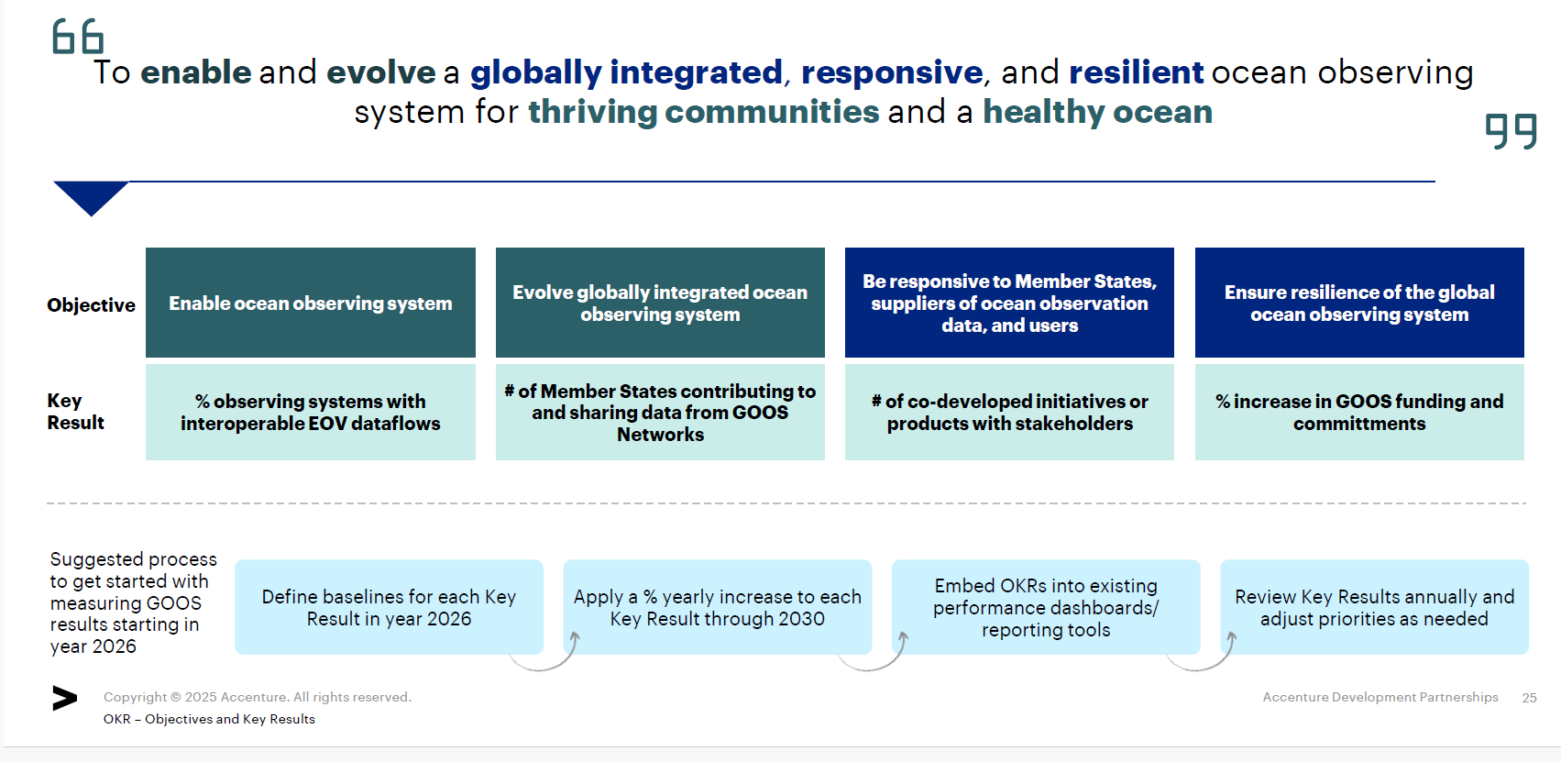
Be responsive to Member States and to the broader community of ocean observation providers and users
Deliver ocean observations and insights that have impact for thriving communities and a healthy ocean
Lead
Deliver to IOC and WMO strategic plans
% of Member States contributing to and sharing EOV data

Slide 12
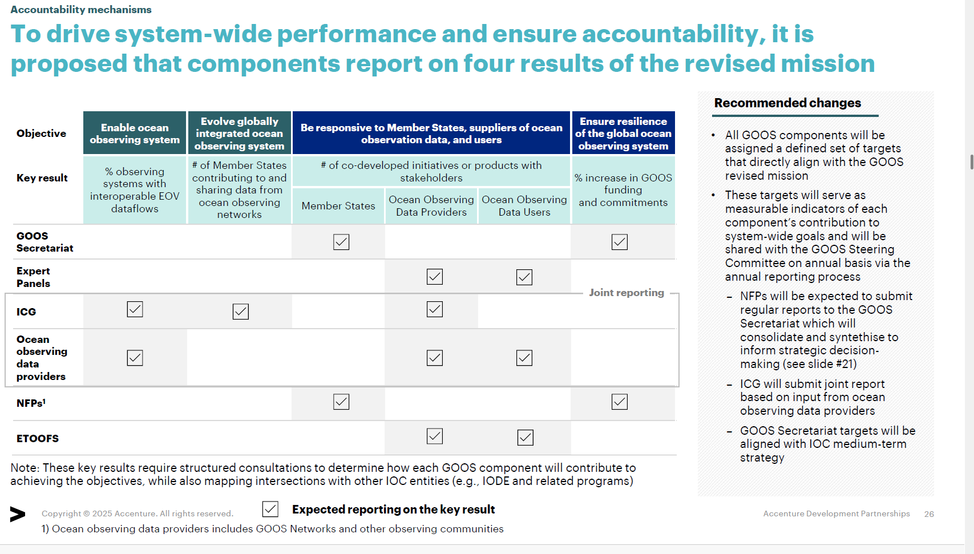
GRAs | y | y | (y) | (y) | (y) | y
Link to homework document - here

Slide 13
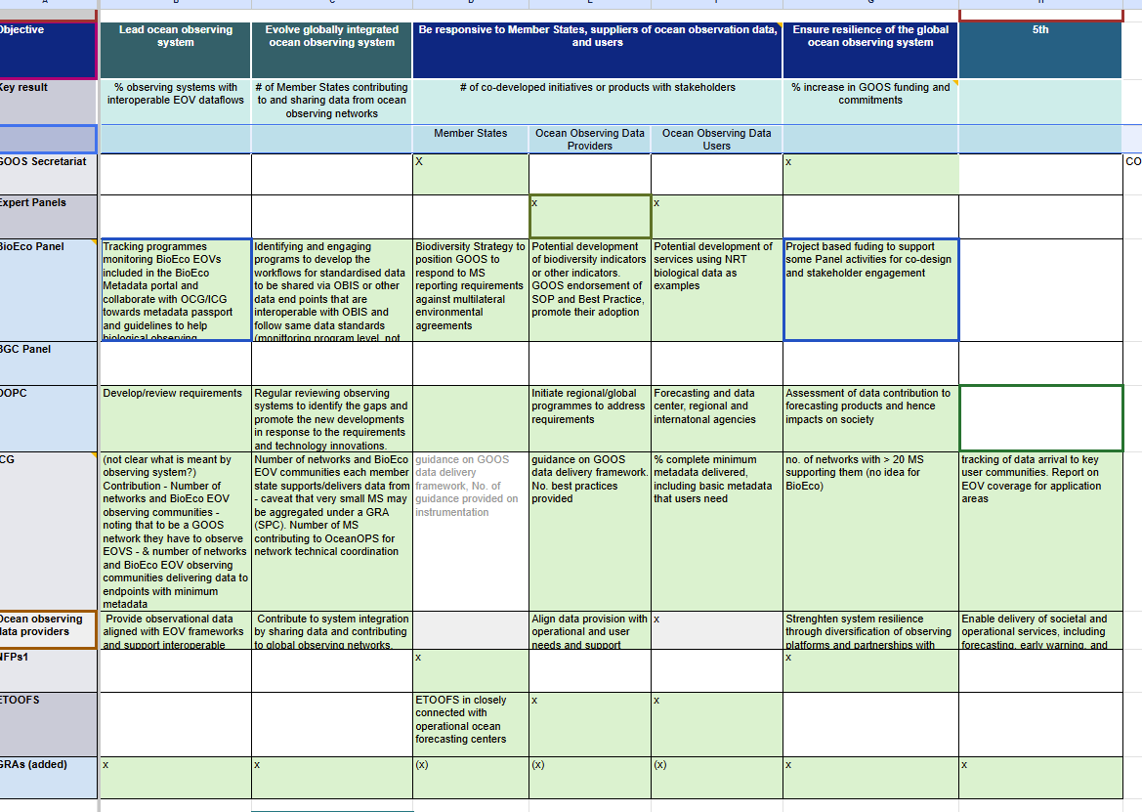

Slide 14
Governance - meetings
GRA Forum will be added to the list of meeting and placed in the appropriate parts of the proposal

Slide 15
GRA’s

Slide 16
Proposed structure – Outstanding decisions (GOOS Regional Alliances)
GRA role will be further investigated and discussed during the GRA Forum XII and GOOS SC-15 in March 2026 (agenda item 5.2)
Degree of integration with GOOS
Differentiate GRAs in GOOS structure
GRAs as self-governed, independent entities
Overview
Renewed mandate and responsibilities to strengthen regional coordination of ocean observation
New and clearer process of engagement
Formalized accountability and reporting (e.g., OKRs)
Continued support from GOOS Secretariat
GRAs encouraged to be basin-aligned
GRAs no longer a separate component of GOOS with no formalized mandate; with flexibility to set their own priorities
Regional autonomy in self-governance and decision-making
Voluntary alignment with GOOS principles rather than formal obligations
No direct support received from GOOS Secretariat
Governance
GRA Council and GOOS Regional Forum
Joint meeting between GRAs and NFPs for regional coordination
Pros
Avoids disruption as builds on existing regional infrastructure and relationships
Possibility to enhance regional coordination if mandates are clearly set and implemented
Greater clarity and structure could improve performance and accountability
Provides full autonomy and flexibility for GRAs to set regional priorities
Encourages open dialogue and idea-sharing without formal obligations
Streamlines GOOS structure
Reduces dependency on GOOS Secretariat resources
Cons
Demands change management to implement cohesively across GRAs
Limits GRA flexibility and autonomy
Requires ongoing GOOS Secretariat resources and capacity
Weaker alignment with global GOOS objectives, with a risk of inconsistent standards and practices across GRAs
GRAs may feel demotivated due to reduced formal authority, potentially limiting regional impact
Note: Other options considered included reconfiguring GRAs to basin-aligned, repositioning them under IOC sub-commissions with a stronger role for regional experts in the GOOS Steering Committee, or removing GRAs entirely (more detailes in Appendix slide 54,55)

Slide 17
2. Major Uptakes from GRA-SC Joint Discussions
GRAs agree they are an integral part of GOOS. Following discussion of the proposed reporting structure in the GOOS reform report, GRAs suggested language changes (GRAs should appear as ‘GOOS Regional Council’) but generally agreed GRAs appear in the right place in the structure. (shown in previous slide)
GRAs discussed the proposed reporting elements (objectives and key results). It was agreed with the SC that a 5th objective focused on delivery areas would be added, that GRAs would be added to the reporting elements table, and that the key results as listed are not appropriate for GRA reporting. GRAs committed to draft a set of key results appropriate for GRA reporting.
Minimum requirements set by GOOS (Member States) that GRAs commit to:
GRAs support the vision and mission of GOOS, and considered adding a statement to reinforce this.
GRAs will report to GOOS on key results via the GRA Council, improving communication.
GRAs commit to collecting data, QC, sharing data and technology transfer
GRAs commit to improve communication with other GOOS components (eg. NFPs)
Minimum requirements expected of GOOS from GRAs:
GOOS to support linking with funding opportunities and connection with donors
GOOS to support access to capacity development, data sharing and new technology access
GOOS to set up global priorities on areas of common ground
GOOS to link GRAs with MS. Met offices in the region
GOOS needs to have a mechanism to link different components of GOOS.

Slide 18
Next steps
GRAs will refresh the Terms of Reference, acknowledging that while each GRA is unique in their structure and priorities, they also commit to the GOOS vision, mission, and objectives.
GRAs will review their vision and mission statements in order to verify alignment with GOOS vision and mission.
GRAs will define minimum requirements aligned with GOOS Strategy that all GRAs can commit to; they will also define specific minimum requirements and contributions from individual GRAs considering their differences.

Slide 19
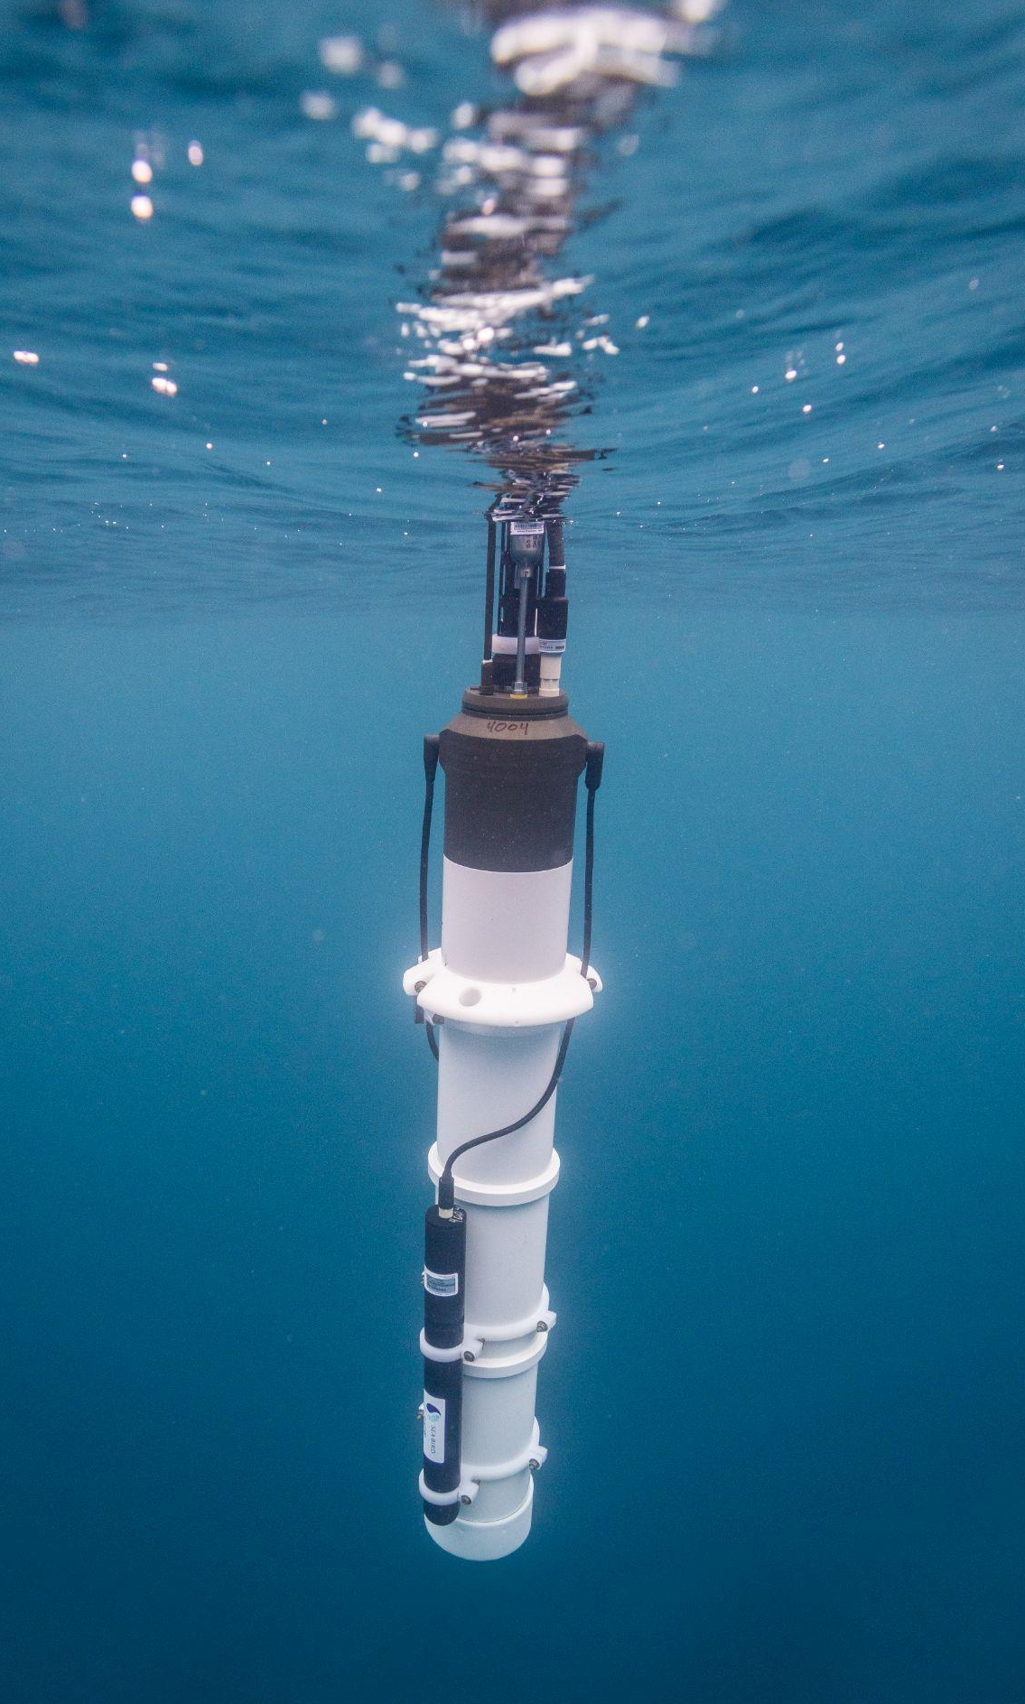

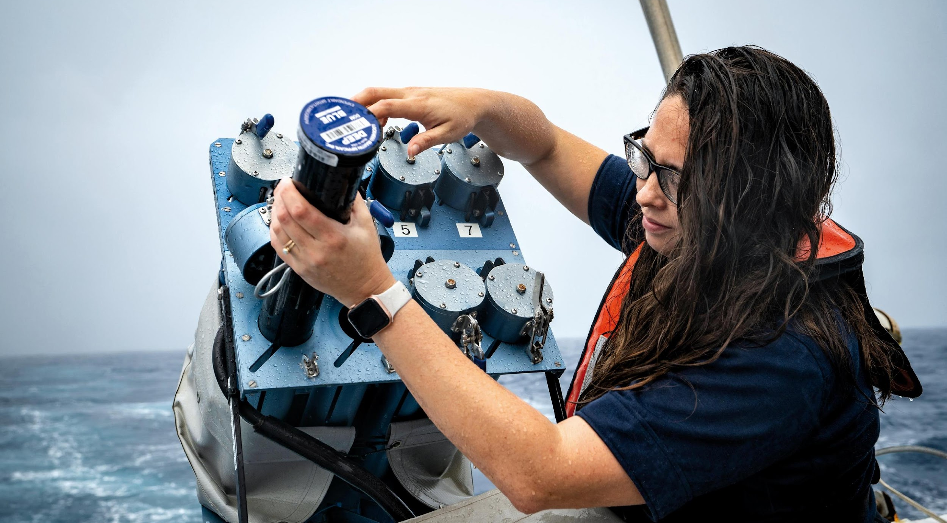
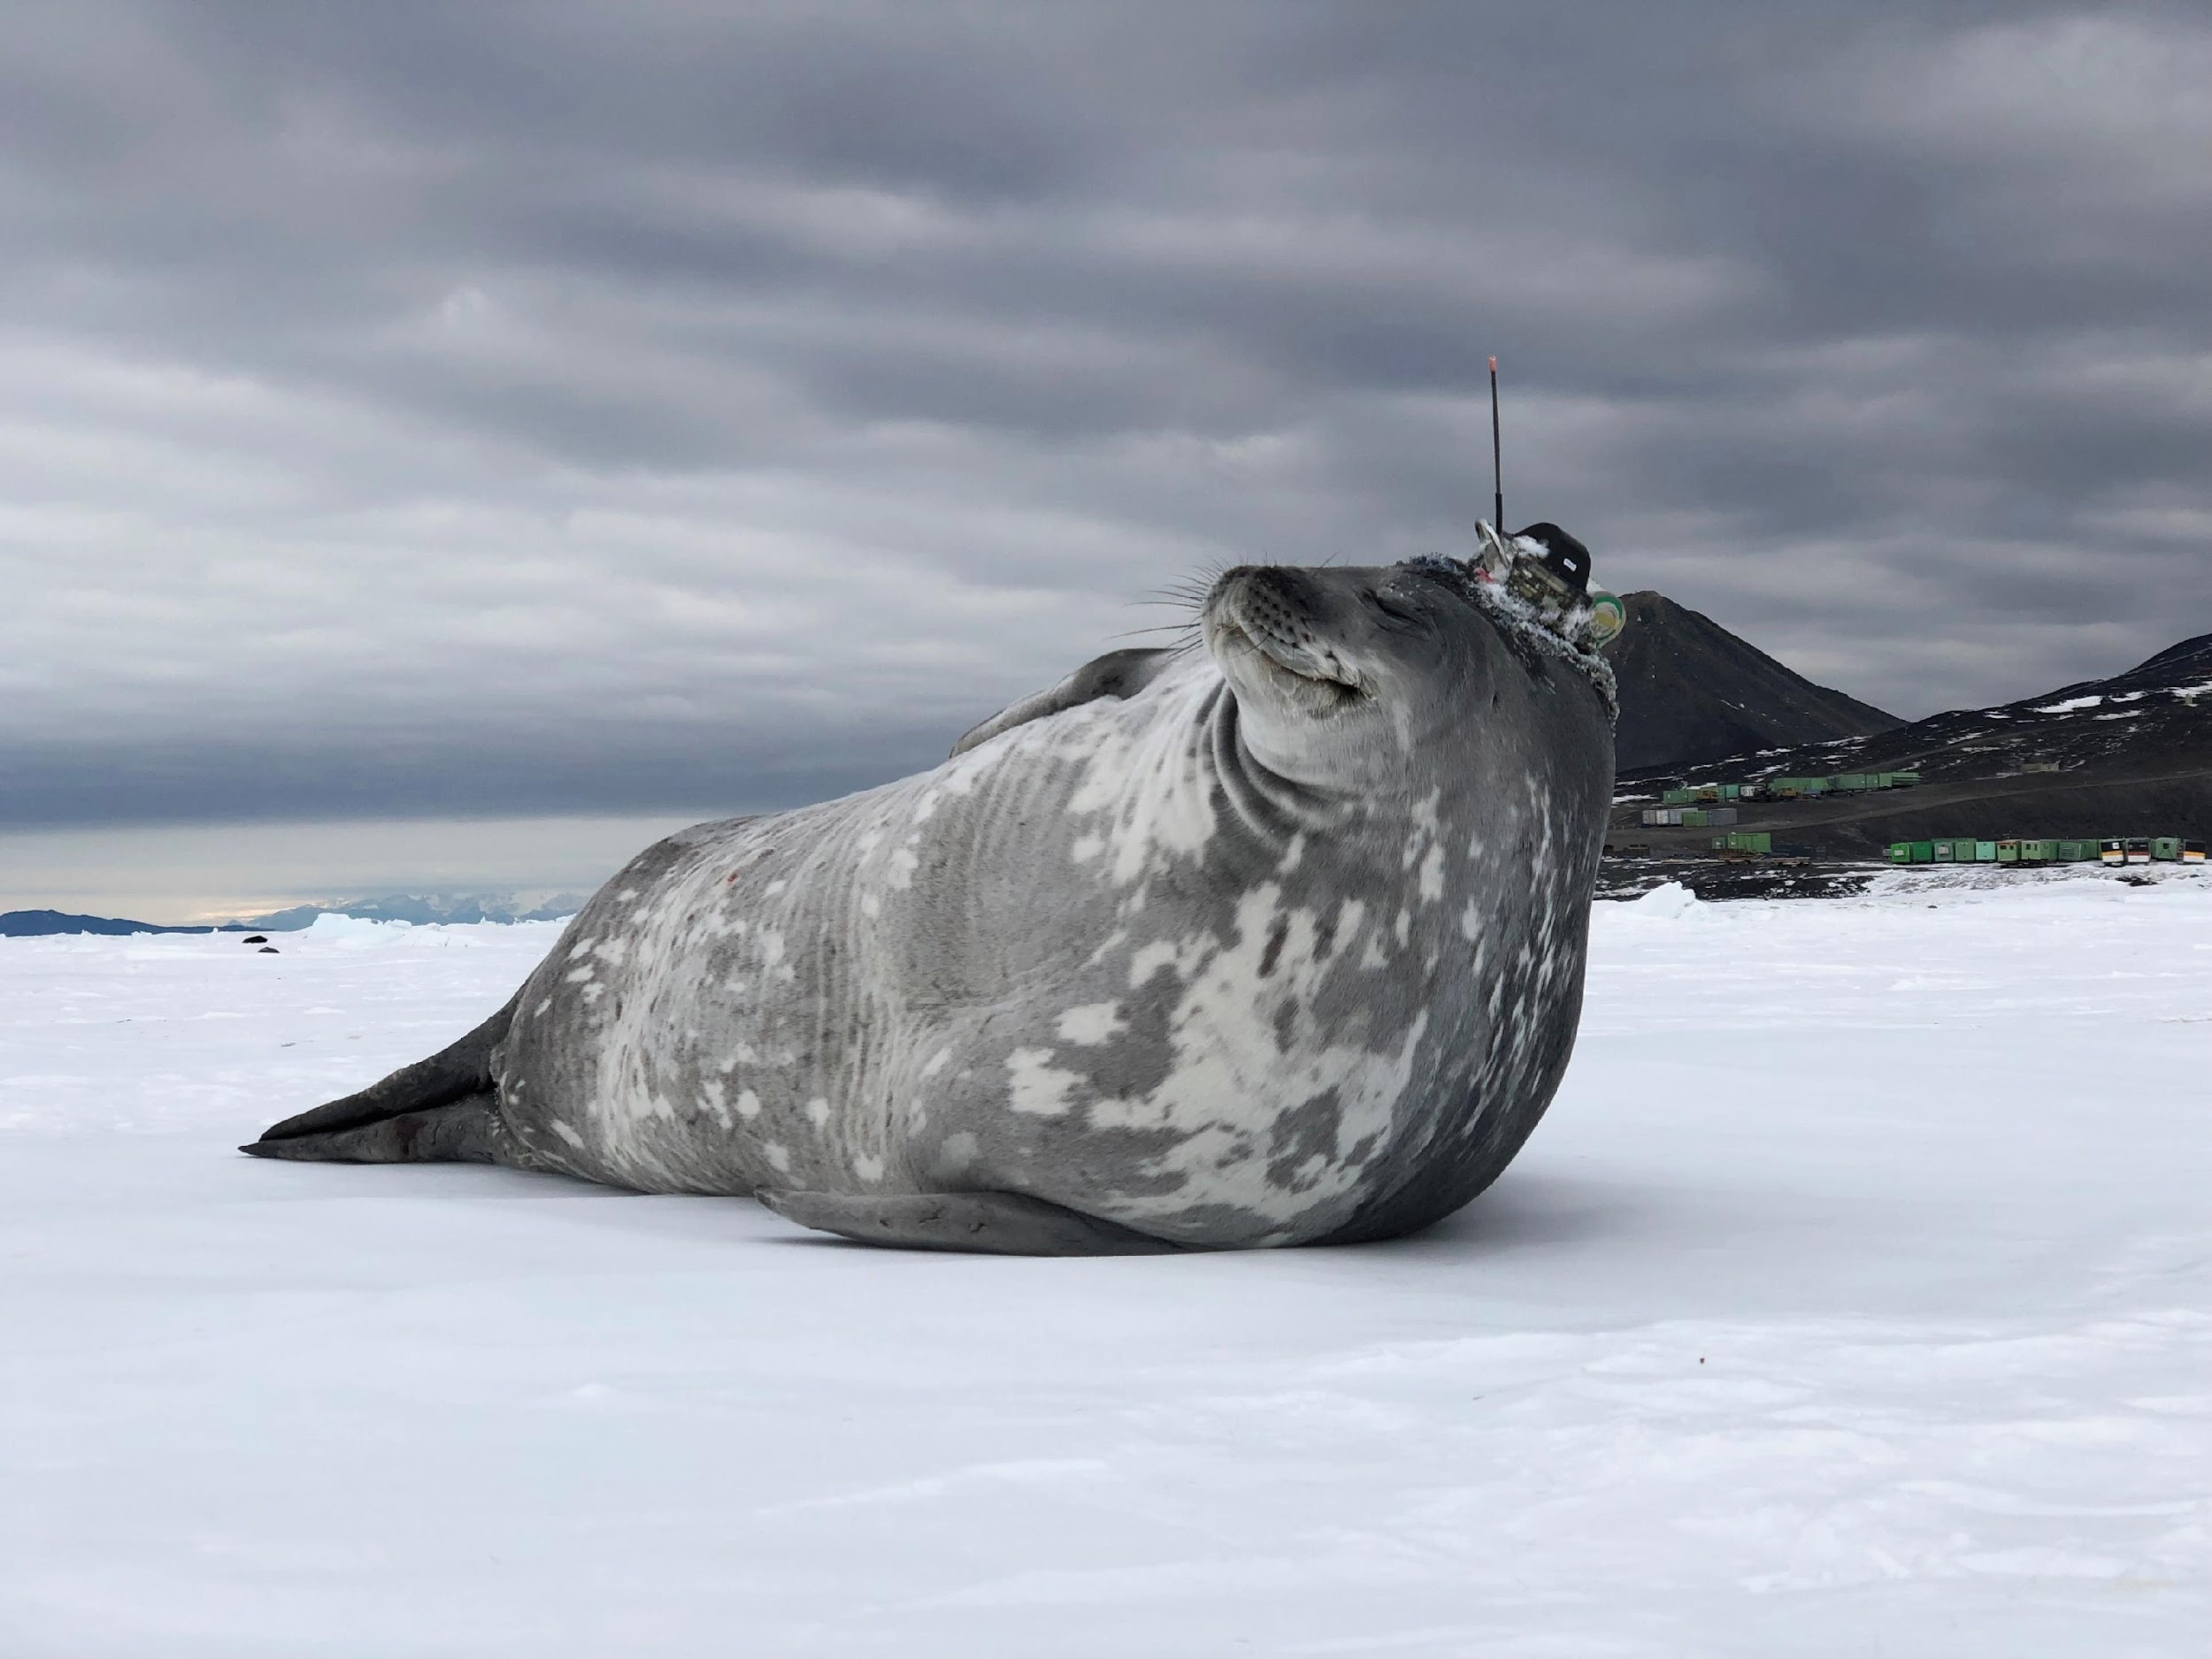
Argo Program / Scripps Institution of Oceanography at UC San Diego

