Slide 2
Tsunami Preparedness for Critical Infrastructure – TSUPORT Project
Ignacio Aguirre Ayerbe
Vice-Chair of the ICG/NEAMTWS
Co-chair Task Team on Governance
TOWS-WG Inter ICG Task Team on Disaster Management and Preparedness (TTDMP2), 5-6 March 2026

Slide 3
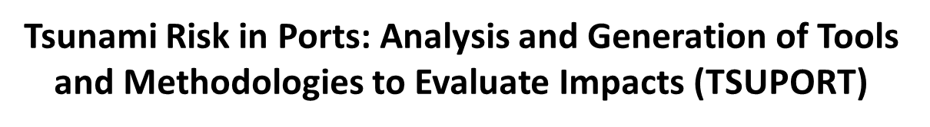
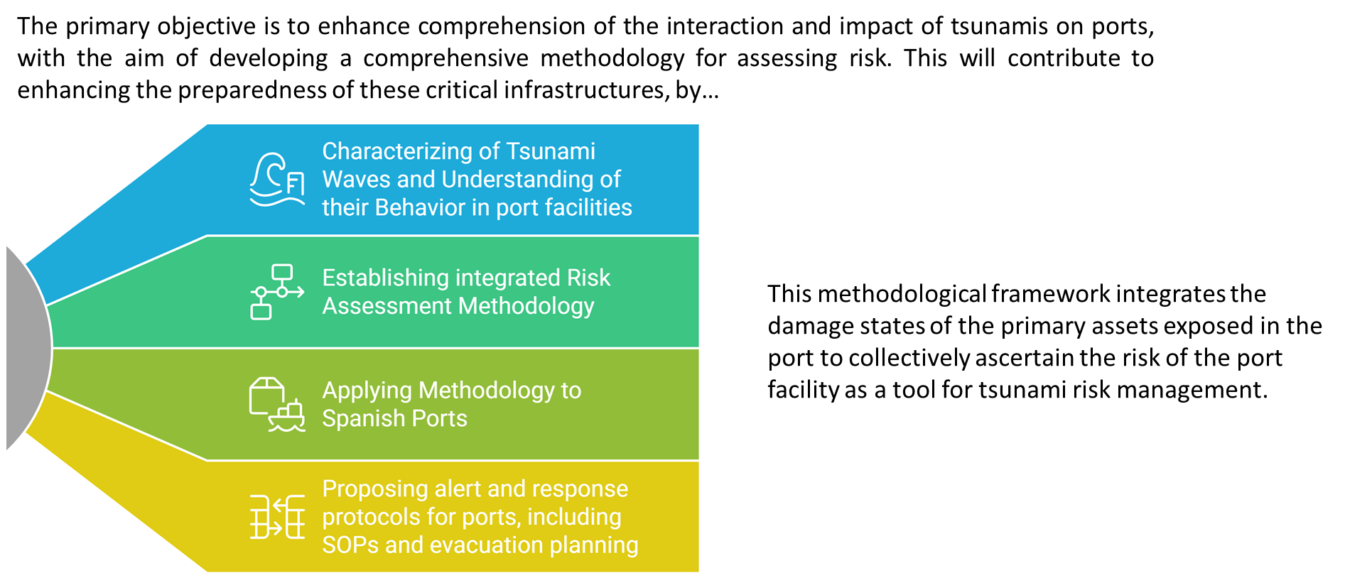


Slide 4


Slide 5
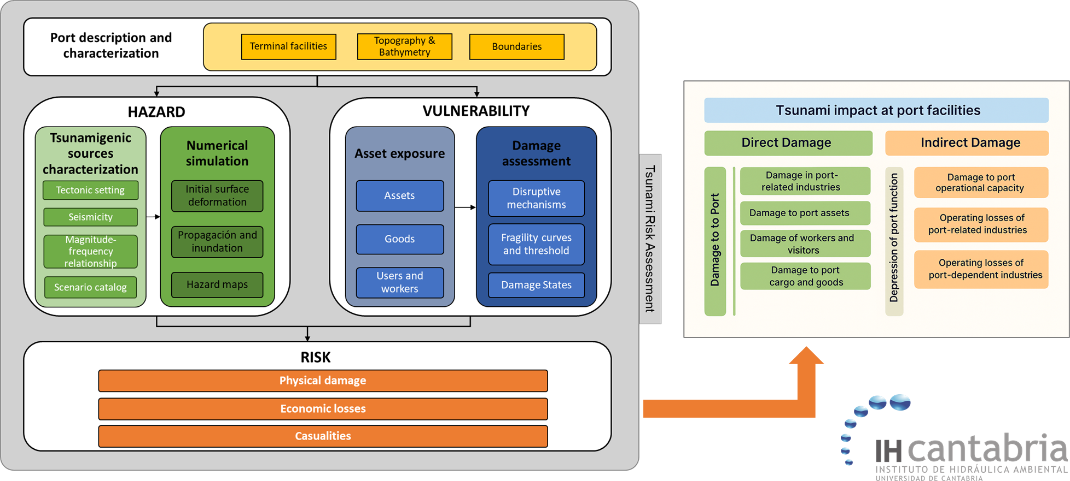

Slide 6

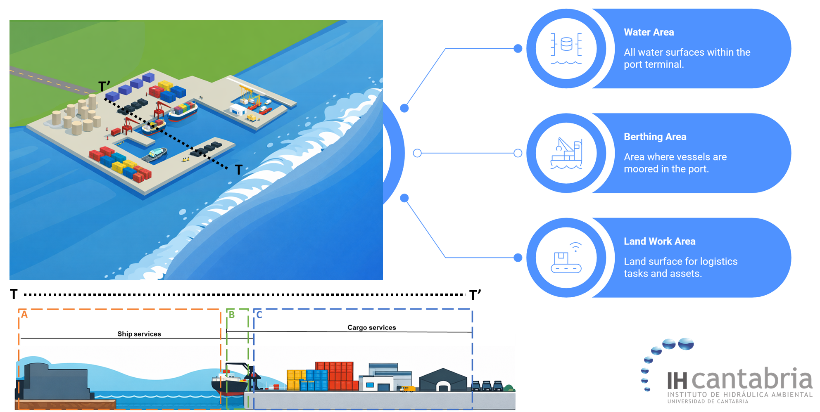

Slide 7

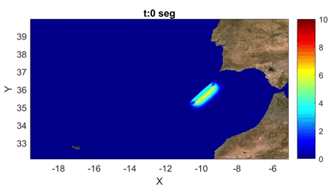
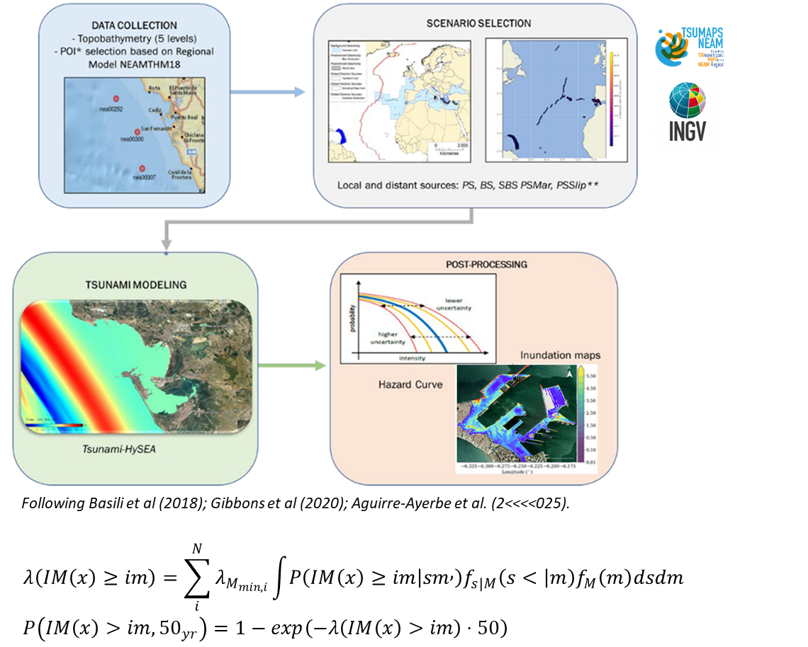
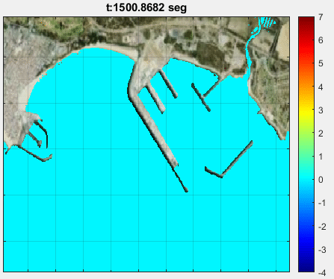
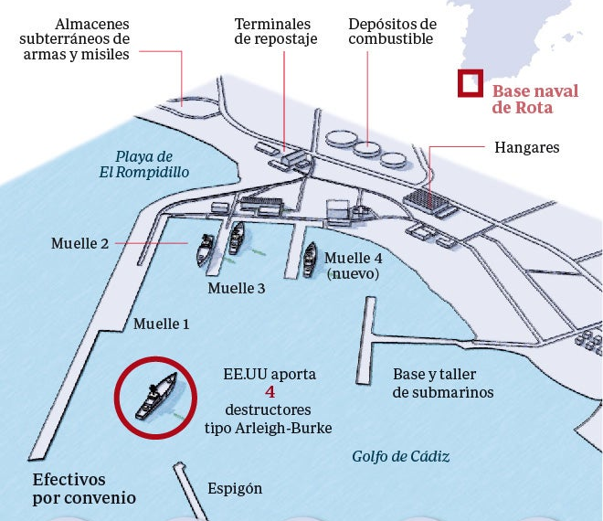

Slide 8

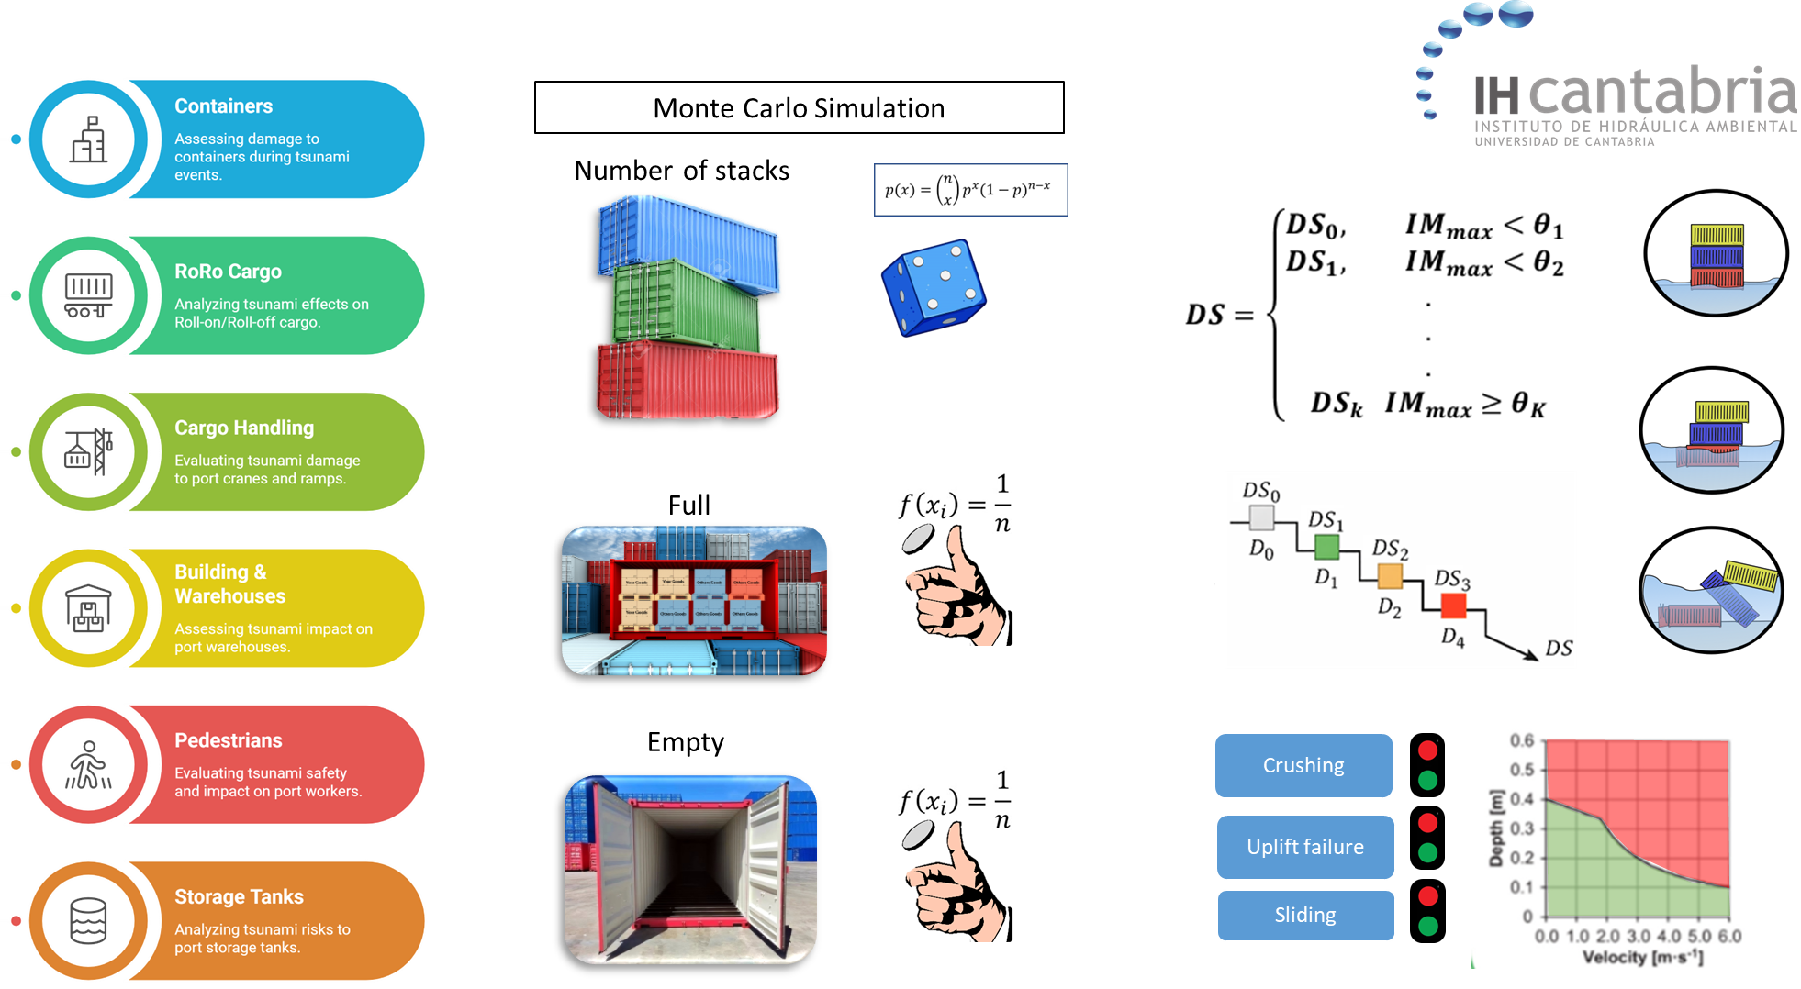

Slide 9

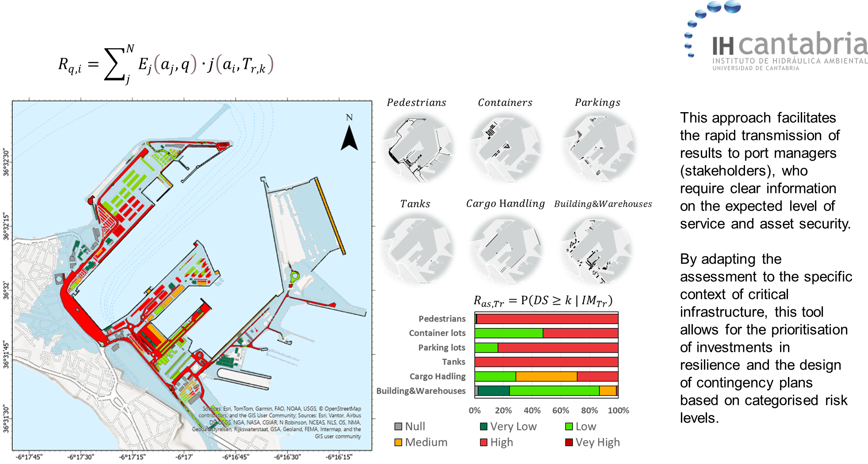

Slide 10
