Slide 1
UNESCO-IOC
Tsunami Ready
Recognition Programme
PTWS Status
PTWS Working Group 3 on Disaster Risk Management and Preparedness, Task Team on Tsunami Ready
ICG/PTWS-XXXI, April 2025
Laura Kong, ITIC
Ashleigh Fromont, NZ
TOWS WG TT-TWO, TT-DMP, 4-6 March 2026
Online

Slide 2
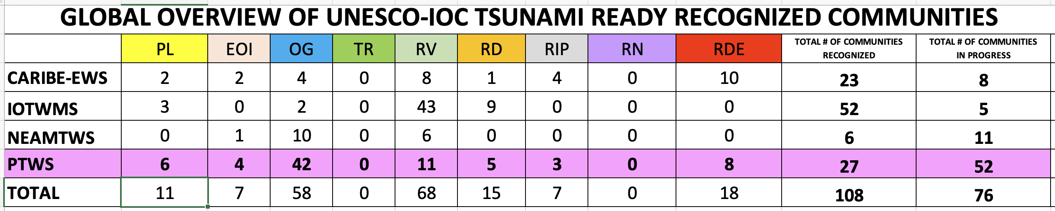
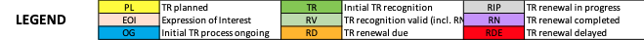
TRRP Implementation Status - Feb 2026
Active Need renewal

Slide 3
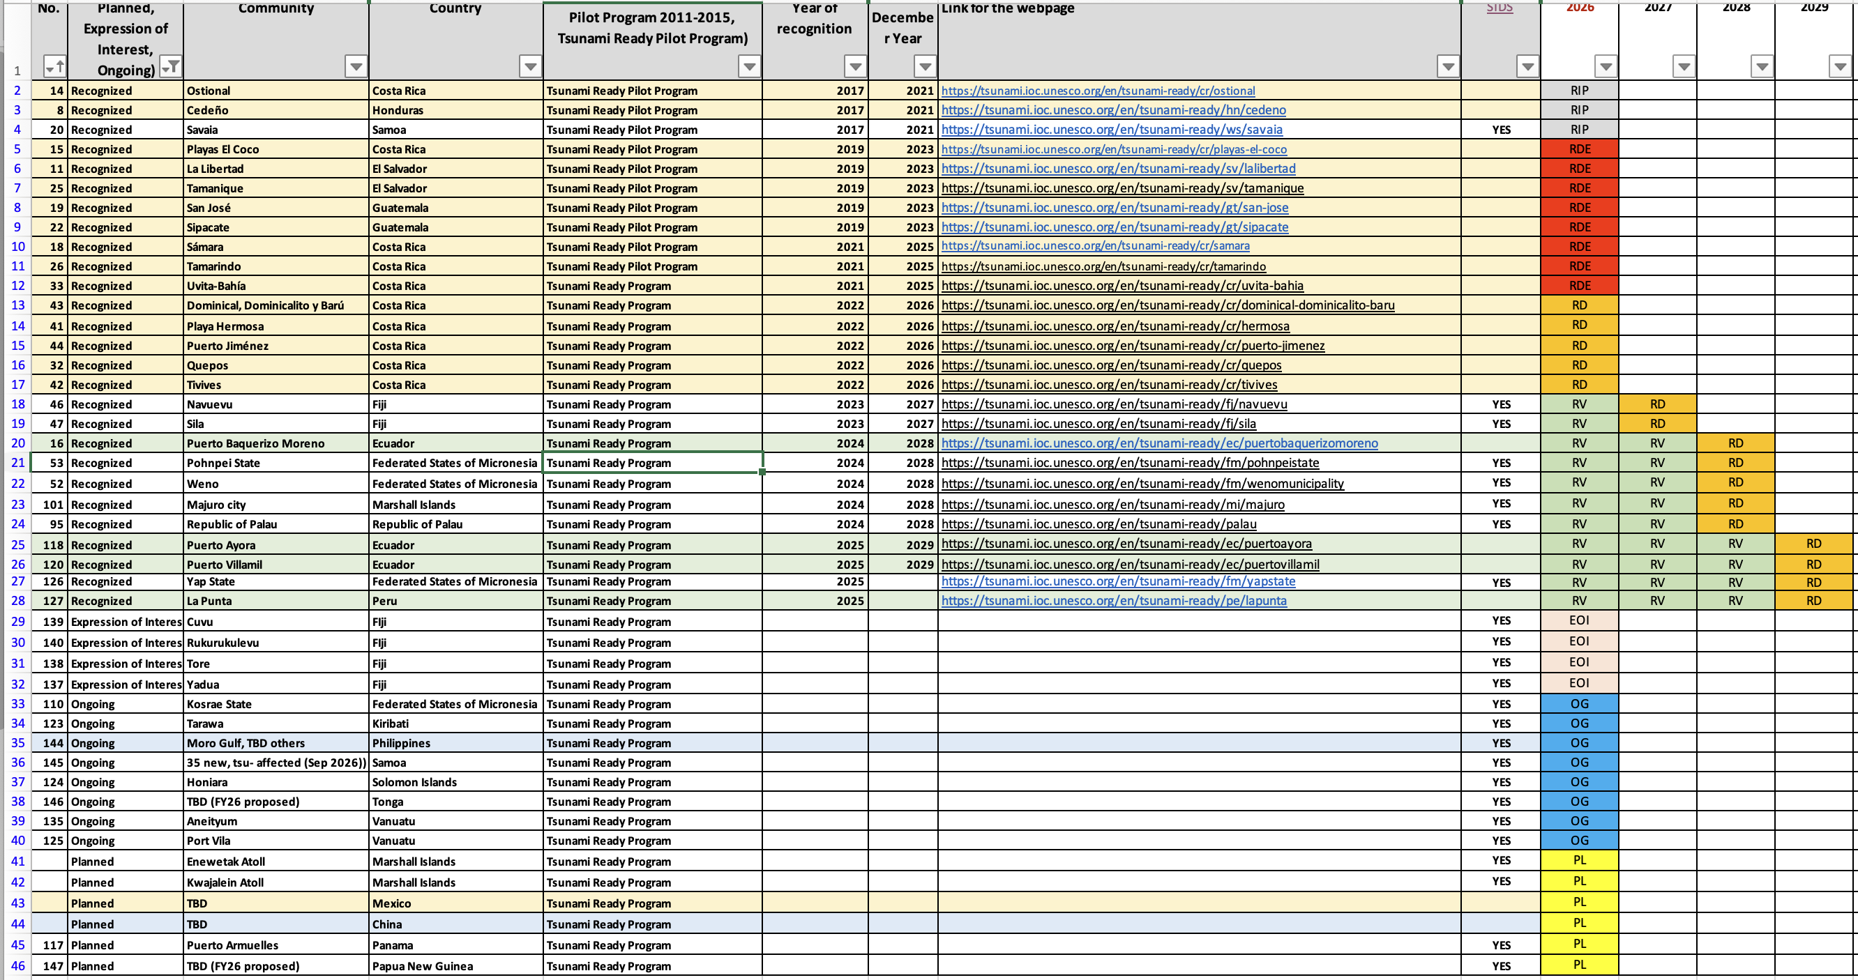
PTWS – Tsunami Ready status (Feb 2026)
All Communities
CA-PAC 16
SEP 4
PICT 57
SE ASIA 2

Slide 4
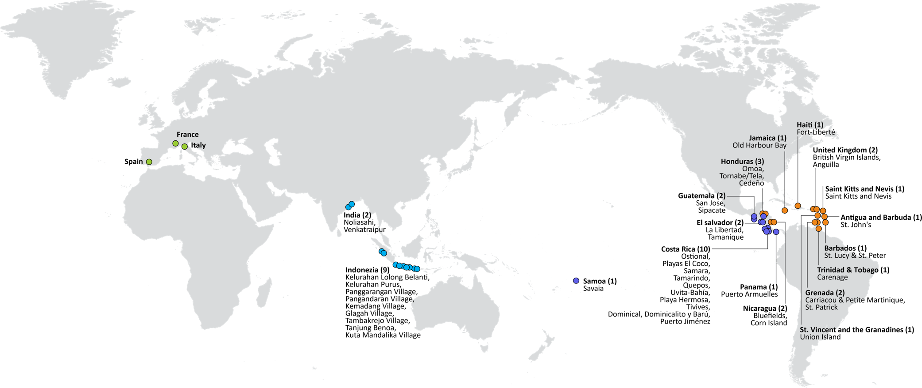


UNESCO/IOC TSUNAMI READY RECOGNITION PROGRAMME (TRRP)
108
TSUNAMI READY COMMUNITIES
52 – IOTWMS)
27 – PTWS (11 MS)
23 – CARIBE-EWS
6 – NEAMTWS (6 MS)
Türkiye
United Kingdom (2)
British Virgin Islands, Anguilla
Dominica (1): Portsmouth
Saint Lucia (1): Laborite
Greece
Israel
China
– PTWS (in progress)
Mexico
Philippines
Moro Gulf
MAJOR ACTIVITIES since 2021
FSM (4)
Yap, Chuuk, Pohnpei, Kosrae
RMI (1) Majuro Enewetak Kwajelein
Palau (1)
Barbados (2)
St. Lucy & St. Peter
Christ Church West
Development of global resources Web site: tsunamiready.org Tsunami Ready Interactive Map Viewer Tsunami Ready Community pages
Development of a new Tsunami Ready and RUNAMI Board Games
Tsunami Ready standards Standard Guidelines for Tsunami Ready Recognition Programme (IOC MG 74, 2022
Tsunami Ready Toolkit (2026) - update MG 74
PNG
Kiribati Tarawa
Solomons
Honiara
Ecuador (3) Galapagos
Peru
La Punta
Vanuatu
Port Vila
Aneityum
35 Tsunami-affected
Fiji (2)
Naevuevu
Sila
Cuvu
Rukurukulevu
Tore
Yadua
Tonga
St. Vincent and the Grenadines (2)
Union Island
Saint George
Frolov, 2023; ITIC, Feb 2026

Slide 5
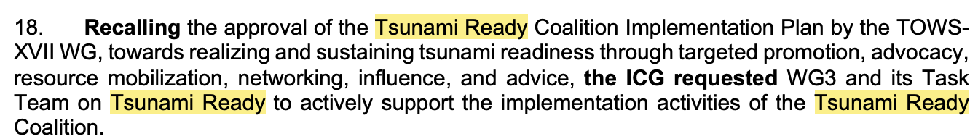
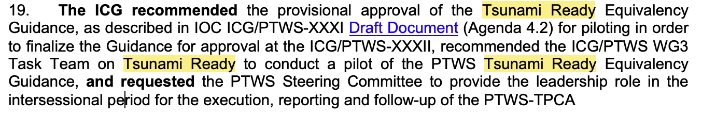

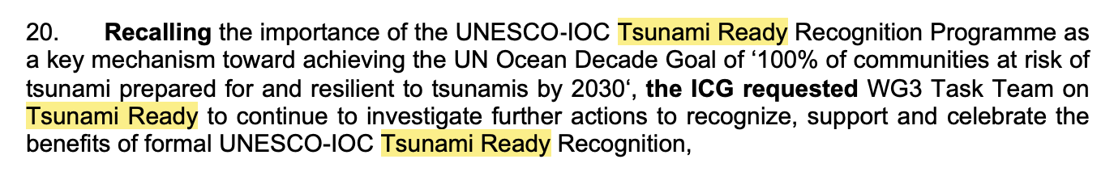
Status of Actions & Decisions – ICG/PTWS-XXXI (April 2025)
Tsunami Ready Coalition, Tsunami Ready Equivalency, UNESCO-IOC TRRP advocacy

Slide 6
ICG/PTWS XXXI April 2025
Further support needed for inundation modelling
The lack of inundation modelling presents real difficulties to tsunami preparedness, and Tsunami Ready Recognition.
Accurate inundation modelling requires the availability of high-resolution bathymetry and topography, which often isn't available at every location, or is very expensive to obtain.
Advances in satellite-derived bathymetry which, when chart survey data is also available, can be used for inundation modelling. Other options considered, include taking offshore wave ampl from PTHA tools and extrapolating to coast using accepted scaling procedures.
The WG3 Task Team Tsunami Ready requested assistance from WG 1:
Notes the barrier that the lack of availability of high-resolution bathymetry and topography for inundation modelling presents to tsunami preparedness and Tsunami Ready Recognition,
Requests Working Group One to consider the collation of existing or creation of new guidance on techniques for inundation modelling where high-resolution bathymetry and topography isn’t available.

Slide 7
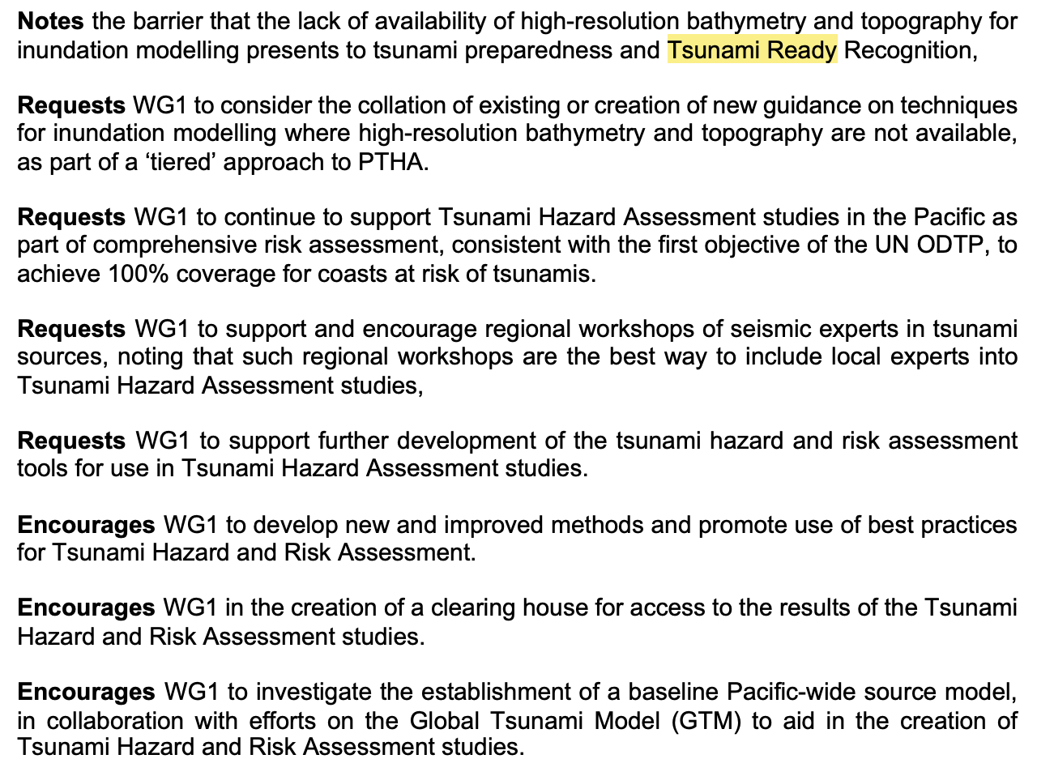
ICG/PTWS-XXXI – Hazard Assessment for TR
ICG/PTWS XXI April 2025
Working Group 1: Understanding Tsunami Risk

Slide 8

ICG/PTWS XXXI April 2025
PTWS Tsunami Ready Implementation Survey
Challenging to maintain awareness of TR implement progress, success & barriers.
To be proposed at ICG/PTWS-XXXI that a regular ‘Tsunami Ready Implementation Survey’ is established for the PTWS.
Supports monitoring reporting on Tsunami Ready across the Pacific and also ensures that PTWS activities are representative of whole Pacific needs.
Questions planned:
Intent & progress with implementing the Tsunami Ready Recognition Programme (TRRP)
Barriers and challenges with TRRP implementation
Is there is national programme instead of Tsunami Ready
Questions consistent with 2025 PTWS Tsunami Preparedness Capacity Assessment, and 2025/2026 Global KPI/ODTP KPI

Slide 9
ICG/PTWS XXXI April 2025
Summary of Implementation Learnings
At the meeting of the PTWS Task Team Tsunami Ready in July 2024, implementation challenges in the Pacific and globally were discussed.
Key challenges reported across ICGs include:
Hazard assessment, esp. inundation modelling and GIS capacity (+ data layers)
Application process is cumbersome / time consuming
Communities can’t be too small as that uses high levels of administration to roll out across a country but must also be meaningful (not too large)
Sustainability in effort, expertise and funding
Awareness & education both in community and government

Slide 10

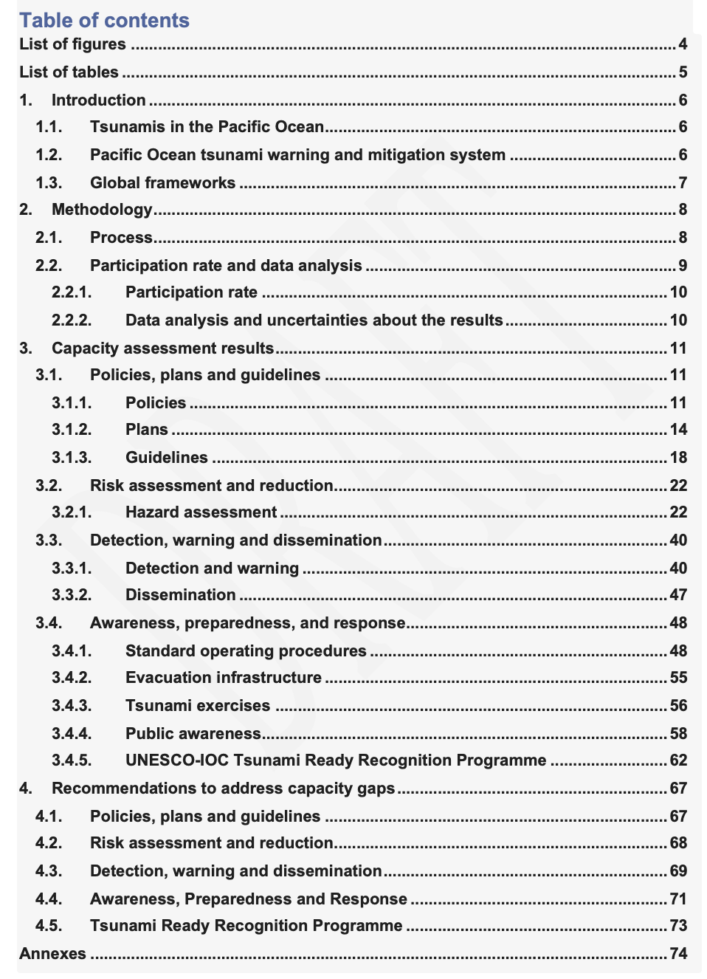
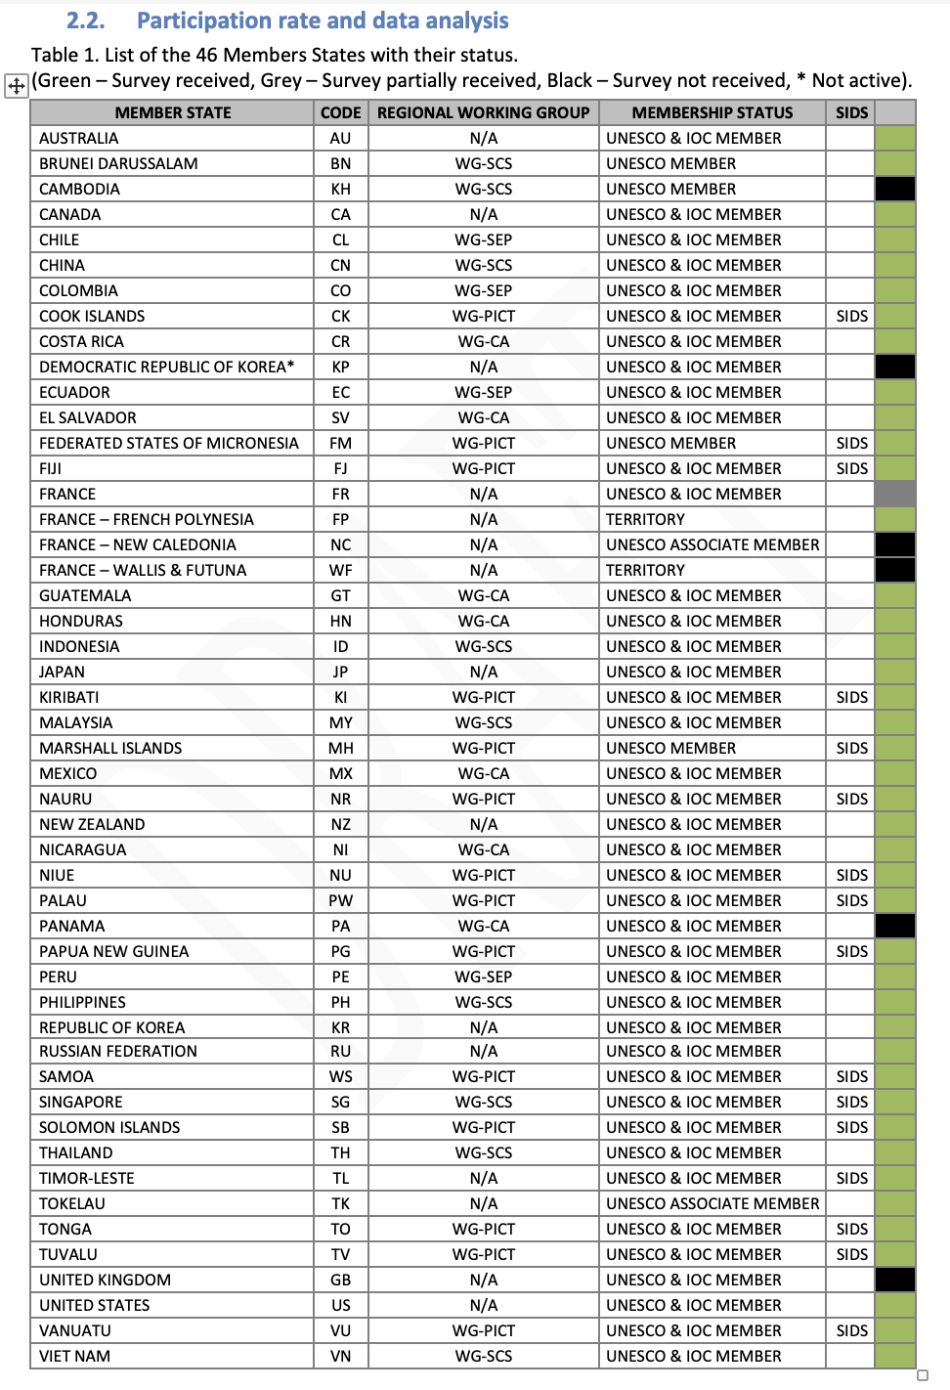
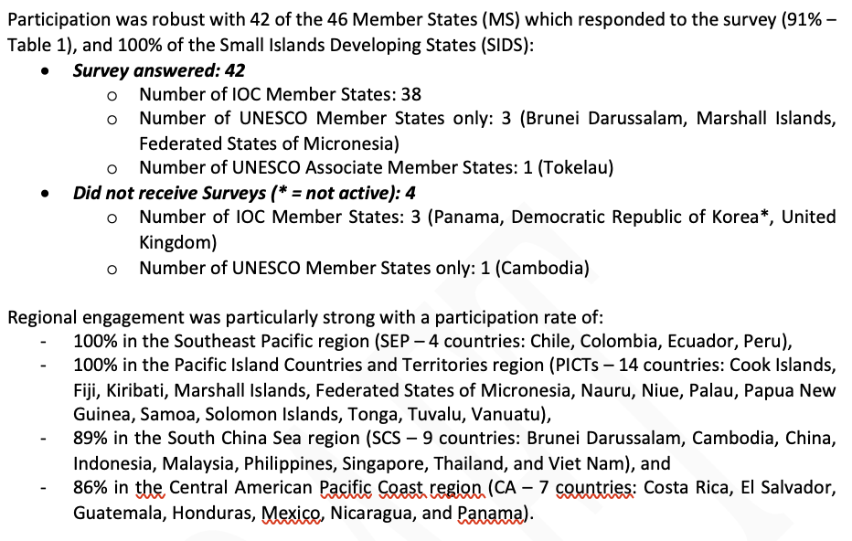
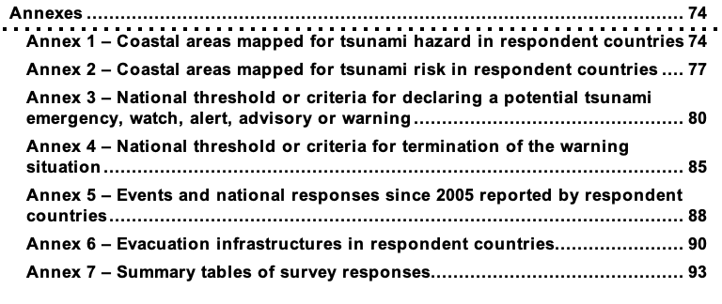
ICG/PTWS XXI April 2025
PTWS Tsunami Preparedness Capacity Assessment - 2025

Slide 11

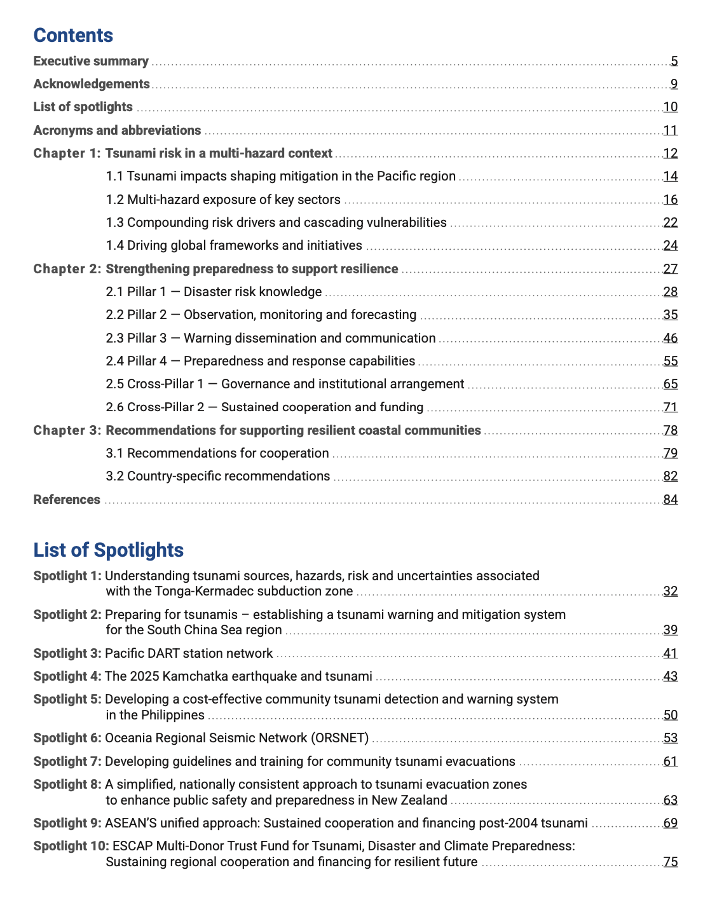
ICG/PTWS XXI April 2025
PTWS Tsunami Preparedness Capacity Assessment - 2025

