Slide 1
Tsunami Ready Recognition Program (TRRP) CARIBBEAN AND ADJACENT REGIONS
Alison Brome
UNESCO-IOC-Caribbean Tsunami Information Centre (CTIC)
Christa von Hillebrandt-Andrade
US International Tsunami Information Center (ITIC-CAR)
Dr. Silvia Chacon Barrantes
Vice-Chair, ICG/CARIBE EWS
TOWS-WG Inter ICG Task Team on Disaster Management and Preparedness (TTDMP2), 5-6 March 2026

Slide 2
TRRP Status 2026
TOWS-WG Inter ICG Task Team on Disaster Management and Preparedness (TTDMP2), 5-6 March 2026

Slide 3
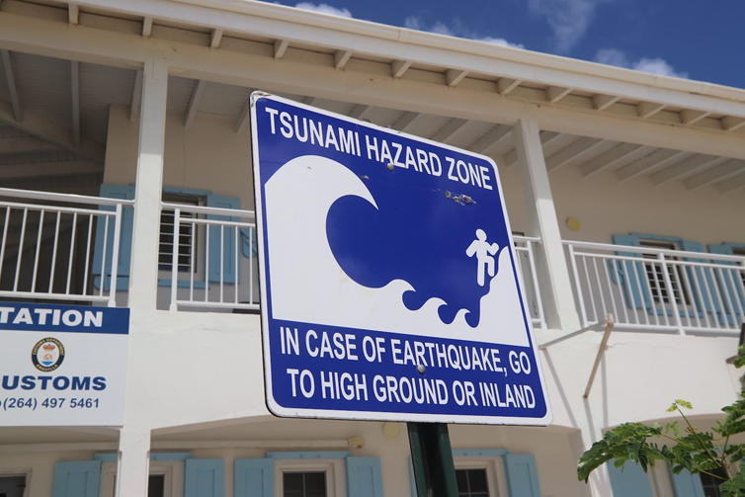
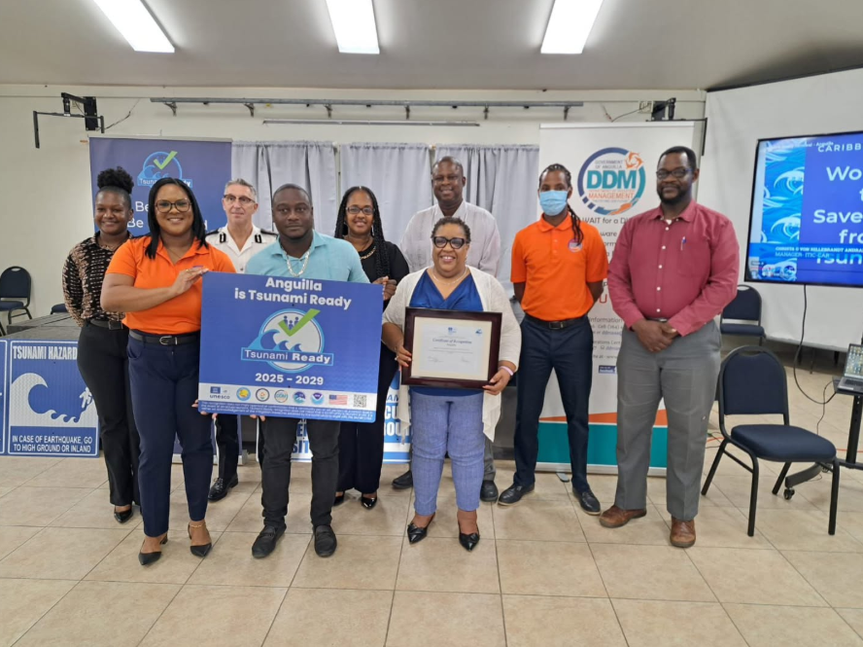
Anguilla TRRP Recognition 2026
Anguilla was the first territory to receive this international recognition in September 2011.
Status recently renewed in late 2025 following a comprehensive "Tsunami Ready Renewal" under UNESCO-IOC TRRP
Utilized advanced scientific modeling to update evacuation zones - recent hazard models have refined at-risk areas, showing that fewer residents are in the high-danger zones than previously estimated using older "bathtub" models
Warning Systems: The Anguilla Warning System uses radio interrupts, RDS receivers, email alerts, and a "hot button" for rapid alert dissemination.
Signage: Physical signage is installed across the island to direct residents and visitors to high ground and assembly points.
TOWS-WG Inter ICG Task Team on Disaster Management and Preparedness (TTDMP2), 5-6 March 2026

Slide 4
Valid TRRP Communities
Barbados – Christ Church West, St. James Central
Costa Rica – Cahuita
Dominica – Portsmouth
Guadeloupe – Deshaies
St. Lucia – Choiseul
St. Vincent and the Grenadines – St. Georges
United Kingdom - Anguilla
Total - 8
TOWS-WG Inter ICG Task Team on Disaster Management and Preparedness (TTDMP2), 5-6 March 2026

Slide 5
TRRP Communities/Renewals In Progress
Antigua and Barbuda - Barbuda
Barbados – St. Michael North West, Renewal of Shermans to Mullins
Belize – Belize City
Dominica - North and North-East Districts
Dominican Republic – Sabana Grande de Palenque, Puerto Plata
Grenada – St. George’s City
Honduras – Renewal of Omao, Tela/Tornabe
Jamaica – Port Maria
Saint Lucia -
St. Vincent and the Grenadines - Bequia
Trinidad and Tobago – Mayaro Village
Total - 15
TOWS-WG Inter ICG Task Team on Disaster Management and Preparedness (TTDMP2), 5-6 March 2026

Slide 6
TRRP Communities Renewal Delayed
Antigua and Barbuda – St. John’s City
Grenada – St. Patricks, Petit Martinique & Carriacou
Haiti – Fort Liberte
Jamaica – Old Harbour Bay
Nicaragua – Bluefields and Corn Island
St. Kitts and Nevis (Territory-wide)
St. Vincent and the Grenadines – Union Island
Trinidad and Tobago – Careenage
United Kingdom - British Virgin Islands (Territory-wide)
Total - 11
TOWS-WG Inter ICG Task Team on Disaster Management and Preparedness (TTDMP2), 5-6 March 2026

Slide 7
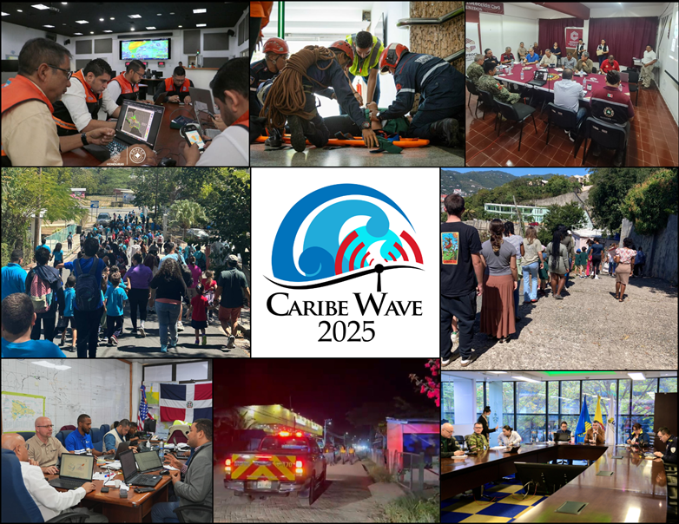
CARIBE WAVE – Key Component of Tsunami Ready implementation and sustainability
In 2025, 45 Member States and Territories participated with a total of over 510,360 people
CARIBE WAVE 26 will take place on 19 March 2026. Registrations and scenario selection, in progress

Slide 8
CONSIDERATIONS AND CHALLENGES
Member States continue to show preference for implementation at local community level
Member States exhibiting good potential for self-implementation
Integration of youth and persons living with disabilities (especially the blind) is being prioritized
Implementation delays experienced due to fiduciary management considerations, political transitions at national level and other factors
Significant number of renewals are delayed for a variety of reasons including natural disasters – need for resilience considerations to be prioritized
US Department of Defense & ITIC CAR – US $20,000 to support position of Tsunami Ready Facilitator to support TRRP Summit, Trainings/Workshops and TRRP implementation
Process supported by dissemination of PAE materials, CARIBE WAVE Exercise and workshops/trainings (UNESCO-IOC led Sea Level Training Nov 2025, TRRP Summit April 2026, proposed Manuals and Guides 86 Training, June 2026)

Slide 9
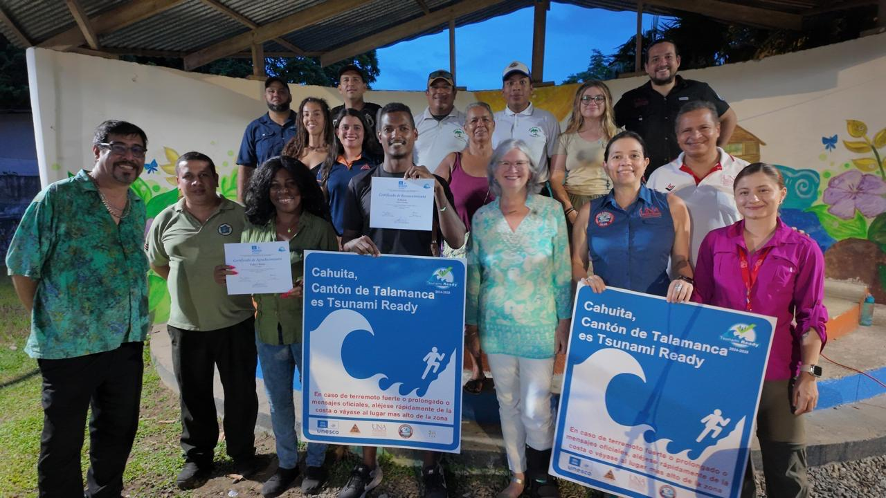
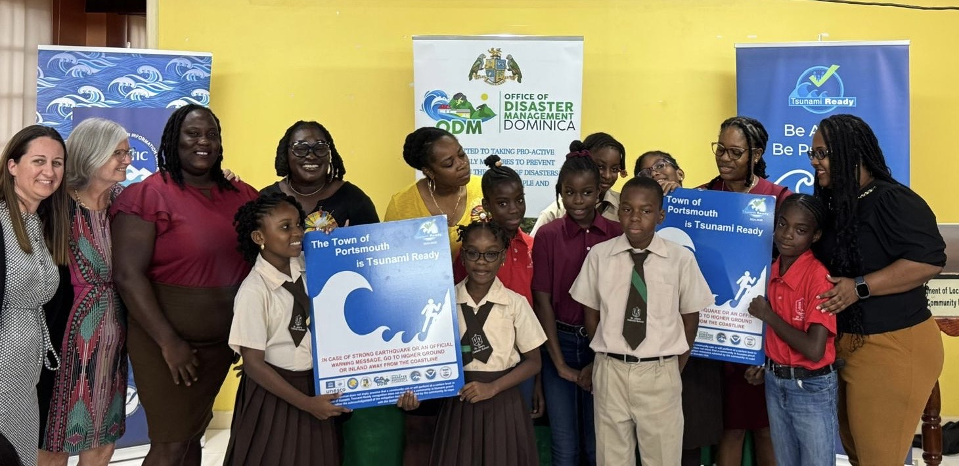
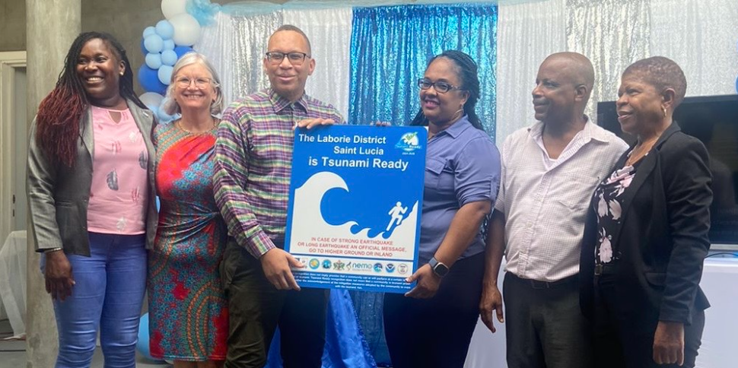
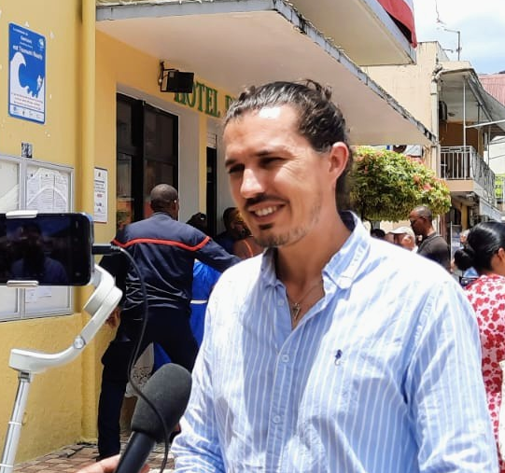
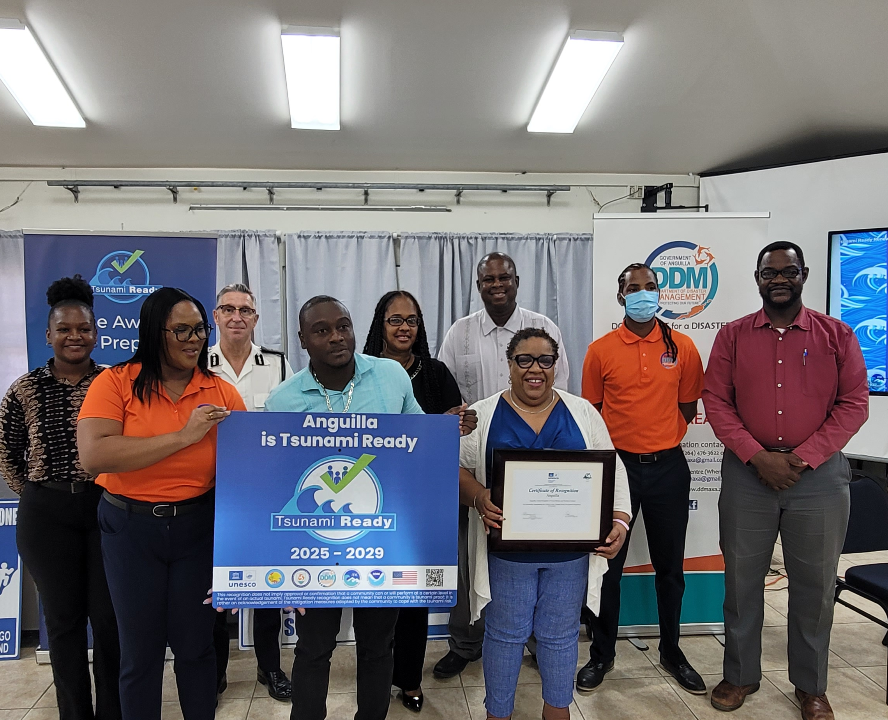
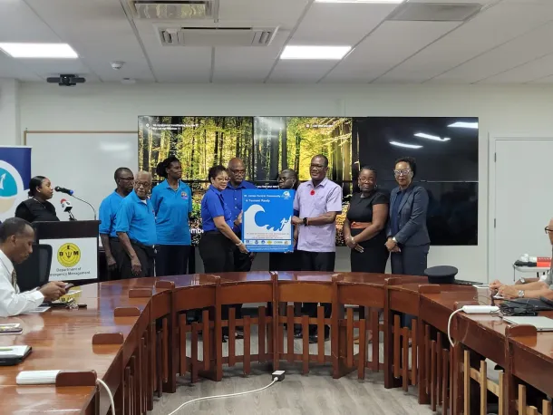
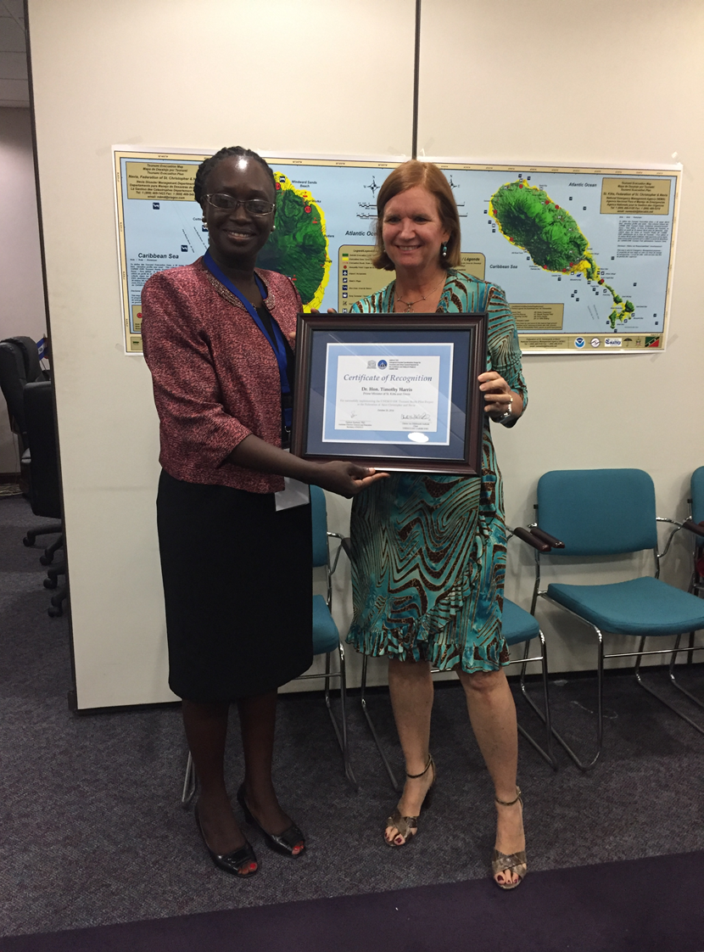

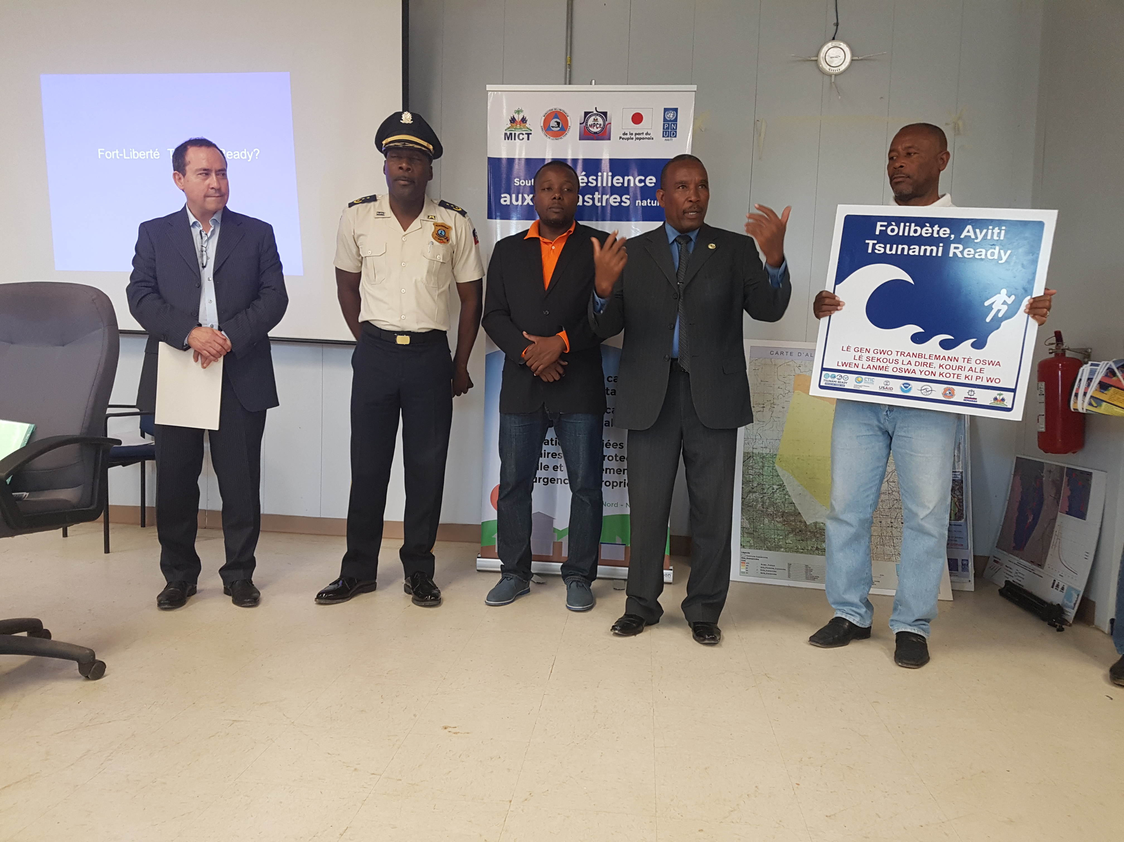
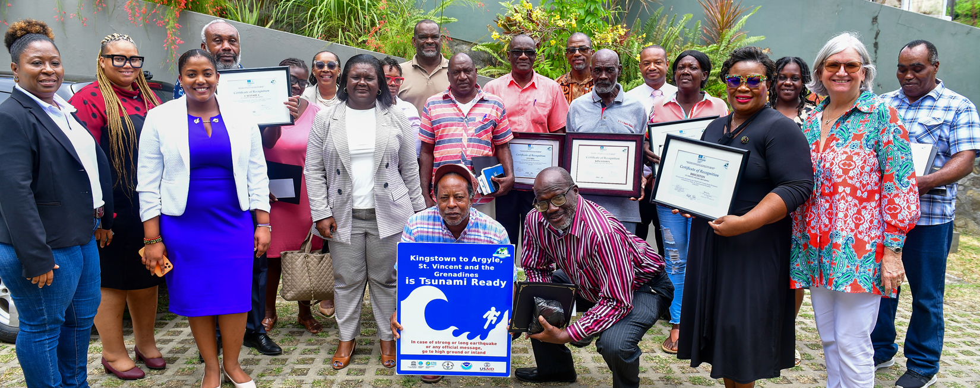
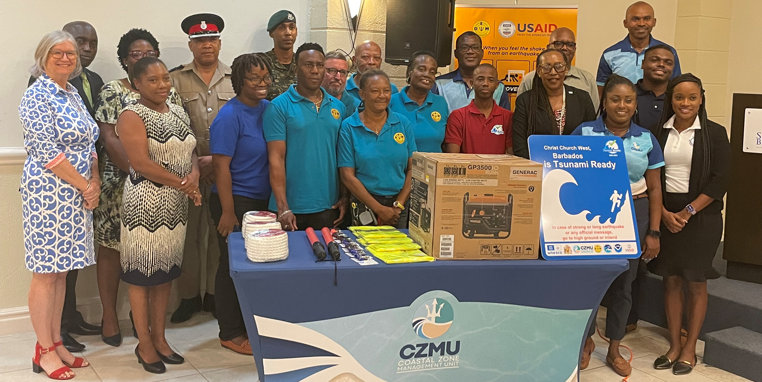
Congratulations to Caribbean Tsunami Ready Coastal Communities

Slide 10
THANK YOU
a.brome@unesco.org
christa.vonh@noaa.gov
TOWS-WG Inter ICG Task Team on Disaster Management and Preparedness (TTDMP2), 5-6 March 2026

