Slide 1
Muhammad Qabus Abid Khairullah
2.4 Assessment Tool on the Impact of Tsunami Ready Recognition to Community
Pilot Study in Indonesia
Ardito M. Kodijat (IOTIC)
Alfath Abu Bakar (IOTIC-BMKG)
Admiral Musa Julius (IOTIC-BMKG)
Elisabet Anggun Pramesthi (IOTIC-BMKG)
Rochmy Akbar Hamdani (UNESCO Jakarta)
Muhammad Qabus Abid Khairullah (UNESCO Jakarta)
Task Team Disaster Management and Preparedness Session
5 - 6 March 2026

Slide 2
Introduction to Assessment
Background
It is equally important to understand the real-world impact of the Tsunami Ready Recognition on communities.
What is the benefit of the recognition to the community
Impact to policy, budget, etc.
How each of the Indicators sustained?
Has it increased awareness?
Has it strengthened local preparedness?
Etc.
Tsunami Ready Recognition itself is a significant milestone

Slide 3
Introduction to Assessment
Survey Tools
The study use structured survey questionnaires administered to three distinct target groups within the recognized community:
Village Leaders: insights of the recognition toward institutional arrangements, policy integration, budget allocation, and oversight.
DRR Committee Members: insights of the recognition toward sustainability and capacity of the 12 indicators, technical capacity and confidence DRR roles.
General Villagers: insights of community members on tsunami preparedness after the recognition is given

Slide 4


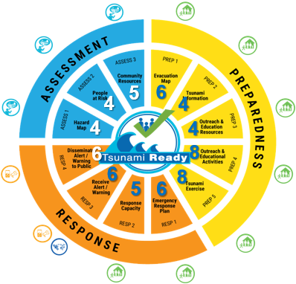
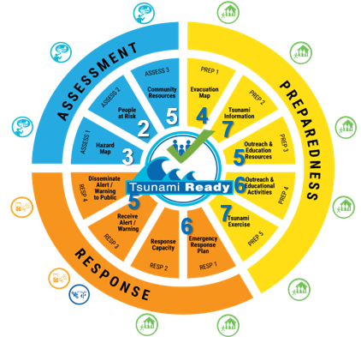
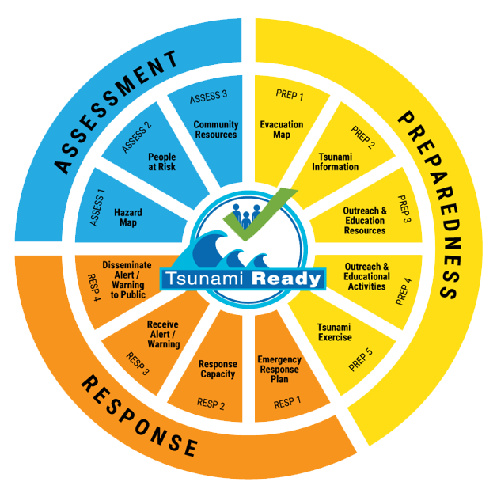


Introduction to Assessment
Survey Tools
Village DRR Members
Community Members
84 Questions
56 Questions
13 general questions on TR
6 general questions on TR
13 questions Assessment
30 questions Preparedness
23 questions Response
10 questions Assessment
29 questions Preparedness
11 questions Response
Head of Village
16 general questions on Tsunami Ready
Respondent:
7-10 respondent
(Gender balance and age between 21 – 70)
Respondent:
Head of DRR (1 respondent)
DRR Team Members (5-7 respondent)
1 Responder per village

Slide 5
Data Collected
Village | HoV | DRR | Com'ties | Total
Gampong Jawa | 1 | 5 | 5 | 11
Deah Glumpang | 1 | 6 | 5 | 12
Mon Ikeun | 1 | 4 | 20 | 25
Lamkruet | 1 | 4 | 8 | 13
Tapakih | 1 | 7 | 20 | 28
Purus | 1 | 8 | 38 | 47
Lolong Belanti | 1 | 19 | 14 | 34
Panggarangan | 1 | 5 | 14 | 20
Pangandaran | 1 | 5 | 19 | 25
Sidaurip | 1 | 7 | 10 | 18
Kemadang | 1 | 6 | 7 | 14
Glagah | 1 | 7 | 9 | 17
Poncosari | 1 | 6 | 9 | 16
Parangtritis | 1 | 6 | 13 | 20
Tirtohargo | 1 | 8 | 15 | 24
Gadingsari | 1 | 6 | 7 | 14
Tambakrejo | 1 | 5 | 9 | 15
Tanjung Benoa | 1 | 10 | 11 | 22
Pengastulan | 1 | 5 | 11 | 17
Kuta Mandalika | 1 | 10 | 15 | 26
Galala | 1 | 4 | 12 | 17
Hative Kecil | 1 | 5 | 8 | 14
Total | 22 | 148 | 279 | 449
The survey was conducted in 22 villages in Indonesia that received the recognition more than 2 years ago.
449 Respondents
Acknowledgement to BMKG staffs at the regional stations as the survey enumerators

Slide 6
Data Analysis - 1
1. Perception of the impact of UNESCO-IOC Tsunami Ready Recognition based on Group of Respondent
279 community members
22 Head of Village
148 DRR Teams
Village head perception on the impact of the UNESCO IOC Tsunami Ready Recognition
DRR Team perception on the impact of the UNESCO IOC Tsunami Ready Recognition
Community perception on the impact of the UNESCO IOC Tsunami Ready Recognition
Overall TR Recognition
Overall TR Recognition
Each TR Indicators
Overall TR Recognition
Each TR Indicators
Early Warning For All

Slide 7
Data Analysis - 2
2. Impact of UNESCO-IOC Tsunami Ready Recognition for each Village
Perception of impact of the Village Heads.
Perception of impact of the DRR Teams.
Perception of impact of the community members.
Overall TR Recognition
Each TR Indicators
Overall TR Recognition
Each TR Indicators
Overall TR Recognition
Early Warning For All
Perception of impact assessment by villages, based on the combined responses of Village Heads, DRR Teams, and community members.
~ 22 Villages

Slide 8
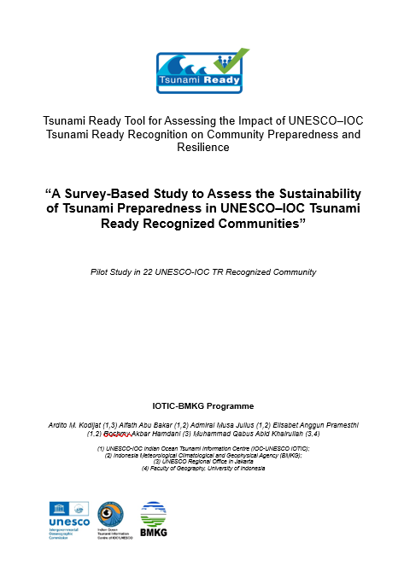
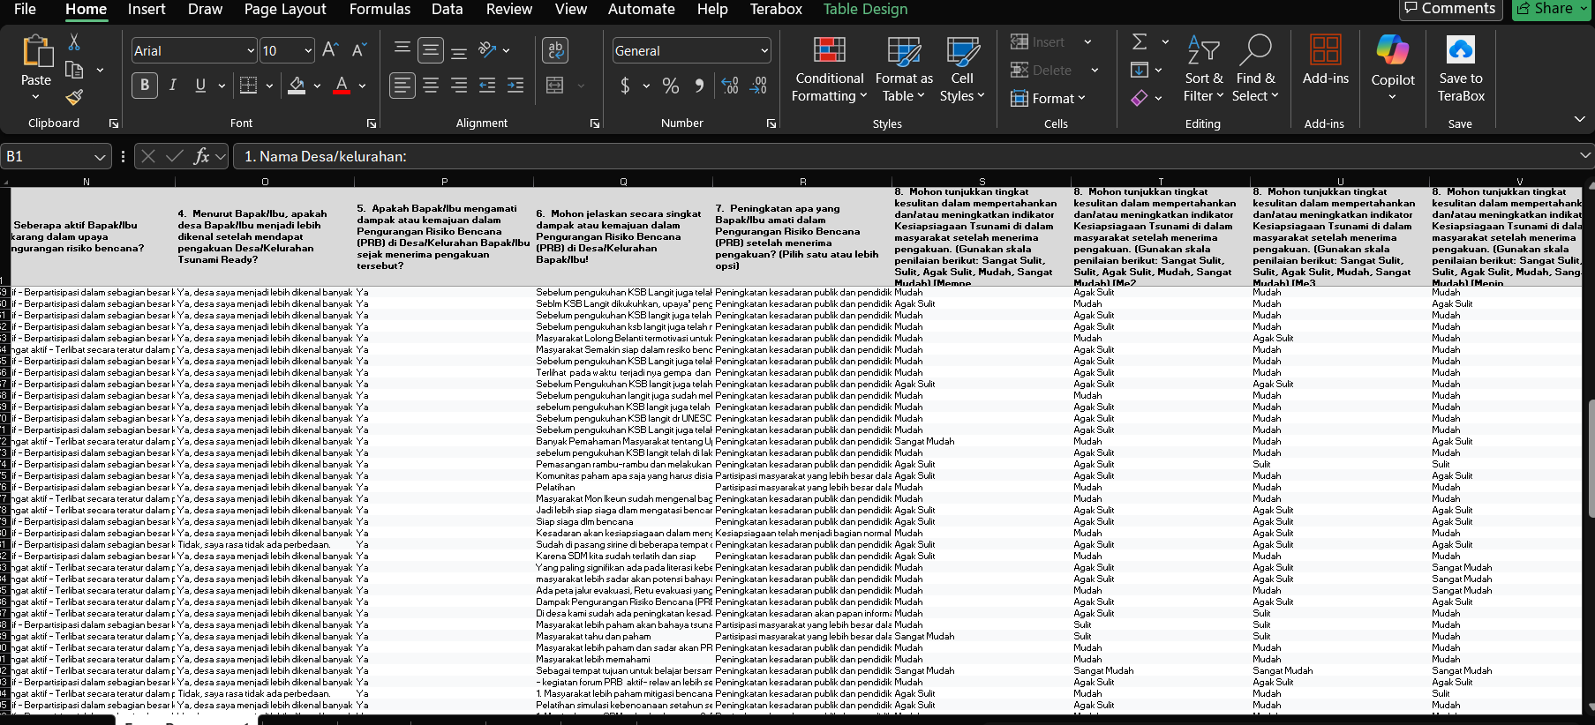
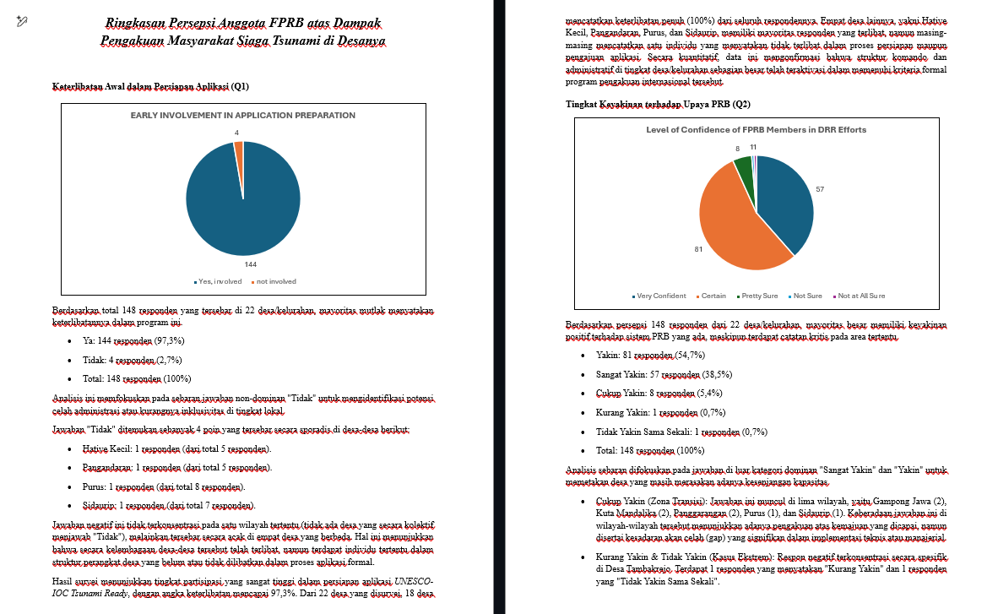
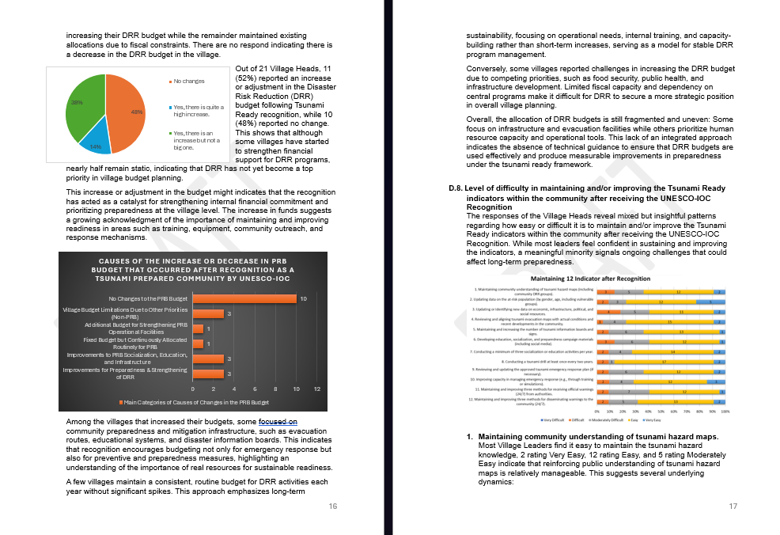
Data Analysis
TR Impact Report in English
Google Form ➔ Raw Data in Excel
Data analysis in Bahasa Indonesia

Slide 9
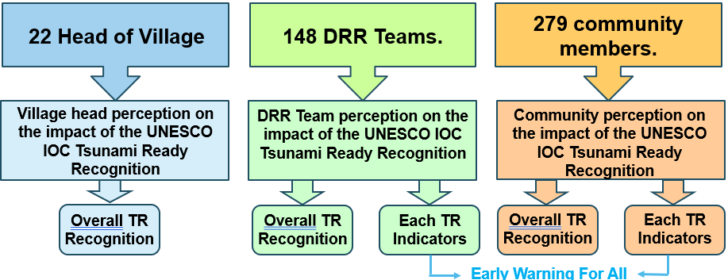
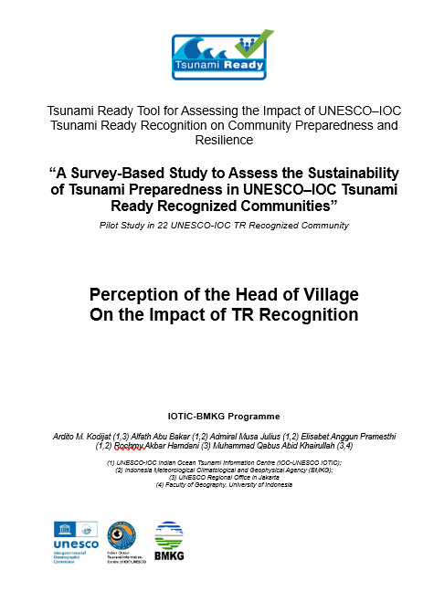
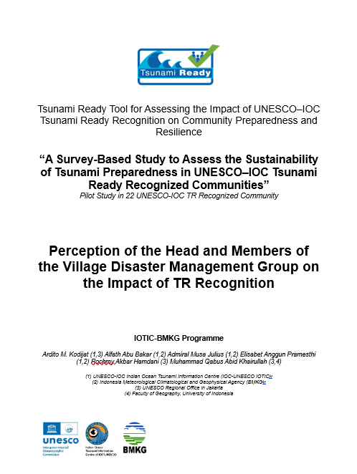
Assessment Progress
Head of Village
Village DRR Members

Slide 10
Example of Data Result
Q: Involvement in UNESCO-IOC TRRP Implementation
Of the 22 villages, 21 (95%) Head of Village were involved in preparing and submitting applications for recognition from UNESCO-IOC
Continuity
Sustainability
Ownership
Of the 148 villages’ DRR members, 144 (97.3%) members were involved in the initial implementation of TRRP

Slide 11
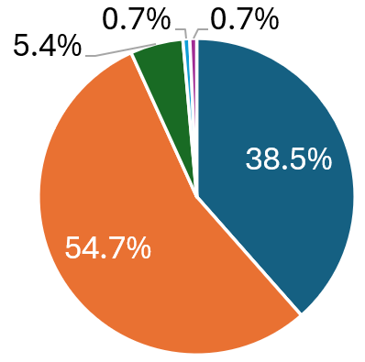
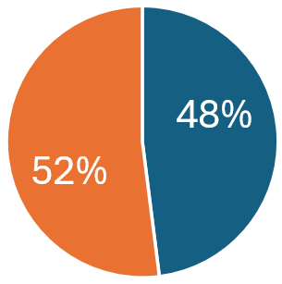
Example of Data Result
Q: Confidence toward DRR efforts in the village after recognition
Very confident, we have a strong system, high community awareness, and they are very well prepared.
Confident, we have improved and are better prepared than before, although some areas still need strengthening.
Fairly confident, we have made progress, but there are still significant gaps remaining.
Less confident, efforts are in place, but implementation and awareness are still weak.
Not confident at all, there has been little or no improvement in disaster risk reduction.
Don’t know / Not sure
Head of Village (22)
Village DRR Members (148)
Very confident
Fairly confident
Not confident
Confident
Less confident

Slide 12
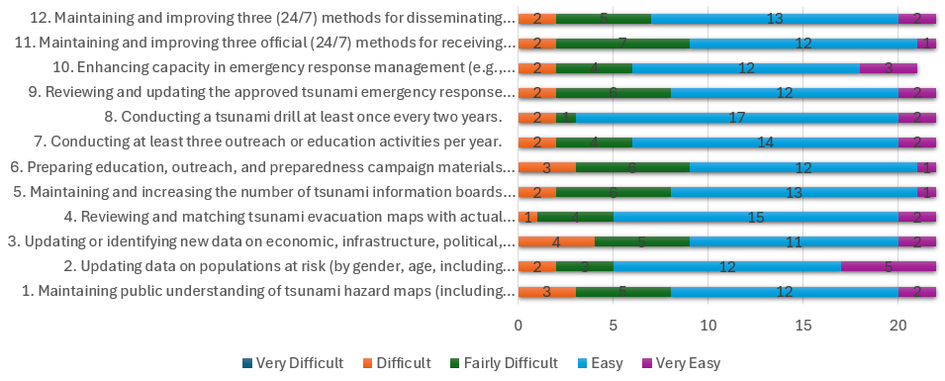
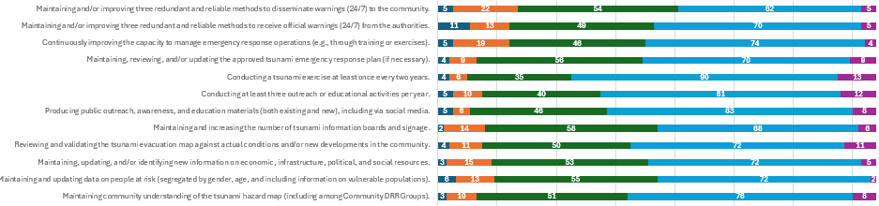
Example of Data Result
Q: Challenges in Sustaining the TR Indicators after Recognition
Head of Village
Very Difficult
We are unable to maintain it properly due to a lack of personnel capacity, technical expertise, and financial resources.
Difficult
We have personnel to maintain it, but we lack sufficient expertise and financial resources.
Somewhat Difficult
Village DRR Members (148)
We have the personnel and expertise, but we often lack adequate funding.
Easy
We are able to maintain it, but not on a regular basis.
Very Easy
We are able to maintain it without difficulty.

Slide 13
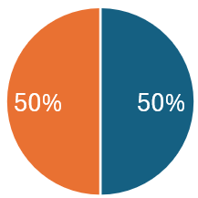
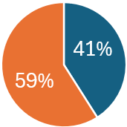
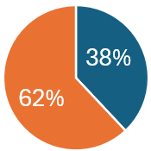
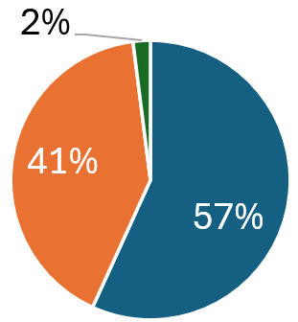
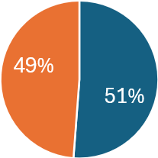
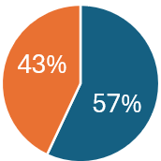
Example of Data Result
Head of Village (22)
Increase
New and Changes
Remain the same or decrease
Remain the same
Change
50%
59%
Remain the same
Q: Impact to DRR Budget
Q: Village DRR Policy Change
Q: Community DRR Structure
Village DRR Members (148)
Change
Increase
New and Changes
Remain the same or decrease
No Change
Remain the same
No DRR structure

Slide 14
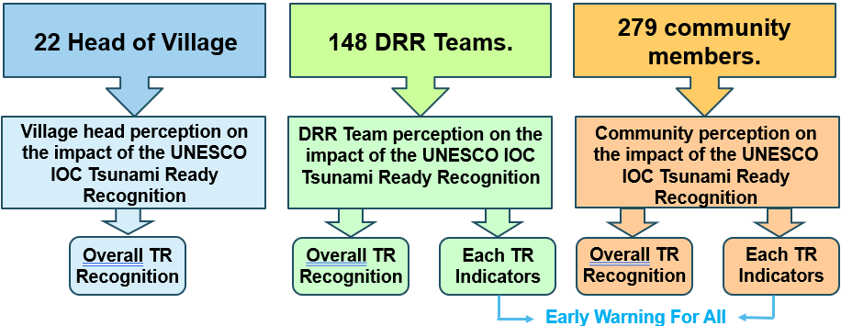
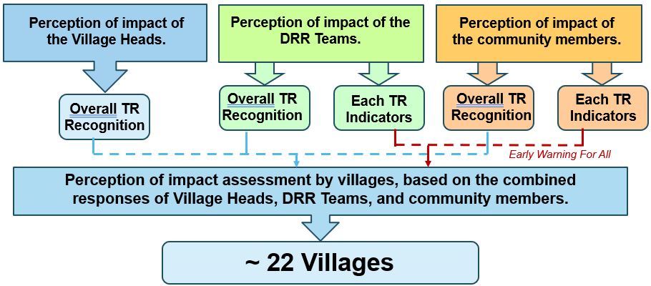
Next Steps
1
2
Indonesia Pilot Case as UNESCO Report ?
3
Improve and adapt the assessment tool and Pilot in other country (India ?)
2.a
Project proposal (?)
Individual Village Assessment
(If there is interest from Indonesia)

Slide 15
Ardito M. Kodijat (1,3)
Alfath Abu Bakar (1,2)
Admiral Musa Julius (1,2)
Elisabet Anggun Pramesthi (1,2)
Rochmy Akbar Hamdani (3)
Muhammad Qabus Abid Khairullah (3,4)
(1) UNESCO-IOC Indian Ocean Tsunami Information Centre (IOC-UNESCO IOTIC);
(2) Indonesia Meteorological Climatological and Geophysical Agency (BMKG);
(3) UNESCO Regional Office in Jakarta
(4) Faculty of Geography, University of Indonesia

