Slide 1
Tsunami Preparedness for Critical Infrastructure (Airport, Port)
Suci Dewi Anugrah
Chair of Tsunami Ready Working Group 3 for the ICG/IOTWMS
TOWS-WG Inter ICG Task Team on Disaster Management and Preparedness (TTDMP2), 5-6 March 2026

Slide 2
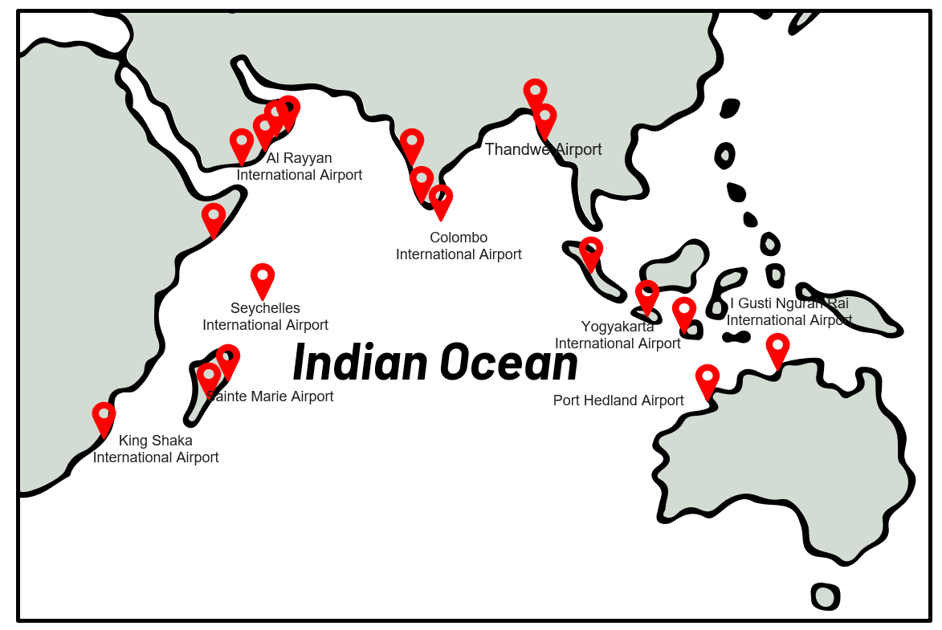
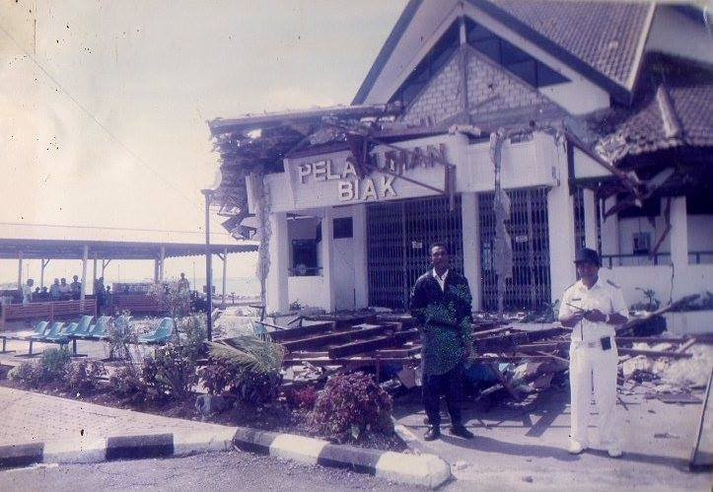
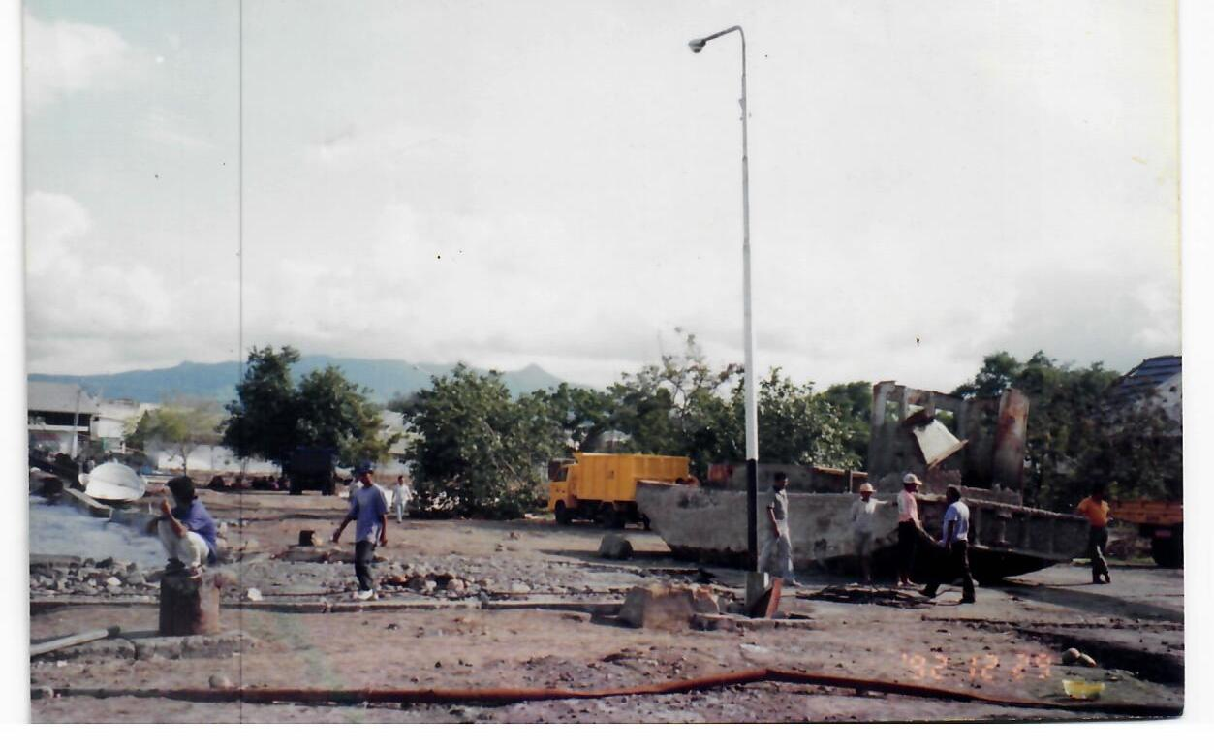
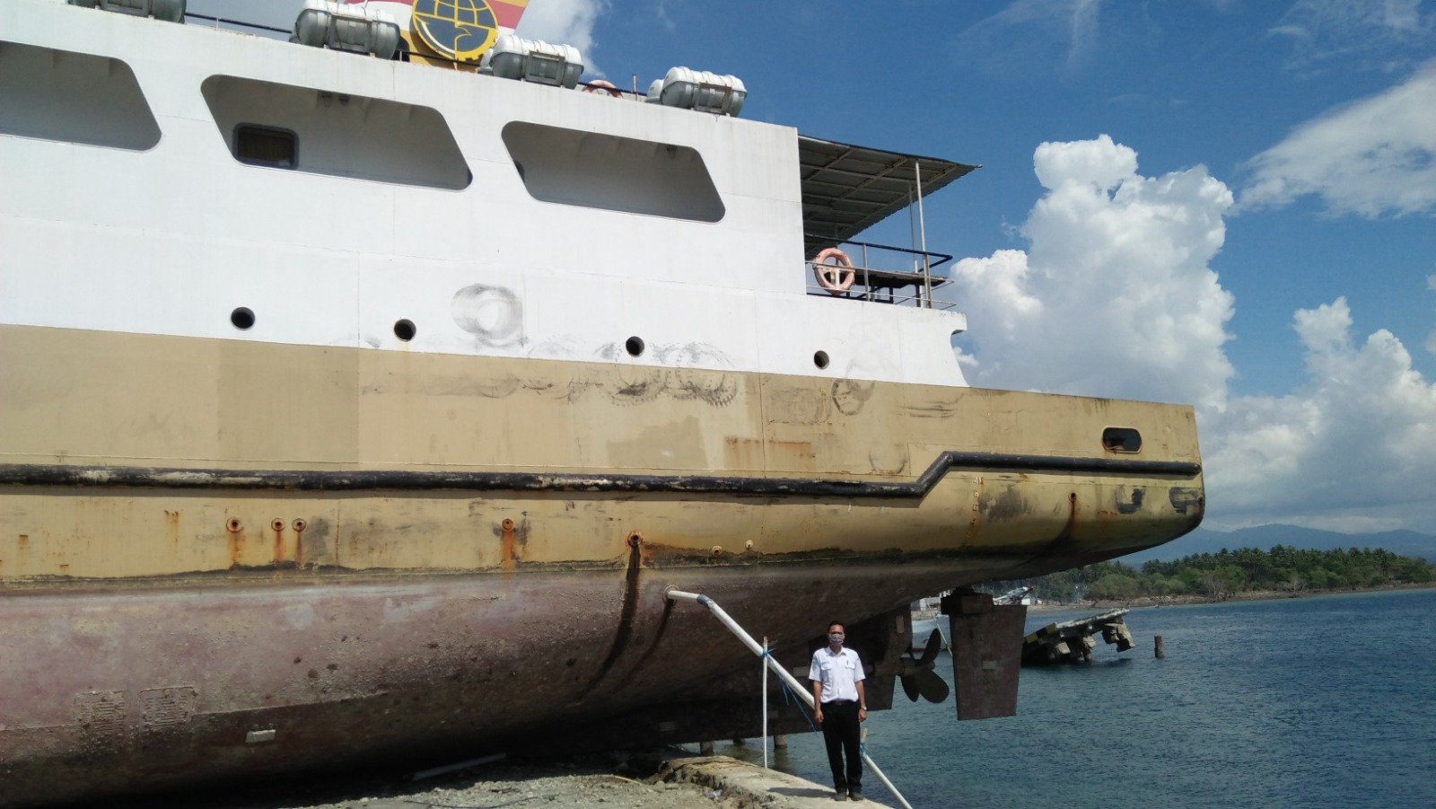
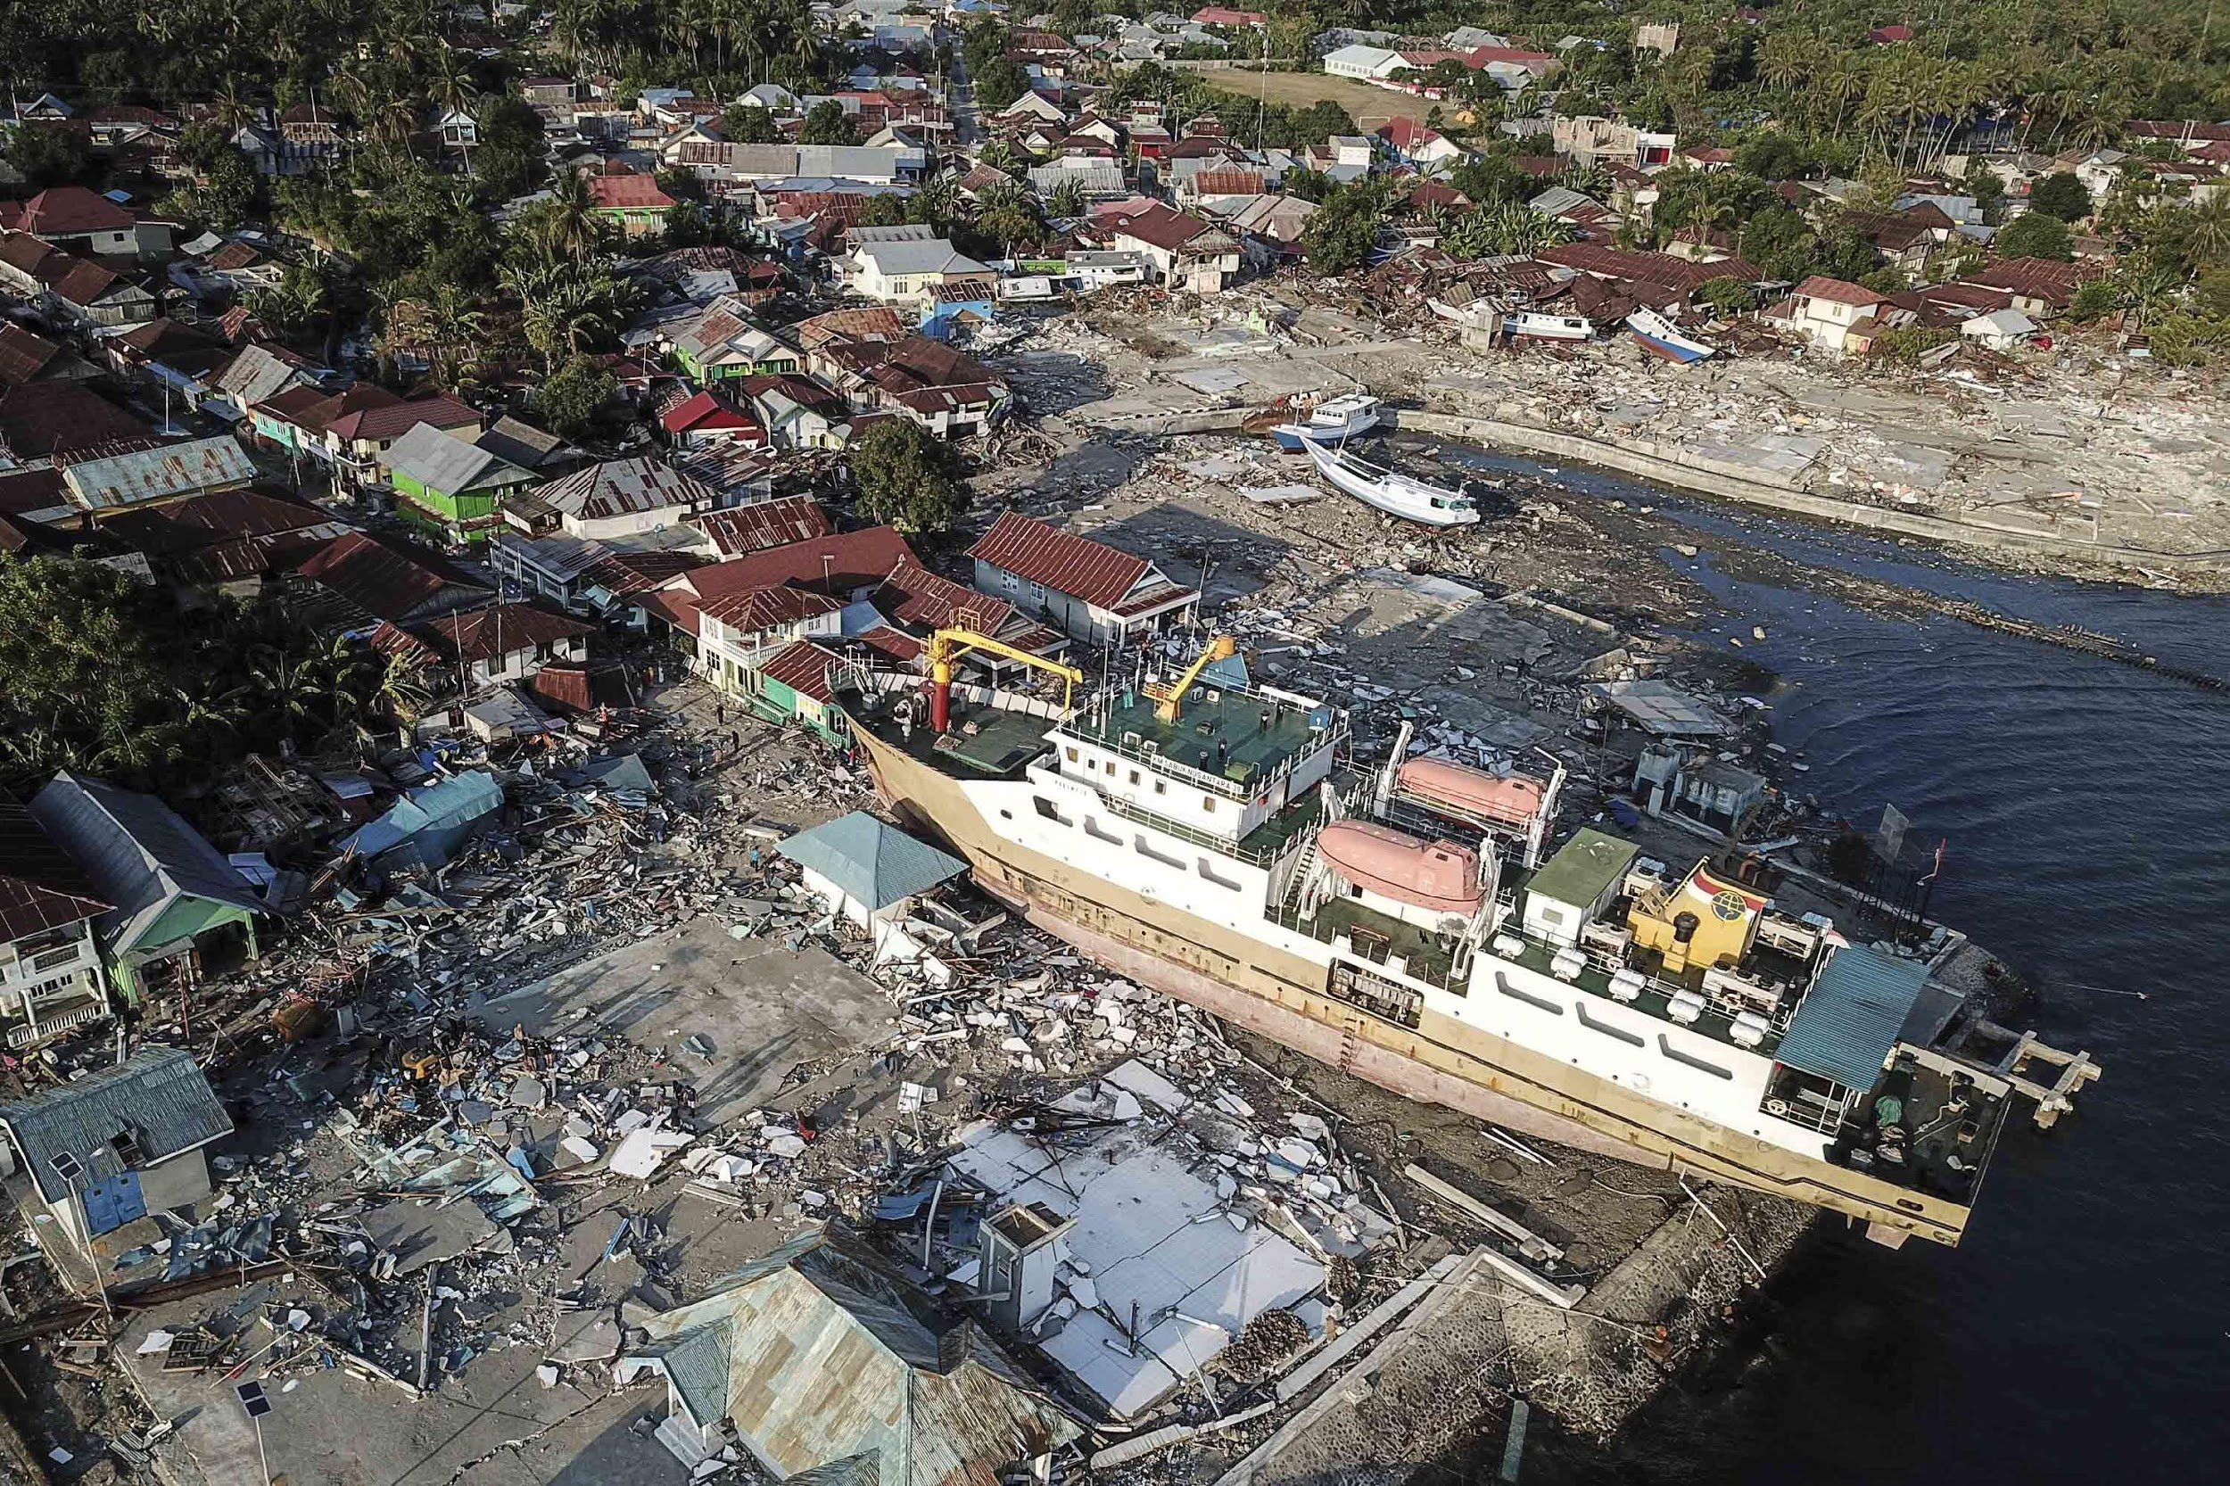
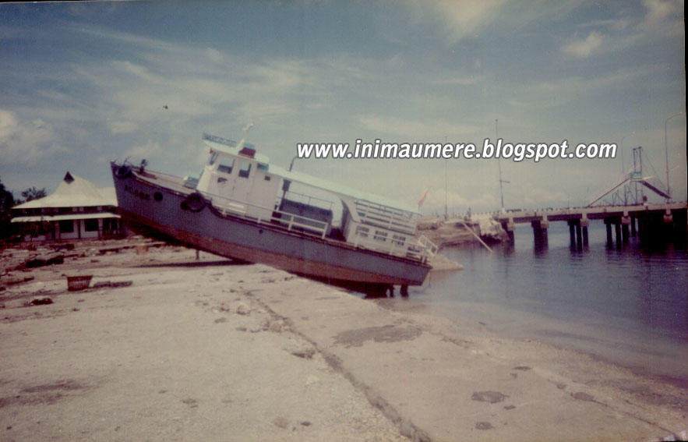
INTRODUCTION
Historical Examples of Critical Infrastructure Affected by Past Tsunamis
EARTHQUAKE AND TSUNAMI – BIAK 1996
EARTHQUAKE AND TSUNAMI
FLORES 1992
EARTHQUAKE AND TSUNAMI – PALU 2018
Airport in the Indian Ocean
Wani Seaport,
Donggala
Biak Seaport, Papua
L. Say Seaport, Maumere
Background:
Many of critical infrastructure are constructed along coastal areas directly facing the sea
Critical infrastructure provides services that are essential for everyday life. A disruption to critical infrastructure could have serious impli​cations for business, governments and the community, impacting supply security and service continuity.
Critical infrastructure also forms an integral part of coastal communities.
With operations running continuously 24 hours a day, seven days a week, these facilities have a distinct advantage in maintaining tsunami preparedness.
Critical infrastructures often possess more comprehensive resources and capacities. Their presence also helps ensure business continuity and facilitates more effective rehabilitation and recovery processes following a tsunami event.

Slide 3
TSUNAMI READY INDICATORS FOR CRITICAL INFRASTRUCTURE
Same Foundation, The approach adopts the 12 UNESCO-IOC Tsunami Ready indicators, adjusts them based on the type and function of each critical infrastructure (e.g., airport, port, industrial zone).
Breakdown Each indicator is interpreted in context:
Assessment,
Preparedness,
Response
Objectives of Implementing the 12 Tsunami Ready Indicators for Critical Infrastructure:
Ensuring Human Safety
Anticipating Cascading Hazards
Accelerating Recovery and Business Continuity
Maximizing the Role of Critical Infrastructure in Strengthening Community Preparedness

Slide 4
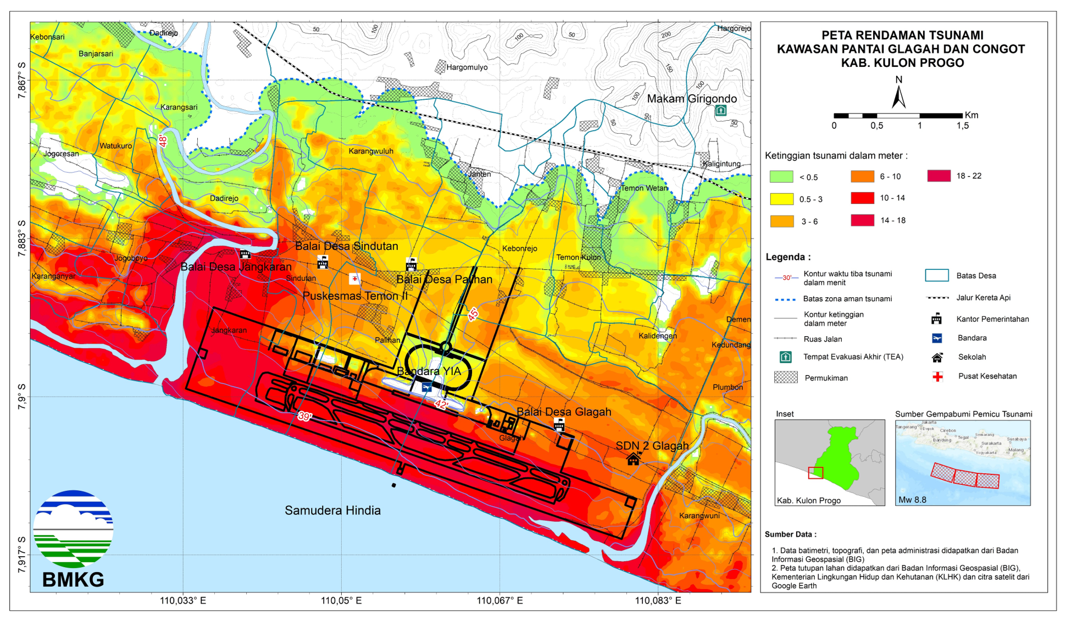
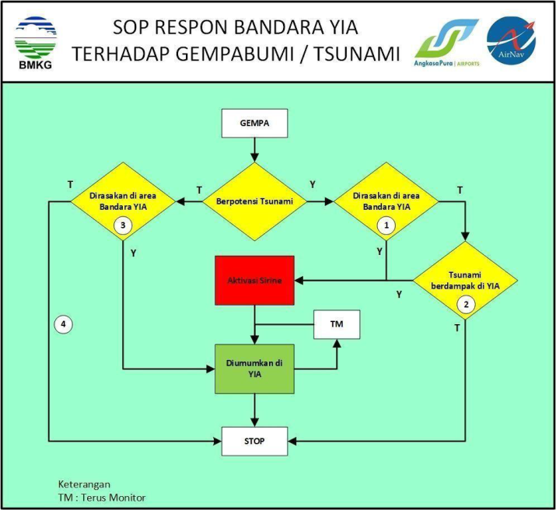
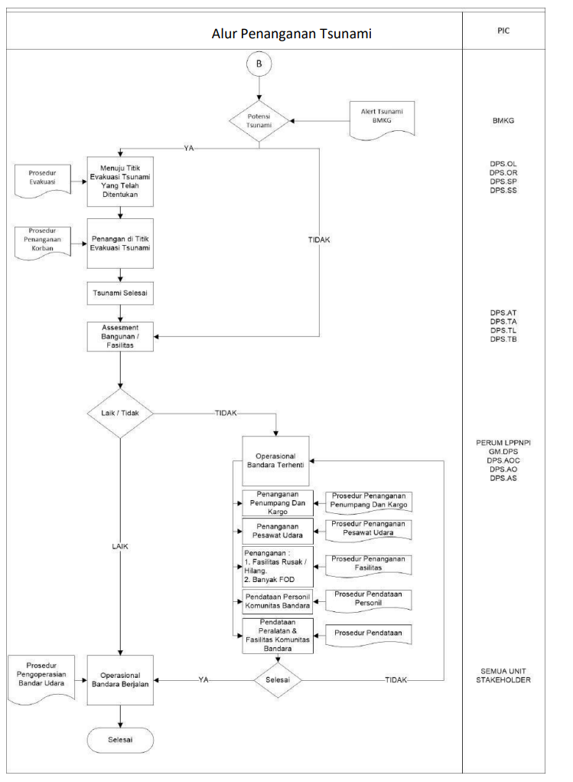
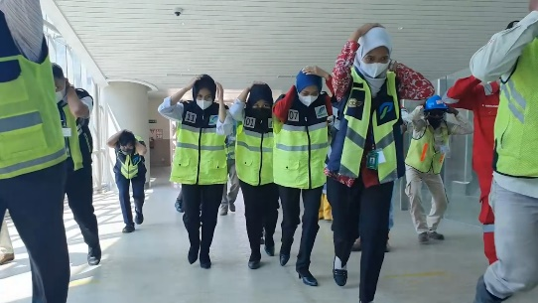
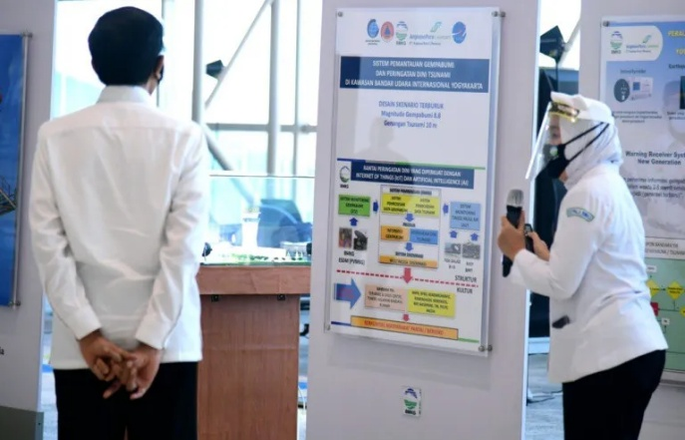
Implementation Tsunami Preparedness (Adoption 12 indicators of Tsunami Ready) in New Yogyakarta International Airport

Slide 5
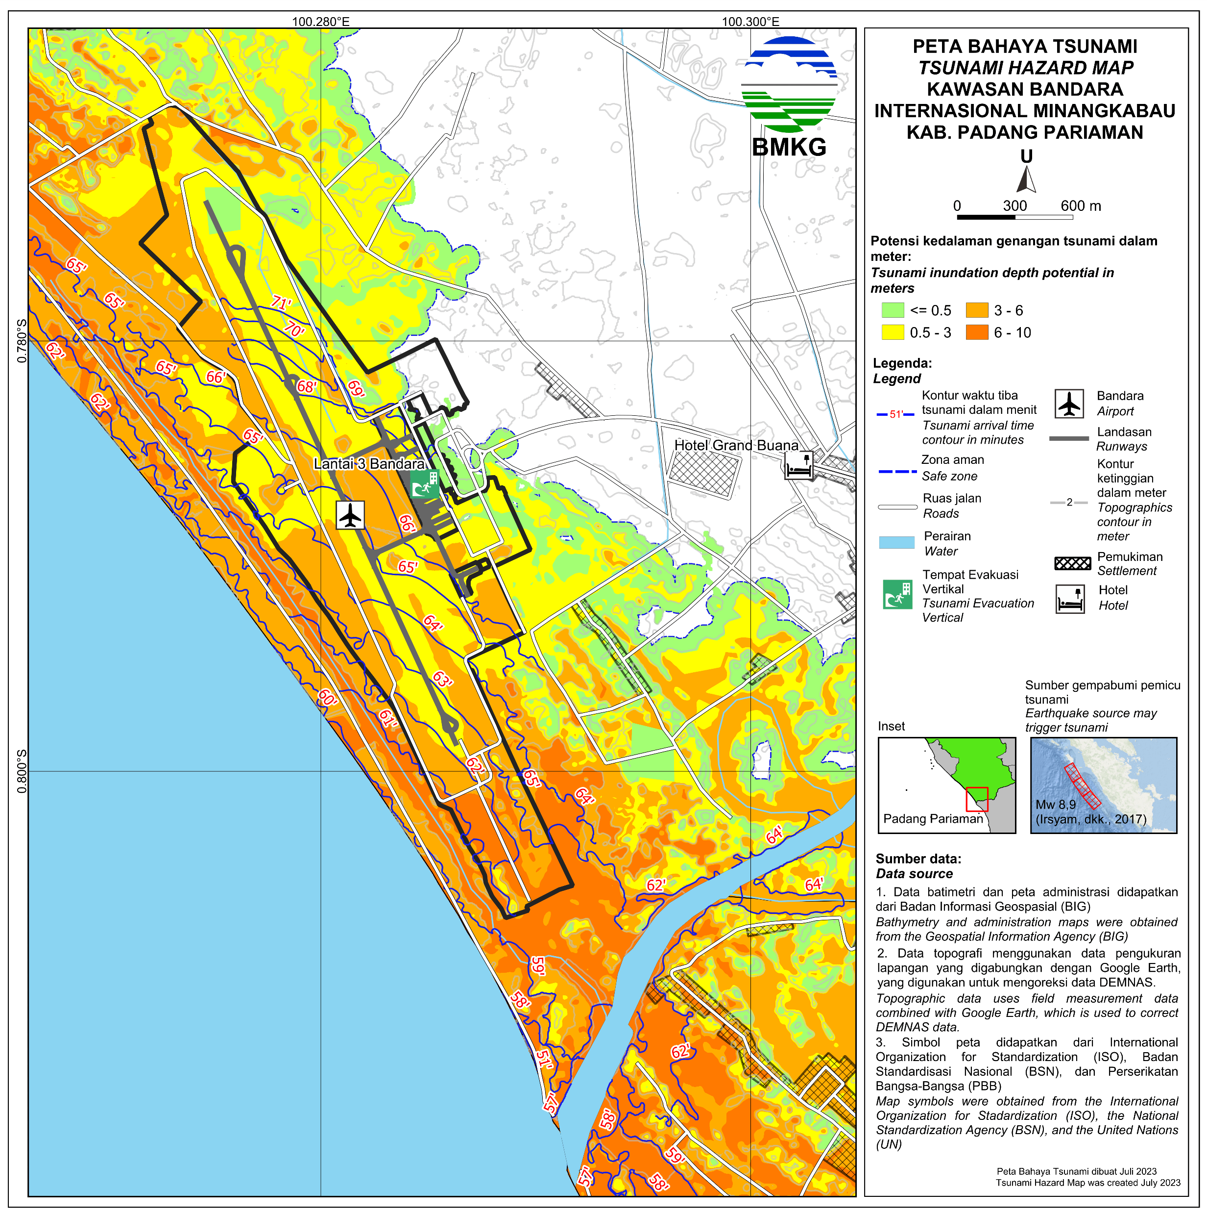
ASSESSMENT INDICATORS
2. Number of people at risk in the tsunami hazard zone is estimated
1. Tsunami Hazard Map
Include all categories of personnel and users who may be present at the facility, such as employees, contractors, visitors, passengers, and nearby residents who rely on or interact with the infrastructure.
This estimated number of people will form the basis for evacuation plans, specifically for:
Evacuation capacity
Evacuation grouping
Hazard maps must clearly show which key areas within the infrastructure are exposed to tsunami risk—and the extent of potential impact.
- Airports: runway, terminal buildings, Parking areas
- Seaports: docks and berths, passenger or cargo terminals, logistics and parking zones
- Industrial facilities: administrative offices, warehouses and production units, utility/service zones
Purpose these maps for planning evacuation routes, risk communication, and emergency protocols tailored to each location.
Tsunami Hazard Map for Minangkabau Airport

Slide 6
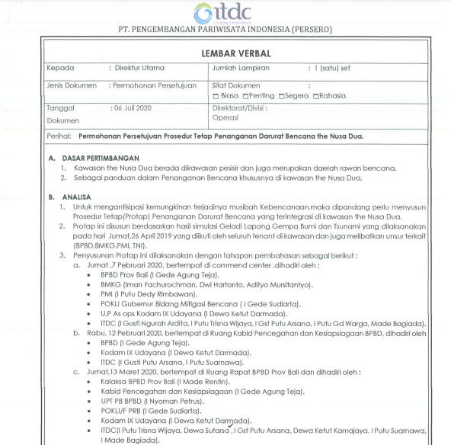
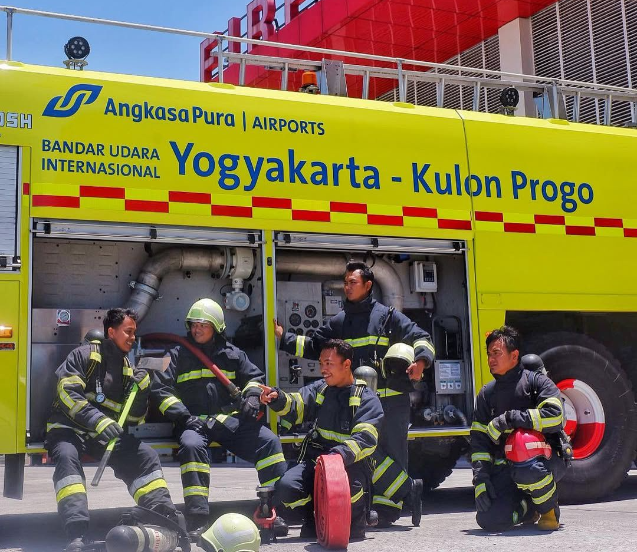
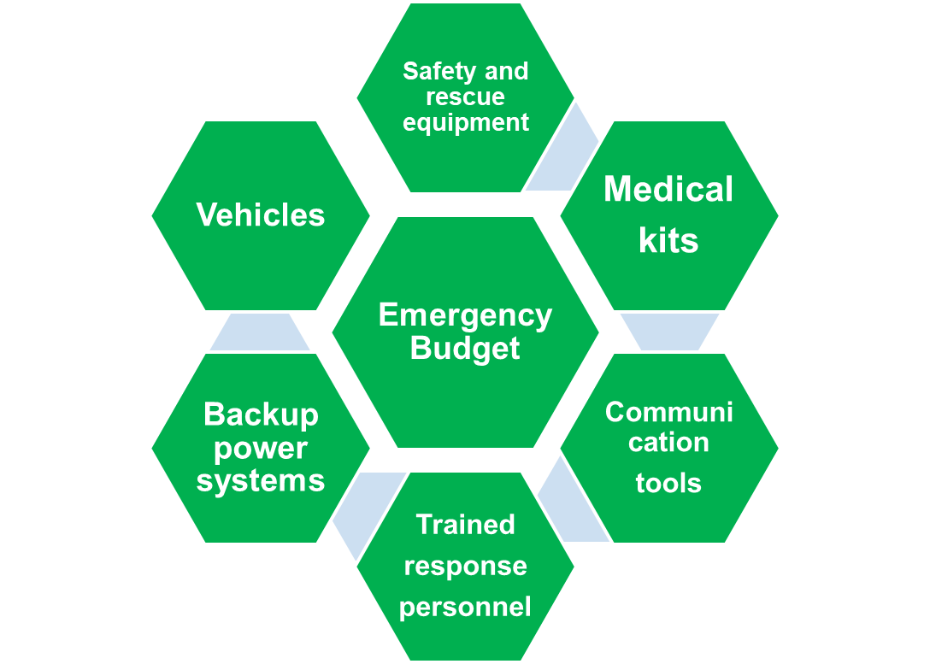
3. Essential economic, infrastructural, technical, and organizational resources available are identified and documented.
ASSESSMENT INDICATORS
This assessment recognizes all available resources—both tangible and intangible—that can be mobilized within and around the critical infrastructure facility to reduce tsunami risk and support emergency response operations. The inventory should include financial, technical, logistical, human, and institutional capacities that can be leveraged before, during, and after a tsunami event.
Policies
Earthquake and Tsunami Response Plan;
SOPs (Standard Operating Procedures);
Emergency Plan
MOU (Memorandum of Understanding) related to mitigation efforts
Disaster Resource Inventory (One-Page Verbal Summary)
Fire service

Slide 7
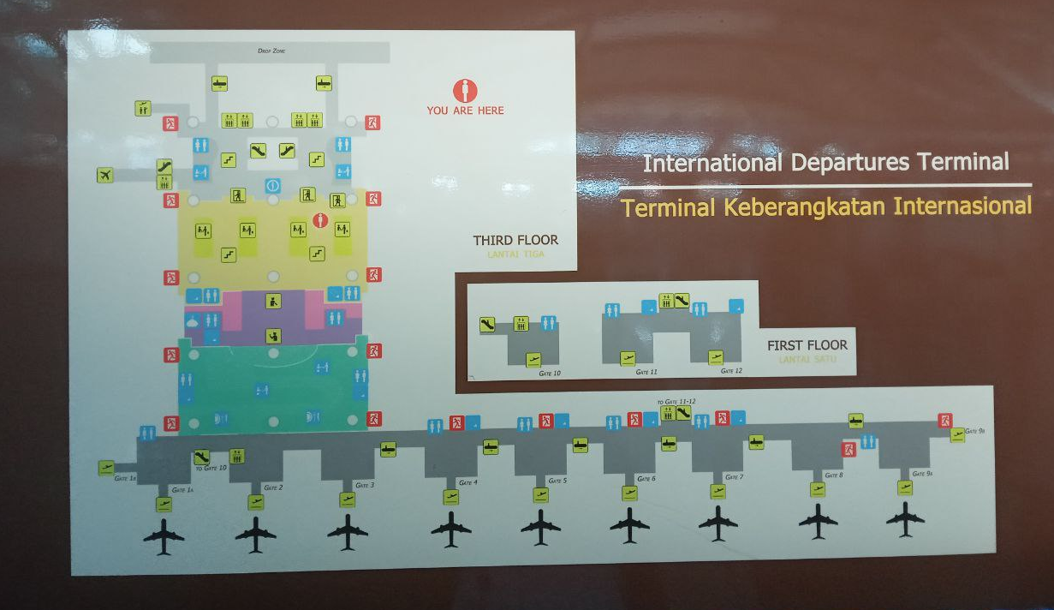
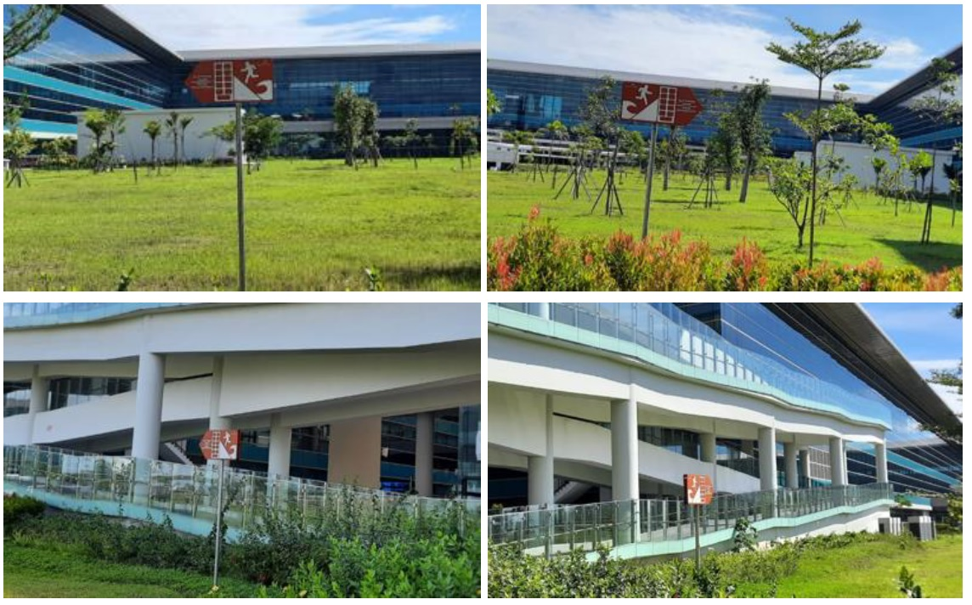
1. Clear and easily understandable tsunami evacuation maps specific to the critical infrastructure
PREPAREDNESS INDICATORS
2. Tsunami information, including evacuation routes and safe zones
Earthquake/tsunami information boards can include:
Evacuation signs
Assembly point signs
Information boards containing earthquake and tsunami response education
Earthquake and tsunami evacuation maps
These information boards must be:
Easy to understand and bilingual (Local language and English)
Installed in easily visible locations within every building and waiting area
Tsunami information signs should be placed in several crowded areas within airport, port, and hotel premises, such as:
Airport arrival/departure terminals.
Port passenger/vehicle loading areas.
Waiting areas, halls, and cafeterias.
Tsunami evacuation maps should illustrate:
evacuation routes,
vertical or horizontal evacuation points,
assembly areas, and
safe zones within and around the facility.
Evacuation Diagram I Gusti Ngurah Rai Airport Building

Slide 8
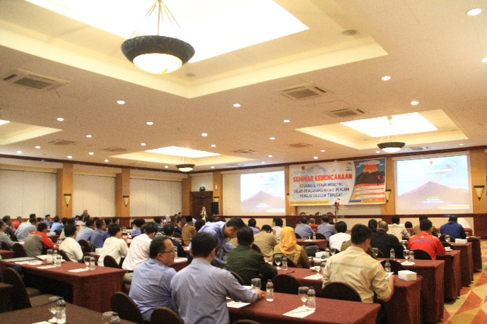
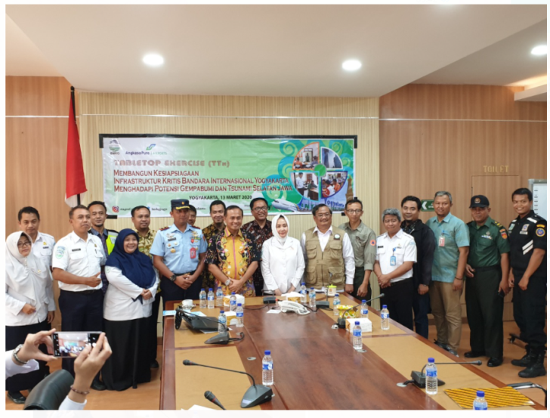
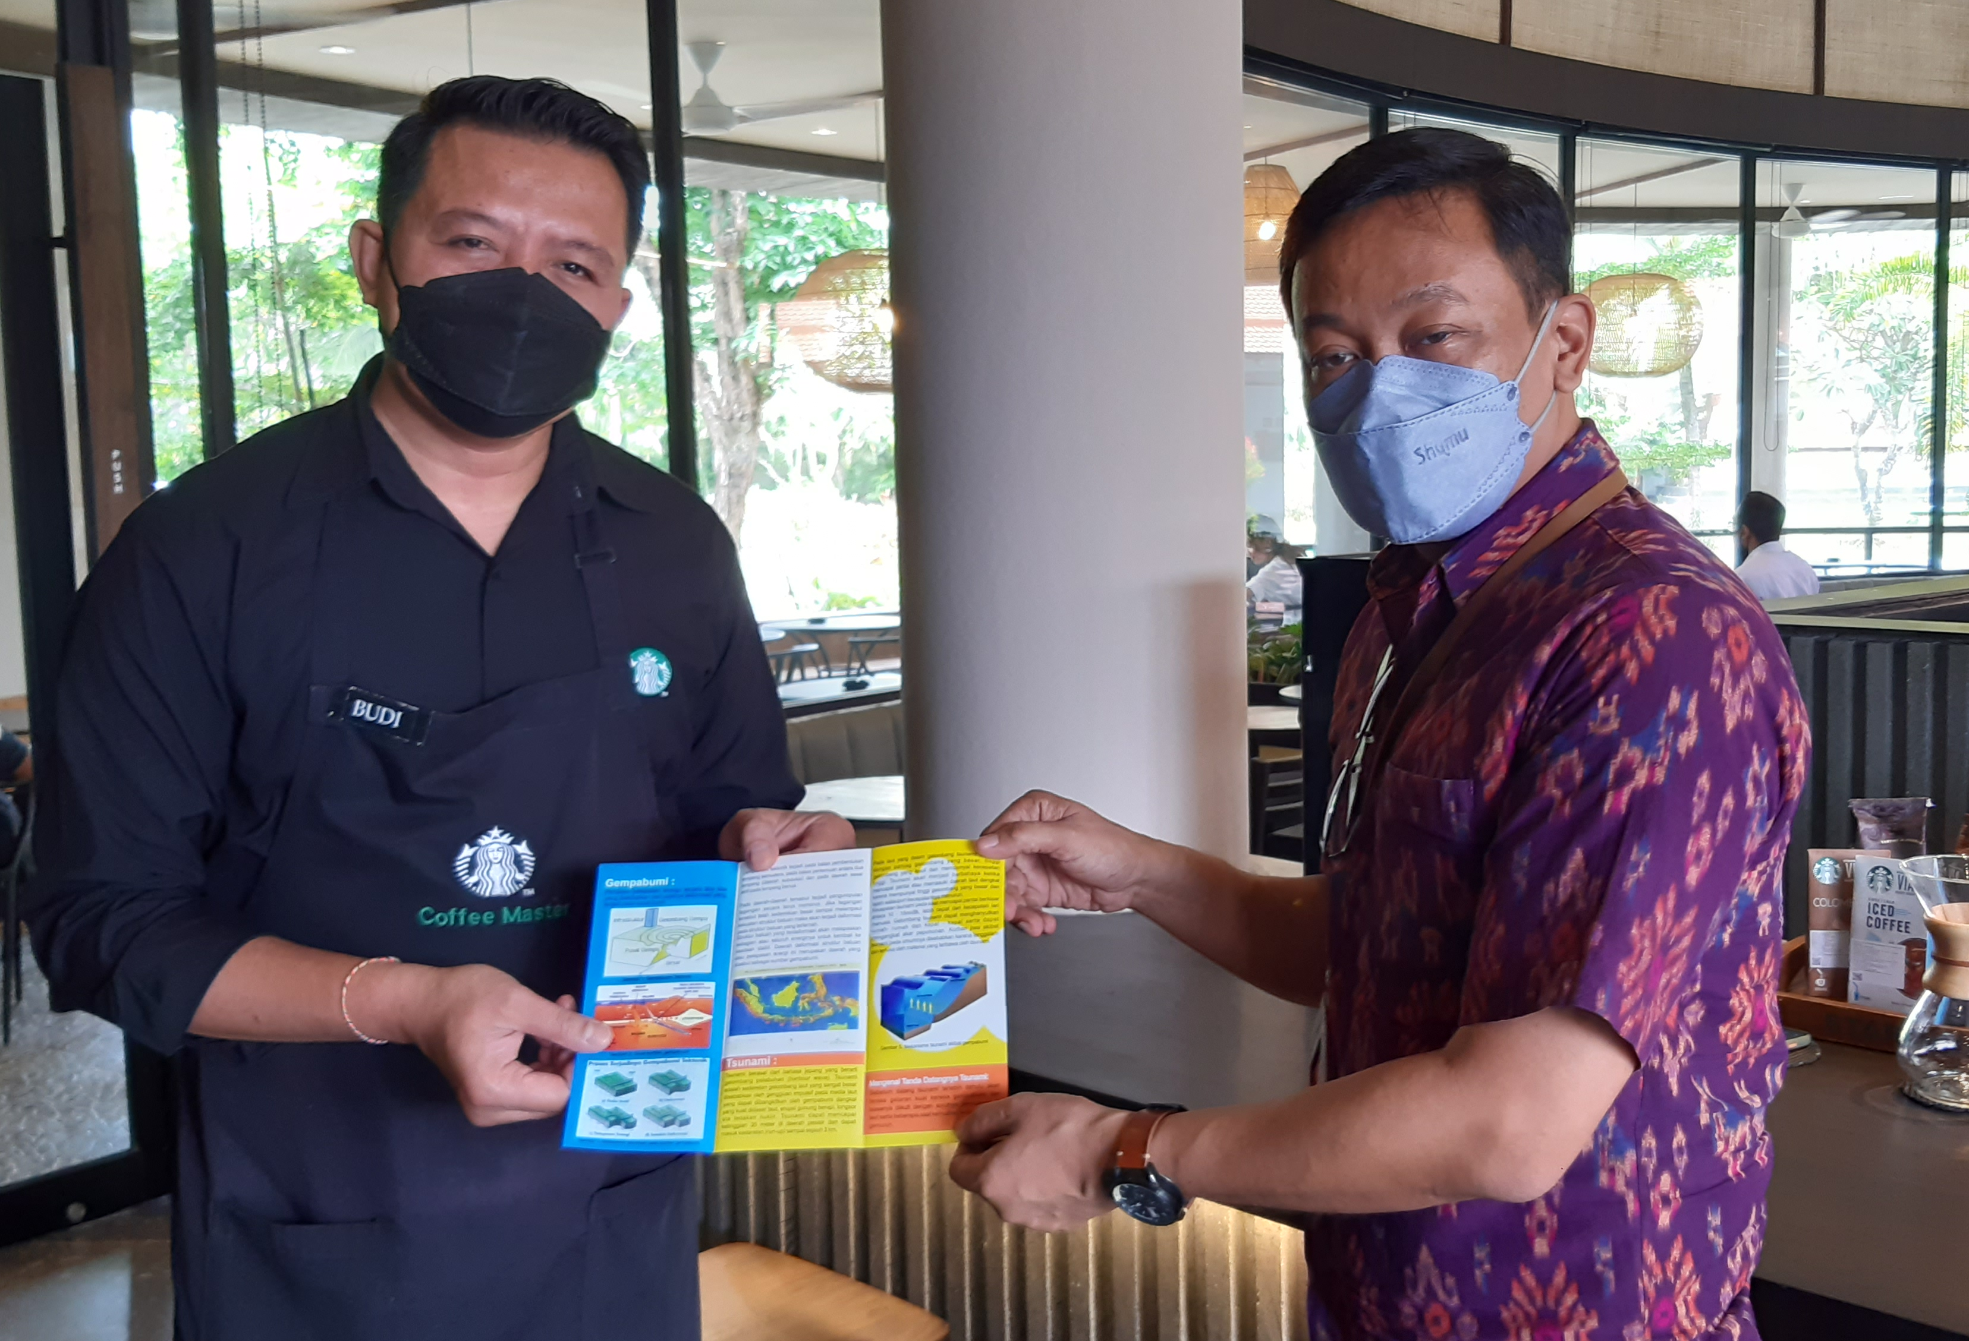
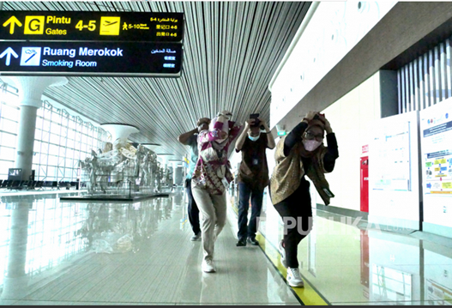
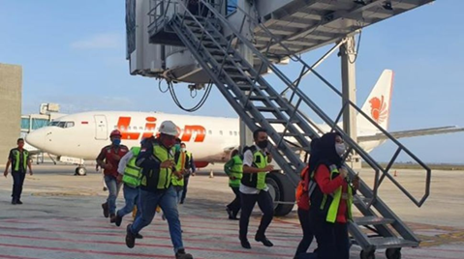
3. Educational, communication, and training materials are made available and disseminated among all personnel and relevant contractors.
4. Regular outreach or internal capacity-building activities on tsunami preparedness are conducted at least 3 times a year
PREPAREDNESS INDICATORS
These activities can include workshops, safety training, and campaigns during exhibitions.
Suggested outreach and dissemination methods include:
Printed materials distributed in staff offices, passenger terminals, and operational control rooms.
Digital dissemination
Visual communication via billboards, LED displays, or safety information.
Public service announcements
Safety videos or briefings
Coordination with local disaster management
5. A full-scale or tabletop tsunami drill involving internal emergency teams and external response agencies is conducted at least once every two years
These exercises can take various forms, such as tabletop exercises, drills, communication tests, and more. Participation should include all staff including Security Officer, AVSEC (Aviation Security), Ground Handling Officer, Air Traffic Controller, Public Announcer, Cargo Officer, etc. And it's even better if users/guests can also be involved.

Slide 9
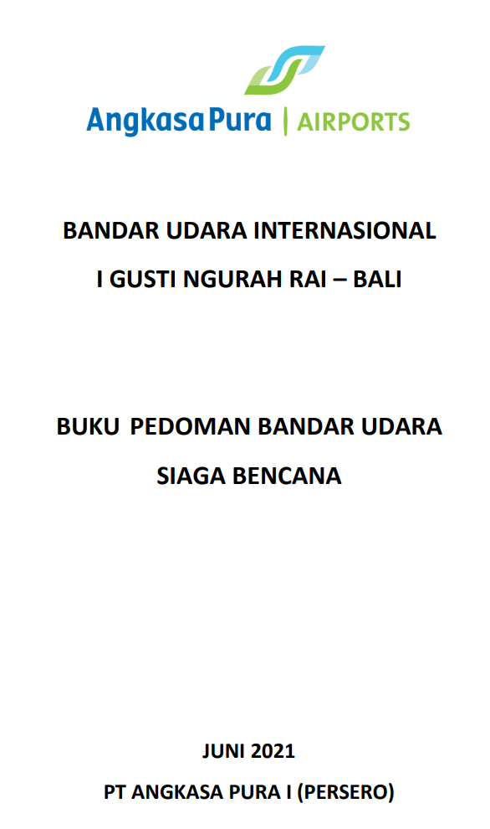
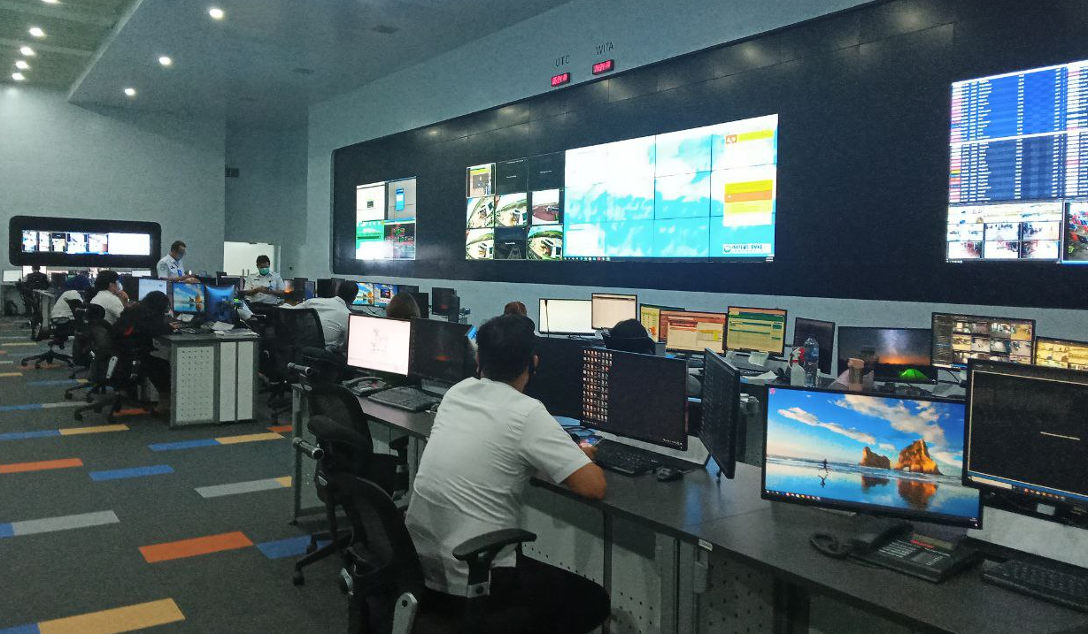
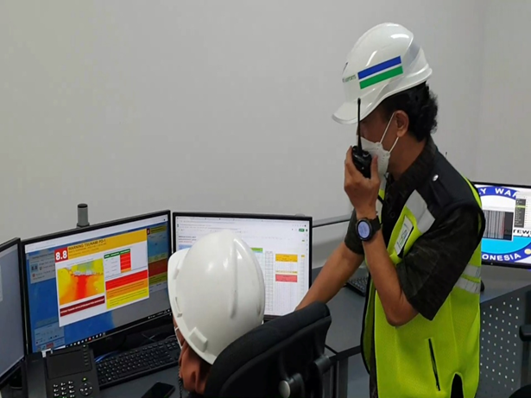
RESPONSE INDICATORS
1. A tsunami emergency response plan specific to the critical infrastructure facility is developed and approved
Emergency Plan Document
Should at least contain:
Identification of potential earthquake and tsunami hazards.
Data on management/staff and users/guests.
SOPs for Earthquake Response and Tsunami Early Warning.
Activation of emergency response and personnel implementing the emergency response.
Contact information for relevant institutions, including Focal Points for earthquake information and tsunami early warnings.
Evacuation plan.
Evacuation maps.
Criteria for "safe" status
Impact reporting
2. The capacity to manage emergency response operations during a tsunami is in place
The Critical Infrastructures Authority should have the capacity to execute the response plan, including:
Quick response team, with the ability and authority to execute tsunami warning and response actions.
Has Command Centre located in safe zone
Available on a 24-hour basis.

Slide 10
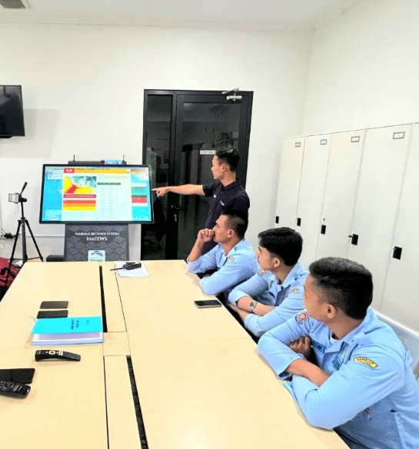

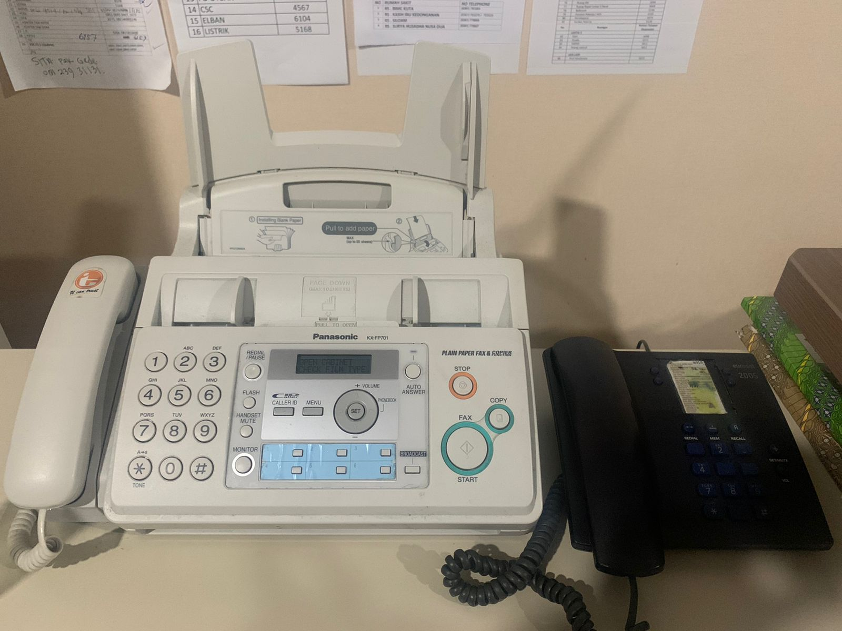
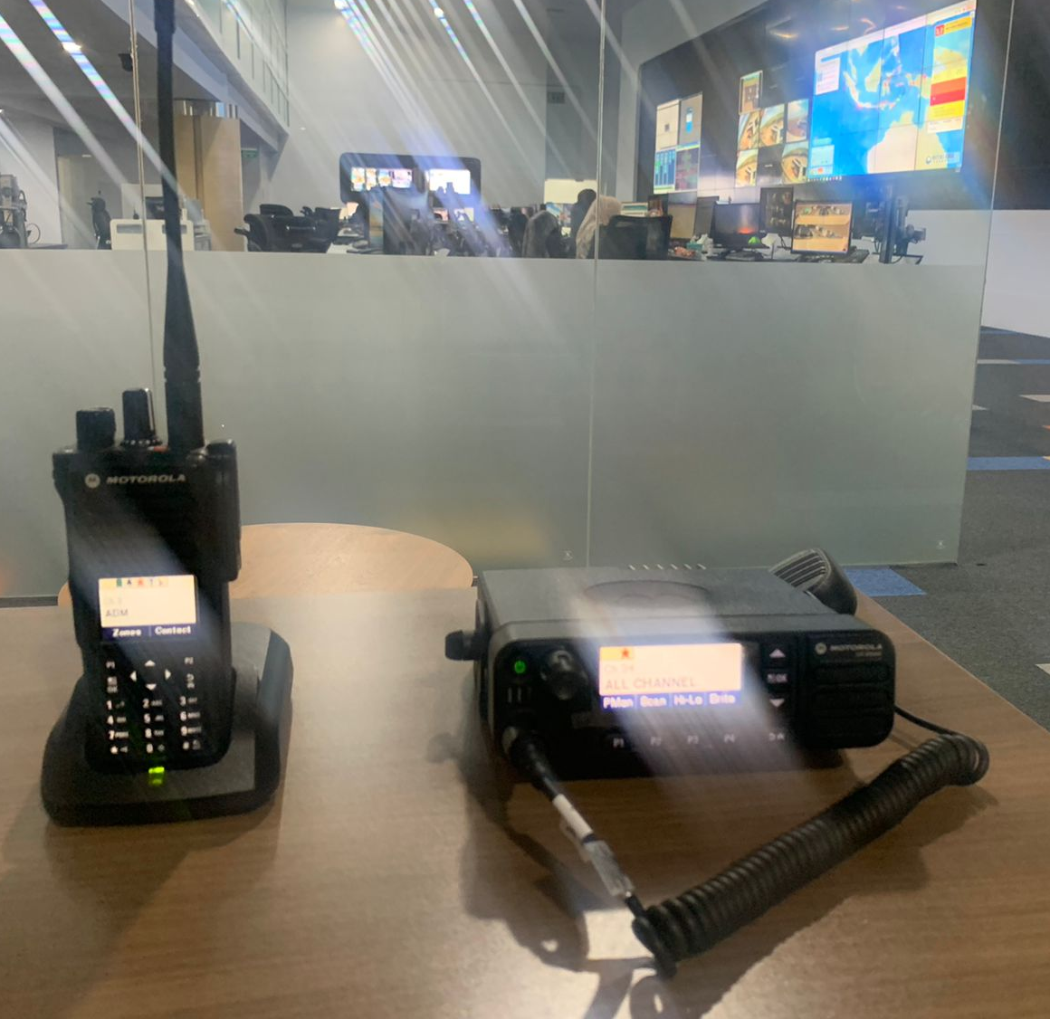
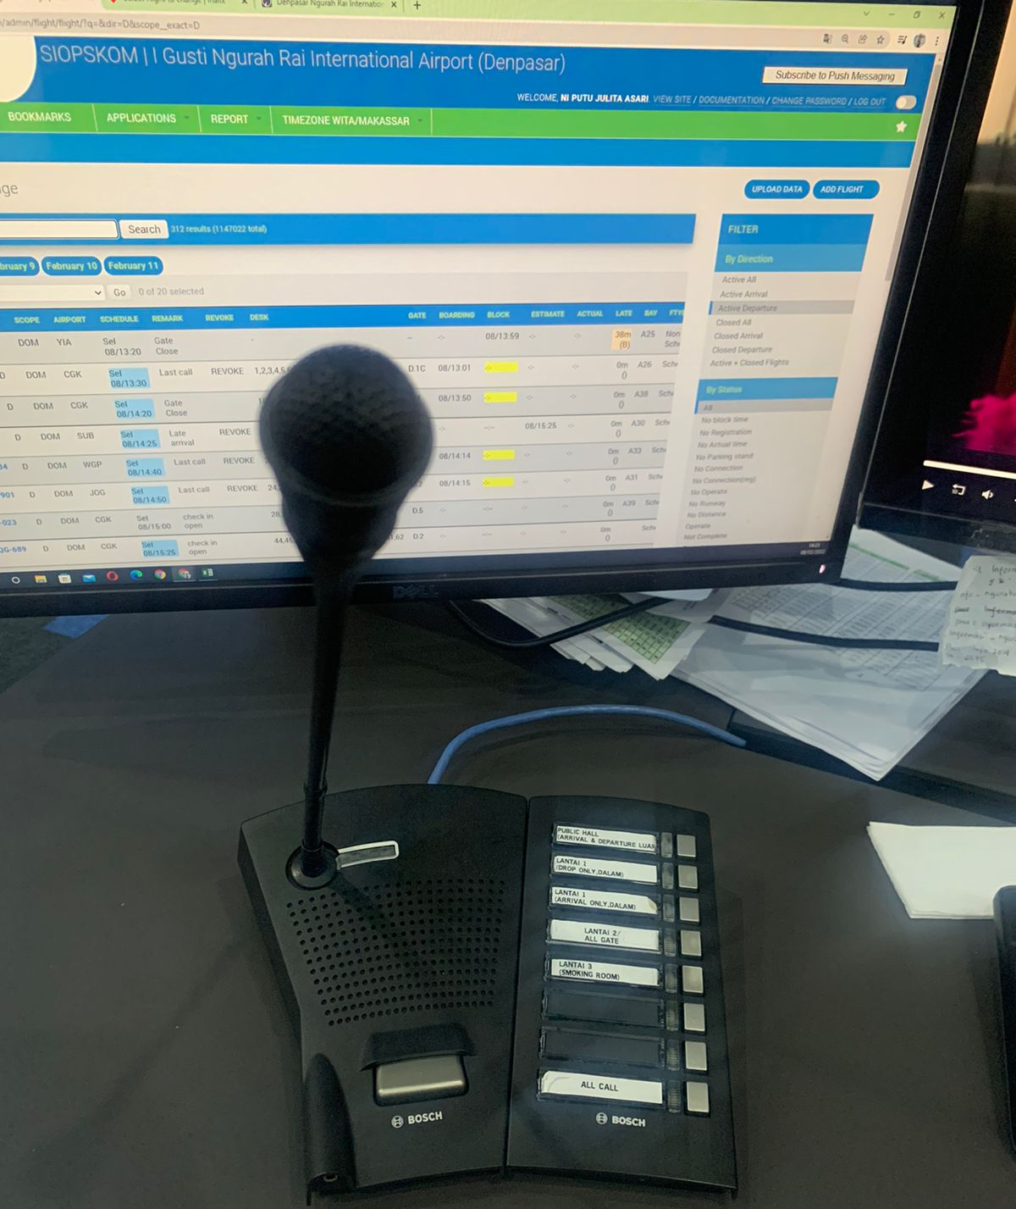

RESPONSE INDICATORS
3 & 4. Reliable, redundant communication systems are in place to ensure timely receipt of 24-hour official tsunami alerts from authorized agencies and disseminate to all staff, contractors, and facility users
Equipment or means capable of directly receiving information from NTWC, can include:
Warning Receiver System
Radio
Telephone
SMS
Warning Receiver System
Public Announcement (PA) systems
Equipment or means capable of reaching all managers and users within the area include:
Alarm;
Public Announcement (PA) systems;
Display screens;
Telephone;
Radio;
Social Media Applications

