Slide 1
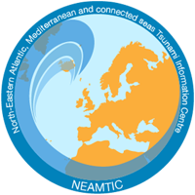

TOWS-WG Inter ICG
Task Team on Disaster Management and Preparedness
Status of Tsunami Ready Implementation (NEAMTWS)
05-06 March 2026 (Online)
members
Elena DASKALAKI (GREECE)
ICG/NEAMTWS TOWS WG TT- DMP
Co-chair of the TT on TR ICG/NEAMTWS
Ignacio AGUIRRE AYERBE (SPAIN)
ICG/NEAMTWS TOWS WG TT- DMP
Vice-Chair ICG/NEAMTWS

Slide 2

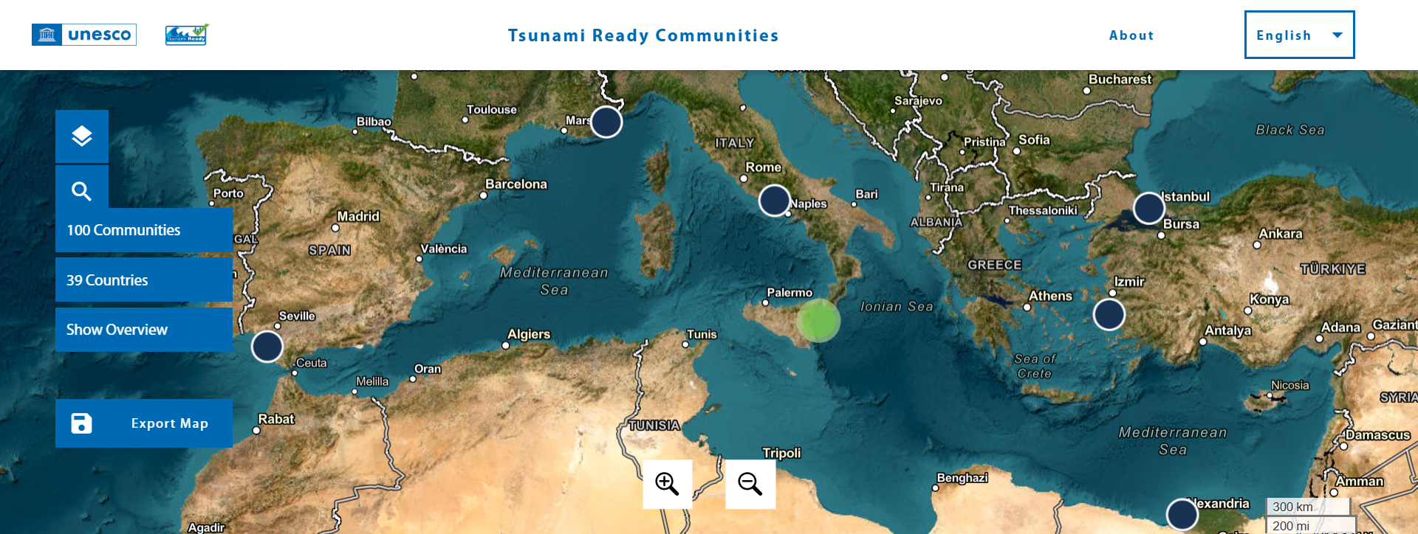
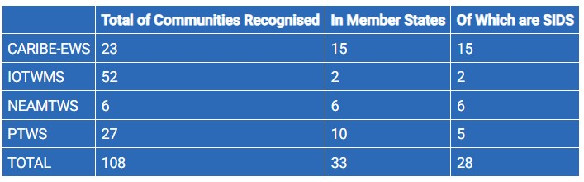
NEAM Tsunami Ready Communities
Upcoming (8 Member States, more than 25 communities)
Cyprus - Larnaka
France - Métropole Nice Côte d’Azur (MNCA), Marseille
Greece - Methoni, Kalamata, Santorini
Italy - Marzamemi-Pachino, Palmi, Otranto, Stromboli
Israel
Morocco - El Jadida, Larache
Portugal - Quarteira and Cascais
Spain - Cadiz
Türkiye - Tuzla, Kartal, Seferihisar
Established (6 Member States, 6 communities)
Egypt – Alexandria
France - Cannes
Greece - Samos
Italy - Minturno
Spain - Chipiona
Türkiye - Büyükçekmece
TOWS-WG Inter ICG Task Team on Disaster Management and Preparedness
05 to 06 March 2026

Slide 3
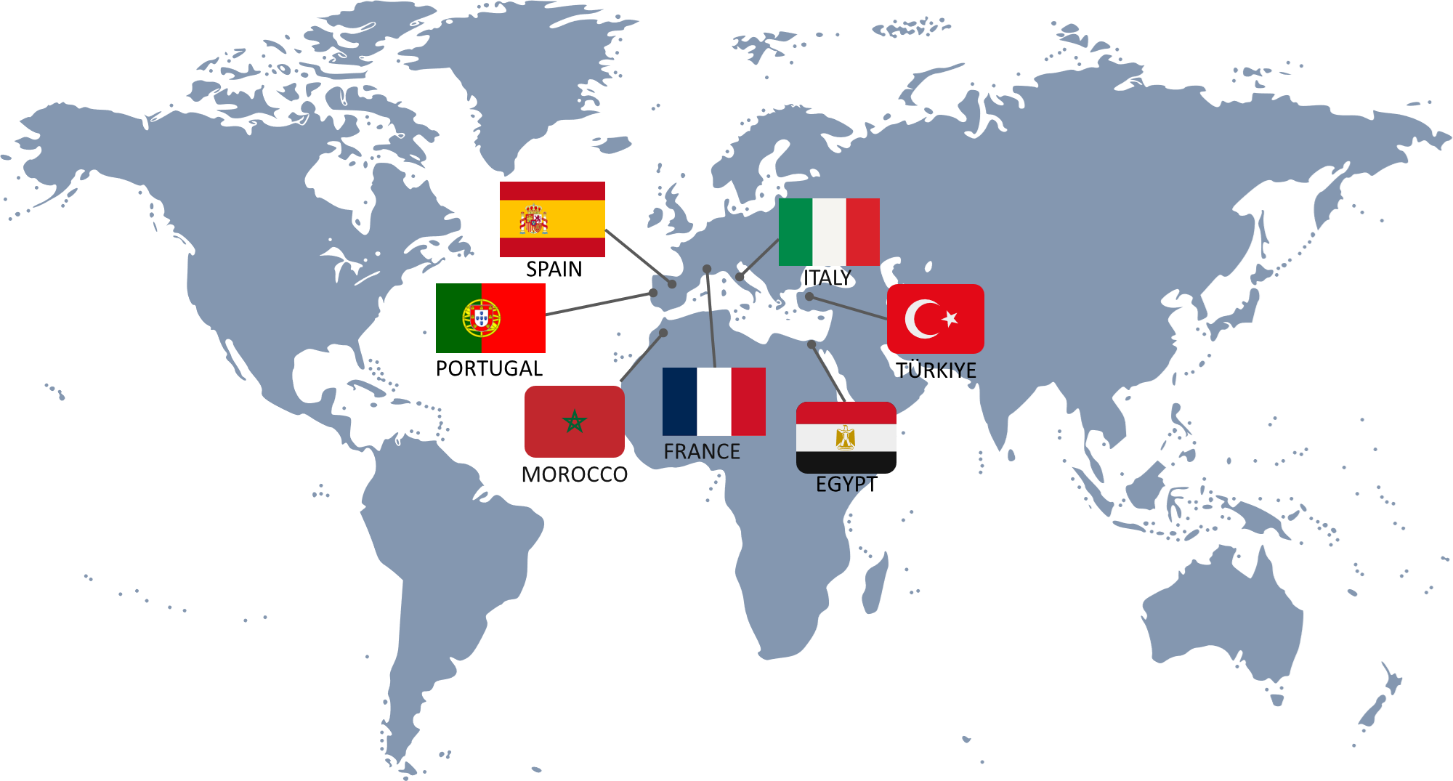
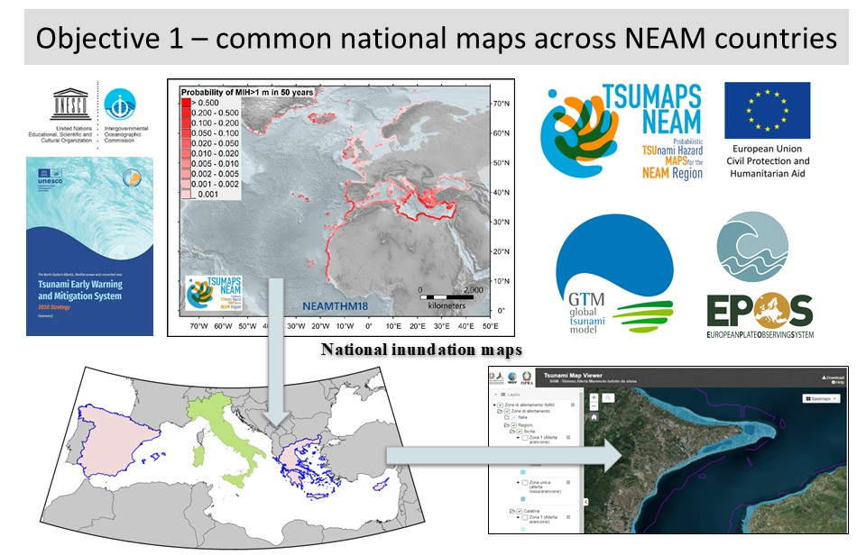





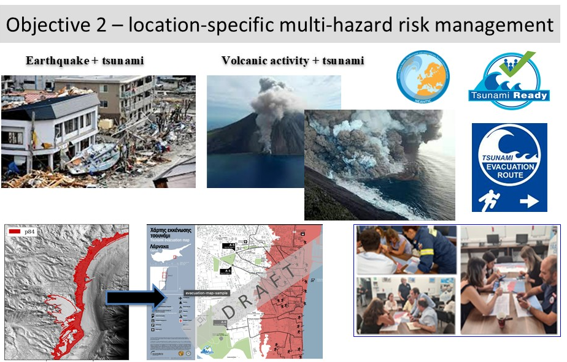
Tsunami Ready Implementation in NEAM region
Component 1 - Build and strengthen tsunami hazard assessments, risk knowledge, risk communication, and decision-making capacities.
Component 2 - Scale-up and expand Tsunami Ready in selected NEAM countries.
Component 3 - Enhance and densify early warning, detection, monitoring, and alerting systems.
Component 4 - Enhance dialogues with Emergency Responders, Decision Makers on High Impact Low Probability (HILP) tsunami events within a multi-hazard context to improve strategies and effective decision-making capabilities.

Slide 4
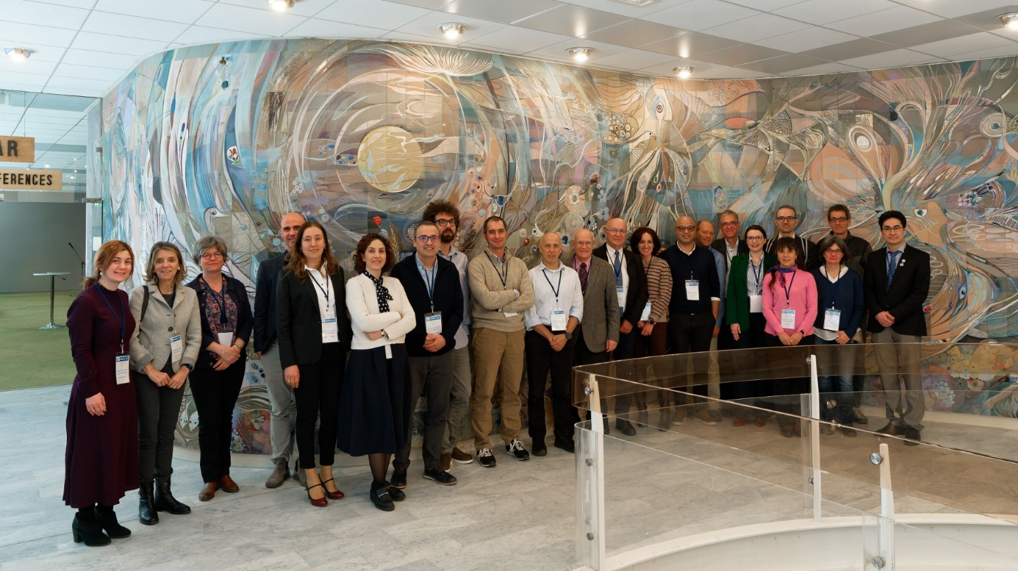
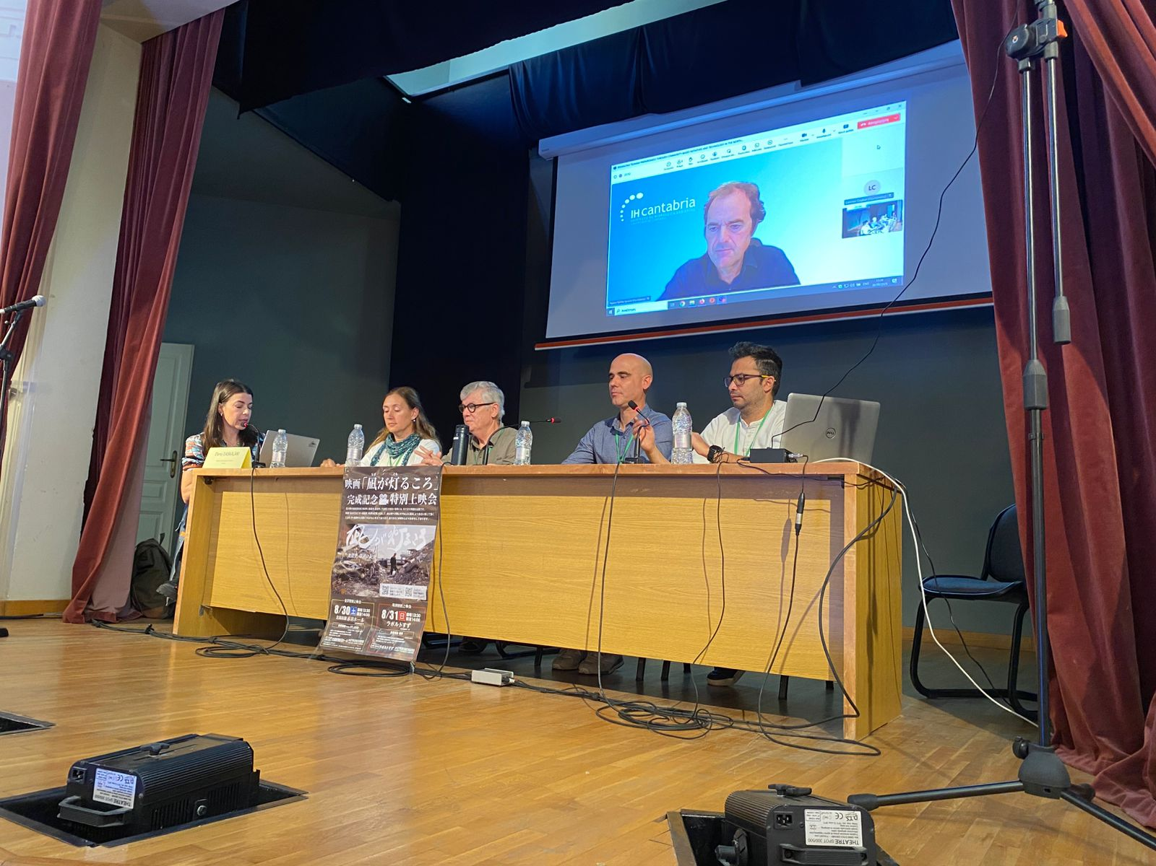

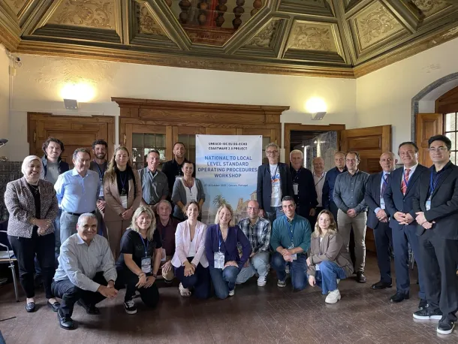
Activities of NEAMTWS
UNESCO-IOC Regional Tsunami Ready Training for the North-eastern, Atlantic and connected Seas Region, 14-15 January 2025, under UNESCO-IOC DG ECHO CoastWAVE Project 2.0 (Assess-2: The number of people at risk in the tsunami hazard zone is estimated & Prep-5: A community tsunami exercise is conducted at least every two years.)
UNESCO-IOC Expert Meeting on Tsunami Sources Associated with Hellenic Arc and Azores–Gibraltar Fault Zone in the North-Eastern Atlantic, the Mediterranean, and Connected Seas (NEAM) Region, 18-20 March 2025, Paris, France.
The TT Co-Chairs organized and participated in the 15th IDRiM2025 conference held in Samos, Greece from 28 September to 1 October, entitled: “Advancing Disaster Risk Reduction in Islands and Remote Areas,” where they led a special session titled “Enhancing Tsunami Preparedness Through Community-Based Initiatives and Technology in the Northeastern Atlantic and Mediterranean Region”.
National to Local Level Standard Operating Procedures (SOP) Workshop under UNESCO-IOC EU DG-ECHO CoastWAVE 2.0, 27-30 October 2025, Lisbon, Portugal.
First Conference Of The Ocean Decade Tsunami Programme, Hyderabad, India, 10-11 November 2025.
Publication by Daskalaki, E, Aguirre Ayerbe, I, Baptista, MA, et.al. 2026. Recent Developments in Tsunami Preparedness in the North-Eastern Atlantic and Mediterranean Region: Challenges, Strengths, and Weaknesses. International Journal of Disaster Risk Reduction, 134 pp. 106029.
TOWS-WG Inter ICG Task Team on Disaster Management and Preparedness
05 to 06 March 2026

Slide 5
Ongoing Activities of NEAMTWS
Promote Tsunami Ready Recognition Programme (TRRP) via online workshops for municipalities, civil protection, and key institutions;
Strengthen engagement with Civil Protection Authorities (CPAs) by promoting the TRRP as a practical and attractive framework for increasing coastal community resilience tailored to their priorities;
Develop and conduct a Survey Questionnaire after TRRP certification to receive feedback from implementers and stakeholders on the benefits and by exploring other ICGs (for examples TRR impact study ongoing in IO);
Explore mechanisms for recognizing communities that implement National Tsunami Ready Recognition Programmes or equivalent initiatives aligned with the IOC UNESCO Tsunami Ready Recognition Programme (TRRP), in collaboration with the TOWS Task Team on Disaster Management and Preparedness (TT on DMP);
Seek collaboration with scientific and transfer entities (such as the Global Tsunami Model (GTM) Association) to help communities with the implementation planning of TRRP;
Contribute to the IOC Technical Series on Tsunami Ready Implementation in NEAM- best Practices, Guidance, Challenges, and Lessons Learned in applying UNESCO IOC TRRP
Adapt the M&G 74 to the NEAM region with the contribution of the Task Team on Documentation
Promote the new Tsunami Ready Tool kit prepared by TICs to assist Member States in implementing the Tsunami Ready Recognition Programme as per TOWS Task Team on Disaster Management and Preparedness’ Decisions and Recommendations
TOWS-WG Inter ICG Task Team on Disaster Management and Preparedness
05 to 06 March 2026

