Slide 1
Inclusive SOPs
Prof. Harkunti Pertiwi Rahayu
(Former Chair TTDMP/ Current Vice Chair IOTWMS)
harkunti@gmail.com and harkunti.rahayu@pwk.itera.ac.id
TOWS Inter ICG Meeting, 04 to 06 March 2026

Slide 2
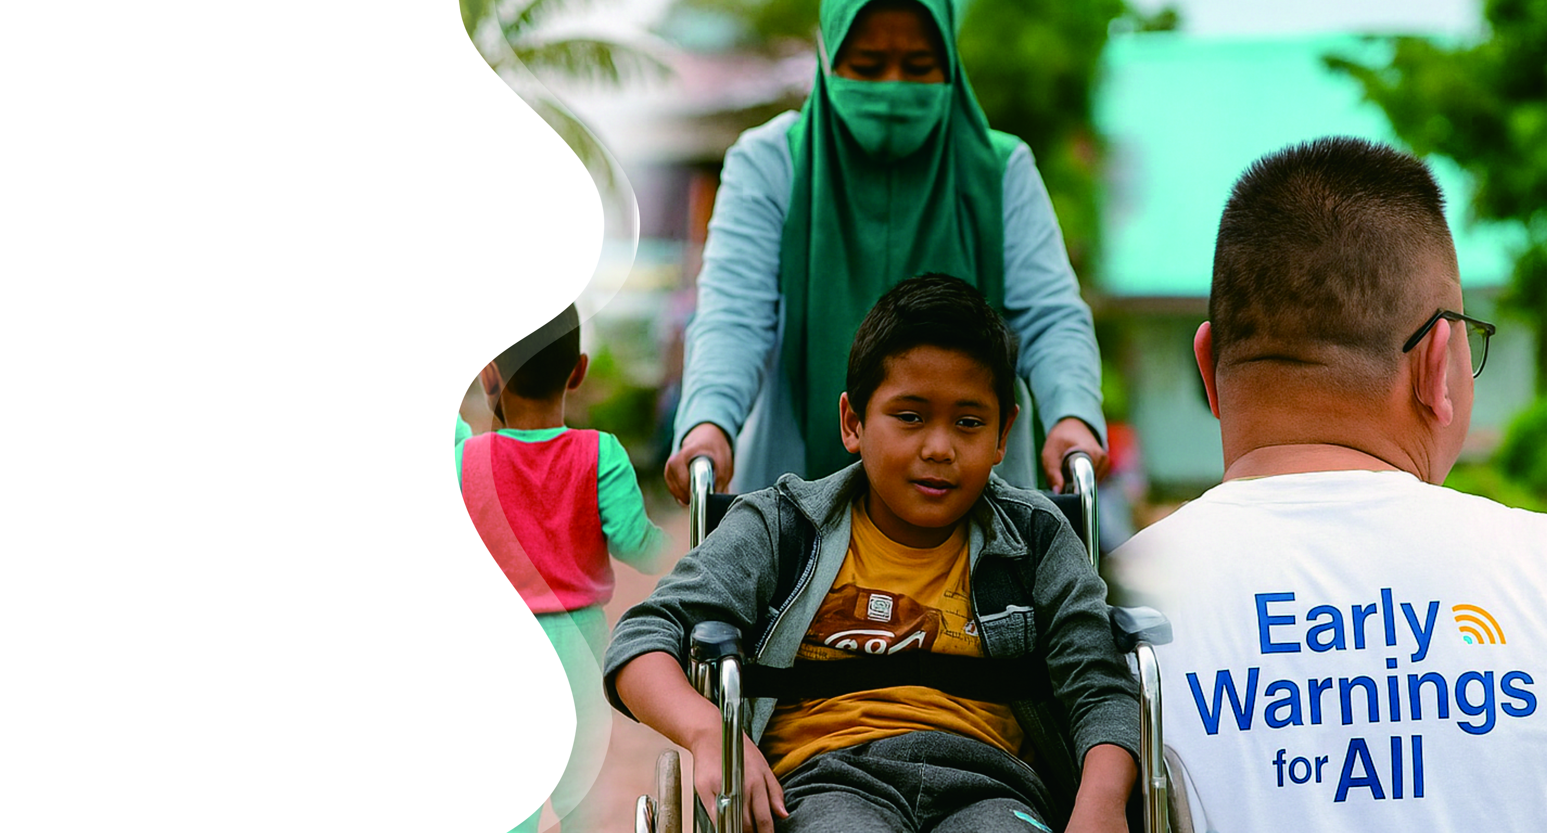
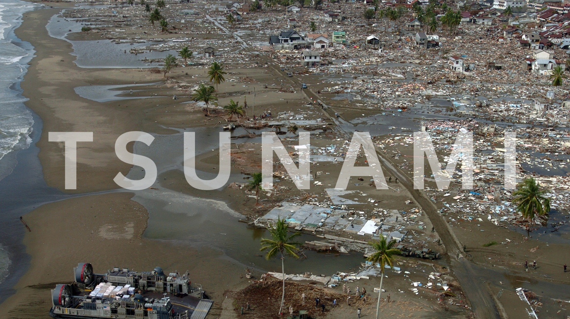
People with Disability – the most vulnerable group in any disaster (Tsunami)

Slide 3
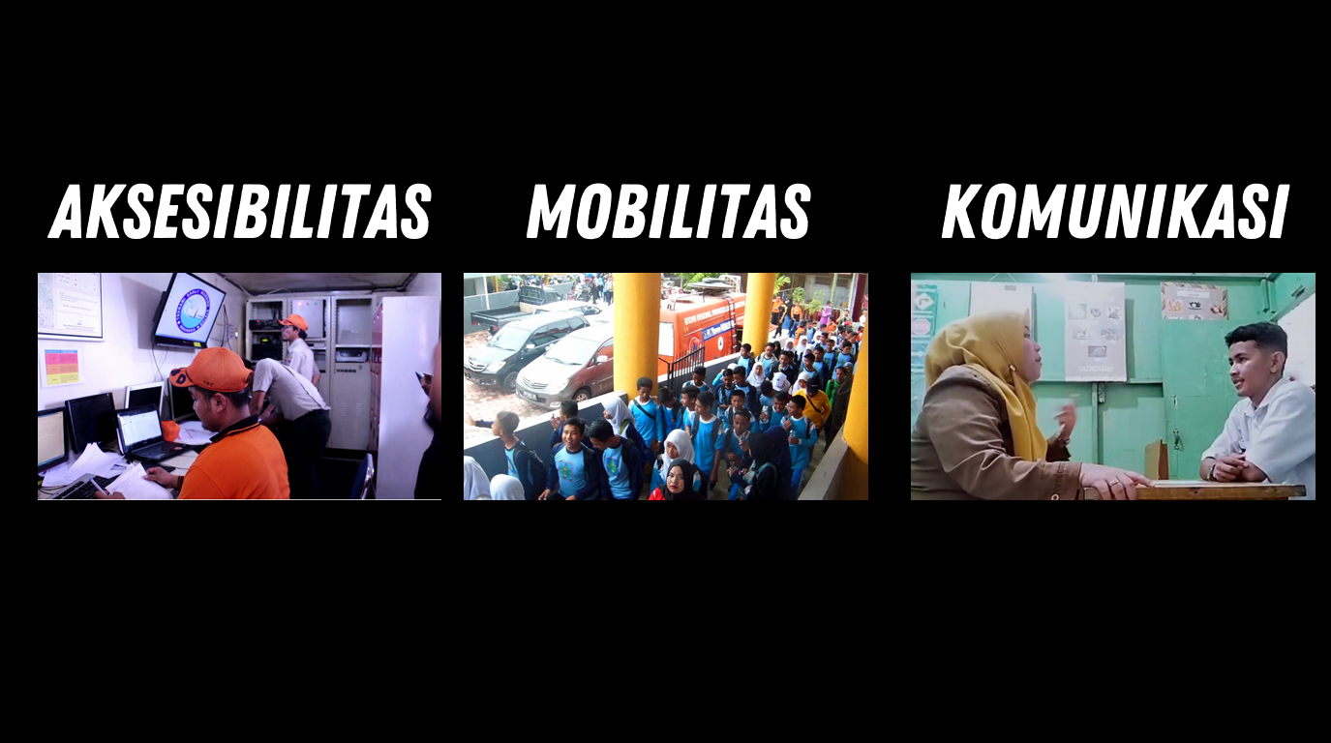
Facing Challenges in:
Accessibility
Mobility
Communication

Slide 4
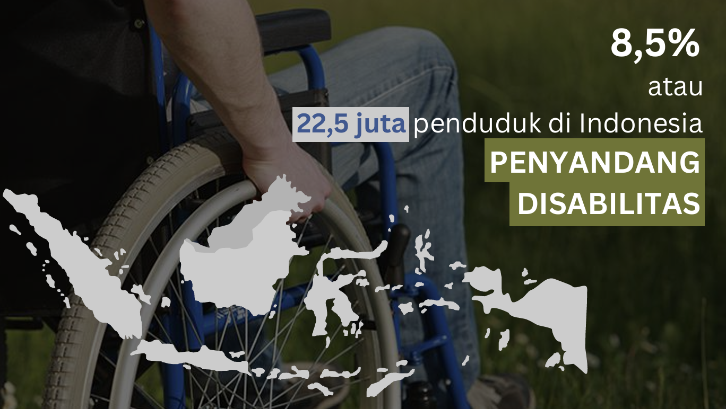
or
22.5 millions of Indonesian population
People with Disability
(Difable – Different Functional Ability)

Slide 5

Challenges & Opportunity
Early Warning for ALL EW4A
Rationale of Inclusive SOP development:
To respond ODTP HL Objective 2:
100% all people at risk are prepared and resilient to tsunami by 2030 (UNESCO IOC ODTP).
People with disability:
1.3 billion disability people in the world (16% global population, WHO Mar 7, 2023)
22.5 million disability people in Indonesia (8.5% of national population, BPS 2023)
Limited access to Tsunami Warning Information → time is very critical for disability living at the tsunami prone area → very short golden time especially for those facing near field tsunami
SDGs: Leaving no one left behind

Slide 6

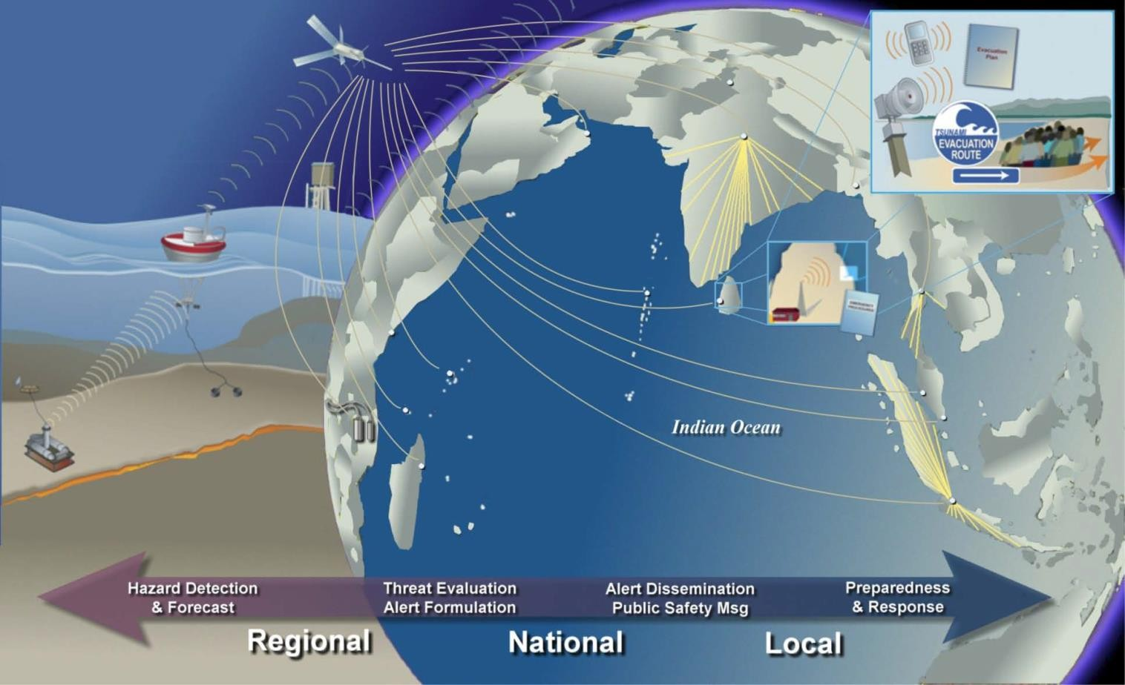
2004 Indian Ocean Tsunami:
a Wake-up Call for Ina TEWS and ICG IOTWMS
“End To End System”
From 0.0 to 4.0
Has it considered reaching all the disability??
?
?
Has it considered the capacity response of disability to the warning message??
4.0
4.0

Slide 7
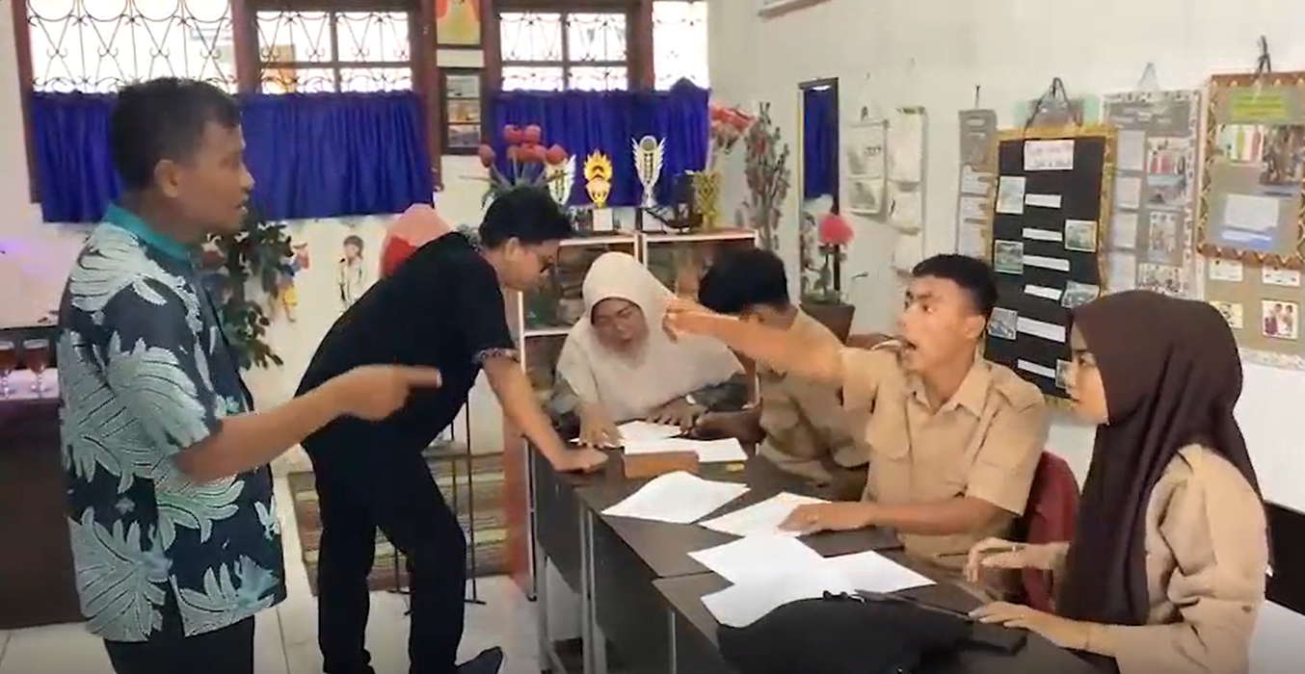
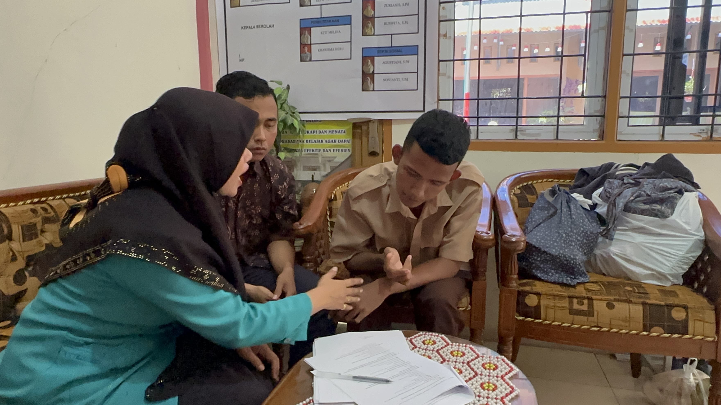
Rationale for Inclusive SOP Development
How is social cognitive behavior of the disability in responding tsunami early warning system for evacuation?
In what ways physical/non-physical factors of urban and rural setting and mobility will affect the disability in evacuation?
In what ways did multiple disaster-related actors including the disability obtain, utilize, and exchange information regarding tsunami warning?
How the characteristics of inclusive network of information flow and multiple actor coordination including the disability responding tsunami early warning message?
How to develop inclusive SOP that will be appreciated by the community with disability?

Slide 8
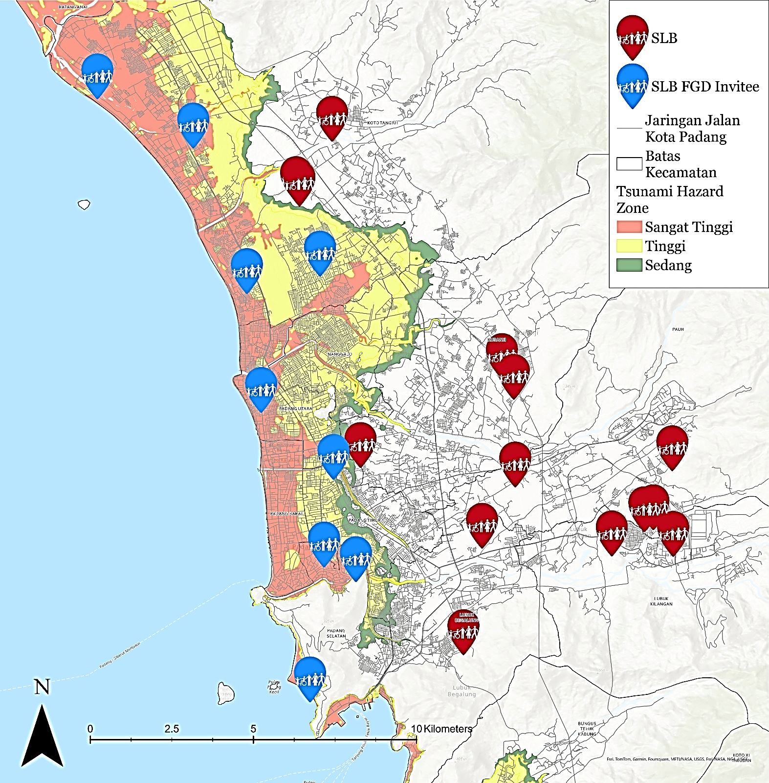
Rationale Local Issues: Special Schools for Disabilities at Tsunami Prone Area in Padang City
No | Special Schools | Number of Teachers | Number of Students
1 | SLBN 2 Padang​ | 44 | 134
2 | SLB Bakti​ | 7 | 22
3 | SLB MGF Lubuk Buaya Padang | 5 | 22
4 | SLB Karya Padang​ | 7 | 25
5 | SLB Perwari (Padang Utara)​ | 10 | 32
6 | SLB YPAC SUMBAR (Padang Utara)​ | 8 | 35
7 | SLB Wacana Asih (Padang Selatan)​ | 18 | 78
8 | SLB Al-Ishlaah Padang (Padang Selatan)​ | 12 | 26
9 | SLB Etnik Kreatif (Padang Selatan)​ | 5 | 19
10 | SLB Samudera Biru​ | 3 | 39
 | TOTAL | 119 | 432
SLB 2 Padang
SLB Bakti Padang
SLB MGF Lubuk Buaya Padang
SLB Karya Padang
SLB PERWARI Padang
SLB YPAC Sumatera Barat
SLB Wacana Asih Padang
SLB Al-Ishlaah Padang
SLB Etnik Kreatif Padang
SLB Samudera Biru

Slide 9
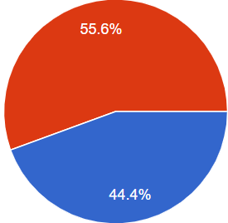
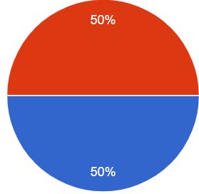
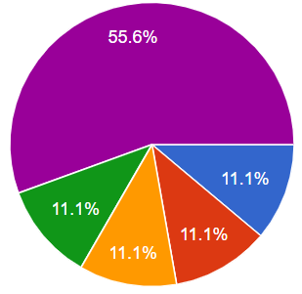
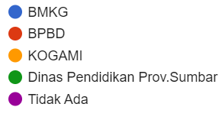
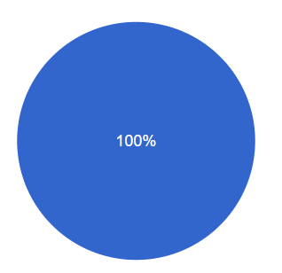
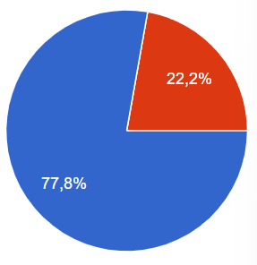
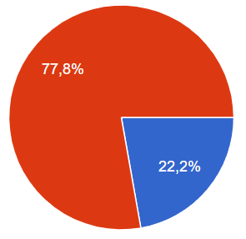
Rationale Local Issues: Challenges in tsunami warning dissemination and response for disability
Availability of Early Warning Dissemination Tools
EWS Condition
Difficulties in accessing warning information
Lack of reachable Tsunami Vertical Evacuation Shelter
Evacuation route road condition (small, steep road, poor pavement, no sidewalk, side by side with open drainage channel )
Need for Evacuation
Need supporting help in evacuation: deaf (no need), blind (1 helper) and physical disability (min 1)
Early Warning Information Dissemination Cooperation
Yes
No
Berfungsi
Tidak berfungsi
Existing
Evacuation Route
Tsunami drill
Tsunami Shelter near School
Pernah
Tidak Pernah
Ada
Ya
Tidak
Tidak Ada

Slide 10
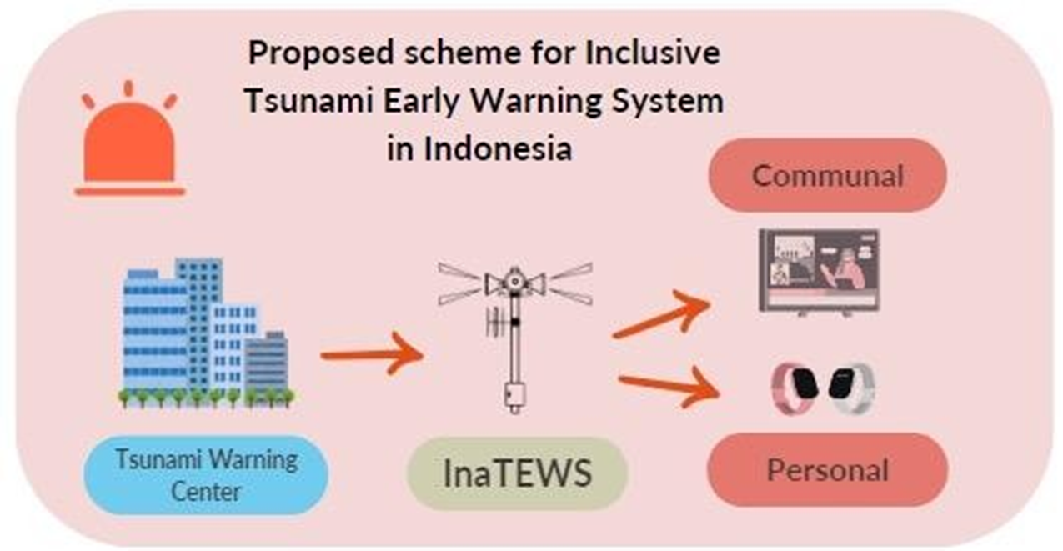
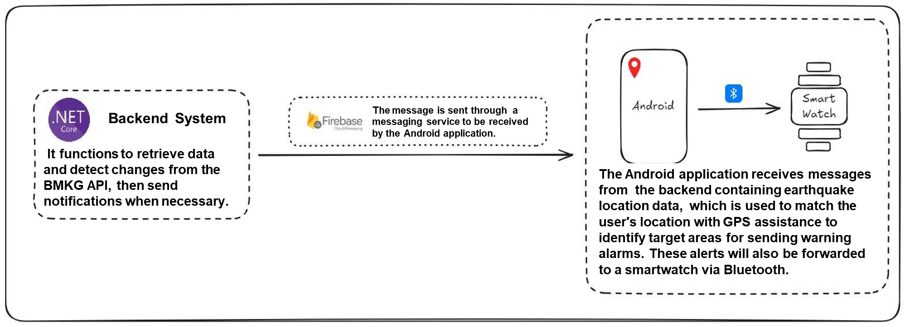
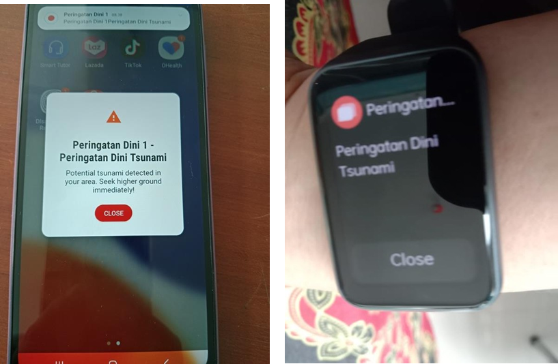
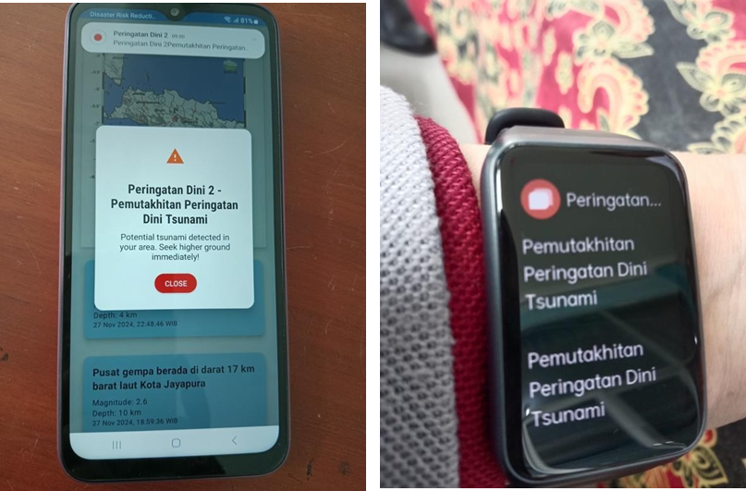
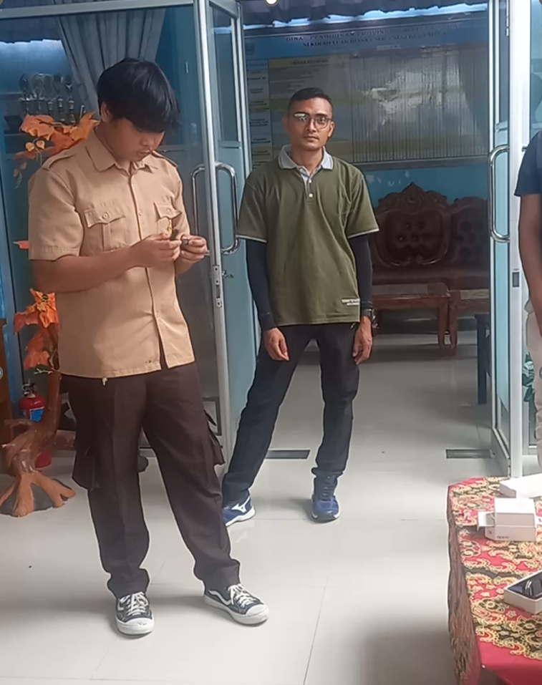
Inclusive Early Warning Tools : Vibration-based Tested in West Sumatera and Lampung
Design of Inclusive Tsunami Early Warning System
Prototype of vibration-based and Visual-based Early Warning Information for tsunami warning dissemination for people with disabilities

Slide 11
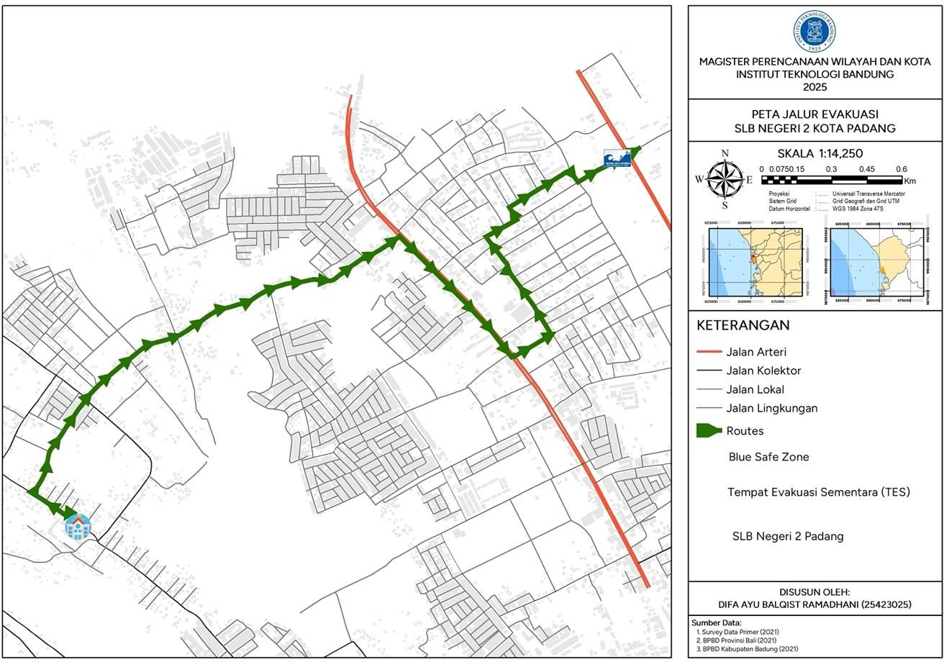
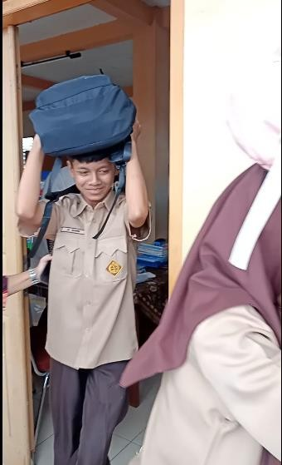
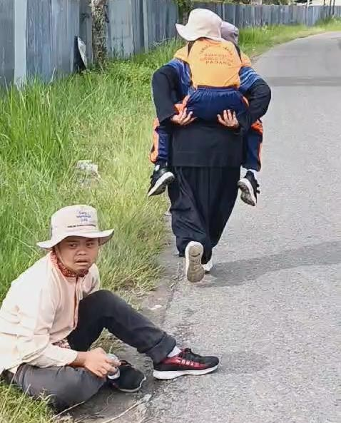
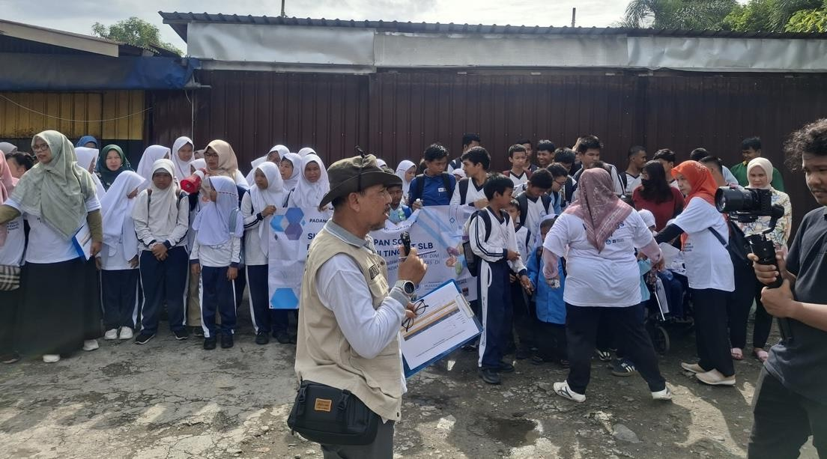
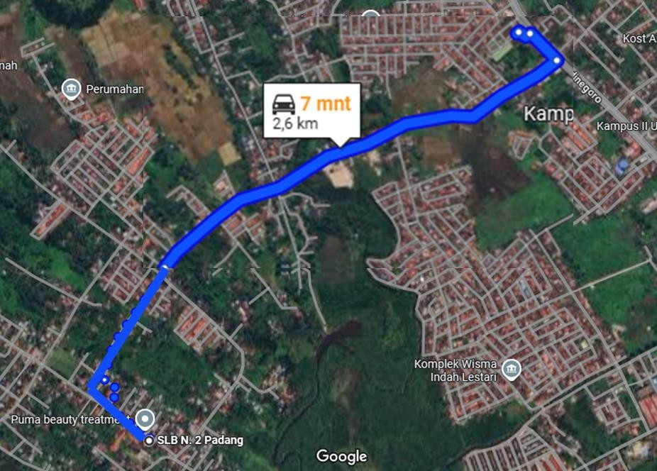
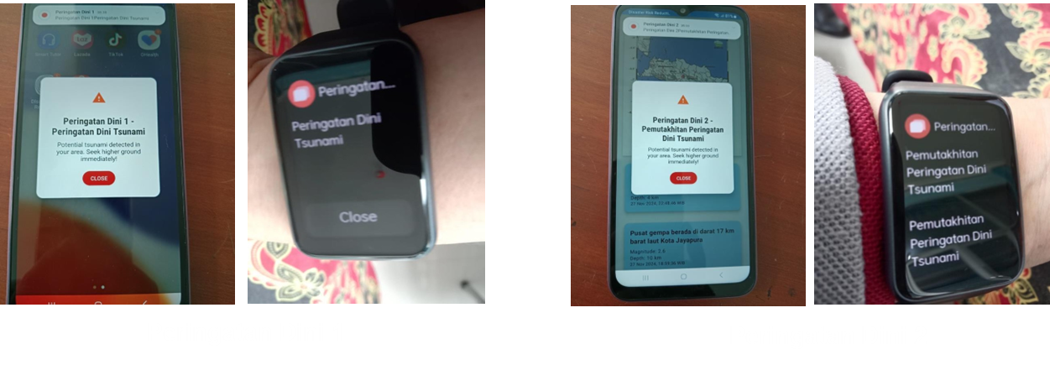
Inclusive Tsunami Warning Technology / Tools and Evacuation Plan
Evacuation route from Network Analysis Model
Simulation of Testing Inclusive SOP and Inclusive Tsunami Early Warning Device (Visual-based and Vibration-based) at the Special Needs School Level
Evacuation route after discussion with stakeholders

Slide 12
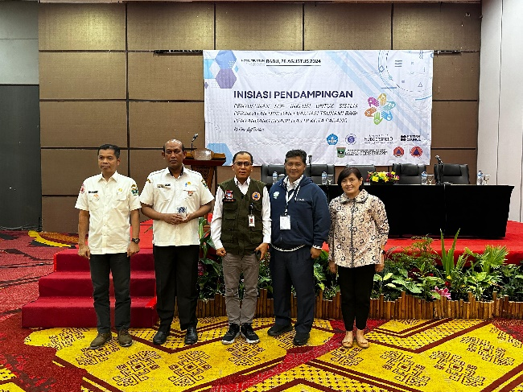
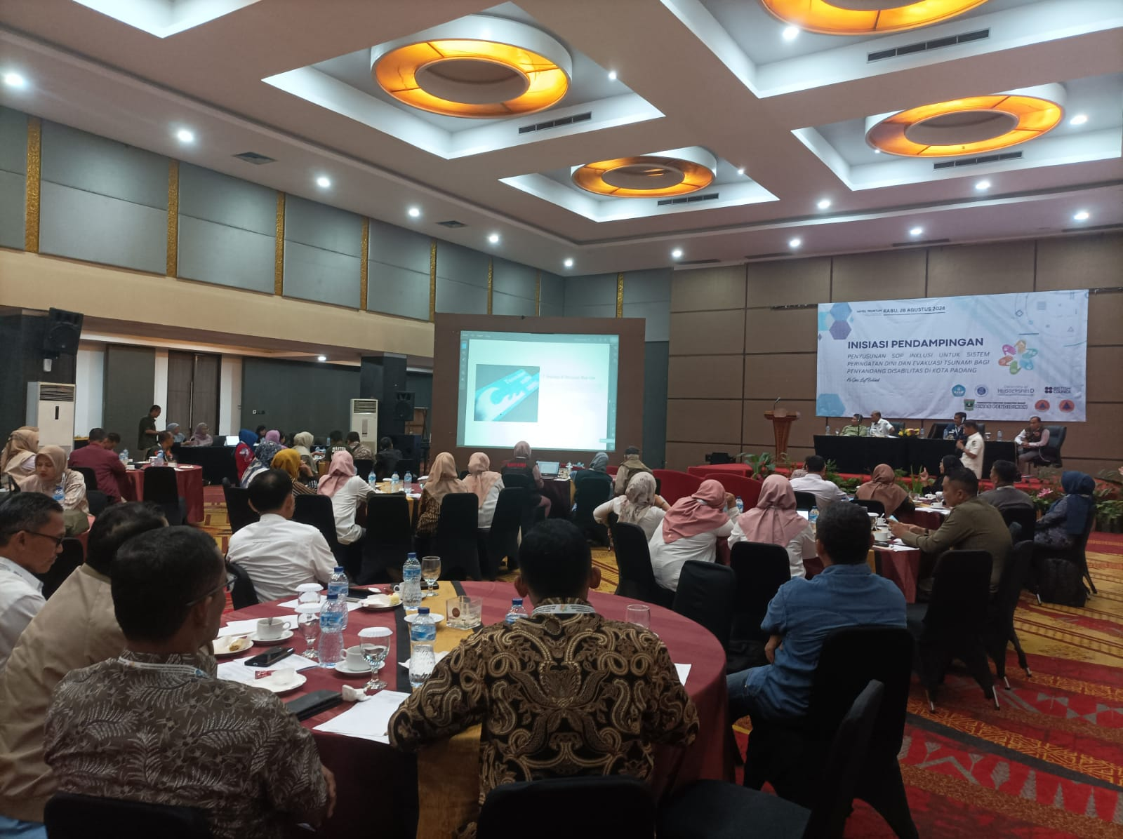
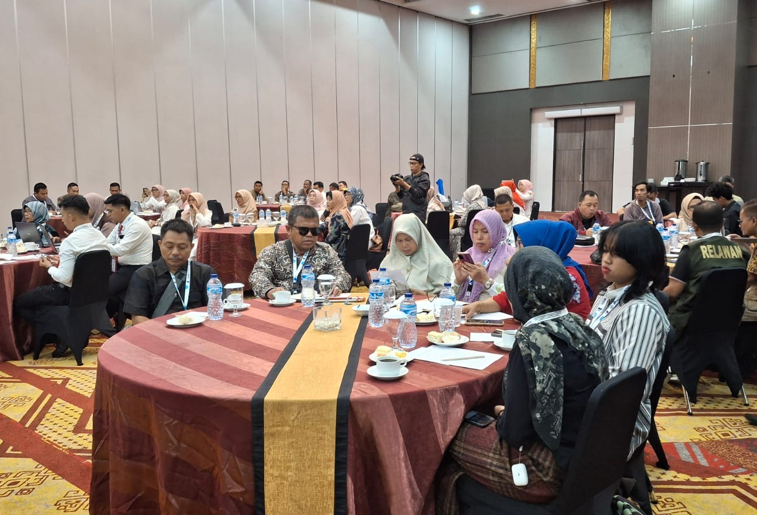
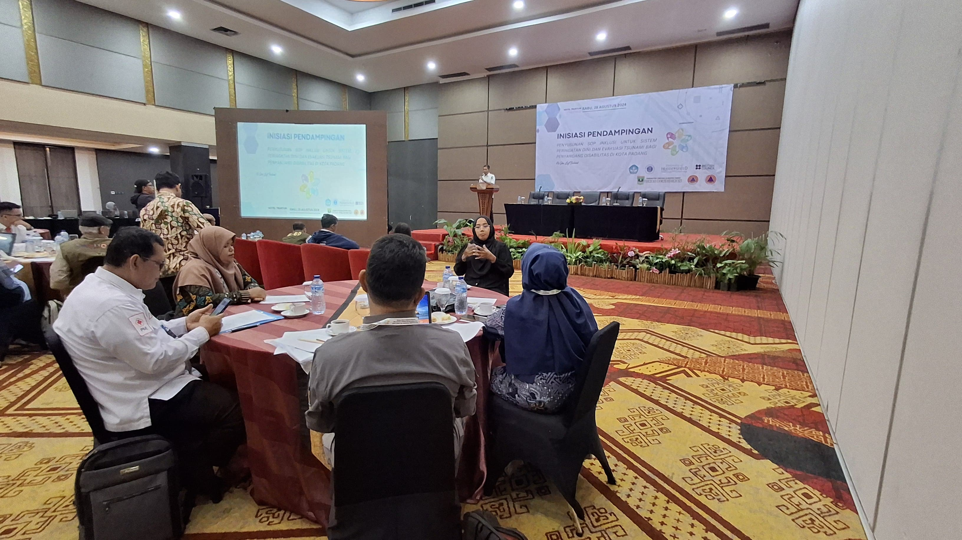
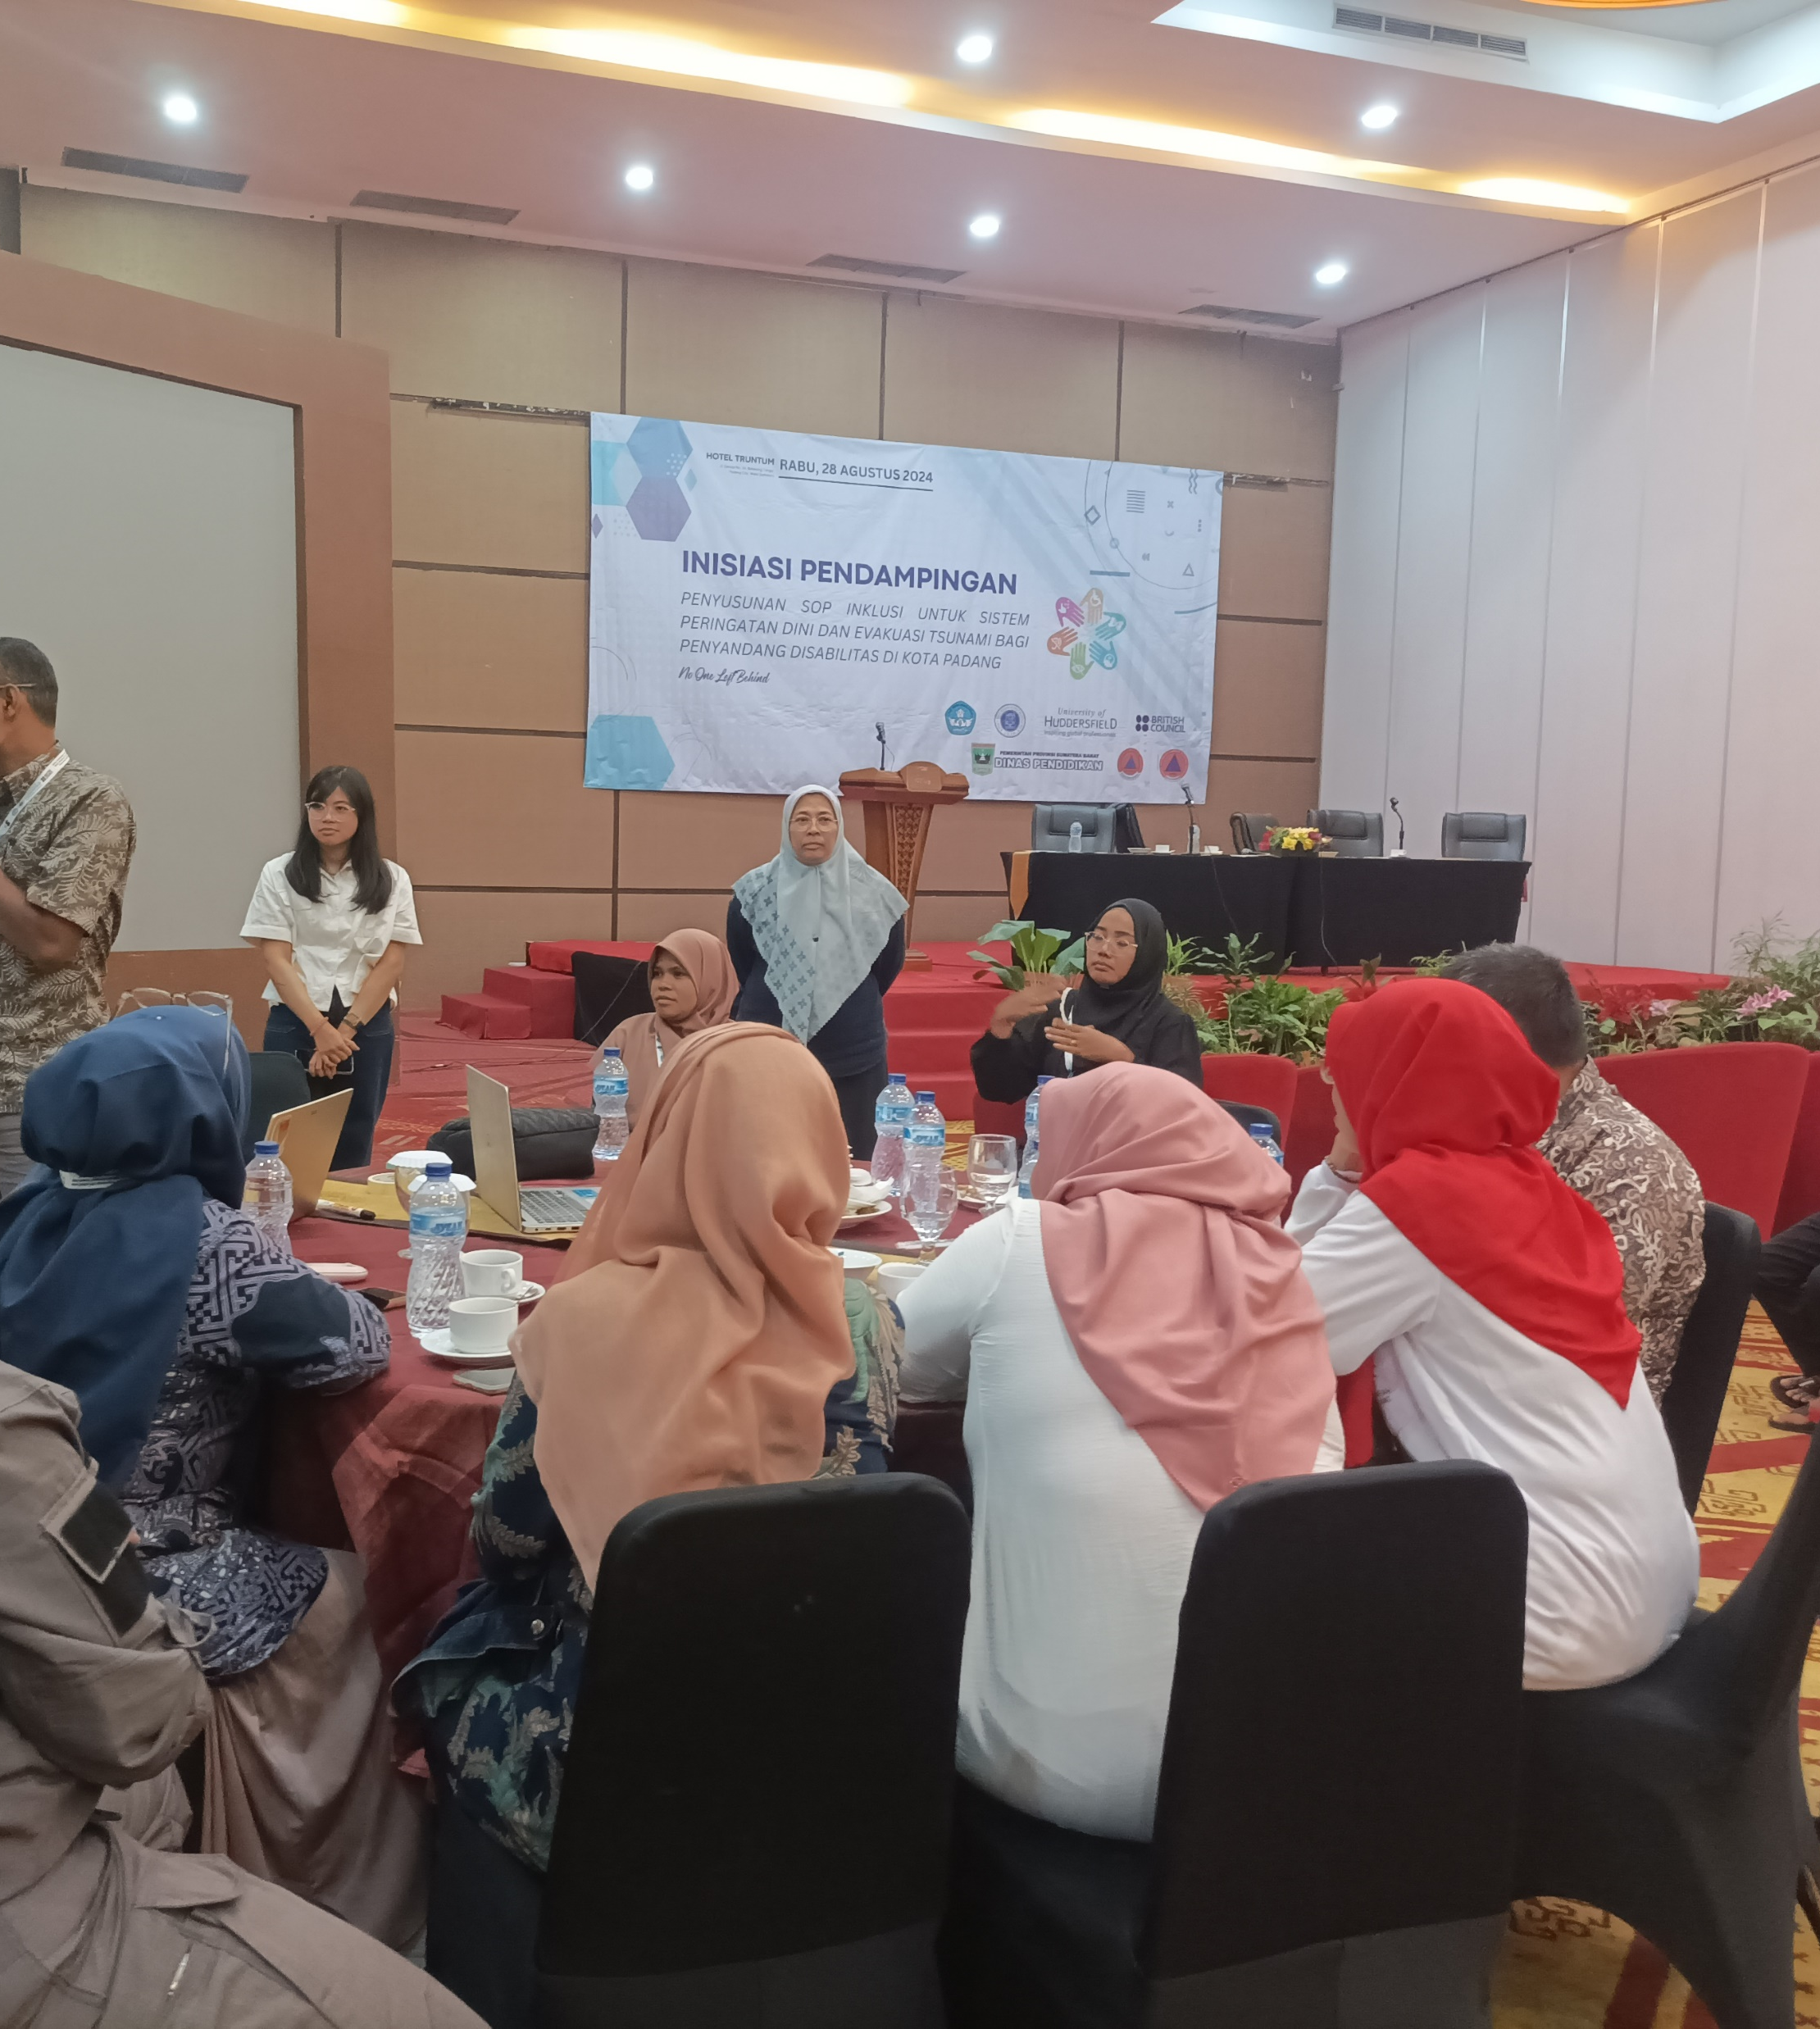
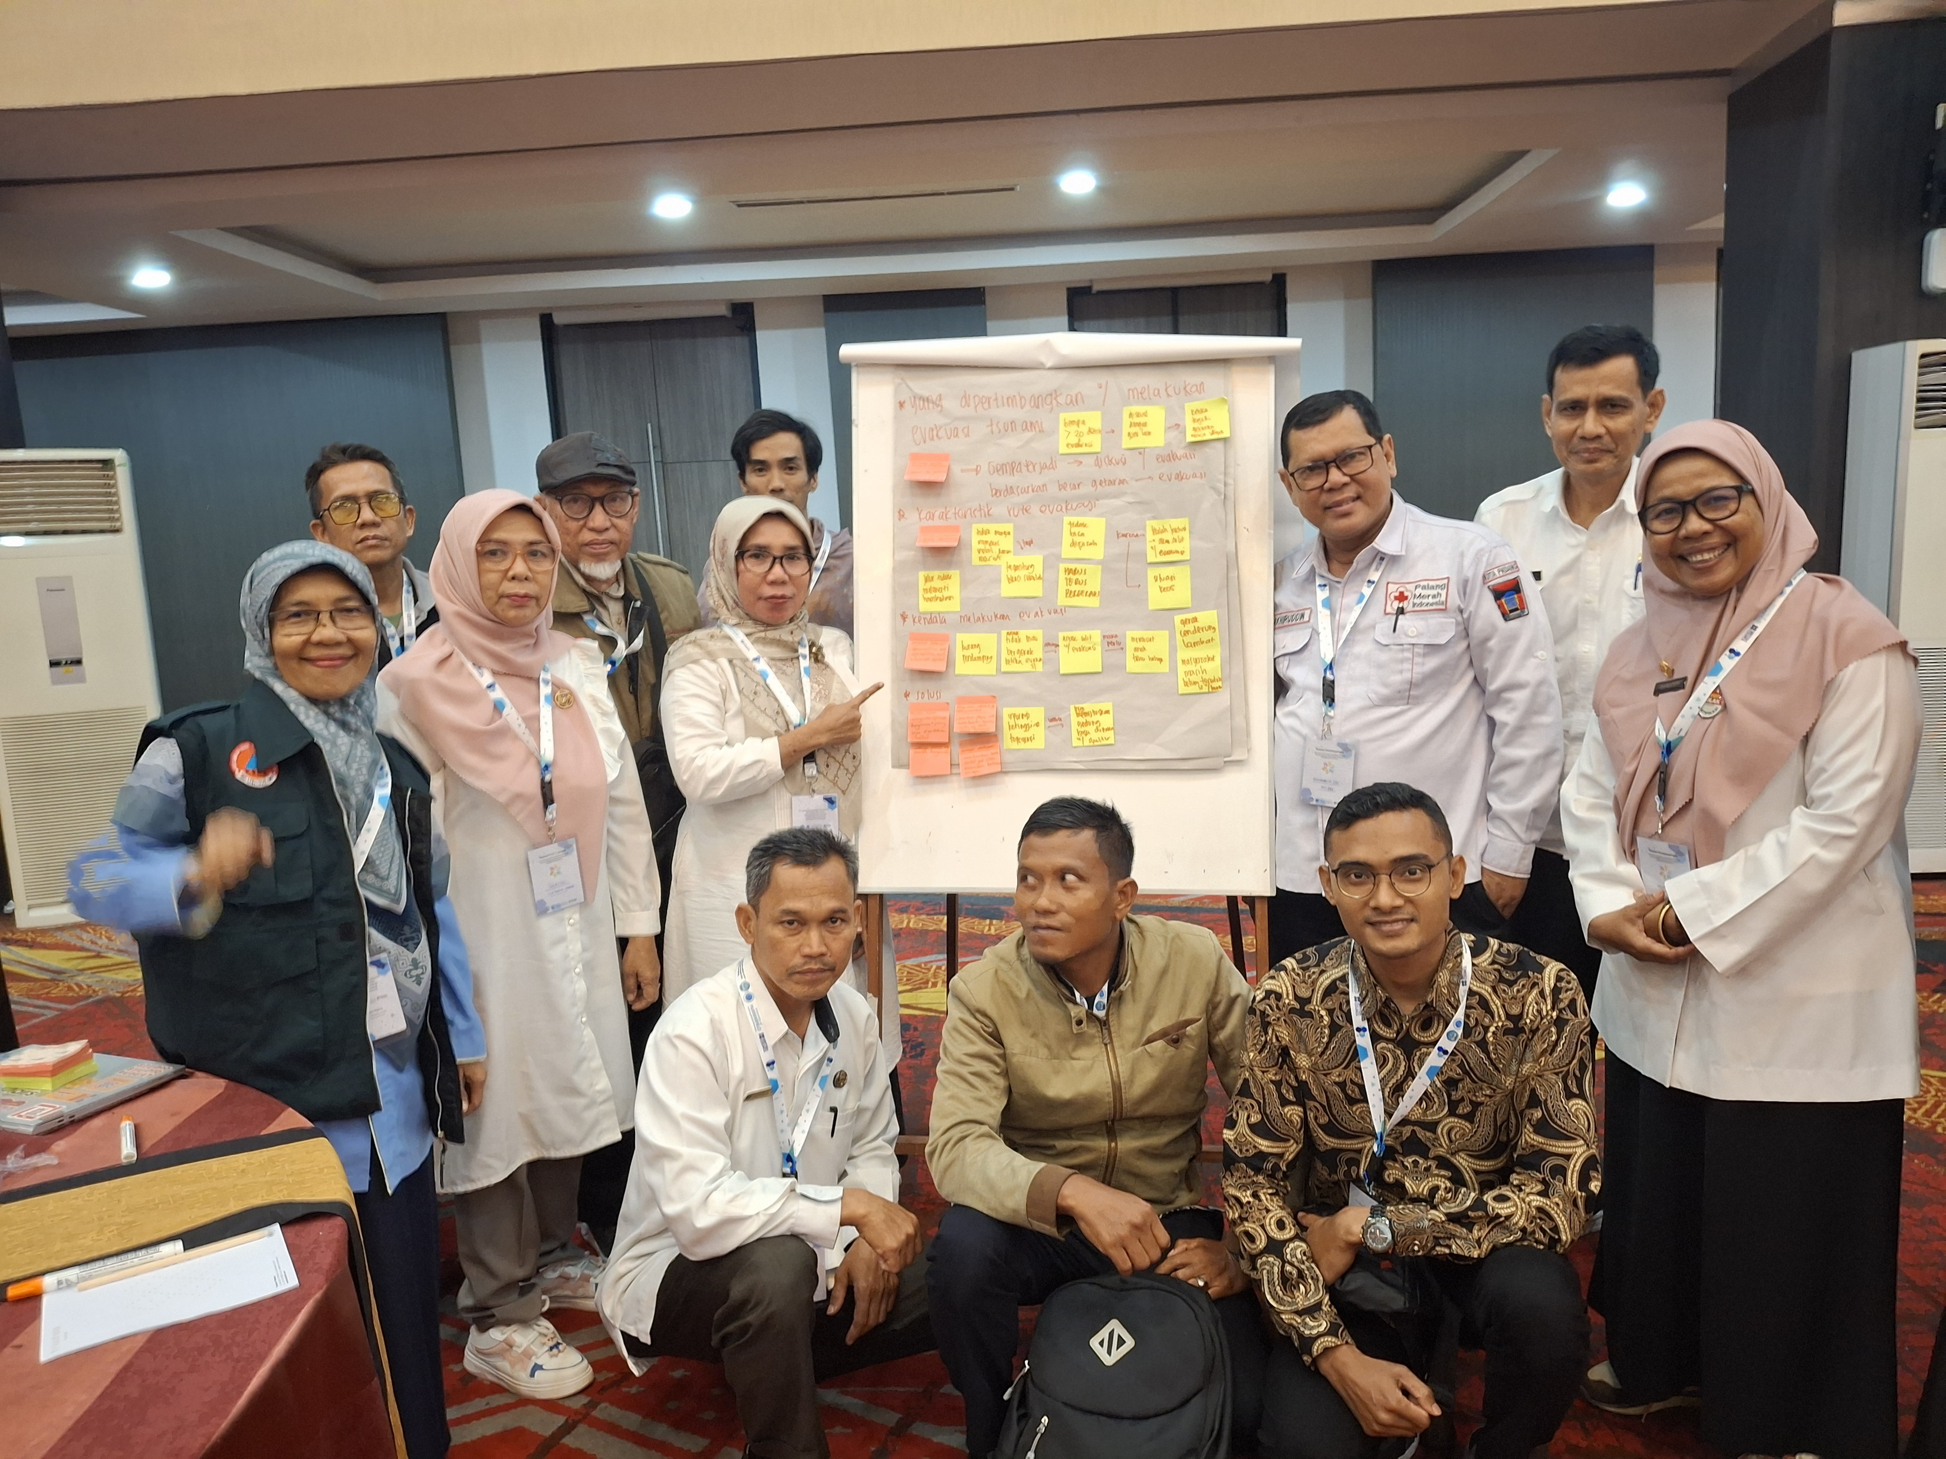
FGD Inclusive SOP in Padang, 28 August 2024 (Multi-helix: Government, Schools, Forums for Disability Community, Business, University, NGOs and Media)

Slide 13
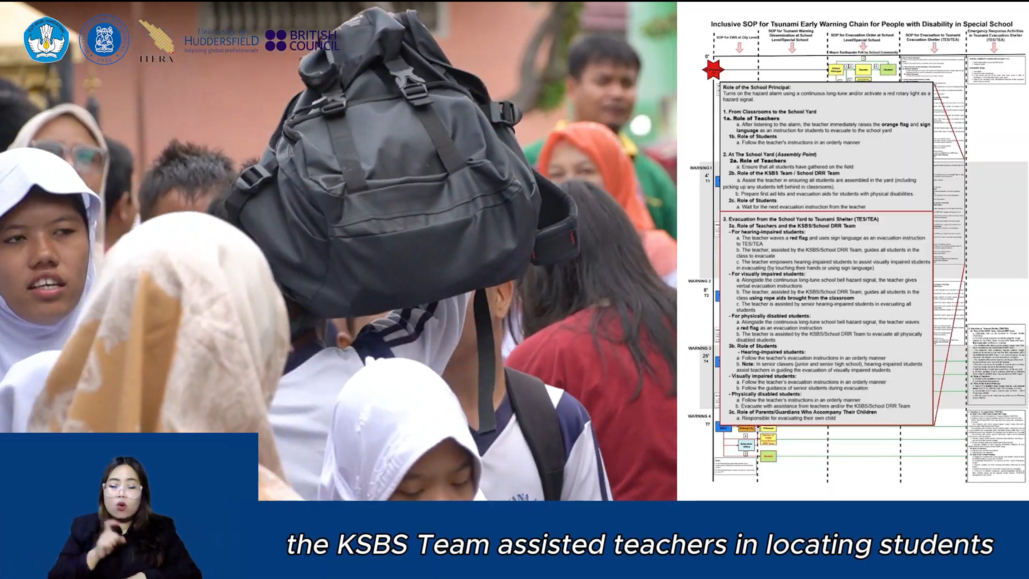


Inclusive SOP (Audio-Video, Sign Language and Text)
Inclusive SOP material are available in audio-video and text format
Audio-visual format include sign language
Available in 2 languages (Indonesia & English)

Slide 14
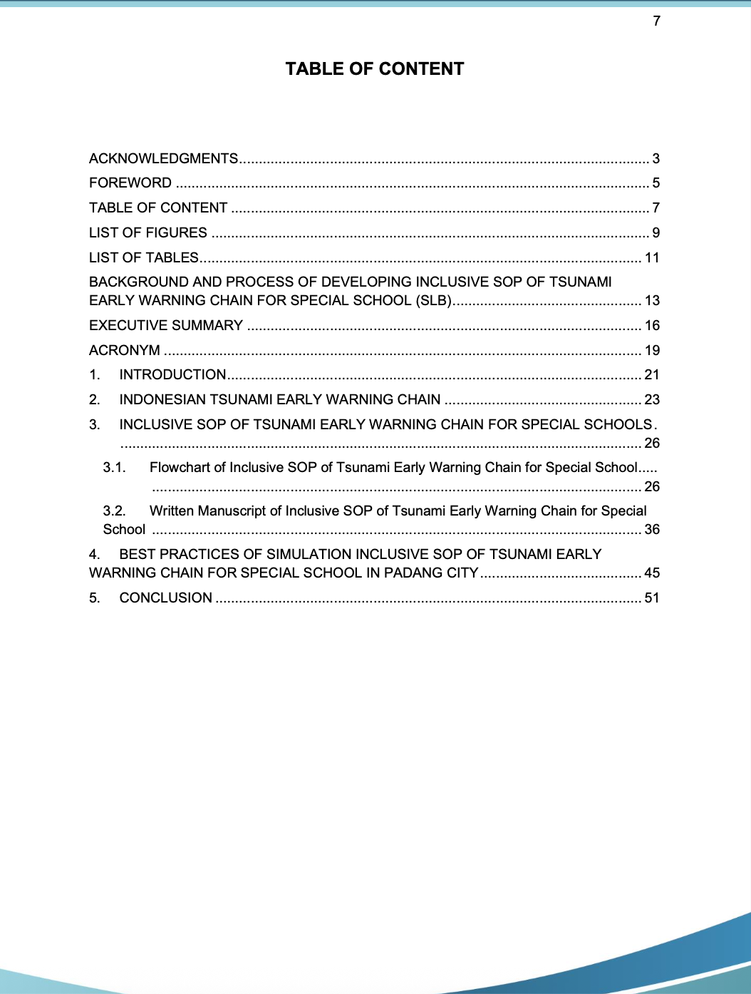
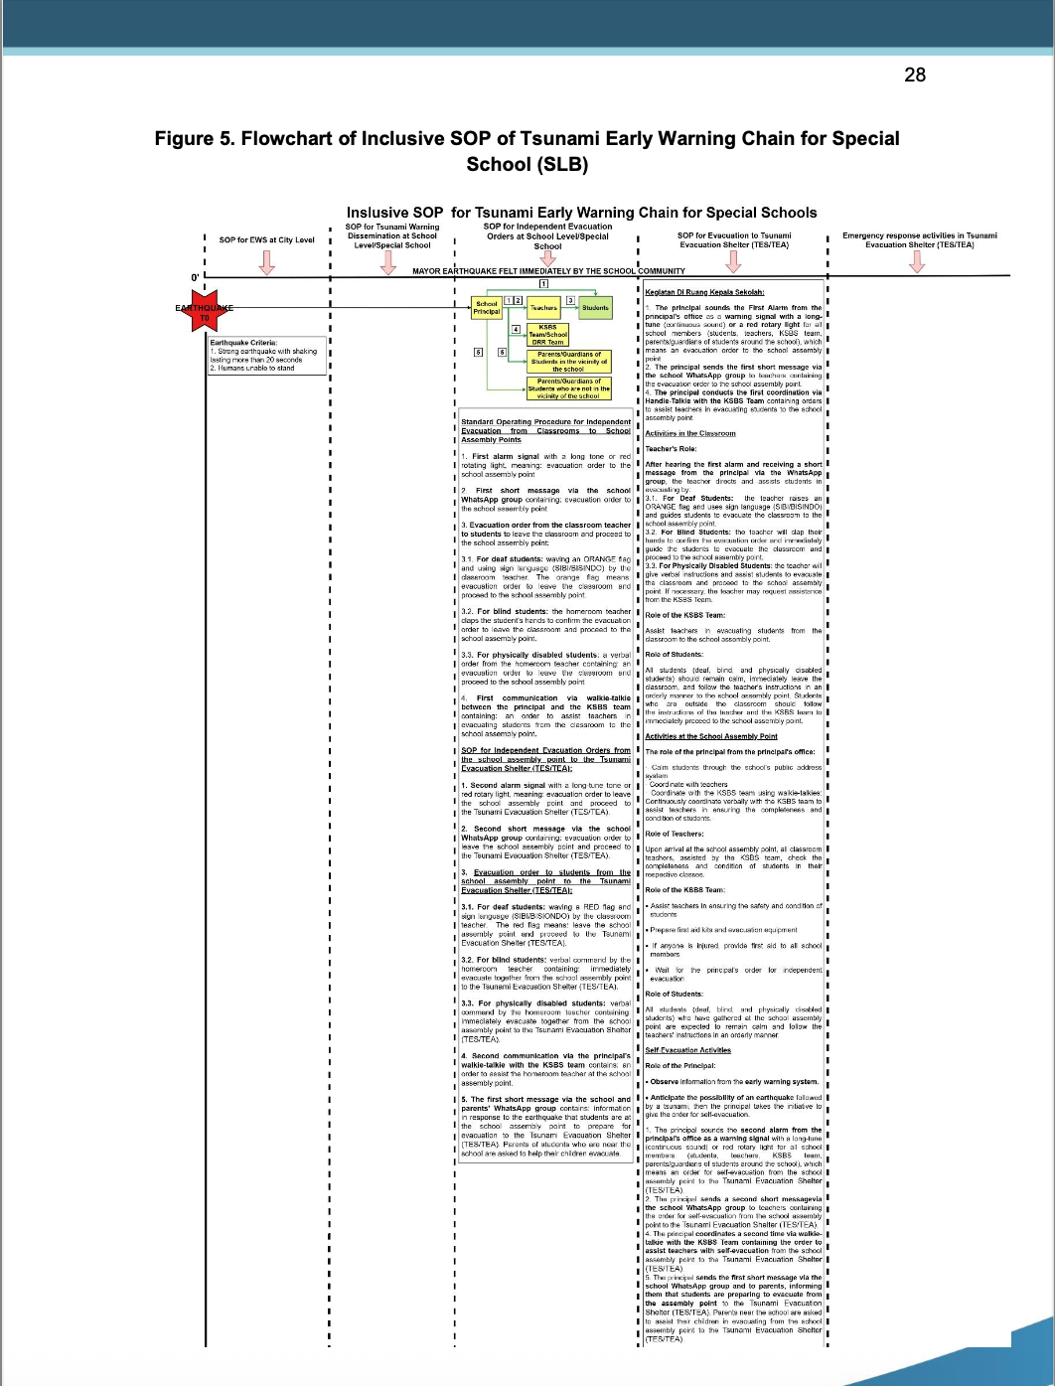
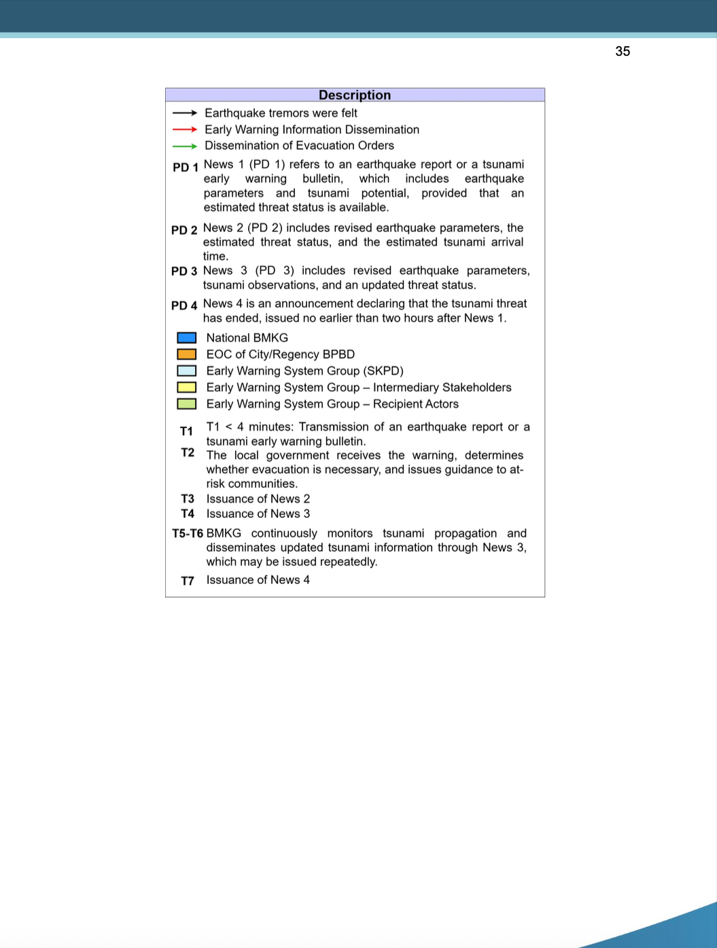
Inclusive SOP
54 pages

Slide 15
Link for the Audio-Video Inclusive SOPs
https://youtu.be/oaLq0oFWOIw?si=Wn-8grnRnItDv3mr

