Slide 1
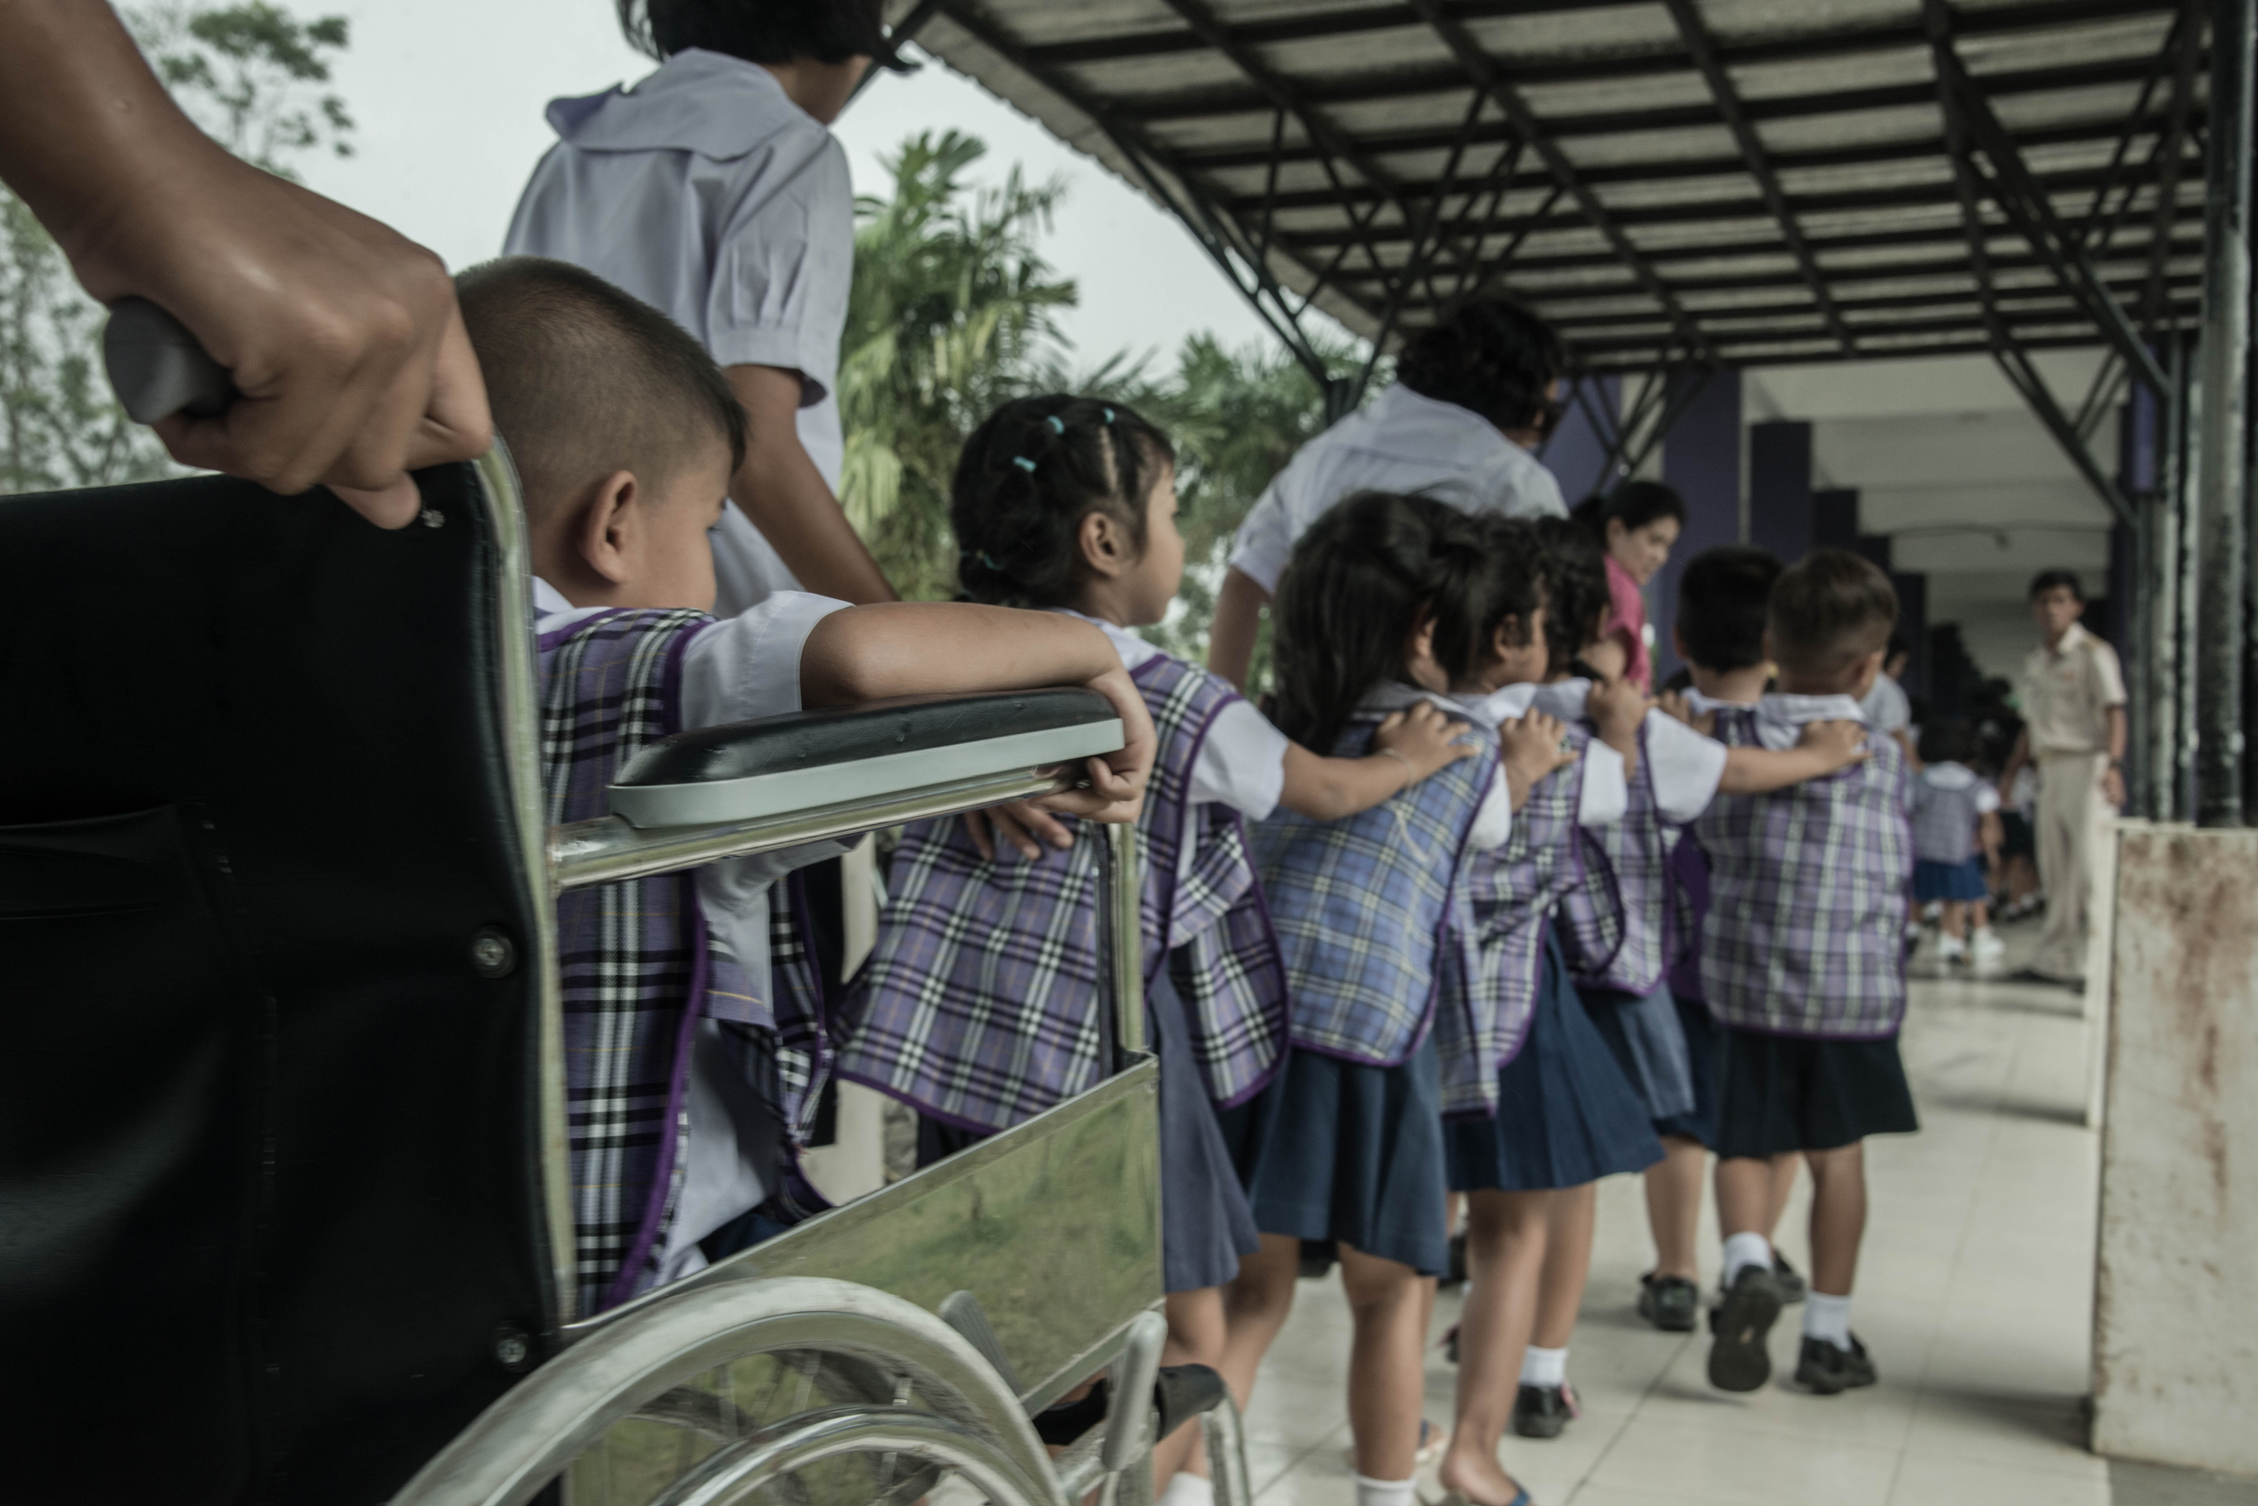


UNDP–ESCAP–UNESCO/IOC–UNESCO collaboration
Regional Roadmap on
Tsunami Early Warnings and Education

Slide 2
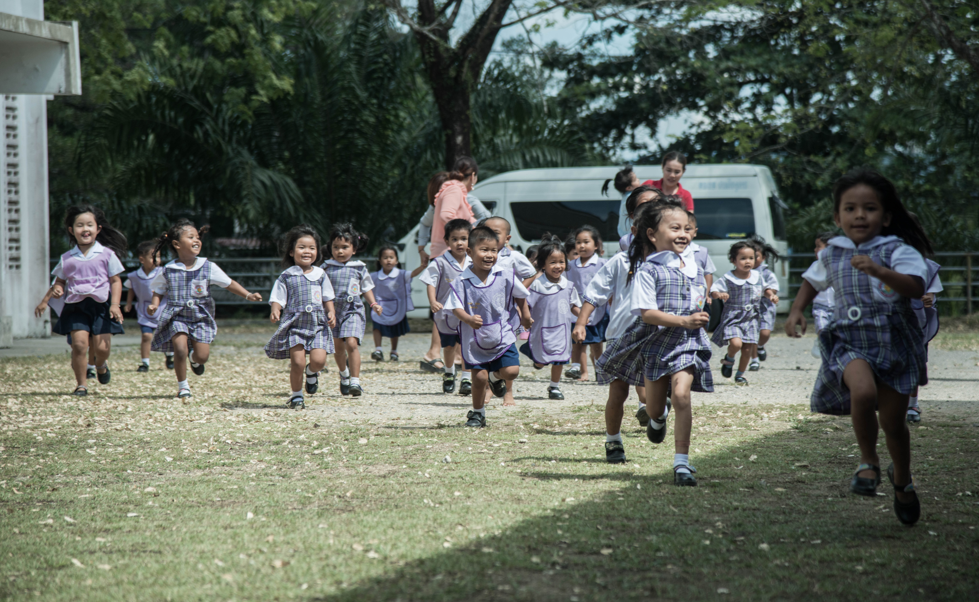
Regional Tsunami Project using school as an entry point to build wider community resilience
800 schools conducted tsunami drills, engaging about 221,000 students, teachers, local officials, and community members across 24 countries

Slide 3
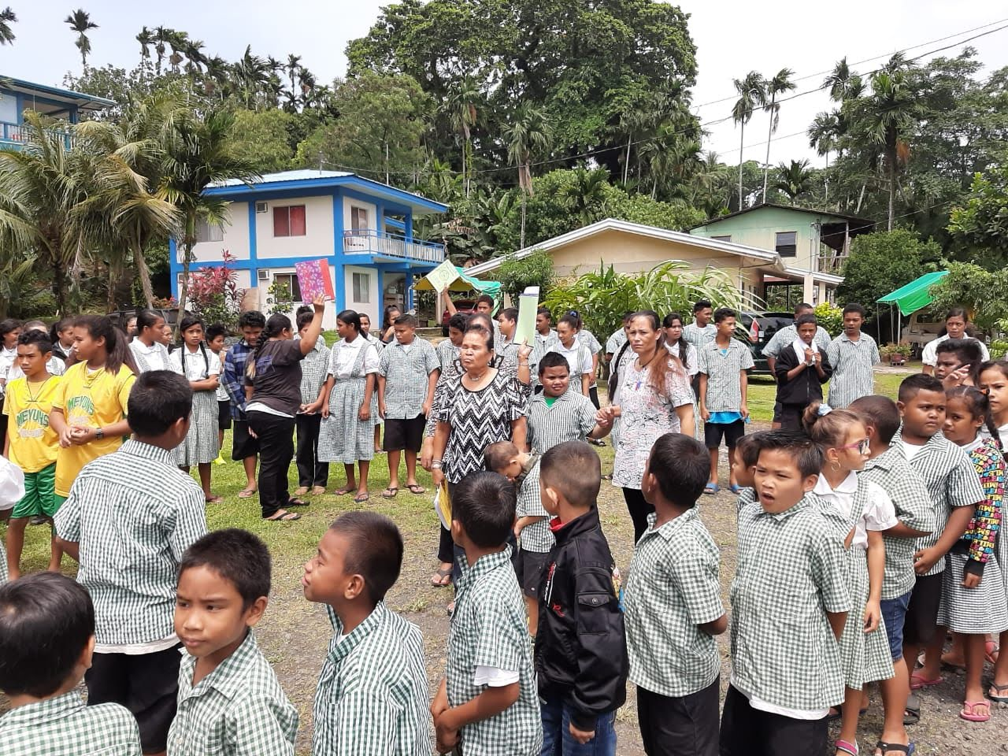
Schools are an entry point for wider community resilience
Students become messengers for preparedness, carrying knowledge and skills home with them
Schools are trusted and visible institutions that bring people together in their communities
Schools act as hubs for multi-stakeholder coordination

Slide 4





Regional Roadmap on Tsunami Early Warnings and Education
To strengthen EWS in AP by placing education at the center of resilience-building, creating a coherent, multi-hazard, regionally-coordinated approach that links schools, communities, scientific institutions, and warning authorities

Slide 5
UNDP–ESCAP–UNESCO/IOC–UNESCO collaboration
to develop the Regional Roadmap on Tsunami Early Warnings and Education
Regional convening power and work through the Trust Fund for Tsunami, Disaster and Climate Preparedness
Integrator role, country presence, building on the
UNDP-GoJ regional Tsunami Project
Scientific and technical expertise on tsunami EW and coordinating ICG/IOTWMS and ICG/PTWS
Global Alliance for Disaster Risk Reduction & Resilience in the Education Sector (GADRRRES)
Global lead on education

Slide 6
Expected outcomes
Phase 2 (1-2 months)
Phase 2 (1-2 months)
Phase 2 (1-2 months)
Phase 2 (1-2 months)
Improved comprehensive school safety and preparedness by aligning education infrastructure, management, and pedagogy/teaching with all-hazards disaster risk reduction and resilience principles
Strengthened intersectoral coordination across education, disaster management, meteorological, and planning ministries
Supported schools as an integral part of the community-based early warning system and wider community resilience
Advanced disaster-resilient education systems, particularly for SIDS and LDCs
1.
2.
3.
4.

Slide 7
Sooin Bang
Project Manager (Regional Tsunami Project), Disaster Risk Reduction and Recovery for Building Resilience Team, UNDP Bangkok Regional Hub sooin.bang@undp.org

