Slide 1
EW4ALL
UNESCO–WMO Technical Exchange on Integrating Volcanic Hazards into the Early Warnings for All (EW4All) Initiative
Based on UNESCO DRR Unit Report
Denis Chang Seng, PhD Programme Specialist
Technical Secretary (ICG/NEAMTWS and TOWS TT DMP)
CoastWAVE Project Lead
Tsunami Resilience Section
IOC of UNESCO

Slide 2
UNESCO–WMO Technical Exchange on Integrating Volcanic Hazards into the Early Warnings for All (EW4All) Initiative
Dates: February 3, 2026
Location: UNESCO HQ, Paris

Slide 3
Participants
World Meteorological Organization (WMO)
Andrew Tupper - Chief, Early Warning Services
Muhibuddin Usamah - Scientific Officer - Early Warning
International Association of Volcanology and Chemistry of the Earth’s Interior (IAVCEI)
Prof. Costanza Bonadonna, University of Geneva
UK Met Office
Matthew Hort - Principal Fellow Atmospheric Dispersion and Air Quality
UNESCO
Soichiro Yasukawa – Disaster Risk Reduction (DRR) Unit
Carlos Uribe – DRR Unit
Anna Norata – DRR Unit
Koen Verbist – Intergovernmental Hydrological Programme (IHP)
Denis Chang-Seng – Intergovernmental Oceanographic Commission (IOC)
Kristof Vandenberghe – International Geoscience and Geoparks Programme (IGGP)
Siying Tan – IHP
Ruth Katui Nguma – IHP

Slide 4
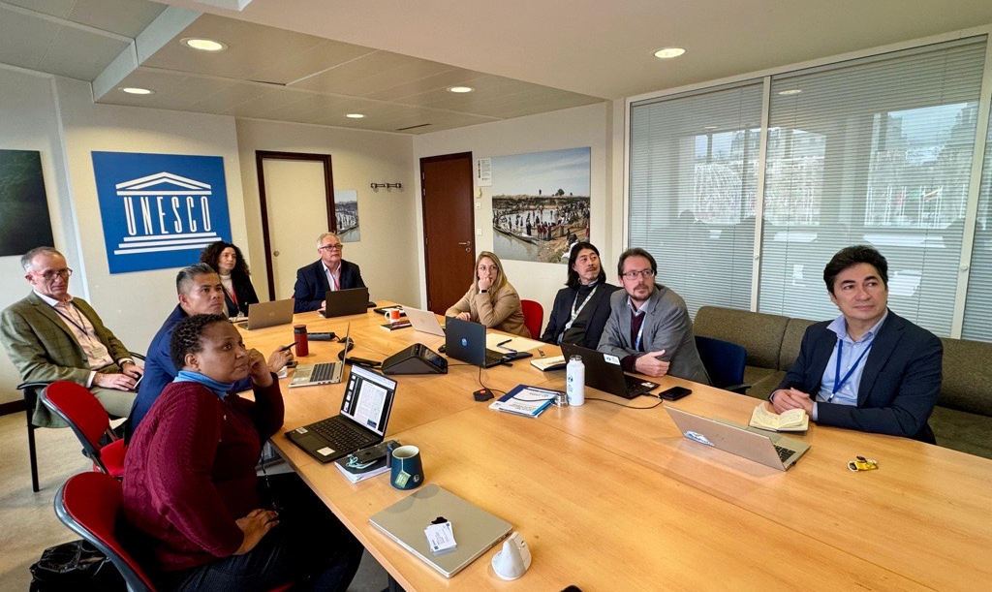
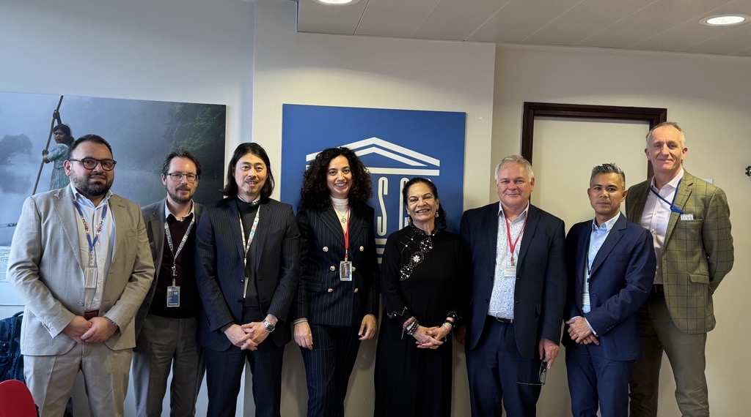
Source: UNESCO DRR Unit

Slide 5
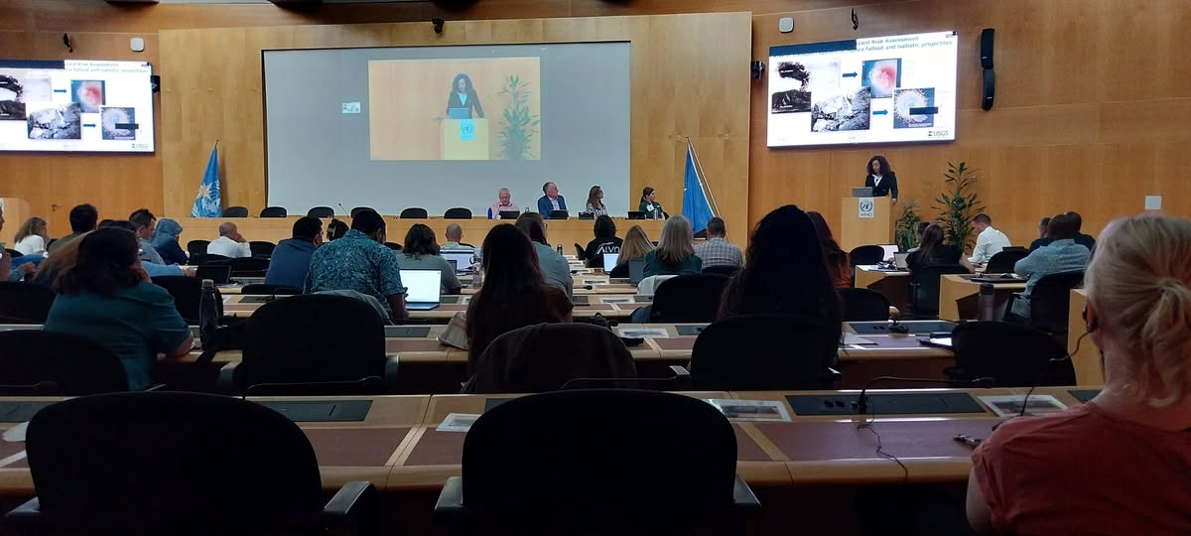
This meeting at UNESCO HQ was convened as a follow-up to the technical workshop on Early Warning Systems (EWS) held in Geneva in July 2025, organized by the University of Geneva (See above picture)
It brought together UNESCO (DRR Unit, IOC/TSR, IHP etc.) , WMO, the International Association of Volcanology and Chemistry of the Earth’s Interior (IAVCEI), and other partners.
Overall aim: Advanced dialogue on governance, operational entry points, and partnerships to embed volcanic hazards within EW4All, strengthening science–policy collaboration for national implementation under Sendai Target G.

Slide 6
Strategic Objective
Strengthening the Integration of Volcanic Hazards into EW4All
Key Outcomes:
Clear governance and institutional anchoring
Operational integration at country level
Sustainable financing pathways
Strong science–policy–practice interface

Slide 7
Governance & Institutional Actions (6–12 months)
Establish structured UNESCO–International Association of Volcanology and Chemistry of the Earth’s Interior (IAVCEI) collaboration
01
Formalize cooperation framework and roles
02
Embed volcanic hazards into EW4All governance architecture
03
Clarify operational entry points across UNESCO entities (DRR, IOC/TSR, IHP, IGGP)
04

Slide 8
Operational & Technical Actions (12–36 months)
Identify
Identify 2–4 pilot countries and regions
Develop
Develop multi-hazard operational SOPs
Strengthen
Strengthen volcano observatory – decision-maker interfaces
Produce
Produce operational guidance for national authorities
Support
Support preparedness actions for HILP risks

Slide 9
Implementation Platforms
UNESCO Global Geoparks: community-based pilots
Volcanic tourism risk management and communication
UNESCO Site Navigator for spatial coordination
Tsunami Ready communities

Slide 10

Financing & Resource Mobilization
Develop
Develop dedicated funding narrative for HILP risks
Align
Align with disaster preparedness, anticipatory action, and climate resilience financing
Build
Build joint multi-partner funding proposals
Promote
Promote catalytic, multi-year funding mechanisms

Slide 11
Roadmap & Next Steps
Next 6 months:
Formalize UNESCO–IAVCEI partnership
Identify pilot countries
Launch technical working group
Next 12–24 months:
Pilot implementation
Develop SOPs and guidance
Secure funding
Next 36 months:
Scale up regionally and globally
Inform post-2030 early warning governance

Slide 12
END

