Slide 1

TSUNAMI UNITED (2025)
Youth-led initiative in raising tsunami risk and strengthening tsunami preparedness
“This experience was truly transformative. I felt deep connection with the other participants, as if we had become a global family, united by a shared mission to learn together and raise awareness about tsunami risks” Pratyusha, Highschool Student, India
“The program completely reshaped how I see things. I realise that even small, personal actions like dedicating time to learn about disaster risks, can make a real difference in protecting and supporting the people around me” Theresia, Junior Highschool Student, Indonesia
331 students and 136 teachers from 71 schools across 16 Indian Ocean Countries
Joint Meeting of the Task Teams on Disaster Management and Preparedness (TT-DMP) and Tsunami Watch Operations (TT-TWO), March 2026

Slide 2
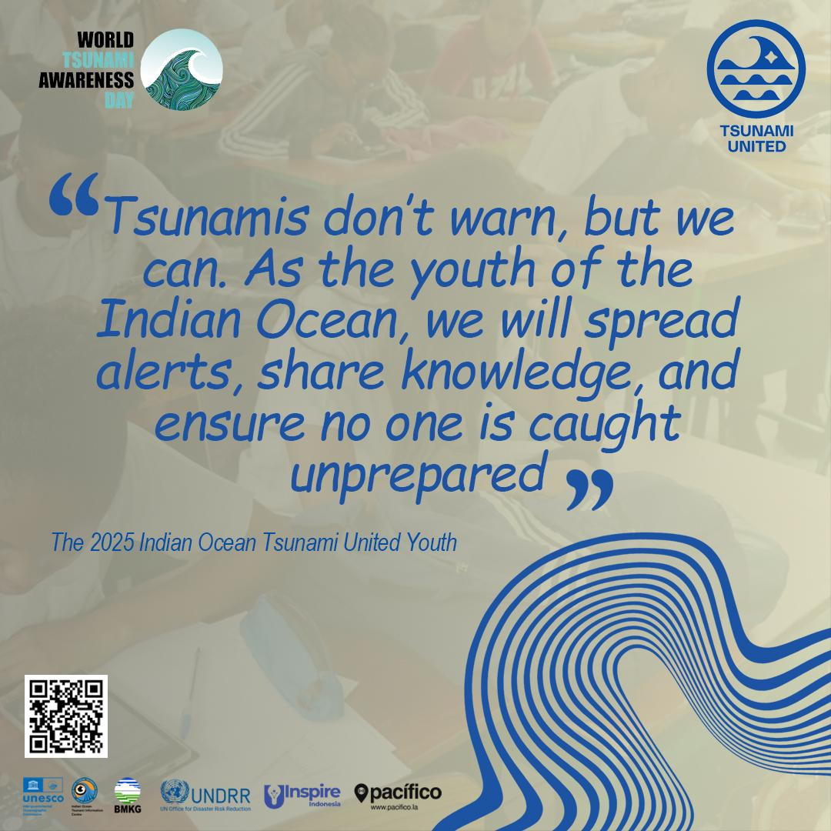
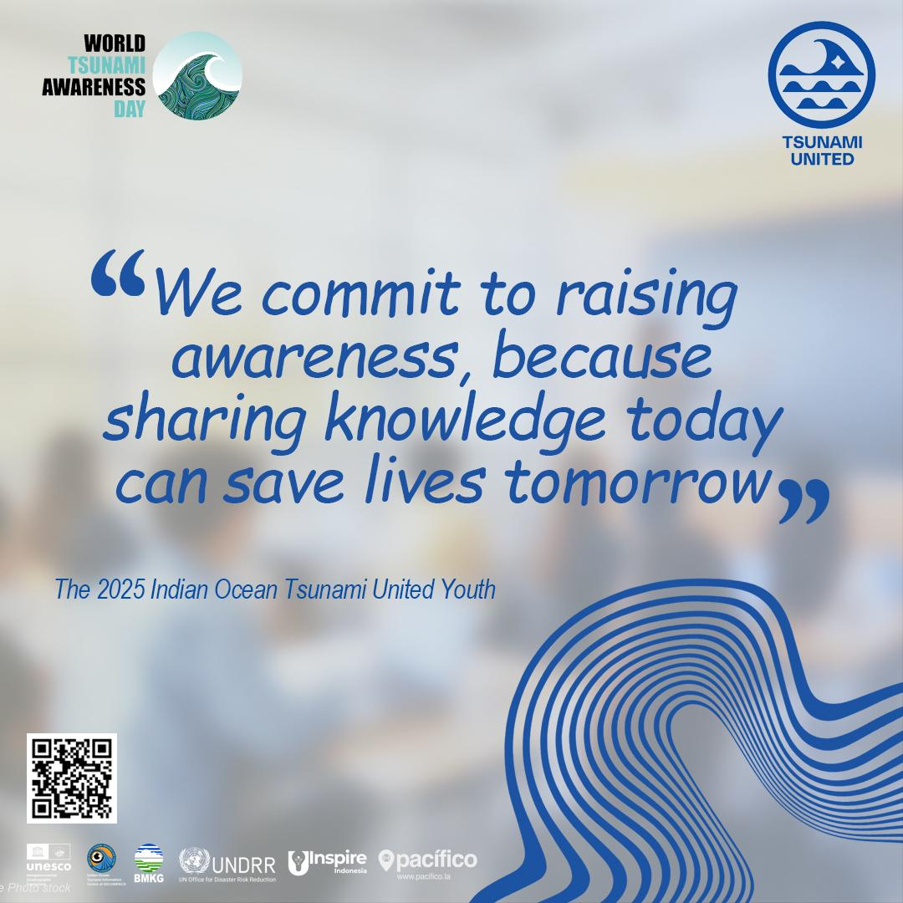

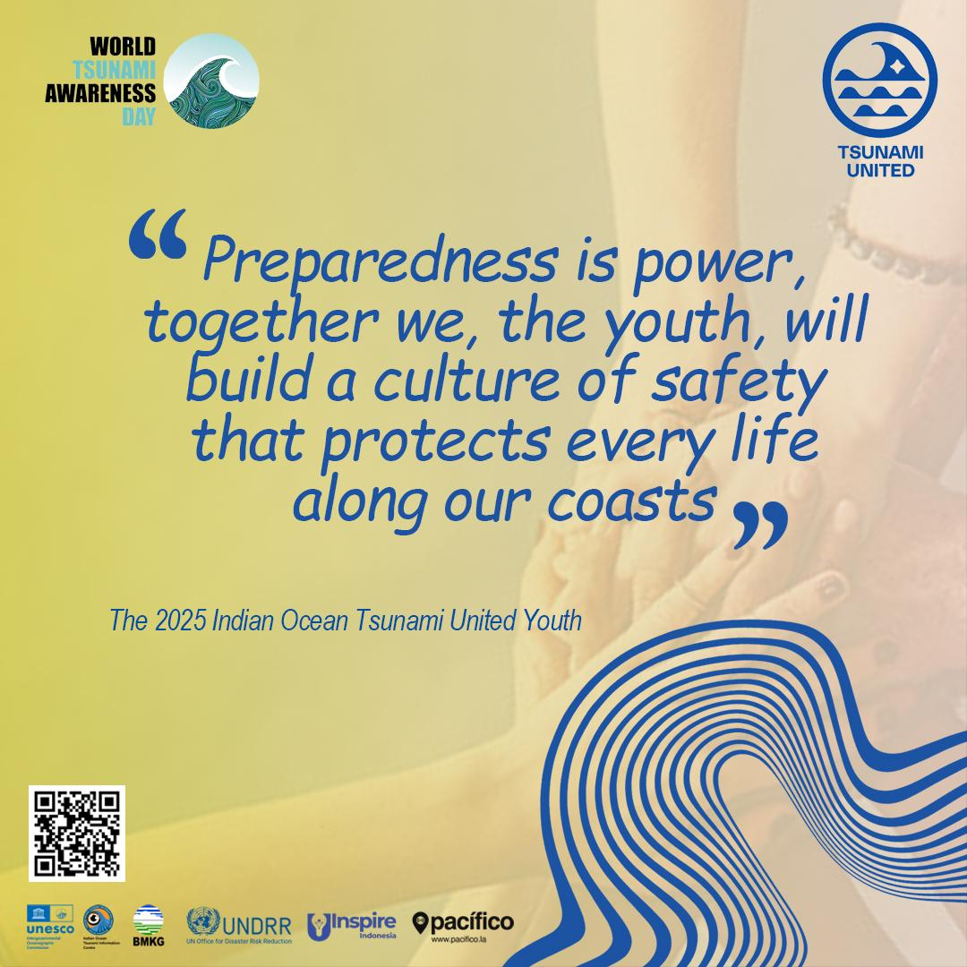
TSUNAMI UNITED (2025)
Youth-led initiative in raising tsunami risk and strengthening tsunami preparedness
Joint Meeting of the Task Teams on Disaster Management and Preparedness (TT-DMP) and Tsunami Watch Operations (TT-TWO), 4 March 2026

Slide 3
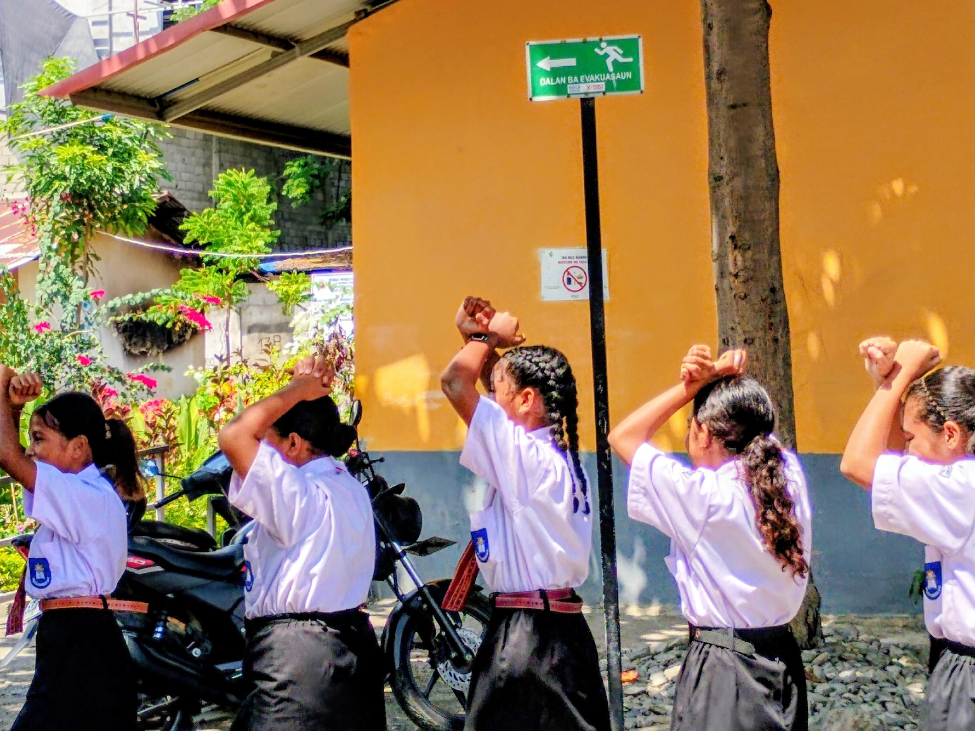
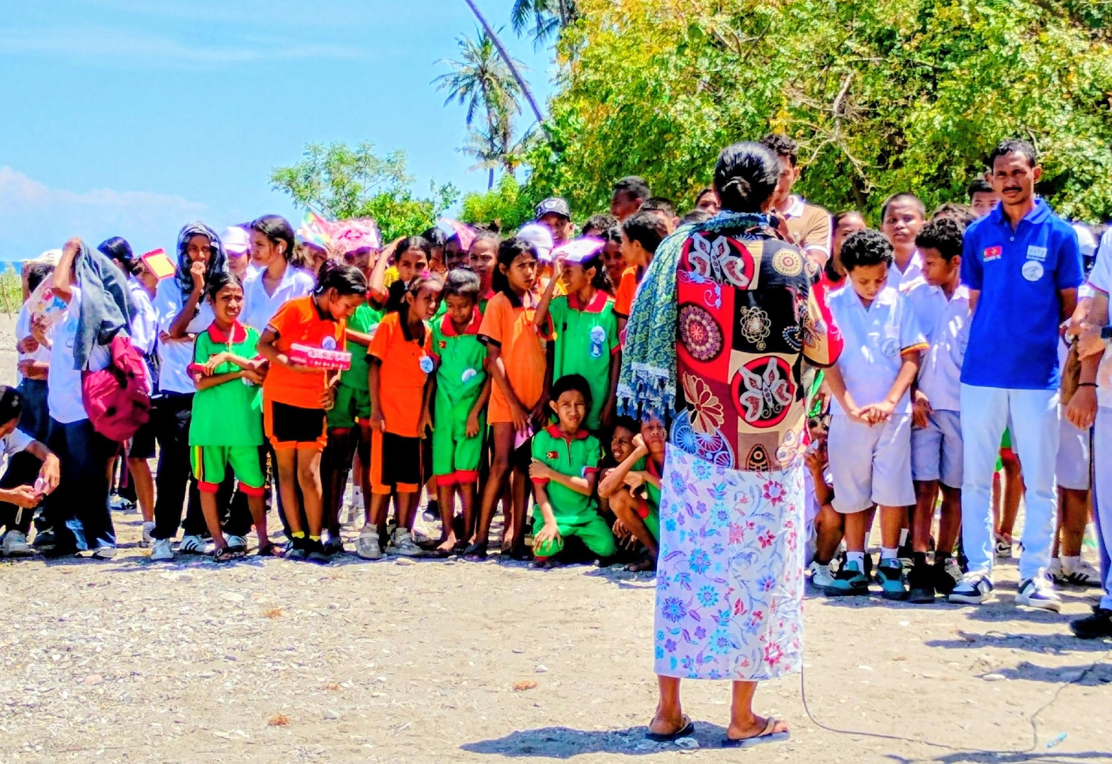
WORLD TSUNAMI AWARENESS DAY (WTAD) 2025
Dili, 05 to 07 November 2025
Around 160 students from five schools in Dili took part in the WTAD 2025 educational campaign.
Ms. Elsa Dos Santos, a survivor of the 1995 tsunami in Dili, shared her unforgettable story to the students.

Slide 4
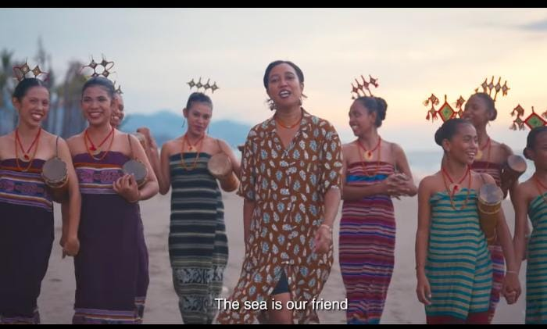
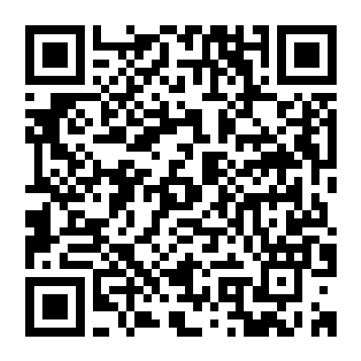
Scan Here for the Tsunami Preparedness song 2025 in Tetum

