Slide 1
Status of Tsunami Ready Equivalency
March 2026 Report to TT DMP

Slide 2
TRRP “Equivalency”
The UN Ocean Decade Goal is to make ”100% of communities at risk of tsunami prepared for and resilient to tsunamis by 2030 through the implementation of the UNESCO/IOC Tsunami Ready Recognition Programme and other initiatives.”
For the proposed ‘equivalency’ concept, the 12 indicators of the Tsunami Ready Recognition Programme are taken as the definition of ‘prepared and resilient’
The purpose of this ‘equivalency approach’ is to ensure that every country can contribute to progress reporting for the UN Ocean Decade Goal.
This process does not require application to IOC/UNESCO for formal TR recognition but will support ICG reporting.
.

Slide 3
TRRP “Equivalency”
The approach has the following principles:
Countries have a strong motivation to ensure tsunami resilience
Builds upon existing programmes, capacities and strengths
We use the 12 indicators of the Tsunami Ready Framework
Contributes to ICG progress reporting for UNOD Tsunami Programme
Where possible, the TRRP should be implemented as a first option
The process is a self-assessment, and countries are encourage to apply it according to the principles of the equivalency – accurately reporting tsunami preparedness.
It is a country action, applied to the most pragmatic definition of community

Slide 4
Progress
At the ICG/PTWS-XXXI in April 2025, the ICG:
Provisionally approved the Tsunami Ready Equivalency Guidance, and recommended the WG3 Task Team Tsunami Ready to conduct a pilot of the PTWS Tsunami Ready Equivalency Guidance
Encouraged Member States to consider working with the Task Team to contribute to the pilot, in order to report back on the feasibility and usability of the approach
Recommended the Task Team to utilize the results of the pilot to finalize guidance for approval at the ICG/PTWS-XXXII.
We are hopeful this may coincide with the Tsunami Ready Implementation Survey and new ICG reporting under consistent KPIs.

Slide 5
Recommendations to TOWS-WG
Notes the provisional approval of the PTWS Tsunami Ready Equivalency Guidance by ICG/PTWS-XXXI, and that the the PTWS will monitor pilot implementation of the guidance towards final approval by ICG/PTWS-XXXII.

Slide 6
Annex: The Proposed PTWS Equivalency Process
https://oceanexpert.org/document/36094

Slide 7
ICG/PTWS XXXI April 2025
The Proposed PTWS Equivalency Process
Approach proposed at ICG/PTWS-XXX had 4 steps, since simplified to 3:
Identify / establish national governance
Assess tsunami preparedness & resiliency against TRRP indicators
Report progress toward UNOD Goal to ICG.
This process would be applied to the most pragmatic definition of community, so that the assessment can be conducted in a meaningful but sustainable manner.
It is important that this is appropriate for each countries existing disaster management context
The Tsunami Ready Recognition Programme gives similar flexibility.

Slide 8
ICG/PTWS XXXI April 2025
1. Establish Governance
National governance should be in place in order to provide oversight of this process. In many cases an existing governance body may be able to be identified for this purpose to avoid duplication, or a bespoke National Tsunami Ready Board could be established.
The functions of this governance group will be to:
Provide expert interpretation of the tsunami ready indicators in the country's own context
Provide expert commentary on the definition of community in the country’s own context
Approve the implementation of this equivalency process
Should formal Tsunami Ready Recognition appropriately wish to be pursued by any individual community, this governance structure may be able to be utilized for the recognition process as per IOC MG 74.

Slide 9
ICG/PTWS XXXI April 2025
2. Cross-Referencing Process
A cross-referencing guide is provided in the documentation, which is intended to be broad enough for multiple contexts, while remaining a high standard of tsunami preparedness. For example, if it is believed that the preparedness activities conducted by the communities in accordance with the law contribute appropriately to an indicator in the communities, this can be appropriately recorded as justification to meet the overall indicator.
This process is a self-assessment, and countries are encouraged to apply it according to the principles of the equivalency process.
This review, along with supporting documentation such as plans, should then be reviewed by the established governance mechanism.
The cross-referencing process should be completed at least once every four years, in alignment with the Tsunami Ready Recognition Programme renewal timeframe.
Notes:
At a national level, a review should be conducted of all existing activities and strategies that contribute to tsunami preparedness as described by the Tsunami Ready Recognition Programme indicators. The purpose of this is the identification of where Tsunami Ready indicators are already being met through existing national or community disaster management or tsunami preparedness efforts.
Before the ICG we will be trying to provide examples of how this might practically be applied in a few countries

Slide 10
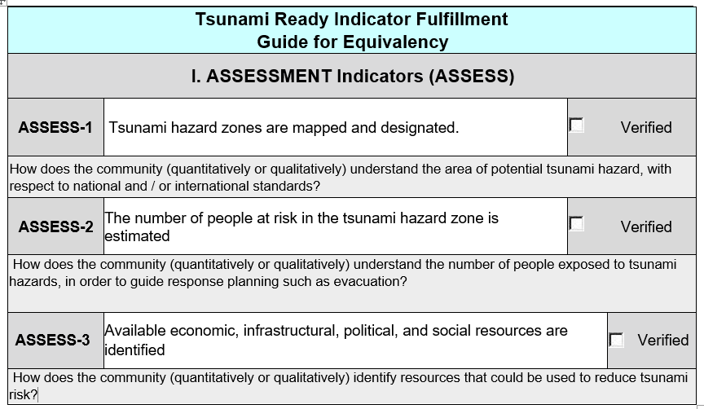

ICG/PTWS XXXI April 2025
2. Cross-Referencing Process cont.

Slide 11
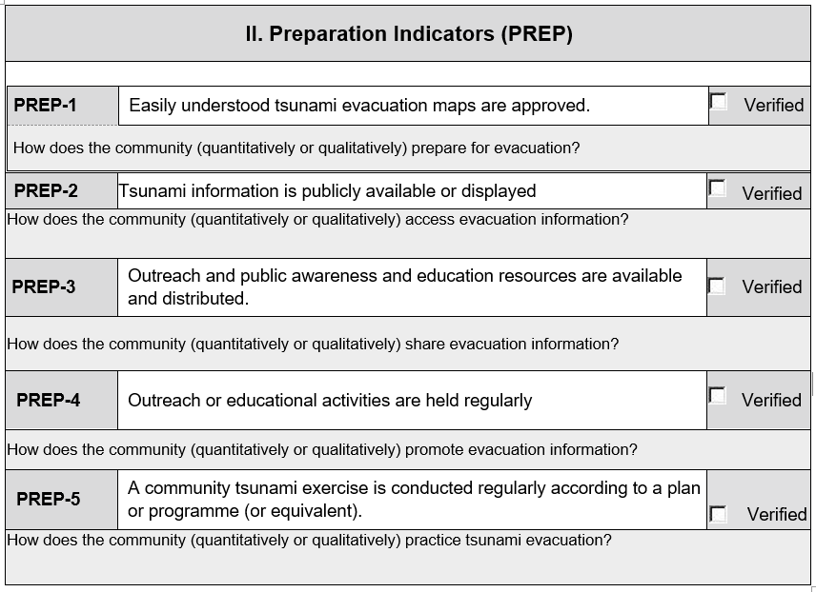
ICG/PTWS XXXI April 2025
2. Cross-Referencing Process cont.

Slide 12
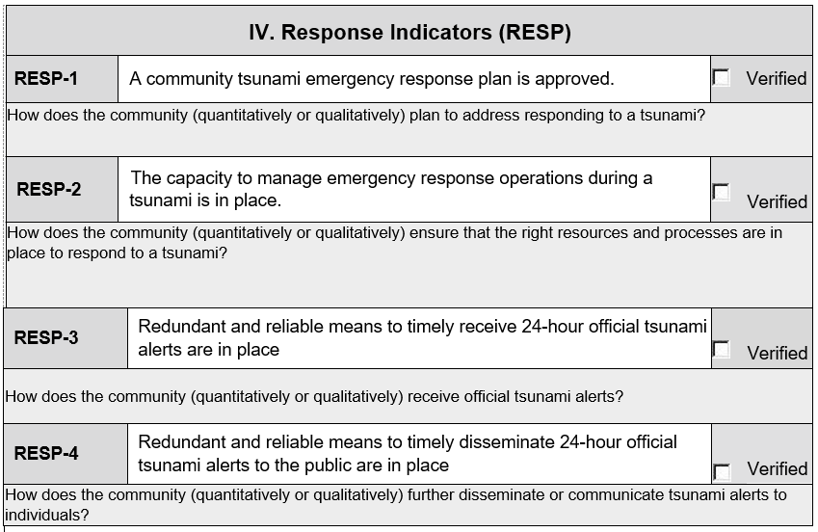
ICG/PTWS XXXI April 2025
2. Cross-Referencing Process cont.

Slide 13
ICG/PTWS XXXI April 2025
3. Reporting
PTWS Member States should report the progress of the preparedness and resilience of at-risk communities either through the Tsunami Ready Recognition Programme Implementation or through the equivalency approach through national reporting to the ICG.
Ideally, these should be integrated with future PTWS KPI and National Reporting frameworks, but reporting could be along the lines of the following:
What % of your at-risk communities are ‘prepared for and resilient to tsunami’?
This will need to continue to be closely aligned to global reporting methods for UNOD goals and the Tsunami Ready recognition programme.

