Slide 1


Automated Tsunami Ready Recognition Platform
Derya Itir Vennin, PhD
Assoc. Project Officer
UNESCO/IOC
d.dilmen-vennin@unesco.org

Slide 2

Current Process Overview
Community expresses intent through TNC
NTRB/RTRB evaluates application
Supporting documentation manually compiled
Submission via email to IOC/TSU Unit (TecSec)
TIC confirms documentation status
IOC HQ prepares certificates & TR sign
TR Viewer updated to “Recognized”
Key Characteristics
Manual submission
Email-based coordination
File naming compliance required
Multiple stakeholders involved
Background: Current Tsunami Ready Workflow

Slide 3



Challenges in the Current Process
Heavy email communication
Manual file renaming and organization
No centralized tracking
Limited visibility of application status
Manual generation of reference numbers
High coordination load for TecSec and TICs

Slide 4

Automated Tsunami Ready Application Platform
Objective:
Digitize and streamline the TRRP application, verification, and recognition workflow.
Core Principles:
Centralized system
Automated notifications
Standardized file management
Transparent status tracking
Secure role-based access

Slide 5
Platform Access & User Roles
Authorized Users-Invitation only-closed group:
TNC (Submitter)
TNC/NTRB(Reviewer 1)
TIC (Reviewer 2)
UNESCO/IOC HQ (Admin)
Access Model
Member States receive:
Role-based permissions

Slide 6

Application Submission Workflow
Step-by-Step Process for Submitters:
Select Region
Select Country
Enter Community Information
Upload Indicators
Submit
Step-by-Step Process for Reviewers:
Select the application
request changes (ask for resubmit) or approve

Slide 7
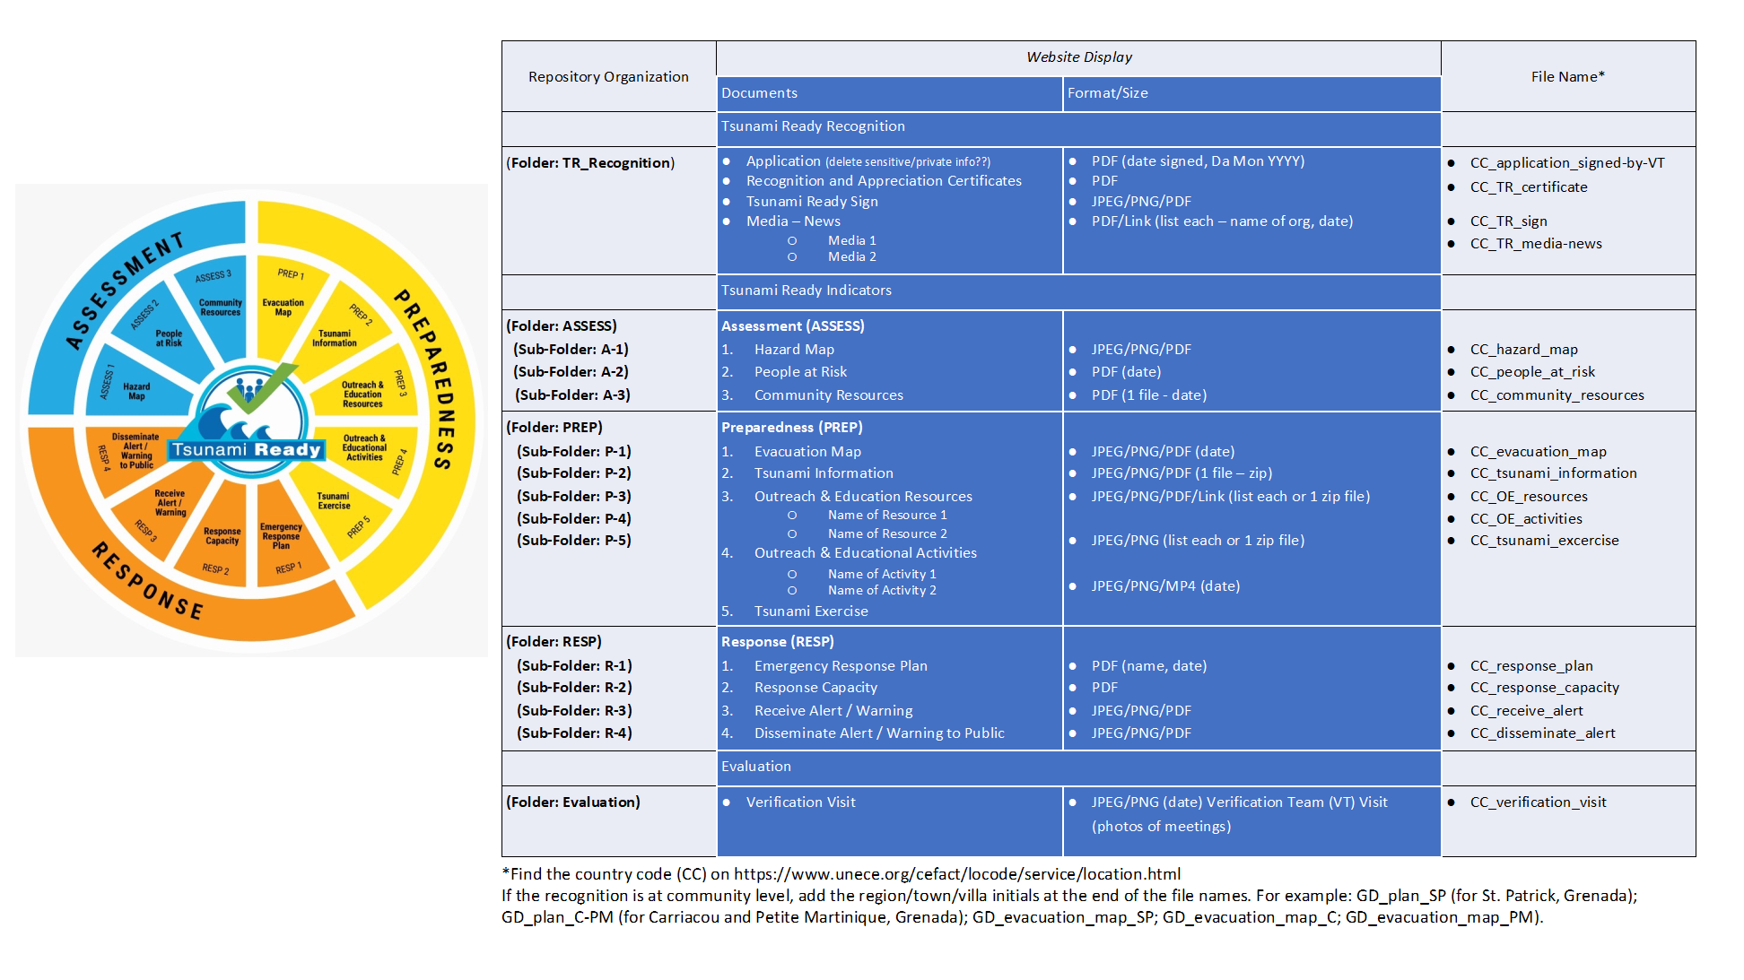
File Management System
Kodijat, 2023:
Automated Features
Automatic file renaming based on
UNESCO/IOC (Kodijat, 2023) naming
Structured folder creation:
TR Recognition
Assessment (ASSES)
Preparedness (PREP)
Response (RESP)
Evaluation
Secure repository storage

Slide 8
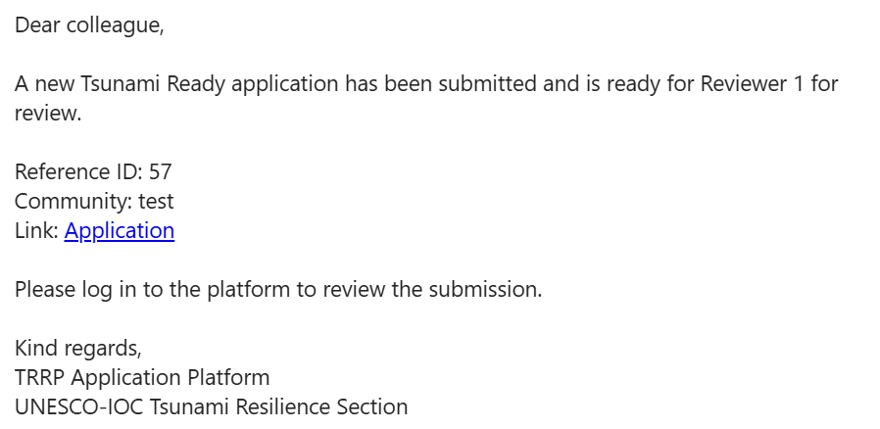
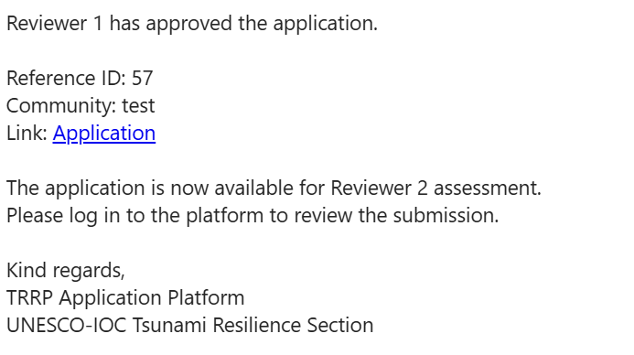
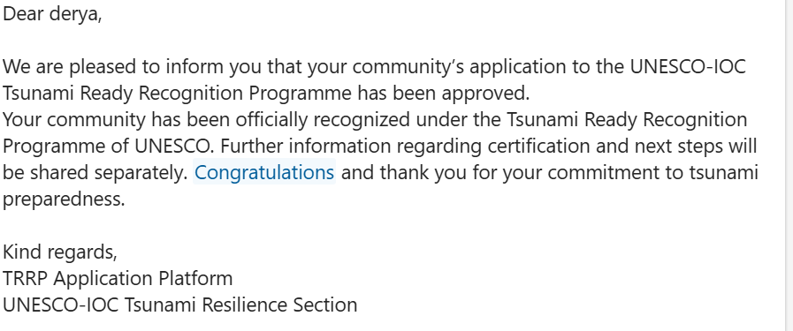
Notification System
Upon Submission:
Automatic email notifications sent to:
Reviewers, admin. and Users

Slide 9
https://unesco.sharepoint.com/sites/TRRP

Slide 10
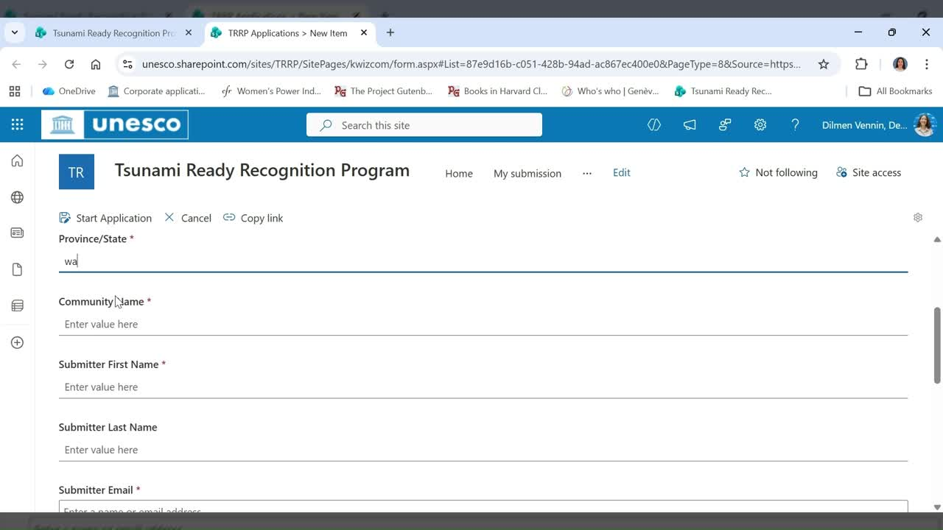

Slide 11
Key Benefits
For Member States
Simplified submission
Clear application tracking
Reduced documentation errors
Faster processing
For Tech Secr.
Centralized monitoring
Reduced email burden
Standardized compliance
Better reporting capability
For TICs
Immediate access to documentation
Easier validation
Structured repository

Slide 12
What is next?
Member States testing
Preparation of guidelines for submitters and reviewers
Webinars

Slide 13

THANK YOU
‹#›
Email d.dilmen-vennin@unesco.org for more information

