Slide 1
TOWS TT Disaster Management and Preparedness,
5-6 March 2026
Update on Tsunami Ready Toolkit, M & G 74 rev and Communication to Member States
Denis Chang Seng, PhD Programme Specialist
Technical Secretary (ICG/NEAMTWS and TOWS TT DMP)
CoastWAVE Project Lead
Tsunami Resilience Section
IOC of UNESCO

Slide 2
TOWS –XIII Decision and Recommendations
DMP-2025-02-11
Requests that TICs continue developing additional tools, including:
1. Application Form in official UN language
2. Tsunami Ready Training providing detailed implementation guidance“
DMP-2025-02-12
Further Requests that TICs continue developing additional tools, including more efficient submission procedures
DMP-2025-02-13
Request Secretariat to inform Member States on the Toolkit’s availability via IOC Circular Letter to the Tsunami National Contacts, National Tsunami Ready Board, and widely through the attaching this as an appendix of the Manual and Guide 74

Slide 3
Work in Progress
The current revision of M&G 74 is primarily ‘cosmetic’ and includes:
Addition of examples of standard templates (letter, certificates etc.) in the annex (as per TOWS 2025 decision )
Inclusion of a list of files and links in the annex
Update of contributors who were missed in the first publication
Other minor editorial updates (e.g., IOC of UNESCO)
[Denis & Anzhela]
New Actions :
Cross-check whether the Tsunami Ready Toolkit files are final [Laura, Ardito and Denis]
Review whether any further connected revisions are needed in the main body of M&G 74 to ensure consistency and provide clarification in line with current processes. [Christa & Laura]

Slide 4
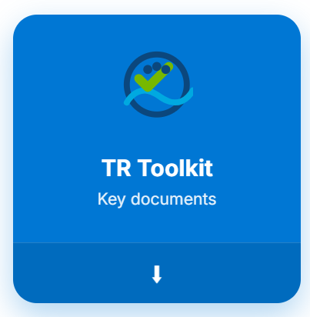
Parallel step is to develop a professional looking Tsunami Ready Toolkit (A.I generated)
[Denis & Sunkyung]

Slide 5
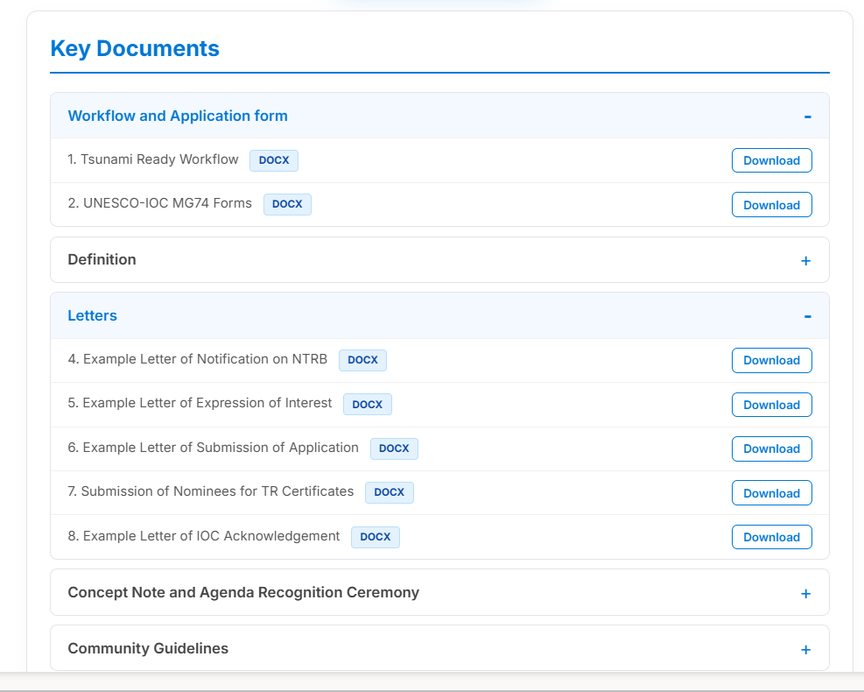
Professional and better structured

Slide 6

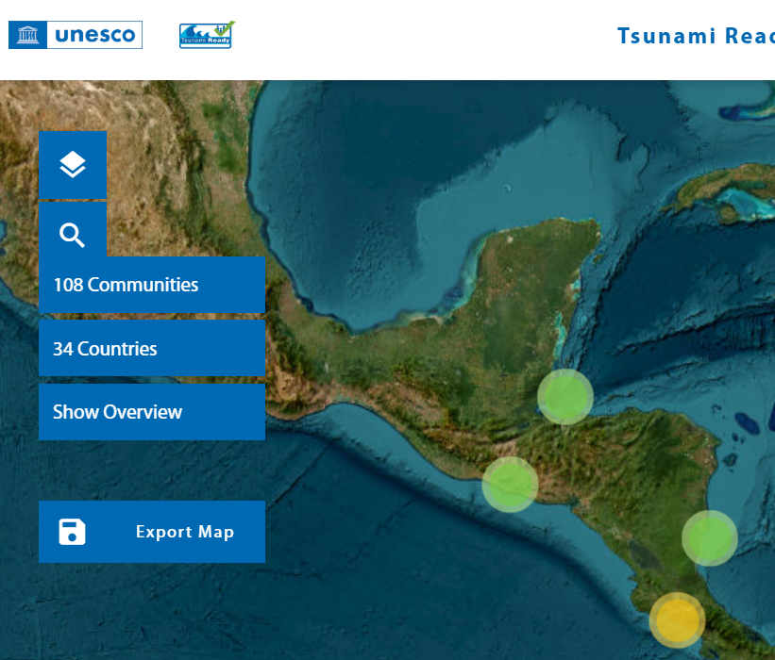
Tsunami Ready Tools
A centralized hub providing access to all Tsunami Ready tools and guidance

Slide 7
Communication to Member States
CL will inform Member States the following:
Revision of UNESCO/IOC (2022) Standard Guidelines for the Tsunami Ready Recognition Programme, published as IOC Manuals and Guides No. 74 in accordance with the Decision/Recommendation of the TOWS WG .
The revised Manual and Guide,74 (rev) integrates in the Annex essential examples and the list of files and links of the Tool Kit.
Tsunami Ready Toolkit, designed to enhance clarity, consistency, and alignment with current best practices in community preparedness and recognition.
Develop a short description of the Tsunami Ready Toolkit ?
Opportunity to also inform MS :
Automated Tsunami Ready Submission ?

Slide 8
Earlier Recommendation
Notes TOWS-WG recommended that Member States and Tsunami Service Providers pilot newly developed tsunami warning products and operational procedures and report back their experiences, lessons learned, and recommendations to the Working Group for further refinement and standardization[IOC Assembly Resolutions on Tsunami Warning Systems TOWS-WG Meeting Reports, especially: TOWS-WG-XII, TOWS-WG-XIII, TOWS-WG-XIV]

Slide 9
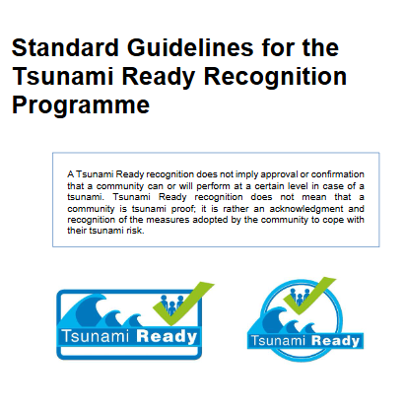
Proposed Recommendation
Recommends that a complete and comprehensive revision of M & G 74 Rev. (2026) be undertaken by end of 2027 informed by the operational experience gained through the implementation of the Tsunami Ready Recognition (TRR) Programme across all IOC regions.
This revision should be evidence-based and inclusive, drawing on:
Lessons learned from national and regional implementation,
Operational challenges and best practices,
Feedback from Member States and relevant technical bodies,
Regional and inter-regional evaluations of TRR implementation.
The objective of this revision shall be to enhance technical accuracy, operational relevance, global consistency, and regional adaptability, thereby strengthening the effectiveness, scalability, and sustainability of the Tsunami Ready Recognition Programme worldwide.

Slide 10
END

