Slide 1
IODE Management Group Meeting
28-29 January 2026
Session 3. Update on the Medium Term Strategy, IODE Activity List, IODE Budget

Slide 2
DRAFT programme and budget 2026–2027 (Draft 43 C/5)
first biennium of the 2026–2029 quadrennium
Draft IOC Results Framework 2026–2027, p22-24
High Level Objectives | Sub-Objectives
1. Healthy ocean and sustained ocean ecosystem services | 1.1 Enhanced observations and data for increased understanding of ocean vulnerability to multiple stressors | 1.2 Enhanced access to scientific knowledge adapted to regional and national needs to inform sustainable management of ecosystems | 1.3 Enhanced application of best practices, tools and approaches for ecosystem-based management
2. Effective warning systems and preparedness for tsunamis and other ocean-related hazards | 2.1 Improved ocean observations and data to underpin models and forecasting for ocean hazards | 2.2 Increased access to data and information products for coastal planning and hazard mitigation | 2.3 Enhanced deployment of regionally or nationally adapted decision support tools including multi-hazard early warning and mitigation systems
3. Resilience to climate change and contribution to its mitigation | 3.1 Enhanced observations and data for increased scientific understanding of the ocean dimension in climate change | 3.2 Enhanced access to scientific knowledge on impacts of climate change on the ocean and on ocean-based climate solutions | 3.3 Enhanced application of fit for purpose tools for Member States to integrate ocean issues in National Adaptation Plans and Nationally Determined Contributions
4. Scientifically founded services for the sustainable ocean economy | 4.1 Enhanced evidence base on the societal and economic return on investment in ocean science and ocean science infrastructure | 4.2 Enhanced dissemination of relevant scientific knowledge to marine industries and economic actors | 4.3 Enhanced application of fit for purpose knowledge-based sustainable ocean planning and management tools
5. Foresight on emerging ocean science issues. | 5.1 Improved capacity and processes to anticipate and prioritize emerging ocean science and technology issues | 5.2 Enhanced dissemination of scientific understanding of priority emerging ocean science issues | 5.3 Improved ability to account for and respond to priority emerging issues in decision making

Slide 3
DRAFT programme and budget 2026–2027 (Draft 43 C/5)
first biennium of the 2026–2029 quadrennium
Draft IOC Results Framework 2026–2027, p22-24
High Level Objectives | Sub-Objectives
1. Healthy ocean and sustained ocean ecosystem services | 1.1 Enhanced observations and data for increased understanding of ocean vulnerability to multiple stressors | 1.2 Enhanced access to scientific knowledge adapted to regional and national needs to inform sustainable management of ecosystems | 1.3 Enhanced application of best practices, tools and approaches for ecosystem-based management
2. Effective warning systems and preparedness for tsunamis and other ocean-related hazards | 2.1 Improved ocean observations and data to underpin models and forecasting for ocean hazards | 2.2 Increased access to data and information products for coastal planning and hazard mitigation | 2.3 Enhanced deployment of regionally or nationally adapted decision support tools including multi-hazard early warning and mitigation systems
3. Resilience to climate change and contribution to its mitigation | 3.1 Enhanced observations and data for increased scientific understanding of the ocean dimension in climate change | 3.2 Enhanced access to scientific knowledge on impacts of climate change on the ocean and on ocean-based climate solutions | 3.3 Enhanced application of fit for purpose tools for Member States to integrate ocean issues in National Adaptation Plans and Nationally Determined Contributions
4. Scientifically founded services for the sustainable ocean economy | 4.1 Enhanced evidence base on the societal and economic return on investment in ocean science and ocean science infrastructure | 4.2 Enhanced dissemination of relevant scientific knowledge to marine industries and economic actors | 4.3 Enhanced application of fit for purpose knowledge-based sustainable ocean planning and management tools
5. Foresight on emerging ocean science issues. | 5.1 Improved capacity and processes to anticipate and prioritize emerging ocean science and technology issues | 5.2 Enhanced dissemination of scientific understanding of priority emerging ocean science issues | 5.3 Improved ability to account for and respond to priority emerging issues in decision making

Slide 4
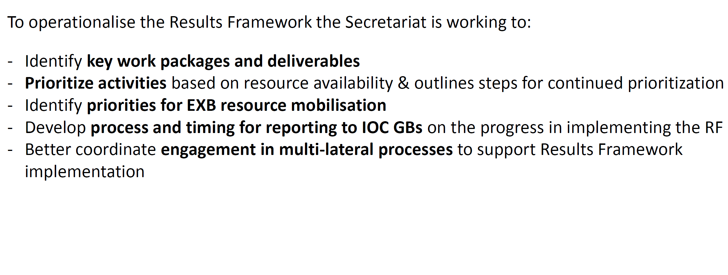
Operationalising the IOC Results Framework 2026 –2027

Slide 5
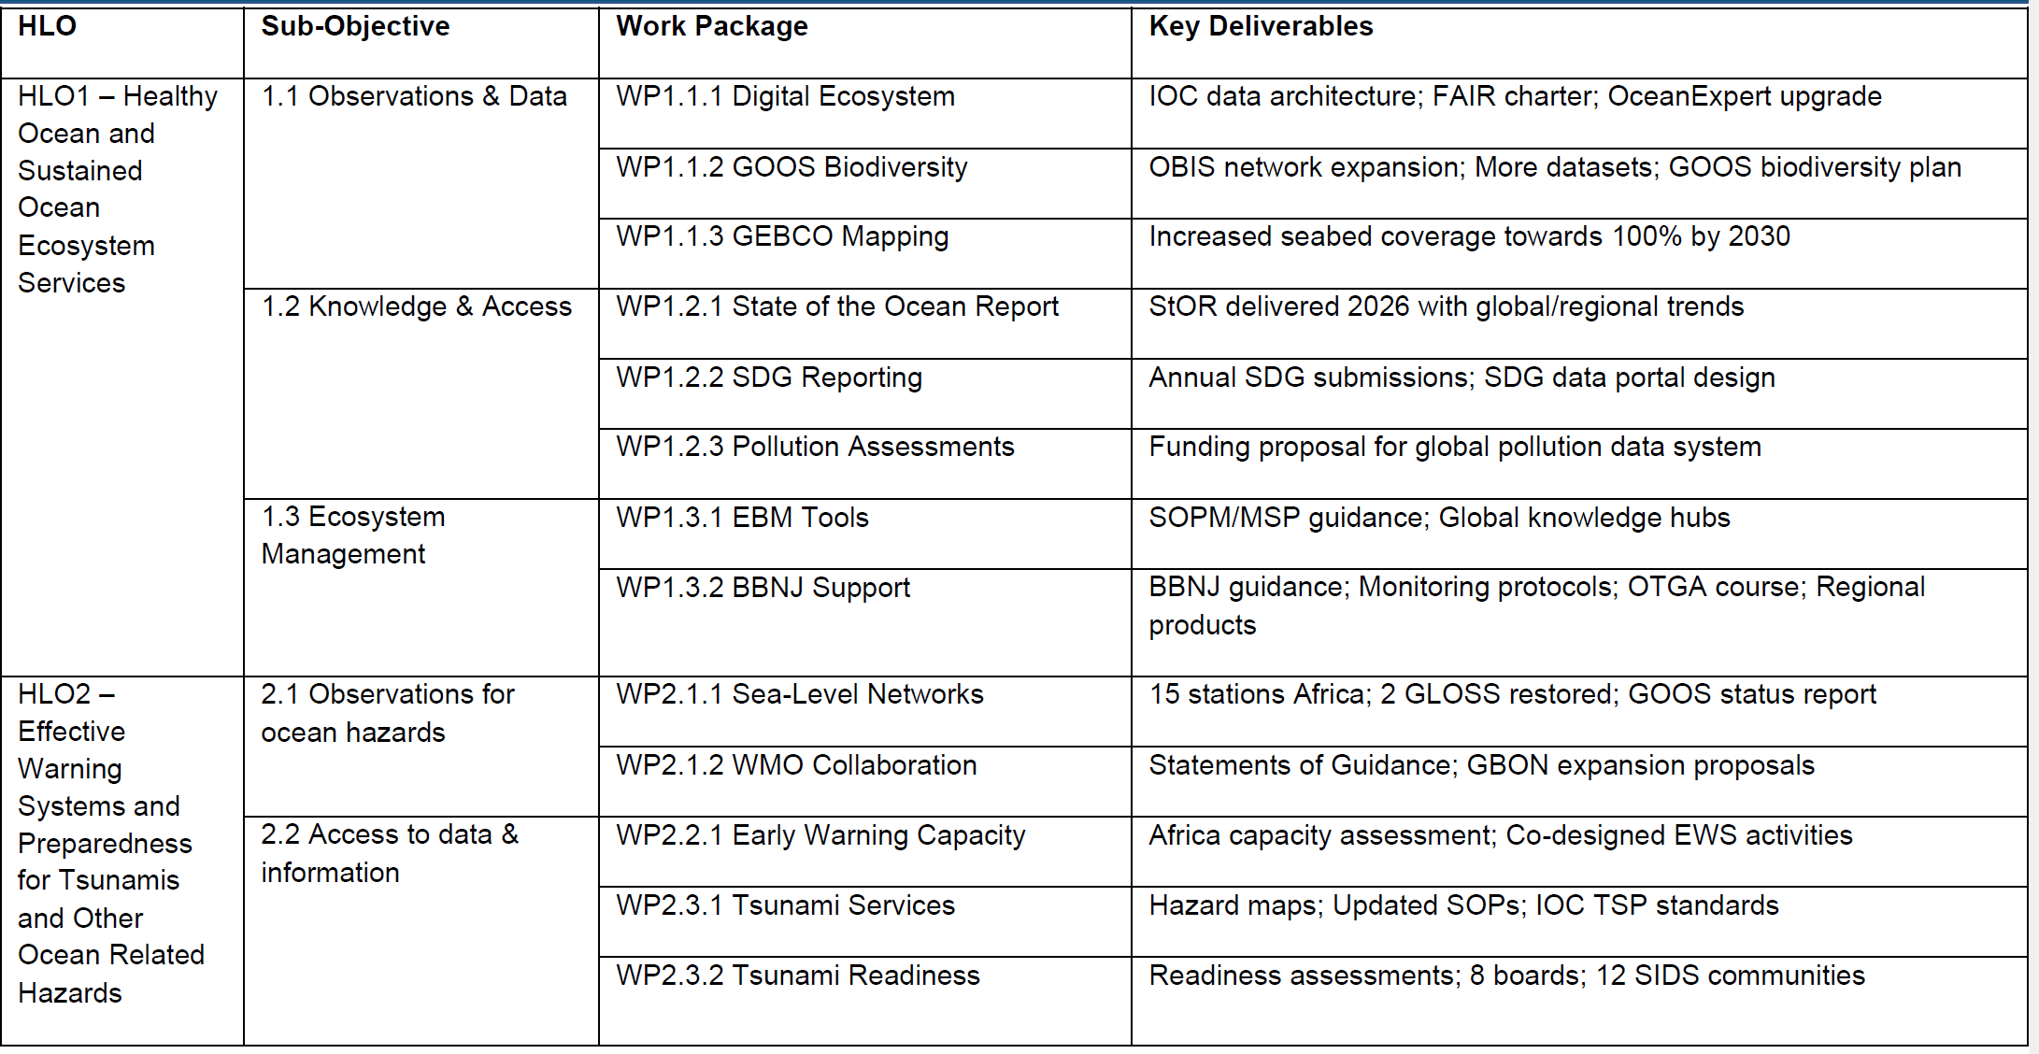
and OBIS

Slide 6
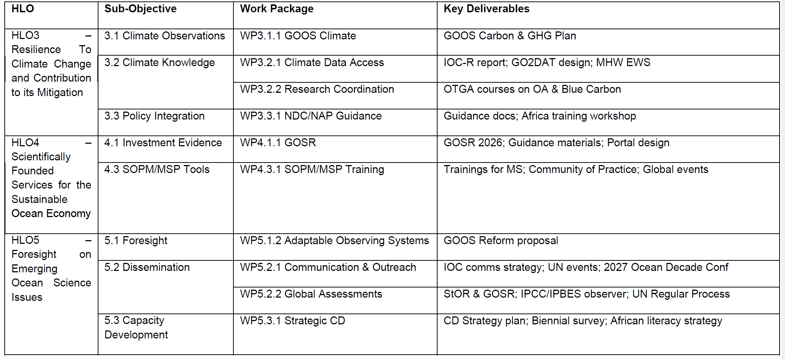

Slide 7
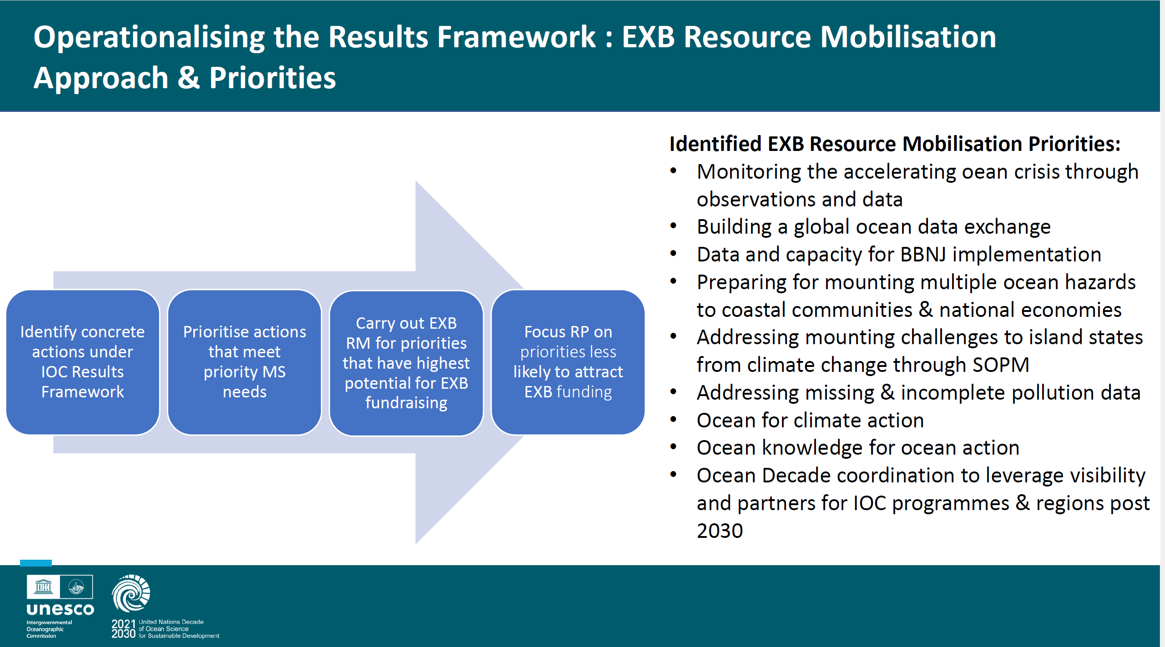

Slide 8
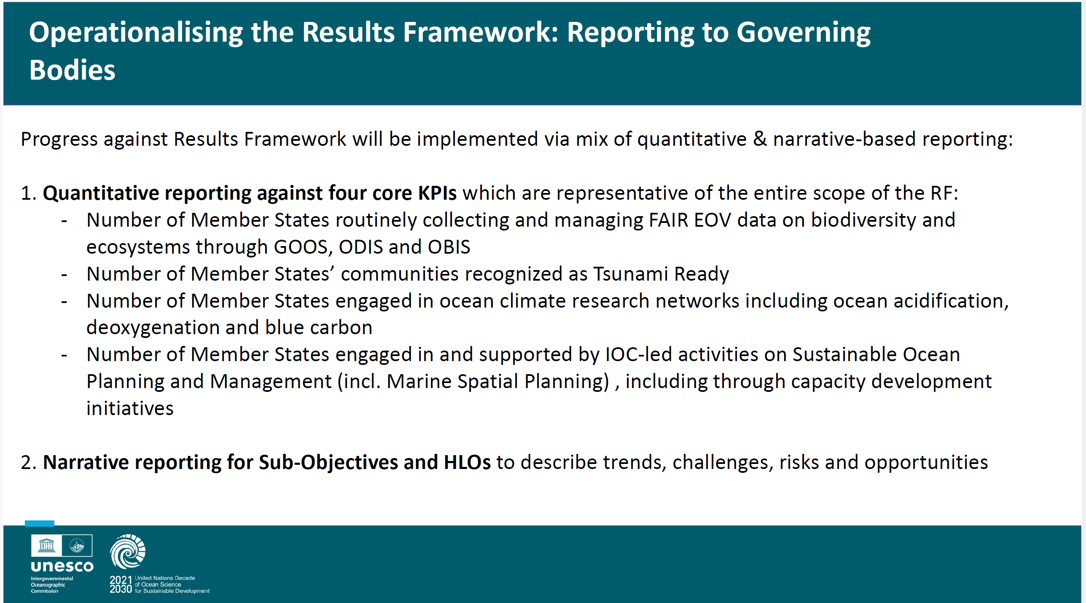

Slide 9
IODE 28 List of Activities

Slide 10
Focus | action no. | Para no. | Adopted Action
IODE MG | 1 | 30 | The Committee instructed the Management Group to review the list of uncompleted action items and decide on whether these should be included in the action sheet for the next inter-sessional period.
IODE MG | 27 | 243 | The Committee tasked the Management Group to monitor the implementation of the new structure and to identify any issues that need attention. This is linked to item 48 (para 366 below)
IODE MG | 47 | 357 | The Committee expressed its desire to continue the series of IODC Conferences and requested the IODE Management Group to make a decision depending on available resources and practical feasibility.
IODE MG | 90 | 557 | The IODE Committee requested the IODE Management Group to discuss the next IODC including the format and allocation of resources
IODE | 34 | 280 | The Committee urged IODE data centres as well as its three Programme Components OBIS, ODIS and OTGA to actively participate in, and contribute to, the development and implementation of science-based, sustainable ocean planning and management activities and invited the IODE programme to collaborate with the IOC Secretariat’s SOPM team for the development of a first pilot initiative that can inform and fine-tune the design of targeted, future IODE data and information knowledge products for SOPM
IODE | 42 | 320 | The Committee thanked the WDS for its ongoing work to enhance the capabilities, impact, and sustainability of our data repositories worldwide, and encouraged IODE data centres and programme components to collaborate on objectives of mutual interest such as data preservation, sustainability, FAIR data and indigenous data governance.
IODE | 46 | 341 | The Committee recognized that other (in-kind) sources can co-invest in IODE activities and requested the IODE Management Group to track and report on and acknowledge these in the next session.
IODE | 48 | 366 | The Committee invited Member States and IOC programmes to provide input on the progress towards delivery of the strategic objectives of the Strategic Plan(*). (*)IOC Manuals and Guides No. 92 (IOC Strategic Plan for Ocean Data and Information Management (2023–2029)).
IODE | 52 | 378 | The Committee recommended that IODE open another call for invitation to all NODCs and ADUs to participate in the mentoring.
IODE | 82 | 531 | The Committee called on Member States to consider seconding, either at the IOC Project Office for IODE, in Oostende, Belgium or in-kind (working from their usual place of work) in order to strengthen the IODE Secretariat.
IODE | 45 | 340 | The Committee strongly recommended NODCs and ADUs in Europe to consider involving IOC/IODE as a partner in future EU project proposals and to encourage their scientific organizations to do the same and to contact the IODE secretariat for guidelines.
IODE - regional | 37 | 303 | The Committee acknowledged the importance of collaboration with IOCINDIO and requested IODE Programme Components to support data architecture efforts (similar to EMODNet / MEDIN) in the region, with the help of RSB funded CD programmes supported or hosted by OTGA RTCs, C2Cs and NODCs and ADUs (ODIS, OBIS nodes) already established in the region.
IODE - regional | 38 | 306 | The Committee regretted the absence of a report from IOC/WESTPAC and urged IOC/WESTPAC to submit a report on IODE related activities in their region.
IODE - regional | 62 | 422 | The Committee invited IOC regional sub-commissions to actively disseminate data and information activities in their own languages by recognizing IODE as a partner in their communication efforts, and also as an outreach strategy, to encourage ocean scientists to join the IODE community through OceanExpert.

Slide 11
ODIS | 3 | 62 | The Committee called on NODCs and ADUs to apply for accreditation as a “quality seal” demonstrating that the data services provided are of the highest quality standards.
ODIS | 4 | 64 | The Committee stressed the importance of hosting an NODC and urged IOC Member States that have not yet established an NODC to do so to ensure their ocean data are shared globally and that their national ocean scientists have easy access to the global ocean data commons.
ODIS | 5 | 89 | The Committee urged all low-scoring NODCs and IOC focal points to contact the IODE Secretariat to discuss actions that may improve their performance.
ODIS | 6 | 90 | The Committee instructed the Secretariat to undertake the remedial actions as listed in Table 2 of Document IOC/IODE-28/3.3.3.
ODIS | 7 | 91 | The Committee approved the recommendations to improve health check criteria as detailed in Document IOC/IODE-28/3.3.3 and instructed the Secretariat and Co-Chairs to revise Document IOC/IODE-28/3.3.3 for discussion by the next meeting of the IODE Management Group.
ODIS | 9 | 126 | The Committee invited existing and new ODIS partner organizations to join the IODE network as IODE Associated Data Units (ADUs) to share their own expertise with, as well as benefit from the expertise within the IODE network.
ODIS | 10 | 128 | The Committee urged all Member States to participate in the Ocean Data and Information System via the creation of ODIS Nodes to increase the visibility of their data holdings to the world, and to enable improved and more efficient access to global Ocean data.
ODIS | 12 | 129 | Decision IODE-28/3.4.1.2: Restructuring the ODIS Programme Activities - Decides to convene IWG for Ocean Data and Information System Activities (IWG ODIS-Act).
ODIS | 20 | 198 | The Committee instructed NODCs and ADUs to create or update their ODISCat record(s) which firstly ensures the visibility of their institution’s data sources to the world, and secondly, is the first step to joining ODIS.
ODIS | 35 | 290 | The Committee further requested IOCAFRICA and IODE to develop a structured strategy for long-term engagement, ensuring that African ocean data systems are fully integrated into global frameworks and contribute effectively to regional and international decision-making.
ODIS | 39 | 317 | The Committee encouraged its NODC and ADU data repositories to join the WDS membership and welcomed cohort activities that assist additional ocean data repositories in its member states to achieve the CoreTrustSeal certification
ODIS | 49 | 369 | The Committee noted the importance of the IOC Data Policy and Terms of Use (2023) and called on Member States to use the policy as a basis for national policies on oceanographic data exchange and to ensure maximum compliance with the policy.
ODIS | 64 | 441 | The Committee agreed on the important role of ODIS and OBIS as systems, and requested that the role of NODCs and ADUs are recognized in the emerging IOC data architecture.
ODIS | 66 | 453 | In response to the survey conducted by the DCO-ODS the Committee urged NODCs and ADUs to work with Decade Actions and DCO-ODS to archive data and make metadata available to ODIS.
ODIS | 72 | 485 | Decision IODE-28/6.2.6: Establishment of an IODE Inter-sessional Working Group to Enact a Rapid Response Mechanism for Emerging Issues

Slide 12
OTGA | 56 | 396 | The Committee recommended that IOC RSBs and ODINs jointly develop an action plan and report on the reactivation of the ODINs in relation to IODE activities within their regions through the RSBs, and requested the IODE programme components and activities to orient their activities accordingly.
Programme Activities | 23 | 218 | The Committee referred discussions on how IODE can facilitate the continuity of WOD data and services to the IODE Management Group.
Programme Activities | 33 | 279 | The Committee requested the IODE representatives on the WG-SOPM to report back to the IODE Community on relevant activities and requests from the SOPM Programme.
Programme Activities | 55 | 390 | The Committee encouraged the community to keep their OceanExpert account up to date to allow IOC programmes including IOC CD to inform the experts in the region on planned CD activities registered in OceanExpert and the IOC CD Hub (https://oceancd.org/) and platforms across the ODIS federation.
Programme Activities | 57 | 397 | The Committee requested the OceanExpert programme activity to provide a document tag for RSB documents to facilitate their discovery and use.
Programme Activities | 73 | 486 | The Committee requested the IWG-RRM addresses with high priority the fact that some WOD services have recently ceased and that IODE programme components and activities and many other programmes worldwide depend on data and services from WOD.
OBPS | 19 | 194 | The Committee urged the IODE community to further document their methodologies and best practices and share them in the Ocean Best Practices System.
IOC | 84 | 540 | The Committee strongly urged IOC Member States to follow Flanders’ example and establish long-term funds-in-trust agreements to support UNESCO Science Activities.
IOC | 85 | 541 | The Committee called on its members and parent institutions to involve IODE in project proposals that include data or information management elements as appropriate.
IOC | 86 | 542 | The committee recognized the support through other funding instruments through national or regional mechanisms and requested to include these contributions in the annual reports of the NODCs, ADUs and IODE programme components, activities and projects.
IOC | 87 | 550 | The Committee noted with appreciation the in-kind support provided by all IODE NODCs and ADUs, OTGA RTC/STCs through their individual and joint activities, to the sharing and exchange of data and information and requested the IODE Management Group in consultation with the IFAG to track and report on and acknowledge these in the next session.

Slide 13
IODE Groups of Experts/ Working Groups/ Steering Groups

Slide 14
Groups of Experts/Working Groups/Steering Groups
Programme Activities
Ocean Biodiversity Information System (OBIS): https://oceanexpert.org/group/230 (Steering Group) | IOC Resolution XXV-4 (2009). IODE Decision XXI.2 (2011): Establishment of a Steering Group for OBIS
Ocean Teacher Global Academy (OTGA): https://oceanexpert.org/group/68 (Steering Group) | Decision IODE-XXIII.4 and approved as Programme Component in IODE-XXVII (2023)
Ocean Data Information Systemn (ODIS): https://oceanexpert.org/group/472 (Steering Group) | Established Decision IODE-XXIV.4
Other
ODIS Operations Group (Steering Group) | IOC Decision A-33/3.4.2 (2025)
Intersessional Working Group on the development of the IOC Data Architecture | IOC Decision A-33/3.4.3 (2025)
IODE Inter-sessional Working Group to Enact a Rapid Response Mechanism for Emerging Issues | IOC Decision IODE-28/6.2.6 (2025)
Intersessional Working Group on Advancing Ocean Data Sharing for Sustainable Development in areas within national jurisdiction (IWG-DSNJ) | IOC Decision A-33/3.4.2 (2025)
10 Programme Activities (managed under ODIS)
Quality Management Framework (QMF): https://oceanexpert.org/admin/group/462 | Recommendation IODE-XXII.18 (2013)
Ocean Expert (OE): https://oceanexpert.org/group/473 | Recommendation IODE-XXIII.2 (2015) and then identified as a programme activity in IODE-27 (2023)
Global Temperature-Salinity Profile Programme Activity (GTSPP): https://oceanexpert.org/group/256 | Recommendation IODE-XXII.11, Recommendation IODE-III.4
International Quality-controlled Ocean Database (IQuOD): https://oceanexpert.org/group/323 | Recommendation IODE-XXIII.3 (2015)
Global Ocean Surface Underway Data Pilot Project (GOSUD) : https://oceanexpert.org/group/350 | Recommendation IODE-XVI/10
International Coastal Atlas Network Project (ICAN): https://oceanexpert.org/group/266 | IODE-XXII.12 (2013)
World Ocean Database (WOD): has no SG | Recommendation IODE-XVI.6. AND Recommendation IODE-XXII.10
Global Oceanographic Data Archaeology and Rescue (GODAR) | Recommendation IODE-XIV.DR.3
Aquadocs: https://oceanexpert.org/group/475 | Decision IODE-XXVI.8.2
Joint working groups/committees/co-sponsored programmes/projects with other organisations
Ocean Best Practices System (OBPS): https://oceanexpert.org/admin/group/448 | Decision IOC-XXX/7.2.1 and IOC Decision A-33/3.4.4
Joint Collaborative Board (JCB) | Resolution XXX-2 (2019)

Slide 15
Budget 2026-2027
IODE: HoS (0.5 FTE) and 3 staff positions: 2 to be advertised in 2026 (P4 and P3)
VLIZ: 3 staff positions
IODE systems regular budget: 344,279 USD
OTGA regular budget: 112,635 USD (CD separate)
IODE - Extrabudgetary (Norad): 460k – NODC engagement, data architecture proposal and Fair data charter, OBIS batch identifiers AND 260k – Traineeships / Sofie / Advancing OE to support CD
OBIS – Extrabudgetary: 4M USD (7 EXB projects) 2PAs and 7 consultants

