Slide 1
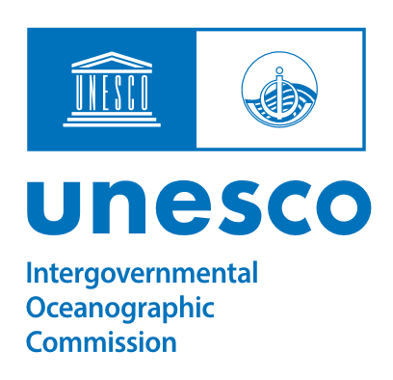


2.2. RTC COLOMBIA Activities 2024-2025
Regional Training Center INVEMAR-Colombia:
Inspiring for capacity development, training, and knowledge of the oceans
Paula Cristina Sierra-Correa, PhD. RTC-Colombia Coordinator
Carolina García Valencia, RTC-Colombia support
SG-OTGA V, November 2025
Notes:
Buenos días a todos, desde el instituto de investigaciones marinas y costeras INVEMAR presentamos una síntesis de scope and priorities, major achievements of training in 2024-2025 (with OTGA); and
course and training activities planned for 2026 desde el Centro regional de entrenamiento Colombia para hispanoparlantes.
Good morning everyone. On behalf of the Institute of Marine and Coastal Research, INVEMAR, we’d like to share a brief overview of our scope and priorities, key training achievements for 2024–2025 in collaboration with OTGA, and a preview of the courses and training activities planned for 2026 from the Regional Training Center in Colombia for Spanish-speaking countries.

Slide 2
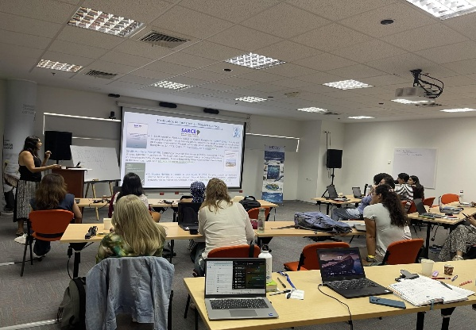
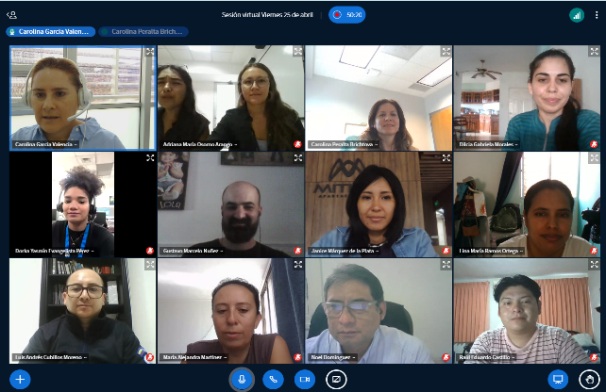
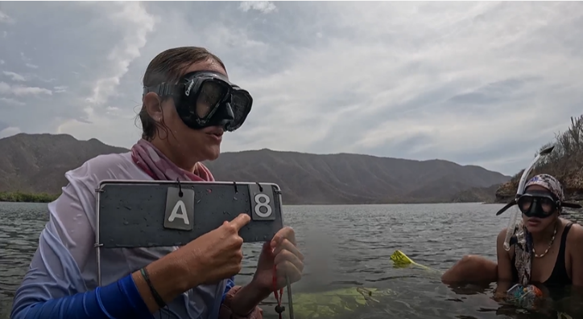
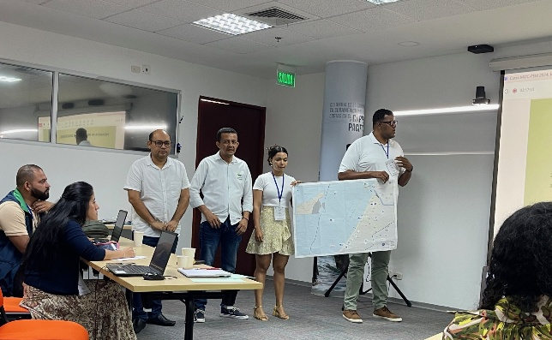
RTC Colombia scope and priorities
Continue aligning training priorities with regional needs.
Support regional project initiatives in the Pacific and Caribbean.
Target audience: ocean data and information managers, and marine researchers needing training in data/information management.
Notes:
For RTC Colombia, our main focus is to keep aligning training priorities with regional needs, support project initiatives across the Pacific and Caribbean, and reach professionals working in ocean data and information management.

Slide 3
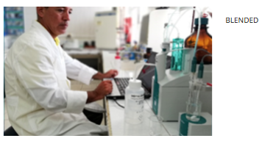
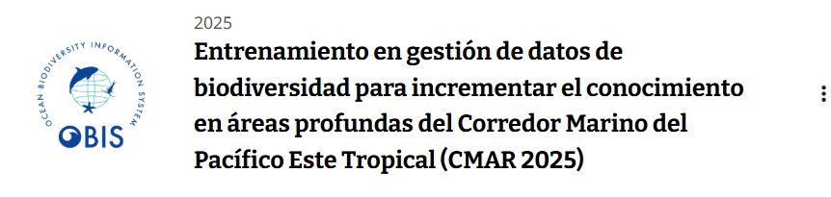
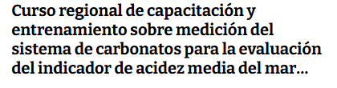
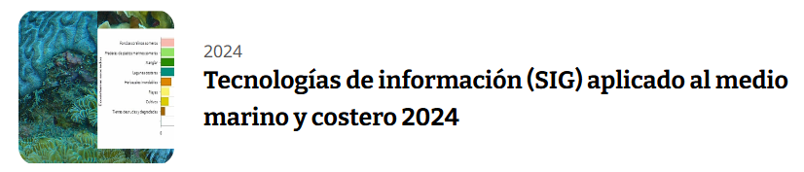
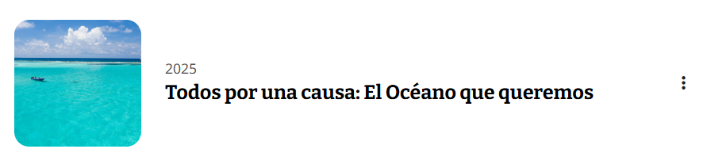
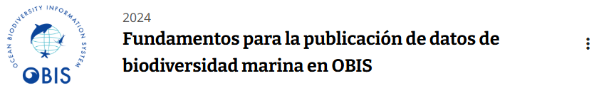
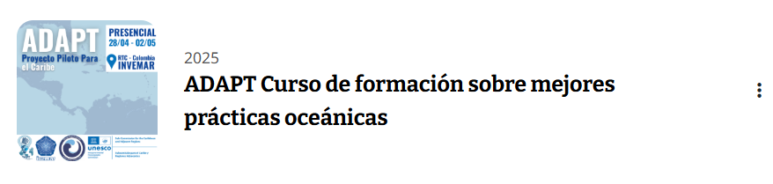


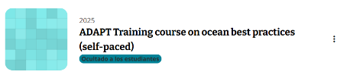
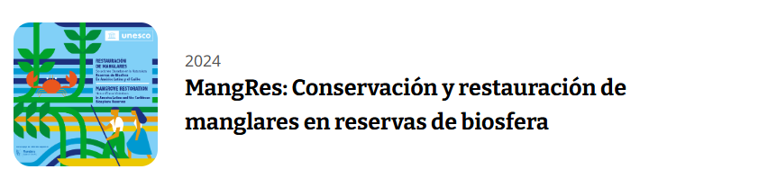
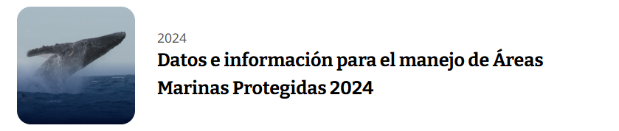
Achievements of training in 2024/2025
2024
5
2025
3
Blended
Blended
Virtual
Self-paced
Self-paced
Blended
In-person
(Fieldwork support)
Virtual
Blended
Notes:
In 2024, we conducted five courses on: ocean acidification, information technologies for marine studies (marine GIS), OBIS data management, ICZM & MSP, and data and information for MPAs. In 2025, we held three more courses: OBIS data management for the Tropical Eastern Pacific Marine Corridor, the Ocean Decade Adapt Workshop, and a fourth course that received support during its fieldwork stage. I’d like to highlight the ADAPT project — a small but meaningful initiative that enabled us to organize an in-person workshop and develop a fully online course, which will be launched soon.

Slide 4


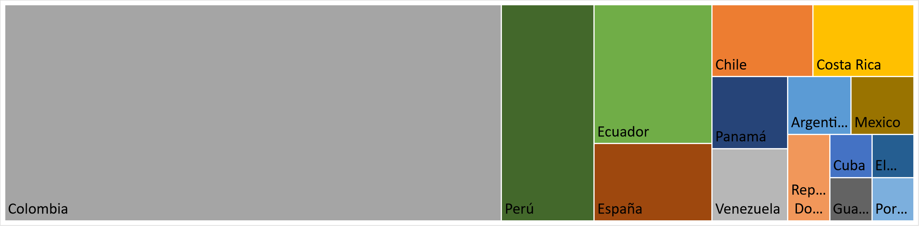

Achievements of training in 2024/2025
Courses
Students
8
(2) Virtual
(3) Blended
(1) In person
(2) Self-paced
108
19
15
16
15
57%
43%
13
13
8
10
Countries
15
2024
2025
Notes:
Entre los dos años un total de 8 cursos fueron impartidos en variedad de modalidades, destacando el logro de 4 de ellos con modalidad presencial. Tuvimos 108 estudiantes de 15 países de la región siendo 57% de ellos mujeres. Hubo predominio de estudiantes de Colombia, dado que algunos tuvieron un alcance nacional , pero países como Perú, Ecuador, Chile Costa Rica, Panamá, Venezuela, Argentina y México, también tuvieron representatividad.
Over the two years, we delivered eight courses in different formats — four of them in person. We reached 108 participants from 15 countries across the region, with women representing 57% of the total. Most participants were from Colombia, since some courses had a national focus, but we also had great representation from Peru, Ecuador, Chile, Costa Rica, Panama, Venezuela, Argentina, and Mexico.

Slide 5
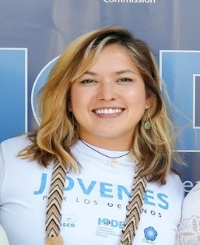
Achievements of training in 2024/2025
UNESCO Internship
Ocean Teacher Global Academy (OTGA) Contributions
  Assisted in developing capacity-building courses, including translating materials from previous courses (Ocean Acidification Course) and transcribing content into new courses (ADAPT Curso de formación sobre mejores prácticas oceánicas).
  Created diagrams and visual materials to enhance course content
Isabelle Nakaima
January – March 2025 (Brazil)
Blended course delivery preferred, subject to funding availability.
Maintain training priorities that respond to regional needs.
Notes:
Additionally, RTC Colombia hosted an intern from Brazil, Isabel Nakaima, who made important contributions to several courses — especially in preparing and designing digital content. We continue to prioritize blended course delivery, depending on available funding, and to keep our training priorities aligned with regional needs.

Slide 6



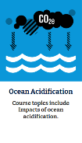
Training activities planned for 2026 with OTGA
Name | Description | Funds | Date | Mode
Blue Governance | Integrated Coastal Zone Management + Marine Spatial Planning + Marine Protected Areas (national) | INVEMAR | May | Blended
Capacitación y entrenamiento sobre medición de carbonatos para la evaluación del indicador de acidez media del mar ODS 14.3.1 | Ocean acidification. In English. | IAEA + IOC-OTGA? (to be defined) | April-May | Blended
ADAPT | Seagrass and mangrove best practices monitoring -from ADAPT workshop. In Spanish. | --- | To be defined | Self-paced
Notes:
Para 2026, a la fecha tenemos 3 cursos en la programación, un curso nuevo producto de la combinación de temáticas para la Gobernanza Azul, propuesto con recursos propios. El curso sobre Capacitación y entrenamiento sobre medición de carbonatos para la evaluación del indicador de acidez media del mar ODS 14.3.1, el cual está actualmente gestionando los recursos financieros, dado que se planea realizar en Ingles e incluye trabajo de campo. Tambien planeando abrir el curso mencionado anteriormente de Proyecto adapt para Formación en mejores prácticas en monitoreo de pastos marinos y mangler - ADAT, In Spanish. For 2026, we have three courses planned so far. One is a new course that brings together topics under Blue Governance, developed with our own resources. Another focuses on training in carbonate measurements to support the SDG 14.3.1 indicator on ocean acidification — we’re currently working on securing funding for this one, since it will be offered in English and includes fieldwork. And we’re also preparing to launch the ADAPT course on Best Practices for Seagrass and Mangrove Monitoring, which will be delivered in Spanish.

Slide 7
Lessons learned / challenges
Course content (new edition courses):
Ensure continuous improvement of all course content — even materials not scheduled for updates — maintaining quality control (audio) and incorporating feedback from the previous edition.
Platform performance:
There were fewer difficulties with OceanExpert–OTGA user profiles than in 2024.
OTGA Team support:
The excellent facilitation and support from the OTGA Project Coordinator (IODE–Belgium) were maintained throughout the planning, content structuring, and content uploading processes for each course, as well as in supporting student activation on the platform.
The feedback summaries (rubric evaluations) provided by the OTGA Project Coordinator at the end of each course were highly valuable for improving subsequent course editions and ensuring continuous improvement.
In General:
Growth of tailor-made courses as a funding opportunity in the region.
RTC Colombia aligns with IOC and IOCARIBE strategies to promote gender balance in ocean science and support internships for young professionals on Caribbean priority topics.
Notes:
Finally, I’d like to highlight a few points.
In terms of course content, we keep improving all materials — even those not scheduled for updates — ensuring good quality and incorporating feedback from previous editions.
Regarding platform performance, we had fewer issues with OceanExpert–OTGA user profiles compared to 2024.
We also want to recognize the excellent support from the OTGA Project Coordinator in Belgium, who helped throughout planning, content development, and student activation. Their feedback summaries at the end of each course were really helpful for improving future editions.
And in general, we continue expanding tailor-made courses as funding opportunities, and staying aligned with IOC and IOCARIBE strategies — especially promoting gender balance in ocean science and supporting young professionals in the Caribbean.

Slide 8
Thank you for taking the time to listen/read!
Notes:
Finally, I’d like to highlight a few points.
In terms of course content, we keep improving all materials — even those not scheduled for updates — ensuring good quality and incorporating feedback from previous editions.
Regarding platform performance, we had fewer issues with OceanExpert–OTGA user profiles compared to 2024.
We also want to recognize the excellent support from the OTGA Project Coordinator in Belgium, who helped throughout planning, content development, and student activation. Their feedback summaries at the end of each course were really helpful for improving future editions.
And in general, we continue expanding tailor-made courses as funding opportunities, and staying aligned with IOC and IOCARIBE strategies — especially promoting gender balance in ocean science and supporting young professionals in the Caribbean.

