Slide 1
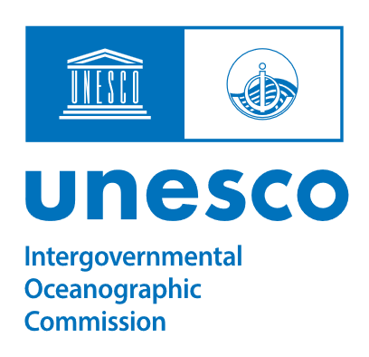

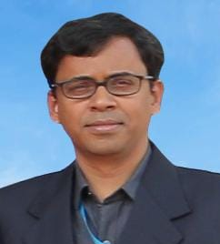
2.2. RTC INCOIS Activities 2024-2025
Dr. TVS Udaya Bhaskar
SG-OTGA V, November 2025

Slide 2
RTC scope and priorities
Scope/Aim:
The International Training Centre for Operational Oceanography (ITCOocean) is aimed at promoting the development and optimization of scientific base, technology and information system for operational oceanography at national, regional and global scales.
Objectives:
Provide advanced training in operational oceanography to trainees from India, IOR countries and other developing nations.
Provide training on generation of data from oceans using in situ and satellite platforms, transmission of data to operational centre, data reception, data processing in real-time, usage of data in models and generation of forecasts and dissemination of the same to end users within the shortest possible time.
To provide ship board experience and training in observational oceanography.
To promote excellence in integrated multidisciplinary oceanography.
To help scientists preparedness for nowcasting and forecasting the behavior of the oceans and also to address the role of ocean science and technology in delivering information critical to safety.
Target Students/Trainees:
Students Staff of Maritime related institutes Staff of Government Departments
Decision Makers Institutes involved in Marine Harzard monitoring
Staff of other operational oceanographic centers

Slide 3
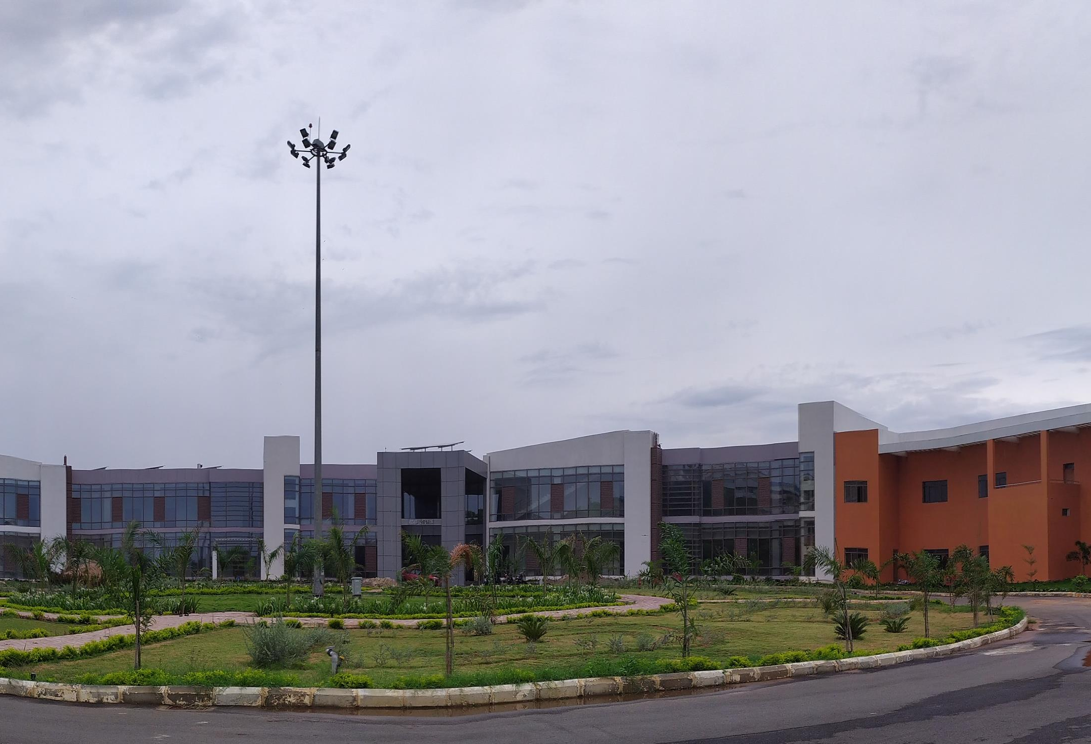
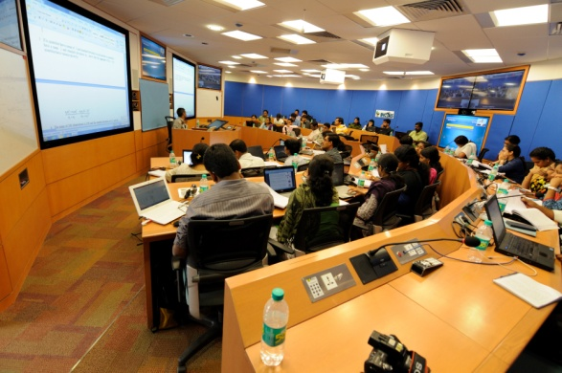
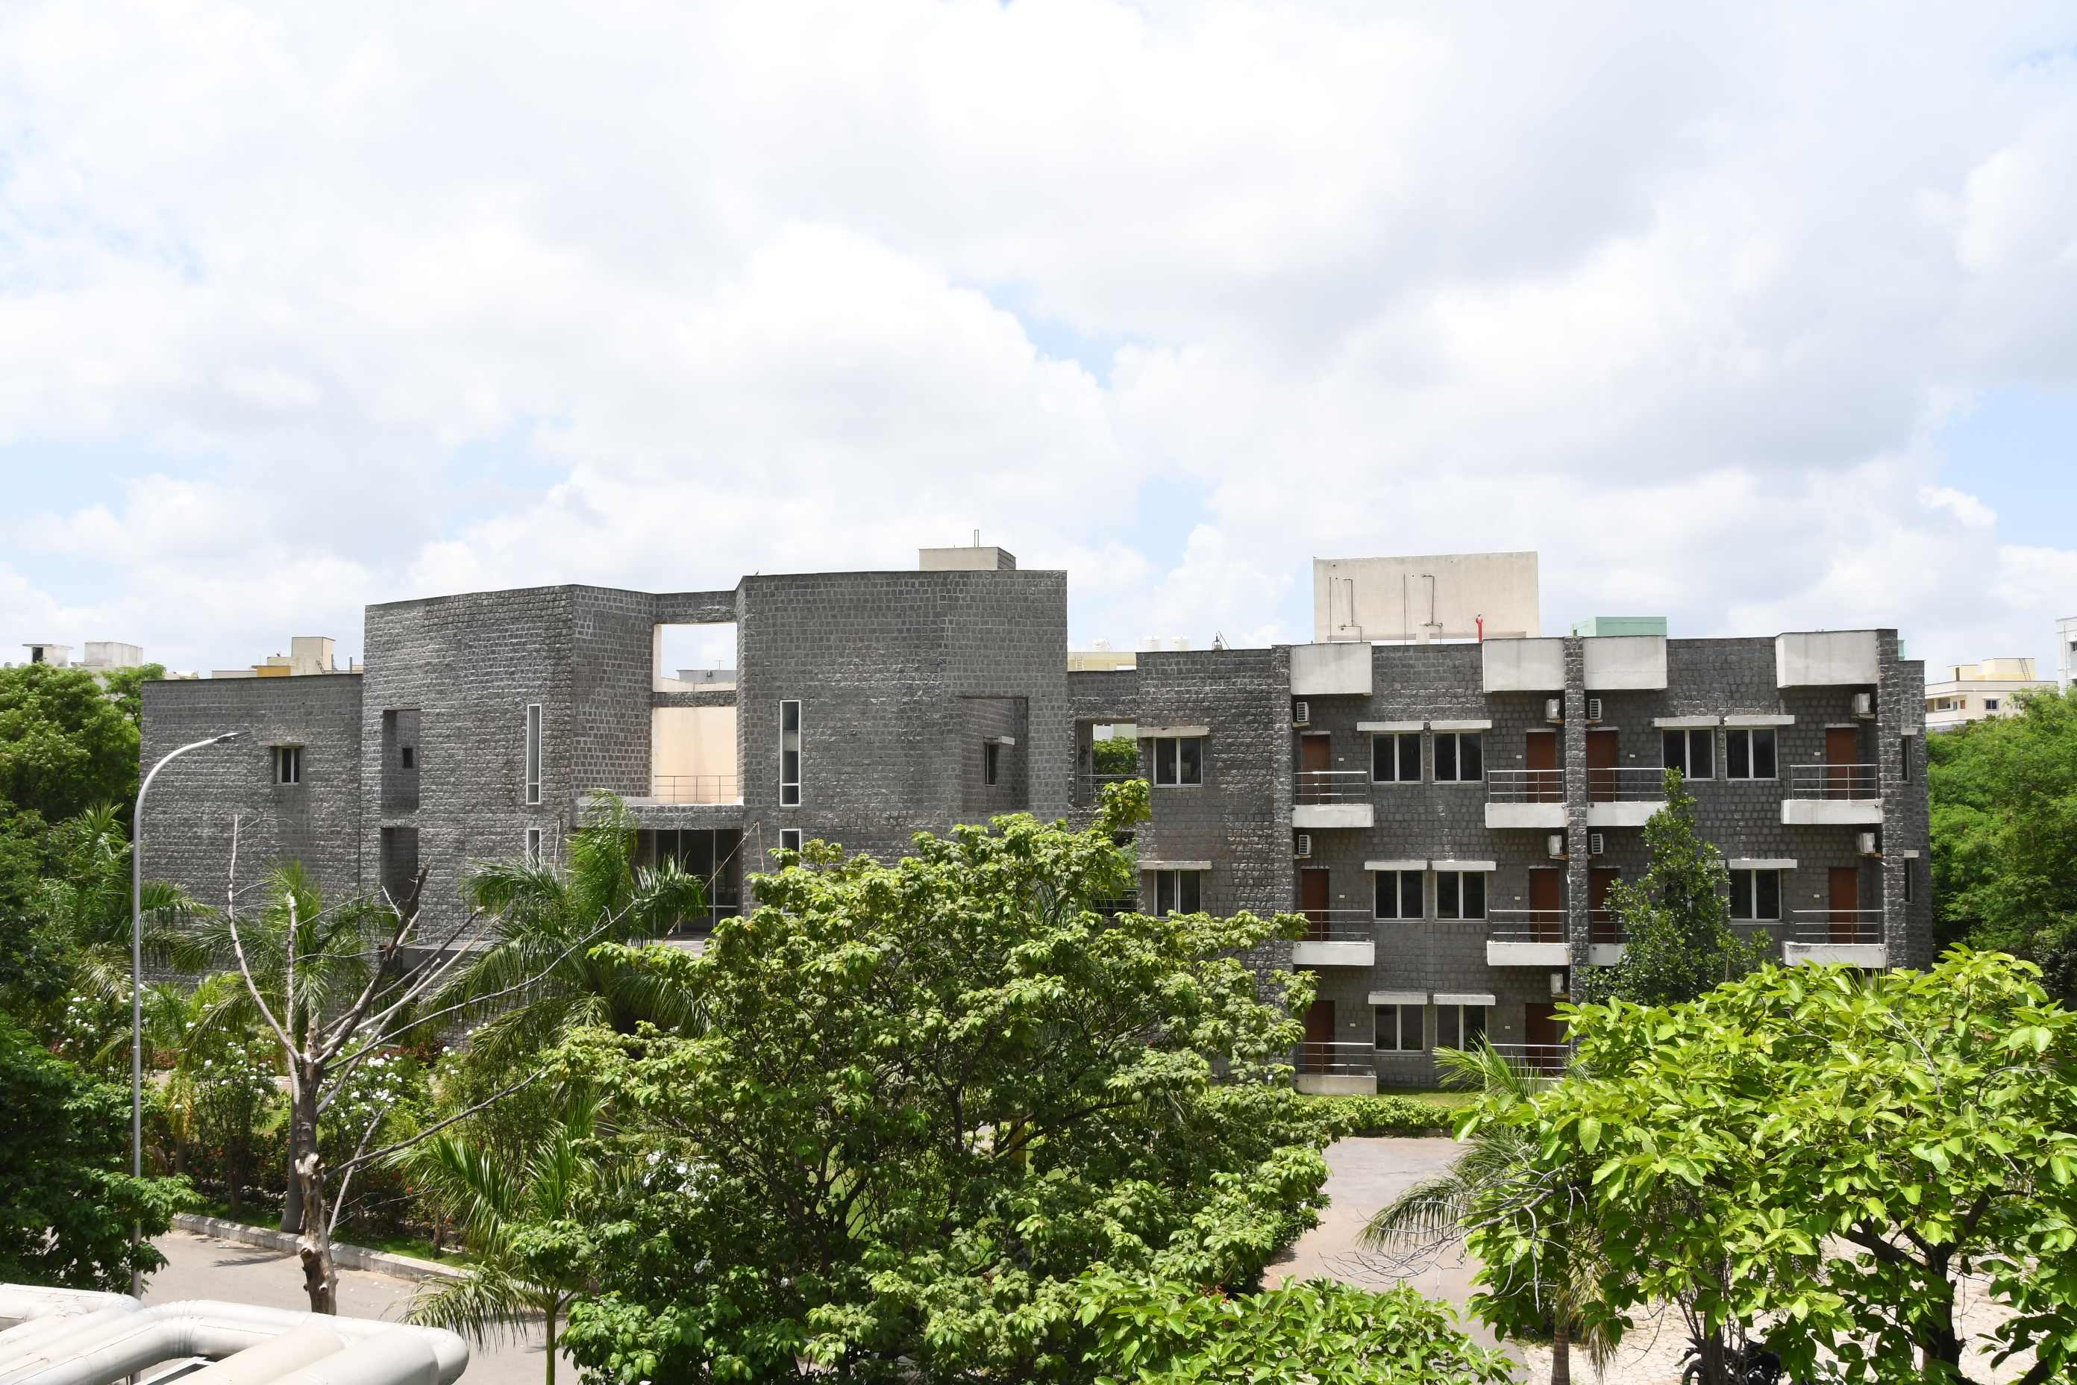
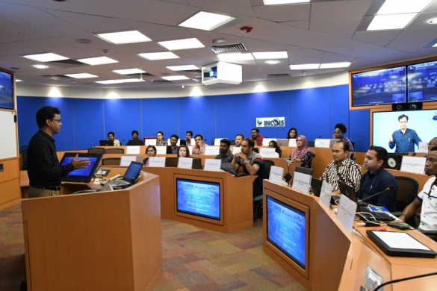
Infrastructure with INCOIS-RTC
Conducted 132 training programs training 7400 trainees from 96 IOC member states.
300 Capacity Open Plenary Hall
172-Seater Auditorium
72-Seater e-classroom
48-Seater e-classroom
30-Seater Board Room
15-Seater Conference Rooms (x 4)
Classrooms, Computer Labs
Physical / Online / Hybrid capabilities

Slide 4
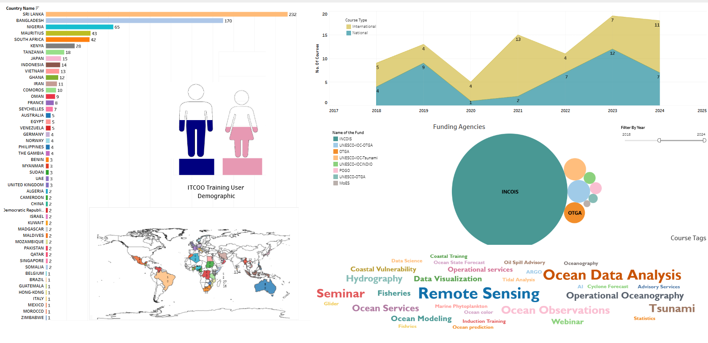
Course Statistics
TOTAL 132 Courses; ~7400 Participant from 96 IOC MS

Slide 5
Achievements of trainings in 2024/2025 with OTGA
Achievements with OTGA
Two courses were conducted during the year 2024. They are:
OTGA-INCOIS Course: Coastal Vulnerability Mapping and analysis using QGIS during November 18 -29, 2024
A total of 25 participants (15 Female, 10 Male from 5 countries)
Ocean Colour Remote Sensing - Data, Processing and Analysis during October 14 – 25, 2024
A total of 21 participants (9 Female, 12 Male from 5 countries)
No courses were conducted in 2025 in collaboration with OTGA
But INCOIS/ITCOO has conducted about 25 (13 international, 12 national) training programs to various participants both from India and abroad training about 690 trainees.
Many training and outreach activities undertaken as pert of Decadal Collaborative Centre for Indian Ocean (DCC-IOR) region and Ocean Decade activities under Challenge - 9

Slide 6
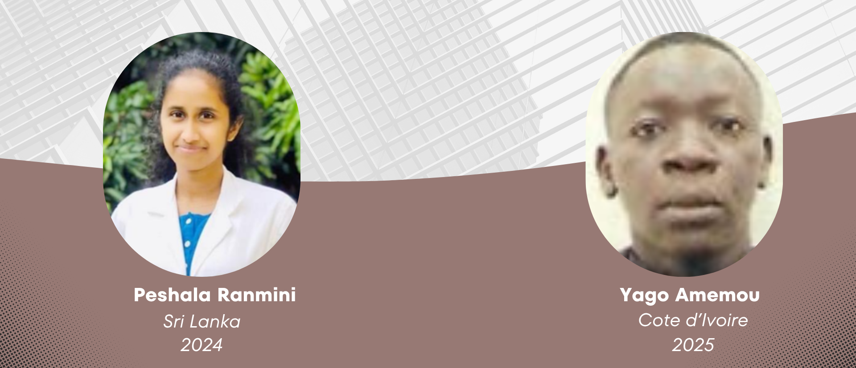
Host IOC traineeship in collab with OTGA
Program summary (Duration 12 weeks)
UNESCO-IOC Ocean Traineeship provides short-term, mentor-led placements to build technical skills required by trainees' home institutions; trainees perform hands-on work and contribute to host workflows.
How INCOIS supports the program
Hosts trainees in operational & research teams (data processing, remote sensing, ocean modelling, glider/ARGO processing, visualization).
Provides mentor pairing, dataset access, and small project briefs that match INCOIS & IOC technical needs and trainee career goals.
Offers follow-up support (code sharing through GitHub, remote debugging, co-authorship when relevant).
Key benefits for trainees
Rapid skill transfer (practical tools, scripts, QC procedures).
Contribution-ready outputs (scripts, QC workflows, prototype dashboards).
Networking, co-authorship, and improved institutional capacity on return.
PROJECT#2024:
“Mapping Sustainable Skipjack Tuna Habitats in the Sri Lankan EEZ: An Integration of Machine Learning and Satellite-Derived Environmental Data.”
PROJECT#2025:
“Quality Control and Value-Added Product Generation for Operational Oceanographic Applications”

Slide 7
Training activities planned for 2026 with OTGA and self courses
Activities planned with OTGA
Two courses are planned during the year 2026. They are:
Coastal Vulnerability Mapping and analysis using QGIS during September 2026.
Ocean Colour Remote Sensing - Data, Processing and Analysis during October/November 2026.
ITCOO will continue with all the planned activities as ITCOO and C2C of UNESCO.
Building own MOODELS platform to provide the pre-course material and online only courses.
Testing the first course early 2026.

