Slide 1


2.2. RTC Portugal Activities 2024-2025
Filomena Cardoso Martins
RTC/STC scope and priorities
Achievements of trainings in 2024/2025 with OTGA
Training activities planned for 2026 with OTGA
SG-OTGA V, November 2025
Notes:
The Portuguese Regional Training Center is an open consortium formed by 17 institutions spread through the territory (continent and islands).
The consortium is currently being coordinated by the University of Aveiro.

Slide 2
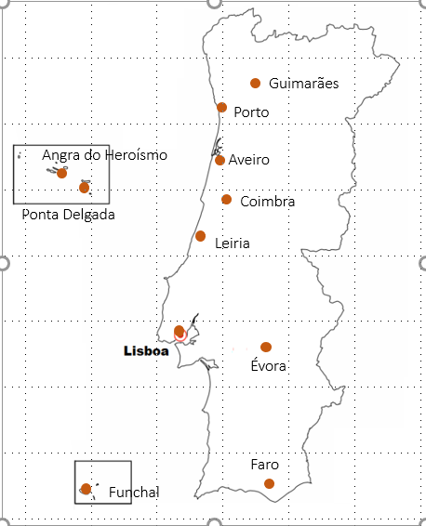
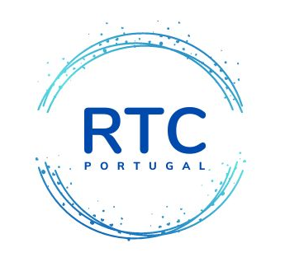
Regional Training Center PORTUGAL
Notes:
The actual members are Universities, Institutes, Research Laboratories, Research Units and Governance Institutions with a long-lasting, and strong international collaboration with worldwide academic and research institutions, namely from Portuguese Speaking Countries
The participating institutions in this consortium, as a whole, cover most domains of Ocean Science, Technology, Management and Governance
In the design of the training courses, the consortium took a multidisciplinary and transdisciplinary approach, covering a wide spectrum of topics, prioritizing those that fulfil the most relevant training needs.
The target audience of this OTGA Regional Training Centre are Portuguese Speaking Countries, but will be open to participants from any other countries.

Slide 3
DATA | CURSO
01-29 | February 2024 | Harmful Algal Blooms (HABs): environmental drivers, impacts, and prediction – 1st ed.
13 March | 15 April 2024 | The change we need for the ocean we want : Ocean Literacy with schools – 2nd ed.
15 October -15| November 2024 | Management and mitigation of coastal erosion - 2nd ed.
15 November - 15 December 2024 | Biomonitorização de substâncias perigosas em ecossistemas costeiros – 1st ed.
31 March - 02 May 2025 | The change we need for the ocean we want : Ocean Literacy with schools – 3nd ed.
02 June - 18 July 2025 | Harmful Algal Blooms (HABs): environmental drivers, impacts, and prediction – 2nd ed..
28 July - 22 August 2025 | Recursos online para análise de ecossistemas marinhos - 1st group
03 November - 08 December 2025 | Biomonitorização de substâncias perigosas em ecossistemas costeiros – 2nd ed.
03 - 28 November 2025 | Recursos online para análise de ecossistemas marinhos - 2nd^{t} group
Notes:
The courses offered are organised by the different members of the consortium, with the collaboration of other consortium members.
In the period of time 2024-2025 we managed to offer 2 new courses and offer courses already held in previous years
The greatest challenge identified, which is common to all courses, although it is more significant in the case of maritime literacy, is the ‘dropout’ of participants.
Additionally, a challenge that has been overcome with the assistance of the OTGA secretariat is the organisation and availability of materials on the Moodle platform.
This challenge is more intense for new courses.

Slide 4
DATA | CURSO
2026 | Harmful Algal Blooms (HABs): environmental drivers, impacts, and prediction – 3rd ed.
 | The change we need for the ocean we want : Ocean Literacy with schools – 4th ed.
 | Management and mitigation of coastal erosion – 3rd ed.
 | Biomonitorização de substâncias perigosas em ecossistemas costeiros – 3rd ed.
 | Recursos online para análise de ecossistemas marinhos
 | Toxic mixtures: Effects of microplastics and PAHs on ecosystems and human health
 | Monitoring using Remote Sensing from theory to practice
 | Conservation of Behavioural Diversity
Notes:
For 2026, we are organising ourselves to offer the courses already held again, plus three new courses that were scheduled for 2025 but were postponed due to the mobility of the course coordinator.
The consortium meeting that should have been held in June was postponed, so no dates have yet been set for the courses to take place.
The Ocean Literacy course aims to adjust and update the materials.
To overcome the constraint of reliable internet access (a problem that had been identified in the proposal to create RTC-Portugal), we intend to strengthen links with entities that can provide this service during the course period.

Slide 5
Obrigado pela vossa atenção …
Thanks for listening …

