Slide 1
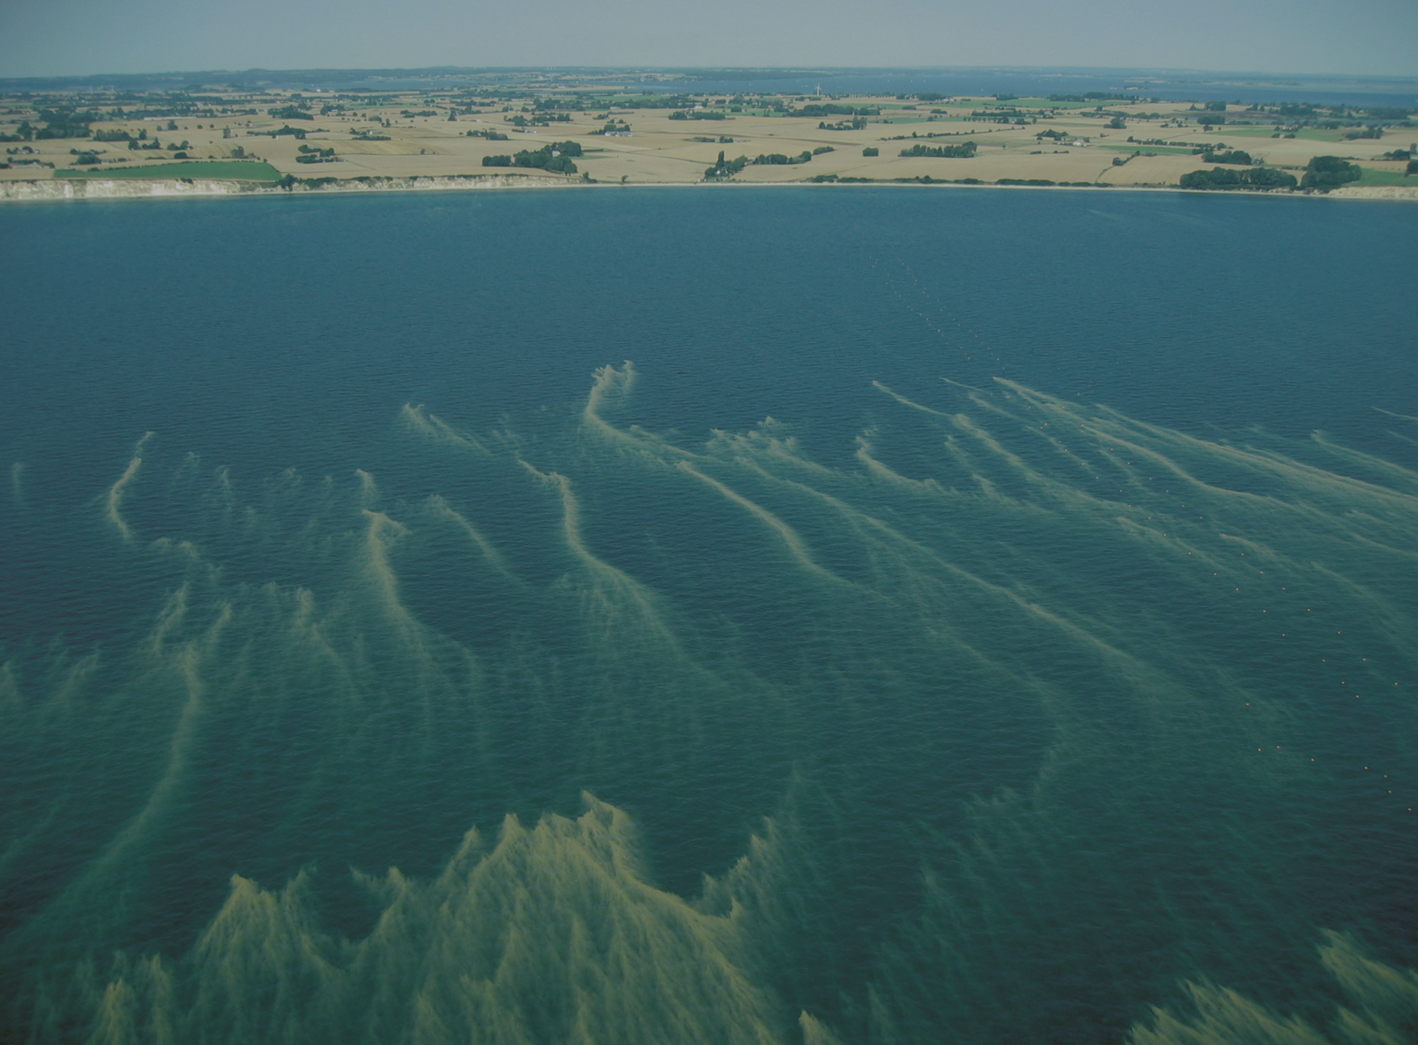

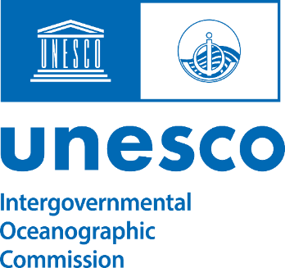
HAB Capacity Building
The IOC SCIENCE AND COMMUNICATION CENTRE ON HARMFUL ALGAE is an OTGA STC:
The Centre in Copenhagen, Denmark, is a decentralized IOC Programme Office for HAB and opened in May 1995 hosted by, and located at, the Department of Biology, University of Copenhagen.

Slide 2
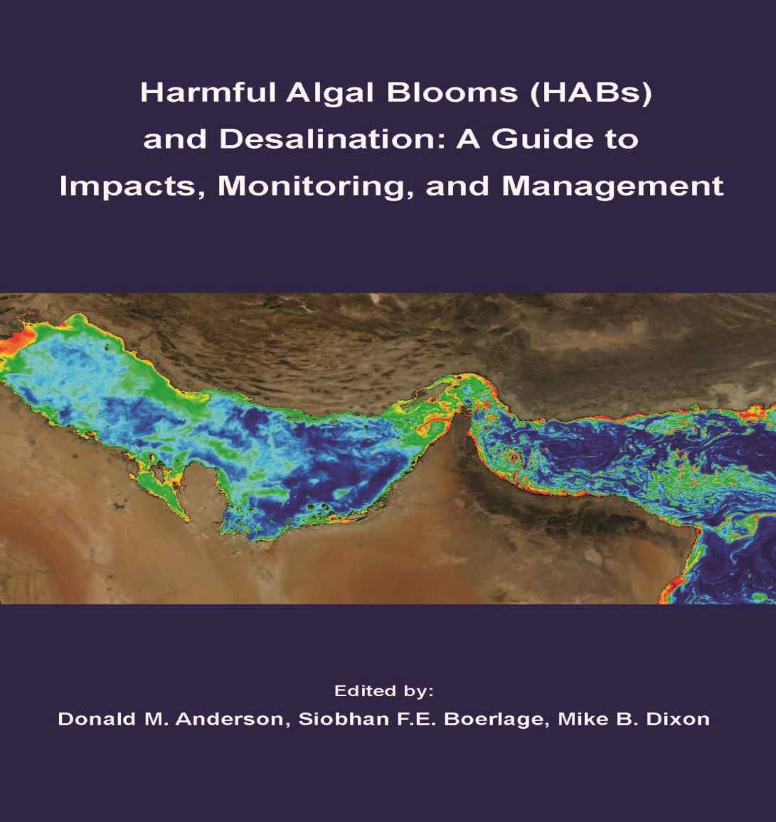
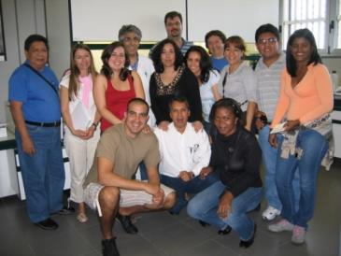
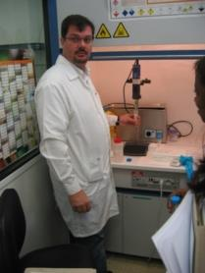
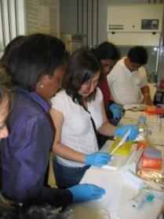
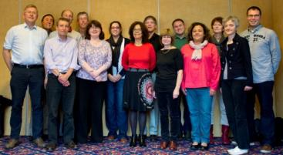
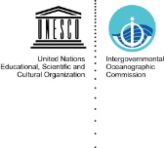
Harmful Algal Blooms Vulnerability of Humans and the Ocean
STRATEGY:
Enhanced of capacity to manage HABs in developing Member States (i.e. training)
Combined with:
A normative global research programme
Manuals and guides for research and management
Global data bases on HAB events and distribution

Slide 3
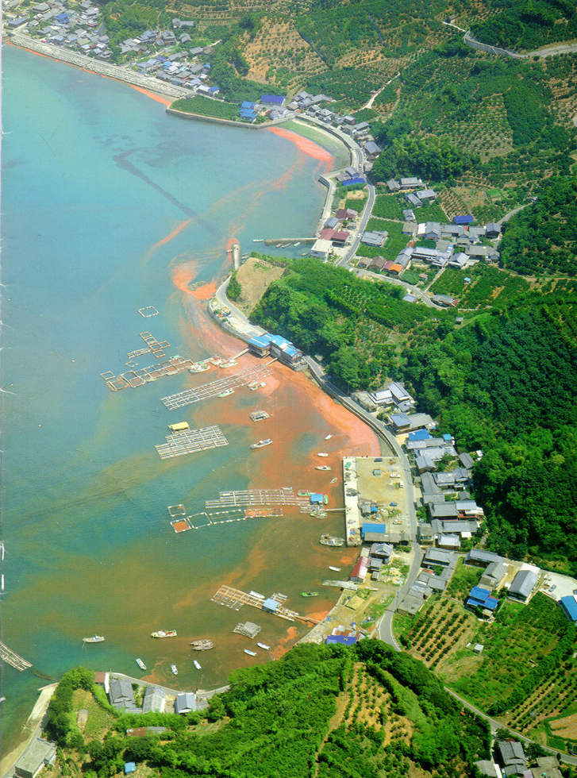
Harmful algal events…..
Affect almost all coastal states
Poison seafood, threatening public health and industries
Kill wild and farmed fish; aquaculture impacts likely to increase with growth of industry
Threaten water supplies from desalination
Cause economic impacts that are increasing along with increase in occurrences of HABs

Slide 4
Courses and training implemented 2024-2025:
IOC Courses with certification continued
IPI in cooperation with Marine Institute and with University of Las Palmas Gran Canarias
Regional and in-country courses
Notes:
4

Slide 5
IOC Training Course and Identification Qualification in Harmful Marine Microalgae, IOC Science and Communication Centre on Harmful Algae Copenhagen, University of Copenhagen, Denmark, E-learning Sept-Nov 2024, followed by practical course.
International Phytoplankton Intercalibration (IPI): University of Las Palmas Gran Canaria – IOC; sample analyses, taxonomic quiz on OceanTeacher, intercalibration report and workshop, from January to December 2024.
Notes:
5

Slide 6
Advanced Phytoplankton Course 13, Stazione Zoologica Anton Dohrn, Italy, 6-26 October 2024. Jointly organized by the Stazione Zoologica Anton Dohrn, the UNESCO/IOC Science and Communication Centre on Harmful Algae and the Station Biologique de Roscoff, with the support of UNESCO/IOC Project Office for IODE/Ocean Teacher Global Academy and partners.
Validation and inter-calibration workshop at the National Marine Information and Research Centre (NATMIRC), Swakopmund, Namibia, 9-22 February 2025.
IOC Training Course and Identification Qualification in Harmful Marine Microalgae, IOC Science and Communication Centre on Harmful Algae Copenhagen, University of Copenhagen, Denmark, E-learning Sept-Nov 2025, followed by practical course.
Notes:
6

Slide 7
Planned courses
IOC Training Course and Identification Qualification in Harmful Marine Microalgae, IOC Science and Communication Centre on Harmful Algae Copenhagen, University of Copenhagen, Denmark, E-learning Sept-Nov 2026, followed by practical course.
International Phytoplankton Intercalibration (IPI): IRTA (Spain) – IOC; sample analyses, taxonomic quiz on OceanTeacher, intercalibration report and workshop, from January to December 2026 and 2027.
Validation and inter-calibration workshop at the National Marine Information and Research Centre (NATMIRC), Swakopmund, Namibia, January 2026
Advanced Phytoplankton Course 14, Station Biologique de Roscoff, Italy, 2026/27, t.b.c
Notes:
7

Slide 8
HAB Capacity Building
Characteristics:
Demand driven
User funded
Examination with certification

