Slide 1




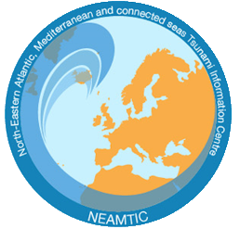

Guide to OTGA
UNESCO-IOC Training Courses:
Tsunami Awareness
Tsunami Ready
UNESCO-IOC Tsunami Information Centres (TICs)
CTIC
IOTIC
NEAMTIC
ITIC

Slide 2
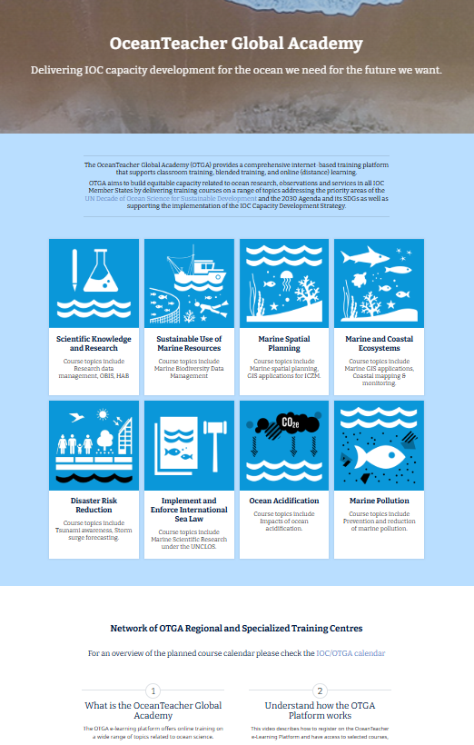
OTGA UNESCO-IOC Tsunami Online Courses
Go To:
https://classroom.oceanteacher.org/

Slide 3
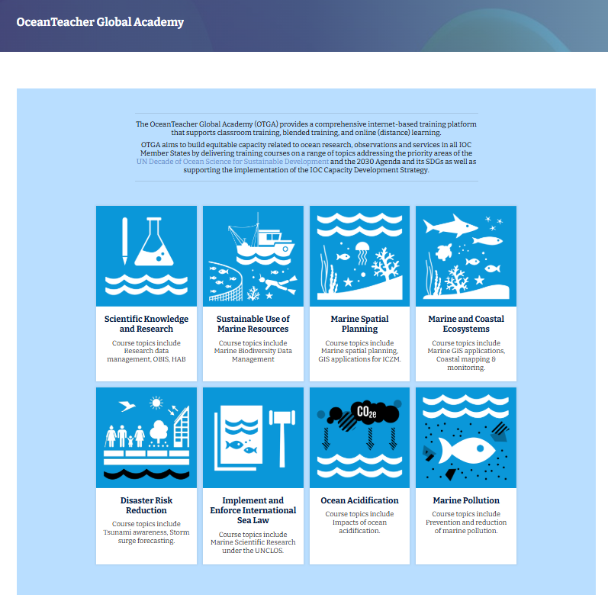
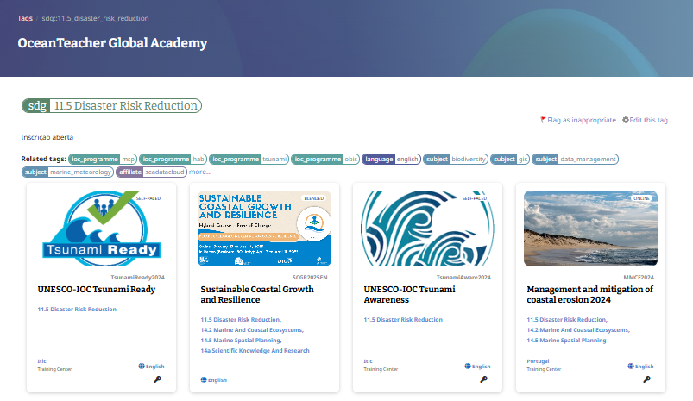
OTGA UNESCO-IOC Tsunami Online Courses
Select:
Disaster Risk Reduction and then UNESCO-IOC Tsunami Awareness

Slide 4
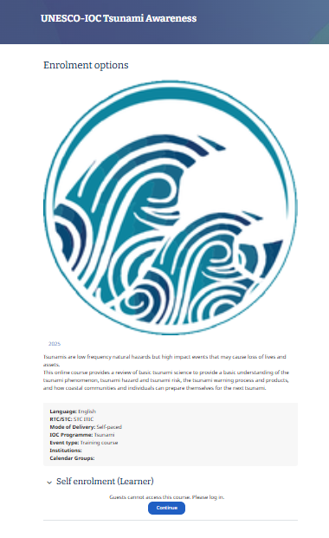
OTGA Online Course
Select:
Continue

Slide 5
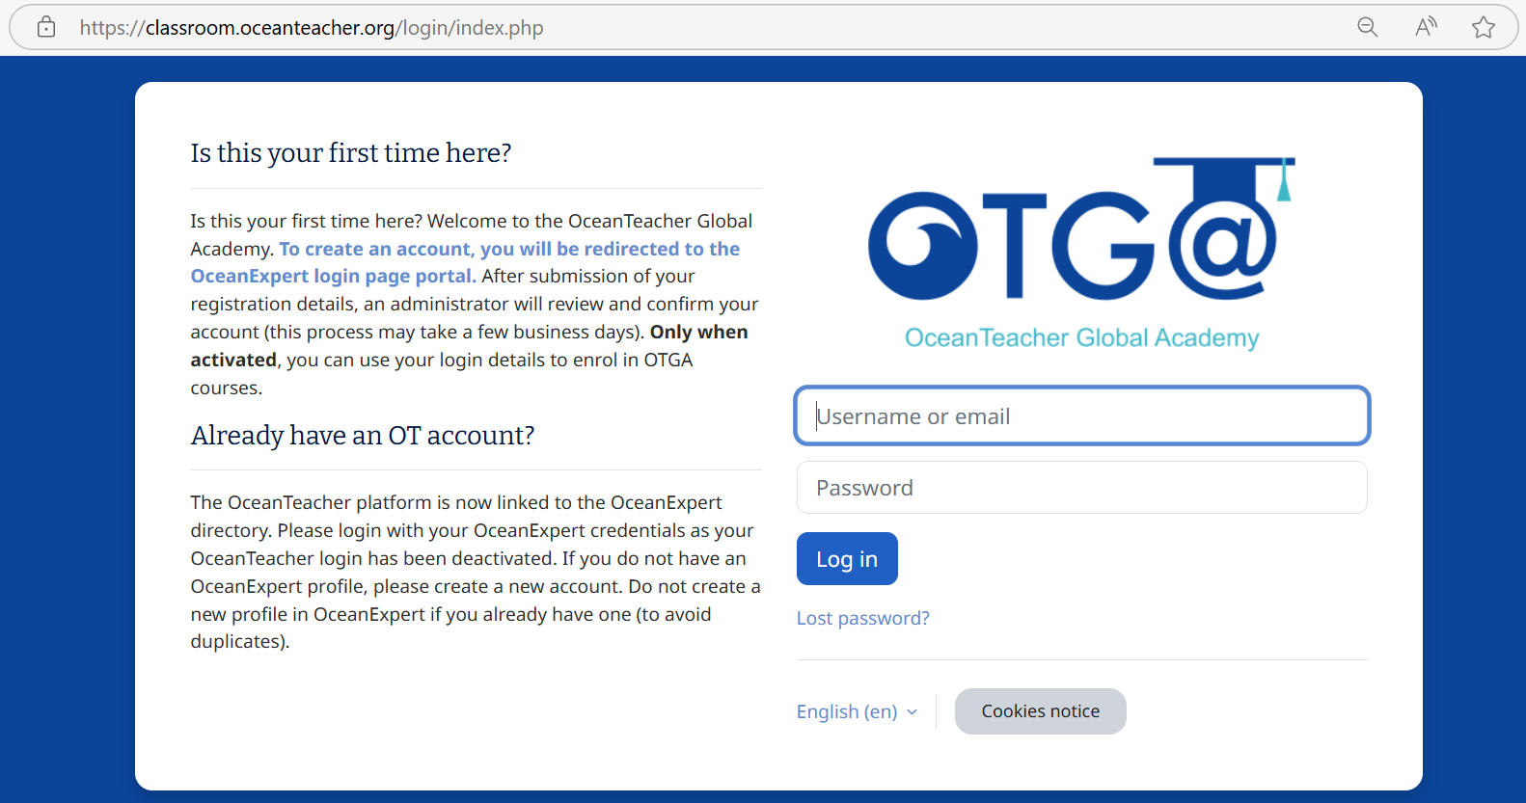
OTGA Online Course
If this is your first time, you need to create OceanExpert Login
Click here
To create an account, you will be redirected to the OceanExpert login page portal.
After submission of your registration details, an administrator will review and confirm your account (this process may take a few business days).
Only when activated, you can use your login details to enroll in OTGA courses.

Slide 6
OTGA Online Course
If you already have login information, proceed to login
The OceanTeacher platform is now linked to the OceanExpert directory
Please login with your OceanExpert credentials as your OceanTeacher login has been deactivated
If you do not have an OceanExpert profile, please create a new account.
Do not create a new profile in OceanExpert if you already have one (to avoid duplicates)

Slide 7
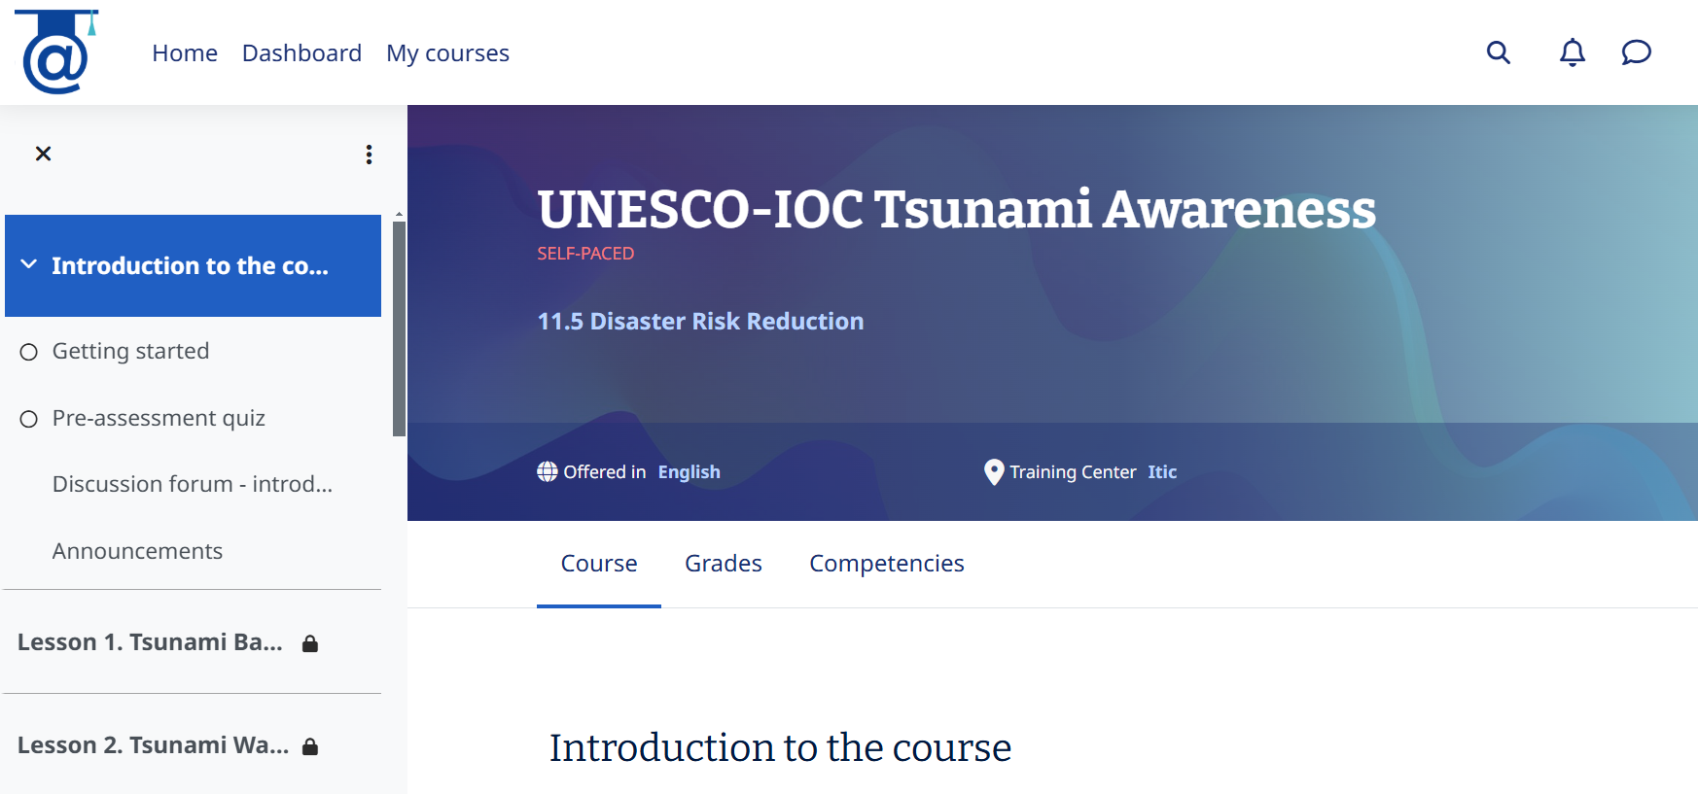
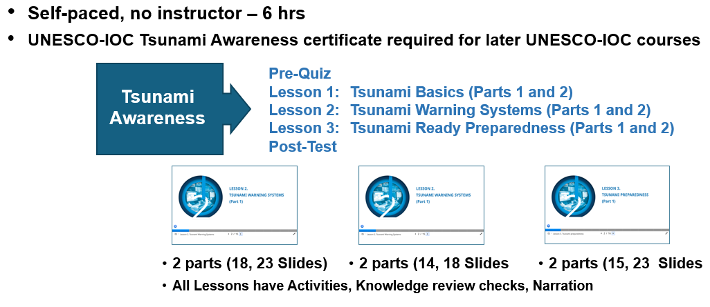
OTGA Online Course: UNESCO-IOC Tsunami Awareness

Slide 8
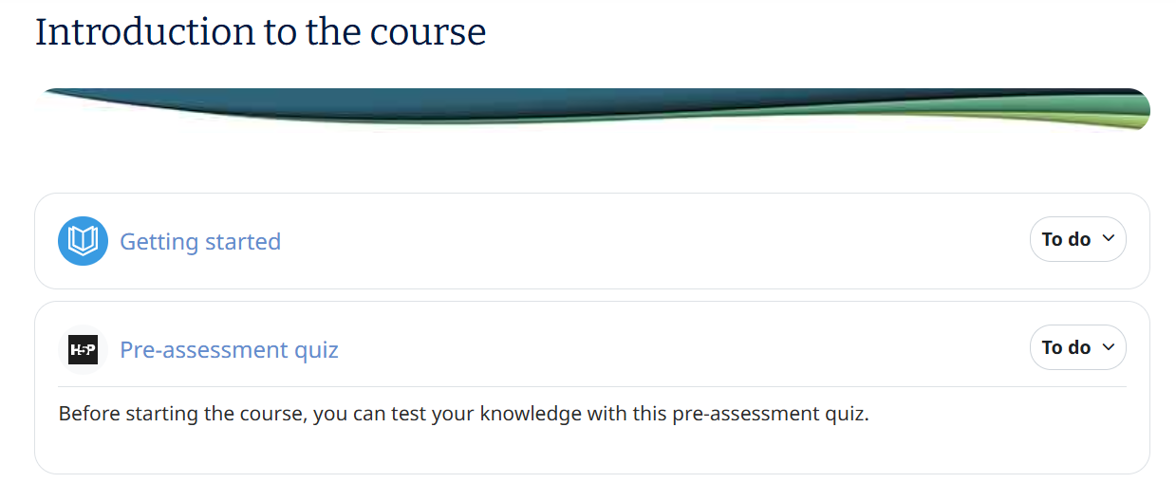
OTGA Online Course: UNESCO-IOC Tsunami Awareness
Start with:
Getting Started
Pre-assessment Quiz

Slide 9
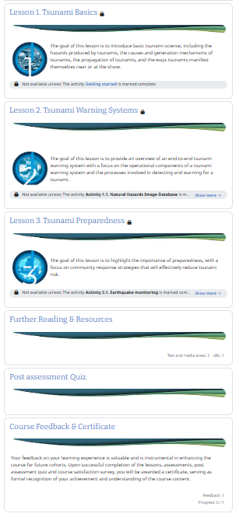
OTGA Online Course: UNESCO-IOC Tsunami Awareness
Follow the instruction to take the course
Getting Started
Pre-assessment Quiz
Complete Lessons 1 to 3
Post Assessment Quiz
Get your Certificate
After completing the Tsunami Awareness course, you can enroll in the UNESCO-IOC Tsunami Ready Course.

Slide 10
OTGA Online Course
Select:
Disaster Risk Reduction and then UNESCO-IOC Tsunami Ready

Slide 11
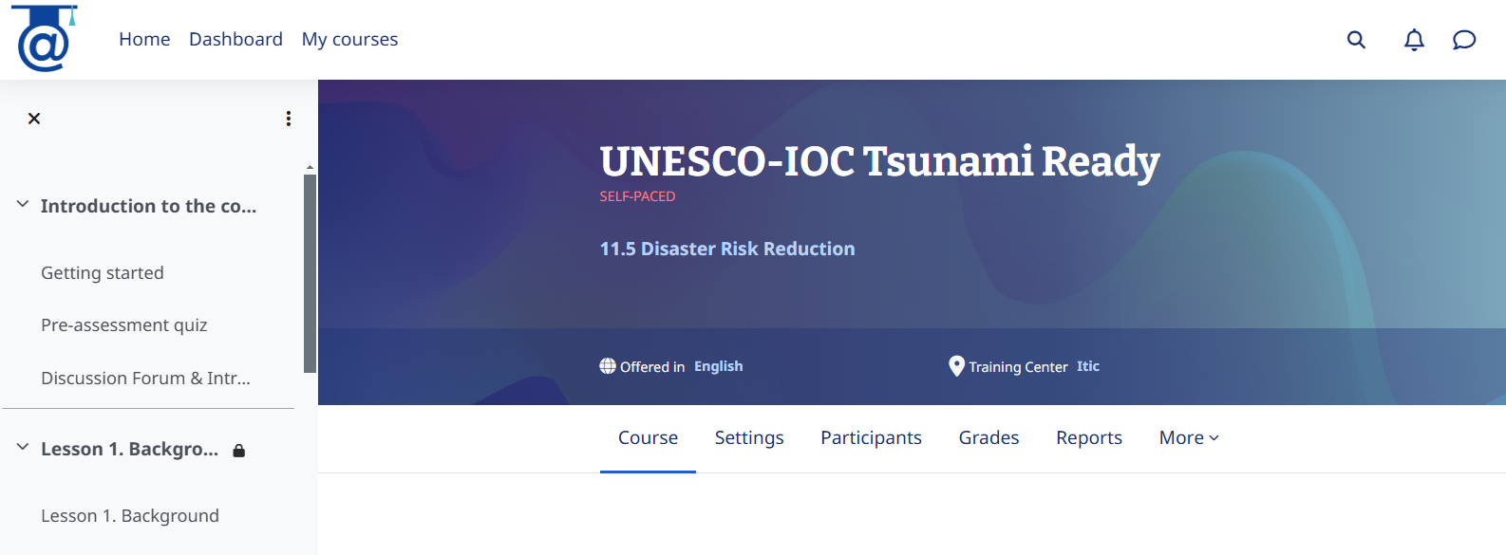
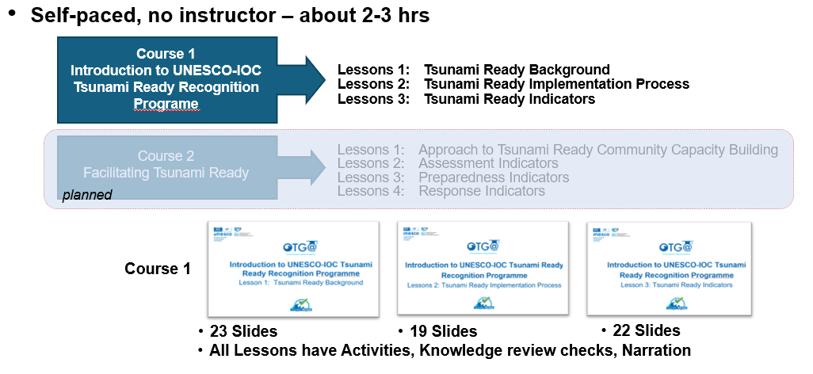
OTGA Online Course: UNESCO-IOC Tsunami Ready

Slide 12
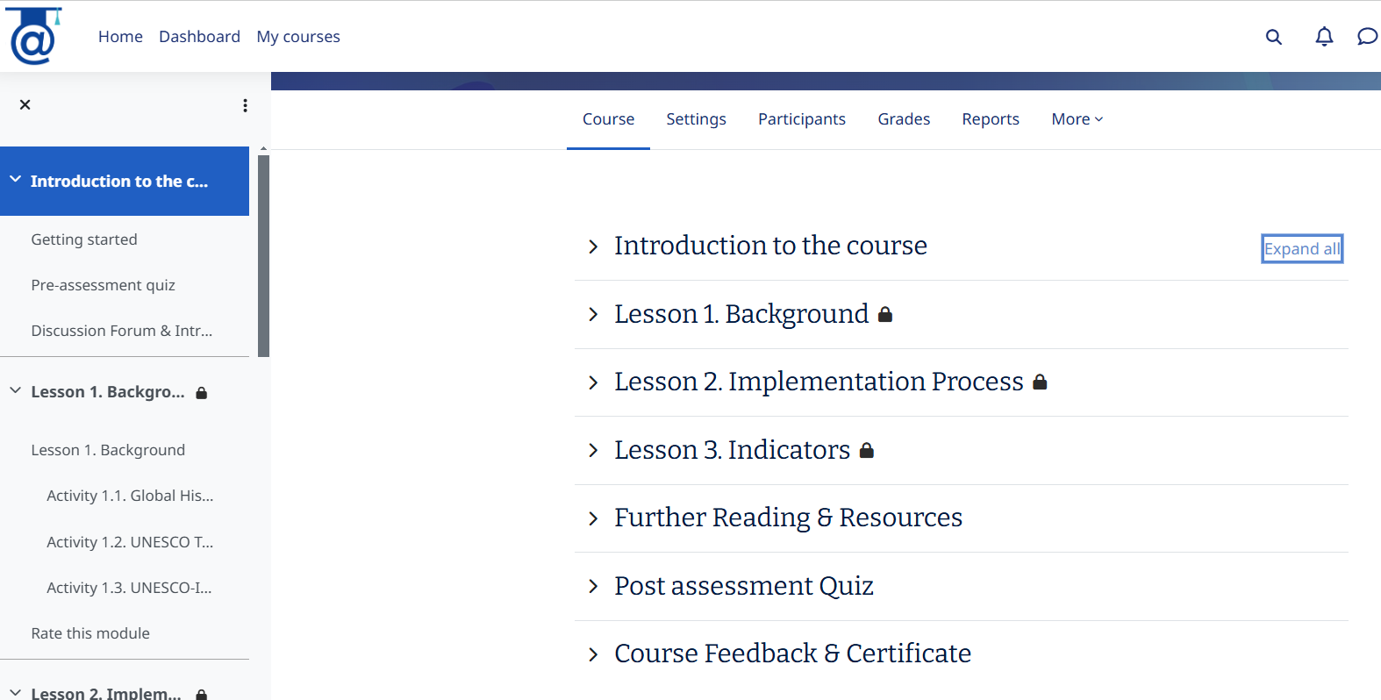
OTGA Online Course: UNESCO-IOC Tsunami Ready
Follow the instruction to take the course
Introduction to the course
Complete Lessons 1 to 3
Post Assessment Quiz
Get your Certificate

Slide 13



THANK YOU
UNESCO-IOC Tsunami Information Centres (TICs)
CTIC
IOTIC
NEAMTIC
ITIC

