Slide 1
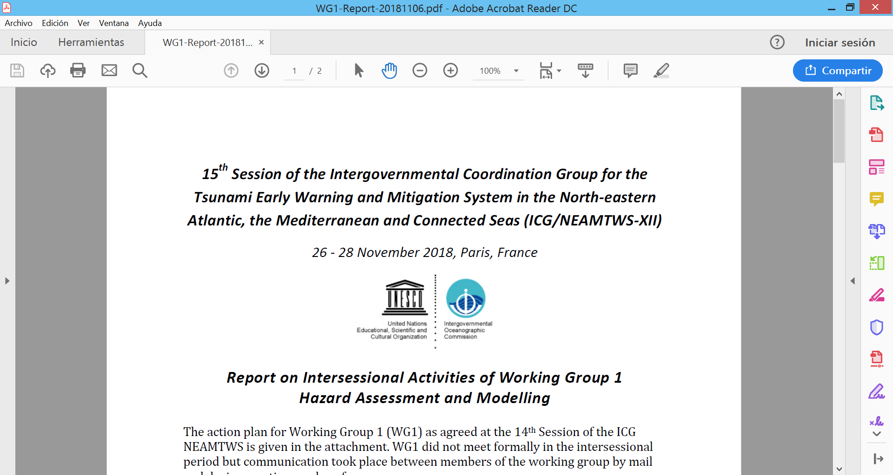
20th Session of the Intergouvenmantal Coordination Group for the Tsunami Early Warning and Mitigation System in the North-eastern Atalntic, the Mediterranean and Connected Seas (ICG/NEAMTWS-XX)
Paris, France 3-5 December 2025
Working Group 1 – Hazard assessment and modelling
Jorge Macías – Universidad de Málaga, Spain
Audrey Gailler – CEA, France
2025 Actions
WG1 members did not meet formally during the intersessional period but communication took place between members of the WG1 and other groups during meeting and conferences.
Some meetings (since previous ICG/NEAMTWS, Nov. 2024):
  Forecast Meeting - Lisbon (IPMA) (5-6 March)
  Expert meeting on tsunami sources – Paris (UNESCO-IOC) (18-20 March)
  EGU 2025 – Vienna (27 April – 2 May)
  Coastwave2.0 training workshops
  OUG drafting on-line meetings

Slide 2
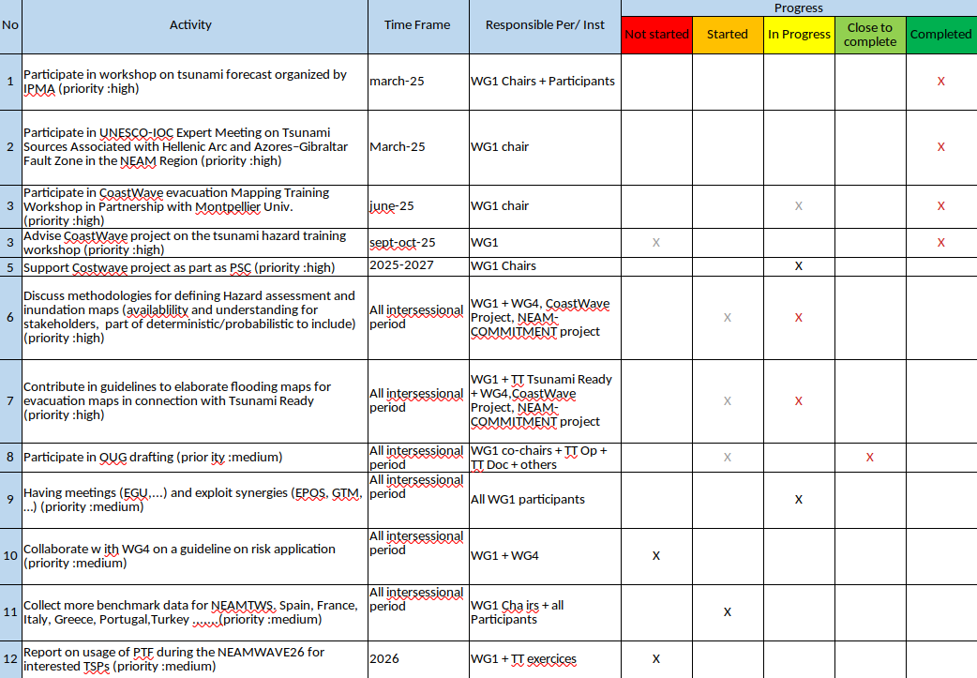
Plan of Action WG1 (agreed at ICG/NEAMTWS-XIX)
updated Dec. 2025

Slide 3
(ICG/NEAMTWS-XX) – 3-5 December 2025 - WG1
Report on the Intersessional Activites of Working Group 1
Hazard Assessment and Modelling
2025 Actions
Items discussed during different project meetings (OUG drafting, CostWave2.0, conferences and other meetings):
  OUG update: Take part in writing the “tsunami forecasting” chapter
  Tsunami sources (expert meeting)
  Take part in the PSC of Coastwave2.0 project
  Presentation in Coastwave2.0 workshops:
    Training on evacuation mapping
    Training on Tsunami hazard
  Tsunami forecast approaches, focus on PTF (workshop organized by IPMA)
  Methodologies and procedures for hazard assessment (deterministic vs probabilistic) for different applications: preparation, mitigation, evacuation (Tsunami Ready).

Slide 4
(ICG/NEAMTWS-XX) – 3-5 December 2025 - WG1
WG1 Interaction with ongoing projects
    DT-GEO - Improved hydrodynamics integration into PTF workflow
    Geo-INQUIRE - VA SDL (Simulation Data Lake)
- VA Ch-HySEA (and others BingClaw/AmpFact/Gauss/Slip)
- TA Ch-HySEA / TA Ch-PTHA
    ChEESE-2P
- Code improvements (dispersion) / New codes (Meteo-HySEA)
- Global Tsunami Hazard Map
- Complex multi-source tsunami modeling
    PCTWIN (UK-India)
    Aristotle4-ENHSP (All Risk Integrated System TOwards Trans-hoListic Early-warning 4 - European Natural Hazards Scientific Partnership)
New projects
    GANANA (EU-India) – TEWS / PTHA / European flagship codes
    NEAM-COMMITMENT (UCPM-2024-KAPP - Knowledge for Action in Prevention and Preparedness) – KoM 24-25 February, Athens
    COST Action THREAT (Tsunami Hazard and Risk Education through Accessible Training)

Slide 5
(ICG/NEAMTWS-XX) – 3-5 December 2025 - WG1
Project meetings
    NEAM-COMMITMENT – KoM 24-25 February, Athens
    GANANA Symposium – 6-7 March, Stockholm
    DT-GEO General Assembly – 11-13 June , Switherland
    Geo-INQUIRE – Jupiter Notebooks meeting – 26-27 June, Potsdam
    Geo INQUIRE – Landslide Workshop – 16-18 September, Barcelona
    Arsitotle meeting – 7-9 October, Azores
    4th EPOS TCS Tsunami – 20-21 October, Athens
    GTM Board Meeting – 22-23 October, Athens
National activities
    Jornada PAL ante el riesgo de maremotos – 10 November, Chipiona, Cádiz, Spain
    Simulacro RespuestA25, 20 November, Cádiz, Spain
Overseas collaboration
    UPRM/RSPR (Puerto Rico) – Hazard Maps
    UNA/SINAMOT (Costa Rica) – 24-28 Novembre – Hazard Maps/PTHA
Interaction with other ICG
    ICG CARIBE-EWS Expert Meeting on Seismic Sources in the Caribbean and on Non-Seismic Sources of Tsunamis for the Caribbean and Adjacent Regions (EMCR-2024) - Heredia, Costa Rica, 3-5 Dec. 2024

Slide 6
Plan of Actions (PoA WG1) 2026
1. CoastWave2.0 EU Project interaction: guidelines evacuation maps for Tsunami Ready (probabilistic and deterministic approximation), coll. with TT TR, WG4:
  input required data
  numerical tools
  map approximation (deterministic, probabilistic)
  standards for map construction (colors, minimal information to be included in maps,…etc)
2. Feedback report on usage of PTF for a chosen scenario (TBD)
3. Contact WG4 to collaborate on a guideline on risk application (preparation, mitigation, evacuation) to be decided---
4. Participation in projects (meetings and tasks)
5. Having meetings (e.g. EGU, EPOS,…)
6. Collect more benchmark data for NEAMTWS. Spain, France, Italy, Greece, Portugal, Turkey, …

