Slide 1
SOP Efforts for
Non-Seismic and
Complex sources
Denis Chang Seng, PhD Programme Specialist
Technical Secretary (ICG-NEAMTWS & TOWS Task Team on Disaster Management and Preparedness
ODTP Focal Point
CoastWAVE Project Responsible Officer
Tsunami Resilience Section
UNESCO IOC
Dr Alessandro Amato
INGV, Italy

Slide 2
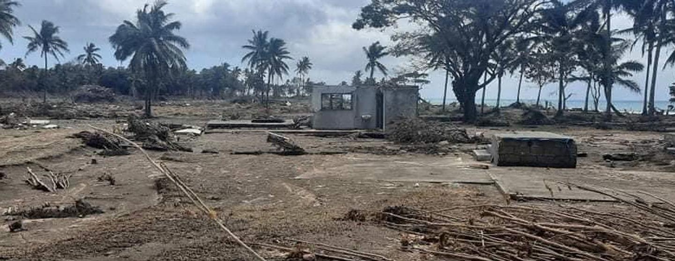
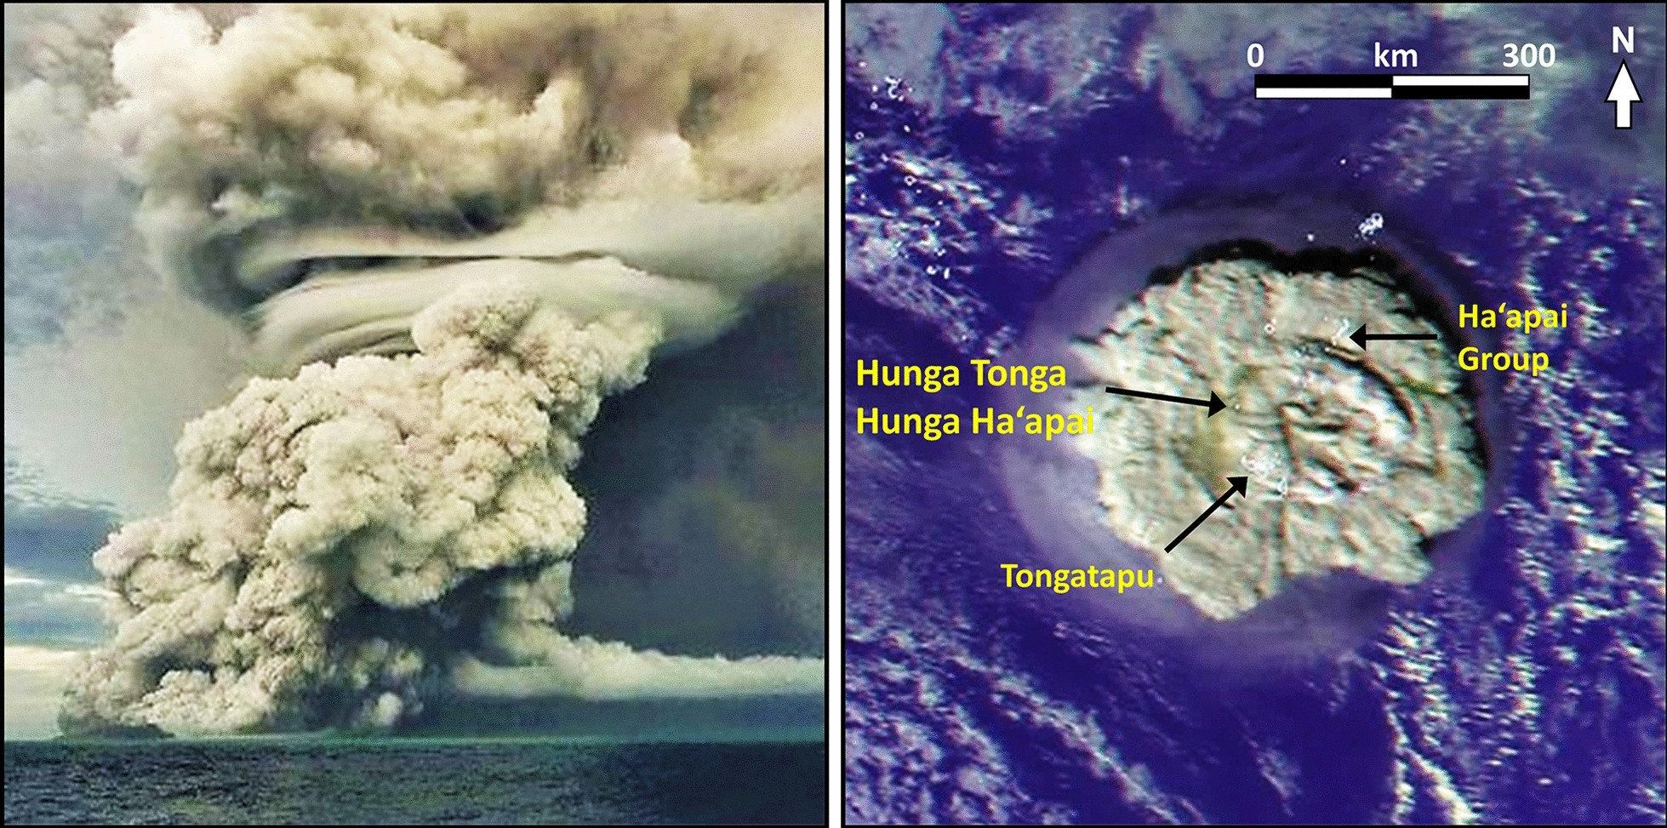
Experience from the Pacific
Hunga Tonga–Hunga Ha’apai Volcanic Eruption (15 Jan 2022)
Largest volcano-atmospheric explosion ever recorded.
Triggered a trans-Pacific tsunami impacting Tonga, Fiji, American Samoa, Vanuatu, New Zealand, Japan, USA, Russian Far East, Chile, and Peru.
Resulted in at least four fatalities.
ICG/PTWS Response
Produced Interim Standard Operating Procedures (SOPs) for responding to tsunamis generated by volcanic eruptions or similar processes.
15 Mar 2022: PTWC implemented Interim SOPs for volcanic tsunami response.
UNESCO 2024

Slide 3
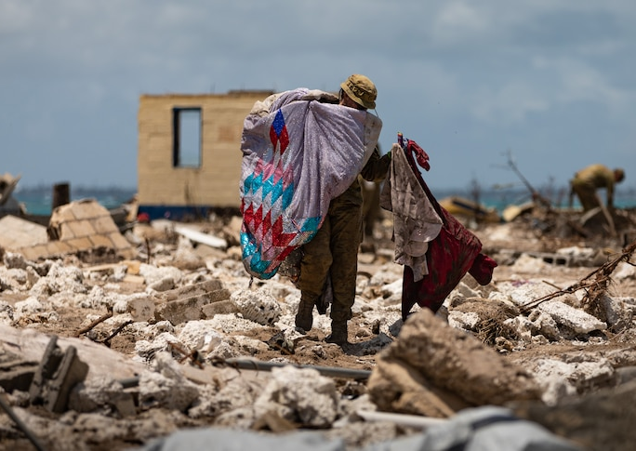
Experience from the Pacific
Included in PTWC Interim Procedures and PTWS Products User’s Guide (IOC Circular Letter 2902).
Task Team then developed HTHH Volcanic Tsunami Hazard Response – Version 1.3.
Sep 2023 (ICG/PTWS-XXX, Tonga): Decision to establish permanent monitoring and warning procedures.
19 Jan 2024: IOC Circular Letter 2984 announced permanent PTWC Procedures and PTWS Products User’s Guide (IOC Technical Series No. 188).
UNESCO 2024

Slide 4
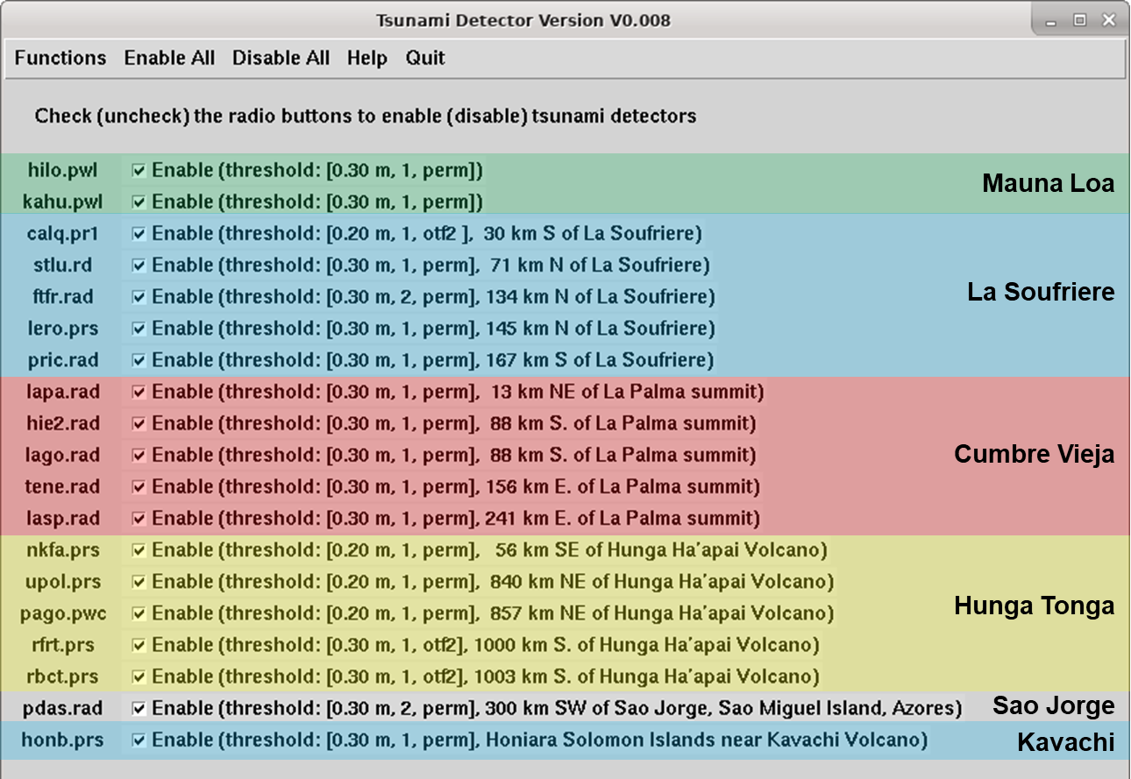
PTWC Procedures for TGV from Other Volcanoes
Volcano or Ash Observatories notify PTWC about potential or actual eruptions.
Sea-level gauge triggers alarm.
At least two independent indicators of a tsunami are required before initiating notification to Member States.
Messages are constructed ad-hoc depending on how much is known about the source and size of the tsunami.
PTWC Tool to Alarm Sea-Level Gauges Near Volcanoes
UNESCO 2024
Quantitative Tsunami Amplitude Forecasts are not available for Other Volcanoes

Slide 5
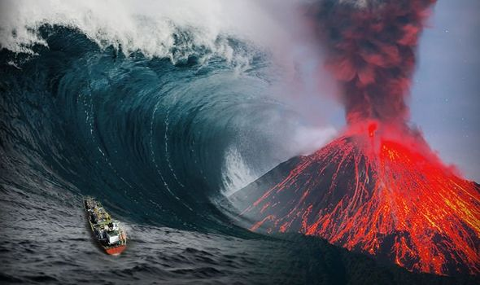
Key Considerations
85-90% of Tsunami's are generated from earthquakes.
Volcanic eruptions are the 2nd most common cause.
Non-seismic SOPs should be as similar to seismic SOP's as possible
Different SOPs for near field and far field
The tsunami warning process can be divided into the following stages:
Source Identification
Threat assessment
Product generation and dissemination
Source: Based on Robert Greenwood BOM, Aug 2025

Slide 6
Source Identification
Source: Robert Greenwood BOM, Aug 2025
Direct observation of event
Volcanic Ash as reports by VAAC’s (Volcanic Ash Advisory Center)
Reports from volcano observatories
Develop seismic processing of volcanic eruption and/or landslides
Sea level observation
Tide Gauge and DART buoy observations can be used to confirm a tsunami has been generated
Continued development of new and emerging Technologies such as GNSS, SMART cables, etc.
Develop automated alerting techniques.
Other considerations
Specific near field threats should be tailored to particular needs or requirements in relation to monitoring.
Non-seismic bulletins from TSP's will not be as timely as for seismic events.
TSPs will not identify every non-seismic event

Slide 7
Threat Assessment
Tsunami Travel Time Assessment
Universally applicable.
Subjective assessment based on size of the event for what time contour used.
Determine level of threat (watch, Marine, Land, etc)
Threat level and areas refined from careful consideration of sea level observations
Pre-computed model runs
Reasonable approach for known potentially tsunamagenic volcanoes
Real time modelling
Adjustments to inversion techniques to account for non-seismic sources may produce reasonable results
Source: Robert Greenwood BOM, Aug 2025

Slide 8
Product Generation and Dissemination
Keep products similar as possible to tsunami warning products for seismic events – Modify to remove seismic information and include non-seismic source details.
Consider having specific products/alerting methods for unique threats for specific near field hazards
Source: Based on Robert Greenwood BOM, Aug 2025

Slide 9


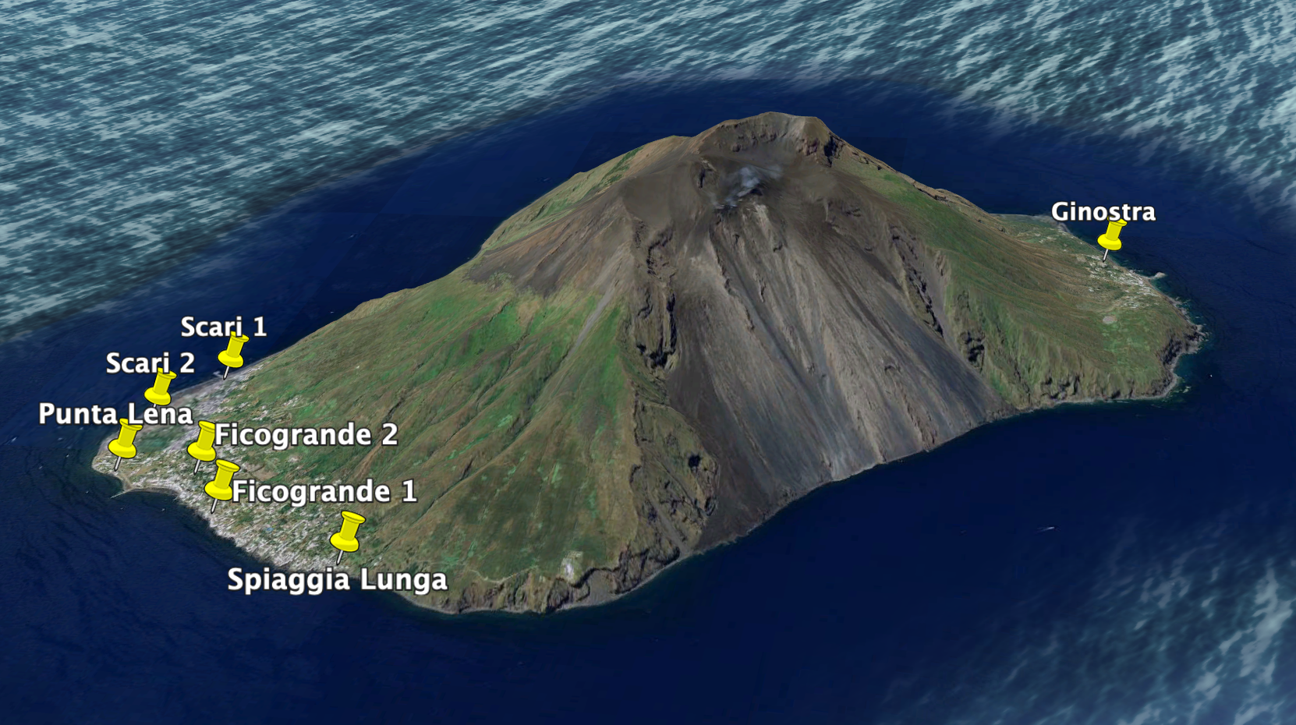
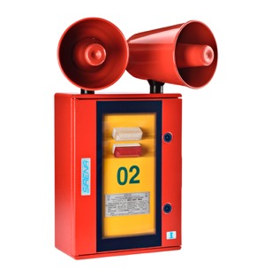

Very Short-Term Early Warning System
Source: Domenico Mangione
Volcanic risk management specialist
National Civil Protection Department (Italy
7 sirens in Stromboli
1 in Panarea
1 in Milazzo (CG premises)

Slide 10
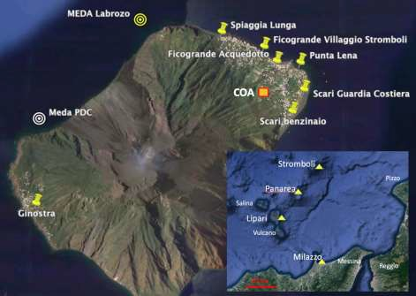
Stromboli Volcanoe Emergency Response Plan
Italian Civil Protection Department (DPC) developed a national emergency plan for non-conventional (volcanic) tsunamis.
Implemented with Sicily Regional Civil Protection, Lipari Municipality, INGV, and University of Florence (LGS).
Alert time < 4 minutes — TEWS issues alert within 20 seconds of onset.
No time for modeling tsunami impact before arrival.
Upon TEWS notification, DPC activates 3-minute acoustic sirens at Stromboli, Ginostra, Panarea, Lipari, and Milazzo Harbour Office.
Automatic alerts (email & SMS) sent to authorities with message: “Tsunami wave in progress at Stromboli.”
UNESCO 2024
Position of the COA and the Acoustic Alert (siren) system used to warn population on the possible occurrence of a tsunami.

Slide 11
Stromboli Volcanoe Emergency Response Plan
The early-warning message is thus automatically delivered to the emergency control rooms for the: i) National Civil Protection; ii) Sicily Regional Civil Protection; iii) Lipary Municipality; and iv) Prefecture of Messina.
In coordination and cooperation with the National Department of Civil Protection, the authorities in-charge will keep contact with: i) Mayor’s delegates for the islands of Stromboli, Vulcano, Panarea, Alicudi, and Filicudi; ii) Municipalities along the Sicily and Calabria coast, iii) Operational bodies present in the territory (e.g., Police, Firefighters, Forestry Corps, etc.); and iv) Voluntary structures of Civil Protection present on the different islands.
The aim is to inform people, apply the safety procedures at local level, and regulate the navigation and the docking of boats.
UNESCO 2024

Slide 12
Stromboli Volcanoe Emergency Response Plan
Once the tsunami risk is declared over, the Lipari Municipality, with the support of the Regional Department of Civil Protection, will evaluate the opportunity to inform the population of Stromboli, Ginostra, and Panarea by using the same acoustic alert system in “voice” mode.
The Department of Civil Protection will monitor the possible effects of the tsunami along the coasts and in agreement with the Sicilian Region, it will evaluate the activation of the emergency national civil protection plan.
UNESCO 2024

Slide 13

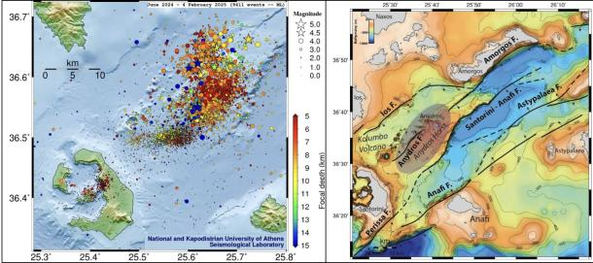
Santorini Experience
Over 1,200 earthquakes, with magnitudes ranging from 1.0 to 5.2, occurred between January 25 and February 7, 2025 (10:00 TS).
A meeting was organized by NEAMTWS Tsunami Service Providers(Feb 2025) to discuss operational procedures and communication strategies for Member States, especially in the event of non-seismic tsunamis.
TSP Experts noted that the existing mandate of Tsunami Service Providers (TSPs) purely covers seismic tsunamis and emphasized the operational challenges that arise when addressing non-seismic tsunami events.
Earthquake distributions of the Aegean Sea Earthquake Storm Figure 1 b: Active faults are represented by black lines, while the subsiding block is indicated by arrows. Modified from Nomikou et al. (2018).
National Observatory of Athens (NOA), Yalçıner et al (2025).

Slide 14
New NEAM OUG and Task Team Key Activities
Proposed renewed structure of the OUG, non-seismic sources are only included in Annex III: Legal Framework.
The idea was to cover the legal aspects in case a non-seismic tsunami were to be generated which would not be currently covered by the services of the TSPs .
Not included in the operations description, since it is not currently covered by TSPs.
New Task Team of Non-seismic tsunamis is mandated to develop future bulletin formats including tsunami from non-seismic sources
Regional webinar on non-seismic tsunamis planned on 27th Nov 2025

Slide 15
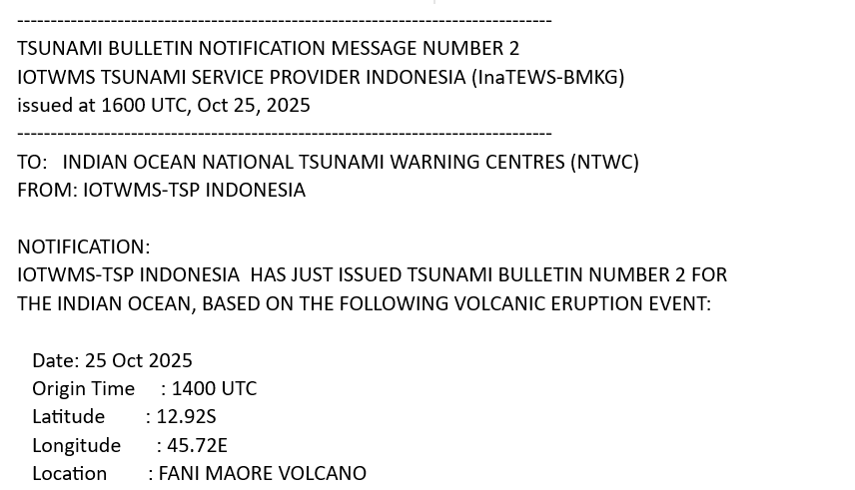
IOTWMS IOWave (2025)

