Slide 1








CoastWAVE 2.0 Project
Local Tsunami SOPs
Cascais, Portugal
28th October, 2025

Slide 2

AGENDA
Introduction of the community
Coordination with provincial/national disaster management agencies
Coordination Structure within Municipality Communication channels
Evacuation procedures
Response Operations
Recovery and rehabilitation
Drills and community awareness

Slide 3

Municipality of Cascais

Slide 4
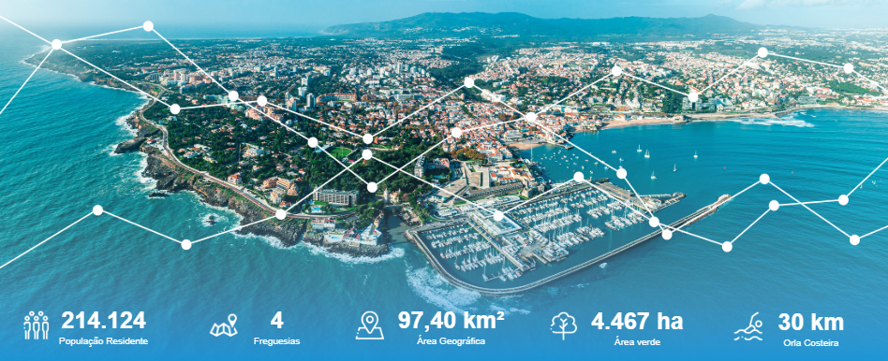
Municipality of Cascais - general data
Notes:
two hundred and fourteen thousand, one hundred and twenty-four inhabitants
4 territorial parishes

Slide 5
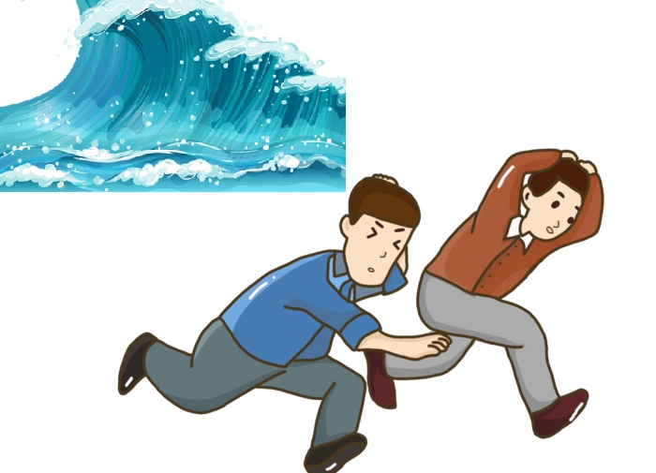
Municipality of Cascais - Vulnerable elements
Approximately 22,000 residents at risk of tsunami
Critical infrastructure at risk: Local Maritime Authority and Cascais Nacional Police Force
4,700 buildings and 15 hotels affected
41 administrative, cultural, sport and educational facilities and 2 health facilities affected
Railways, roads, trade and essential services affected

Slide 6
Coordination with national disaster management agencies

Slide 7



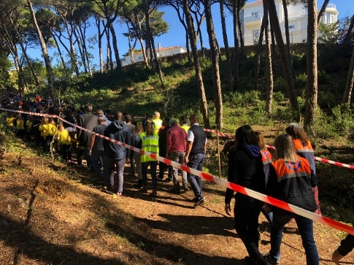
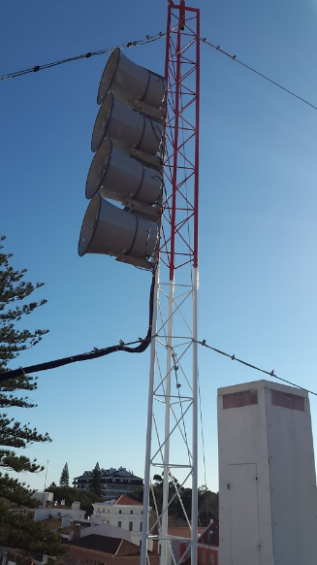

Coordination with national level
National Tsunami Warning Centre (IPMA)
Rede NEAMTWS – North-Eastern Atlantic, The Mediterranean Tsunami early Warning
National Authority for Emergency and Civil Protection
Cascais Civil Protection

Slide 8
Coordination Structure within Municipality Communication channels

Slide 9
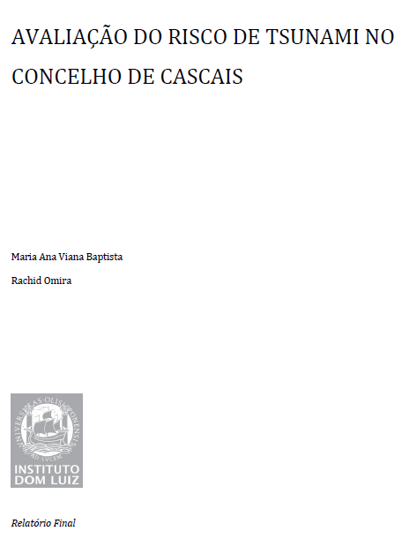
Tsunami risk management
2012- 2014
A study was conducted to assess the risk of tsunamis in Cascais, by Dom Luiz Institute

Slide 10
Tsunami risk management
Study conducted by the Dom Luiz Institute
It considered three scenarios:
1st Tsunami generated after an earthquake measuring over 8.0 on the Richter scale in the Glória fault zone;
2nd Tsunami occurred after an earthquake measuring 8.0 on the Richter scale in the Ferradura – Marquês de Pombal zone;
3rd Tsunami occurred after an earthquake measuring 8.8 on the Richter scale in the Ferradura – Marquês de Pombal zone.

Slide 11
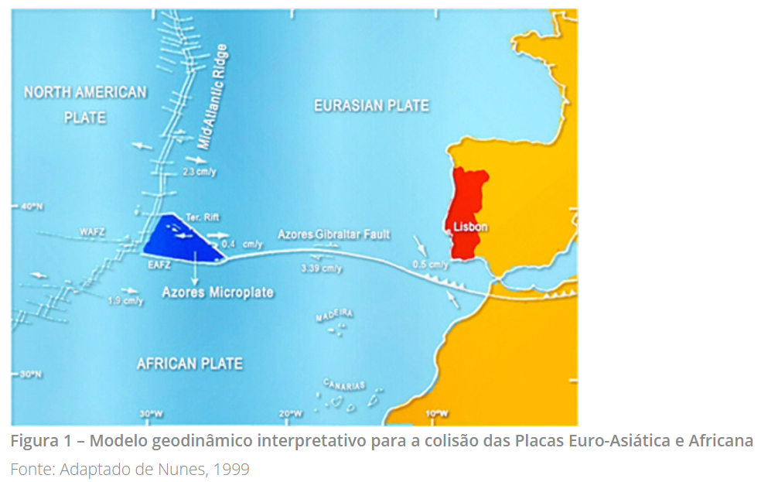
Tsunami risk management
Study conducted by the Dom Luiz Institute
Scenario 1:
Tsunami generated after earthquake measuring over 8.0 on the Richter scale in the Gloria fault zone;
Similar to what happened after the earthquake of 25 November 1941
Reaches Cascais in 60 to 80 minutes
Maximum wave height should not exceed 1 metre
Only flooded beaches

Slide 12
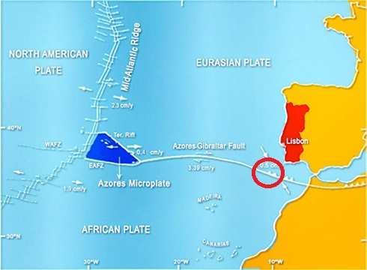
Tsunami risk management
Study conducted by the Dom Luiz Institute
Scenario 2:
Tsunami following an 8.0 magnitude earthquake in the Ferradura area – Marquês de Pombal
Similar to what happened after the earthquake of 28 February 1969
Reaches Cascais in 30 to 40 minutes
Beaches flooded with 1 metre of water
At high tide, it can reach beach and waterfront concessionaires in some locations from Cascais to Carcavelos.
Adaptado de https://spessismica.pt/risco-sismico-em-portugal/

Slide 13
Tsunami risk management
Study conducted by the Dom Luiz Institute
Scenario 3:
Tsunami following an 8.8 magnitude earthquake in the Ferradura area – Marquês de Pombal
Similar to what happened after the earthquake of 1 November 1755
Worst-case scenario – High tide
Reaches Cascais in 30 to 40 minutes
Wave height between 6 and 8.5 metres. (At high tide, waves can reach 12 metres in height)
Flood levels between 10 and 20 metres
Adaptado de https://spessismica.pt/risco-sismico-em-portugal/

Slide 14
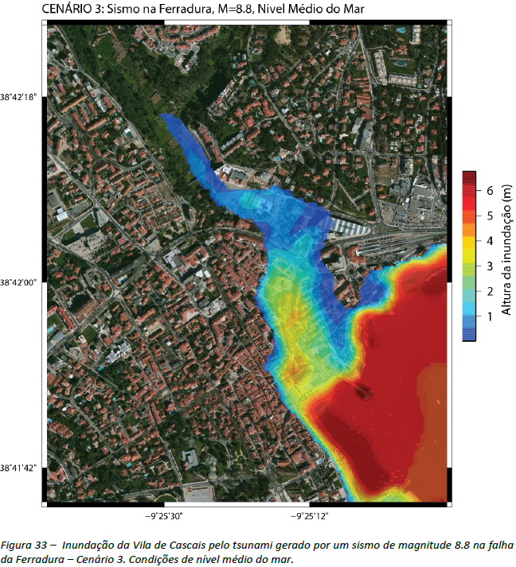
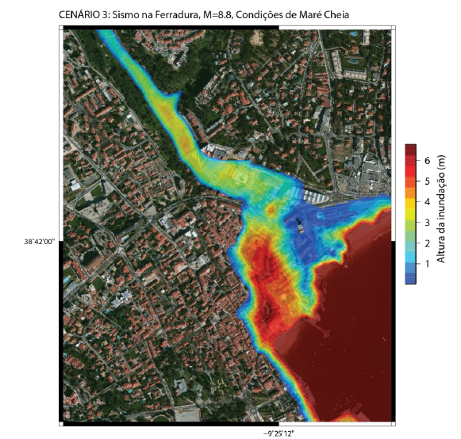
Tsunami risk management
Study conducted by the Dom Luiz Institute
Scenario 3:
Flooding of the Village of Cascais by the tsunami generated by an 8.8 magnitude earthquake Average sea level or high tide conditions

Slide 15
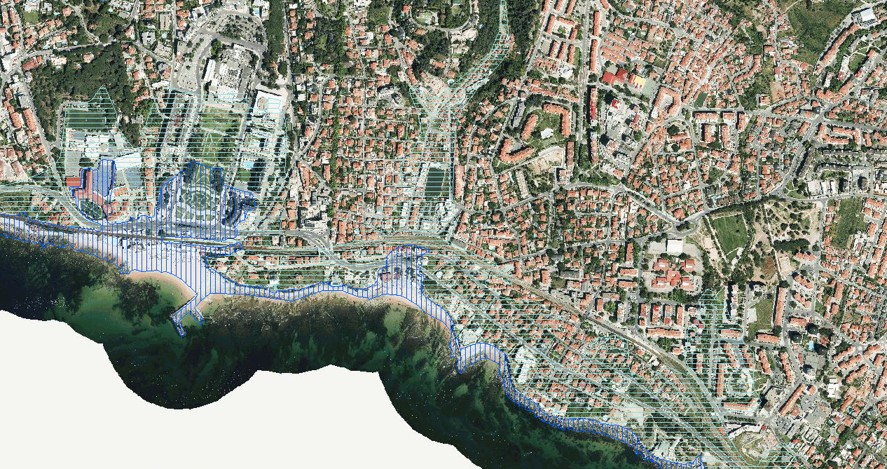
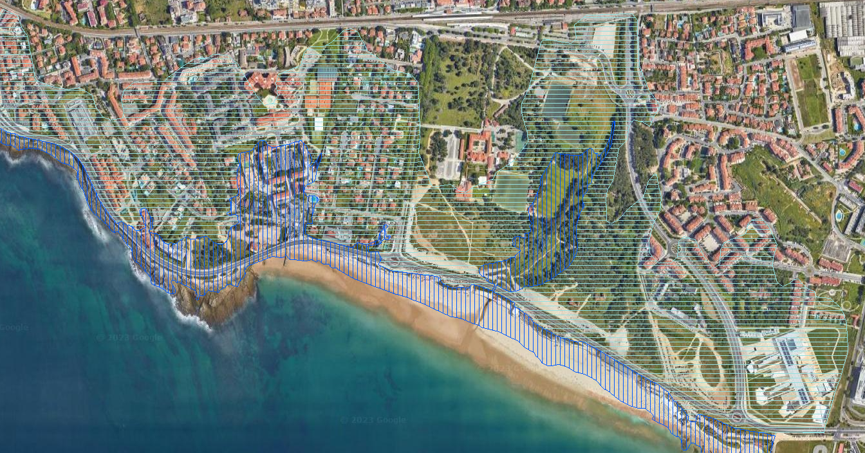
Scenarios of areas prone to flooding in the event of a tsunami, as in 1755
Mapping of tsunami susceptibilities in the Cascais Municipal Strategic Plan - Estoril and Carcavelos areas: Potentially floodable area up to a topographical elevation of 20 metres
Estoril
Carcavelos

Slide 16
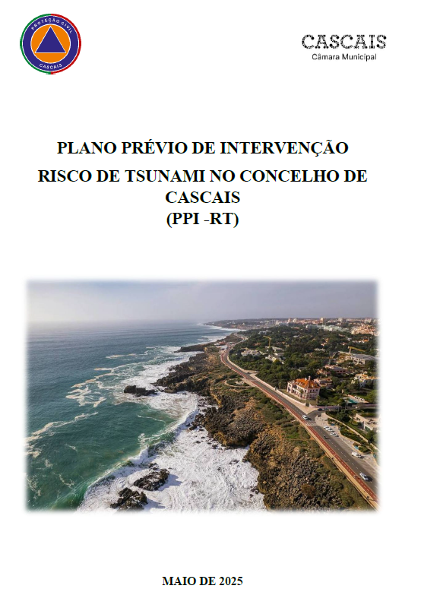
Preliminary Intervention Plan for Tsunami Risk
Approved by the Municipal Civil Protection Commission on June 27th, 2025
Anticipates risk scenarios and prepares emergency response
Ensures coordination between all civil protection stakeholders
Aims for a rapid and effective response in case of a tsunami
Identifies the most vulnerable areas
Defines roles and responsibilities of each involved entity

Slide 17
Preliminary Intervention Plan for Tsunami Risk
Alarm and action levels: For each level specific actions and entities mobilisation.
Yellow alert: Vigilance (1st alarm)
Seismic event in Cascais, whose perceived impact has the potential to generate a tsunami, but with no confirmation of immediate danger.
Orange Alert: Advance Warning (2nd alarm)
Tsunami confirmed by IPMA (less than 30 minutes) and high risk for the coastal area of Cascais.
Red Alert: Emergency
(3rd alarm)
Local tsunami with imminent impact. Confirmation of extreme danger to life and infrastructure.

Slide 18
Evacuation procedures

Slide 19
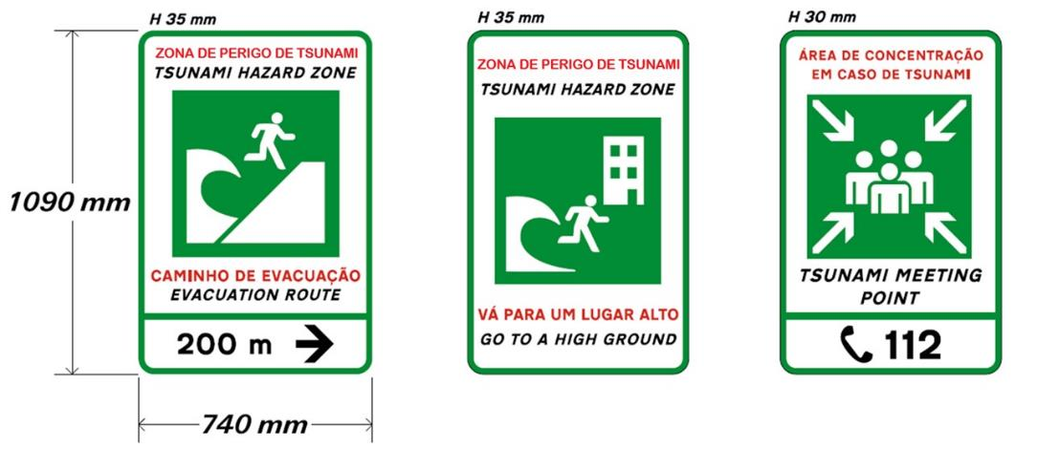
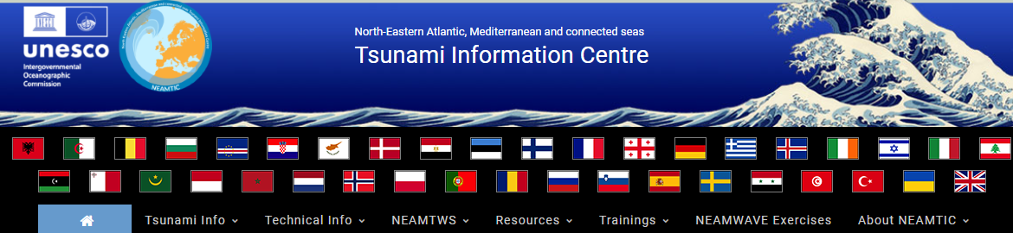
Evacuation signage
INTERNATIONAL STANDARD – ISO 20712-1:2008
Water safety signs and beach safety flags

Slide 20
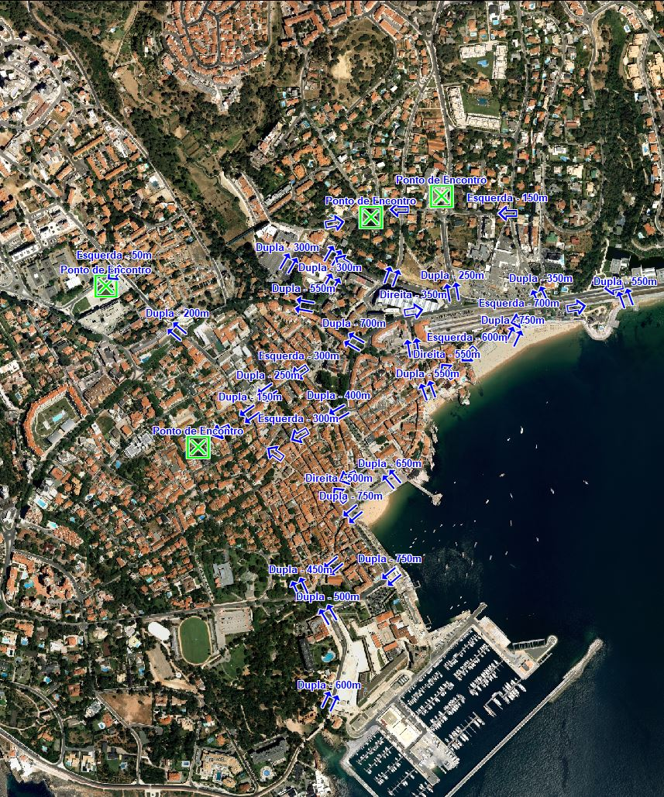

Signage and evacuation routes
Fieldwork, route identification
Evacuation signage
Meeting points
Direction
Dual steering
Meeting Point

Slide 21
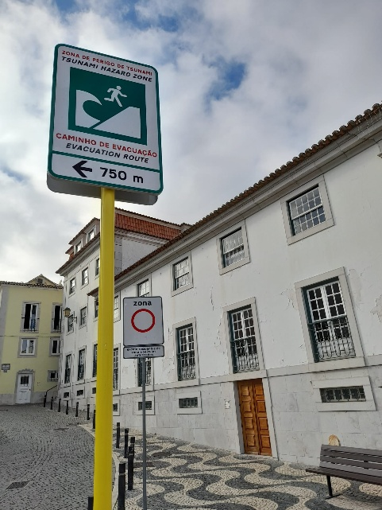
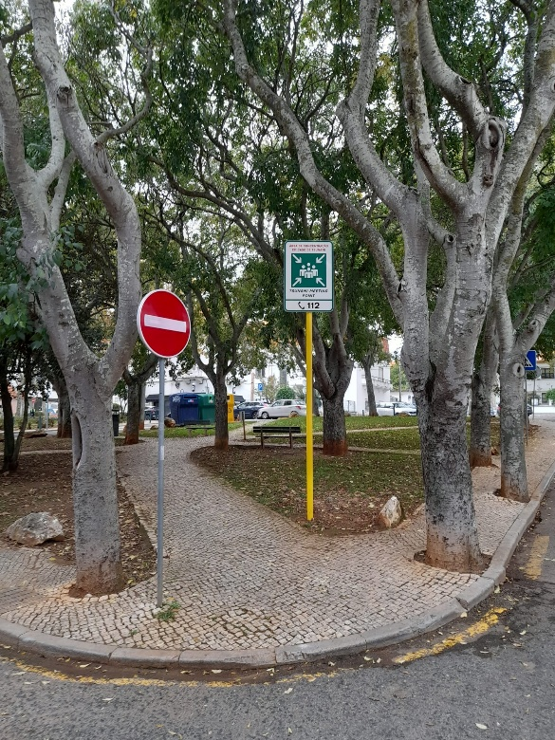
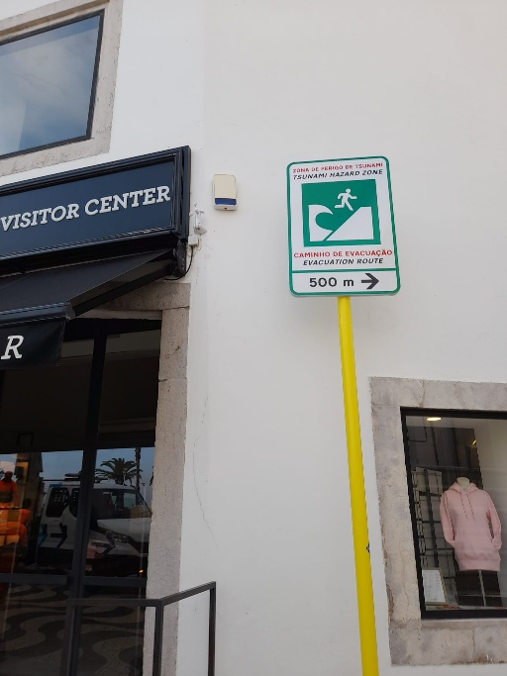
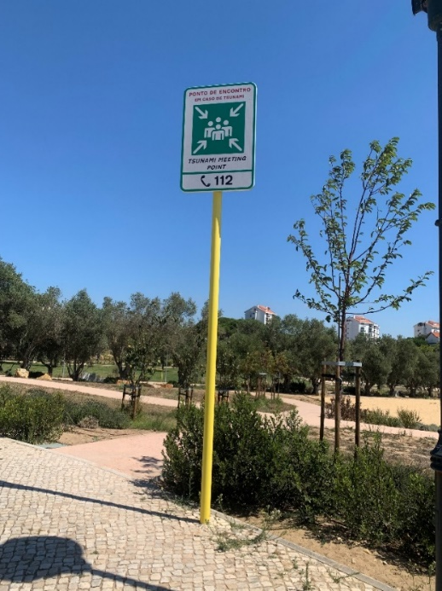
Evacuation signage

Slide 22
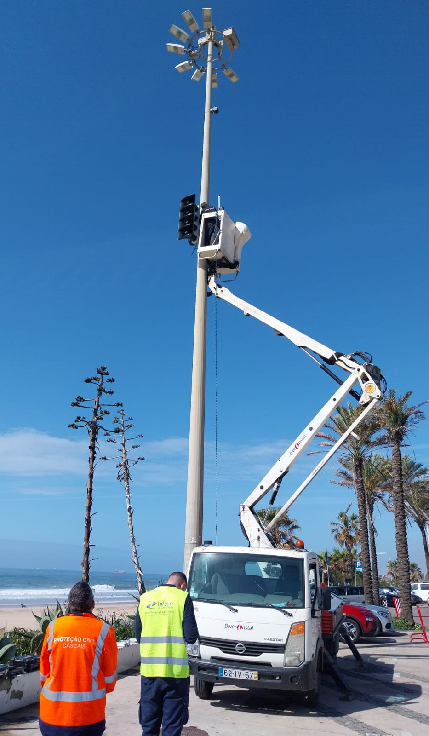
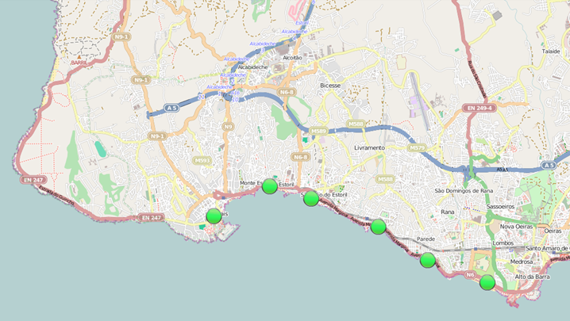
Cascais Tsunami Warning and Alert System
6 sirens installed in the municipality of Cascais, in the areas most vulnerable to tsunami risk, and with the most popular bathing beaches

Slide 23
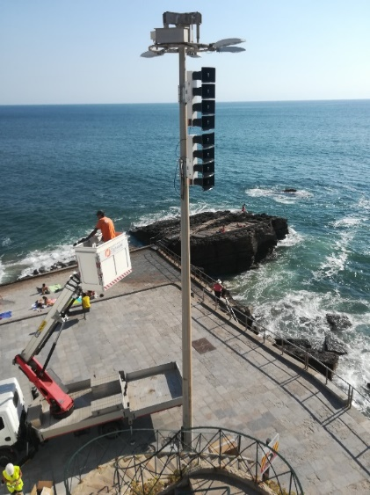
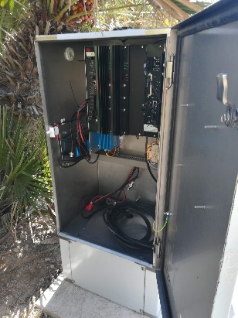



Cascais Tsunami Warning and Alert System

Slide 24
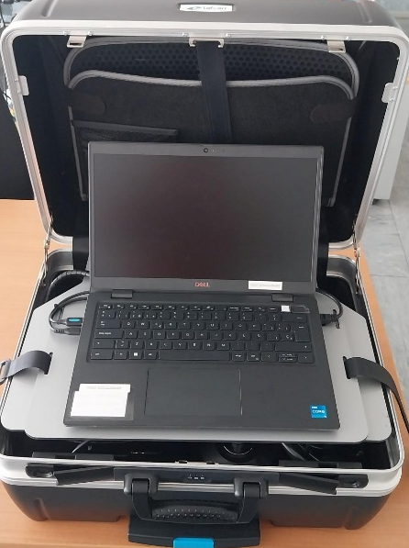
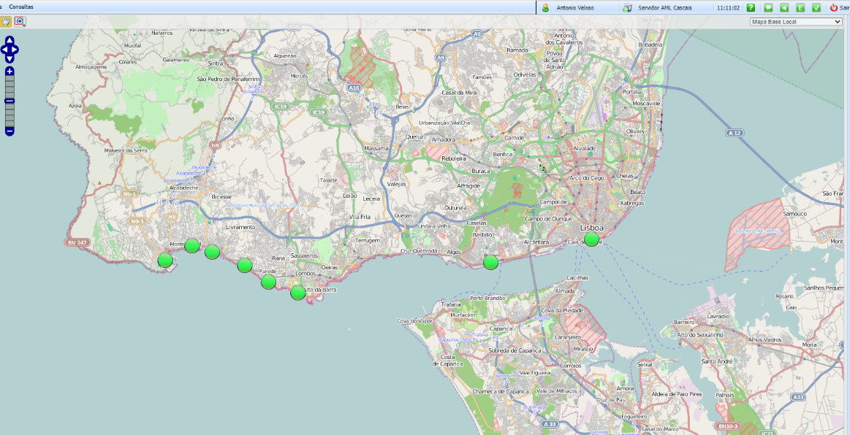
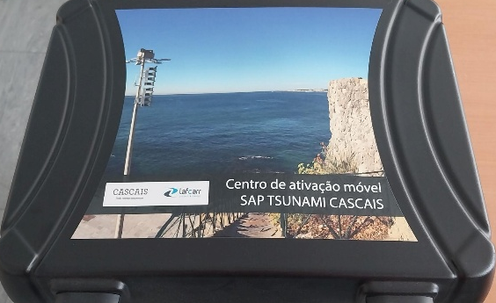
Cascais Tsunami Warning and Alert System
Sirens Activation
Rede GPRS
Rede TETRA
Portable Suitcase
Desktop Environment

Slide 25
Response Operations
Recovery and rehabilitation

Slide 26
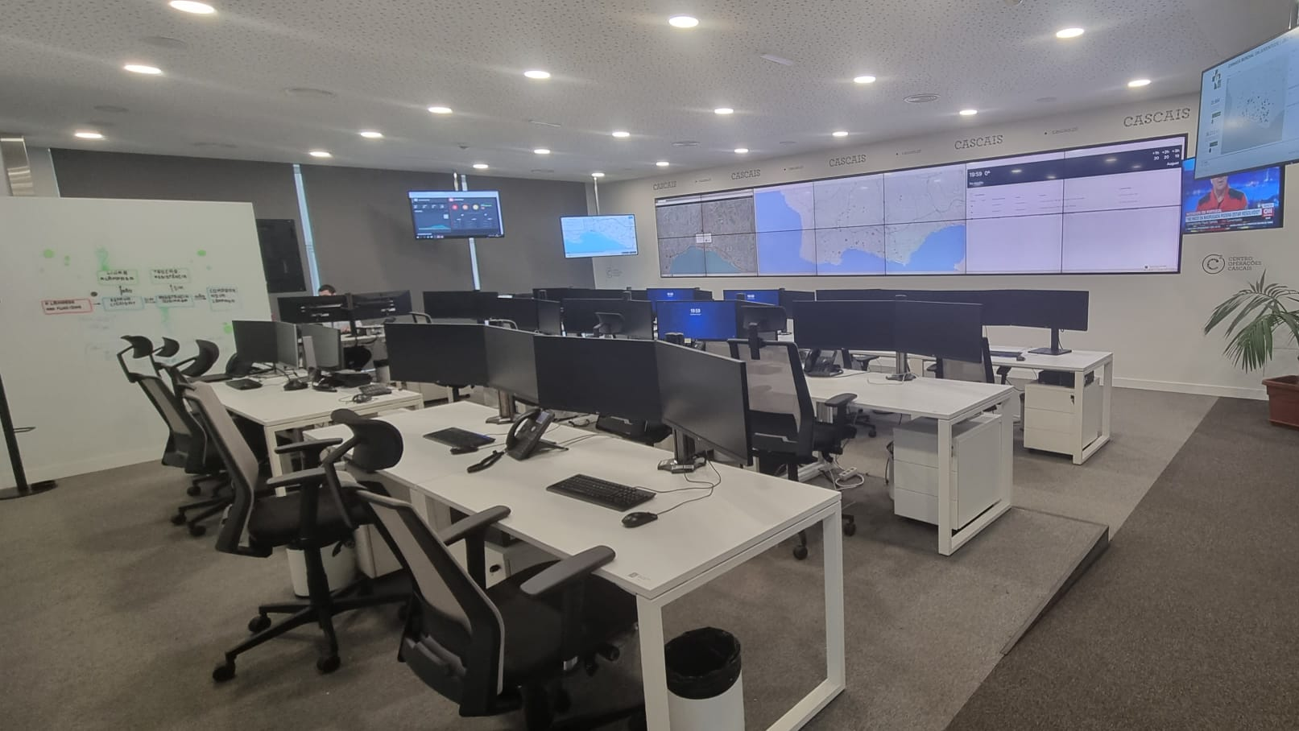
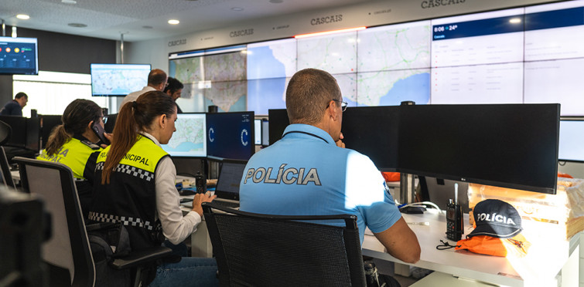
Municipal Emergency Operations Centre
In the event of an effective tsunami occurring, with an impact on the coastline, the activation of the Cascais Municipal Civil Protection Emergency Plan is determined.
Operations will be managed at the Cascais Municipal Emergency Operations Centre.

Slide 27
Drills and community awareness

Slide 28
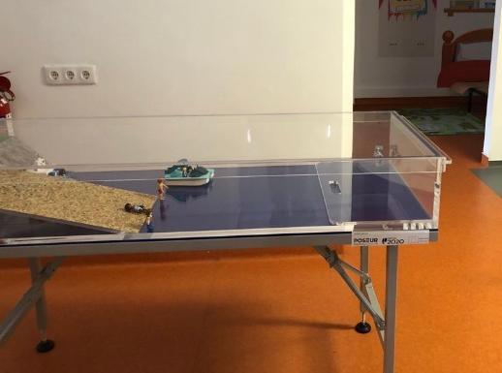
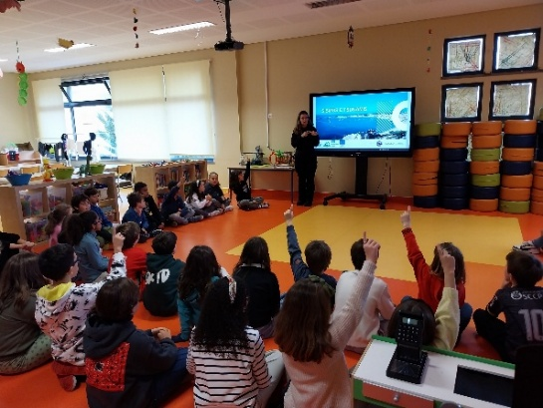
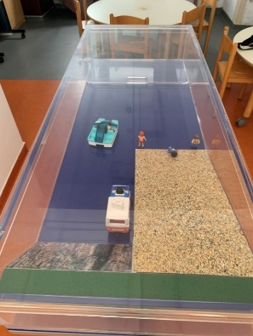

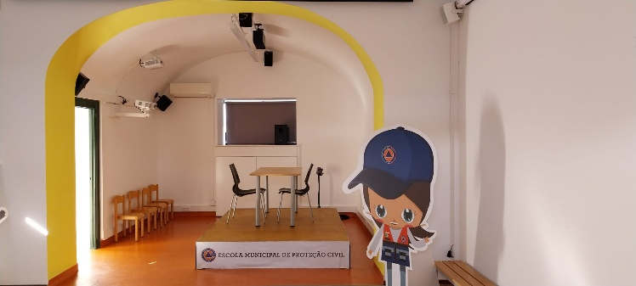
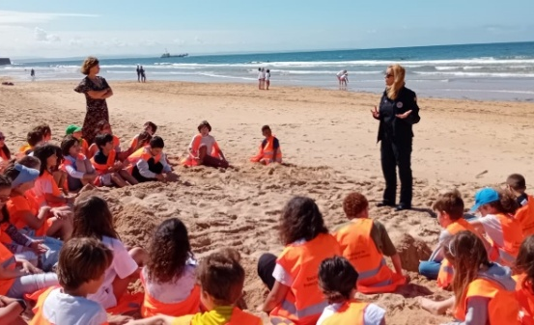
Empowerment of citizens - children and families
Simulation Tsunami tank
Actions in Schools
Cascais Municipal Civil Protection School
Seismic simulation table
Actions in Beaches

Slide 29
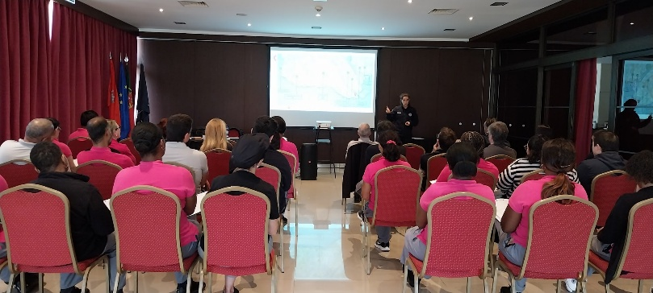
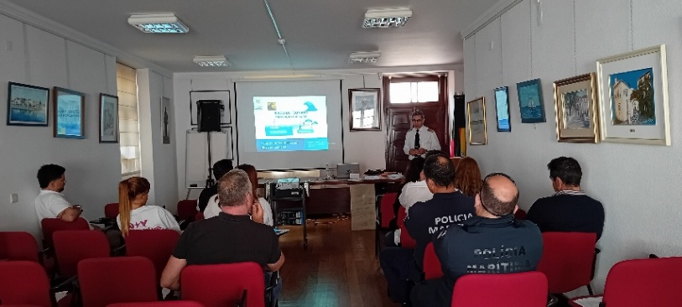
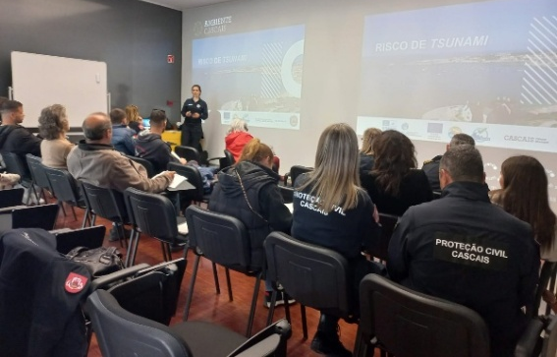
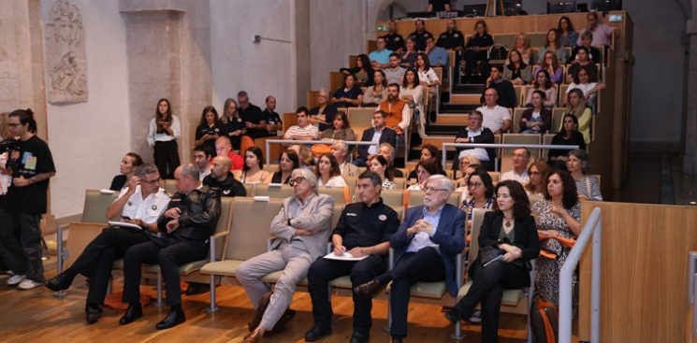
Empowerment of Workers and organisations
Hotels
Cascais Marina Traders and Fishermen
172
Beach Traders and Lifeguards
Municipality and civil protection agents

Slide 30
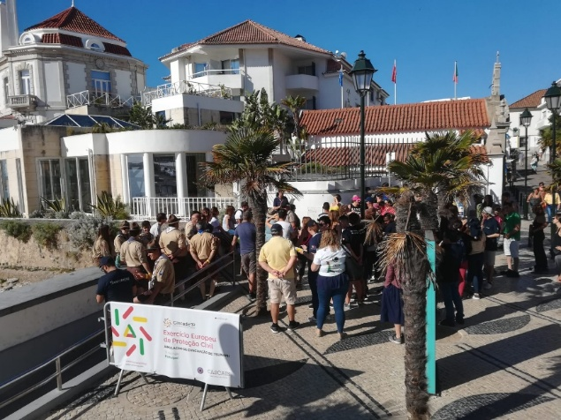
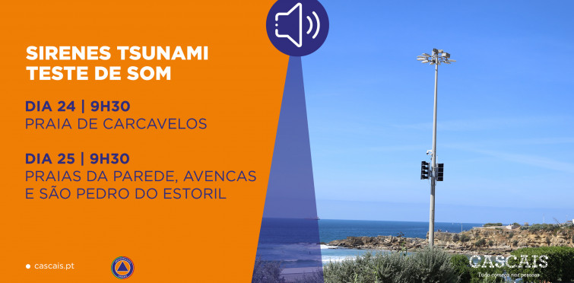

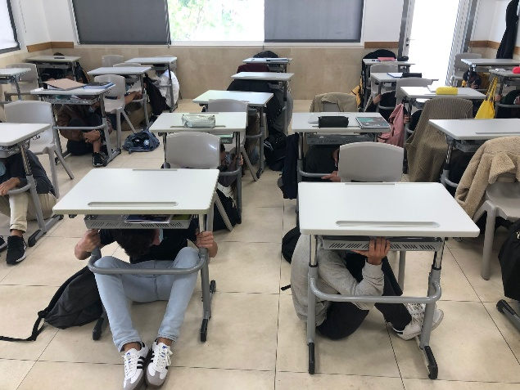

tsunami drill - conducting a simulation exercise
Coastline and beaches
Schools

Slide 31
Challenges for the future

Slide 32
Challenges for the future
Direct communication from IPMA (national level) simultaneously to National/Regional Civil Protection and Municipalities
Capacity to activate municipal sirens by the National Civil Protection Agency (redundancy of facilities)
‘Immediate’ public communication capability by:
Text message to the population
Robotic telephone messages for organisations and civil protection officers
Municipal Relief Operations Centre, to ensure the ‘Command and Control’ of relief operations, located in a safe area for tsunami risk

Slide 33

Thank you.

