Slide 1
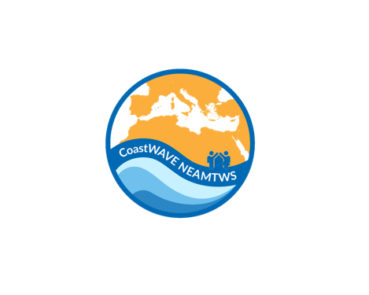



Local Tsunami SOPs
CoastWAVE 2.0
Palmi, Italy
UNESCO-IOC EU DG-ECHO CoastWAVE 2.0 Project: National
to Local Levels Standard Operating Procedures (SOP) Workshop
27 - 30 October 2025,
Cascais, Portugal
Alessandro Amato

Slide 2
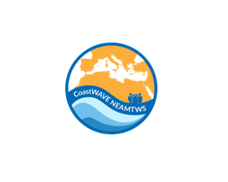

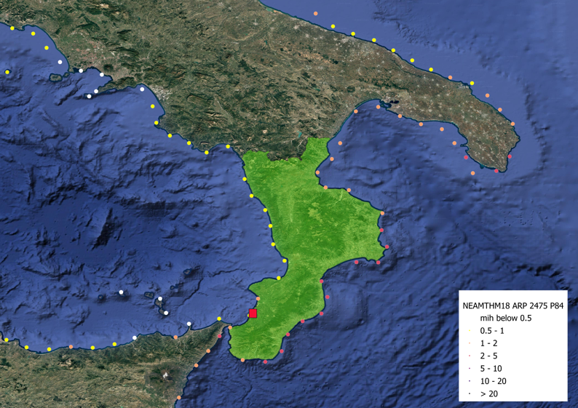
Community Overview
CoastWAVE 2.0
Palmi, located on the Thyrrenian coast of the Calabrian Region in Southern Italy. According to data from the ITED (Italian Tsunami Effects Database, INGV), which describes the effects of observed tsunamis along the Italian coasts from 79 AD to the present day, the stretch of coastline between Capo Vaticano and Scilla, nearby Palmi, has been struck by 9 tsunami events, two of them have been observed at Palmi, one in 1894 with intensity 2 (weak) and another one in 1908 intensity 3 (rather strong), https://tsunamiarchiveservices.ingv.it/ited.1.0/report/op/150.
NEAMTHM18 model, the most updated resource to estimate the tsunami hazard in the area established that Palmi and the surrounding localities are exposed to moderate tsunami hazard, where the expected Maximum Inundation Height (MIH) varies between 0.5 and 2 meters for an ARP 2475 years at percentile 84th.
Palmi, Reggio Calabria, Italy

Slide 3
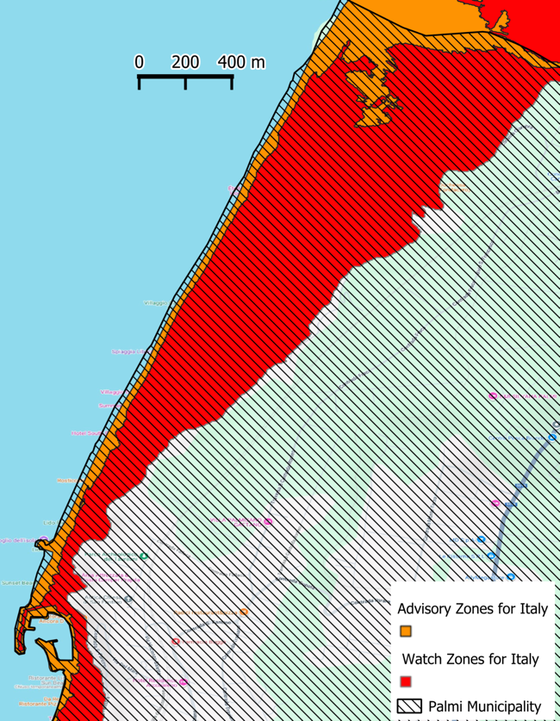
Community Overview
CoastWAVE 2.0
Inundation Maps
The critical areas for possible tsunami waves in the territory of Palmi can be deduced from the inundation maps elaborated by ISPRA and viewable via the “TsunamiMap Viewer” platform.
The inundation maps have been elaborated through the application of a method for probabilistic quantification of tsunami hazard (PTHA - Probabilistic Tsunami Hazard Assessment by the NEAMTHM18 model, , with an Avrage Return Period of 2475 years and the 84th percentile of the probability distribution that characterizes the prediction uncertainty, the critical areas result in:
Alert Zone 1, associated with the Orange alert level (Advisory) (1m -> 2m elevation)
Alert Zone 2, associated with the Red alert level (Watch) (5m elevation)

Slide 4
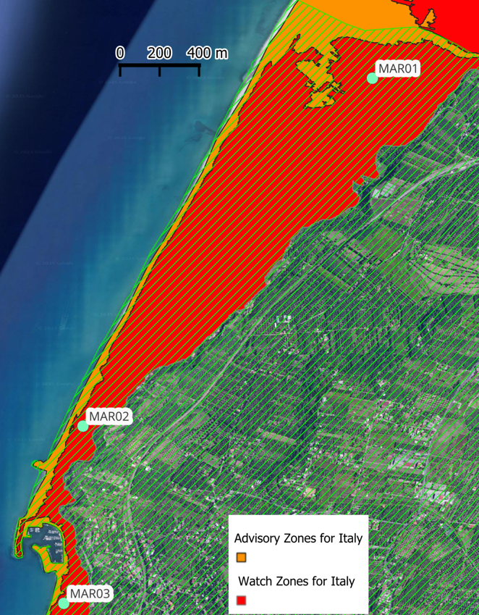
Community Overview
CoastWAVE 2.0
Palmi census on the exposed areas
MAR01 | Località Scinà e Ciambra
MAR02 | Località Pietrenere
MAR03 | Porto di Palmi e località Tonnara
 | mar-01 | mar-02 | mar-03
Inhabitants | 351 | 300 | 582
Tourists | 600 | 500 | 400
Residential Buildings | 380 | 209 | 210
Commercial Buildings | Hotels, restaurants,B&B, camping (14 buildings) | Hotels, restaurants, grocery shop, parking area, shipyard, camping(13 buildings) | Hotels, restaurants, supermarket, nautical company(14 buildings)
Public buildings and services | SNAM methane pipeline and Trans-Mediterraeno gas pipeline | harbour, church, museum | church

Slide 5
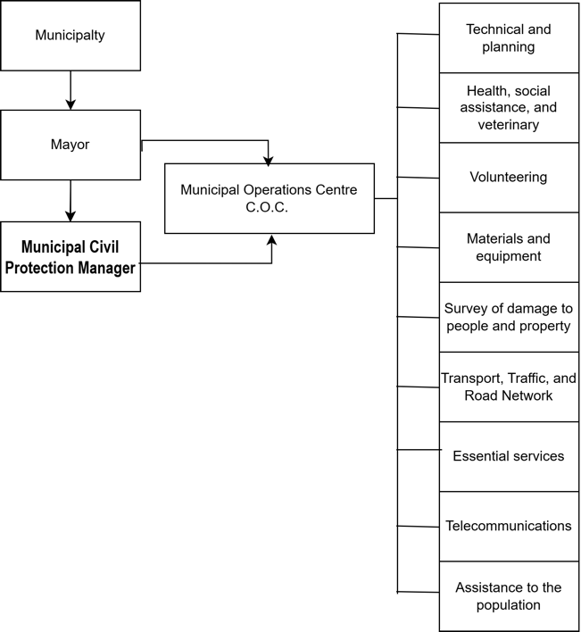
Local authorities/stakeholders responsible
CoastWAVE 2.0
The Mayor
The Mayor is responsible for coordinating and directing all emergency management activities within the municipality. They ensure the implementation of the emergency plan, activate the Municipal Operations Center, and liaise with regional and national authorities to protect the population and restore normal conditions.
The Municipal Civil Protection Manager
The Municipal Civil Protection Manager is responsible for coordinating and implementing civil protection activities at the municipal level. During an emergency, they support the Mayor in managing response operations, ensure the activation of the municipal emergency plan, coordinate communication among local services and volunteers, and oversee the collection and dissemination of information to guarantee effective emergency response and public safety.
Composition C.O.C. Palmi

Slide 6



CoastWAVE 2.0
LOCAL LEVEL WARNING CHAIN
Activation and coordination C.O.C.
Prefetture
Regional CPA
Interface MCPM
Order evacuation
Order road network closure and further measures
TSP CAT
Mayor
NTWC SiAM
Activation of sirens, signs
Activation of Volunteers and local police,
Coordinates information and evacuation,
Coordinates road networks
Coordinates communication activities to the population
Local EMA Municipality
NEMA DPC
Local Media
National media
Municipal Civil Protection Manager
National
Local

Slide 7
CoastWAVE 2.0
Coordination with provincial/national disaster management agencies
The Major informs the Prefecture of Reggio Calabria, the Metropolitan City of Reggio Calabria, and the Regional Civil Protection Operations Room of the C.O.C. activation and maintains contact.

Slide 8
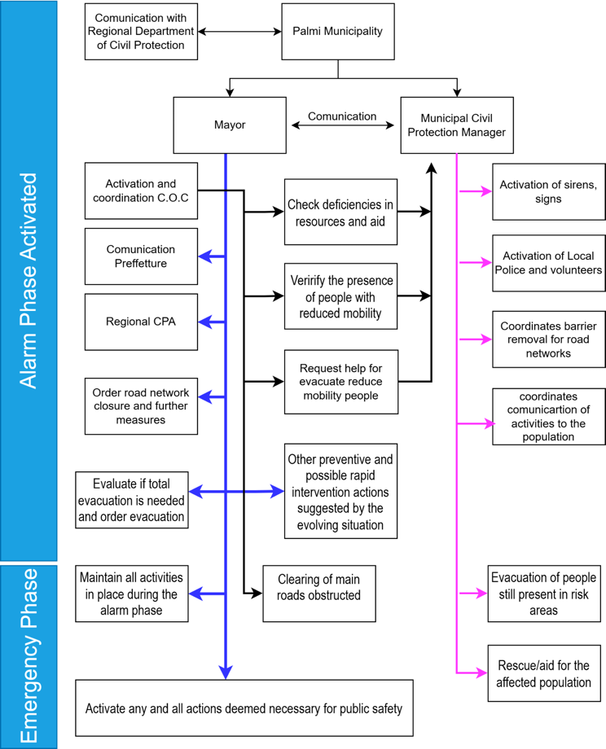
Coordination Structure within Municipality
CoastWAVE 2.0
The alarm phase is activated:
For tsunamis of seismic origin, based on an alert message issued by the SiAM and addressed directly to the coastal municipalities, which indicates the alert level (Orange or Red) for one of the Municipality's reference forecast points.
For tsunamis of non-seismic origin, based on any reports from the national or regional civil protection.
The alarm phase is deactivated:
In the case of seismically induced tsunamis, when the SiAM issues a revocation message or an end of alarm message.
In the case of tsunamis of a different origin, when the Entity that activated the alert issues an end of alarm message.
The emergency phase is activated when the event has occurred/manifested.
The emergency phase ceases with the completion of rescue operations/actions.

Slide 9
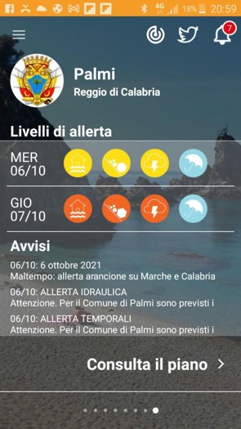
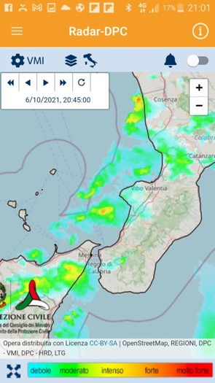
CoastWAVE 2.0
Communication channels
The Municipal Administration of PALMI has activated the LibraRisk risk communication services, a technological platform to make the Civil Protection Plan available to the population on smartphones and tablets (iOS and Android).
direct communication channel with the population, with a push notification service: Messages reach, via push notification, the entire population or targeted User Groups (e.g., Civil Protection Operators and Volunteers, School Principals, contacts for homes located in risk zones)
For Citizens:
To consult the Plan interactively,
To use the push notification service to always be informed, via messages sent by LibraRisk or the Municipality, on Civil Protection matters.
To disseminate, through a multi-channel system (WhatsApp, email, social networks, and SMS, also with Family Plan functionality), the received notifications and thus facilitate the wide dissemination of information broadcast by the Municipality through the app.
To consult the Twitter stream of the main Civil Protection hashtags or channels at the national and local level.
LibraRisk App

Slide 10
CoastWAVE 2.0
Evacuation procedures and Response Operations
The actions to be developed in the alarm phase are:
Activation of the C.O.C. (Municipal Operations Center) in its complete composition.
Information to the population, using the methods defined in the municipal emergency plan.
Preparation of manned gates to block access to areas considered at risk of flooding, with the removal of anyone found transiting through them.
Activation of municipal volunteer services.
Verification of the presence of people with reduced mobility in risk areas to prepare for their precautionary evacuation/removal.
Coordination with the municipal intervention structures of neighboring centers to supplement any deficiencies in resources and aid.
Non-self-sufficient people and/or people with disabilities, under the coordination of the head of Support Function 2, must be notified of the possible event through shared communication systems (SMS, etc.) and must be contacted by phone and potentially rescued.
Other preventive and possible rapid intervention actions suggested by the evolving situation.
The actions to be developed in the emergency phase are:
Maintain all activities in place during the alarm phase or activate them, should the event occur in the absence of an alarm phase.
Evacuation of people still present in risk areas.
Rescue/aid for the affected population.
Clearing of main roads obstructed by objects dragged by the water.
Activate any and all actions deemed necessary for public safety.

Slide 11
CoastWAVE 2.0
Drills and community awareness
Within the frame of the CoastWAVE 2.0 project, the Palmi Municipality is planning some activities aiming to increase the public awareness, one of them is to be hold during the WTAD on November the 5th.
The Municipality is also getting ready for the NEAMwave26 exercise in March 2026.
Acitivities with teachers and students are also planned during the next months in the framework of the TRRP and the CW2.0 project

Slide 12
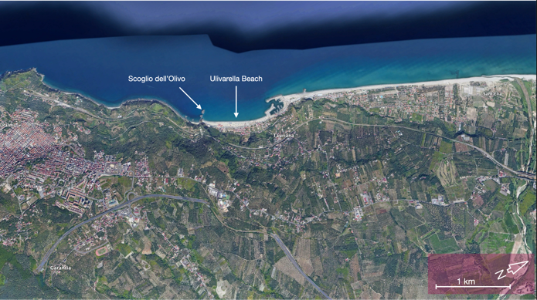
Challenges
CoastWAVE 2.0
Gaps in SOPs (infrastructure, resources, awareness)
In the frame of the CoastWAVE 2.0 project, INGV team organised a field survey in the coastal area of Palmi, aimed at verifying the signage and the main evacuation routes outlined in the existing Tsunami Evacuation Plan.
A good coverage of the signage along the beach area was observed, some signs were incorrectly oriented or obscured by vegetation, the municipality has been informed and agreed to address this issue. We also found some critical points, that due to the local topography need to be handled more accurately.
The oad indicated as the main evacuation route is quite steep and its width is appropriate to avoid overcrowding, we identified some potential assembly points than can be reached earlier than those identified in the evacuation map. Additionally, we observed several critical areas with significant landslide hazards along the morphological scarp limiting the coastal plain, emphasizing that these aspects must be carefully considered throughout the entire evacuation plan.
A local critical issue was identified in the extremely narrow width of some streets in the fishing village, which supports the preference for using the long-beach route, even though it runs parallel to the coast.
An additional recommendation was to enhance the identification of the main evacuation route through the use of horizontal signage to install a panel featuring an illustrated map of the overall local evacuation plan.
Palmi Olivarella Beach

Slide 13
Planned Improvements
CoastWAVE 2.0
Planned SOP updates
The evacuation map for the Palmi community has been already prepared following the indications of the Italian Department of Civil Protection (DPC) and based on a regional estimation of the hazard. In the frame of the CoastWAVE 2.0 project it is planned the update of the evacuation map. The results might be reflected in some of the actions already identified by the municipality.

Slide 14


CoastWAVE 2.0
Thanks

