Slide 1
National Tsunami Warning Chains and SOPs
MOROCCO

Slide 2
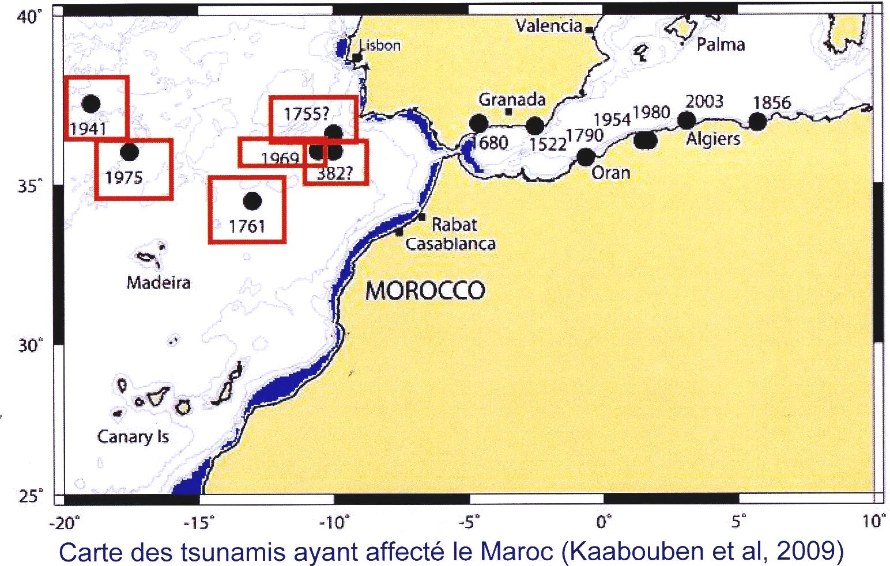
Historical tsunamis that affected Moroccan coasts (El Mrabet 2000, Kaabouben et al 2009)

Slide 3

Warning chain from TSP to public
To provide standardized procedures for Moroccan authorities and communities to respond effectively to tsunami threats, minimizing casualties and damages through timely alerts and safe evacuations.
Province Authority
Local natural risks focal point
Public
Red crescent
Local technical offices
Police
Gendarmerie
Volunteers
Marine rescue agency
National
Meteo
Agency
MINISTRY OF INTERIOR
TSP
IPMA
CENALT
CNRST
CIVIL PROTECTION
Media
2 min
4 min
Fax - Email
Fax - Email
Fax – Email – Radio - Phone
Regional
National
Local

Slide 4
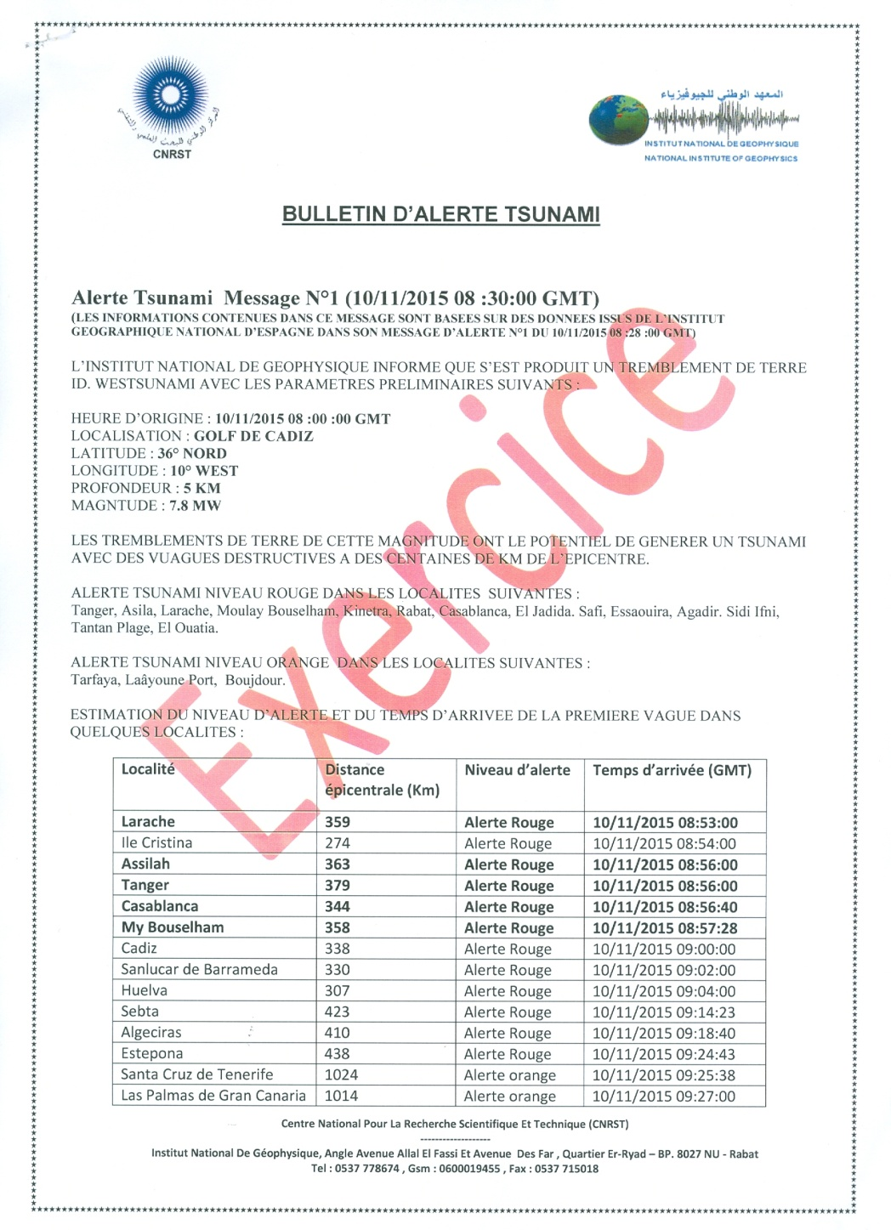
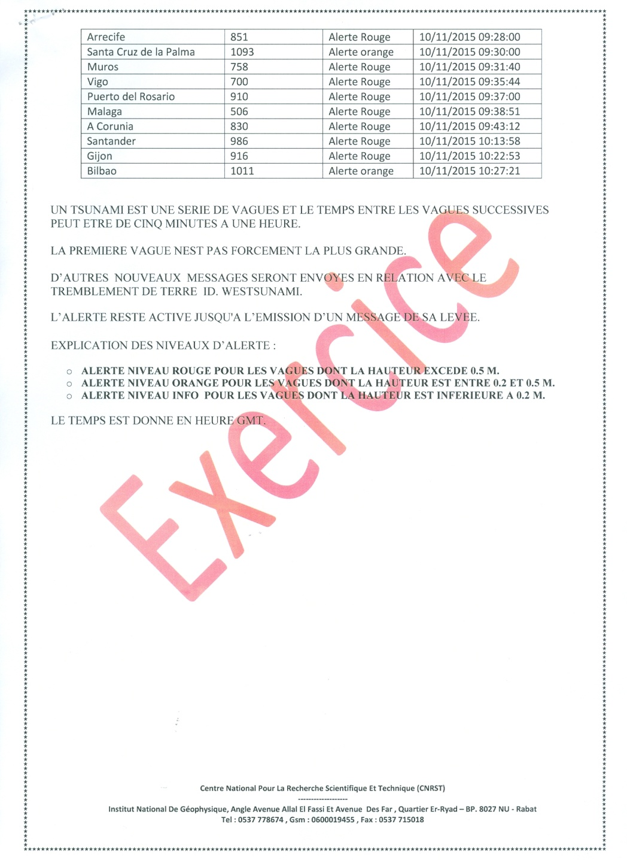

Slide 5
BULLETIN SISMOLOGIQUE SPECIAL
LE RESEAU NATIONAL DE SURVEILLANCE SISMIQUE A ENREGISTRE LA SECOUSSE TELLURIQUE SUIVANTE :
DATE : 20/02/2026
HEURE ORIGINE : 14 H 03 MIN 47 SEC (GMT+1)
MAGNITUDE : 8.0 (ECHELLE DE RICHTER)
LATITUDE : 36.554 °N
LONGITUDE : 9.965 °W
PROFONDEUR : 13 Km
L’EPICENTRE EST SITUE DANS L’OCEAN ATLANTIQUE.
REMARQUE : ALERTE TSUNAMI

Slide 6
Challenges
Gaps in SOPs (infrastructure, resources, awareness)
Coordination with local/regional agencies
Evacuation Procedures:
1 - Activation (Issue early warning with less delay)
2 - Evacuation Routes and Safe Zones (More studies for candidate cities)
3 - Population Evacuation (Periodic evacuation drills)
4 - Evacuation Timing

Slide 7
Planned Improvements
Communication and Dissemination
National warning issued by Ministry of Interior / Civil Protection (Communication exercises with several techniques).
Make use of resistant buildings as TSUNAMI SHELTERS.
Implementation of regional emergency management centers

Slide 8
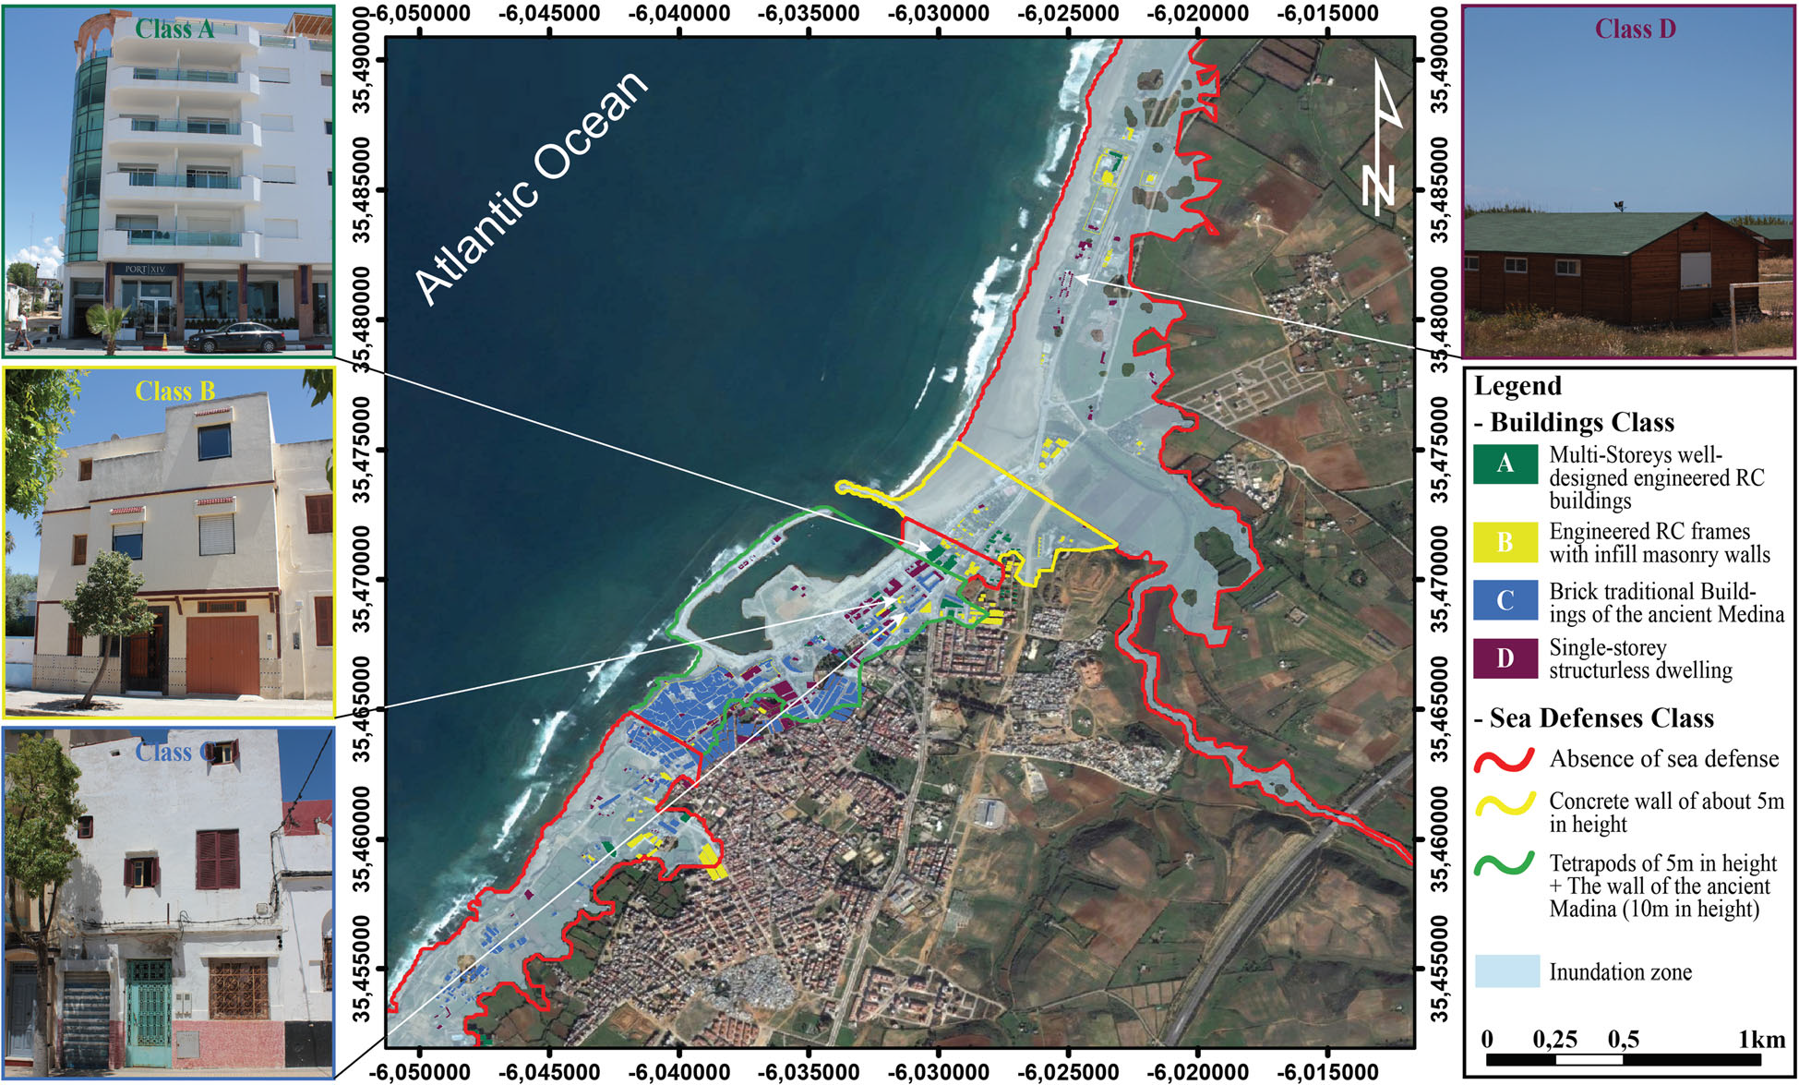
Tsunami impact studies: Assilah city , Northern Morocco, (El Moussaoui et al 2017)
THANK YOU

