Slide 1
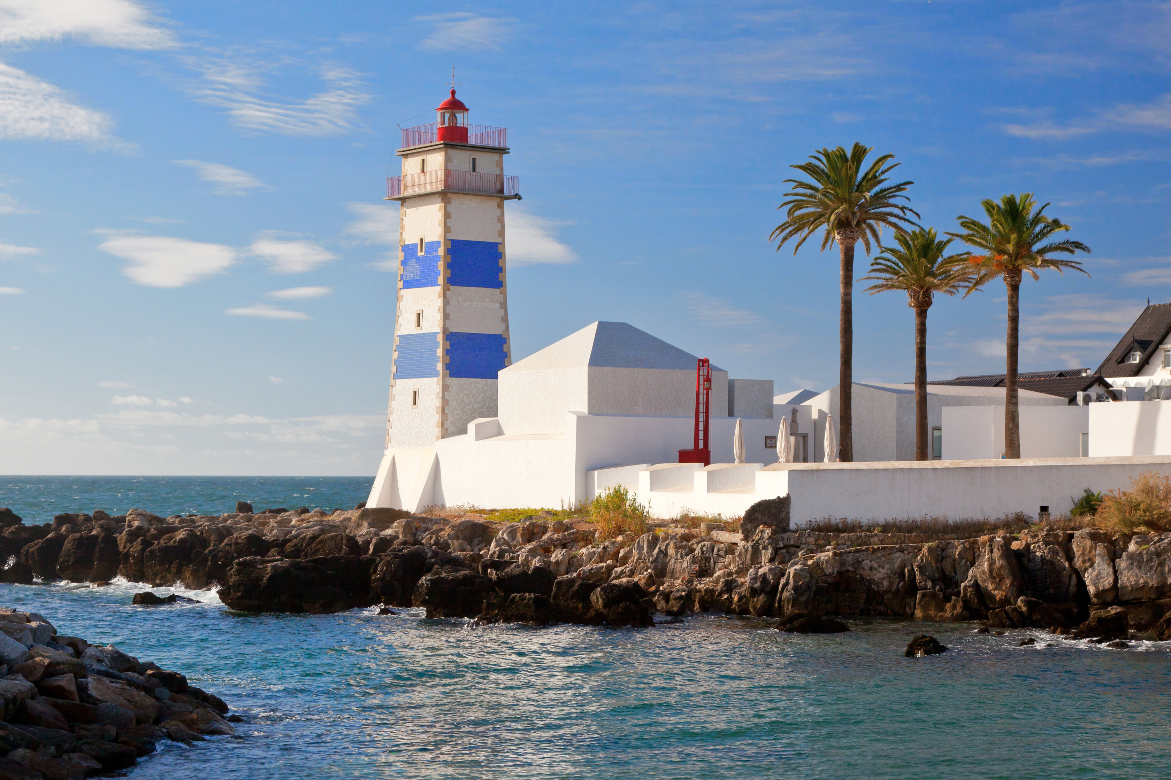










DG ECHO CoastWAVE 2.0 National to Local Level SOP Workshop
27 October-20 October
Cascais, Portugal
30. CARIBE WAVE Exercise overview
Kimberly Maisonet González
ITIC-CAR

Slide 2
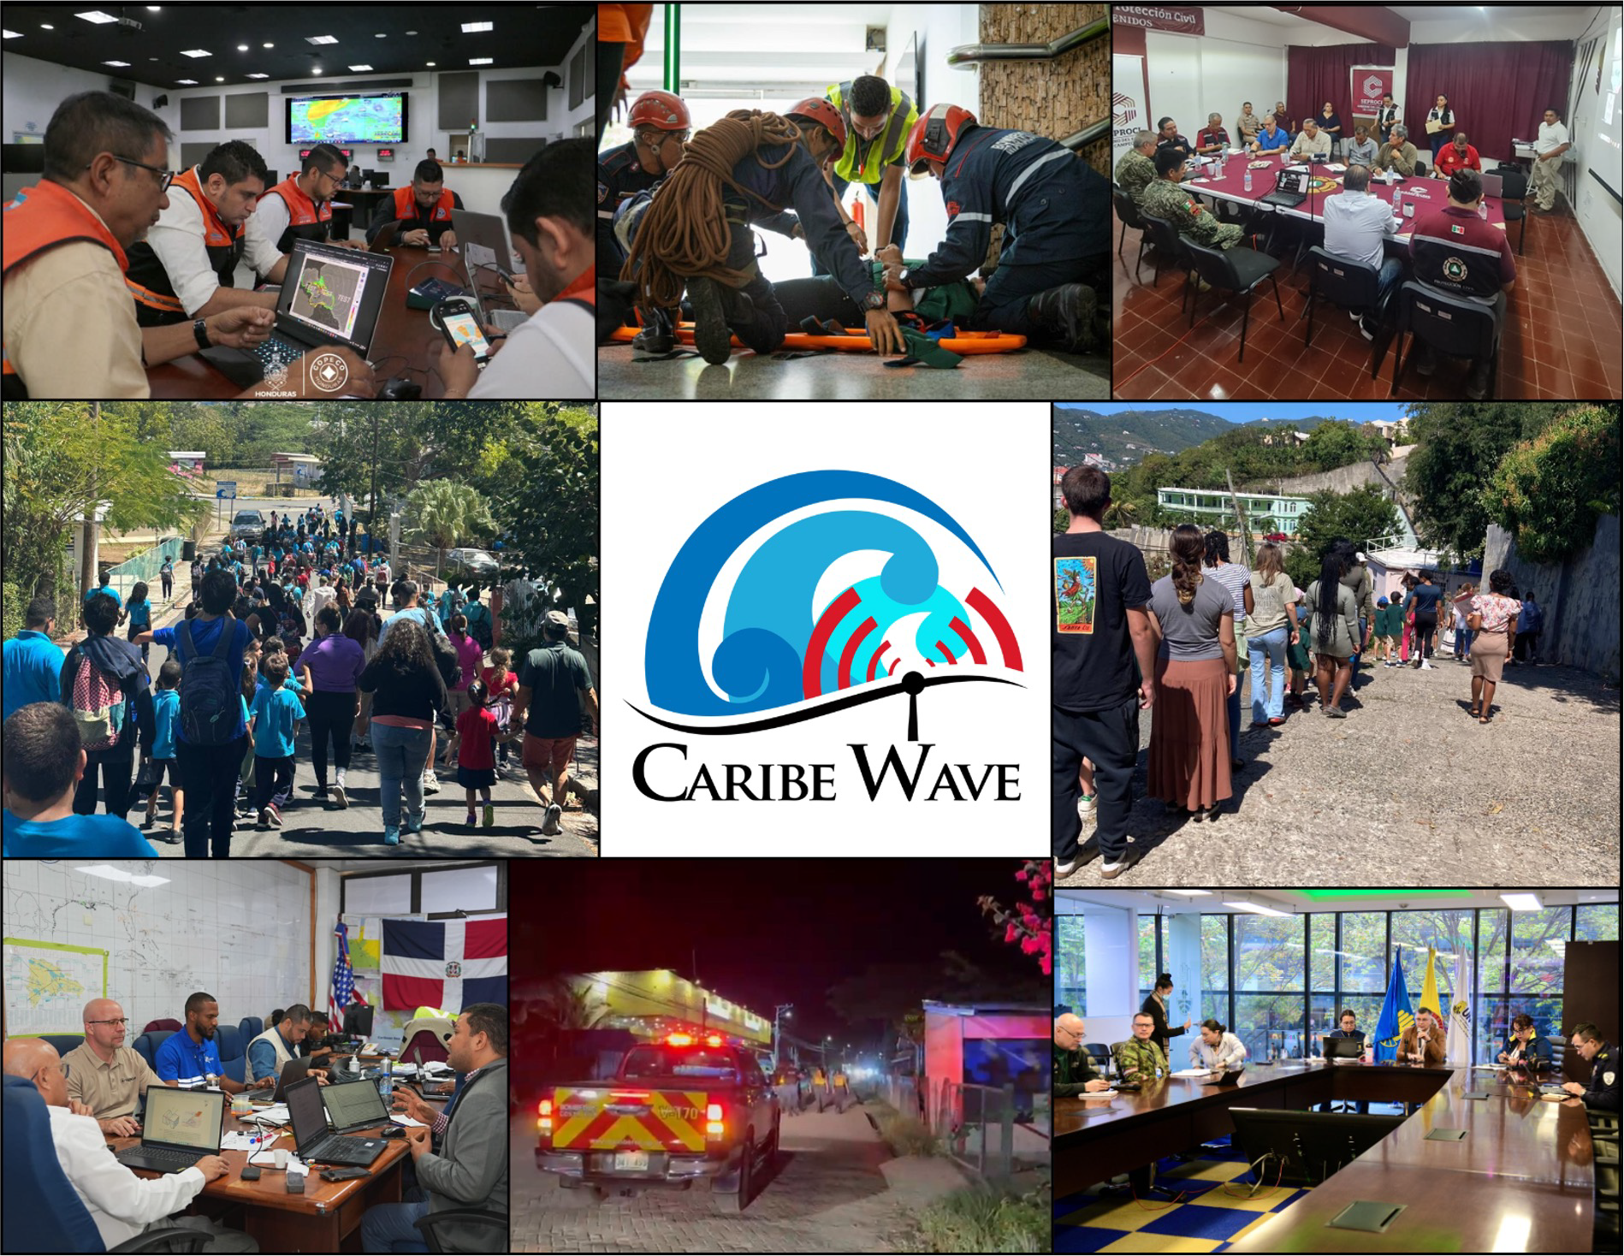
UNESCO/IOC-NOAA SHOA
International Tsunami Information
From left to right is: Honduras, Venezuela, Mexico, Puerto Rico, British Virgin Islands, Dominican Republic, Costa Rica,
and Colombia.

Slide 3
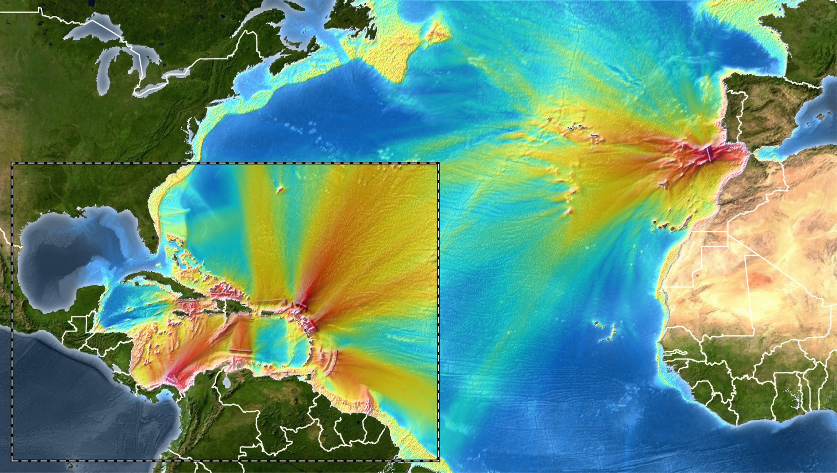
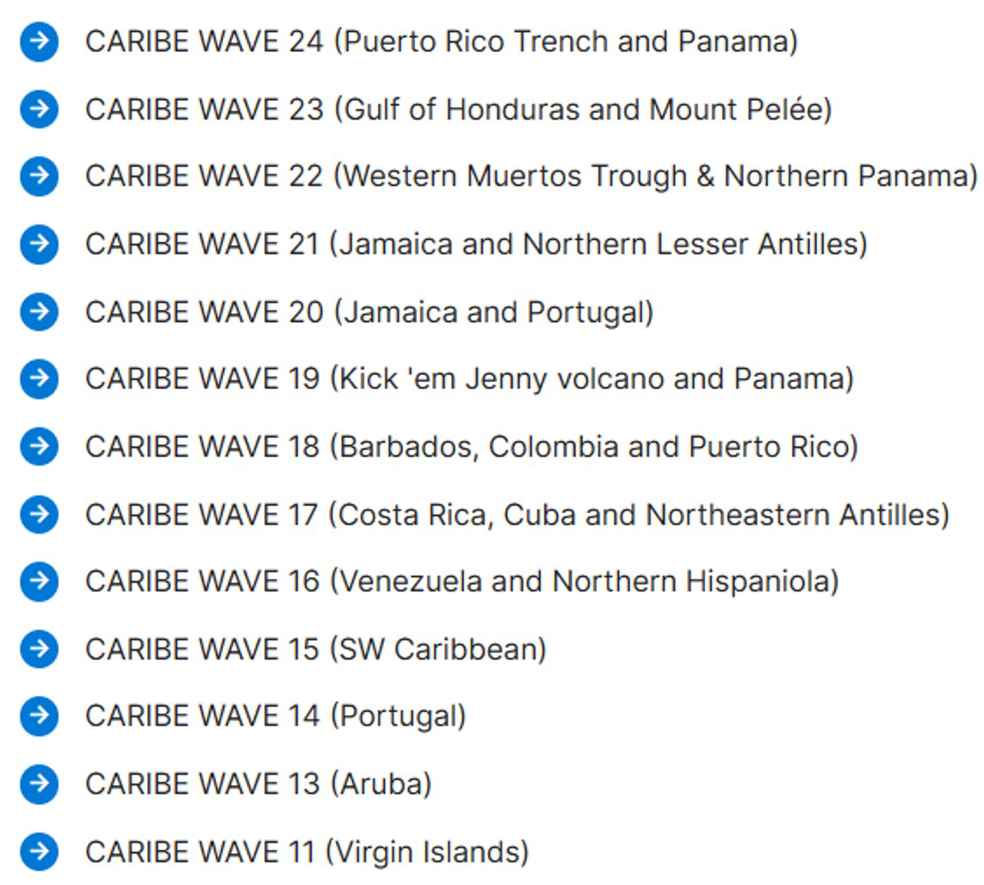
Title
Previous Exercise Scenarios

Slide 4
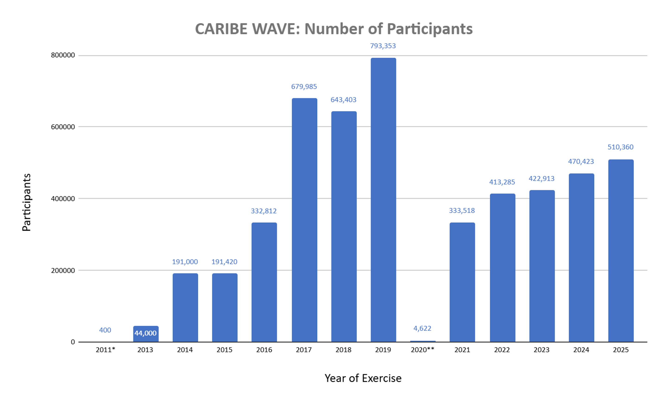
Title
Point 1
Point 2
Subpoint 1
Subpoint 2

Slide 5
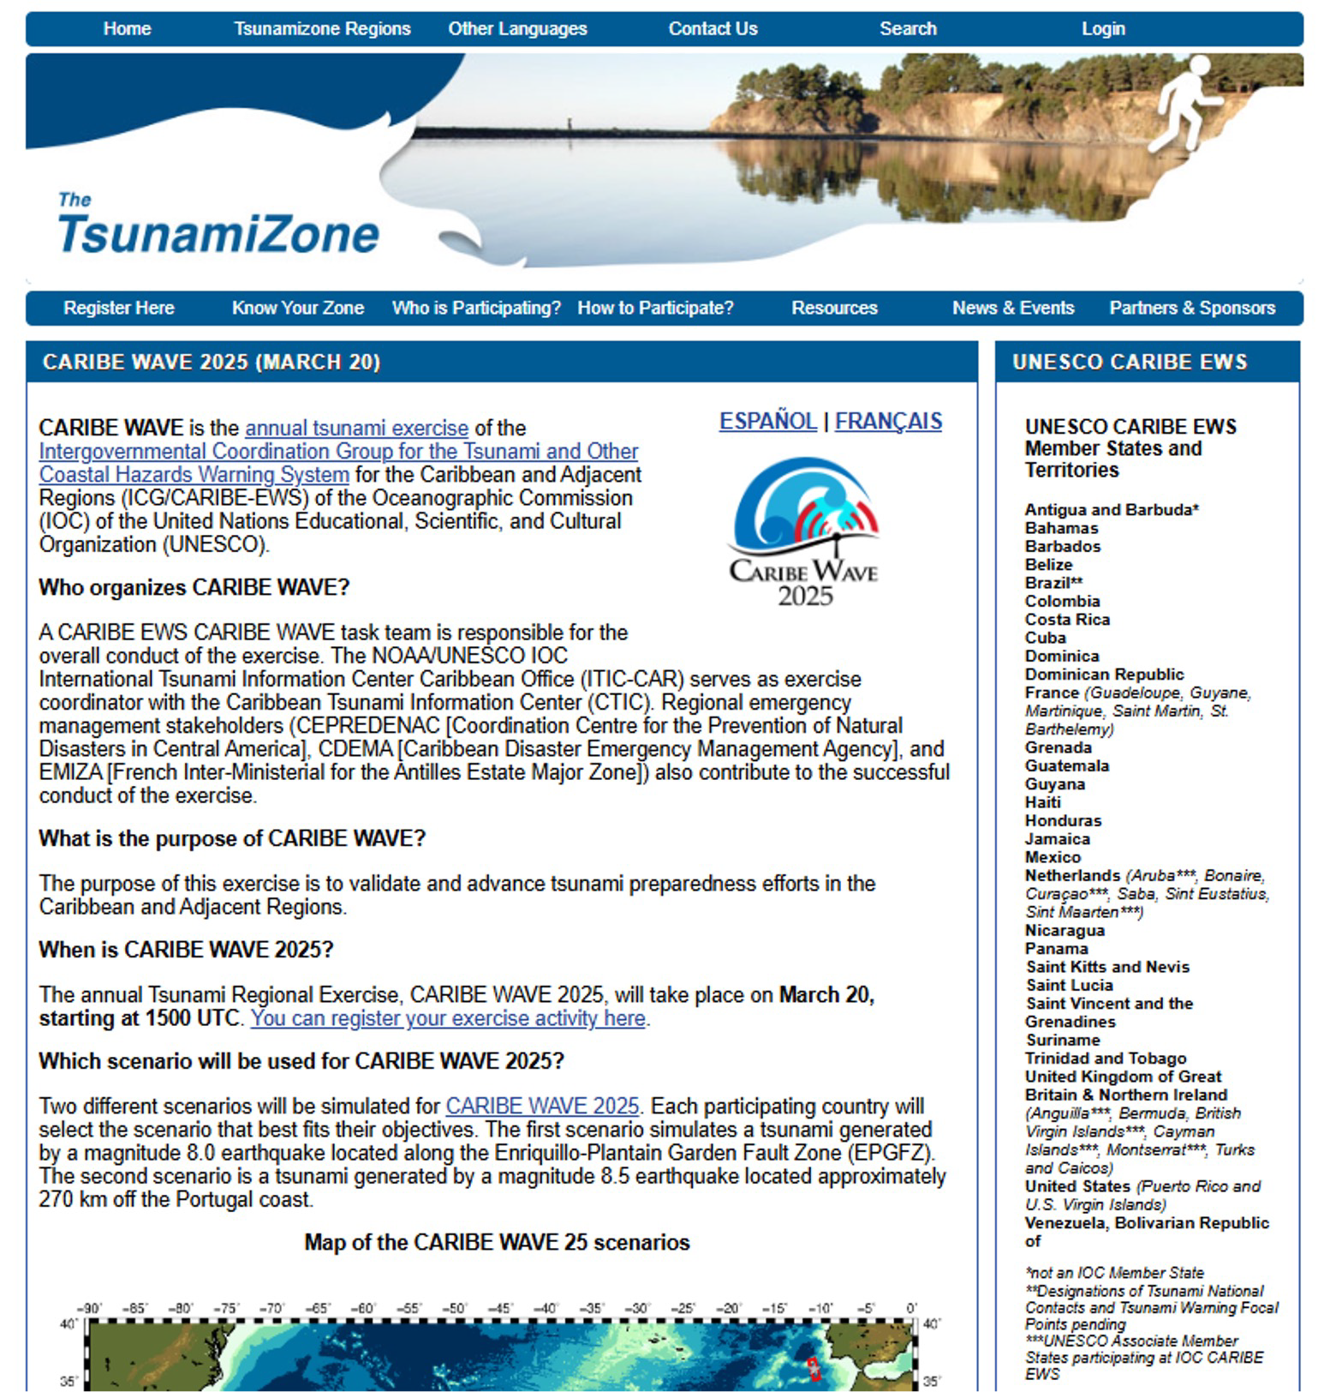
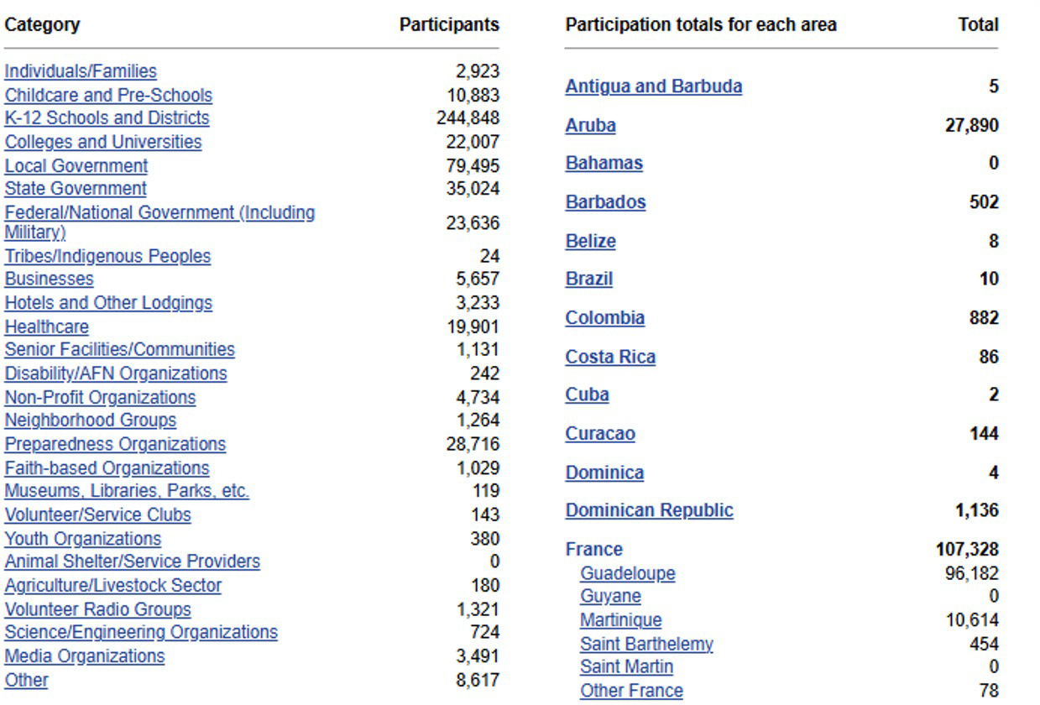
UNESCO/IOC-NOAA SHOA
Web link: http://tsunamizone.org
International Tsunami Information

Slide 6
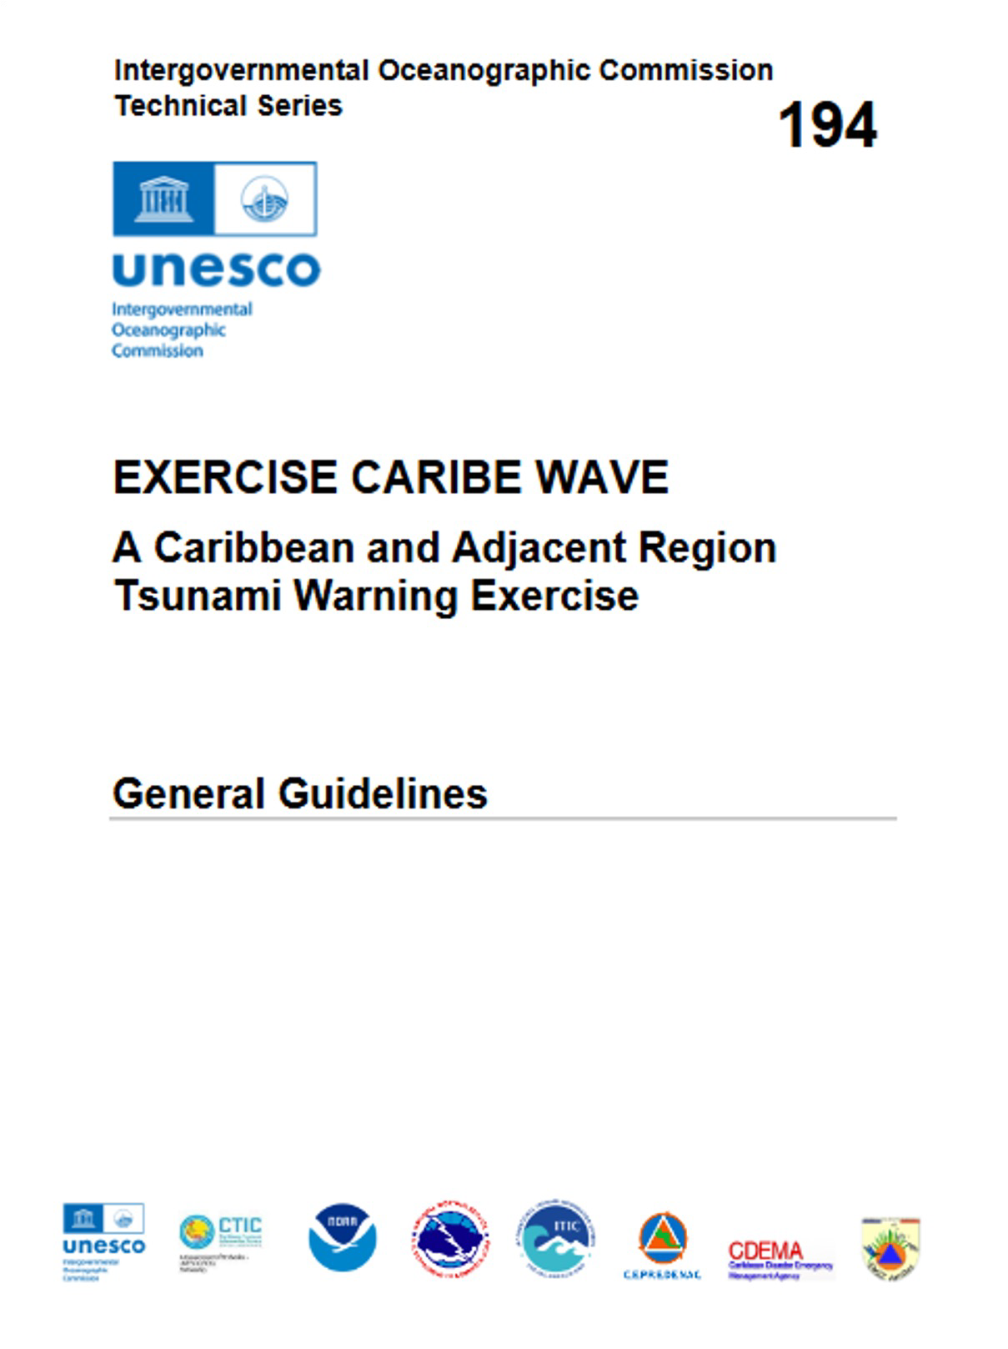
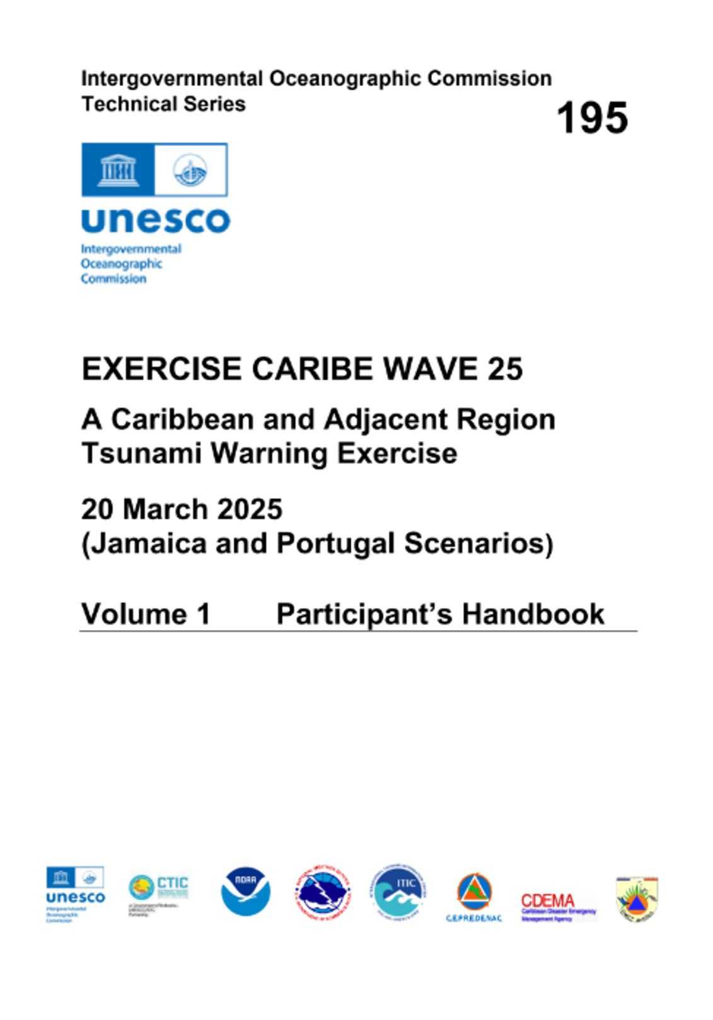
caribewave.org
UNESCO/IOC-NOAA SHOA
International Tsunami Information

Slide 7
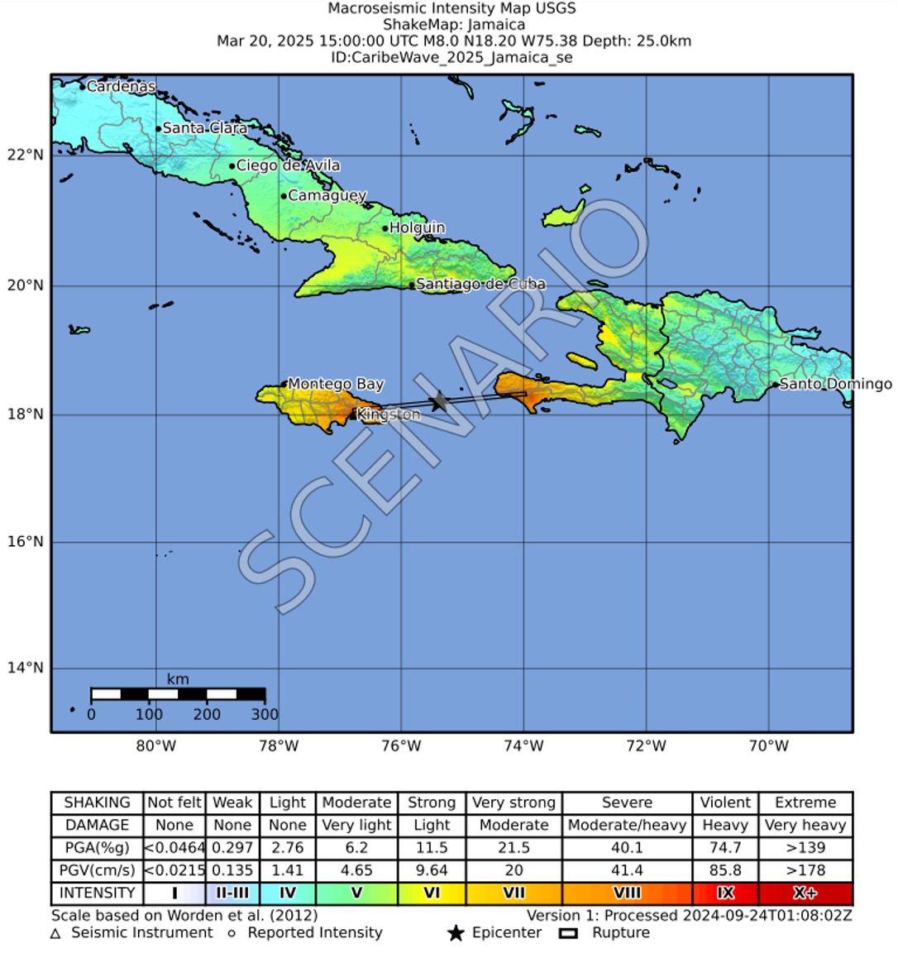
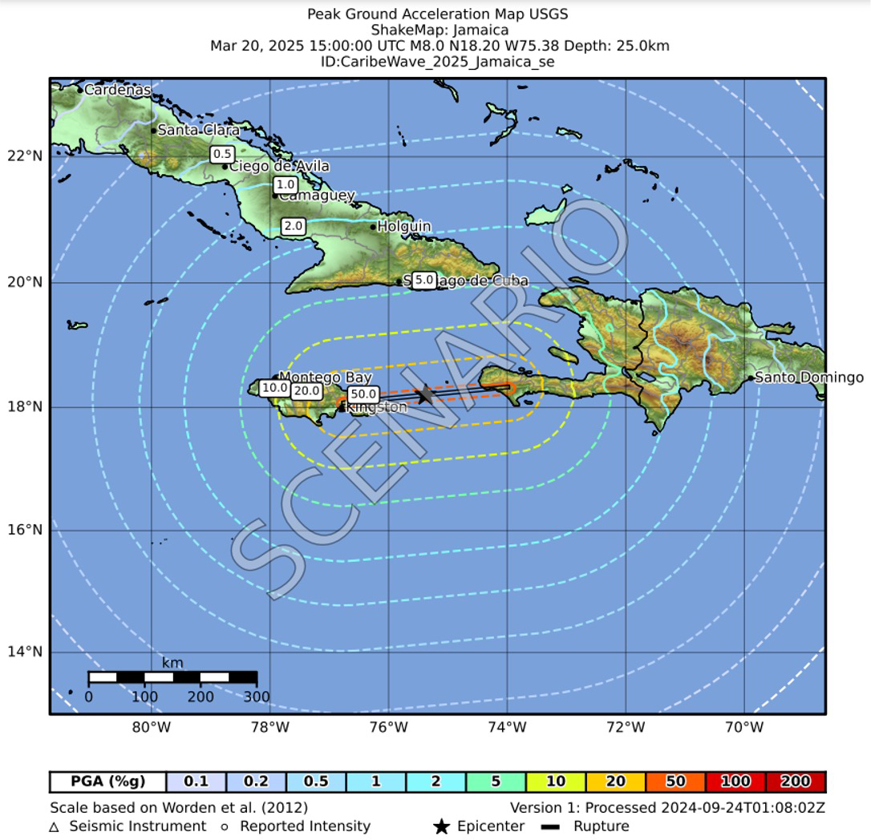
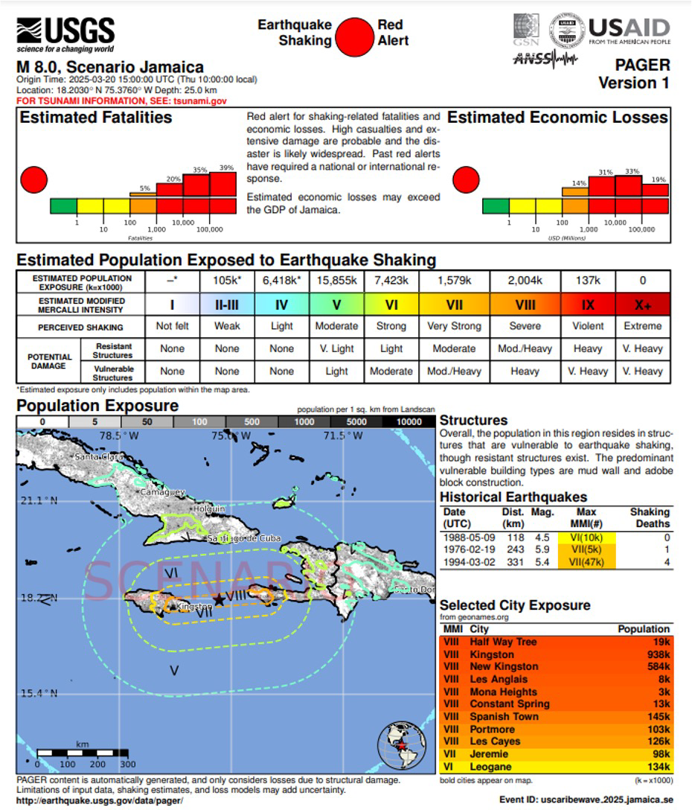
USGS - ShakeMap and Pager

Slide 8
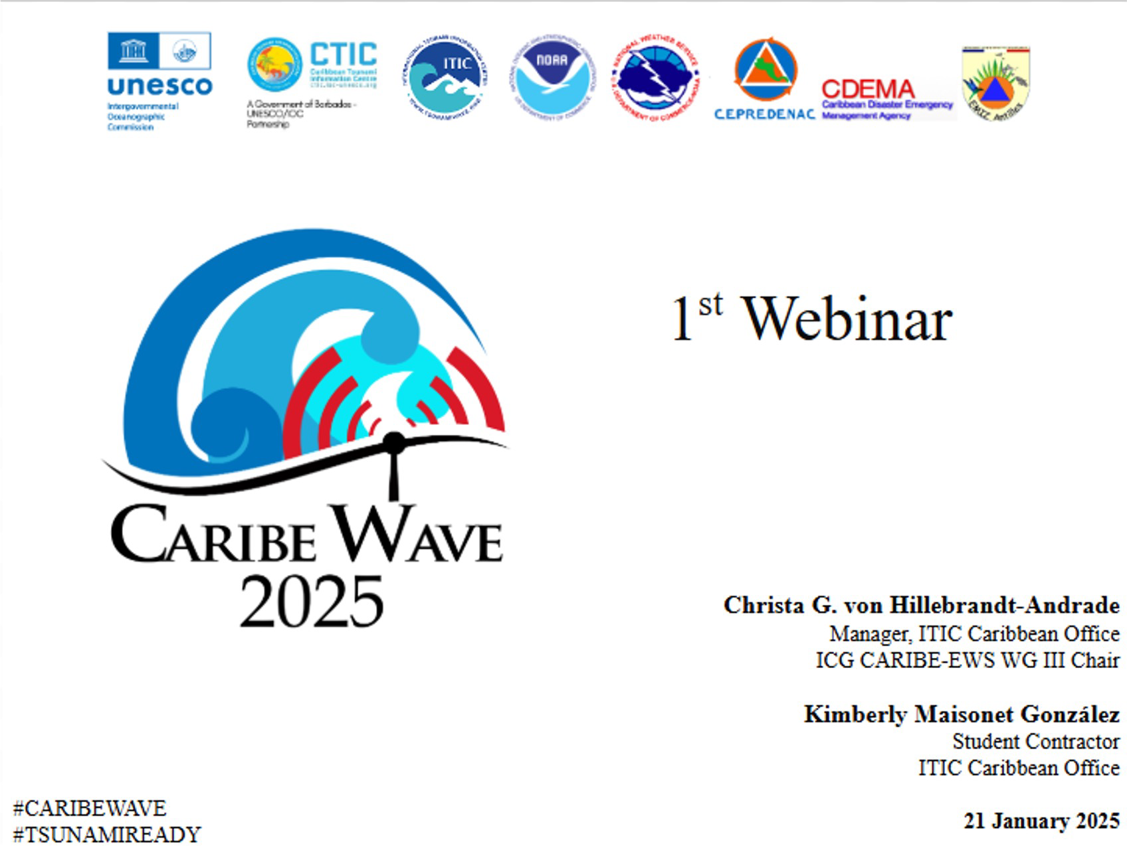
Webinars
2 Virtual Webinars
January
February
3 Languages
English, Spanish, French

Slide 9
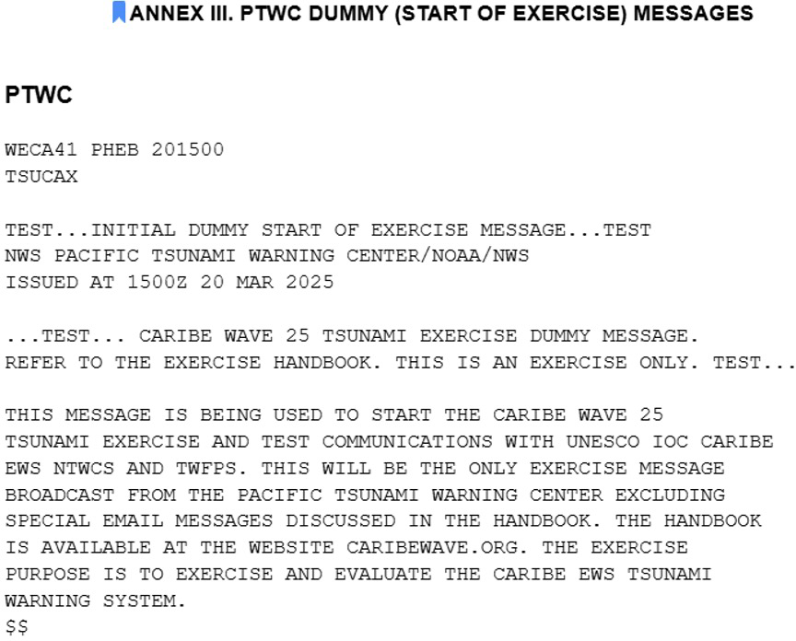
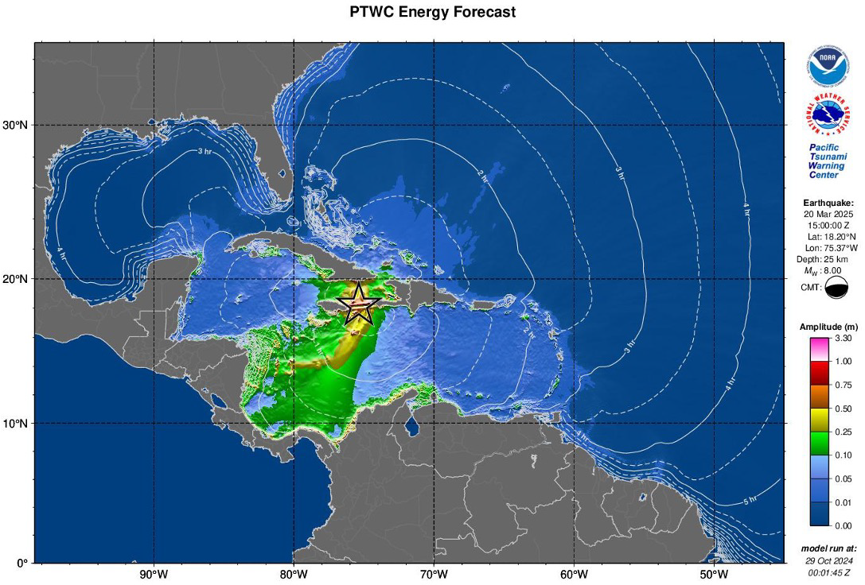
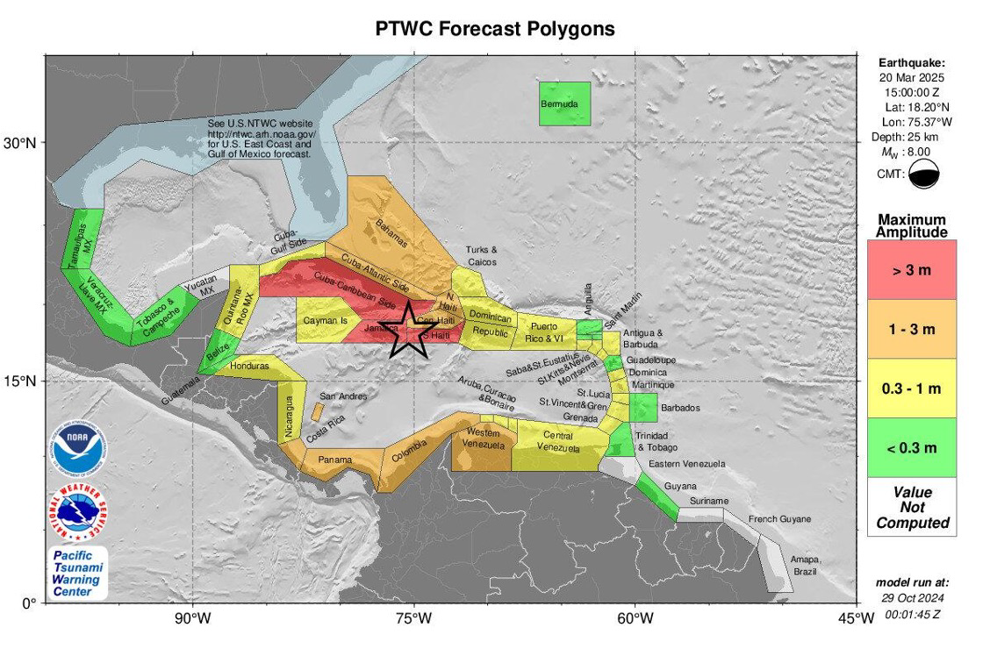
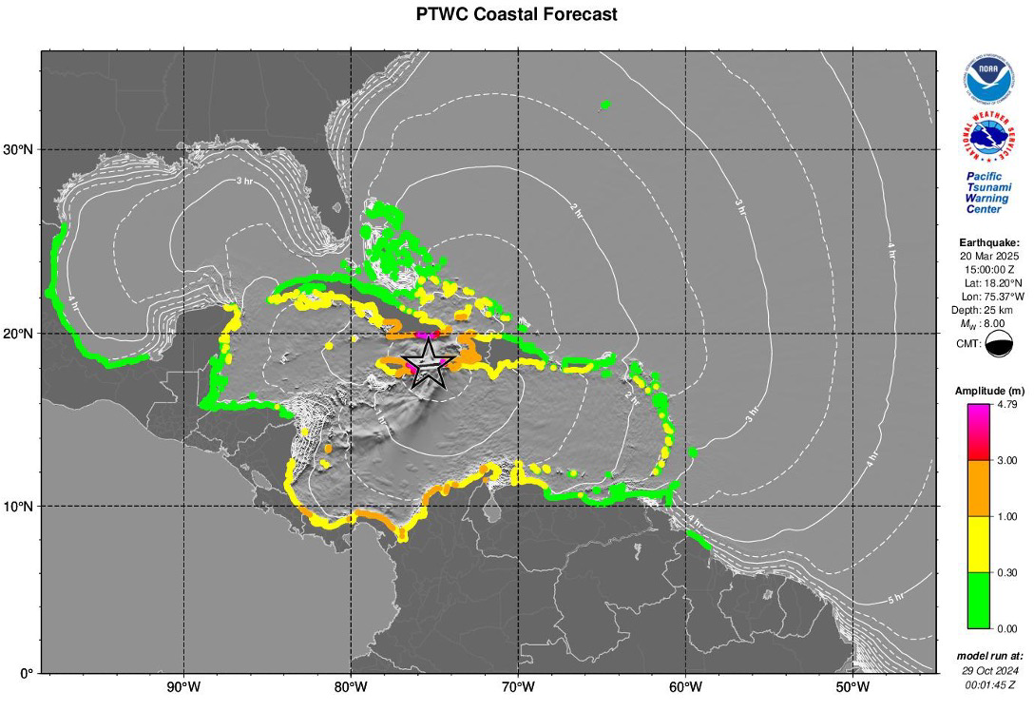
PTWC - Text and Graphical Products
AWIPS ID NWWS GTS EMWIN AISR
Email
UNES
Inter
CO/IOC-NOAA SHOA
national Tsunami Information

Slide 10
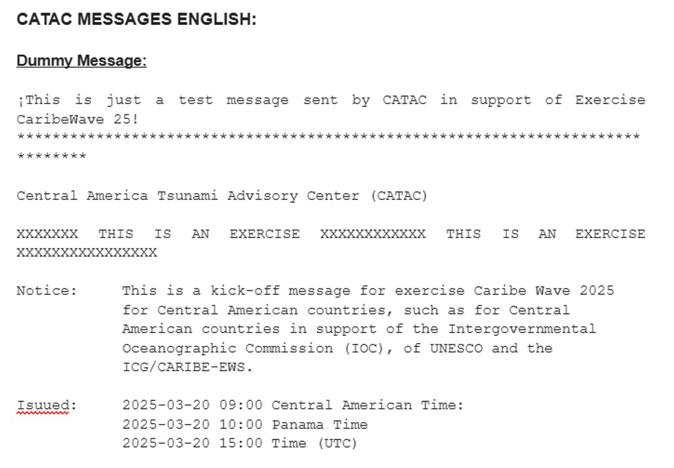
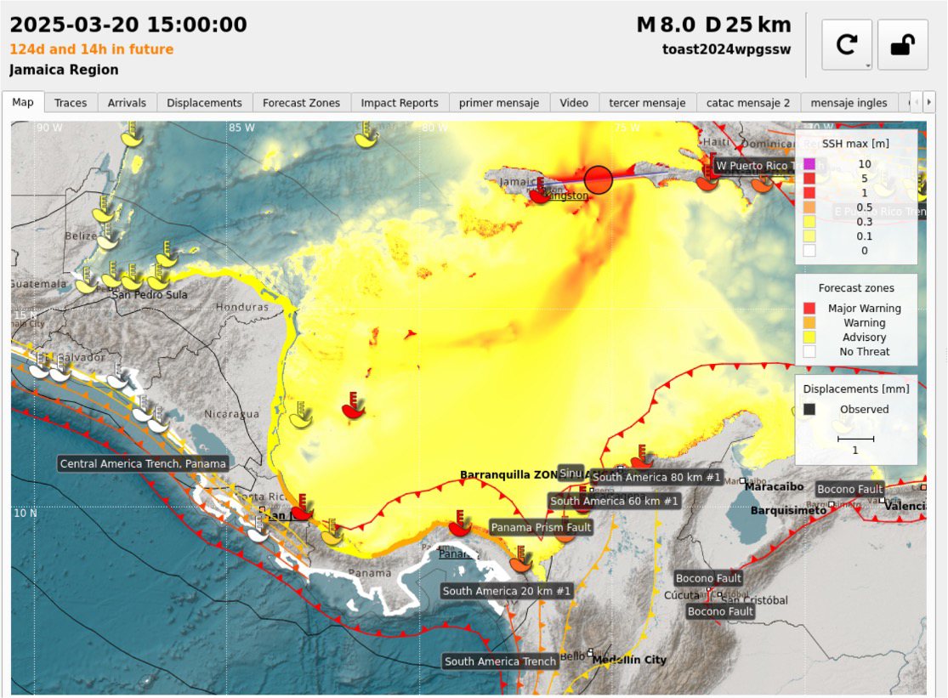
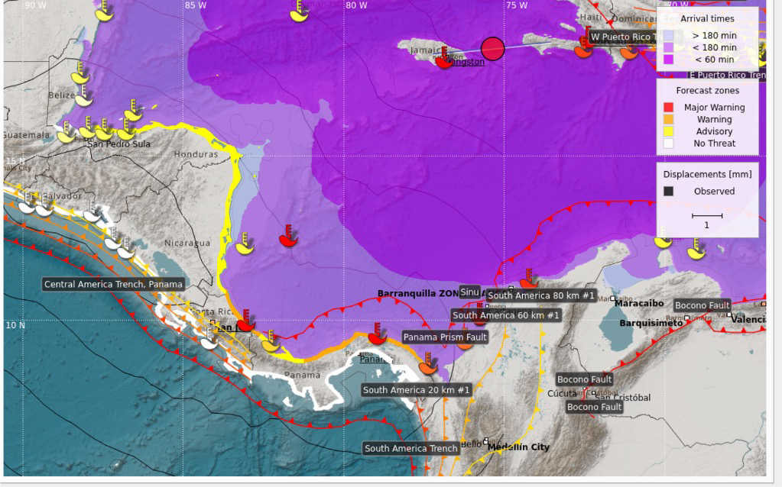
Products

Slide 11
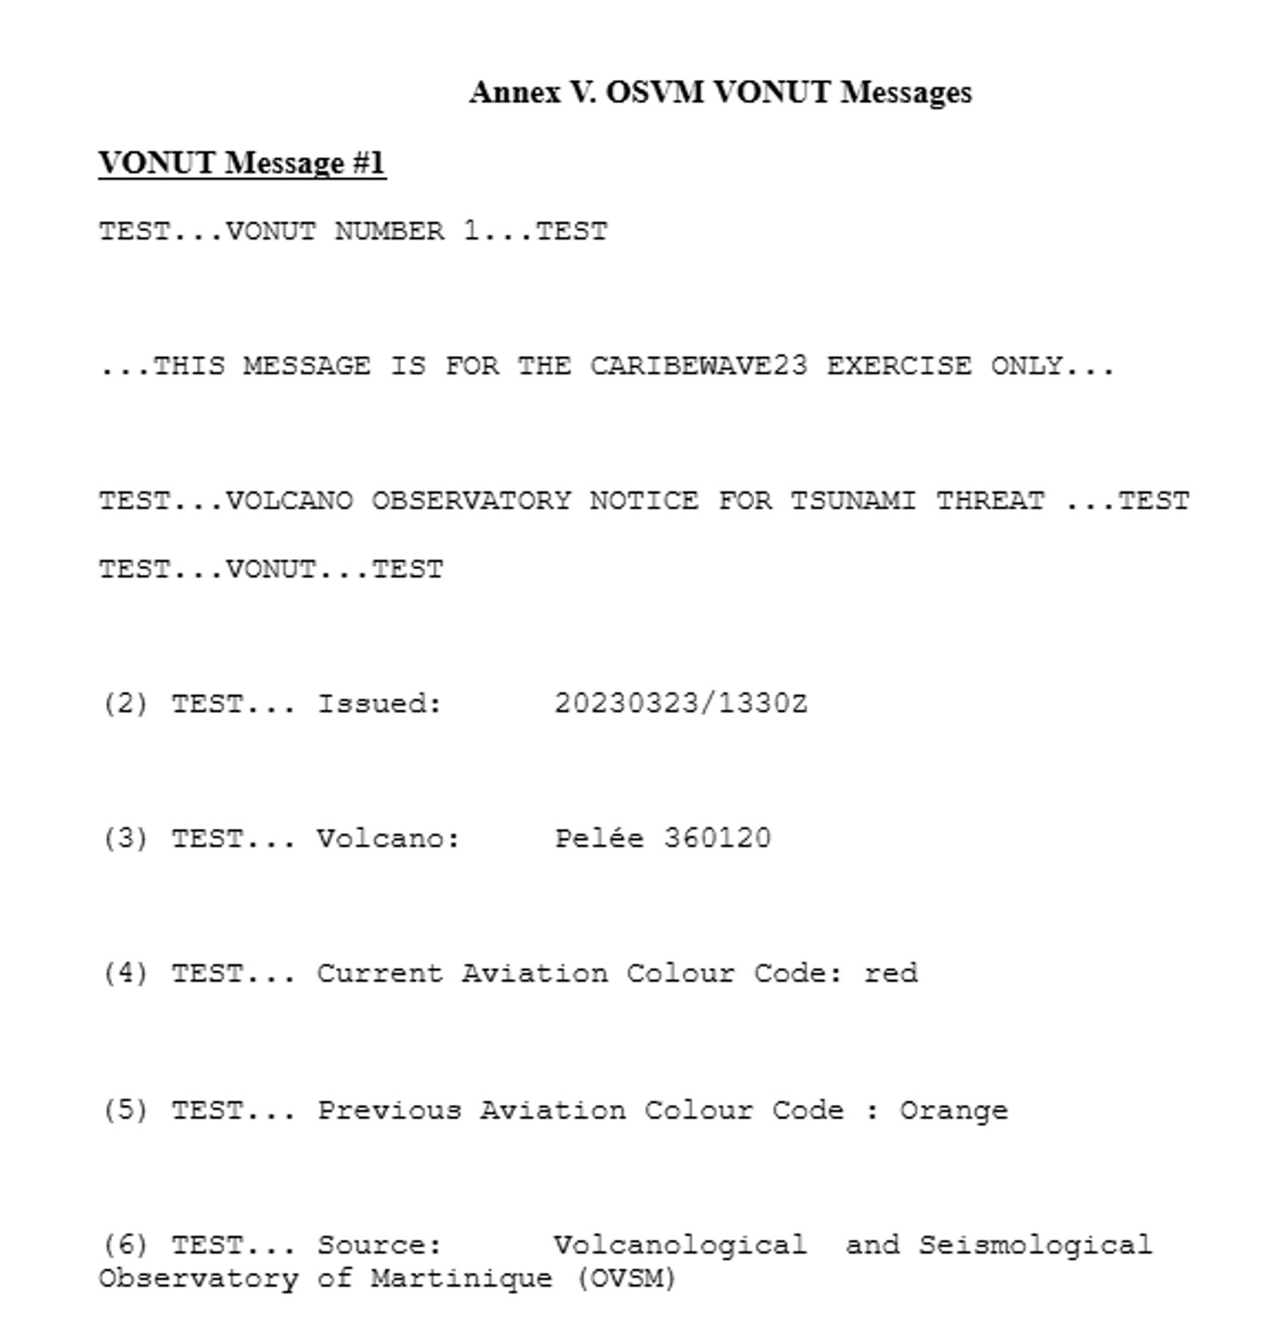
Volcano Observatory Notice for Tsunami Threat (VONUT)

Slide 12

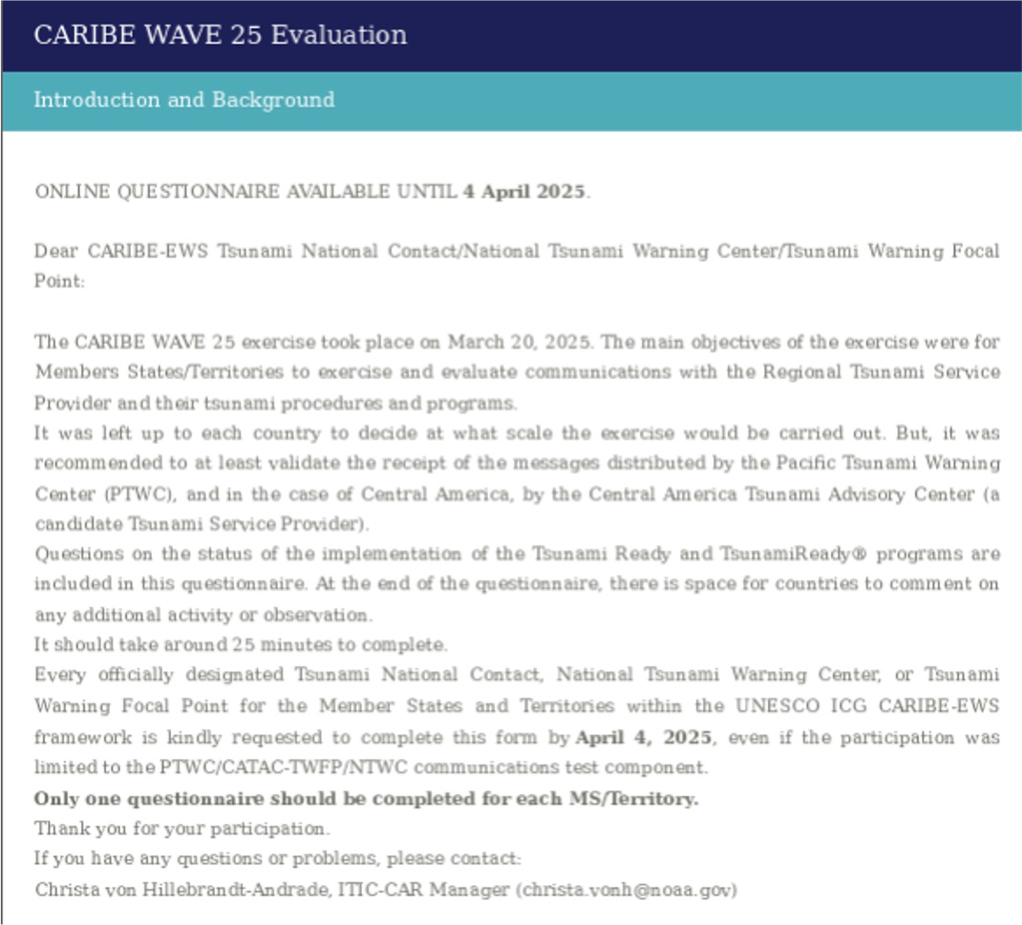
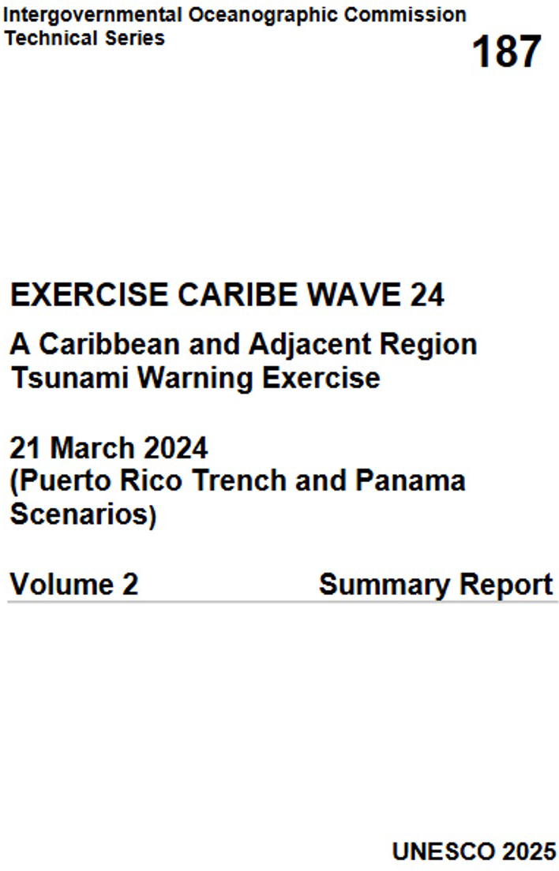
Evaluation
Title

Slide 13
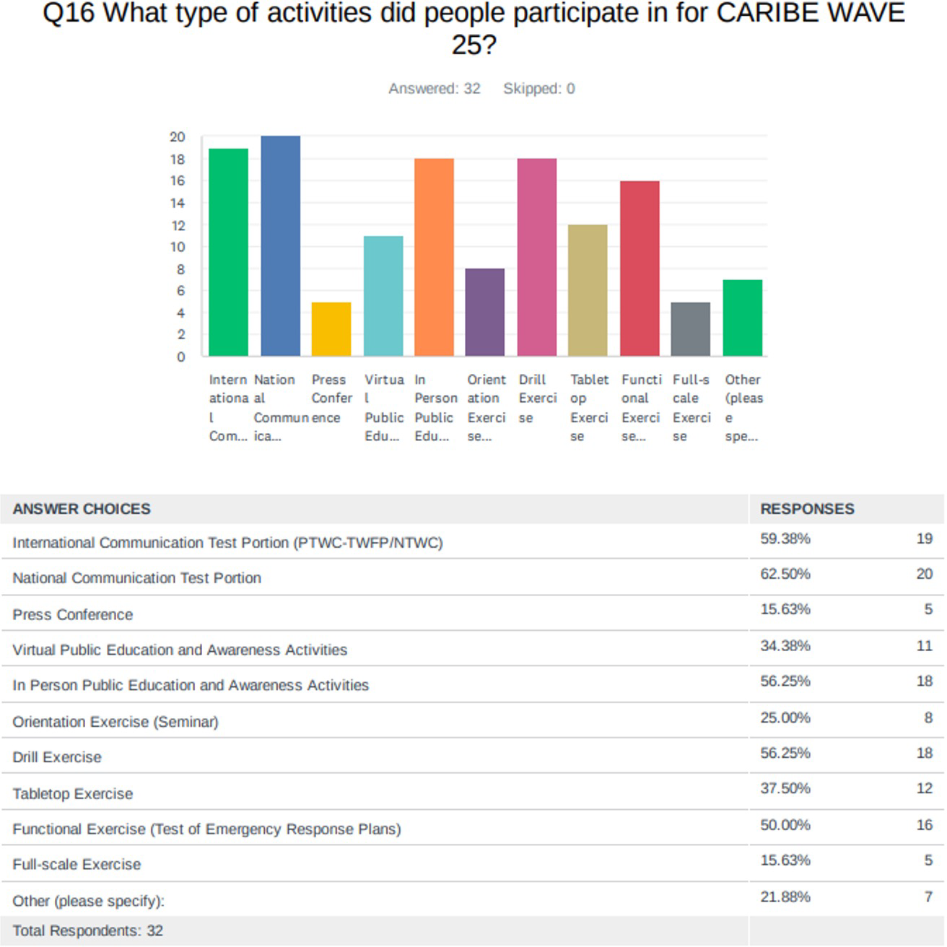
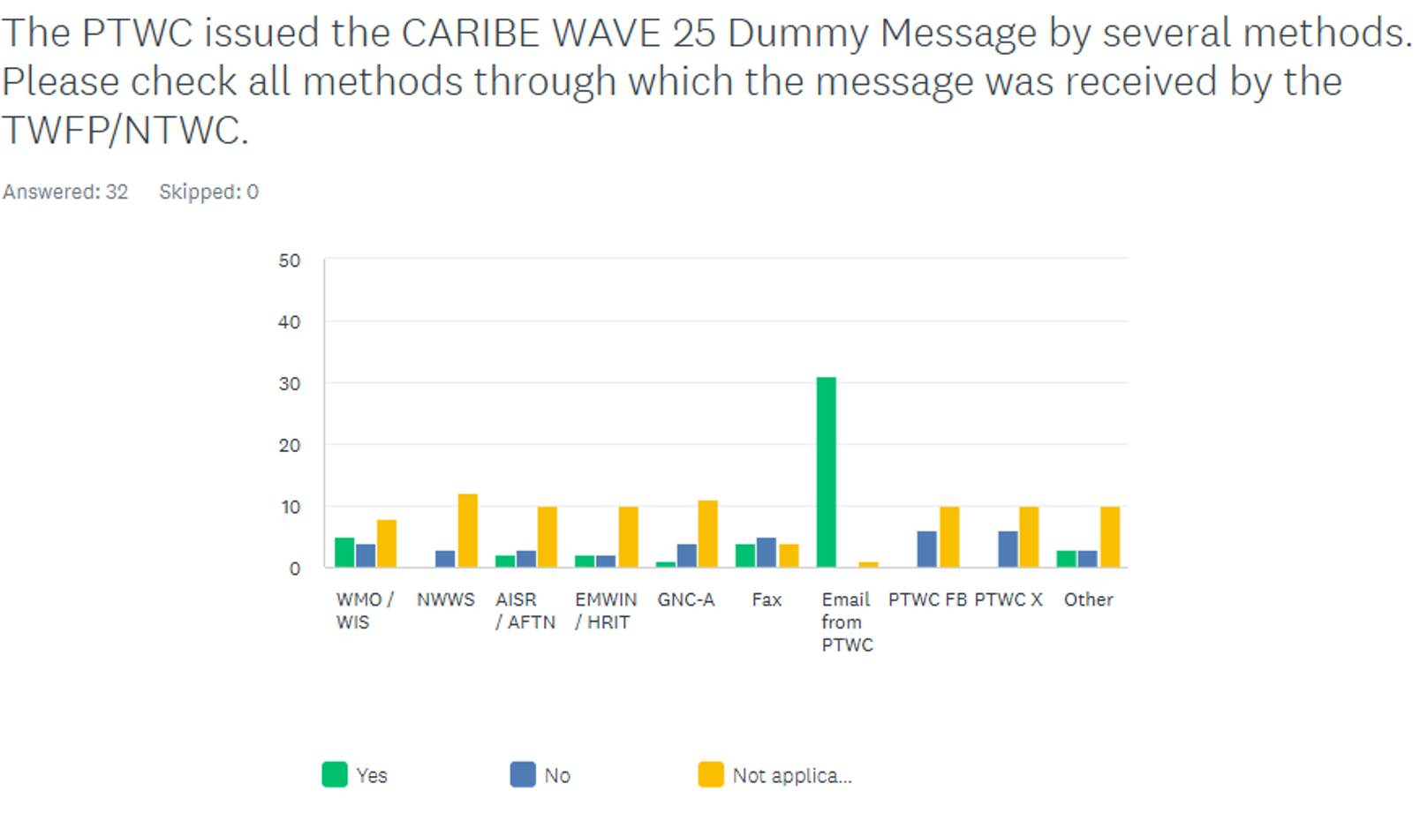
Results

Slide 14
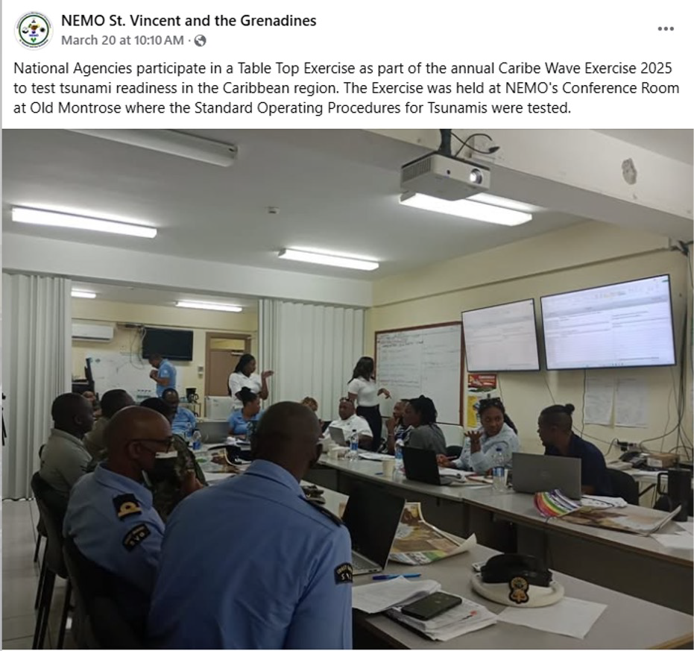
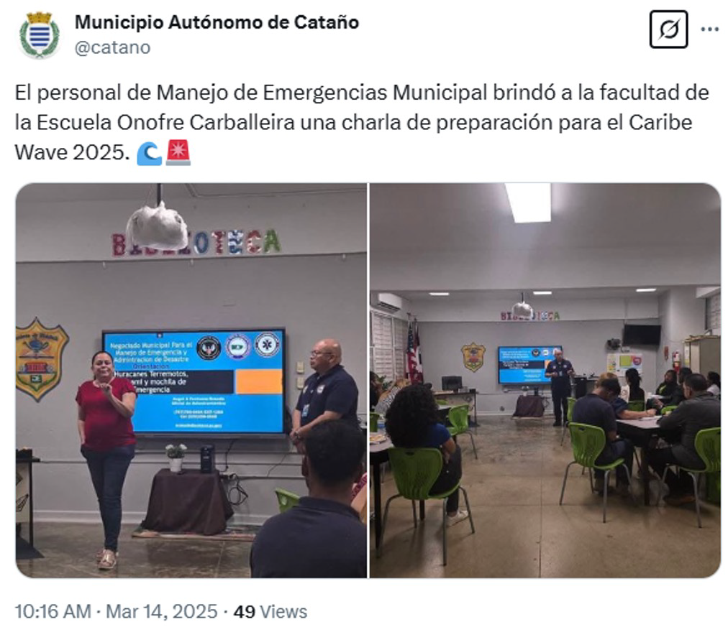
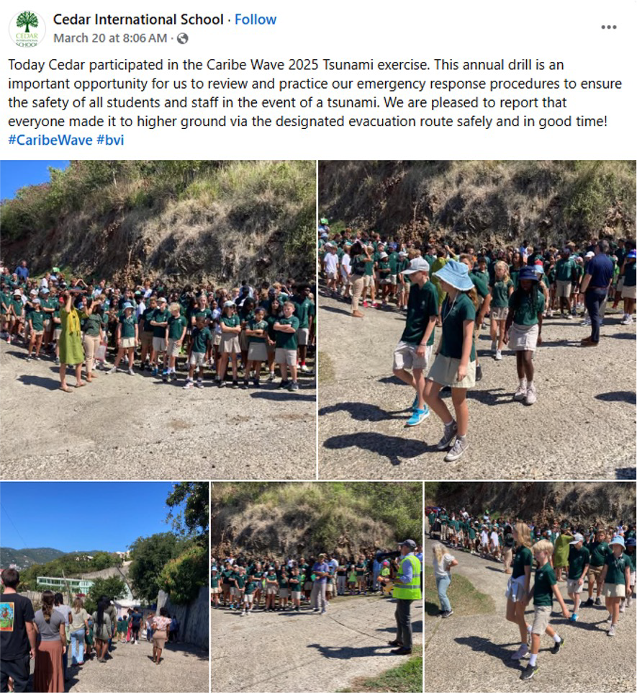
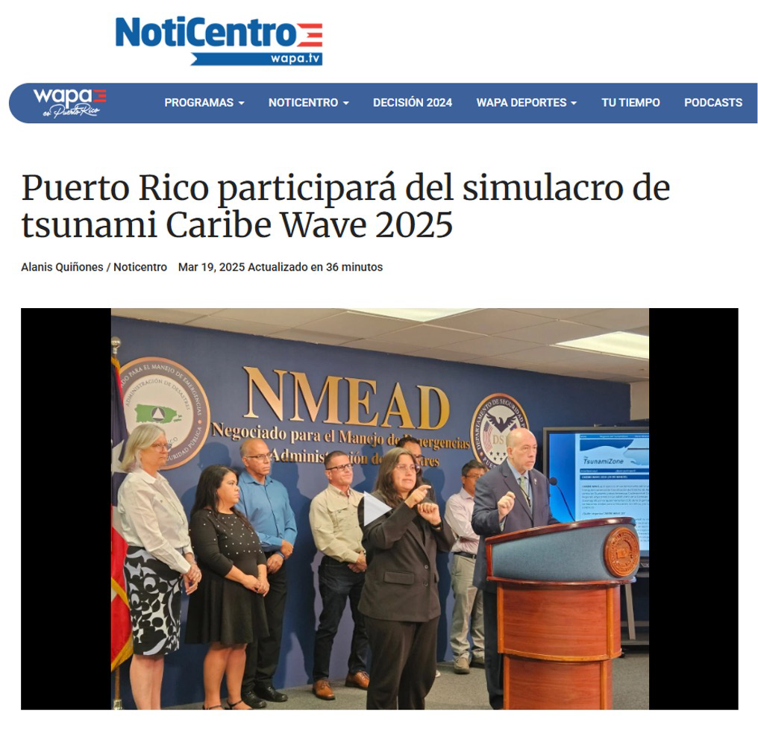
Activities and Social media

Slide 15
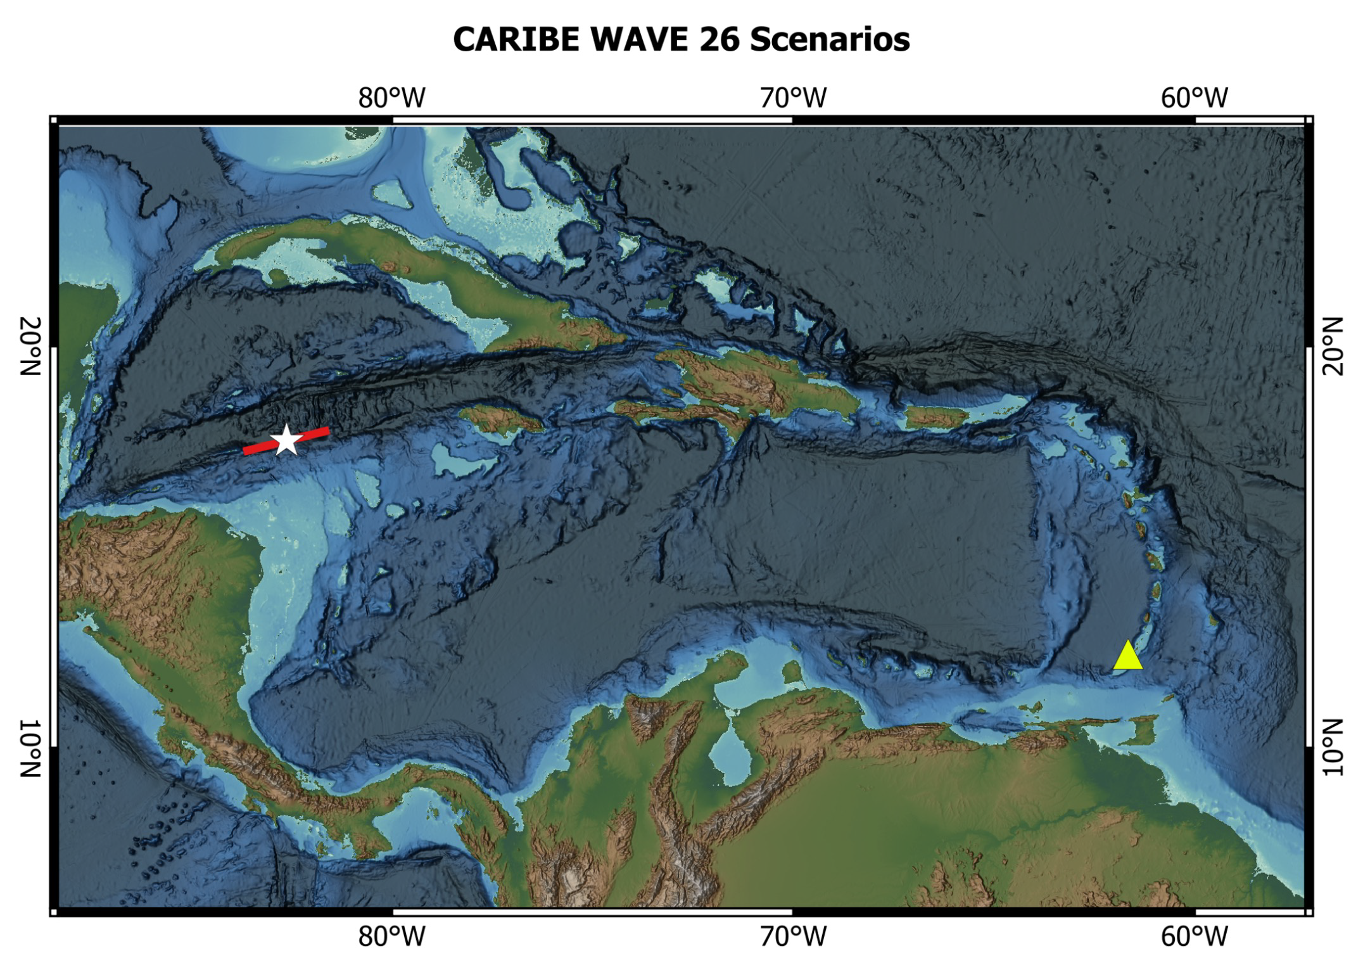
CARIBE WAVE 26
March 19, 2025
Scenarios:
Cayman Islands
Kick ‘em Jenny

Slide 16
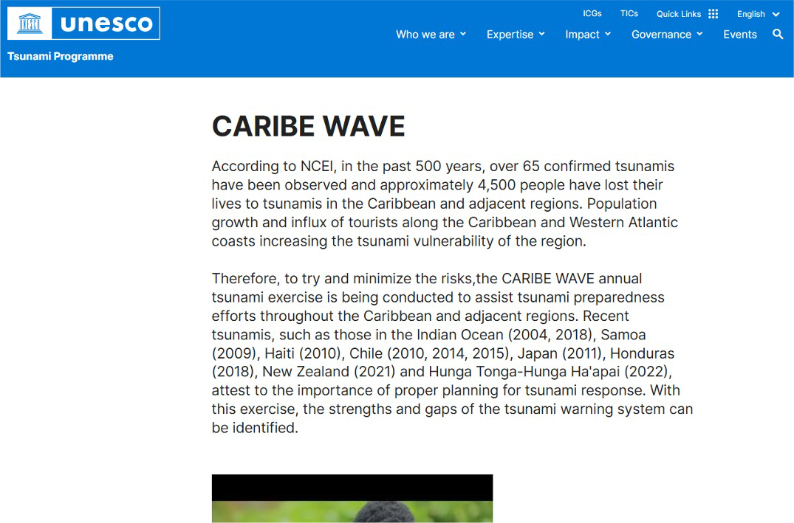
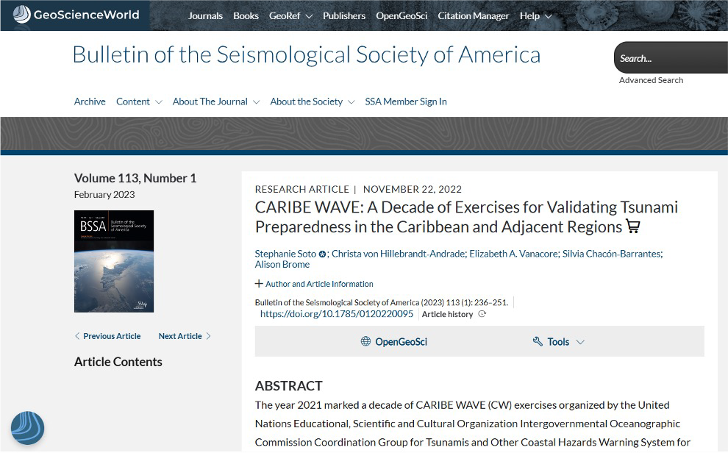
Resources available at caribewave.org
Manual and Guides 86: Multi-Annual Community Tsunami Exercise Programme Guidelines for the Tsunami and Other Coastal Hazards Warning System for the Caribbean and Adjacent Regions.
PTWC Enhanced Products and Staging for the Caribbean and Pacific, English
IOC Manuals “How to plan, conduct and evaluate tsunami exercises” and “Module on Tsunami Exercise” are useful resources.
CARIBE WAVE 2011 - 2025 Handbook
CARIBE WAVE 2011 - 2024 Final Reports
PTWC Communications Plan and Users Guide for the Caribbean
TsunamiZone registration guide
https://doi.org/10.1785/0120220095

Slide 17








UNESCO/IOC – NOAA ITIC Training Program in Hawaii (ITP-TEWS Hawaii) TSUNAMI EARLY WARNING SYSTEMS
AND THE PACIFIC TSUNAMI WARNING CENTER (PTWC) ENHANCED PRODUCTS
TSUNAMI EVACUATION PLANNING AND UNESCO IOC TSUNAMI READY PROGRAMME
15-26 September 2025, Honolulu, Hawaii
Thank You
Kimberly Maisonet González
ITIC-CAR

