Slide 1
National Tsunami Warning Chains and SOPs
France

Slide 2


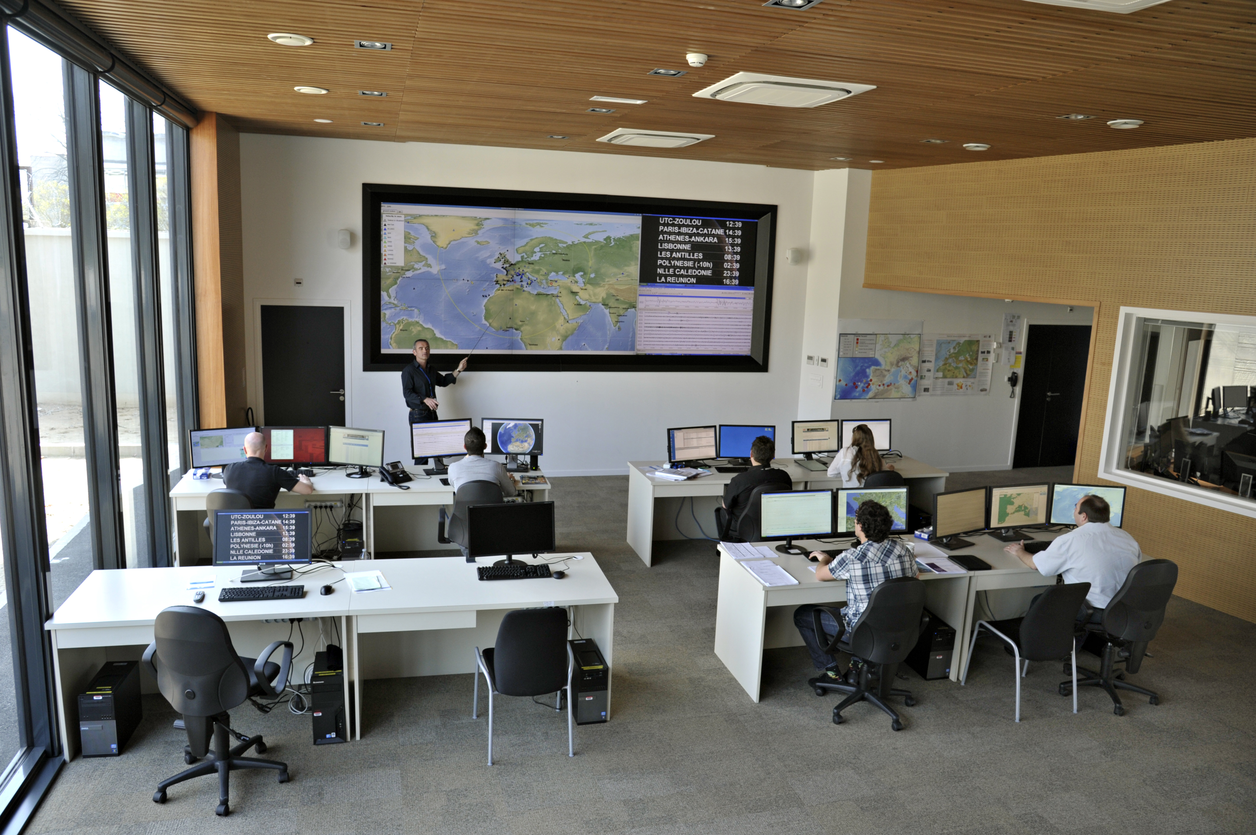



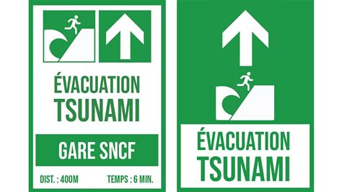
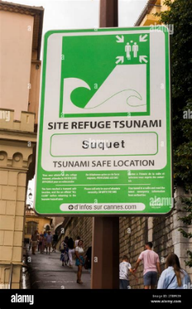
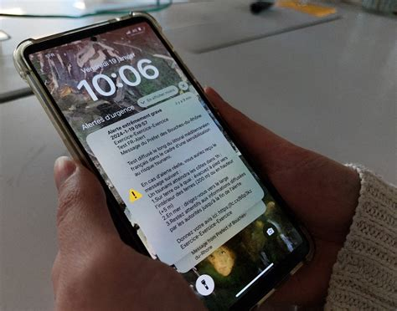
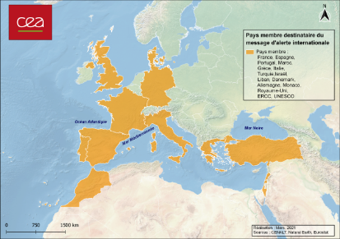




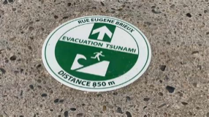
<15 min
<17 min
<20 min
Local Media
Public
Prefectures
French TSP
&
French NTWC
CENALT
Fire
COGIC
Town employees and professionals
Police
Town authorities
Local Media
Regional
National
Local
Automatic phone call
FR Alert
Cell broadcast
Town preparedness

Slide 3
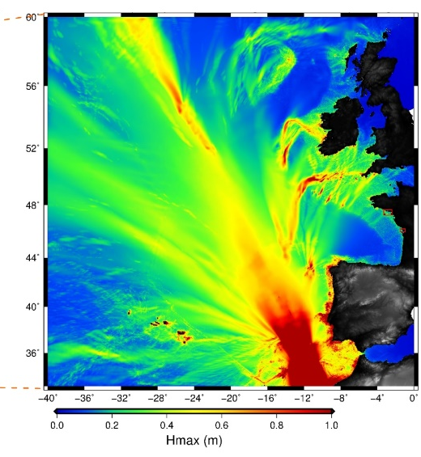
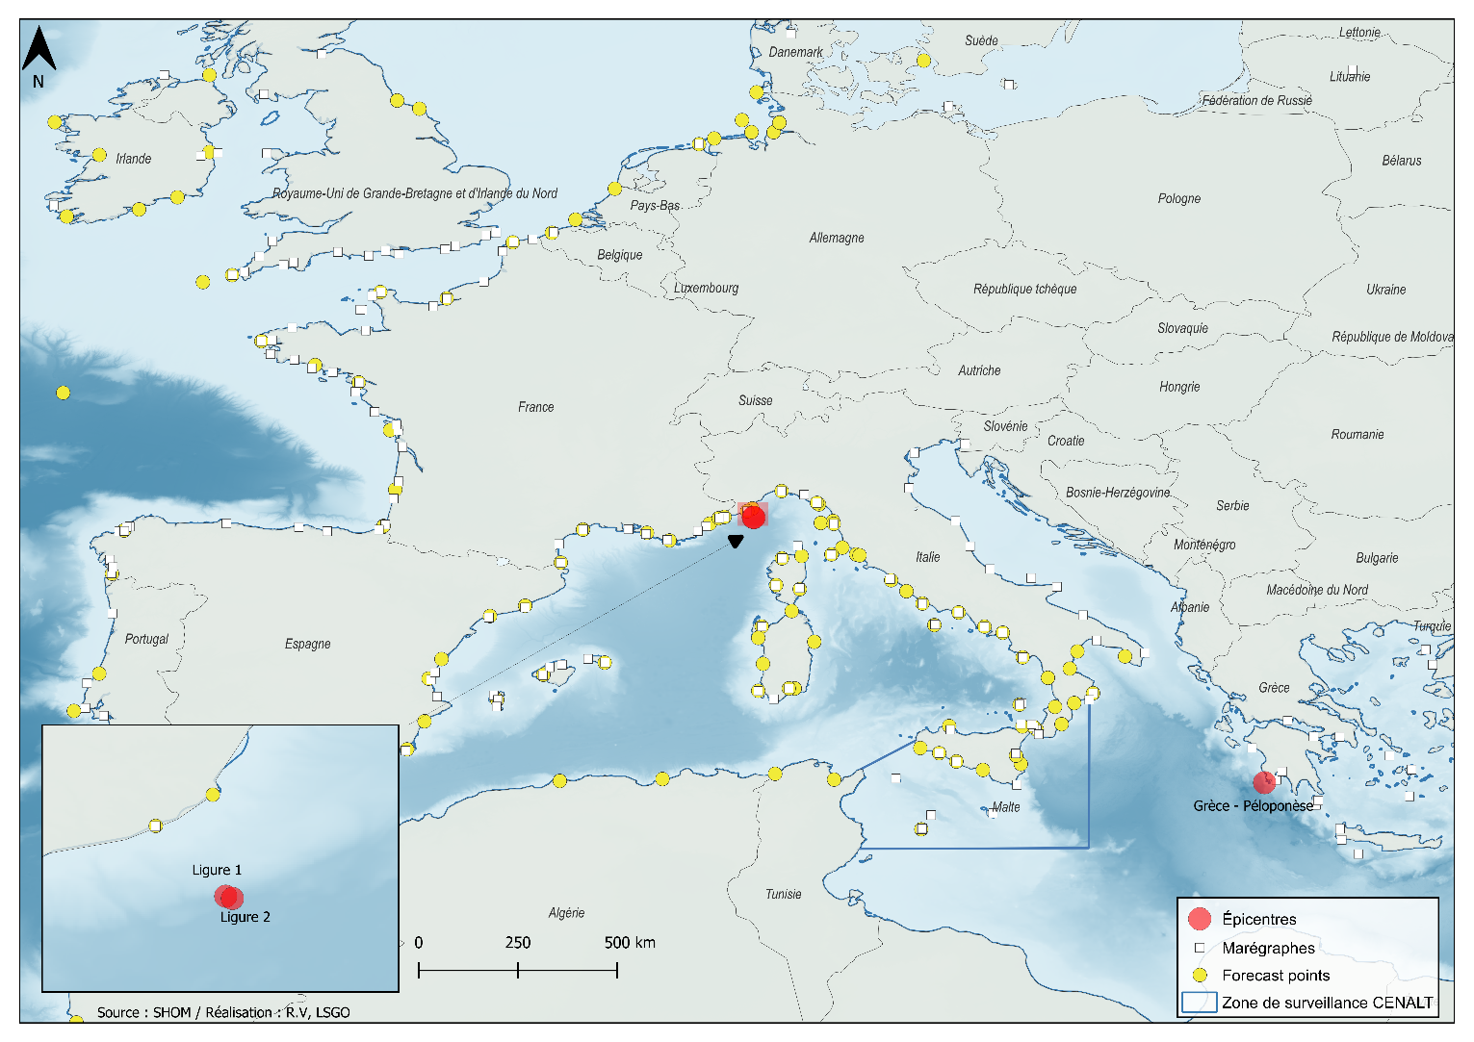
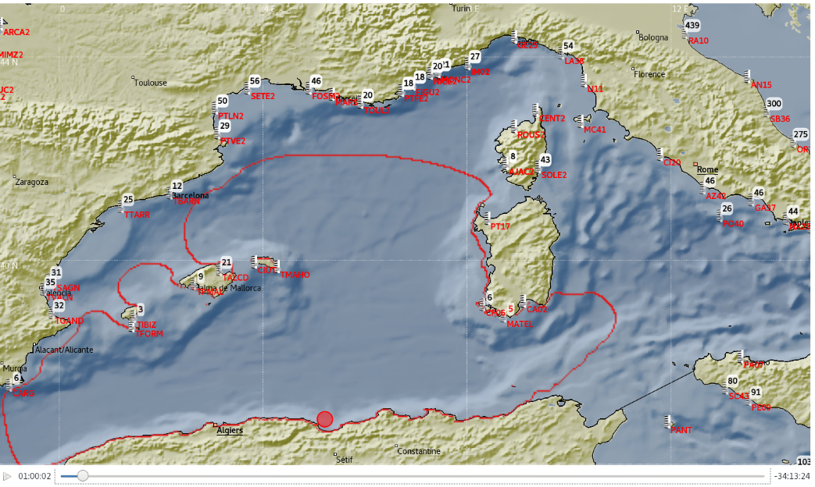
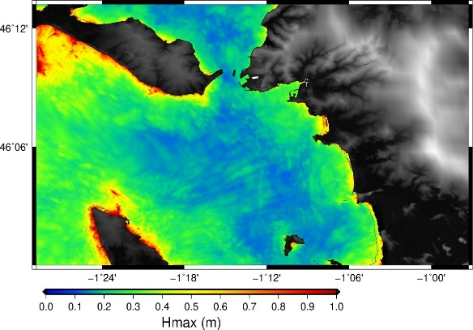
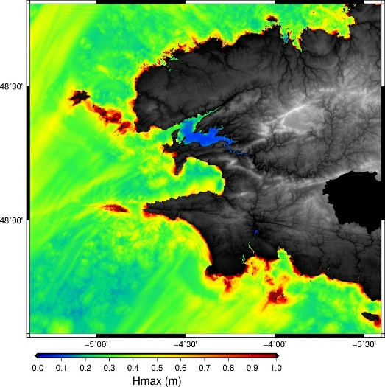
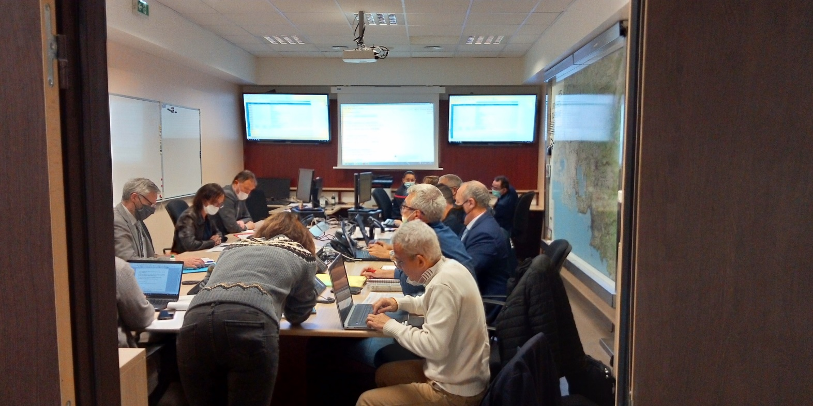
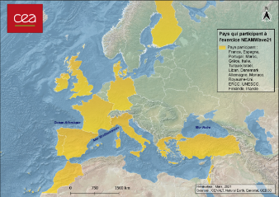
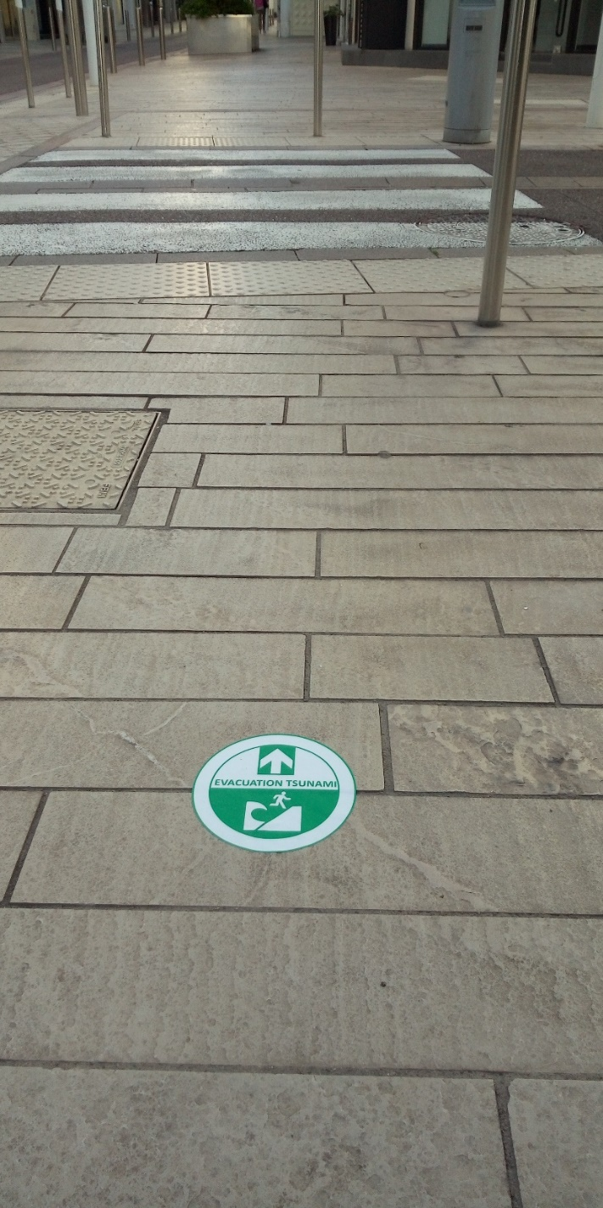
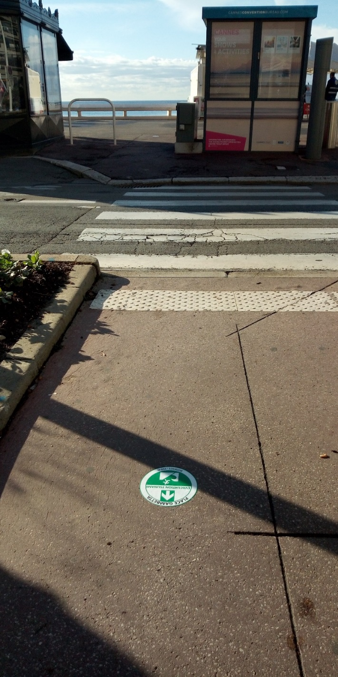
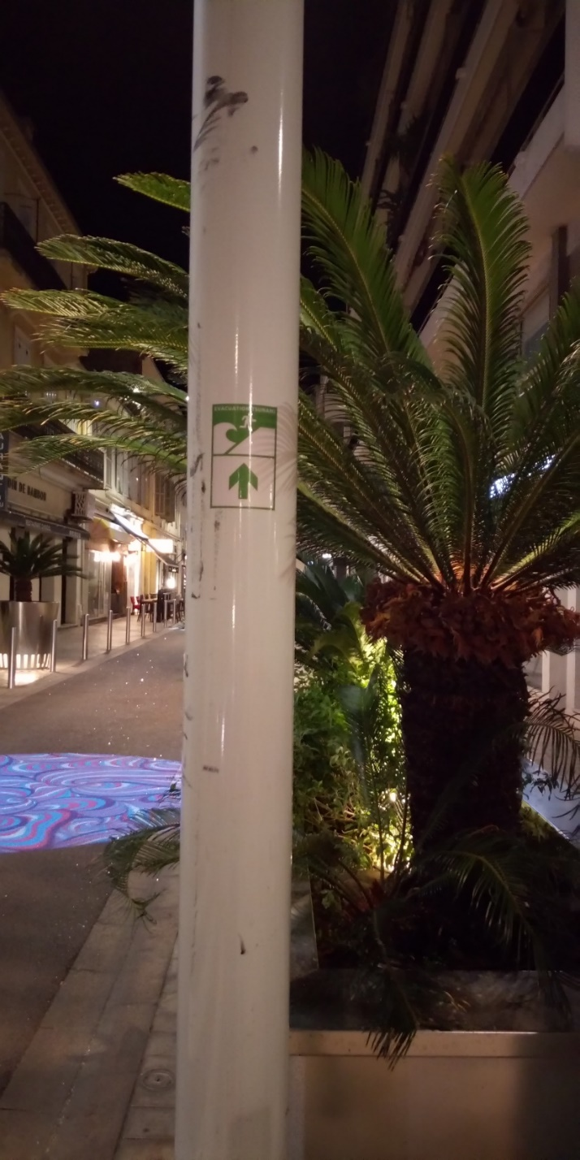


Exercises
International exercises NEAMWave23
Exercises with the COGIC
Test of the warning chain
Training
Internal exercises internal
Test and validation
Training
Crisis exercise
28/06/2024
Joint scenario with IPMA (Portugal)
Marseille
NEAMWave26 to be conducted
in March 2026 (joint scenario with IPMA and INGV)
Cannes

Slide 4
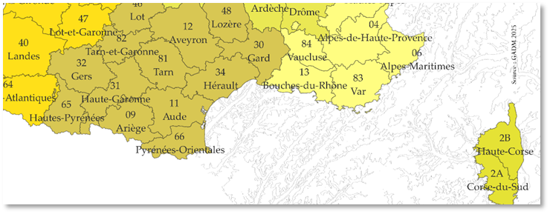
Lessons learned from exercises
EXERCICE TSUNAMI 26/06/2024
Origine : CENALT
Message n°1 du 26/06/2024 à 13:55:01 (heure de Paris)
Caractéristiques du tsunami :
- Zone maritime concernée : Méditerranée Occidentale
- Niveau ROUGE pour les départements suivants:
06 ... 11 ... 13 ... 2A ... 2B ... 30 ... 34 ... 66 ... 83
- Heures prévues d'arrivée pour les départements suivants:
06 - 28/06/2024 11:04
11 - 28/06/2024 12:18
13 - 28/06/2024 11:30
2A - 28/06/2024 11:12
2B - 28/06/2024 11:11
30 - 28/06/2024 12:23
34 - 28/06/2024 12:24
66 - 28/06/2024 11:57
83 - 28/06/2024 11:09
- Départements concernés classés par heure prévue d'arrivée:
11:04 28/06/2024 - 06
11:09 28/06/2024 - 83
11:11 28/06/2024 - 2B
11:12 28/06/2024 - 2A
11:30 28/06/2024 - 13
11:57 28/06/2024 - 66
12:18 28/06/2024 - 11
12:23 28/06/2024 - 30
12:24 28/06/2024 - 34
Caractéristiques du séisme :
- Evénement Sismique : 28/06/2024 - 10:55:24 (heure de Paris)
- Localisation : Corsica, France
- Coordonnées : 43.71 N, 8.19 E
- Profondeur : 20 km
- Magnitude : 7.1
30
06
34
13
83
11
66
2B
EXERCICE TSUNAMI 02/07/2019
Origine : CENALT
Message n°1 du 02/07/2019 à 14:04:46
EXERCICE - EXERCICE - EXERCICE
Caractéristiques du tsunami :
- Zone maritime concernée : Méditerranée
- Niveau ROUGE pour les départements suivants:
06 ... 11 ... 13 ... 2A ... 2B ... 30 ... 34 ... 66 ... 83
- Heures prévues d'arrivée pour les départements suivants:
06 - 02/07/2019 15:14
11 - 02/07/2019 15:43
13 - 02/07/2019 15:13
2A - 02/07/2019 14:58
2B - 02/07/2019 15:04
30 - 02/07/2019 15:54
34 - 02/07/2019 15:51
66 - 02/07/2019 15:21
83 - 02/07/2019 15:06
Caractéristiques du séisme :
- Evénement Sismique : 02/07/2019 - 14:02:10
- Localisation : Western Mediterranean Sea
- Coordonnées : 37.18 N, 6.78 E
- Profondeur : 8 km
- Magnitude : 7.4
2A
Ordered by departement number (local authorities request)
Ordered by departement number (local authorities request)
Ordered by arrival time on departement (national authorities request)

Slide 5
Lessons learned from exercises
EXERCICE D'ALERTE TSUNAMI 01/07/2013
Origine : CENALT
Message du 01/07/2013 à 16:03:47
Fin d'alerte
Levée des mesures de surveillance
Plus d'autre message
Initial end off national message
End of alert
End of surveillance measures
No more message
EXERCICE D'ALERTE TSUNAMI 23/06/2025
Origine : CENALT
Message n°4 du 23/06/2025 à 11:29:54 (heure de Paris)
Fin de surveillance du CENALT
Attention, des effets peuvent perdurer dans les ports et dans certaines baies.
La fin d'alerte et des mesures de sauvegarde seront émises par la préfecture.
Plus d'autre message.
Evolution of end off national message
End of CENALT monitoring
Please note that effects may persist in ports and some bays.
The prefecture will issue the end of alert and safety measures
No more message

Slide 6
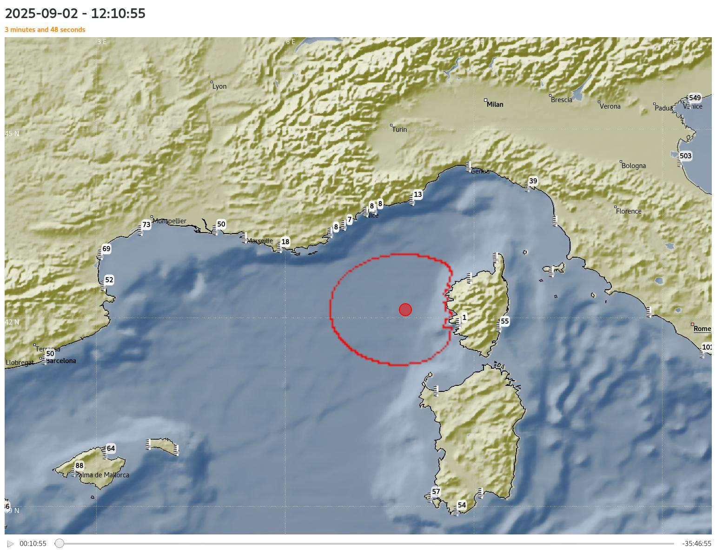

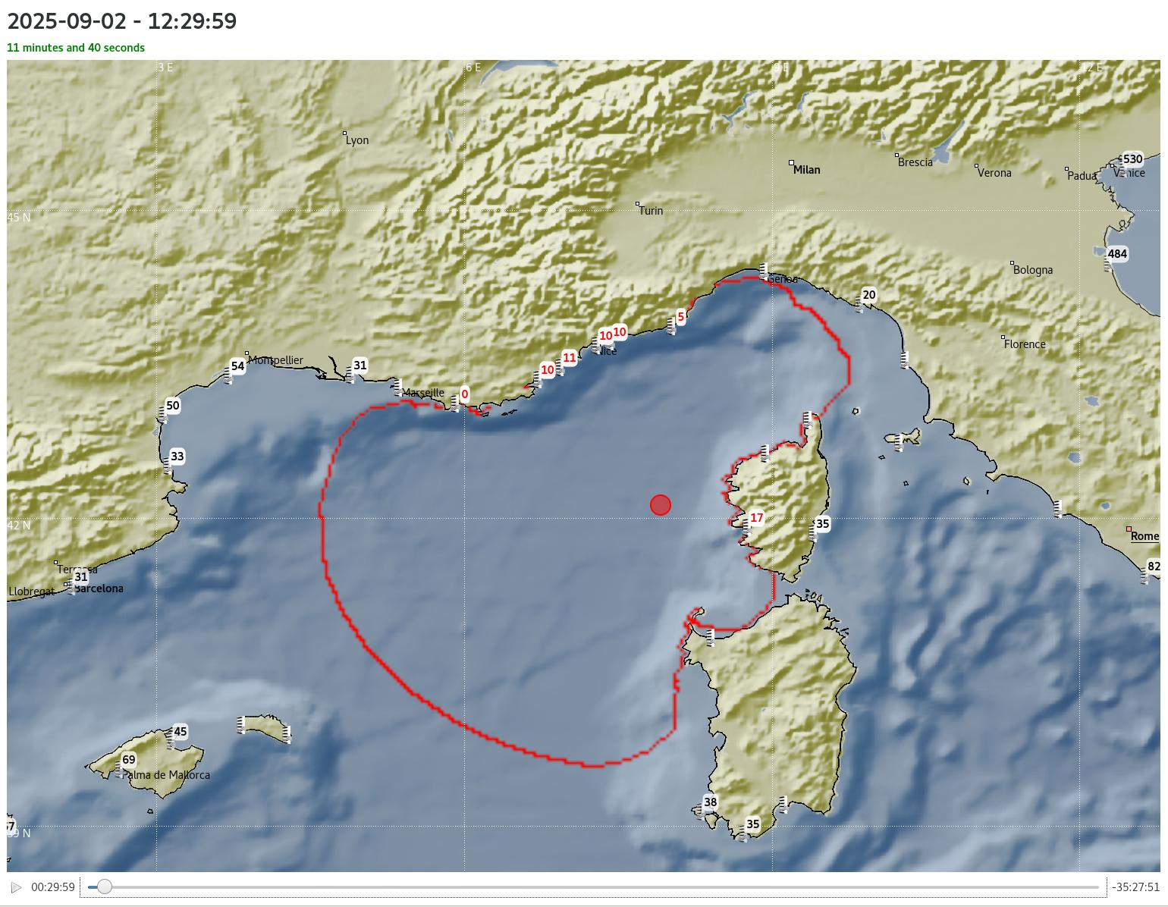
Lessons learned from exercises
Propagation +5 min
Propagation +20 min
Propagation +30 min
The CPA needs to understand the state of the propagation of the tsunami wave

Slide 7
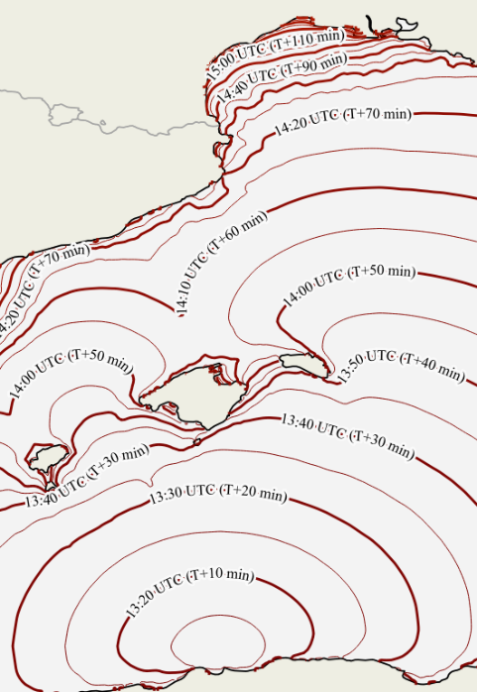
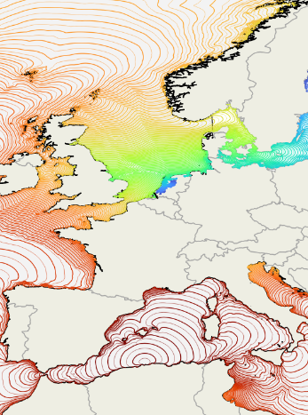
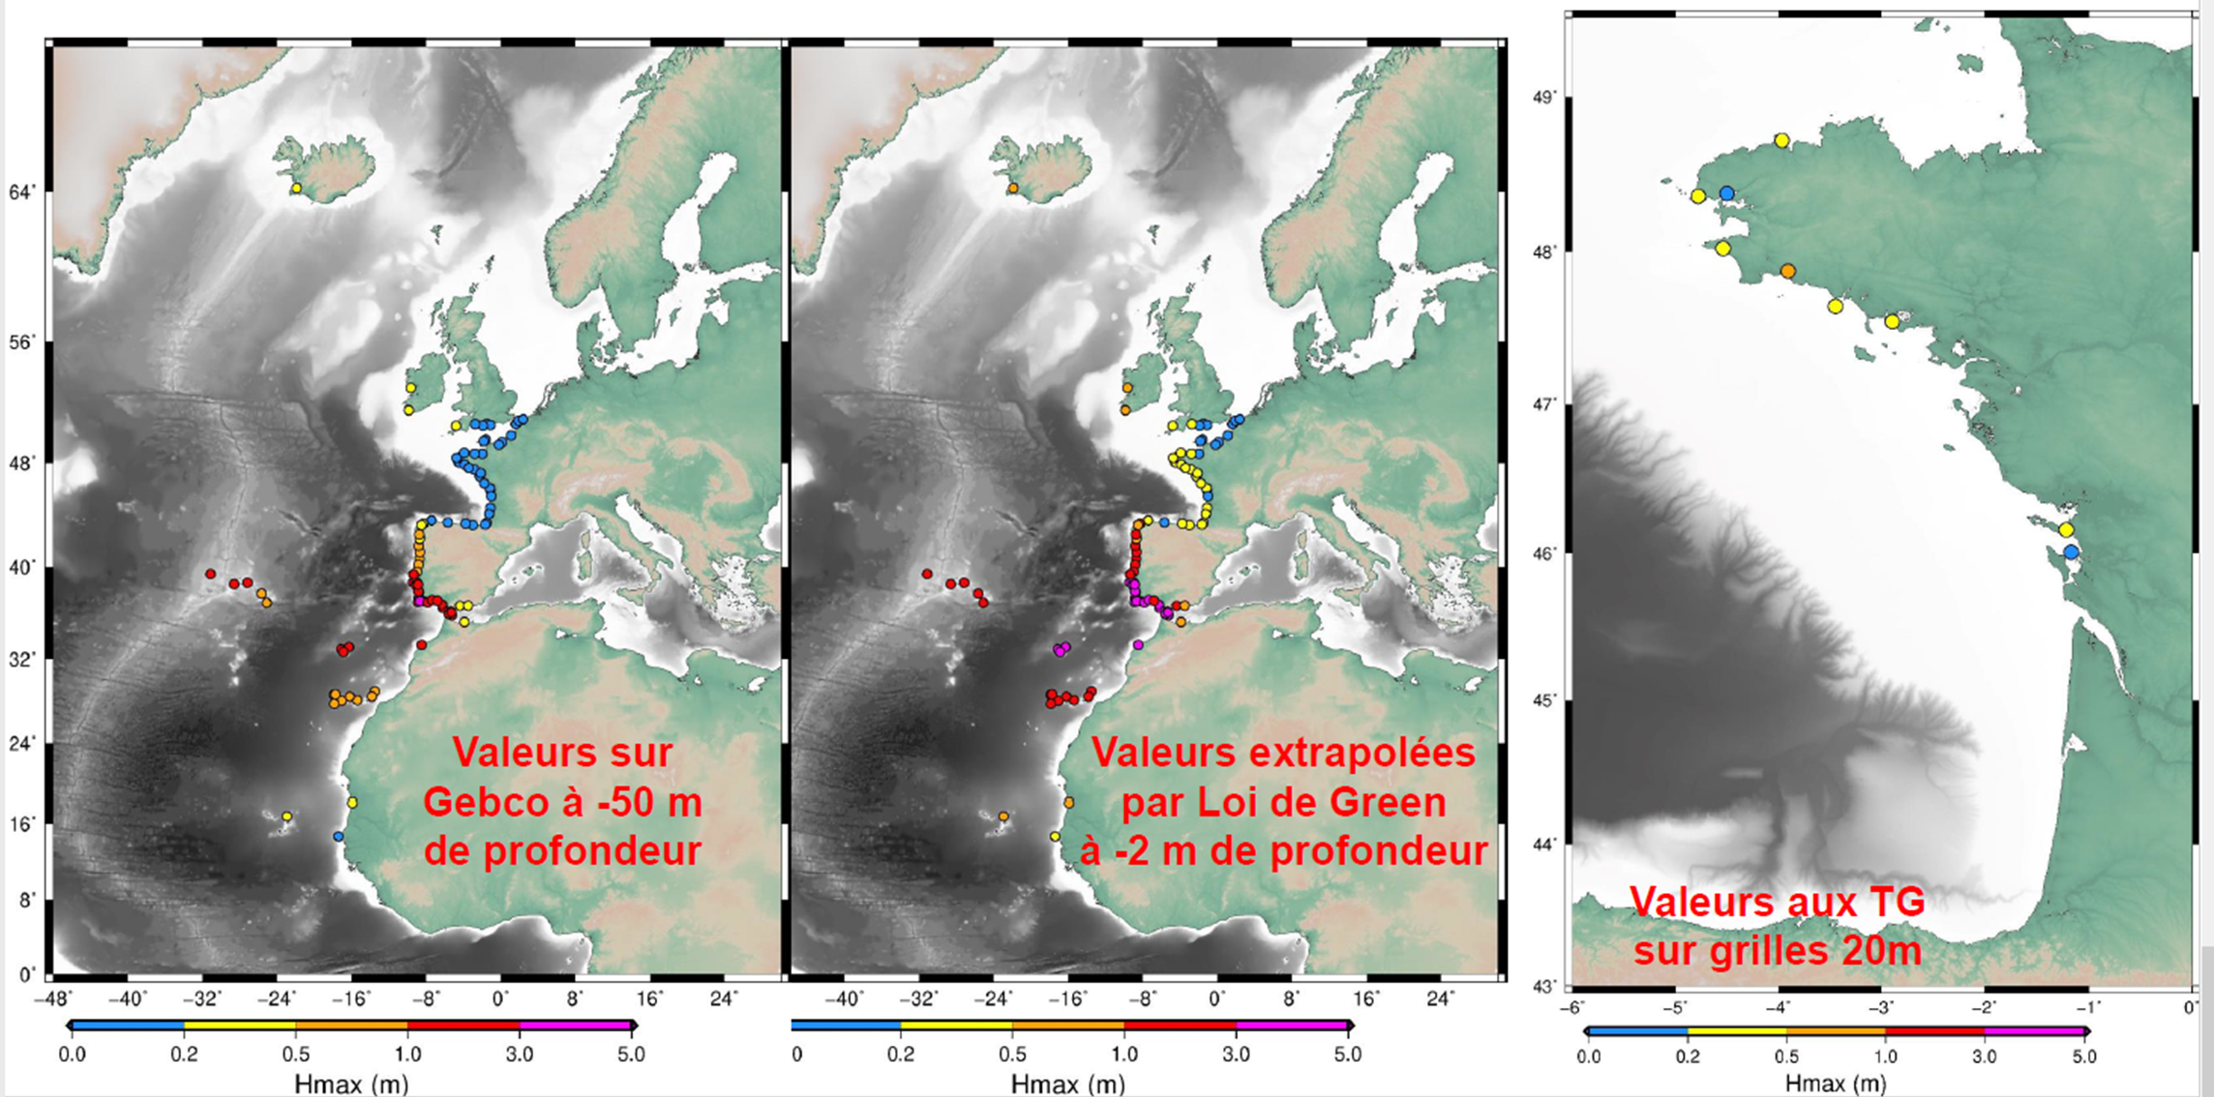
Improvements to come
Automatic transmission of maps to integrate the propagation of the tsunami wave in the national map system (SYNAPSE).
Automatic phone calls to warn subscribers as NTWC. When operationnal, this service will be proposed to international subscribers as TSP.
Calculation of wave heigth at the coast line and transmission of the information to the CPA (fine threat level).

Slide 8
Conclusion
Communication and exchanges between TSP, NTWC and CPA at national and local levels permit to integrate the CPA needs in the operationnal chain
Exercises are an important part of the warning chain to
Train all the different levels of participants from NTWC to the local authorities to be more efficient
Understand how it works to propose evolutions
Make the public more aware of the tsunami risk to improve the resilience
Implication of the CPAs is important in
Exercices
Definition of their needs → NTWC / TSP
Participation to the different meetings and actions (WG and TT in ICG, particularly WG4)

