Slide 1
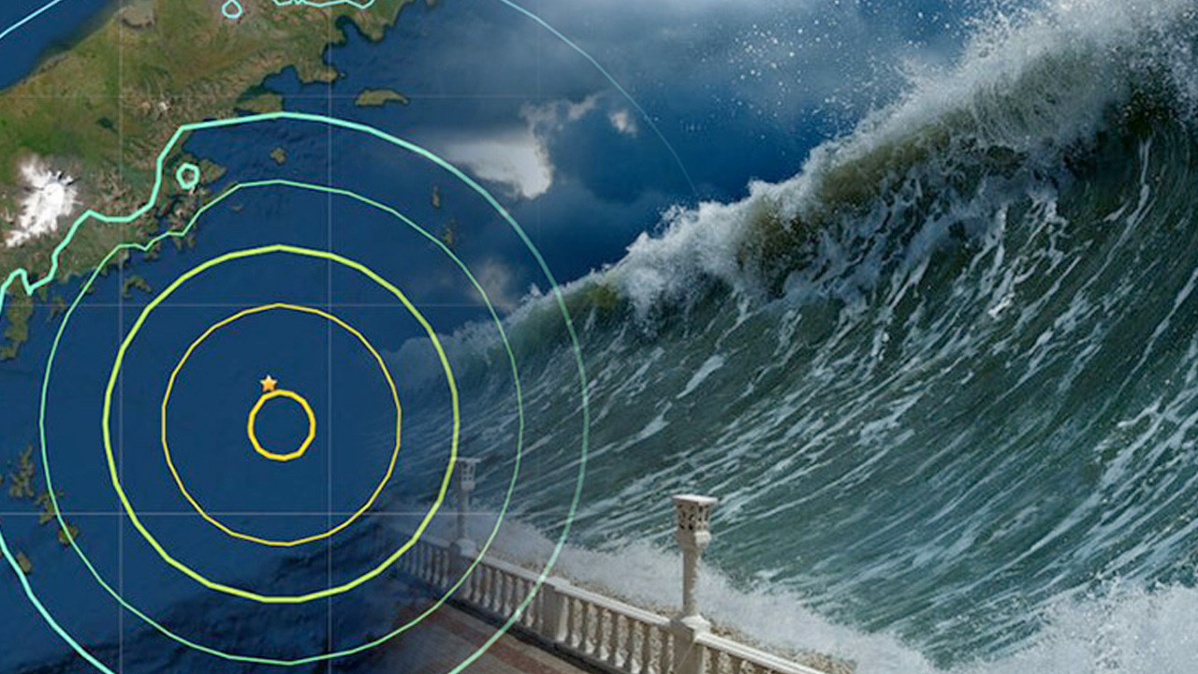






CoastWAVE 2.0 Project Standard Operating Procedure Workshop
Cascais,Portugal
2025

Slide 2
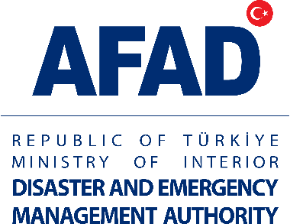



SOP (Standart Operating Procedure)
Definition:
It outlines the responsibilities and sequence of actions to be taken by each institution in specific scenarios such as disasters, tsunami warnings, or evacuations.
Goal:
Reducing uncertainty during a crisis
Preventing loss of time
Ensuring coordination between institutions
Features:
Being clear, practical, and understandable by everyone
Roles, responsibilities, and the communication chain should be clearly defined
Should be tested and updated through drills

Slide 3
LOCAL
KOERI
Tsunami Service Provider (TSP)
KOERI
National Tsunami Warning
Center
(NTWC)
PUBLIC
Vulnerable Community
Metropolitan Municipality,
District Municipality,
Distirict Governorship
SOP
SOP
SOP
Provincial Directorate of AFAD
(LDMO)
SOP
Gendarmerie,
Coast Guard
AFAD
National Disaster Management Organization
(NDMO)
SOP
SOP
Other Stakeholders:
SHOD, EGM, STK, vb.
National and Local
Radio/ TV/ Two way radio
NATIONAL
Information
Warning
Warning and Advice
Official Call for Evacuation
Feed Back

Slide 4
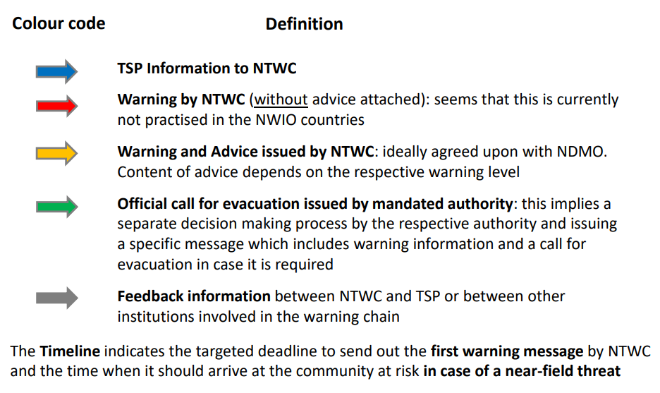
Colour Codes and Definitions

Slide 5
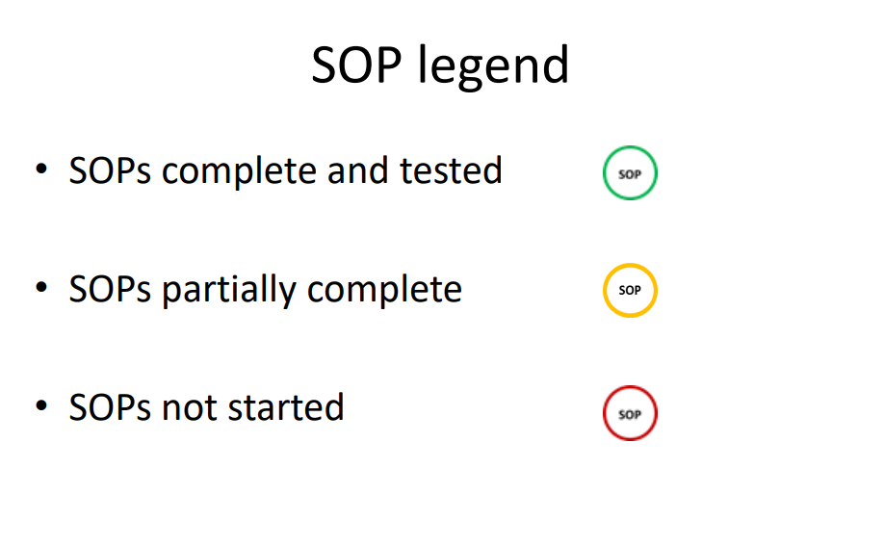
SOP Legend

Slide 6
Tsunami Risk Management– Basic Abbreviations and Their Definitions
Abbreviation | Full Form | Role / Description
TSP | Tsunami Service Provider | An officially designated center responsible for providing data, analysis, and warning messages to countries. In Türkiye, KOERI functions as the Tsunami Service Provider (TSP) within the NEAMTWS system.
NTWC | National Tsunami Warning Centre | An official authority at the national level that assesses tsunami hazards, generates official warnings, and distributes them to relevant stakeholders.
TWFP | Tsunami Warning Focal Point | The official institution or authority responsible for receiving and transmitting tsunami warnings in the country. Operates 24/7 to receive alerts and relay them to the national emergency mechanism.

Slide 7
Why is this information flow important?
•The Tsunami Service Provider (TSP) performs early technical evaluations of undersea earthquakes and the potential tsunami waves they may generate.
• The National Tsunami Warning Center (NTWC) uses this information to issue tailored warnings for its own country, including coastal evacuation advisories and alert level declarations.
How does the information flow work?
1. An earthquake occurs.
2. KOERI analyzes whether the earthquake has triggered a tsunami and issues a warning message.
3. AFAD receives this message and conducts its own assessment. 4. If necessary, local warnings and evacuations are initiated by AFAD and the relevant provincial authorities.

Slide 8
AFAD – Tsunami SOP
Purpose: To ensure an effective, rapid, and coordinated response process against the threat of a tsunami.
Scope: This procedure covers the receipt, evaluation, and transmission of tsunami warnings issued by Boğaziçi University Kandilli Observatory and Earthquake Research Institute (KOERI), as well as the processes of informing the relevant stakeholders and the public.
Responsibilities:
AFAD National Disaster Management Center (NDMO): Receives and evaluates warnings, forwards them to relevant institutions, and informs the public.
Provincial AFAD Directorates (LDMO): Conduct evacuation, alert, and guidance activities at the local level.
KOERI: As the Tsunami Service Provider (TSP), technically generates the tsunami warning.
Local authorities: implement local evacuation and alerts procedures
Radio/TV Organizations/social media: Ensure the warnings are communicated to the public.

Slide 9
AFAD – Tsunami SOP
Procedure Steps:
KOERI detects the tsunami threat and informs AFAD.
AFAD evaluates the received data and determines the threat level.
If a threat exists, official warnings are issued to the relevant Provincial AFAD Directorates and public institutions.
Warning messages are broadcast to the public via national TV, radio, and other mass communication channels.
Provincial AFAD and local authorities activate evacuation and emergency plans.
Developments are monitored regularly, and updates are provided.
When the danger has passed, a “danger is over” notification is issued.

Slide 10
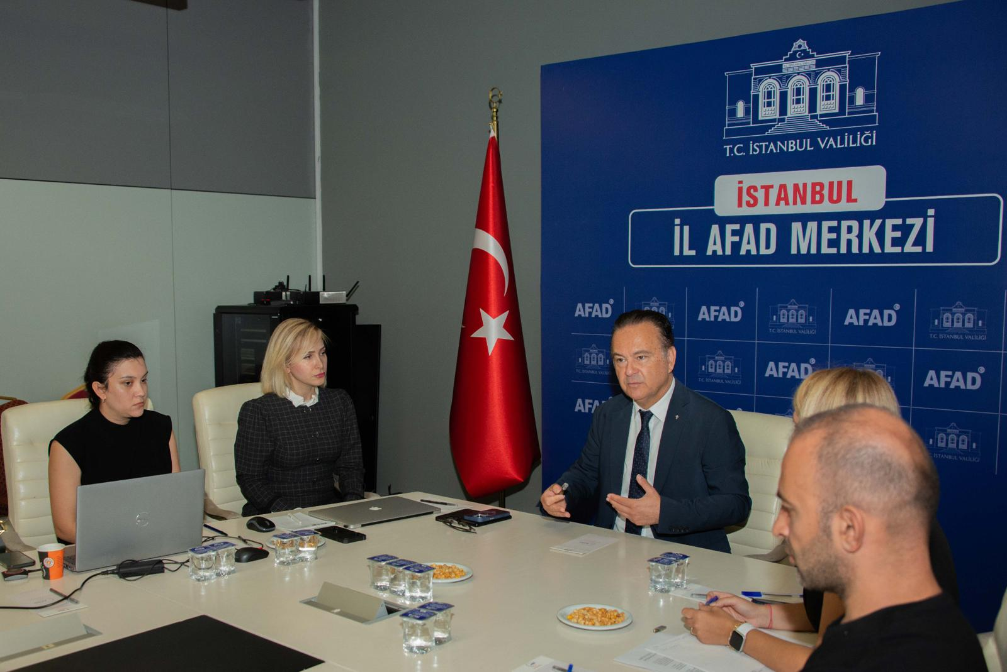
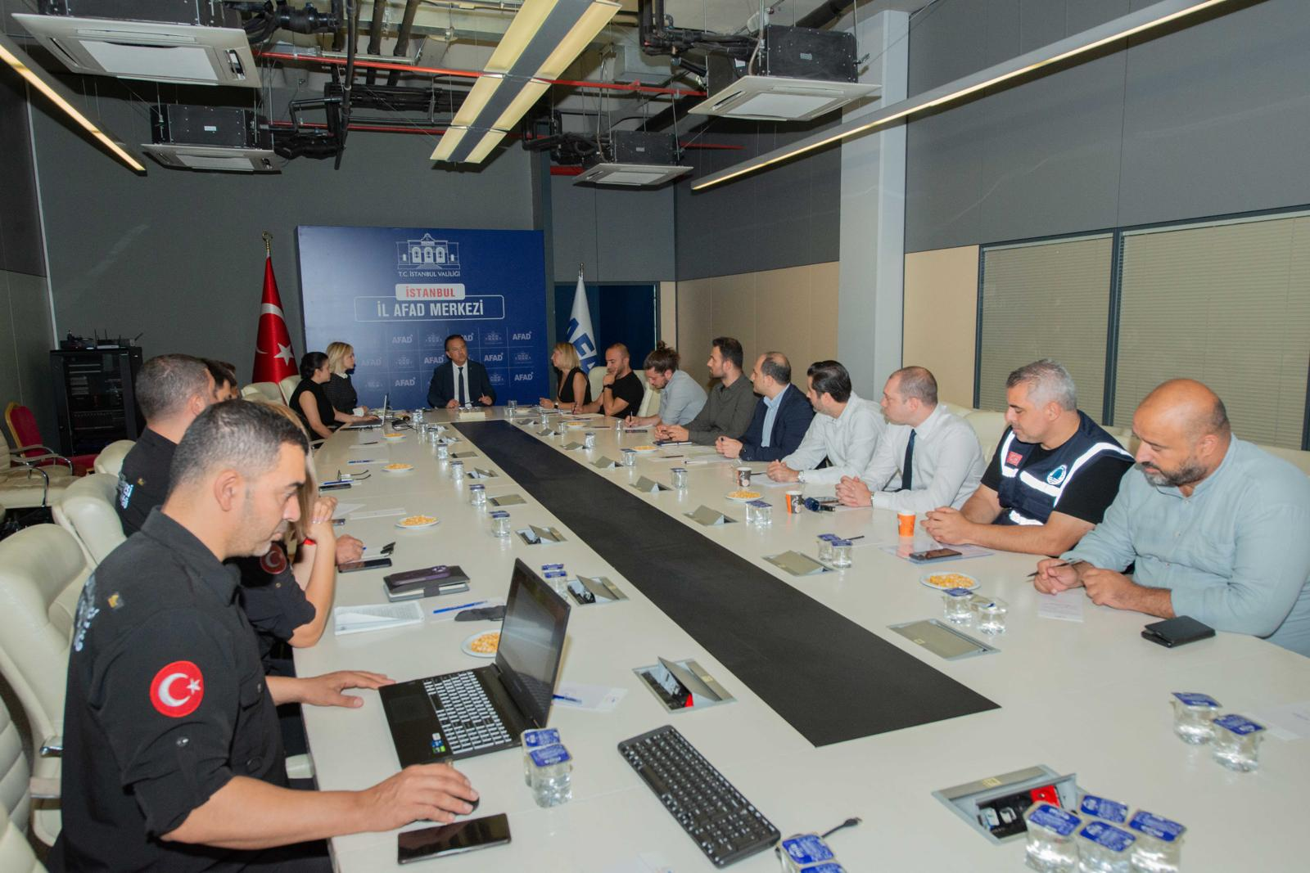
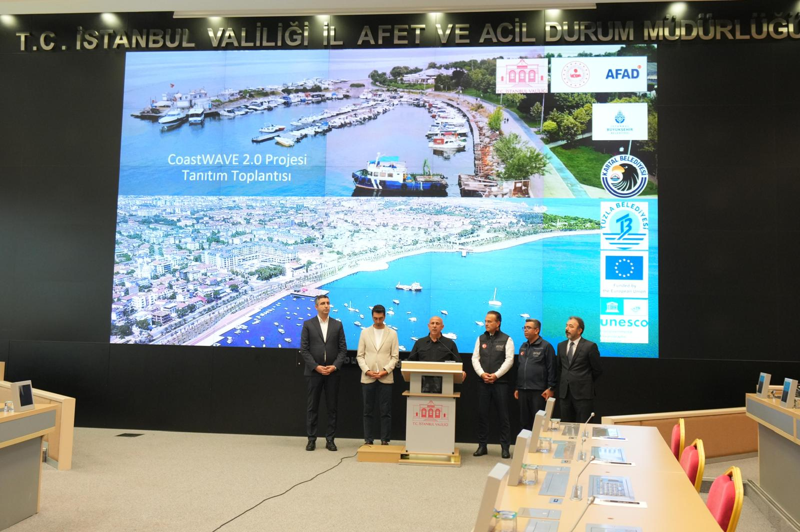
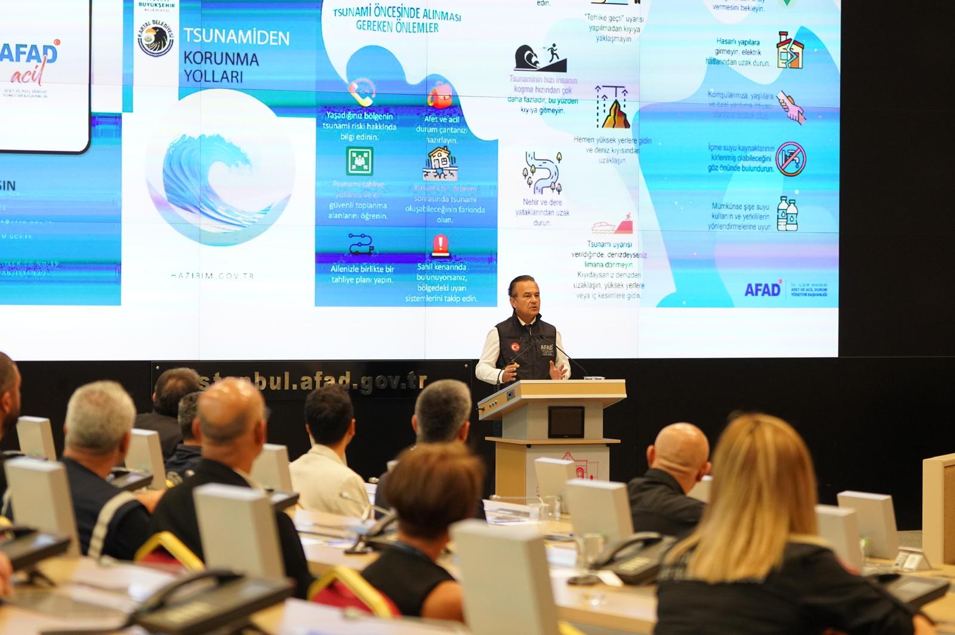
AFAD – CoastWAVE 2.0 Project SOP Workshop and Launch Event
On August 21, 2025, the SOP Workshop took place at AFAD’s Hasdal Campus in Istanbul. After the SOP Workshop, the CoastWAVE 2.0 Project was officially launched.

Slide 11

Thank You For Your Attention!

