Slide 1


Observations methods for salinity and freshwater transport in the Atlantic Ocean
Marlos Goes
Ivenis Pita, Shenfu Dong, Denis Volkov
NOAA AOML and U. Miami CIMAS
IQUOD/GTSPP/SOOP/XBT meeting
November 14, 2024, Bologna, Italy 2024

Slide 2
Outline
Updates on salinity estimates for XBT
South Atlantic and Florida Current.
Florida Current synthetic methodology.
AXMOC: Freshwater budget for the South Atlantic between 22°S and 35°S.
Optimal mapping (OM) comparison with SAMBA array, synthetic method, and Neural Network (NN) method.

Slide 3
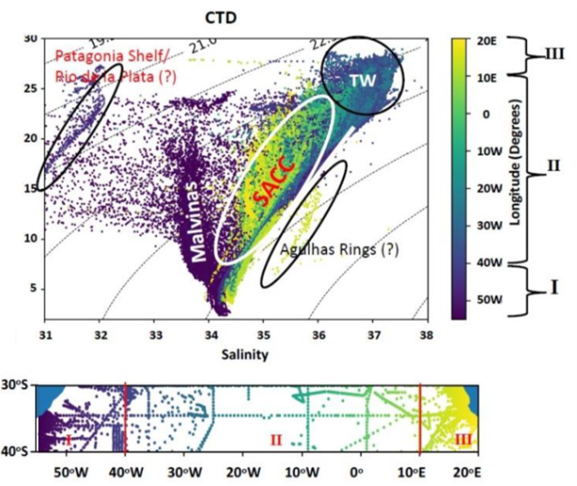
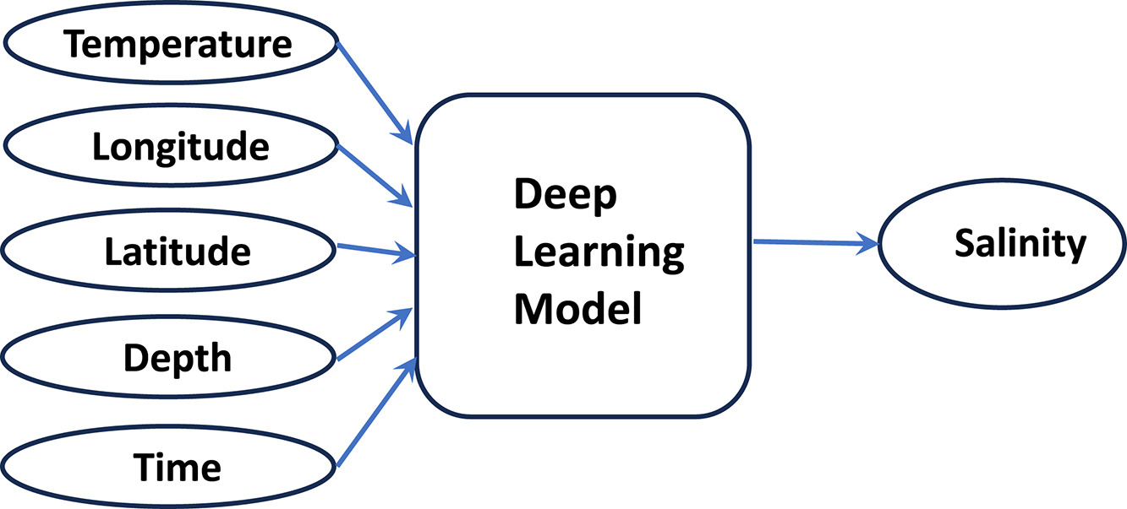
Statistical Method 1: Deep Learning
Deep learning method trained with 3000 CTD salinity profiles in the South Atlantic
Campos et al., 2024

Slide 4
Sensitivity to predictors

Slide 5
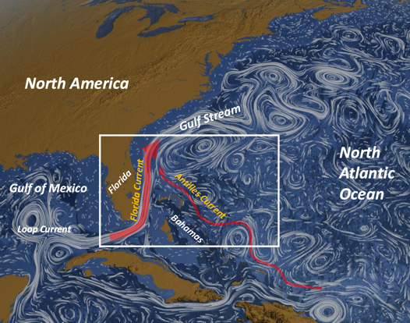
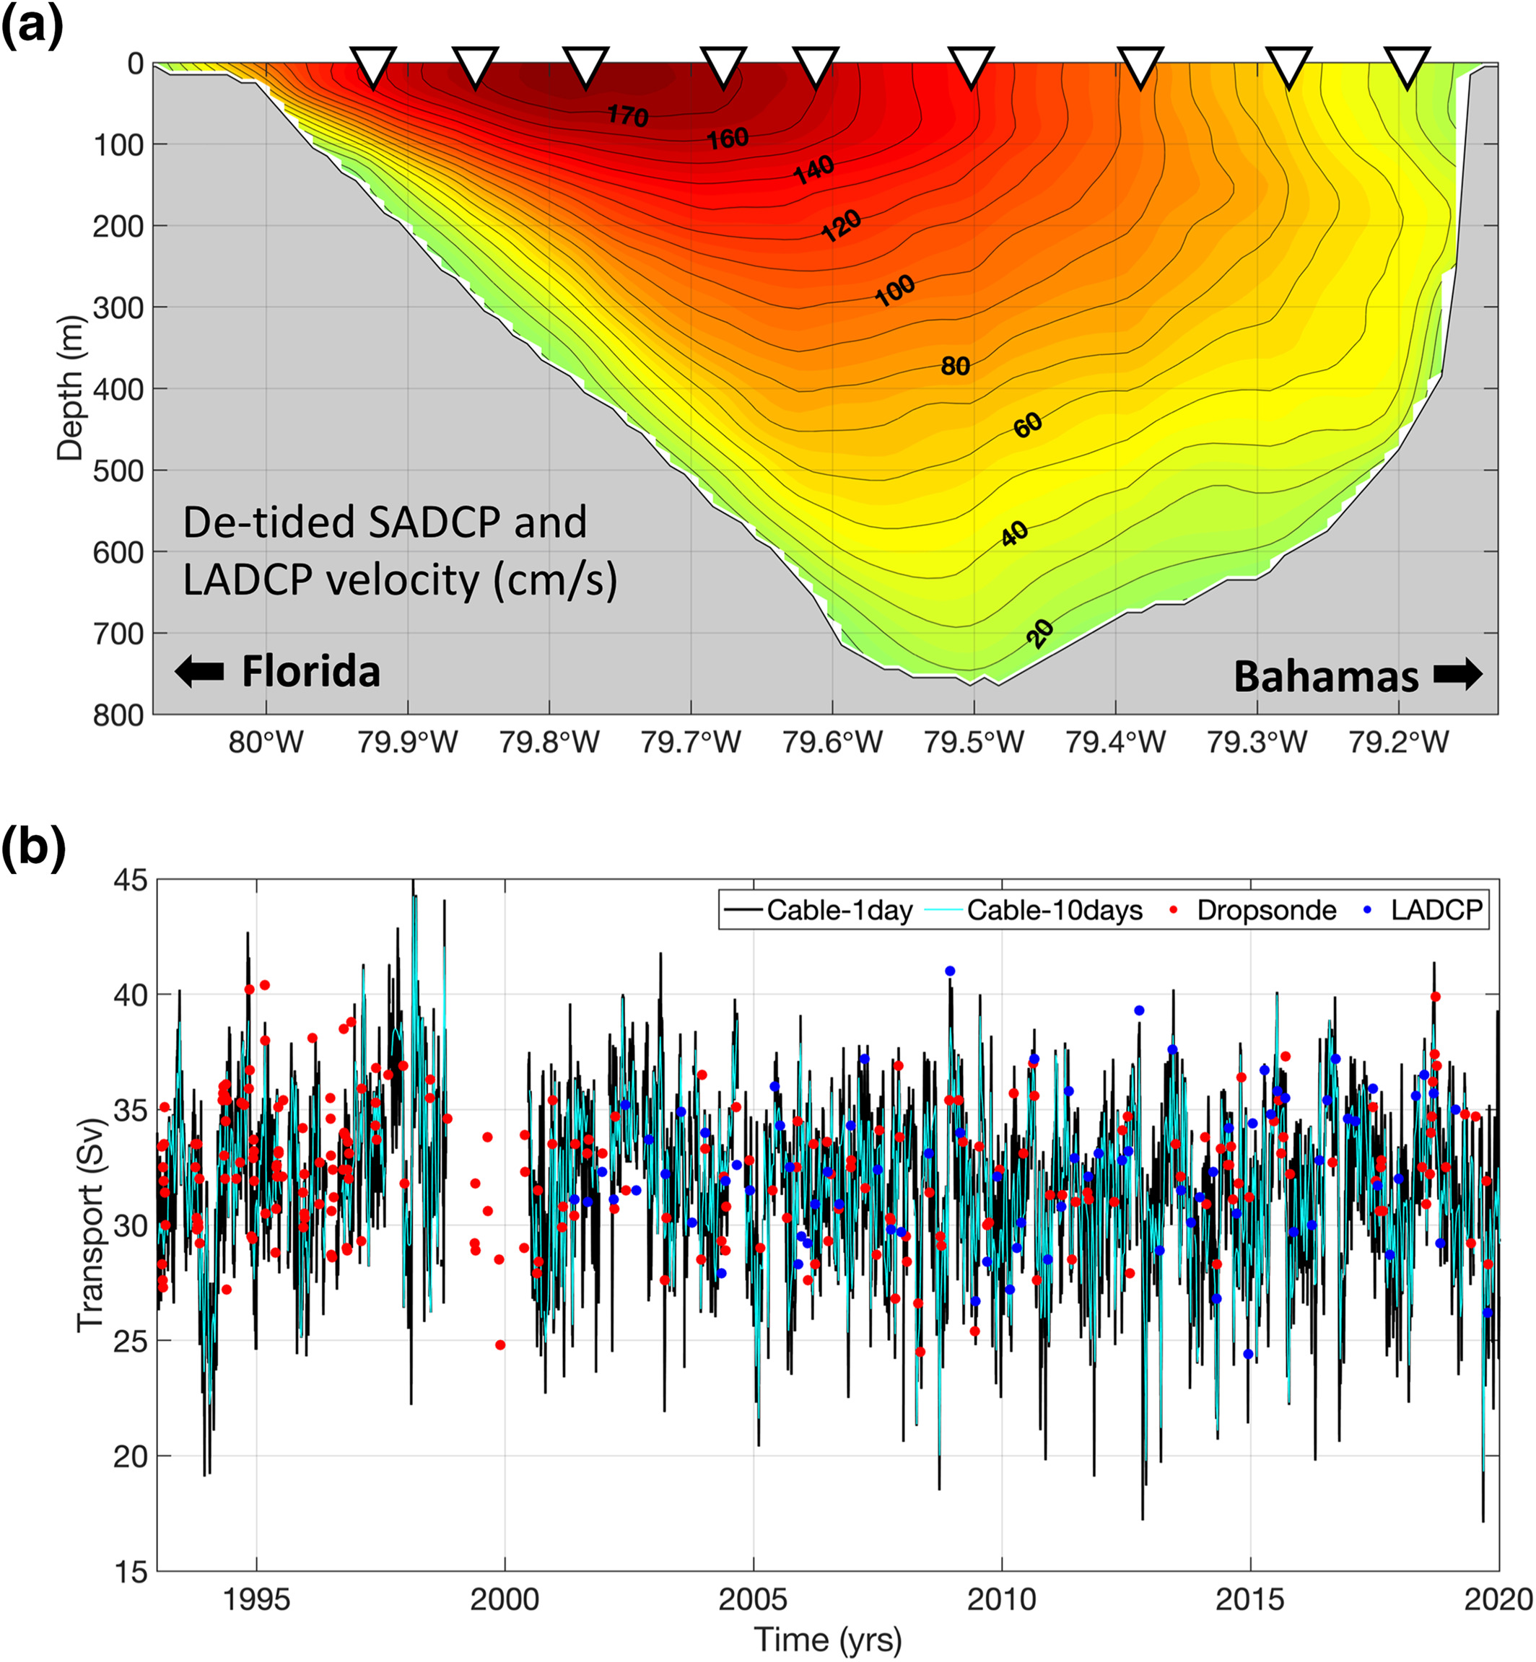
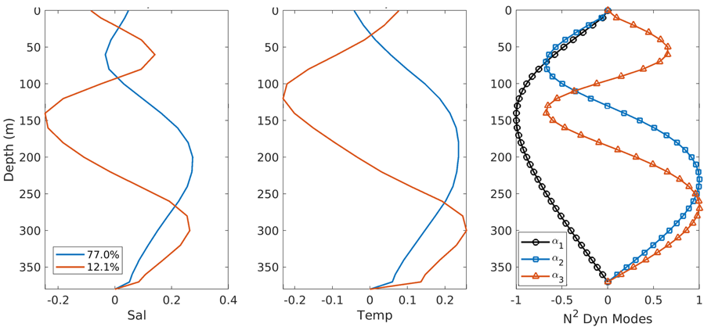
Statistical Method 2: Singular Value Decomposition
Florida Current
Use to estimate the relationship between T and S, and use it to predict S.
Maintains the vertical structure of the profiles.

Slide 6
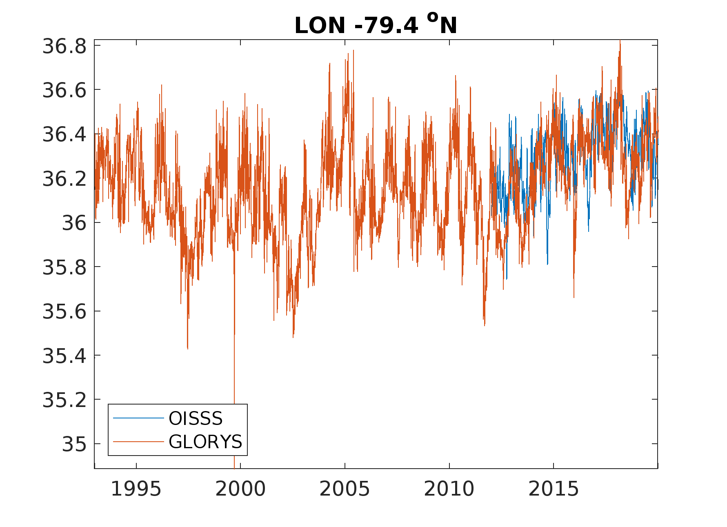
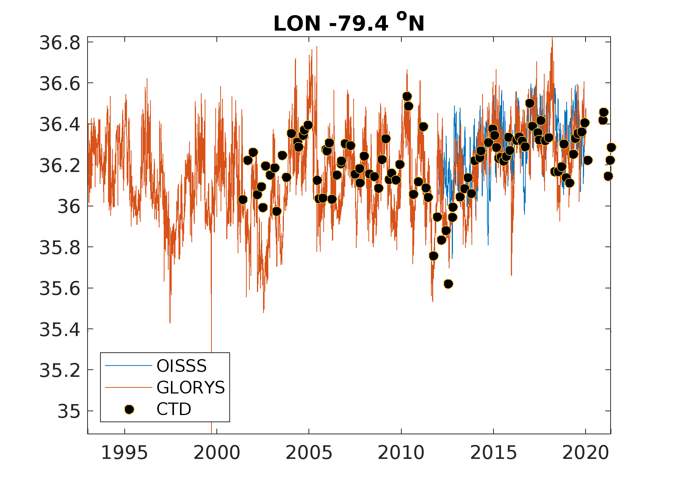
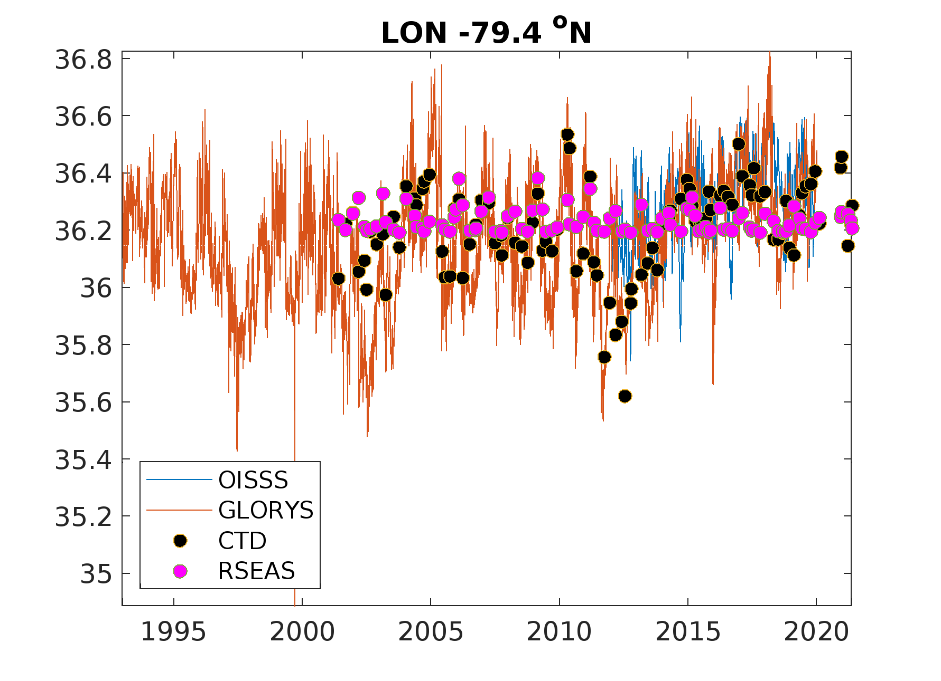
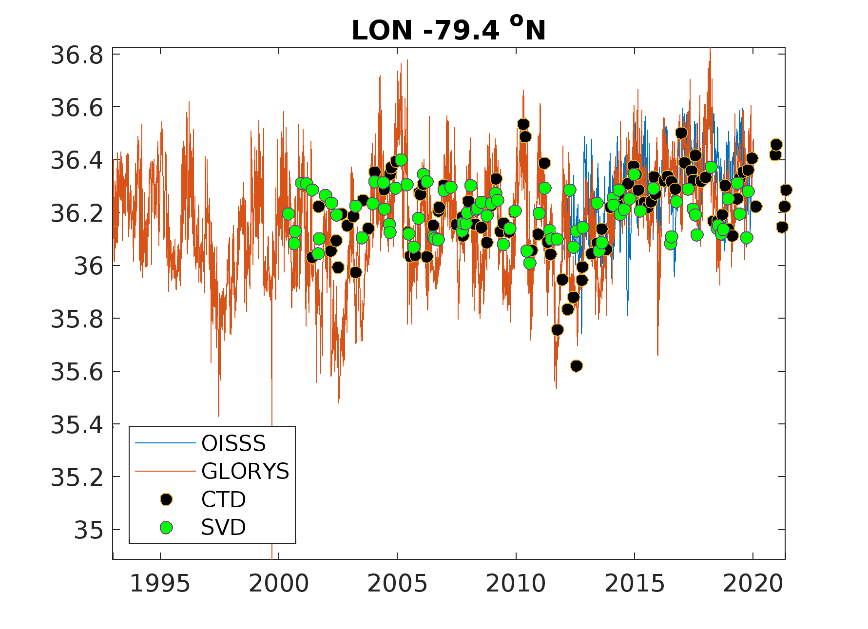
Sea surface salinity comparison

Slide 7
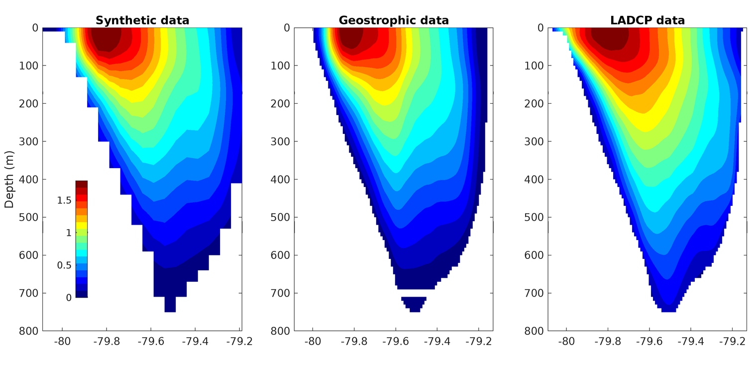
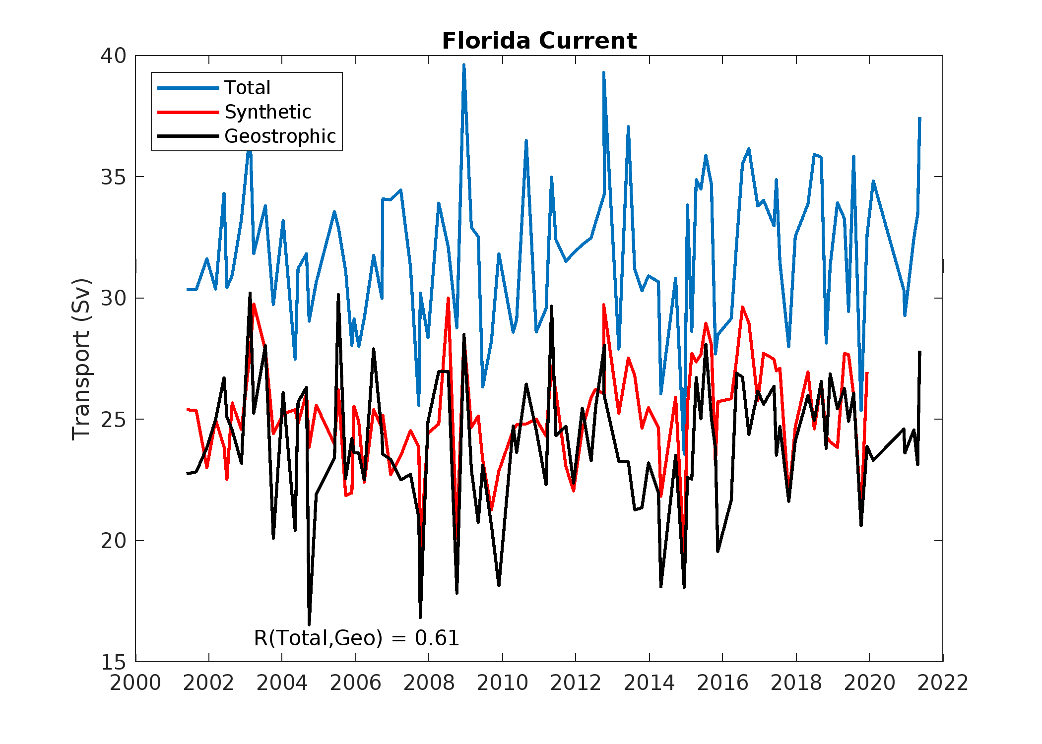
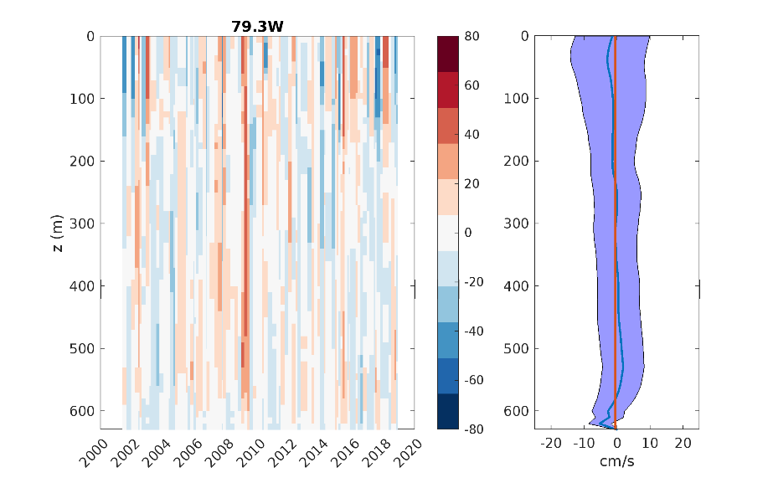
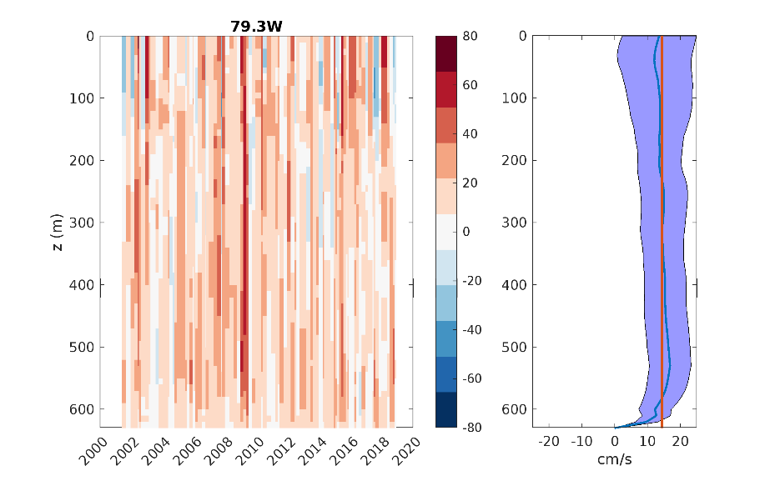
Florida Current velocity reconstruction
a.
b.
Good agreement between synthetic and CTD/XBT geostrophic velocity.
ADCP data are stronger than geostrophic data, producing a 6 Sv stronger transport.
Surface variables (SSH,SST,SSS,wind) are used to predict the FC modes over time.
c.

Slide 8
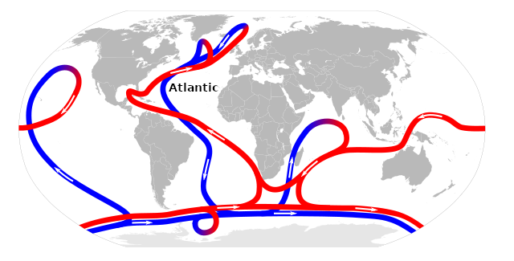
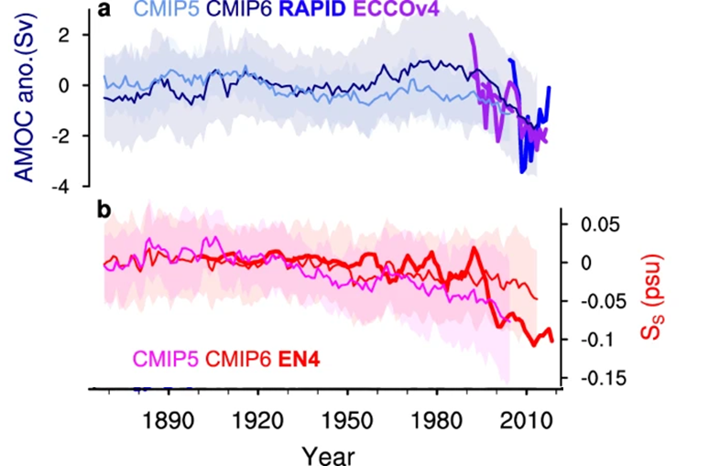
AMOC monitoring and fingerprints
BAMS, 2024
Zhu et al., 2023

Slide 9
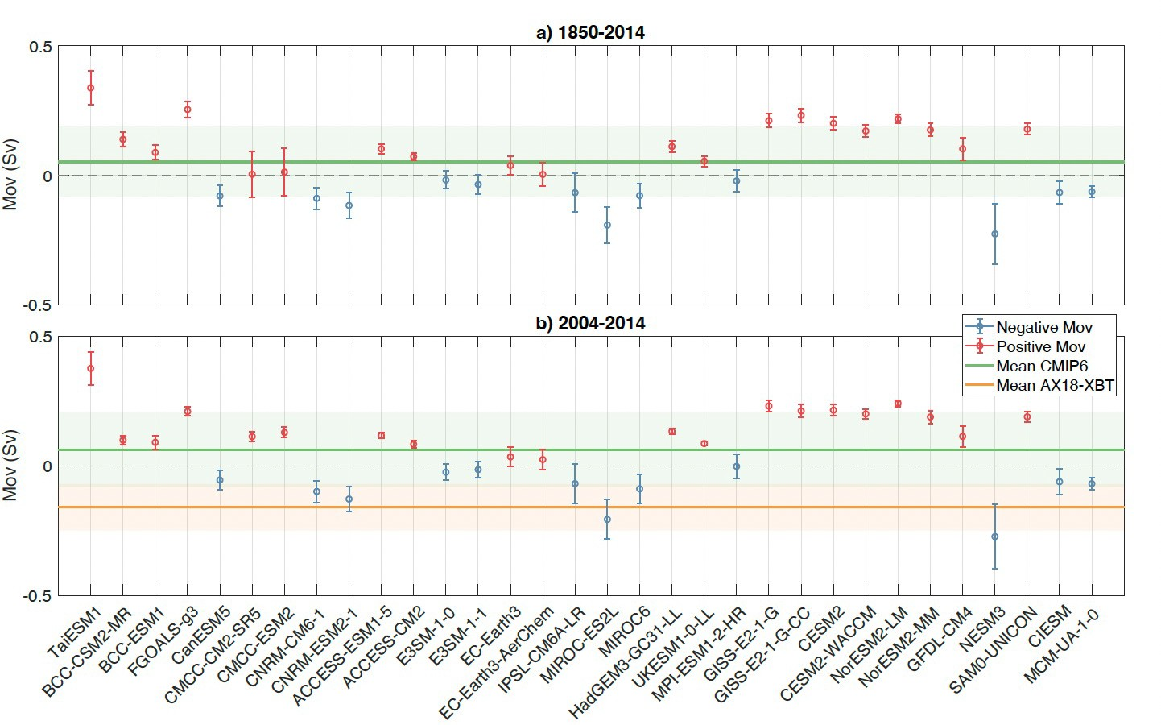
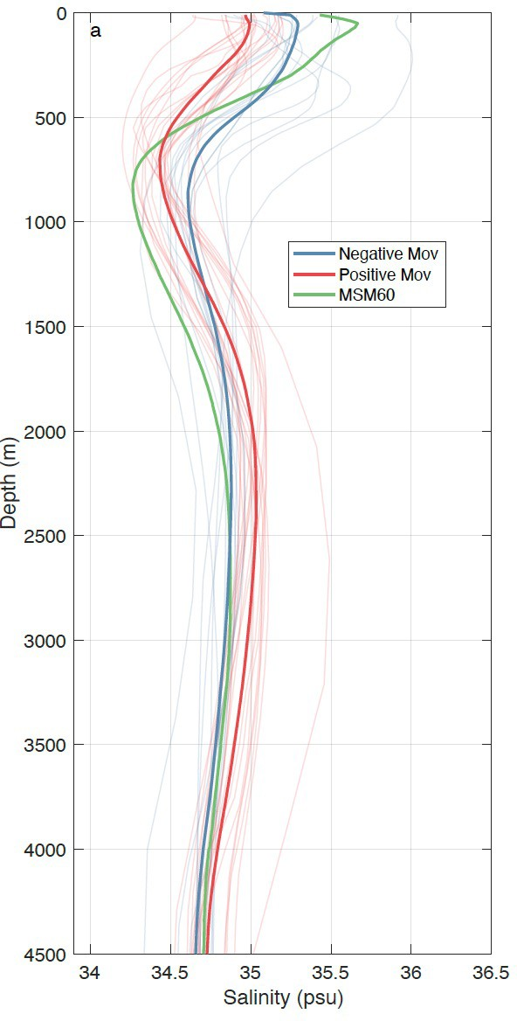
Evaluation of numerical models
Only 12 out of 32 CMIP6 models have a negative mean of M_{ov}
Salinity profiles present a clear separation of the models that have positive or negative M_{ov} mean
Arumí-Planas et al. (2024)

Slide 10
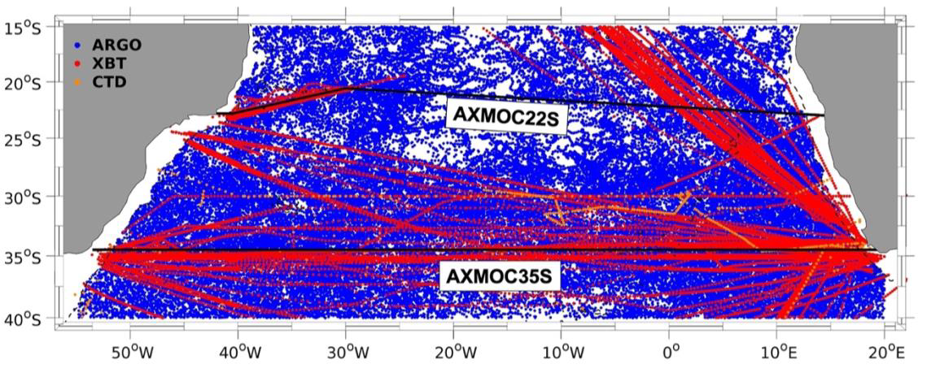
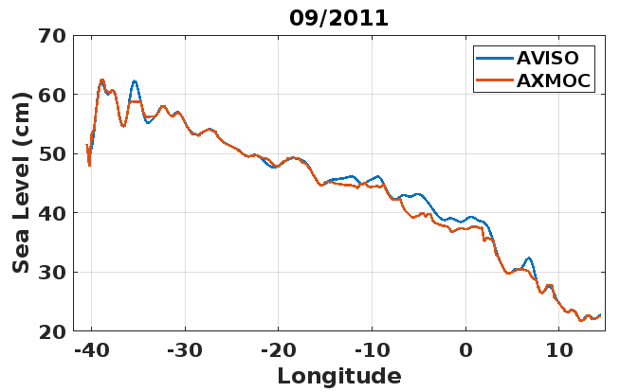
Analysis of heat and freshwater transports in the subtropical South Atlantic
AXMOC: Argo - XBT Meridional Overturning Circulation section
Use of T/S data from Argo, XBT/S and CTD.
Approximately 90,000 profiles.
Data range: 2005 – 2023/15° - 40°S.
AXMOC22: Jan/2007 – May/2023
AXMOC35: Jan/2005 – May/2023
Optimal mapping methodology: Minimizes RMSE of detrended (ADH,SSH)

Slide 11
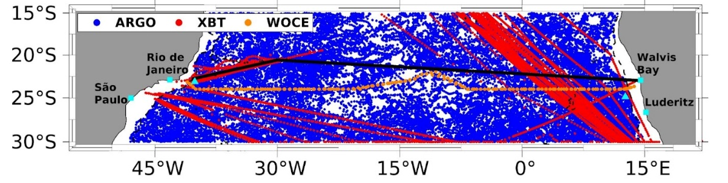
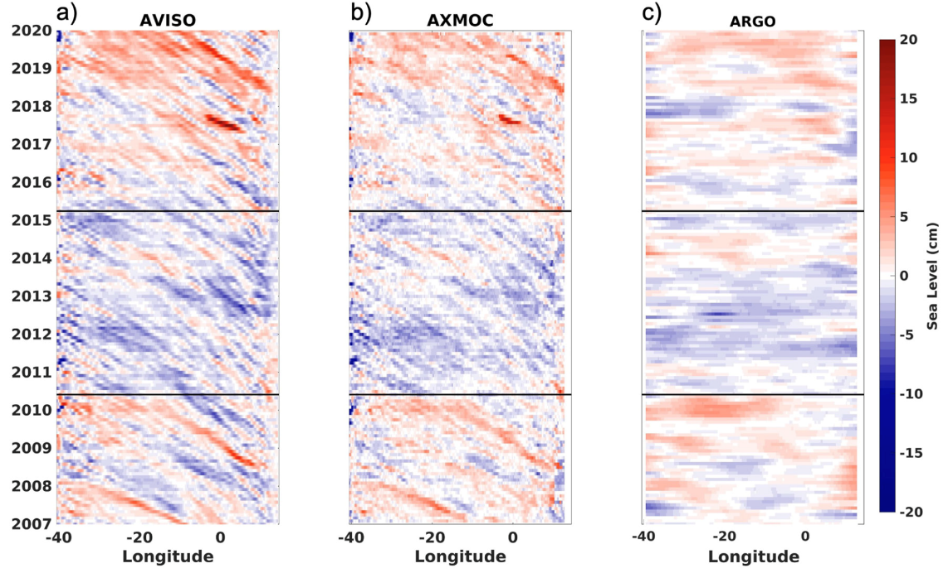
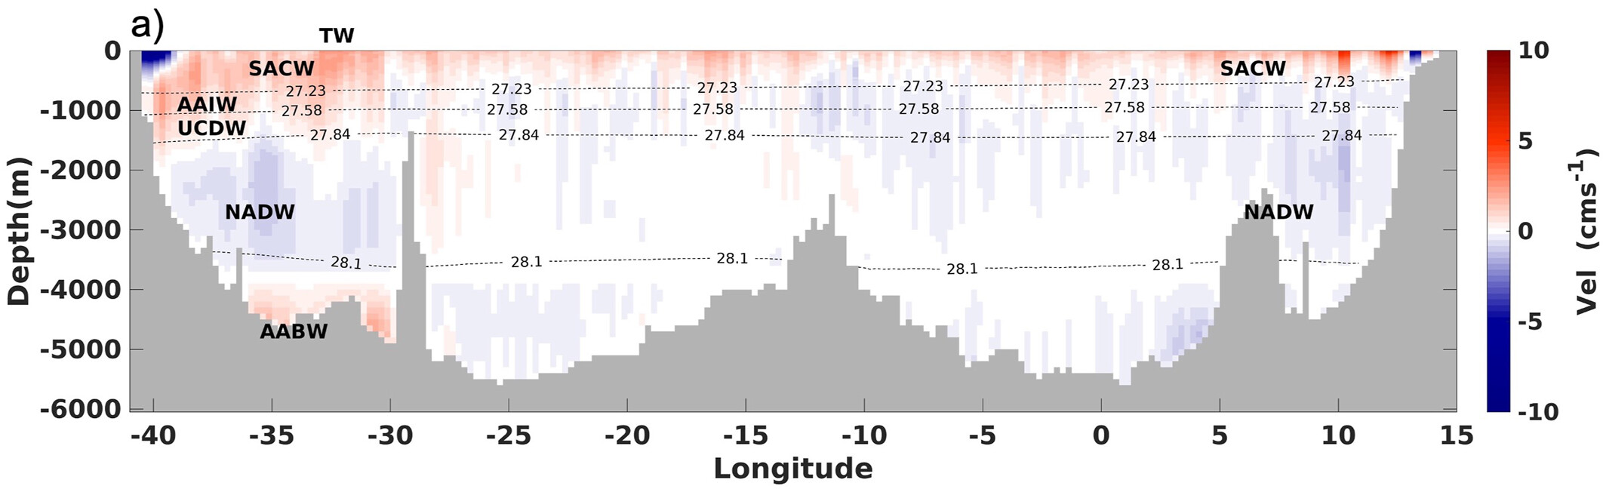
AXMOC22
Westward propagating signals from the east – Rossby waves.
Improvement against other gridded products.
Lower sea level between 2010-2015.
Resolves boundary currents, and top-to-bottom currents agree with literature.
5.9 ± 1.6 km/day
Pita et al., 2024

Slide 12
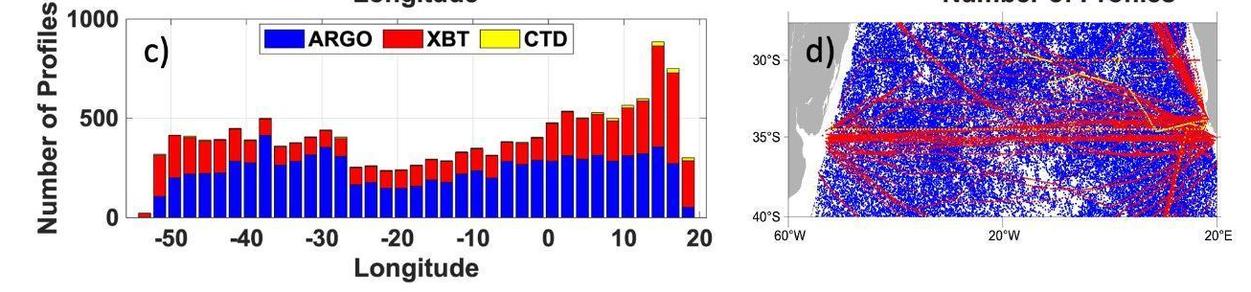
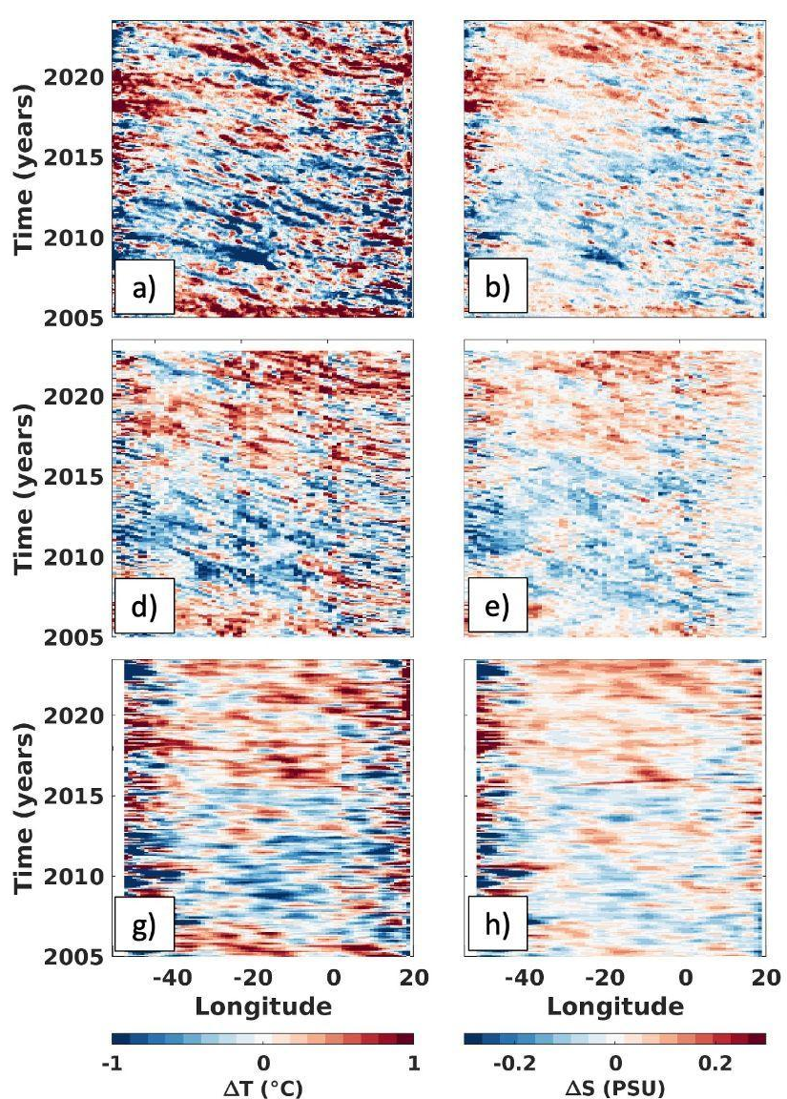
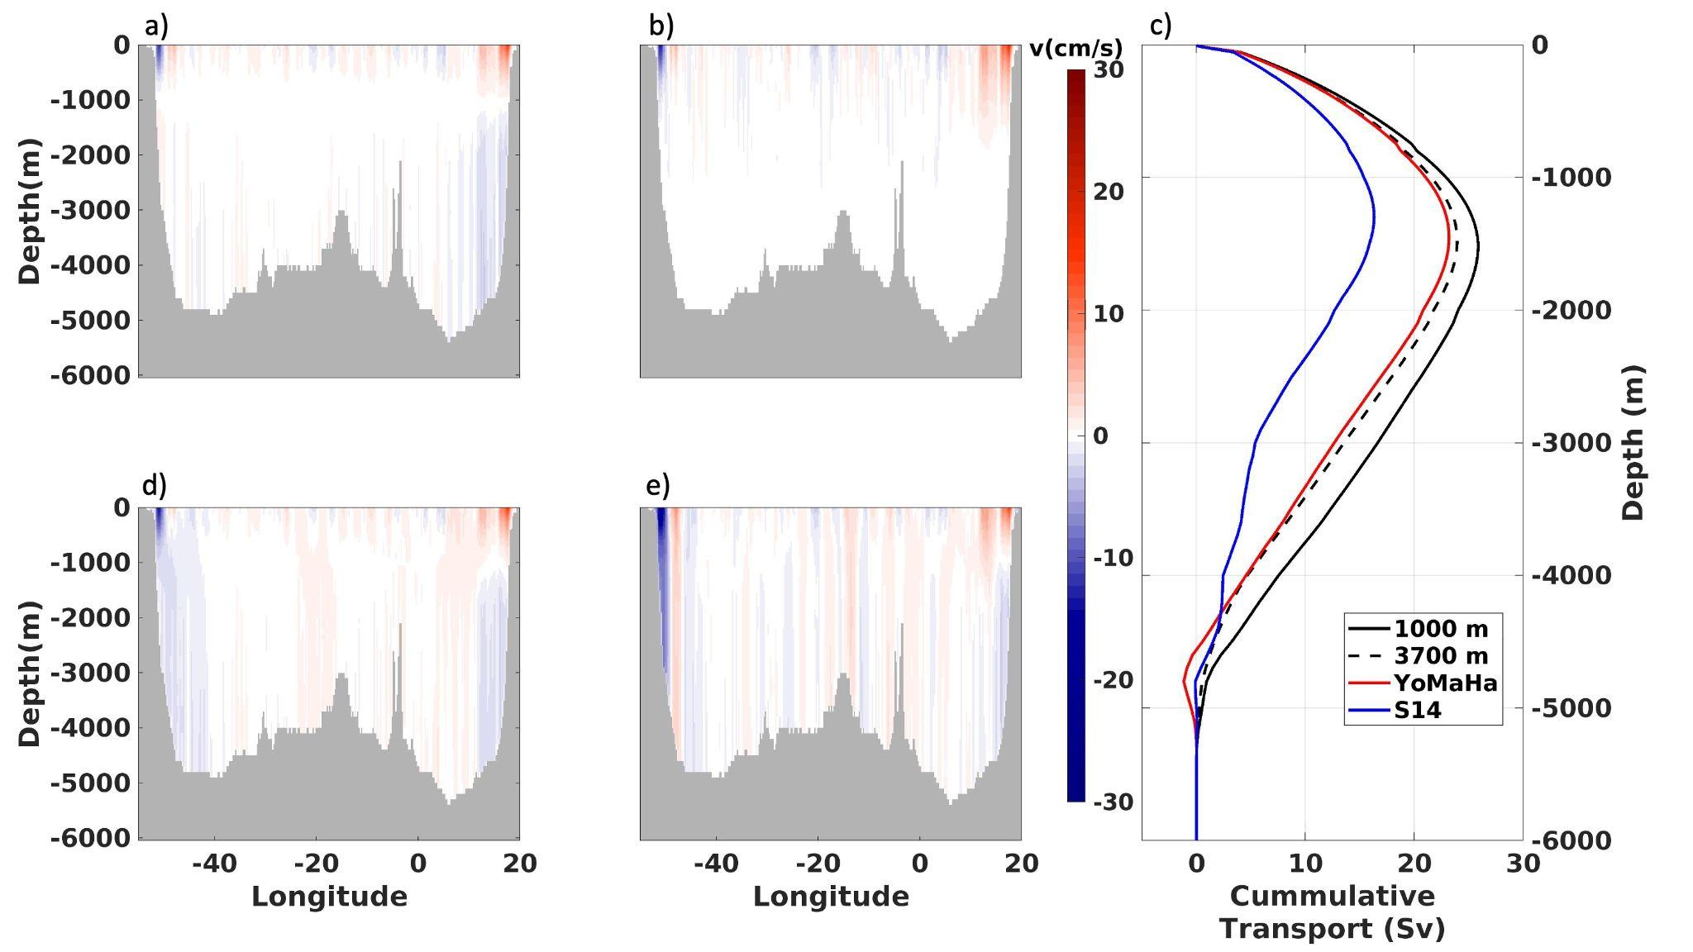
AXMOC35
Westward propagating signals from the east – Rossby waves.
Improvement against other gridded products.
Lower sea level between 2010-2015.
Sensitivity to deep reference velocity for AMOC calculation.
T300
S300
AXMOC
ORAS5
EN4
Pita et al., in review

Slide 13
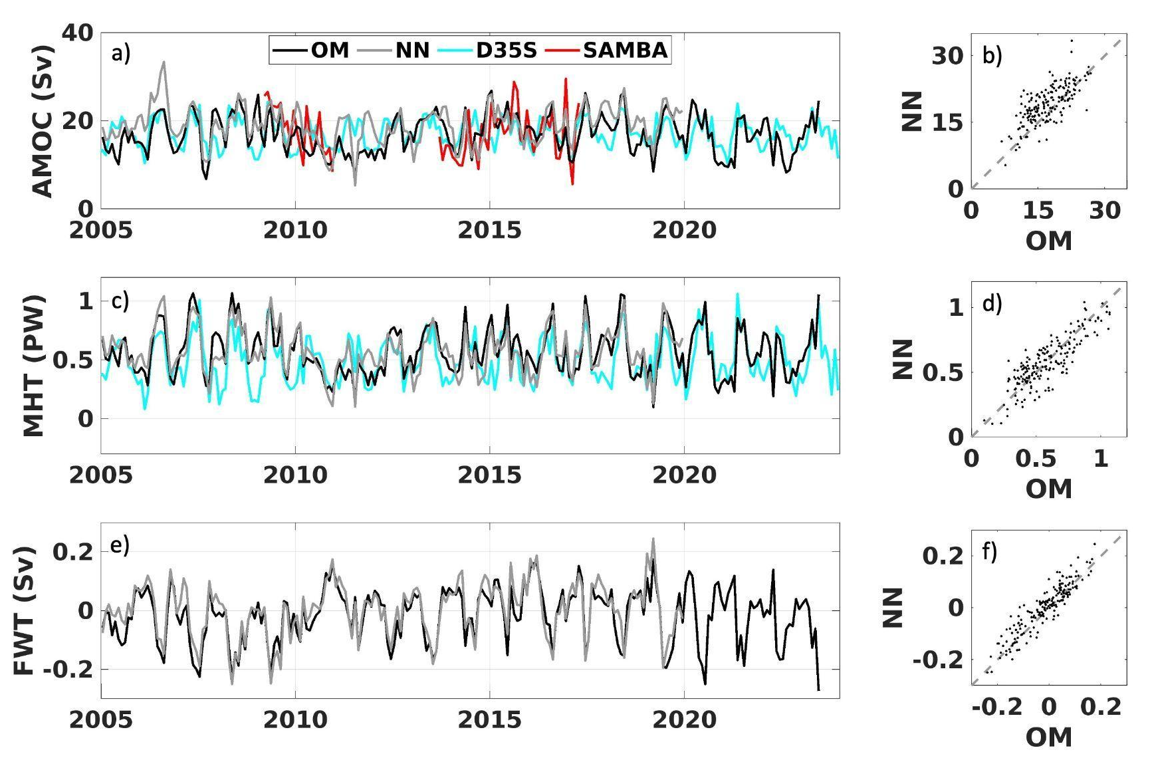
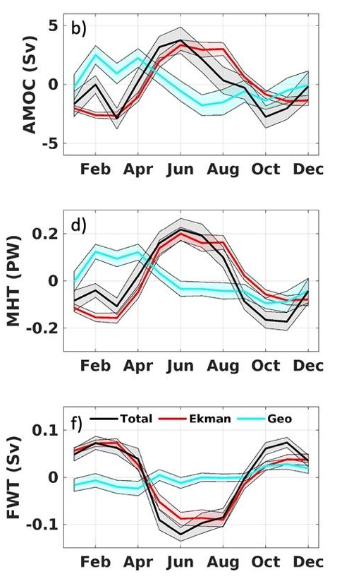
Transports and comparison with other methods and datasets
35°S
OM
OM: Optimal mapping
NN: Neural network
SAMBA: mooring array at 35°S
D35S: synthetic method
AXMOC | SAMBA | D35°S
17.0 ± 4.0 | 17.3 ± 5.4 | 17.0 ± 3.1
R | 0.41 | 0.45
Pita et al. (in review)

Slide 14
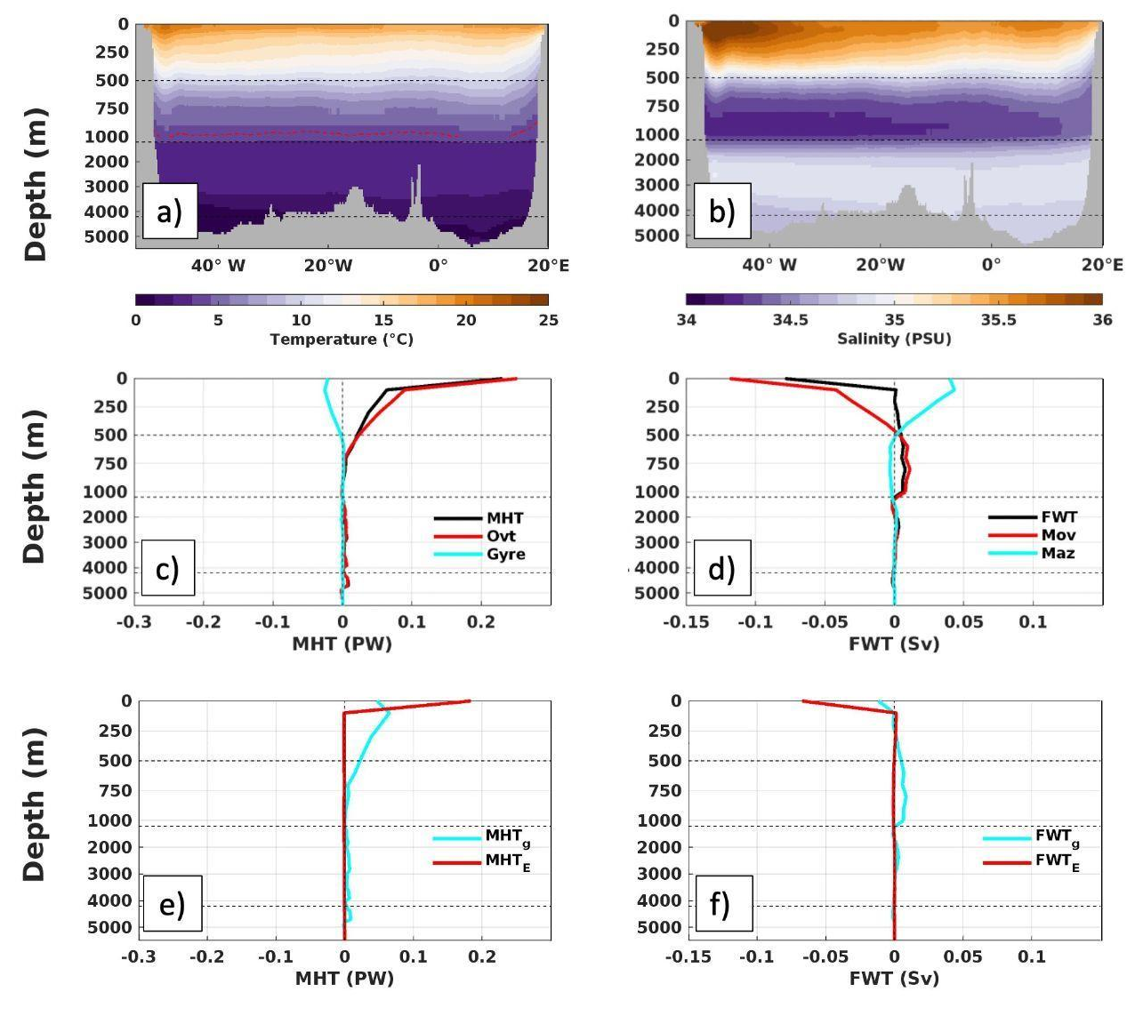
Vertical structure of heat and freshwater transport at 35°S
Freshwater transport
FWT = Mov + Maz = FWT_{g} + FWT_{E}
Meridional Heat transport
MHT = Hovt + Hgyre = MHT_{g} + MHT_{E}

Slide 15
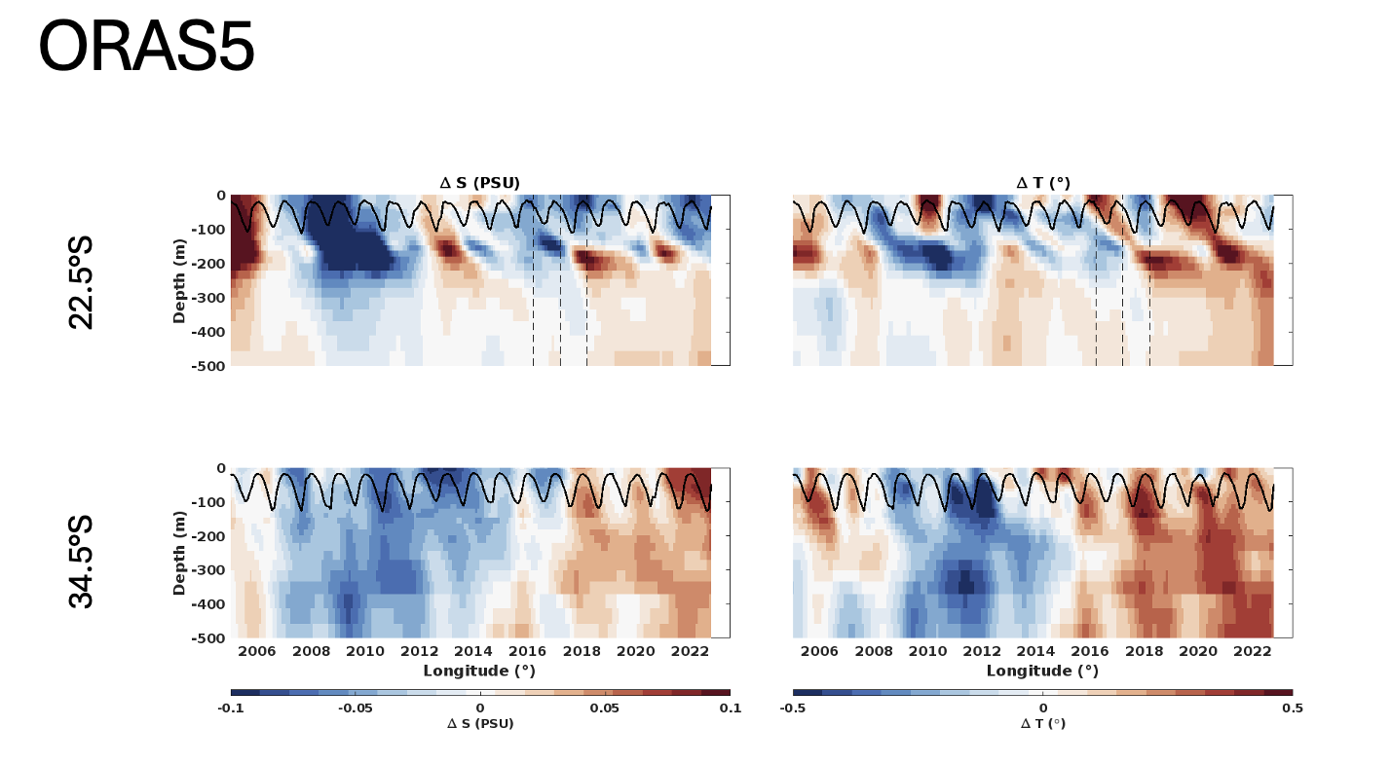
Evolution of mean T/S along section

Slide 16
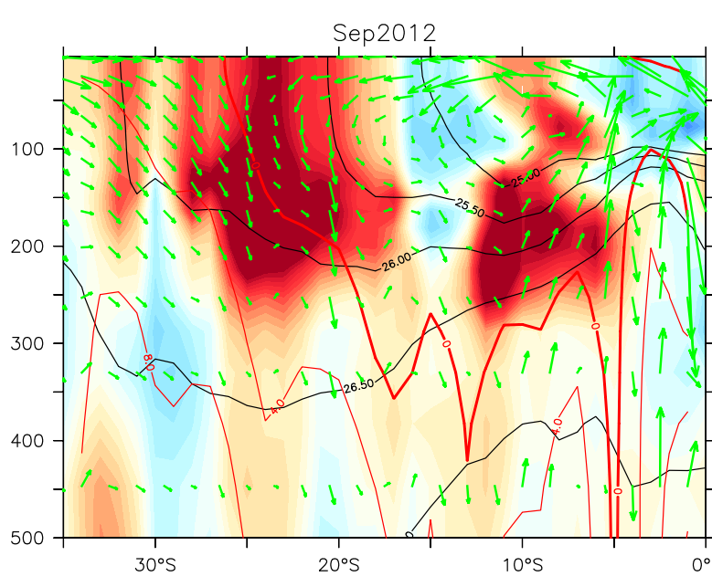
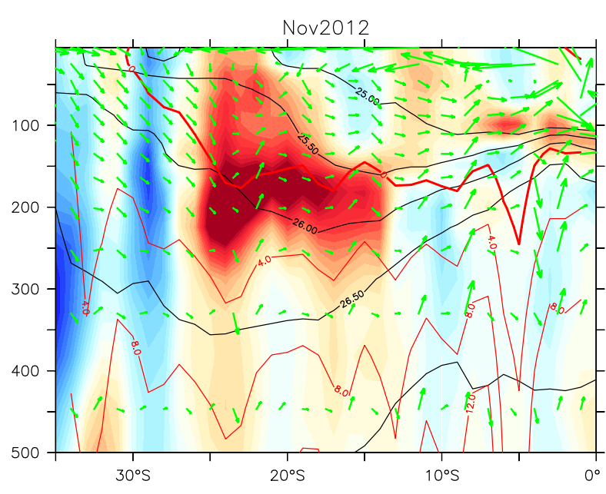
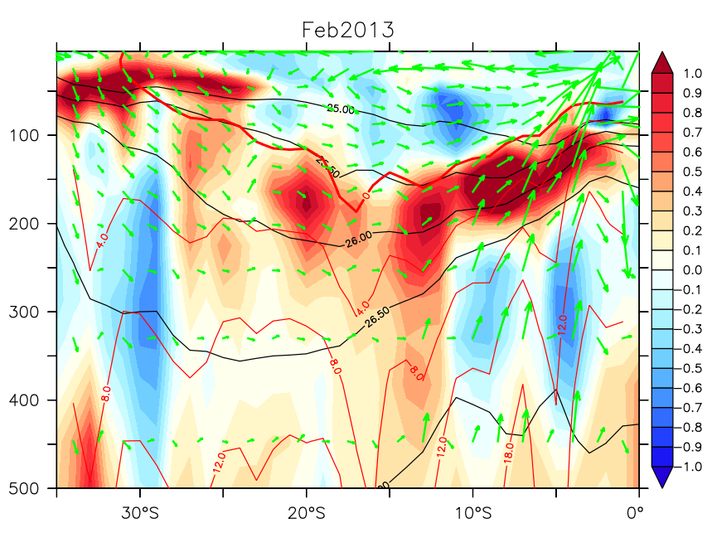
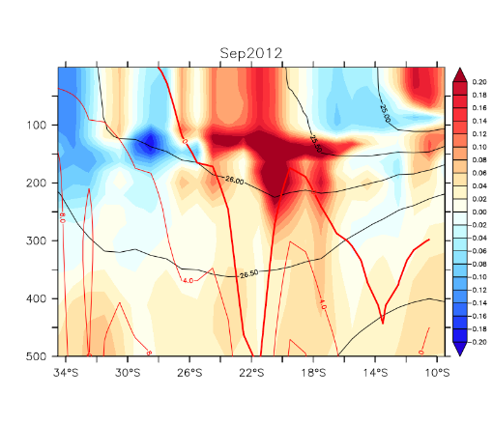
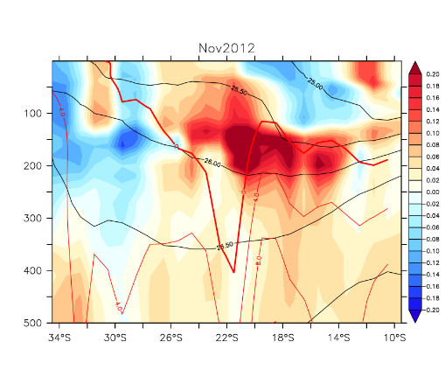
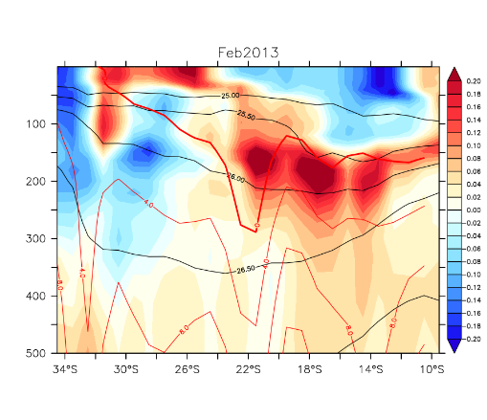
Reemergence via Subtropical Cells
SODA
ORAS5

Slide 17
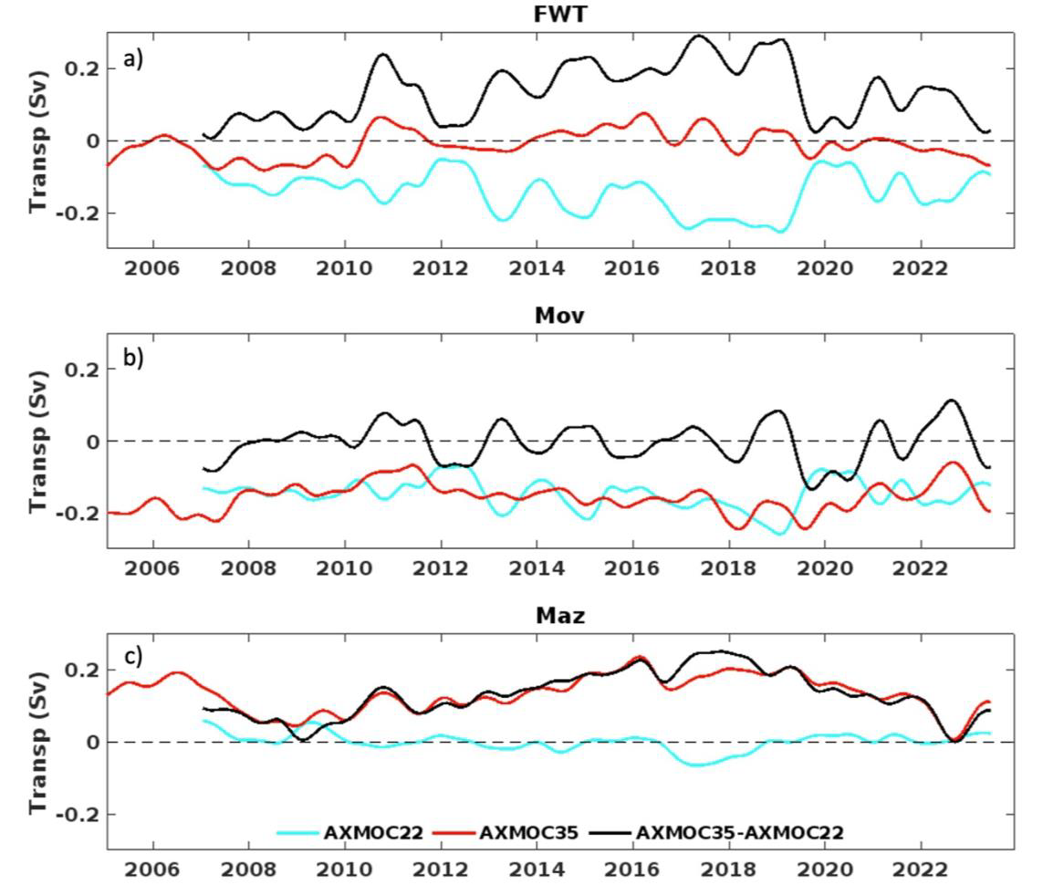
Freshwater convergence between 35°S-22°S
FWT: convergence since 2007 is mostly driven by 22°S.
Mov: is negative and similar between 22°S and 35°S.
Maz: low frequency convergence driven by 35°S. Maz at 22°S is negligible.
Strong compensation between Mov and Maz at 35°S reduces its effect on the FW convergence.

Slide 18
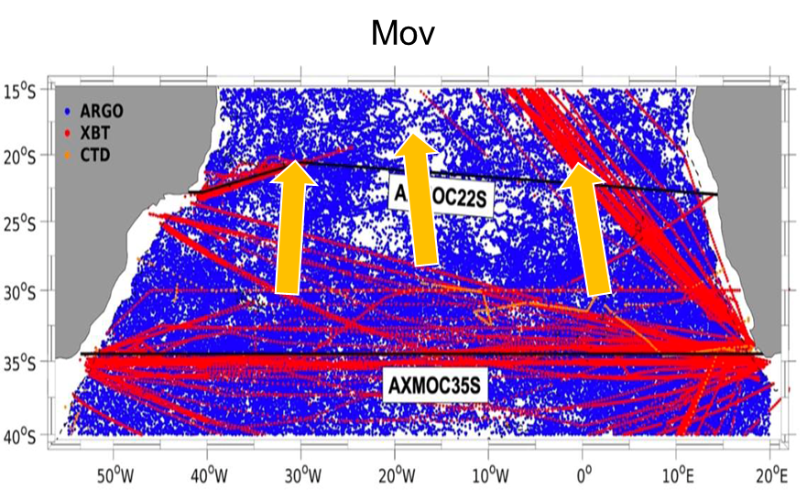
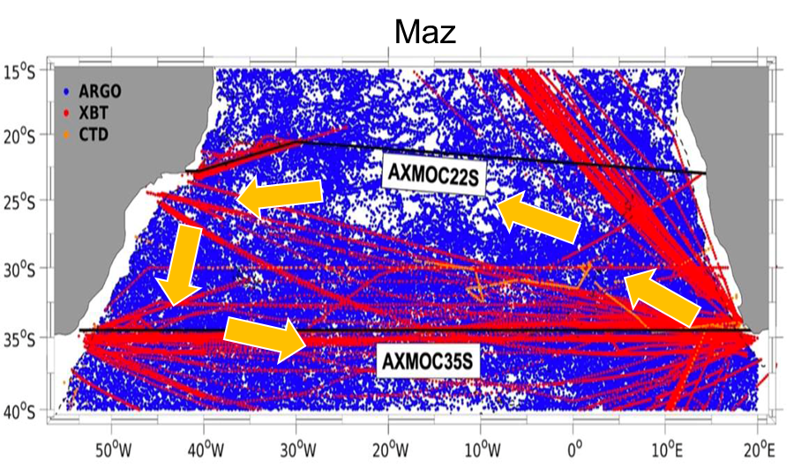
Conclusions
Mechanism for SA freshwater budget:
Mov similar across the SA.
Maz balances Mov at 35°S and recirculates south of 22°S.
22°S may be a better location to measure the freshwater transport.
22°S Mov drives the recent increase in salinity in the SA.

Slide 19
Thank you!

Slide 20
Comparison with other methods

Slide 21
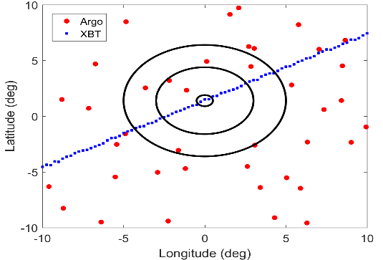
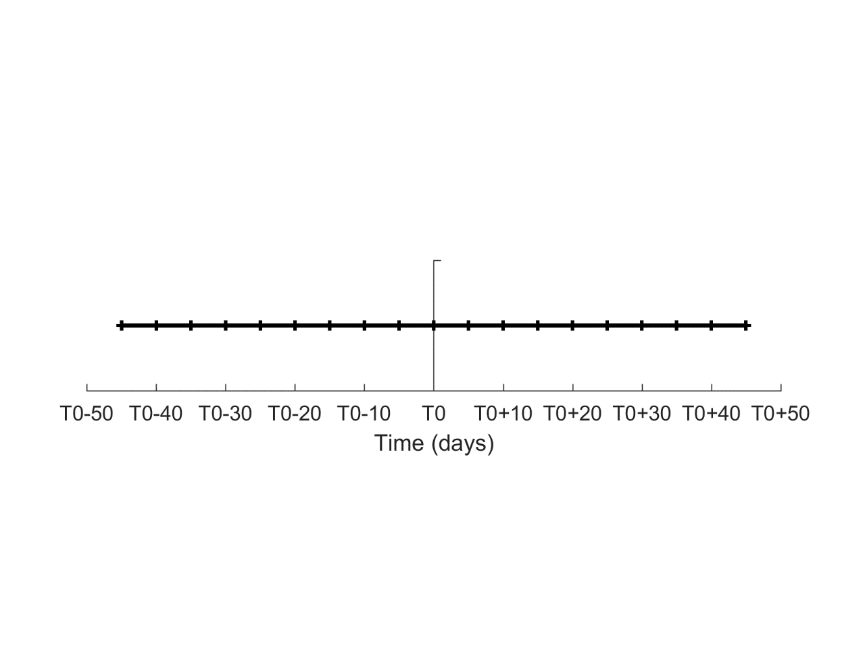
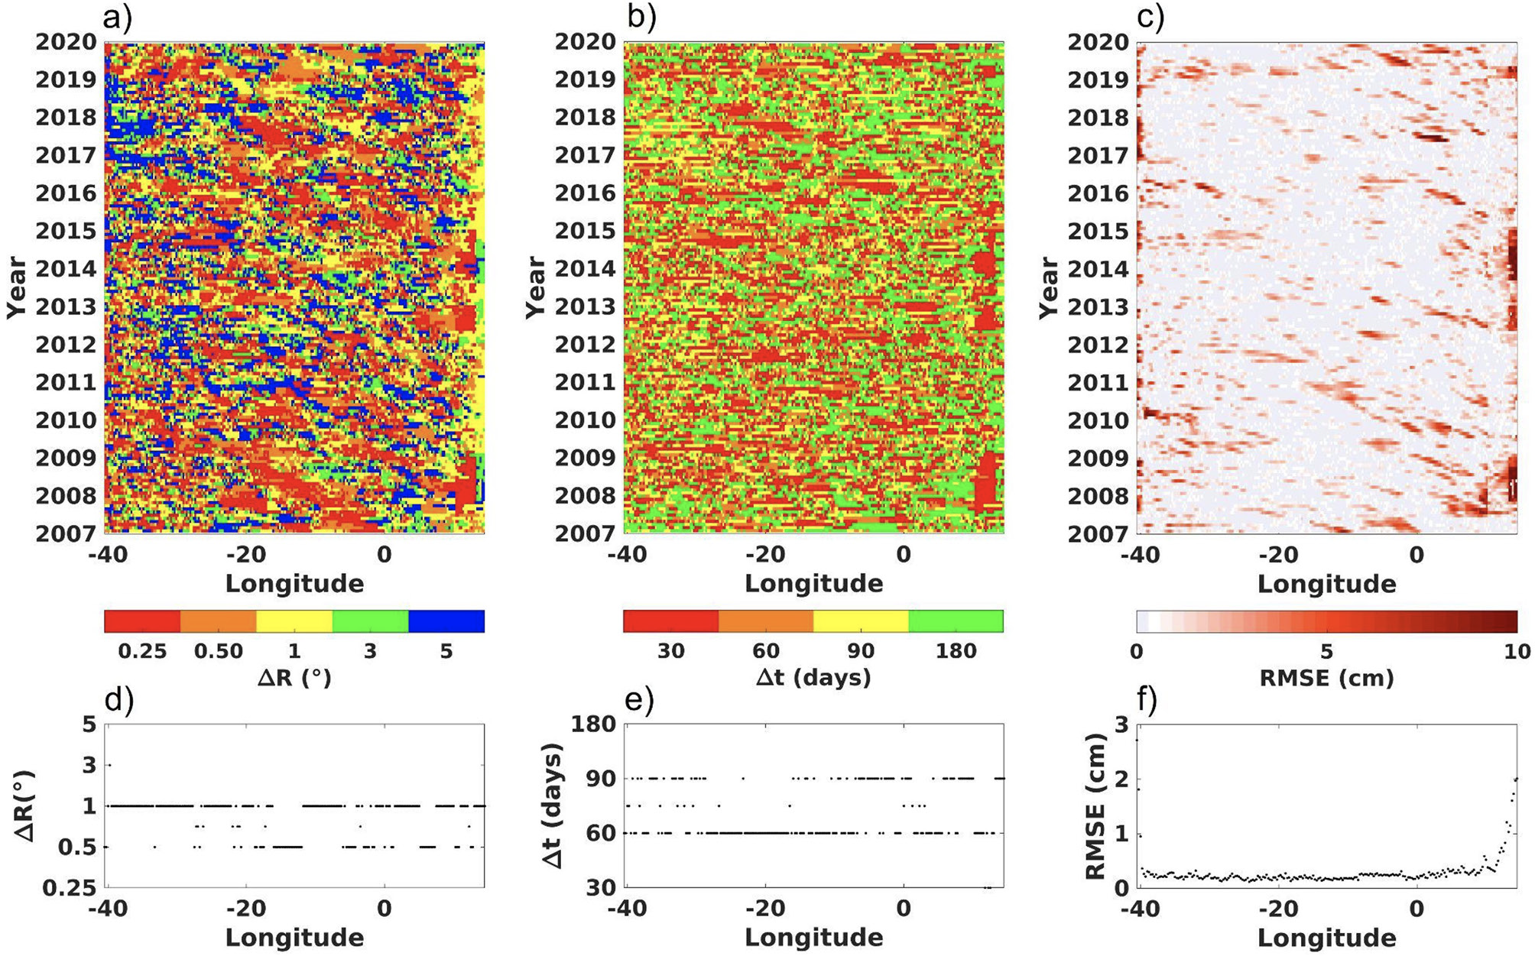
AXMOC optimal mapping
Weighted averages [32]
Δt and ΔR - 20 parameter subsets
Cost-function: minimize RMSE of detrended (ADH,SSH)
Monthly, ¼°,140 z-levels along transect
Δt/2
Δt/2
Goes et al,. 2020
Δt (days) | 30 | 60 | 90 | 180
ΔR (°) | .25 | .50 | 1 | 3 | 5

Slide 22
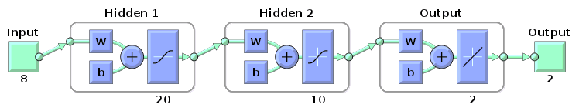
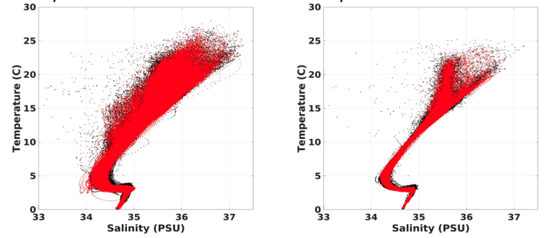
Neural Network method
Validation (20% of profiles)
 | Mean ± Std | RMSE
T - Target | 8.15 ± 5.43 | 0.60
T - Predicted | 8.16 ± 5.41
S - Target | 34.87 ± 0.45 | 0.12
S - Predicted | 34.87 ± 0.44

Slide 23
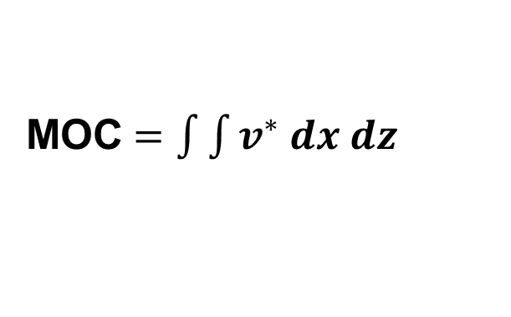
AMOC, MHT and FWT calculations
AMOC
Meridional Heat transport
MHT = Hov + Hhor = MHT_{g} + MHT_{E}
Freshwater transport
FWT = Mov + Maz = FWT_{g} + FWT_{E}
Optimal mapping (OM) comparison with SAMBA array, synthetic method, and Neural Network (NN) method.
MOC $=\int{\int{v^{∗} dx dz}}$

Slide 24
Vertical structure of heat and freshwater transport at 35°S

Slide 25
Transports and comparison with other methods and datasets
35°S
OM
AXMOC | SAMBA | D35°S
17.0 ± 4.0 | 17.3 ± 5.4 | 17.0 ± 3.1
R | 0.41 | 0.45
AXMOC (OM), SAMBA and D35S
Pita et al. (in review)

