Slide 1
Sharing NRT and DM XBT data
through ERDDAP
Claudia Fratianni
INGV

Slide 2
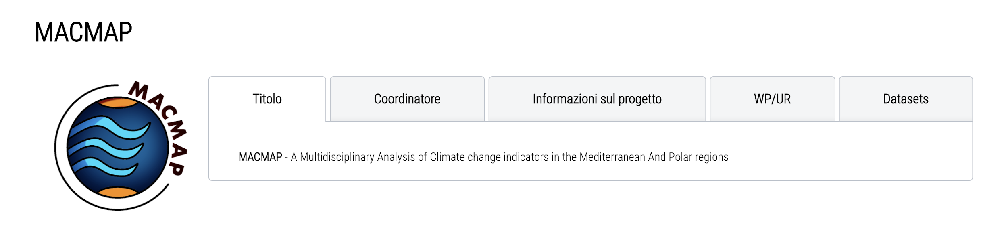



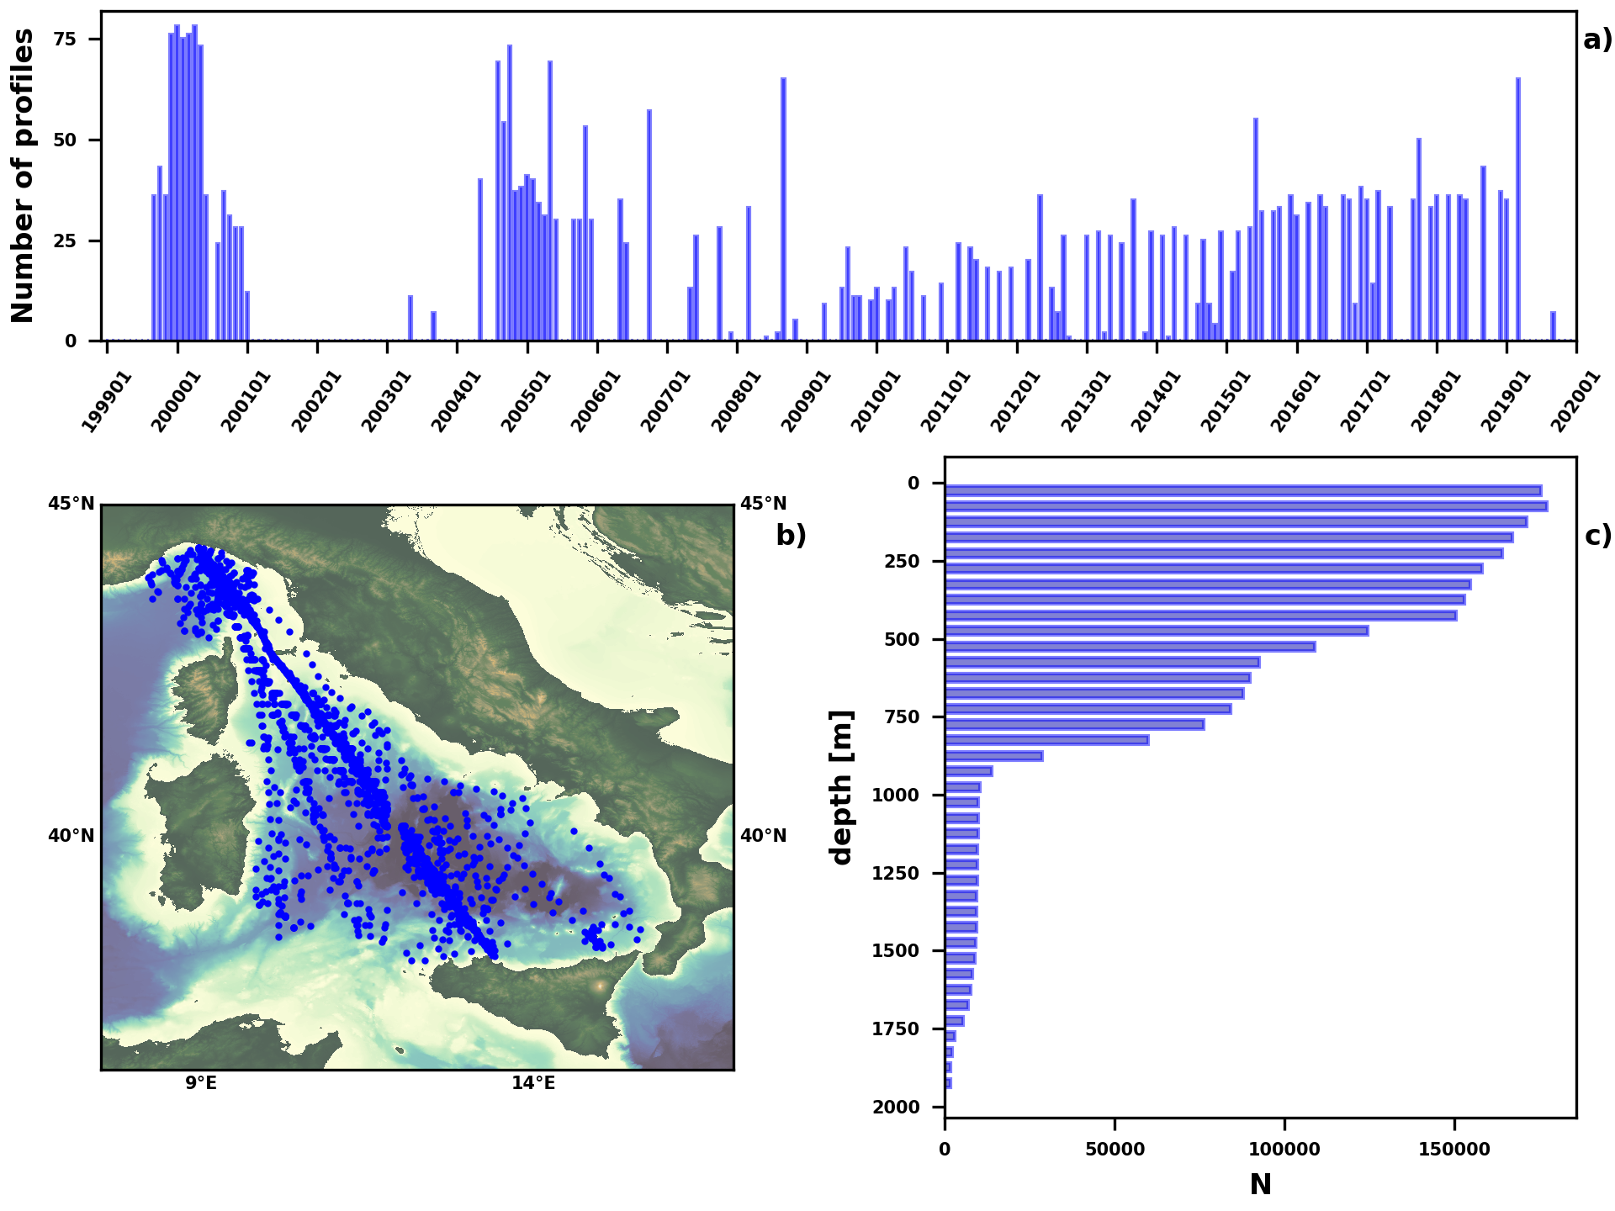
Background
The present version of historical XBTs from Ligurian and Tyrrhenian Seas is available through:
The dataset
3757 profiles (managed by ENEA)
September 1999 – September 2019
Commercial and research vessels
SeaDataNet
World Ocean Database
Copernicus Marine Services
Different version
Incomplete metadata
Notes:
Data are sparse and mainly concentrated along the MX04 Genova-Palermo line
Vertical data distribution is non –omogeneous due to the local bathymetry, the use of different probes types and the ship speed

Slide 3
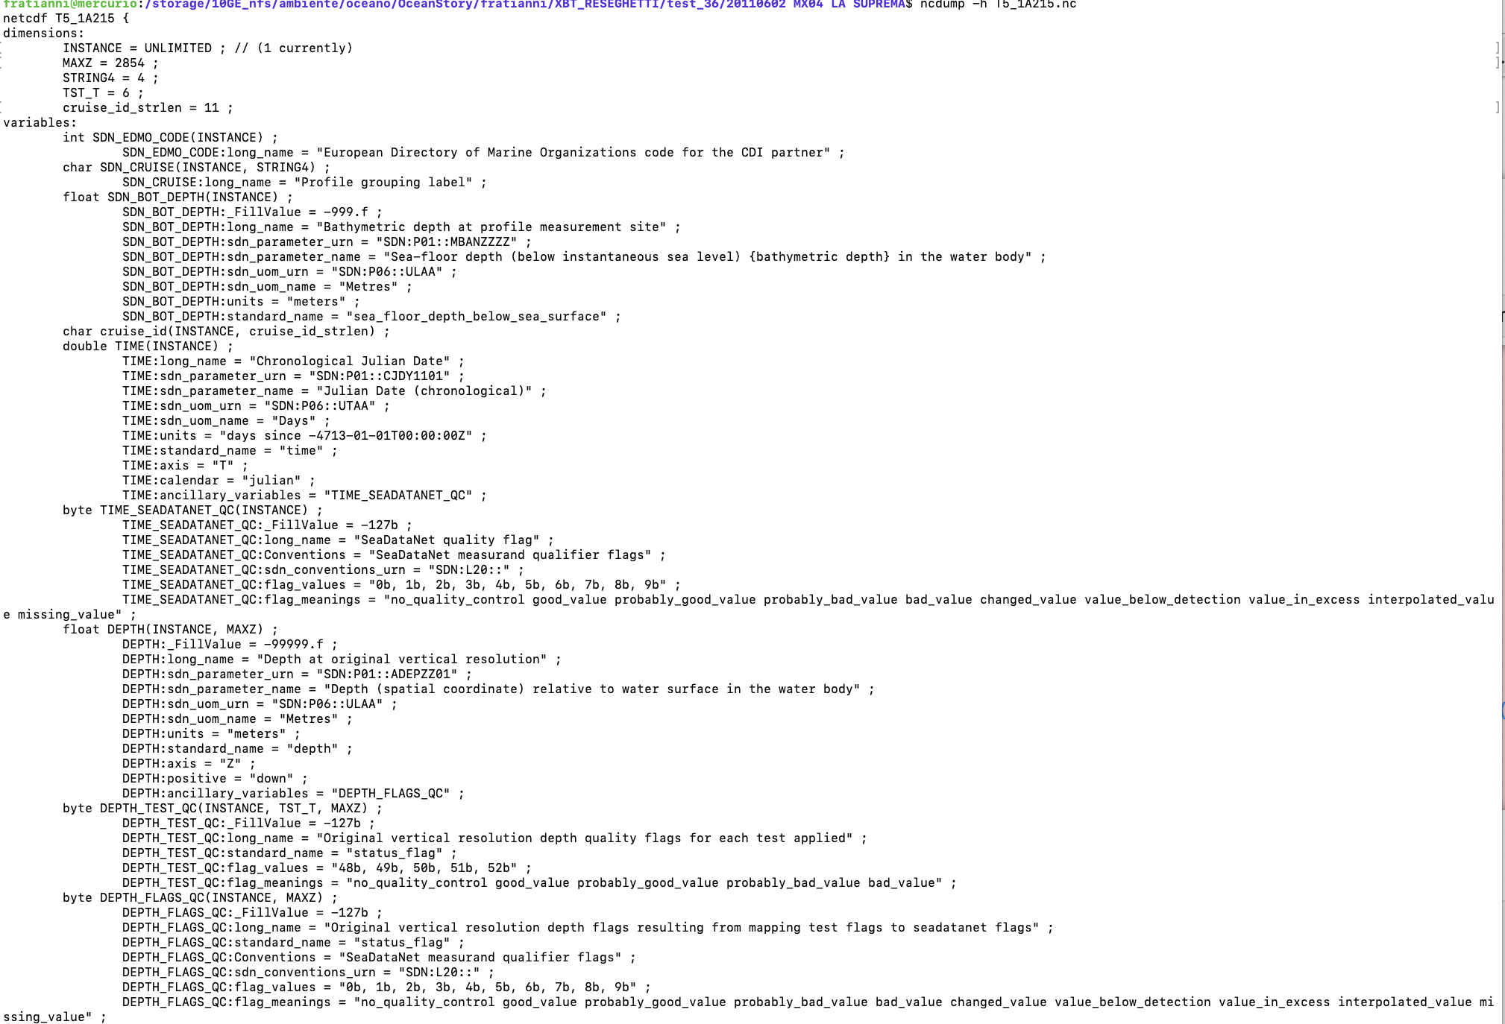
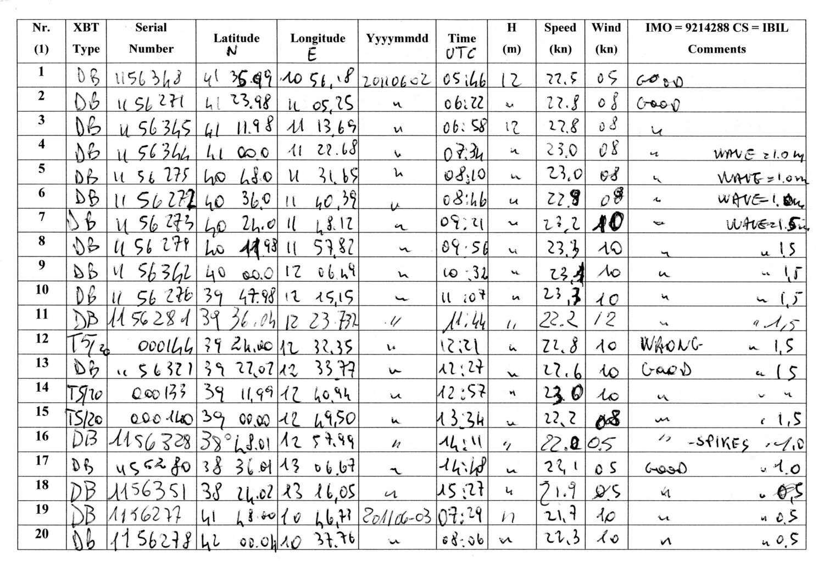
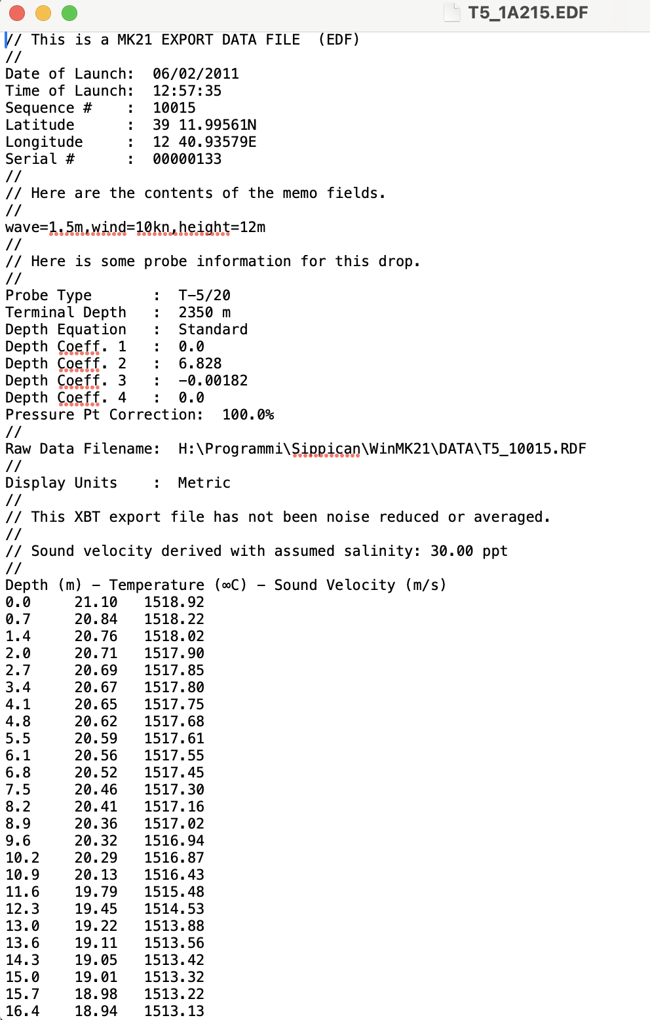
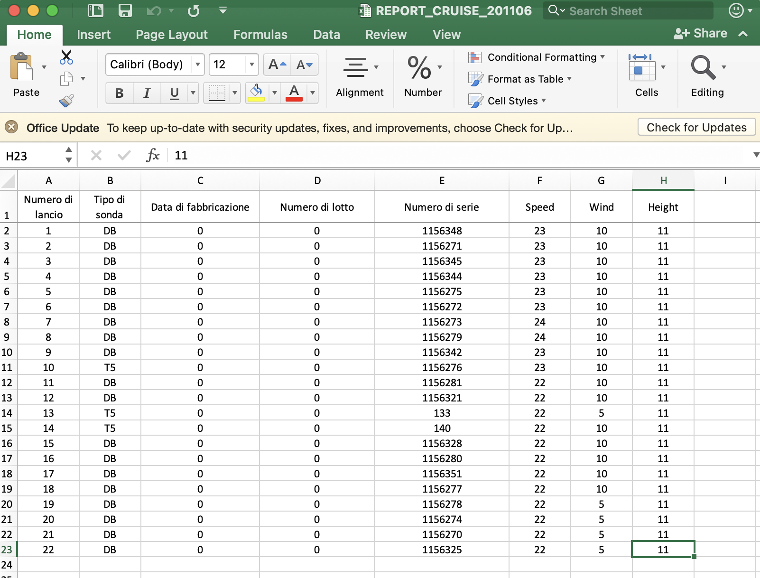
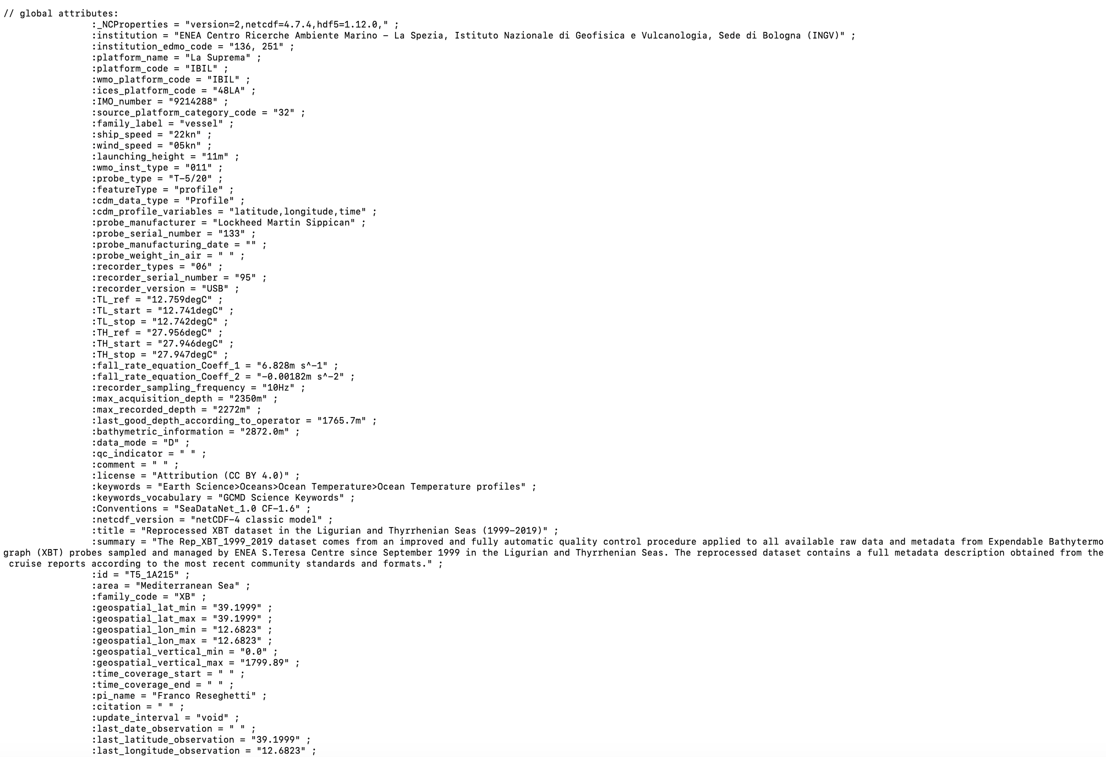
Format and standards
The data have been formatted and standardized according to the latest community best practices and enriched with all available metadata, including calibration information
Operational log sheet
Original raw data
Each original XBT profile is stored as individual netCDF CF compliant and is standardised by adopting SDN vocabulary (P01, P06, L20, C17, L06)
Notes:
P01 parameter codes
P02 units
L20 for flags
C17 ICES Platform Codes
L06 SeaVoX Platform Categories

Slide 4
Each original XBT profile is stored as individual netCDF CF compliant and is standardised by adopting SDN vocabulary (P01, P06, L20, C17, L06.
Notes:
C17 ICES platform code
L06 SeaVoX Platform Categories
L20 SeaDataNet measurand qualifier flags

Slide 5
VESSEL
PROBE
ACQUISITION SYSTEM
CALIBRATION

Slide 6
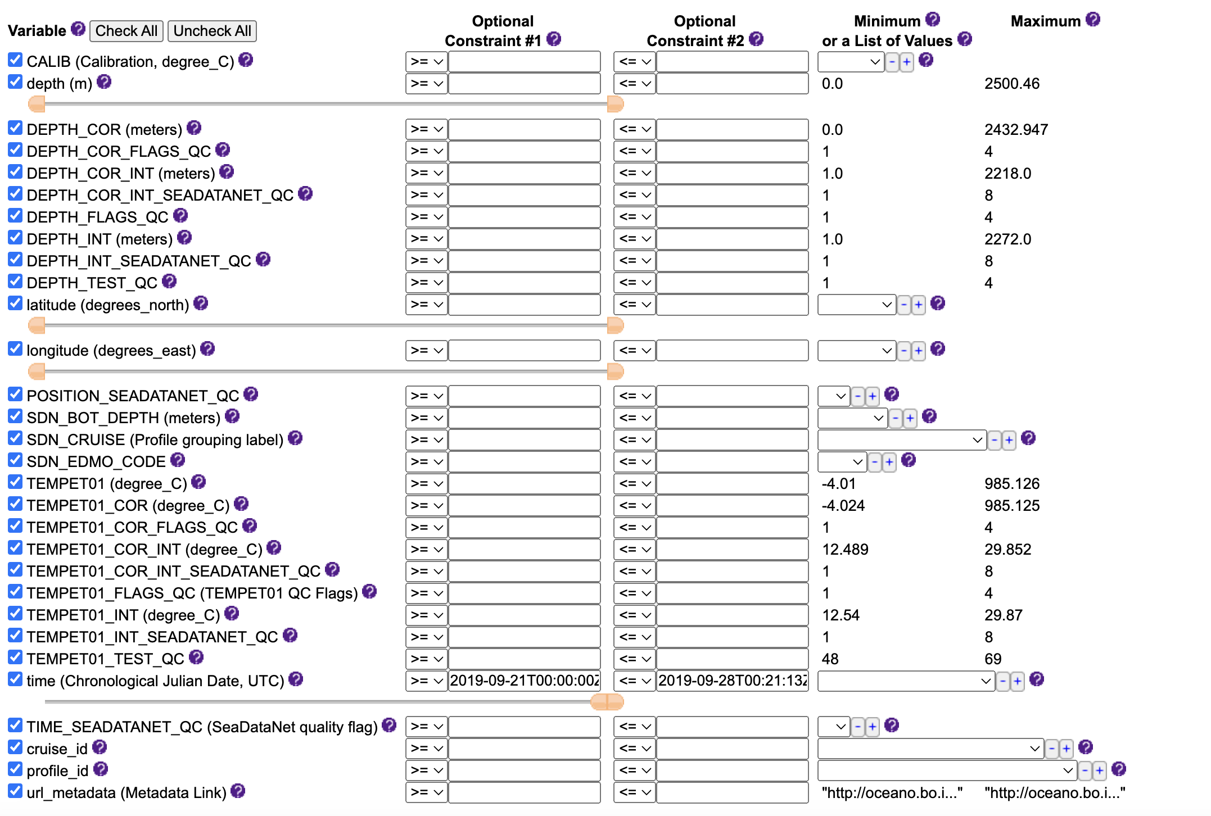
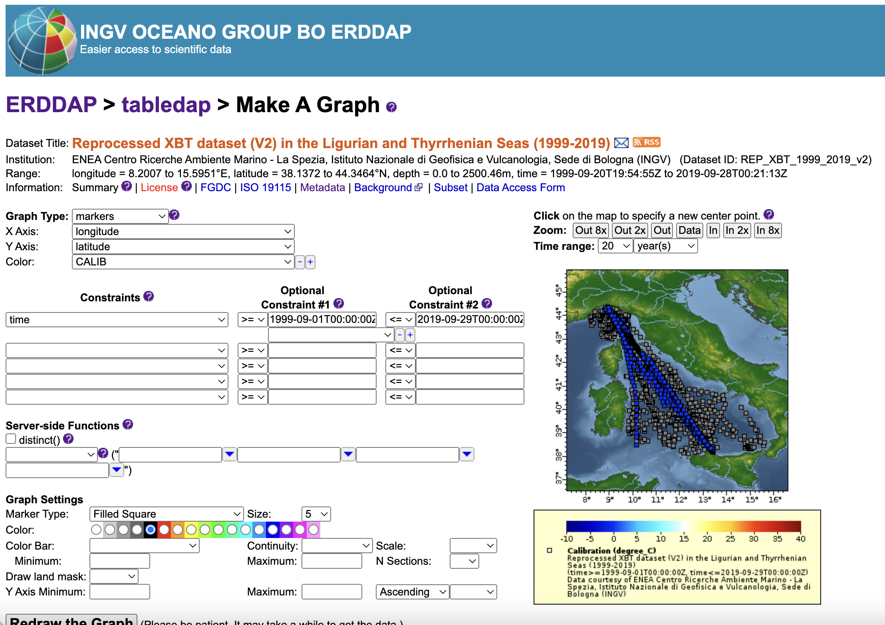
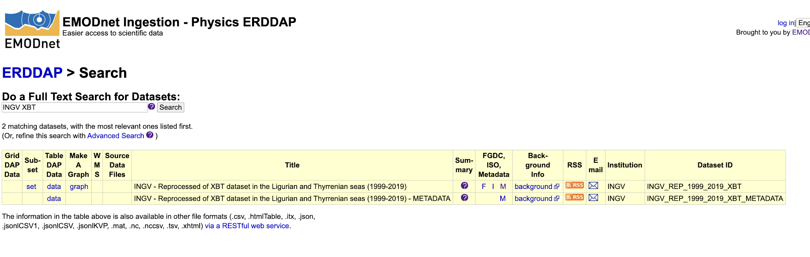
Dissemination
New automatic QC workflow (python routines) implemented with basic independent QC tests on depth and temperature measurements
QC flags mapped in a unique Quality Flag associated to each depth and temperature record -> SeaDataNet standards applied
Full metadata description (manufacturer, probe type, manufacture date, serial number, fall rate coefficients used, launch height, recording system etc…) and all processing information
ingestion-erddap.emodnet-physics.eu
Data ingestion as is
The dataset is assigned a DOI by INGV
Notes:
All the metadata are available through a url_metadata and can be easily associated through the profile_id and cruise_id, which indentify single profile. W also prepare a jupyter notebook which downloads all metadata from a url_metadata variable and it combines them with the corresponding data via profile_id and cruise_id into single files to facilitate data reusability.

Slide 7
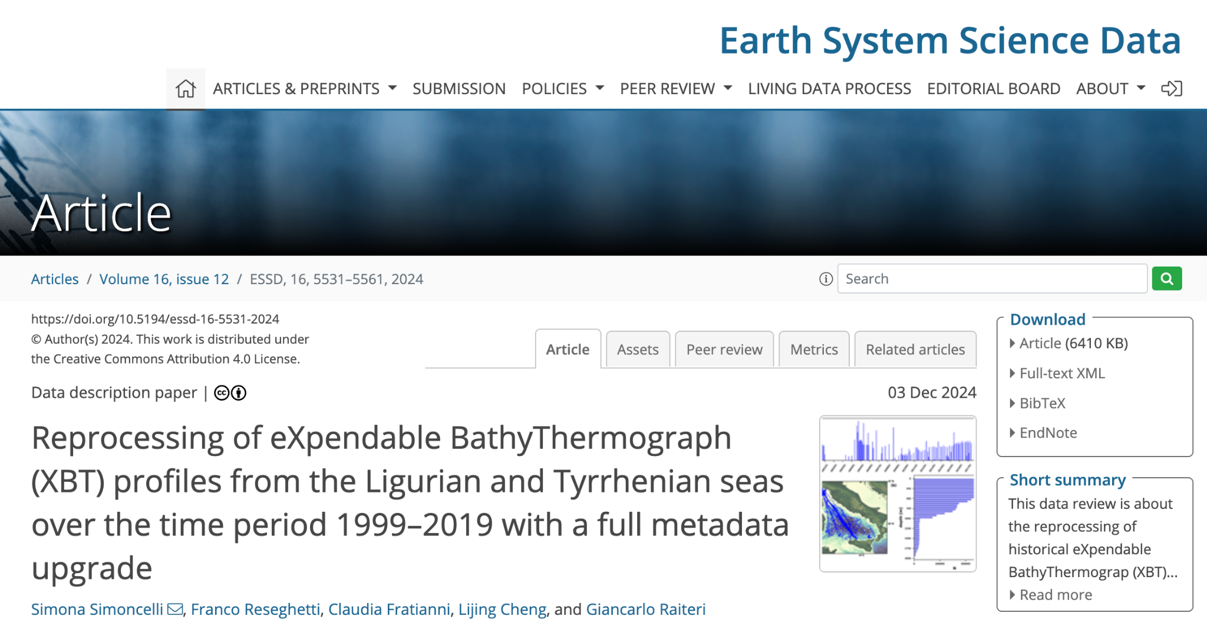

Slide 8


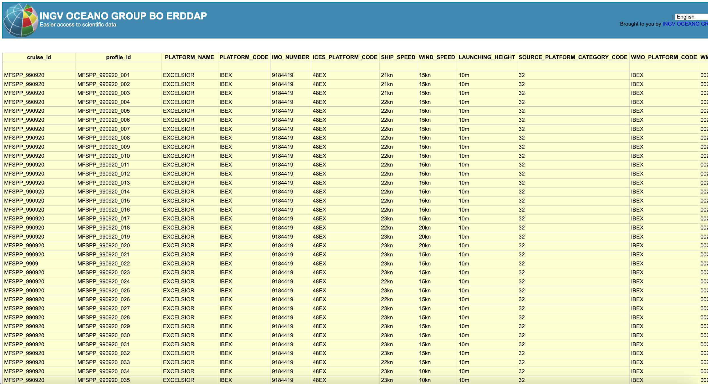
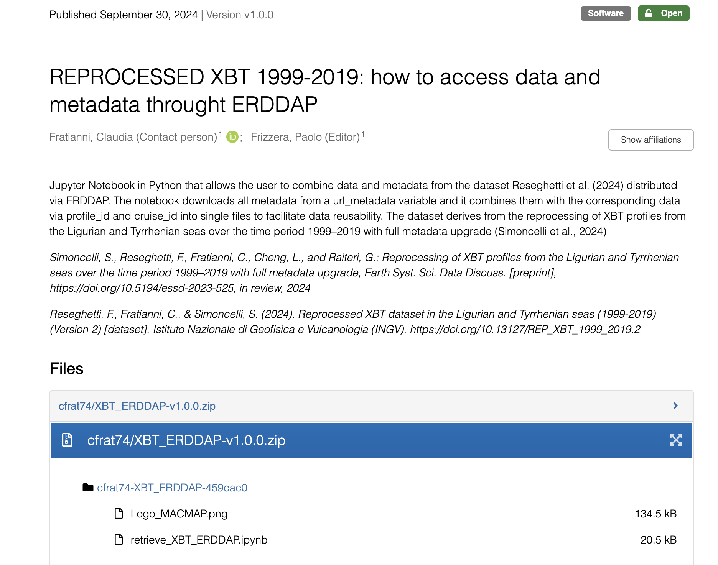
Some issues
I downloaded a netcdf file via the ERDDAP server and it created one netcdf file with many profiles dimensioned by 'row'. That means that all of the global variables that would apply to ONE profile now do not apply and need to be made into variables.
46 variables
url_metadata
https://zenodo.org/records/13862792

Slide 9

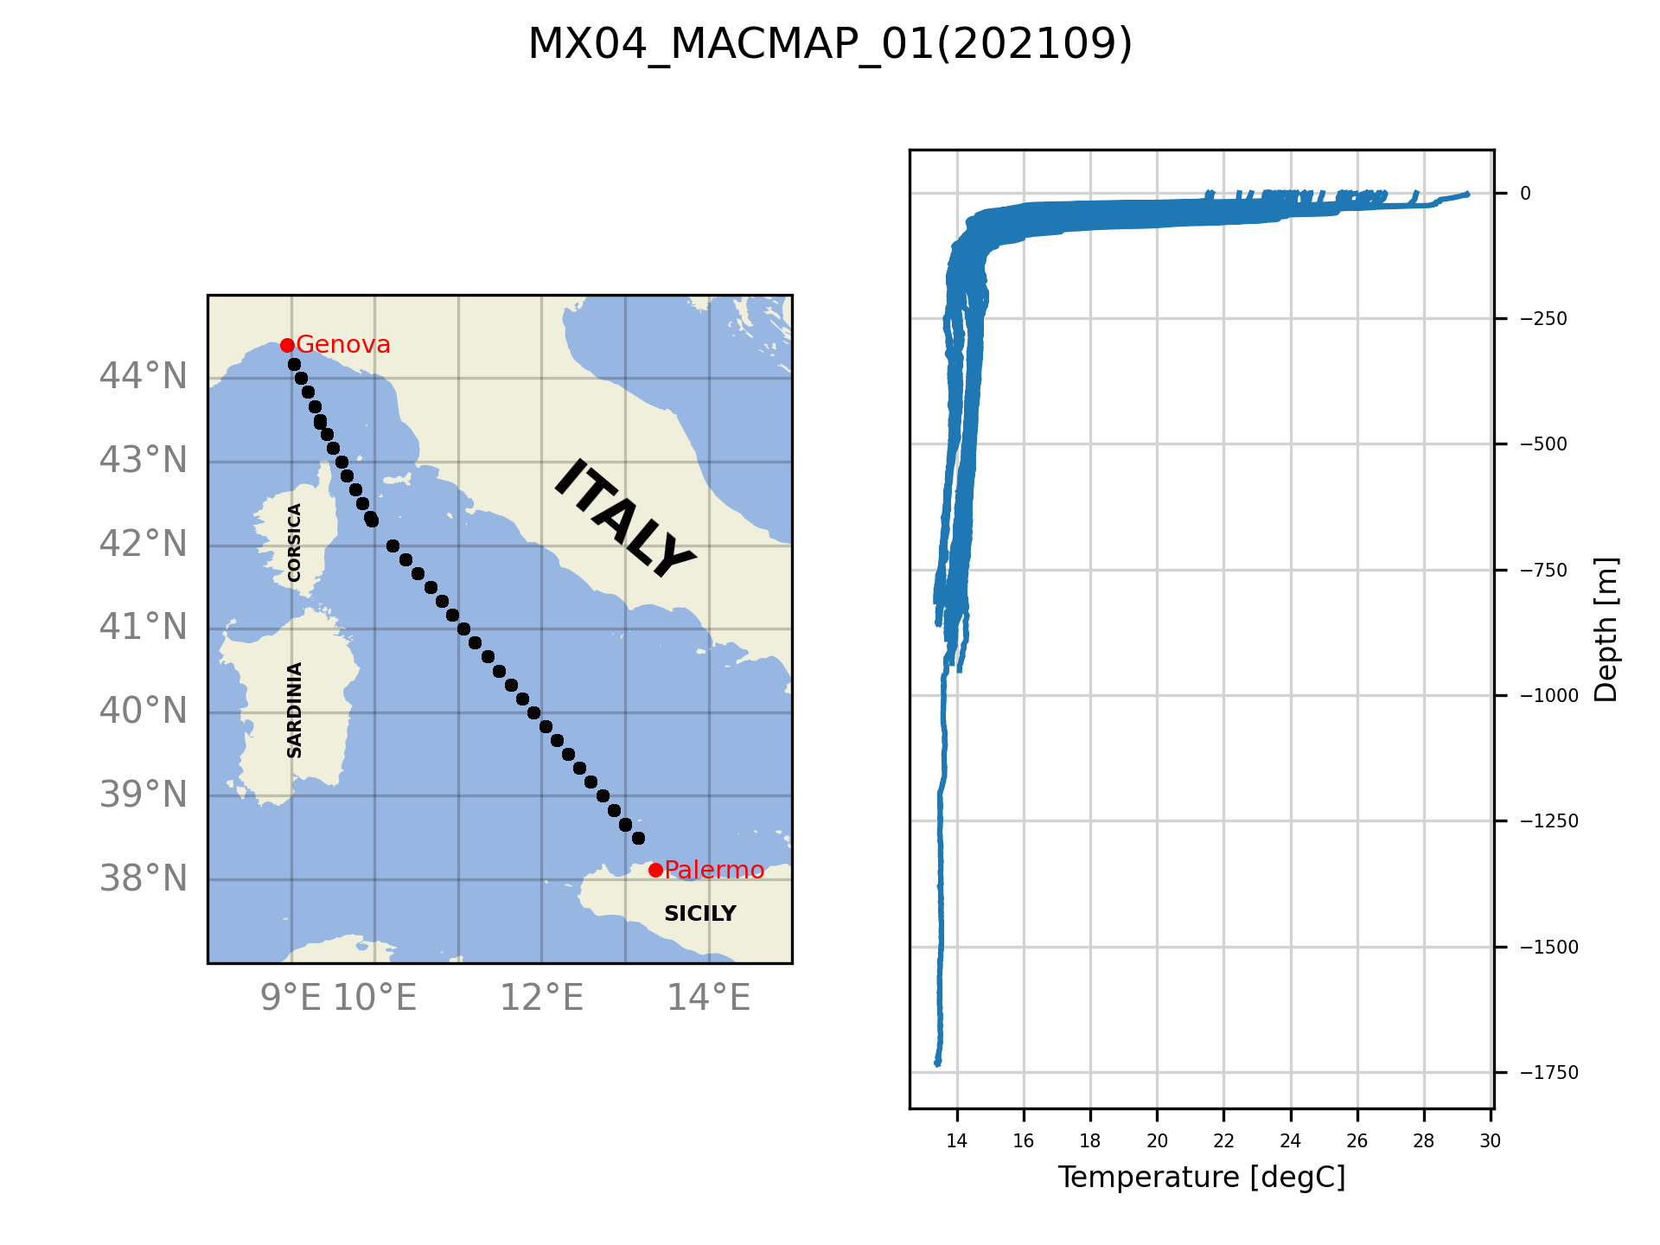
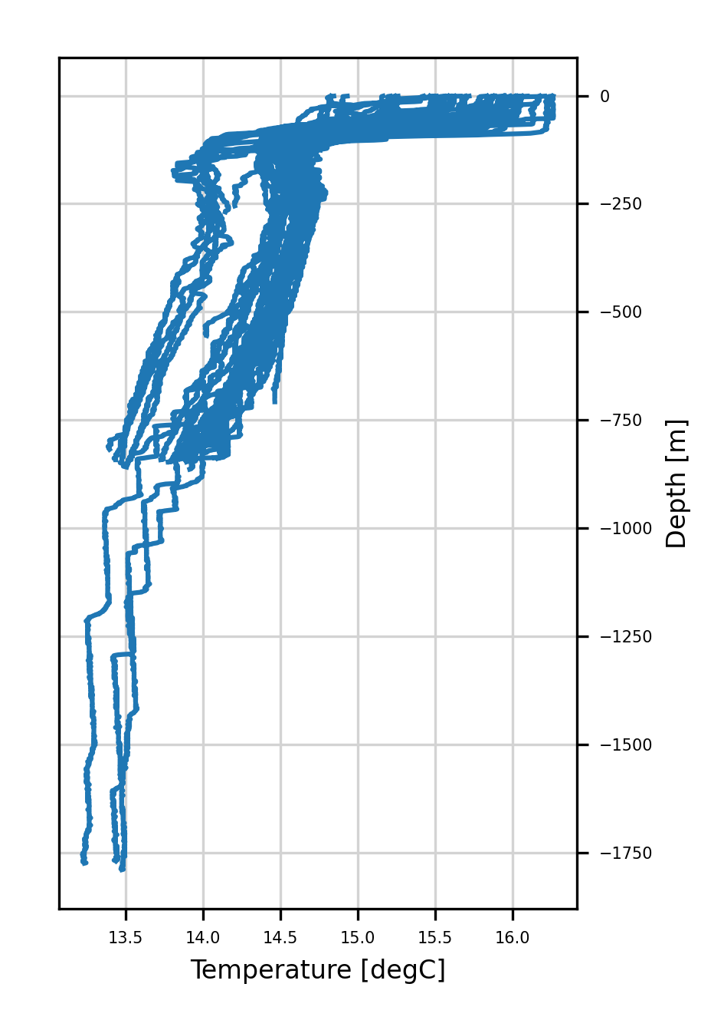
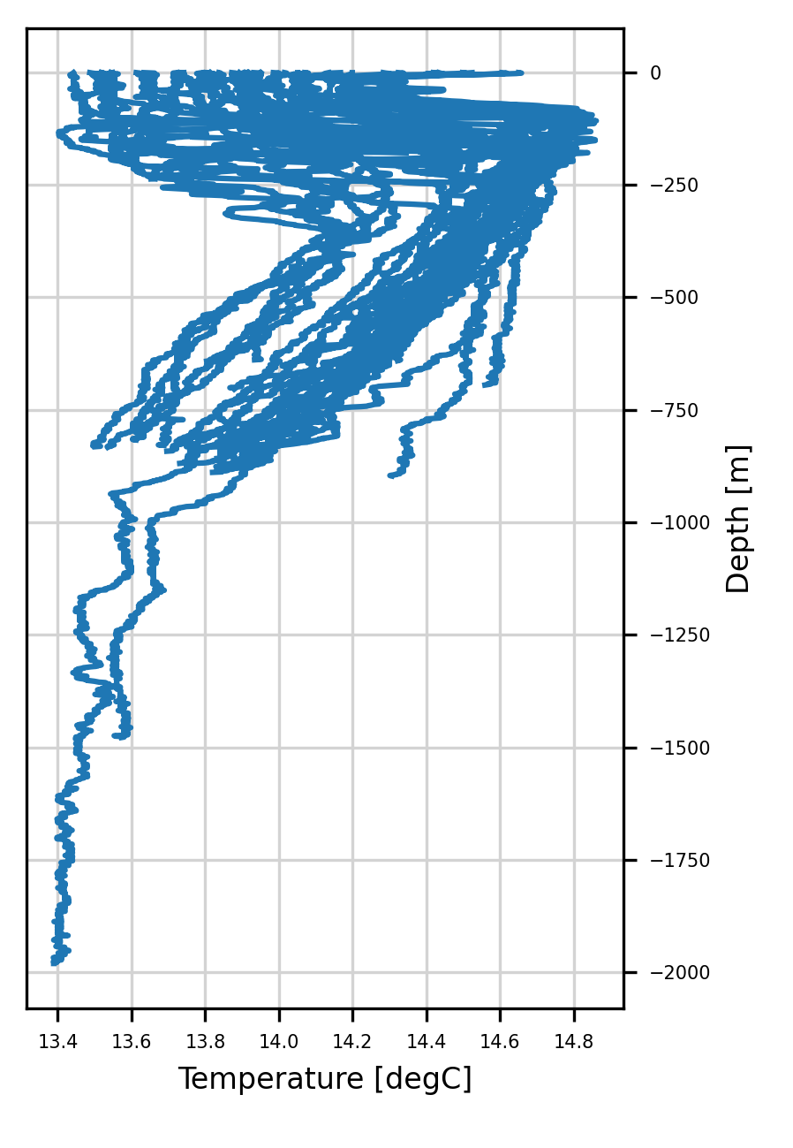
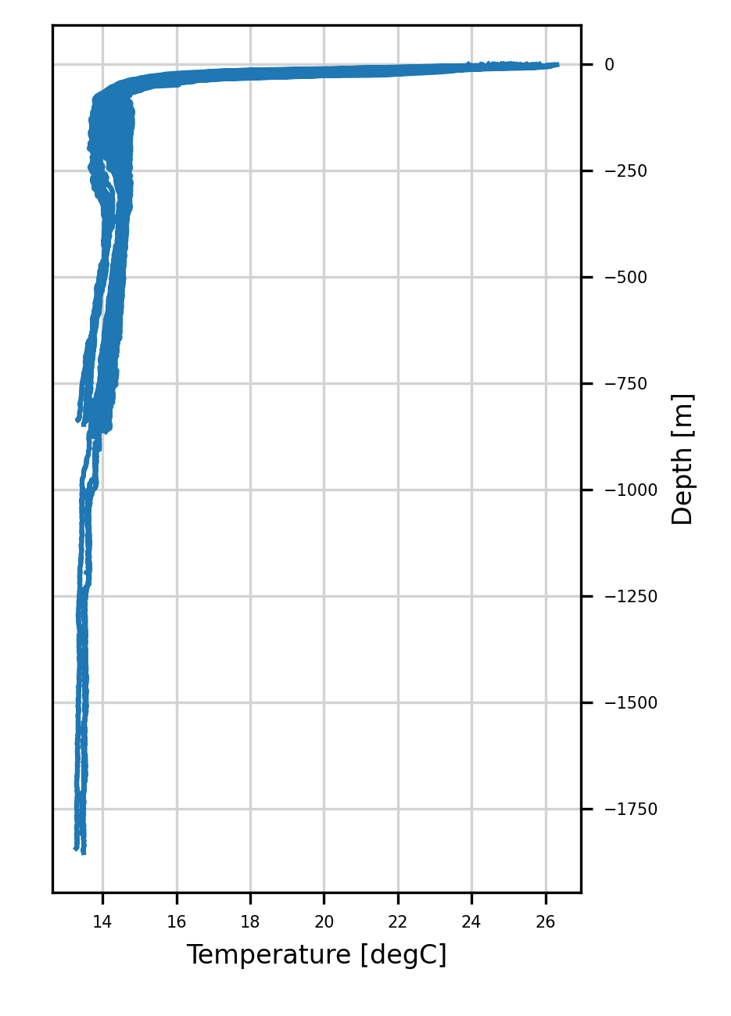
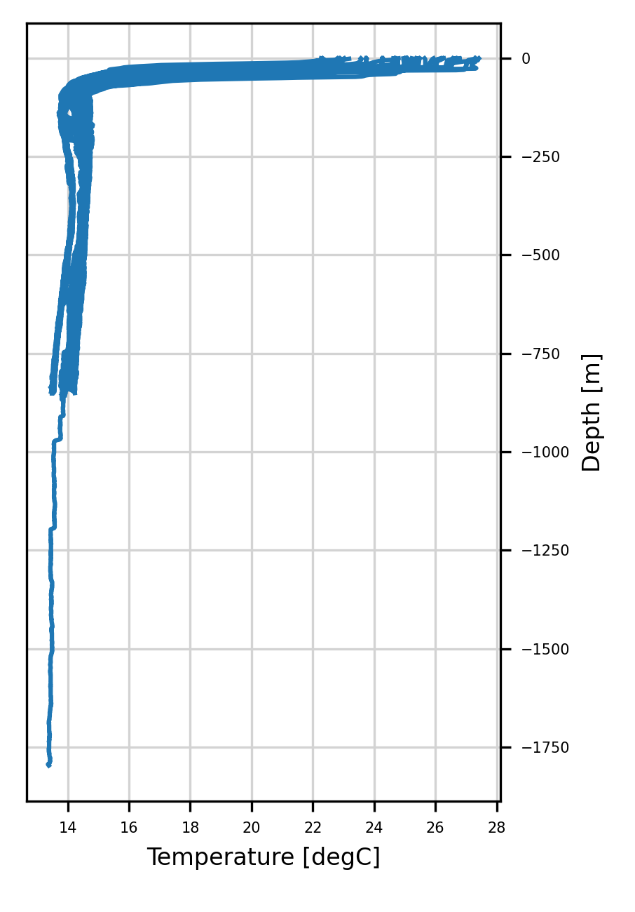
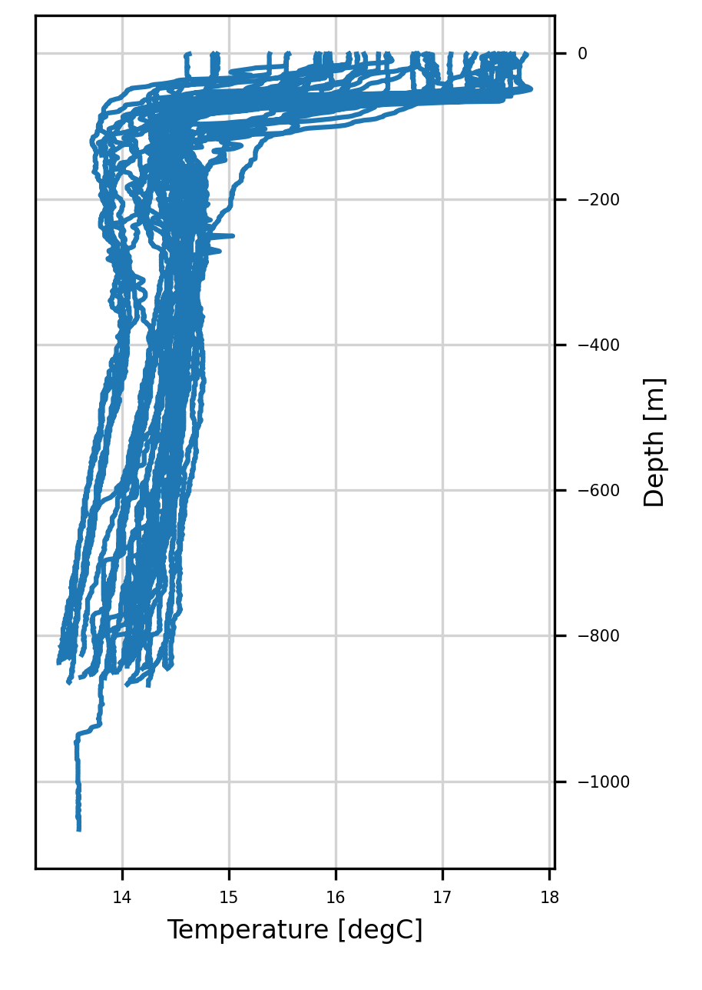
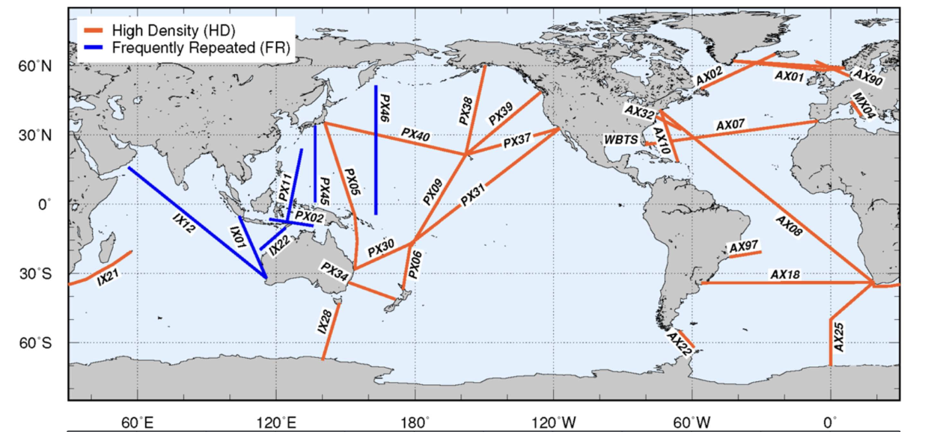
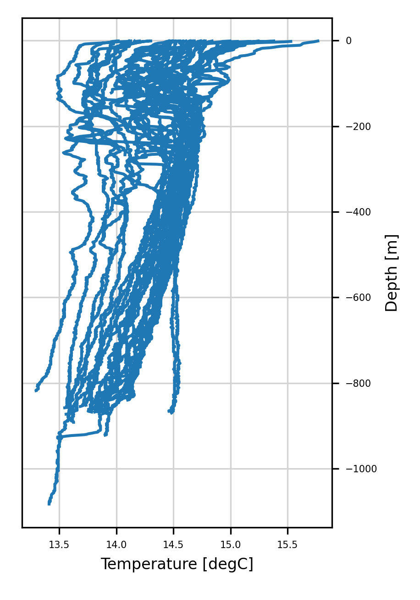
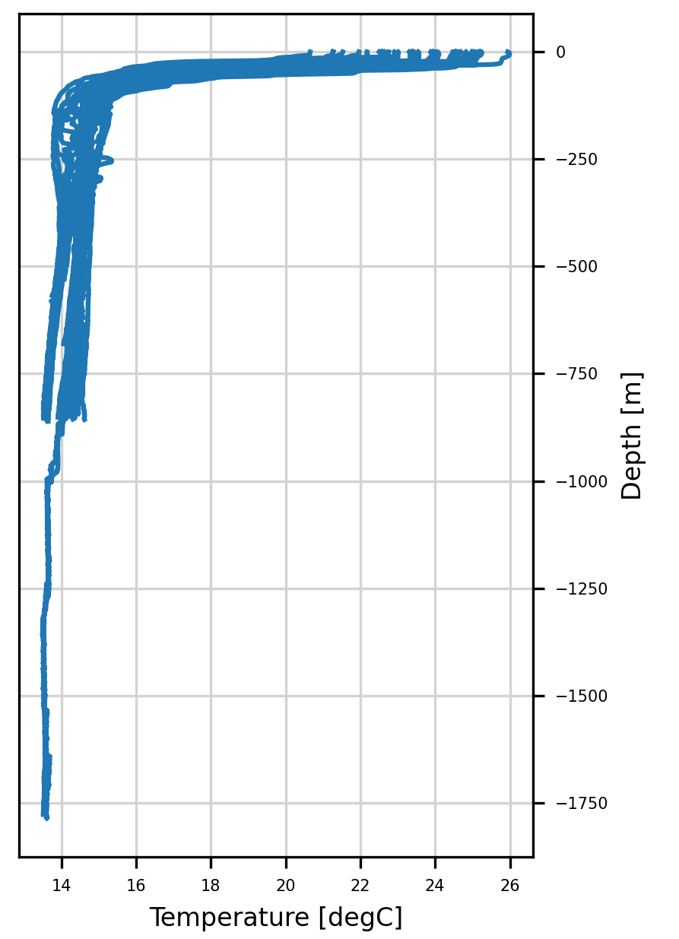
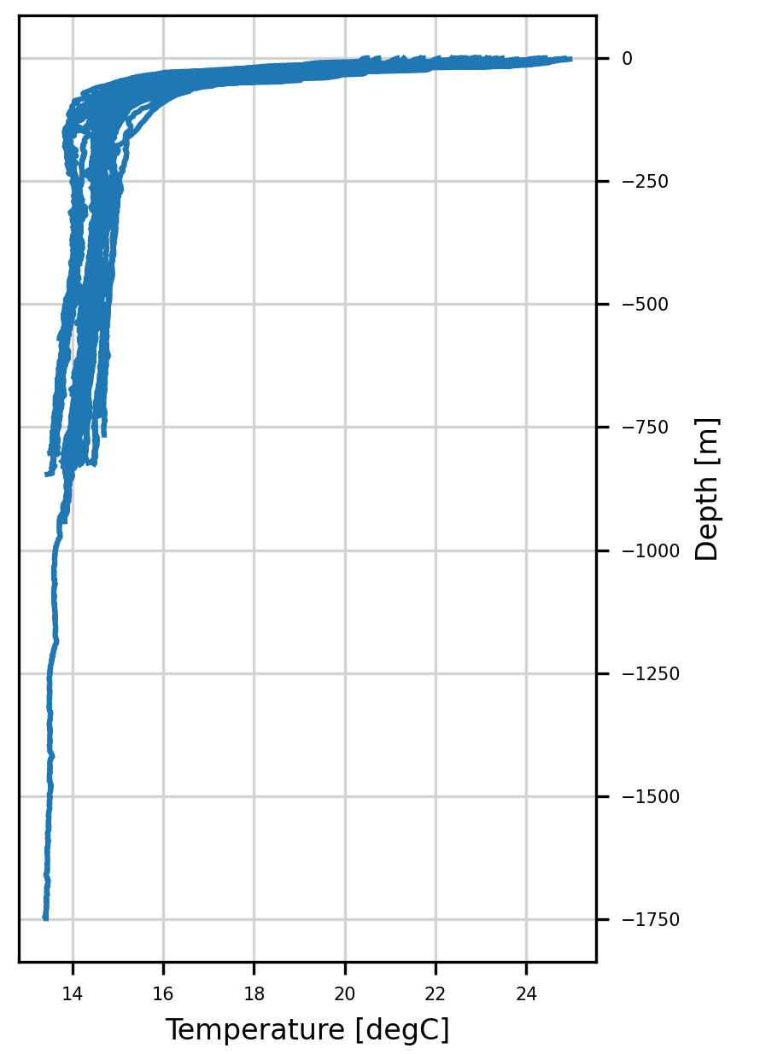
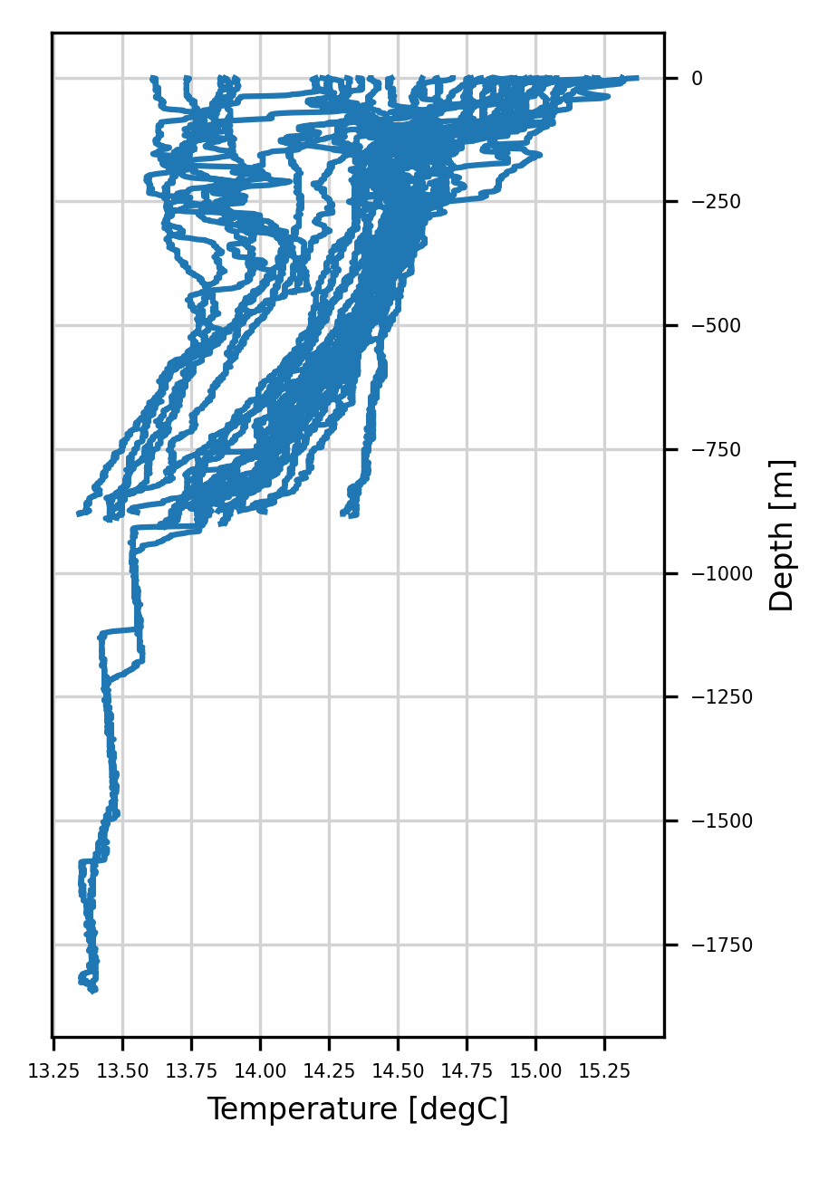
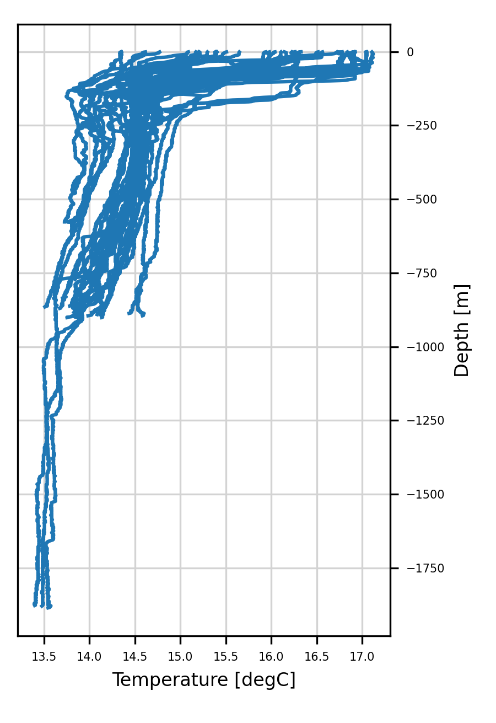
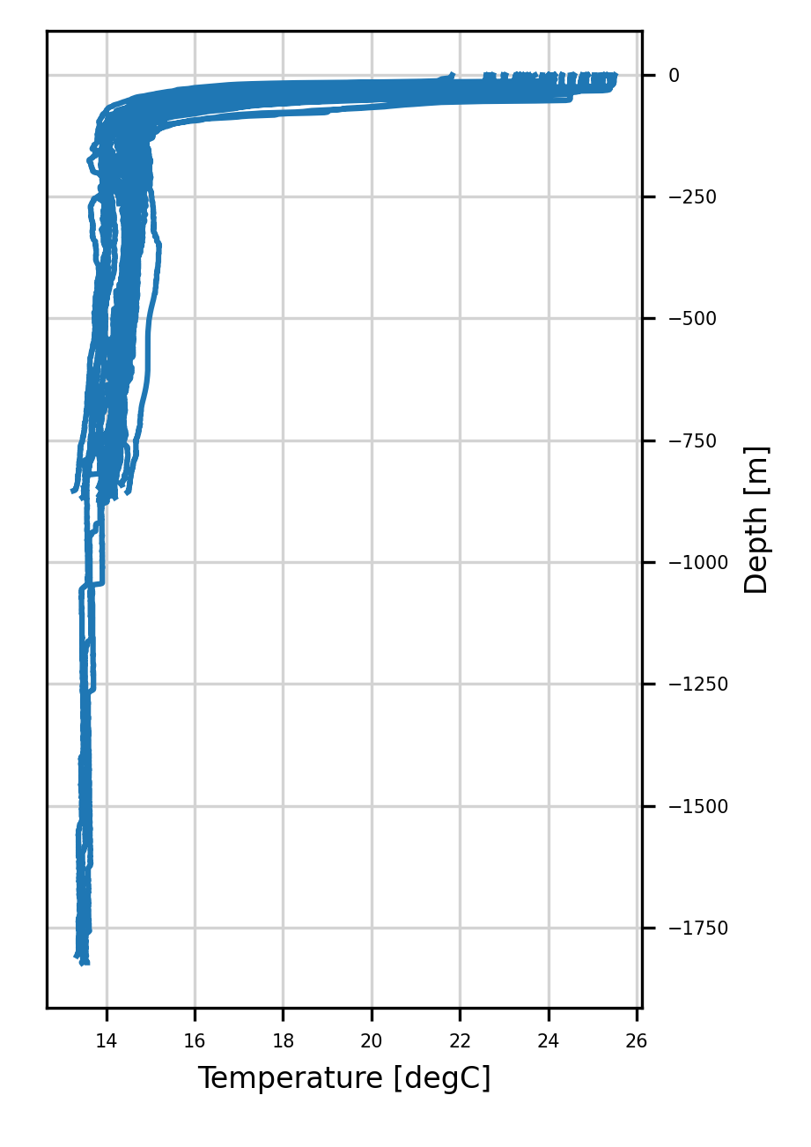
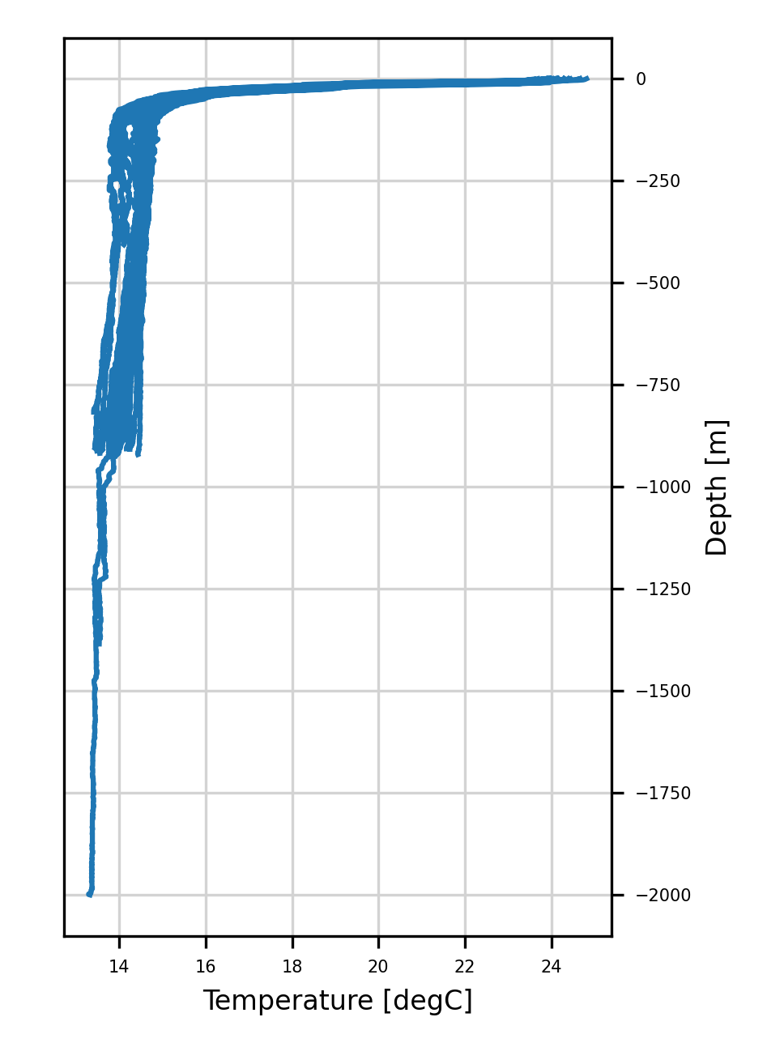
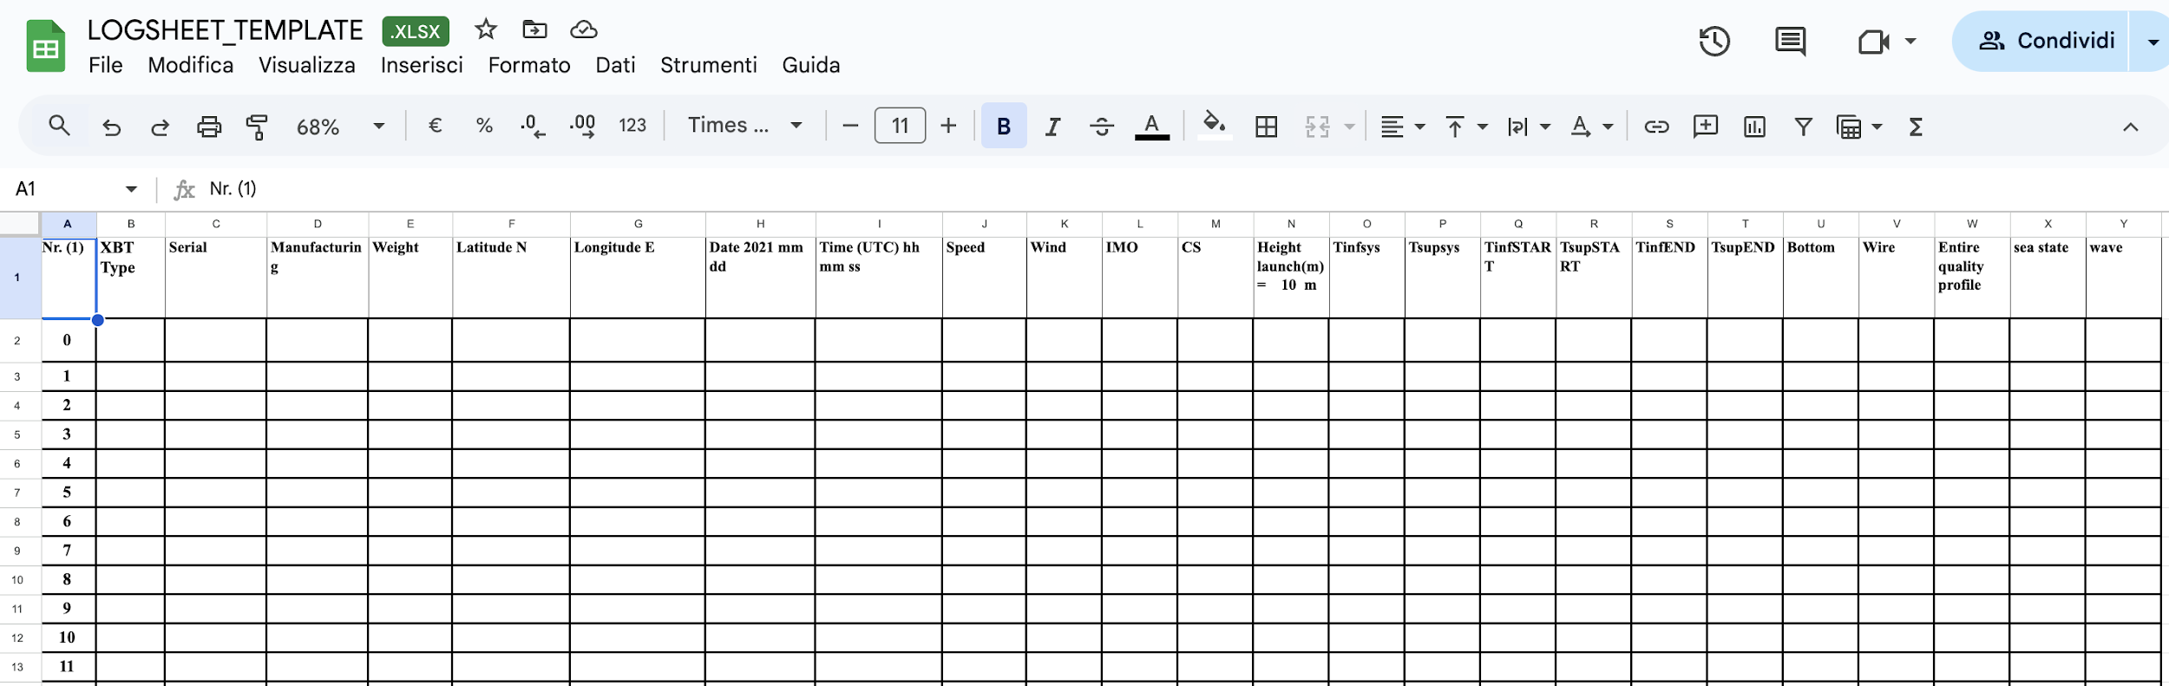
MX04 Monitoring cruises
The new automatic QC is used for the monitoring campaigns re-started in September 2021 in the framework of the MACMAP project
202109
202112
202203
202206
202209
202212
HR: Usually four or more repetitions are conducted annually along a fixed transect with an average of one XBT deployment about every 10–50 km along the ship track (35 XBT deployments per day at a ship speed of 20 kts). This mode is aimed at obtaining high spatial resolution in a single realization to resolve the spatial structure of mesoscale eddies, fronts, and boundary currents. These transects are designed to resolve boundary currents and to estimate basin-scale geostrophic velocity and mass and heat transports, including the MOC, and heat transport. This is currently the most widely used deployment mode.
202303
doi: 10.3389/fmars.2019.00452
The new developed automatic QC procedure has been applied to the MACMAP cruises
202306
202409
202406
202403
202312
202309

Slide 10
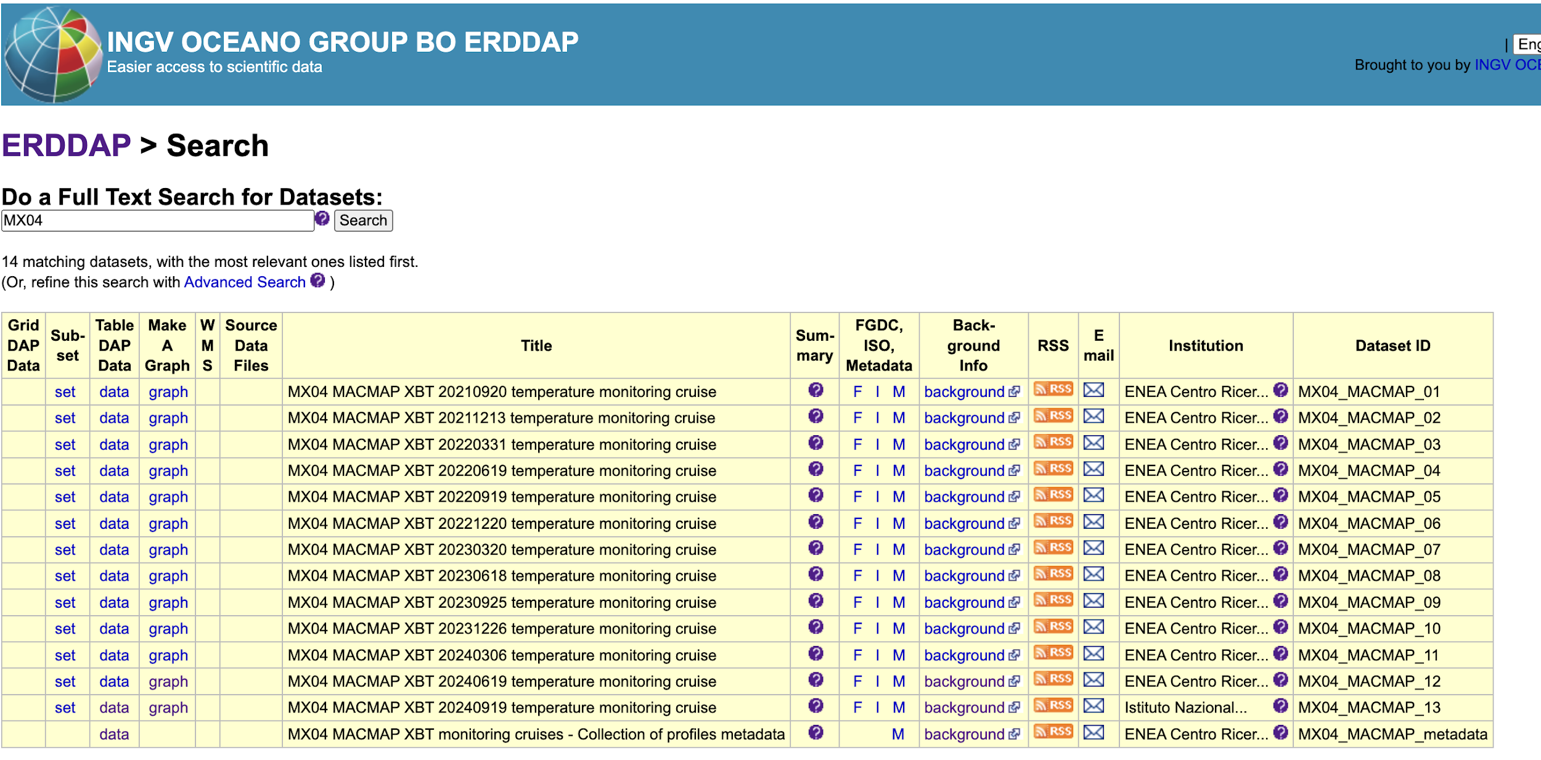
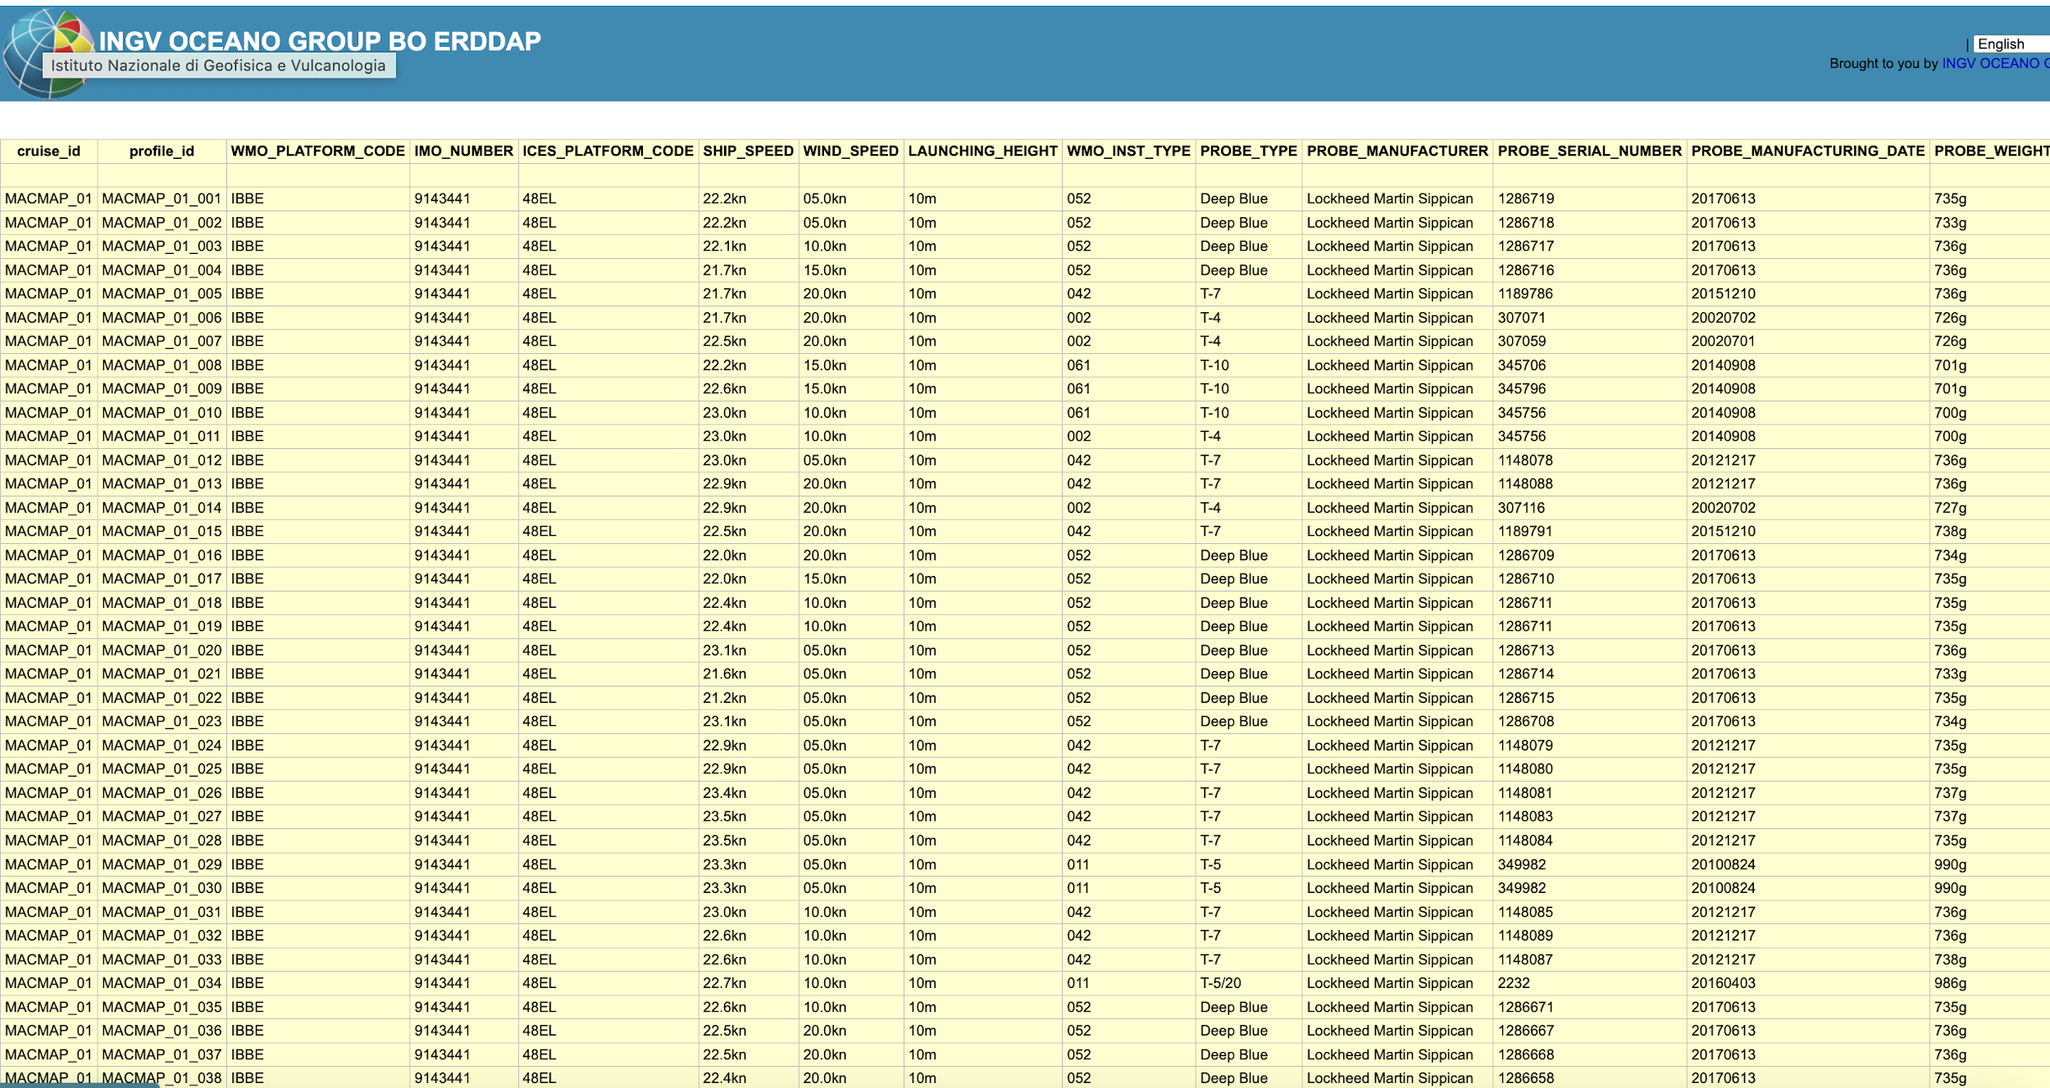
Each dataset are assigned a DOI by INGV

Slide 11
Comments
Datasets (DM &NRT) enriched with full metadata description
New QC implemented
Datasets available and accessible through ERDDAP server and shared with EMODnet (m2m)

