Slide 1

EuroGOOS FerryBox Task Team
Joint Meeting of IQuOD/GTSPP/SOOP/XBT
Bologna November 11-15, 2024
Anna Willstrand Wranne, Voice of the Ocean Foundation

Slide 2
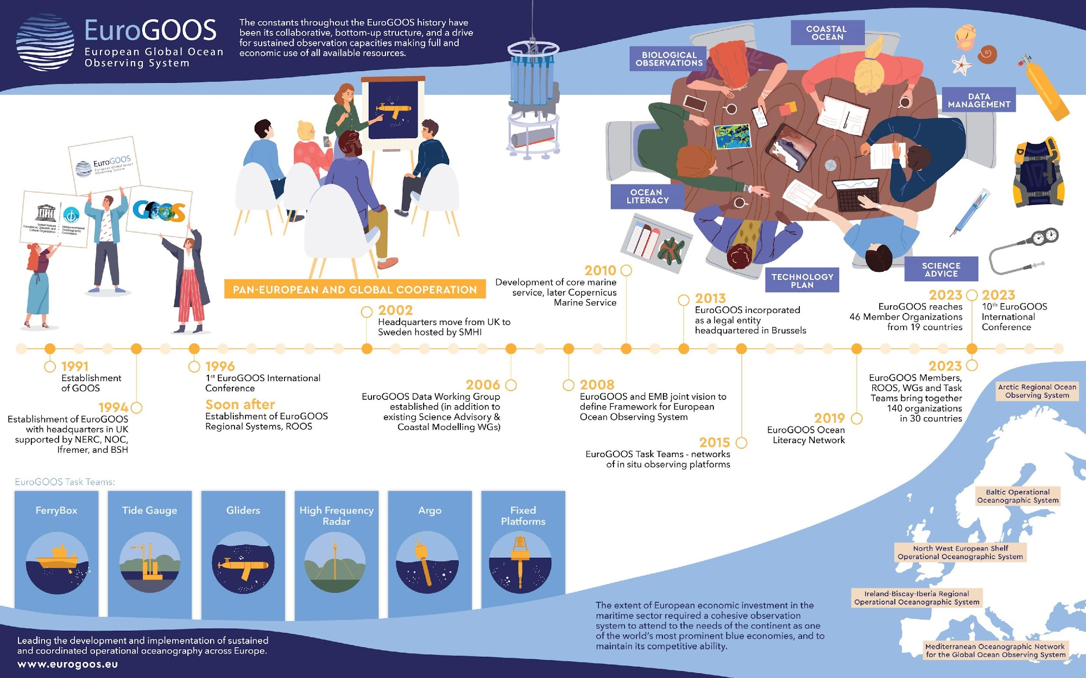
EuroGOOS overview

Slide 3
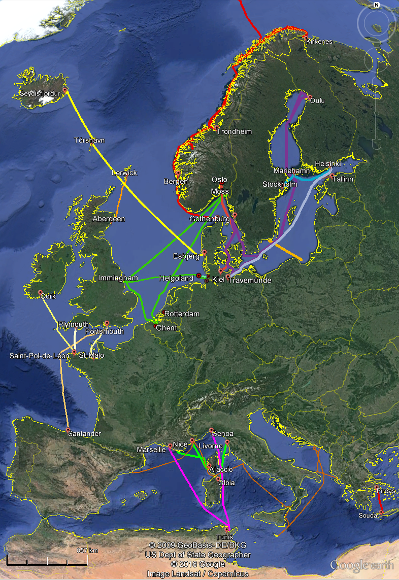
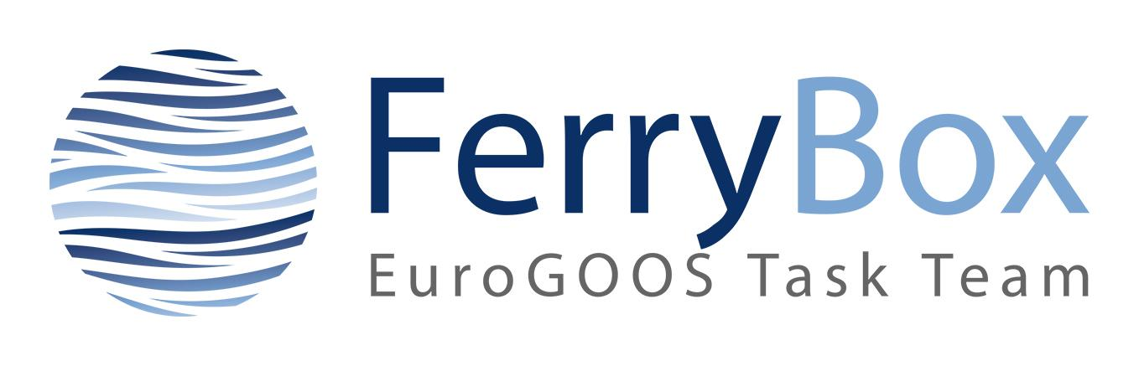
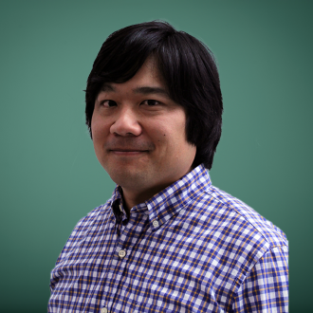
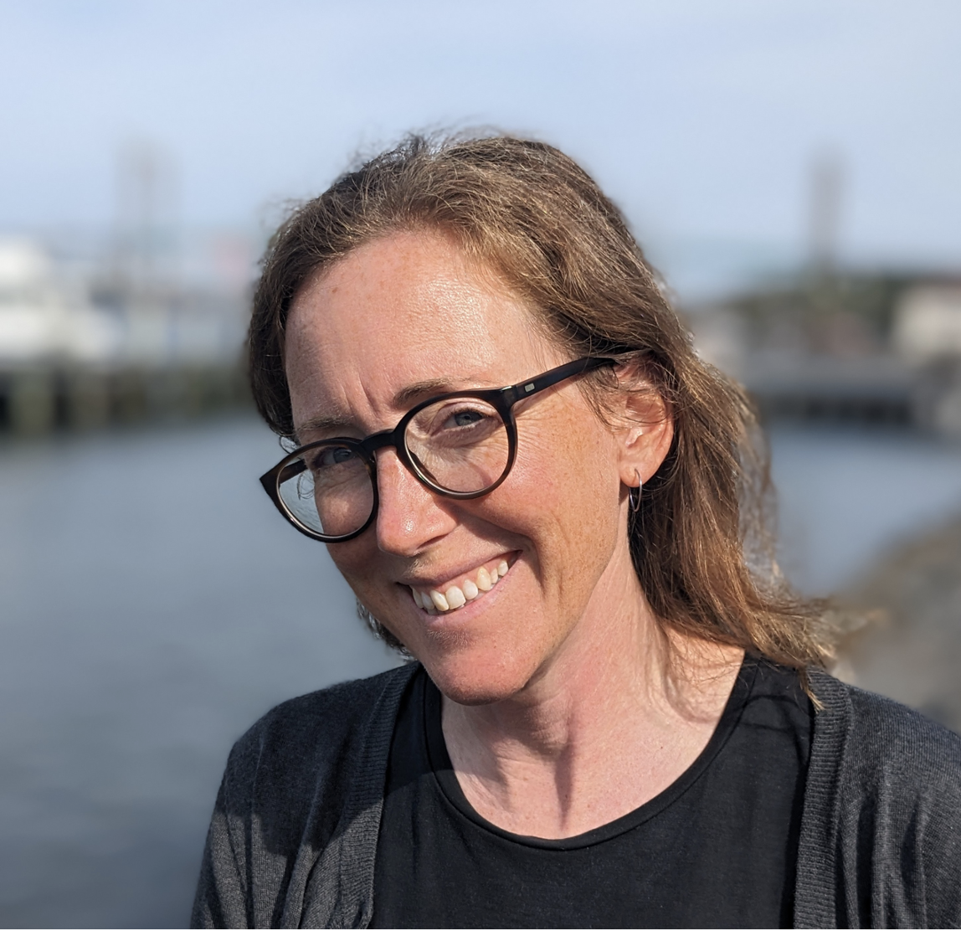
FerryBox Task Team
~30 lines operational
Partners involved:
NIVA, IMR (Norway)
Hereon (Germany)
EuroGOOS (Belgium)
SYKE, FMI (Finland)
SMHI, VOTO (Sweden)
TalTech (Estonia)
HCMR (Greece)
IFREMER (France)
CEFAS (UK)
Deltares (Netherlands)
VLIZ (Belgium)
CNR-ISMAR (Italy)
PLOCAN, IEO (Spain)
IPMA (Portugal)
IO-BAS (Romania)
Tubitak (Turkey)
Chairs: Andrew King (NIVA) & Anna Wranne (VOTO)
www.ferrybox.org

Slide 4
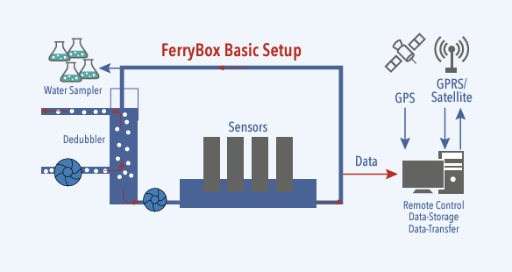
FB Task Team
Parameters for flow through systems:
Temperature
Salinity
Oxygen
Bio-optical sensors:
  Chlorophyll fluorescence
  Turbidity
  Phycocyanin fluorescence
  CDOM/fDOM
pH
pCO2
CH4
TA
Marine meteorology

Slide 5

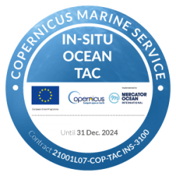
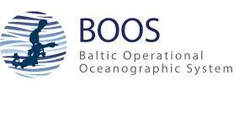
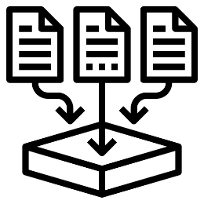
Example of data sharing within BOOS
SMHI via BOOS community collects FB data mainly via FTP in different formats. (Offers a solution for delivery with a specific folder for each provider)
Homogenises data regarding format and parameters
Automatic Quality Control is performed
Data is made available for BOOS members and globally via Copernicus Marine Service and EMODnet Physics
Auto
QC
Data
Notes:
0. The activity to provide timely ctd observations from the Baltic was done within BOOS and supported by CMEMS In situ TAC and a temporal COINS project, Copernicus In-Situ observation coordination project.
FTP is used, mainly because practical reasons, we already had a working flow for swedish monitoring cruises
2. cnv-files are to prefer but other formats may also be solved

Slide 6
FB Task Team objectives
To act as the European component of the global community using ships of opportunity
Develop links with other TT, WG, ROOS, GOOS, OCEAN-OPS, ICOS (Integrated Carbon Observation System), and other complementary activities
Ensure the integration of FerryBox networks in the European ocean observing efforts and contribute to the development of EOOS
Operate and promote a common European FerryBox data portal
Ensure and enable data availability via the EuroGOOS ROOS data portals including data quality procedures and links to CMEMS and EMODnet

Slide 7
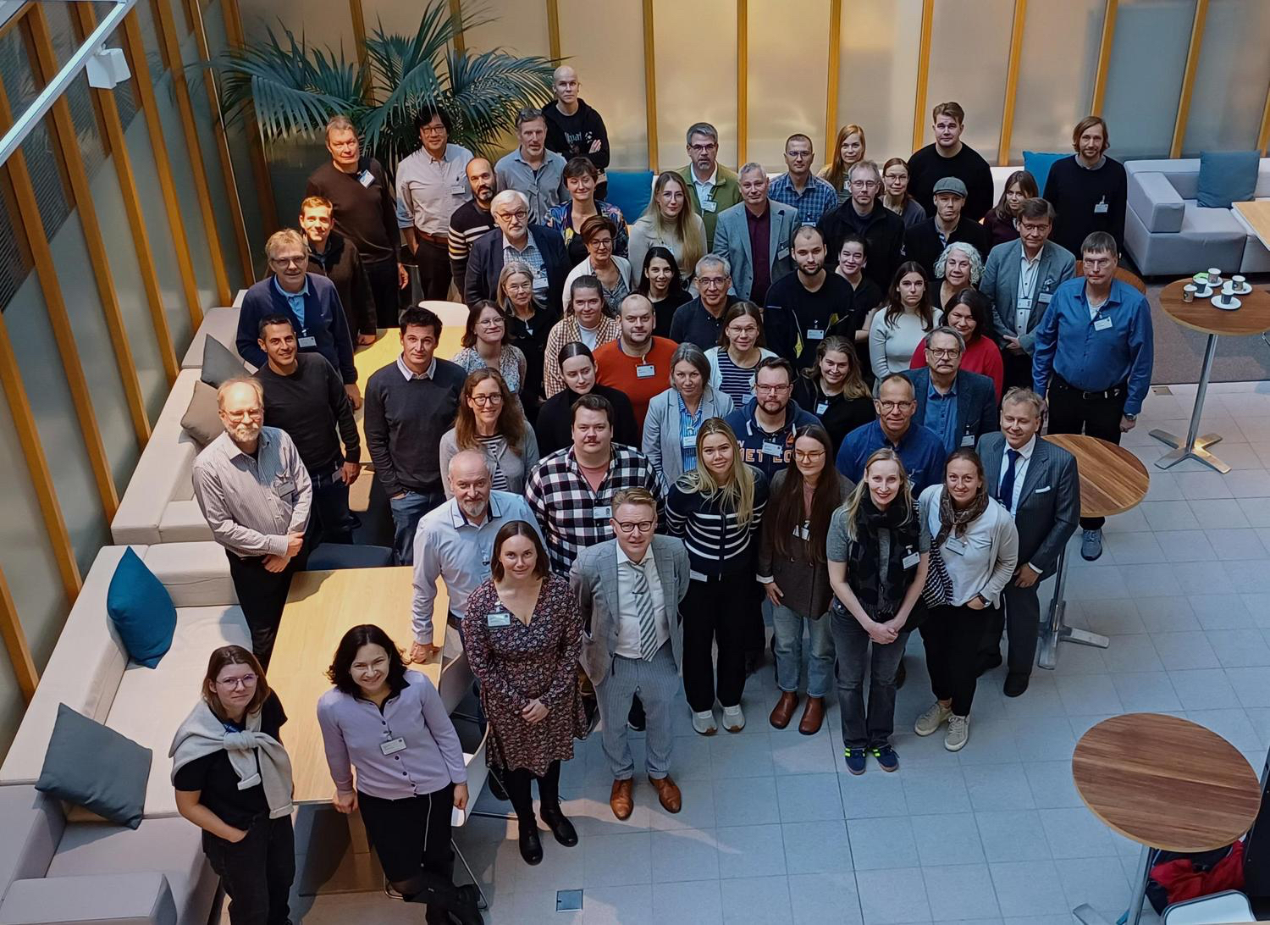
FB Task Team Highlights
12th Ferrybox Workshop in Helsinki, Oct 1-2, 2024.
Over 60 participants covering 11 countries, 28 institutes and University's and 4 manufactures.
Also, in conjunction with MINKE (Project funded by the European Commission within the Horizon 2020 Programme (2014-2020)
Grant Agreement No. 101008724) workshops for Fluorescence and Imagine Flow cytobot work.

Slide 8
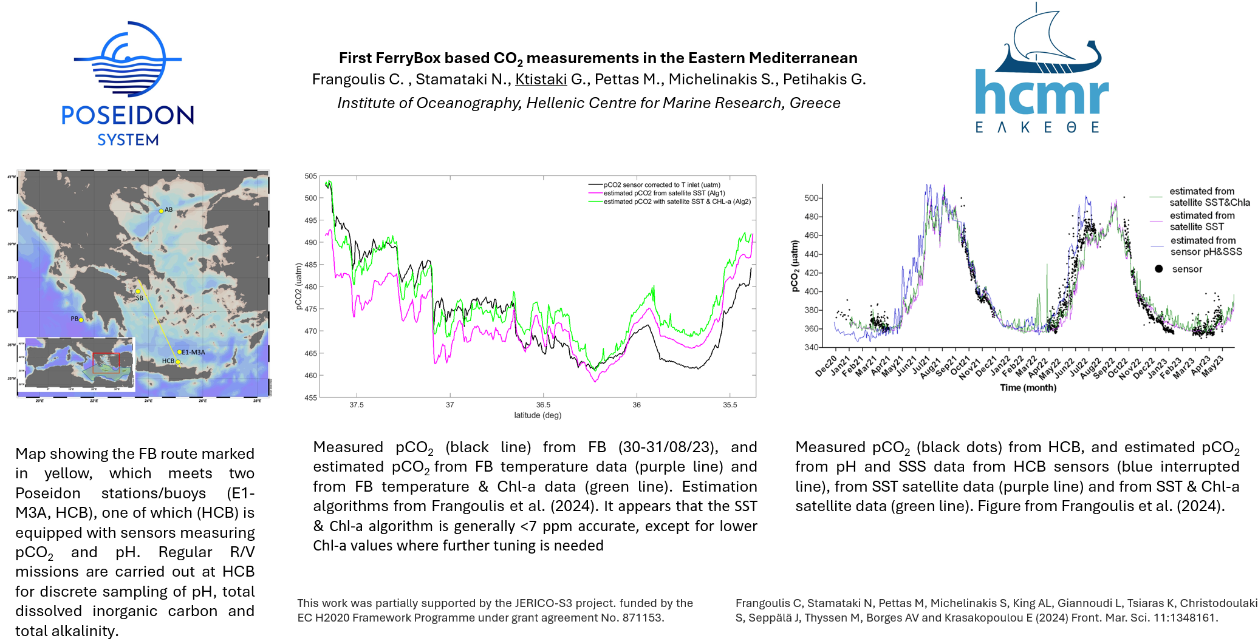
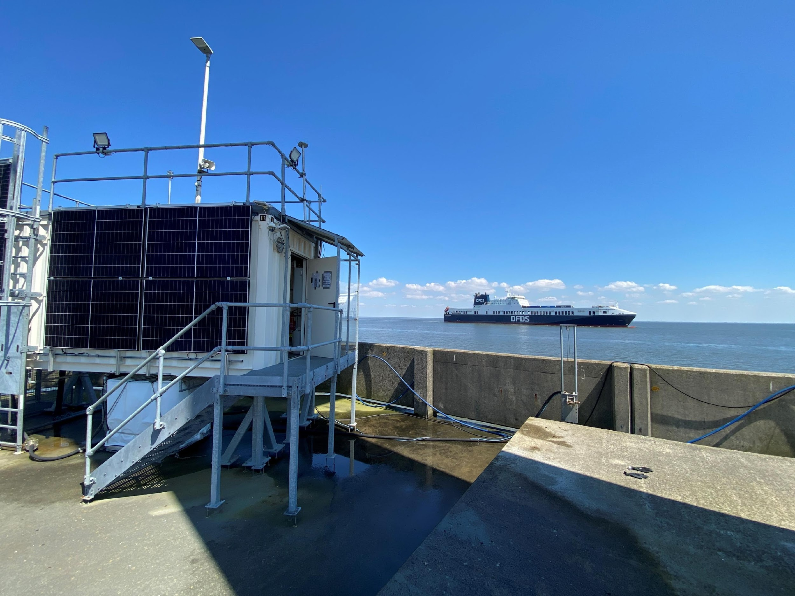
FB Task Team Highlights
HCMR, Greece (Costas Frangoulis):
First CO2 recordings in the Eastern Mediterranean using a FB; CO2 data to be processed and submitted to the next SOCAT submission i.e. in 2025
Hereon, Germany (Yoana Voynova)
  M/S Magnolia Seaways and M/S FunnyGirl (Büsum-Helgoland) are operating in the North Sea (Hereon)
  Tesperhude Station is now also providing nitrous oxide measurement (stationary, Elbe River, Hereon)
  Solar panels installed at Cuxhaven station 2022-2023
FerryBox installation in planning on RV Akademik (IO-BAS) Black Sea, with support from SeaReCap project (IO-BAS - Hereon collaboration)
  Cuxhaven Station (stationary, Elbe Estuary, Hereon), pilot ICOS-D estuarine station since 2023, will add methane measurements in 2025
Source: H Rust, Hereon

Slide 9
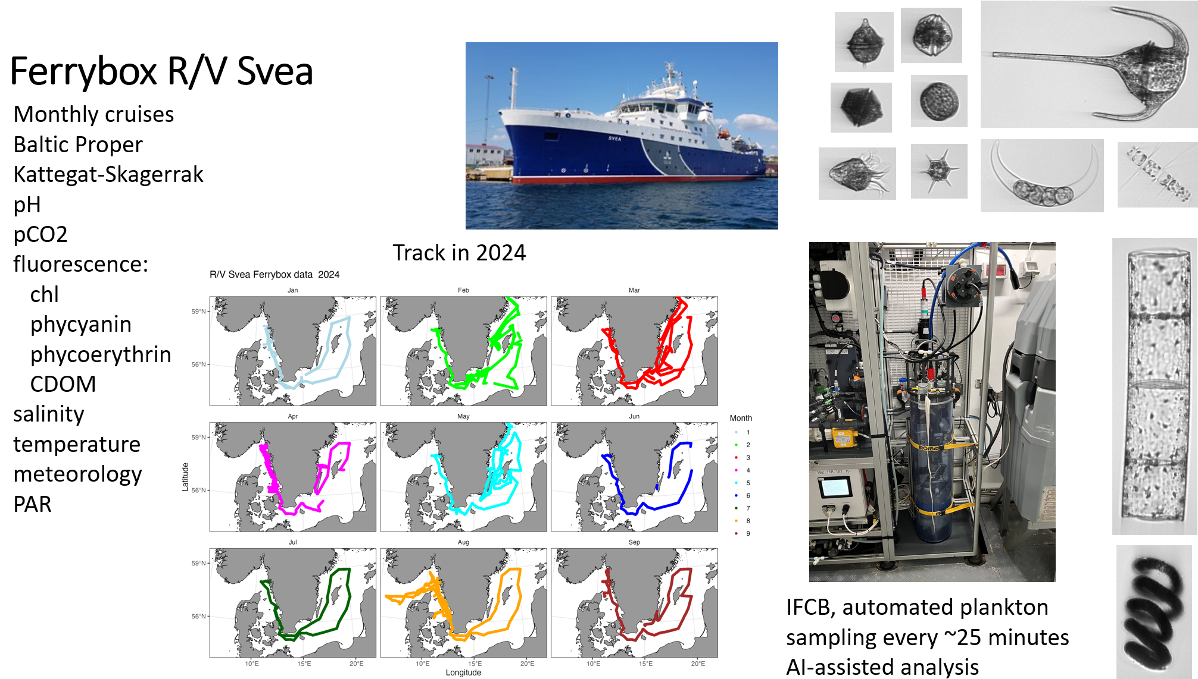
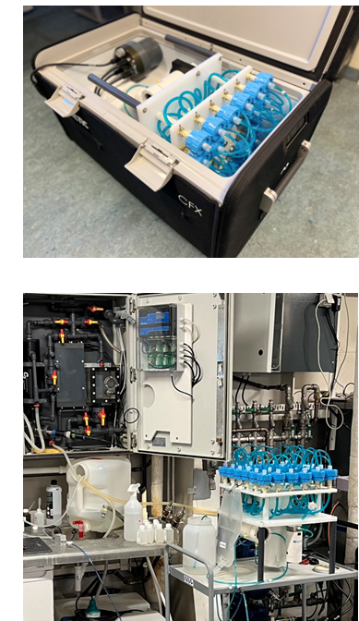
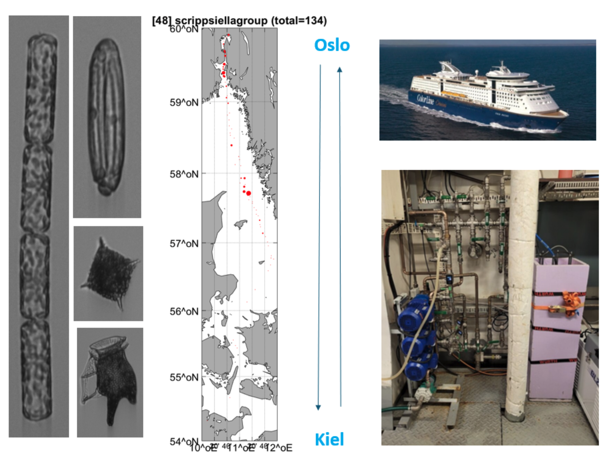
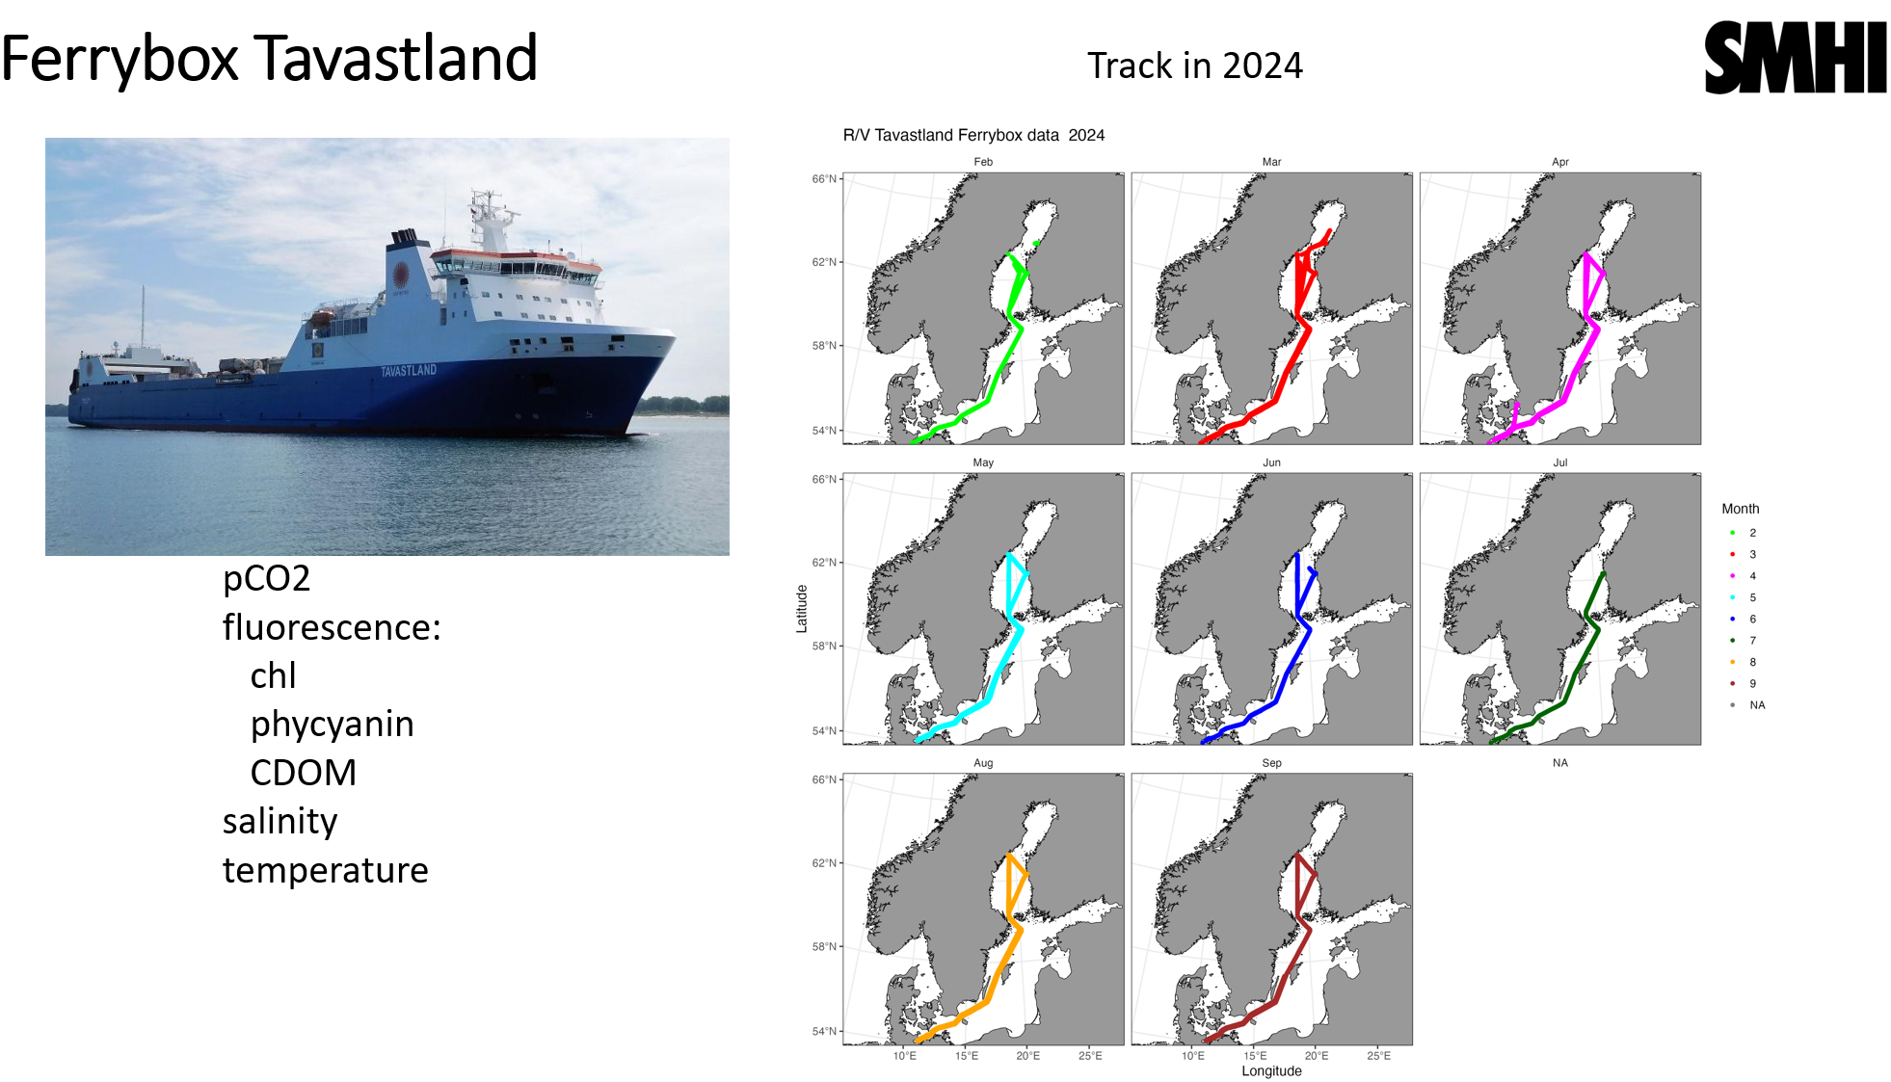
FB Task Team Highlights
NIVA, Norway (Andrew King):
New FerryBox complete on coastal steamer MS Richard With, also with General Oceanics pCO2 sensor for ICOS Norway, will apply soon for ICOS station labeling.
eDNA and Imaging Flow Cytobot (IFCB) deployments on MS Color Fantasy as part of H2020 projects
Nearly complete with re-establishing data links with EMODnet and beyond.
SMHI, Sweden (Bengt Karlson):
SOOP line Tavastland is back in the Baltic Sea covering again the Bothnian Bay and the Baltic Proper.

Slide 10
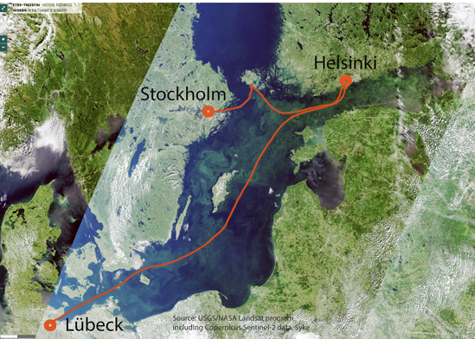
FB Task Team Highlights
SYKE, Finland (Jukka Seppala):
celebrating 30 years of FerryBox measuriments in Algaline “project”; demonstrated the operationality of plankton Imaging (IFCB, Cytosense) on SOOP line FINNMAID (Helsinki-Travemunde) for 5-month period
TalTech, Estonia (Villu Kikas):
upgraded FerryBox system installed onboard Victoria I (Tallinn/Helsinki/Stockholm)
FMI, Finland (Lauri Laakso):
pCO₂ measurements onboard Silja Serenade (Helsinki-Stockholm) joining ICOS OTC
PLOCAN, Spain (Eric Delory):
PLOCAN fixed platform FB (4H JENA) has been delivered to our offshore platform, plans to have the system commissioned by end of this year

Slide 11
Future direction and new initiatives
Strengthen the collaboration between the related European RIs and other projects and initiatives (ongoing project include JERICO-RI, ICOS-ERIC, NAUTILOS, AQUARIUS, MINKE, LandSeaLot, and others)
Work towards an updated “white book/paper” about FerryBoxes for potential users/stakeholders. (Last edition from 2017)
13th FerryBox Workshop in Spring 2026 hosted by HCMR on Crete
Yearly workshop in February within the Alg@line community for calibration of optical sensors for chlorophyll fluorescence, turbidity, CDOM and phycocyanin fluorescence.

Slide 12
Future collaborations between the ferrybox community and IQuOD/GTSPP/SOOP/XBT groups
How can we have a closer collaboration between the different networks to share knowledge and experience within:
  QC
  Best Practices
  Data management
  Other

