Slide 1
Global Tsunami Early Warning System, ICG/NEAMTWS, Ocean Decade Tsunami Programme and Tsunami Ready Programme
Denis Chang Seng, PhD Programme Specialist
Technical Secretary (ICG-NEAMTWS & TOWS Task Team on Disaster Management and Preparedness
ODTP Focal Point
CoastWAVE Project Responsible Officer
Tsunami Resilience Section
UNESCO IOC

Slide 2

Coastal communities face significant risks and impacts from ocean-related hazards, including tsunamis
.
EWSs are important tools for building resilience and DRR
EWSs are a proven, efficient, and cost-effective way to save lives and jobs, land and infrastructure, and support long-term sustainability

Slide 3
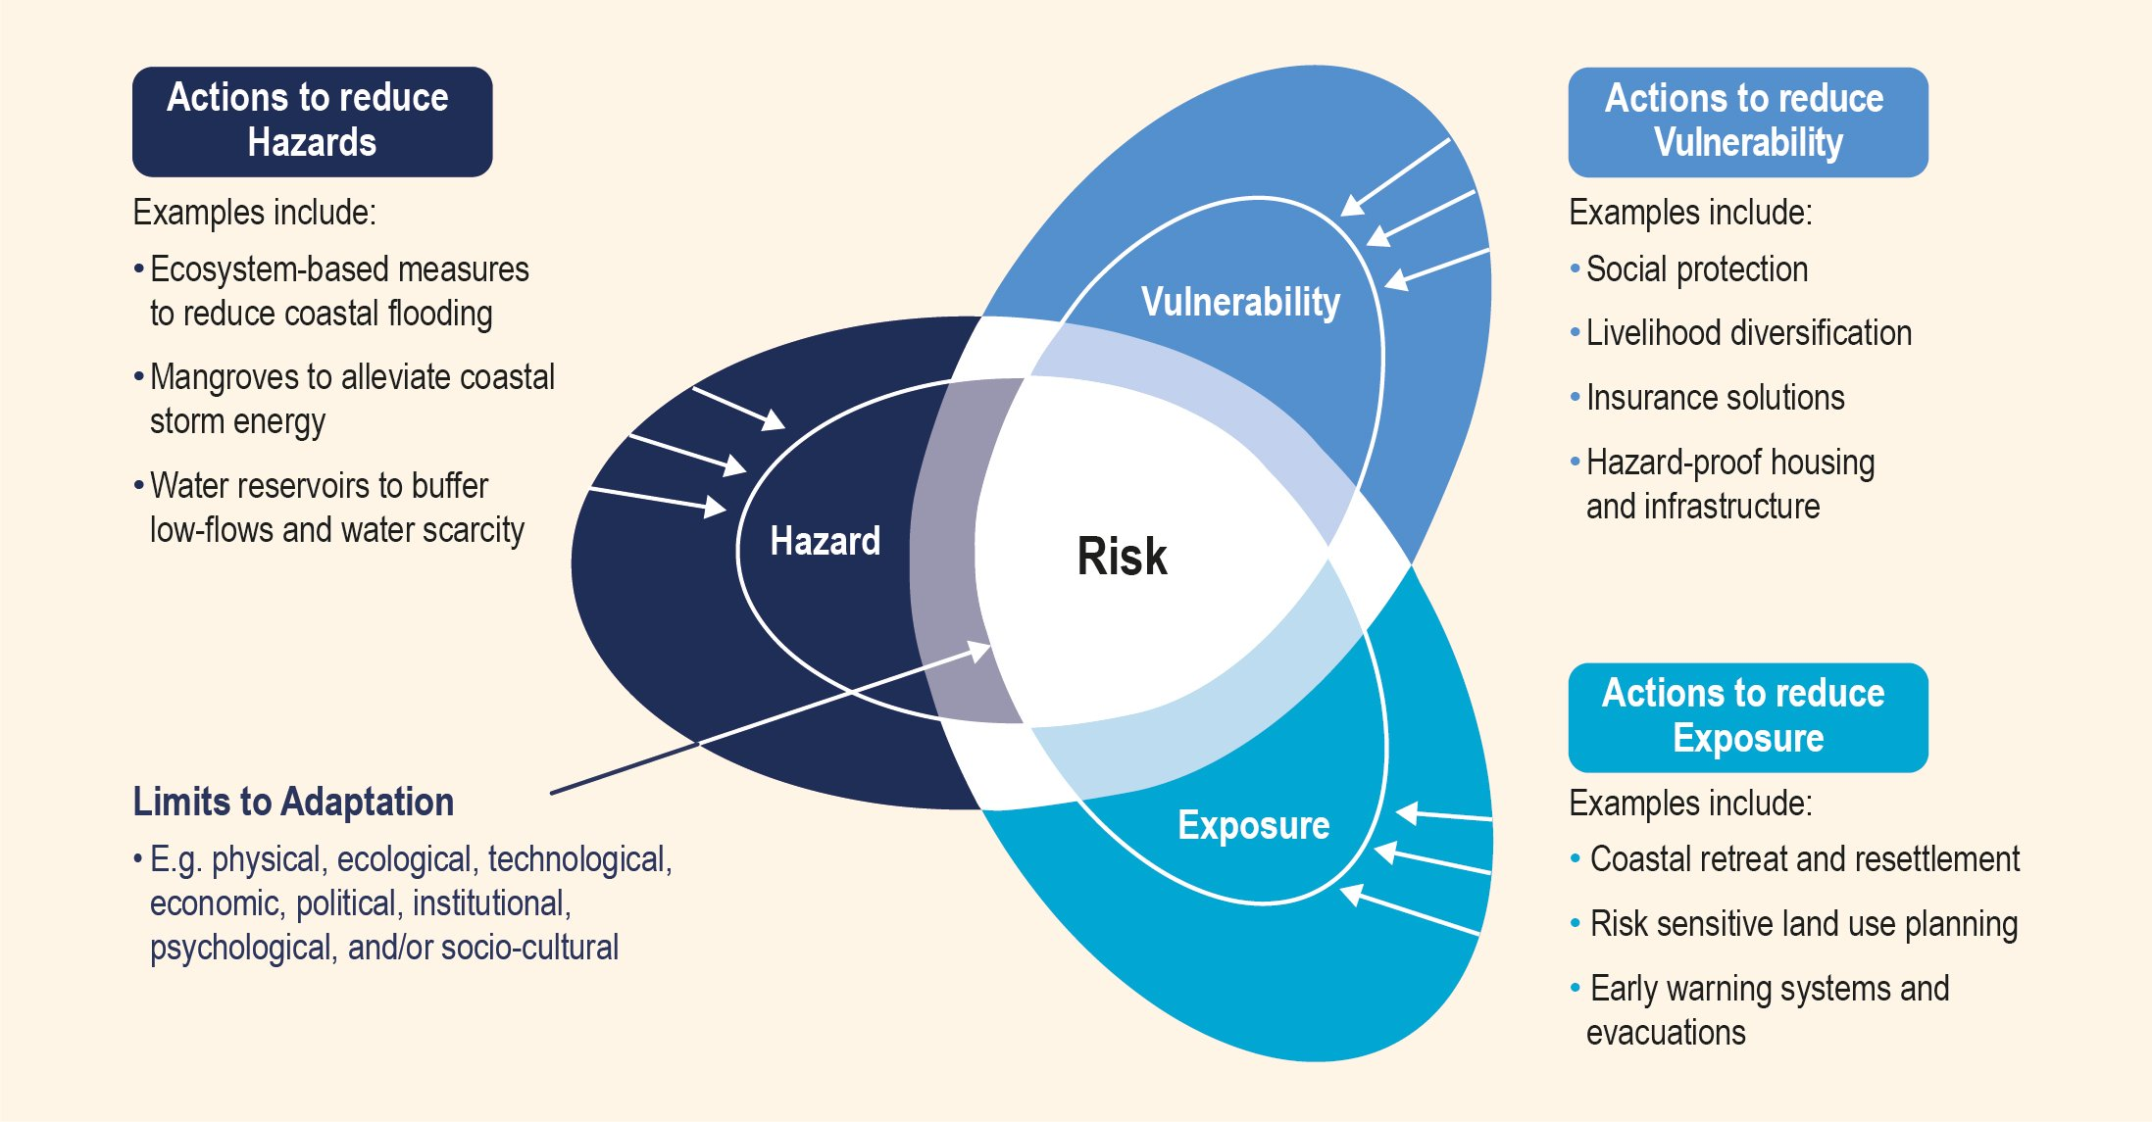
IPCC

Slide 4
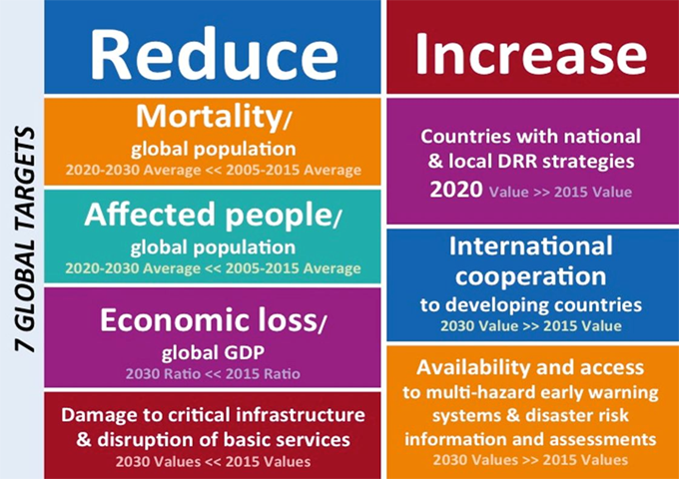
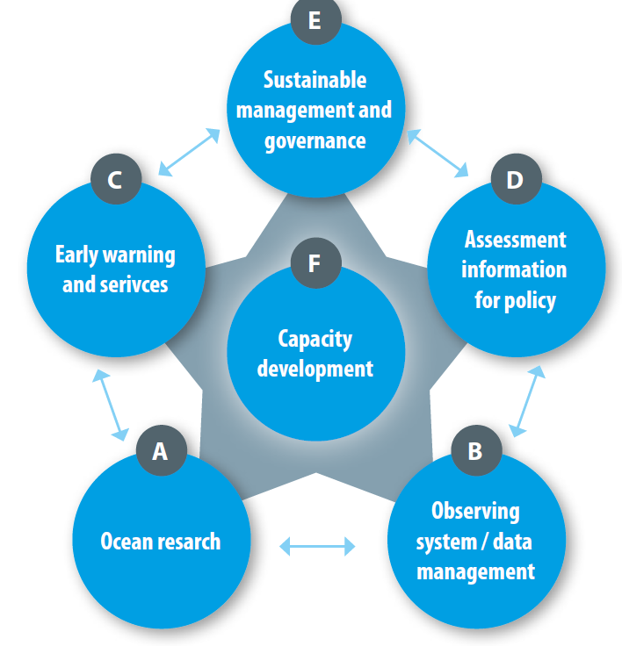
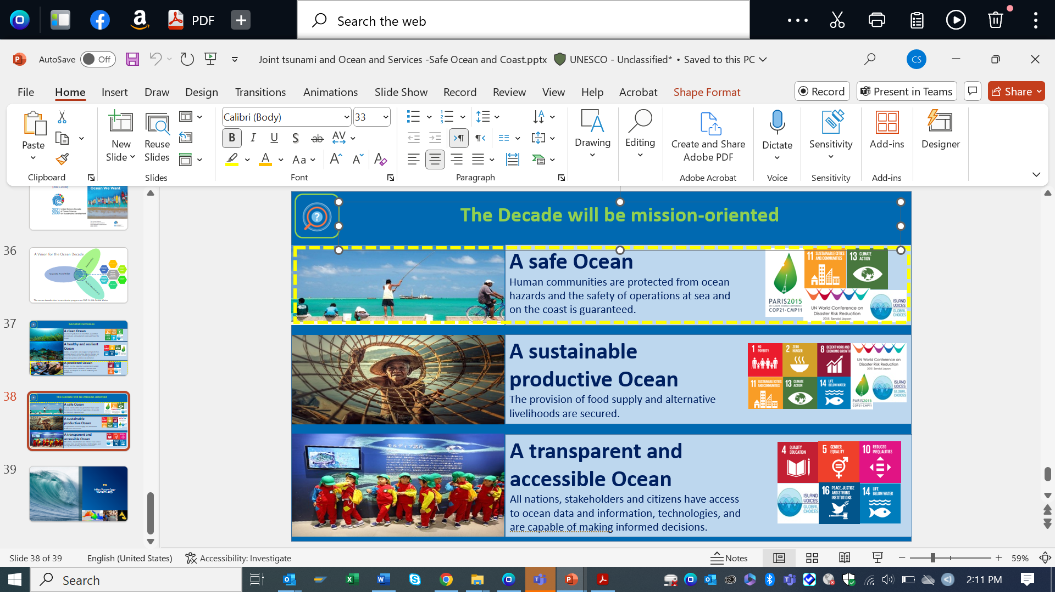

Sendai Framework for DRR
Ocean Decade A Safe Ocean Challenge 6
EW4 ALL
The Global Frameworks/ Initiatives-EWS
IOC Functions and Value Chain

Slide 5
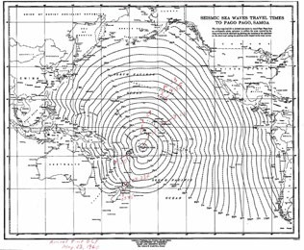
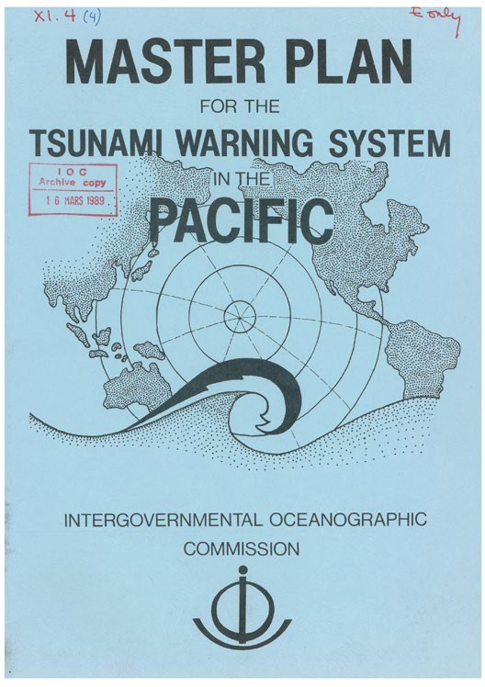
We have gone a long way…
ITSU renamed
September 2005, Vina del Mar, Chile
The 20th Session of the ICG/PTWS- XX decides to change its name to the Intergovernmental Coordination Group for the Pacific Tsunami Warning and Mitigation System
1948 the Honolulu Magnetic Observatory, under the US Coast and Geodetic Survey (USCGS)established
GITEWS
ITSU
IOC/IV-6, International Aspects of the Tsunami Warning System in the Pacific, Paris, November 1965
ITSU development
The tragedy brings world attention to the dangers of tsunamis in every nation and initiates the development of warning and mitigation systems in the Indian Ocean
1989
2005
1965
The Honolulu Observatory renamed Pacific Tsunami Warning Center PTWC
Indian Ocean Tsunami
3 ICGs established
First Master Plan
1952. The Japan Meteorological Agency started its national tsunami warning center
Indian Ocean (ICG/IOTWS), Caribbean and Adjacent Seas (ICG/CARIBE-EWS),
Mediterranean and North Eastern Atlantic (ICG/NEAMTWS) (IOC/XXIII-11, 12, 13, June 2005)
1977
2004
1965 - IOC Working Group on the International Aspects of the Tsunami Warning System in the Pacific, organized by the USCGS on behalf of the IOC, Honolulu, 27-30 April 1965
Single Regional coordination and cooperation | Global Coordination and Cooperation

Slide 6
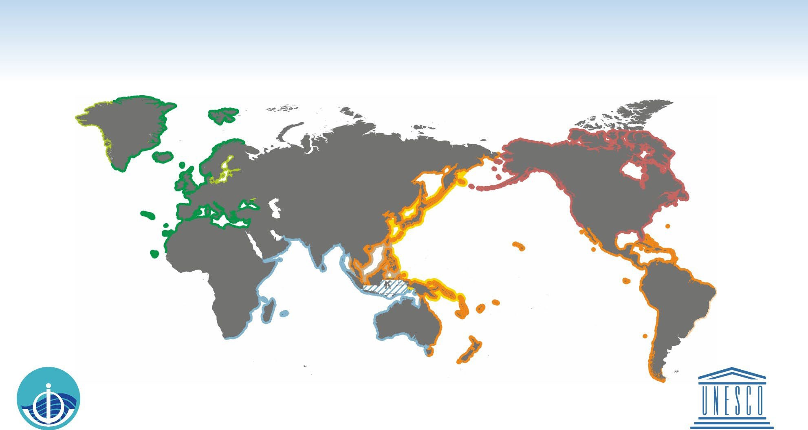







GLOBAL TSUNAMI WARNING AND MITIGATION SYSTEM
Intergovernmental Oceanographic Commission of UNESCO 2025 www.ioc-tsunami.org
144 Member States
40 Member States
Services provided by the US National Tsunami Warning Center are outside the framework of the IOC-coordinated tsunami warning systems
NEAMTWS
North Eastern Atlantic, Mediterranean and connected seas Tsunami Warning and Mitigation System
CARIBE-EWS
Tsunamis and Other Coastal Hazards Warning System for the Caribbean and Adjacent Regions
CTIC Caribbean Tsunami
NEAMTIC NEAM Tsunami
Information Centre (Barbado
Information Centre (IOC)
32 Member States
Accredited TSPs:
CENALT
Centre d'Alerte aux Tsunamis of France
IPMA
Instituto Portugues do Mar e da Atmosfera of Portugal
INGV
Istituto Nazionale di Geofisica e Vulcanologia of Italy
KOERI
Kandilli Observatory and Earthquake Research Institute of Turkey
NOA
National Observatory of Athens of Greece
Planned NEAMTWS
46 Member States
PTWC TSP
Pacific Tsunami Warning Center /
PTWS
Pacific Tsunami Warning and Mitigation System
NWS/NOAA of USA
Planned TSP PTWS, CARIBE-EWS
ITIC International Tsunami
Information Centre (USA, Chile, IOC)
IOTWMS
Indian Ocean Tsunami
Warning and Mitigation System
NWPTAC TSP
Northwest Pacific Tsunami Advisory Center /
Japan Meteorological Agency
27 Member States
IOTIC Indian Ocean Tsunami
PTWC TSP
Pacific Tsunami Warning Center / NWS/NOAA of USA
Information Centre (Indonesia)
InaRTSP
Indonesian Regional Tsunami Service Provider
ITEWC TSP
Indian Tsunami Early Warning Centre
JATWC TSP
Joint Australian Tsunami Warning Centre
Service iprovided by the InaTEWS
Indonesian Tsunami Early Warning System at the BMKG, outside the framework of the IOC- coordinated tsunami warning systems
SCSTAC TSP
South China Sea Tsunami Advisory Center / National Marine Environmental Forecasting Center of P. R. China

Slide 7

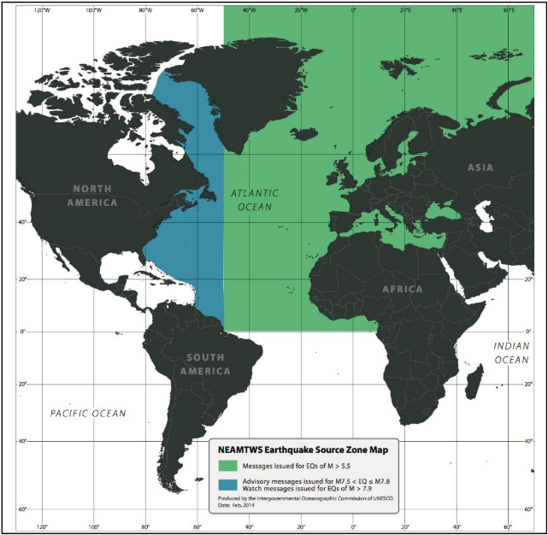
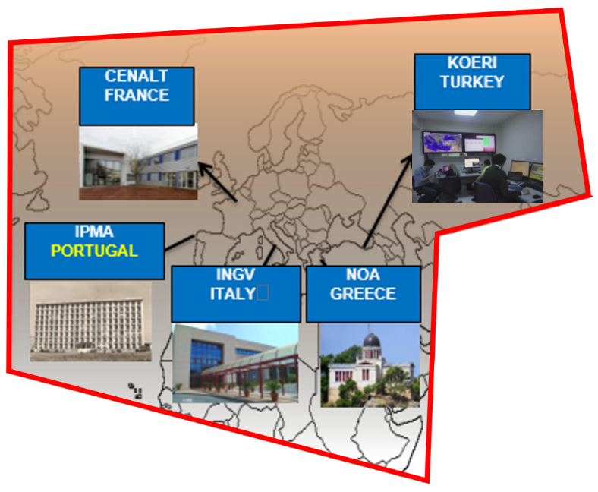
NEAMTWS
5 accredited TSPs
IOC, GSDD, 2016
Source: A. Amato

Slide 8
ICG-NEAMTWS
Chair and Vice Chairs
A. Amato, I. Aguirre Ayerbe, Amr Hamouda
Technical Secretary
D. Chang Seng
Projects
WG1 - Hazard assessment and modelling
(J. Macias / A. Gailler)
WG2-3 - Seismic, Geophysical and Sea Level Measurements
(A. von Gyldenfeldt / D. Cambaz)
WG4 - Public Awareness, Preparedness and Mitigation
(C. Valbonesi / R. Partheniu)
Task Team on Tsunami Exercises
C. Ozer Sozdinler /
M. Charalampakis
Task Team on Operations
A. Piatanesi /
F. Carrilho
Task Team on Documentation
N. Kalligeris /
S. Lorito
Task Team on Tsunami Ready
E. Daskalaki /
M.A. Baptista
New Task Team
Non seismic tsunami sources
F. Romano / R. Omira
New Task Team
Governance
I. A. Ayerbe/ D. Cambaz
Source: A. Amato

Slide 9
UNESCO-IOC
Assembly/Executive Council
UN OCEAN DECADE
Global Coordination
Working Group for Tsunami & Other sea level related Warning & mitigation Systems (TOWS-WG) [4x ICG Chairs, WMO, UNDRR, UNDP, IMO, IHO]
Task Team Disaster Management & Preparedness
UN Ocean Decade Tsunami Programme
Science Committee
Task Team Tsunami Watch Operations
ICG
Caribbean & Adjacent Seas (CARIBE-EWS)
Intergovernmental Coordination Group (ICG) IOTWMS
ICG
Pacific Tsunami Warning & Mitigation System (PTWS)
ICG
NE Atlantic & Mediterranean Seas (NEAMS-TWS
UNESCO-IOC Member States
ICG/IOTWMS Secretariat
Srinivasa Kumar Tummala
Nora Gale
Hosted by BOM, Australia
UNESCO-IOC Tsunami Resilient Section
Indian Ocean Tsunami Information Centre (IOTIC) Ardito Kodijat
Hosted by BMKG, Indonesia
IOC Regional Programmes and Offices

Slide 10

The Three Strategic Pillars-Effective EWS
Risk Assessment and Reduction
Systematically collect data and undertake risk assessments
Detection, Warning and
Dissemination
Develop hazard detection, monitoring and early warning services
Communicate threat information and early warnings
People centered and end to end in design
Awareness and Response
Build national and community response capabilities

Slide 11



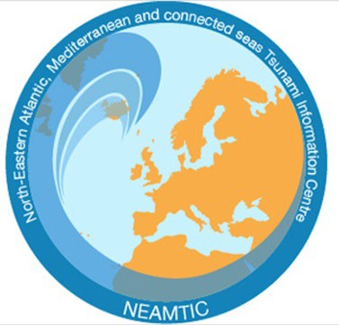

IOC Tsunami Information Centers
PTWS
USA NOAA – IOC Partnership
1965
Chile SHOA Associate Director
1998
ITIC
NEAMTWS
EC DG ECHO
France, Greece, Italy, Portugal 2011-13
NEAMTIC
IOTIC
IOTWS
Indonesia – IOC Partnership 2012 (formerly JTIC since 2006)
CARIBE-EWS
Barbados– IOC Partnership 2015 (approved 2007)
CTIC

Slide 12
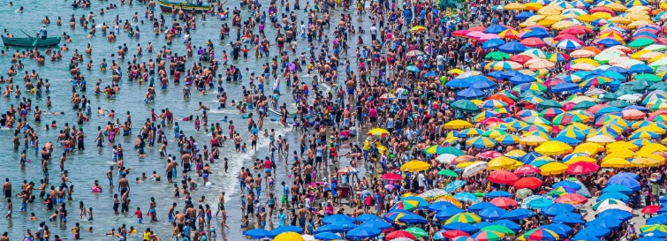
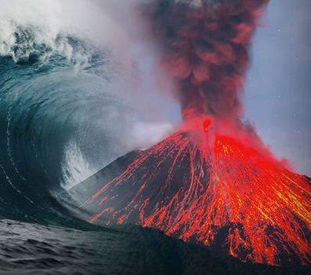
A Remarkable Journey of Progress because of International Cooperation and Coordination
Increasing Challenges
Other tsunami sources (volcano, landslides etc.) and complexity , including climate change induced)
Changing and increasing coastal exposure & risk-socio-economic pathways

Slide 13
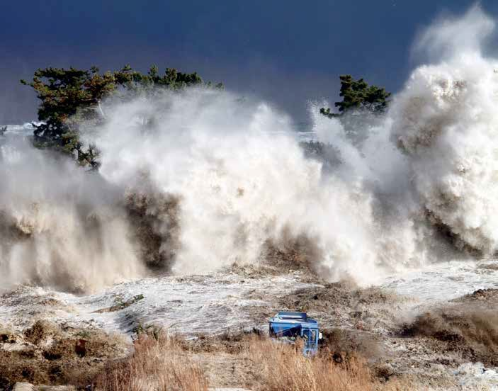
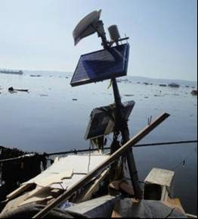
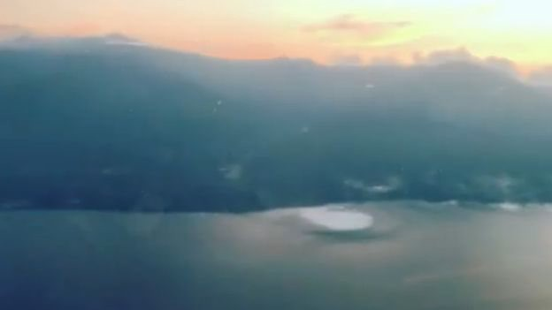

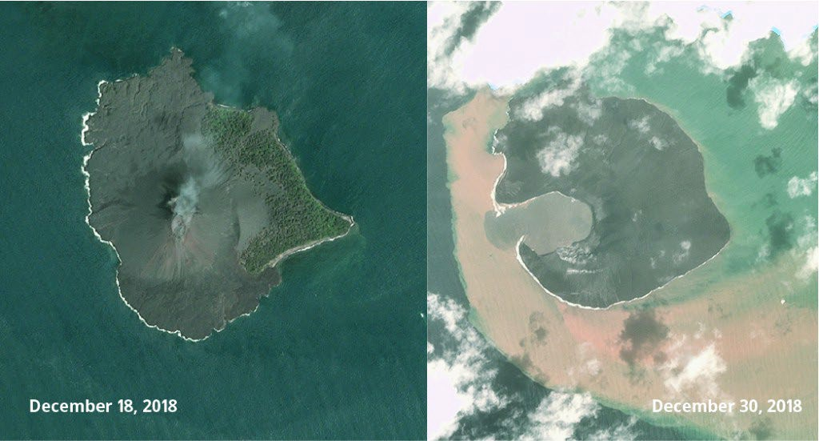
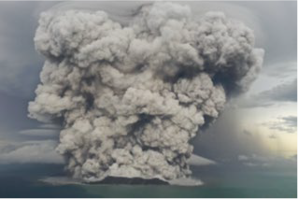
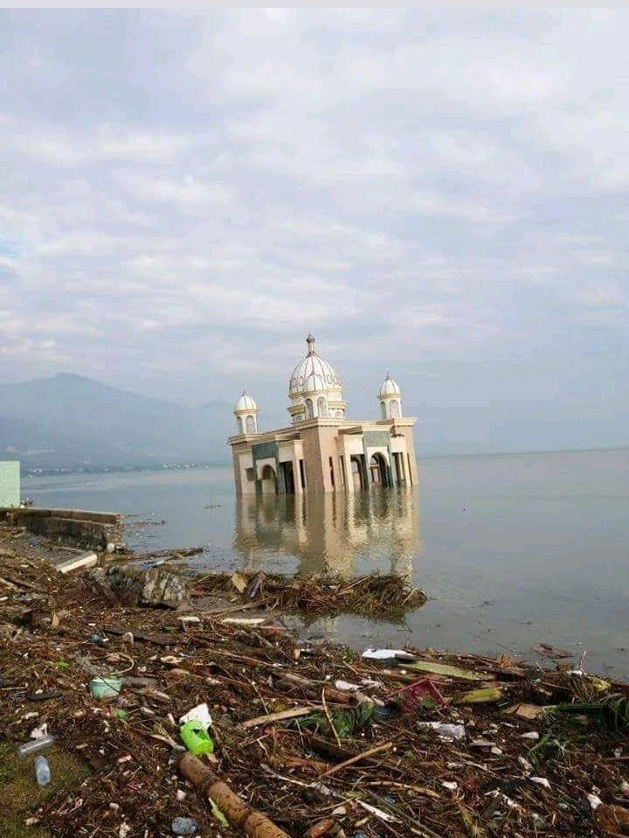
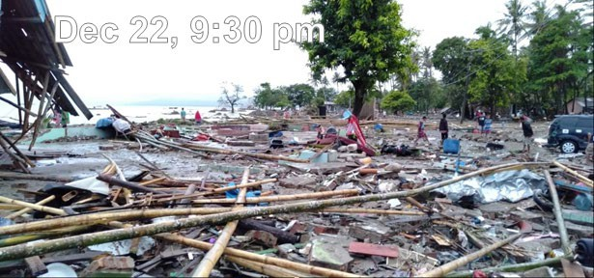
Photo 1. Damaged sea level station the day after the 27 February 2010 tsunami, Talcahuano, Chile
Photo by Rodrigo Núñez Gundlach
2016 ->Recent case studies demonstrated complexity and variability, as well as importance of other types of tsunami sources.
Minamisoma, Fukushima prefecture, Japan. 2011 March 11, Mw 9.0, Honshu, Japan earthquake and tsunami. (Credit: AFP/AFP/Getty Images.)
December 18, 2018
December 30, 2018
2011 Tōhoku earthquake and tsunami
2018
CLIMATE INDUCED
Volcano generated tsunami
2010
Chile
2011
Tonga
Palu, Indonesia
Sunda strait, Indonesia
Inter-ICG Task Team on Hazard Assessment Related to Highest Potential Tsunami Source Areas
Landslide generated tsunami
2022
2018
The Group decided to establish a specific Ad Hoc Team on Meteo- tsunamis &Ad Hoc Team on Tsunamis Generated by Volcanoes

Slide 14

OCEAN DECADE TSUNAMI PROGRAMME
AN OCEAN DECADE ACTION

Slide 15
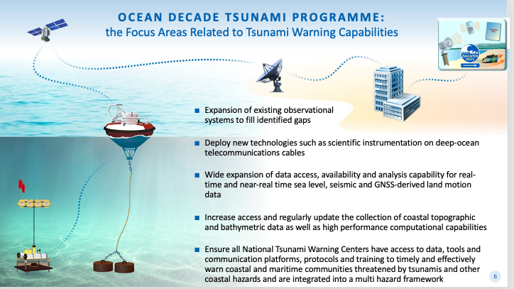
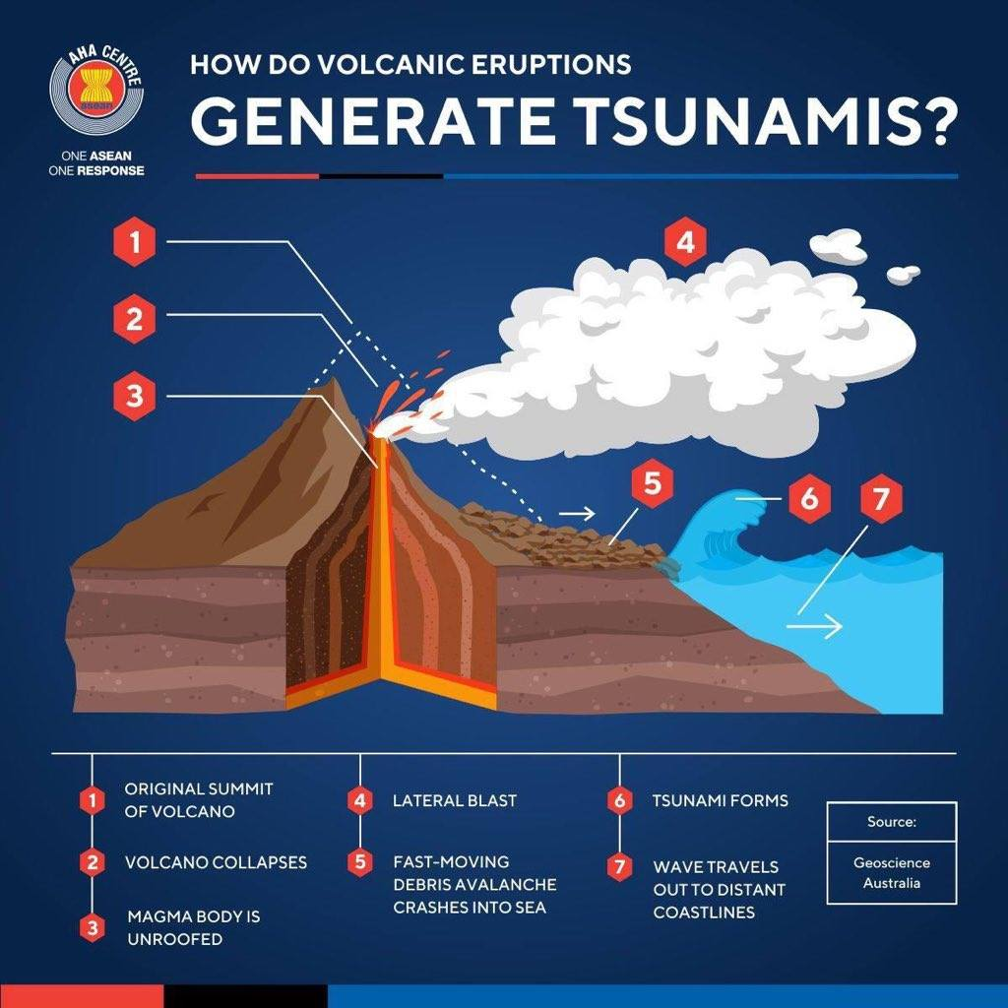

Transformation in the Global TEWS (2022) Aim: To significantly enhance the existing Global Tsunami Warning System
Photographer of the city of Cannes: Michel Giroldo
ODTP -Objectives
To develop the warning systems’ capability to issue ACTIONABLE and TIMELY (<10 min) tsunami warnings for tsunamis from ALL IDENTIFIED SOURCES to 100% OF COASTS AT RISK
100% of communities at risk be prepared and resilient to tsunamis by 2030 through programmes like the IOC-UNESCO Tsunami Ready Recognition Programme (TRRP)

Slide 16
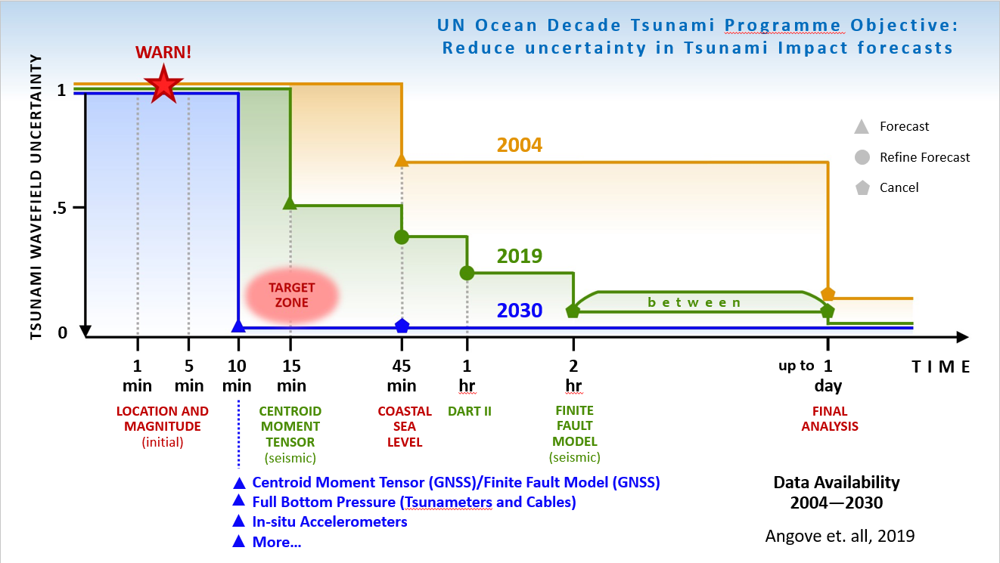
Advancing Warning Systems’ Capability
T<10 min, all sources,100% of coasts at risk
Objective 1
To improve capability to directly detect and measure tsunamis and reduce reliance on seismic proxy relationships in terms of projecting impacts
To develop the warning systems’ capability to issue actionable and timely tsunami warnings for tsunamis from all identified sources, including non-seismic tsunamis.
New cooperation and partnerships needed.

Slide 17



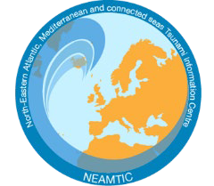

Tsunami Ready
Tsunami Ready Recognition Programme is:
UNESCO-IOC Tool for Reducing Tsunami Risk and Building Resilience through Community Preparedness
Voluntary international performance-based community programme with 12 indicators
Objective 2
100% of communities at risk be prepared and resilient to tsunamis by 2030 through programmes like the IOC-UNESCO Tsunami Ready Recognition Programme (TRRP)
Implemented through the UNESCO-IOC Tsunami Information Centres

Slide 18

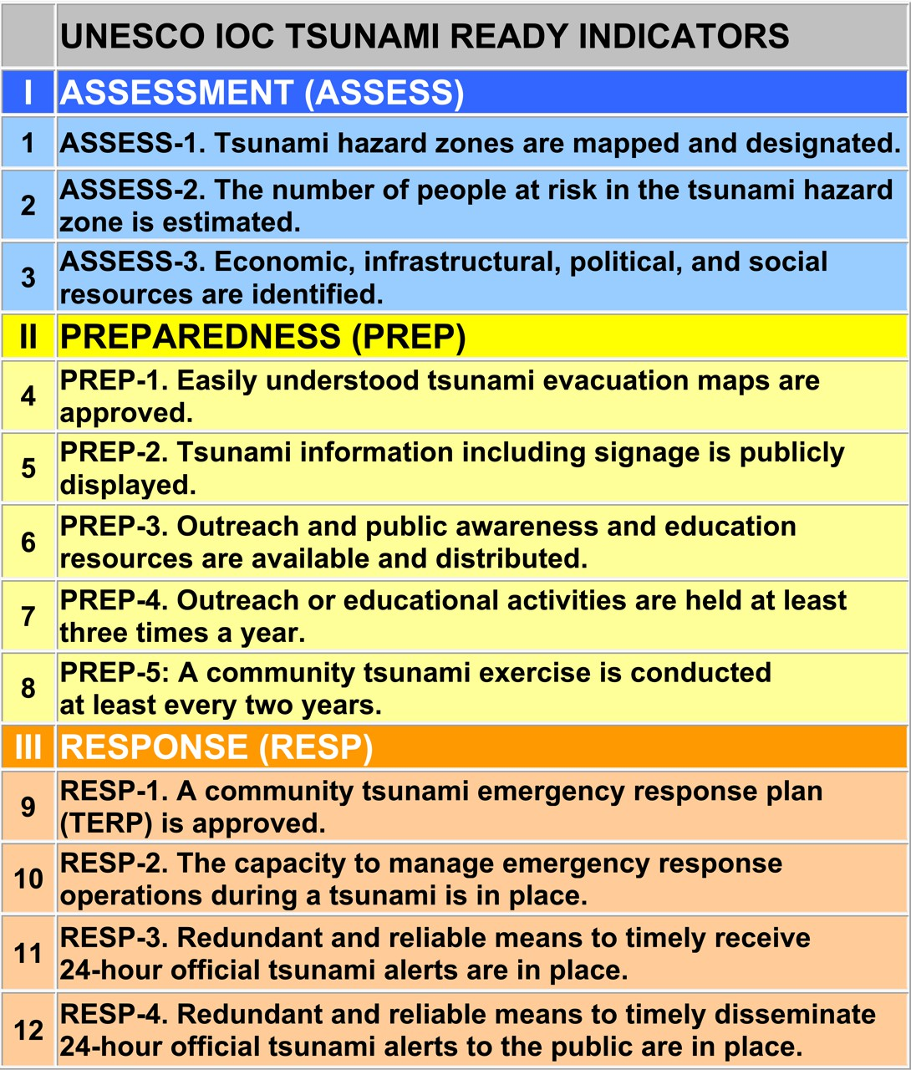

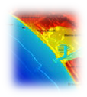
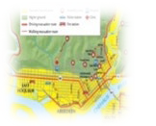





UN OCEAN DECADE TSUNAMI PROGRAMME:
100% AT-RISK COMMUNITIES TSUNAMI READY
STRATEGY:
Be Aware, Be Prepared
FRAMEWORK:
Harmonized global guidelines UNESCO IOC Tsunami Ready
Performance-based Community Recognition
ACTION:
National programs empower Communities
GLOBAL MEASURE
Standard Guidelines for the Tsunami Ready Recognition
Program, UNESCO IOC TS 74

Slide 19

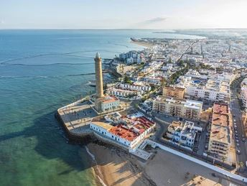
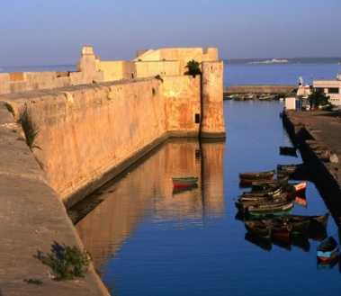
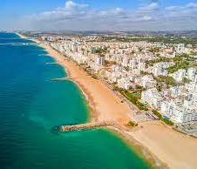
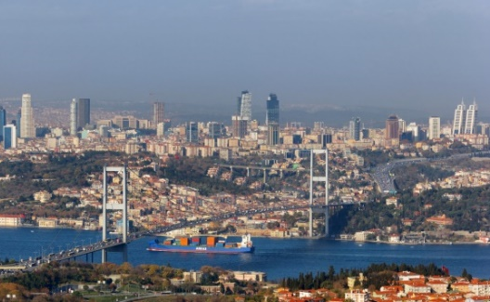
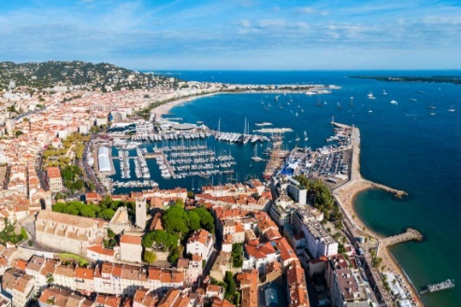
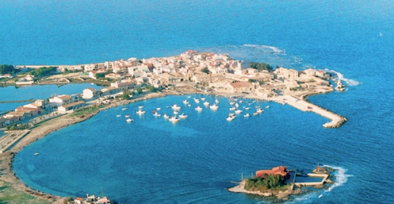
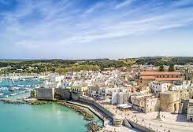
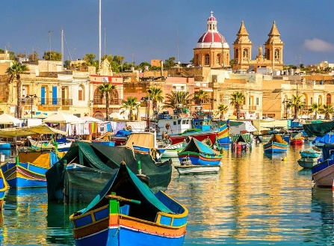
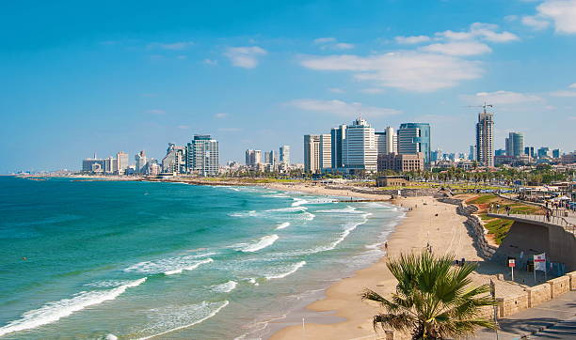
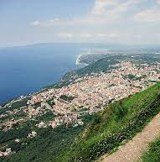
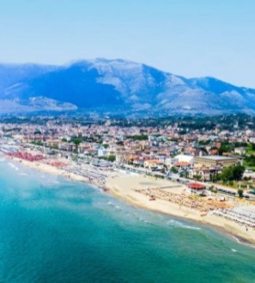
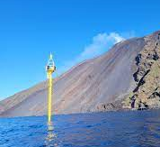
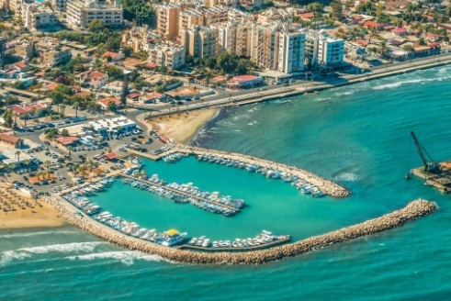
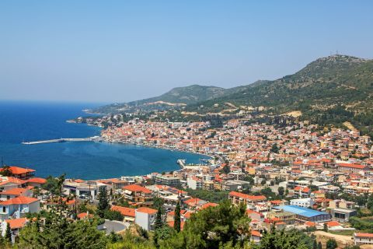
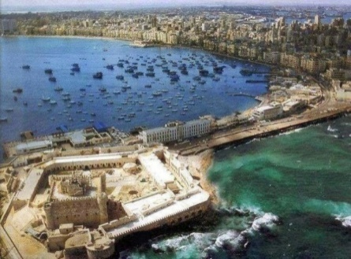
Tsunami Ready Implementation in NEAM REGION
11 Countries
15+ Communities
6 Recognized in 2024
…more coming!
Chipiona
El Jadida
Loulé
Büyükçekmece
Cannes
Marzamemi
Otranto
Marsaxlokk
Israel
TRS/Chang
Seng /Amato 2024
Palmi
Minturno
Stromboli
Larnaca
Samos
Alexandria
Notes:
DG ECHO Key

Slide 20
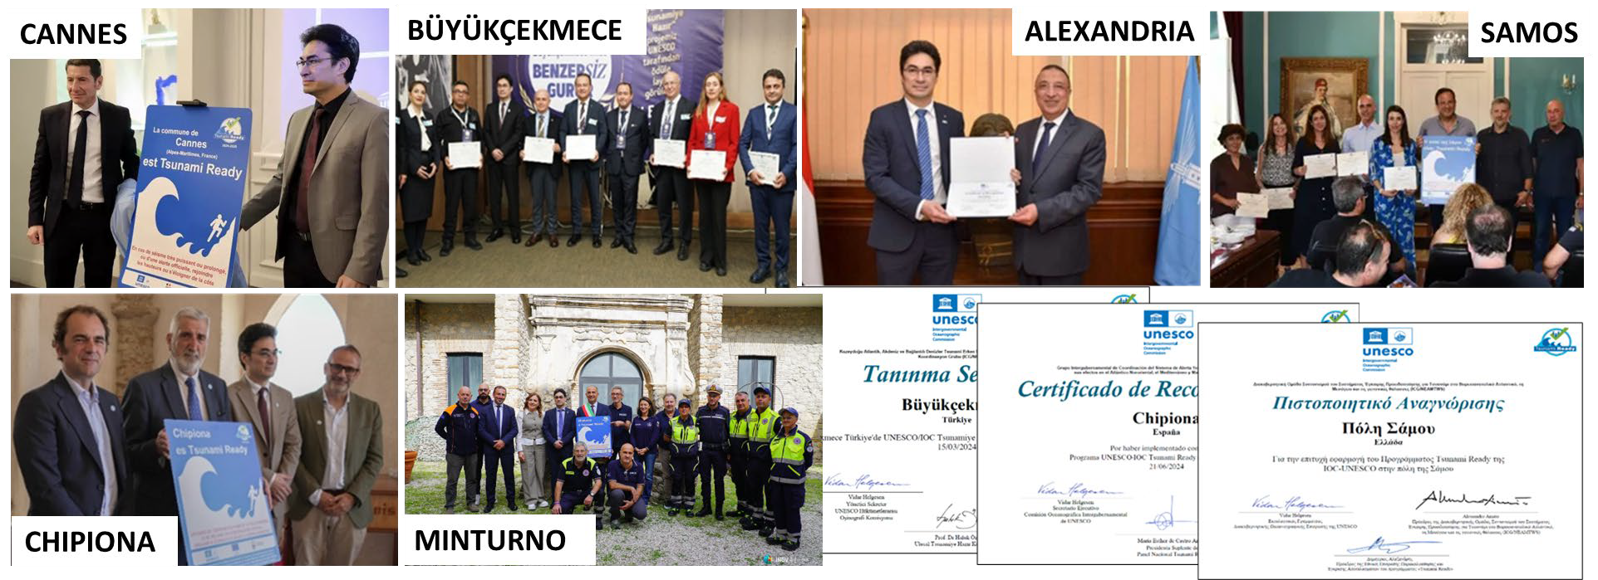
TRRP IMPLEMENTATION - NEAM REGION
International, National, Local Engagements City Mayors and Governor | 6 communities Recognized as Tsunami Ready. Several others in the process. 25 by 2025
EC DG ECHO SUPPORT-CoastWAVE Project

Slide 21

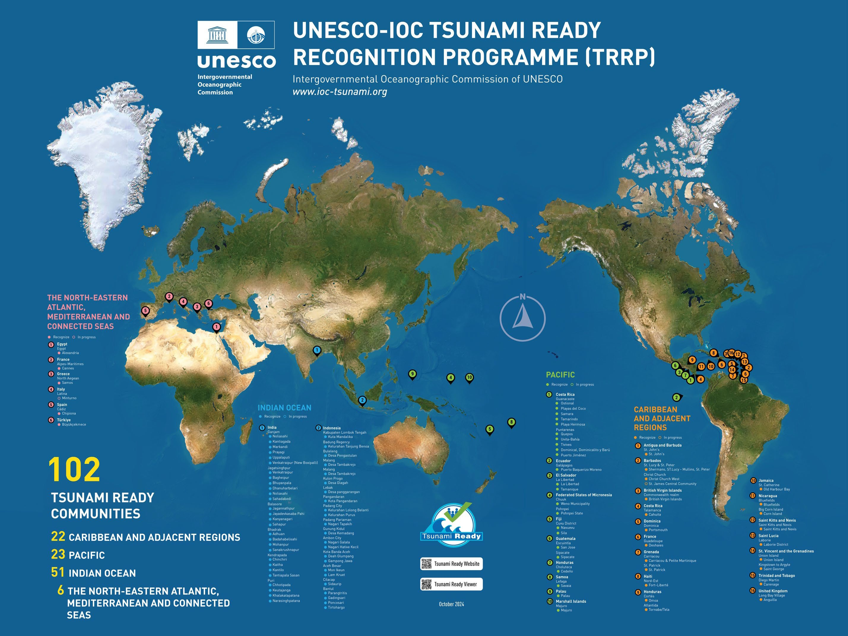
100
Tsunami Ready Communities
48 INDIAN OCEAN
23 CARIBEAN & ADJACENT REGIONS
23 PACIFC
6 NORTH EASTERN ATLANTIC , MEDITERRANEAN AND CONNECTED SEAS
30 / 139 Member States
14 CAR
18 PAC
2 IO
6 NEAM
3
15 SIDS
10 CAR
5 PAC
0 IO
0 NEAM

Slide 22

International Tsunami Ready Coalition
The IOC Executive Council at its 55th session also approved the establishment of an International Tsunami Ready Coalition
New Implementation Plan of the Tsunami Ready Coalition has been endorsed at the 33rd IOC Assembly, June 2025

Slide 23
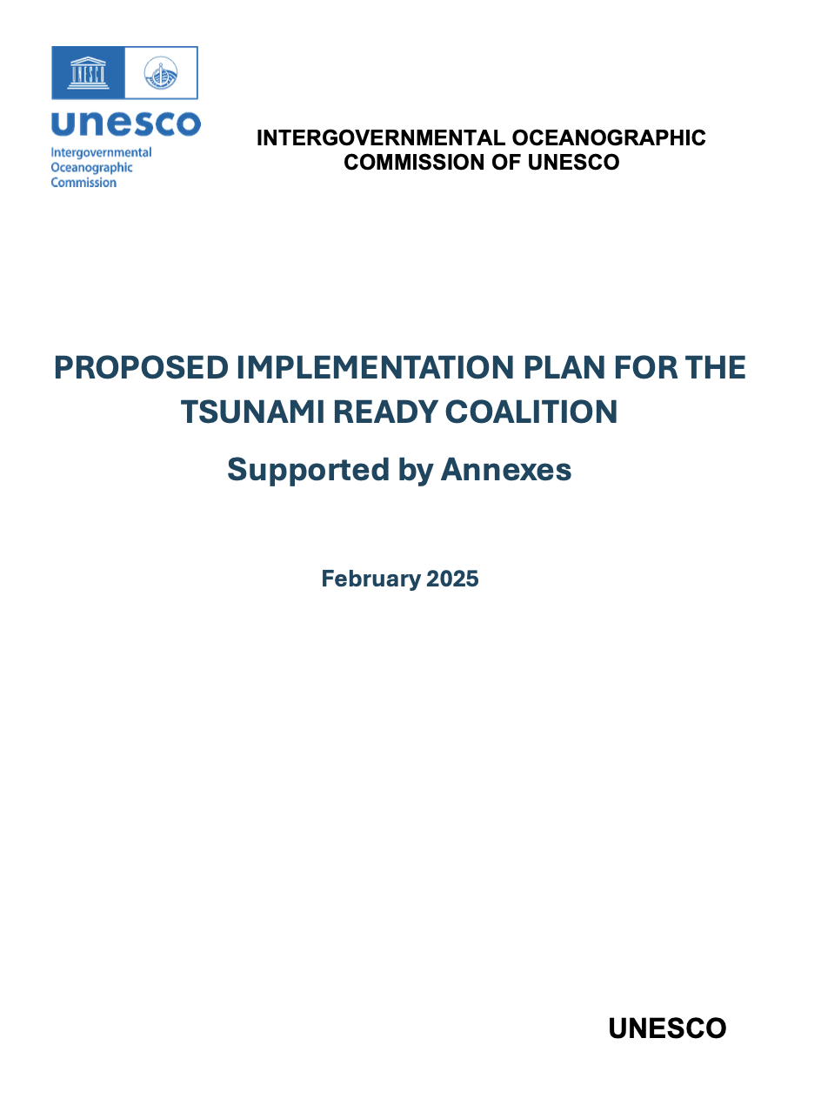
The Tsunami Ready Coalition Collaboration and Cooperation
The Tsunami Ready Coalition is a collaboration between global, regional, and national stakeholders to advance and sustain the UNESCO-IOC Tsunami Ready Recognition Programme (TRRP)
The Coalition will establish a network of critical stakeholders that will advocate for and facilitate support towards the implementation and sustaining of Tsunami Ready through targeted promotion, advocacy, resource mobilization, networking, influence, and advice.
The Coalition will have a diverse, yet relatively small, membership (including ‘TRC Ambassadors’ by invitation of the UNESCO-IOC. Membership is primarily at the institutional level.

Slide 24
Partners Increasing Investment contributing to ODTP
~20 Million Euros
Muti-Lateral cooperation and investments

Slide 25
1965
International Aspects of the Tsunami Warning System in the Pacific
1977
The Honolulu Observatory renamed Pacific Tsunami Warning Center PTWC
1989
First Master Plan
2005
New ICGs
2022
Ocean Decade Tsunami Programme
2004
Indian Ocean Tsunami
Regional(Pacific ) coordination and cooperation | Global coordination and cooperation | Reinforced global coordination & cooperation
Regional-Global KPI
M & T Tool

Slide 26
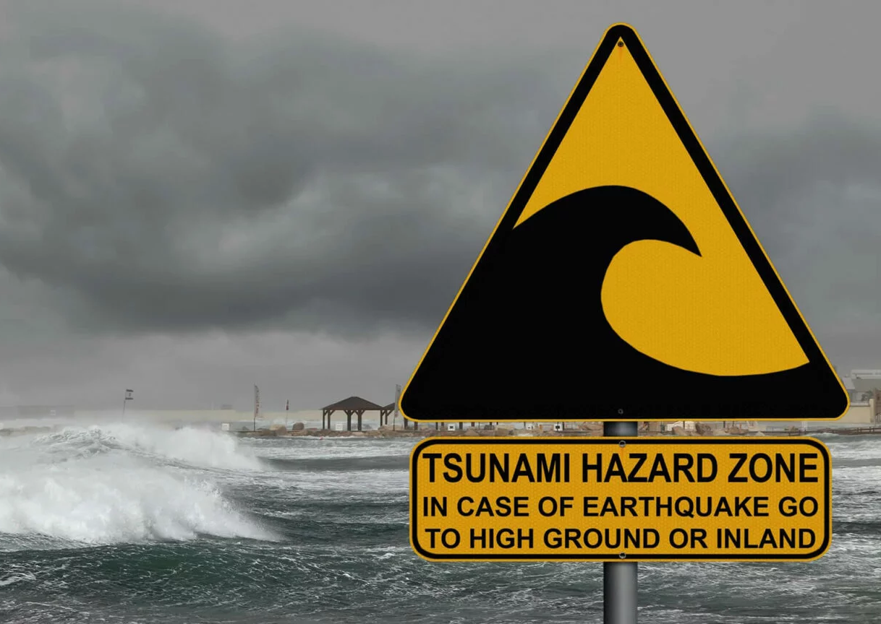
Performance Monitoring and Tracking
The TRS inspires to develop an Ocean Decade Tsunami Programme –Monitoring and Tracking Tool to better support implementation of the ODTP and the Tsunami Resilience Programme

Slide 27


Global Tsunami Early Warning and Mitigation System and ODTP Performance M & T Tool
Solution: To develop a unified KPI based M & T tool/platform
Users can select ICG-KPIs and or ODTP-KPIs depending on application and use.
SMART indicators( Specific, Measurable, Achievable, Relevant:
Seamless connections- ensuring efficiency and avoiding duplication in assessments and reporting.

Slide 28
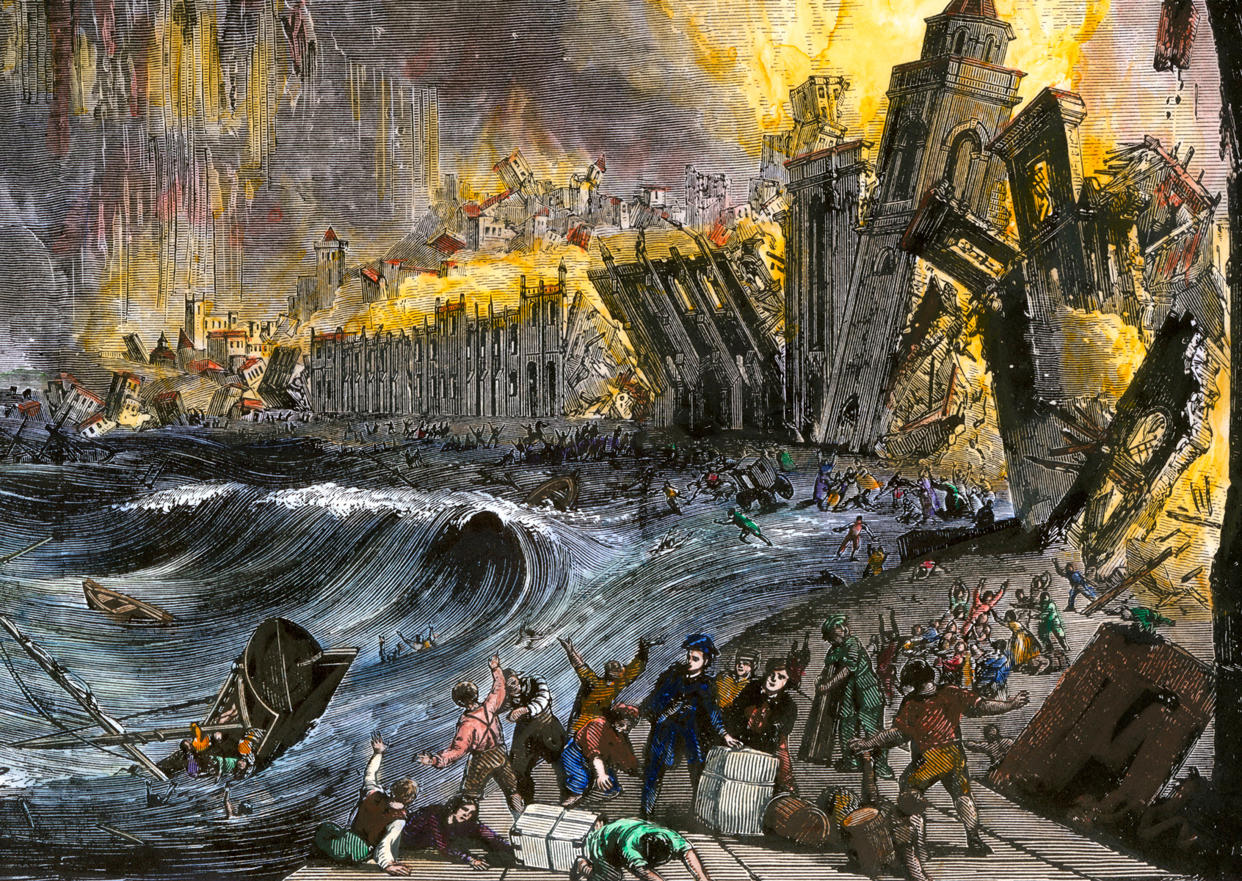
Upcoming Significant Activities 2025
Oct.25: Tsunami Ready ceremonies in Portugal (Loule, Cascais)
From 27th Oct: Regional SOP (Cascais, Portugal) TBD
Nov. 1: Lisbon Tsunami 270th Commemoration "From Memory to Resilience: Coastal communities Leading the Wave of Change” (Civil Protection Cascais, Portugal)

Slide 29
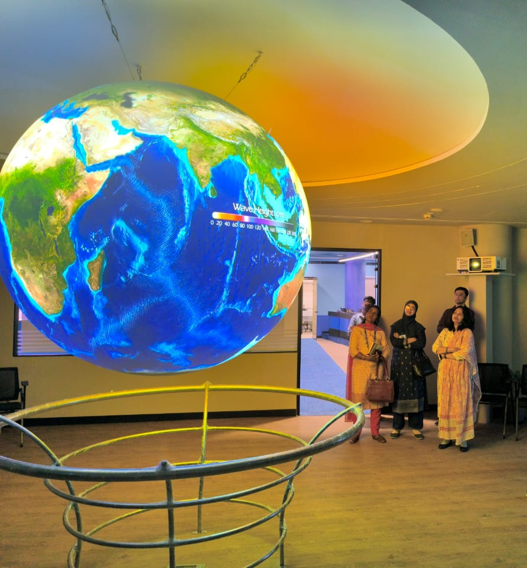
First Conference of the ODTP
At the 5th ODTP-SC held in Paris, 16-17Janary 2025 members agreed to collaborate on conferences addressing both the ODTP’s high-level objectives alongside the IAPSO/IASPEI/IAVCEI Joint Tsunami Commission (JTC) International Tsunami Symposium (ITS) in Hyderabad, scheduled for November 12–14, 2025.
INCOIS on 8th April 2025 agreed to host the first ODTP Conference, 10-11 Nov 2025.

Slide 30
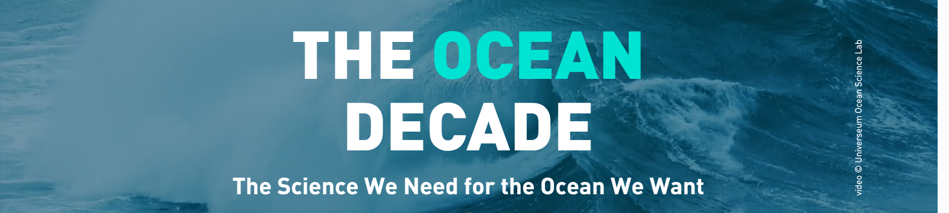
We have gone a long way because of International Cooperation and Coordination.
We are committed to taking the Tsunami Early Warning and Mitigation System to new heights by igniting global collaboration and enhancing international coordination like never before.
END

