Slide 1
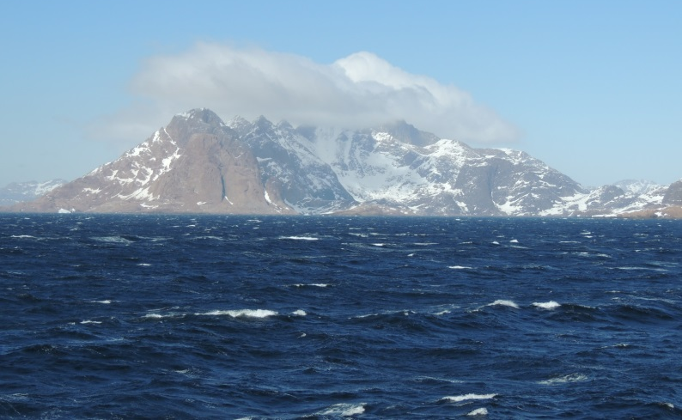
DEEP - OCEAN OBSERVATION & RESEARCH SYNTHESIS
Multiplatform Multisensor Approach to Studying Processes and Variability in the subpolar North Atlantic
XBT as a key exploratory tool
Igor Yashayaev
Bedford Institute of Oceanography
DOORS → from the Labrador Sea to the World Ocean

Slide 2
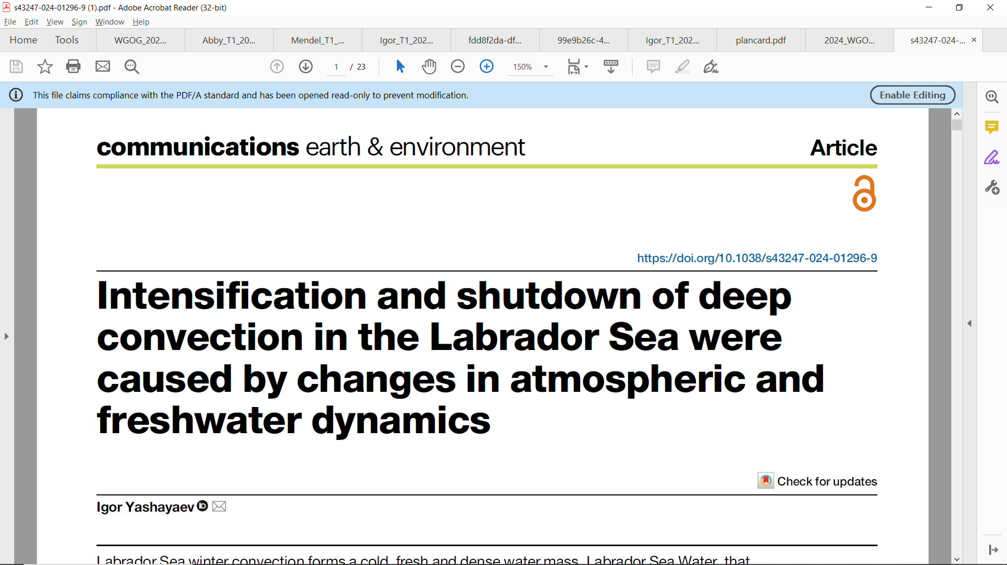
If the story presented in the next 10 minutes sparks any interest, please see this paper and its long practical supplementary information section
2024 March 27
Nothing will be said about
the atmospheric forcing
& freshwater sources
but the paper gets
all of them.

Slide 3
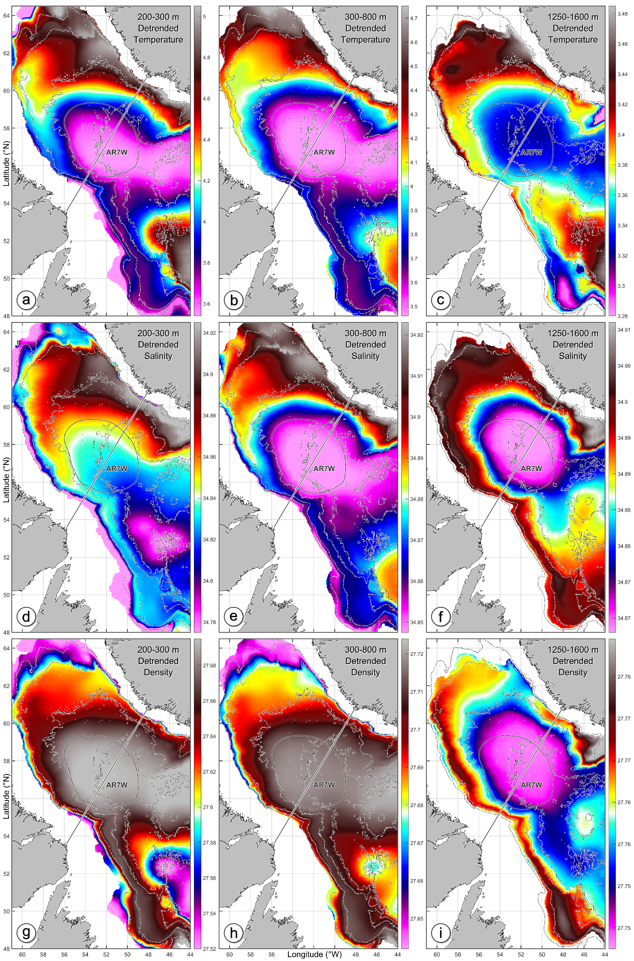
2002-2023 Multiplatform Vertically-Averaged Temperature Climatology
Hydrographic measurements from all platforms (e.g., profiling floats, ships) pass thorough multistep quality control, problem (e.g., sensor drift)
detection and correction.
Seasonal and interannual signals removed before spatial gridding.
Here, 2002-2023 was chosen because of spatiotemporal uniformity of data.

Slide 4
2002-2023 Multiplatform Vertically-Averaged Temperature Climatology
AR7W Atlantic Repeat hydrography line 7-West
Central Labrador Sea (CLS)
A reservoir of warm Atlantic Water in the northern Labrador Sea

Slide 5
2002-2023 Multiplatform Vertically-Averaged Salinity Climatology
Here freshwater
and gases sink deeper
than anywhere else in the subpolar North Atlantic

Slide 6
2002-2023 Multiplatform Vertically-Averaged Density Climatology
In the top 1000 m, the densest water is found in the center
Below 1000 m, the central Labrador Sea showcases a density minimum, explaining low stratification of the 200-1600 m layer.
This means that salinity dominates density at depth.

Slide 7
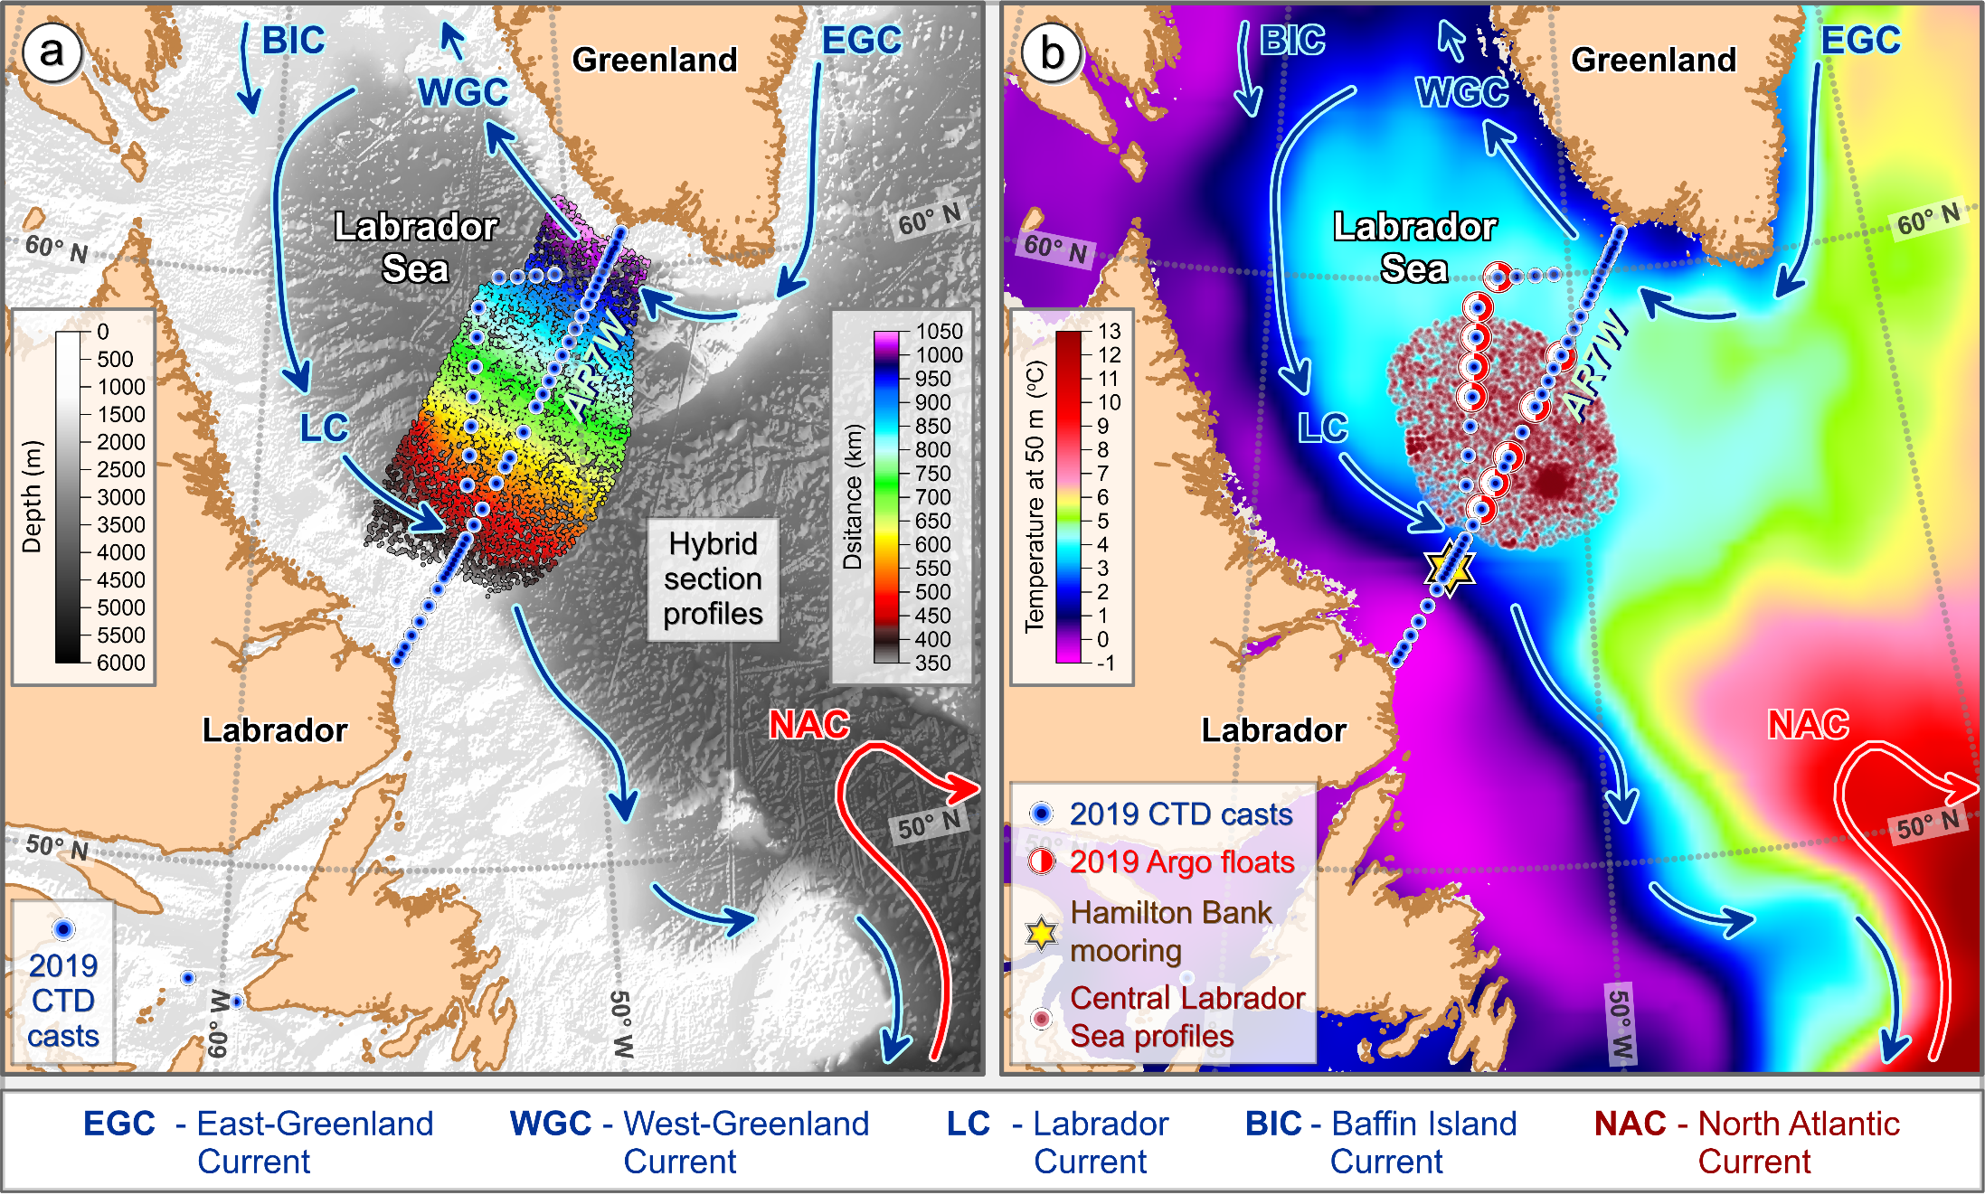
The Labrador Sea Deep-Ocean Observation and Research Synthesis (DOORS)
Oceanographic data uptake, quality control, analysis and synthesis platform
Distance color-coded locations of profiles used to construct the composite sections
Locations of the central
Labrador Sea (CLS) profiles

Slide 8
The first destination of our magical Labrador Sea mystery tour is a 75-year record of the regional environmental changes. It poses a few interesting questions we may try to answer.

Slide 9
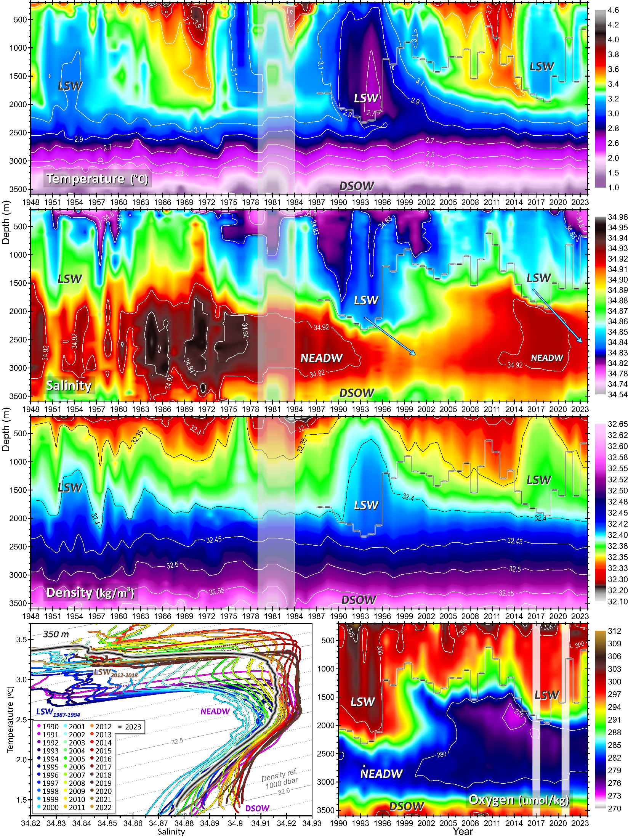
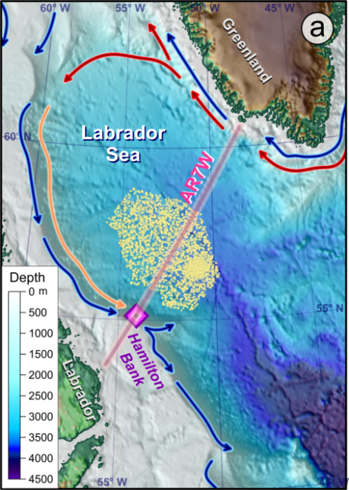
The Labrador Sea oceanographic record
contains water sample,
reversing thermometer,
CTD and Argo float data
Vertical profile
averaging:
Early years – isobaric;
1948-1975 – isobaric-isopycnic hybrid;
1976-2023 – isopycnic;
Argo-only – isobaric
2017 & 2021
Data Sources
0.02

Slide 10
Increasing
the temporal resolution
by merging quality-controlled
post-calibrated Argo float profiles
with ship-based measurements

Slide 11
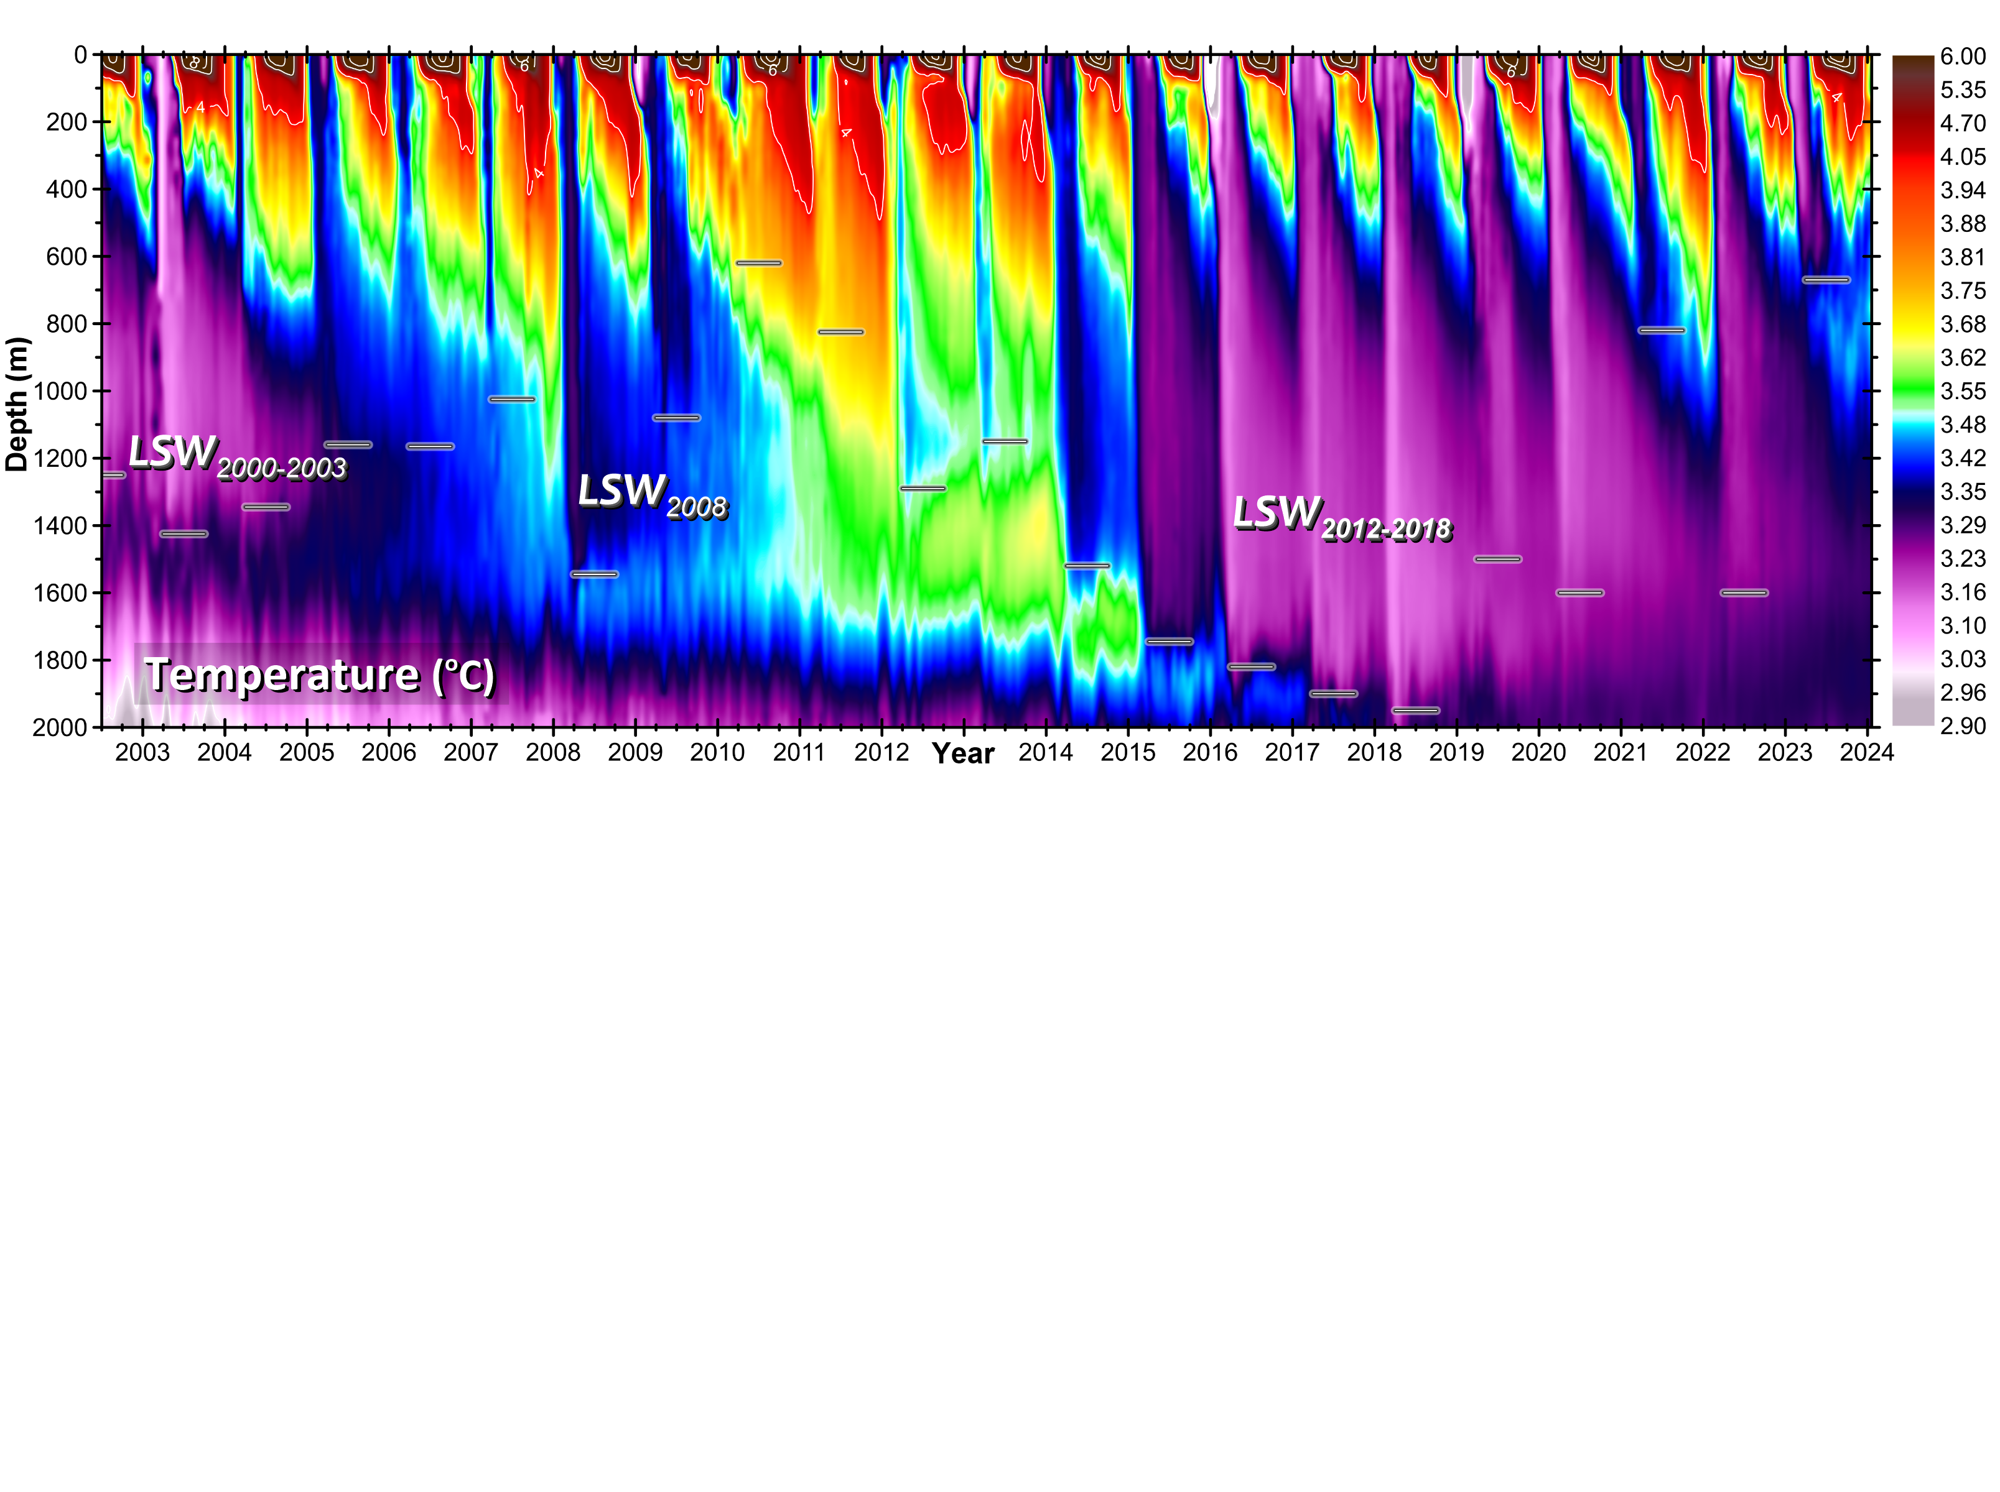
2002 June – 2024 January
Temporal averaging is limited
to maximum of two weeks,
nominally – one week.
This is why the seasonality
is resolved in all years
from surface to bottom.
The ship-based data alone
do not resolve the seasonal
and interannual changes
in the top 700 m layer.
Shallowest but Cold
Mixed Layer in 2023
Strongest Cooling
in 2015
Deepest Mixing
in 2018
Rapid
Warming
in 2021

Slide 12
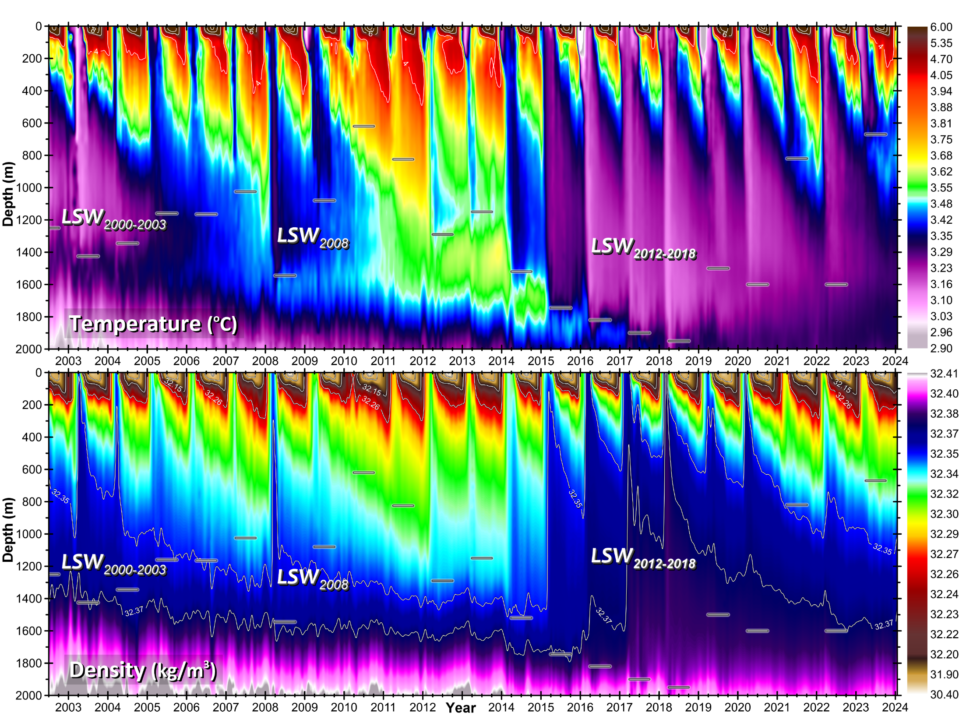
Denser LSW in 2015
Densest LSW in 2018
Least Dense in 2021 and 2023

Slide 13
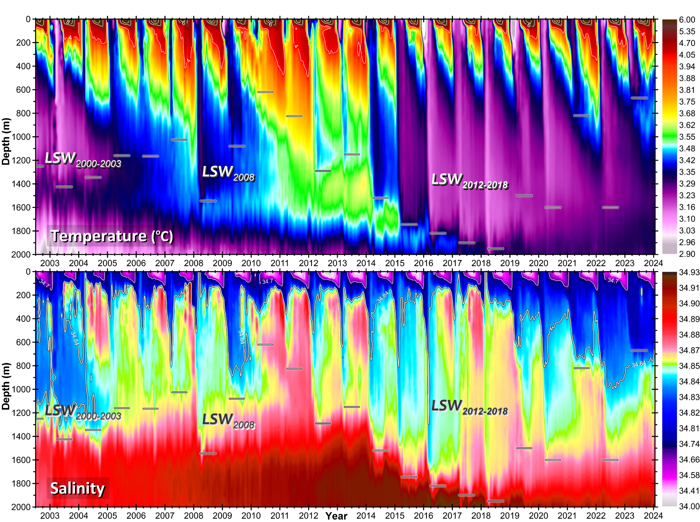

Slide 14
The Labrador Sea Deep-Ocean Observation and Research Synthesis (DOORS)
Oceanographic data uptake, quality control, analysis and synthesis platform
Distance color-coded locations of profiles used to construct the composite sections
Locations of the central
Labrador Sea (CLS) profiles

Slide 15
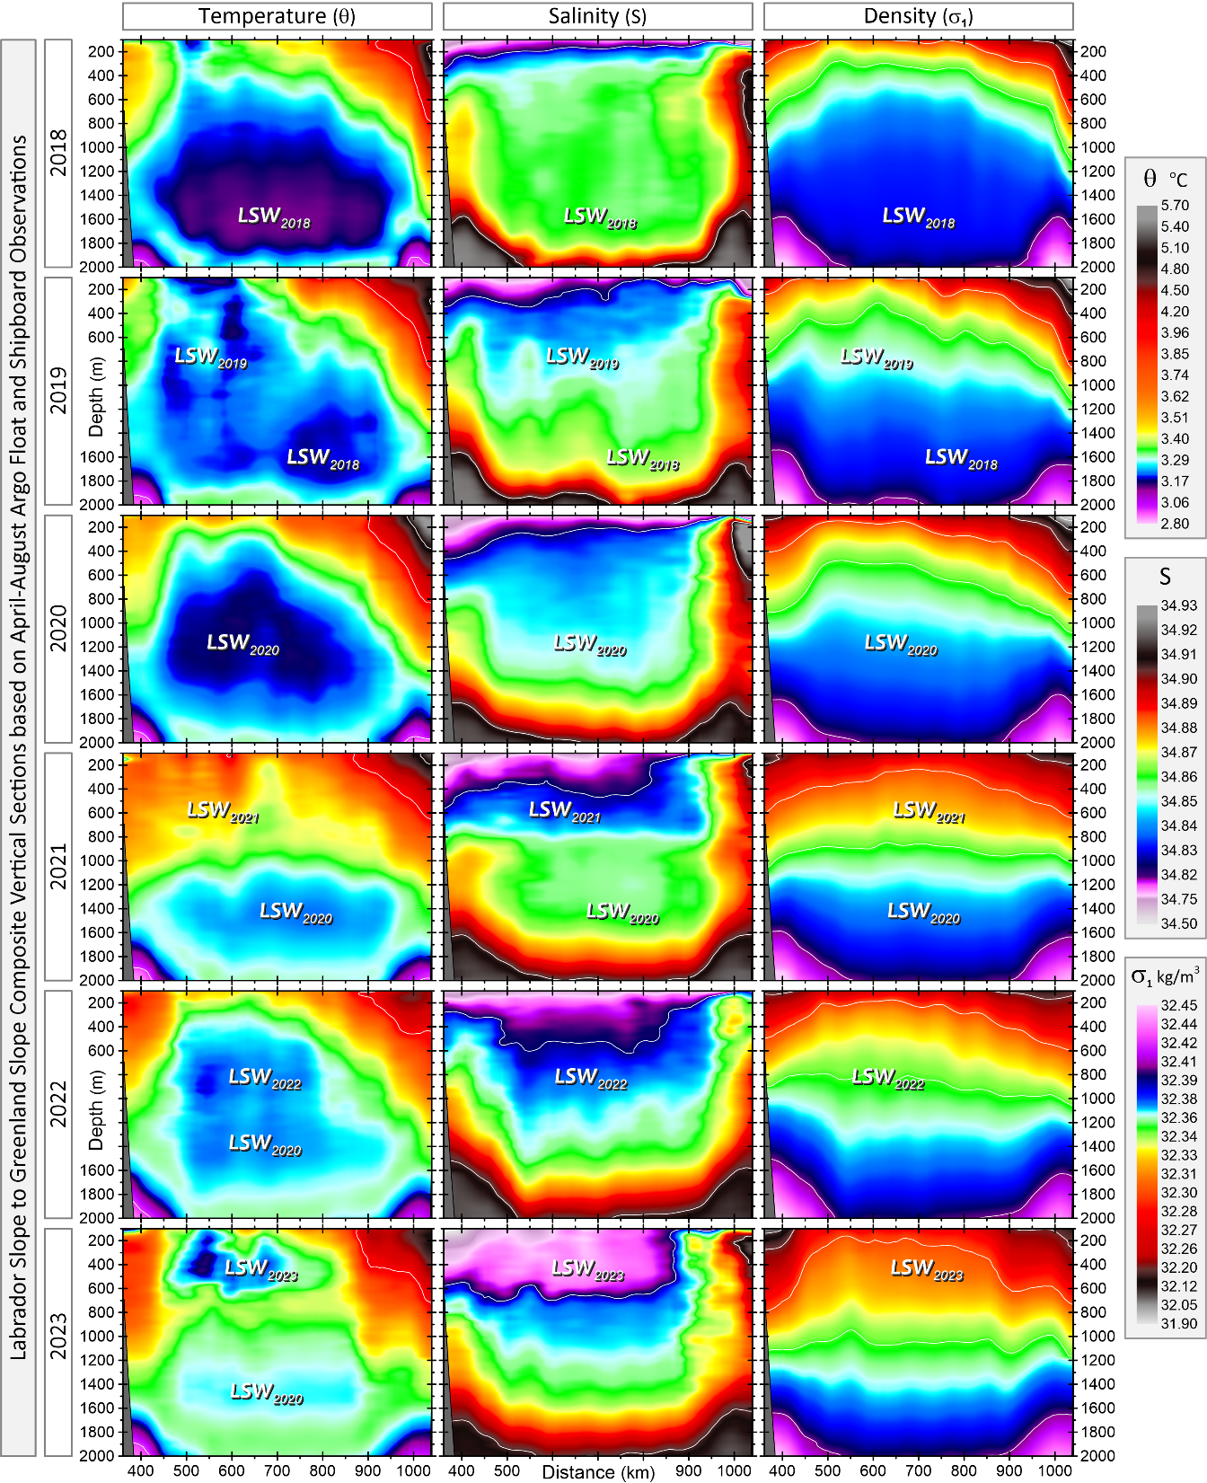
2018
April-August Temperature,
Salinity and Density on AR7W
from Multiplatform
Observations
The sections were constructed
using the hybrid coordinate
method.
In the first year in this series, 2018, convection
(large cold blob - LSW₂₀₁₈) reached 2000 m.
LSW₂₀₁₈ was still present in 2019, when convection was much shallower, making the sea
more stratified.
Most remarkable changes occurred in 2021 and 2023:
warm fresh low-density
800 m deep layer in 2021, and massive layer of fresher
colder low-density
water in 2023.
2023

Slide 16
If the story presented in the next 10 minutes sparks any interest, please see this paper and its long practical supplementary information section
2024 March 27
It predicted that deep convection
would not be possible in 2024.
We will soon either support
or reject that prediction!

Slide 17
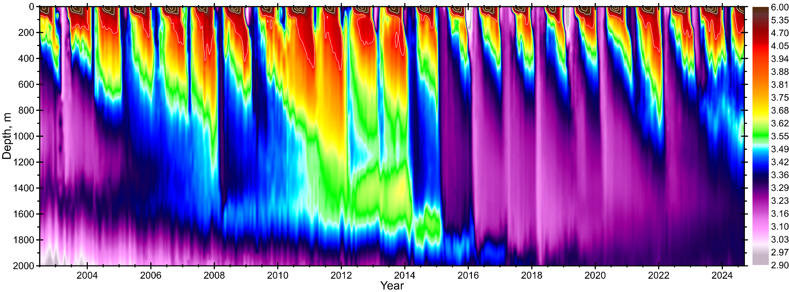
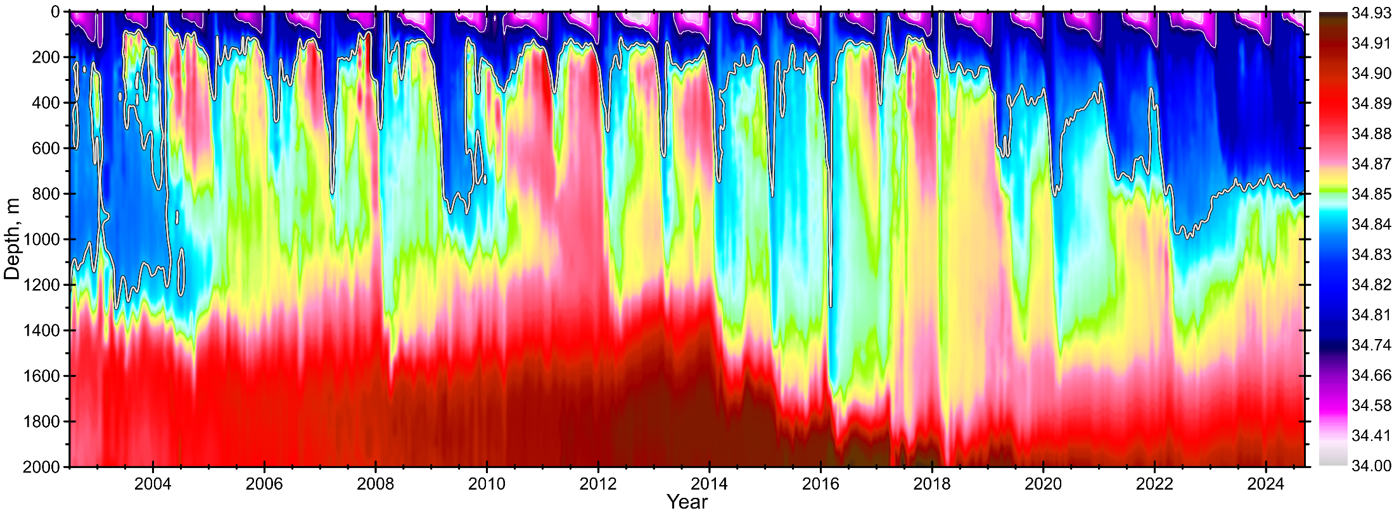

Slide 18

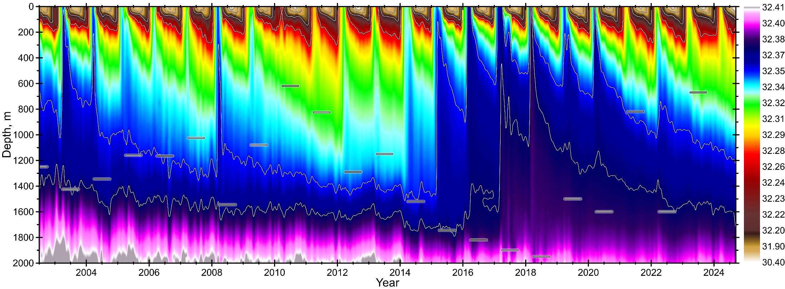

Slide 19
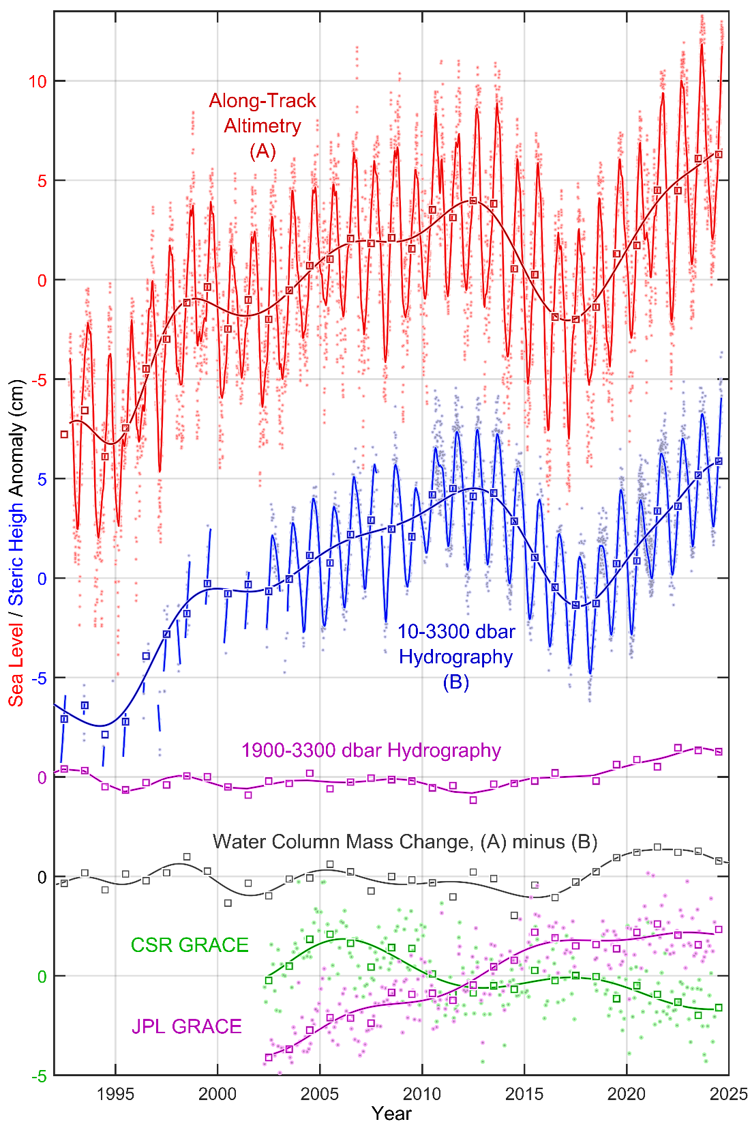
Total Variance
=
Interannual
+
Regular
Seasonal
+
Irregular
Seasonal
+
MesoSynopitc
+
High-Frequency
+
Noise
Igor Yashayaev
& Yang Zhang,
in preparation

Slide 20
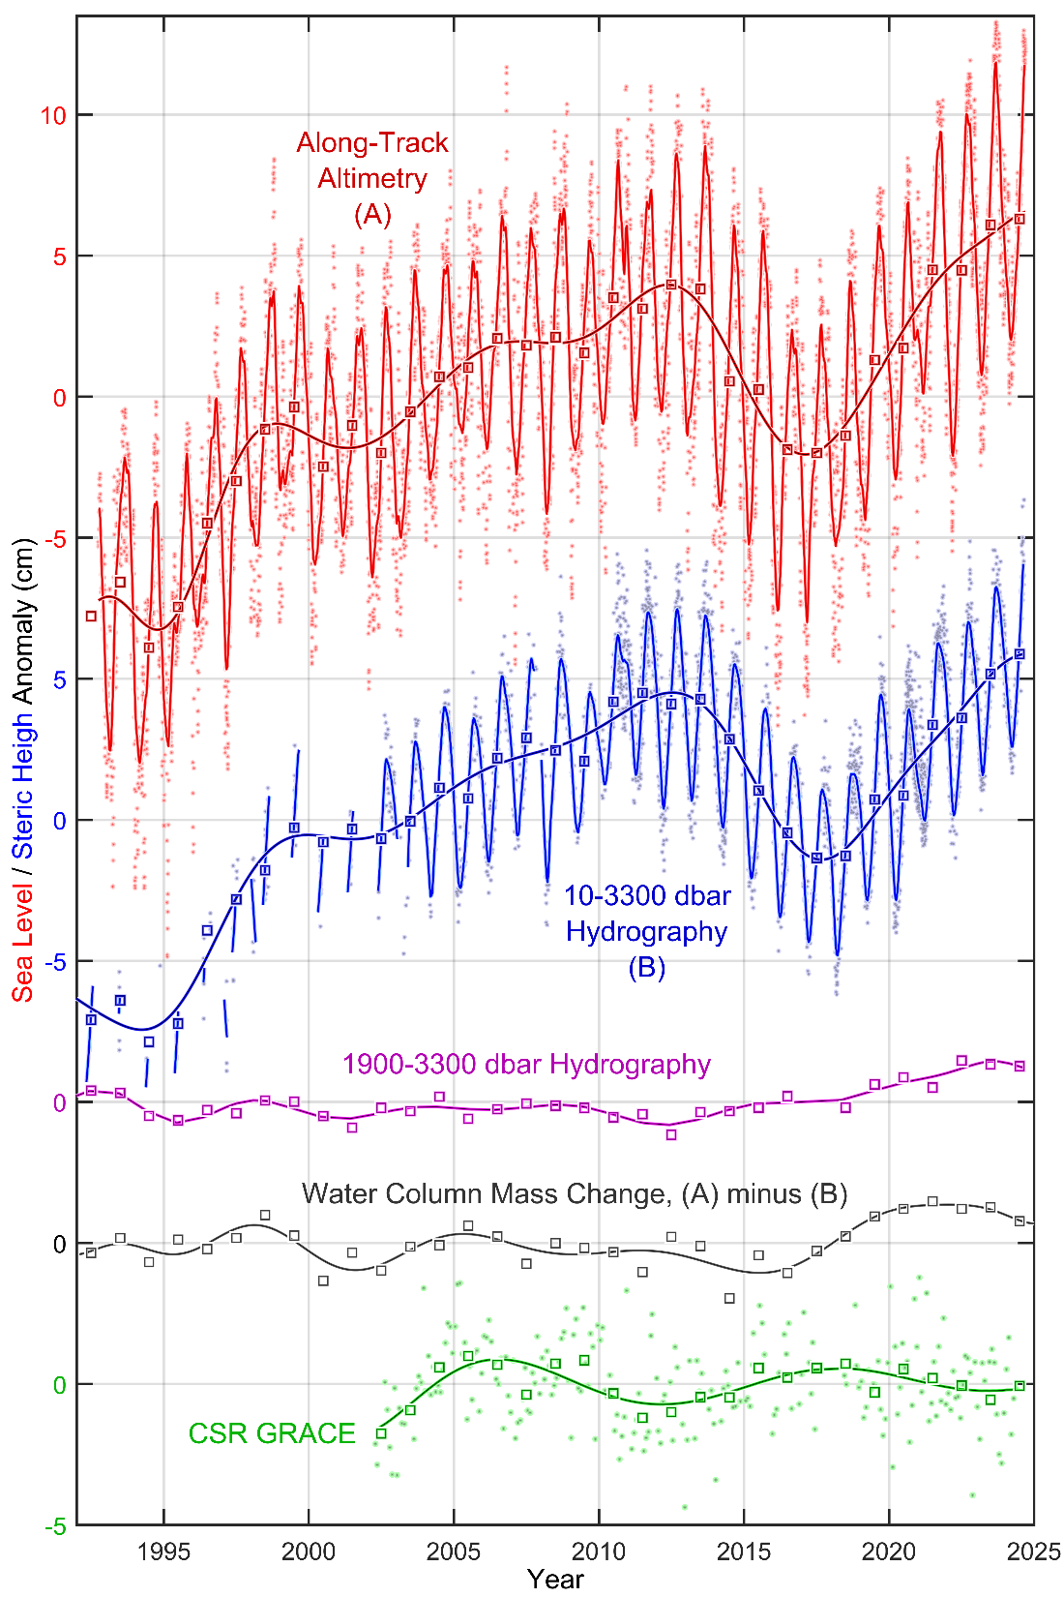
Total Variance
=
Interannual
+
Regular
Seasonal
+
Irregular
Seasonal
+
MesoSynopitc
+
High-Frequency
+
Noise
Igor Yashayaev
& Yang Zhang,
in preparation

Slide 21
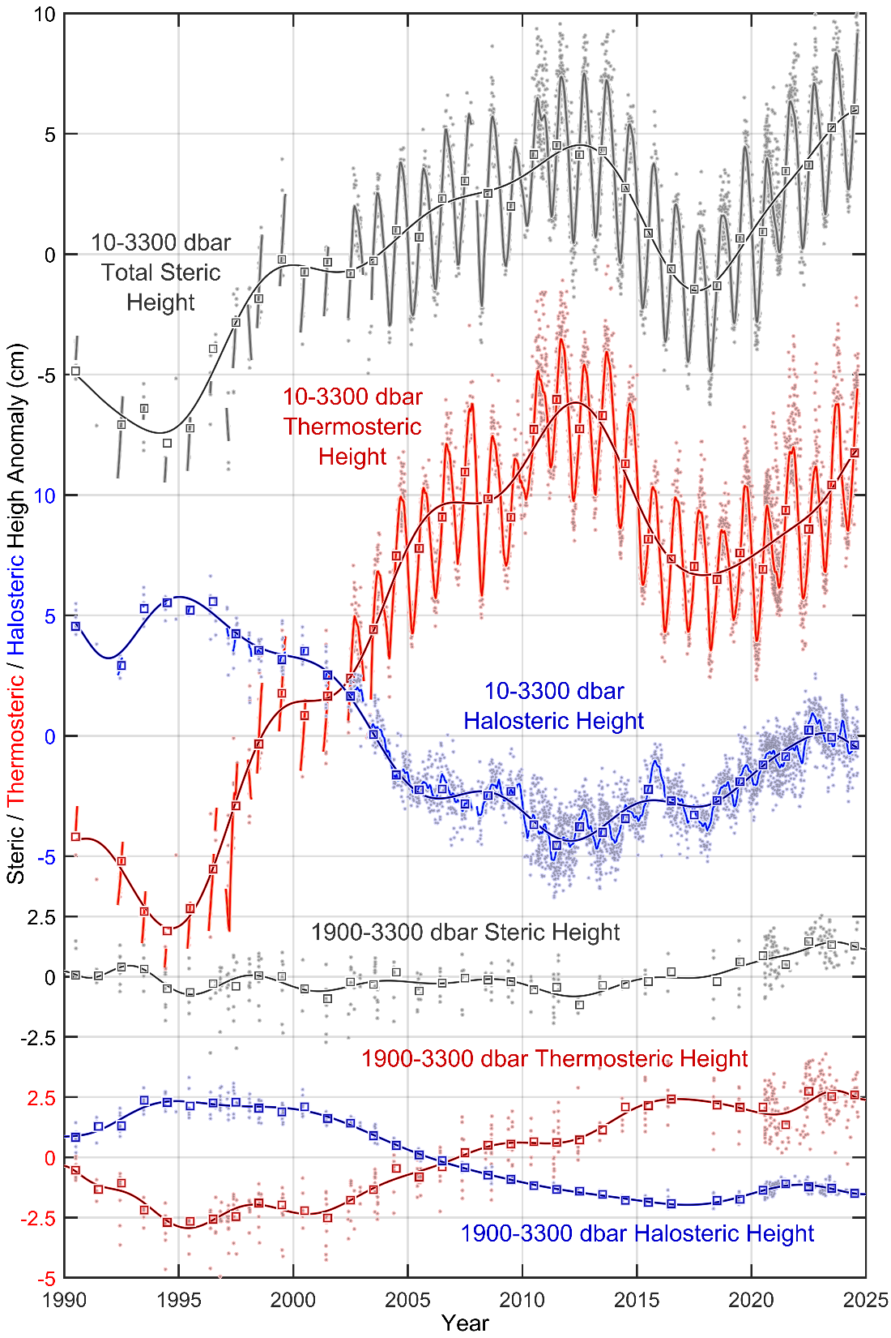
Halosteric effect reversal
Igor Yashayaev
& Yang Zhang,
in preparation

Slide 22
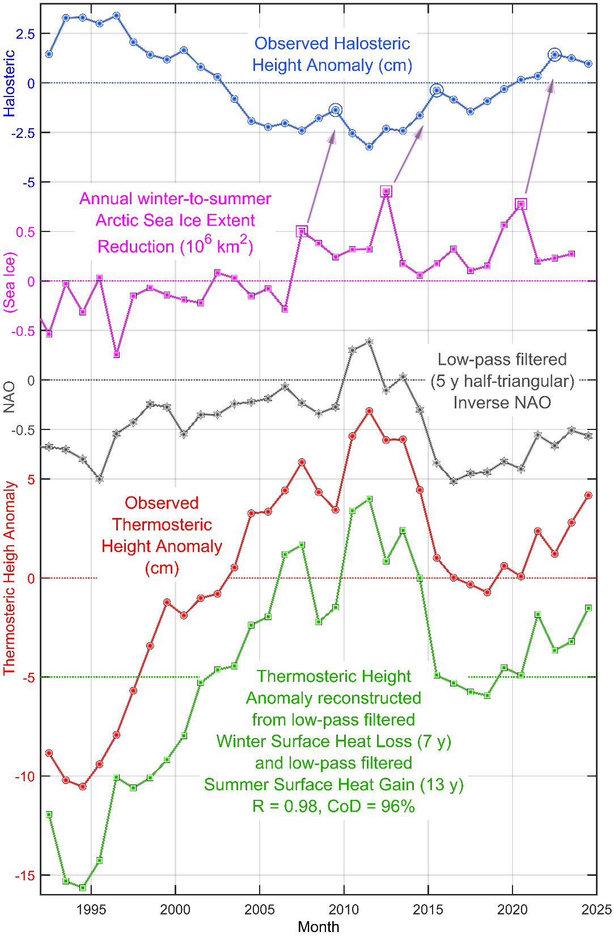
Igor Yashayaev
& Yang Zhang,
in preparation

Slide 23
XBT
2001-2019

Slide 24
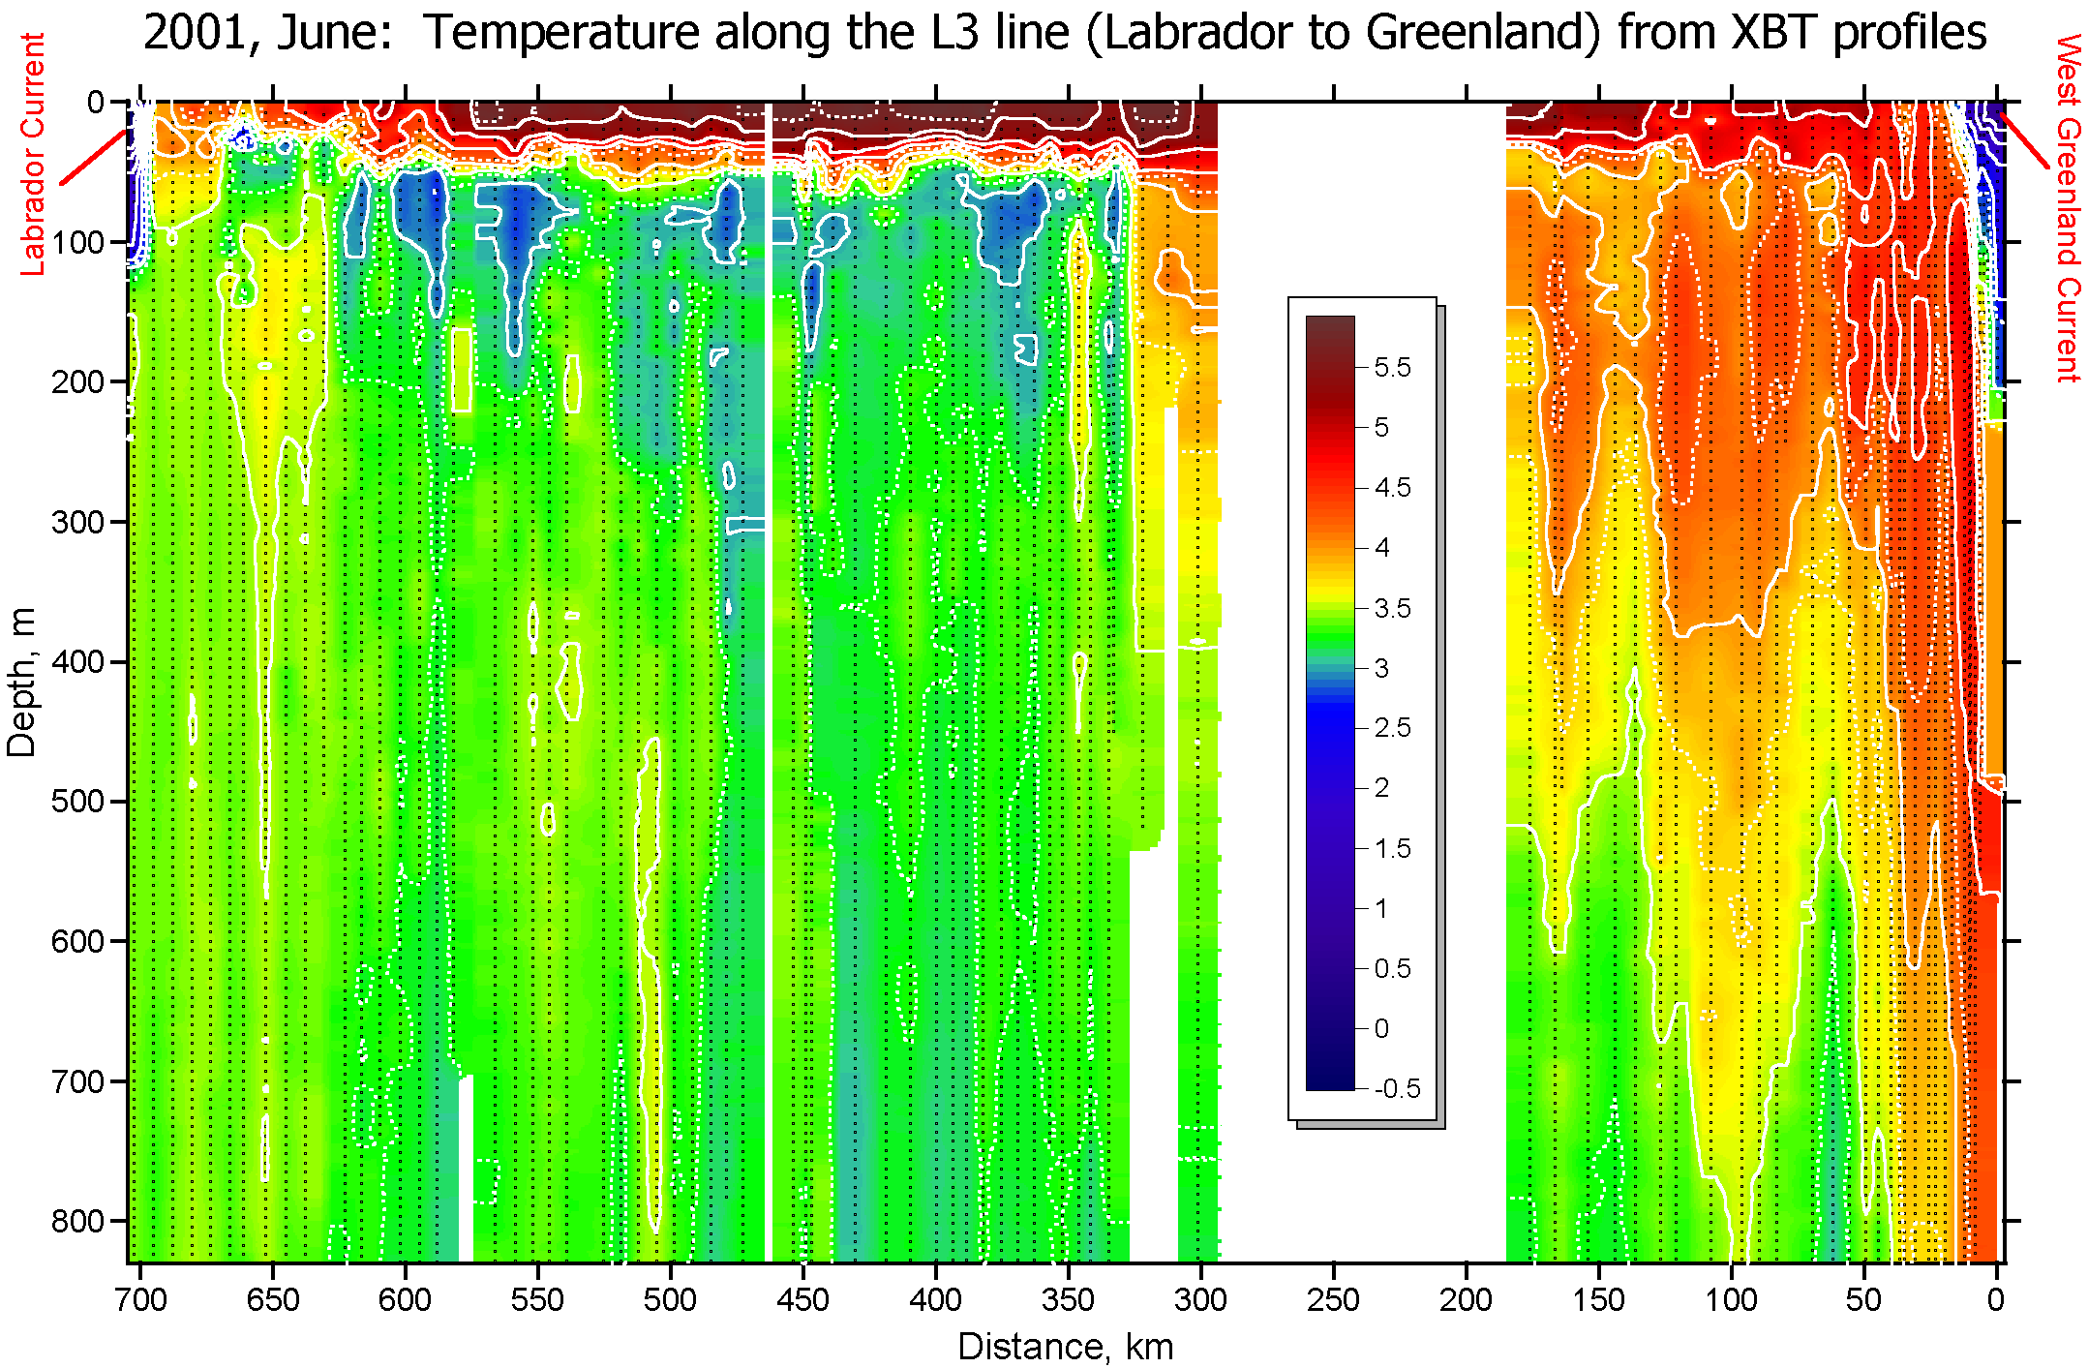
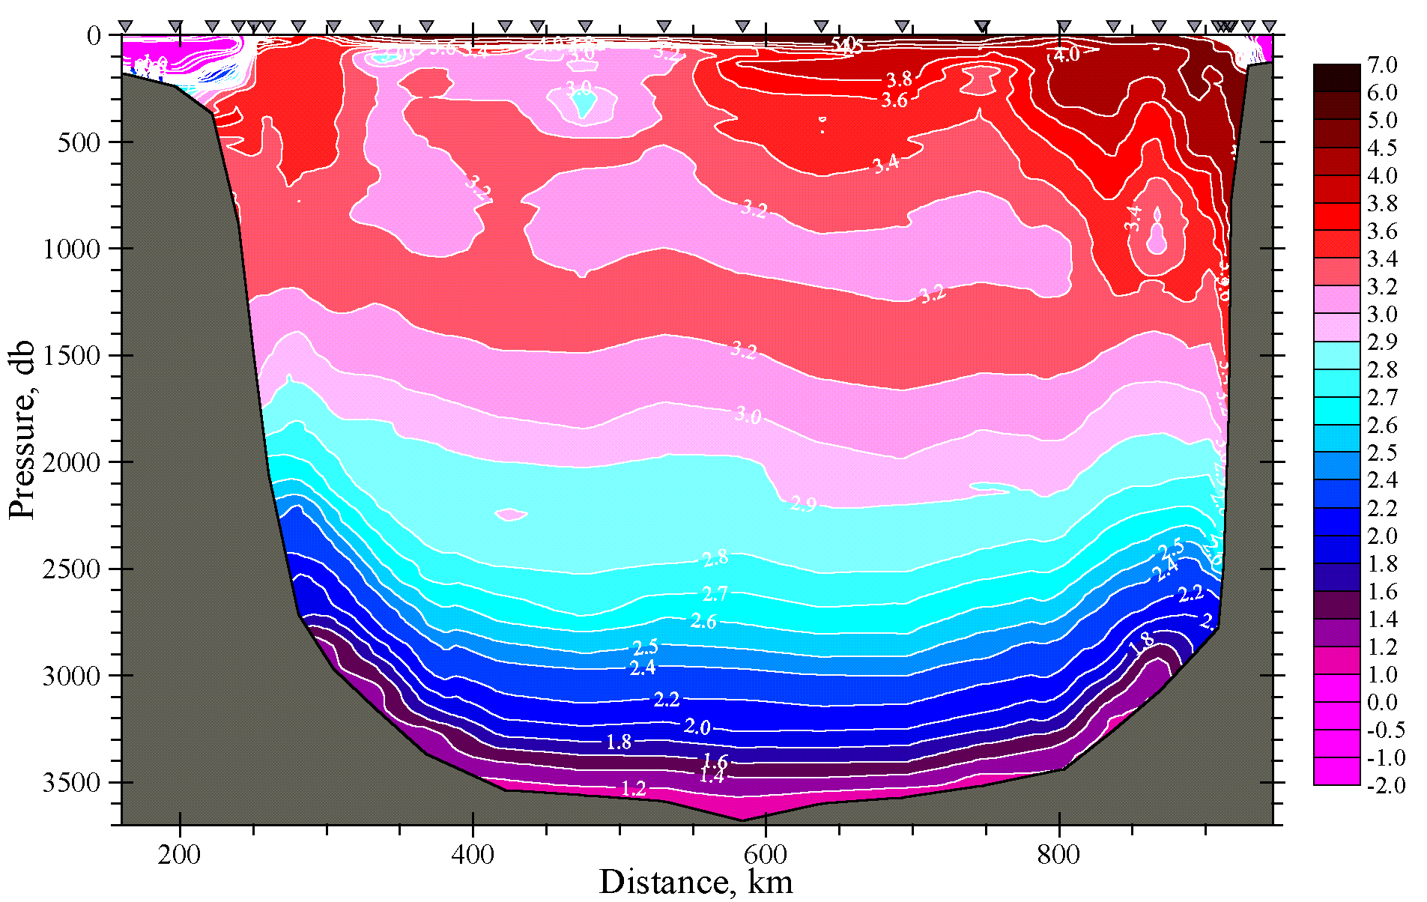
First Detailed XBT Survey of the Labrador Sea
2001

Slide 25
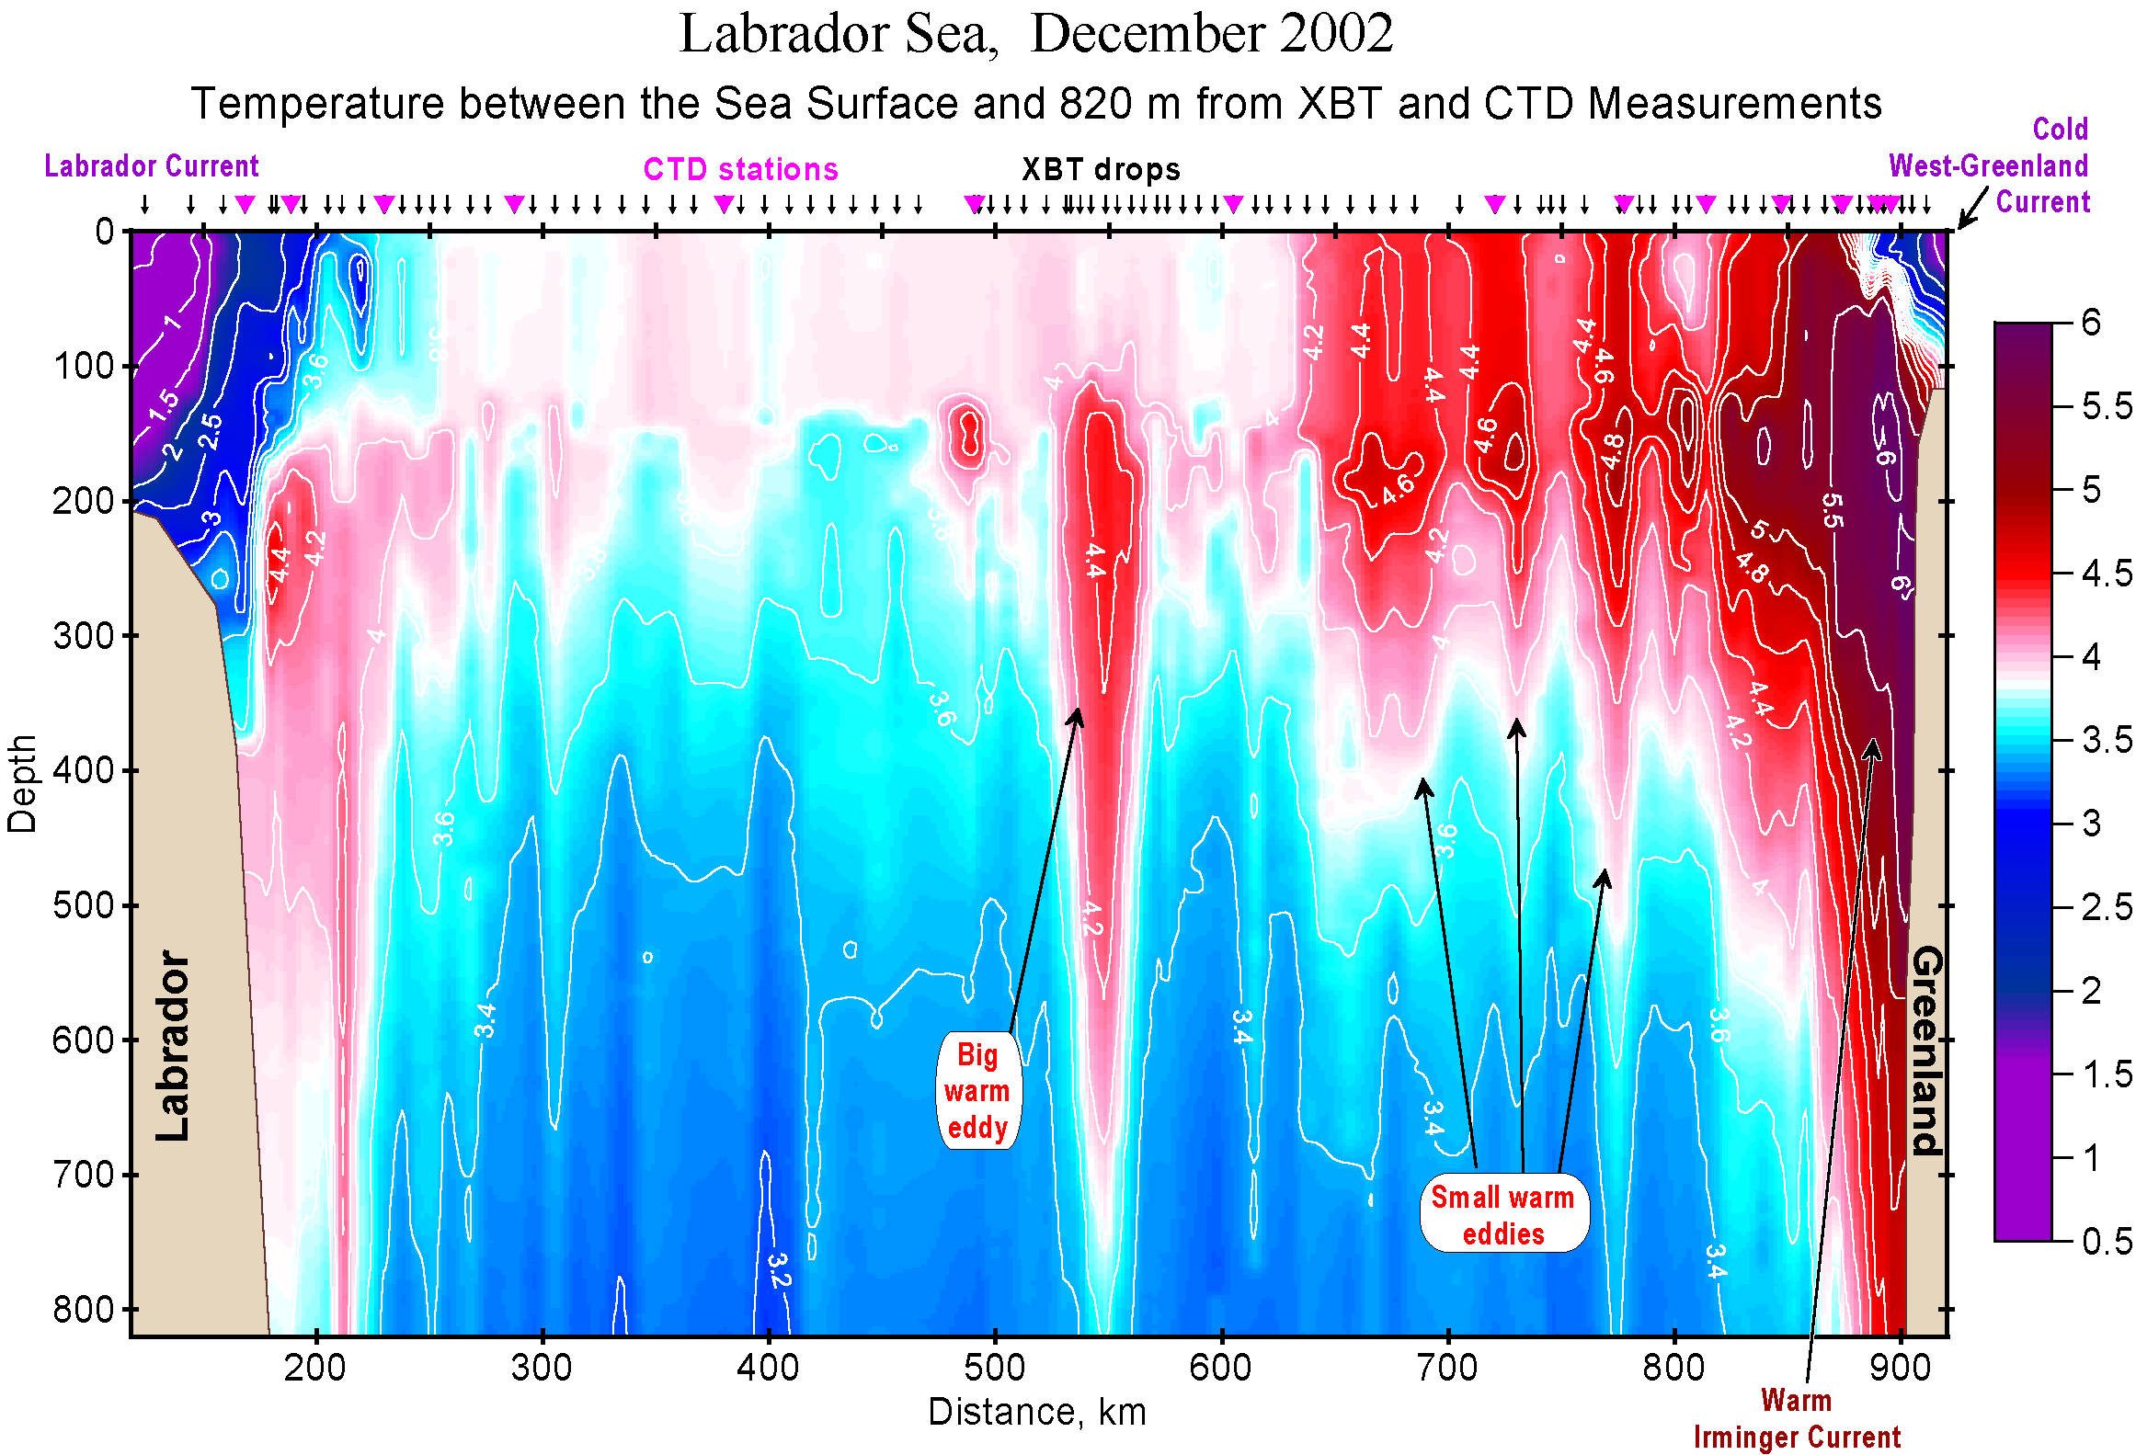
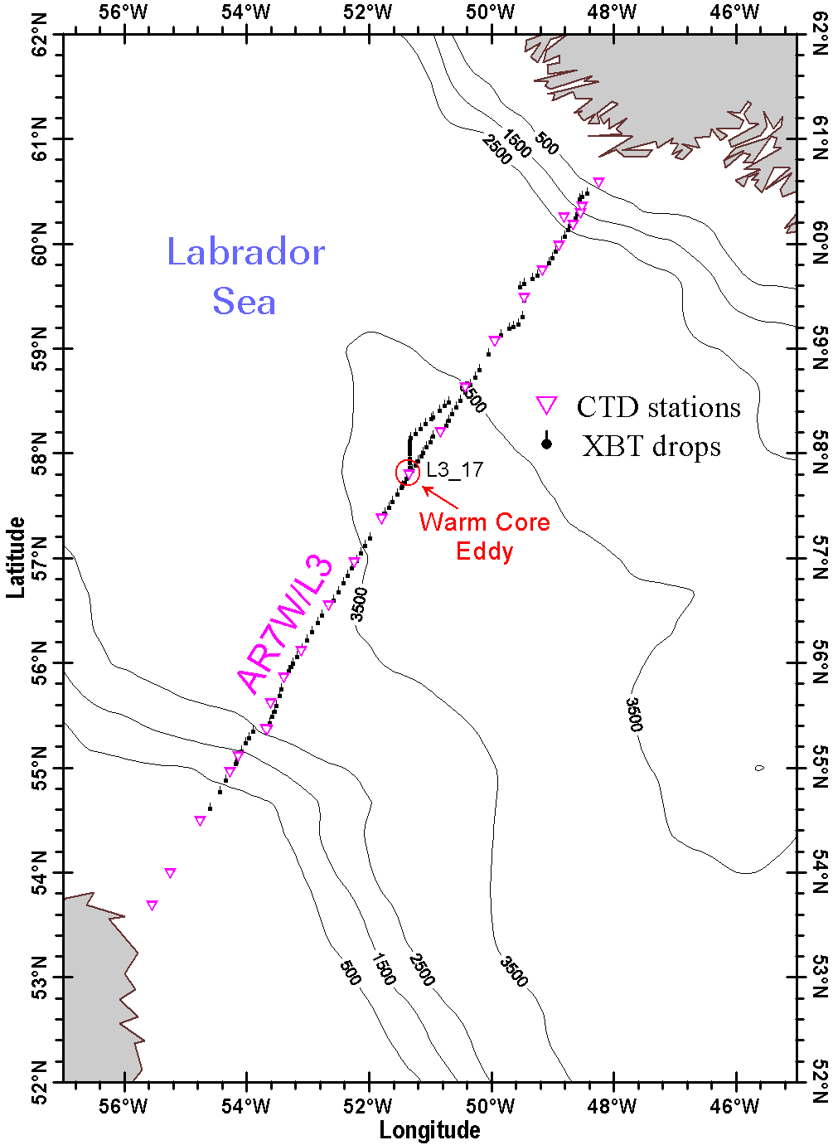
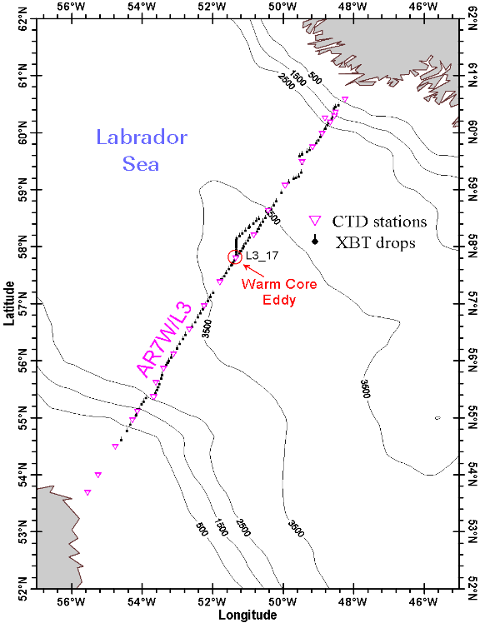
December 2002

Slide 26
December 2002

Slide 27
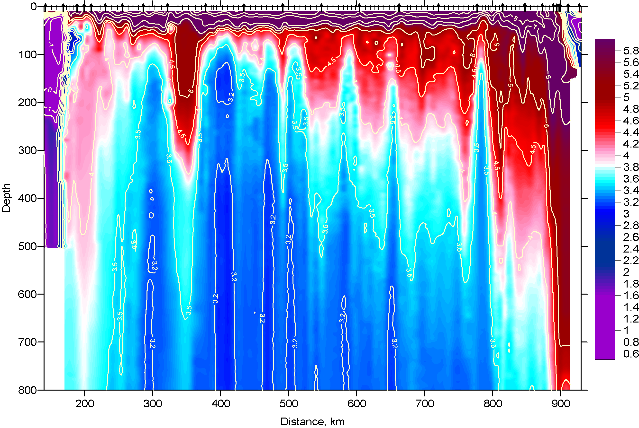
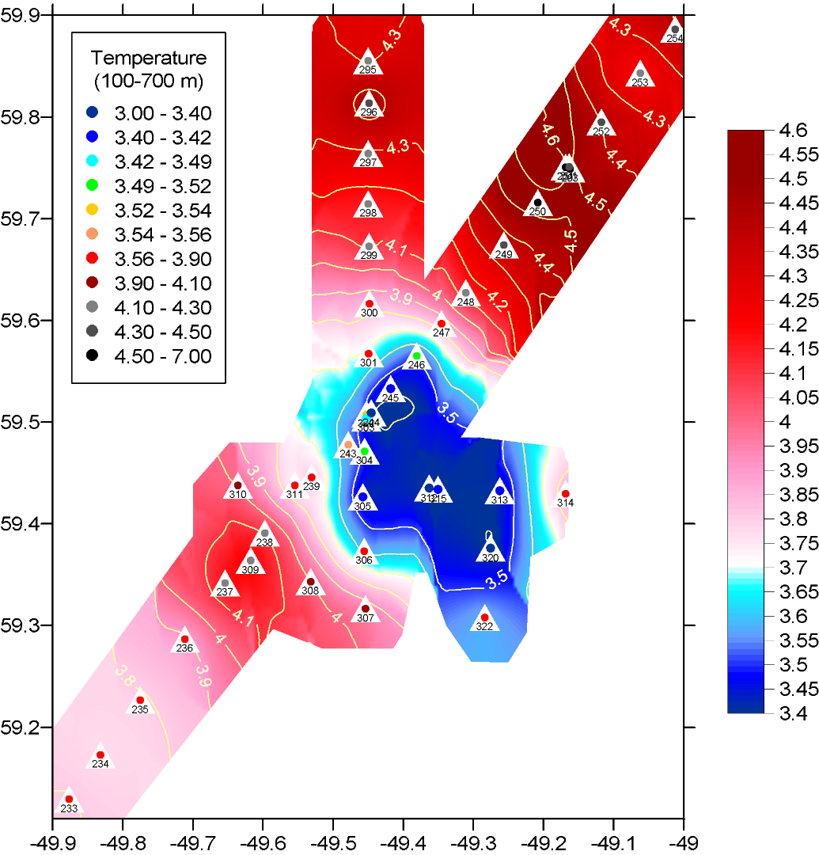
July 2003

Slide 28
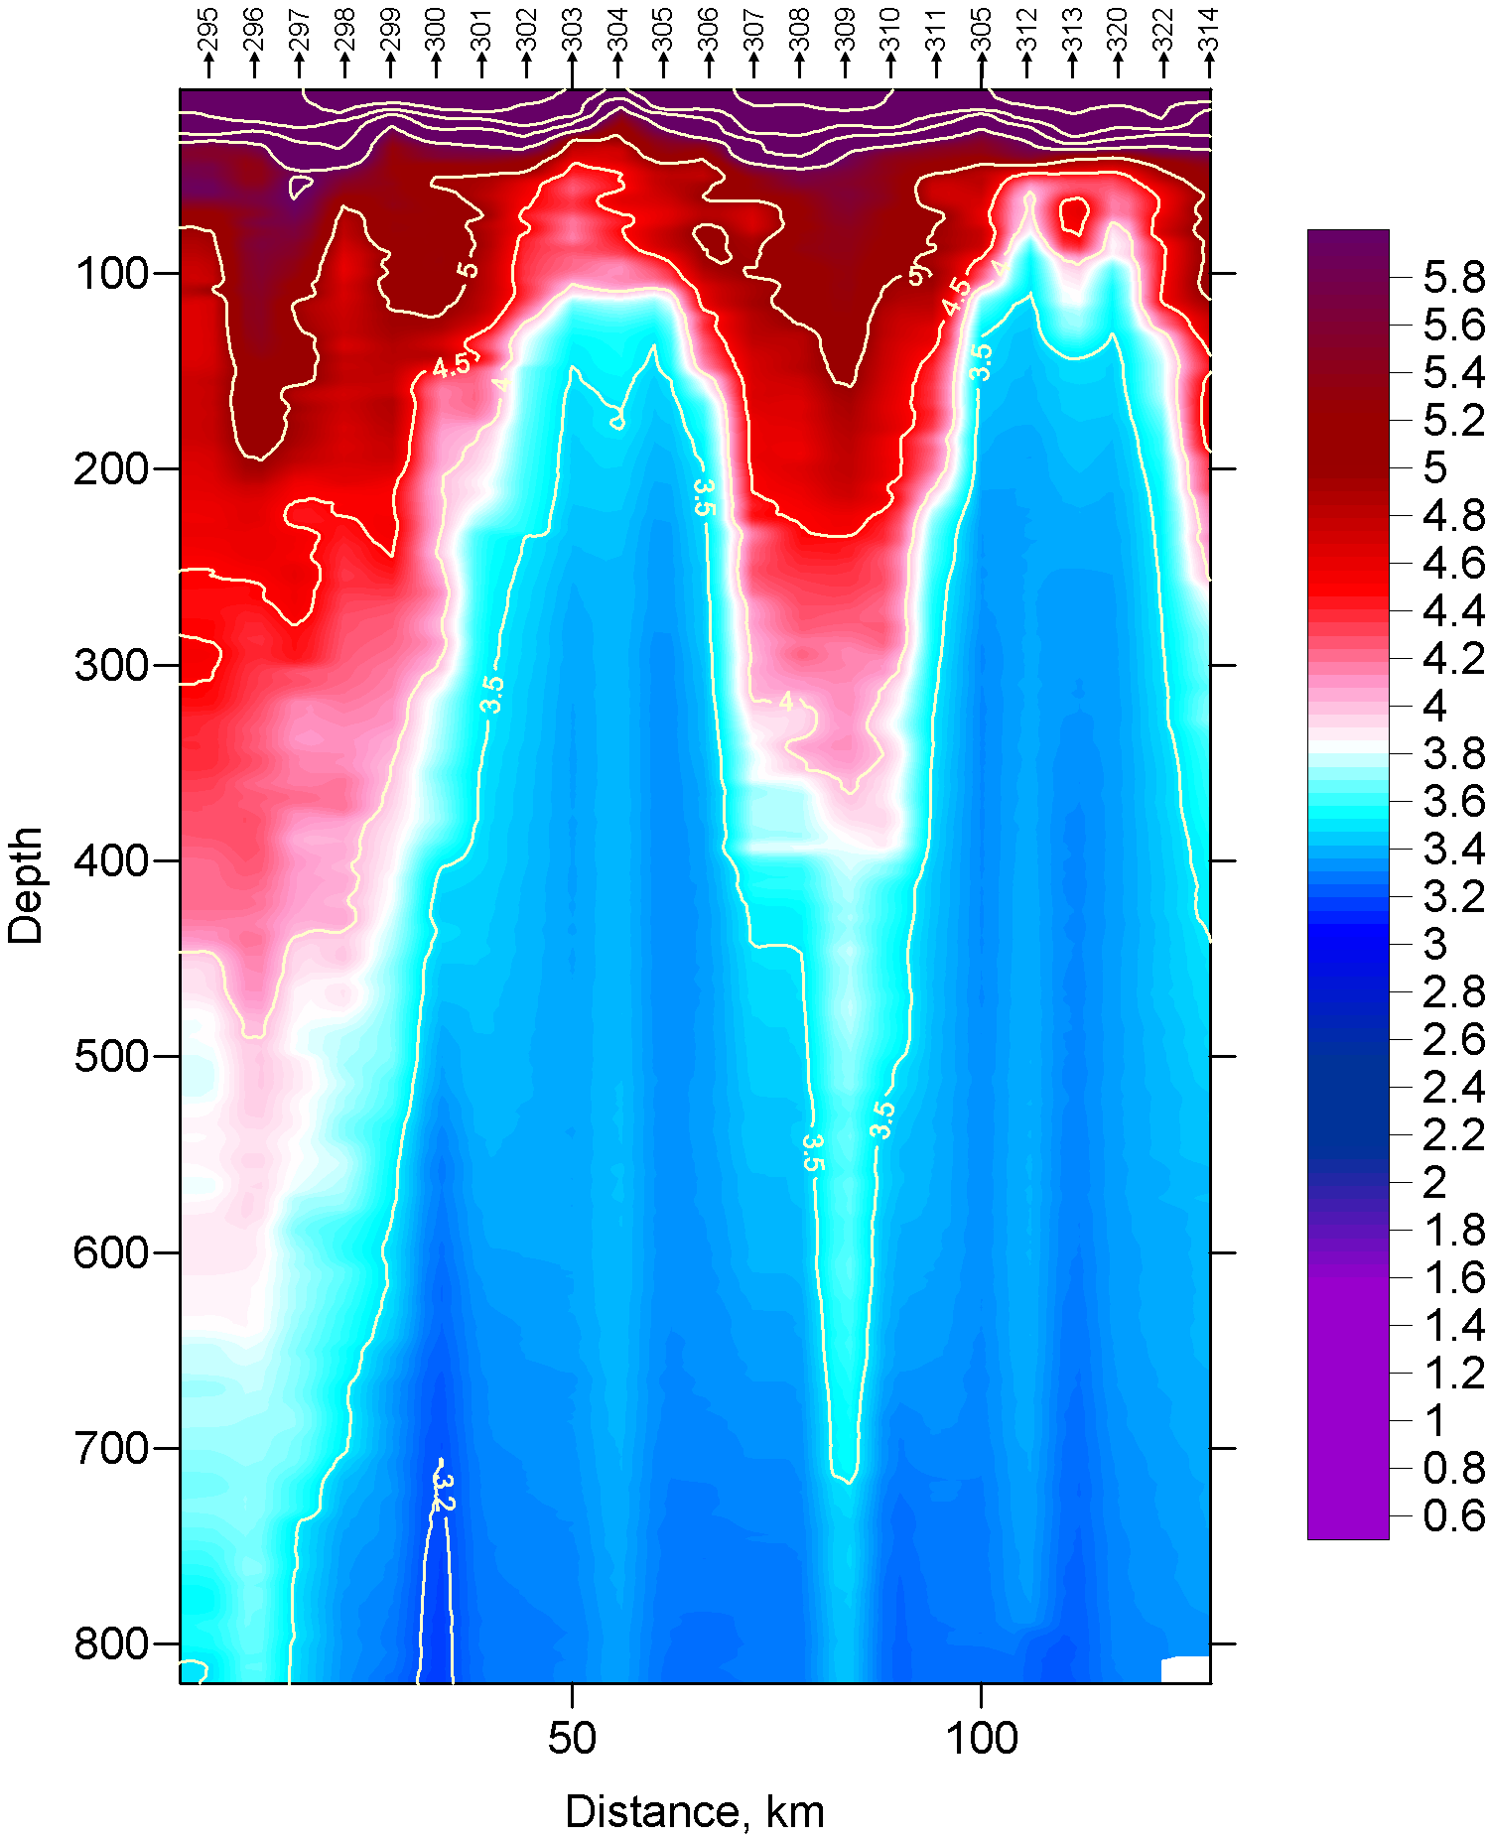
July 2003

Slide 29
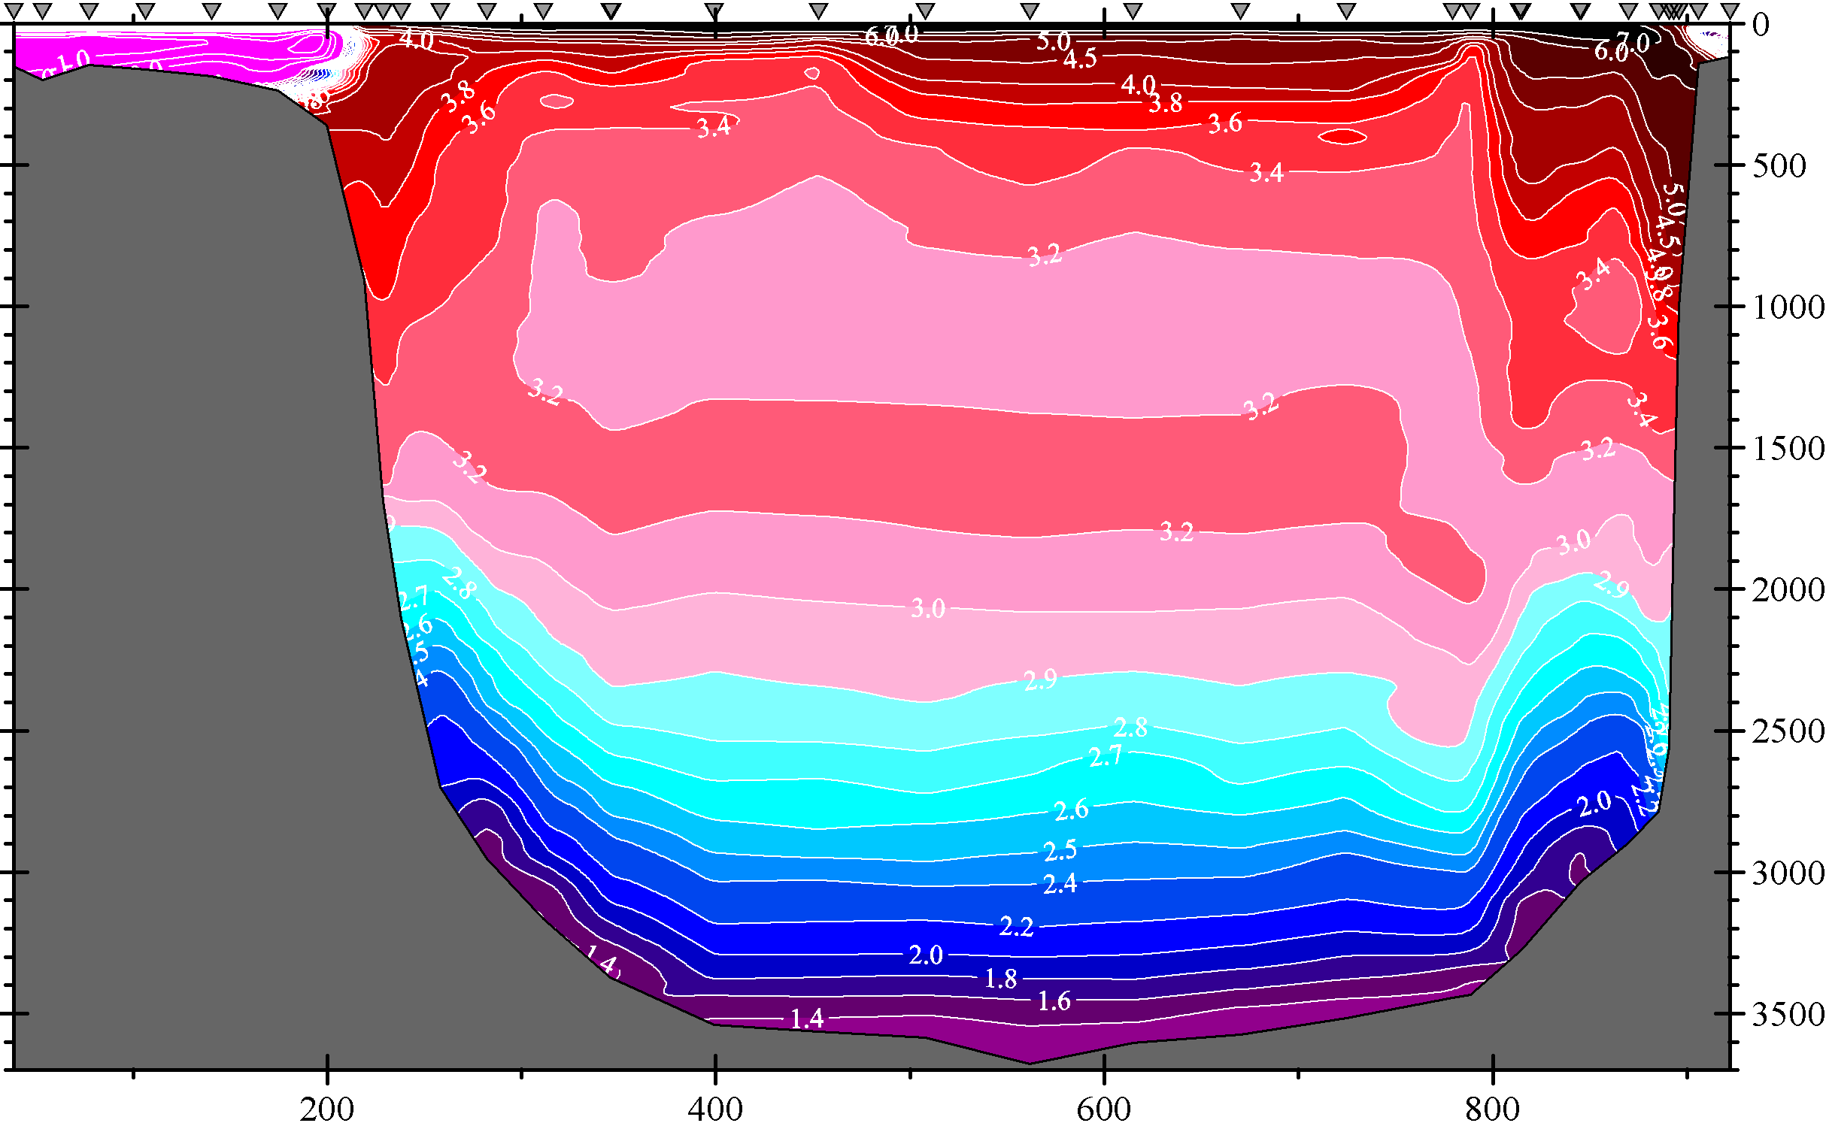
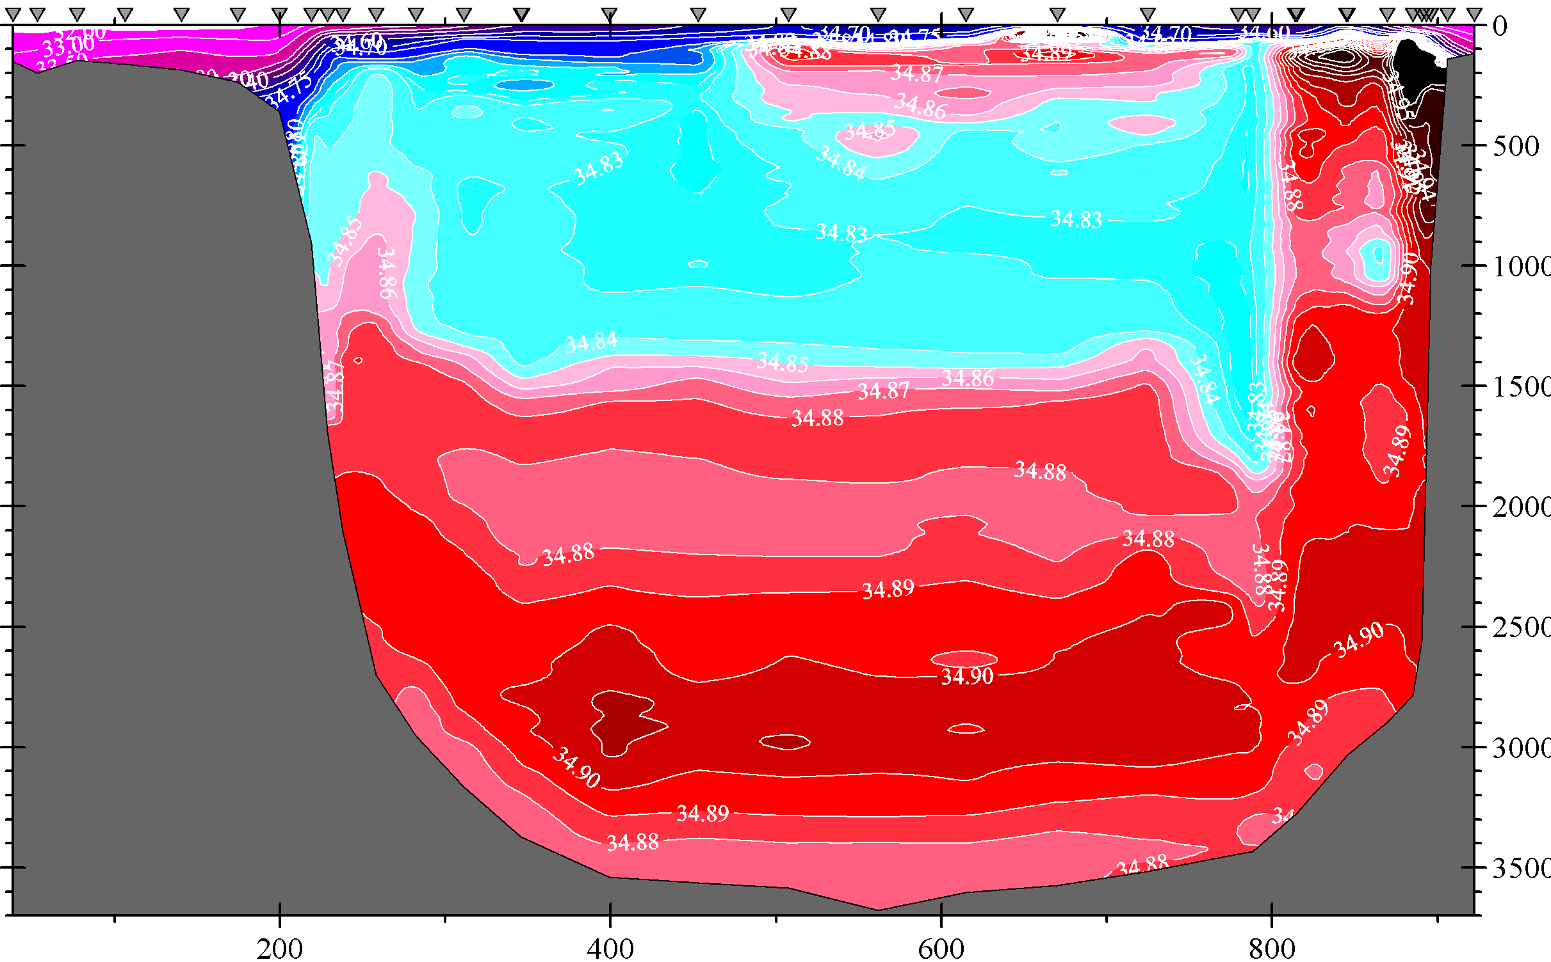
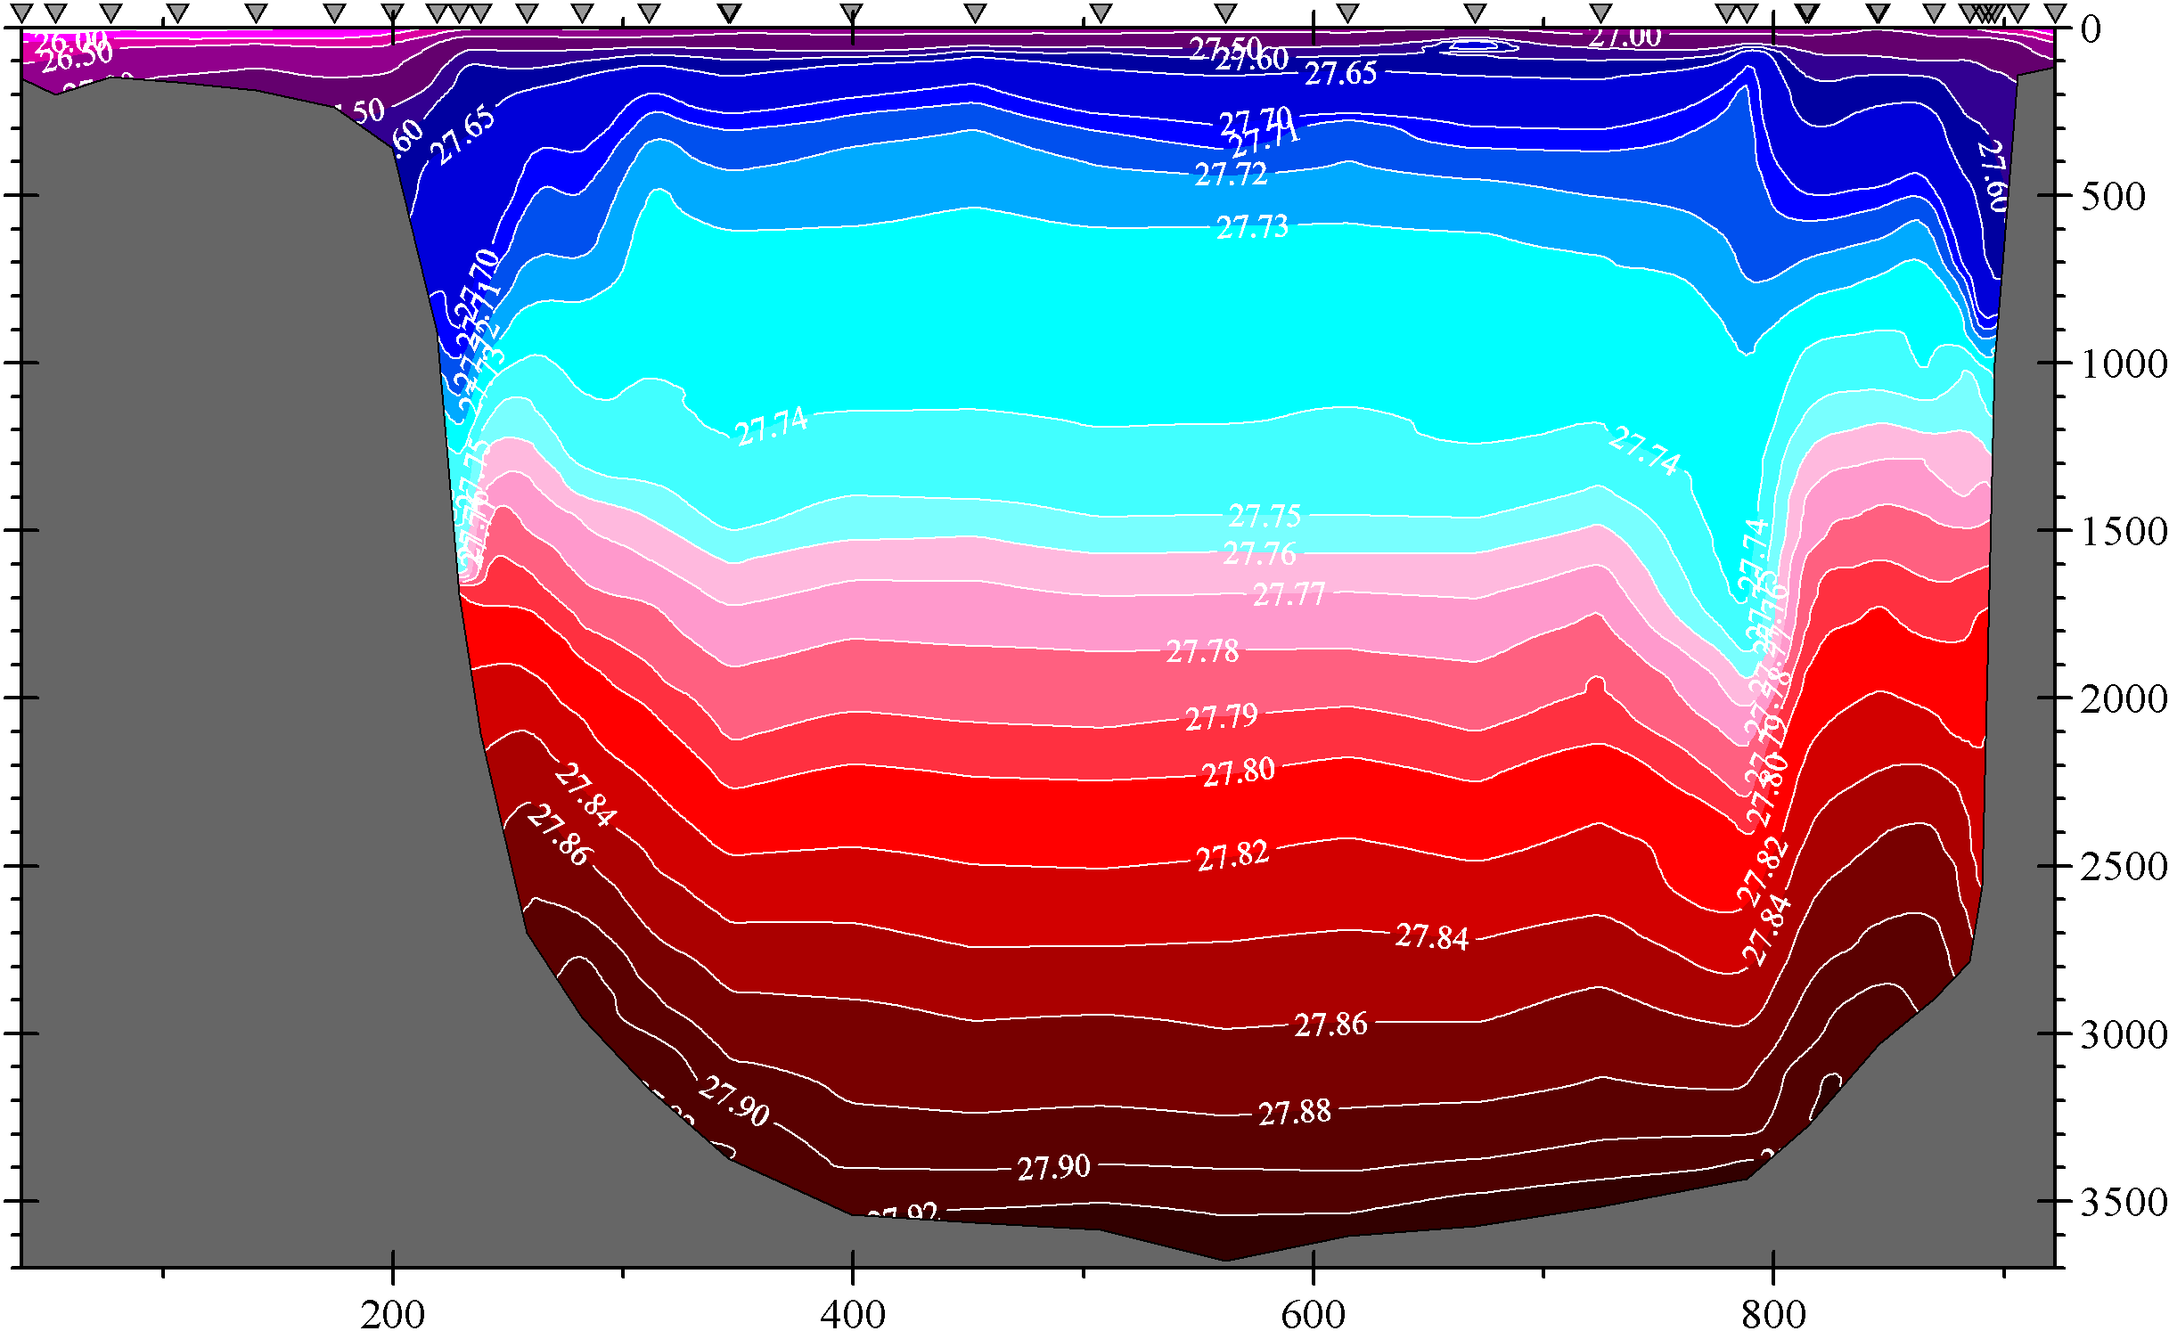
July 2003

Slide 30
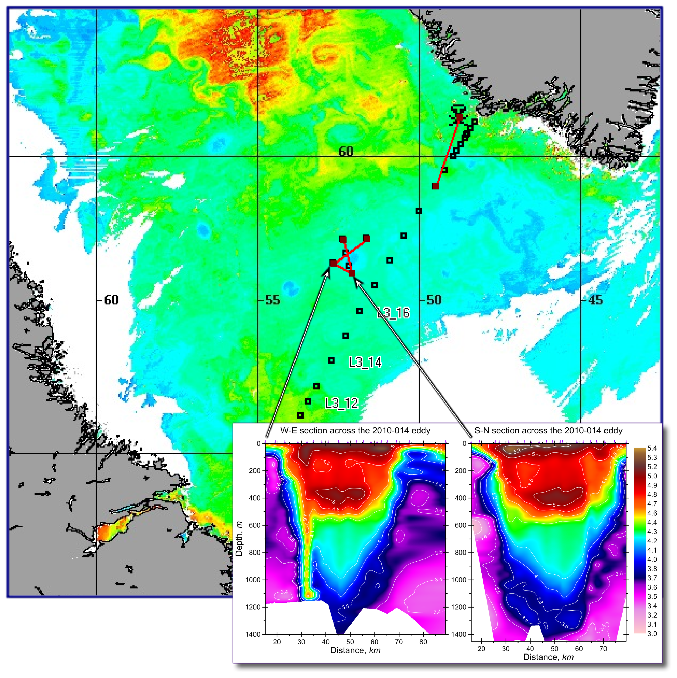
Navigating to an eddy with satellites and surveying it
with XBTs

Slide 31
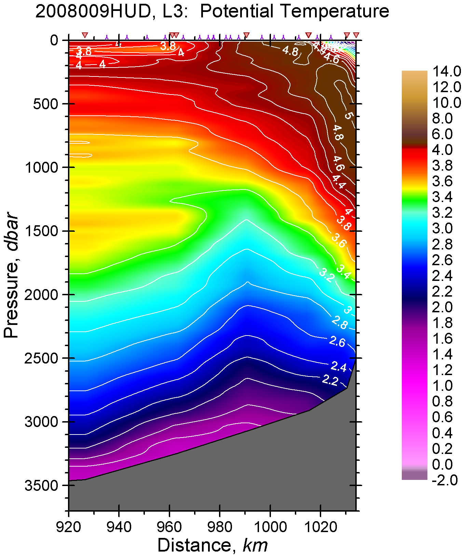
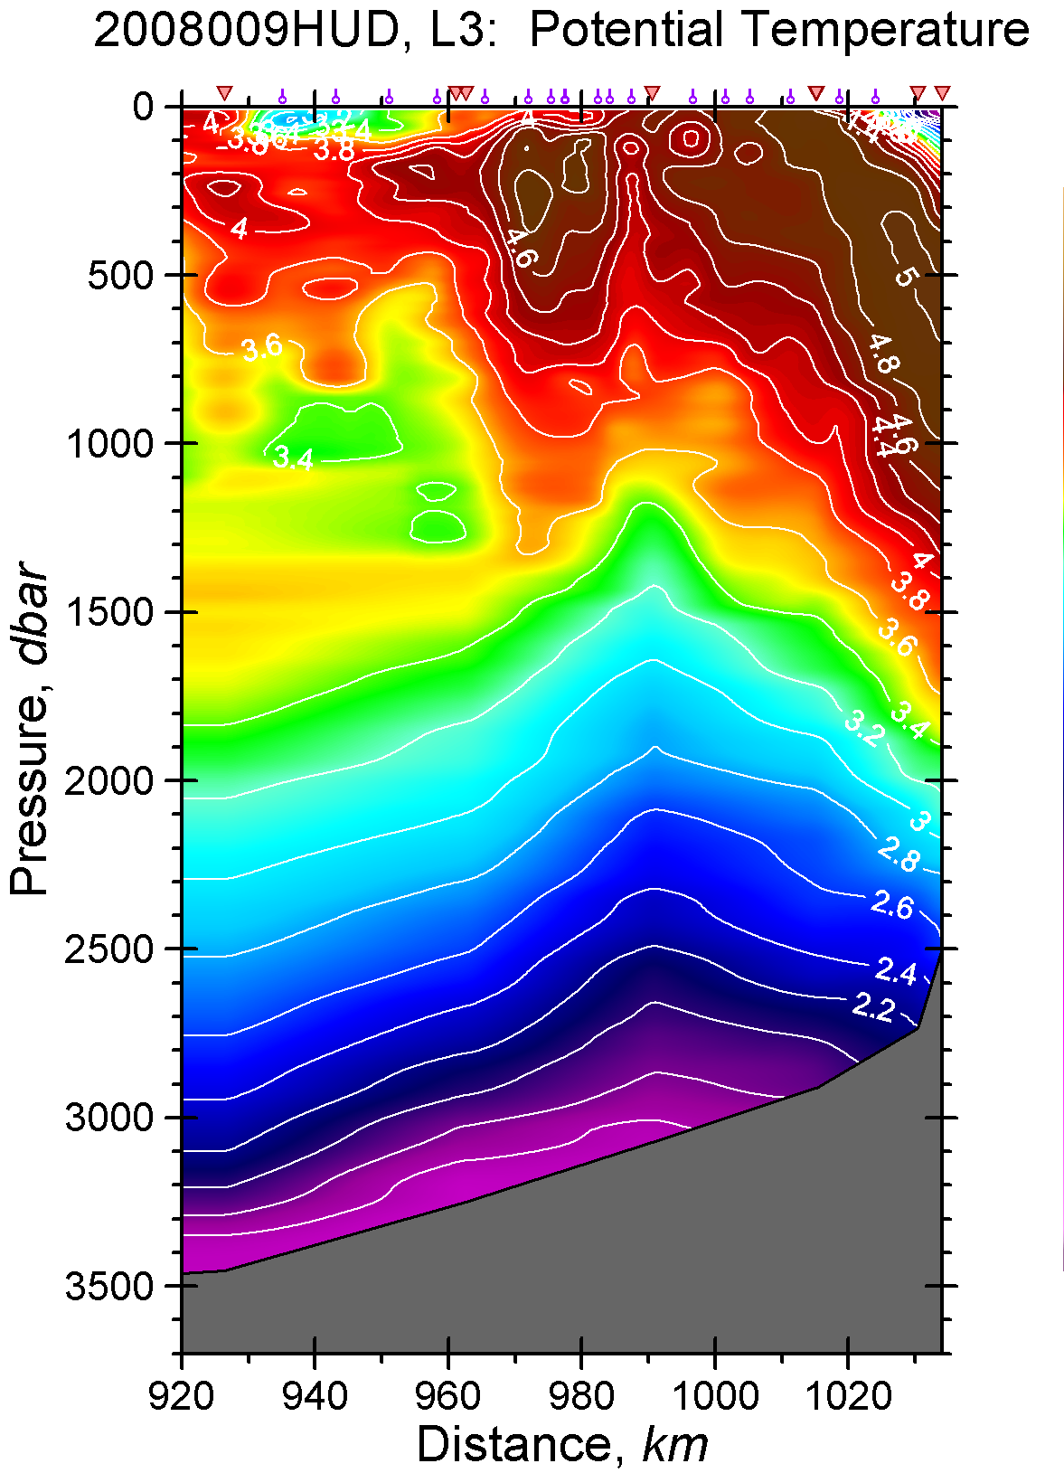
Discovering important transport (here recirculation) arteries
CTD
CTD + XBT

Slide 32
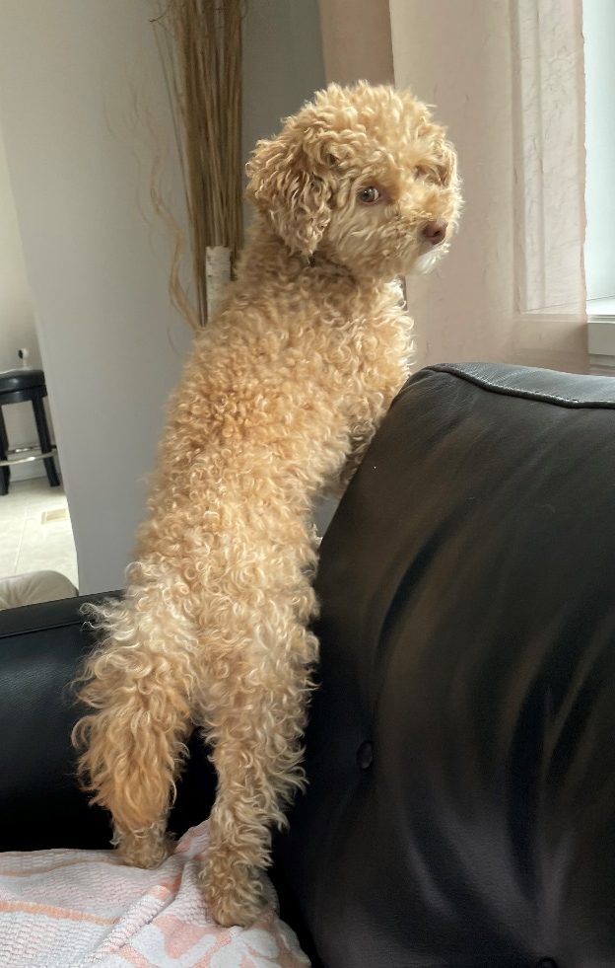
Conclusions
Record strong freshening, record shallow convection and record high sea level
in the Labrador Sea in 2023-2024
A switch from the halosteric
compensation of the thermosteric
contribution to the sea level rise
to the halosteric enforcement
after 2015
Predictability of thermosteric
and halosteric height changes
XBTs are still proactive, informative,
effective and overall useful in
exploratory oceanography

Slide 33
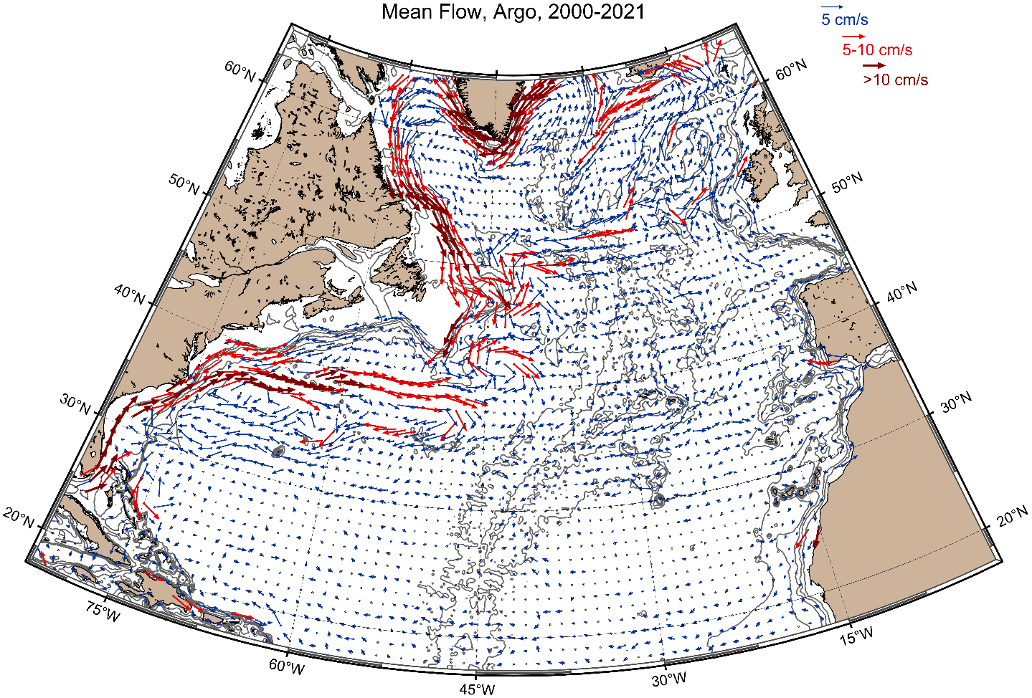
1000 m is just at the top of the Labrador Sea Water depth range
Mean Currents
at 1000 m
from Argo
Floats
1° grid
Labrador Sea Water
Pathways

Slide 34
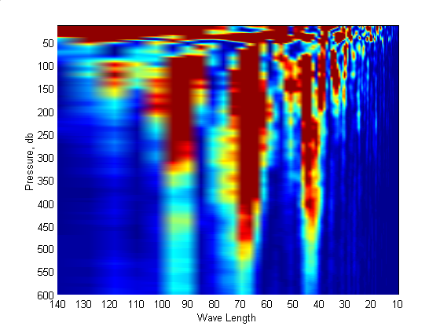
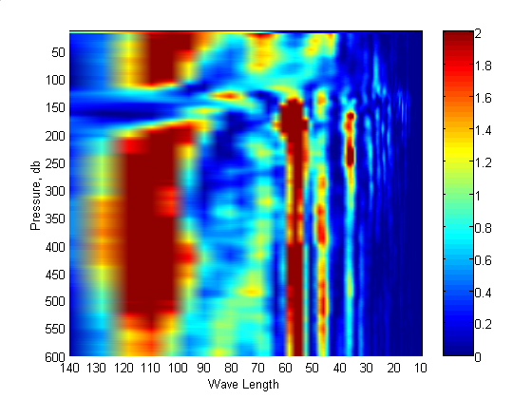
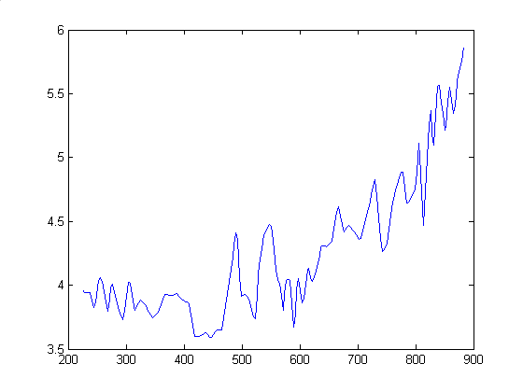
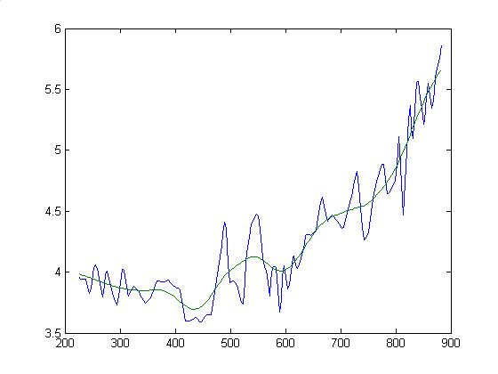
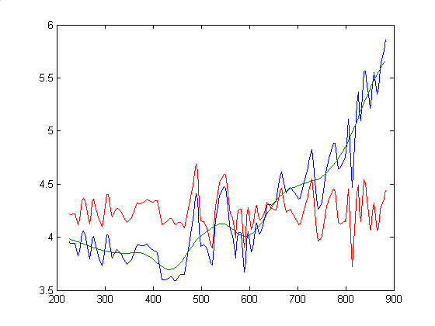
December 2002
Spectral Density
July 2003

Slide 35
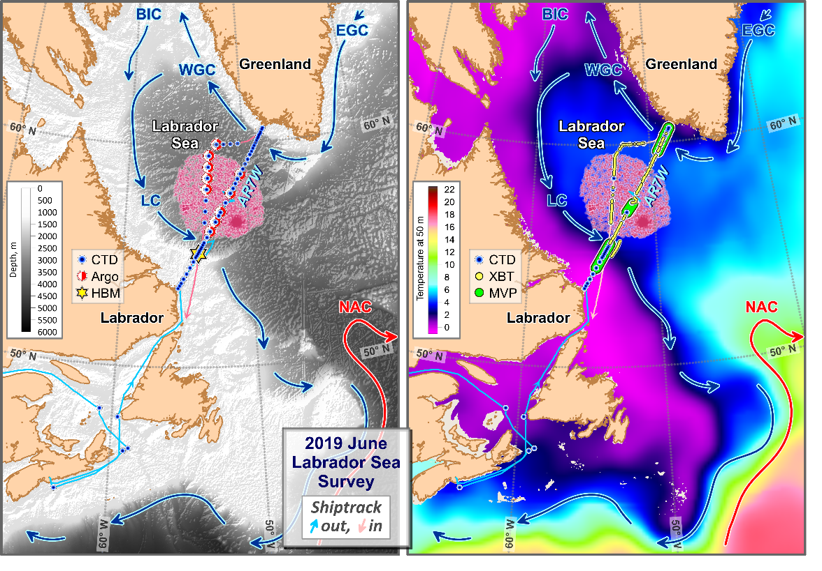
The Labrador Sea Deep Ocean Observation and Research Synthesis
High quality deep-sea oceanographic observations (temperature, salinity, oxygen) were collected
by the Bedford Institute of Oceanography during 1990-2019 & Hamilton Bank Mooring (HBM)

Slide 36
The Labrador Sea oceanographic record
contains water sample,
reversing thermometer,
CTD and Argo float data
Vertical profile
averaging:
Early years – isobaric;
1948-1975 – isobaric-isopycnic hybrid;
1976-2023 – isopycnic;
Argo-only – isobaric
2017 & 2021
Data Sources
The impact of convection
on ventilation based on
corrected dissolved oxygen
Similarly to 1996, the 2023 shutdown of deep convection triggered a decline in the oxygen concentrations below 700 m.

Slide 37
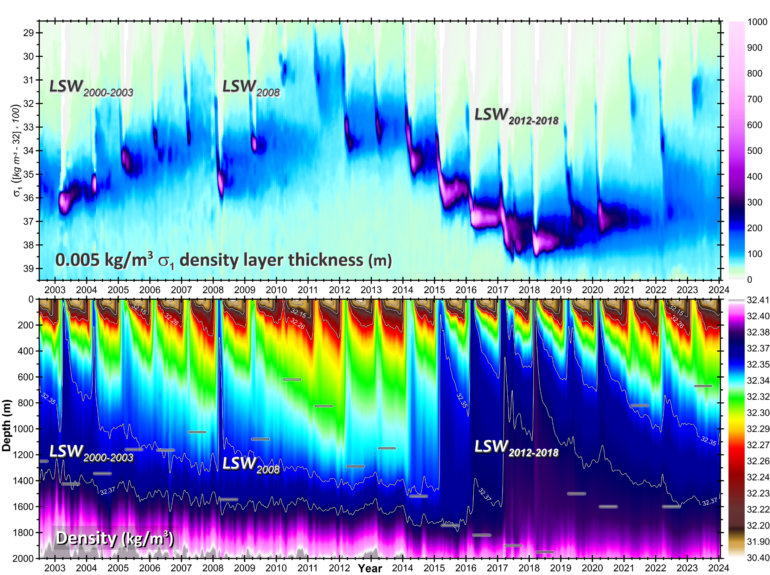
Denser LSW in 2015
Densest LSW in 2018
Least Dense in 2021 and 2023

Slide 38
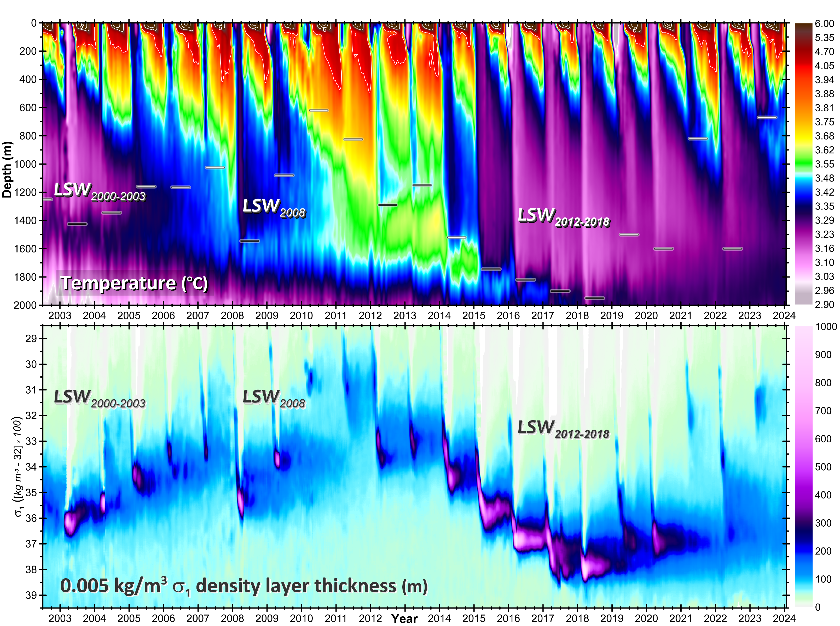

Slide 39
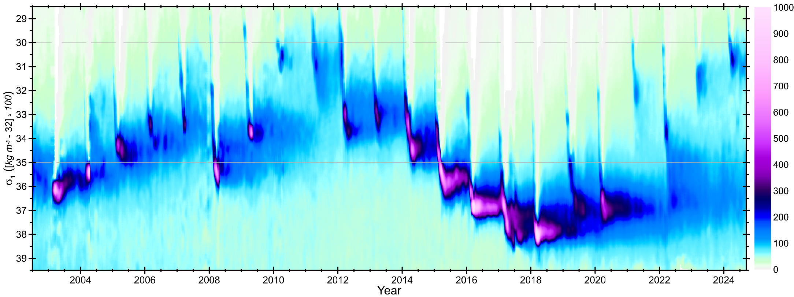

Slide 40
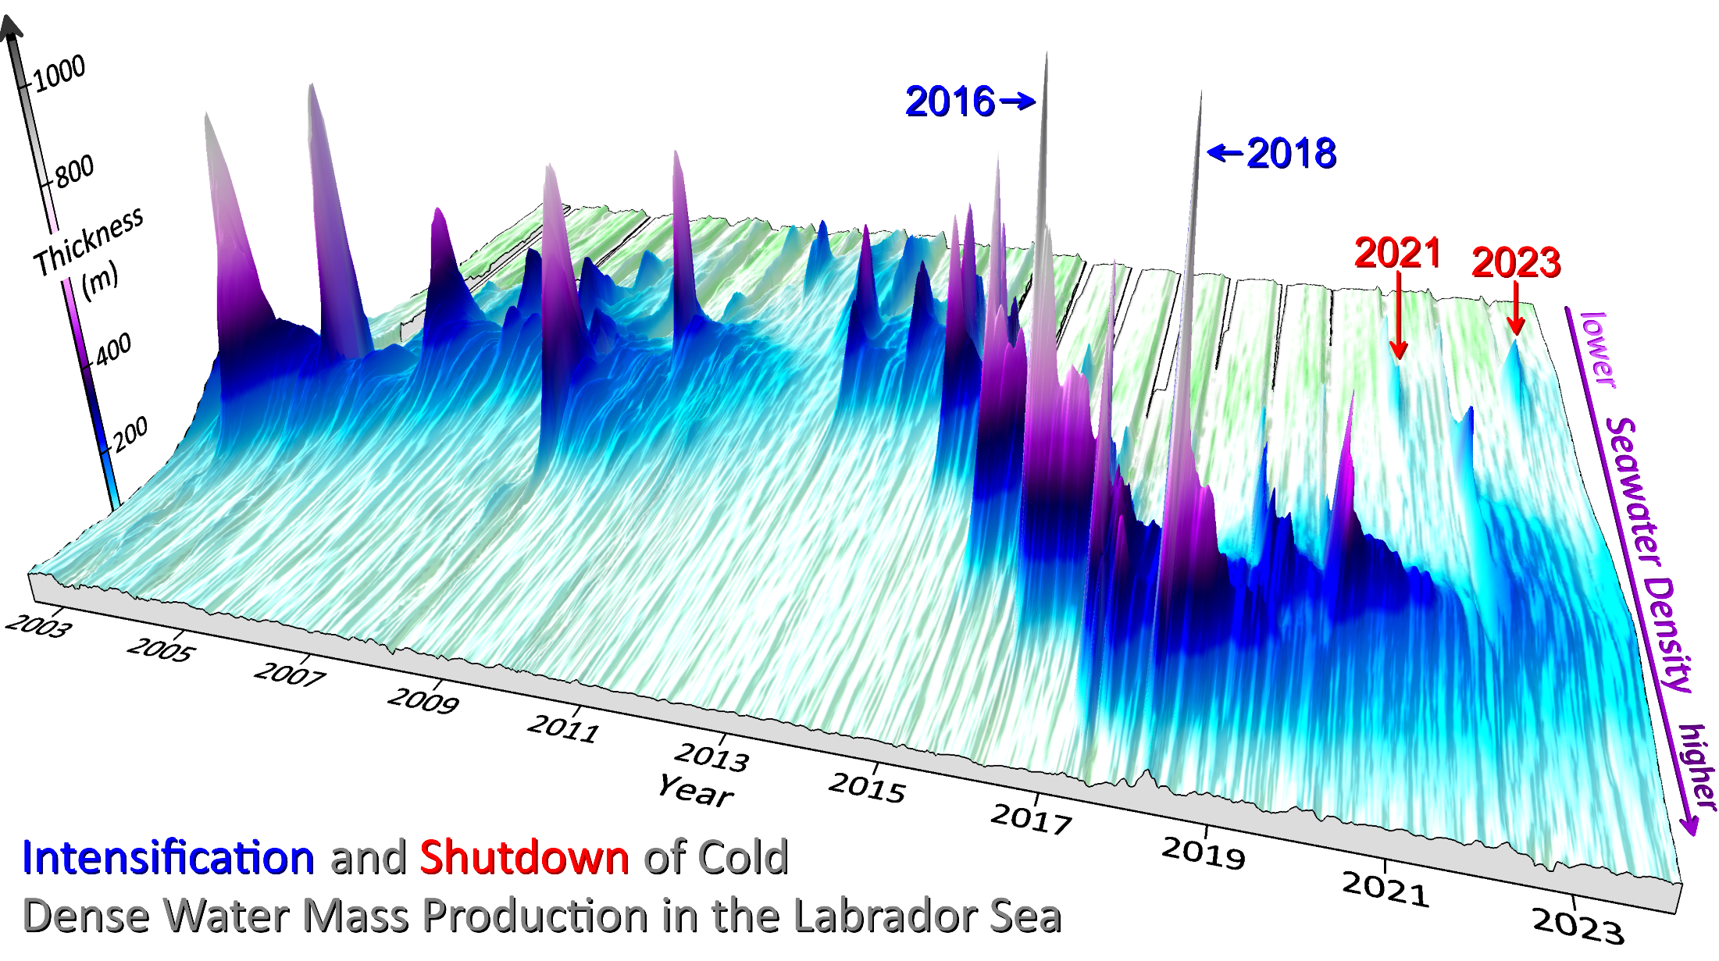
These features could only be discovered with Argo!
The densest and thickest
mixed layer formed
in 2018
Shoaled convection in 2021
Convective shutdown
in 2023

Slide 41
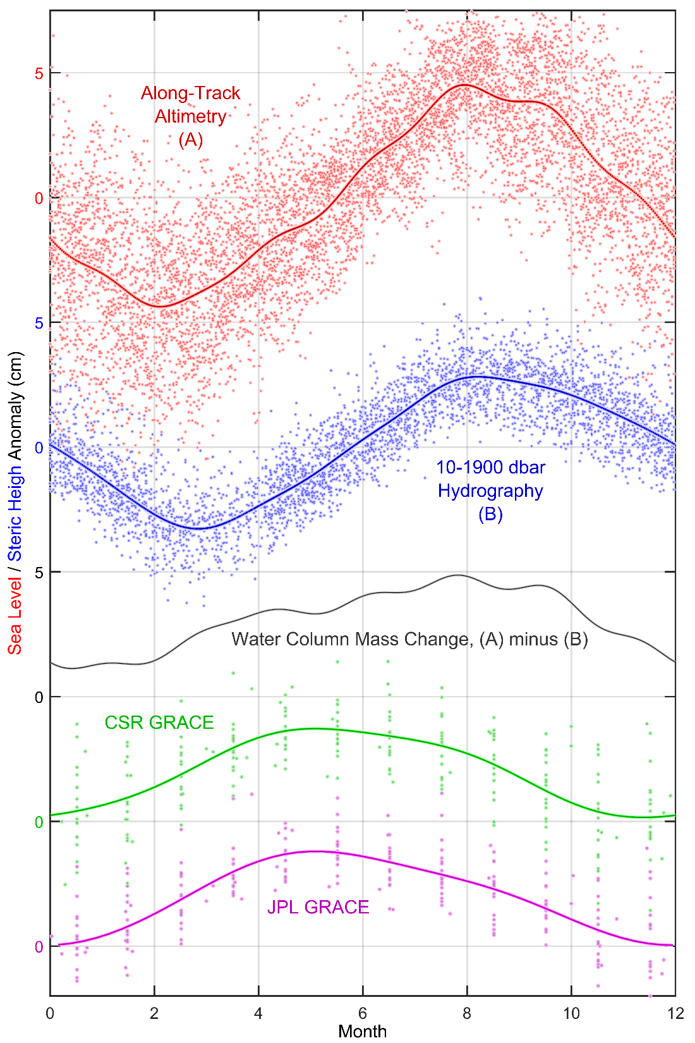
Regular
Seasonal
(solid)
+
Irregular
Seasonal
(scatter)
+
…

