Slide 1

Developing a GOOS Data and Metadata Hypernode through ERDDAP Federation
Kevin O’Brien
UW/CICOES, NOAA/PMEL
GOOS OCG Vice-chair for Data and Information
Joint Meeting of IQuOD/GTSPP/SOOP/XBT
November, 2024

Slide 2
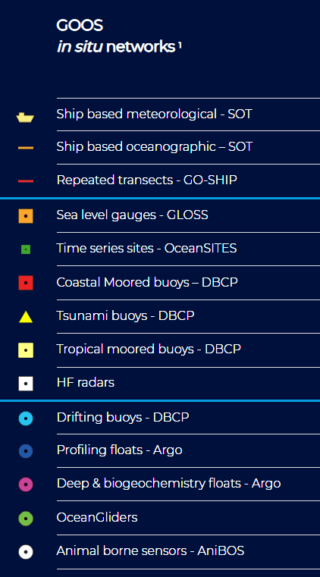
GOOS Observations Coordination Group (OCG)
The Observation Coordination Group (OCG) works to efficiently operate, maintain, coordinate and integrate a comprehensive in-situ global ocean observing system
Observation Coordination Group Executive
Chair, Vice Chairs WMO/Technical, Standards and Best Practice, OceanOPS, Data Management, Developing Community representative
Among the FOCI for the GOOS OCG are:
Data Management
Standards and Best Practices
Current Data Management Activities:
First attempt at mapping data/metadata flows for the Global Ocean Networks
Released a Data Strategy Implementation Plan to support WMO and IODE Data Policies/Services, FAIR data principles and improved interoperability of data
Developing a cross-network Data Task Team
Improve data links to Bio Eco communities

Slide 3
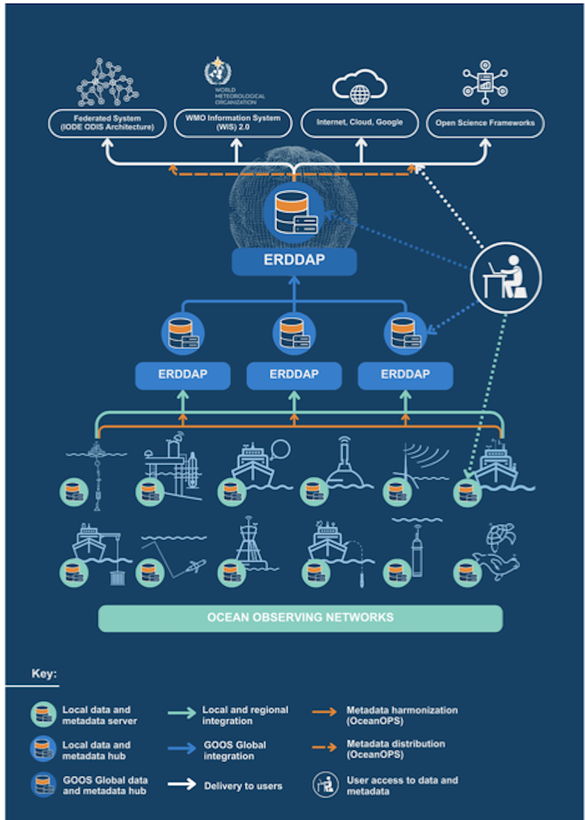
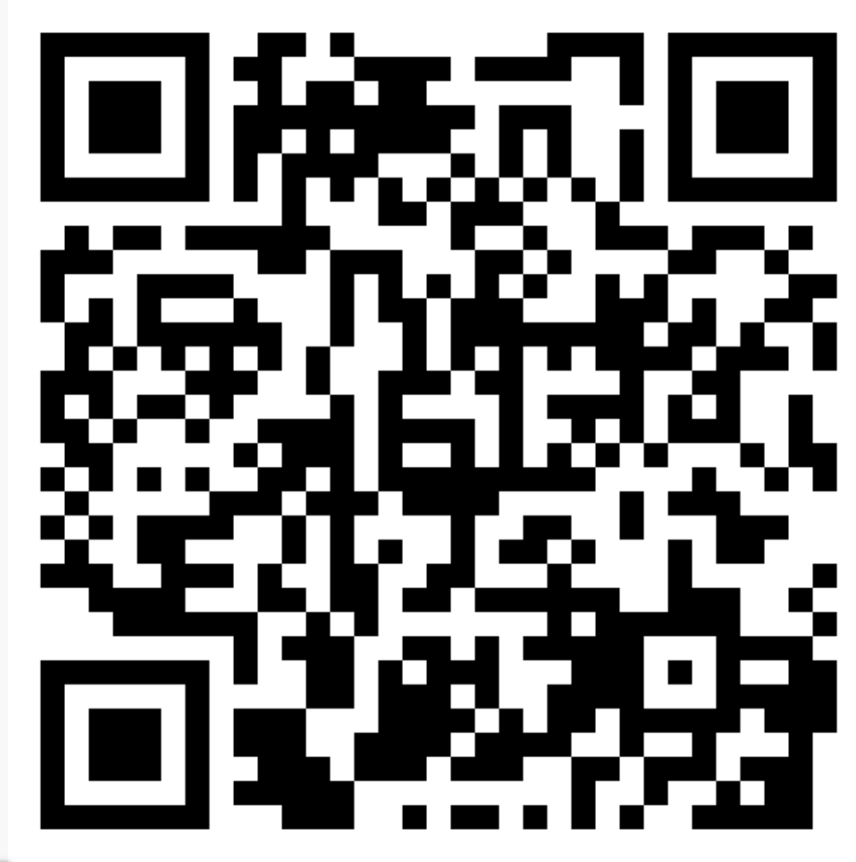
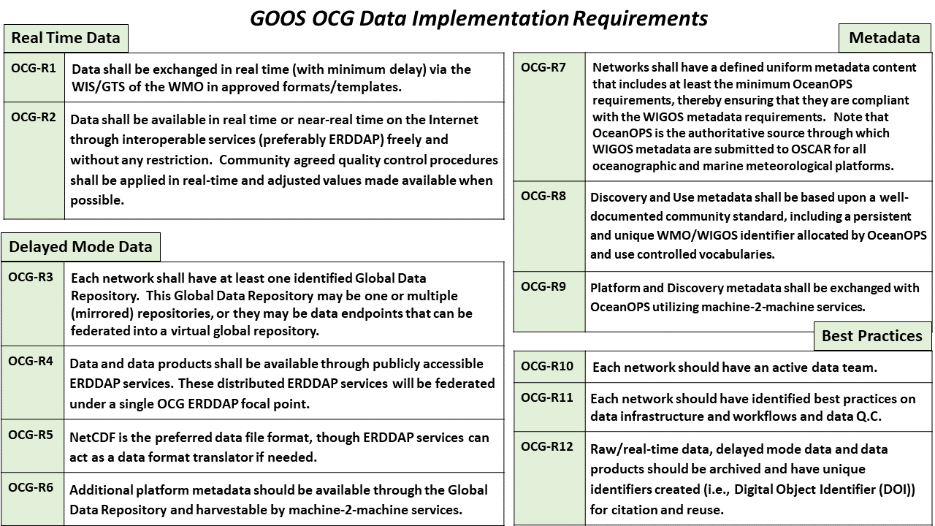
OCG Cross-Network Data Implementation Strategy Released
This Implementation Plan is an effort to define specific and actionable ways OCG network/programs can move towards FAIR compliance
Improve (meta)data discovery, exchange, accessibility and usability for all stakeholders
Improve access to distributed (meta)data endpoints through federated, uniform data services

Slide 4
GOOS OCG Data Users
\
Members of the GOOS Networks
Cross-network projects
Global stakeholders
WMO
ODIS
UN Decade projects (DiTTO, etc)
Who knows?

Slide 5
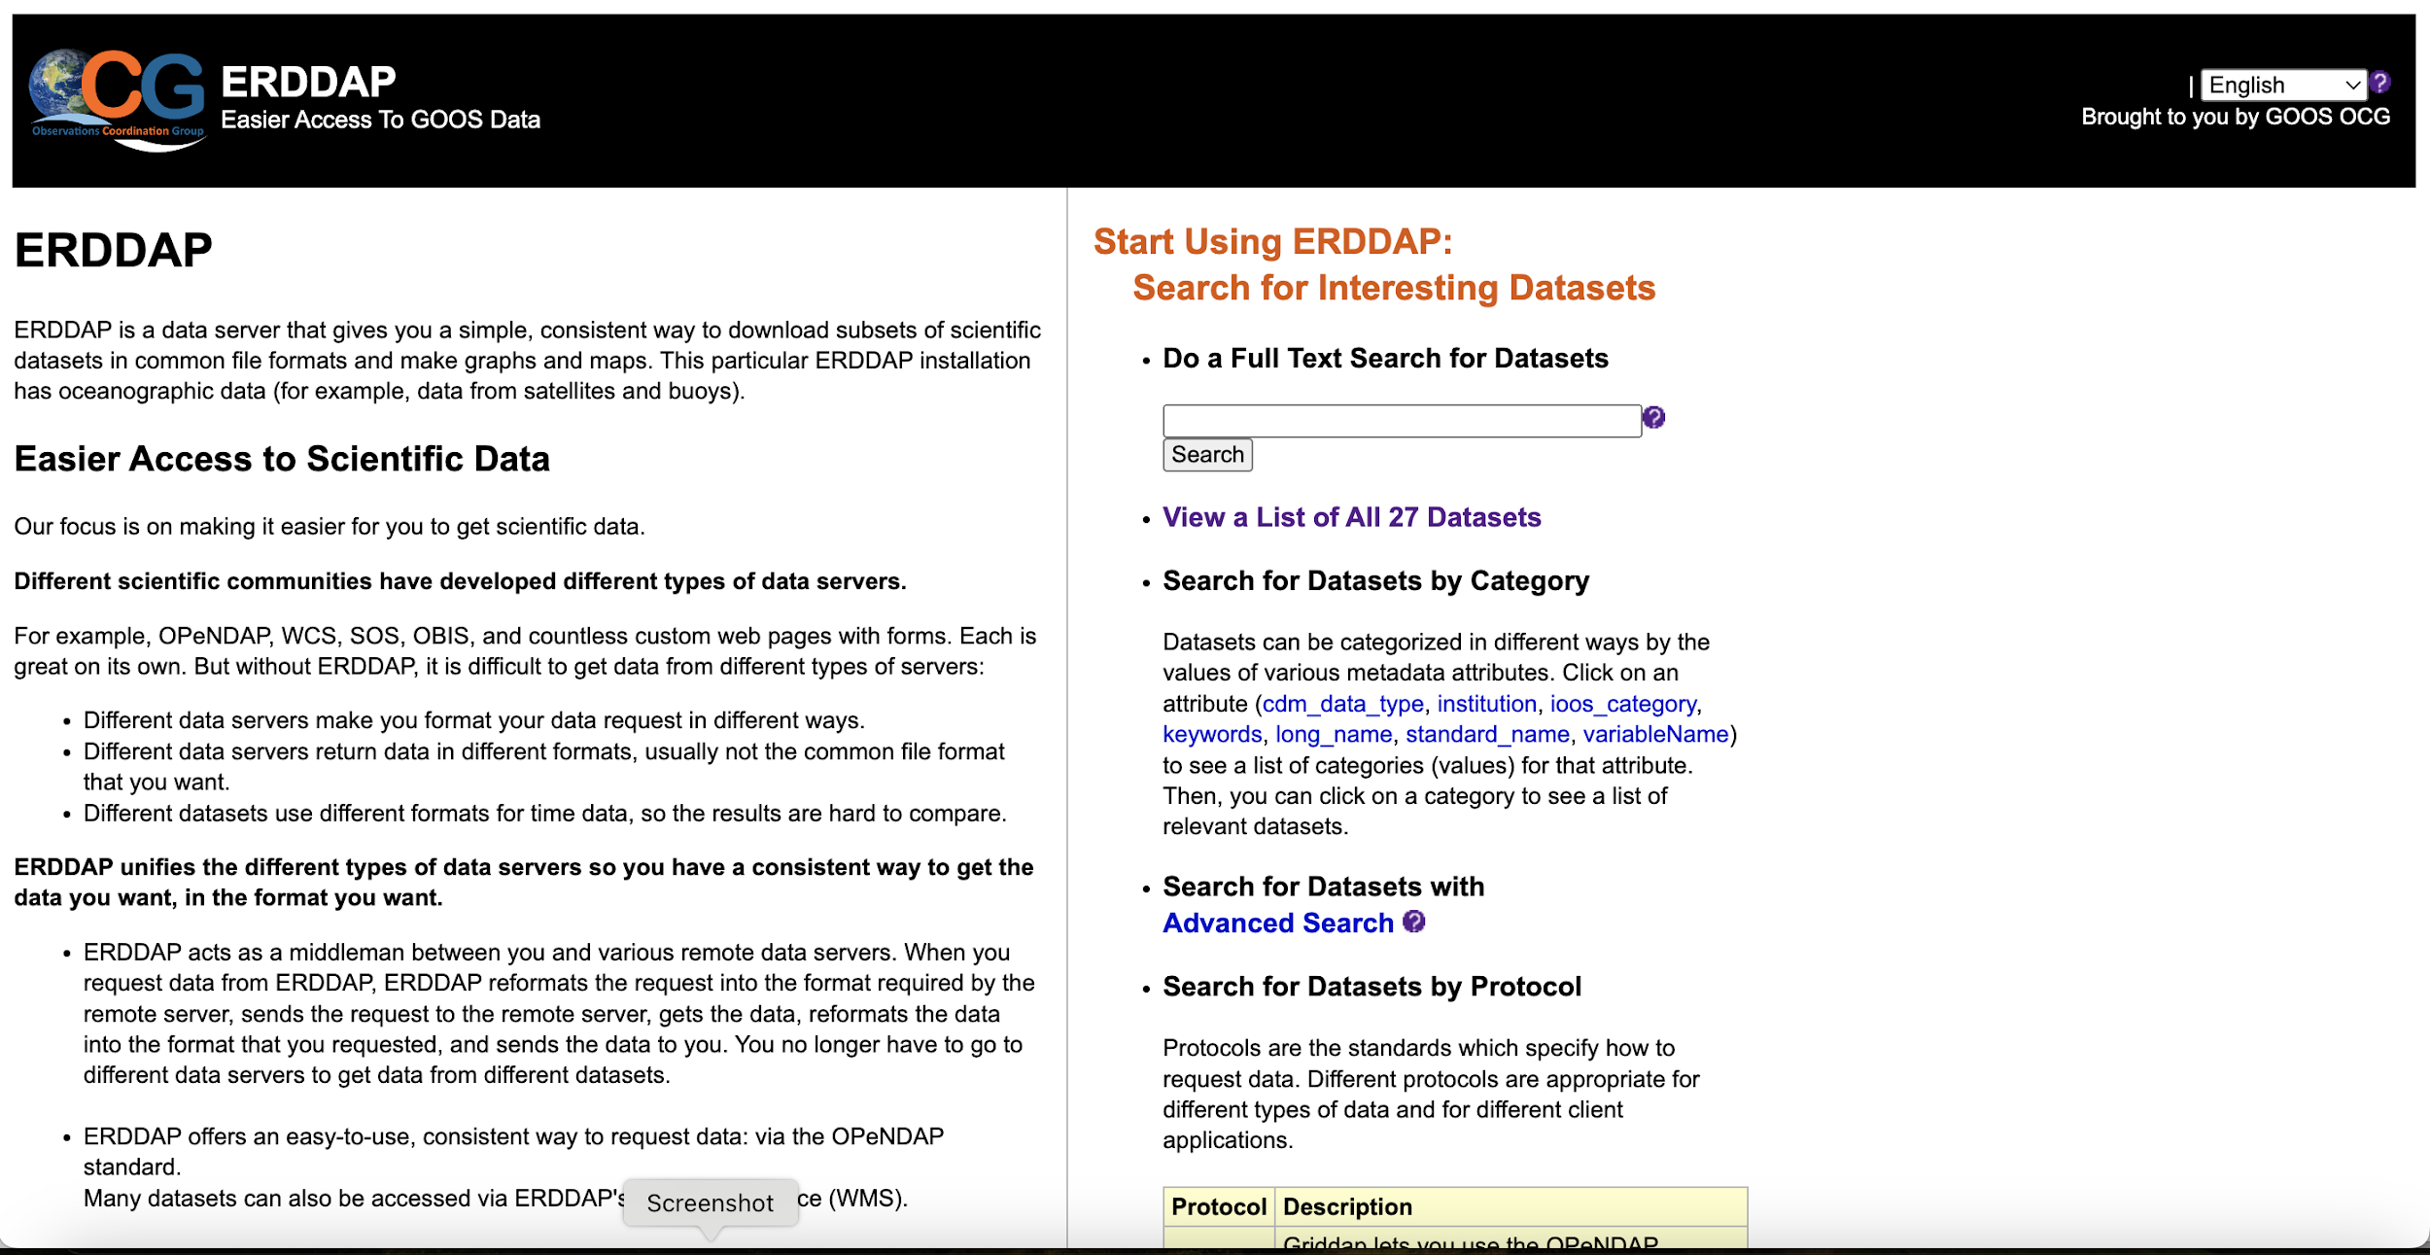
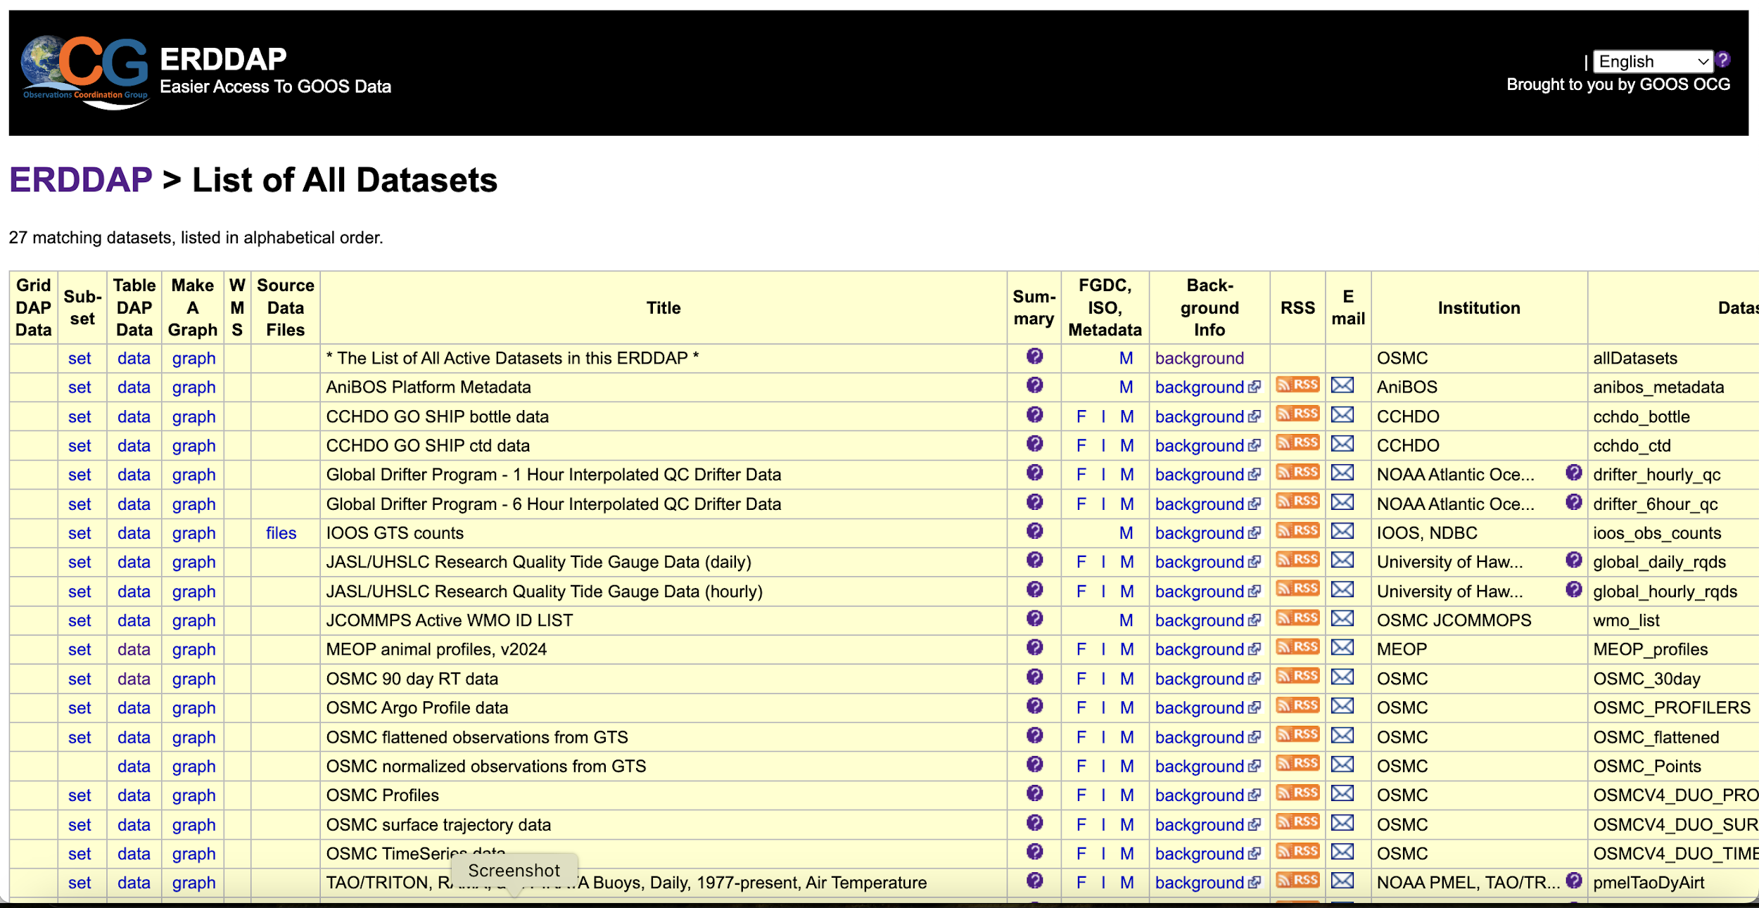
OCG Federated ERDDAP Node

Slide 6
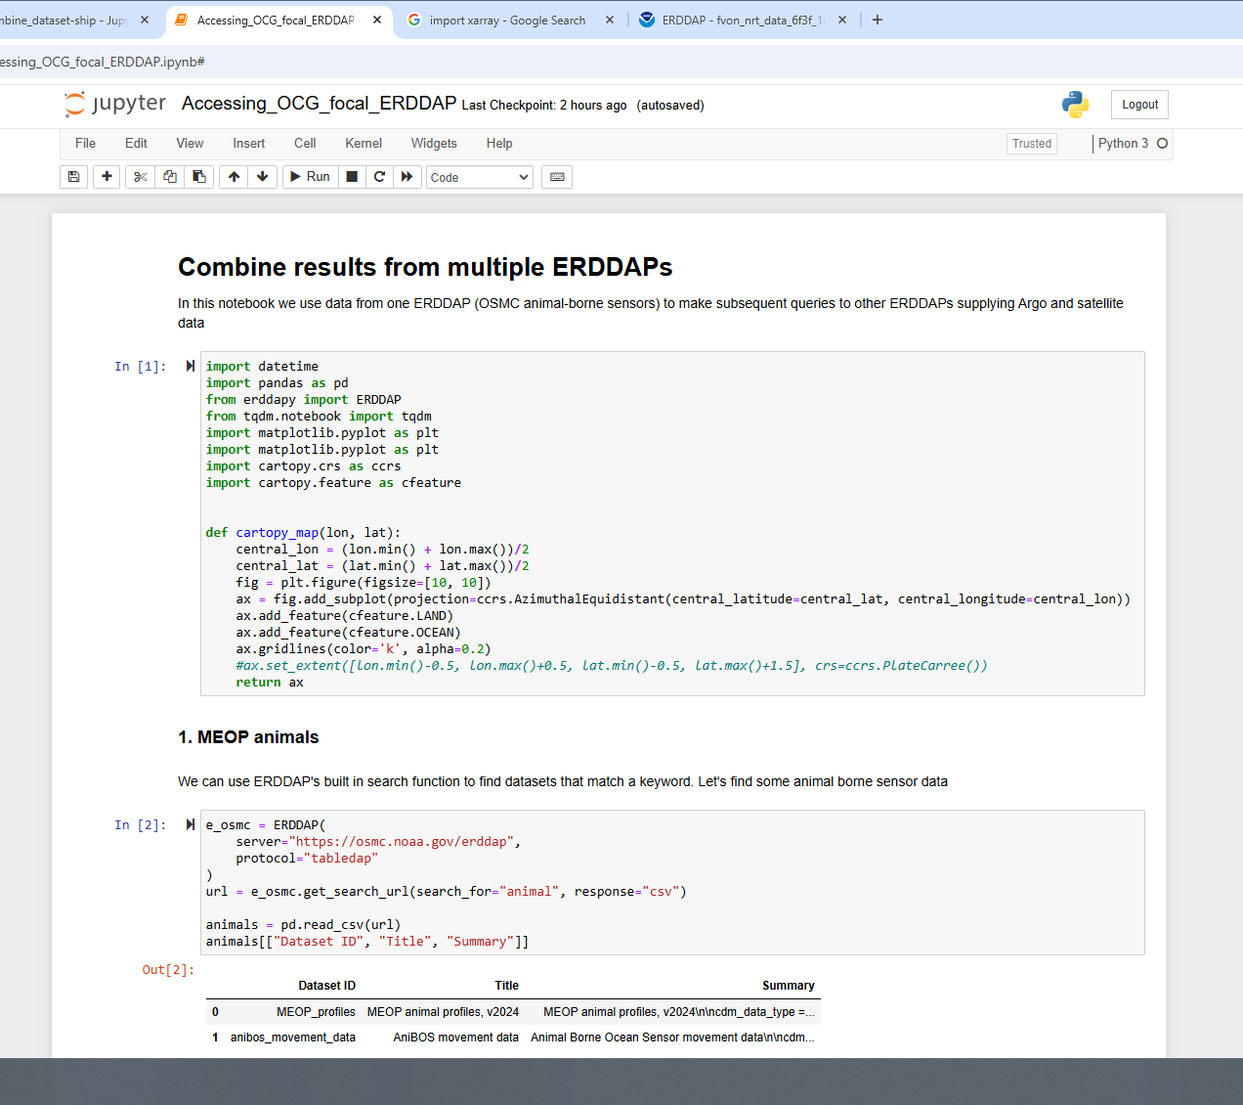
OCG Federated ERDDAP Node - Example

Slide 7
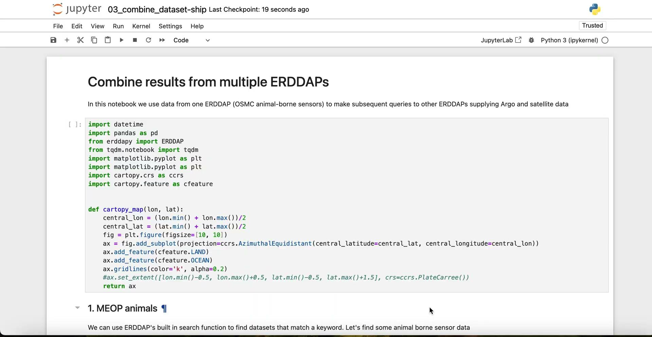
OCG Federated ERDDAP Node - Example

Slide 8
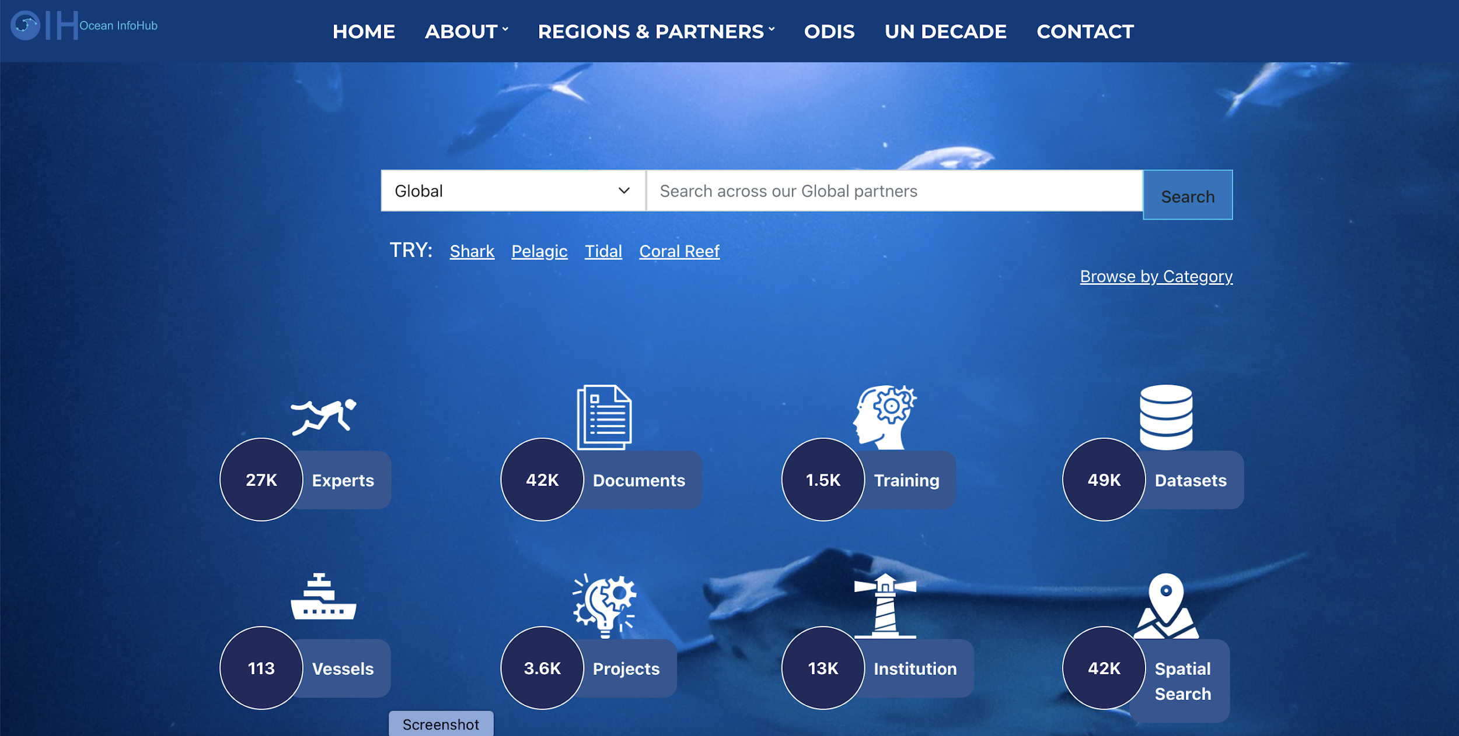
Integration with IODE Ocean Data and Information System (ODIS)*
*Federation of distributed metadata catalogs to further discovery and access of ocean data

Slide 9
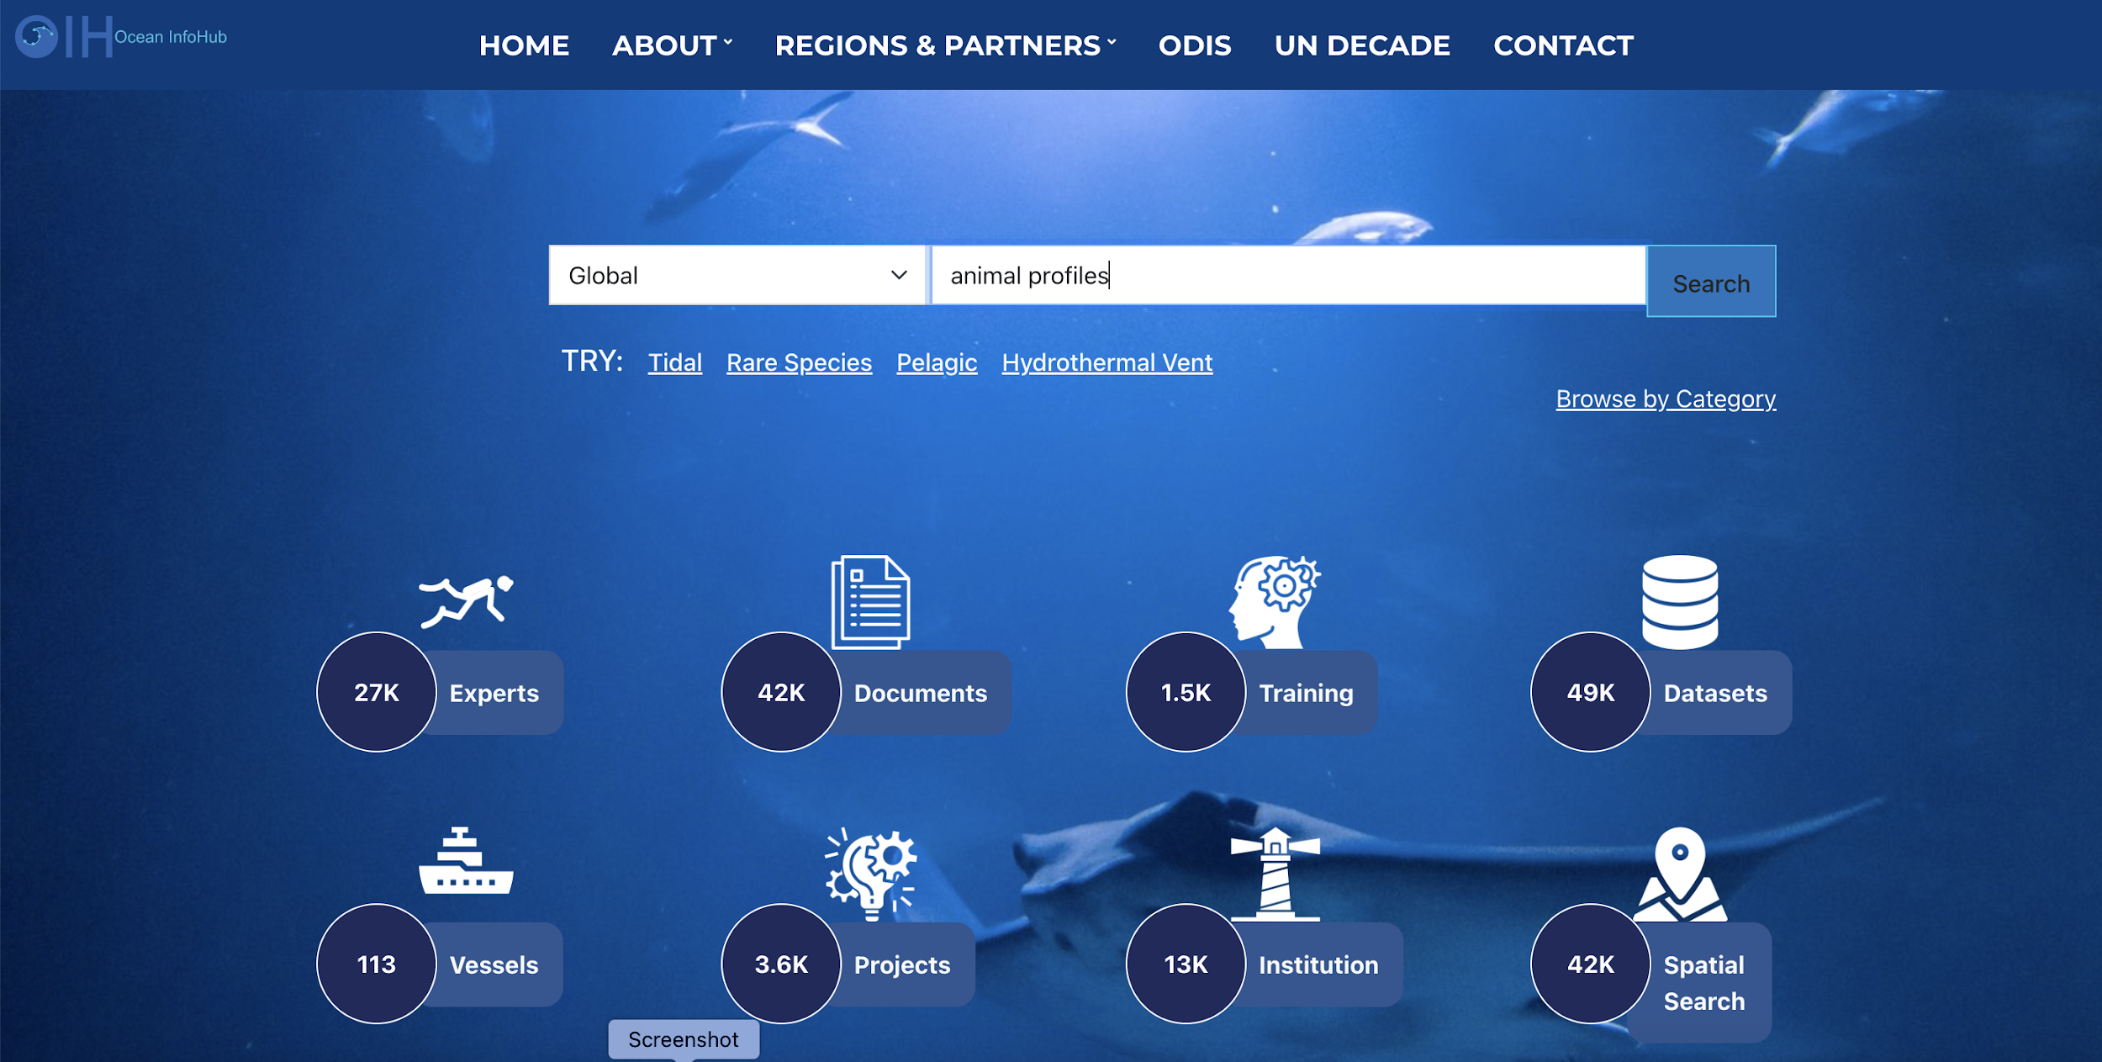
Integration with IODE Ocean Data and Information System (ODIS)

Slide 10
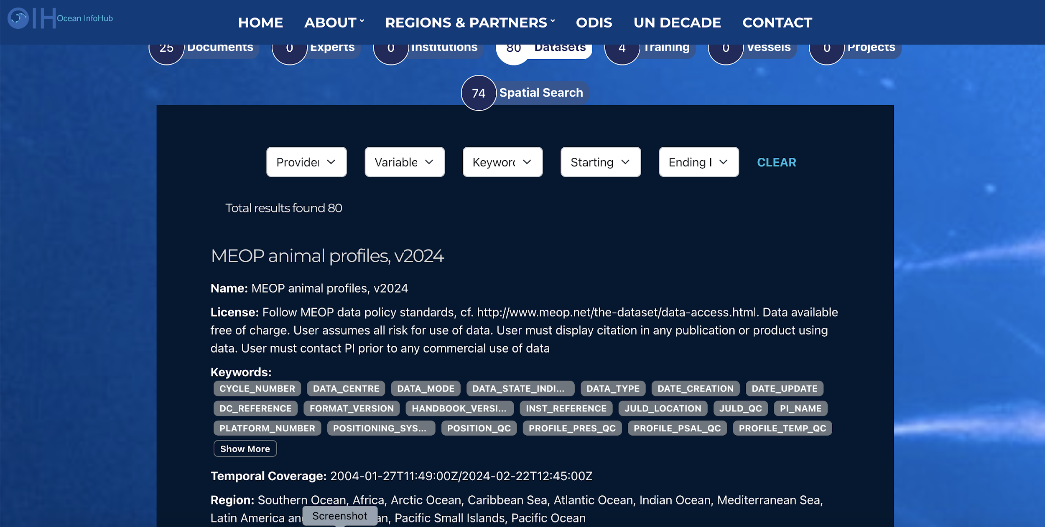
Integration with IODE Ocean Data and Information System (ODIS)

Slide 11
Integration with IODE Ocean Data and Information System (ODIS)

Slide 12
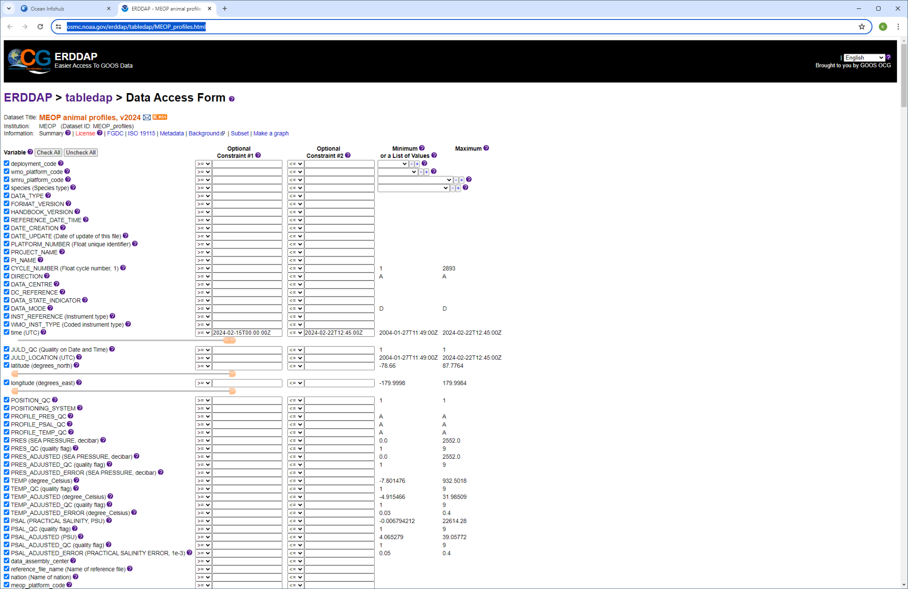
Integration with IODE Ocean Data and Information System (ODIS)

Slide 13
What could a cross-GOOS infrastructure look like?
Within GOOS, we will harness the power of ERDDAP to provide easy federation of distributed data nodes
ODIS seems well placed to act as the glue between disparate systems
ODIS
GOOS/OCG ERDDAP
OBIS
OceanOPS
BioEco Portal
GOOS RAs

Slide 14
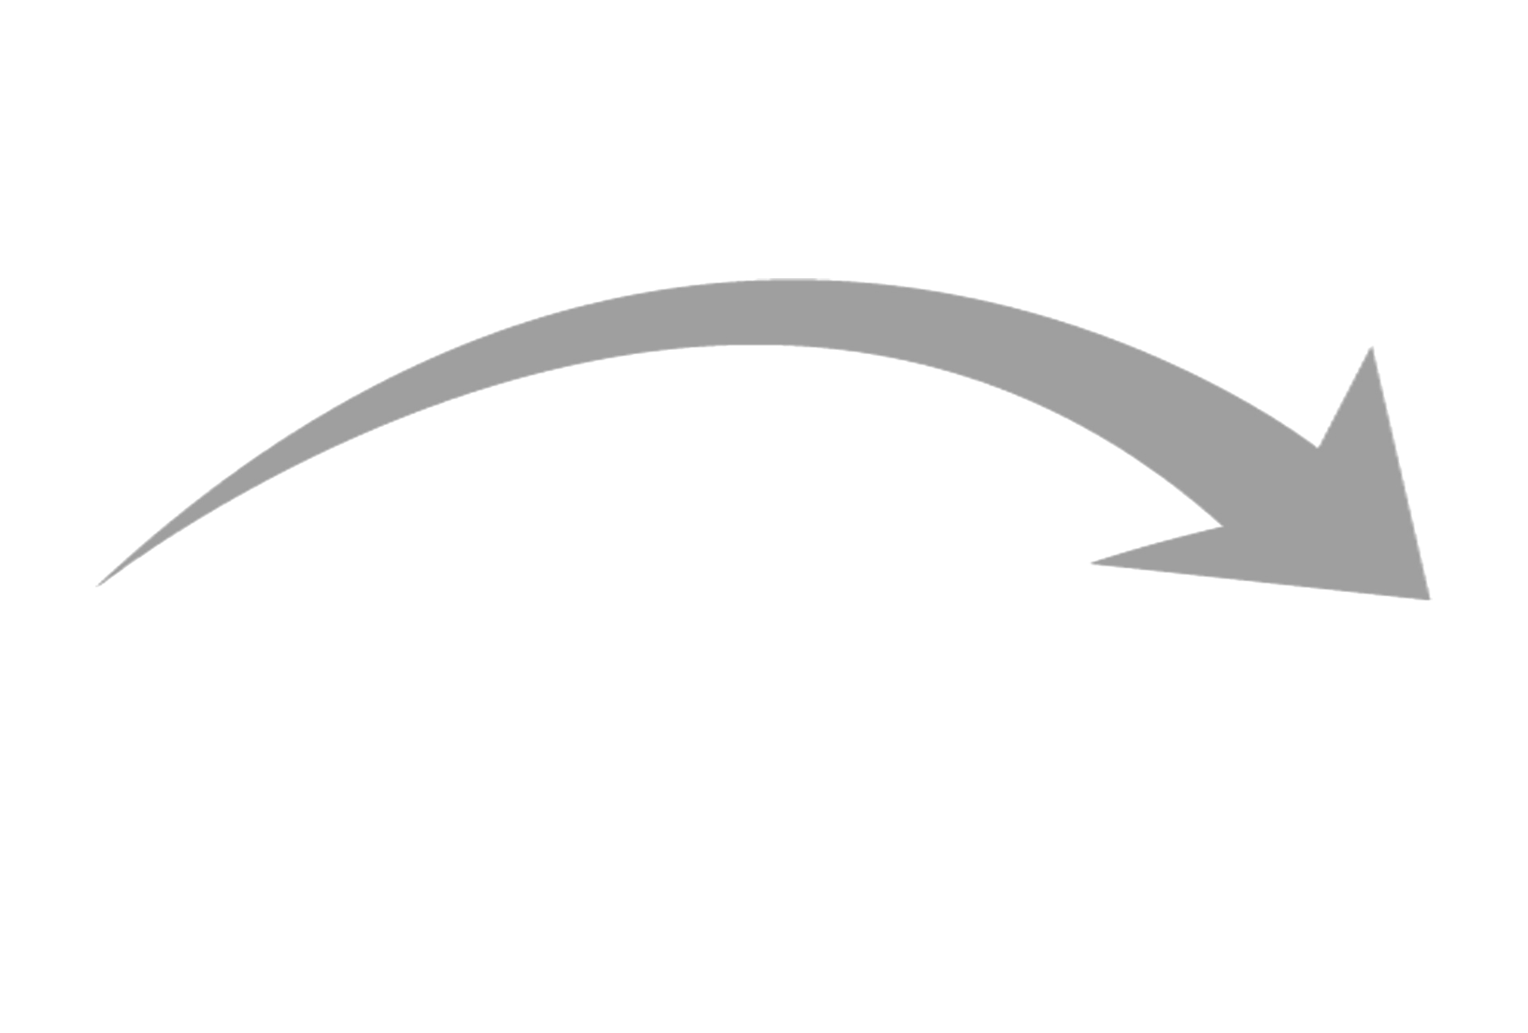
OCG Federated ERDDAP - integration with WIS 2.0
1963 World Weather Watch
1970s Global Telecommunication System (GTS)
2007 WMO Information System (WIS)
2019 WMO Reform (Earth System Approach)
2021 WMO Unified Data Policy (Core, Recommended)
WIS 2.0
… collaborative system of systems using Web-architecture and open standards to provide simple, timely and seamless sharing of trusted data and information …
Open Standards (OGC, W3C, IETF, …)
Free and Open Source tooling
Data sharing through Web and real-time notifications with publication/subscription (Pub/Sub) protocols
Cloud ready (turn-key solutions)
Web APIs (Application Programming Interface)
Slide courtesy Tom Kralidis

Slide 15
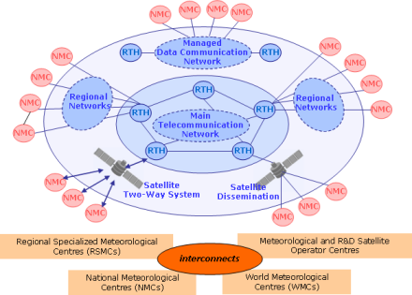
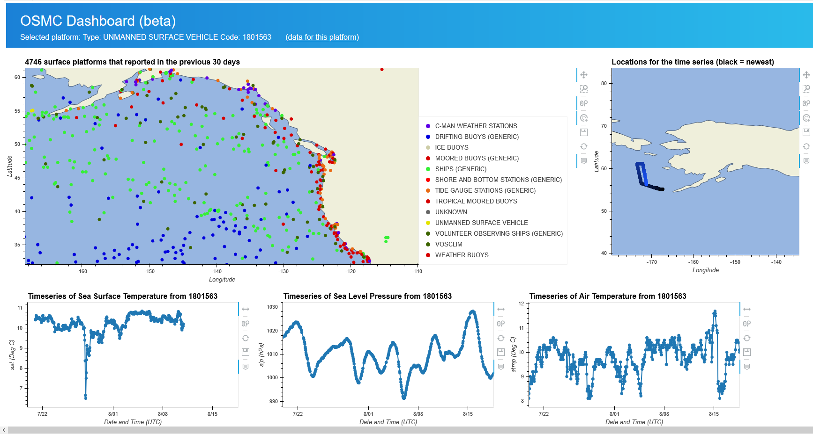
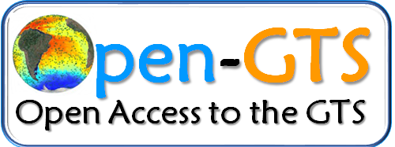
GOOS Open-GTS Data Exchange Workflow
The Open-GTS currently uses the GTS for exchanging data in near real-time
NOAA/PMEL
NOAA/NDBC
GTS
Platform
Platform
Local storage
Harvest and encode
SFTP
Platform
ERDDAP*
*Supports many data formats
However, the ERDDAP data/metadata endpoints are available to the public.
Notes:
Data is avbialgble either through the traditional GTS, but also through interoperable data services, thanks to the ERDDAP server.

Slide 16
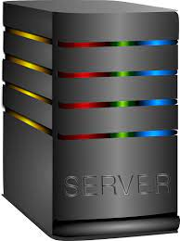
Open-GTS, WMO and WIS 2.0
Subscribe
Retrieve
Platform
Platform
Local storage
Publish
Pub/sub
broker
Retrieve
SFTP
Platform
ERDDAP*
*Supports many data formats
Subscribe
User might receive:
CSV/NCCSV file
NetCDF file
Service URL to access the data
Notes:
Data is avbialgble either through the traditional GTS, but also through interoperable data services, thanks to the ERDDAP server.

Slide 17
Current Open-GTS contributions
USV data exchange
Data from 80+ missions to the GTS
Most recently 12 USVs involved in 2024 hurricane season
Science RoCS data exchange
Science Research on Commercial Ships
Data from Xaymaca going to GTS
Non-traditional ship data exchange
Working with OceanSync to pilot exchange of weather data from commercial chips
1 vessel at this time
Non-VOS ships only
Fishing Vessel Observing Network (FVON)
New GOOS OCG emerging network
Place data from 45 fishing vessels onto the GTS
Temperature profile data from fishing tows and traps

Slide 18
Developing a GOOS Data and Metadata Hypernode through ERDDAP Federation
Thank you!
Joint Meeting of IQuOD/GTSPP/SOOP/XBT
November 2024

