Slide 1
GTSPP Status Update
2024 Joint Meeting of IQuOD/GTSPP/SOOP/XBT
Chris Paver, GTSPP SG Chair
2024-11-11

Slide 2
GTSPP Mission
Global Temperature and Salinity Profile Program
Part of the IODE Ocean Data and Information System.
Tasked to provide researchers and marine operations managers with accurate, up-to-date temperature and salinity profile data.
Jointly manage network of capture, archive, and dissemination systems to ensure sustained quality control, storage, and access.
NCEI maintains the program’s long-term archive by providing storage and quality control services to ensure that best copy versions of GTSPP data are properly preserved and available to the public.

Slide 3
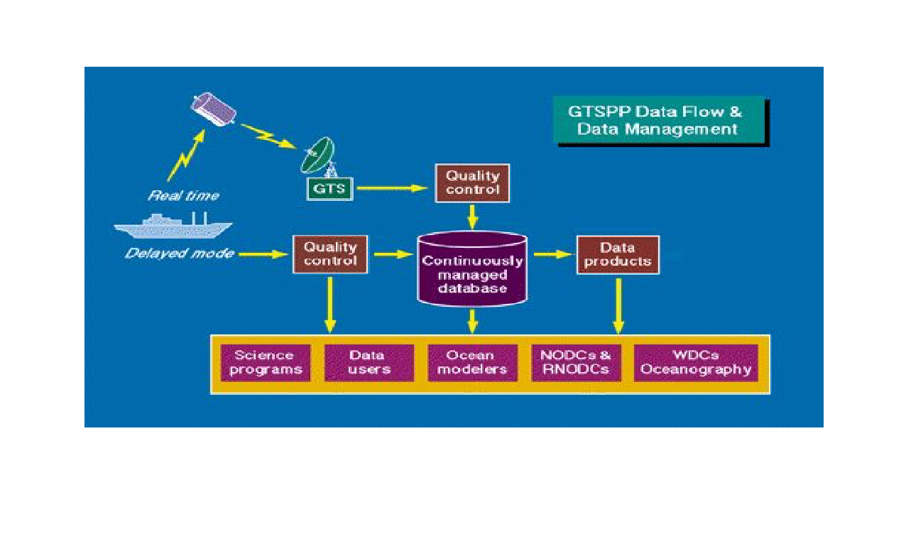
GTSPP Data Flow
Near real time GTS
Canada DFO; 3 packages a week
Argo since BUFR: 2019 to present via non-standard acquisition
AOML SEAS
Shipboard Environmental data Acquisition System
Weekly updates
Delayed Mode
ABOM, AOML HD, CSIRO, SIO
Quarterly updates

Slide 4
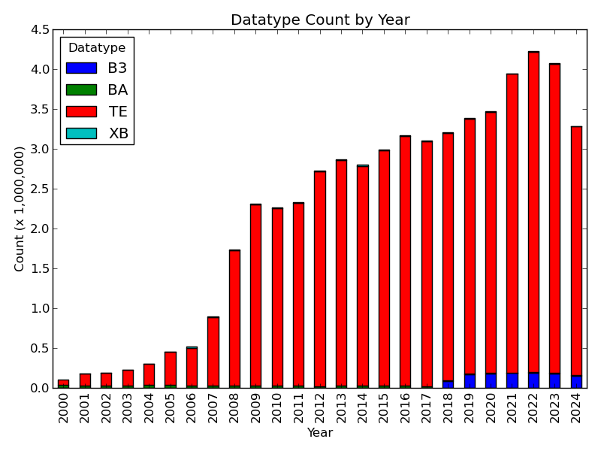
Real TIme Holdings

Slide 5
GTSPP Data Access and Products
Real TIme
Generated weekly
MEDS ASCII, NetCDF
Best Copy
Monthly
MEDS ASCII, NetCDF
Web Application
Directly query database
geospatial
dates
seasons
Quality RT/DM
Instrument Type

Slide 6
GTSPP Issues
BUFR
Not capturing from GTS
Argo since 2018; sep. process
Partner resourcing issues
NCEI Resources
3 (~2013) to 1 (~2020)
No Manual QC
Web and Tech maintenance lagging
Best Copy Product
Mainly RT data
WOD captures DM; available Quarterly
Resourcing issue

Slide 7
SG Activities
Elect SG Chair
Wed. - Provide nominations
Fri. - vote via email
Budget
$25,000 for 2024 and 2025
Mainly used SG meetings
Other requirements to facilitate?

