Slide 1


Capacity Development of IQuOD achievements through OTGA
TVS Udaya Bhaskar
Member, IQuOD
Ana Carolina Mazzuco
IODE Training Coordinator
OTGA Coordinator

Slide 2

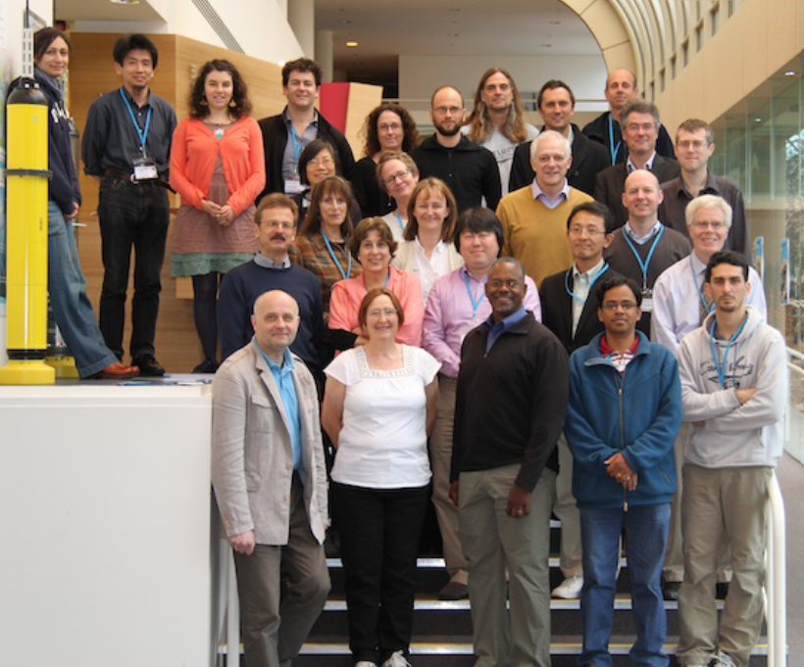
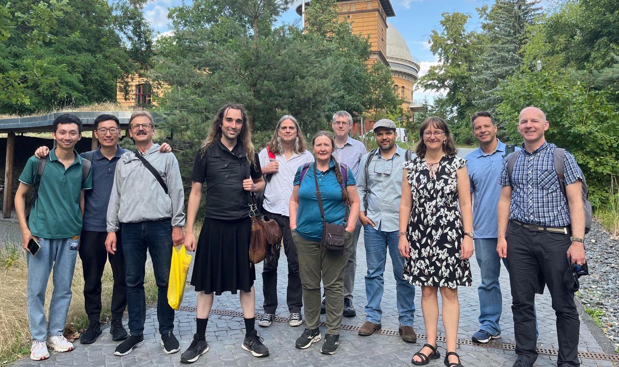
International Quality-controlled Ocean Database
IQuOD “Mission Statement”
To maximize the quality, consistency, and completeness of the long-term global subsurface ocean temperature (and salinity) database.
The power of IQuOD: Ability to pull together the expertise from the international research community (producers/users) and to focus that combined effort into a single “best” dataset.
Inaugural meeting was June 2013 in Hobart, Australia.
Successfully completed 10 years in 2023 and going strong.

Slide 3
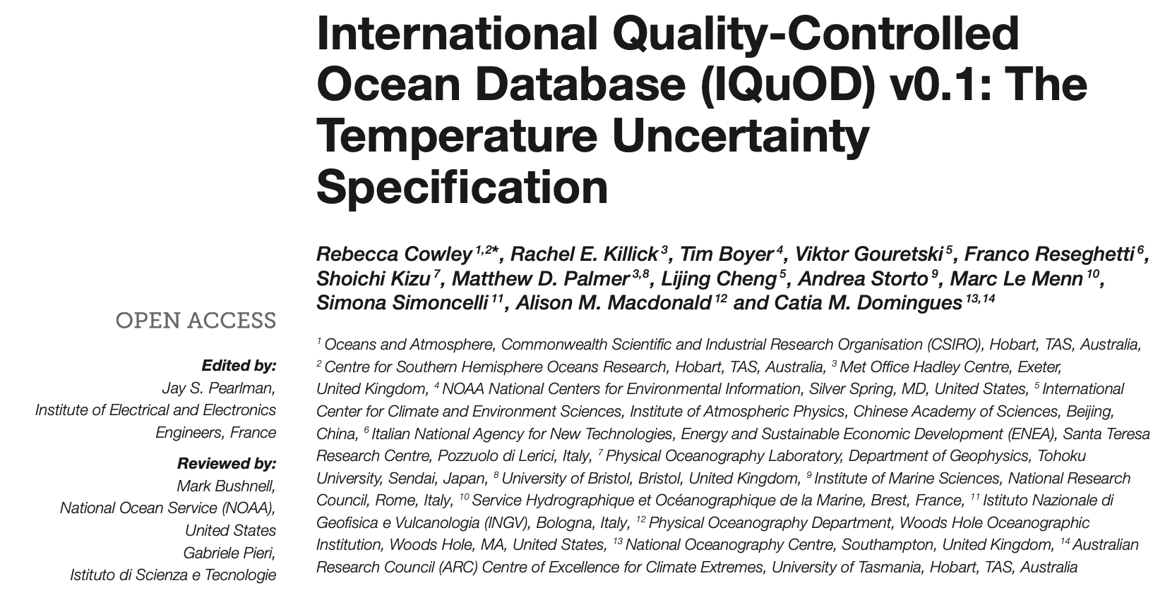
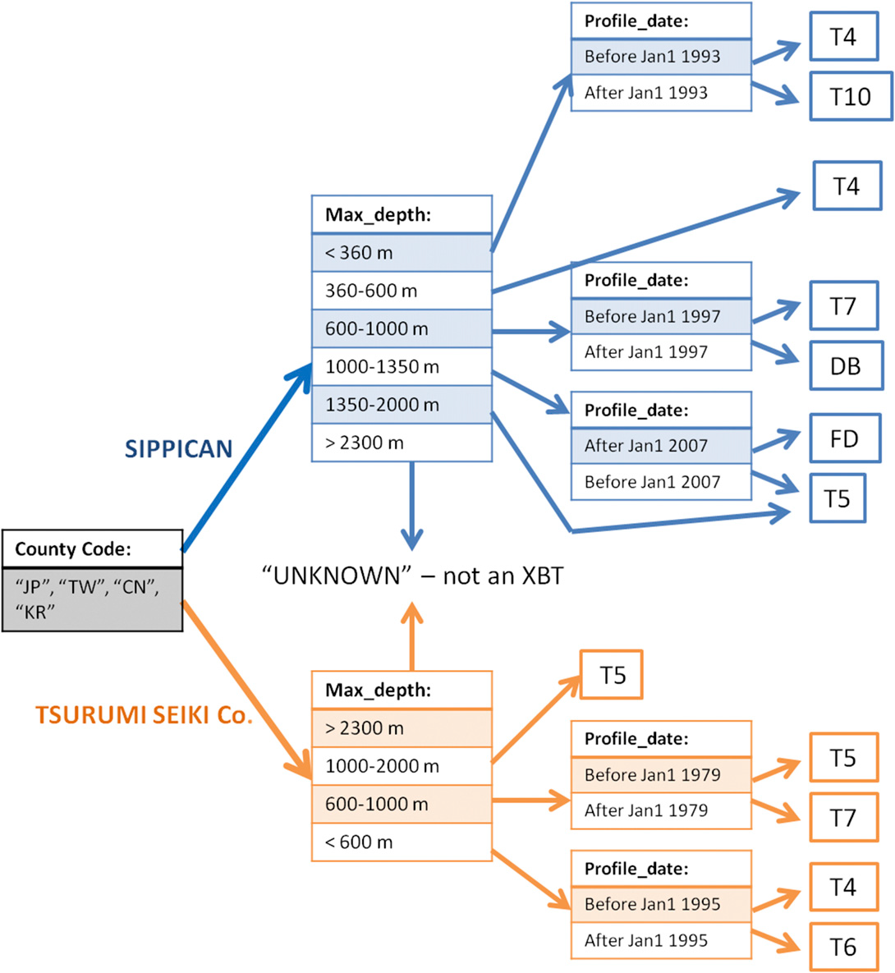
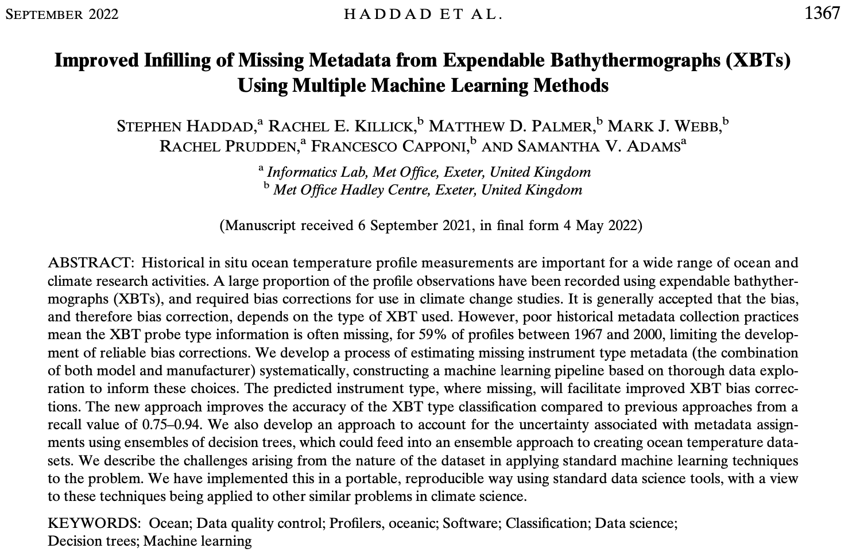
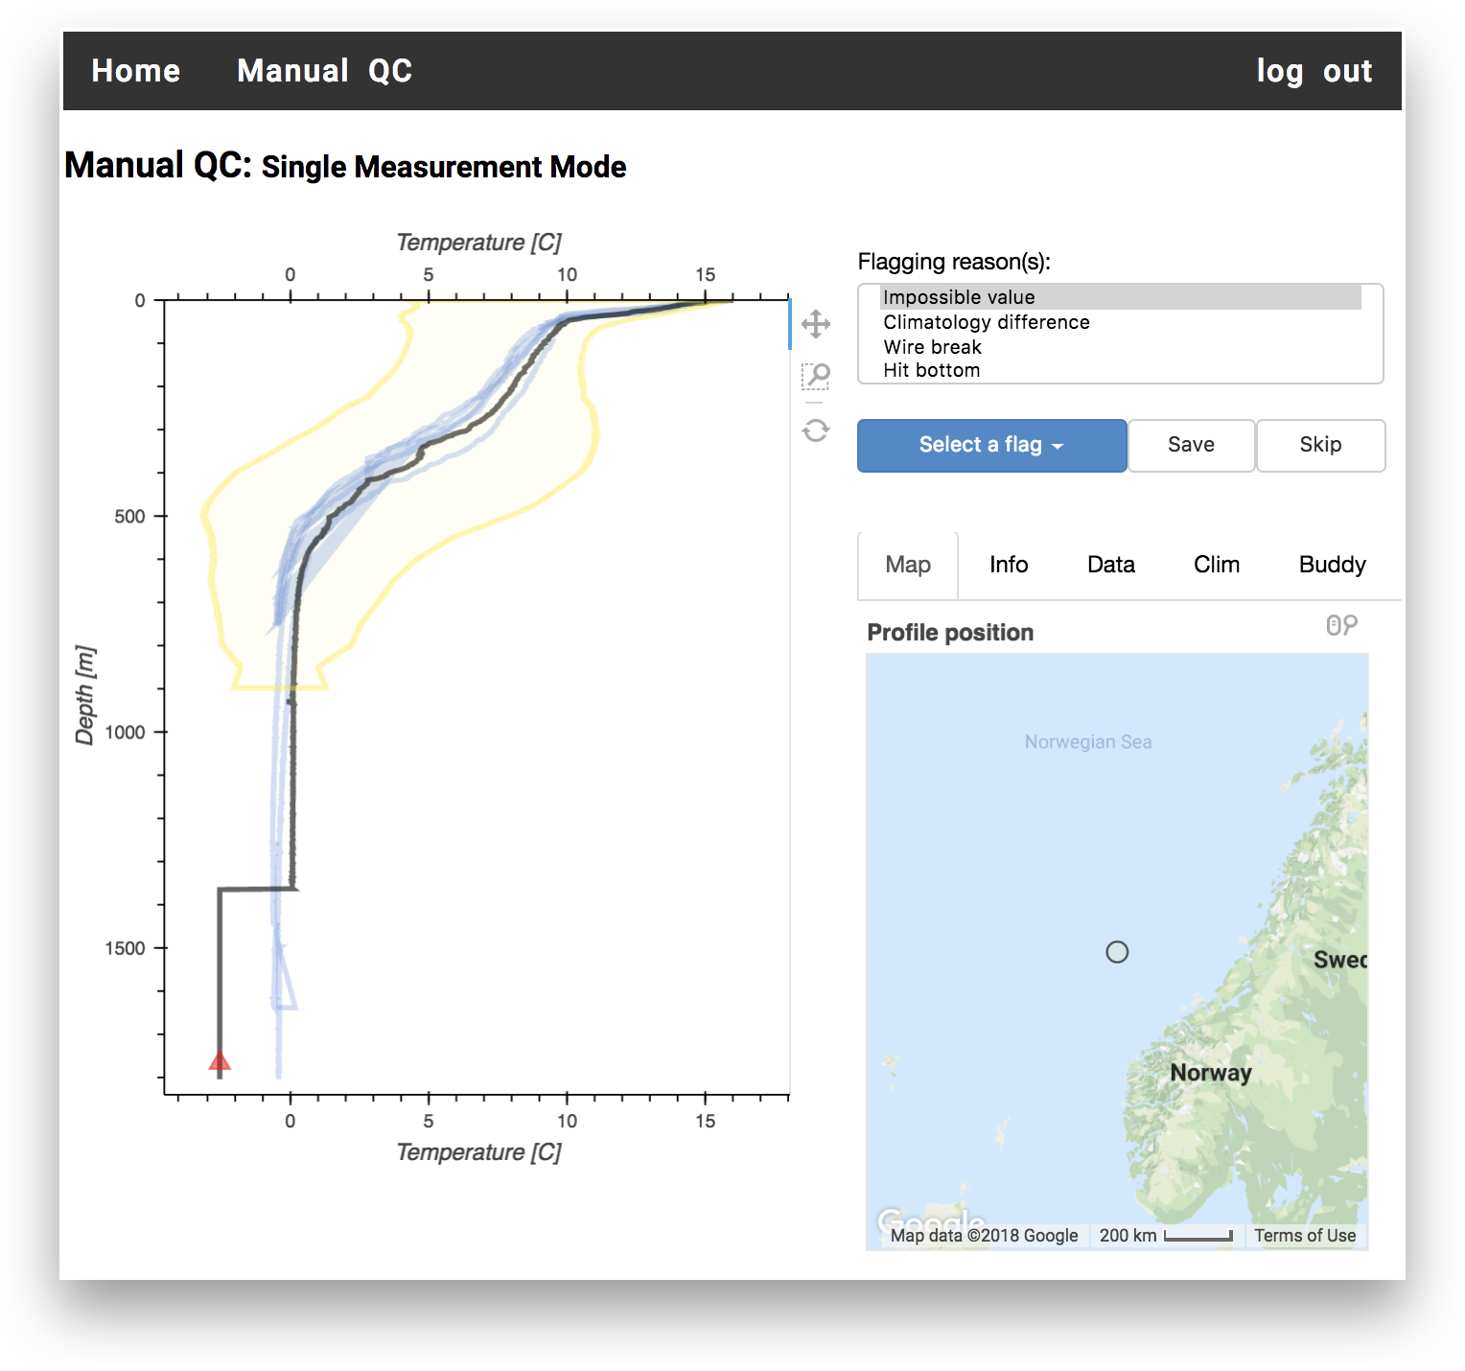
International Quality-controlled Ocean Database
Achievement during the Decade+ (2013 – 2024)
Assign instrumental uncertainty to each individual temperature measurement.
Using Machine Learning to:
  Infer Intelligent Metadata.
  Assign XBT probe type.
  Expert QC system.
Successful handling of Duplicate checking.
IQuOD-v1 online, publicly available through NOAA/NCEI service.

Slide 4
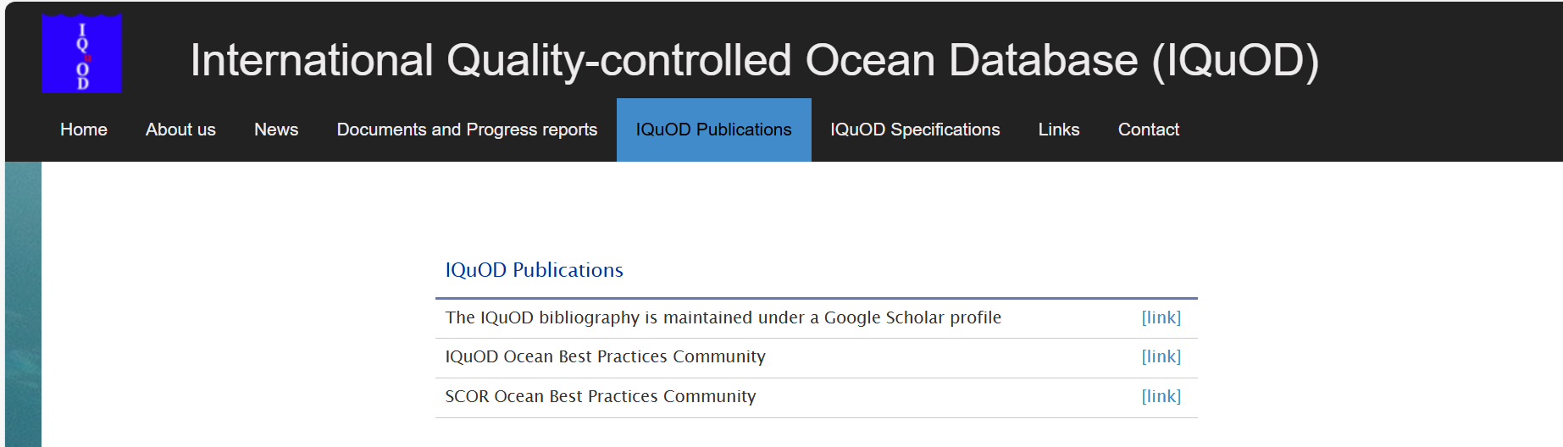
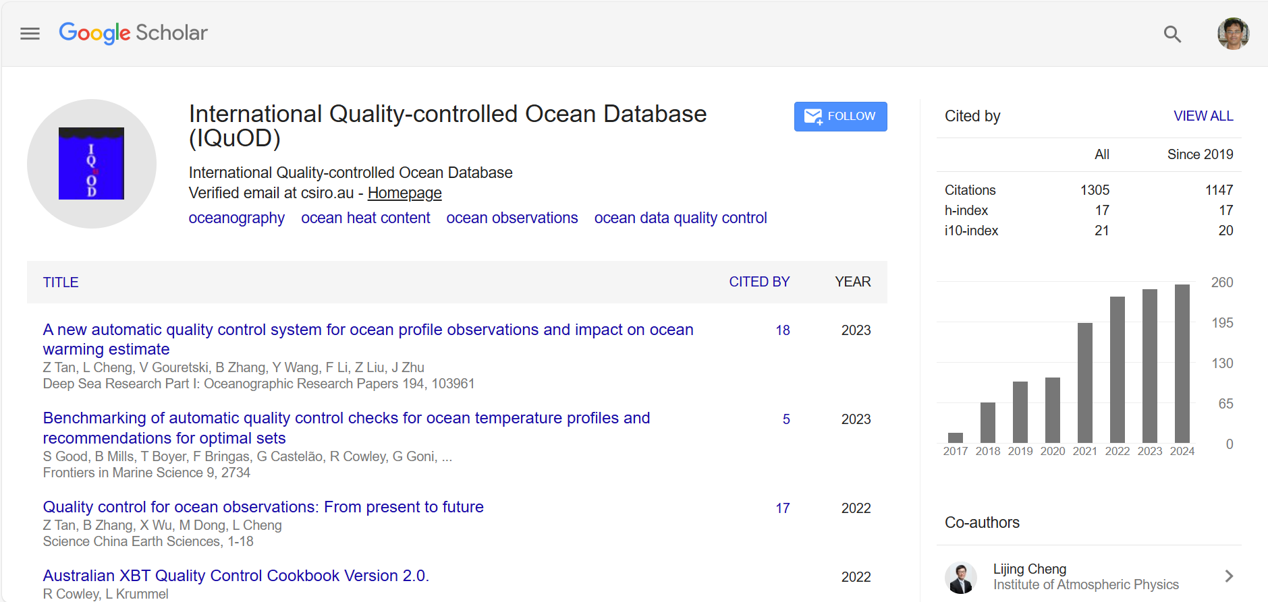
International Quality-controlled Ocean Database
Achievement during the Decade+ (2013 – 2024)

Slide 5
International Quality-controlled Ocean Database
Issue and how to address them
Issues:
Poor visibility. Rarely know within the Joint community.
Overshadowed by WOD where the data is ultimately residing.
Overcome them by:
Propagating the same in wider forums.
Utilizing the platforms like Ocean Teacher Global Academy (OTGA) of IODE.
Create self-paced courses using Moodle platform:
  Content on Quality Control, Uncertainties, Handling duplicate checking and Machine Learning approaches.
  Use the infrastructure of OTGA, build course once and use it for ever.

Slide 6

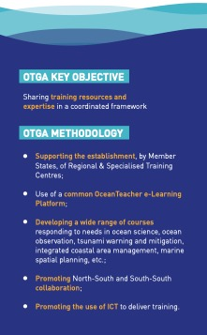


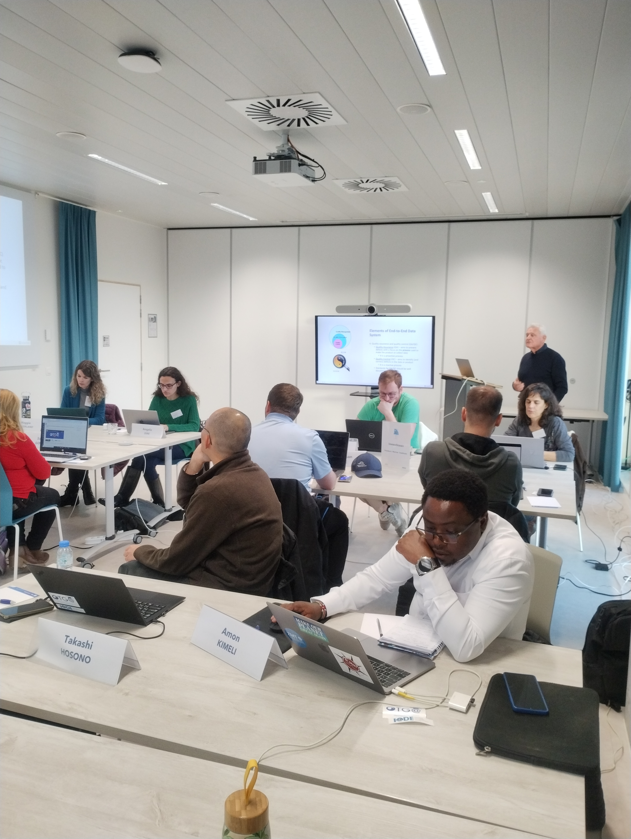
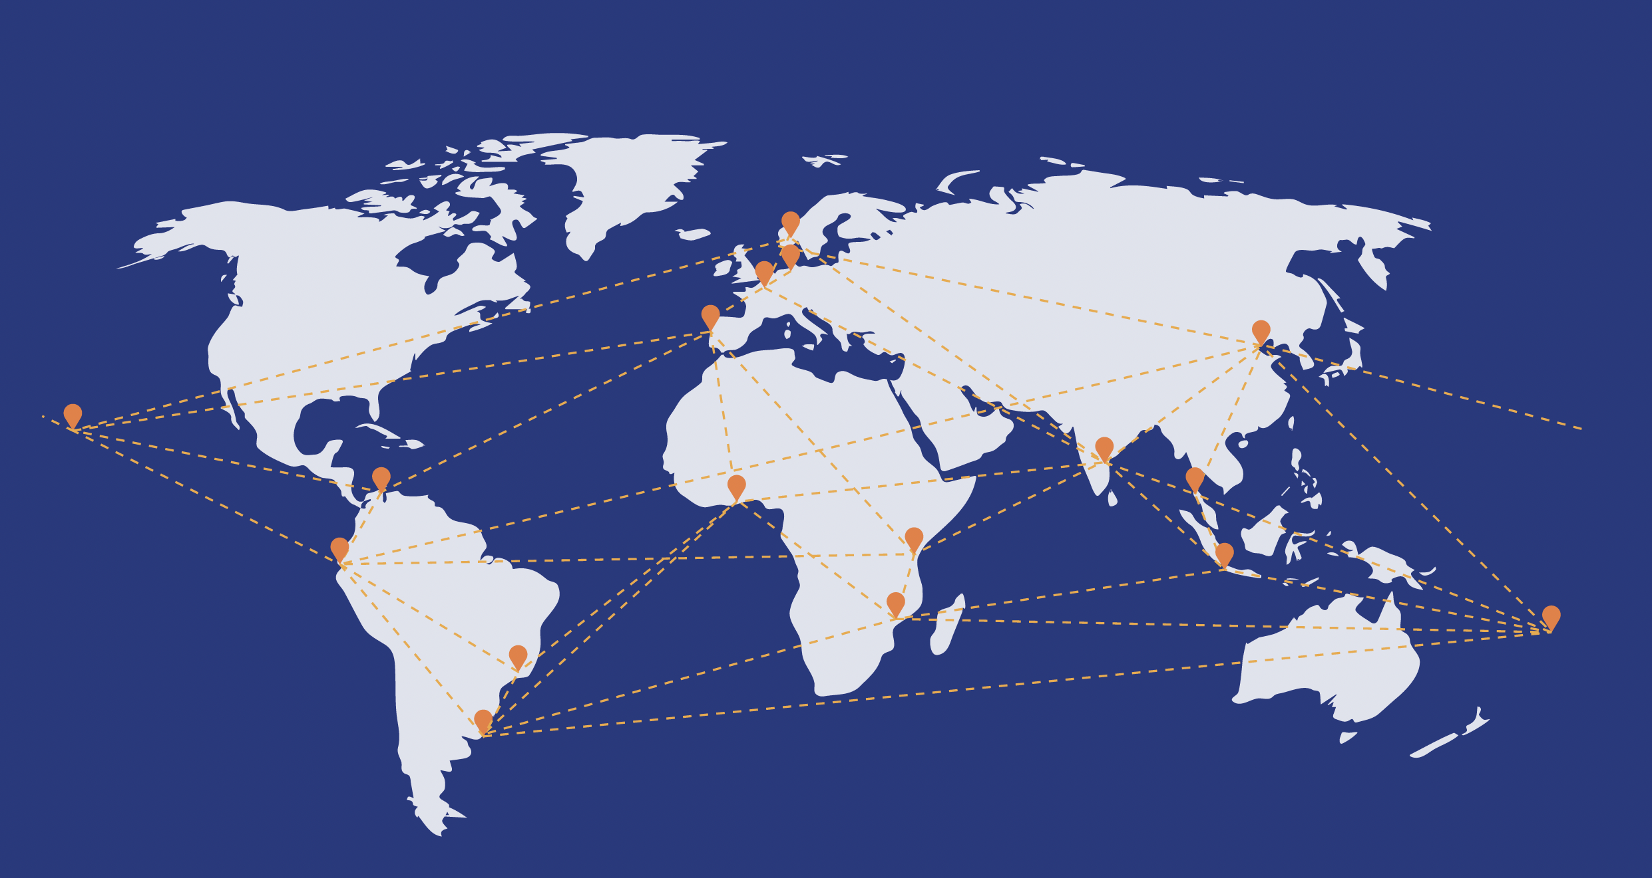
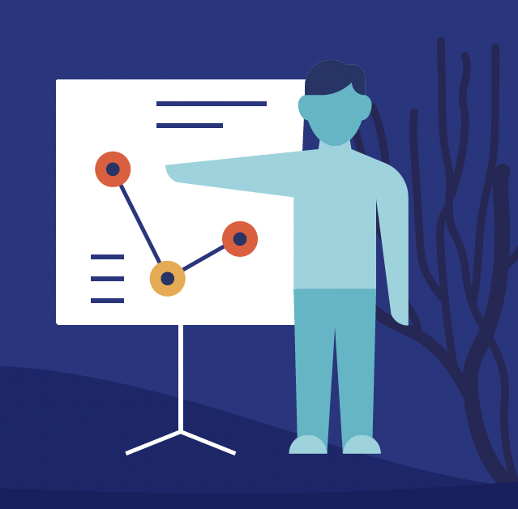
Aims at building equitable capacity related to ocean research, observations, and services in IOC Member States, delivering training to meet the needs of IOC Programmes, Regions, and the UN Decade of Ocean Science for Sustainable Development.
UNESCO-IOC global network of Regional and Specialised Centres, and affiliated partners, delivering training on ocean sciences, services, and management.
OTGA builds on the legacy of more than 20 years of training initiatives led by UNESCO IOC.
OTGA governance is structured with training centres nominated by IOC Member States, for about 10 years, with the support of Flanders.
OTGA was designated as a Programme Component of IODE in 2023.

Slide 7
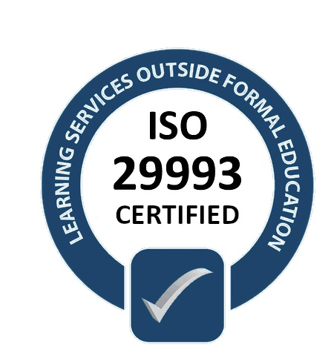
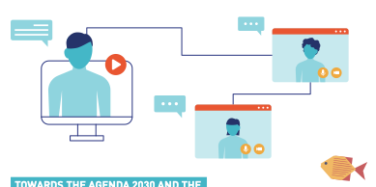
Planning, development, and delivery of training in various formats (online, face-to-face, and blended)
Coordination and management of courses and alumni.
Shared e-learning platform
Creation of learning resources and activities
Mechanisms for connecting with experts, facilitators, and training centres
Guidance on learning services procedures and standards
Training and mentoring exchange and internships
ONLINE
FACE-TO-FACE
BLENDED
Supports a complete set of learning services and products, freely and openly available to the global ocean community
The UNESCO/IOC Project Office for IODE is an ISO certified Learning Service Provider.
17
13.600
50
4
Training centres
Learners
Courses per year
Languages EN ES PT FR

Slide 8

IOC Programmes, RSBs, Member States
Alumni
Researchers
Data managers
Natural resource managers
Practitioners in operations and support
Decision and policymakers
Institutional managers
Technicians, advisors, and consultants
Extension services
Teachers and educators
ECOPs, graduates and postgraduates
Training courses cover a wide range of topics, benefiting the ocean science community, and beyond.
Regional and Specialized Training centres
Universities
Research Centres
Data Centres
Marine Institutes
Partners
International organizations, programs, and projects
UN Agencies
OTGA courses are open for everyone interested in learning new skills.

Slide 9
Summary
Mission: To maximize the quality, consistency, and completeness of the long-term global subsurface ocean temperature (and salinity) database.
  IQuODs achieved many things during the past decade and going strong but had poor visibility and need to reach out to more and more.
OTGA aims at building equitable capacity related to ocean research, observations, and services in IOC Member States.
  The infrastructure and RTC/STC available with OTGA can be used for effectively making IQuOD activities and output (Ver 1.0 data) known to as many as possible.

Slide 10
Discussion Points
What course to be designed using the outcomes of IQuOD project.
Who all will be contributing to building the content of the course.
Who will be leading the content creation.
Expected timelines by which OTGA to be ready to host the course through their LMS.

