Slide 1
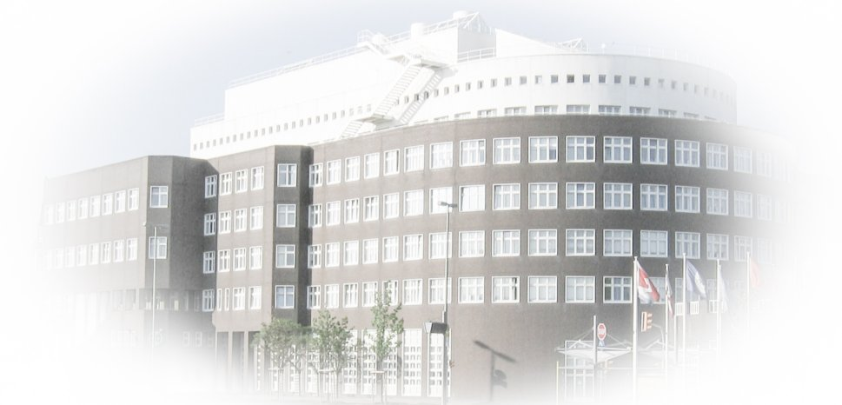

ODV / webODV
Low-barrier Access to Environmental Data
Reiner Schlitzer and Sebastian Mieruch-Schnülle
Alfred Wegener Institute for Polar and Marine Research

Slide 2
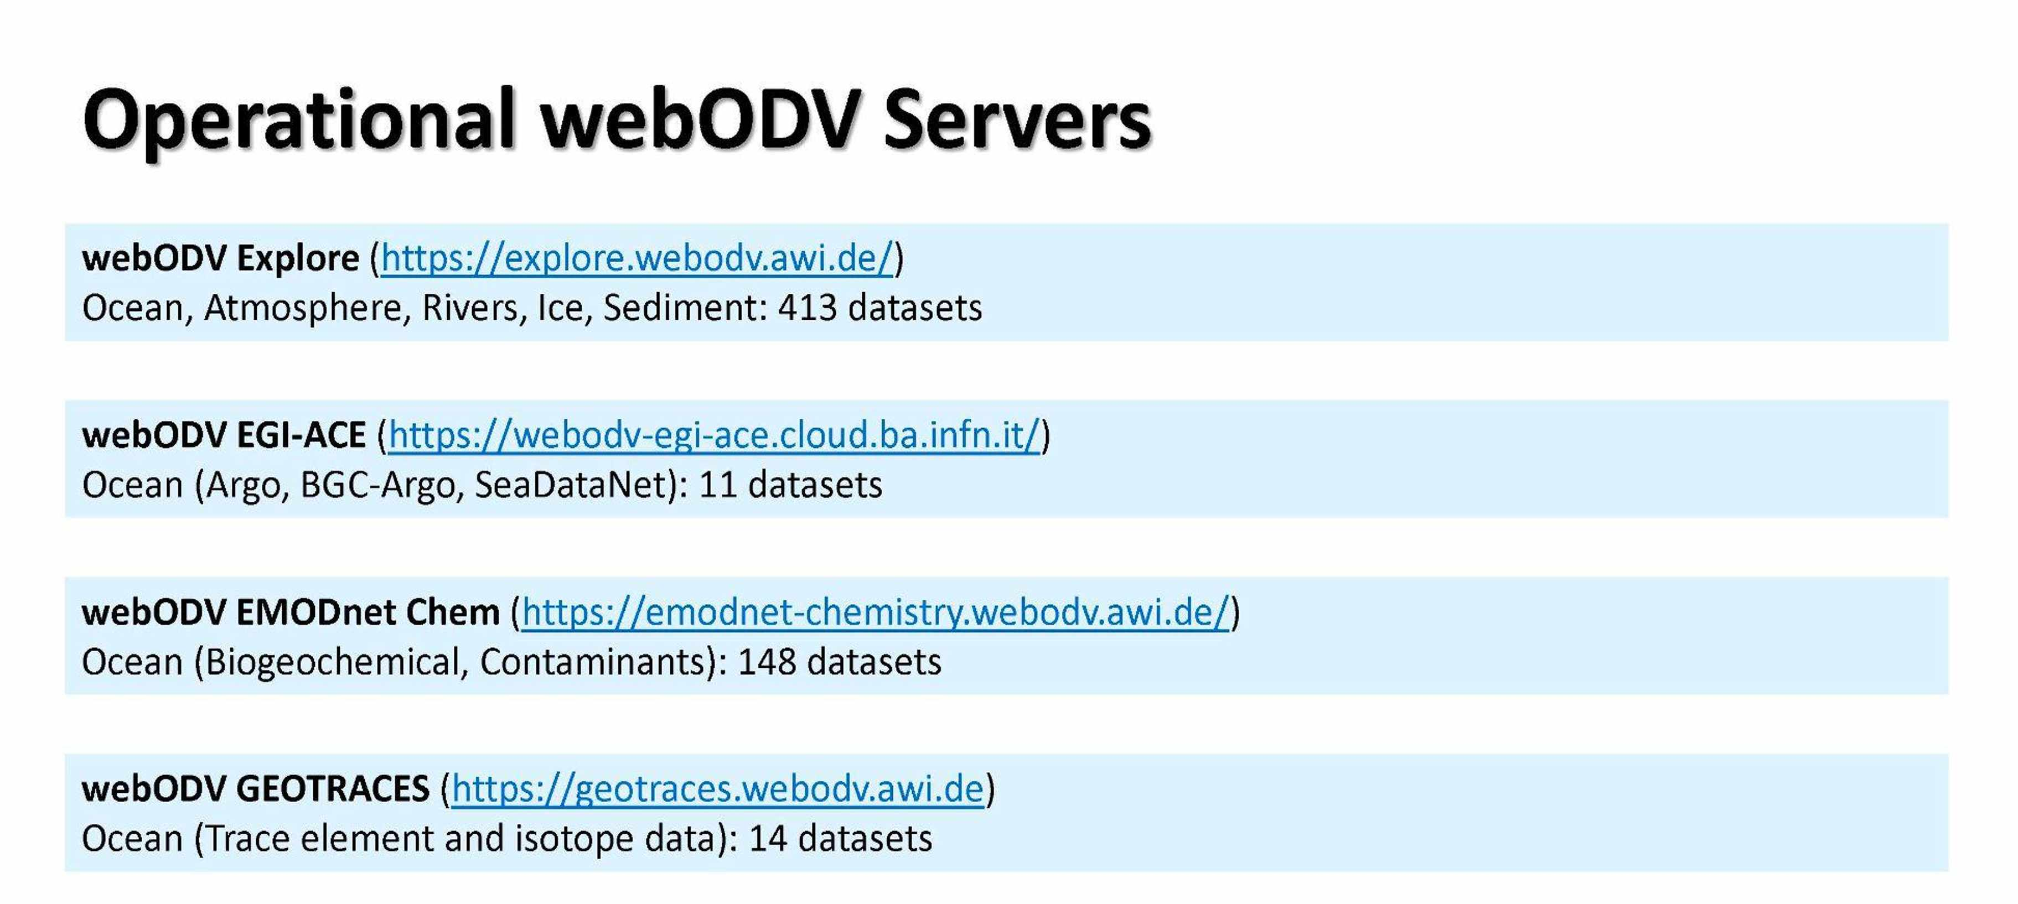

Slide 3
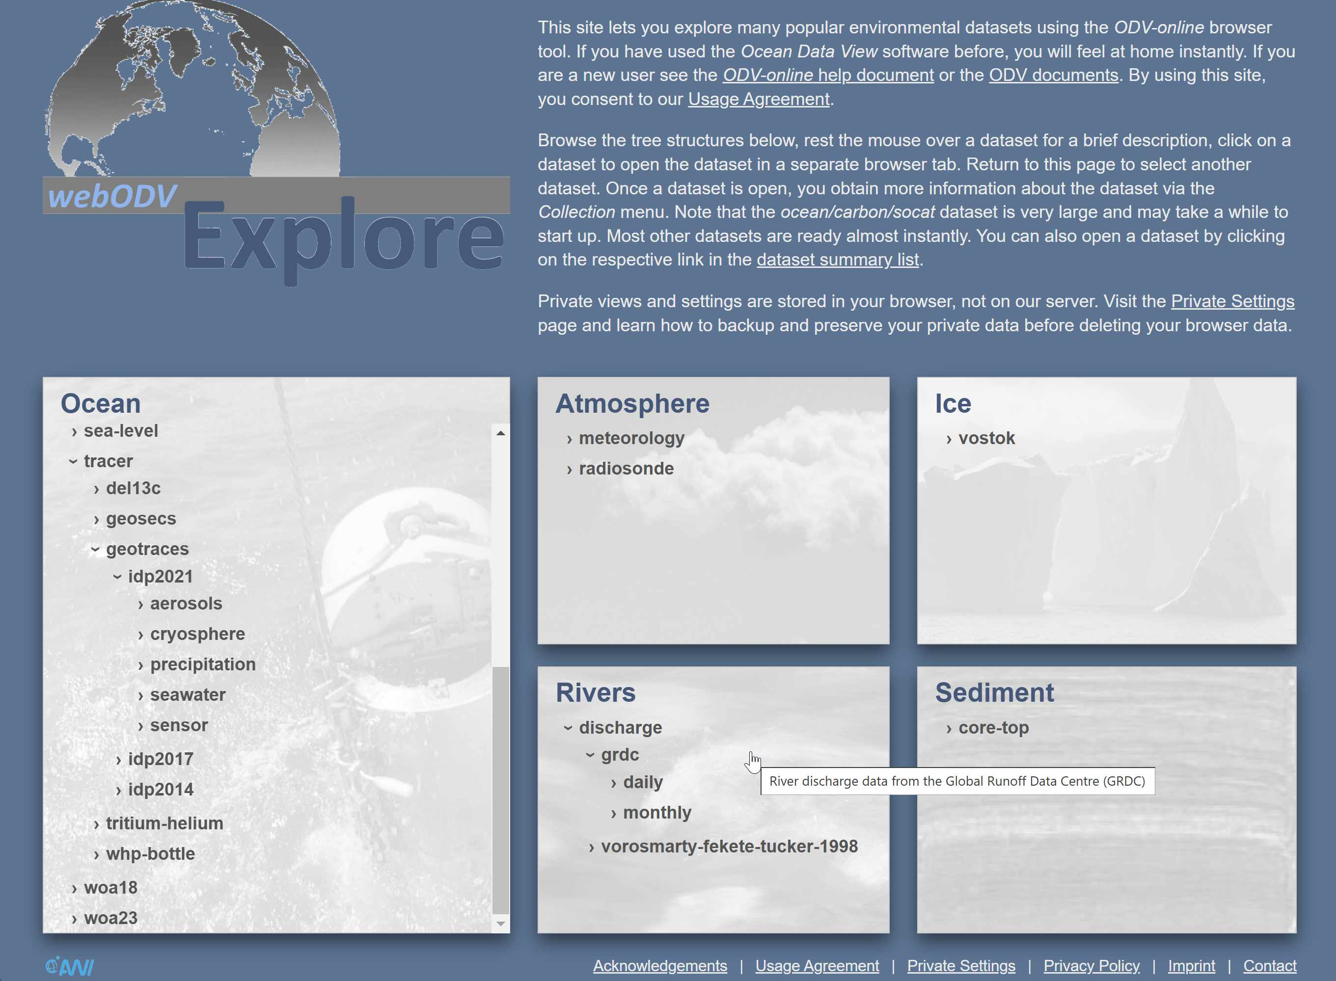
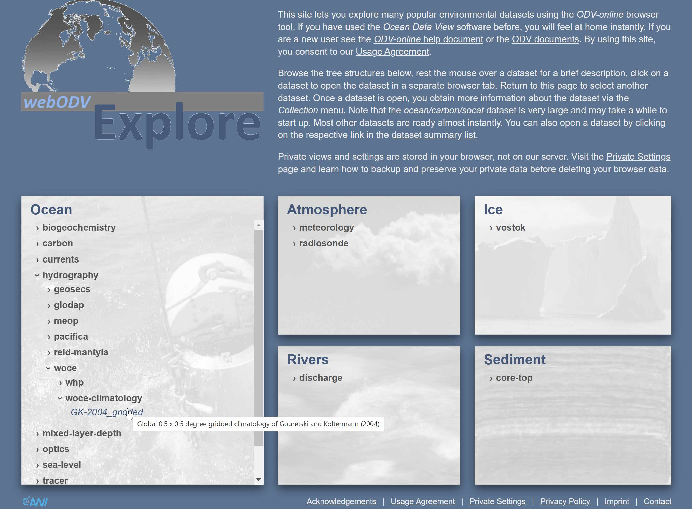
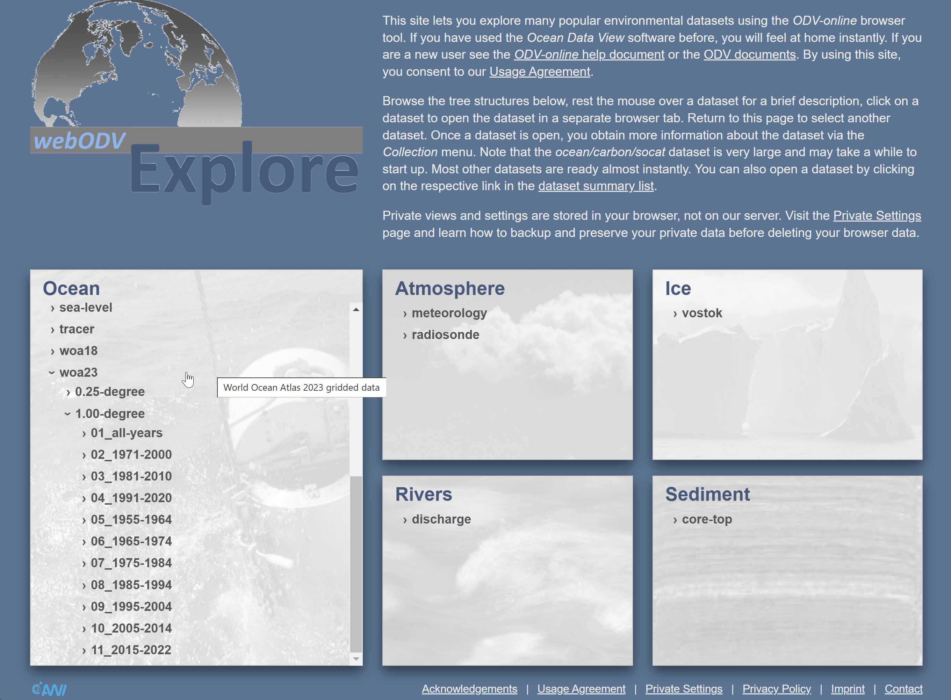

Slide 4
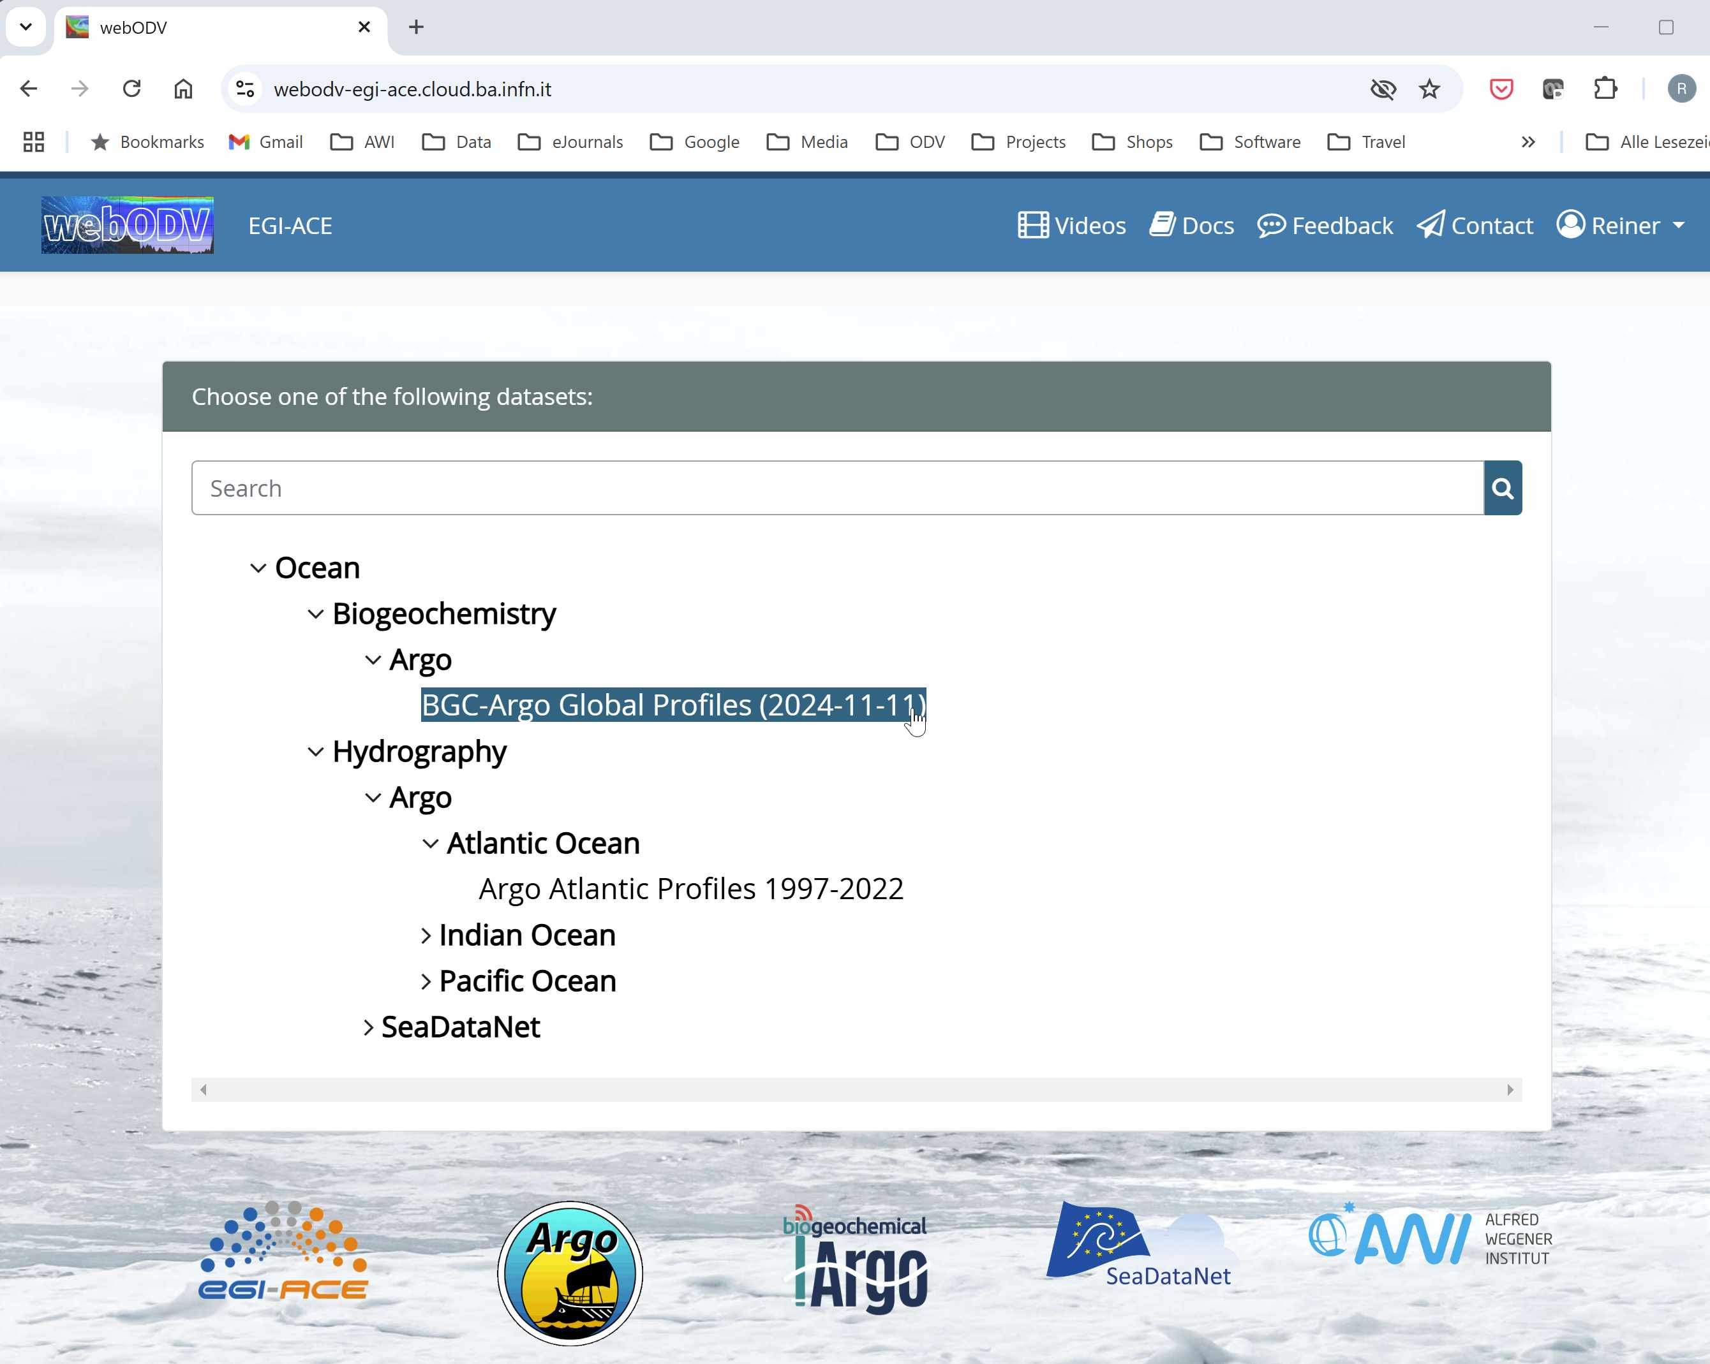
Daily updated

Slide 5
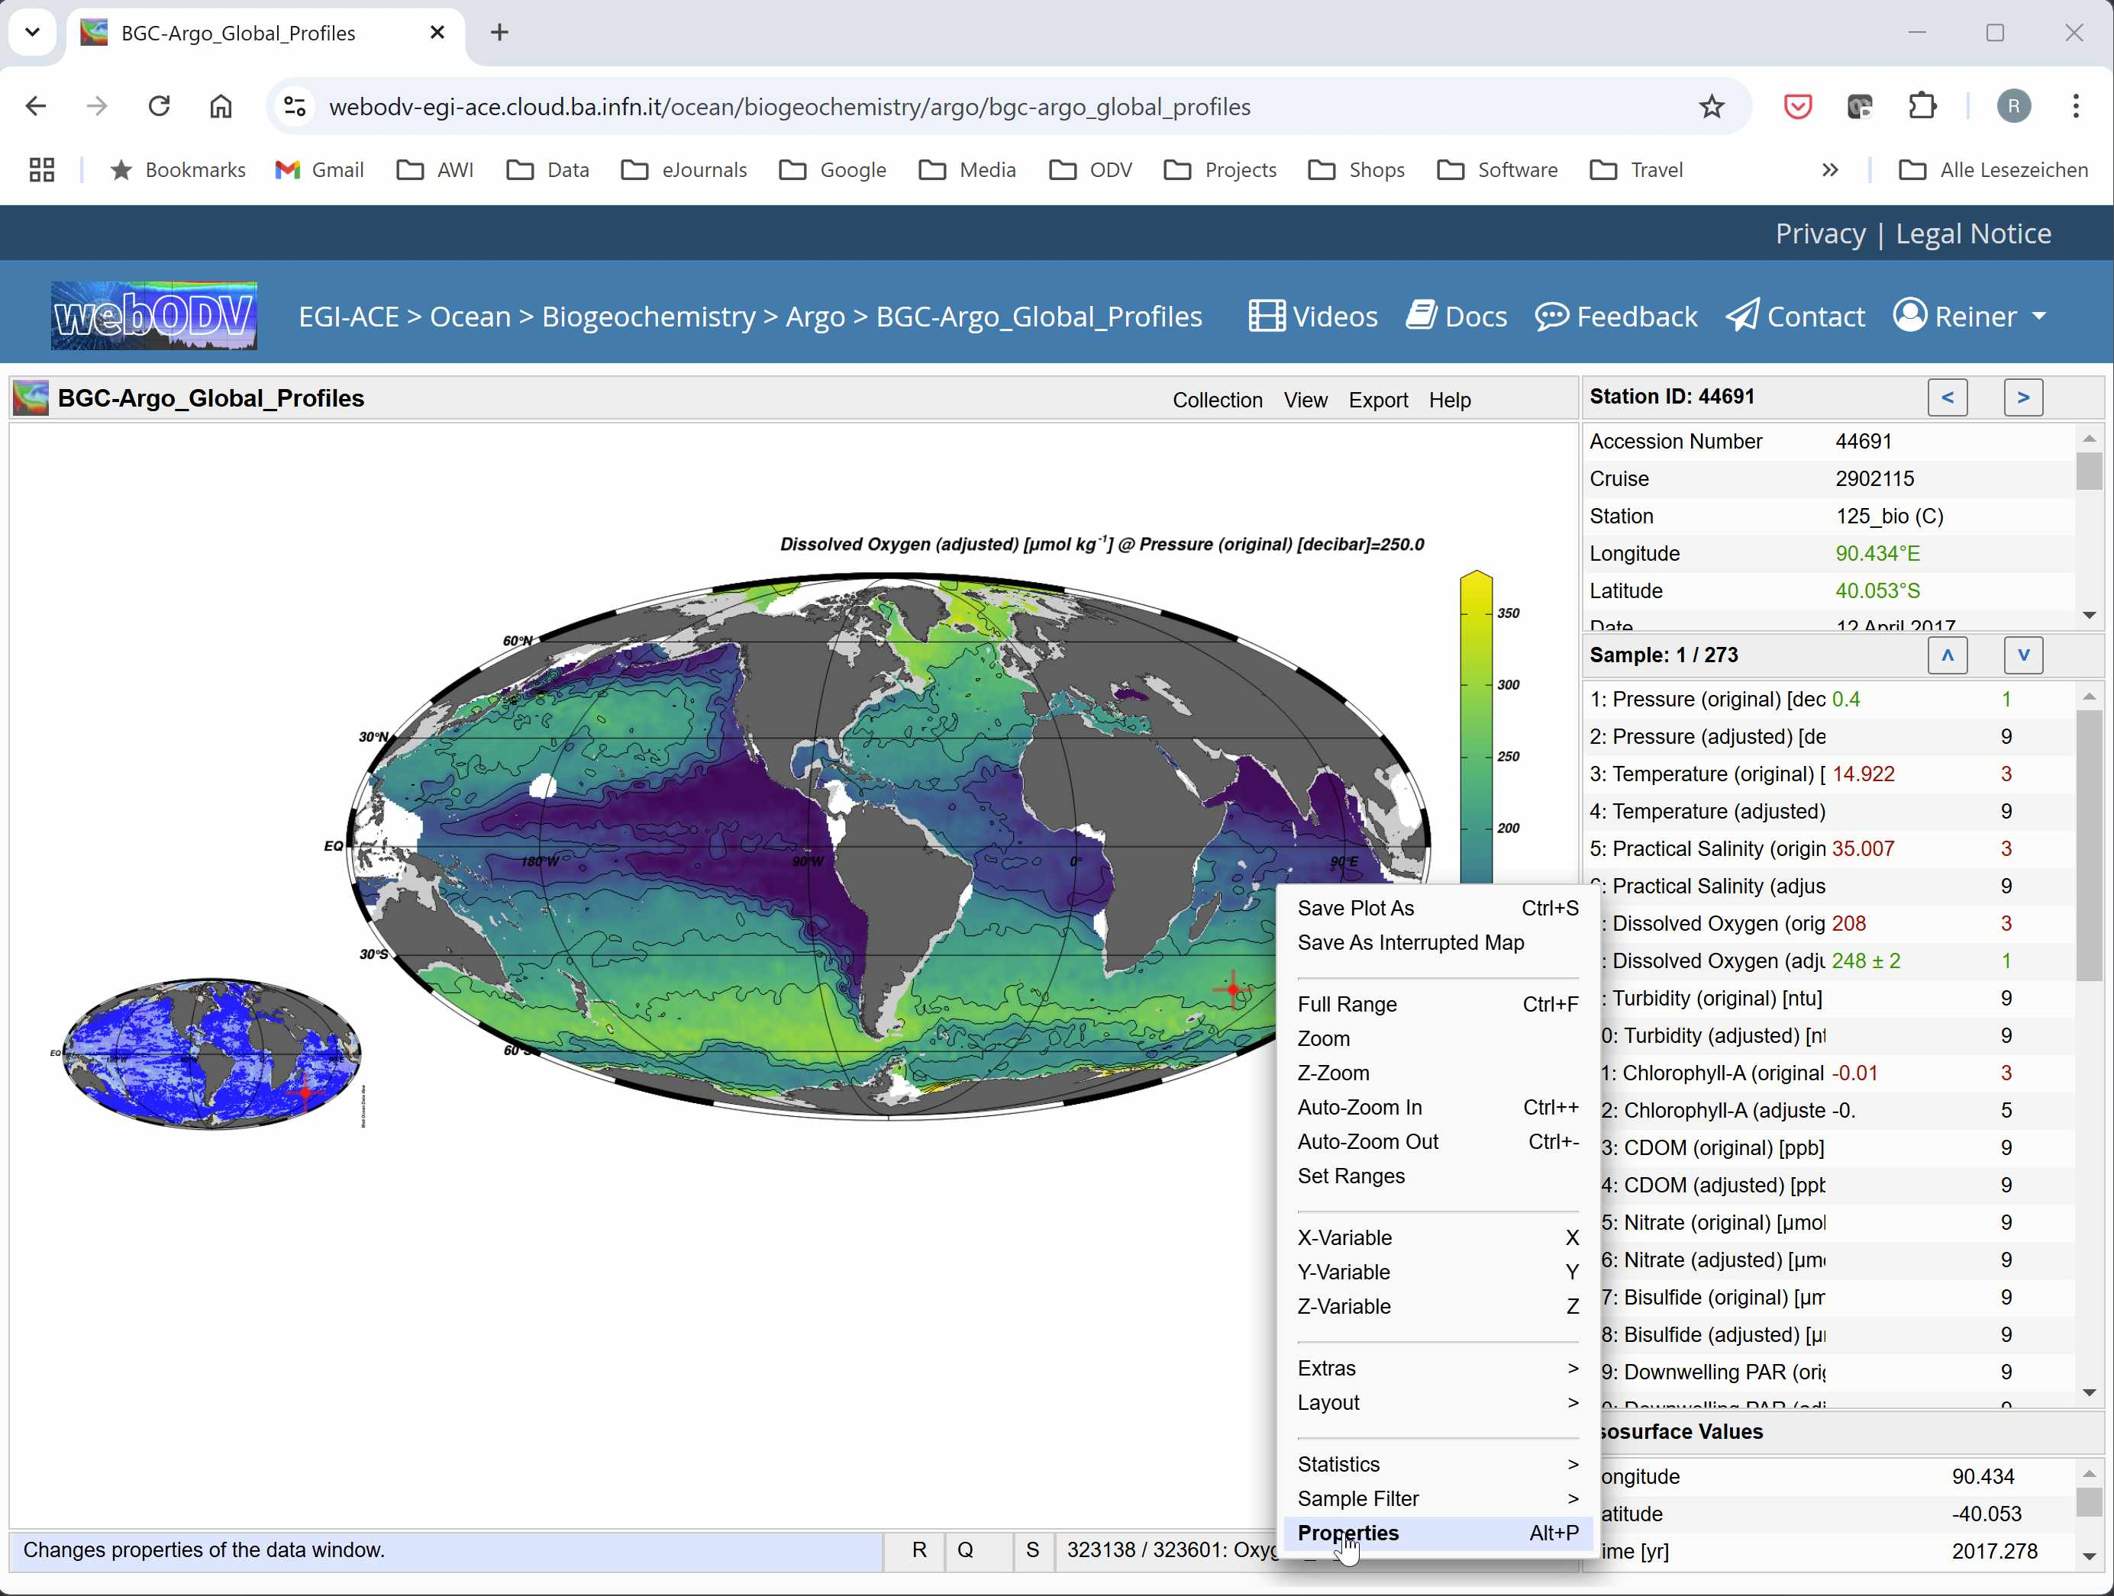
Interactive Browser Interface
Looks and behaves like ODV desktop
Zero learning for previous ODV users
No data download
No software installation

Slide 6
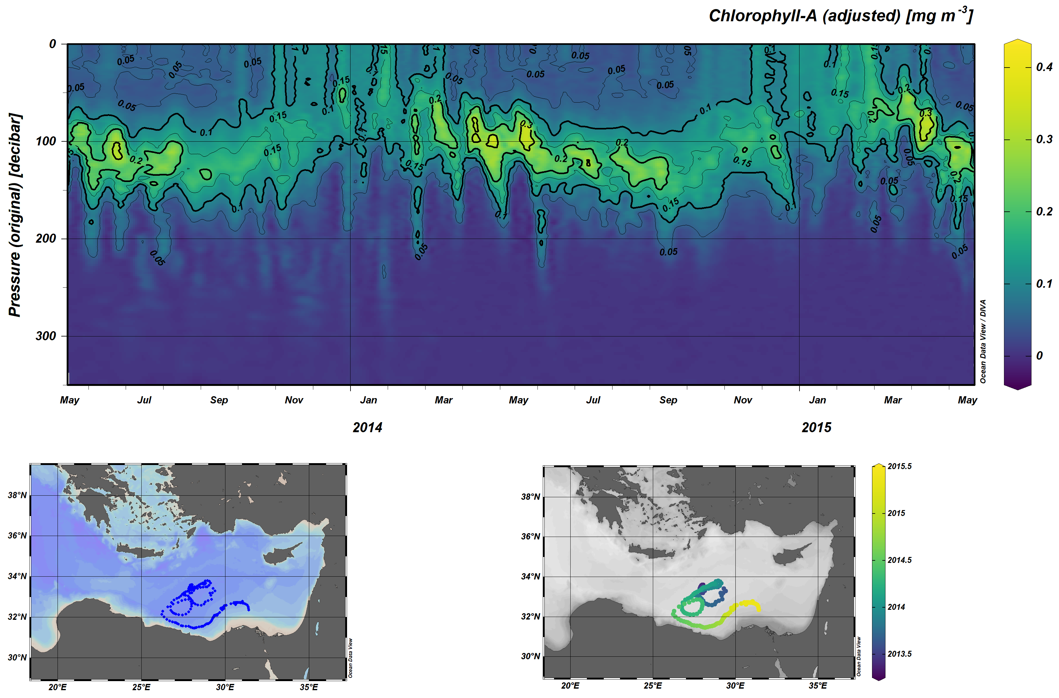

Slide 7
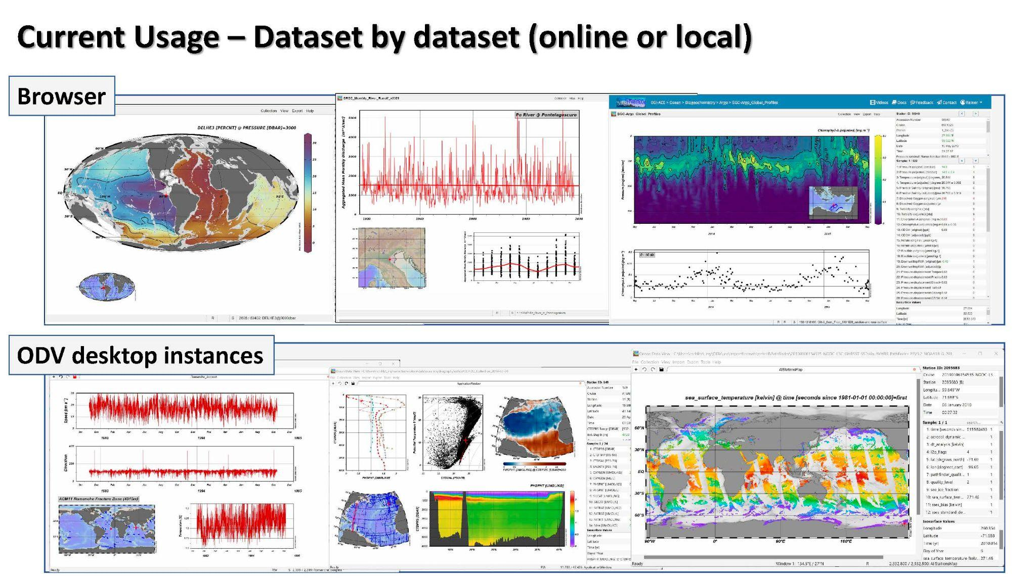

Slide 8
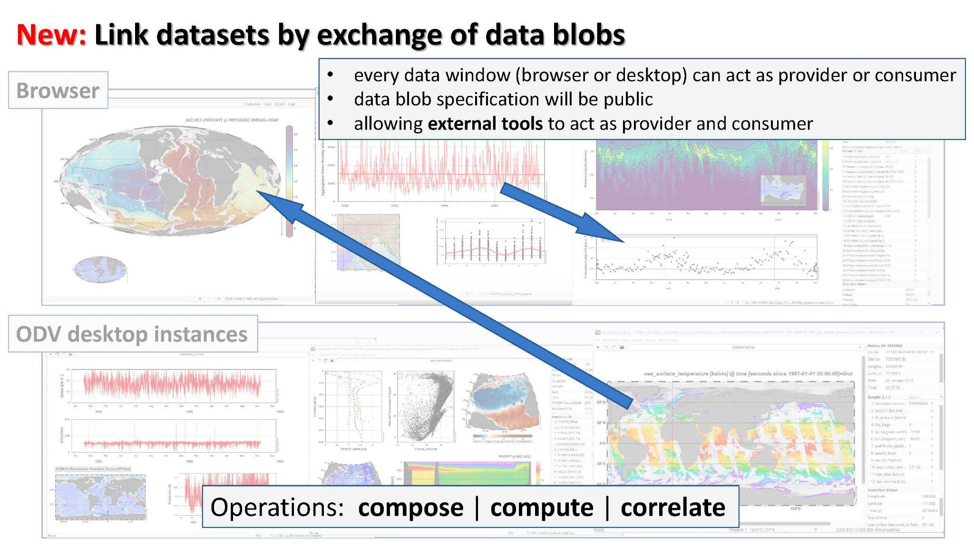

Slide 9
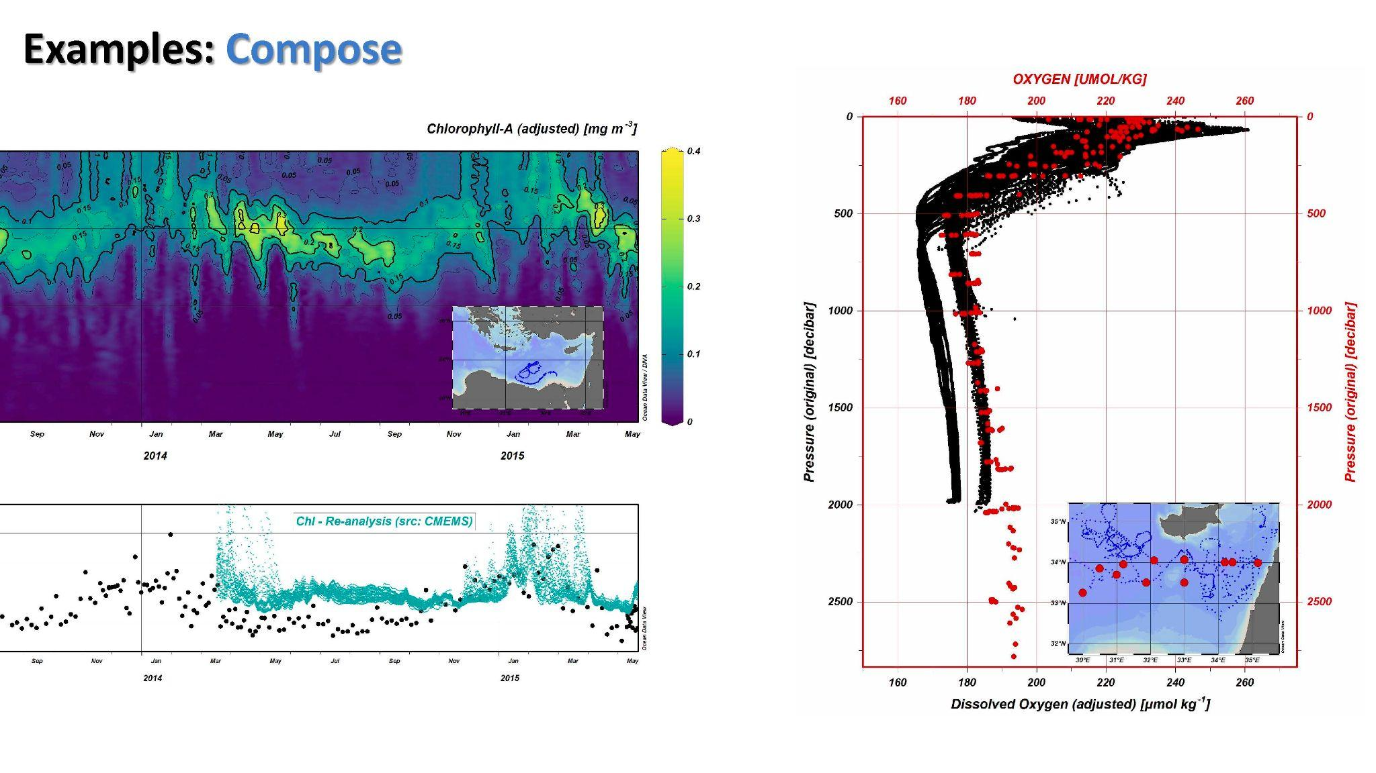

Slide 10
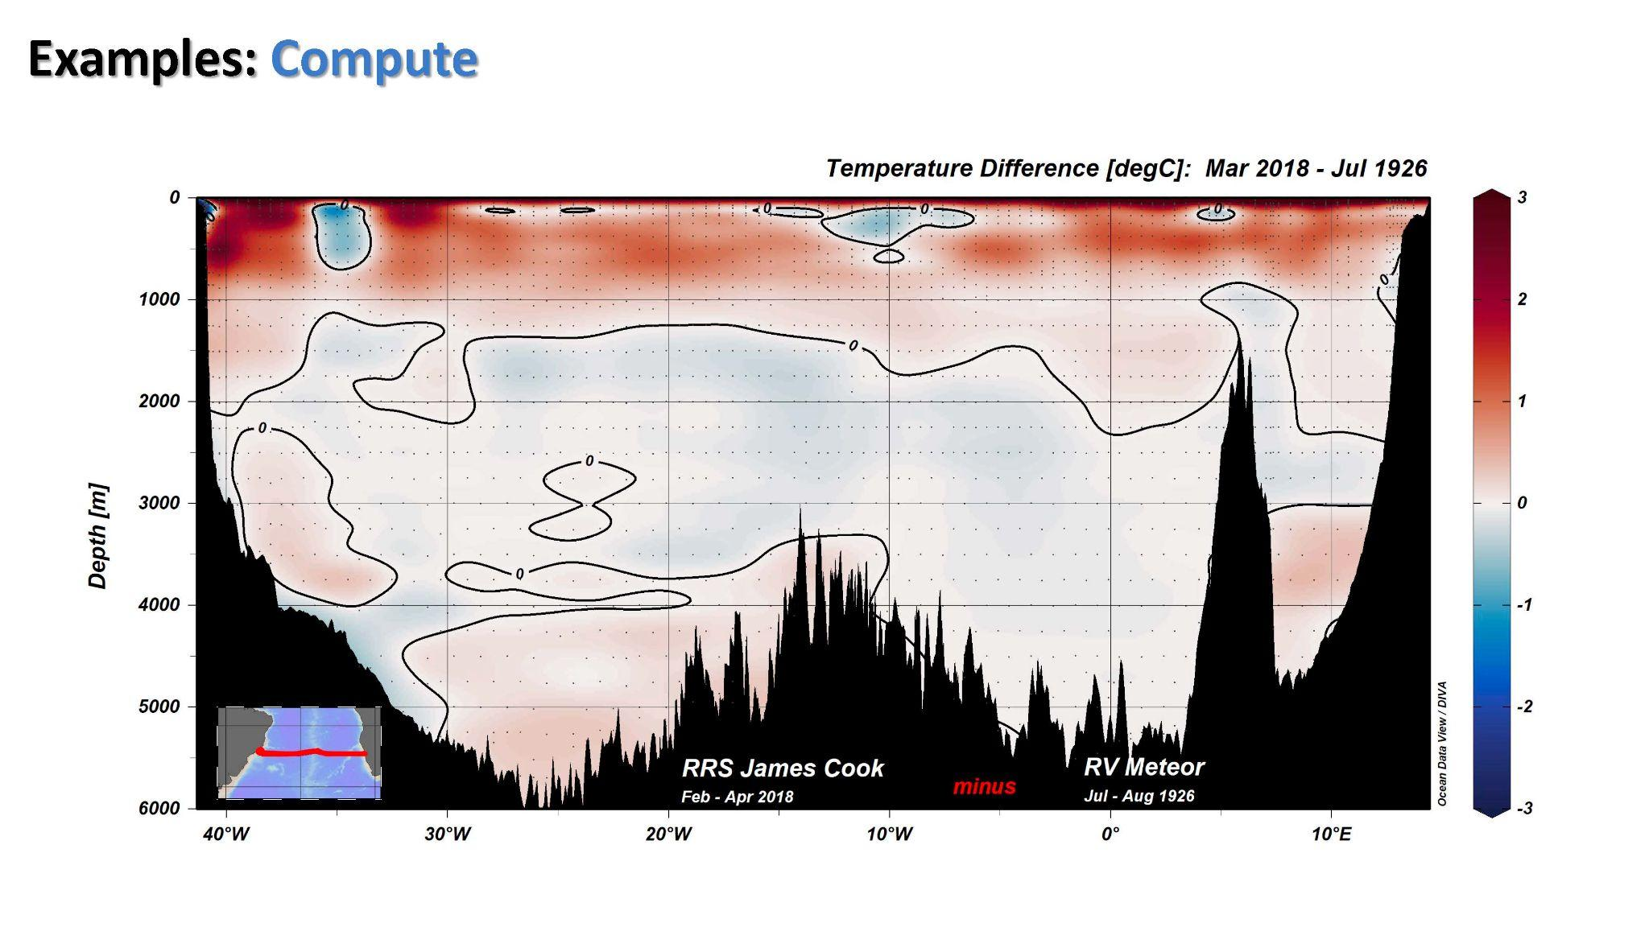

Slide 11
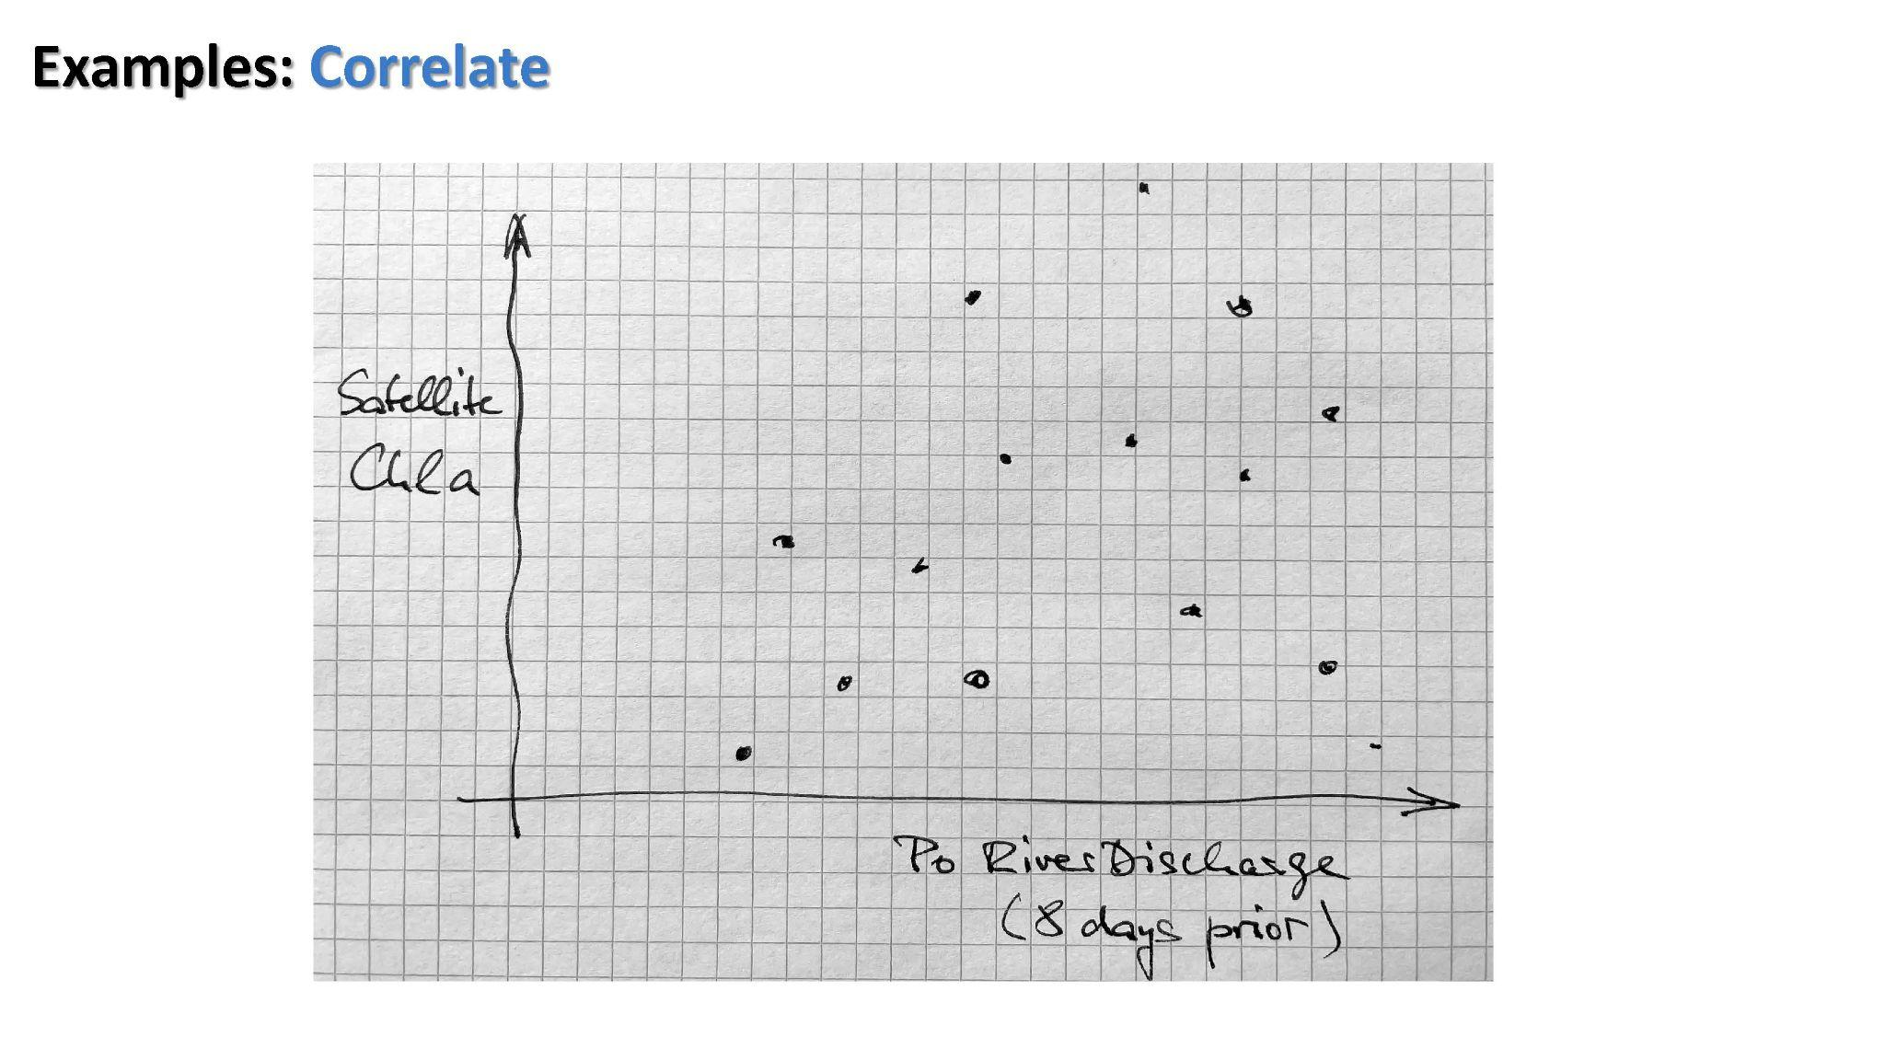

Slide 12

Expected: mid 2025
Funding:

Slide 13
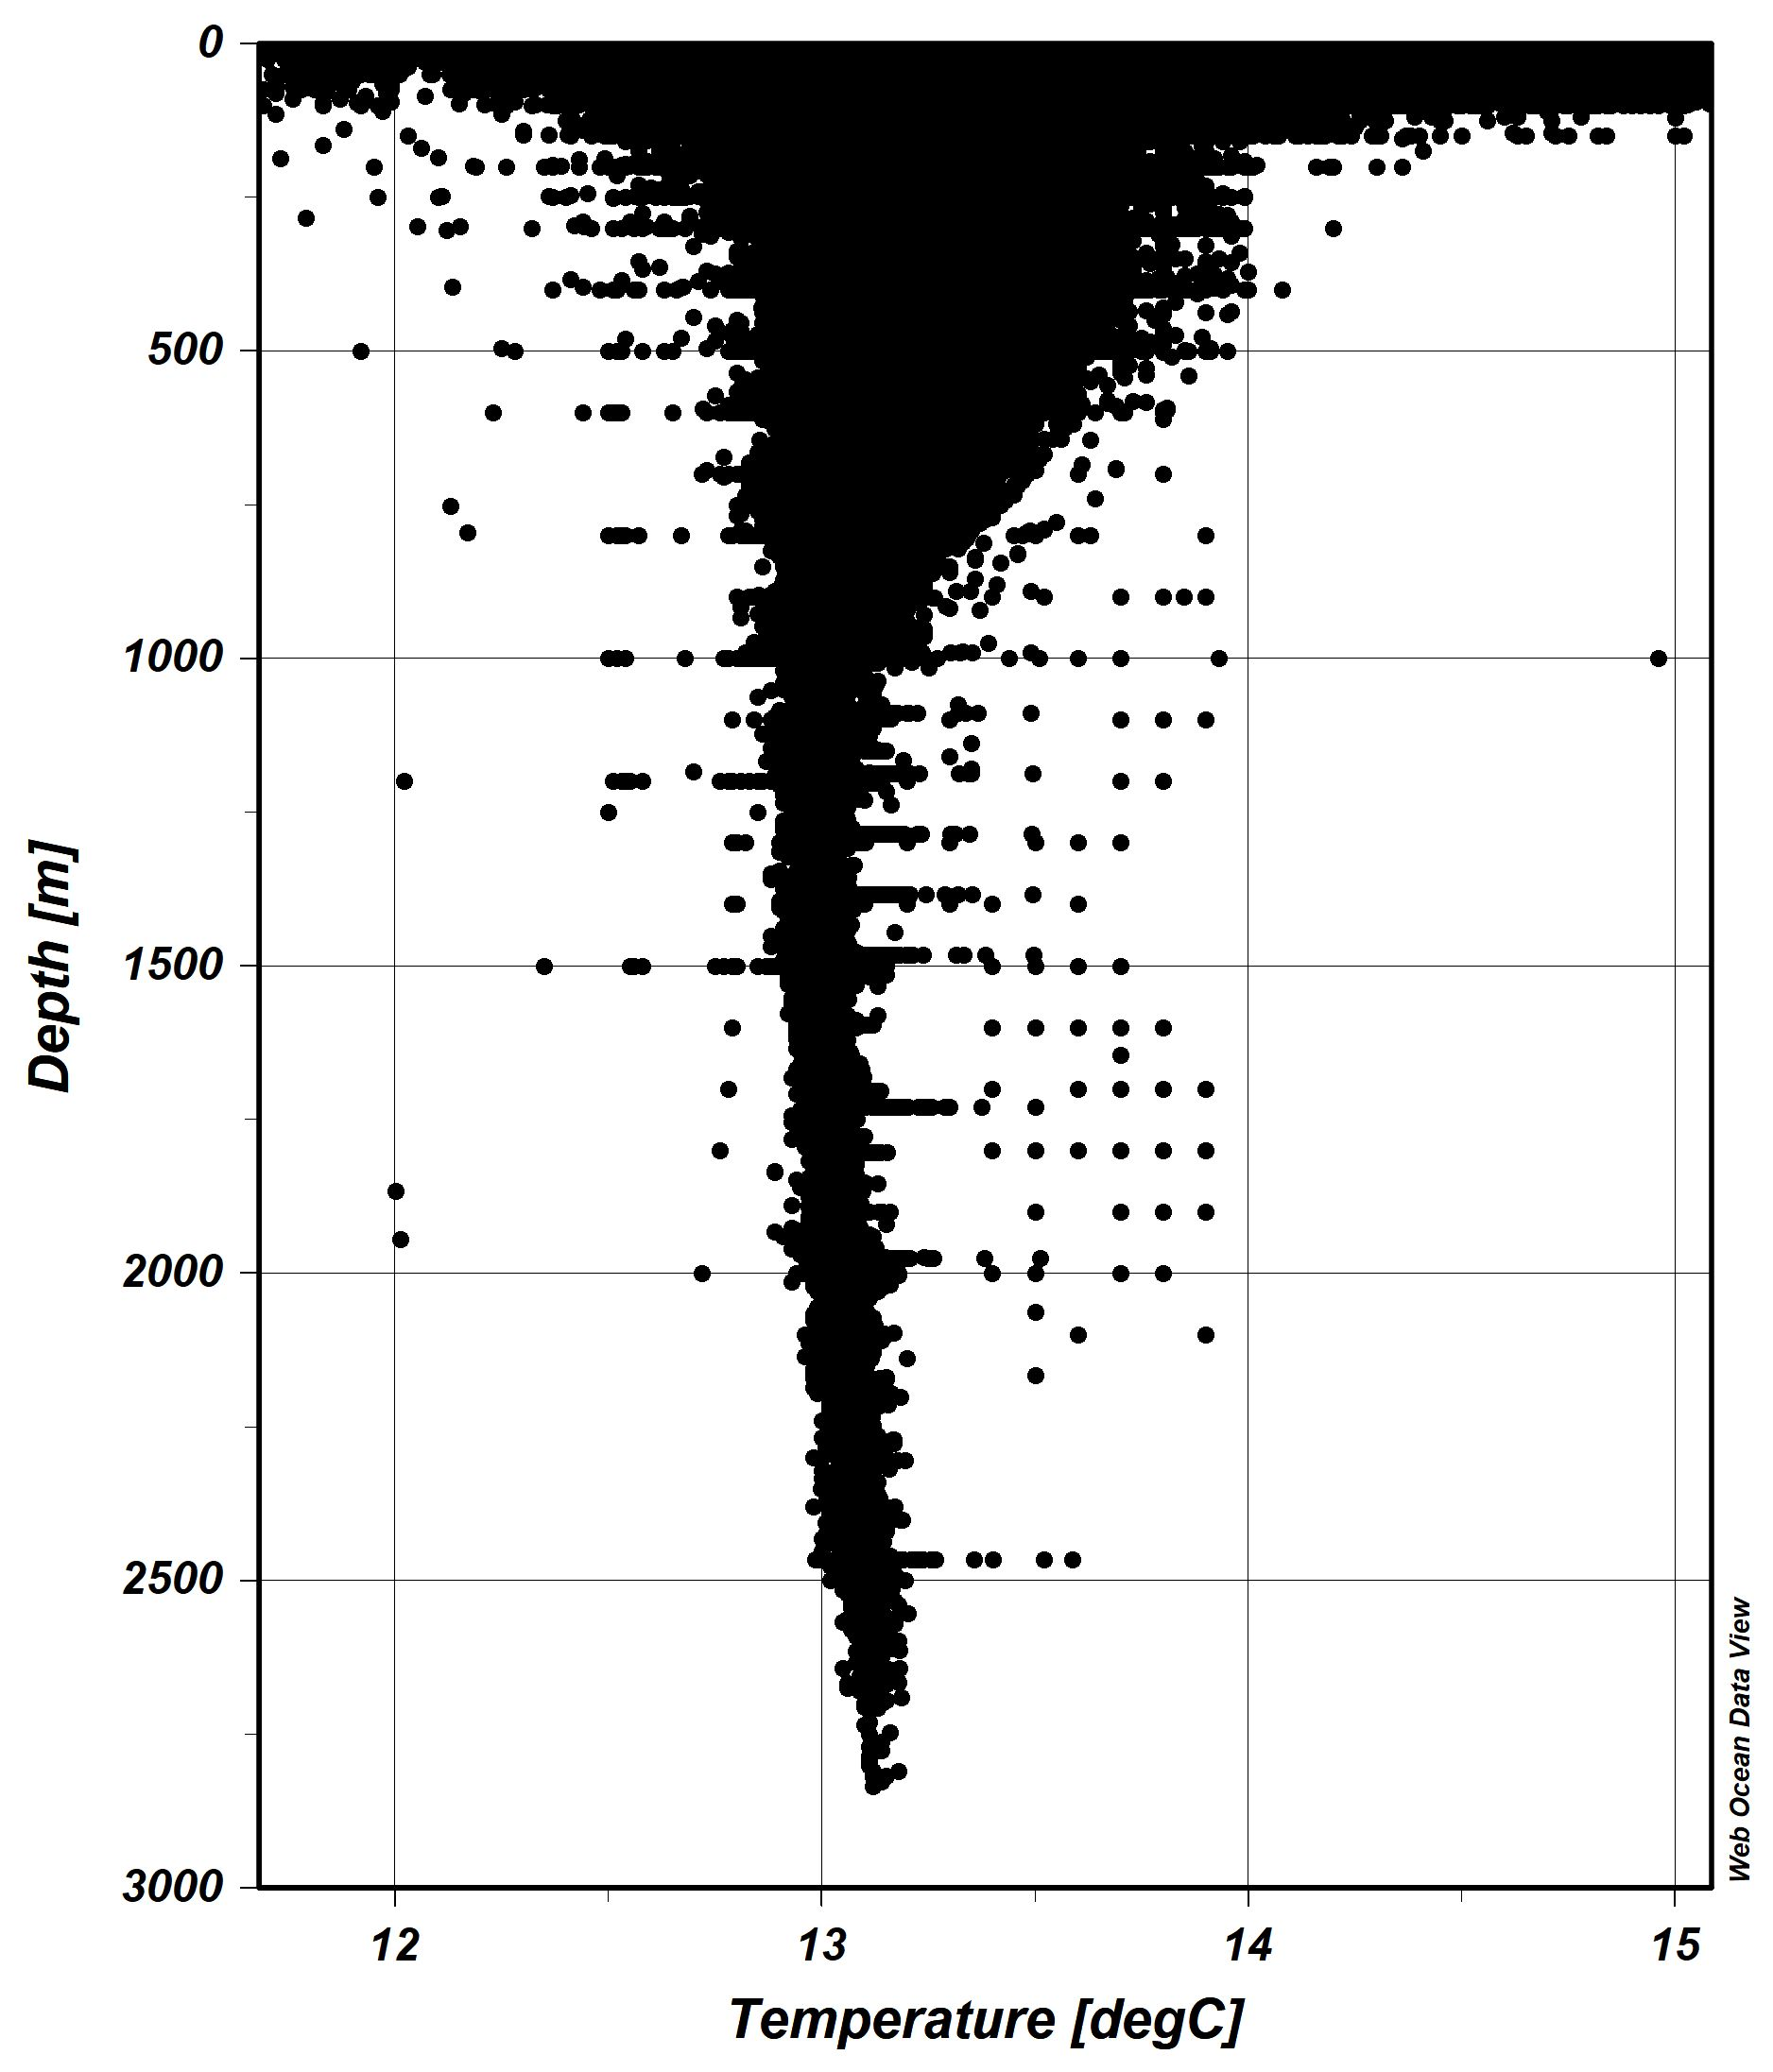
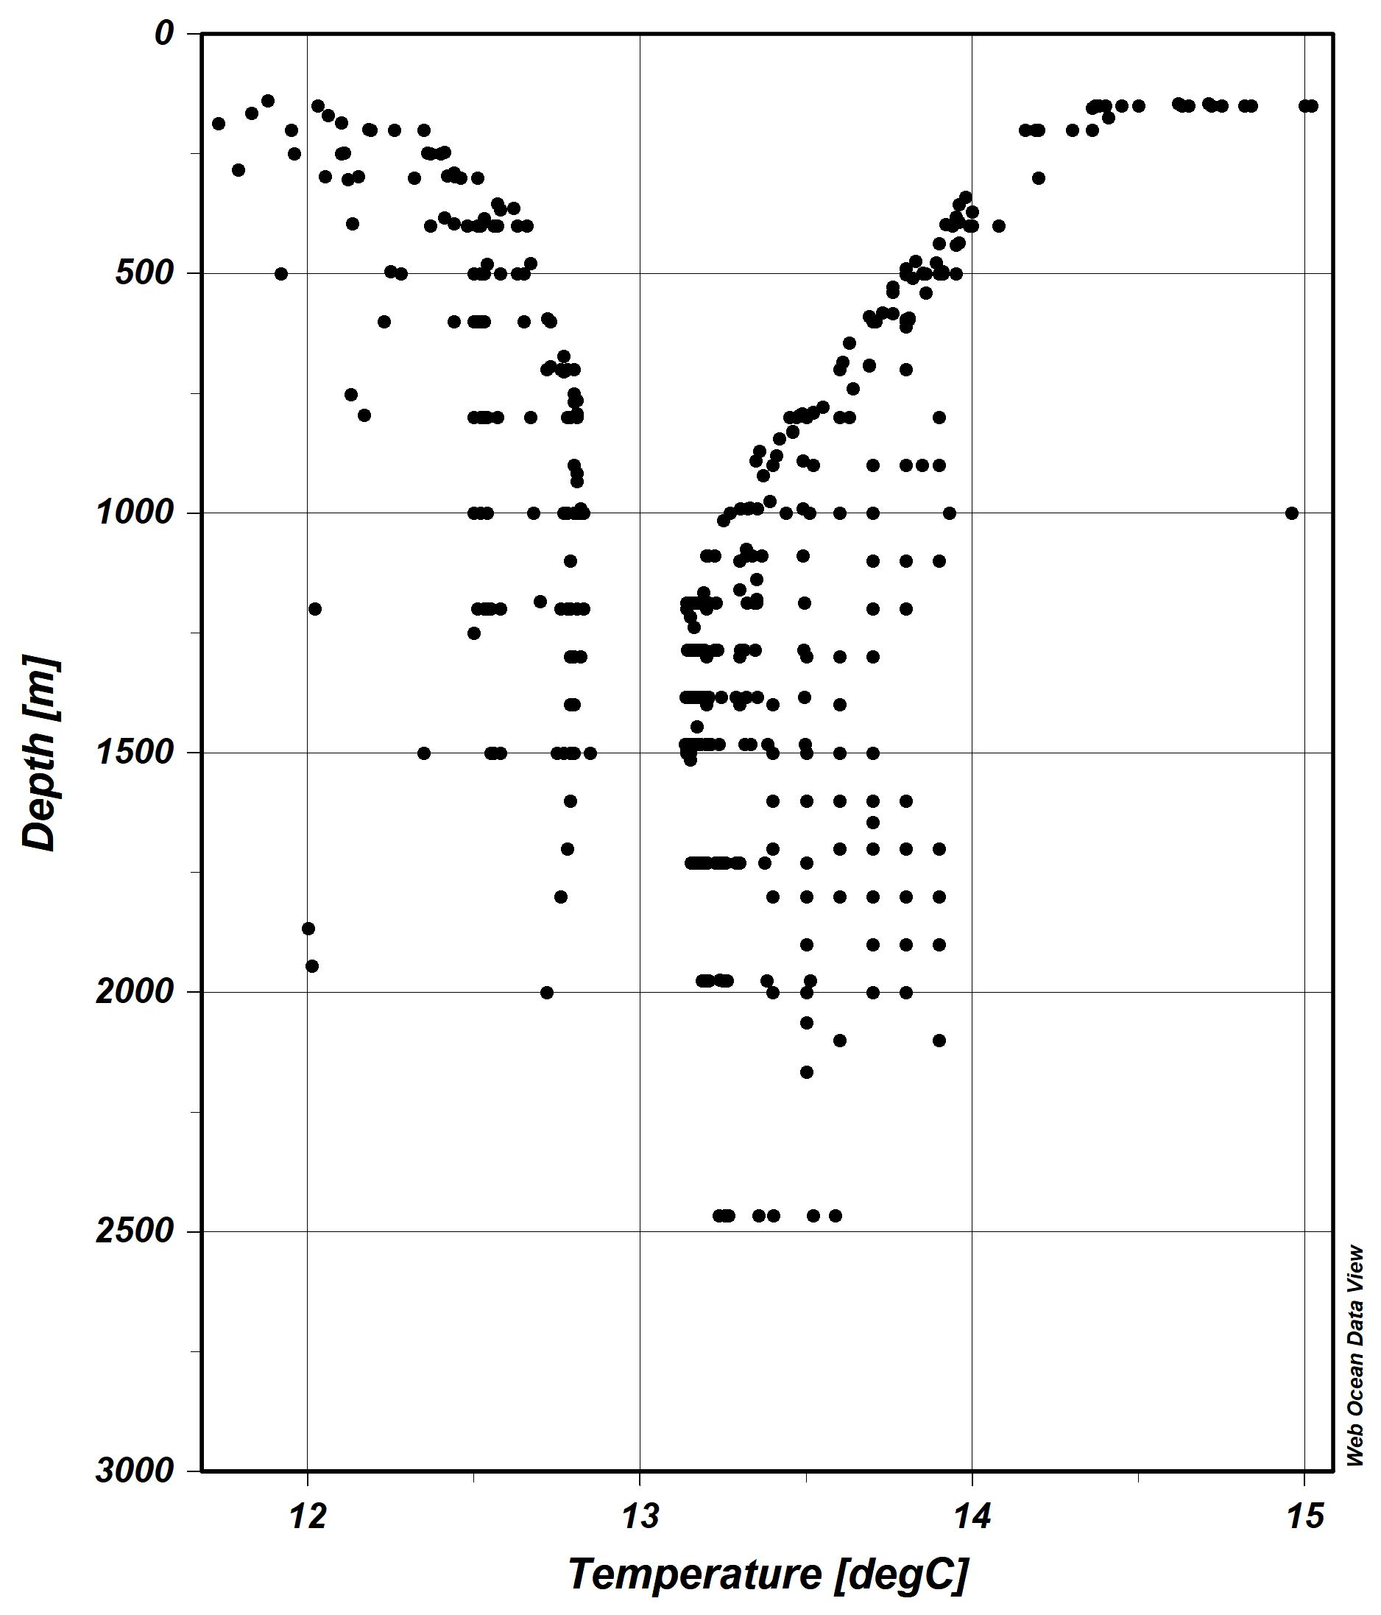
Visual QC using Sample Filter Polygon
Procedure
Click exclusion polygon
Right-click a Temperature value
choose Assign Quality Flag > All Samples in Window 1
choose new quality flag

Slide 14
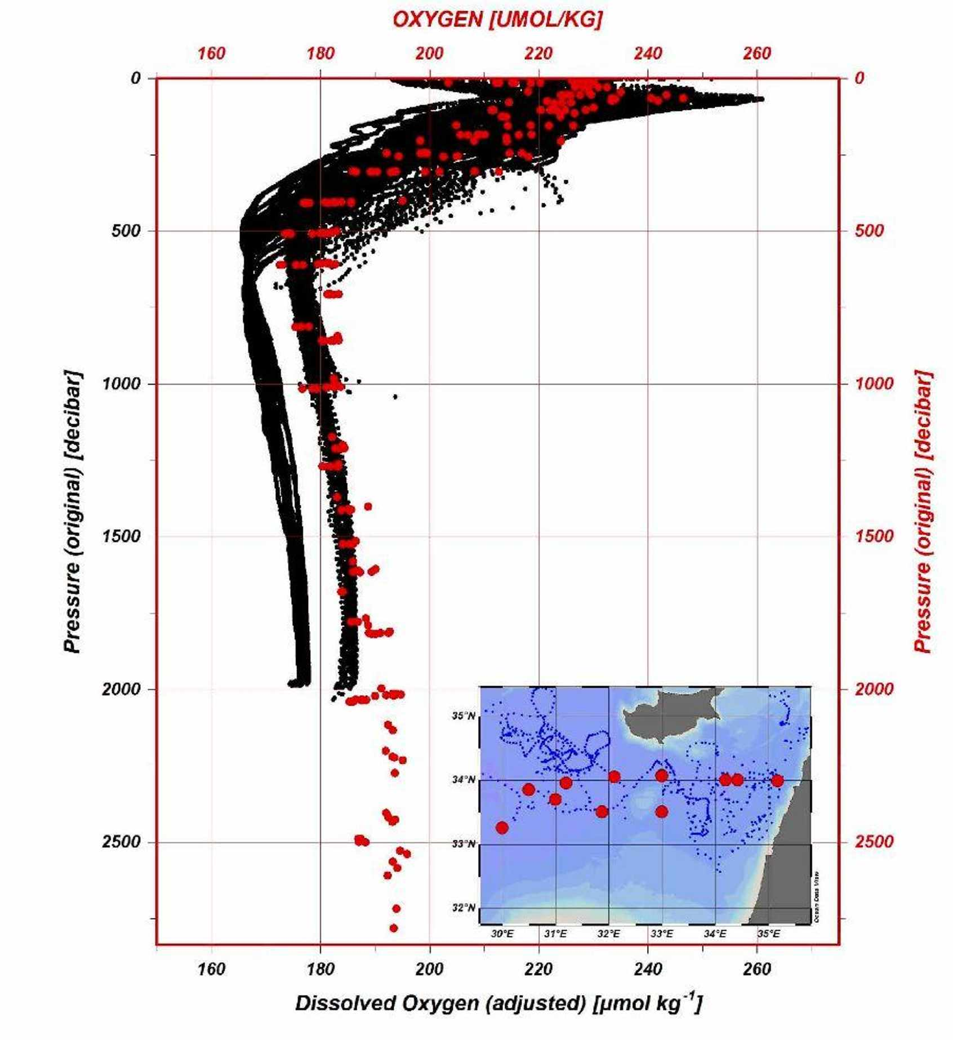
Visual QC using Overlay of Trusted Reference Data
Example:
Eastern Meditteranean
BGC Argo
GLODAPv2.2023

Slide 15
Edit Logs
Station Id
When
Who
[747: WOD05_35000433 6553523 (B)] 2023-11-21T18:01:01 rschlitz@BGEO05P110 EDITFLAGS Temperature [°C] @ Depth [m] = {#5:40:0} -> 4
Action
Parameter
Sample Id
Old
Value
New
Value
Can be exported and used to implement the flag changes in core database.

Slide 16
