Slide 1



IOC Data Ecosystem
Emma Heslop
BioEco Panel Meeting 03 February 2025

Slide 2
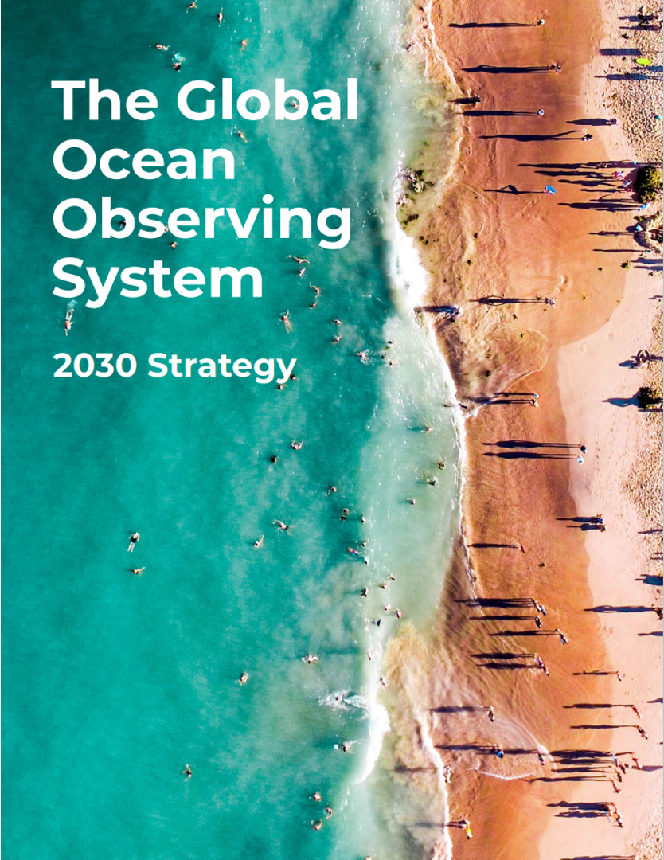
Global Ocean Observing System 2030 Strategy
Goal 2: System integration and delivery, provide authoritative guidance on integrated observing system design, sustain, strengthen and expand observing system implementation, and ensure FAIR data
SO7. Ensure GOOS ocean observing data and information are FAIR with appropriate quality and latency
Outcomes foreseen:
An identified GOOS data architecture as part of broader oceanographic, atmospheric, earth system data architectures
Data products based on EOVs/ECVs
More data available, more appropriately, to more users
Meaningful data metrics
Notes:
(findable, accessible, interoperable, and reusable)

Slide 3
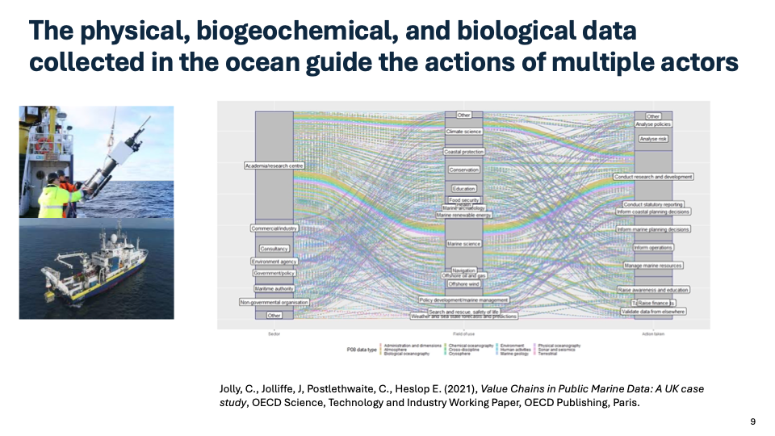


Slide 4

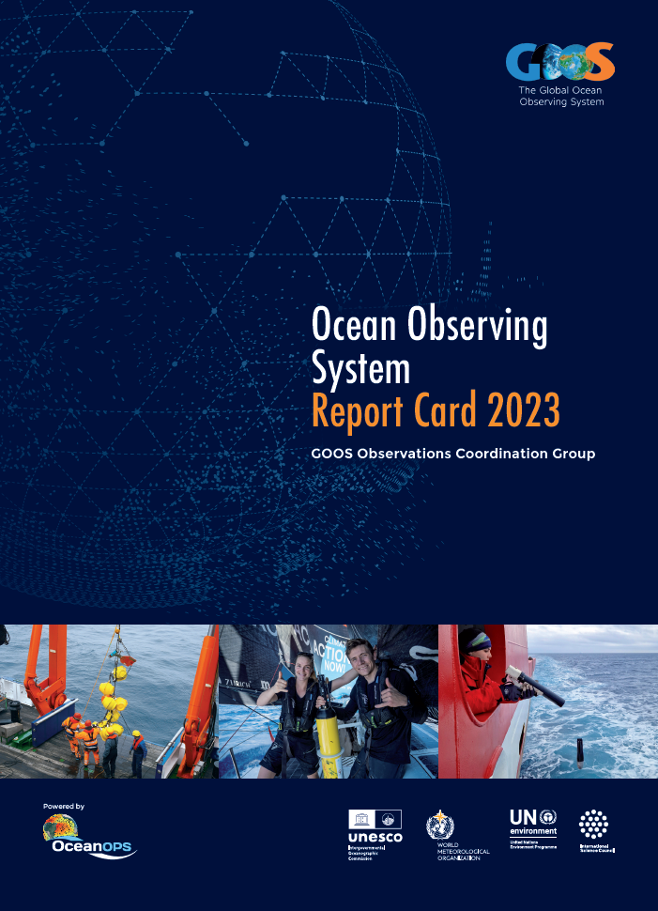
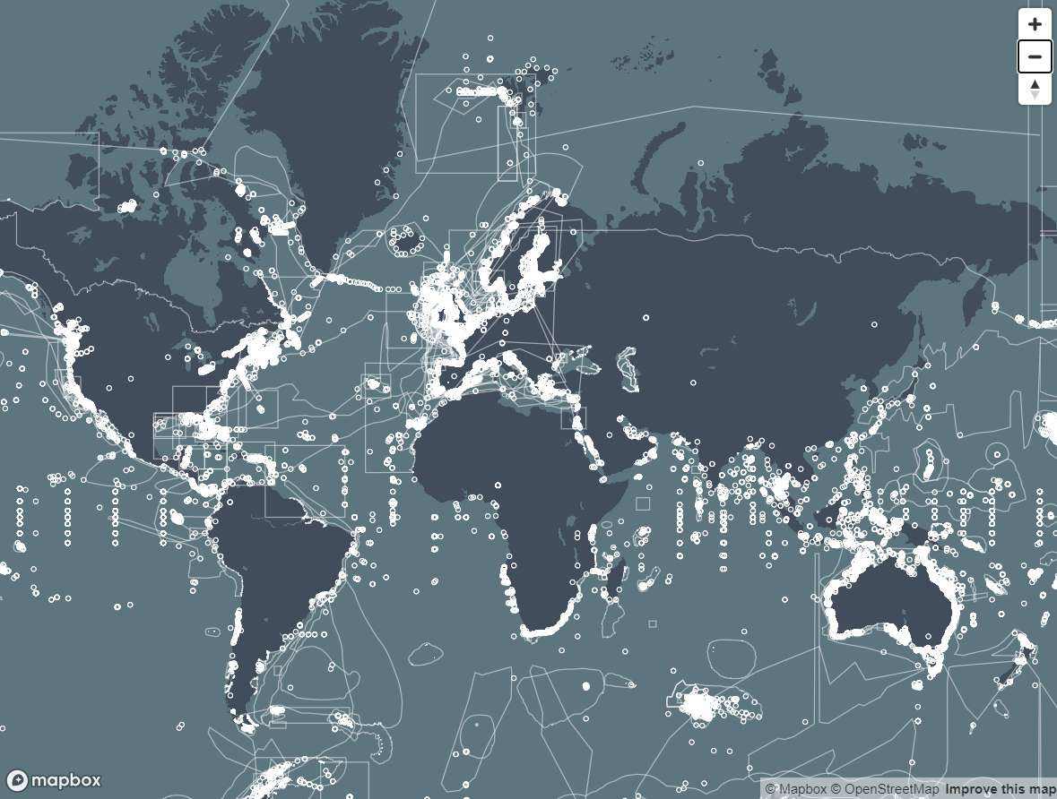

Developments – building blocks - since 2019
GOOS Observations Coordination Group (OCG)
GOOS Biology and Ecosystems Expert Panel
GOOS Biogeochemistry Expert Panel
OCG network data mapping
OCG Data Implementation Strategy
WMO unified Data Policy - EOVs
Report Card – cross GOOS
Best practices documented
BioEco Portal launched
BIoEco network data flows integrated with OBIS
Best practices documented
BGC Panel working towards BGC value chains (not stable) GDAC and products
Best practices documented
Not integrated cross discipline, sustained or trackable
Not working towards a shared vision

Slide 5

GOOS SC-13 - April 2024
Action 9.1 Create and adopt a cross GOOS Digital Infrastructure/Ecosystem Strategy in alignment with IODE, Ocean Decade Data Strategy and other partners.
What do our users want from a GOOS digital ecosystem infrastructure?
Access for each EOV to all observational data, from wherever in the world, with a known uncertainty documented in the metadata
GOOS ocean data ecosystem that is foundation for the IODE 2030 Data, Decade 2030 Data Implementation Plan, WMO WIS 2.0
EOV products that are user-led

Slide 6
Executive Council 57 Decision 2024 Proposal for Assembly 2025 and ongoing outreach
A first step – is a proposal for assembly 2025 – whilst building coordination, integration and advocacy
Proposal for evolving GOOS (outlining what needs to be done as a first step)
Focus GOOS to be fit for purpose to meet the needs of Member States
Review components and revise TOR, as well as MoUs with sponsors and partners
Create a functioning Digital Ecosystem to enable end user applications
Evolve a user and uptake strategy
Determine a process to set a new GOOS strategy synergised with Decade Challenge 7 and across IOC processes

Slide 7
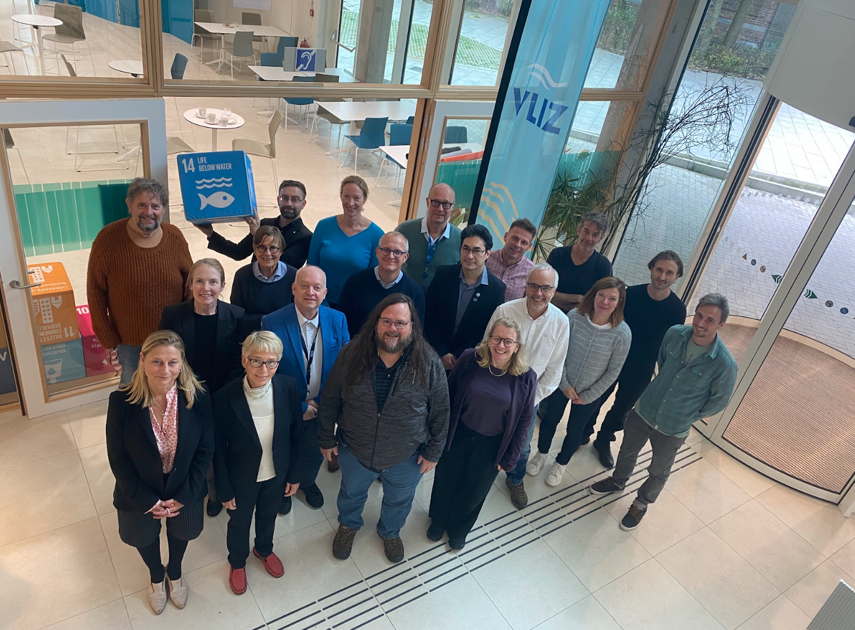
IODE-GOOS Data Workshop - Sept/Oct 2024
FIRST cross IODE-GOOS (IOC) Data Workshop to support data access for the future
Identify roles and synergies
Develop a joint vision
Technical solutions identified
Coordination & future planning
GOOS, IODE Mgmt., OCG, BGC Panel, BioEco Panel, OceanOPS, OBIS, Ocean Decade, IOC Ocean Science Section and Tsunami Unit
WMO presented WIS2 and discussed connections to ODIS

Slide 8
Joint Vision – north star
Defined a clear niche in the digital ecosystem which is unique to IOC, that is investable, built on existing infrastructure, and aligned with other architectures
IOC (federated) gateway to all ocean data with core GOOS certified EOV data clearly identified
EOV data of documented quality, following FAIR & CARE principals, available for all
Wherever you are in the world to be able to appropriately access EOV data
Harnessing the IOC value chain to deliver trusted information to as many as possible
High value products that deliver EOV data into global assessments and multilateral processes, and that can be traced back to the point of truth (i.e. observations)
IOC has a clearly defined role in digital ecosystem which is unique and investable
Help bridge the digital divide and mature digital ecosystems globally

Slide 9
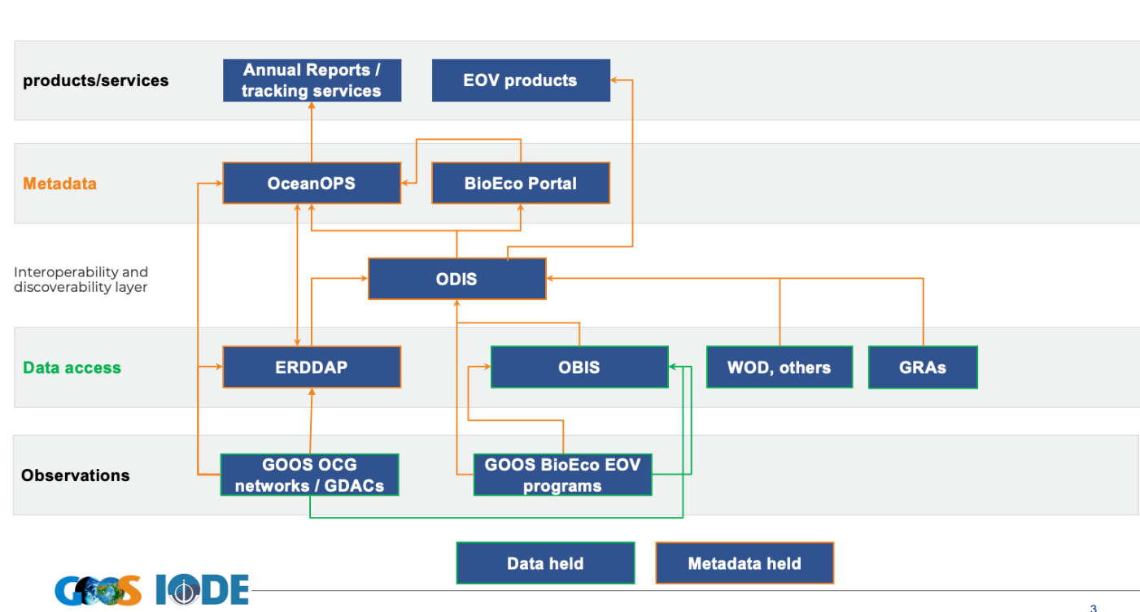
Data Architecture
Agreed IOC Data Architecture – major step forward
Based on ODIS, EOVs, FAIR & CARE principals, and metadata linked to original source
Prepare a joint proposal IOC Assembly June 2025
GOOS OCG ERDDAP is a Hyper node
OBIS is a Super GDAC for BioEco EOVs
GOOS metadata tag to signal quality
Harvest and compile EOVs, support creation data products,, e.g. O2 synthesis
Need provenance and licensing in metadata
OceanOPS / BioEco Portal will interface for services
Meeting Report

Slide 10
Next Steps - How
How
Form a Working Group - ToRs and members in report
Proposal for joint session at IOC Assembly 2025 - based on existing, with minimum viable product demonstrations and passed implementation/resource needs
Undertake some work in OCG, OBIS and BioEco Panel
JAN/FEB 2025
IOC Officers
WG Formed
Support hired
GOOS SC
MAR/APR 2025
IODE Committee Draft proposal
JUNE 2025
IOC Assembly
Joint session
Proposal and
Decision
2025 - 2026
Implementation
Phases with MVP

Slide 11
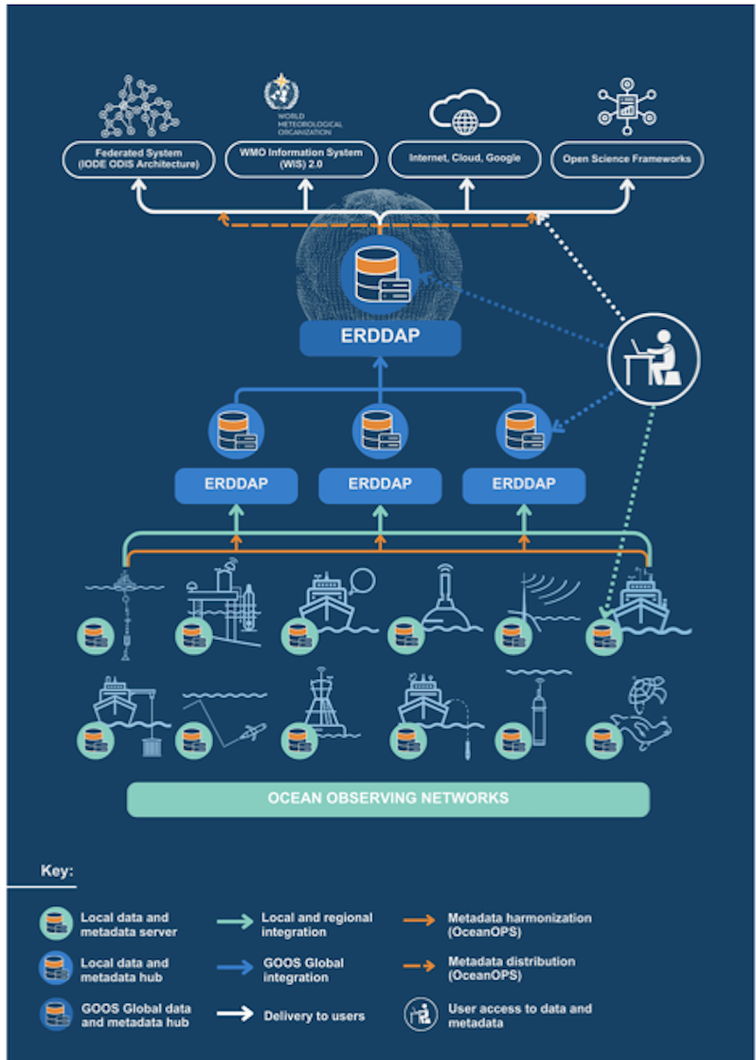
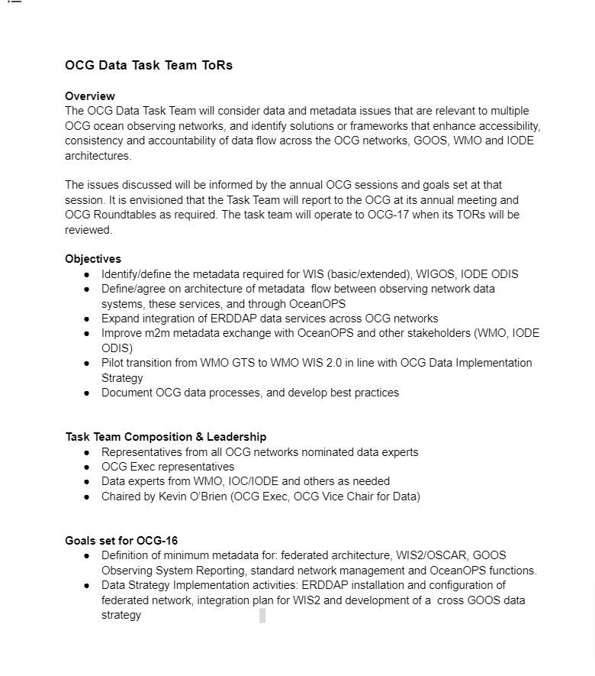
OCG Data Task Team
Ensure metadata specifications meet needed requirements (i.e., WMO/OSCAR, GOOS reporting needs, IOC Data Architecture)
Identify global data nodes for federation, expand ERDDAP
Define/agree minimum metadata flow between network data systems, OceanOPS, and external stakeholders (WMO, IODE, etc)
Pilot transition from WMO GTS to WIS 2.0
Document and develop best practices
ToRs – here

Slide 12
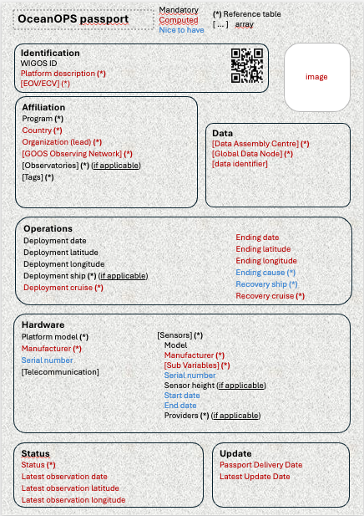
OceanOPS metadata outline
Minimum metadata a concept - passport – metadata required/meaning unique identifier (WIGOS Number) across networks, basic metadata enriched
Metadata flow from initiation (unique identifier) to delivery, tracking and GOOS/Network services
Consider metadata for provenance and licencing
Identify GDACs for RT and DM >> federate
Consistency, framework agreed across networks, visibility, services

Slide 13
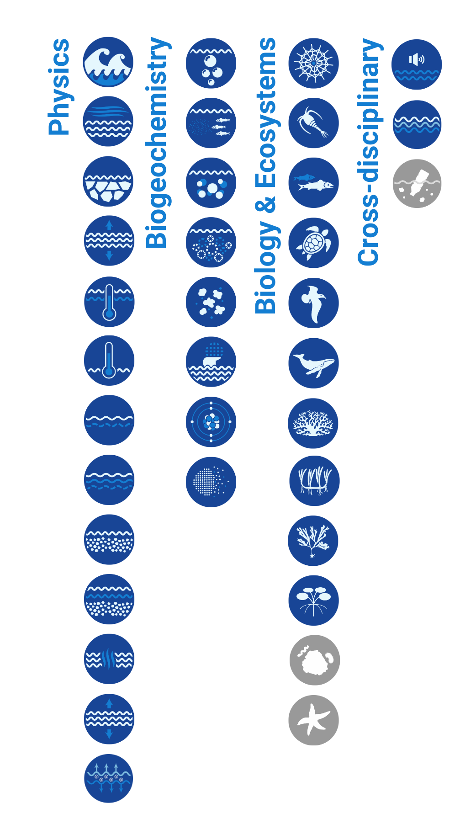
BioEco Panel
Thoughts/questions?
Important focus area for 2025/65 – co-chair engagement:
Consistency with and across BioEco communities
Consistency with OCG networks and ideas
Support relevant services, support GOOS B Plan, support BioEco community needs?
Leaders for data/metadata in each BioEco EOV Community?
Notes:
Not going to go through them all, many on track or work underway
Two perhaps of more concern

Slide 14
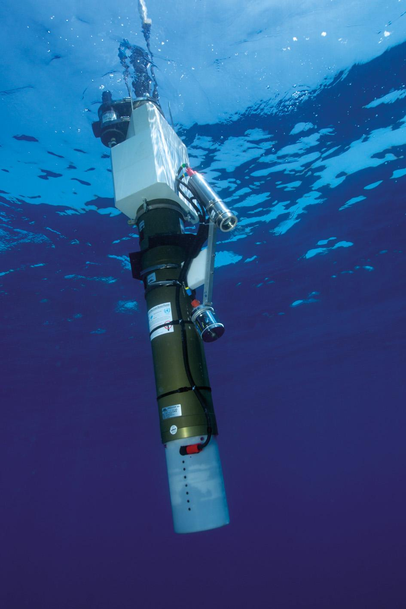

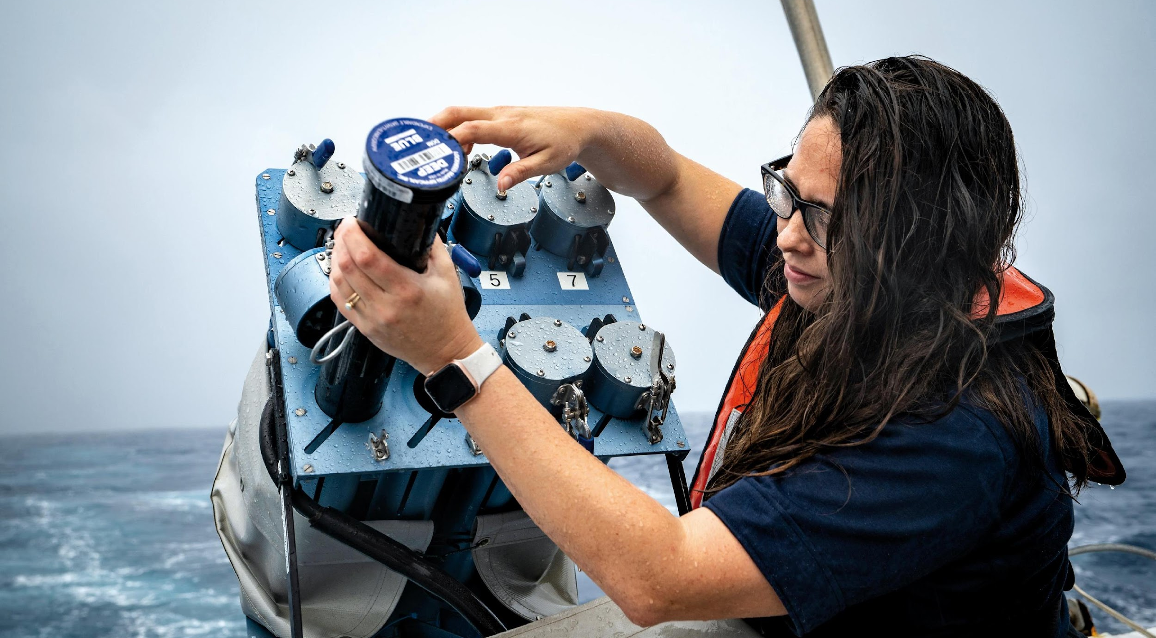
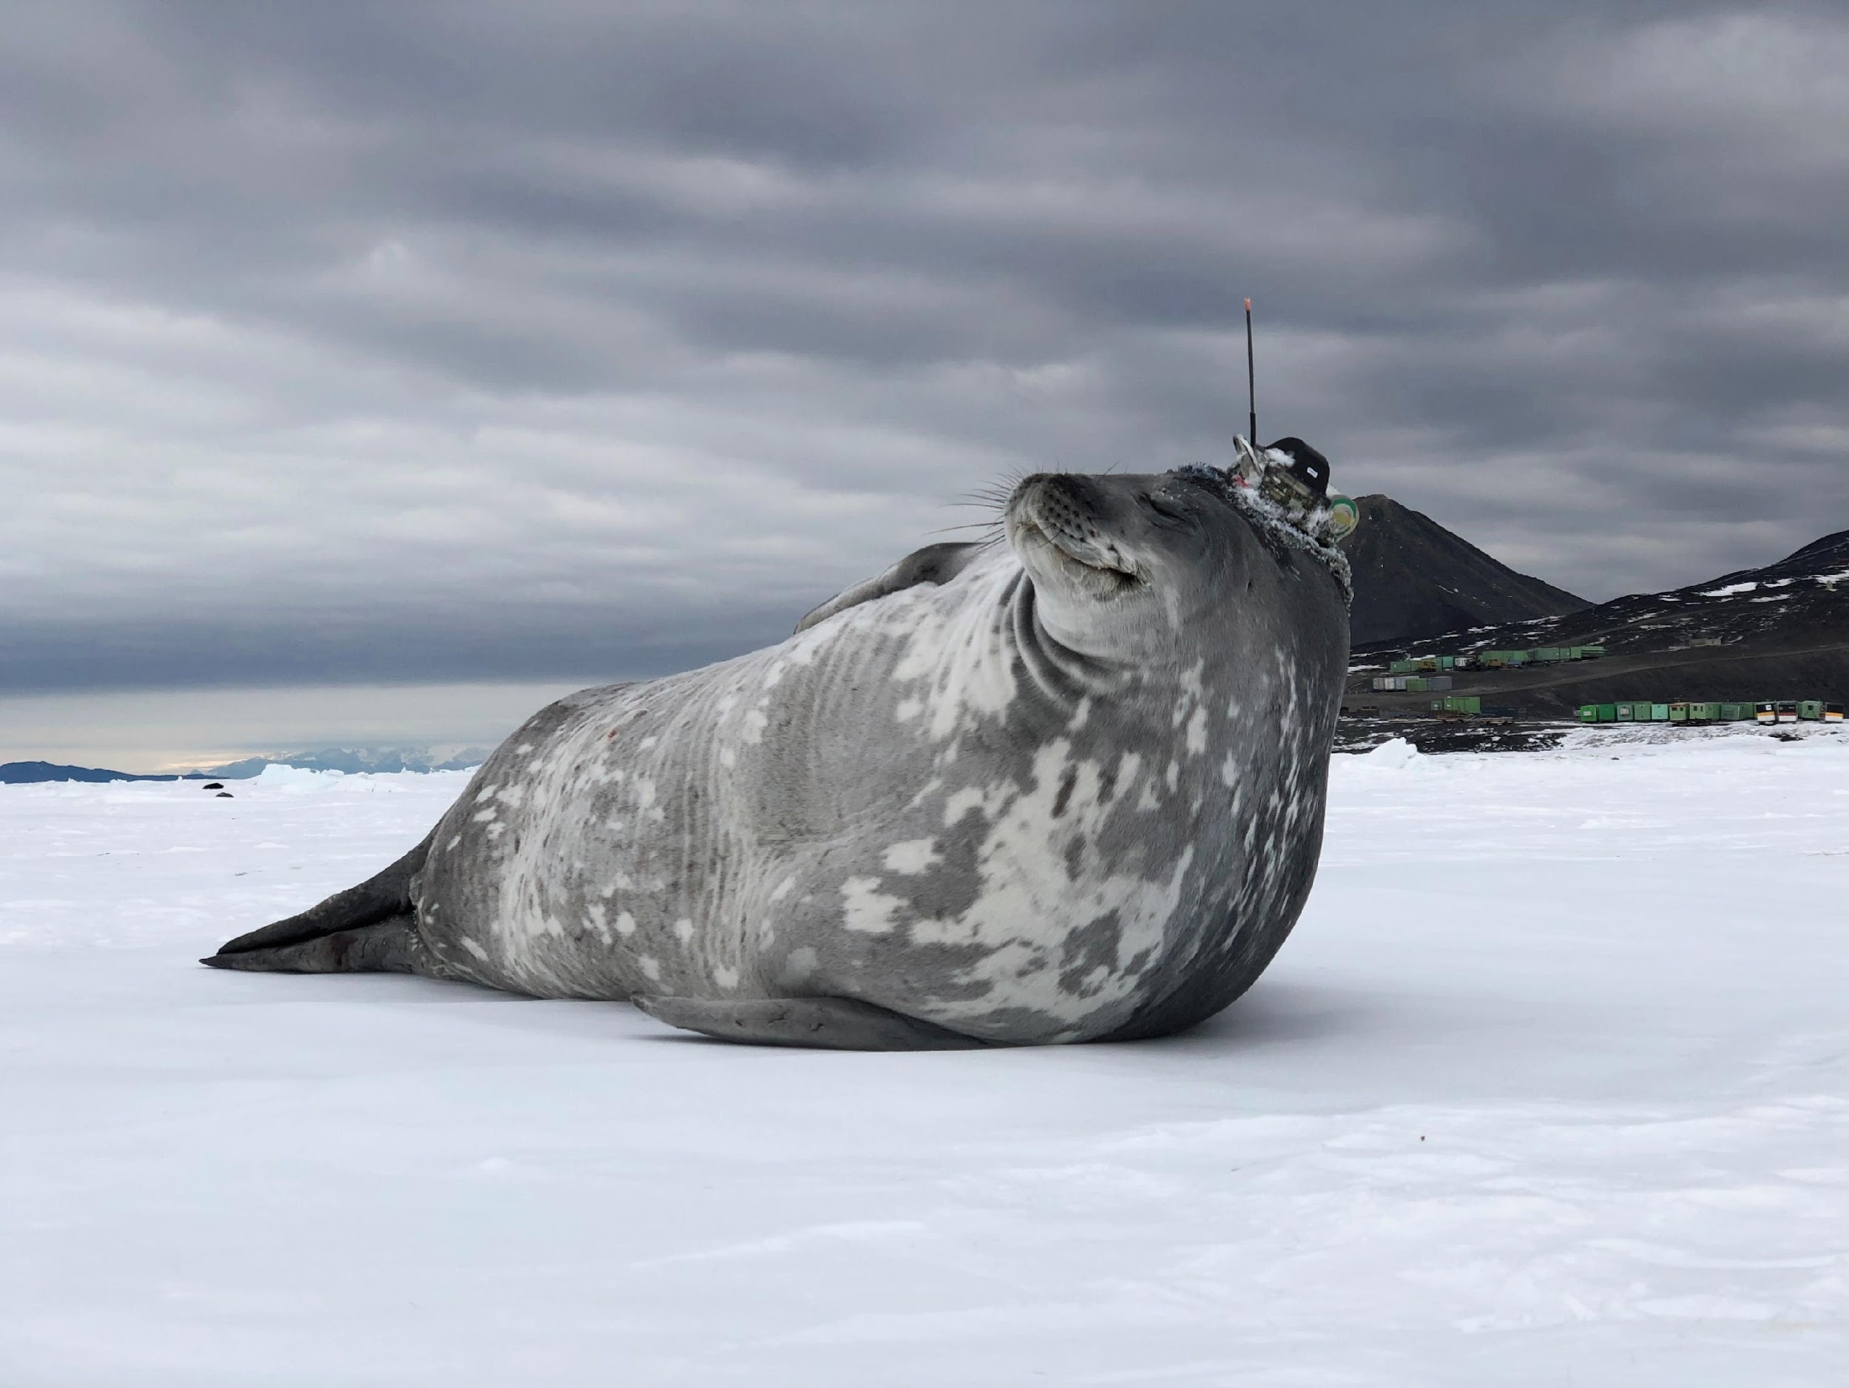
Thank you
goosocean.org

Slide 15
WMO Unified Policy for the International Exchange of Earth System Data (Resolution 42)
Single ‘unified’ data policy across multiple domains: Weather, Climate, Hydrology, Atmospheric Composition, Cryosphere, Oceans and Space Weather that aims to broaden and enhance the free and unrestricted international exchange of Earth system data
For oceans - covers in situ and remotely sensed observational data both in and above the ocean and at the sea-surface, from the open ocean to the coast, along with other data that provide necessary input to ocean monitoring and prediction and for a variety of other Earth system applications
Acknowledges the right of governments, based on their national laws and policies, to choose the manner by, and the extent to which, they make data available domestically or for international exchange – so does not override national data policies
Approved by WMO INFCOM I(III) 12 to 16 April 2021 to go to WMO EC-73 in June for consideration, aim is for final approval by WMO Congress in October
Core data (shall be exchanged on a free and unrestricted basis) | Recommended data (should be exchanged)
Marine meteorological and oceanographic observations, as defined in the WIGOS Manual (WMO-No. 1160) | Physical GCOS ECV and GOOS EOV observations that have been collected outside of designated GOOS activities
All other physical GOOS EOVs and GCOS ECVs collected as part of a GOOS observational network, programme or project consistent with the IOC Oceanographic Data Exchange Policy (IOC Resolution XXVI 8) | All other observed biogeochemical and biological/ecosystems GCOS ECVs and GOOS EOVs;
Ocean analysis and prediction fields provided by global NWP systems operating under the auspices of the GDPFS, as defined in the Manual on the Global Data-processing and Forecasting System (WMO-No. 485); | Observations of pH, chlorophyll-A, suspended particles and downwelling irradiance which are fundamental to address significant scientific and societal ocean/climate-related issues
All ocean reanalysis fields provided by the Global Processing Centres of the GDPFS;
All watches, warnings, advisories and alerts for public safety (protection of life and property) issued by Members’ designated warning and alerting authorities according to WMO Technical Regulations

Slide 16
IOC-WMO Joint Collaborative Board (JCB) Meeting September 2024
Priority areas of work for next intersessional period
1.Global Basic Observing Network(s) for Ocean
Co-create definition for ocean GBON (through WMO Technical Regulation, for weather & expanding to climate), integrate additional ocean variables & expand to open ocean, consider the need for GOOS to define a core basic ocean observing network
2.Data Management and Interoperability
Enhance interoperability for an integrated observing and data system
Improve data sharing/interoperability between the WIS and ODIS
Develop a structured approach to Marine Climate Data Systems & enhance integration of observation networks
3.Coastal and Maritime Resilience
Strengthen coastal and maritime community resilience against hazards like tsunamis, supporting the UN’s Early Warning for All (EW4All) initiative
4.Capacity Development
Establish Joint Oceanographic and Meteorological Specialized Training Centre(s)
Share data management capabilities with developing countries & provide guidance on marine observing systems

Slide 17

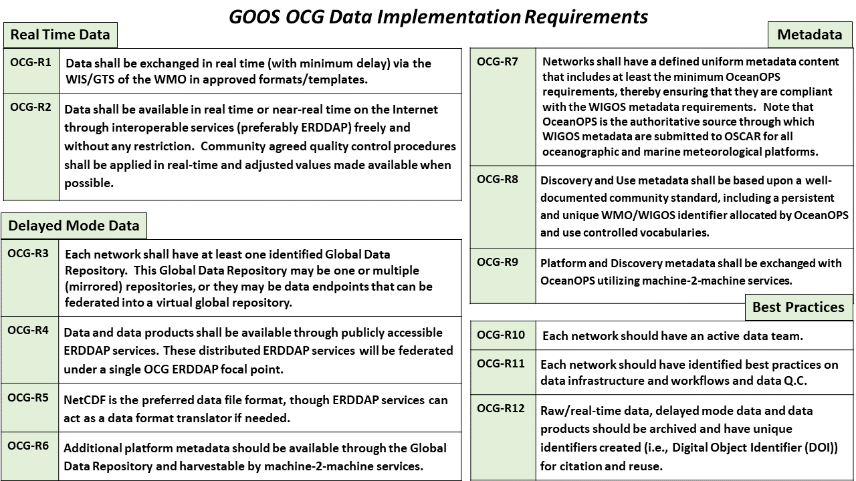
OCG Cross-Network Data Implementation Strategy
Why?
Many existing or developing data strategies
WMO Unified Data policy
Revision of IOC Strategic Plan For Data
UN Decade Data Strategy
Ocean community pushing for compliance with FAIR data principles - what does that mean?
This Implementation Plan is an effort to define specific and actionable ways OCG network/programs can move towards FAIR compliance
Improve (meta)data discovery, accessibility and usability for all stakeholders
Improve access to distributed (meta)data endpoints through federated, uniform data services
Data and Metadata Implementation Requirements:
Real Time Data (2)
Delayed Mode Data (4)
Metadata (3)
Best Practices (3)

Slide 18
OCG Cross-Network Data Implementation Strategy

Slide 19
OCG Cross-Network Data Implementation Strategy
Next step: Implementation!
Deploy ERDDAP services where needed for delayed mode data and metadata
Federate distributed ERDDAP nodes in OCG focal ERDDAP
Improve metadata availability and exchange with OceanOPS
Where possible, leverage these ERDDAP services for platform metadata exchange with OceanOPS

Slide 20
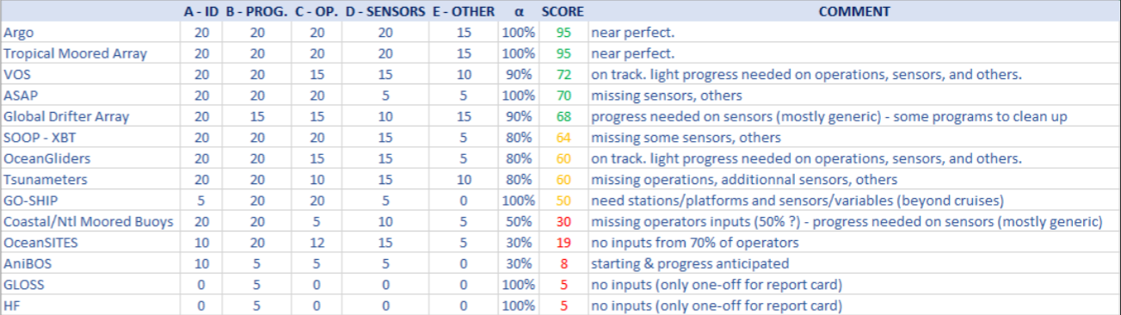

Network Status
Extracted from OCG report 2023

