Slide 1
Session 11: Modelling and services input
Hao Zuo, Senior Scientist, ECMWF
Sixteenth Observations Coordination Group Meeting (OCG-16)
7-10 April 2025, IFREMER, Brest, France.

Slide 2
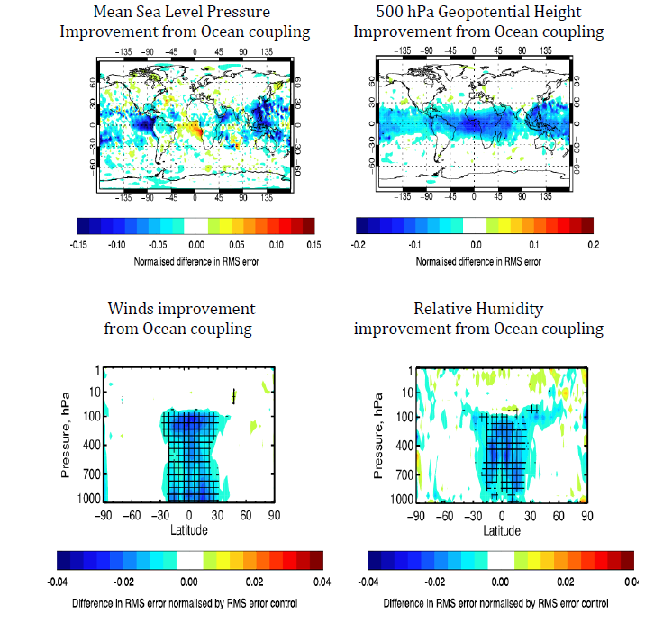
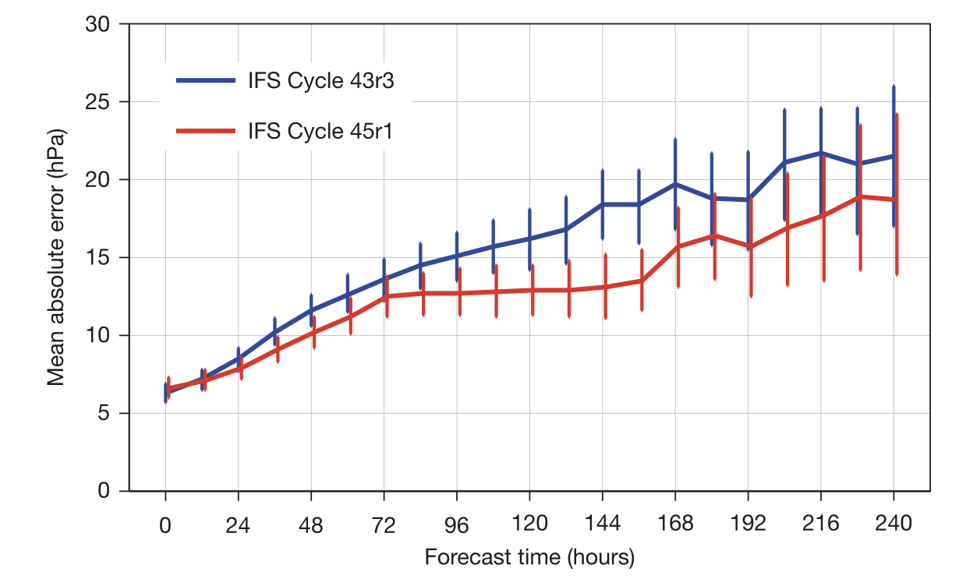
Why Ocean DA?
ECMWF forecasts became coupled for all timescales since 2018 (CY45R1) - include dynamical ocean and sea-ice components (Mogensen et al., 2018, Buizza et al., 2018 ).
Coupling (partial) with the ocean improves the weather forecast scores, with reduced RMSE (blue) in Day+5.
Coupling with ocean reduces intensity error in HRES forecasts of tropical cyclone (TC).
un-coupled
coupled
Mean absolute error of TC intensity

Slide 3
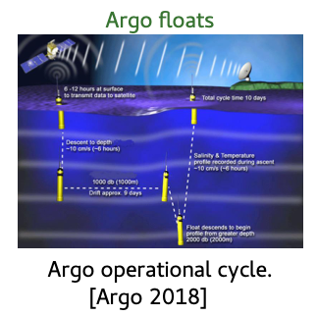
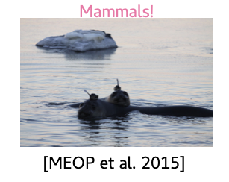
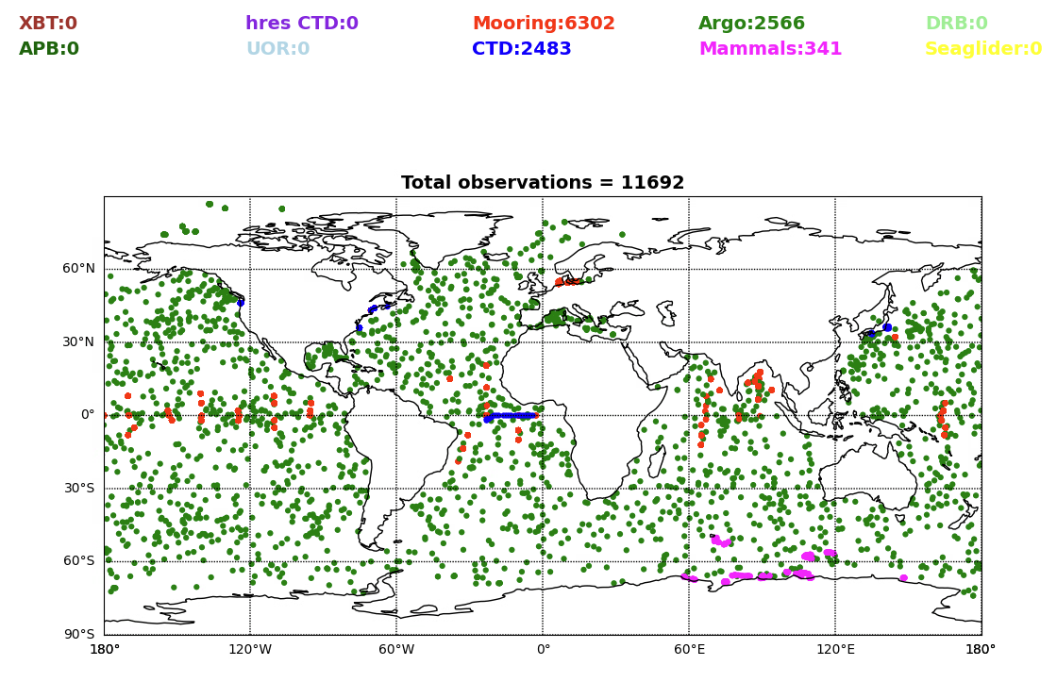
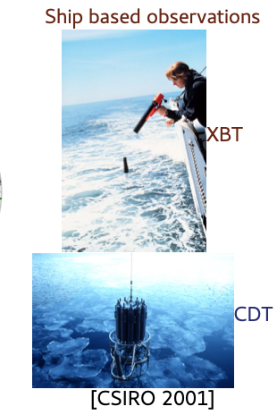
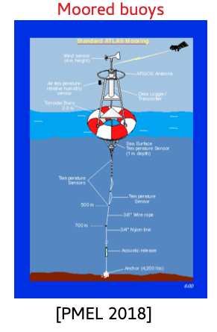
What observations are used
Ocean in-situ observation is about 1/1000 to 1/10000 smaller than Atmospheric observation
In-situ obs from GTS
(20250323-0328)
+ other platforms: ALAMO/AXBT, saildrone, ice-tethered profilers …

Slide 4
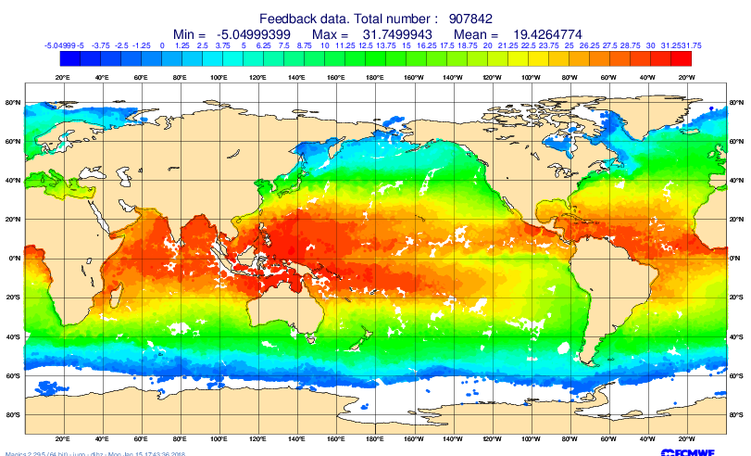
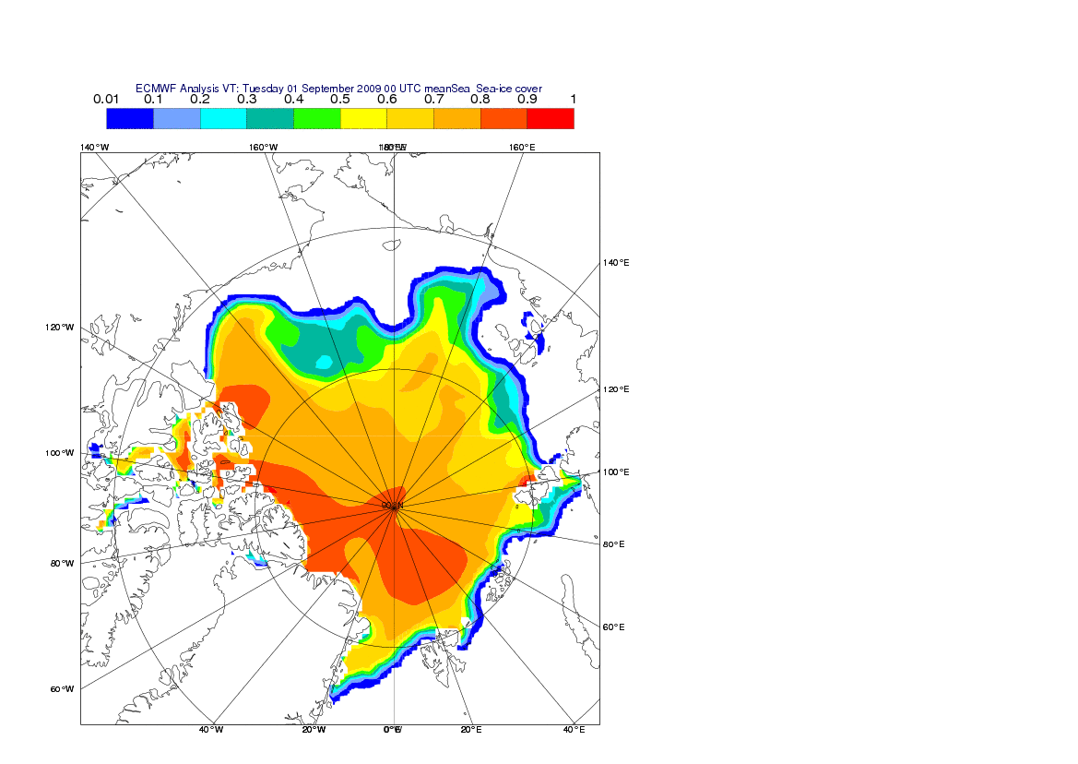
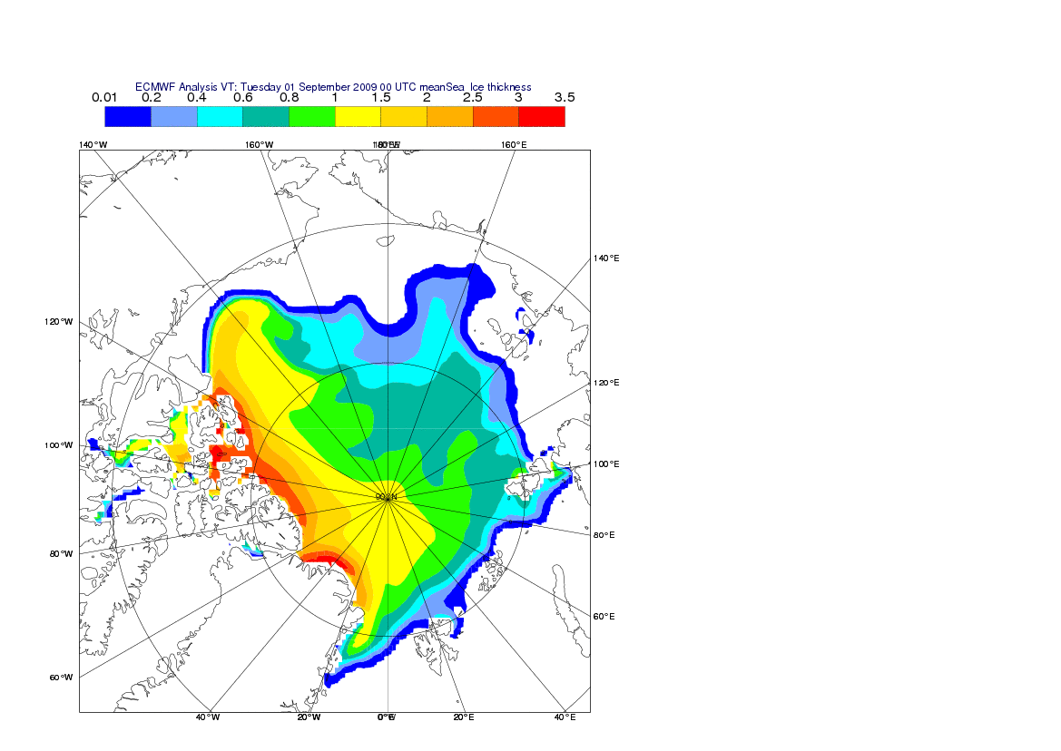
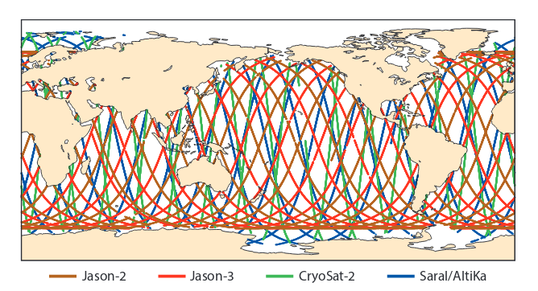
What observations are used
Satellites provide important observations on monitoring sea surface states. These sea surface observations are complemental data sources to the ocean in-situ observing networks.
Wave – altimeter wave height (C2/Al/J3/S3A/S3B)
Sea Level – satellite altimeter (J3/Al/S3A/S3B/C2/…)
SST – OSTIA (insitu+satellite instruments AVHRR/SLSTR/VIIRS/TMI/AMSR2/…)
Sea-ice concentration – OSI-SAF (satellite instruments SSMI/SSMIS/SMMR)
Sea-ice thickness – laser/radar altimeter freeboard (CryoSat2/IceSat2/SMOS/…)
other passive types: sea surface salinity, ocean currents, ocean color.
SST (IR, PMW)
Sea-ice concentration
Sea-ice thickness (fb)
Sea-Level Anomaly (Altimeter)

Slide 5
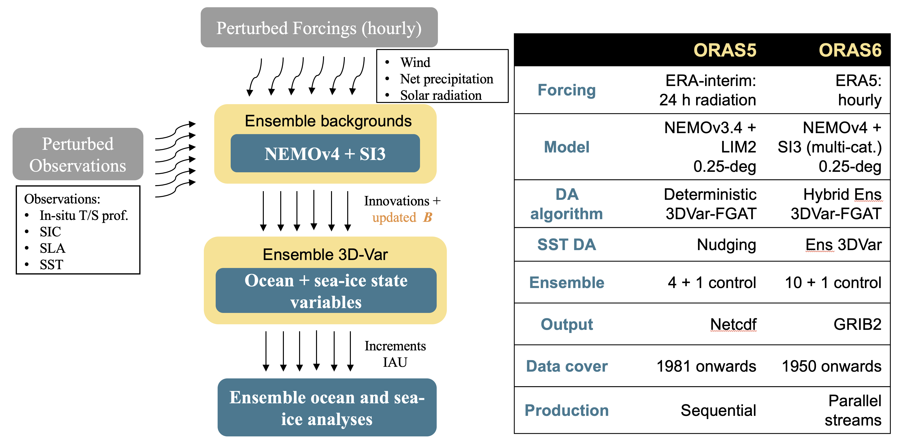


What model/DA method ?
Zuo et al., NL180, 2024
ORAS6 will provide ocean and sea-ice initial conditions for
ECMWF coupled forecasts (medium-range, sub-seasonal, SEAS6)
Climate monitoring (C3S)
ERA6 (new)
Development of ORAS6 has been partially supported by EU-funded projects: C3S-ERGO, CMEMS-GLORAN and their follow-ups.

Slide 6
Impact on NWP - seasonal forecasts
Adding Ocean data assimilation leads to
Gain about 2 months in ENSO prediction skill
Without ocean observations and DA, we would lose about 15 years of progress (from S1 to S5).
Figure adapted from McPhaden et al, 2020

Slide 7
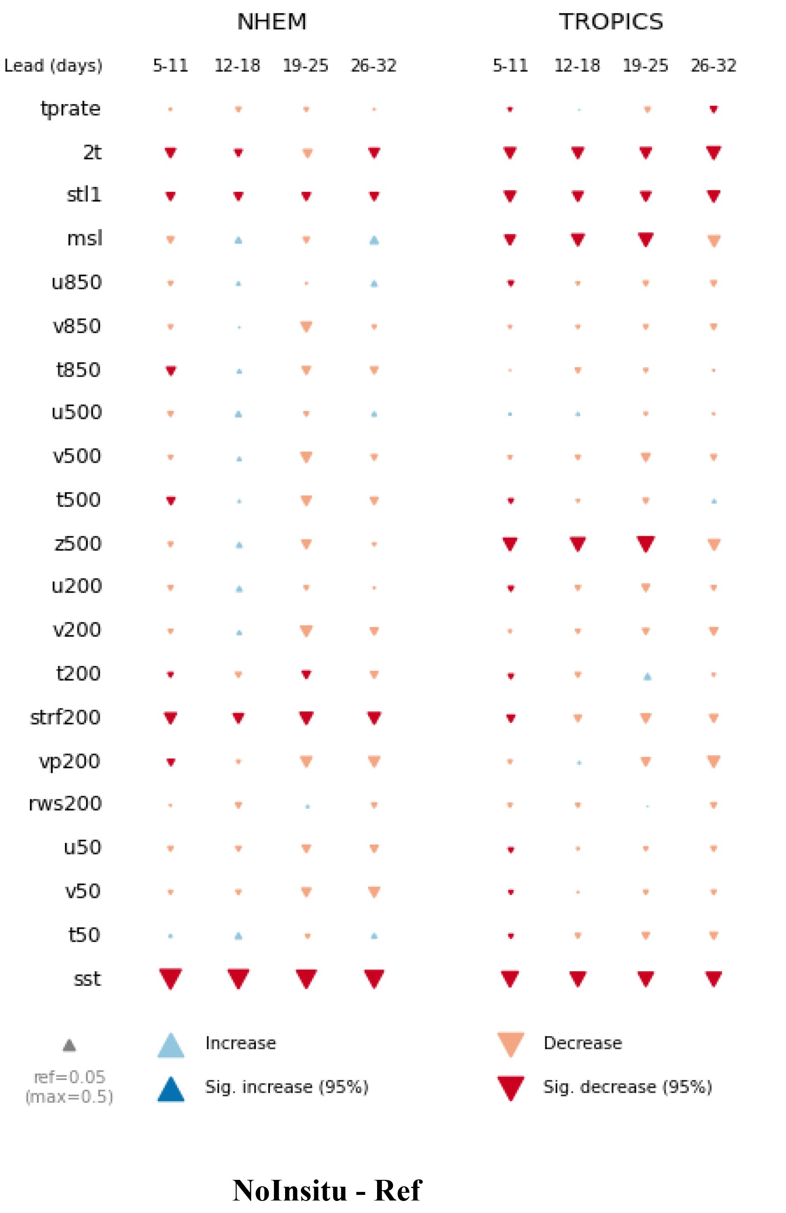
Impact on NWP – Sub-seasonal
Bias score of atmospheric forecasts
Withdrawing ocean observations (in-situ) from the initial conditions
Significant degradation in ocean forecasts from week 1 to week 4
Also degrades the atmospheric mean state (e.g. increased biases), from week 1 to week 4
No insitu - REF
Reduced bias
Increased bias
Balan-Sarojini et al., 2024, Frontiers in Marine Science

Slide 8
Summary
ECMWF assimilates ocean observations from different platforms and instruments (both in-situ and satellite), leads to improved ocean and sea-ice initial states (SST at WBCs, diurnal cycle, upper ocean temperature and salinity, regional/global sea-level changes, sea-ice conditions).
The ECMWF coupled forecasting system (medium-range/S2S/seasonal) and coupled reanalysis system (ERA6) are all initialized from ocean and sea-ice analysis.
Removal of all ocean observations leads to significant degradation in forecasted ocean states from week 1 to week 4, and has a negative impact (~2-month skill) on coupled forecasts of ENSO prediction.
Impact of ocean observations on NWP performance is comparable to a major IFS cycle update in the ECMWF system.

Slide 9
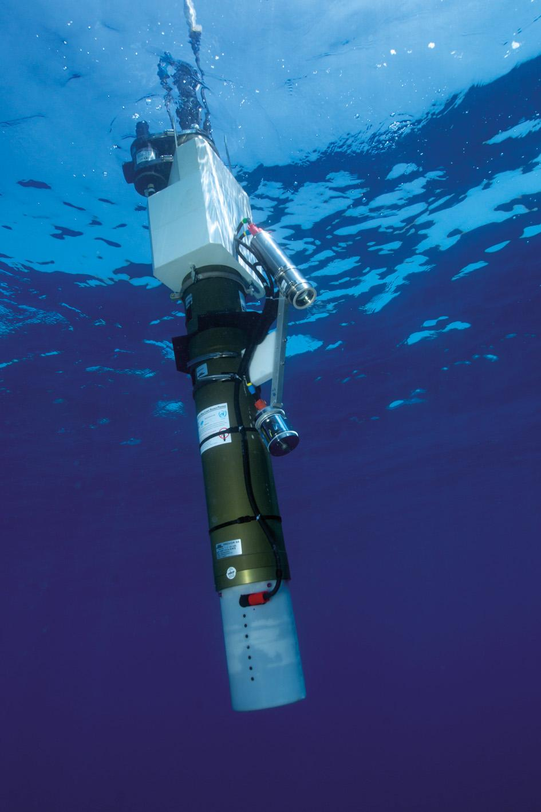
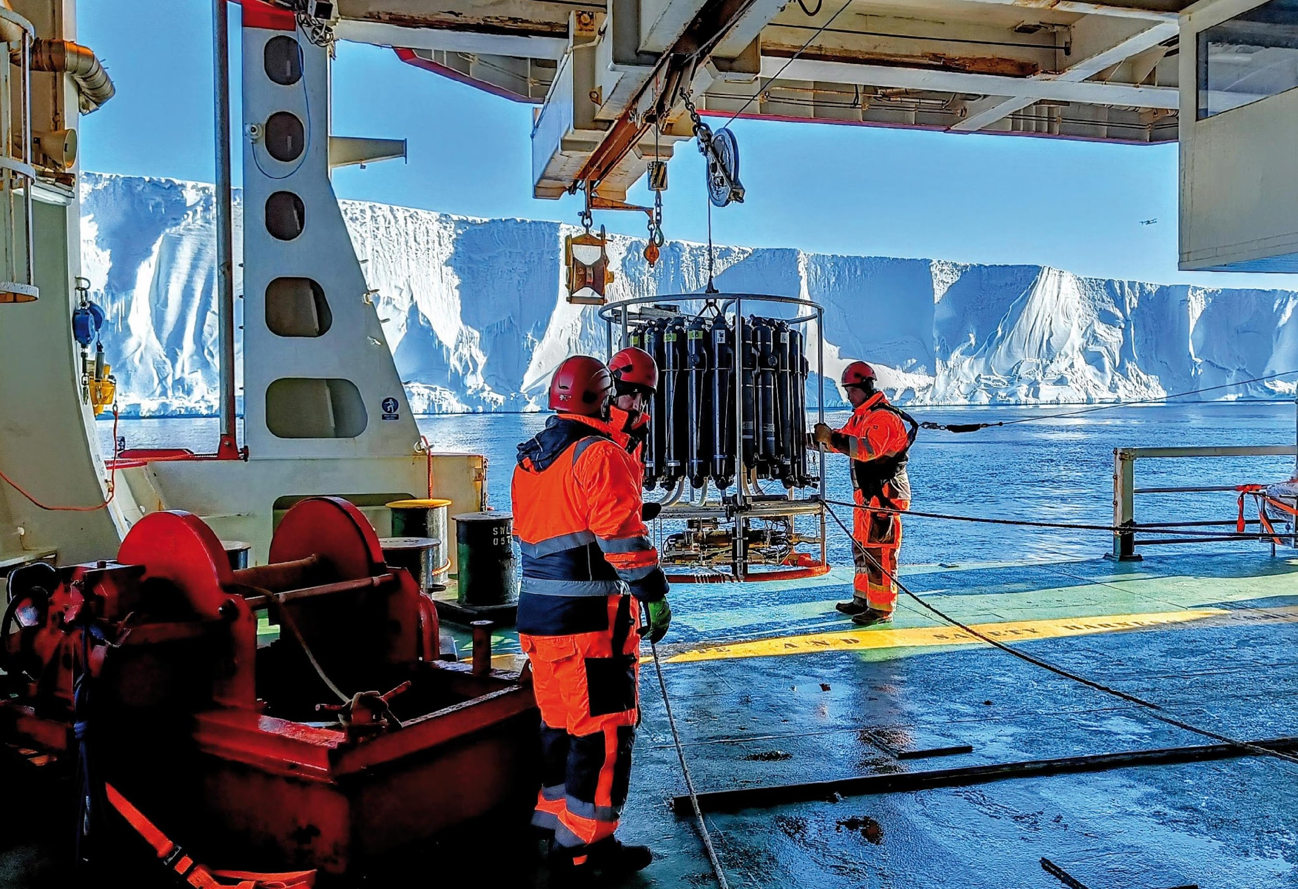
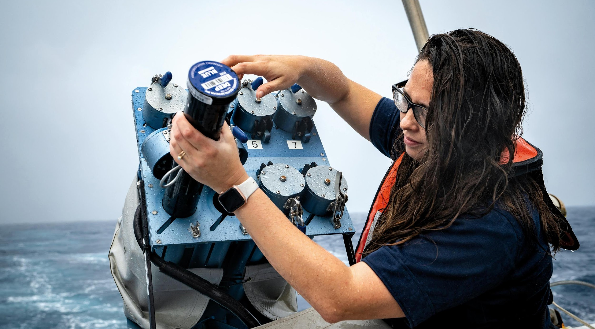
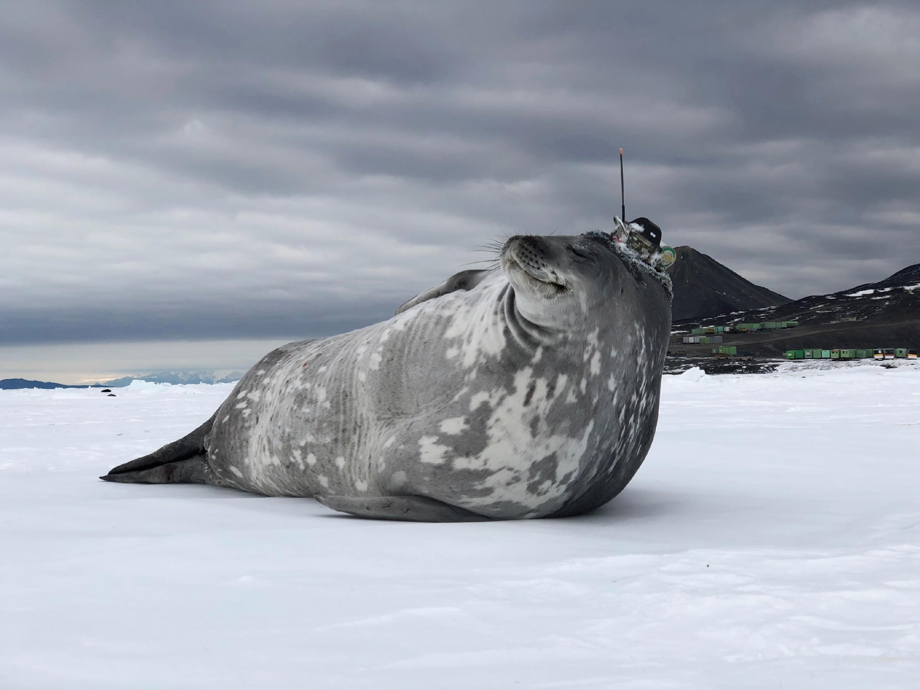
Thank you
goosocean.org

