Slide 1



ICG/PTWS-XXXI, 7-11 April 2025, Beijing, China
Intergovernmental Coordination Group for the
Pacific Tsunami Warning and Mitigation System (PTWS)
Tsunami Preparedness
Capacity Assessment
(ESCAP Phase II)
Project Overview and Update
Lara Bland (NEMA, NZ), and Laura Kong (ITIC)

Slide 2

Plan
PTWS Tsunami Preparedness Capacity Assessment Overview – Laura Kong
Preliminary Results – Céline Barré
Next Steps (Intrasessional Working Group to follow) – Lara Blande

Slide 3
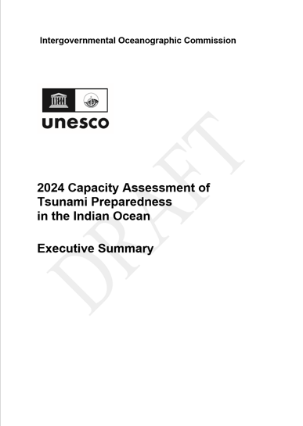
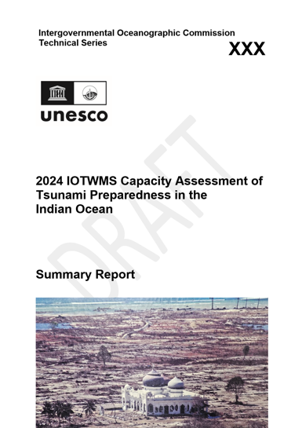
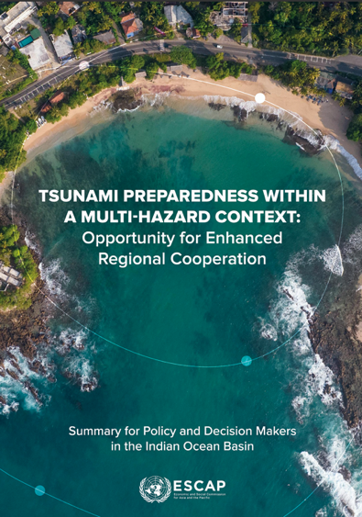

A brief overview of ESCAP Phase-I and Phase-II
Phase I – Indian Ocean Basin
Phase II – Pacific Ocean Basin
Nov 2023- Dec 2024
20th Commemoration of IOT
Sept 2024- Sept 2025
60 years of PTWS
1A/1B IOTWMS Technical Capacity Assessment Report and Exec Summary
2A/2B PTWS Technical Capacity Assessment Report and Exec Summary
3A/3B Tsunami Preparedness summary for ESCAP Indian Ocean policy makers
3C Tsunami Preparedness summary for ESCAP Pacific Ocean policy makers

Slide 4







A brief overview of ESCAP Phase-I and Phase-II
The Trust Fund for Tsunami, Disaster and Climate Preparedness, was established in 2005 directly following the 2004 Indian Ocean Tsunami, to fill the gaps in regional early warning, focusing on high risk, low-capacity countries.
Project Period: 23 months (Phase-I and Phase-II)
Resources: In-kind support from UNESCAP, UNESCO-IOC, and partners
Extra-budgetary activities funded by Asian Development Bank (ADB), the Swiss Agency for Development and Cooperation (SDC), and the Italian Ministry for Foreign Affairs and Cooperation through the ESCAP Trust Fund for Tsunami, Disaster and Climate Preparedness.

Slide 5
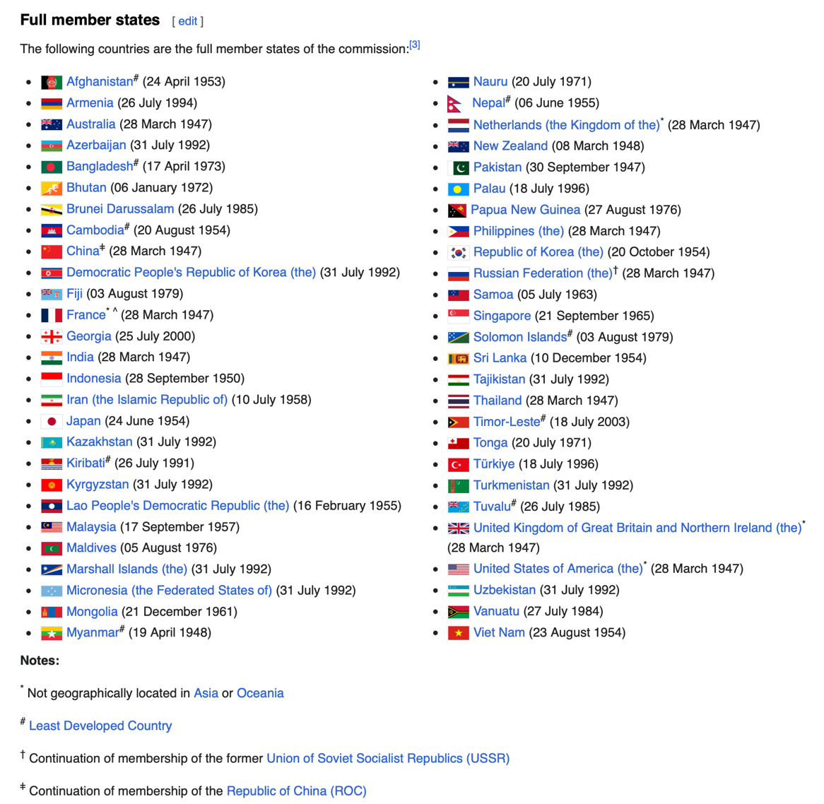
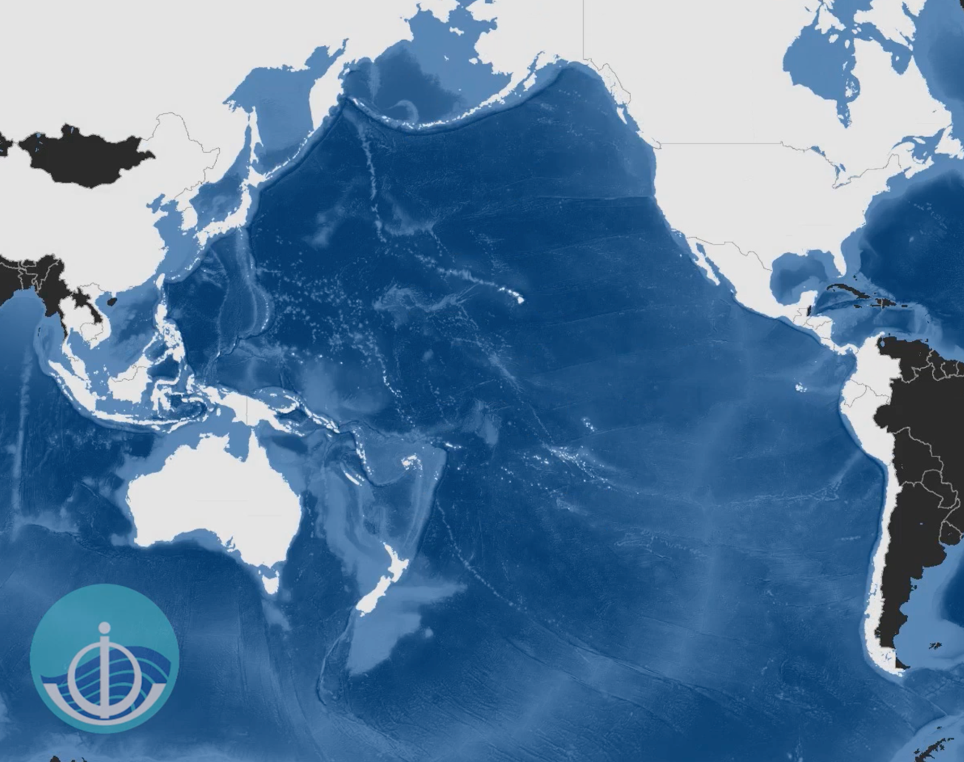
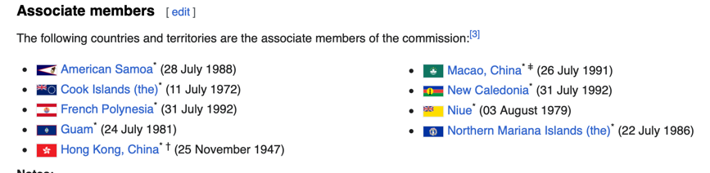
PTWS and ESCAP Scopes overlap
PTWS: 46 member states, Pacific Ocean and its Marginal Seas
Of 46, 4 are UNESCO & not IOC (Brunei, Cambodia, RMI, FSM), 1 is UNESCO Assoc MS & not IOC (Tokelau)
UNESCAP: 53 member and 9 associate member states in Asia-Pacific.
🡪 33 out of 46 PTWS members under ESCAP
UNESCAP, incl also Netherlands, UK, USA

Slide 6



Tsunami Preparedness Capacity Assessment
2025 is the 60th anniversary of the PTWS (ITSU)
Assessment is the 1st ever done for the PTWS
Establishes baseline to measure progress against over life of PTWS MTS
TPCA Objectives
To evaluate the existing technical capacity of the Pacific Tsunami Warning & Mitigation System (PTWS)
To identify specific gaps and capacity development requirements at regional and national levels for strengthening the technical and policy aspects of the tsunami warning and mitigation system in the Pacific
To reinvigorate political commitment and provide recommendations for investments in tsunami preparedness, aiming to address the identified gaps in the PTWS area through regional and subregional cooperation

Slide 7





TPCA aligns with many of our strategic drivers
PTWS VISION (MTS 2022-2030)
The countries of the Pacific Ocean and its marginal seas are resilient to tsunami risk they face. Our Pacific communities are empowered to manage this risk, and actionably build their resilience so they can live, work, and thrive in a diverse, tsunami prone environment.
We will achieve this by delivering the following objectives:
1. Understanding and Managing Tsunami Hazard and Risk
2. Tsunami Detection, Measurement, Warning & Dissemination
3. Enhancing tsunami preparedness for effective community response
4. International Cooperation and Partnerships
(including capacity building)

Slide 8


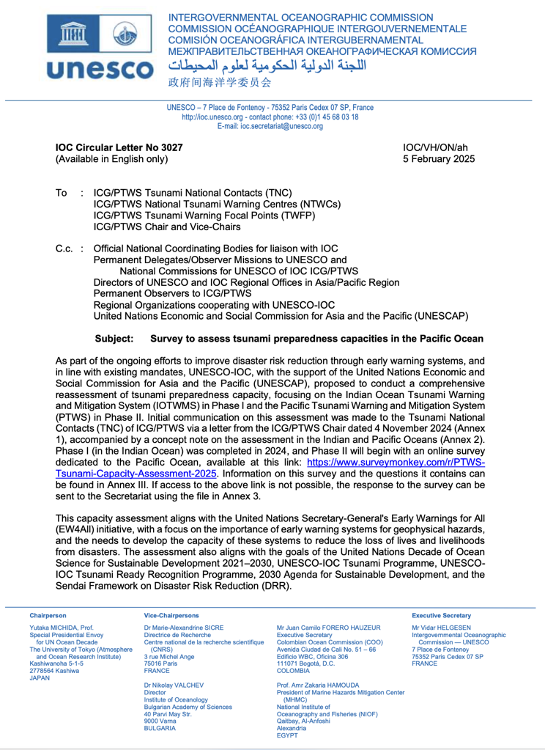
TPCA Implementation Timeline 1: Pre-survey
PTWS SC 2024 - Introduction to ESCAP project and implementation for the Indian Ocean (Phase I)
4-6 September 2024 - PTWS observers (Bland, Kong) to IO Capacity Assessment Validation Workshop. Review initial findings and identify key recommendations for IOTWMS Steering Group endorsement
4 Nov 2024 - Letter from ICG/PTWS Chair
5 Feb 2025 - IOC CL 3207 issued from IOC Executive Secretary
  Letter of the ICG/PTWS Chair
  Concept Note (2024 IOTWMS and 2025 PTWS Tsunami Preparedness Capacity Assessment)
  Survey
  Survey deadline – 4 March 2025
  OceanExpert website (info) : https://oceanexpert.org/event/4696

Slide 9
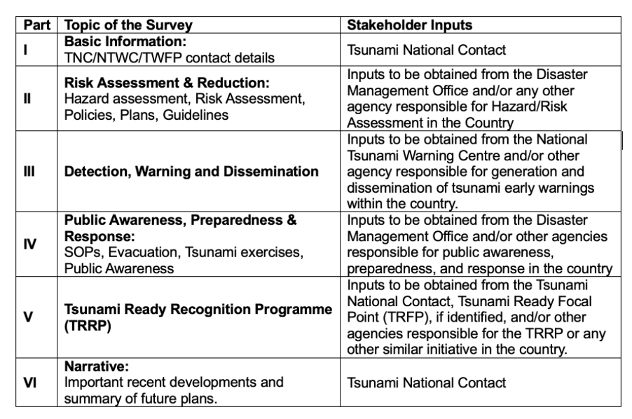
Assessment Structure - Survey
The survey has six (6) parts – 100+ questions
Each part requires inputs from the responsible stakeholders of the tsunami warning and mitigation system
Stakeholders:
Science, DMO
NTWC, TWFP
DMO, NTWC, Science, NGO
Tsunami Ready focal points
Topics

Slide 10
TPCA Implementation Timeline 2: Post-survey
Planning and Inception
Approval PTWS Steering Committee
Sep 2024
Review IO questions
20 Sep – 30 Oct 2024
Collection and Analysis
IOC Circular Letter distributes survey
4 Feb 2025
Validation and Review
Technical Report tabled at IOC General Assembly June 2025
Project end
30 Sep 2025
Finalisation and Sharing
Finalise questions
by 31 Dec 2024
Budget and timelines for ESCAP meeting
8 Oct 2024
Compilation/ analysis of survey findings
5 Mar – 1 Apr 2025
Survey completion by MSs
4 March 2025
SC approves final Technical Report 30 June 2025
Initial findings to ICG/PTWS-XXXI
7 – 11 Apr 2025
Review findings and draft recs
by 30 June 2025
Evaluation & Recs Workshop
14 – 16 May 2025
Final reports submitted to ESCAP September 2025
Policy report finalised
We are here

Slide 11
ICG/PTWS-XXXI, 7-11 April 2025, Beijing, China
Intergovernmental Coordination Group for the
Pacific Tsunami Warning and Mitigation System (PTWS)
Tsunami Preparedness
Capacity Assessment
(ESCAP Phase II)
Preliminary Findings
Céline Barré
Technical Report Consultant

