Slide 1


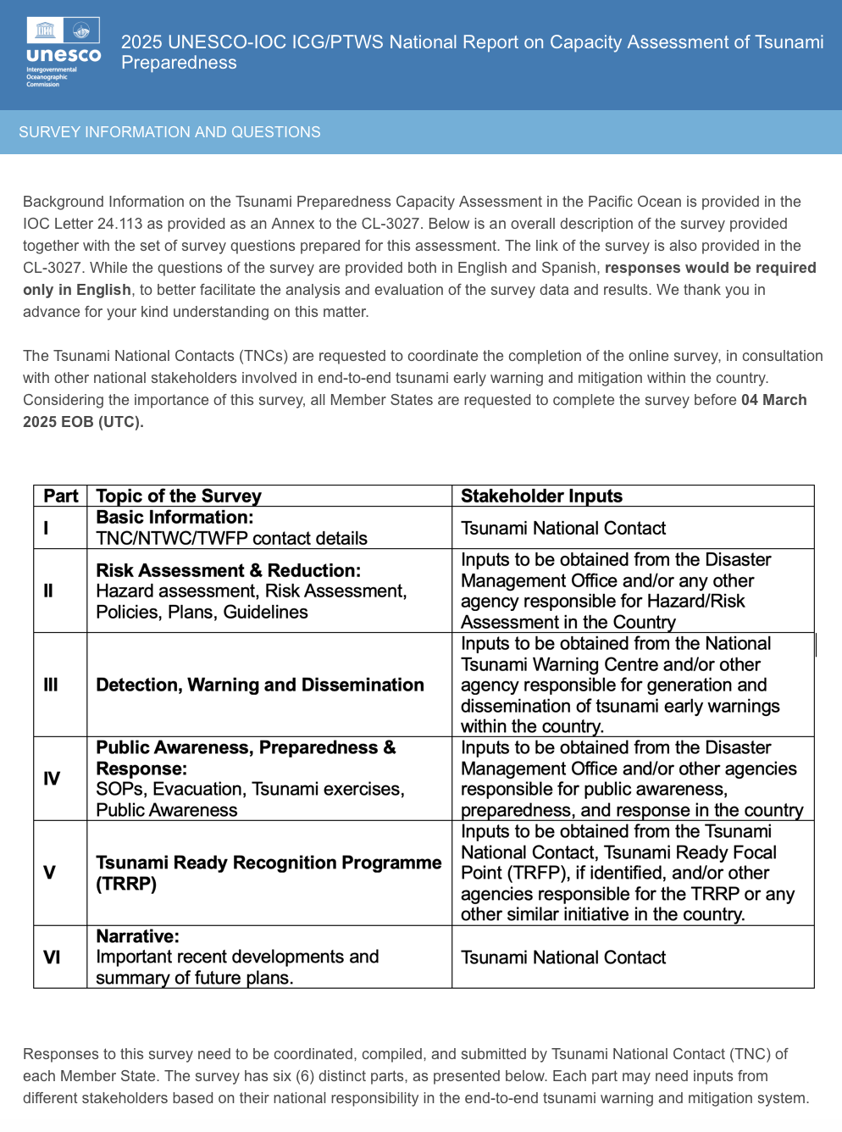
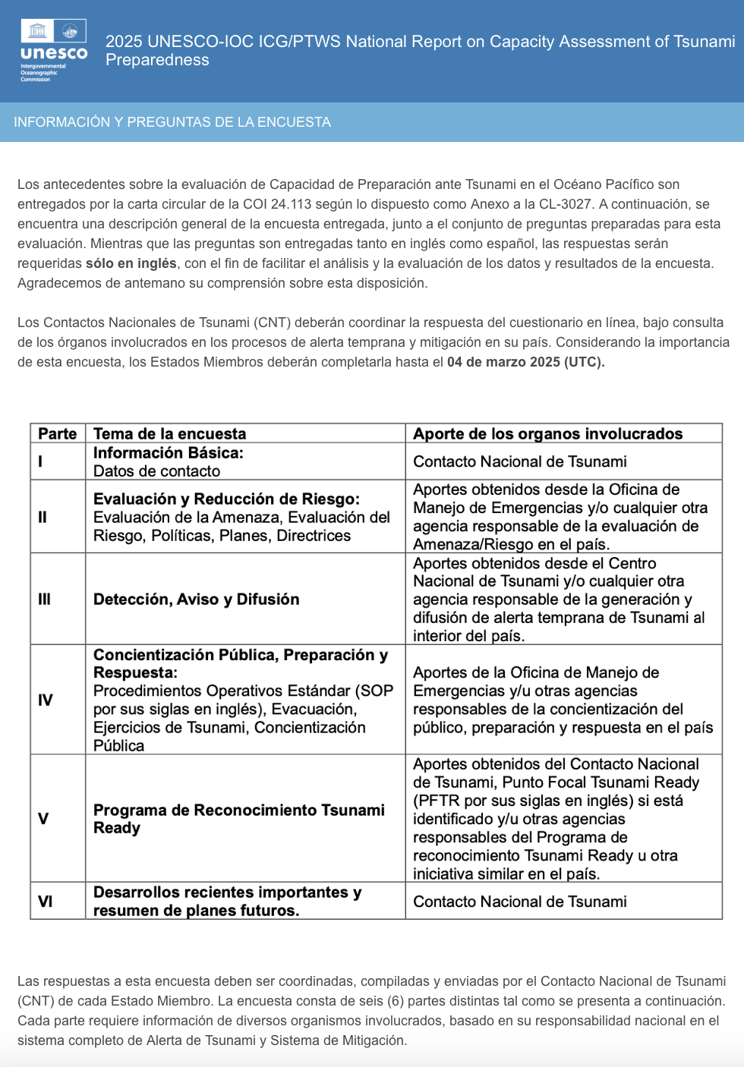

PRELIMINARY RESULTS
OF THE SURVEY

Slide 2

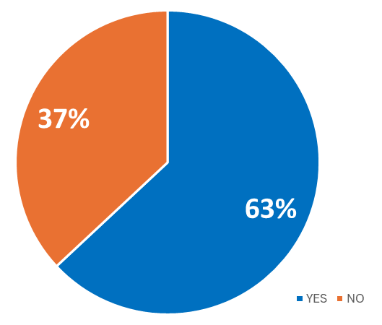

Participation rate to date
63% - 29 of the 46 member states surveyed answered
Australia, Brunei, Canada, Chile, China, Colombia, Cook Islands, Ecuador, El Salvador, Federated States of Micronesia, Fiji, Guatemala, Indonesia, Japan, Malaysia, Mexico, Nauru, New Zealand, Nicaragua, Palau, Papua New Guinea, Philippines, Republic of Korea (South), Singapore, Solomon Islands, Thailand, Tonga, Vanuatu, Vietnam
+3 countries since beginning of analysis: Costa Rica, Peru and United States
Last deadline to provide answers 18 April 2025

Slide 3
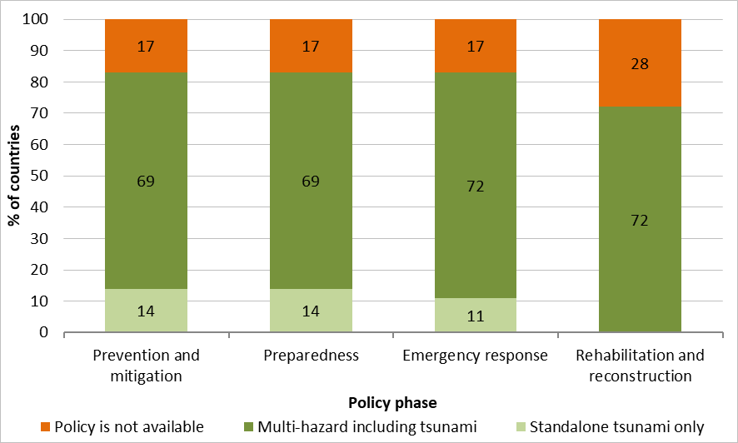
NATIONAL POLICIES
6a) Does your country have a national tsunami policies?
For each of the four disaster management phases, select standalone policy / multi hazard policy / policy not available.
Answered: 29 Skipped: 0
25 countries (86%) with some form of national policy
Mostly multi-hazard including tsunami
21 countries (84%) addressed all four phases

Slide 4
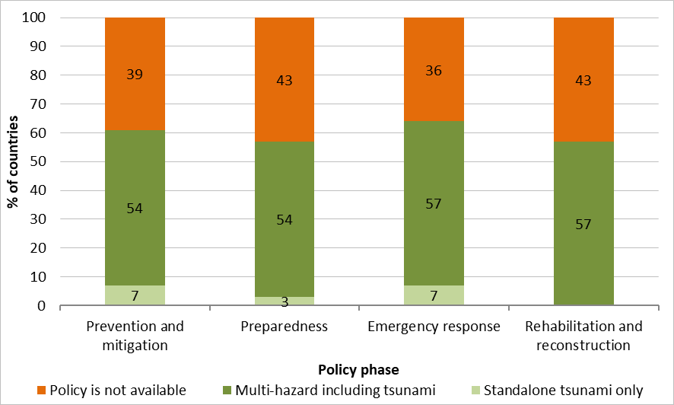
LOCAL POLICIES
6b) Does your country have local tsunami policies?
For each of the disaster management phases, select standalone policy / multi hazard policy / policy not available.
Answered: 28 Skipped: 1
18 countries (64%) with some form of local policy
Multi-hazard including tsunami except for 2 countries
16 countries (89%) addressed all four phases

Slide 5
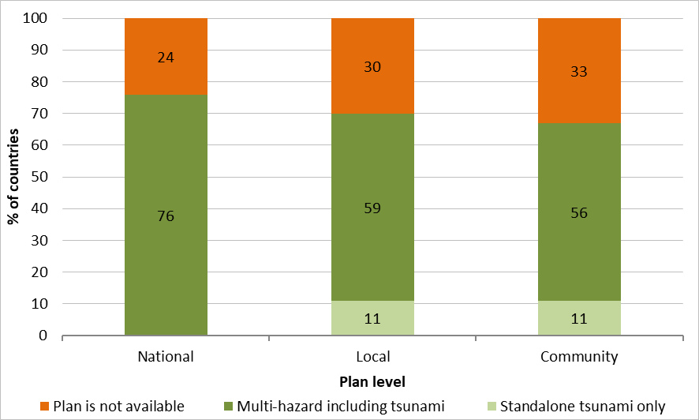
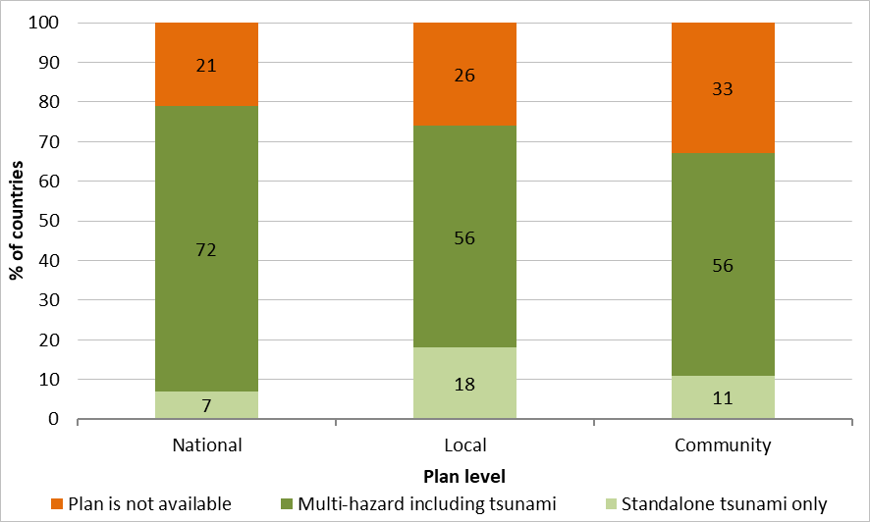

Disaster risk reduction plans (1/2)
7a) Does your country have a national, local and community level tsunami disaster risk reduction plans?
For each of the four disaster management phases, select standalone plan / multi hazard plan / plan not available.
Prevention and mitigation phase Preparedness phase
Answered: 29 Skipped: 0
Answered: 29 Skipped: 0
Results to be taken with caution, since 20 countries skipped answering at the community level
To date, 27 countries (79%) with some form of DRR plan

Slide 6
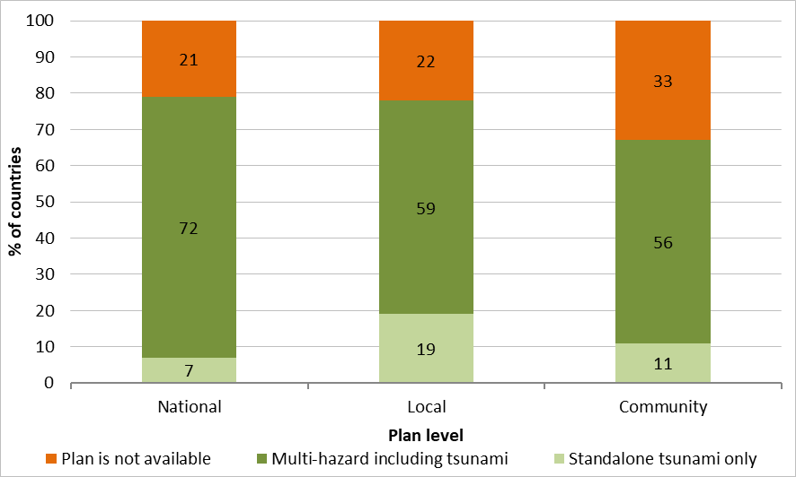
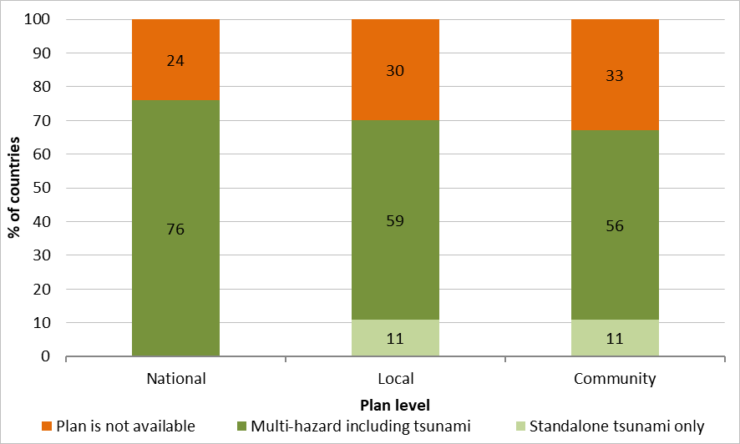
Disaster risk reduction plans (2/2)
7a) Does your country have a national, local and community level tsunami disaster risk reduction plans?
For each of the four disaster management phases, select standalone plan / multi hazard plan / plan not available.
Emergency response phase Rehabilitation and reconstruction phase
Answered: 29 Skipped: 0
Answered: 29 Skipped: 0
Mostly multi-hazard including tsunami for all phases
7b) Are your country's tsunami disaster risk reduction plans based on hazards and risk assessments?
Answered: 29 Skipped: 0
23 countries (79%) reported that DRR plans are based on hazard and risk assessments

Slide 7
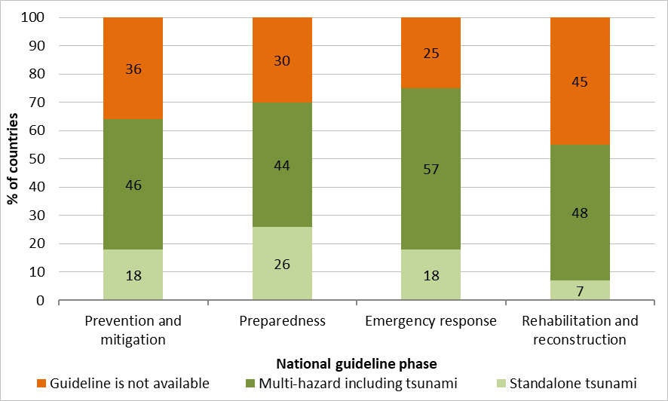
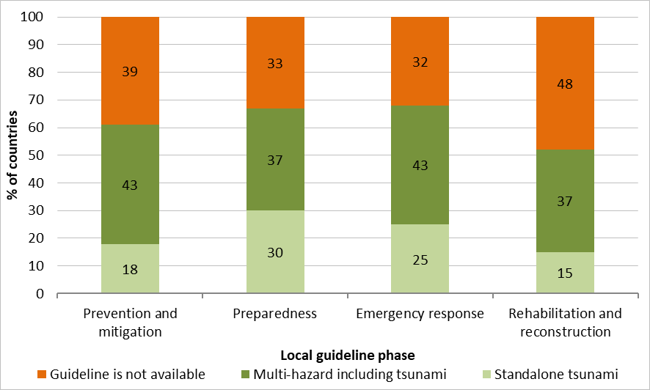
Guidelines
8a) Does your country have national tsunami DRR guidelines? & 8b) Does your country have local tsunami DRR guidelines?
National Local
Answered: 28 Skipped: 1
Answered: 28 Skipped: 1
19 countries (68%) with some form of national and local DRR guidelines
Mostly multi-hazard including tsunami

Slide 8
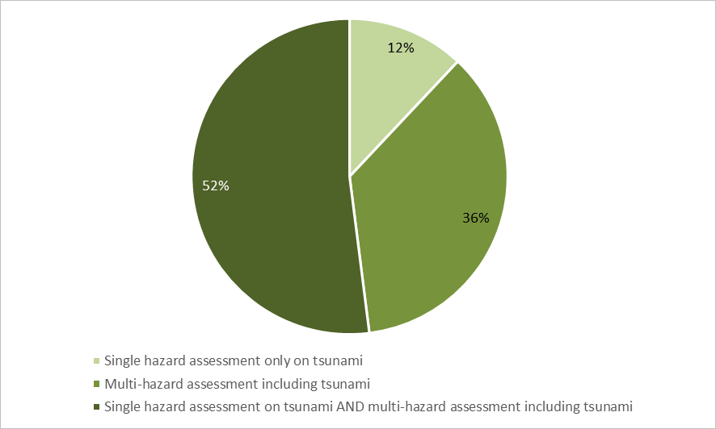
Hazard assessment (1/9)
4a) Has your country undertaken a tsunami hazard assessment?
Answered: 29 Skipped: 0
Conducted by 25 countries (86%) of 29 respondents
Type of hazard assessement
4b) What type of hazard assessment has been carried out?
Answered: 29 Skipped: 0

Slide 9
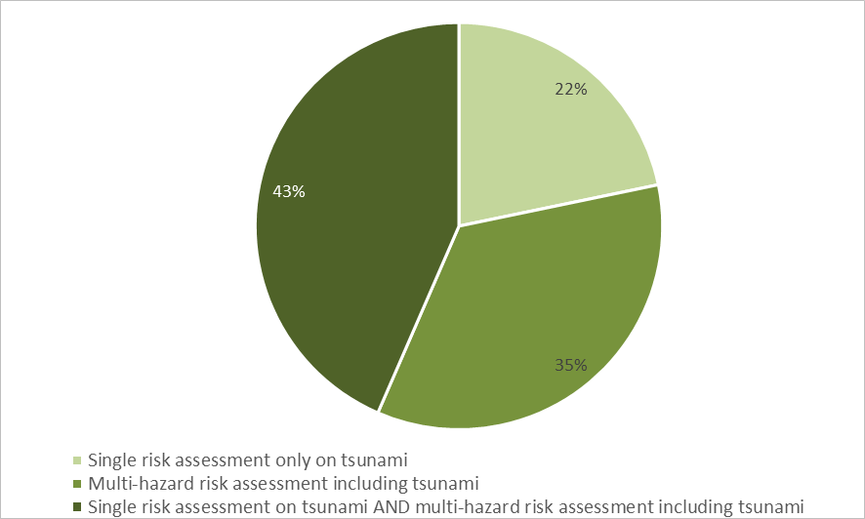
RISK assessment (1/8)
5a) Has your country undertaken a tsunami risk assessment?
Answered: 29 Skipped: 0
Conducted by 23 countries (79%) of 29 respondents
Type of risk assessement
5b) What type of tsunami risk assessment was undertaken?
Answered: 23 Skipped: 6

Slide 10
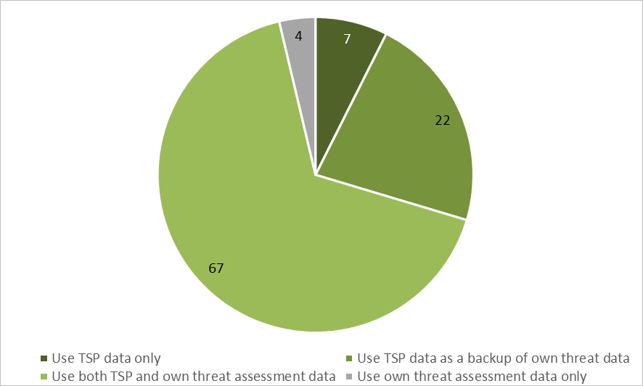
DETECTION AND WARNING (1/10)
9a) Does your country have a national capability to assess and/or receive potential tsunami threat information and advise/warn its coastal communities?
Answered: 29 Skipped: 0
Capability for 27 countries (93%) to assess and/or receive potential tsunami threat information and advise / warn its coastal communities
Data used for determining national threats
9b) Does your country utilise the data provided by the PTWS Tsunami Service Providers (TSPs) for the Threat Assessments of your country’s coastline to determine national threats or does it undertake its own threat assessments?
Answered: 27 Skipped: 2

Slide 11
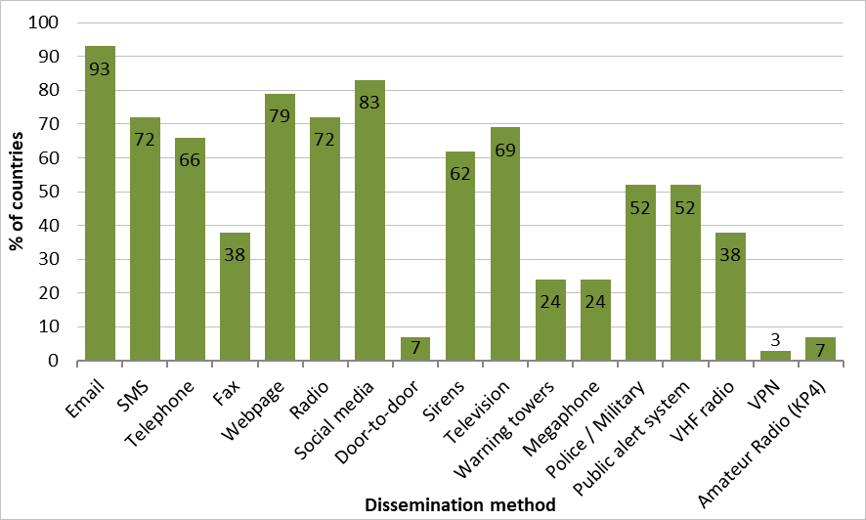
DISSEMINATION
Methods
10a) How is the tsunami information (warning, public safety action, etc) disseminated within country?
Multiple ways used by 100% of the countries, at least three
Other: community word distribution, cell broadcast, mobile applications, and traditional instruments
10e) Does your country's national tsunami warning system utilize the Common Alert Protocol (CAP) for the dissemination of warnings?
Answered: 28 Skipped: 1
32% of the countries with a national tsunami warning system using CAP
Answered: 29 Skipped: 0

Slide 12
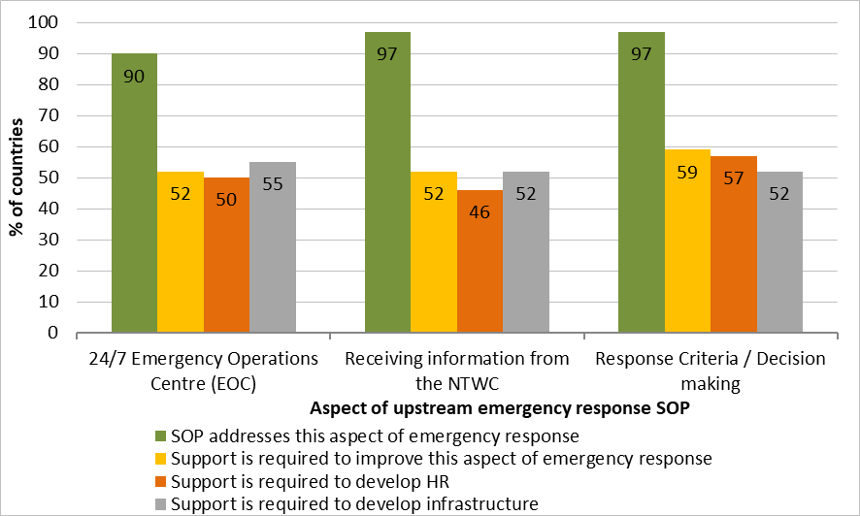
Standard operating procedures (1/4)
Emergency response during upstream stages
Does your SOP address this aspect of tsunami emergency response? Answered: 29 Skipped: 0
Is support required to develop/improve this aspect of tsunami emergency response in your SOP? Answered: 29 Skipped: 0
Is support required to develop Human Resources in this aspect of tsunami emergency response? Answered: 28 Skipped: 1
Is support required to develop infrastructure for this aspect of tsunami emergency response? Answered: 29 Skipped: 0
Each aspect addressed by ≥90% of the countries
However, support to develop these aspects still needed by 52‒59% of the countries

Slide 13
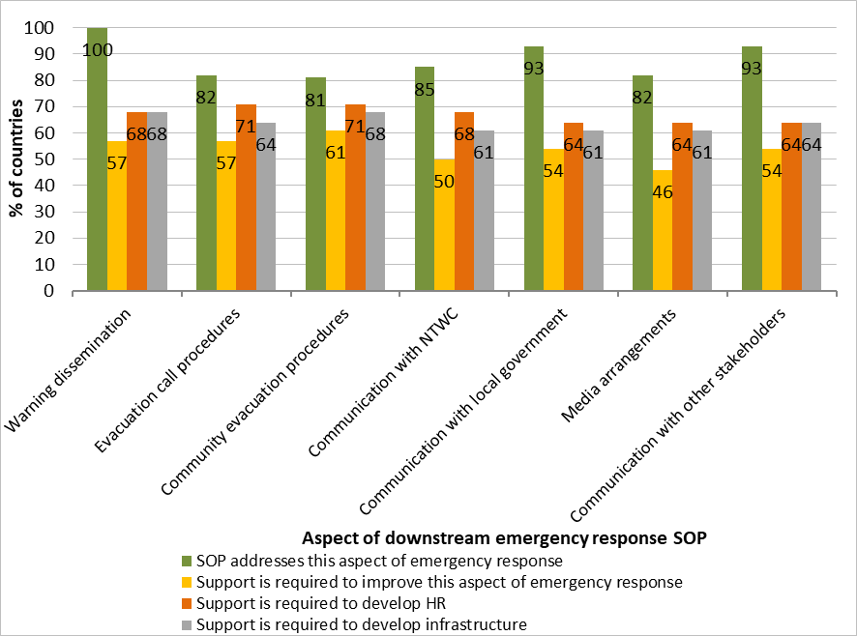
Standard operating procedures (2/4)
Emergency response during downstream stages
Does your SOP address this aspect of tsunami emergency response? Answered: 28 Skipped: 1
Is support required to develop/improve this aspect of tsunami emergency response in your SOP? Answered: 28 Skipped: 1
Is support required to develop Human Resources in this aspect of tsunami emergency response? Answered: 28 Skipped: 1
Is support required to develop infrastructure for this aspect of tsunami emergency response? Answered: 28 Skipped: 1
Each aspect addressed by ≥80% of the countries
However, support to develop these aspects still needed by 46‒61% of the countries

Slide 14
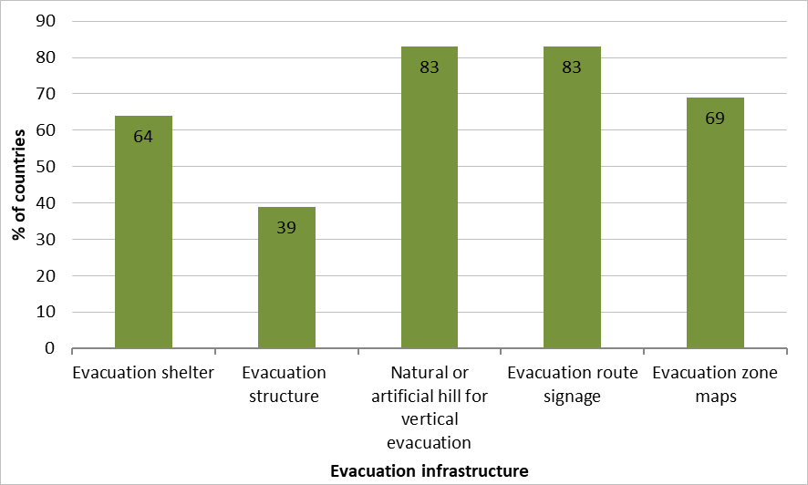
Evacuation infrastructure
Availability
12a) Does your country have the following evacuation infrastructure?
Answered: 29 Skipped: 0
Integration in evacuation plans
12b) Is your evacuation infrastructure integrated in the evacuation plan?
Answered: 28 Skipped: 1
Evacuation structures integrated in plans for 18 countries (64%)

Slide 15
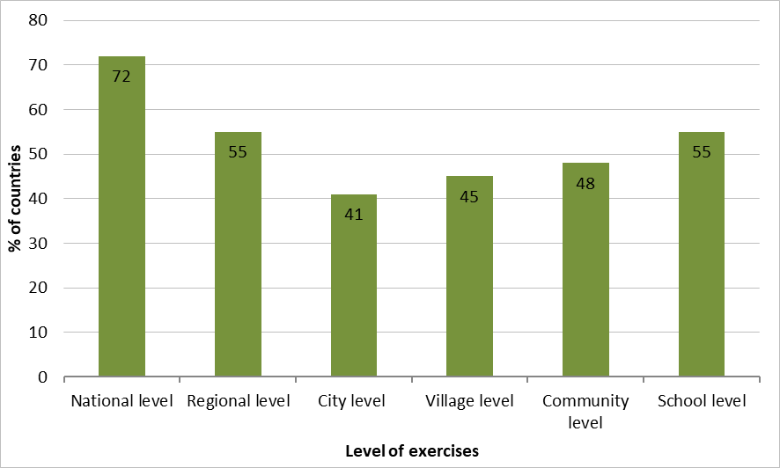
Tsunami exercises (1/2)
Integration in documentations and level
12c) Are tsunami exercises incorporated within national policies and guidelines?
Answered: 29 Skipped: 0
In national policies – 13 countries (45%)
In national guidelines – 16 countries (55%)
Not included – 8 countries (28%)
12d) At what levels were the exercises conducted during the inter-sessional (between ICG meetings) period?
Exercises conducted at multiple levels for 21 countries (72%)
Answered: 29 Skipped: 0

Slide 16
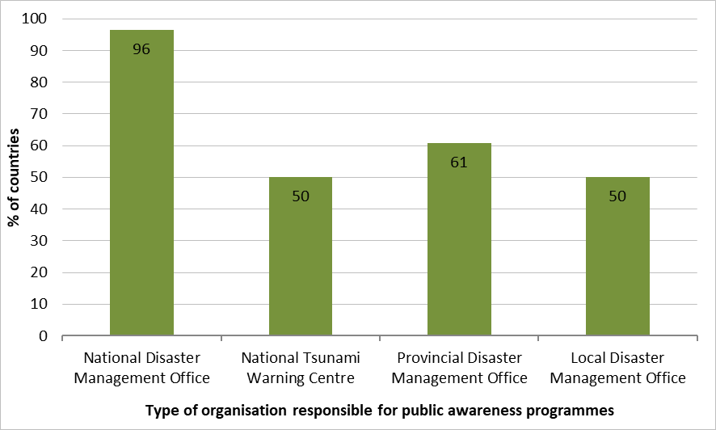
PUBLIC AWARENESS (1/4)
Organisation responsible
13b) Who is responsible for tsunami public awareness programmes in your country?
Shared responsibility between multiple organisations for 71% of the countries
Other: international organisations (e.g. IOM, UNDP), non-governmental organisations (e.g. Red Cross), community of practice and civil society
Answered: 28 Skipped: 1

Slide 17
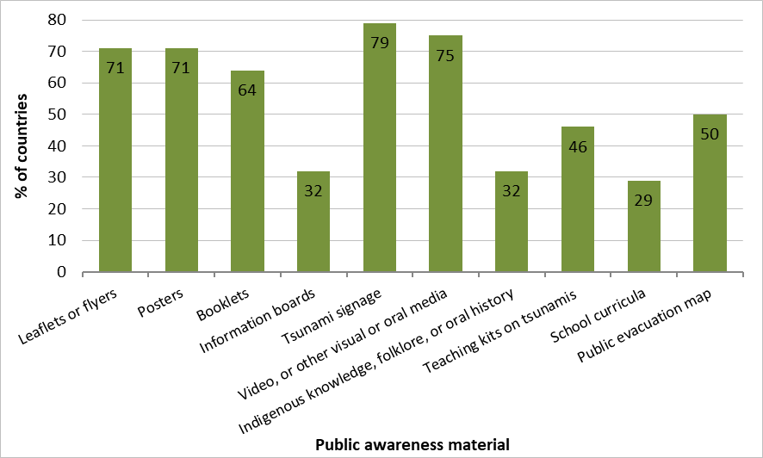
PUBLIC AWARENESS (2/4)
Types of materials
13c) What tsunami related education and awareness materials do you have?
Use of at least two communication tools by all countries (100%)
Other: webpages, social media toolkits, tsunami tank exhibits, comics, online tsunami education resource
13d) Would your country be willing to share these education and awareness materials with the International Tsunami Information Centre (ITIC) and other countries?
Answered: 29 Skipped: 0
Willingness of sharing their materials with ITIC and other countries by 27 countries (93%)
Answered: 28 Skipped: 1

Slide 18
UNESCO-IOC Trrp (1/5)
Involvement of the countries in TRPP
14a) Does your country have an interest to participate in the UNESCO-IOC TRRP?
Answered: 29 Skipped: 0
15 countries (52%) participating in TRRP
8 countries (27%) have plans to do so - Reasons for not having contributed yet:
lack of human resources
on-going negotiation with relevant authorities
process of determining how existing programmes would translate to TRRP and if they meet all aims
6 countries (21%) do not plan to implement TRPP - Reasons:
existence of other programmes that do not require external certification
lack of knowledge on the subject
evaluation according to the Tsunami Ready Equivalency Guidance discussed by the ICG/PTWS both effective and efficient

Slide 19
CONCERNS ABOUT RESULTS
Summary sheets have been sent to each country to address these issues
4h) For each of the data types listed, were these data used? Publicly available? | Question partially answered by 2 countries
4k) On a scale of 1 (Not a priority) to 5 (Essential), what is the priority level in your country to improve capacity in the following areas of tsunami hazard assessment? | Question partially answered by 1 country
7a) Does your country have a national, local and community level tsunami disaster risk reduction plans? | Question partially answered by 21 countries
9b) Does your country utilise the data provided by the PTWS Tsunami Service Providers (TSPs) for the Threat Assessments of your country’s coastline to determine national threats or does it undertake its own threat assessments? | Need some precisions about how TSP data are used as a backup
9j) Does your organisation have access to GNSS data (Global Navigation Satellite System) data? (Q68) & 9q) What other observing networks are operated by your country and used for tsunami early warning? (Q75) | Need consolidation - Q68: 16 countries have access to GNSS data / Q75: only 4 countries declare it as observing networks
9l) When compared to the IRIS database (https://ds.iris.edu/mda/) have you decommissioned or added broadband seismometers operated by your country. | Question skipped by 12 countries
9p) When compared to the IOC Sea Level Station Monitoring Facility, have you decommissioned or added sea level stations, including tsunameters, operated by your country. | Question skipped by 17 countries
10b) For each Disaster Management Office listed below, which communication methods for emergency response are available? | Question partially answered by 4 countries
Does your SOP address this aspect of tsunami emergency response? | Question partially answered by 1 country
12d) At what levels were the exercises conducted during the inter-sessional (between ICG meetings) period? | Need some precisions about what is N/A answer, 3 countries answered this, does it mean that they do not conduct any type of exercises?
13a) What kind of activities have been tested during your country tsunami exercise, and how many times during the inter-sessional (between ICG Meetings) period? | Question partially answered and some contradictions
13c) What tsunami related education and awareness materials do you have? | Question partially answered by 1 country
13e) Do you undertake the following tsunami awareness activities? | Question partially answered by 4 countries
14a) Does your country have an interest to participate in the UNESCO-IOC TRRP? (Q113) & 14f) Are any communities in your country currently working towards implementing or interested in implementing the UNESCO-IOC TRRP or similar national initiative? (Q118) | Incoherences in the answers for 2 countries, which checked NO to Q113 and YES to Q118

