Slide 1


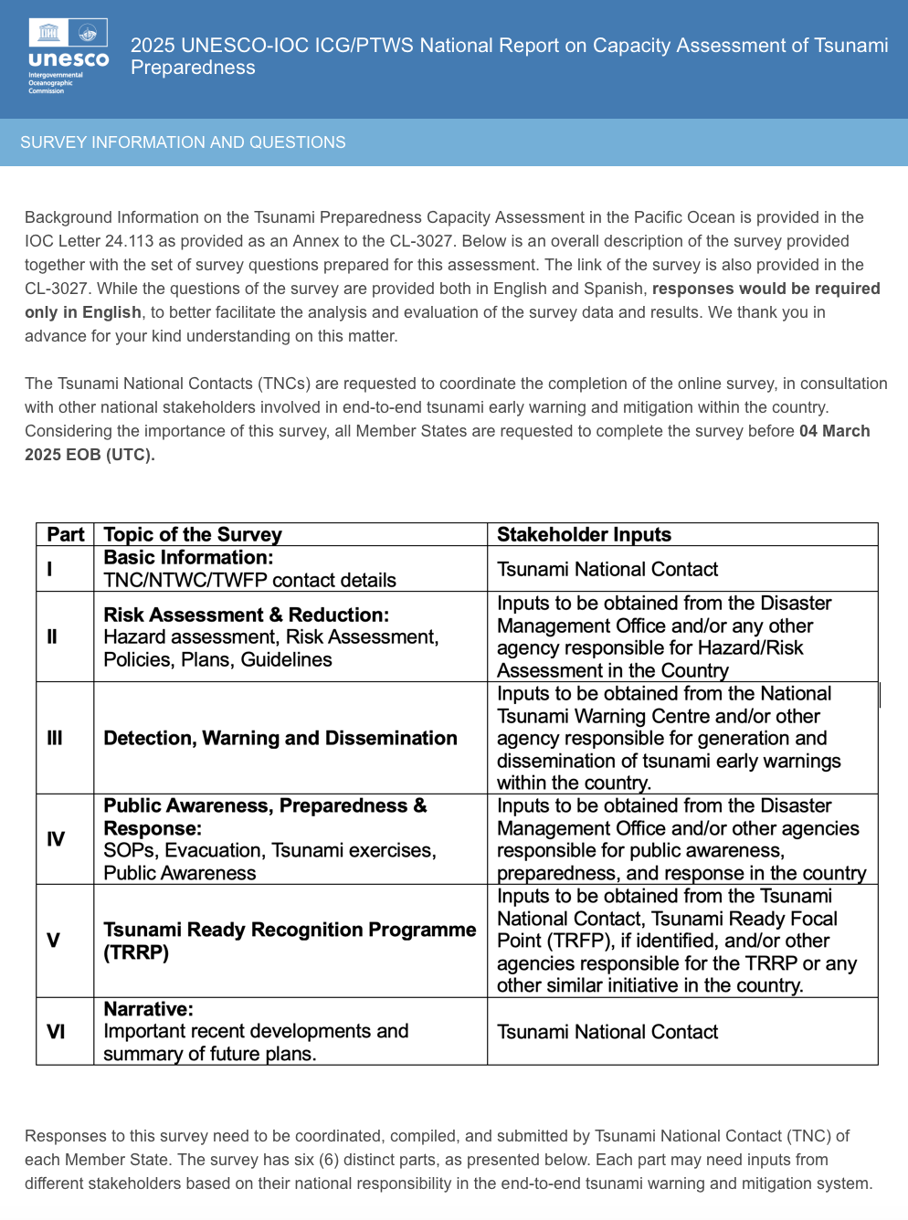
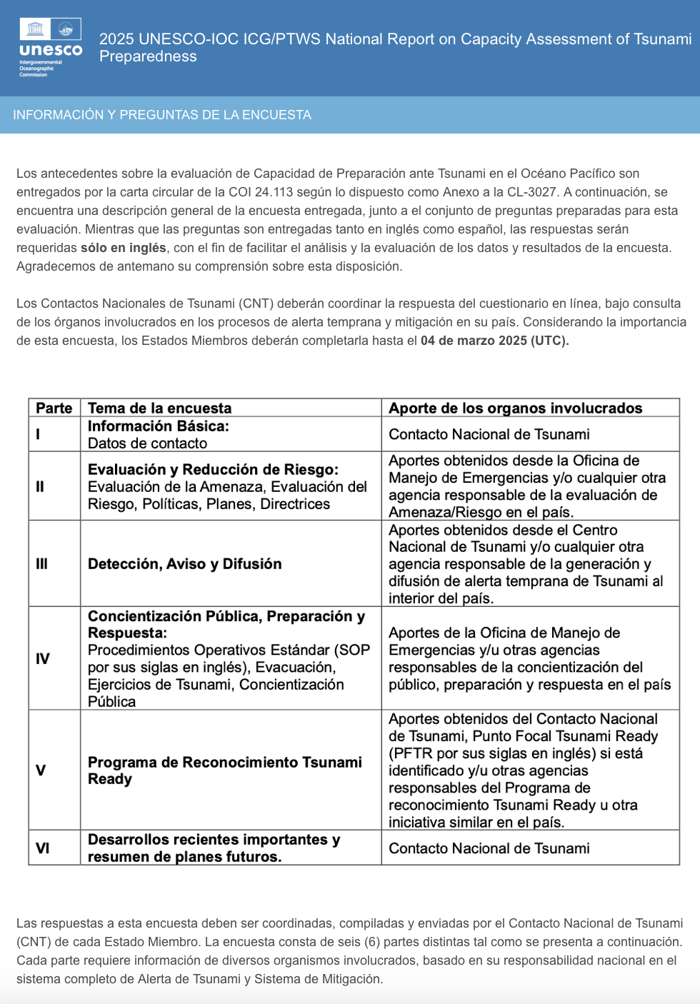

PRELIMINARY RESULTS
OF THE SURVEY

Slide 2

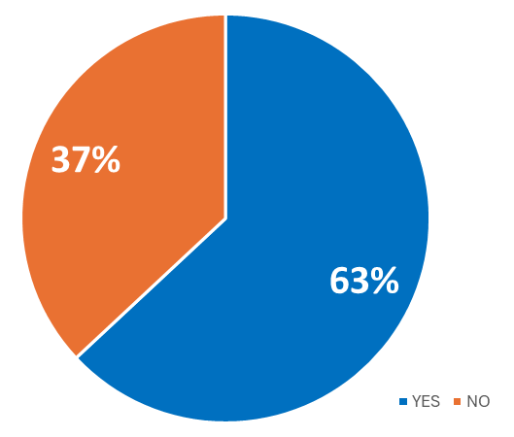

Participation rate to date
63% - 29 of the 46 member states surveyed answered
Australia, Brunei, Canada, Chile, China, Colombia, Cook Islands, Ecuador, El Salvador, Federated States of Micronesia, Fiji, Guatemala, Indonesia, Japan, Malaysia, Mexico, Nauru, New Zealand, Nicaragua, Palau, Papua New Guinea, Philippines, Republic of Korea (South), Singapore, Solomon Islands, Thailand, Tonga, Vanuatu, Vietnam
+3 countries since beginning of analysis: Costa Rica, Peru and United States
Last deadline to provide answers 18 April 2025

Slide 3
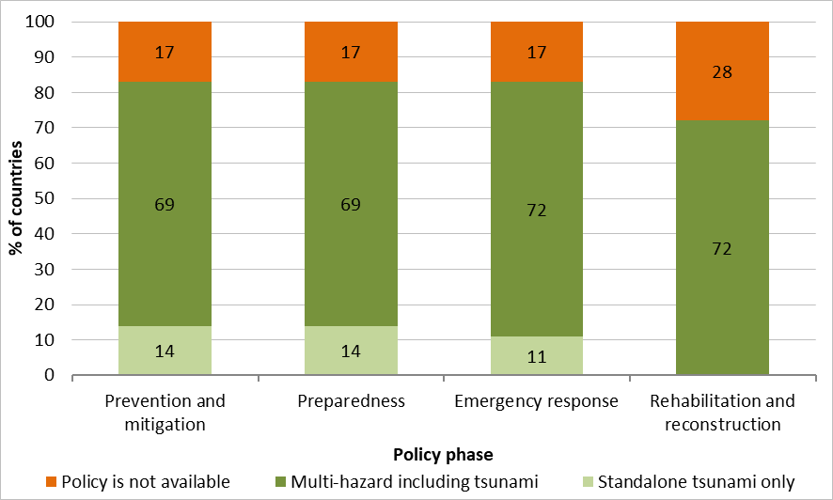
NATIONAL POLICIES
6a) Does your country have a national tsunami policies?
For each of the four disaster management phases, select standalone policy / multi hazard policy / policy not available.
Answered: 29 Skipped: 0
25 countries (86%) with some form of national policy
Mostly multi-hazard including tsunami
21 countries (84%) addressed all four phases

Slide 4
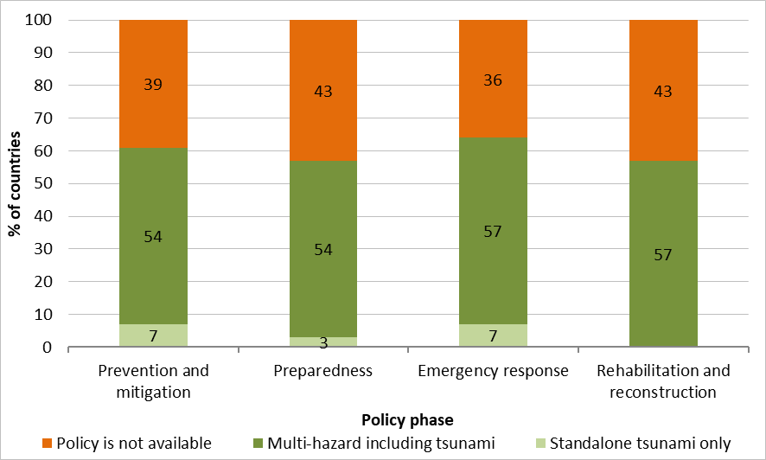
LOCAL POLICIES
6b) Does your country have local tsunami policies?
For each of the disaster management phases, select standalone policy / multi hazard policy / policy not available.
Answered: 28 Skipped: 1
18 countries (64%) with some form of local policy
Multi-hazard including tsunami except for 2 countries
16 countries (89%) addressed all four phases

Slide 5
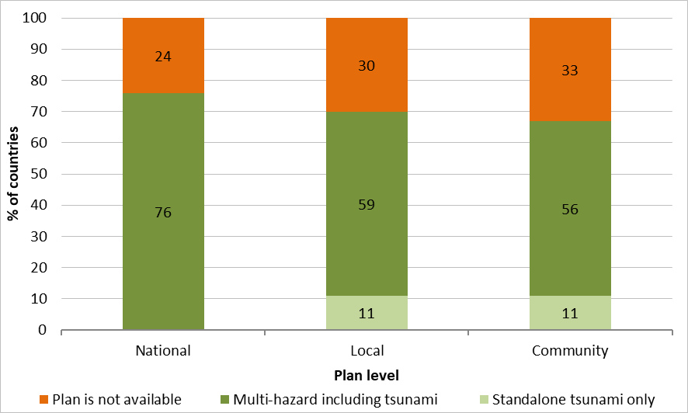
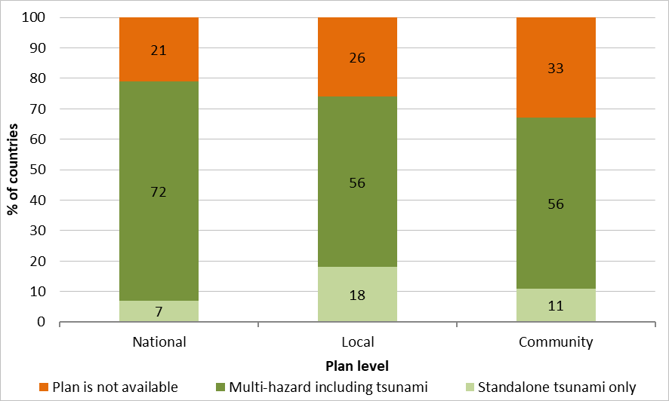

Disaster risk reduction plans (1/2)
7a) Does your country have a national, local and community level tsunami disaster risk reduction plans?
For each of the four disaster management phases, select standalone plan / multi hazard plan / plan not available.
Prevention and mitigation phase Preparedness phase
Answered: 29 Skipped: 0
Answered: 29 Skipped: 0
Results to be taken with caution, since 20 countries skipped answering at the community level
To date, 27 countries (79%) with some form of DRR plan

Slide 6
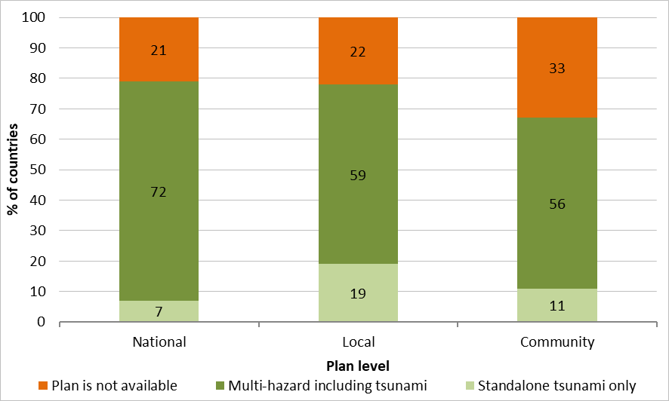
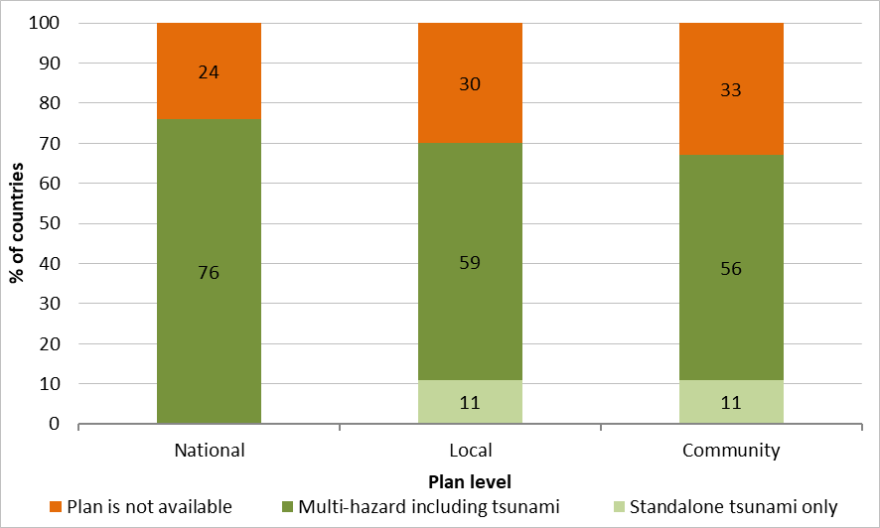
Disaster risk reduction plans (2/2)
7a) Does your country have a national, local and community level tsunami disaster risk reduction plans?
For each of the four disaster management phases, select standalone plan / multi hazard plan / plan not available.
Emergency response phase Rehabilitation and reconstruction phase
Answered: 29 Skipped: 0
Answered: 29 Skipped: 0
Mostly multi-hazard including tsunami for all phases
7b) Are your country's tsunami disaster risk reduction plans based on hazards and risk assessments?
Answered: 29 Skipped: 0
23 countries (79%) reported that DRR plans are based on hazard and risk assessments

Slide 7
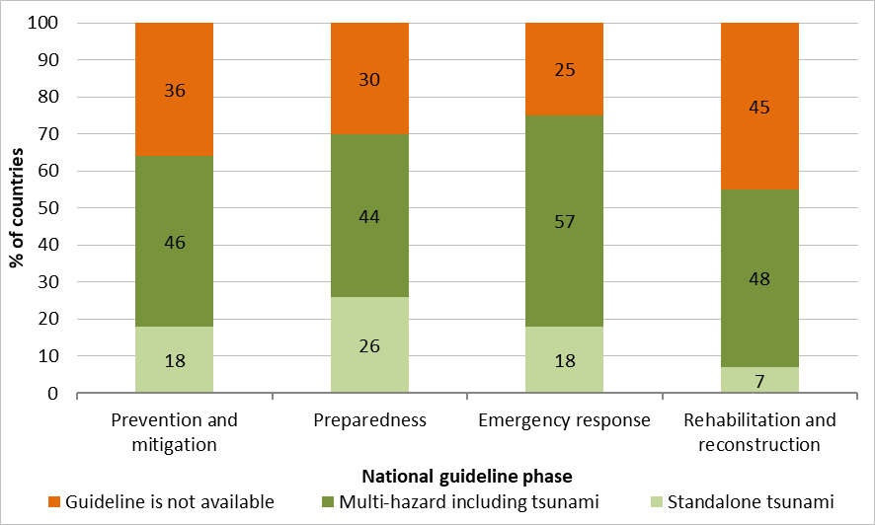
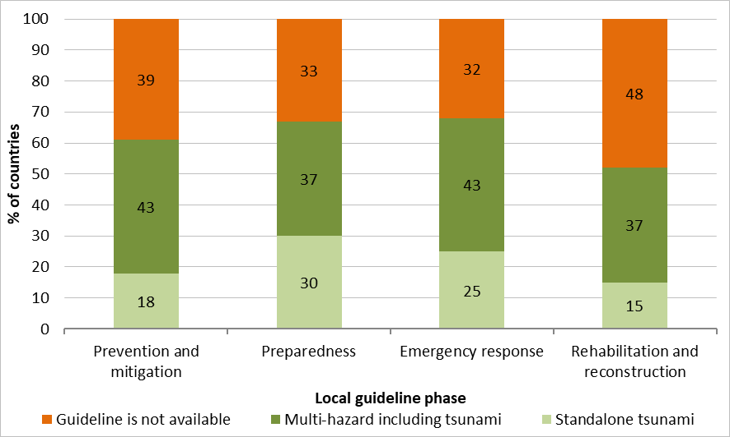
Guidelines
8a) Does your country have national tsunami DRR guidelines? & 8b) Does your country have local tsunami DRR guidelines?
National Local
Answered: 28 Skipped: 1
Answered: 28 Skipped: 1
19 countries (68%) with some form of national and local DRR guidelines
Mostly multi-hazard including tsunami

Slide 8
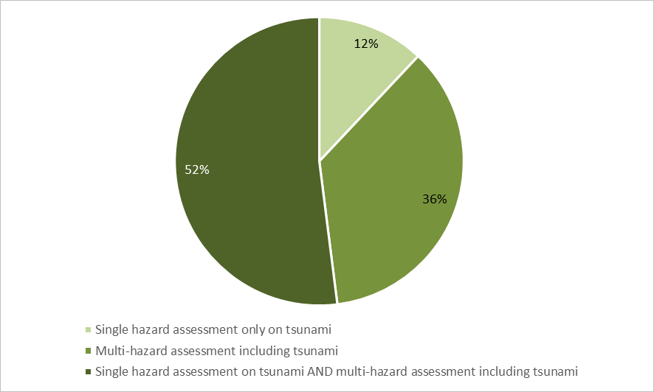
Hazard assessment (1/9)
4a) Has your country undertaken a tsunami hazard assessment?
Answered: 29 Skipped: 0
Conducted by 25 countries (86%) of 29 respondents
Type of hazard assessement
4b) What type of hazard assessment has been carried out?
Answered: 29 Skipped: 0

Slide 9
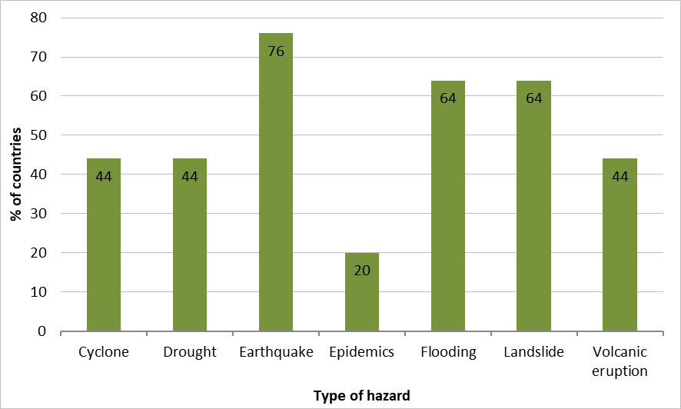
Hazard assessment (2/9)
Type of hazards
4c) If multi-hazard, what additional hazard assessments has been carried out?
Answered: 25 Skipped: 4
Other : torrential floods, coastal erosion, forest fires, sea surge, pandemic Covid, storm surge, ocean wave, sea ice and liquefaction
7 hazards considered by 2 countries, mostly 3 hazards by 7 countries – no pattern of hazard combination

Slide 10
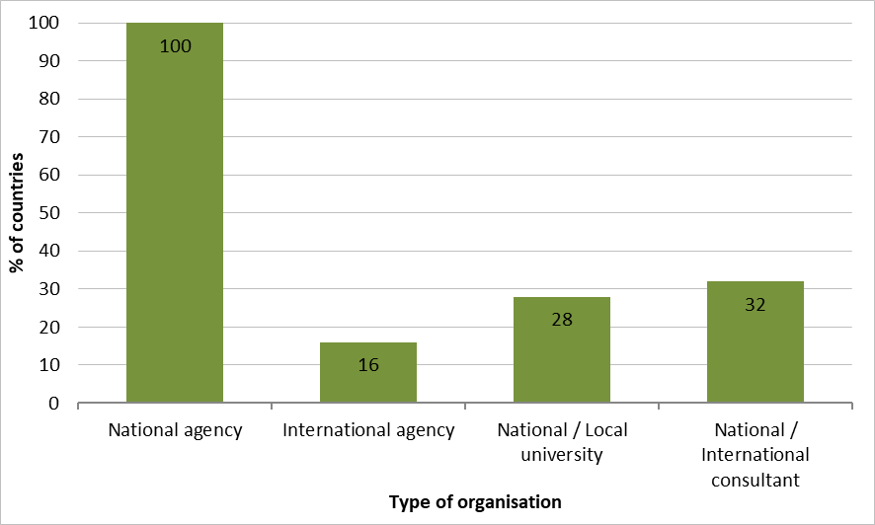
Hazard assessment (3/9)
Organisation in charge
4d) Who did the tsunami hazard assessment in your country?
Answered: 25 Skipped: 4
14 countries (56%) involved multiple organisations
Other: local governments, private consultants, regional scientific organisations (e.g. SPC, SPREP) and non-governmental organisations (e.g. Red Cross)

Slide 11
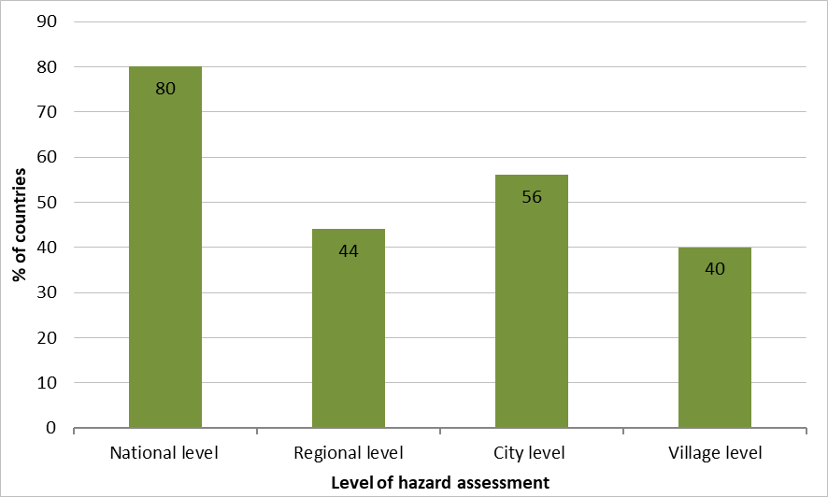
Hazard assessment (4/9)
Level
4e) At what level was the tsunami hazard assessment carried out?
Answered: 25 Skipped: 4
16 countries (64%) carried out hazard assessment at multiple levels
Other: state or province

Slide 12
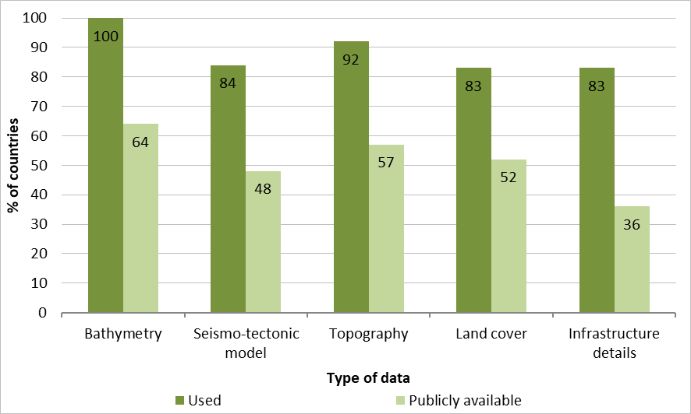
Hazard assessment (5/9)
4f) For which type of sources was the tsunami hazard assessment carried out?
Answered: 25 Skipped: 4
Mostly based on earthquake source (96%) and slightly volcanic and landslide sources (28%)
Type of data and availability
4h) For each of the data types listed, were these data used? Publicly available?
Two or more data types used by 100% of the countries
All data available to the public in over 36%
Other: field studies, reports and surveys on tsunami impacts, sea level and tidal regime calculations, household vulnerability data, volcano and landslide source models, and imagery (aerial, satellite, LiDAR)
Answered: 25 Skipped: 4

Slide 13
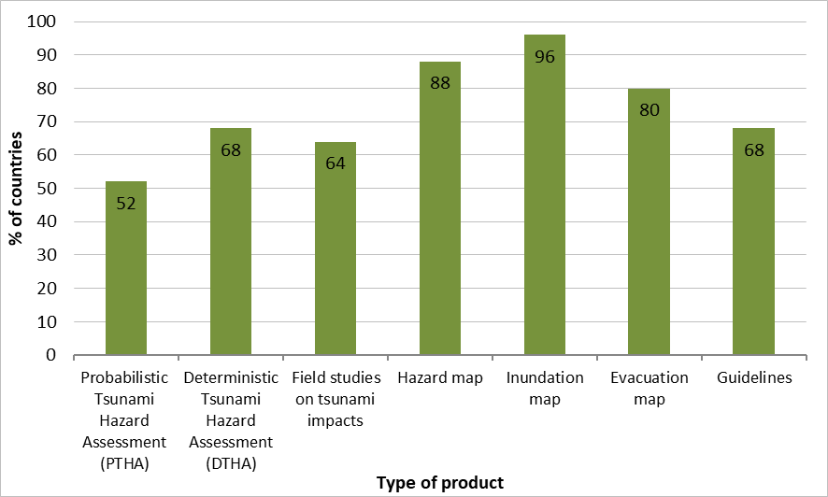
Hazard assessment (6/9)
Derivative products
4i) What products do you have from the tsunami hazard assessment?
Answered: 25 Skipped: 4
20 countries have ≥5 products and 5 countries have ≤3 products
Other: Tsunami Travel Times (TTT) and Standard Operating Procedures (SOPs)

Slide 14
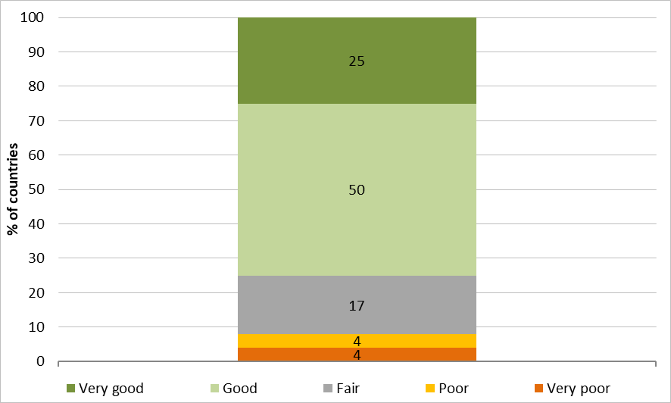
Hazard assessment (7/9)
Countries capability
4j) On a scale of 1 (Very poor) to 5 (Very good), please rate your country's capability to undertake tsunami hazard assessment.
Answered: 28 Skipped: 1
75% of the countries consider having good or very good capability to undertake tsunami hazard assessment

Slide 15
Hazard assessment (8/9)
Capacity improvement
4k) On a scale of 1 (Not a priority) to 5 (Essential), what is the priority level in your country to improve capacity in the following areas of tsunami hazard assessment?
Answered: 28 Skipped: 1
Areas of tsunami hazard assessment | RII | Rank
Inundation map | 0,83 | 1
Hazard map | 0,81 | 2
Evacuation map | 0,81 | 2
Deterministic Tsunami Hazard Analysis (DTHA) | 0,80 | 4
Field studies on tsunami impacts | 0,75 | 5
Probabilistic Tsunami Hazard Assessment (PTHA) | 0,70 | 6
All areas require improvement with highest priority on inundation map
Other:
  Development and establishment of minimum tsunami competency standards / requirements for staff of the NTWC and capacity development for tsunami watch keepers in terms of building seismic skills
  Identification of tsunamigenic sources such as submarine landslides and volcanic eruptions
  Consideration of smaller settlements and islands
  Increase of human resources for tsunami software analysis, development and dissemination
  Development of communication between all parties (from modelers to emergency management)
  to ensure that the scientific results are translated into emergency management response

Slide 16
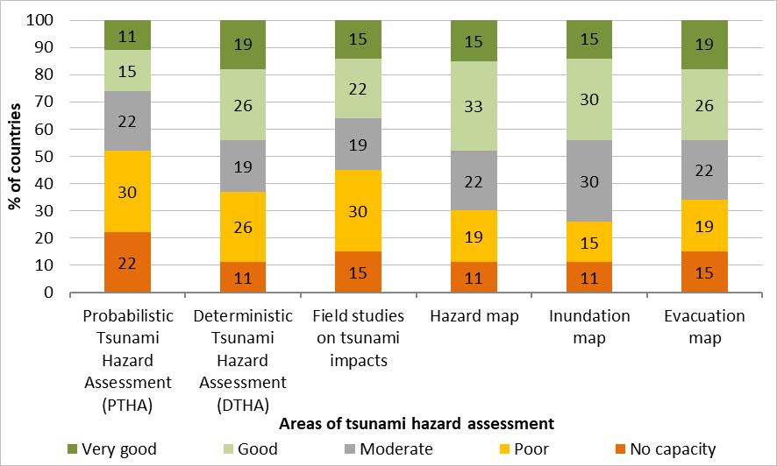
Hazard assessment (9/9)
Countries capacity to give training and/or consultancy
4l) On a scale of 1 (No capacity) to 5 (Very good), what capacity does your country have to give training and/or consultancy on tsunami hazard assessment to other countries?
Answered: 27 Skipped: 2
Capacity available in all six areas, more specifically in mapping
No capacity for none of the areas for 2 countries

Slide 17
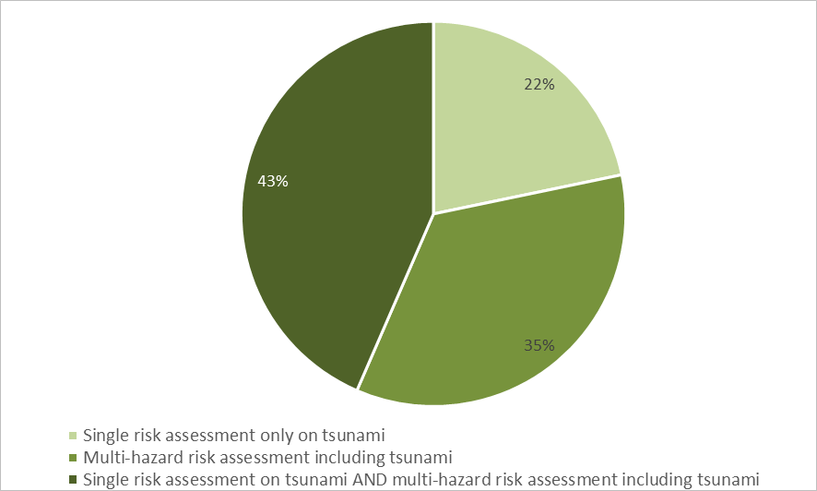
RISK assessment (1/8)
5a) Has your country undertaken a tsunami risk assessment?
Answered: 29 Skipped: 0
Conducted by 23 countries (79%) of 29 respondents
Type of risk assessement
5b) What type of tsunami risk assessment was undertaken?
Answered: 23 Skipped: 6

Slide 18
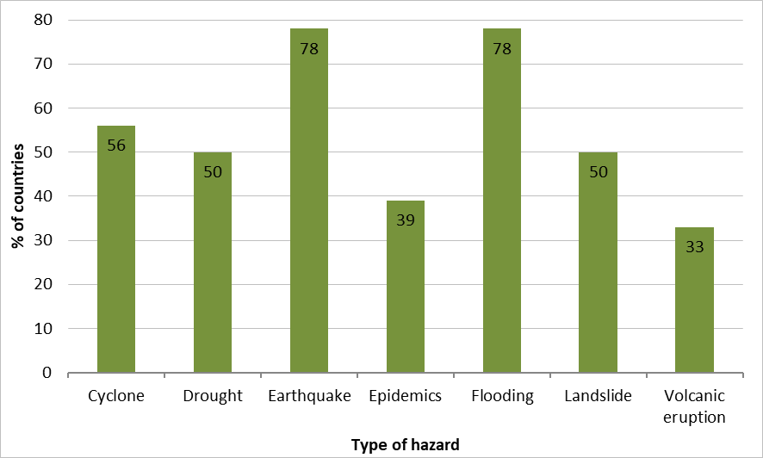
RISK assessment (2/8)
Type of hazards
5c) If multi-hazard, what additional hazards have been considered in your multi-hazard risk assessment?
Answered: 18 Skipped: 11
Other : forest fires, sea surge, king tide, extreme weather, extreme wave / abrasion, flash flood, and pandemic Covid

Slide 19
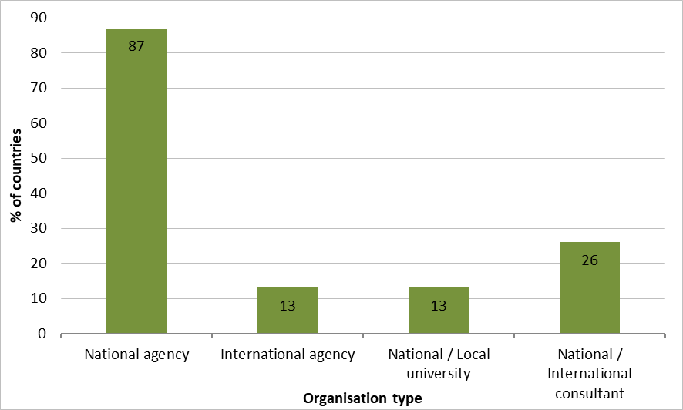
RISK assessment (3/8)
Organisation in charge
5d) Who did the tsunami risk assessment in your country?
Answered: 23 Skipped: 6
Multiple actors for 11 countries (48%)
Other: regional agencies, state and local governments, local communities, private sector consultants, and non-governmental organisations (e.g. Red Cross)

Slide 20
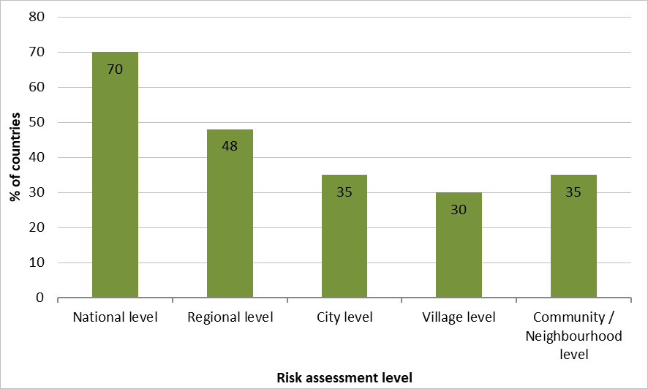
RISK assessment (4/8)
Level
5e) At what level was the tsunami risk assessment carried out?
Answered: 23 Skipped: 6
Carried out at multiple levels for 56% of countries

Slide 21
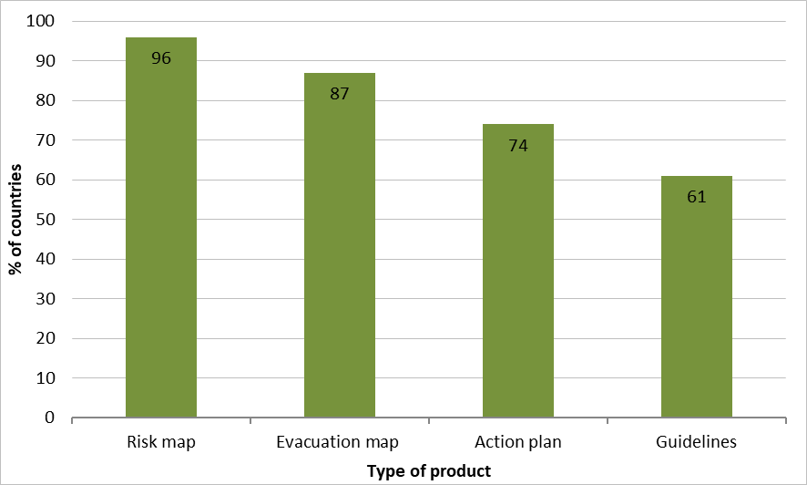
RISK assessment (5/8)
TYPE OF PRODUCTS
5h) What products do you have from the tsunami risk assessment?
Answered: 23 Skipped: 6
Development of ≥2 products for 21 countries (91%) - single product for 2 countries being risk map
Other: Standard Operating Procedures (SOPs) and decrees
5i) Has pedestrian evacuation modelling been included in the tsunami risk assessment?
Answered: 22 Skipped: 7
Pedestrian evacuation modelling included for 14 countries (64%)

Slide 22
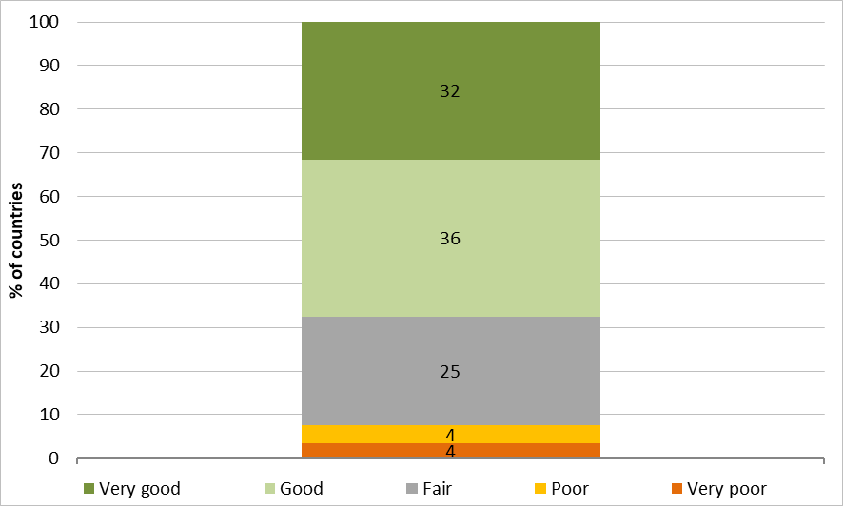
RISK assessment (6/8)
Countries capability
5j) On a scale of 1 (Very poor) to 5 (Very good), please rate your country's capability to undertake tsunami risk assessment.
Answered: 28 Skipped: 1
68% of the countries consider having good or very good capability to undertake tsunami risk assessment

Slide 23
RISK assessment (7/8)
Capacity improvement
5k) On a scale of 1 (Not a priority) to 5 (Essential), what is the priority level of your country to improve capacity in the following areas of tsunami risk assessment?
Answered: 28 Skipped: 1
Priority level | RII | Rank
National level | 0,81 | 1
Regional level | 0,81 | 1
City level | 0,79 | 3
Village level | 0,71 | 4
Community / neighbourhood level | 0,70 | 5
Other:
  Tsunami ready components
  Tsunami competency standards
  Scholarship opportunities
  Continuous advocacy on tsunami awareness and drills
  Required data for proper tsunami risk assessment

Slide 24
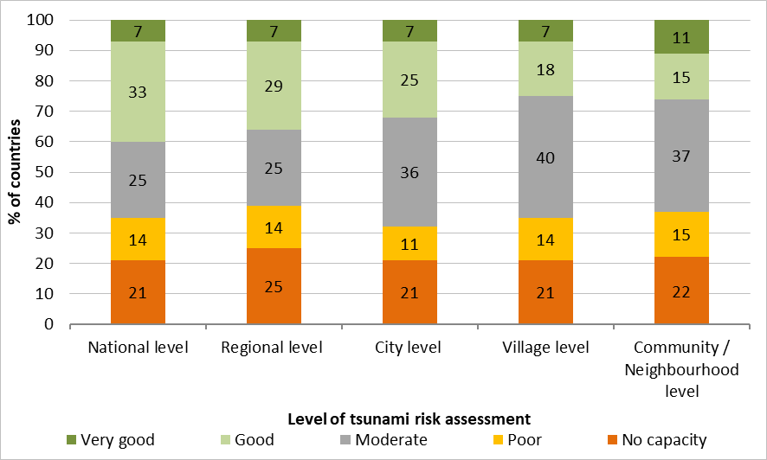
RISK assessment (8/8)
Countries capacity to give training and/or consultancy
5l) On a scale of 1 (No capacity) to 5 (Very good) what capacity does your country have to give training and/or consultancy on tsunami risk assessment to other countries?
Answered: 28 Skipped: 1
Good or very good capacity at each level for 7 countries (25%)
No capacity in any of the levels for 4 countries (14%)

Slide 25
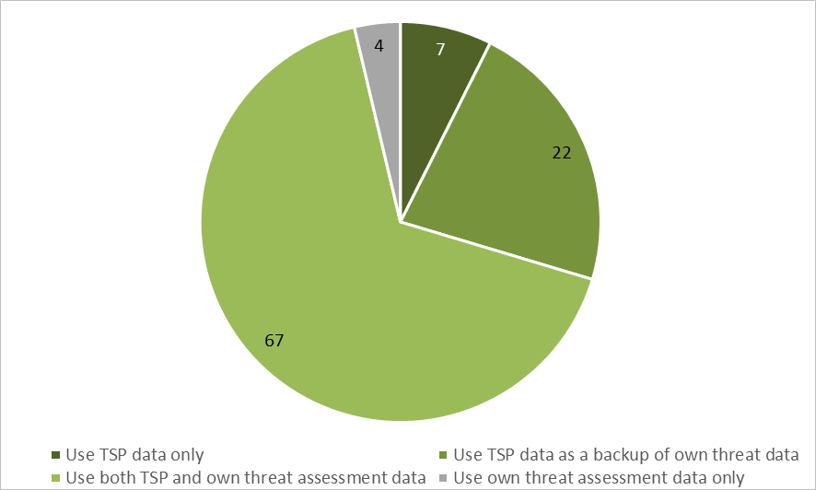
DETECTION AND WARNING (1/10)
9a) Does your country have a national capability to assess and/or receive potential tsunami threat information and advise/warn its coastal communities?
Answered: 29 Skipped: 0
Capability for 27 countries (93%) to assess and/or receive potential tsunami threat information and advise / warn its coastal communities
Data used for determining national threats
9b) Does your country utilise the data provided by the PTWS Tsunami Service Providers (TSPs) for the Threat Assessments of your country’s coastline to determine national threats or does it undertake its own threat assessments?
Answered: 27 Skipped: 2

Slide 26
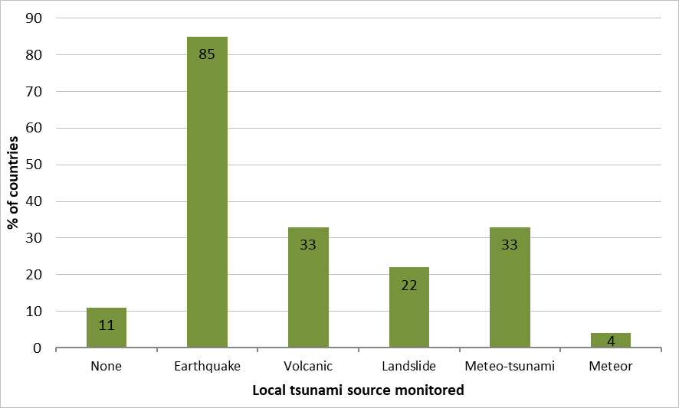
DETECTION AND WARNING (2/10)
9e) Does the organisation responsible for assessing and/or receiving potential tsunami threat information operate 24x7?
Answered: 27 Skipped: 2
Responsible organisation operates 24x7 for 26 countries (96%)
Monitoring by NTWCs
9c) What known local tsunami sources is your country's NTWC able to monitor?
Answered: 27 Skipped: 2
No monitoring for none of the listed sources for 3 countries (11%)
More than one source monitored 12 countries (44%)

Slide 27
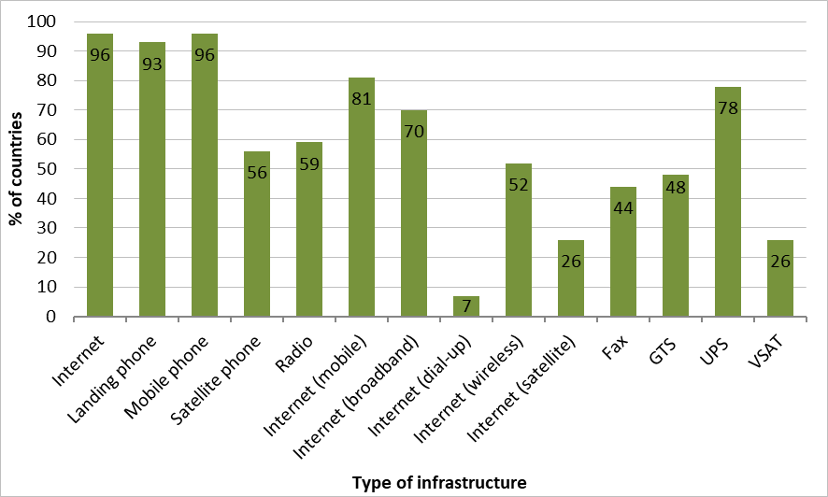
DETECTION AND WARNING (3/10)
Type of infrastructure available
9f) What / which infrastructure is available to enable 24x7 operations?
Answered: 27 Skipped: 2
Use of at least 3 different types of infrastructures by all countries
Other: national tsunami siren system, warning receiver system, radio alerting system, California Integrated Seismic Network (CISN), GEONETCast, mobile applications, social networks and TV station dedicated

Slide 28
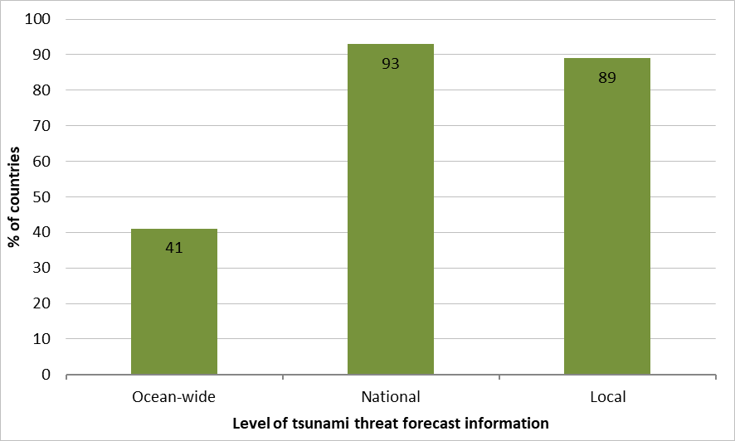
DETECTION AND WARNING (4/10)
Level of tsunami threat forecast information
9g) Which level of tsunami threat forecast information is produced by the responsible organisation?
Answered: 27 Skipped: 2
Multiple levels information produced by 85% of the countries

Slide 29
DETECTION AND WARNING (5/10)
Access to seismic network
Access to both national & international networks by 23 countries (85%) Access to either network by 3 countries (11%) No access at all by 1 country (4%) | 9h) Does the organisation have access to national and/or international seismic networks? | Answered: 27 Skipped: 2
National seismic data all shared in real time by 16 countries (67%) or partially shared by 7 countries (29%) Main shared data: earthquake magnitude, location and depth | 9i) Is national seismic data shared in real time? | Answered: 24 Skipped: 5
Broadband seismometers listed accurately in the IRIS GSN by 55% of respondent countries | 9k) Is the list of broadband seismometers operated by your country listed accurately in IRIS database? | Answered: 22 Skipped: 7
Stations added by 6 respondent countries (40%) Stations decommissioned by 2 respondent countries (13%) No changes reported by 8 countries (37%) Results biased since only 15 countries answered to this question | 9l) When compared to the IRIS database have you decommissioned or added broadband seismometers operated by your country? | Answered: 15 Skipped: 14

Slide 30
DETECTION AND WARNING (6/10)
Access to sea level network
Access to both national & international networks by 25 countries (92%), to international network by 1 country / No access by 1 country Sources of information: national data through national communication infrastructures / international data through WMO GTS, IOC Sea level Facility, PTWC | 9m) Does the organisation have access to national and/or international sea level networks? | Answered: 27 Skipped: 2
National sea level data all shared in real time by 16 countries (67%) or partially shared by 7 countries (29%) Main shared data: sea surface temperature, sea level height, pressure, ETA 100% of sensors share data in real time for 6 countries, 57% for 1 country | 9n) Is national sea level data shared in real time? | Answered: 24 Skipped: 5
Sea level stations accurately listed in the IOC database for 18 countries (78%) | 9o) Is the list of sea level stations operated by your country listed accurately in the IOC Sea Level Station Monitoring Facility | Answered:23 Skipped: 6
Stations added by 3 respondent countries (30%) Stations decommissioned by 2 respondent countries (20%) No changes reported by 5 countries (50%) Results biased since only 10 countries answered to this question | 9p) When compared to the IOC Sea Level Station Monitoring Facility, have you decommissioned or added sea level stations operated by your country | Answered:10 Skipped: 19

Slide 31
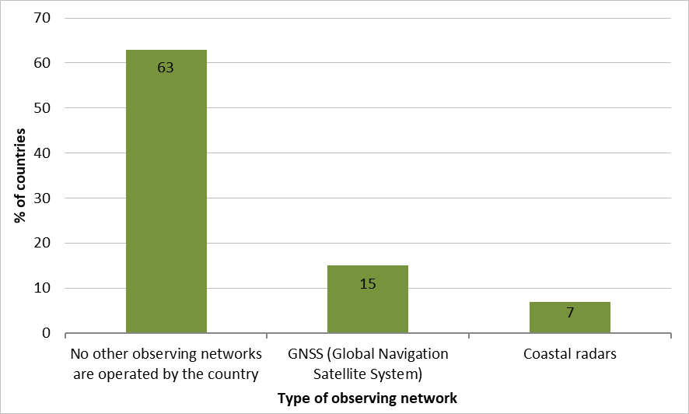
DETECTION AND WARNING (7/10)
Access to gnss network
9j) Does your organisation have access to GNSS data?
Answered: 26 Skipped: 3
Access to GNSS network by 62% of respondent countries (16 countries)
Access to other national networks
9q) What other observing networks are operated by your country and used for tsunami early warning?
Other: offshore water pressure gauges, fiber optic array, one-point vertical sea level observation with radar sensor, DART network, tsunami buoys and a monitoring network for volcanic activity
Probable bias concerning GNSS network answers (16 versus 4 countries)
Answered: 27 Skipped: 2

Slide 32
DETECTION AND WARNING (8/10)
Countries capacities
85% YES (23 respondent countries) Software tools used: Seismic data: Atlas, SeisComP (3 & 5), TOAST, SWIFT, EQP, SEISAN, Antelope (TM), SIGMA Sea level data: Tsunami database, Hydra, TTT, Moment tensor and tsunami analysis software, TsuCAT, Tsunami synthesizer model, SIPAT, TeWS Visualization, IOC Sea Level Facility, IOC Tide Tool, SIFT inversion of DART data, MOST | 9r) Does the organisation have the capability of analysing real-time seismic and sea-level data for potential tsunami threat? | Answered: 27 Skipped: 2
81% YES (21 respondent countries) Modelling tools: ComMIT, Tsunami Synthesizer Model, GPU-based tsunami model, TOAST, RCET SIFT, SIPAT, WINITDB, CISN, EMWIN, TsuCAT, TsuSim (EasyWave), JAGURS, TOAST, TUNAMI, COMCOT, MOST, in-house-developed tools Used data: bathymetry (GEBCO, NAMRIA, ETOPO), topography (NAMRIA IfSAR, SRTM), source parameters, shoreline data (CoastSaT, NAMRIA) | 9s) Does the organisation have the capability for tsunami modelling to support generation of threat forecasts? | Answered: 26 Skipped: 3
74% YES (20 respondent countries) | 9t) Does the organisation responsible for identifying a potential tsunami threat also issue national tsunami no threat, watches, advisories, alerts, evaluation messages and/or warnings? | Answered:27 Skipped: 2

Slide 33
DETECTION AND WARNING (9/10)
Participation to communication tests and exercises
9w) Did your country's NTWC and/or TWFP participate in the regular communications tests conducted by the PTWS TSPs?
Answered: 27 Skipped: 2
96% participation at communication tests
9x) Did your country's NTWC and/or TWFP participate in national and/or international Tsunami Exercises (e.g. PacWave) conducted in the inter-sessional period between ICG meetings?
Answered: 27 Skipped: 2
93% participation at national and/or international exercises (e.g. PacWave, CaribeWave, IOWave, PacifEX)
Damaging tsunamis since 2005
9y) Since 2005 was your country impacted by any damaging tsunami?
Answered: 27 Skipped: 2
56% YES
Most cited tsunamis with an earthquake source, particularly the 2011 Tohoku earthquake in Japan
Mention of the 2022 Hunga Tonga Hunga Ha'Apai (HTHH) volcanic eruption by several countries, bringing out another tsunami source

Slide 34
DETECTION AND WARNING (10/10)
Major enhancements to SOPs and alerting since 2020
9z) Since 2020, were there any major enhancements in your national warning SOPs and alerting?
Answered: 26 Skipped: 3
21 countries reported a wide range of improvements, including:
review of national warning SOPs and/or response plans
improvement of seismic networks / increasing number of seismic stations / use of offshore pressure gauges / installation of DART buoy network
consideration of non-seismic generated tsunami sources such as volcanic activity and landslide
inclusion of more warning points and of the outer islands
automation of the reception of seismic information, processing, writing and issuing of the bulletin / ability to provide scientific advice containing ensemble and time-dependent forecasting / introduction of the W-Phase as an official source / consideration of database of precomputed scenarios
establishment of full 24/7 warning operations / creation of community groups of trained volunteers
implementation of EEW to send warning messages using social networks / improvement of communication systems / upgrade and increasing number of siren stations
introduction of constant training of the different stakeholders with exercises

Slide 35
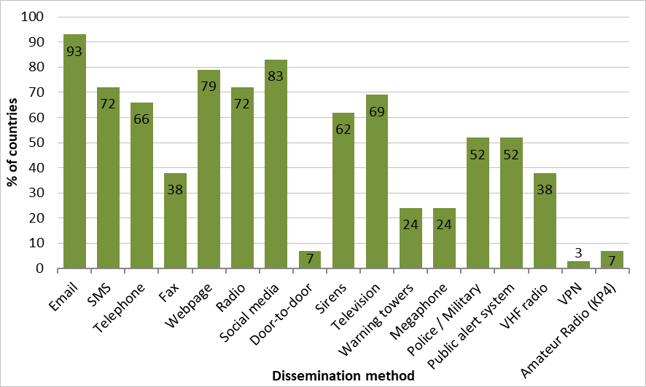
DISSEMINATION
Methods
10a) How is the tsunami information (warning, public safety action, etc) disseminated within country?
Multiple ways used by 100% of the countries, at least three
Other: community word distribution, cell broadcast, mobile applications, and traditional instruments
10e) Does your country's national tsunami warning system utilize the Common Alert Protocol (CAP) for the dissemination of warnings?
Answered: 28 Skipped: 1
32% of the countries with a national tsunami warning system using CAP
Answered: 29 Skipped: 0

Slide 36
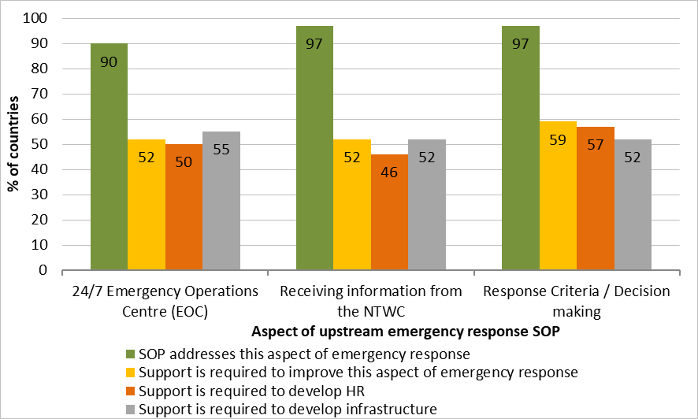
Standard operating procedures (1/4)
Emergency response during upstream stages
Does your SOP address this aspect of tsunami emergency response? Answered: 29 Skipped: 0
Is support required to develop/improve this aspect of tsunami emergency response in your SOP? Answered: 29 Skipped: 0
Is support required to develop Human Resources in this aspect of tsunami emergency response? Answered: 28 Skipped: 1
Is support required to develop infrastructure for this aspect of tsunami emergency response? Answered: 29 Skipped: 0
Each aspect addressed by ≥90% of the countries
However, support to develop these aspects still needed by 52‒59% of the countries

Slide 37
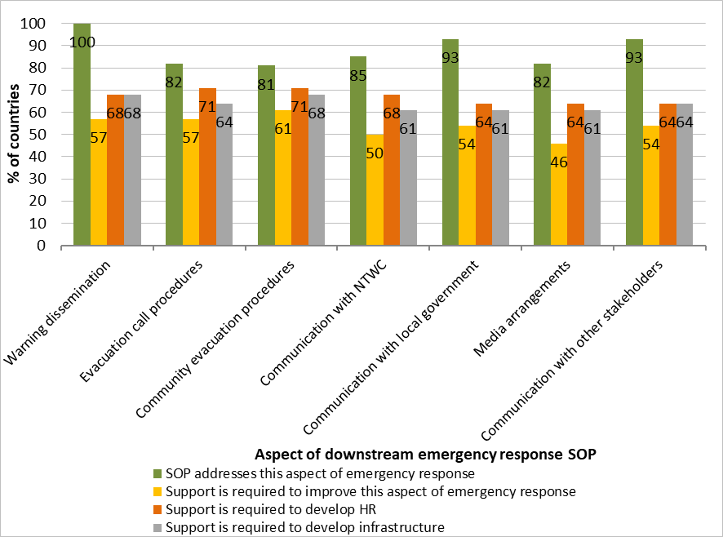
Standard operating procedures (2/4)
Emergency response during downstream stages
Does your SOP address this aspect of tsunami emergency response? Answered: 28 Skipped: 1
Is support required to develop/improve this aspect of tsunami emergency response in your SOP? Answered: 28 Skipped: 1
Is support required to develop Human Resources in this aspect of tsunami emergency response? Answered: 28 Skipped: 1
Is support required to develop infrastructure for this aspect of tsunami emergency response? Answered: 28 Skipped: 1
Each aspect addressed by ≥80% of the countries
However, support to develop these aspects still needed by 46‒61% of the countries

Slide 38
Standard operating procedures (3/4)
Sharing with ITIC and other countries
11c) Would your country be willing to share your SOPs with the ITIC and other countries?
Answered: 29 Skipped: 0
Willingness to share SOPs with ITIC and other countries for 97% of the countries
11d) Indicate any areas in which you require support from the ITIC to develop or conduct capacity development activities.
Answered: 24 Skipped: 5
67% need ITIC support to consolidate and/or update SOPs, and also in other topics:
  Evacuation planning ‒ 75%
  Decision support tools ‒ 75%
  Staff competency ‒ 79%
  Tsunami exercises ‒ 79%
  Hazard assessment tools and techniques ‒ 92%

Slide 39
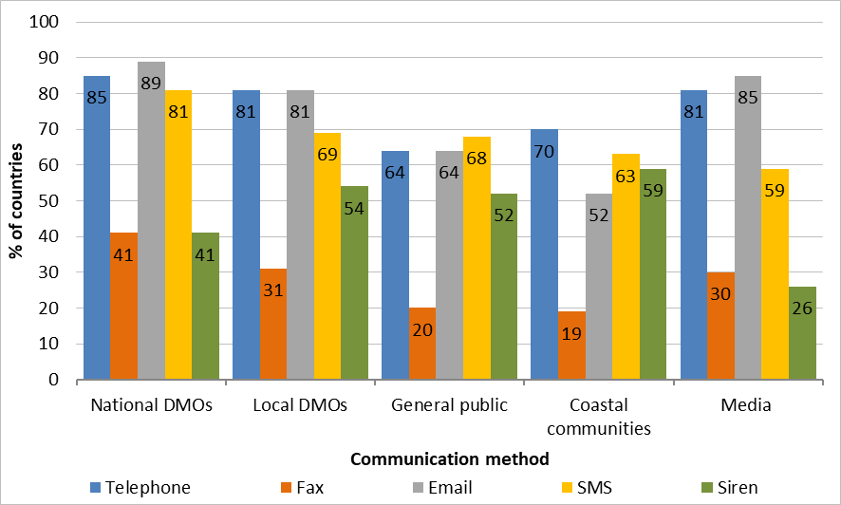
Standard operating procedures (4/4)
Communication methods for emergency response
10b) For each Disaster Management Office listed below, which communication methods for emergency response are available?
SMS, telephone and Email most widely used
Sirens = complementary communication method
Other: warning tower system, Marine VHF radio, radio and TV broadcast, broadcast alert systems, dedicated mobile applications, social media, websites
Answered: 28 Skipped: 1

Slide 40
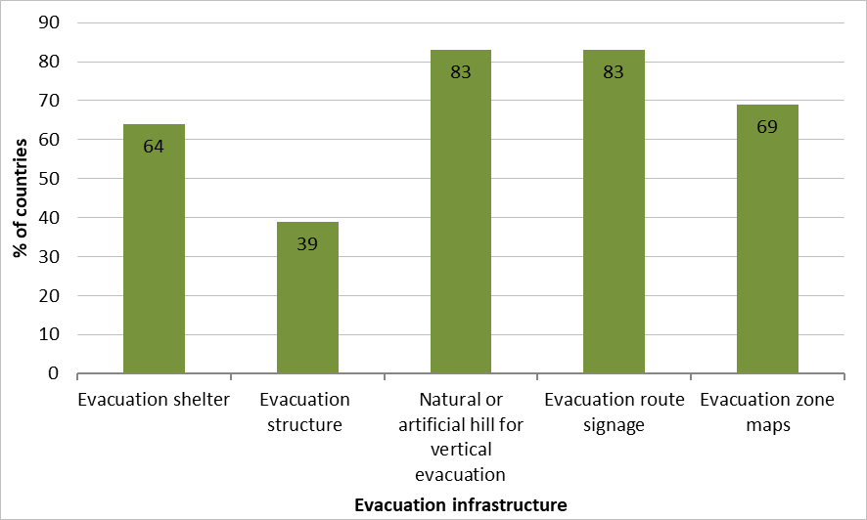
Evacuation infrastructure
Availability
12a) Does your country have the following evacuation infrastructure?
Answered: 29 Skipped: 0
Integration in evacuation plans
12b) Is your evacuation infrastructure integrated in the evacuation plan?
Answered: 28 Skipped: 1
Evacuation structures integrated in plans for 18 countries (64%)

Slide 41
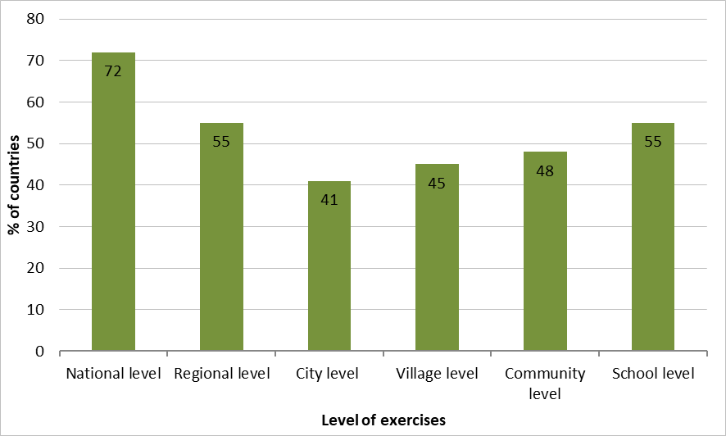
Tsunami exercises (1/2)
Integration in documentations and level
12c) Are tsunami exercises incorporated within national policies and guidelines?
Answered: 29 Skipped: 0
In national policies – 13 countries (45%)
In national guidelines – 16 countries (55%)
Not included – 8 countries (28%)
12d) At what levels were the exercises conducted during the inter-sessional (between ICG meetings) period?
Exercises conducted at multiple levels
for 21 countries (72%)
Answered: 29 Skipped: 0

Slide 42
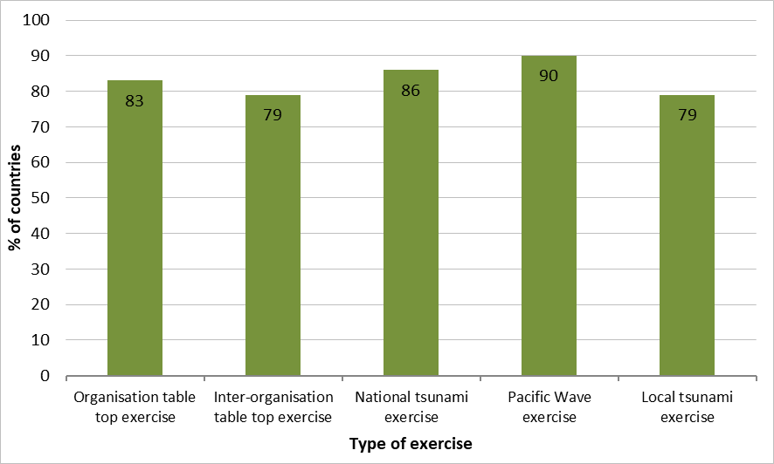
Tsunami exercises (2/2)
Types of exercises
12e) What kind of tsunami exercises activities have been undertaken in your country and how many times during the inter-sessional period?
At least two kinds of exercises undertaken by 27 countries (93%)
No participation to any of the exercises by 1 country
Annual frequency most common
13a) What kind of activities have been tested during your country tsunami exercise, and how many times during the inter-sessional period?
Answered: 29 Skipped: 0
SOPs tested mostly annually by 86% of the countries
Warning products dissemination tested mostly annually by 89% of the countries
Backup operating procedures tested by 50% of the countries
Answered: 29 Skipped: 0

Slide 43
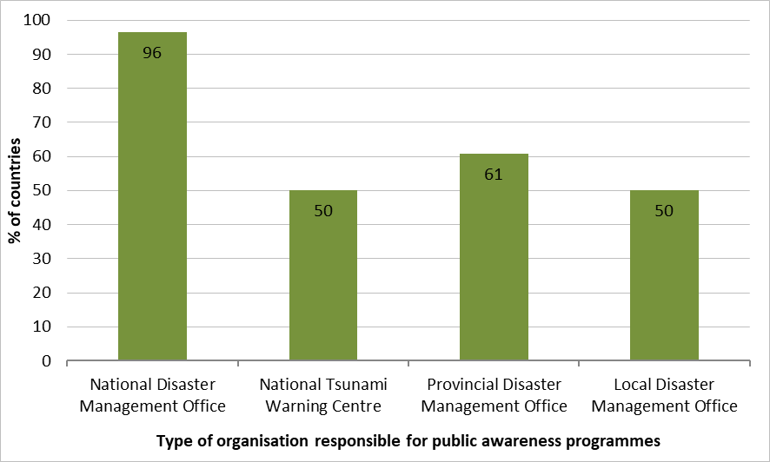
PUBLIC AWARENESS (1/4)
Organisation responsible
13b) Who is responsible for tsunami public awareness programmes in your country?
Shared responsibility between multiple organisations for 71% of the countries
Other: international organisations (e.g. IOM, UNDP), non-governmental organisations (e.g. Red Cross), community of practice and civil society
Answered: 28 Skipped: 1

Slide 44
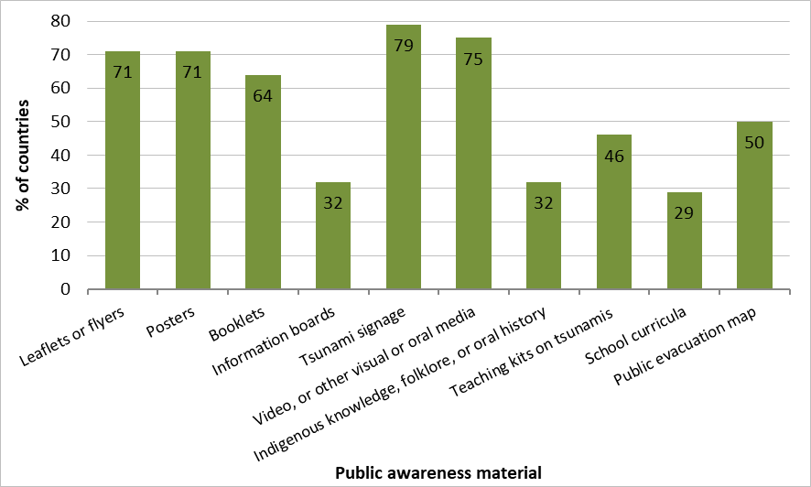
PUBLIC AWARENESS (2/4)
Types of materials
13c) What tsunami related education and awareness materials do you have?
Use of at least two communication tools by all countries (100%)
Other: webpages, social media toolkits, tsunami tank exhibits, comics, online tsunami education resource
13d) Would your country be willing to share these education and awareness materials with the International Tsunami Information Centre (ITIC) and other countries?
Answered: 29 Skipped: 0
Willingness of sharing their materials with ITIC and other countries by 27 countries (93%)
Answered: 28 Skipped: 1

Slide 45
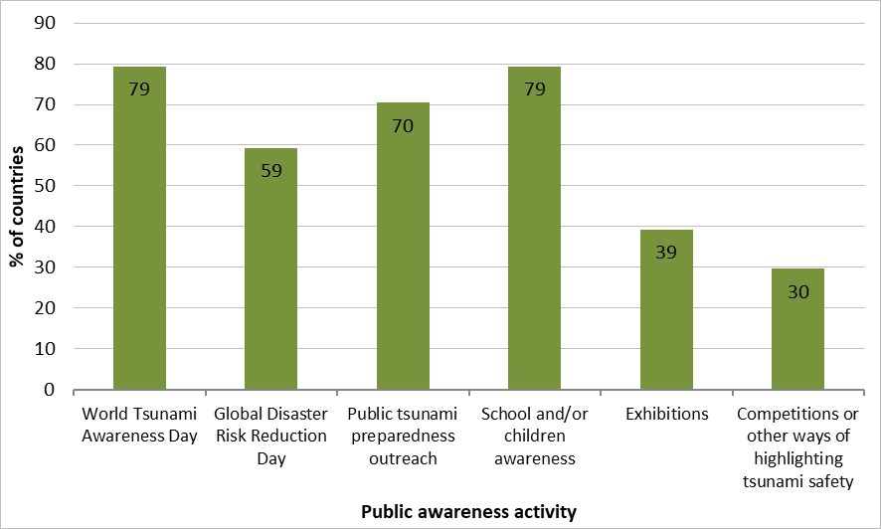
PUBLIC AWARENESS (3/4)
Activities undertaken
13e) Do you undertake the following tsunami awareness activities?
Answered: 29 Skipped: 0
3 countries (10%) conducted none of these activities

Slide 46
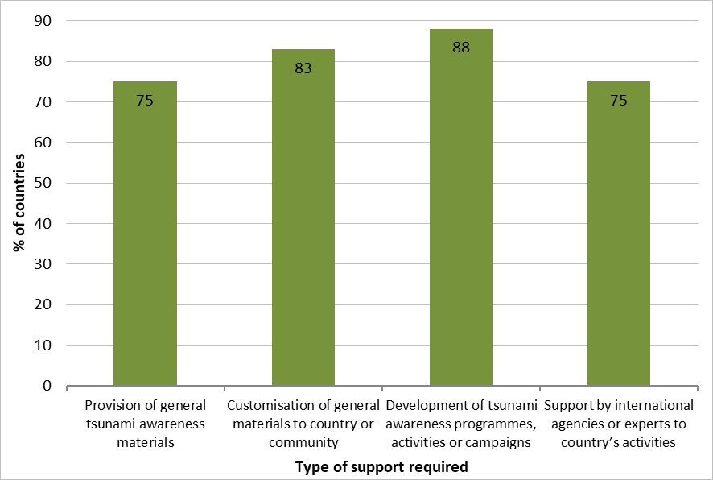
PUBLIC AWARENESS (4/4)
Support from ITIC and other countries
13f) Use the boxes below to indicate any areas in which you require support from the ITIC to develop or enhance public awareness in your country.
6 countries declared not requiring any support
13g) Can your country offer support to other Member States to develop or enhance public awareness in their country?
Answered: 27 Skipped: 2
Proposition of support by 52% of the countries, especially:
to provide consultation, human resources and technical assistance
to share relevant materials and resources
to improve monitoring and information dissemination
to conduct or support training activities, online talks, experience sharing, and lessons learned
Answered: 24 Skipped: 5

Slide 47
UNESCO-IOC Trrp (1/5)
Involvement of the countries in TRPP
14a) Does your country have an interest to participate in the UNESCO-IOC TRRP?
Answered: 29 Skipped: 0
15 countries (52%) participating in TRRP
8 countries (27%) have plans to do so - Reasons for not having contributed yet:
  lack of human resources
  on-going negotiation with relevant authorities
  process of determining how existing programmes would translate to TRRP and if they meet all aims
6 countries (21%) do not plan to implement TRPP - Reasons:
existence of other programmes that do not require external certification
lack of knowledge on the subject
evaluation according to the Tsunami Ready Equivalency Guidance discussed by the ICG/PTWS both effective and efficient

Slide 48
UNESCO-IOC Trrp (2/5)
Involvement of the countries in other initiatives
14b) Aside from UNESCO-IOC TRRP, is your country currently implementing any other tsunami resilience and preparedness related initiatives or programmes?
Answered: 29 Skipped: 0
16 countries (55%) implementing other initiatives and programmes:
running local / national programmes (e.g. DESTANA, TOWER project, COAST project), national multi-hazard programmes, and international programmes (e.g. Tsunami Safe School Programme)
participating in the World Tsunami Awareness Day
conducting earthquake and tsunami exercises in schools and performing tabletop exercises
training on community-based disaster risk management with a multi-hazard approach
improving facilities for tsunami disaster prevention
conducting public education, preparedness and awareness activities
mapping out evacuation center

Slide 49
UNESCO-IOC Trrp (3/5)
At risk to tsunami
14c) What number of villages, cities/districts and provinces/state levels in your country are at risk to tsunami? Answered: 27 Skipped: 2
Estimation of 457 527 villages - 2 554 cities/districts - 278 provinces/states
NRTB
14d) Does your country have a National Tsunami Ready Board (NTRB)? Answered: 29 Skipped: 0
8 countries with a NTRB
7 countries with an existing coordination mechanism that could fulfil this role, consisting of National Councils and Advisory Groups
Institution needing to be involved
14e) Which institution(s) should be involved in the implementation of TRRP or similar national initiative? Answered: 26 Skipped: 3
From individual institutions (e.g. NDMO, NTWC), to a variety of national agencies, coastal councils, local and provincial governments, ministries, police, army forces and emergency services, academics, civil societies, and non-governmental organisations (e.g. Red Cross)
Implementation
14f) Are any communities (for example, villages, cities, districts, provinces, or states) in your country currently working towards implementing or interested in implementing the UNESCO-IOC TRRP or similar national initiative? Answered: 27 Skipped: 2
For 17 countries (63%): communities currently working towards implementing UNESCO-IOC or interested to do so
14g) Have any communities in your country achieved recognition through UNESCO-IOC TRRP or similar national initiative? Answered: 28 Skipped: 1
For 9 countries (32%), completion of TRPP or similar initiatives

Slide 50
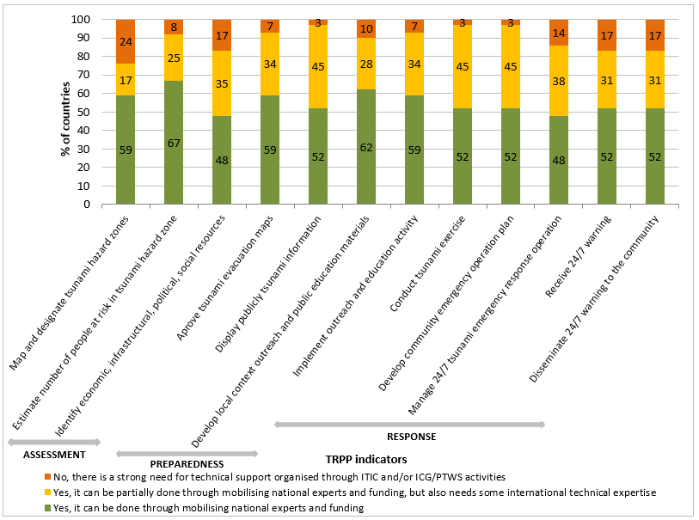
UNESCO-IOC Trrp (4/5)
National capacity to implement indicators
Questions 15a) to 15l)
Answered: 29 Skipped: 0 (except for question 15b Answered: 24 Skipped: 5)
Between 76% and 97% of the countries have the national capacity for implementing indicators totally or partially
≥90% are very much able to achieve entirely or partially 7 aspects relying on their national capacity and some international technical expertise
Between 14% and 24% need technical support from ITIC and/or ICG/PTWS activities for 5 aspects

Slide 51
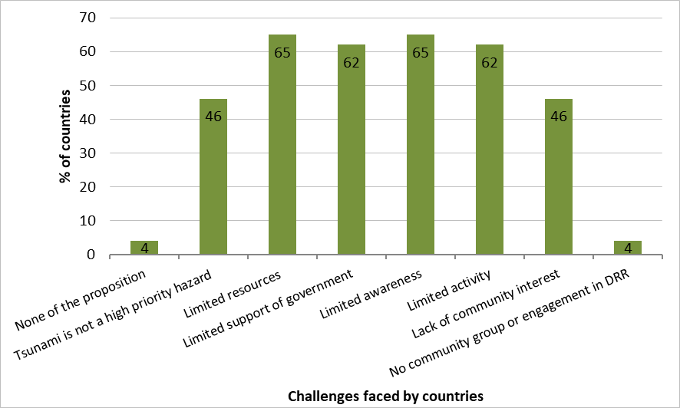
UNESCO-IOC Trrp (5/5)
Challenges faced by countries
15m) Which of the following challenges inhibit the implementation of TRRP or similar national initiatives in your country?
Answered: 26 Skipped: 3
Other: lack of tangible benefits in implementing TRRP and limited guidelines

Slide 52
CONCERNS ABOUT RESULTS
Summary sheets have been sent to each country to address these issues
4h) For each of the data types listed, were these data used? Publicly available? | Question partially answered by 2 countries
4k) On a scale of 1 (Not a priority) to 5 (Essential), what is the priority level in your country to improve capacity in the following areas of tsunami hazard assessment? | Question partially answered by 1 country
7a) Does your country have a national, local and community level tsunami disaster risk reduction plans? | Question partially answered by 21 countries
9b) Does your country utilise the data provided by the PTWS Tsunami Service Providers (TSPs) for the Threat Assessments of your country’s coastline to determine national threats or does it undertake its own threat assessments? | Need some precisions about how TSP data are used as a backup
9j) Does your organisation have access to GNSS data (Global Navigation Satellite System) data? (Q68) & 9q) What other observing networks are operated by your country and used for tsunami early warning? (Q75) | Need consolidation - Q68: 16 countries have access to GNSS data / Q75: only 4 countries declare it as observing networks
9l) When compared to the IRIS database (https://ds.iris.edu/mda/) have you decommissioned or added broadband seismometers operated by your country. | Question skipped by 12 countries
9p) When compared to the IOC Sea Level Station Monitoring Facility, have you decommissioned or added sea level stations, including tsunameters, operated by your country. | Question skipped by 17 countries
10b) For each Disaster Management Office listed below, which communication methods for emergency response are available? | Question partially answered by 4 countries
Does your SOP address this aspect of tsunami emergency response? | Question partially answered by 1 country
12d) At what levels were the exercises conducted during the inter-sessional (between ICG meetings) period? | Need some precisions about what is N/A answer, 3 countries answered this, does it mean that they do not conduct any type of exercises?
13a) What kind of activities have been tested during your country tsunami exercise, and how many times during the inter-sessional (between ICG Meetings) period? | Question partially answered and some contradictions
13c) What tsunami related education and awareness materials do you have? | Question partially answered by 1 country
13e) Do you undertake the following tsunami awareness activities? | Question partially answered by 4 countries
14a) Does your country have an interest to participate in the UNESCO-IOC TRRP? (Q113) & 14f) Are any communities in your country currently working towards implementing or interested in implementing the UNESCO-IOC TRRP or similar national initiative? (Q118) | Incoherences in the answers for 2 countries, which checked NO to Q113 and YES to Q118

