Slide 1
4.12 GLOBAL TSUNAMI PERFORMANCE MONITORING FRAMEWORK
ICG/PTWS XXXI
Öcal Necmioğlu
Technical Secretary of ICG/PTWS
Tsunami Resilience Section

Slide 2
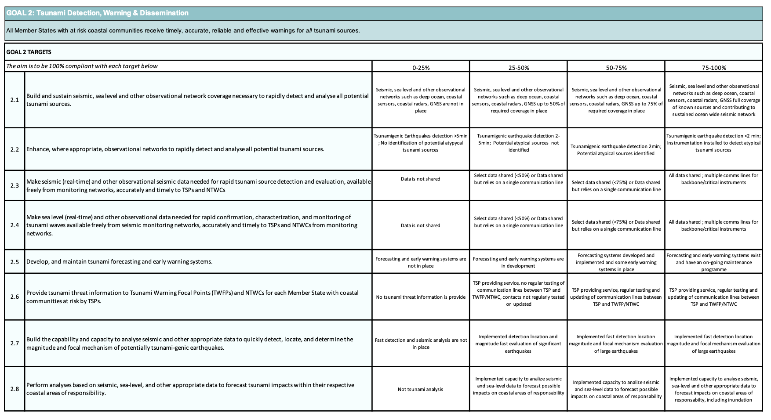
Global Tsunami Performance Monitoring Framework Assessment Table

Slide 3
Backgroung
Action Item 6 from the 'Report of the Inter-ICG Task Team on Disaster Management and Preparedness' (19/20 Feb 2019) relates to the development of key performance indicators that are harmonised with the goals and actions of the the Sendai Framework for Disaster Risk Reduction.
The Action Item requests a team comprising of representatives from the PTWS, IOTWMS, CARIBE-EWS, and NEAMTWS to review the current PTWS performance monitoring framework, compare this with other, similar ICG initiatives and develop a consistent global performance monitoring framework, which includes data collection tools/questionnaire and reporting formats. This work needs to be completed by the next meeting in Paris in February 2020.
The team will comprise Sarah-Jayne McCurrach (PTWS), Yuelong Miao and Harkunti Rahayu (IOTWMS), Elizabeth Vanacore and Mary Regifo (CARIBE-EWS), and Öcal Necmioglu (NEAMTWS).

Slide 4
ICG/PTWS XXX (2023)
Notes and appreciates the contribution of the Task Team on Future Goals and Performance Monitoring in developing the Global Performance Monitoring Framework,
Recommends the latest version of the Framework be presented at the next TOWS-WG for endorsement of the global adoption by all ICGs…

Slide 5
TOWS-WG XVII (2024)
Global Performance Monitoring Framework was not presented…
BUT…
The Group requested the Task Teams TT-TWO and TT-DMP to develop KPIs for the relevant sections of the ODTP - Research, Development and Implementation plan to monitor progress;
The Group requested the IOC Secretariat to develop a reporting mechanism to allow ICGs to report progress on related projects within the Ocean Decade and against the ODTP-RDIP KPIs, aligning this with the
proposed Global KPI Framework for the UNESCO-IOC Tsunami Programme;
Appendix 1-4 (Pages 60-80) of the ODTP-RDIP was developed to guide the assessment of progress actions.

Slide 6
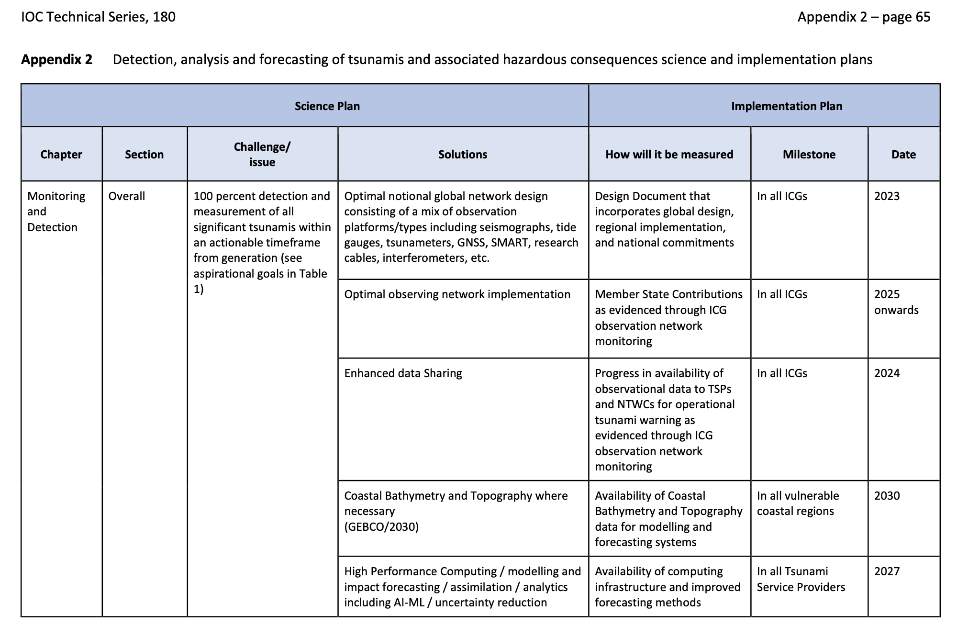
ODTP-RDIP KPIs

Slide 7
Matching ODTP-RDIP KPIs with the Global Tsunami Performance Monitoring Framework Assessment Table

Slide 8
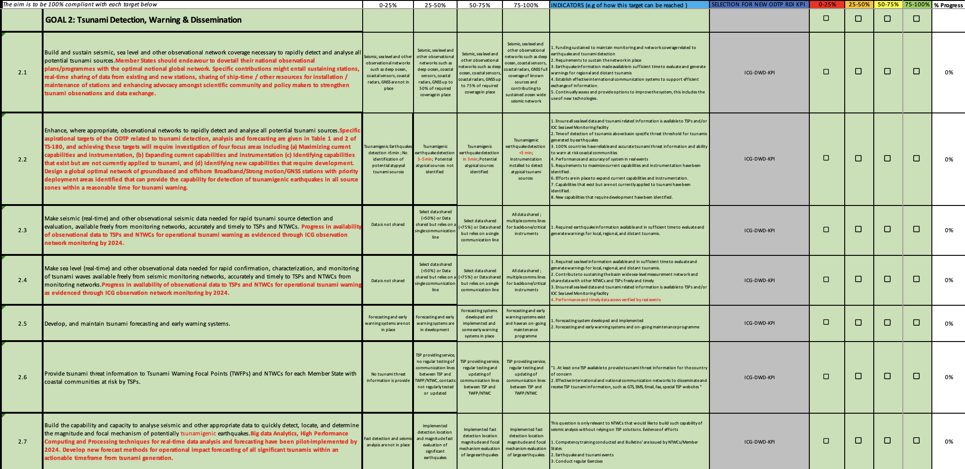
Matching ODTP-RDIP KPIs with the Global Tsunami Performance Monitoring Framework Assessment Table
AIM:
To develop Single Tsunami Performance
M &T Tool.
From this tool, users can choose ICG-KPIs and or ODTP-KPIs depending on application and use.

