Slide 1
Report on the South China Sea Regional Working Group ICG/PTWS
Suci Dewi Anugrah
Chair of SCS WG ICG/PTWS
suci.anugrah@bmkg.go.id
XXXI Session of the Intergovernmental Coordination Group for the Pacific Ocean Tsunami Warning and Mitigation System (ICG/PTWS-XXXI), Beijing, China
7, 8–11 April 2025

Slide 2
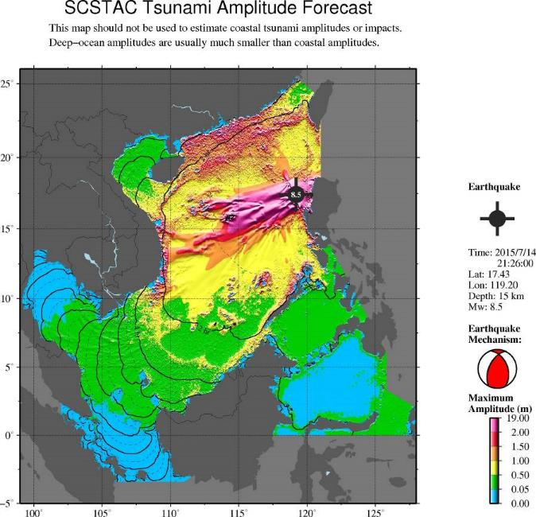
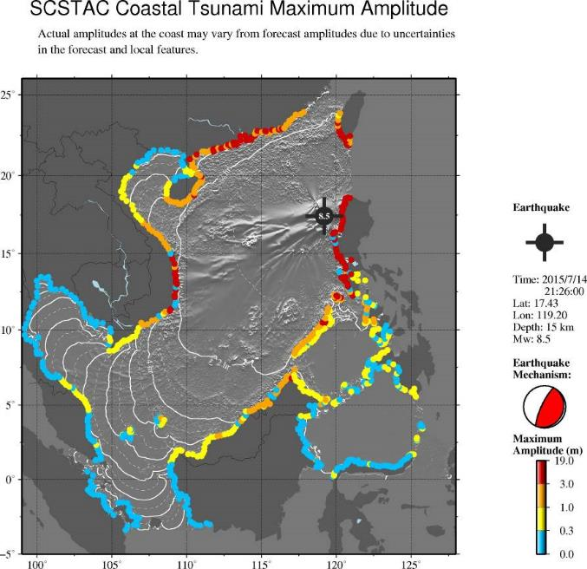
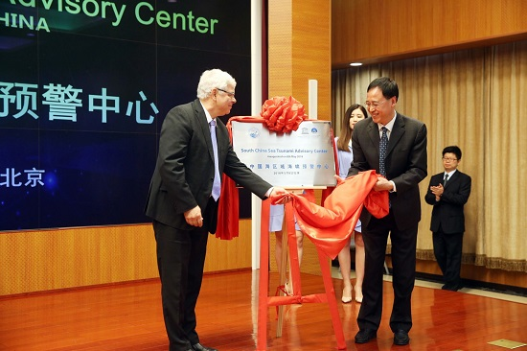
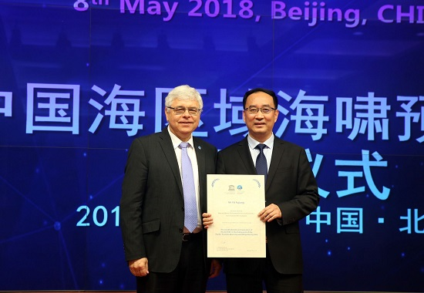
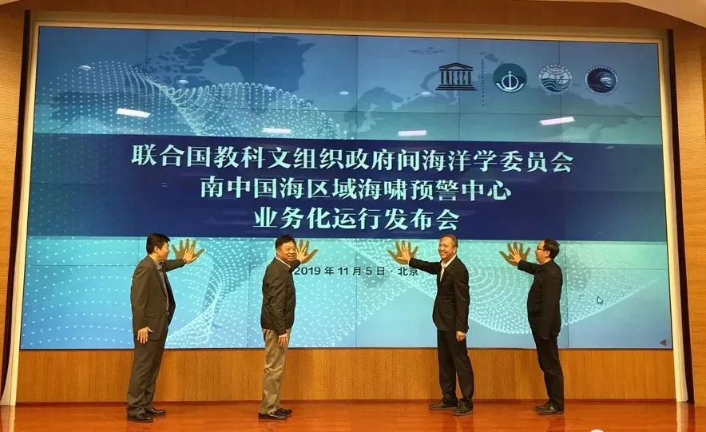
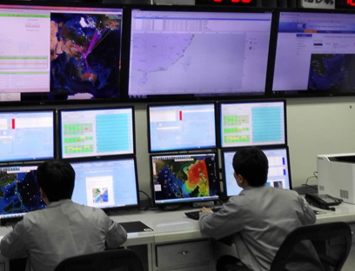
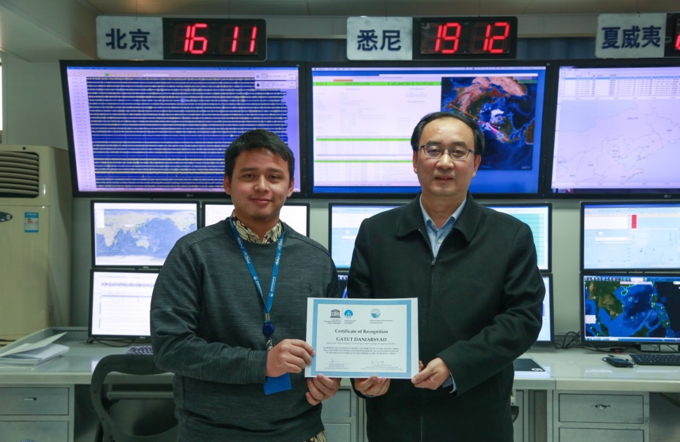
SCS Tsunami Warning and Mitigation System
Tsunami Advisory Products
Text messages
Graphical Products
The Area of Service (AoS) for the SCSTAC specified by ICG/PTWS embraces all coasts of the South China Sea, and the adjacent Sulu Sea and Celebes Sea, separated by Palawan and Sulu Archipelago from north to south respectively. Nine Member States of the SCS region include Brunei, Cambodia, China, Indonesia, Malaysia, Philippines, Singapore, Thailand, and Vietnam (in alphabetic order).
The South China Sea Tsunami Advisory Center (http://scstac.oceanguide.org.cn) has been in full operation since November 5th, 2019.

Slide 3
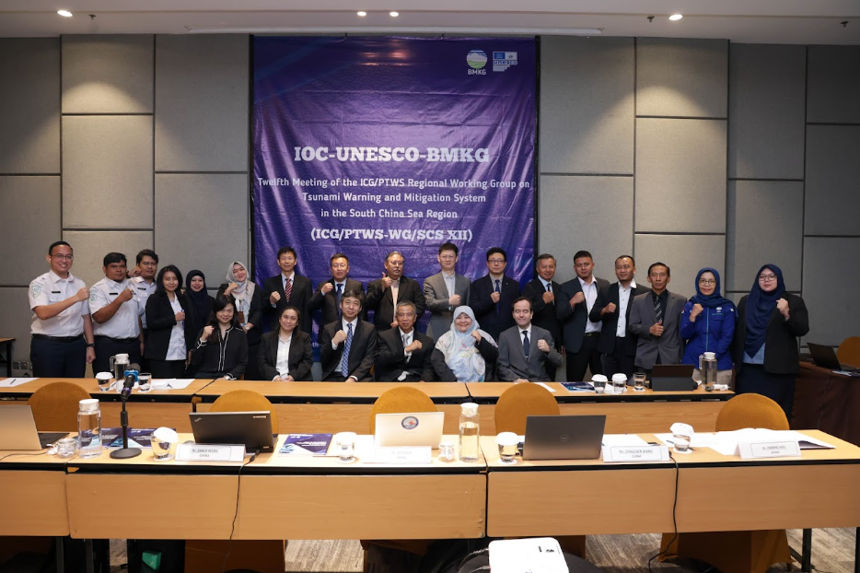
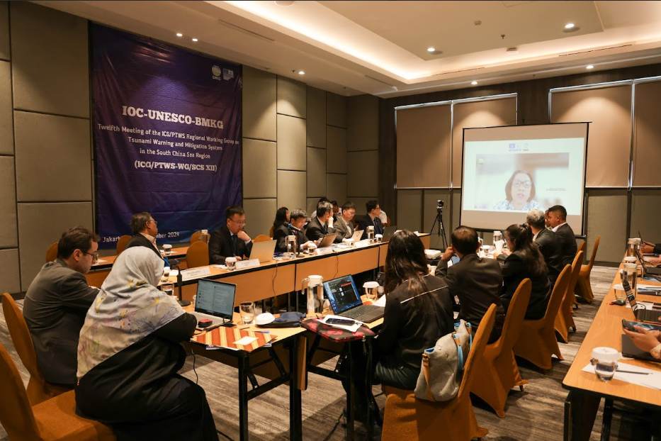
12th Meeting of the SCS Working Group of the ICG/PTWS
Outcome:
Continue the International Staff Programme, encourage participation of the Member States especially those who have not joined before
Encourages the to implement the IOC-UNESCO Tsunami Ready Recognition Programme (TRRP) or its equivalency
Promote and conduct the trainings related to the TRRP through the Task Team on Capacity Development and Services
To revise the Tsunami Service Providers (TSPs) User’s Guide needs
To consider conducting its future meetings from 2025 onwards in-person only every second year, and online every other;
Decides to conduct the 13th meeting of the ICG/PTWS WG-SCS in 2025 online;
Accepts with appreciation the offer of China to host the Fourteenth Meeting of WG-SCS in Hong Kong tentatively in early December of 2026
Jakarta, 7-8 November 2024
Participants: 15 participants from China, Indonesia, Malaysia, Philippines, Vietnam (virtually), Secretariat.
With 19 observers from Indonesia

Slide 4
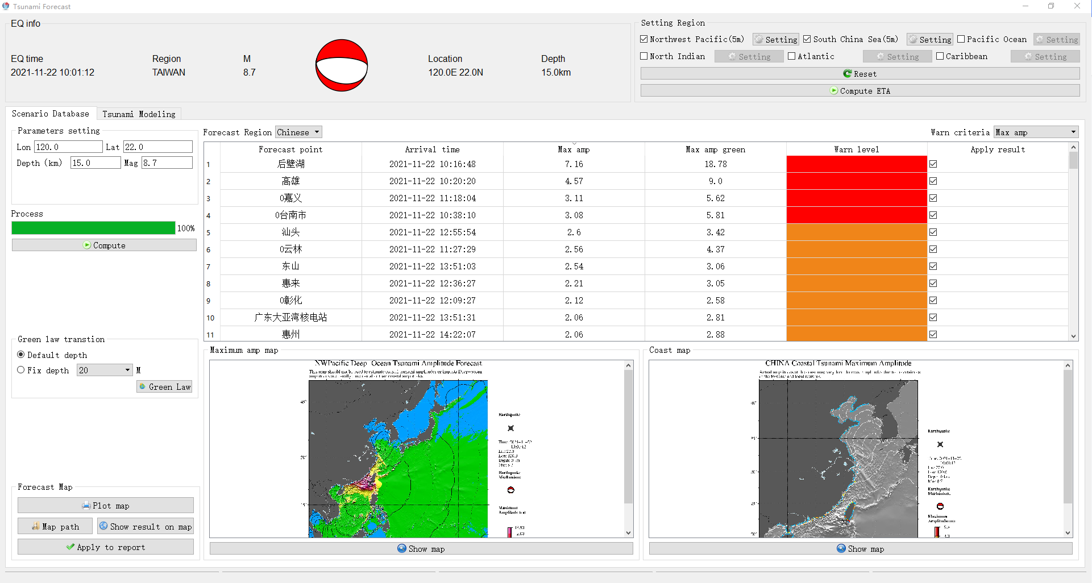
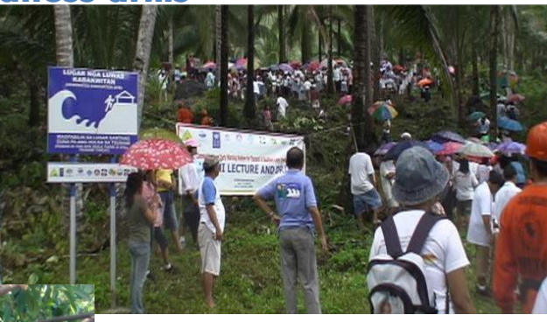
Progres on Tsunami Warning and Mitigation System
China Developed and fully operated the DSS of Smart Tsunami Processing System (STIPS), Tsunami Risk Assessment for Macau, Joint Workshop with Indonesia and Bangladesh,
Indonesia developed Tsunami Non-Seismic Early Warning System, 533 seismographs, on going process on the deployment of 100 tide gauges and coastal cameras, the Indonesia Cable-based Tsunameter (InaCBT) system since February 2022
Malaysia continuous the advancements Malaysia's Tsunami Early Warning System (SAATNM), 80 seismic stations, 25 tide gauges and coastal camera systems, and 83 tsunami sirens
Philippines developed a database for 30,000 tsunami scenarios, 121 seismographs, 24 real-time tide gauges, 10 community tsunami detection and warning systems, 87 community tsunami alerting stations (sirens), Tsunami Hazard Map for municipal scale, and initiate to implement the TRRP
Smart Tsunami Processing System (STIPS)
Tsunami Drill in Philippines

Slide 5
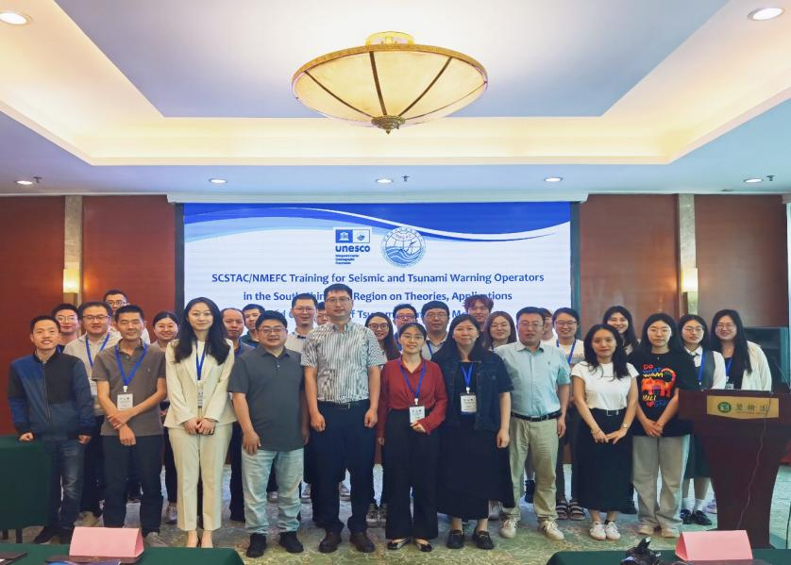
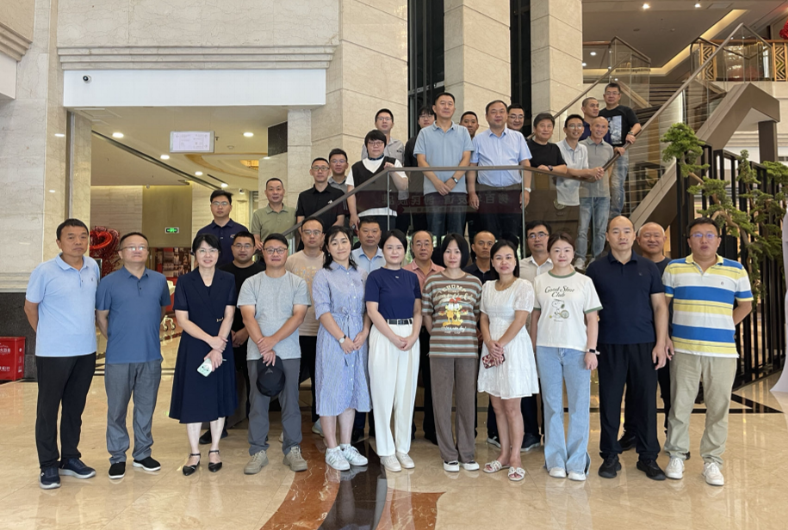
Regional Training and Workshop
International Training Course on Numerical Tsunami models for the South China Sea Region (Hybrid)
Hosted by the Intergovernmental Oceanographic Commission (IOC) and the National Marine Environmental Forecasting Center (NMEFC), about 100 people from Indonesia, Malaysia, the Philippines, Vietnam, Tonga, China and other countries.
Management and operation seminar on seismic station for tsunami warning services
Hosted by the National Marine Environmental Forecasting Center (NMEFC), domestic technicians from Marine bureaus, central stations, ocean observation stations et al..

Slide 6
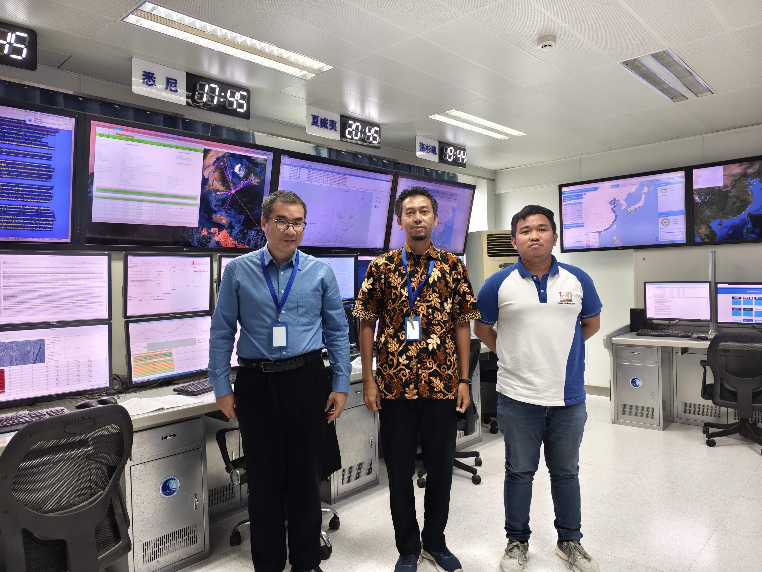
Short-Term visits of International Staff in 2024
SCSTAC continues International Secondment Programme with full funding by hosting 3 experts from SCS-WG Member States from Jul. to Sept. 2024 for a two-month period.
Mr. Mohammad Obie Restianto from BMKG of Indonesia,
Mr. Bhenz Rodriguez from PHIVOLCS of the Philippines
Mr. Yip Weng Sang from MMD of Malaysia.
the major activities will be involved in are:
Receive training on the earthquake location and focal mechanism inversion and tsunamiscenario database, forecast model and decision support system of the SCSTAC;
Serve as a watch-stander once every week with shift time of 12 hours;
Conduct communication and coordination among WG-SCS Member States regarding theactivities related to the full operation of SCSTAC.

Slide 7
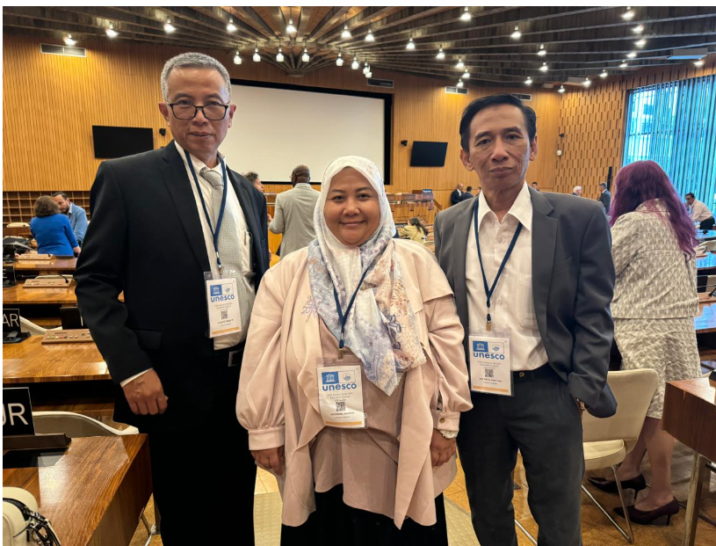
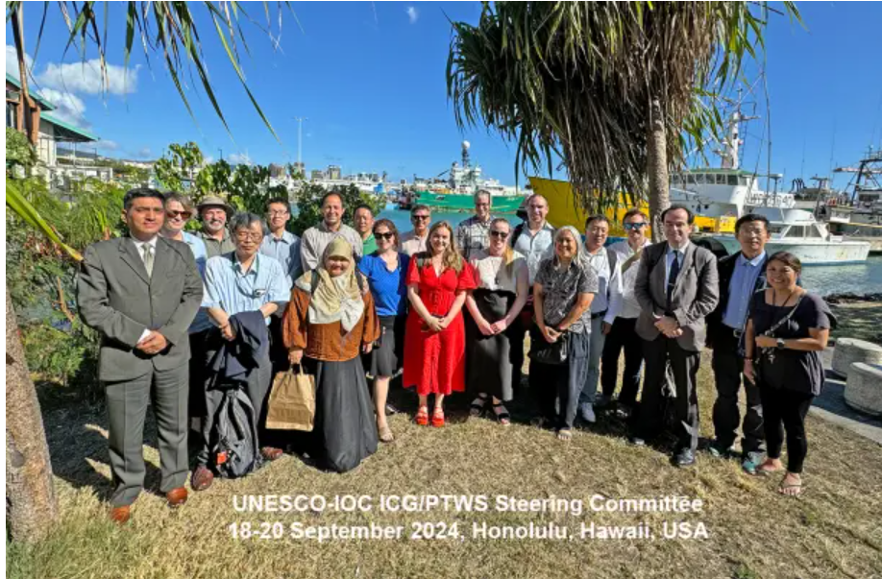
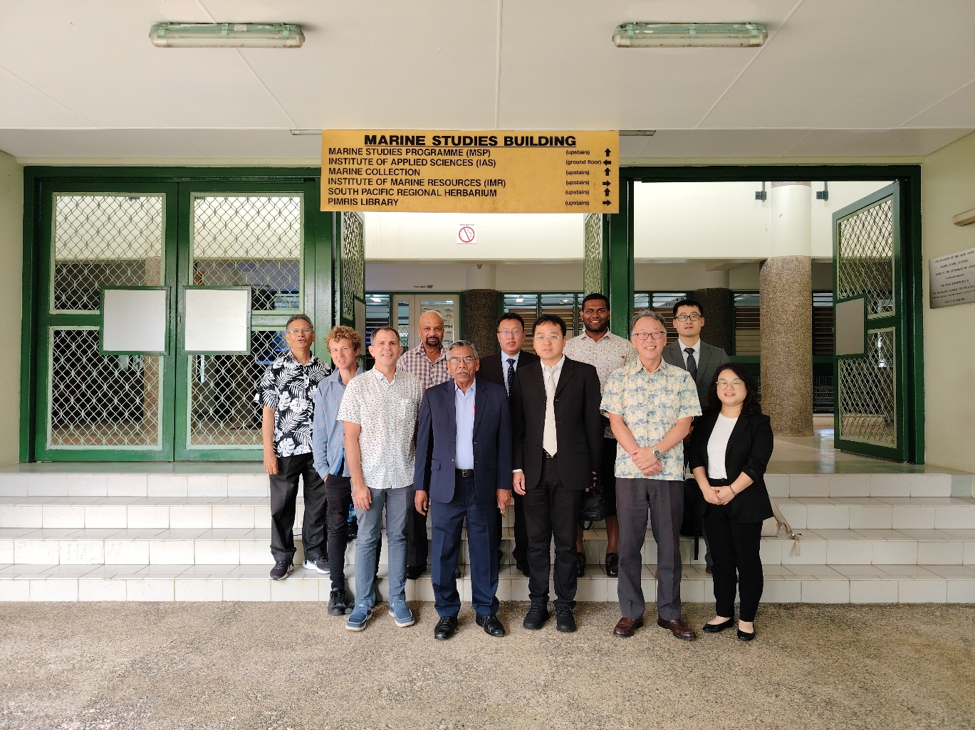
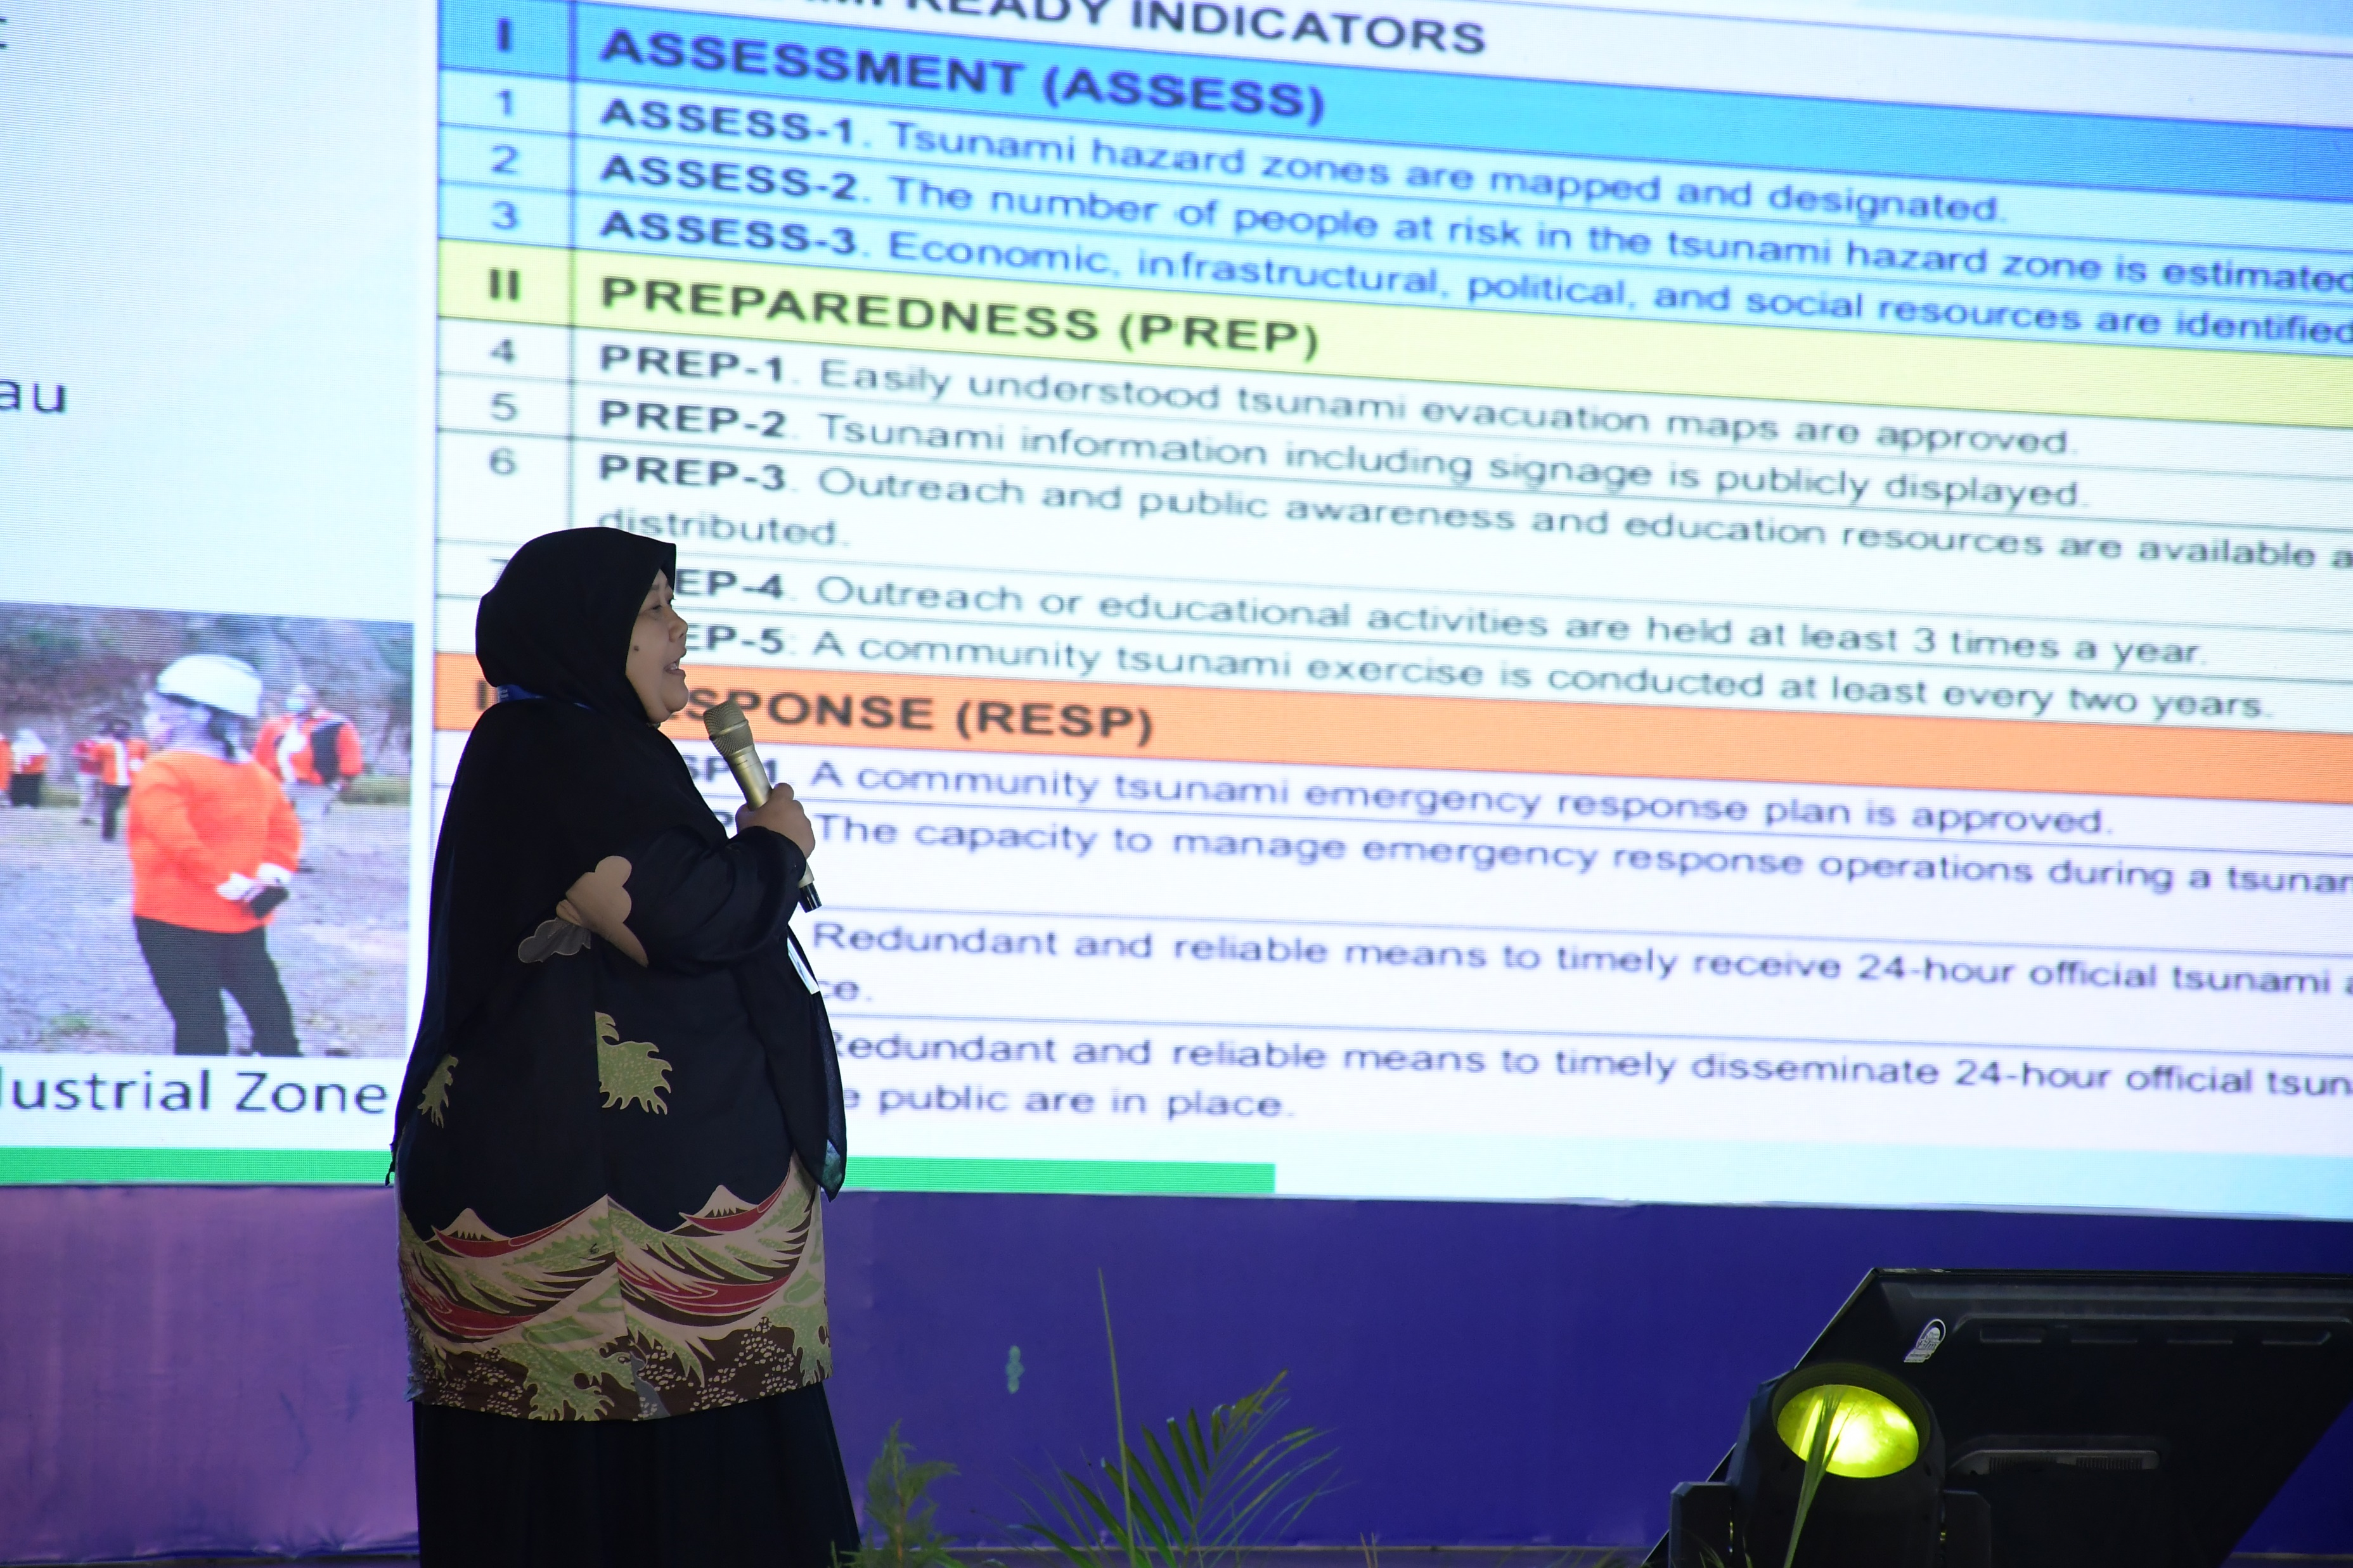
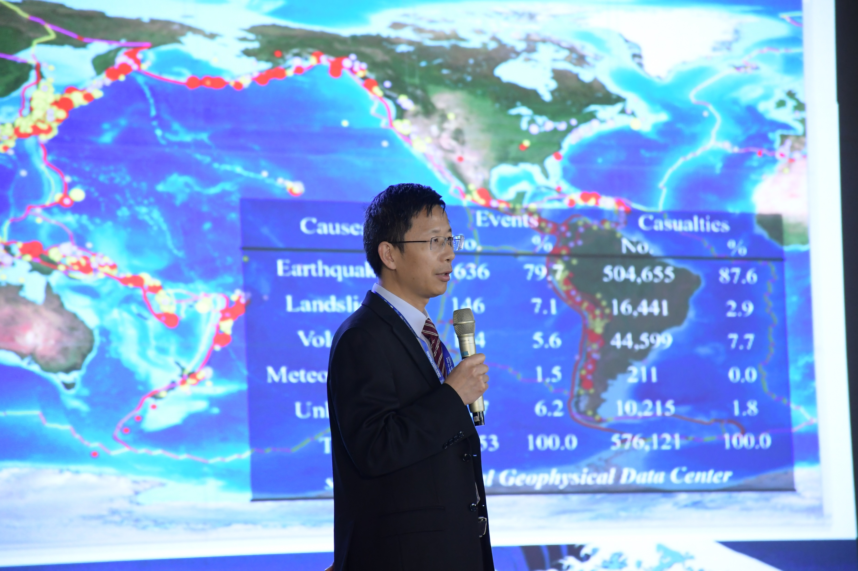
Events Participation
Participation in the 57th session of the Executive Council in Paris, 24-28 Juni 2024
Attending the SC meeting of the ICG/PTWS in Hawaii, 18-20 September 2024
Participated in the Global Tsunami Symposium in Banda Aceh, 11-14 November 2024
Signed a Memorandum of Understanding (MoU) with STMKG of Indonesia;
Carried out technical exchanges on Marine disaster prevention and reduction in Italy and South Pacific island countries
Technical exchanges on Marine disaster prevention South Pacific island countries
The 57th session of the Executive Council
The SC meeting of the ICG/PTWS
the Global Tsunami Symposium
Notes:
How do we Enhance Timeliness and Accuracy of Tsunami Warnings

Slide 8
Further Plans
Continues to provide opportunities for in-person education, outreach and training activities in the region
Promoting and Implementing Tsunami Ready Program in the South China Sea Regional Working Group
Conducts an online Training Workshop on Tsunami Warning Technology and Platforms in the South China Sea region hosted by China.

