Slide 1
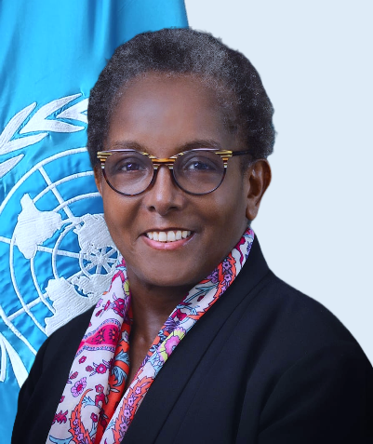
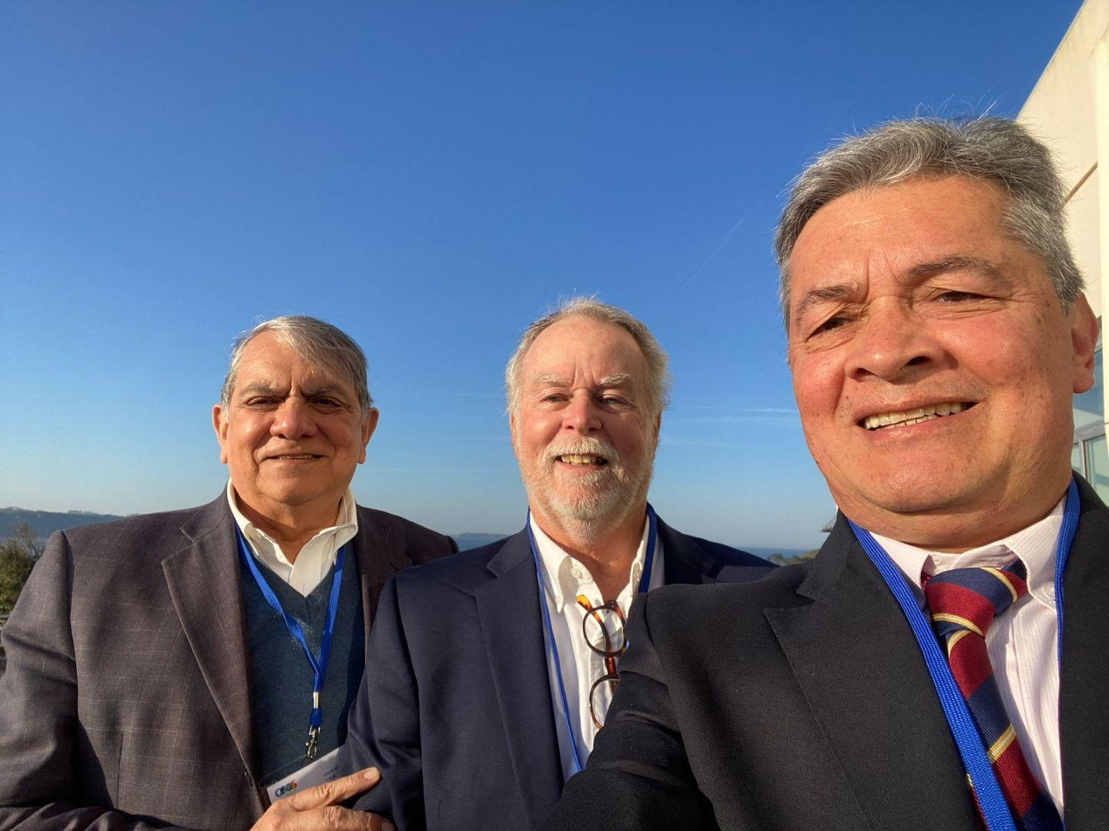
IOCARIBE-GOOS Expert Delegation
IOC sub-commission for the Caribbean and Adjacent Regions (IOCARIBE)
Sixteenth Observations Coordination Group Meeting (OCG-16)
7-10 April 2025, IFREMER, Brest, France.
Edgard Cabrera
Doug Wilson
Cesar Toro
Devin Burri
Dr. Lorna Inniss
Regional Coordinator
UNESCO-IOC (IOCARIBE)

Slide 2
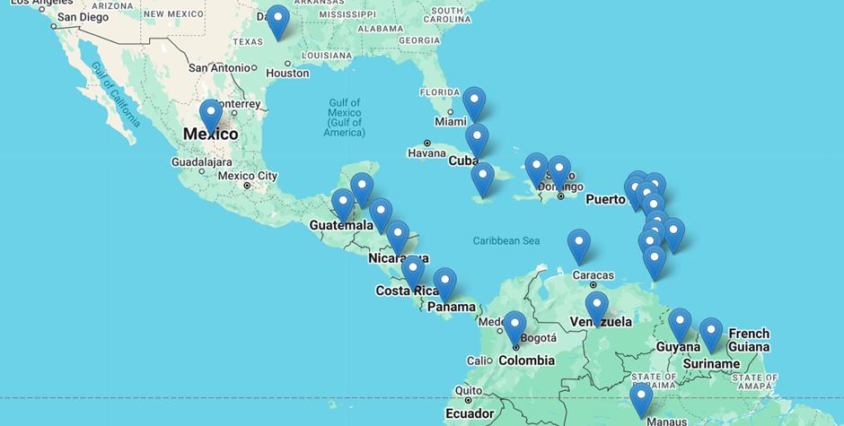
IOCARIBE REGION
IOCARIBE is the Sub-Commission of the Intergovernmental Oceanographic Commission (IOC) for the Caribbean and adjacent regions.
It promotes cooperation in ocean science, data management, and capacity development.
Contributes to the UN Decade of Ocean Science for Sustainable Development.

Slide 3
KEY IOCARIBE PROGRAMS AND PROJECTS
MARINE SPATIAL PLANNING (MSP)
OCEAN DATA AND INFORMATION MANAGEMENT
HARMFUL ALGAL BLOOMS
GLOBAL OCEAN OBSERVING SYSTEM
IOCARIBE-GOOS
TSUNAMIS & COASTAL HAZARDS
SARGASSUM
OCEAN LITERACY
CAPACITY DEVELOPMENT
OCEAN DECADE
OIL SPILLS

Slide 4
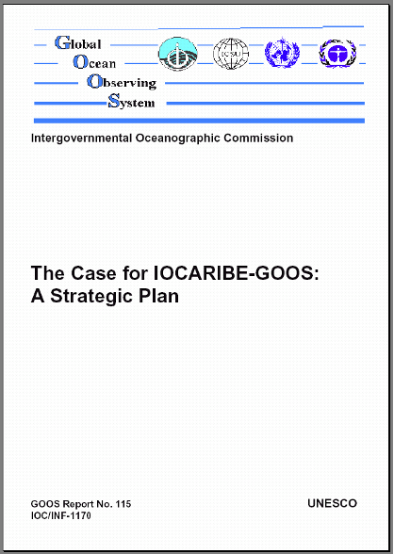

IOCARIBE-GOOS Evolution
1998 - Initiated by Member States as the
‘GOOS Regional Alliance for the Wider Caribbean Region’.
An IOCARIBE Expert Group created a Strategic Plan, published in 2002, and IOCARIBE-GOOS was approved by GOOS as a Regional Alliance.

Slide 5
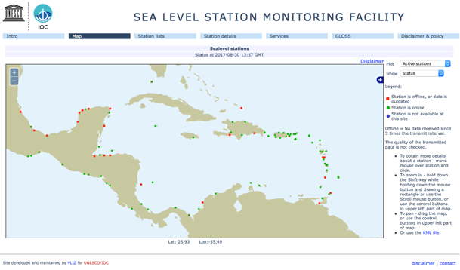

IOCARIBE-GOOS History
Sea Level Monitoring Network
IOCARIBE-GOOS first implementation pilot project to support a working sea level network in the Caribbean (2005)
Evolved into the IOCARIBE Early Warning Systems- Sea Level
80+ active real time Sea Level Stations reporting
Notes:
IOCARIBE Sea Level Monitoring Network
IOCARIBE-GOOS first implementation pilot project was supporting a working sea level network in the Caribbean [in 2005, there was one functional real-time sea level gauge in the non-US Caribbean].
The Programme has evolved to become CARIBE EWS SL Network and with IOC support there are now 80+ active real time Sea Level stations reporting.

Slide 6
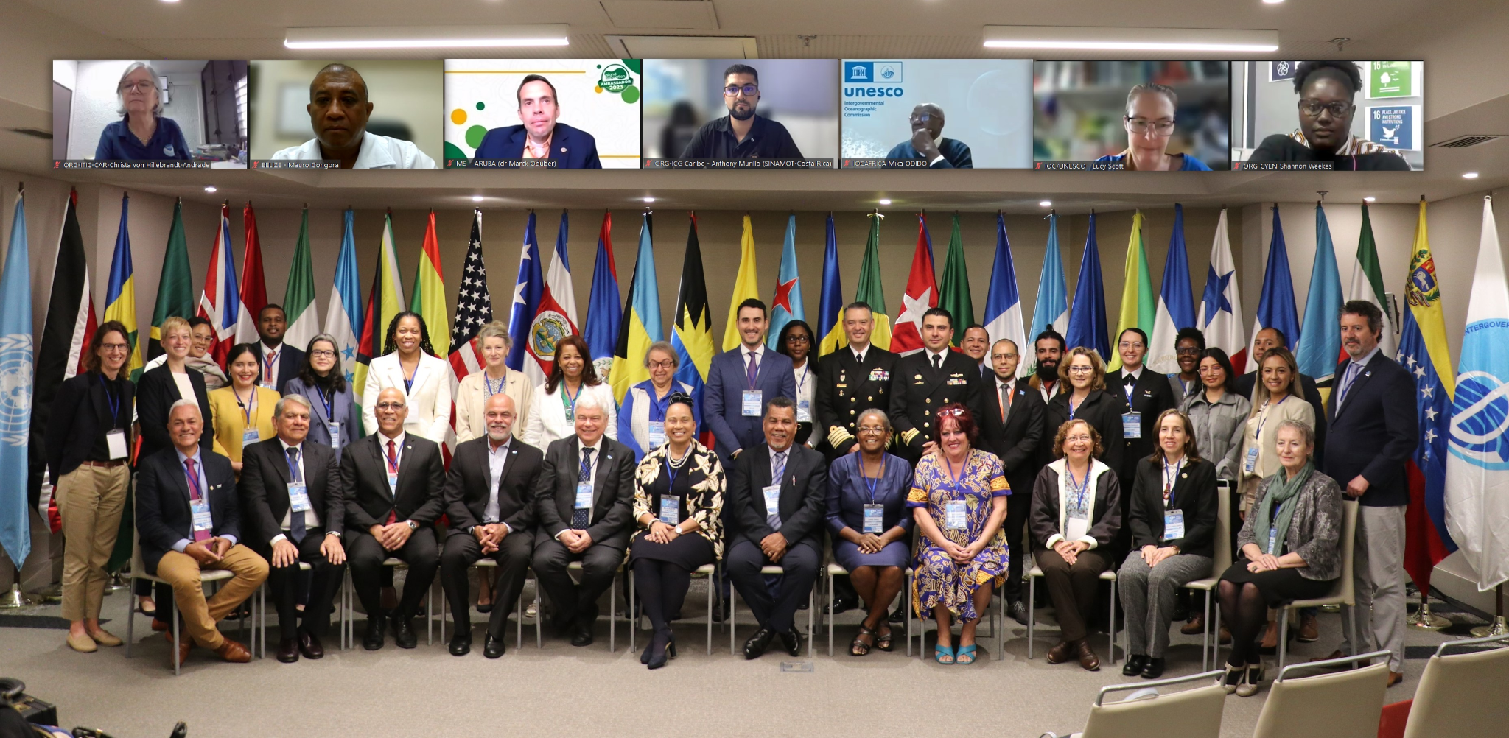
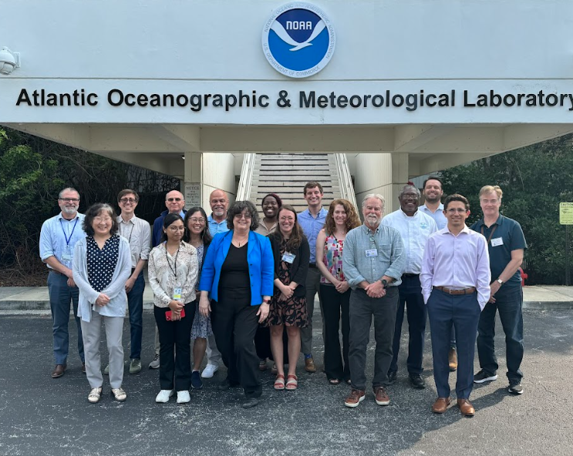
Recent Accomplishments
IOCARIBE-GOOS and GOOS Co-Design TC Exemplar Caribbean
May 2024
IOCARIBE-GOOS Workshop at IOCARIBE XVII

Slide 7
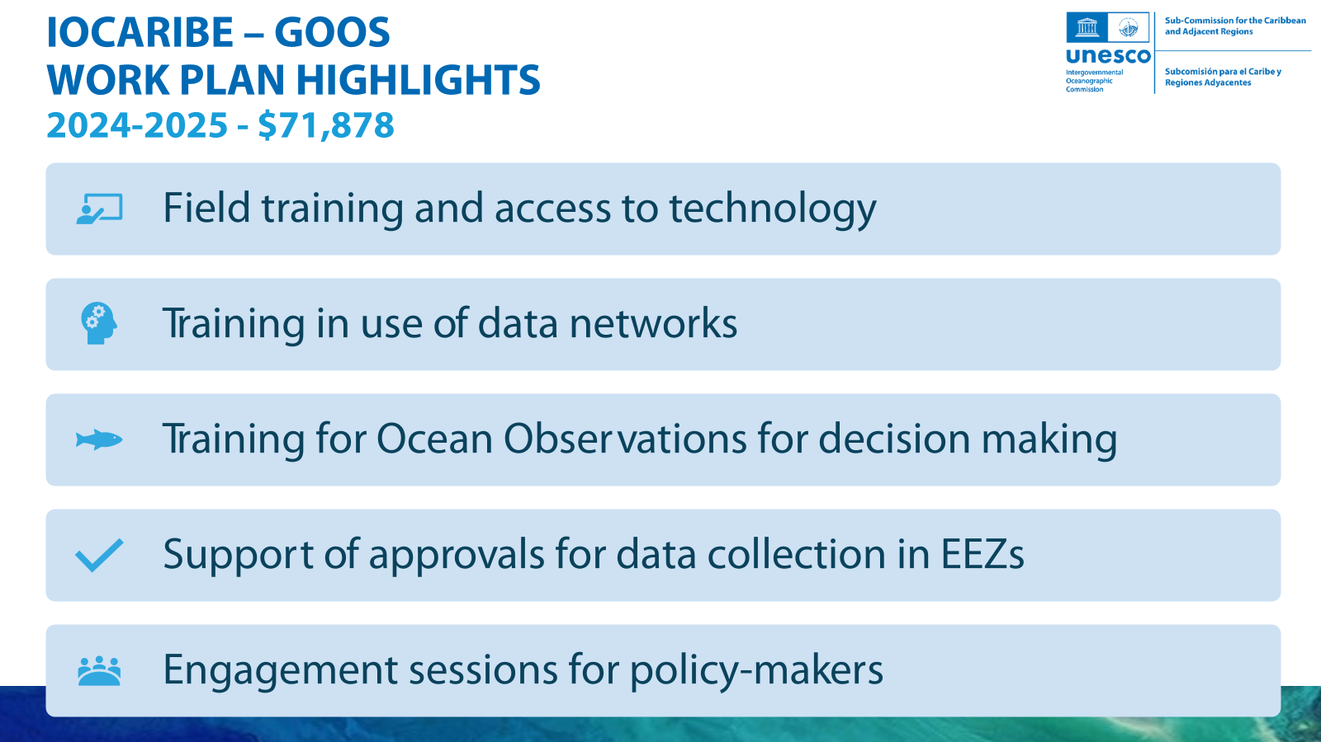

Slide 8
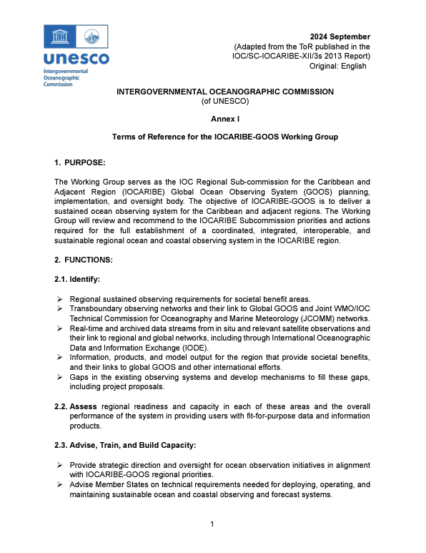
Short Term Goals
Develop Governance Structure
  Establish the Working Group
    Member State representation
    Inclusion of ECOPS, SIDS, and underrepresented communities
  Circular Letter (COMPLETE)
  Updated (Draft) Terms of Reference (TOR) (COMPLETE)
  Working Group to accept TOR, Finalize Work Plan and Begin Road Map
Next: Identify stakeholder needs - specific priorities
Notes:
Our Working Group established consisting of experts and representatives from organizations expected to participate. A final framework will be co-designed by the regional principals.
Goal: IOCARIBE-GOOS Governance structure framework fits into Global GOOS overarching structure, with inclusive and equitable representation
We want to increase advice and operational support, be inclusive of additional stakeholders, and be open to advice from a process of governance change;

Slide 9







IOCARIBE-GOOS LONG TERM PRIORITIES
Long-term high-quality observations
Observations, forecasts, and products address essential ocean variables based on regional needs
Open access to data
Widely available marine products
Measurable benefits
Standardization of best practices
Multidisciplinary partnerships
Notes:
Revised biannually at IGM and interthrough WGs
Sustained long-term high-quality observations of marine and coastal environments, including human interactions, creation and operation of models based on stakeholder needs, and delivery of forecast and decision-support tools that help fulfill the multiple sustainable development goals of the Decade.
Observations, forecasts and products that address essential ocean variables as determined by regional needs, including biological and ecological variables useful for ecosystem management and the generation of ocean health indicators,
Widely available ocean and marine products that contribute to TAC ocean health, safety of life and property, and stakeholder needs.
A system that delivers measurable benefits to the region’s social, environmental, and economic welfare.
A system that delivers observations, data, forecasts, and products targeted to support other Tropical Americas and Caribbean Outcomes and Actions
Open access to data, information, and technologies.
Standardization and best practices for coordinated data collection, management, and use.
Multidisciplinary partnerships to integrate earth system/social sciences, and cross-sectoral participation to mobilize constituencies for national policy and community decision-making processes.
A system with project components to be co-designed, but including at least components focused on regional ocean observations; modeling, forecasts, and products; data management; and capacity building.

Slide 10
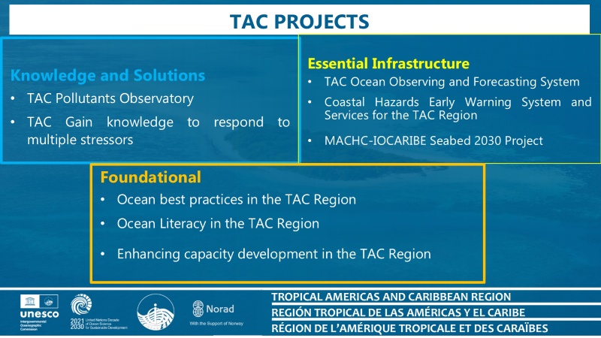
Notes:
Revised biannually at IGM and interthrough WGs
Sustained long-term high-quality observations of marine and coastal environments, including human interactions, creation and operation of models based on stakeholder needs, and delivery of forecast and decision-support tools that help fulfill the multiple sustainable development goals of the Decade.
Observations, forecasts and products that address essential ocean variables as determined by regional needs, including biological and ecological variables useful for ecosystem management and the generation of ocean health indicators,
Widely available ocean and marine products that contribute to TAC ocean health, safety of life and property, and stakeholder needs.
A system that delivers measurable benefits to the region’s social, environmental, and economic welfare.
A system that delivers observations, data, forecasts, and products targeted to support other Tropical Americas and Caribbean Outcomes and Actions
Open access to data, information, and technologies.
Standardization and best practices for coordinated data collection, management, and use.
Multidisciplinary partnerships to integrate earth system/social sciences, and cross-sectoral participation to mobilize constituencies for national policy and community decision-making processes.
A system with project components to be co-designed, but including at least components focused on regional ocean observations; modeling, forecasts, and products; data management; and capacity building.

Slide 11
An Ocean Observing and Forecasting System for the
Tropical Americas and Caribbean Region
Based on Workshop’s co-designed outcomes, Kickoff Conference discussions, and in consultation with the Regional Planning Group, it was recommended to submit a proposal for an Ocean Decade Action in support of An Ocean Observing and Forecasting System for the Tropical Americas and Caribbean Region (TAC-OOFS)
The Action was endorsed by the UN Ocean Decade Coordination Unit in
September 2022.
The Action is intended to provide a roadmap to a Regional System that meets the operational ocean observing and forecasting goals of IOCARIBE-GOOS.

Slide 12
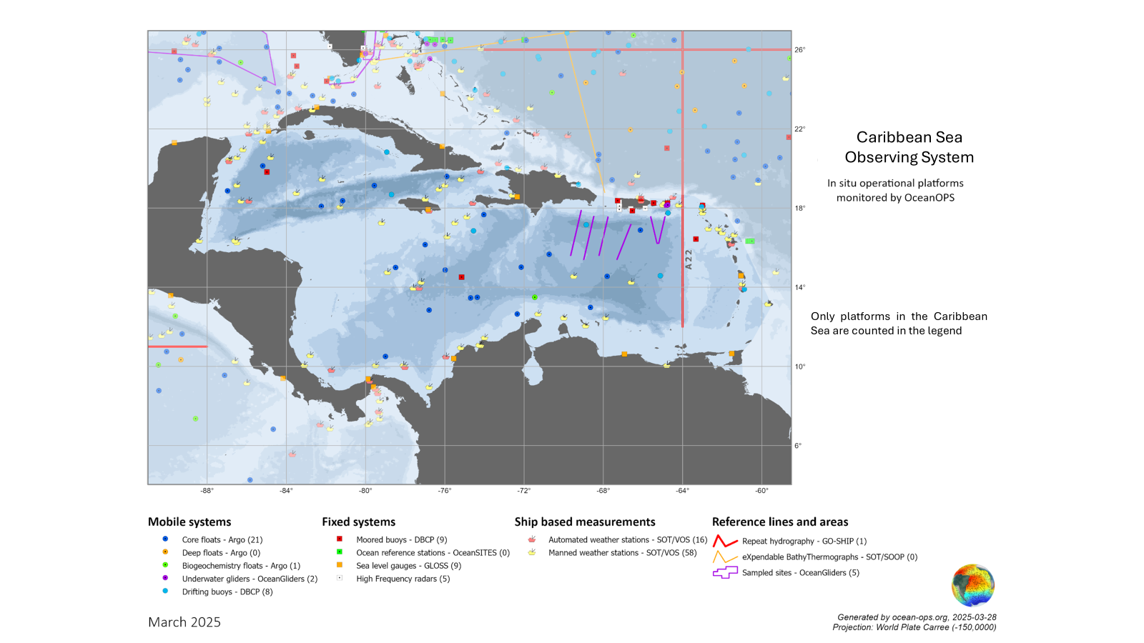
An Ocean Observing and Forecasting System for the Tropical Americas and Caribbean Region
Notes:
Design and Implementation ‘framework’ System,
using existing assets and filling gaps as necessary, that demonstrates multiple
aspects of the system (including data and knowledge sharing), targets Essential Ocean Variables, links to other regional projects, and creates a framework for expansion.

Slide 13
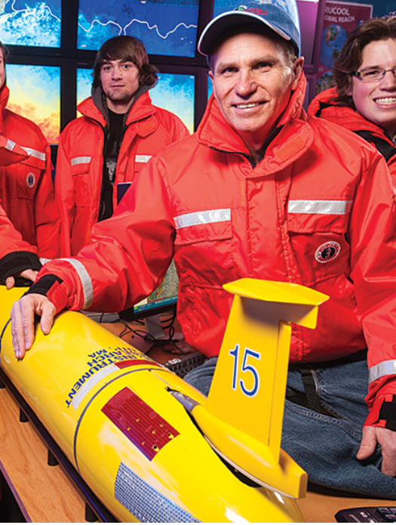

GOOS Co-Design Programme’s
Tropical Cyclone Exemplar (Slides)
Co-Designing Ocean Observing Systems for Improving the Understanding
and Forecasting of Tropical Cyclones
Scott Glenn, Distinguished Professor, Rutgers University, USA
Cheyenne Stienbarger, Program Manager, NOAA, USA
Sixteenth Observations Coordination Group Meeting (OCG-16)
7-10 April 2025, IFREMER, Brest, France

Slide 14

IOCARIBE Collaboration with IODE: Access to Data, Information, and Technology
AREAS OF COLLABORATION:
OTGA (OceanTeacher Global Academy): Training and capacity development.
OBIS (Ocean Biodiversity Information System): Management of marine biodiversity data.
ODIS (Ocean InfoHUB LAC): Data interoperability and access.
KEY PARTNERS:
INVEMAR (Institute of Marine and Coastal Research): Collaboration on data management and technology.
Other regional partners: Support in project implementation and information access.
ACHIEVEMENTS:
Access to data and information: Facilitating the use of oceanographic data for decision-making.
Knowledge transfer: Training and capacity building in advanced technologies.
Technology: Implementation of tools for data management and visualization.

Slide 15
iCHEWS
Safe Ocean - iCHEWS (Integrating Coastal Hazards Early Warning Systems in the Tropical Americas and Caribbean)
  IOCARIBE Lead
  In 2022 Endorsed under the CoastPredict Programme
  4 main elements:
    Risk Knowledge
    Detection and Forecasting
    Warning Dissemination and Communication
    Preparedness, Response and Mitigation –
  2 Overarching elements:
    Governance
    Capacity Development

Slide 16
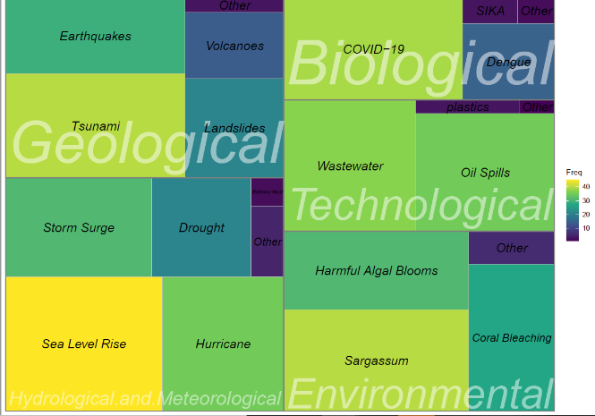




ICHEWS: Prioritization of Hazards
TOP SEVEN
❏ Sea Level Rise (Climate Change)
❏ Sargassum Influx
❏ Tsunami
❏ COVID 19
❏ Waste Water
❏ Hurricanes
❏ Oil Spills

Slide 17
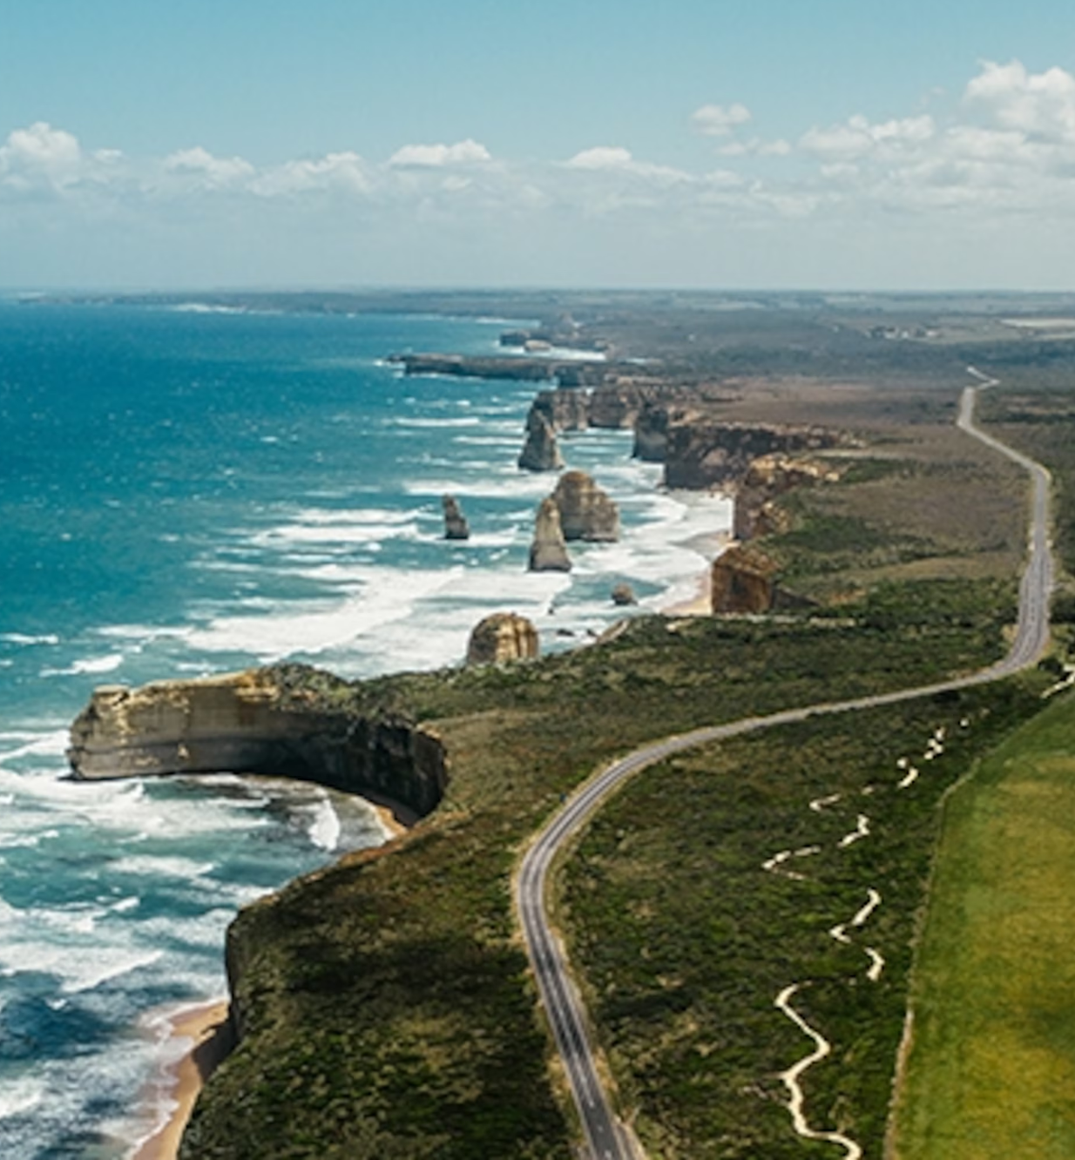
Next Steps
1.Capacity/Stakeholder Needs Survey
•Inventory of existing observing networks
•Understand member state/user priorities
•Gauge stakeholder capacities (technical, staff, identify gaps, what measurements where?)
2. Establish and maintain regional partnerships
•Plan 2025 virtual and in-person WG meetings
•Identify shared goals/priorities
3. Roadmap: identify achievable/actionable steps
•Utilizing Work Plan and GOOS 2030 Strategy/Roadmap to develop IOCARIBE-GOOS Work Plan
4. Development of the Initial Observing and Forecasting System

Slide 18
Current and Potential Networks and Partnerships
[Other National Observing Systems]
Cuba
FR, UK, NED representatives in the Caribbean
* WMO
* Global/Regional Ocean, atmosphere, climate modelers
US NOAA
US Navy
ECOFS
CIMH
Copernicus
* OceanOPS
* CARICOOS
* GCOOS
* CoastPredict
* CIMH
* NOAA Global Ocean Monitoring and Observing (GOMO)
NOAA Atlantic Oceanographic and Meteorological Laboratory
* Colombia (CIOH)
* Brazil
* CICESE (MX)

Slide 19
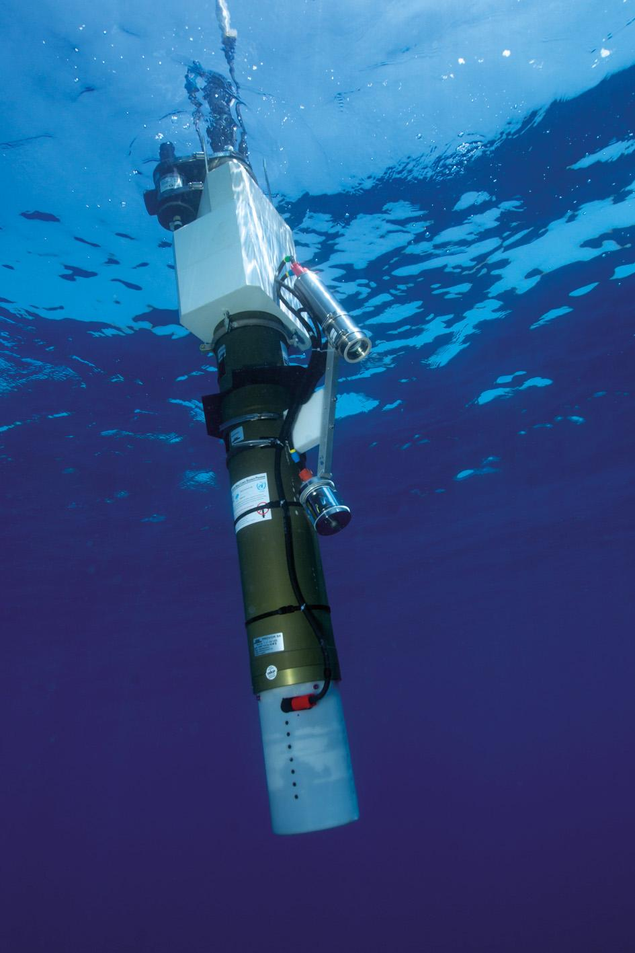
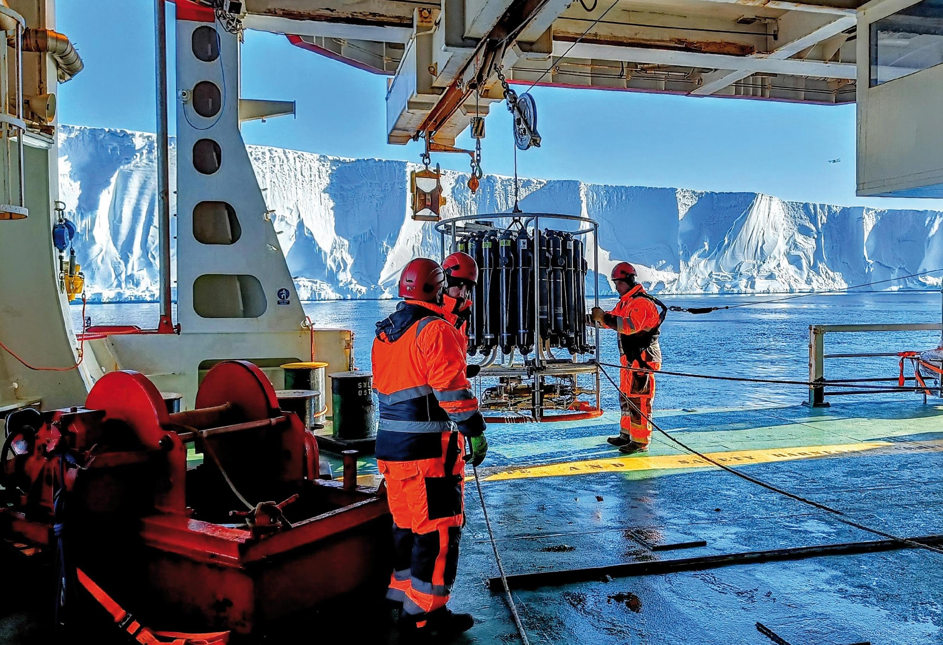
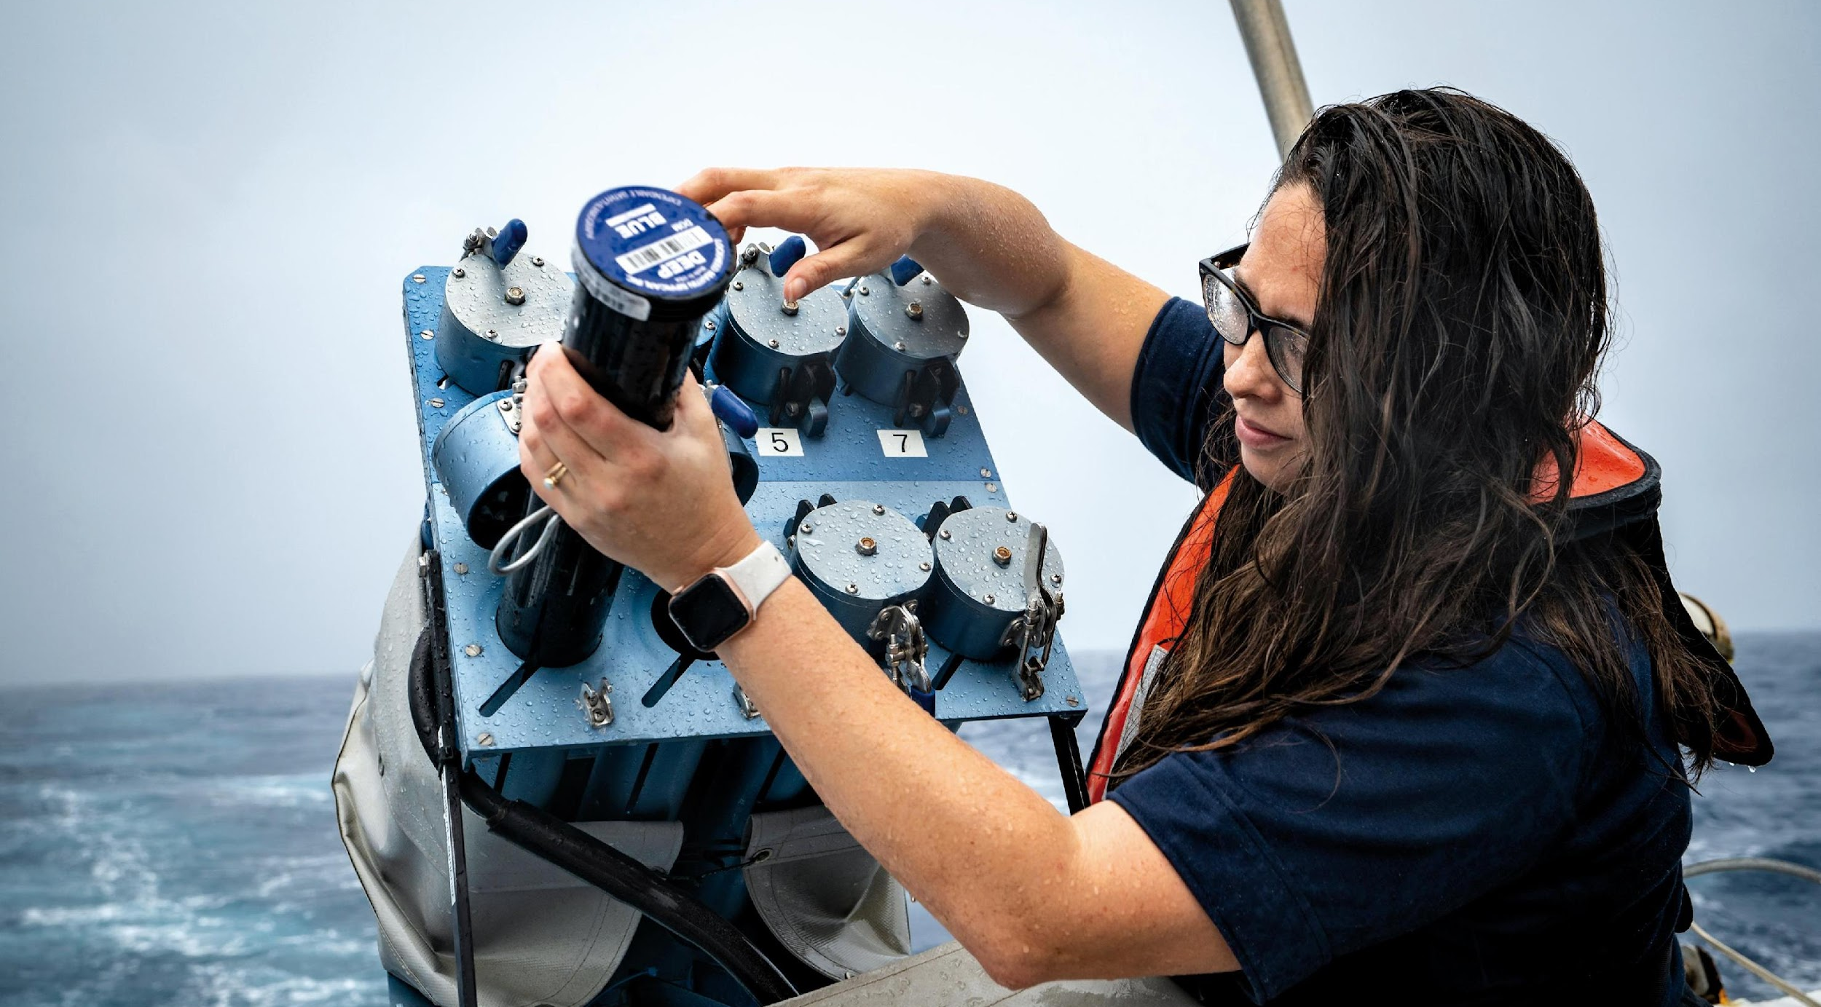
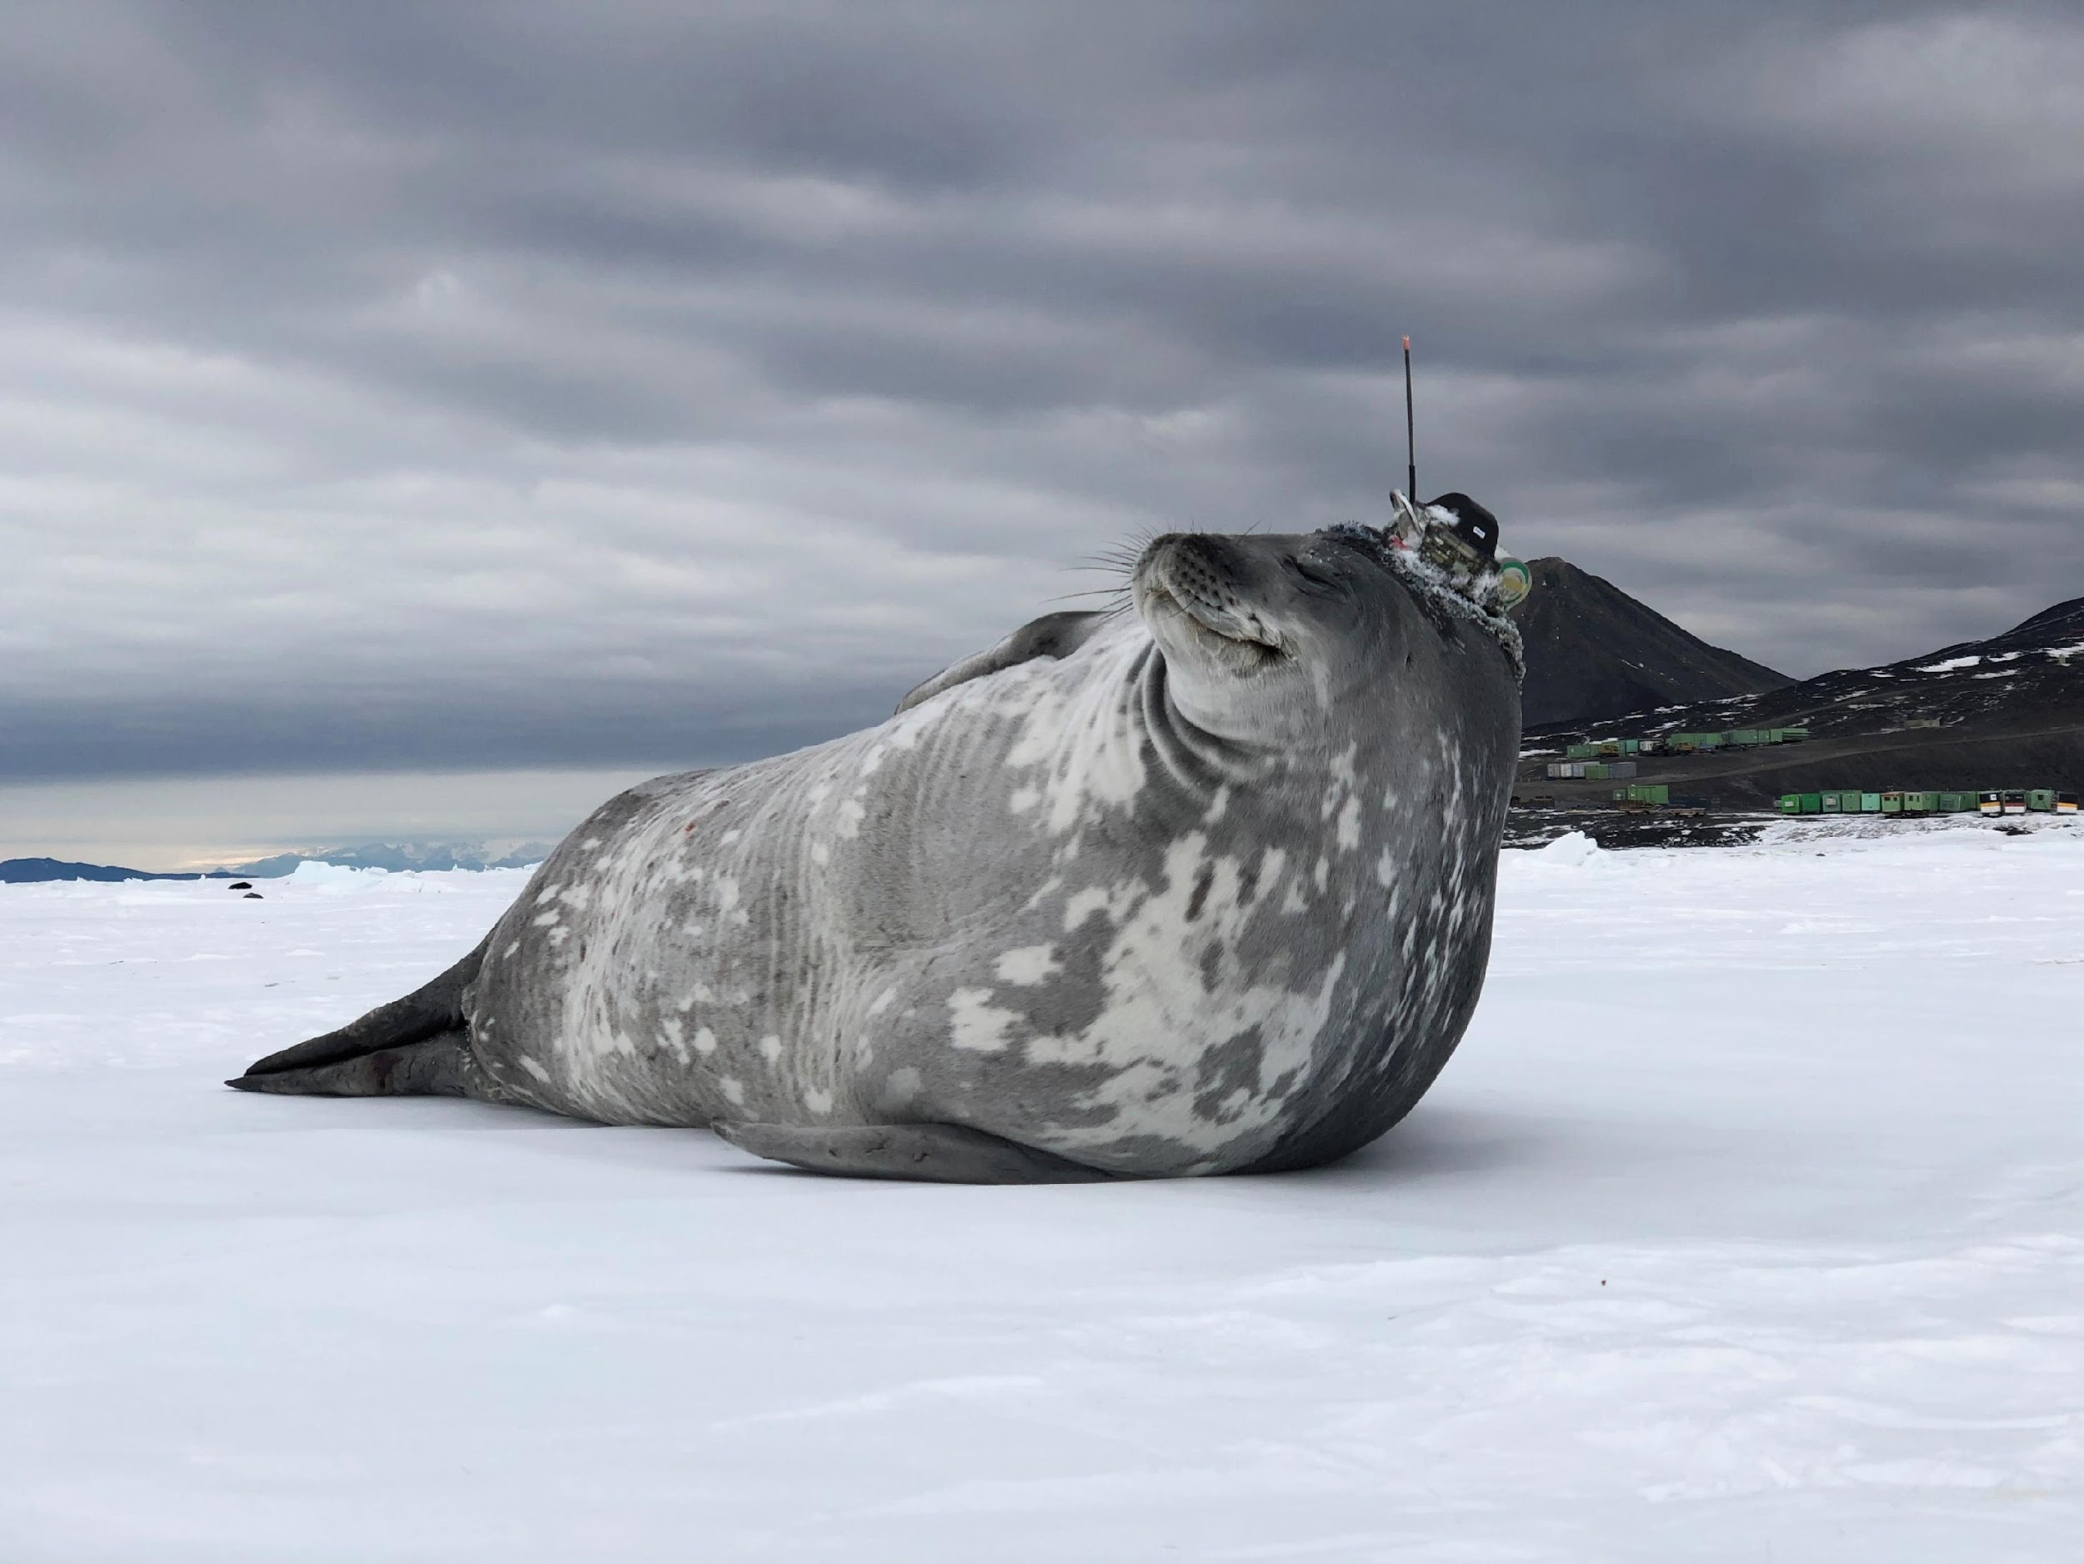
Thank you
goosocean.org

Slide 20
Session 2- Mapping Activity

Slide 21
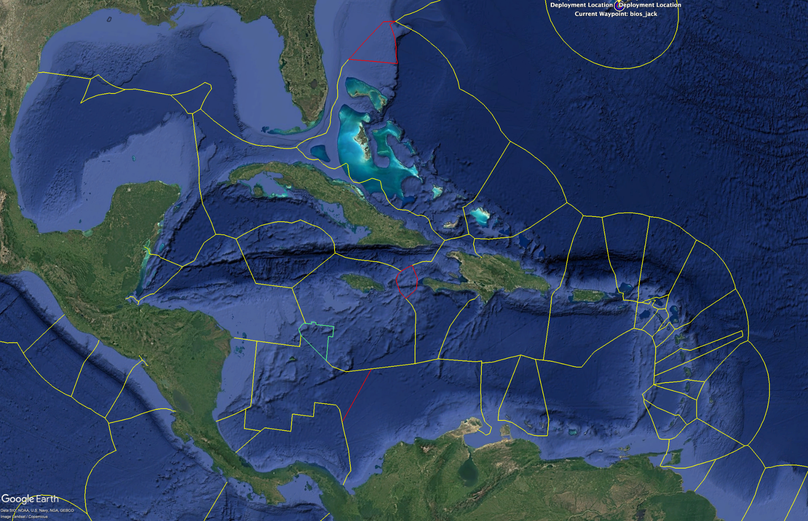
Discussion
Caribbean EEZs
Notes:
EEZ: Develop a draft “Permission to Roam” proposal [EEZ focused?] to CARICOM and OECS that will be led by IOCARIBE-GOOS and submitted/advocated for by David/CIMH – ensure it touches on education, capacity building, and societal benefits. Develop a Roadmap for the action.

Slide 22
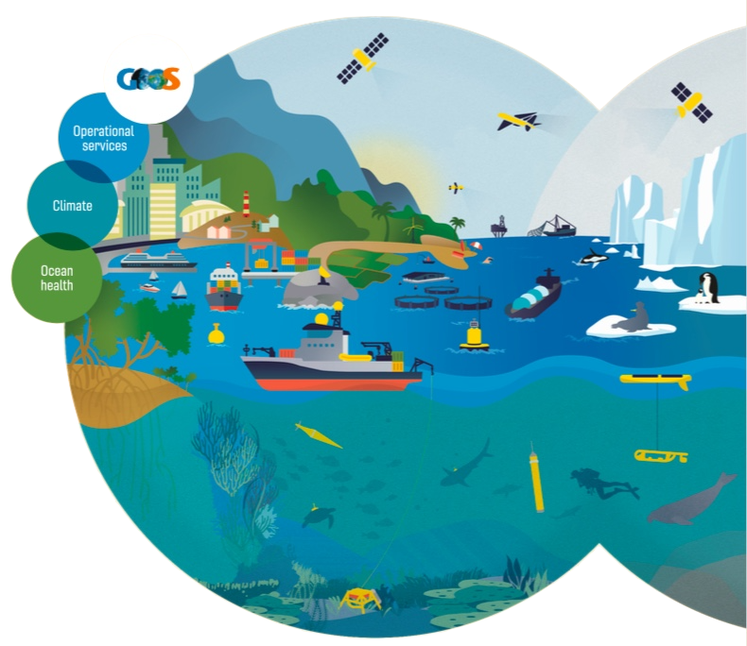
The Case for a Collective System
Knowing our priorities are:
Reporting to MEAs (Multilateral Environmental Agreements)
Hazard forecasts & coastal resilience..
And our current capacity is…
CARICOOS, CIMH, DIMAR, OBIS, Ocean Info Hub..
How do we assess feasibility and impact and develop a phased approach that will allow us to take step forward that will demonstrate the value of the collective system?

Slide 23
Session 3- Mapping Activity

Slide 24




IOCARIBE
TECHNICAL ASPECTS OF THE INITIAL OBSERVATION SYSTEM
CO-DESIGNED WITH PARTNERS
ROADMAP
Established - 1998

